Slide 1
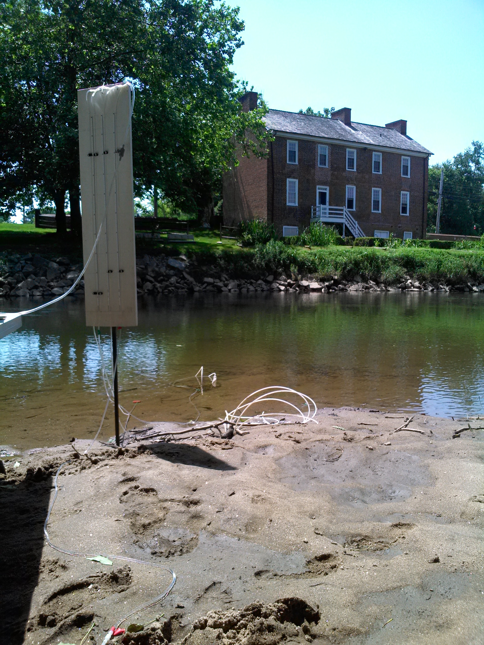



DYNAMIC SURFACE WATER-GROUNDWATER INTERACTIONS AND NITROGEN CYCLING IN A TIDALLY INFLUENCED RIVER
Cole Musial, Audrey Sawyer, Rebecca Barnes, Samuel Bray, Deon Knights

Slide 2
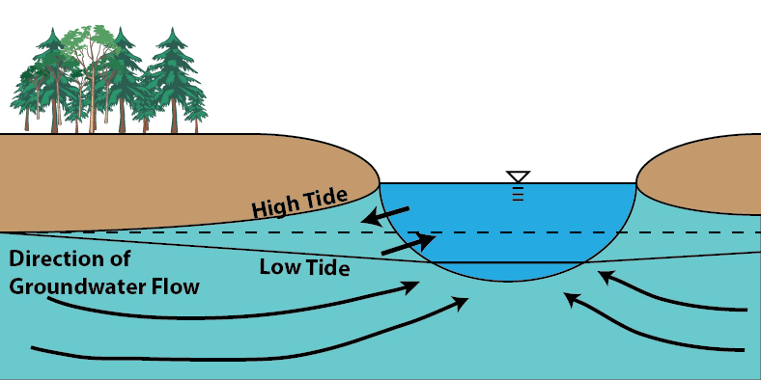
Conceptual Model
Stage fluctuations in tidal rivers drive bank storage
Bank storage zones may be intense zones of nitrogen transformation

Slide 3
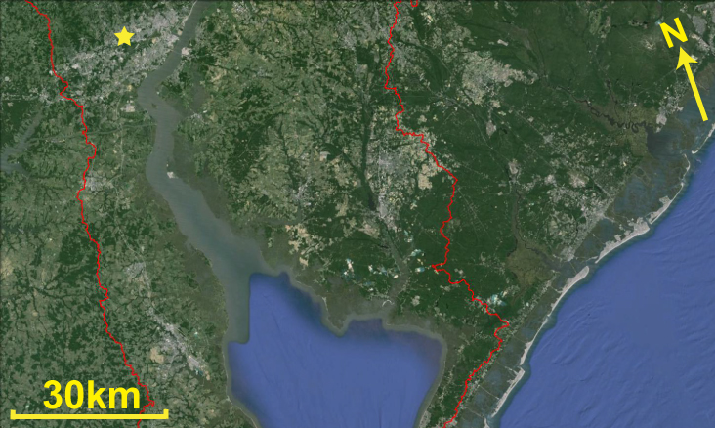
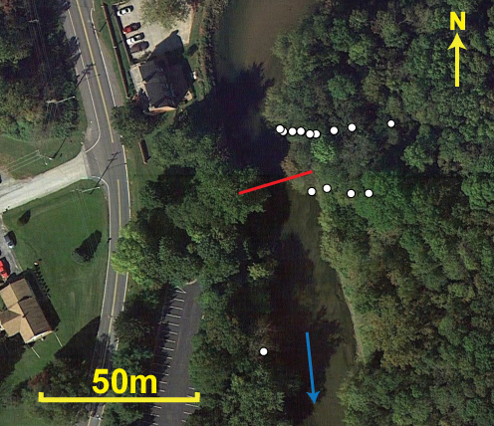

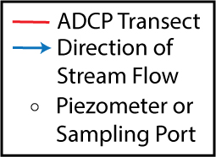
Field Site

Slide 4
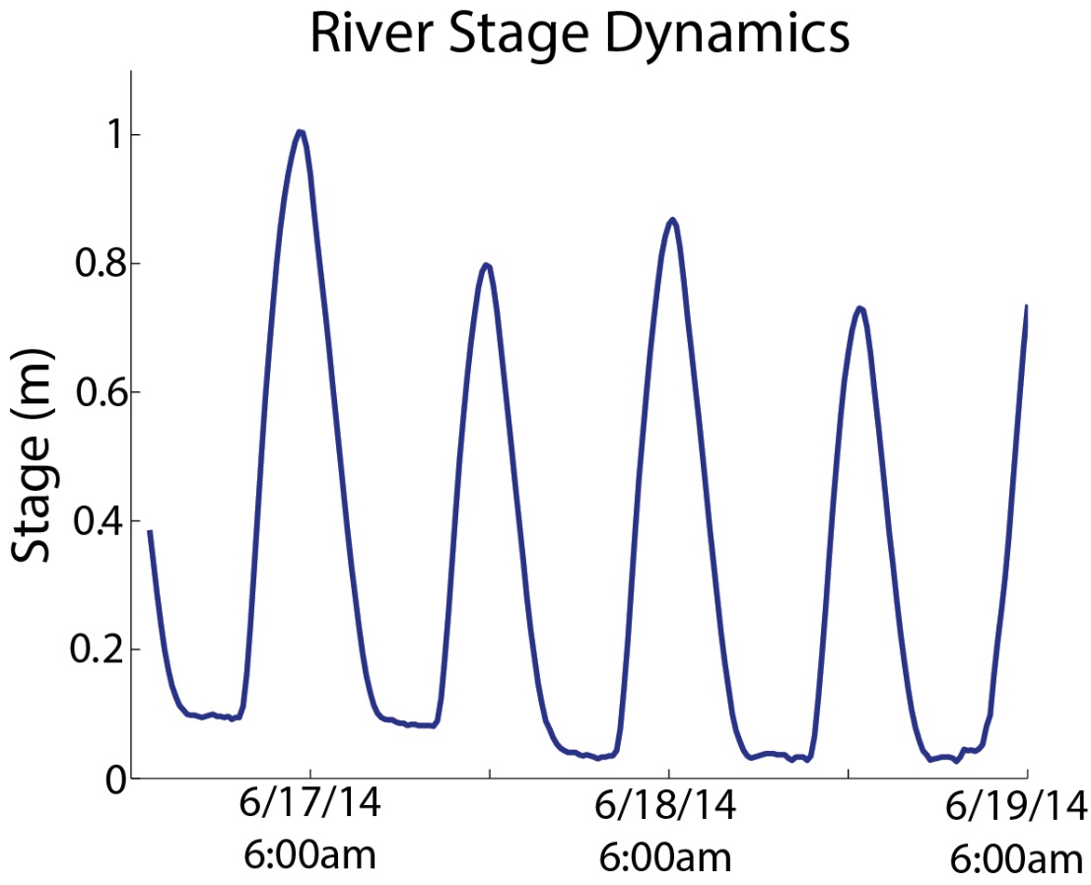
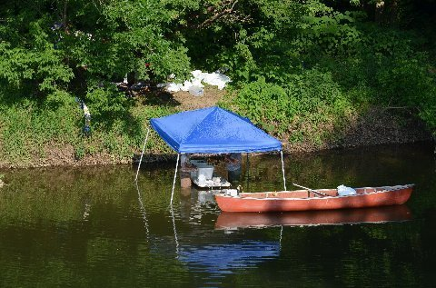
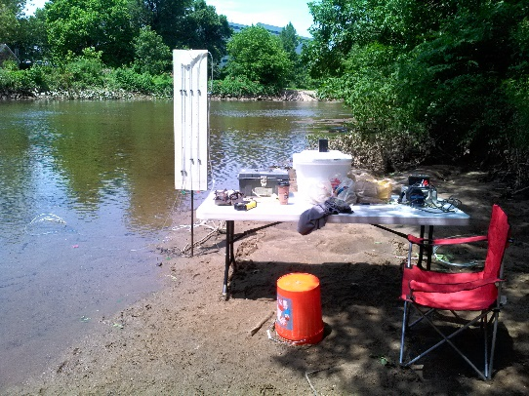
High tide
Low tide
Notes:
Talking Points: The point you're making here is that this is an incised river in the coastal plain, the tidal water level fluctuations stay completely confined within the channel, but they're BIG (almost a meter) twice per day

Slide 5
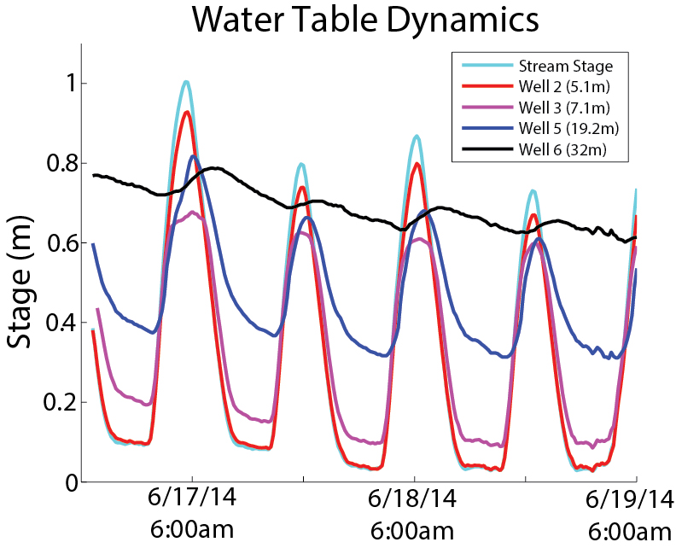
Notes:
Talking Point: The point is that the water table is really dynamic too, and there's times when it's higher than the stream and times when it's lower, so flow is in and out of the banks.

Slide 6
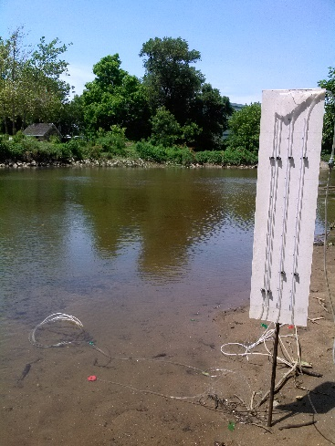
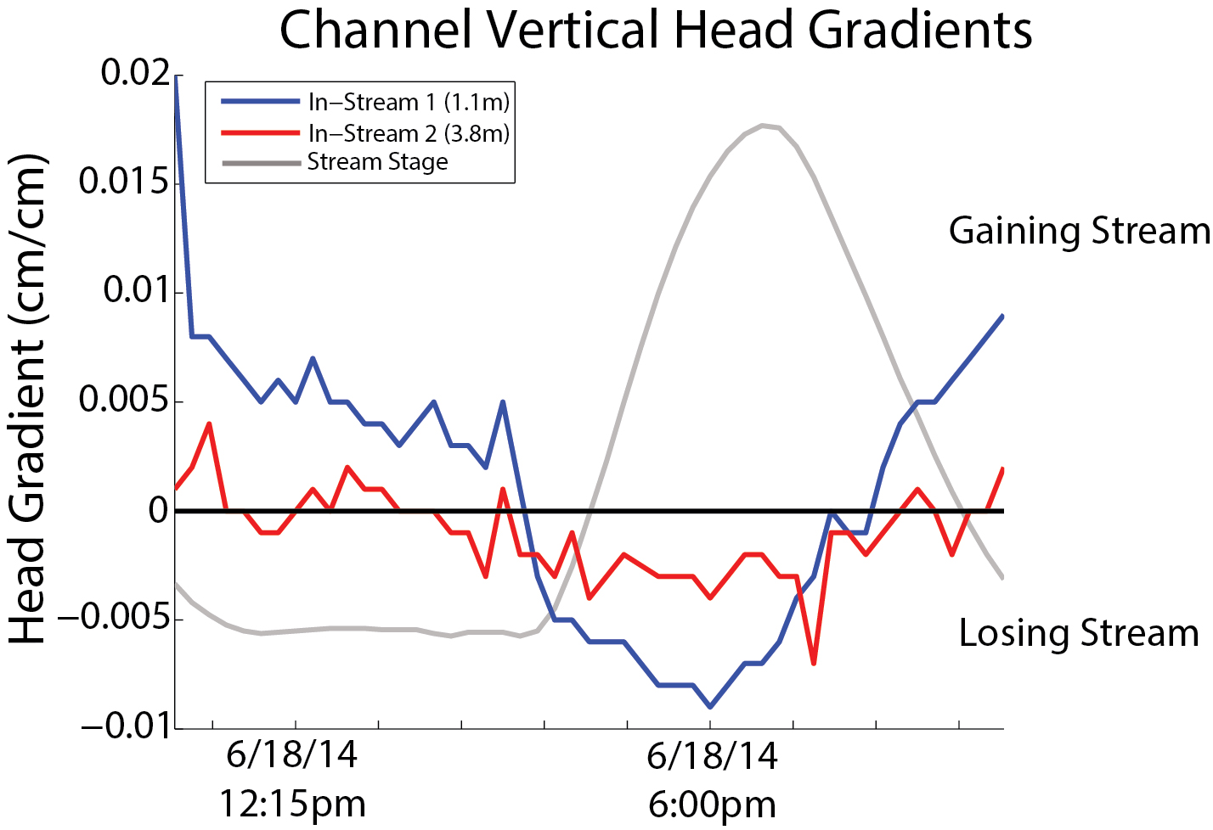
Notes:
AHS: fonts in legend are again too small.
Talking Point: The point is that there's also surface water-groundwater exchange in and out of the bed (discharge at end of falling tide going into the period of steady river stage, recharge during the rising tide and early part of the falling tide).

Slide 7
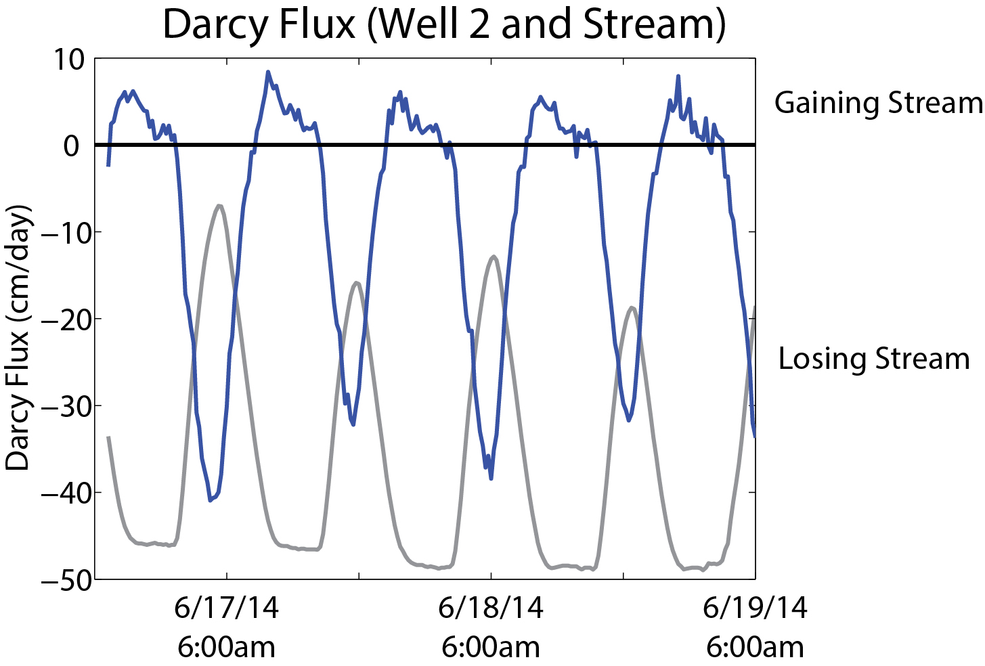
Tidal Surface Water-Groundwater Exchange
Average Tidal Exchange over 1 cycle = .02m³
Percent of River Discharge = 0.4%
K = .000269m/s
Notes:
Is this per m of river or the entire TFZ? per cm of river, how should I show that?
AHS: Per cm of river? That’s not what I get when I go from your plot to the volume of water exchanged over 1 cycle. Check your units again. For example, using simple triangles, maximum gain is ~5 cm/d, occurring over timespan ~0.25 days. Area under triangle ~ ½ B*h = ½ (0.25 d)*(5 cm/d). So now you’ve got 0.0063 “cm” of water traveling out of the banks on each tidal cycle and just need to multiply that by the area of bank it’s flowing across. Pretend the TFZ is 10 km long, 2 banks on each side, and that the seepage face on each bank is 1 m high. 0.0063 cm *20,000 m^2 = 1.26 m^3 of water exchanged on each tidal cycle. Two tidal cycles per day is 2.52 m^3/d, which is only 2.9e-5 m^3/s, which is a negligible % of the ~4 m^3/s of surface water flow. However, this calculation seems totally wrong to me. Look at it this way from specific yield (go back to my class notes if you don’t remember what’s about to follow…)
Let’s say that head rises and falls 0.3 m over an area 7 m away from the channel stretching 10 km along the TFZ, on average. If the specific yield is a little less than the porosity (let’s guess it’s 0.2), then the volume of water released when the head drops is 0.2*0.3m*7m*20,000m = 8400 m^3/tidal cycle. This happens twice per day or 16800 m^3/d, or 0.2 m^3/s, which is 5% of the stream discharge. So perhaps your K that you used to make the Darcy flux plot should be much higher.
Also note how big the outflow is relative to the inflow (for example see calculations in my 2009 Hydrologic Processes paper—there was net groundwater discharge, meaning a gaining stream, or more groundwater discharge than recharge). Should also note what you used for K.

Slide 8
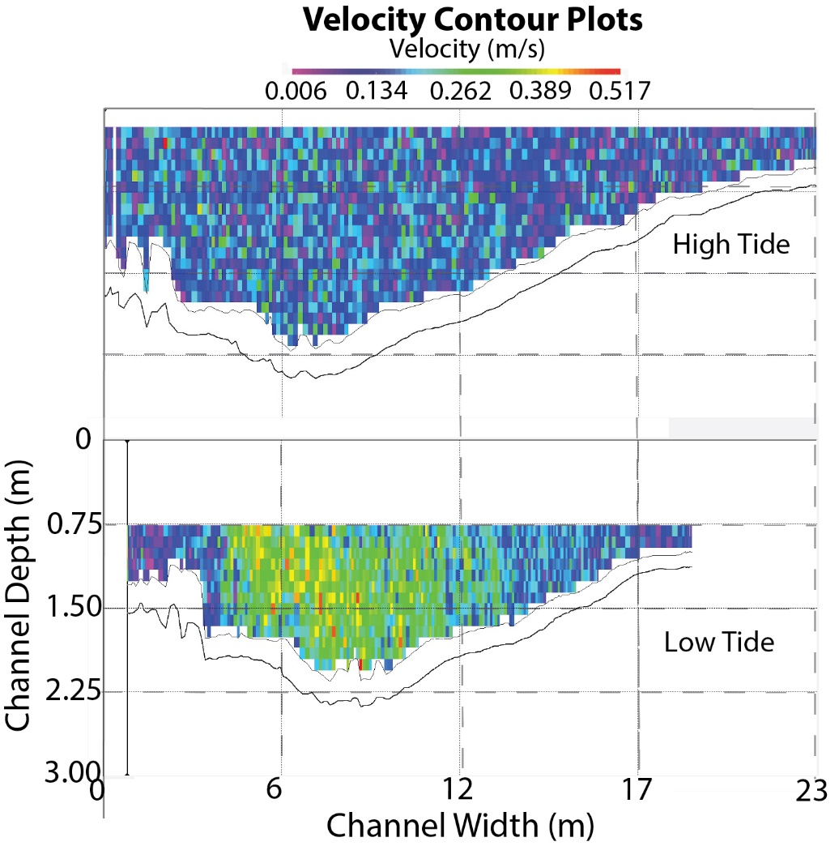
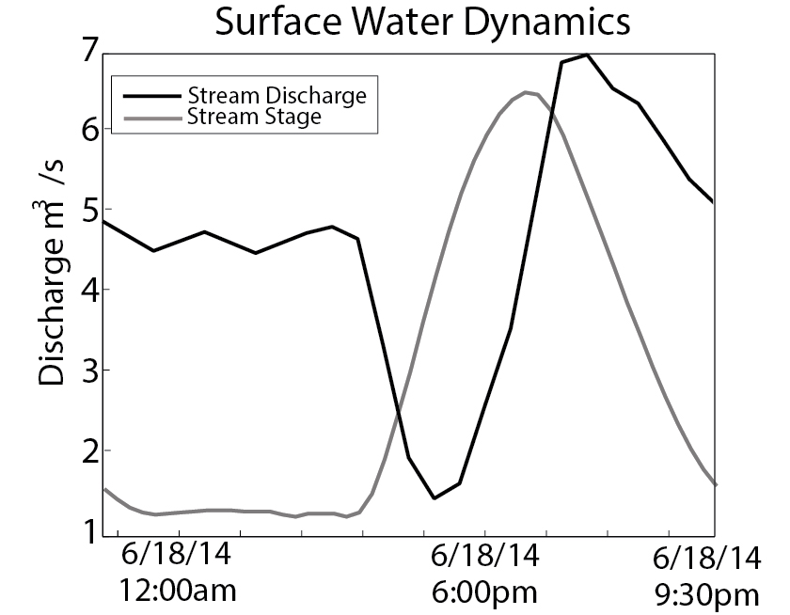
River Discharge
Notes:
Talking Point: discuss the fact that high stage doesn't correspond with high discharge. Stage is actually rising when discharge is falling, then discharge rises again and they're both high, then they both fall. This is because of the different stream velocities on the rising and falling tides, which produce different discharges on the rising and falling tides.

Slide 9
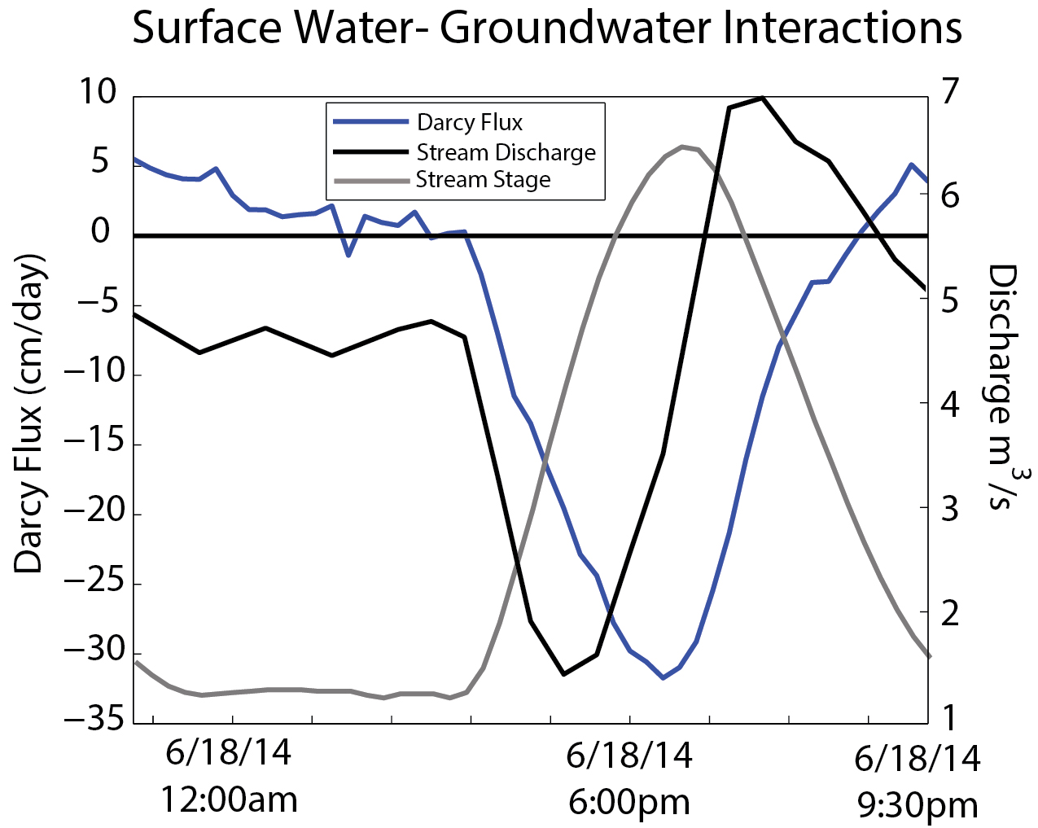
Notes:
Talking Point: Point out that river water is infiltrating into bank storage zones during the lowest discharges in the channel up to the point when discharge peaks. Then bank storage water and groundwater are being released during periods of moderate downstream transport. You want to know whether this might affect downstream N transport.

Slide 10
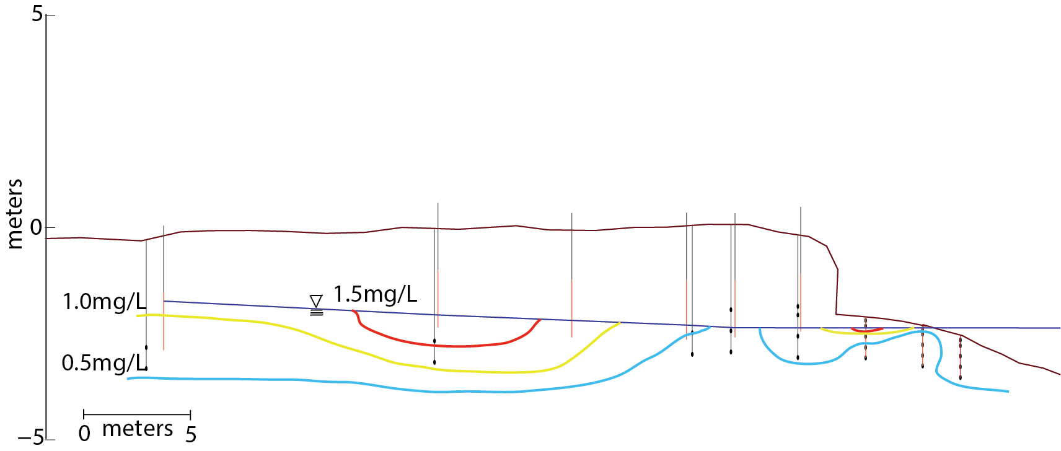
Low Tide DO

Slide 11
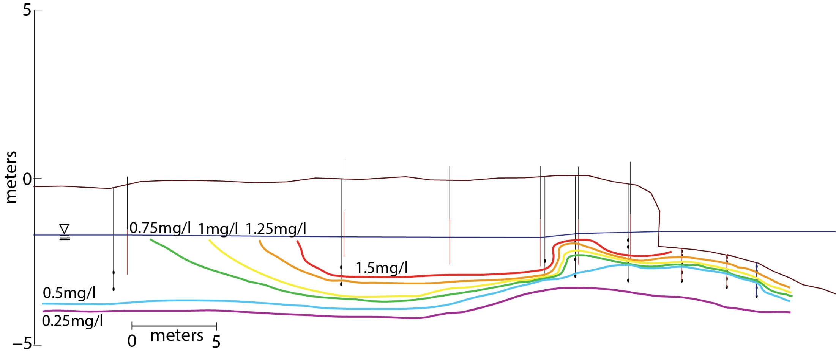
High Tide DO

Slide 12
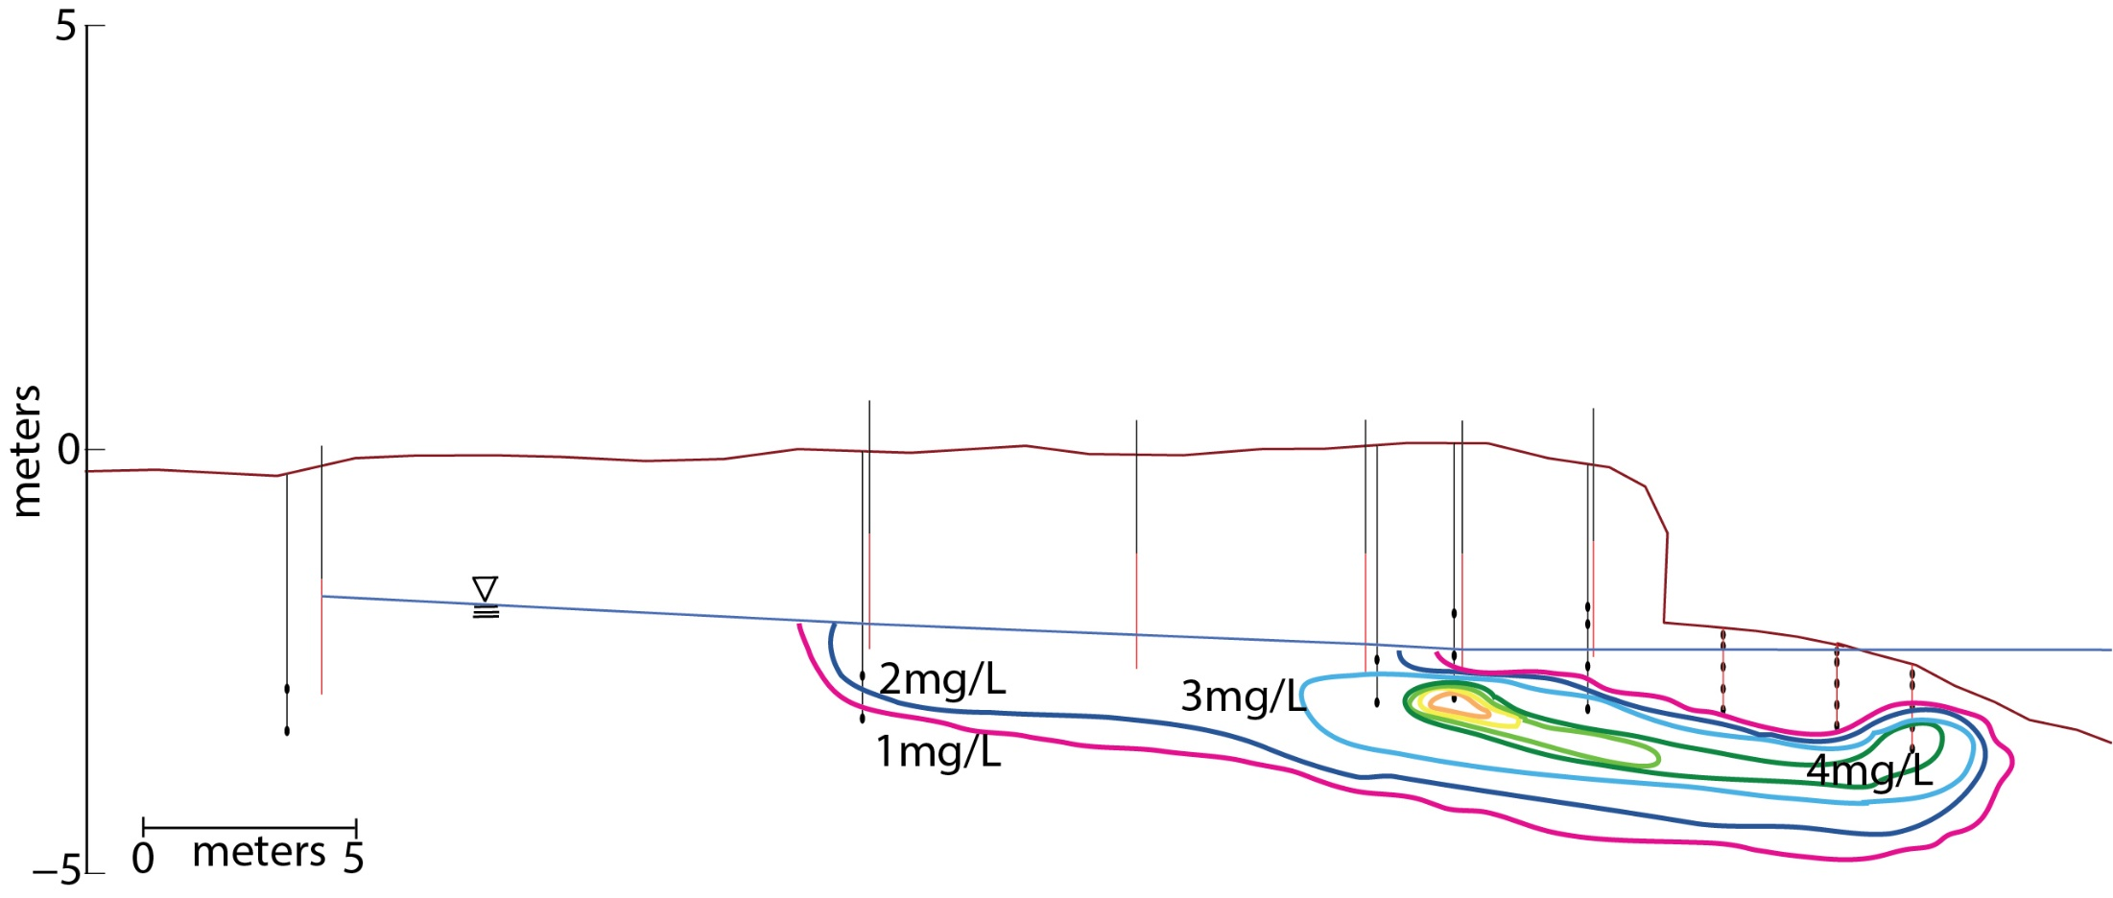
Low Tide NO3+NO2

Slide 13
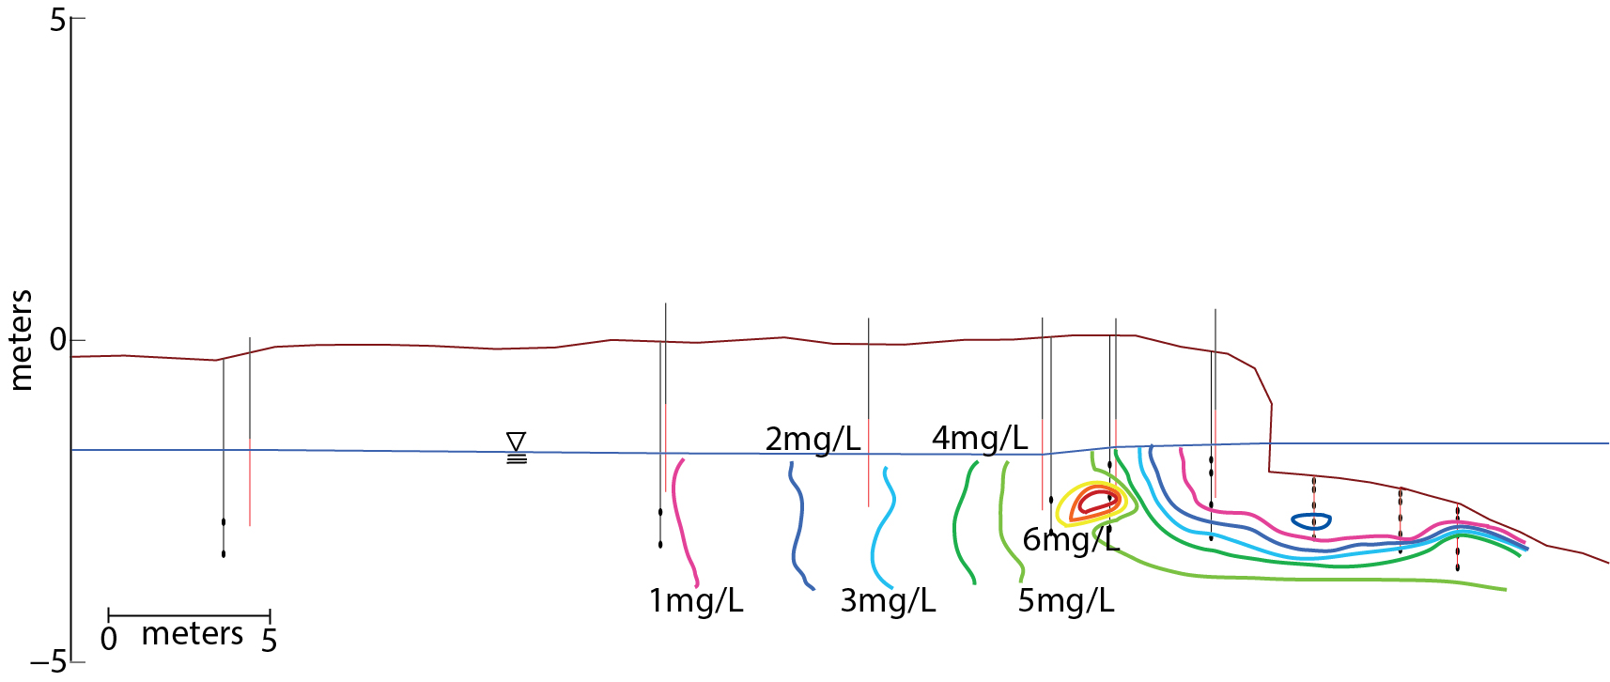
High Tide NO3+NO2

Slide 14
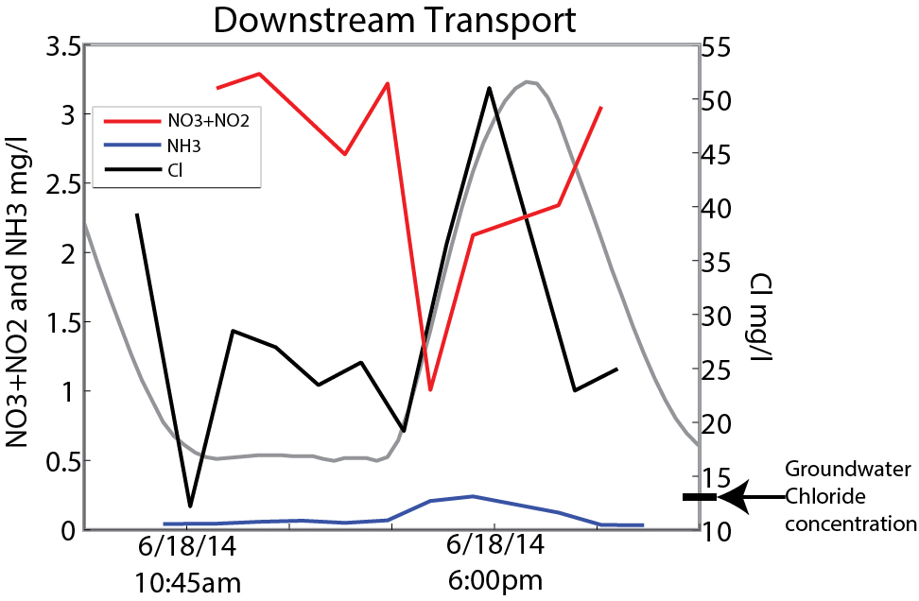

Slide 15
Conclusions
Low river discharge corresponds with reversals in surface water-groundwater exchange. Peak aquifer discharge is at times of intermediate stream discharge.
Tidal rivers are dynamic environments for nutrient cycling
DO and nitrate vary with tides near water table and streambed due to surface water-groundwater exchange

Slide 16


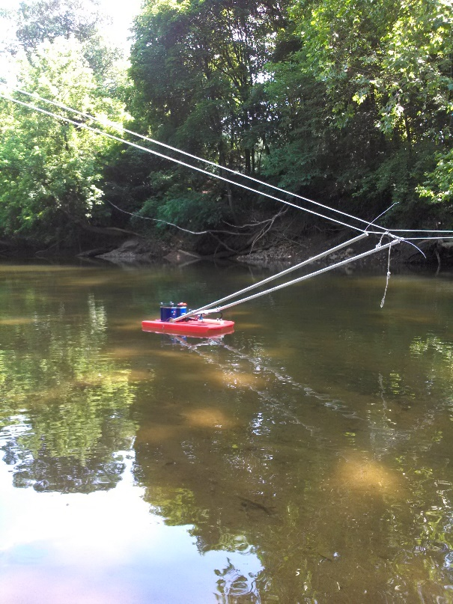
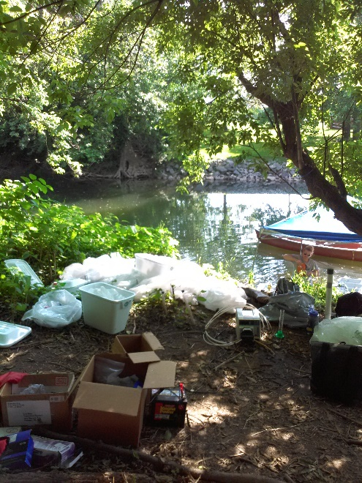

Acknowledgments
Anthony Aufdenkampe Ph.D.
Louis Kaplan, Ph.D.
Holly Michael
Chris Russoniello
Kaileigh Calhoun
Hale Byrnes House, Kim and Ralph Burdick

