Slide 1
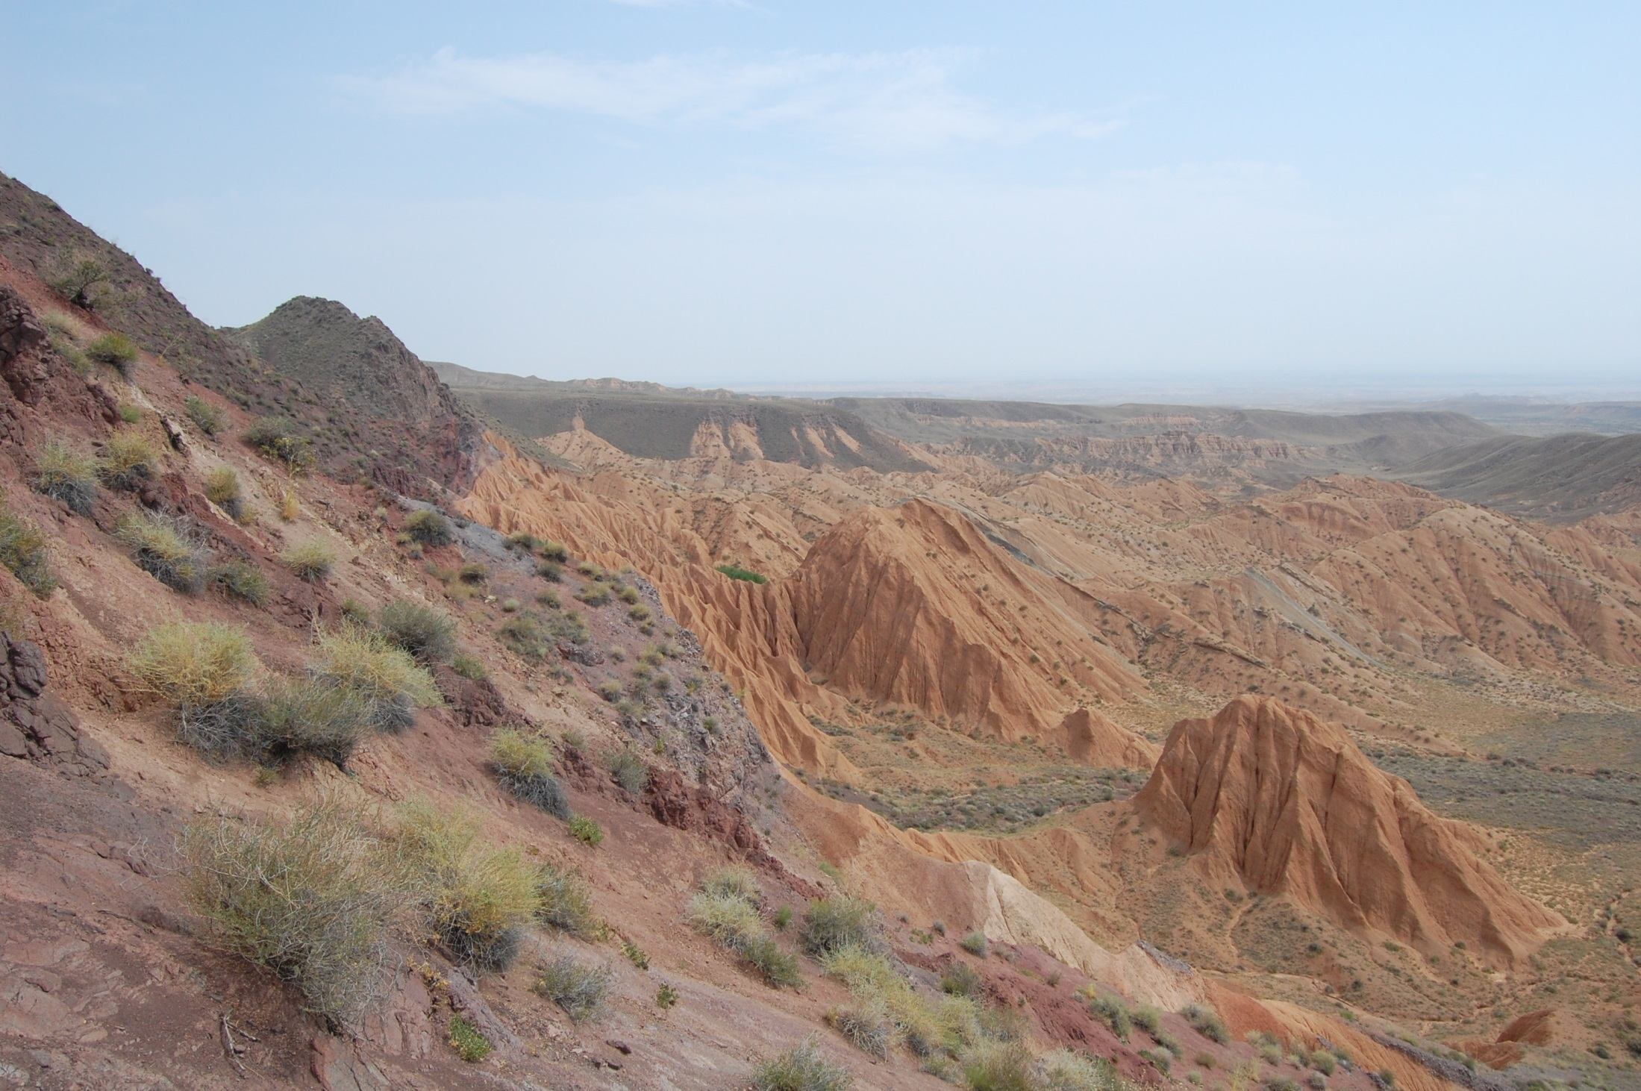


Preexisting faults and faults that should not exist:
Effects of mechanical anisotropy on different scales?
Jonas Kley¹ Alexander Malz²
¹Geoscience Center
Georg-August-Universität Göttingen, Germany
²Institute for Geosciences
Friedrich-Schiller-Universität Jena, Germany

Slide 2
Reverse faults
Dip-slip faults with initial cutoff angles of ca. 45-70°, indicating horizontal contraction
Reactivated
Existing faults
Bedding planes
etc.
Best example:
Inversion tectonics
Non-reactivated
Transpressive?
Rotated?

Slide 3
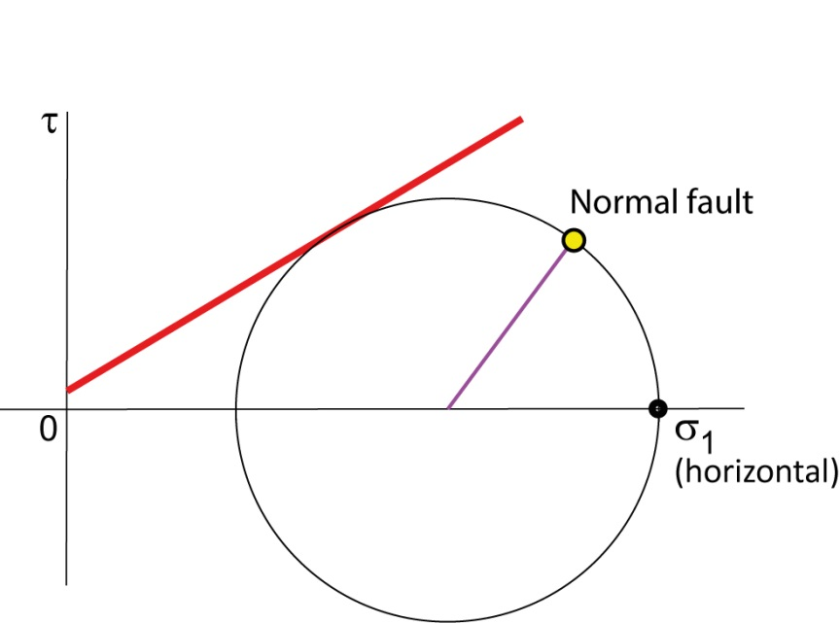
Inversion tectonics
What makes extensional basins mechanically weak?
Heating of crust (and mantle); time-dependent
Replacing crystalline basement with sediments
Weak pre-existing faults
What makes faults weak?
Fluid overpressure
Weak minerals (talc, smectite,
serpentine, graphite),
preferred orientation

Slide 4
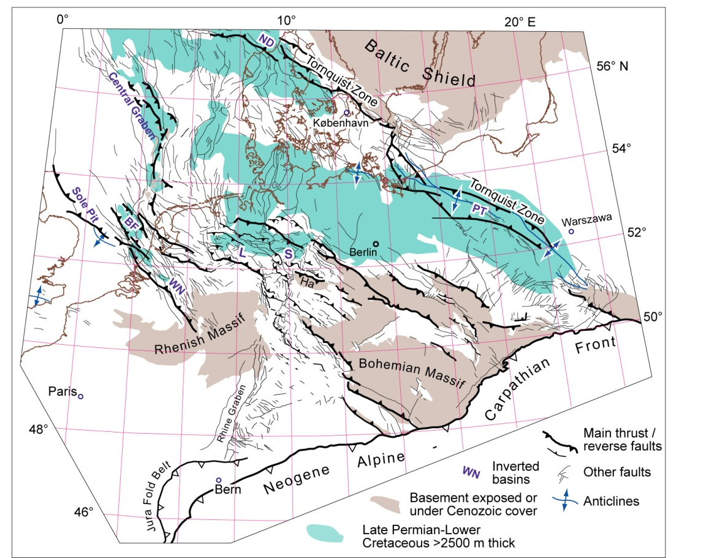
Distributed extension and inversion, Central Europe
Harz Mts.
> 500 km width
< 50 km extension
β < 1.1
Kley and Voigt 2008

Slide 5
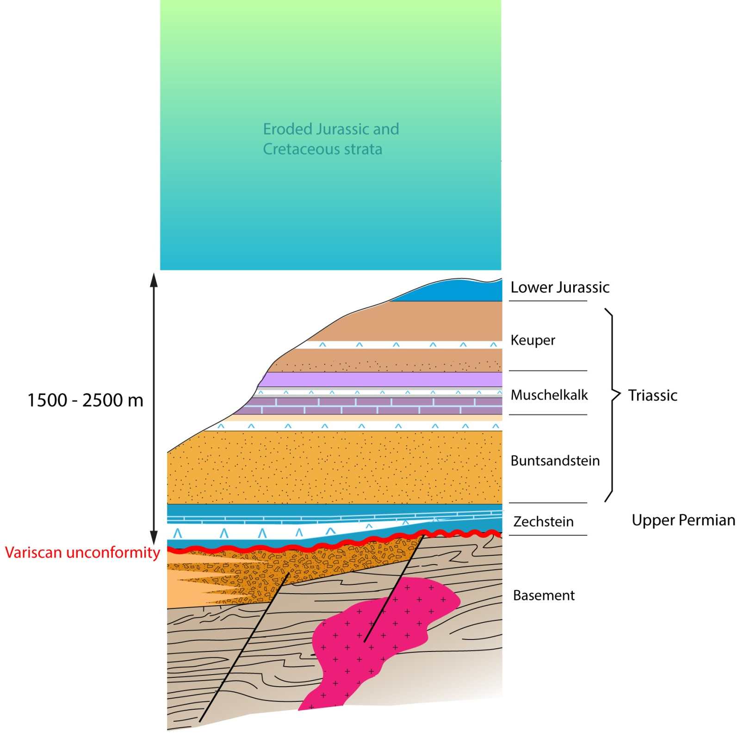
Generalized stratigraphy

Slide 6
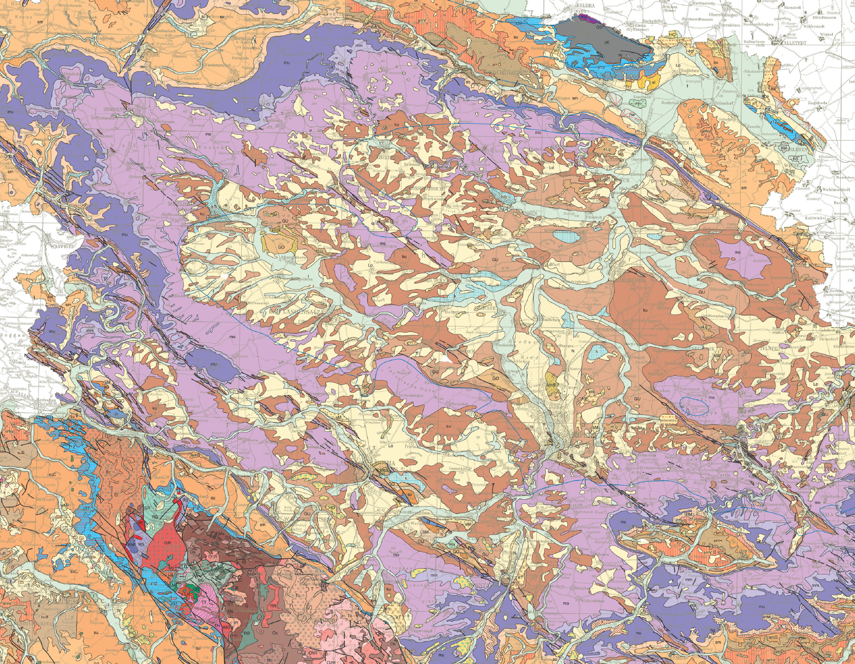
11° E
51° N
Geological Map of Thuringia, 1 : 200.000
10 km

Slide 7
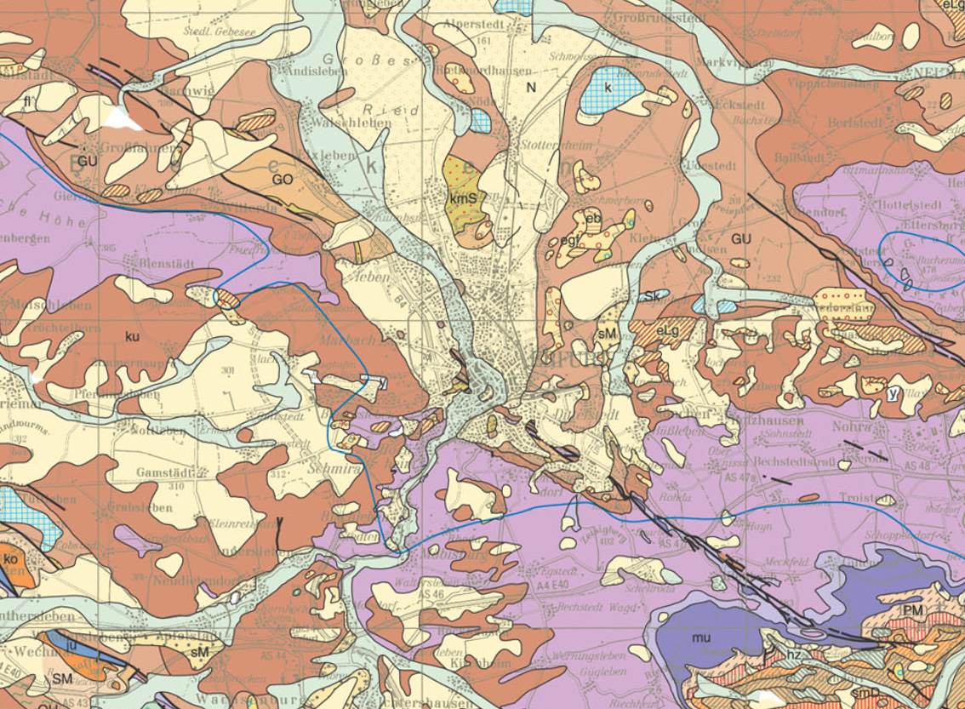
Trace of geological
and seismic section
Erfurt fault zone / graben
Geological Map of Thuringia, 1 : 200.000

Slide 8
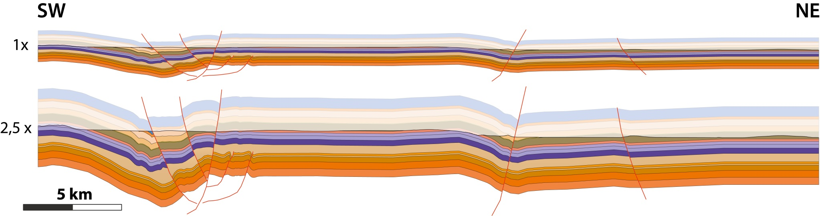
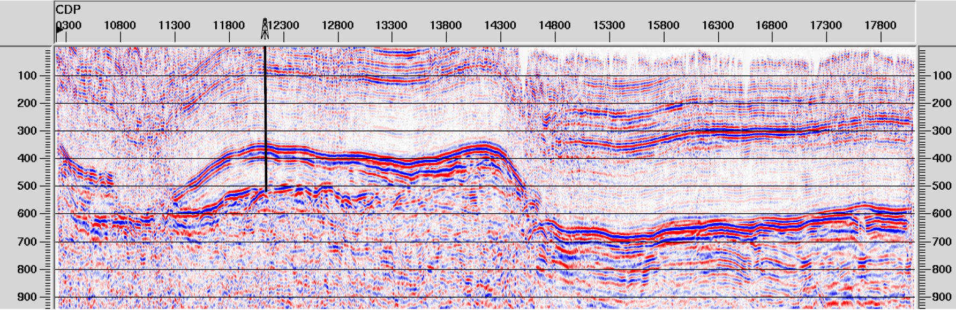

Geological and seismic section
Erfurt Fault
z
z
Keuper
Top Permian carbonates
Muschelkalk
Salt
Buntsandstein
Basement
Seismic line acquired by the INFLUINS project
10 km

Slide 9
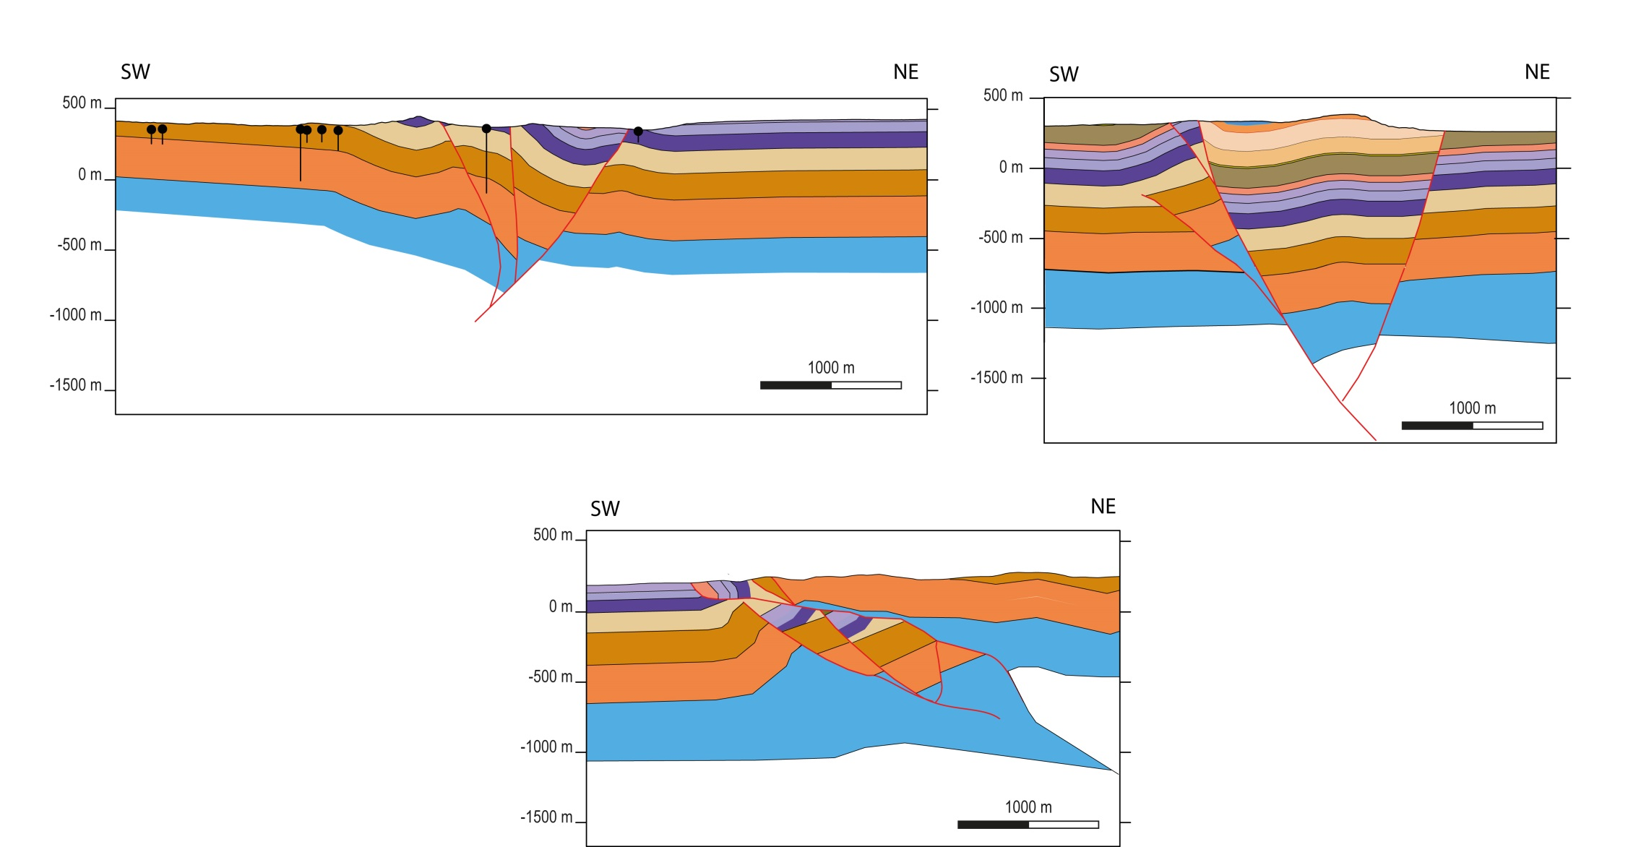
More examples of shortened extension structures
z
z
Folded half-graben
Footwall shortcut,
folded graben shoulder
z
Shoulder thrust
over graben
Direct reactivation of normal faults in the cover is rare
Extension and contraction are spatially tied to underlying basement faults
Basement faults were mechanically weak (with some contribution from strength contrasts in offset cover succession)

Slide 10
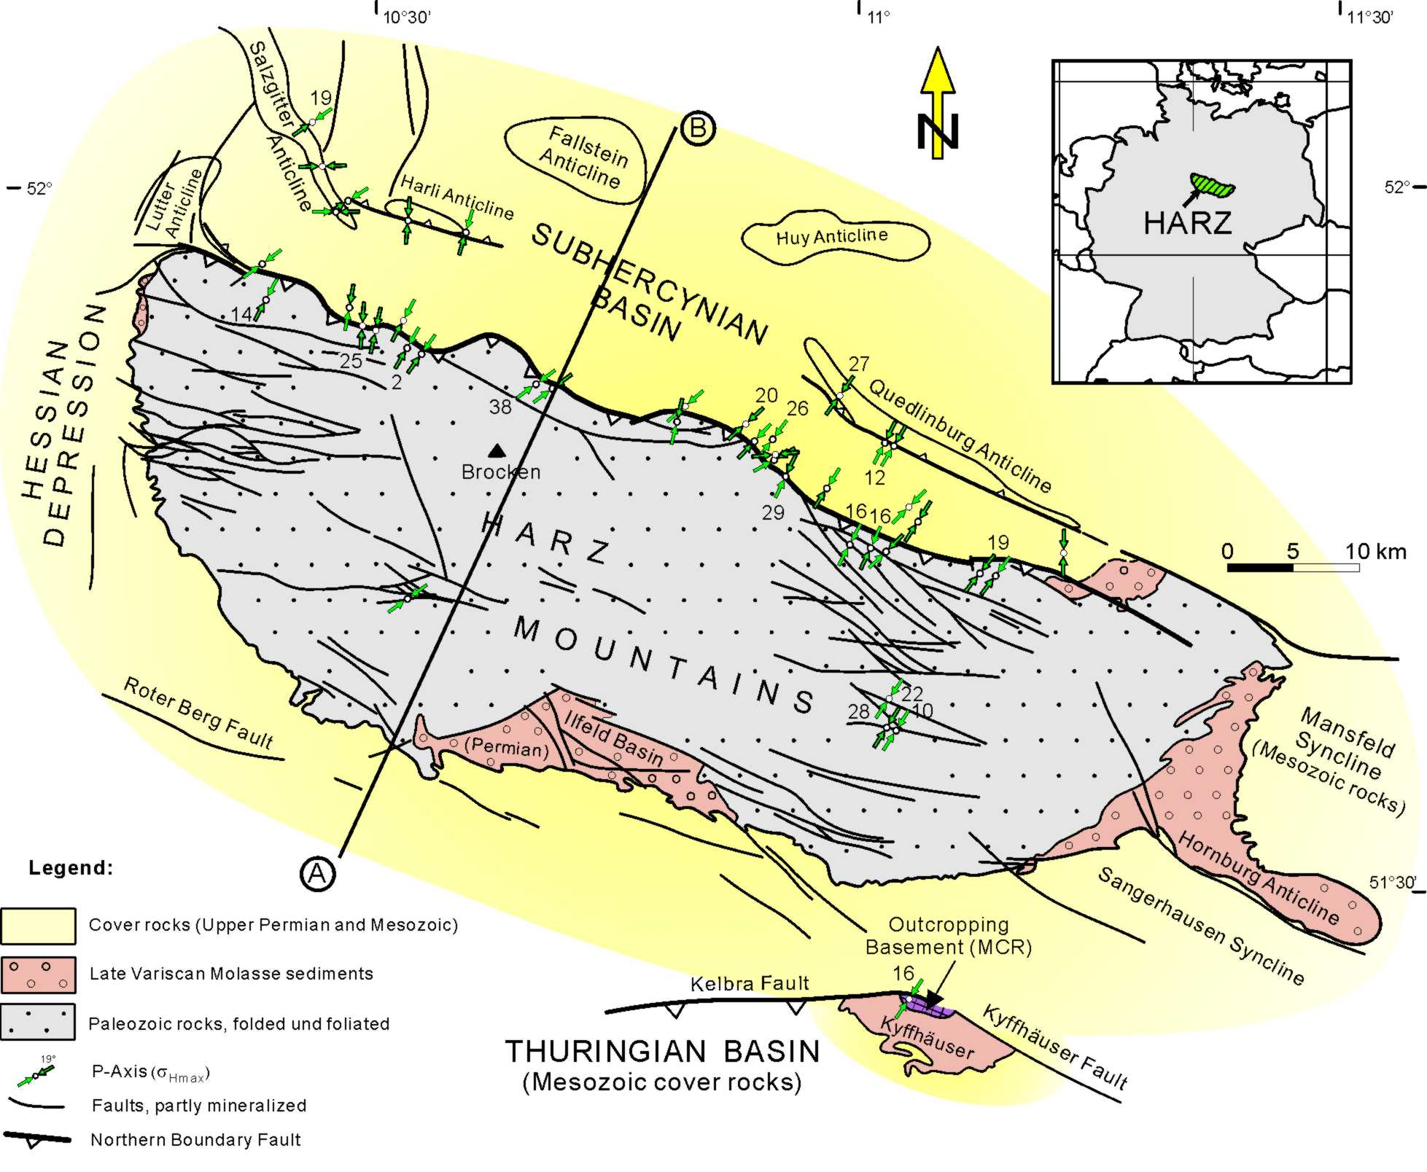
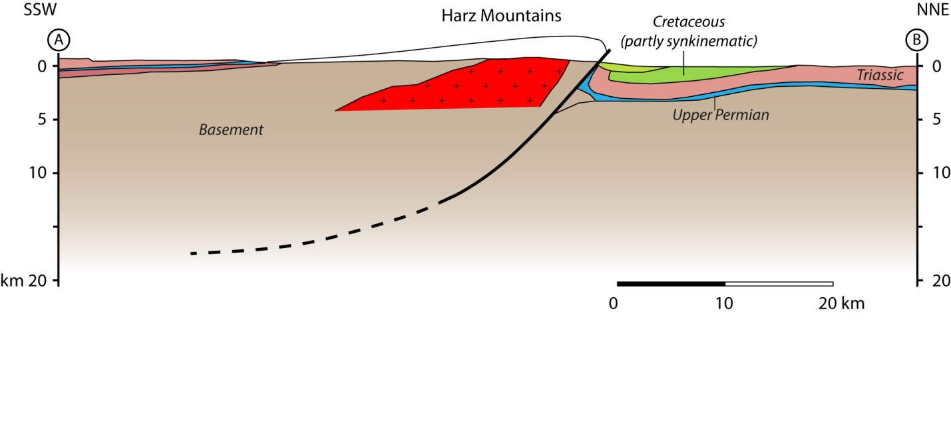
The Harz Mts.
Basement uplift
Franzke in Kley et al. 2008
Redrawn from
Franzke in Kley et al. 2008

Slide 11
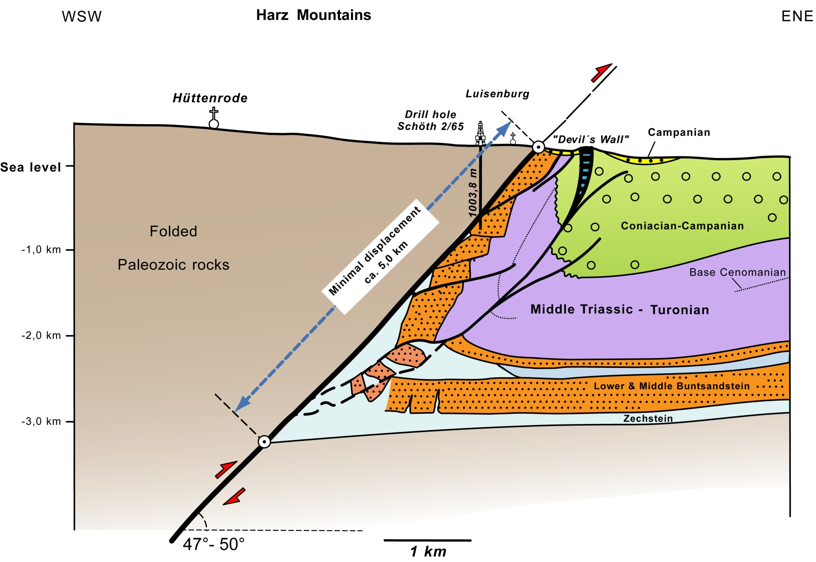
Master reverse fault of the Harz uplift
Franzke in Kley et al. 2008

Slide 12
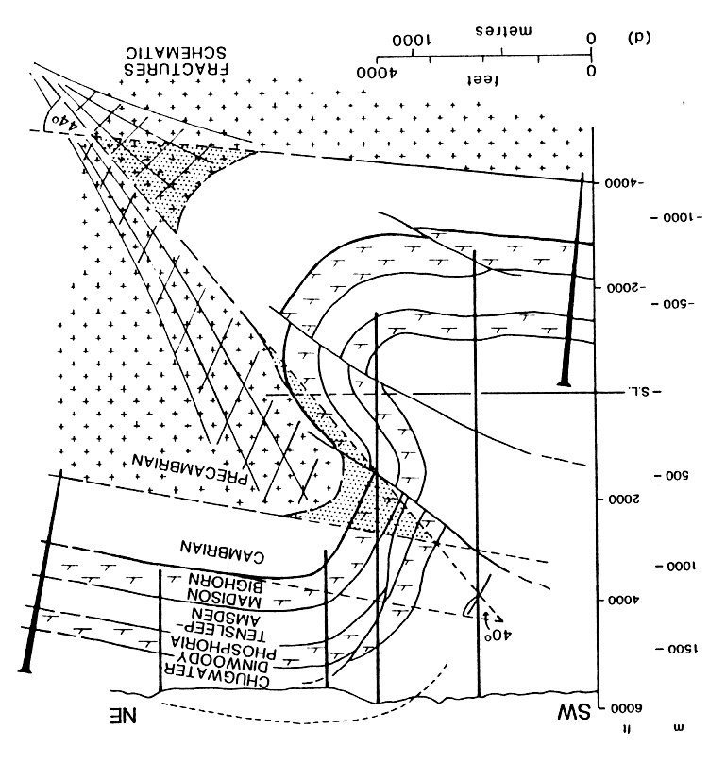
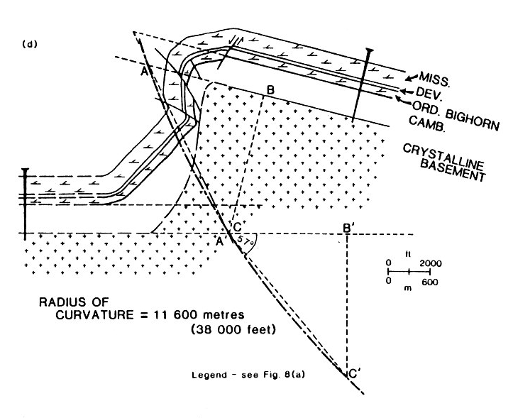
Laramide uplifts and reverse faults
57°
44°
Cook 1988

Slide 13
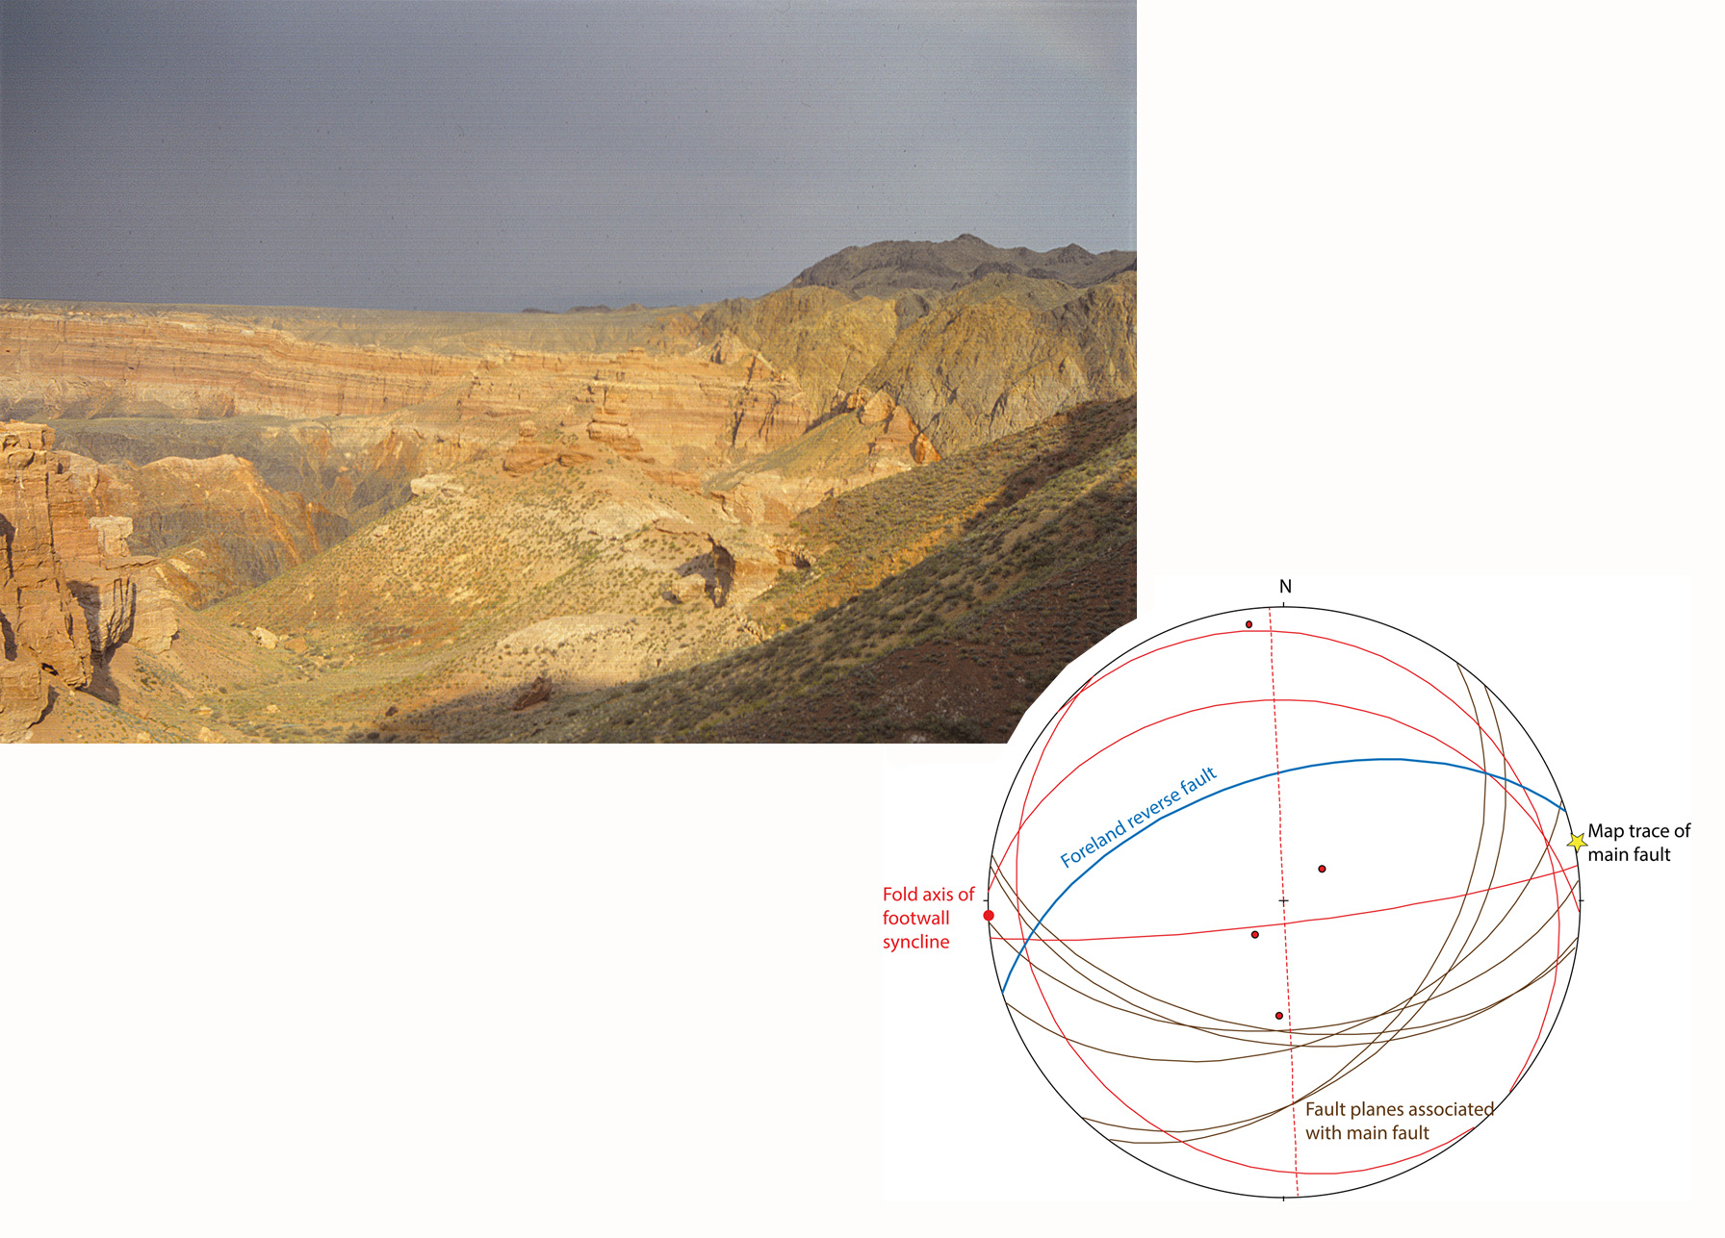
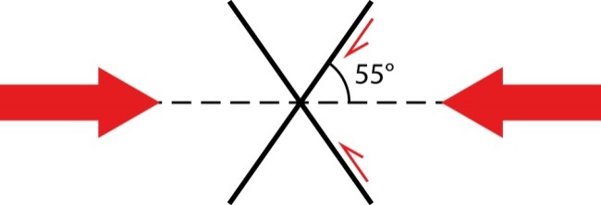
Conjugate reverse faults, Tien Shan Mts., Kazakhstan
N
S
Pz
Cz
45-65°
Pz

Slide 14
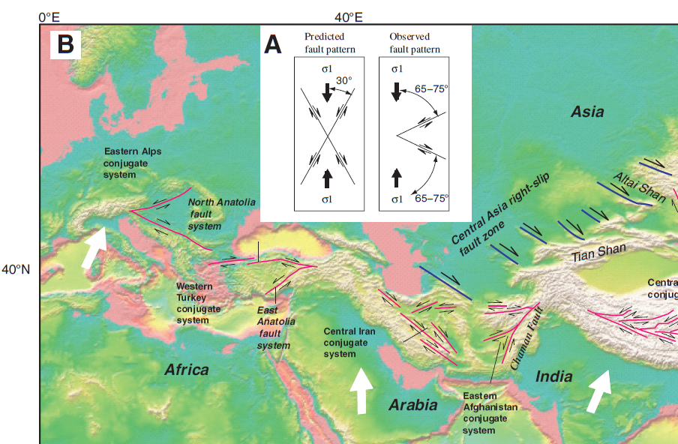
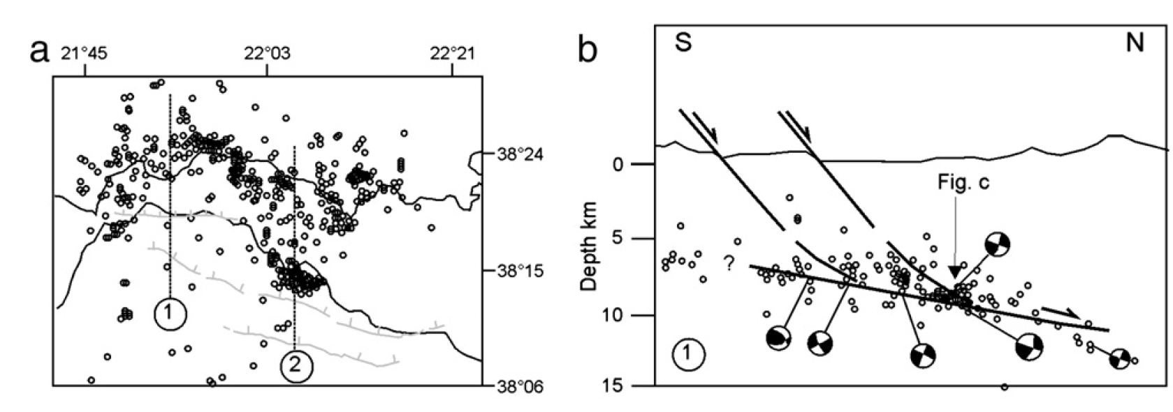
„Non-Coulomb“ strike-slip and Low-angle normal faults
Yin and Taylor 2011
Collettini 2011

Slide 15
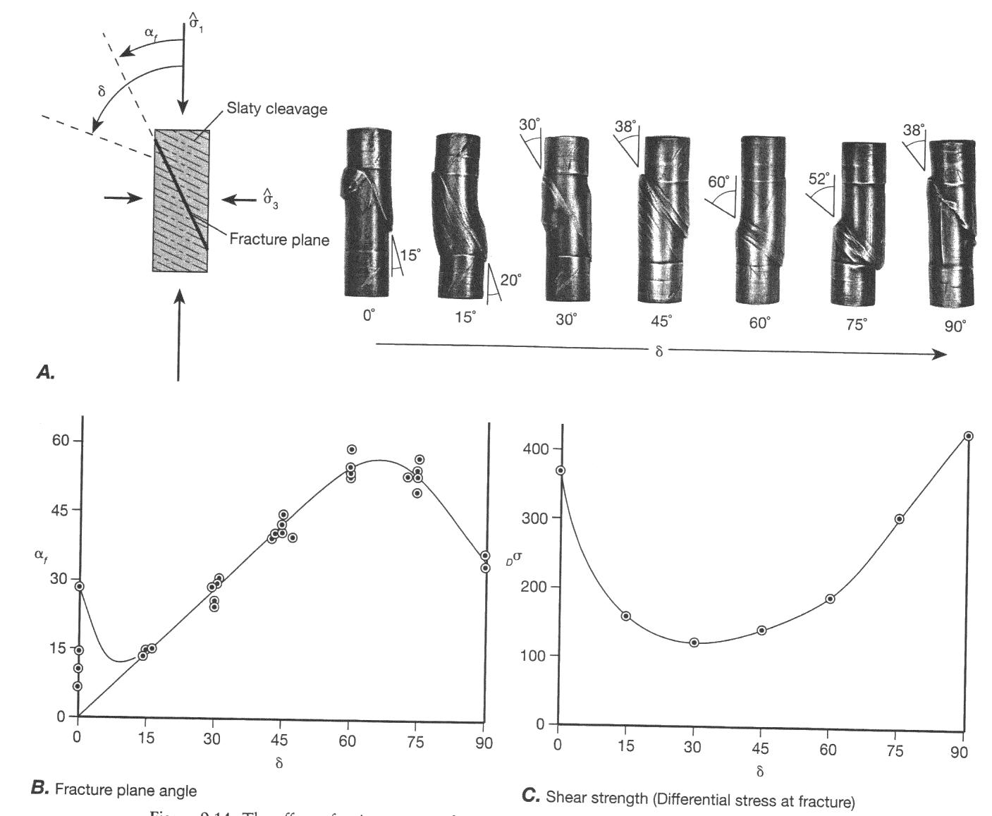
Effect of slaty cleavage on shear fracture orientation
ca. 6 cm
Cleavage orientation
α_{f} = δ
Twiss & Moores 2007, after Donath 1961

Slide 16
Summary
Steeply dipping reverse faults come in two classes: reactivated and non-reactivated
Reactivated faults can be substantially weaker than the unfaulted crust in spite of severe misorientation
The nucleation of non-reactivated reverse faults requires some type of anisotropy
We speculate that this controlling anisotropy can occur on length scales much smaller than the reverse faults themselves

