Slide 1
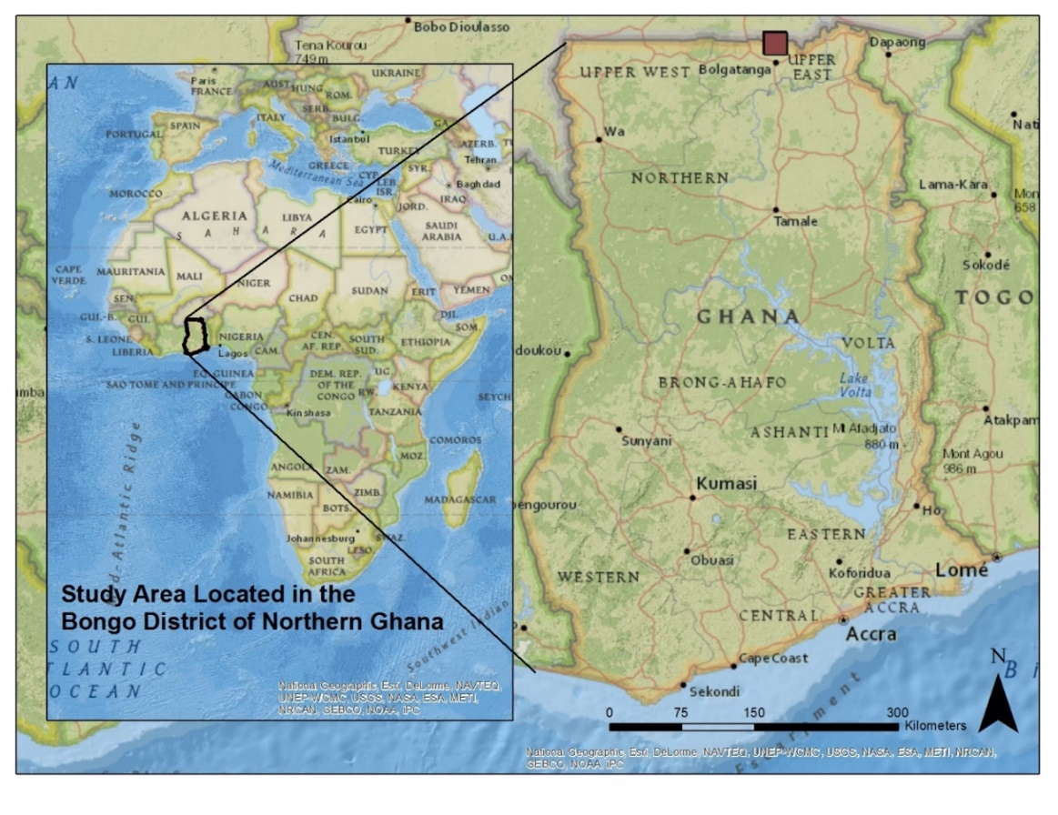
Comparing Indigenous Laterite and Bauxite with Imported Activated Alumina for use in Small-scale Fluoride Adsorption Filters in Rural Northern Ghana
Laura Craig¹, Lisa L. Stillings², David L. Decker¹, Jim M. Thomas¹
^{1.} Desert Research Institute and University of Nevada, Reno; 2. U.S. Geological Survey, Reno, NV

Slide 2




Acknowledgments
University of Nevada, Reno
Desert Research Institute, Reno, NV
U.S. EPA STAR Graduate Research Fellowship
Geological Society of America Graduate Student Research Grant

Slide 3
Presentation Outline
Describe study area in northern Ghana and problem - fluorosis
Possible solution - fluoride (F⁻) adsorption filters
Compare F⁻ adsorption: Ghana bauxite and Namoo laterite (study area) to imported synthetic activated alumina
Physical and chemical properties controlling F⁻ adsorption
Improve F⁻ adsorption capacity of Ghana bauxite and Namoo laterite
Pros and cons of each sorbent for de-fluoridation filters in Ghana
Conclusions

Slide 4
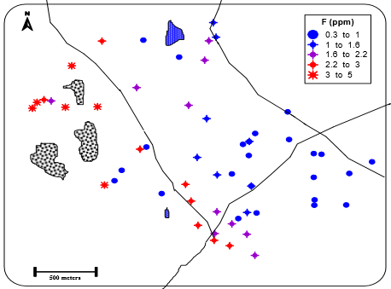
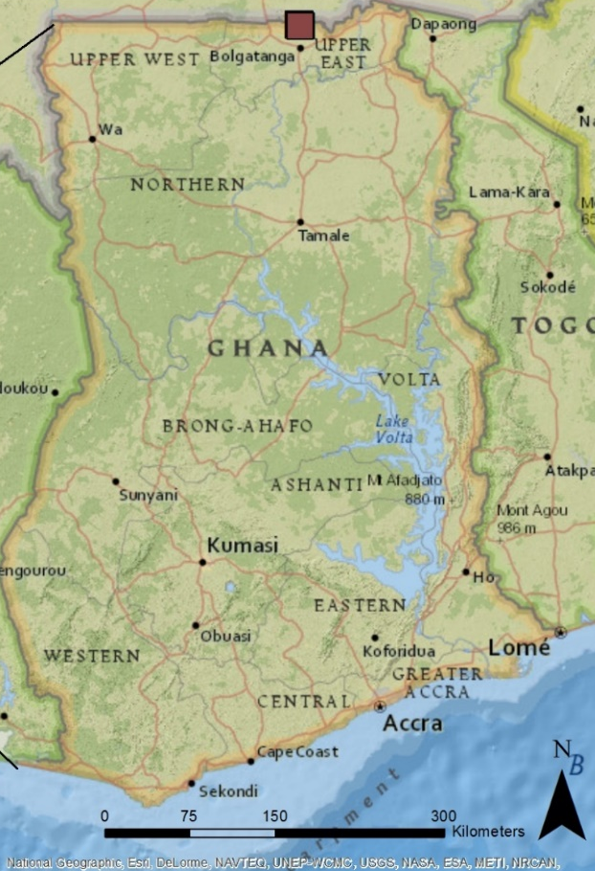

Study Area – Northern Ghana
High F⁻ GW
2-4.6 ppm F⁻
Low F⁻ GW
< 1 ppm F⁻
Granite
(F⁻ source)
Dental Fluorosis
Rural, poor - groundwater as primary water source
24 of 58 wells have F⁻ above WHO limit of 1.5 ppm (mg/L)
Result – dental fluorosis (picture), risk of skeletal fluorosis

Slide 5
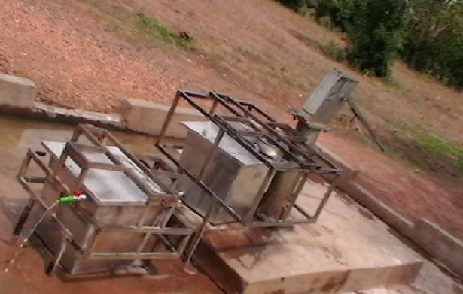
One Solution? Adsorption Filters at High F⁻ Hand-pump Wells
Hand-pump well
Collect treated water
Two bins with sorbent
Testing fluoride adsorption filter at hand-pump well, World Vision Ghana

Slide 6
Compare F⁻ Loading: % F⁻ Adsorption vs. F⁻ Concentration
pH_{o} ~ 6.9, I = 0.01 M, grain size = 0.5-1.0 mm
Possible Ghanaian sorbents:
Namoo laterite (in study area)
Bauxite (western Ghana)
compared to
activated alumina (imported)
GW F⁻ range

Slide 7
Physical and Chemical Properties of Sorbents
Sorbent | Surf. Area* (m² g⁻¹) | pH_{PZNPC} | %Al₂O₃ | %Fe₂O₃ | %SiO₂
Act. alum. | 288.9 | 8.3 | 99.4 | 0.0 | 0.0
Gh. bauxite | 5.5 | 7.1** | 70.9 | 23.6 | 2.2
N. laterite | 21.9 | 7.3** | 13.5 | 36.8 | 45.7
<------pH_{PZNPC}
*Surface area at grain size 0.5 to 1.0 mm
**Permanent charge not included
S - is sorbent surface:
< pH_{PZNPC} <

Slide 8
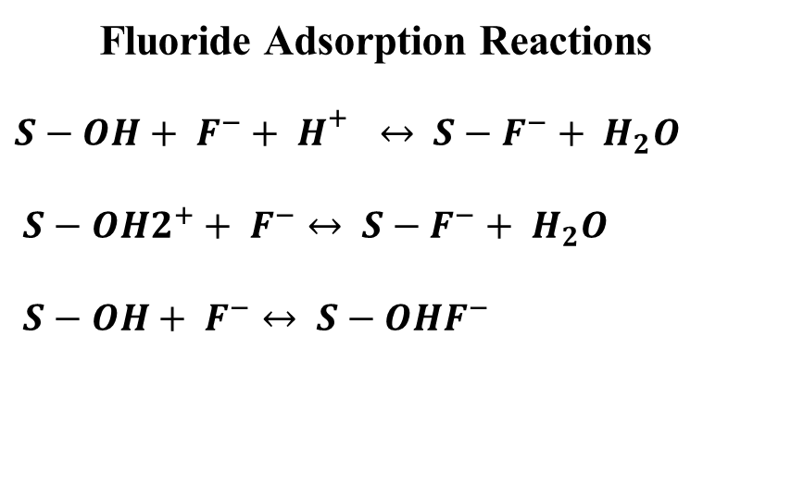
Improving Adsorption: % F⁻ Adsorption vs. pH
F_{o} = 10 mg/L, I = 0.01 M, 6.67 g/L
Fluoride Adsorption Reactions
$S−OH+ F^{−}+ H^{\begin{aligned}+ \\ \end{aligned}}↔ S−F^{−}+ H_{2}O$
$S−{OH2}^{+}+ F^{−}↔ S−F^{−}+ H_{2}O$
$S−OH+ F^{−}↔ S−OHF^{−}$
G. Bauxite
=
N. Laterite
(S - is sorbent surface)
pH range of groundwater

Slide 9
Improving Adsorption: F⁻ Adsorption vs. Grain Size
Namoo Laterite
Ghana Bauxite
Adsorption improves with: (1) decreased pH (N. laterite < 4.5, G. bauxite < 6)
(2) decreased grain size (above)
(Note: activated alumina no increase in adsorption/surface area at 0.125 mm grain size)

Slide 10
Pros and Cons Each Sorbent
Activated Alumina
Pros: high surface area & pH_{PZNPC} ( surf. OH sites), Al₂O₃ = good F⁻ sorbent
Cons: cost, imported
Ghana Bauxite
Pros: available in Ghana, mostly Al₂O₃ & Fe₂O₃ = good F⁻ sorbent
Cons: low surface area, not available in north (must be transported)
Namoo Laterite
Pros: abundant in study area (no cost), ~50% Al₂O₃ & Fe₂O₃
Cons: contains a lot of quartz = adsorbs F⁻ best low pH, moderately low
surface area

Slide 11
Conclusions
Laterite and bauxite are not comparable to activated alumina as F⁻ sorbent – but can be improved:
Much finer grain size will increase surface area and number of sorption sites for bauxite and laterite – feasible
Dropping pH of treatment water will increase F⁻ adsorption of bauxite (pH<6) and laterite (pH<4.5) – less practical at small-scale
Additional long-term solutions?
* Large-scale drinking water treatment and distribution
* Find another water source (i.e. low F⁻ piped water, rainwater)
* Health education – awareness of cause of fluorosis
Greater priorities in study area: jobs and improved access to water

Slide 12
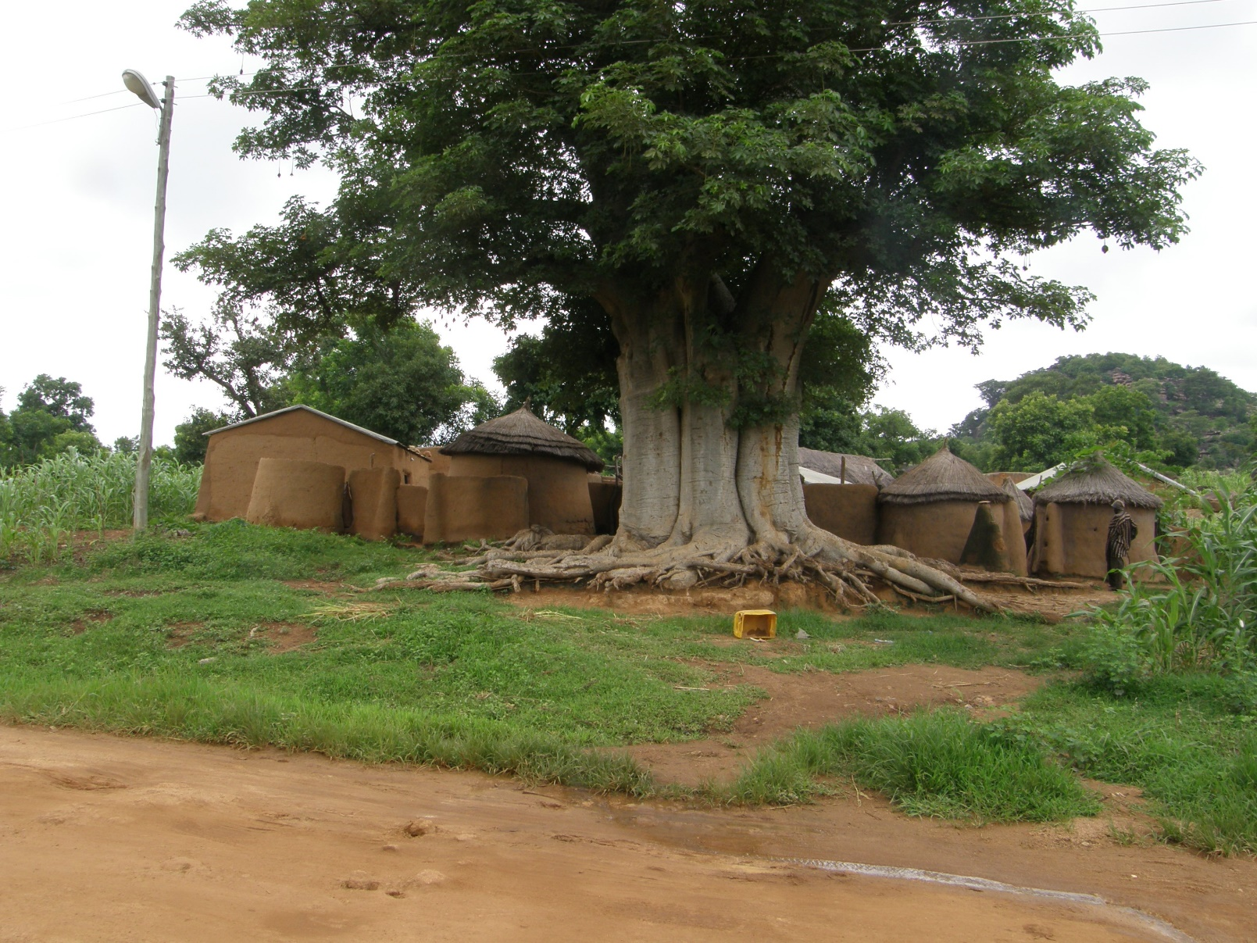
Questions? Comments?

