Slide 1
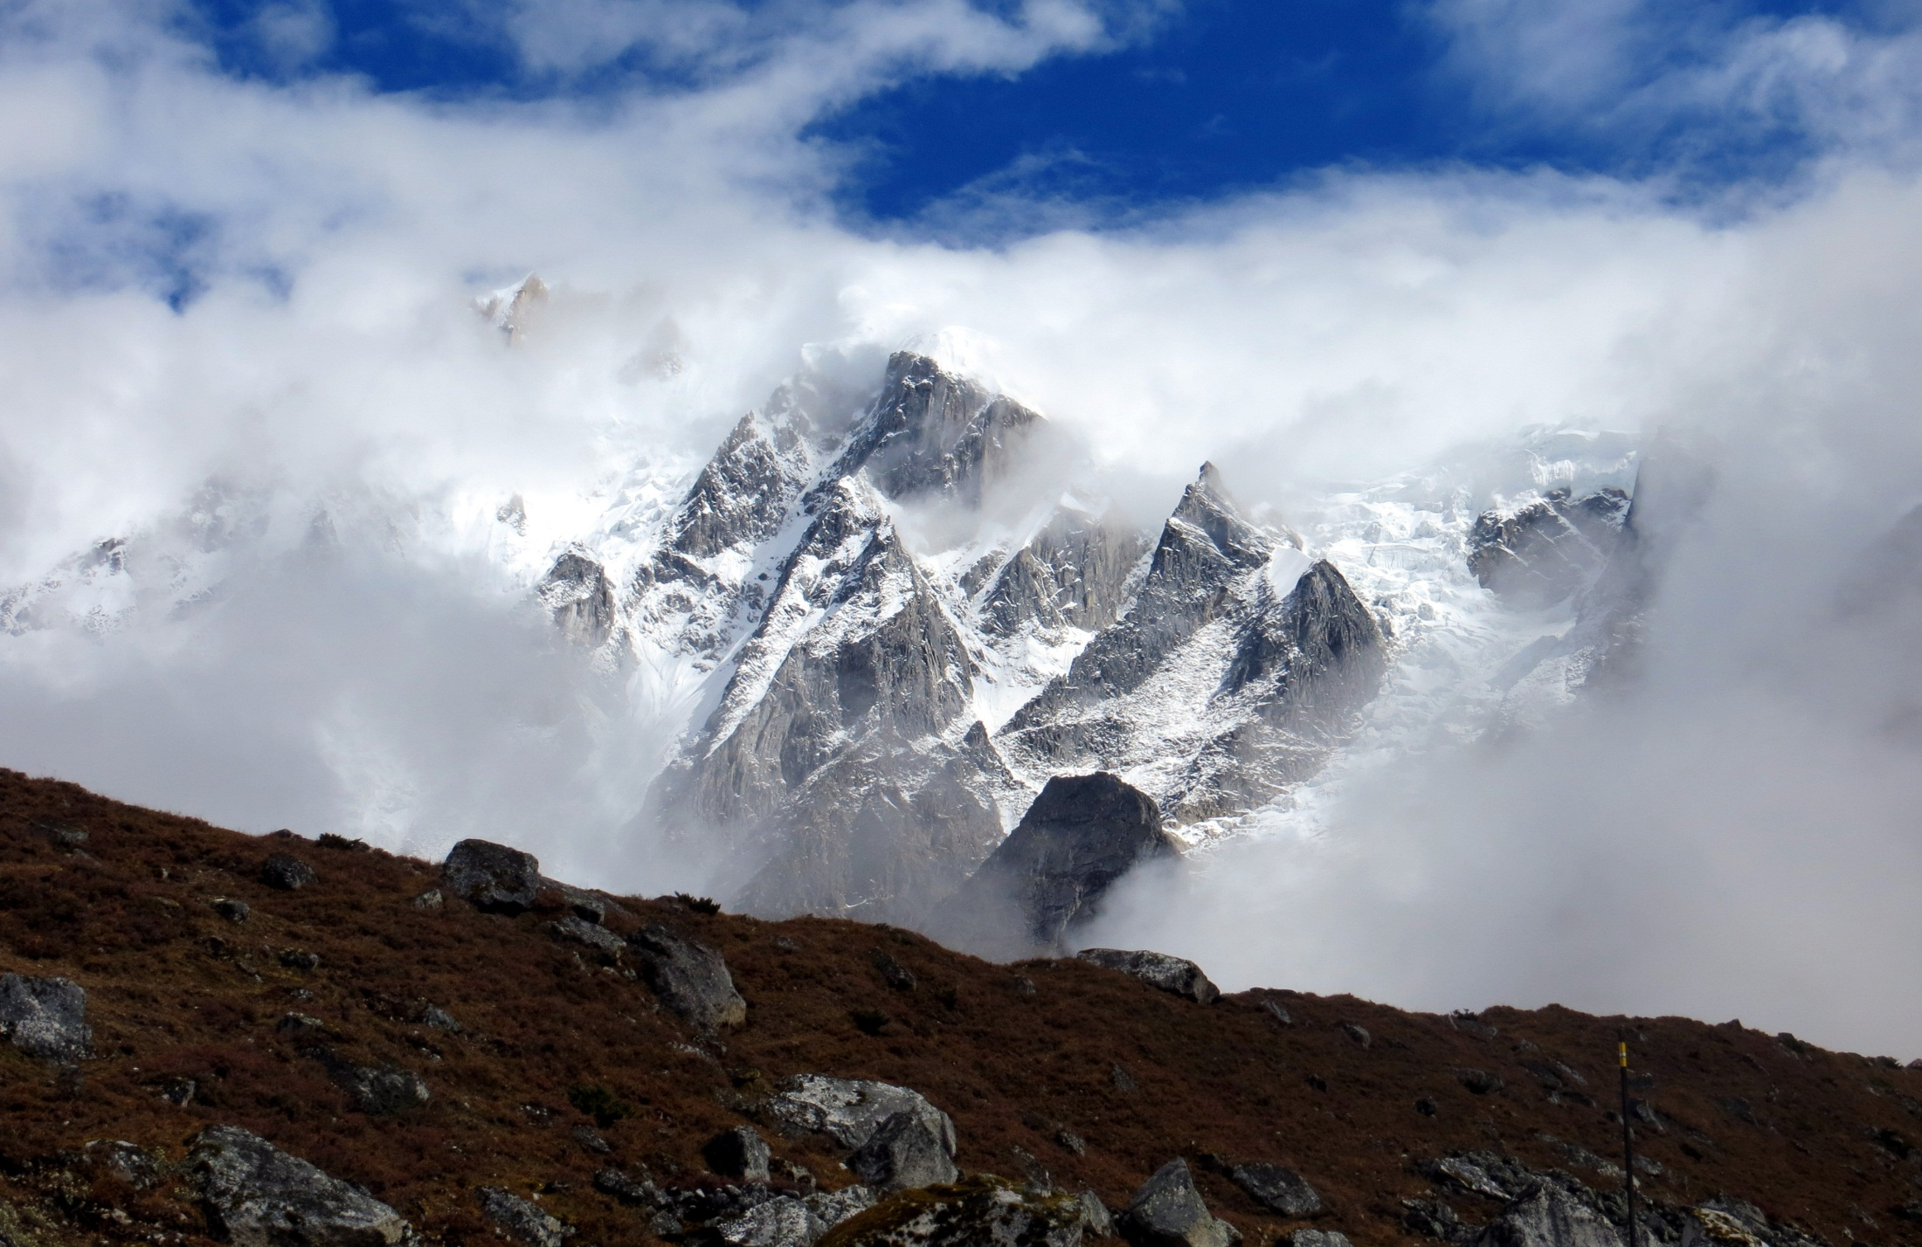

Combining Spectral, Topographic and SAR Coherence Data Within an Object Based Classification Environment for the Automatic Delineation of Debris Covered Ice
ROBSON, Benjamin Aubrey¹, NUTH, Christopher², DAHL, Svein Olaf¹,
HÖLBLING, Daniel³, STROZZI, Tazio⁴, and NIELSEN, Pål Ringkjøb
(1) University of Bergen, Norway (2) University of Oslo, Norway, (3) University of Salzburg, Austria (4) GAMMA Remote Sensing, Switzerland
GSA 2014 19th – 22 October Vancouver

Slide 2
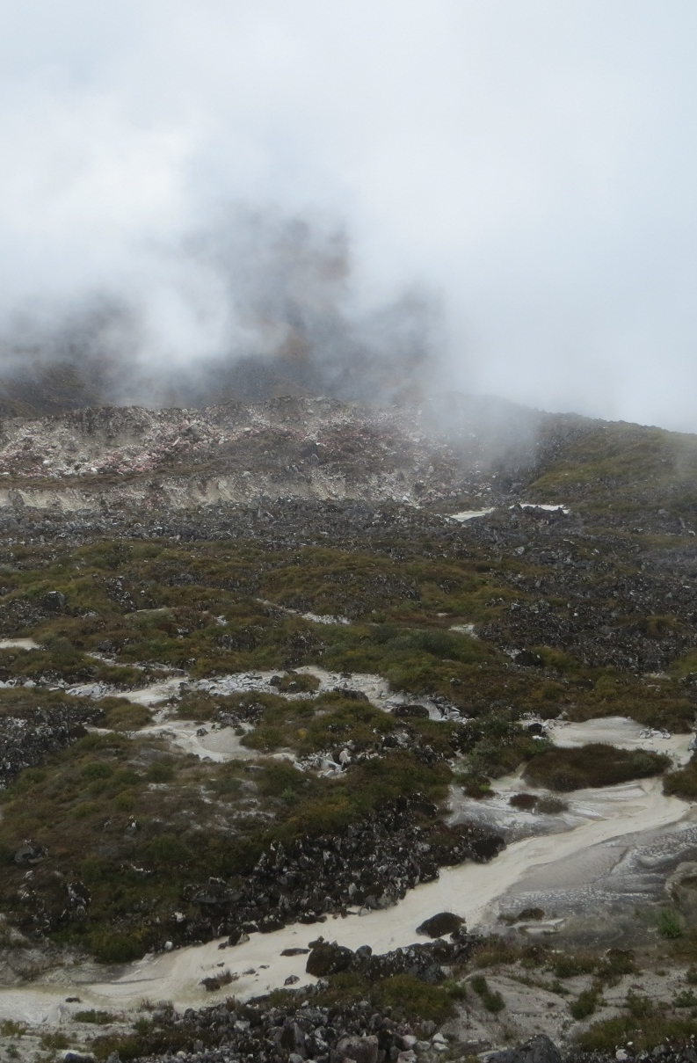
Introduction
Need for up to date glacier outlines
Classification of Debris Covered Ice
  Mostly use topographic parameters
  Largely require manual correction
  Recent use of SAR coherence to aid delineation (Frey et al., 2012, Saraswat et al., 2013)
  OBIA offers a method to combine SAR data within optical and topographic data
Notes:
Area Change Analysis
Velocity Analysis
Volume Analysis
Modelling and Estimation of Sea Level Rise
Clean ice is straightforward to delineate, tm4/tm5 band ratio, transferable, quick and robust
Also thermal band from satellite image, but works only with thin debris, otherwise thermal signature not well defined
Reason is that the lithogical make up of debris varies a lot, can be hard to distiguish from surrounding bedrock
SAR – anything that changes shows up as a loss of coherence, but problems as also water, rockfalls and unstable slopes
SAR methods still rely on some degree of manual interpretation, SAR used as a guide

Slide 3
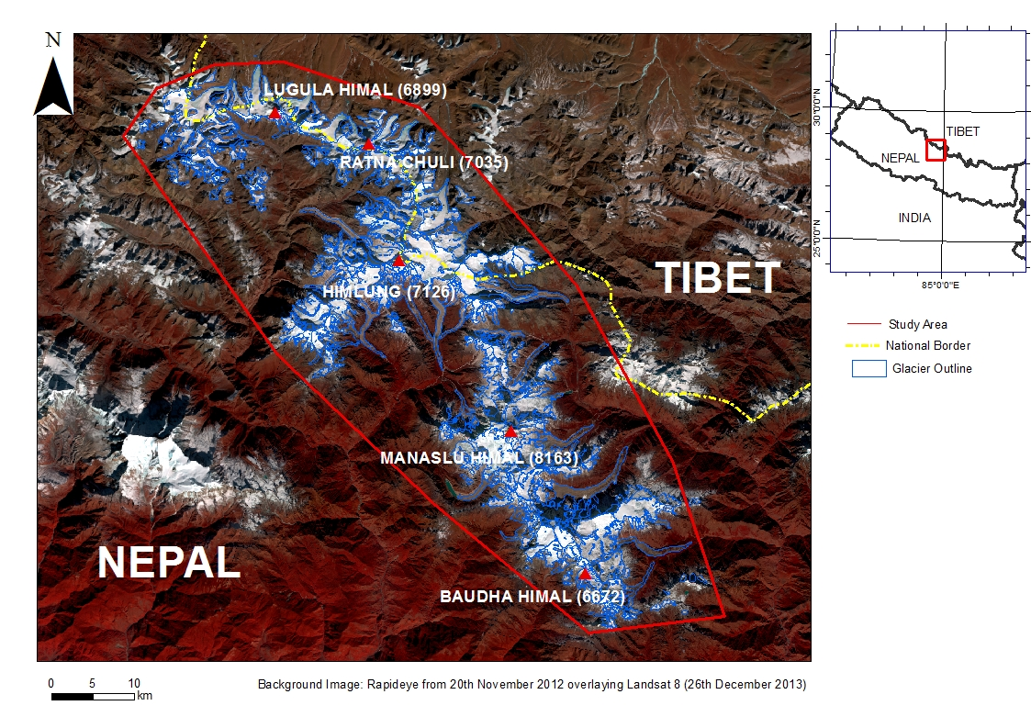
Study Area
17 debris covered glaciers
11 clean ice glaciers
3000 m.a.s.l. – 7000 m.a.s.l.
Notes:
17 debris covered glaciers and 12 clean ice glaciers . 788 km2 of ice, 113km2 of which is debris covered
Contrast between debris covered ice on the southern facing slopes and clean ice when flowing north of the mountain divide
Also big contrast in the climates of the same region

Slide 4
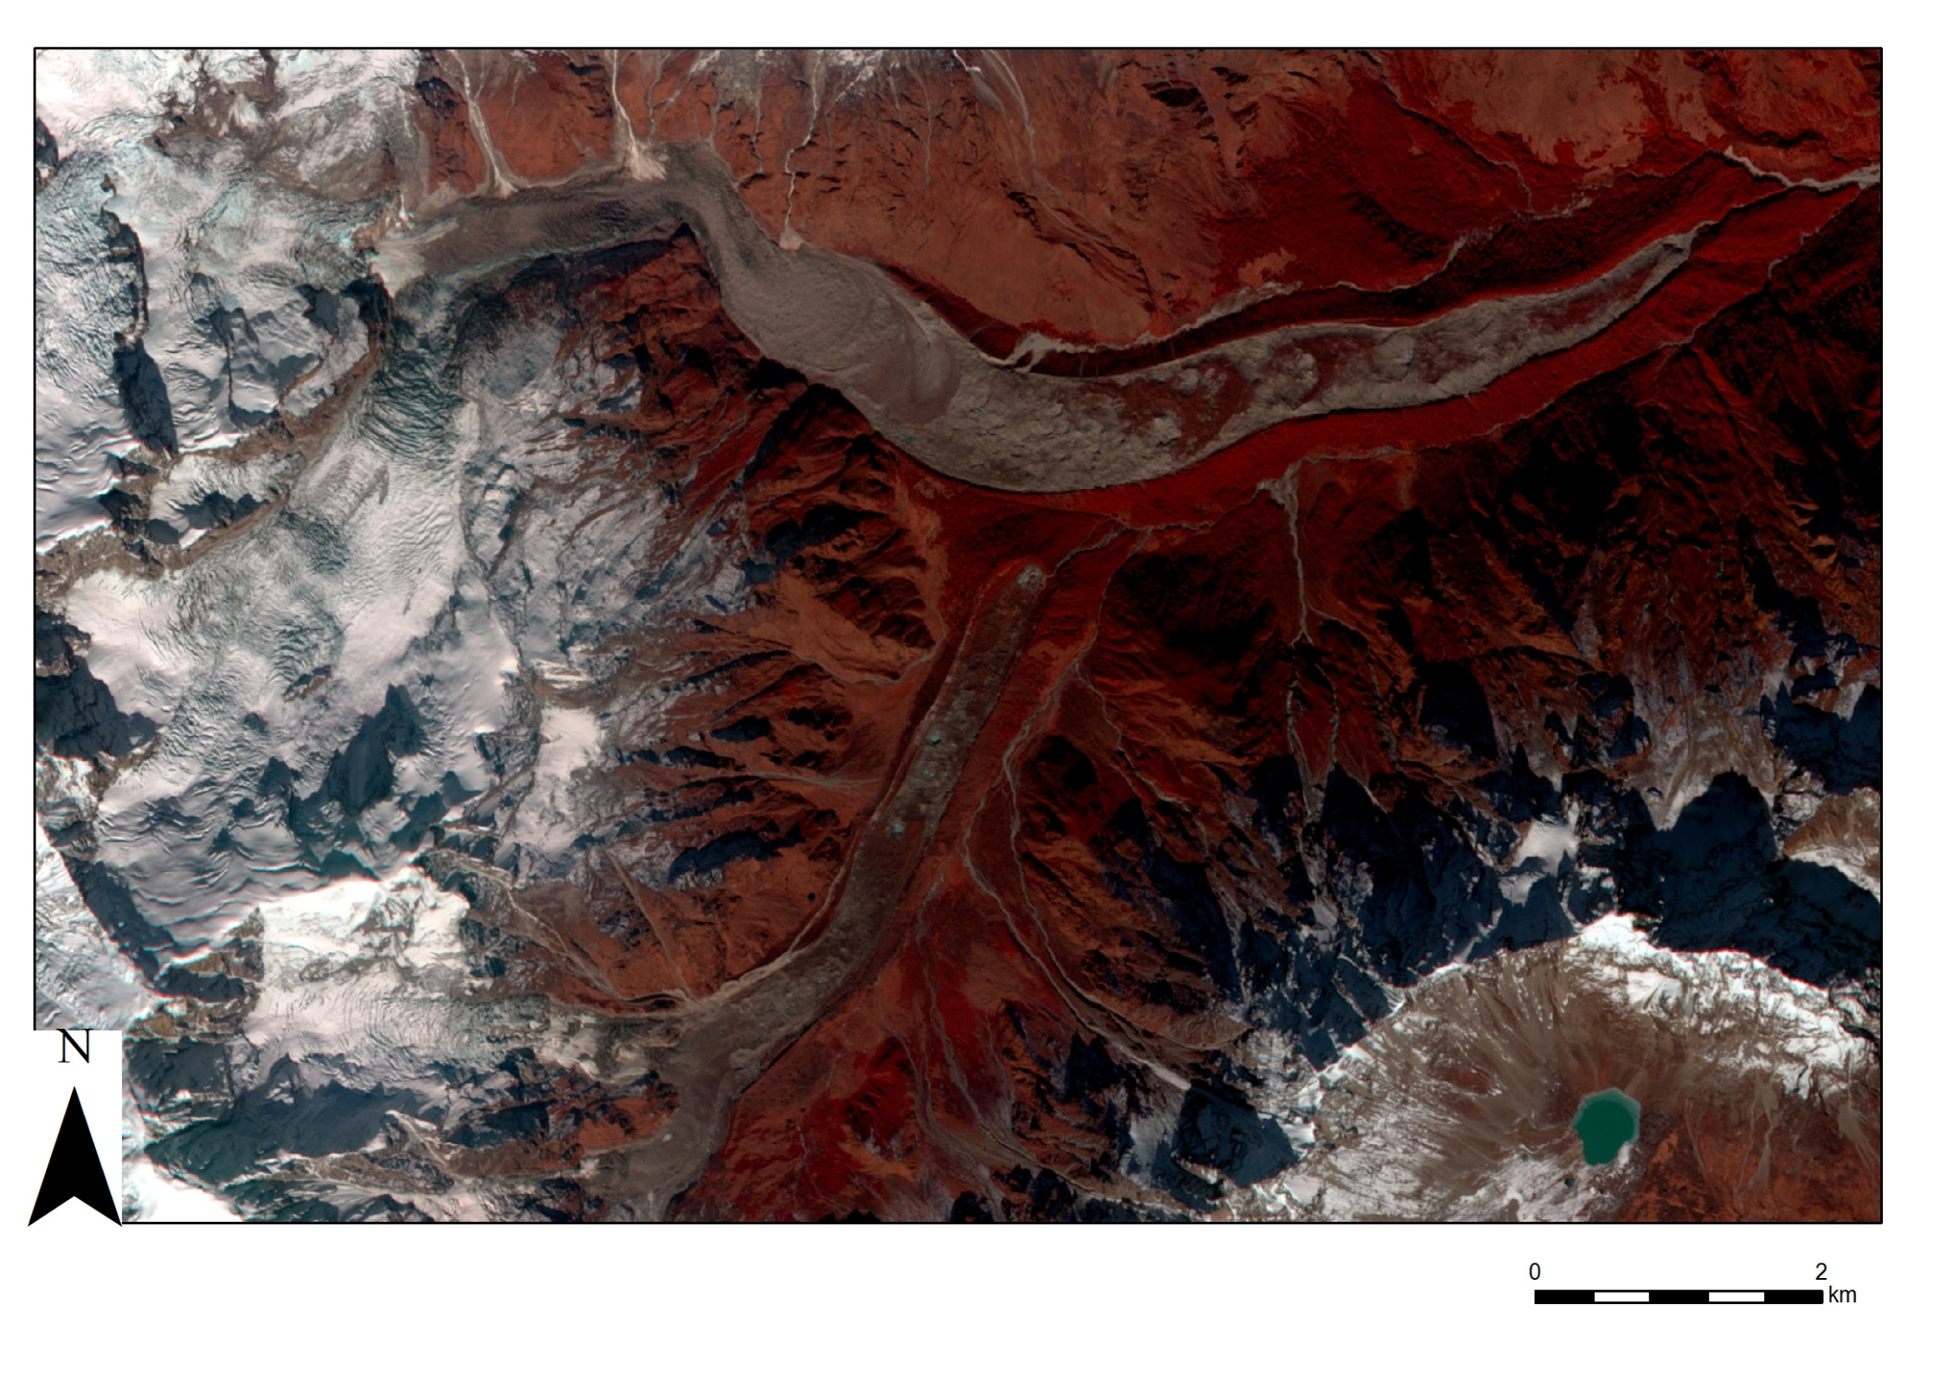
What data can be used to help delineate debris covered ice?
False colour RapidEye Image
Notes:
Can sort of see in some areas due to litholgical changes, but often it can be hard to tell, blends in with surroundings, parts of Ponkar. Notice big changed in debris composotion that spectral methods fall prey to

Slide 5
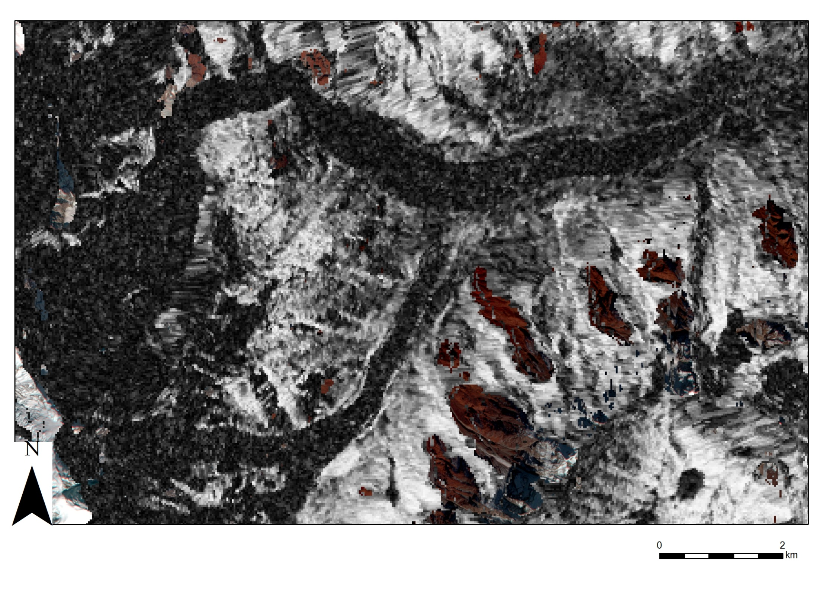
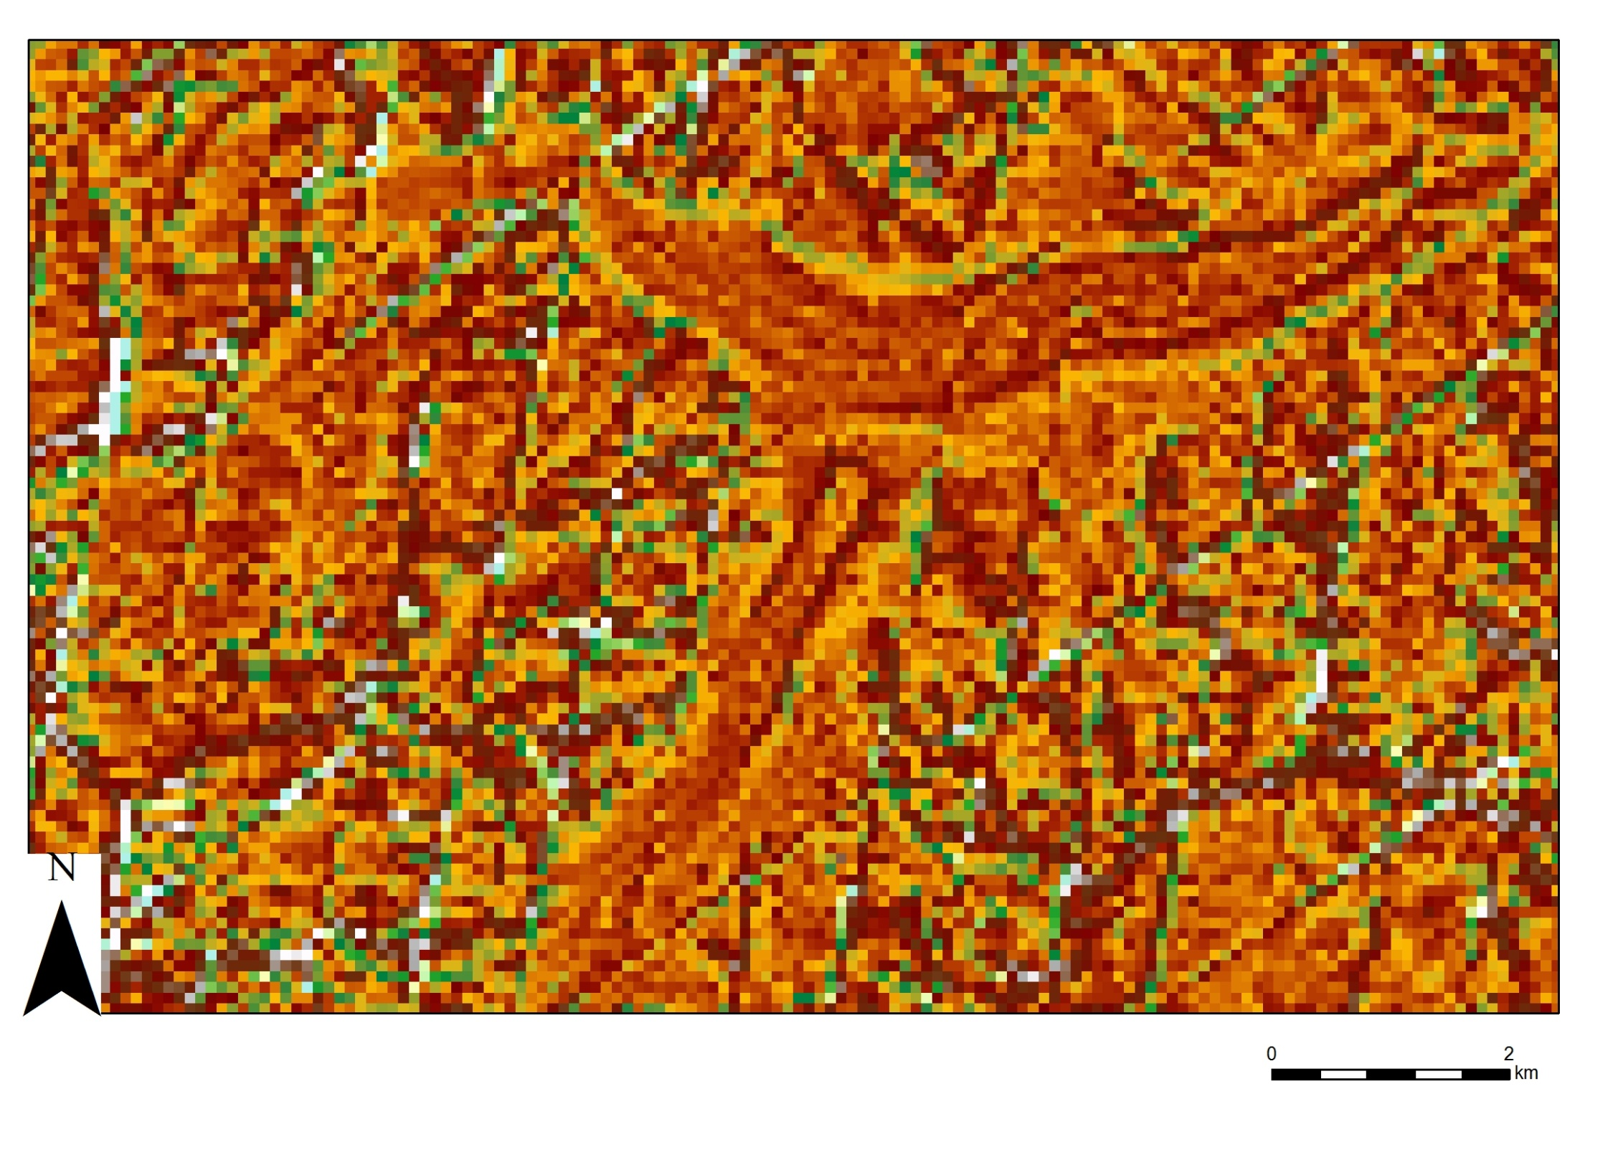
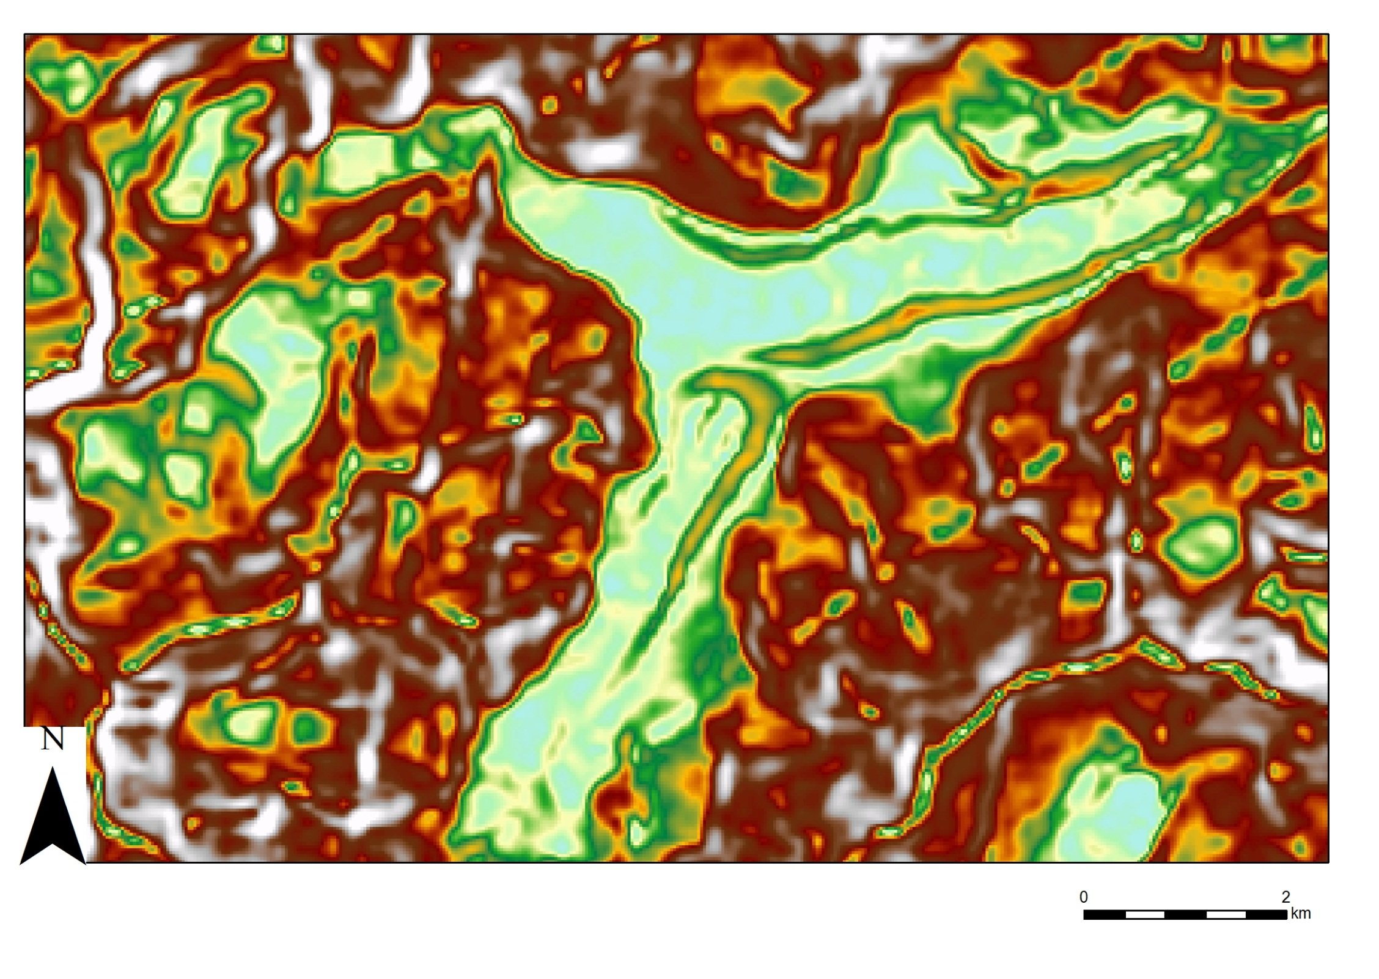
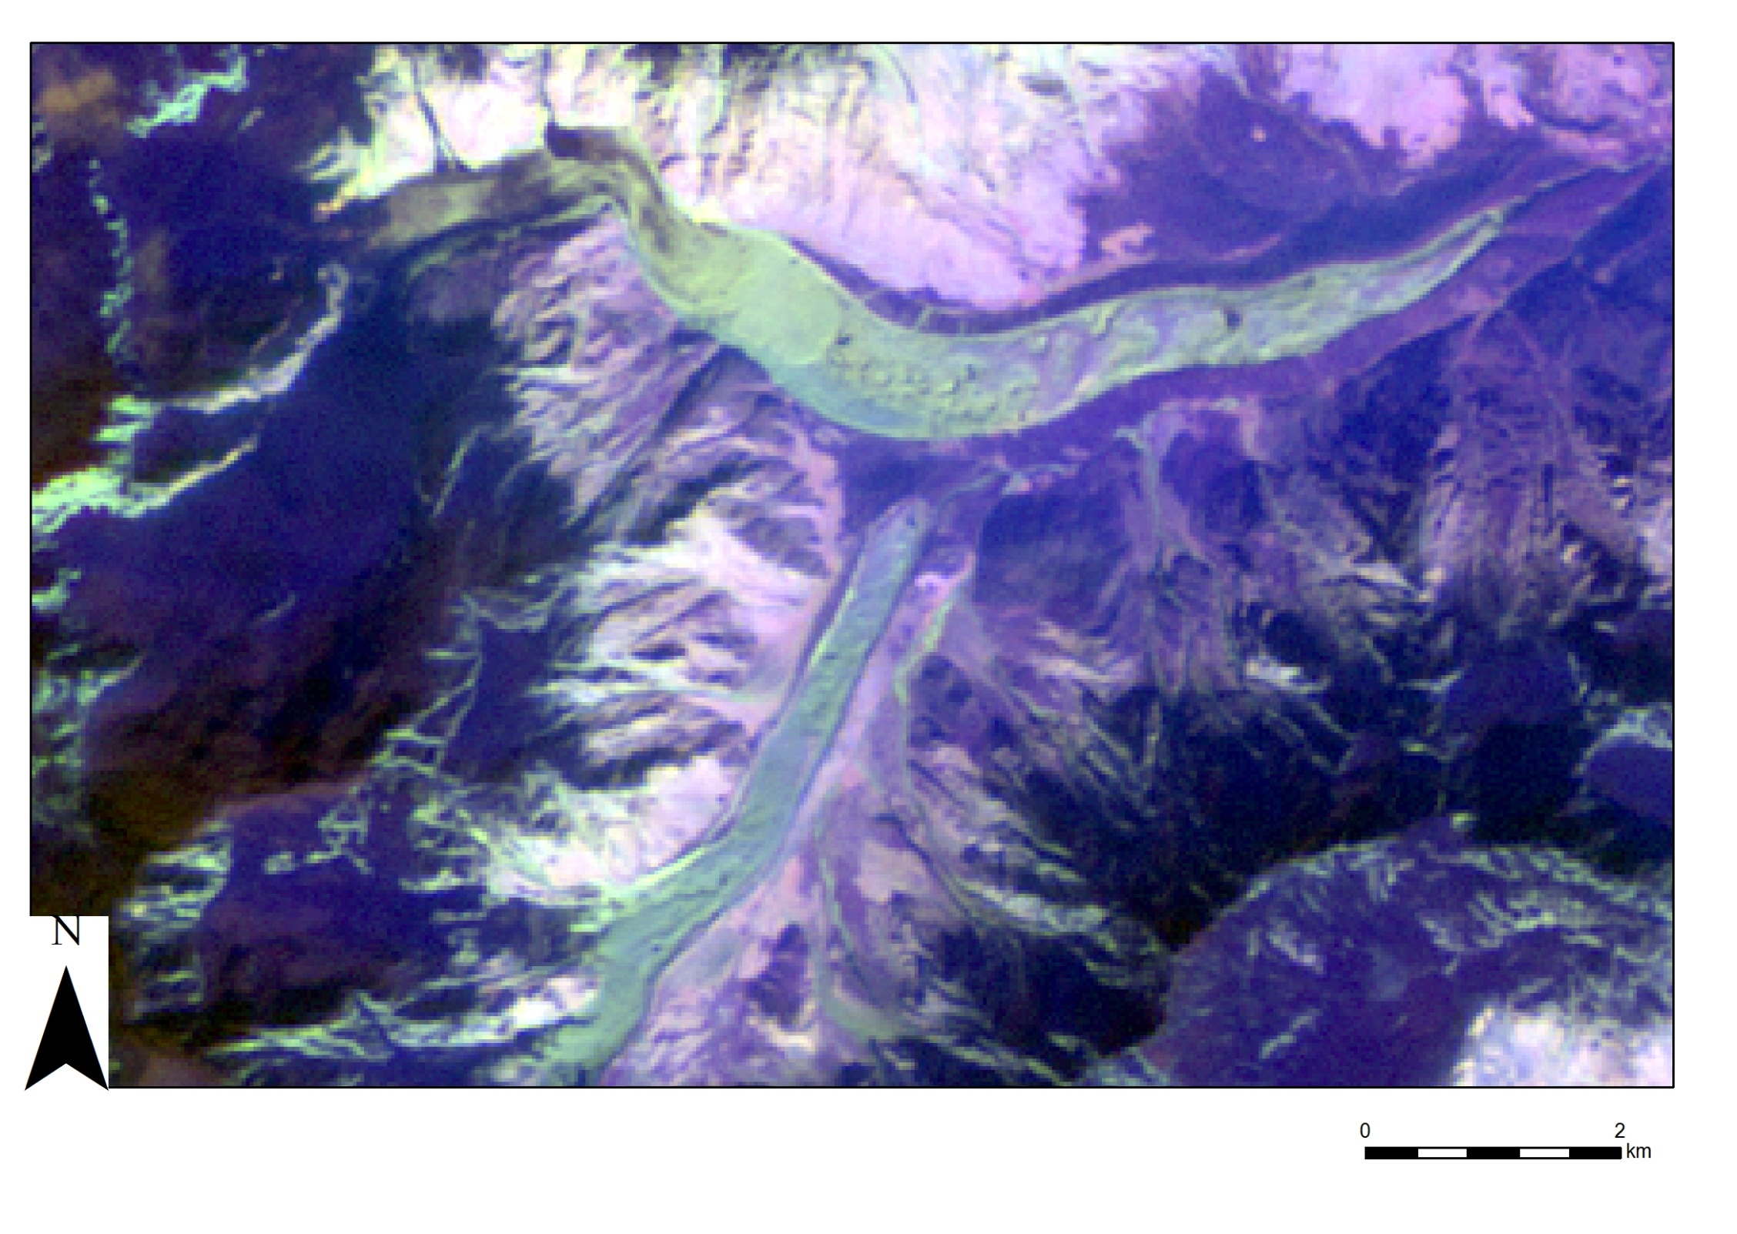
What data can be used to help delineate debris covered ice?
False colour ASTER Image
Notes:
Bands for NIR, SWIR and TIR. Helps illustrate lithogical differences

Slide 6
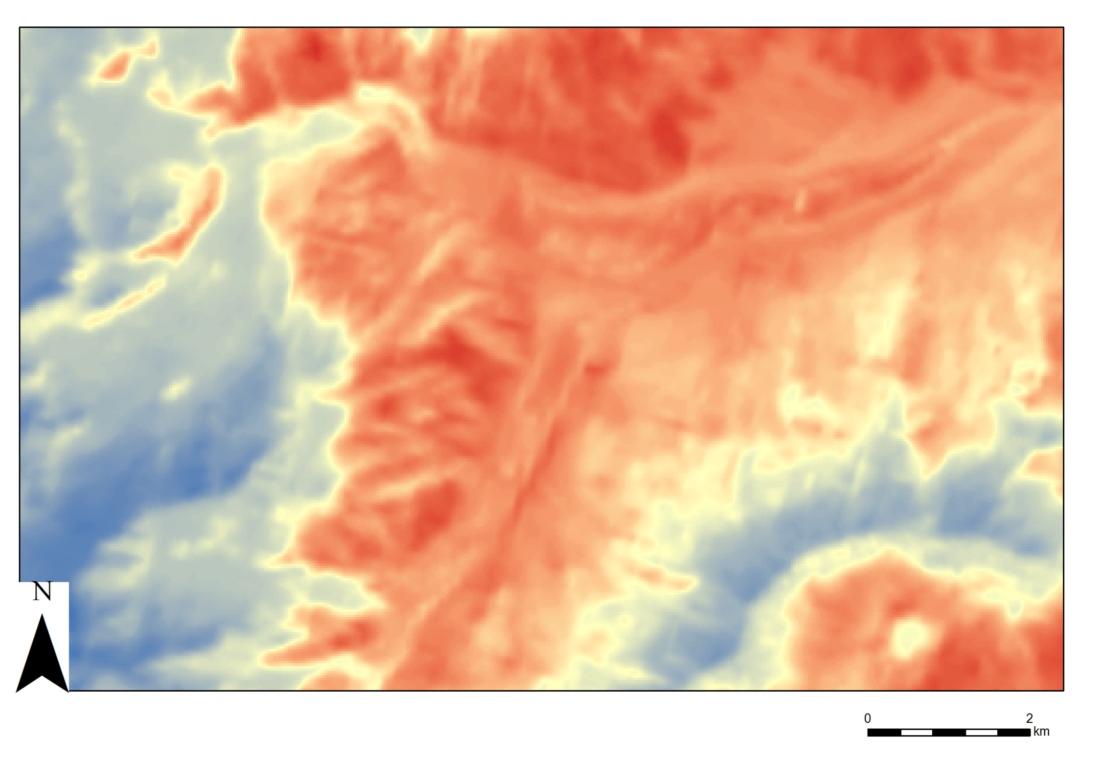
What data can be used to help delineate debris covered ice?
Thermal Band (Landsat 8)
Notes:
Sometimes can use the difference between a nightime and daytime thermal image

Slide 7
What data can be used to help delineate debris covered ice?
Slope (SRTM)
Notes:
Slope is one of the most used parameters for delineating debris covered glaciers, but as you can see with only the SRTM available, it’s not ideal, can only be used as a guide.
Can see a break in the slope

Slide 8
What data can be used to help delineate debris covered ice?
Curvature (SRTM)
Notes:
Can sort of see in some areas due to litholgical changes, but often it can be hard to tell, blends in with surroundings, parts of Ponkar

Slide 9
What data can be used to help delineate debris covered ice?
ALOS PALSAR SAR Coherence
Notes:
Anything that has moved or changed shows up as a loss of coherence

Slide 10
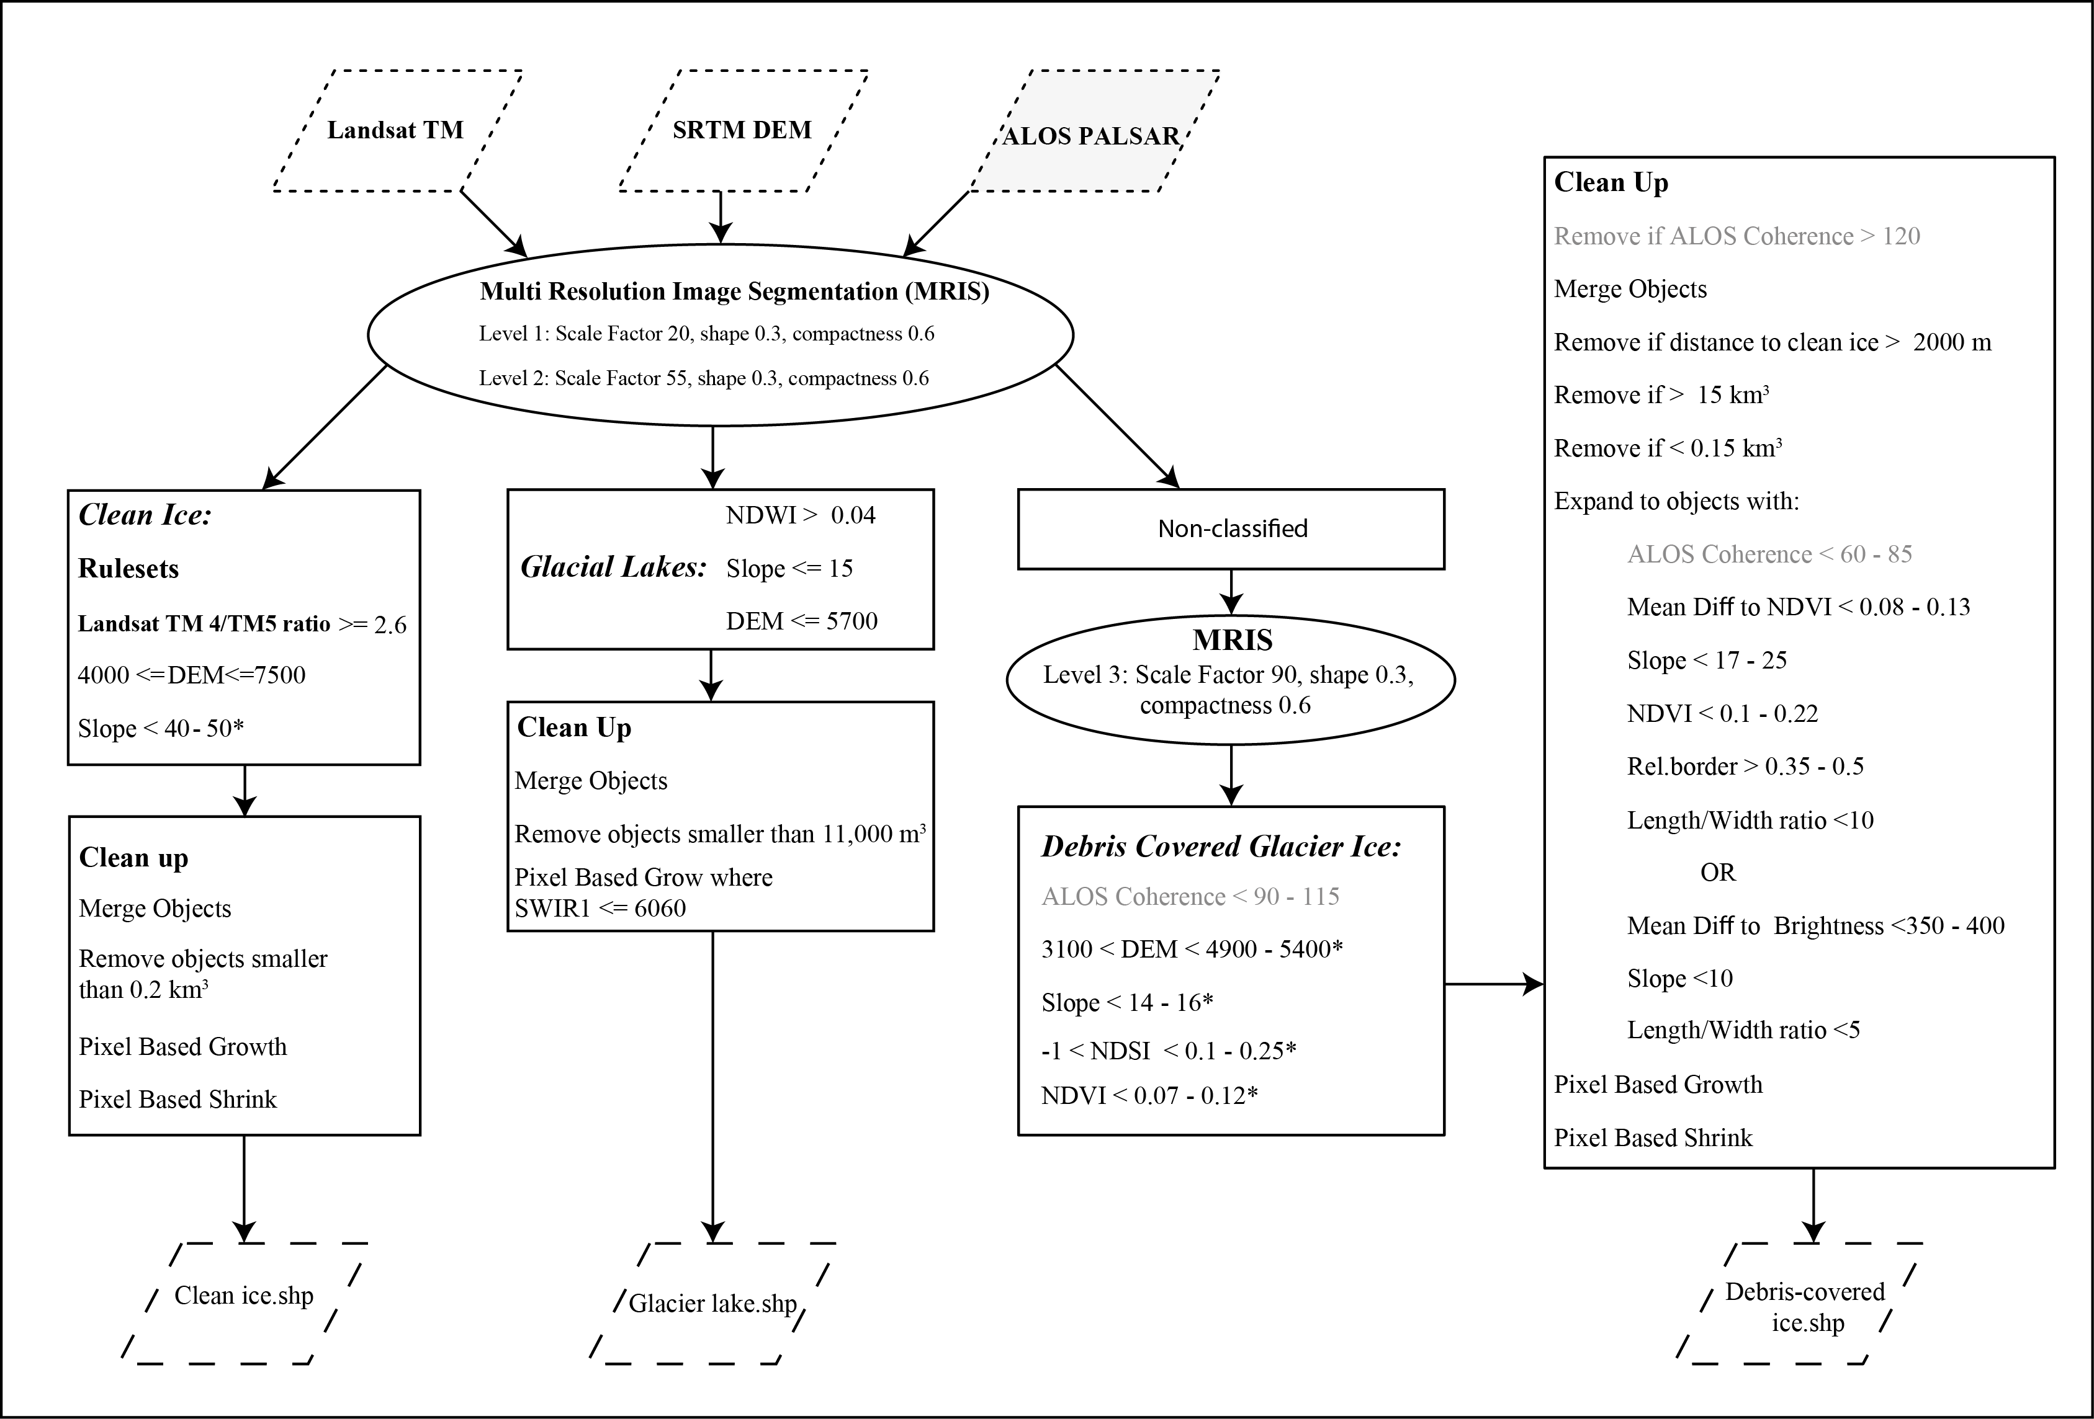
Methods
Notes:
Show the difference between two methods
Fuzzy memorsup, where defining criteria are given a range of values

Slide 11
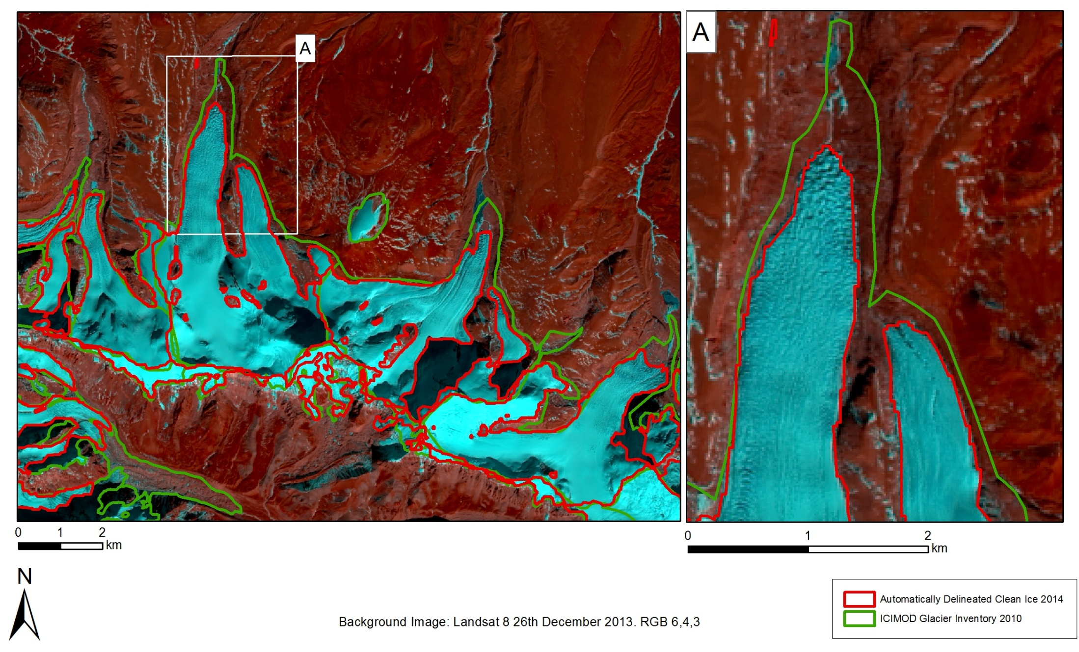
Clean Ice
Notes:
Mainly using band ratios, an established method already, but some advantages within OBIA, removes salt and pepper effect of classificiations, could contextually reclassify many shadows to either ice or rock(unclassified) based on slope and neighbouring objects
In most cases the outlines are within ± 30 m, the resolution that everything was resampled to within eCognition
From the manually corrected outlines by 7.46%. If the glaciers with the three largest differences are excluded this falls to 536%, comparable to accuracies found by others (Paul et al., 2013).
ICIMOD outlines in many cases overestimate the extnet by 500 and 1000 m, must be seasonal snow

Slide 12
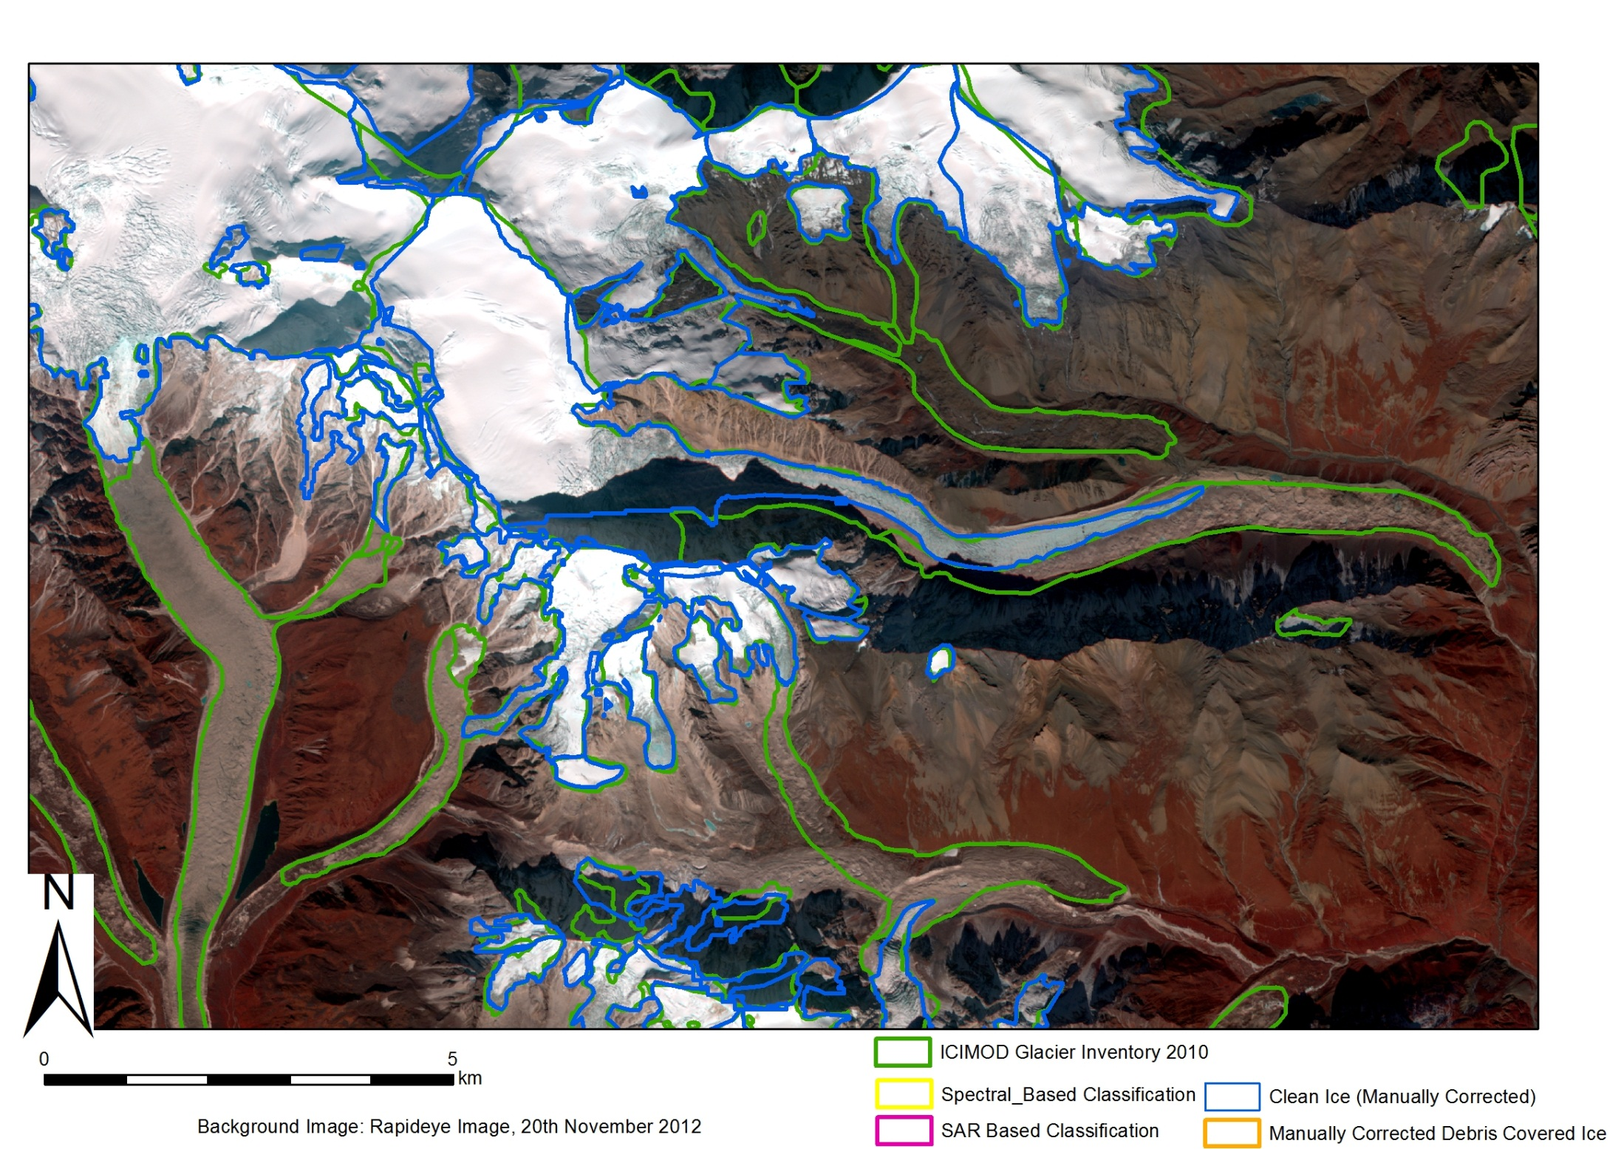
Results

Slide 13

Results

Slide 14
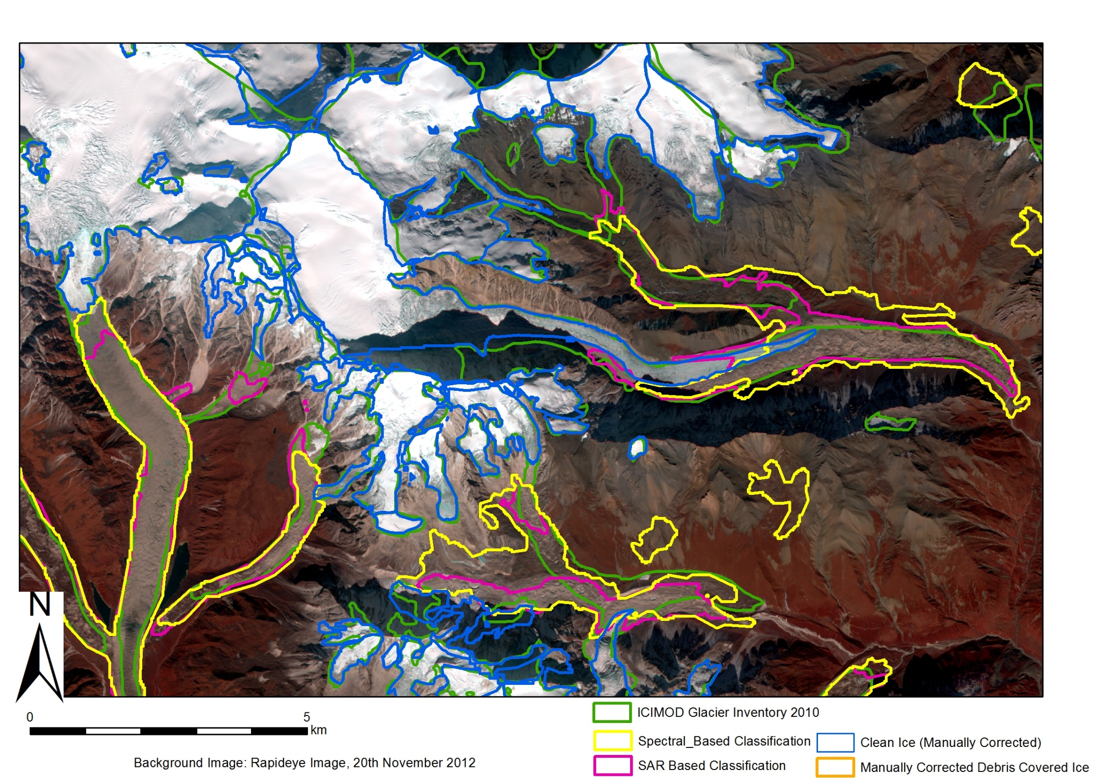
Results

Slide 15


Slide 16
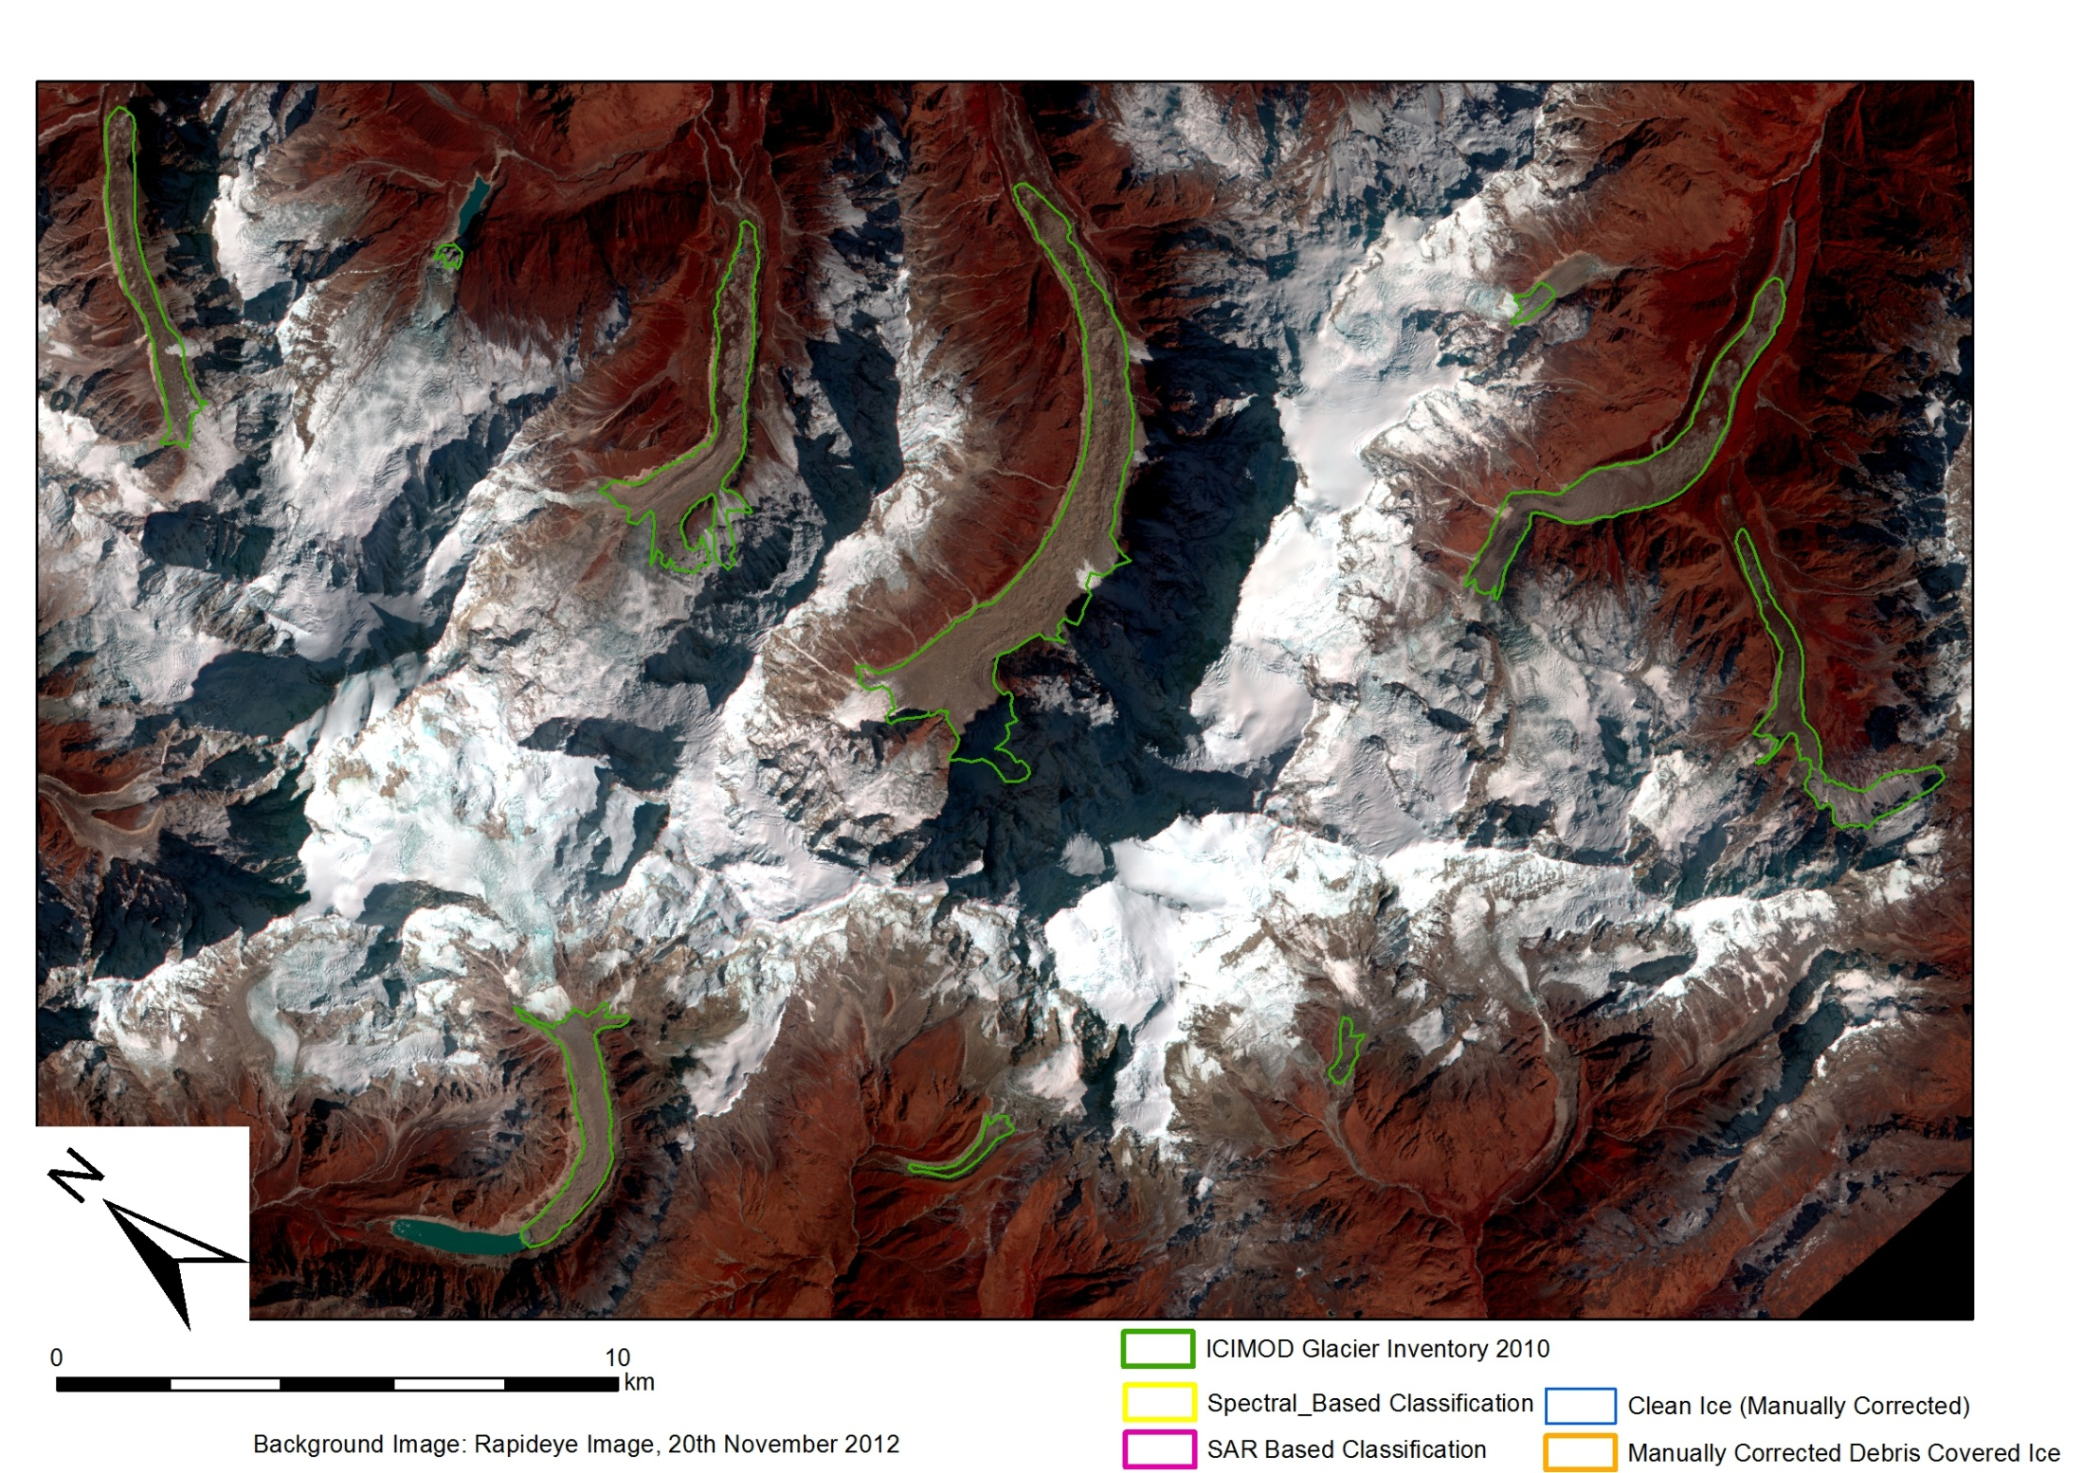

Slide 17
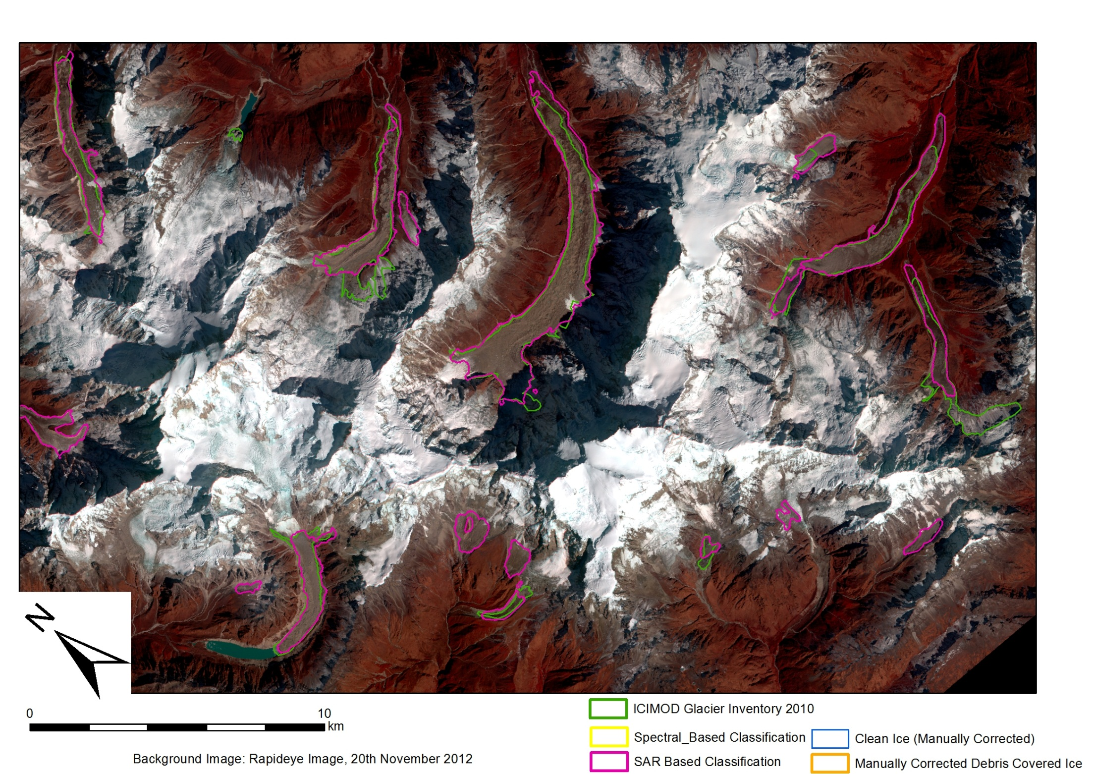

Slide 18
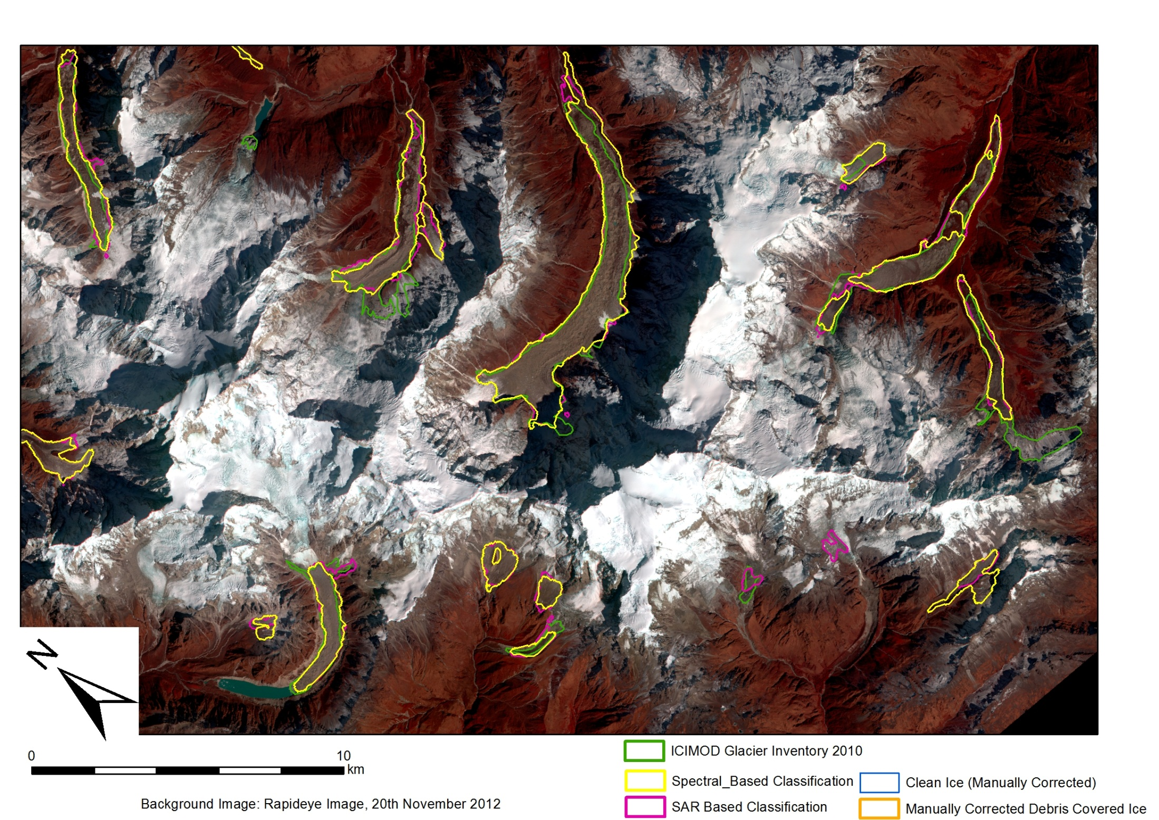
Notes:
Point out break in difficult glacier on spectral

Slide 19
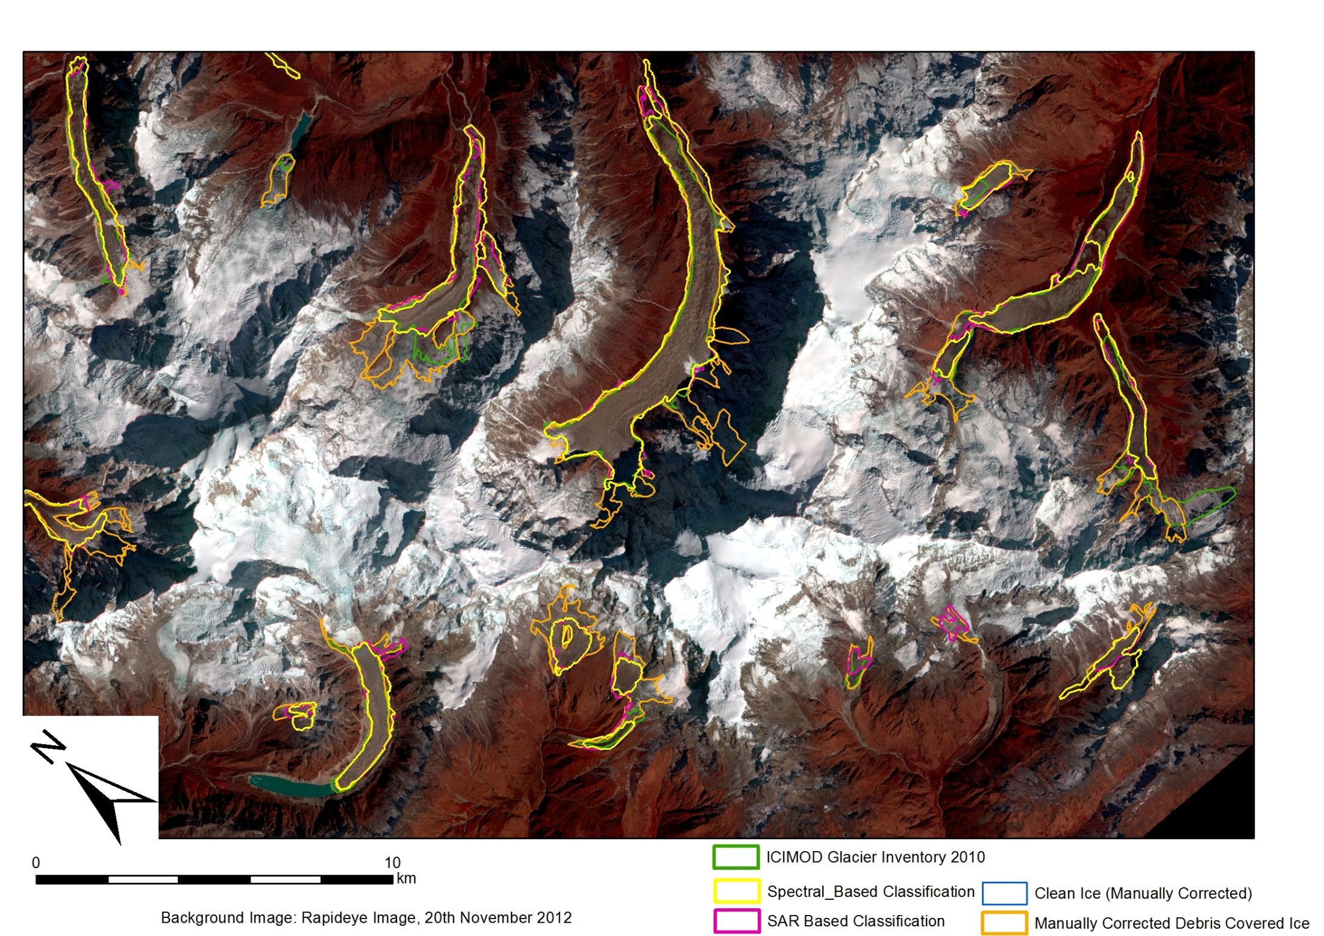

Slide 20
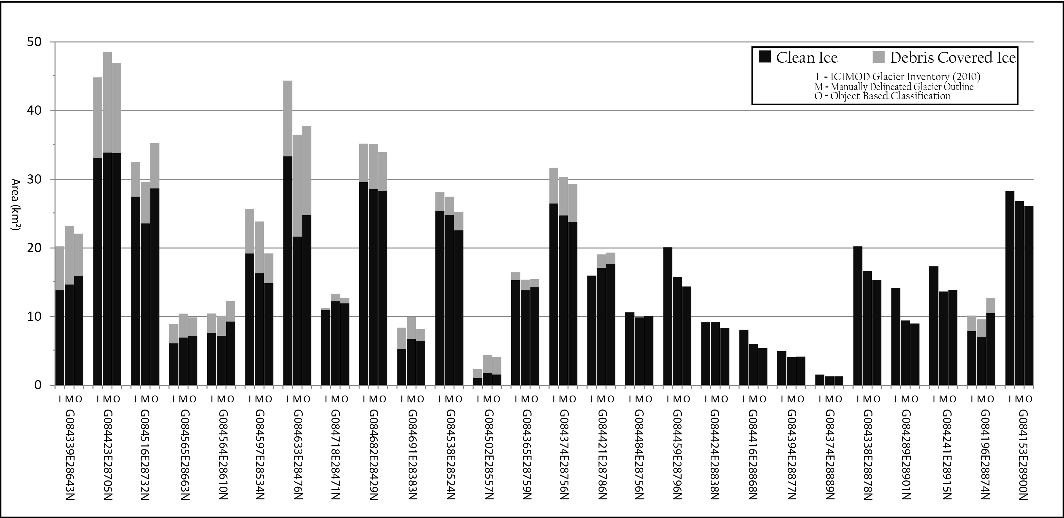
Results

Slide 21
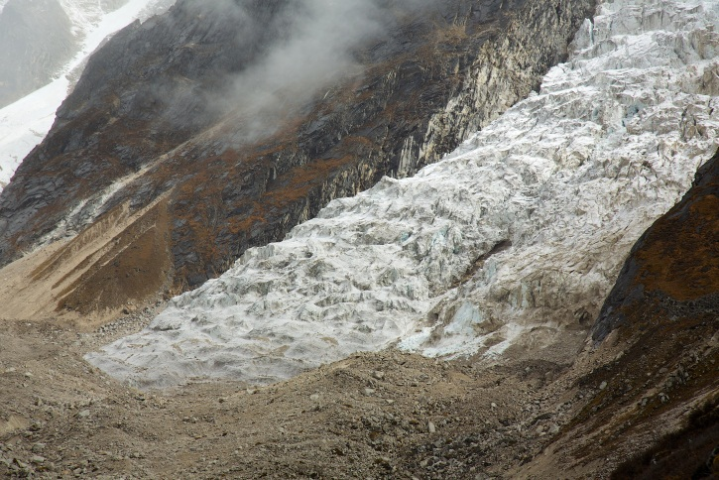
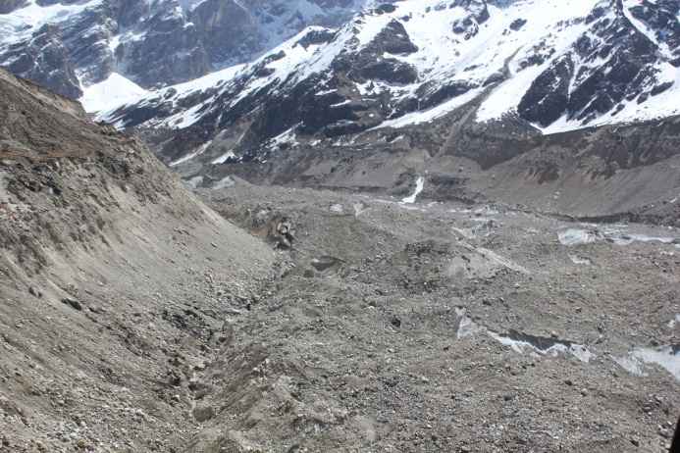
Results II
Automated Outlines varied by 13.92% from the manual outlines
  Falls to 7.16% if the three largest deviations excluded
Without SAR Coherence Data, the accuracy falls to 28.75% 21.75% excluding three largest deviations)
Classifications struggle with steep glacier tributaries and steep erosional scarps
  If steep tributaries are excluded, the error falls to 7.80% (5.80% is three largest deviations omitted)

Slide 22
Future Work
A higher resolution DEM would allow a greater reliance on topographic parameters
Optical imagery, DEM and SAR imagery from a similar point in time
Transferability across other areas of the Himalayas/further afield?
Notes:
Surface roughness especially, curvature at edge of glacier

Slide 23
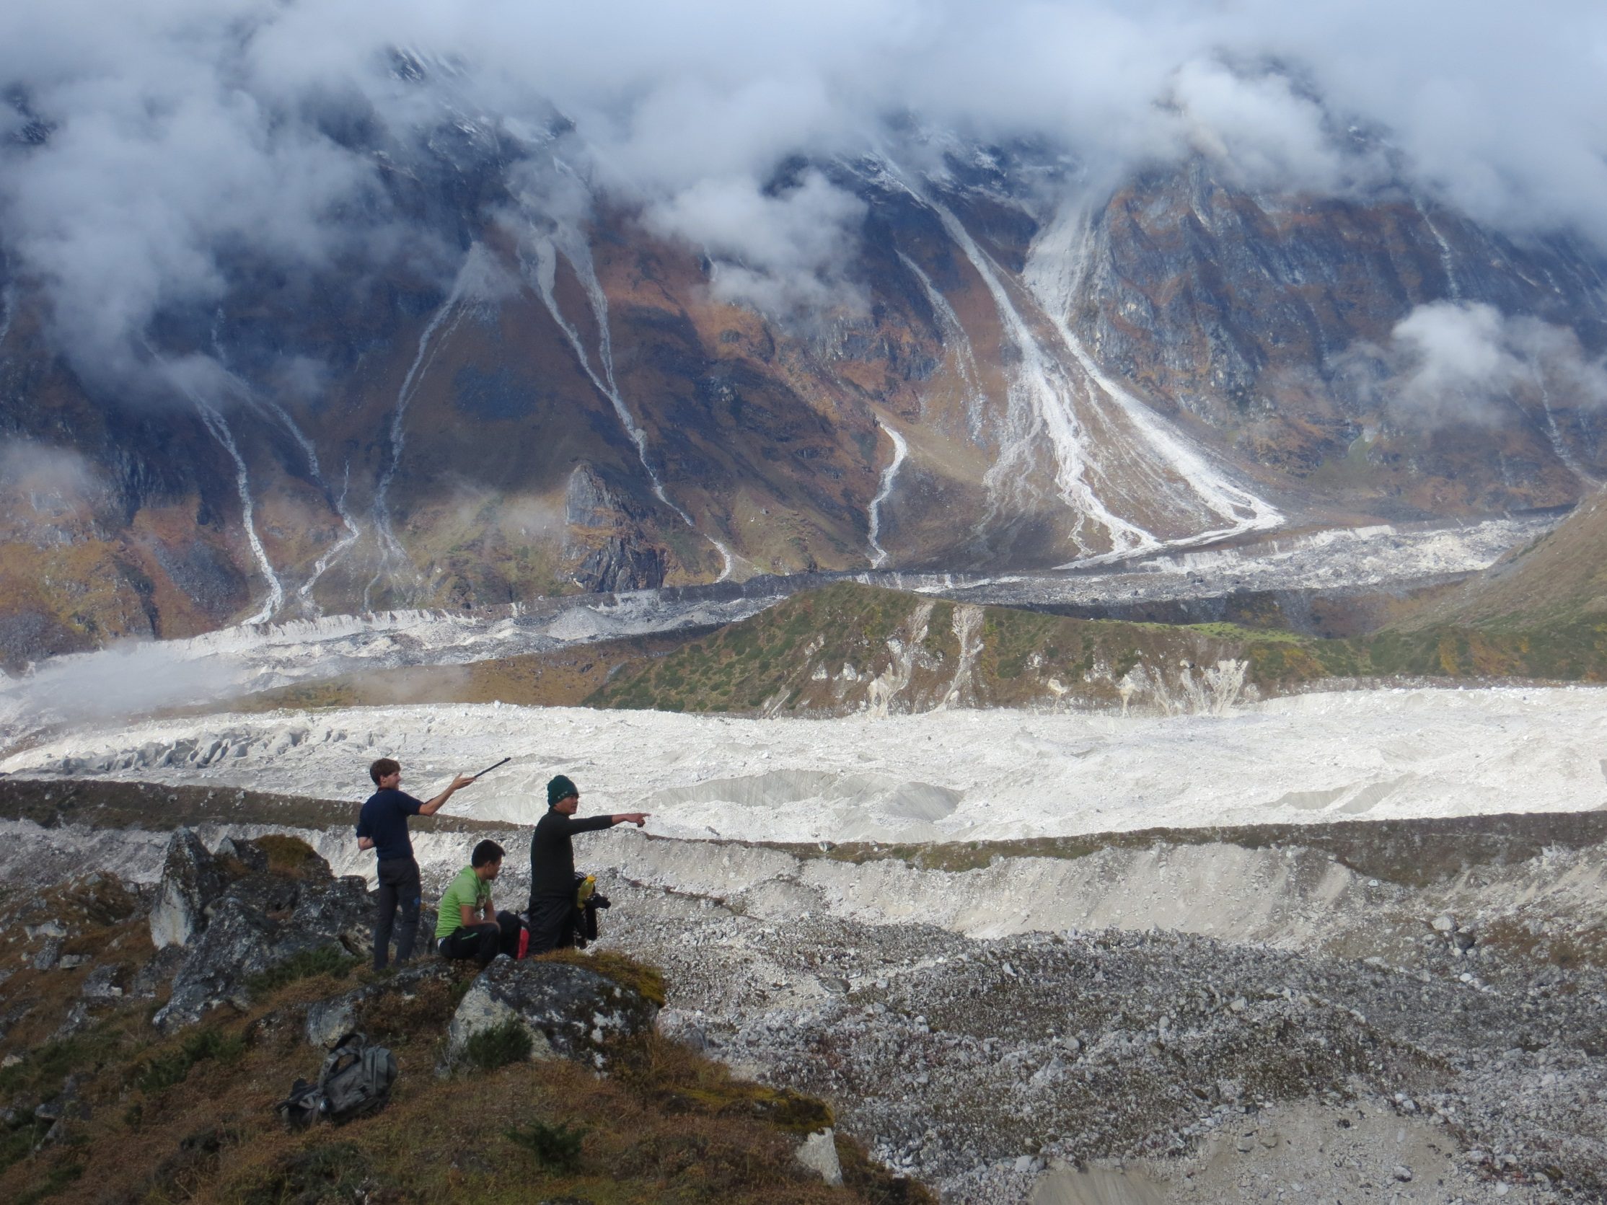
Thank you for your attention
Any questions?

