Slide 1
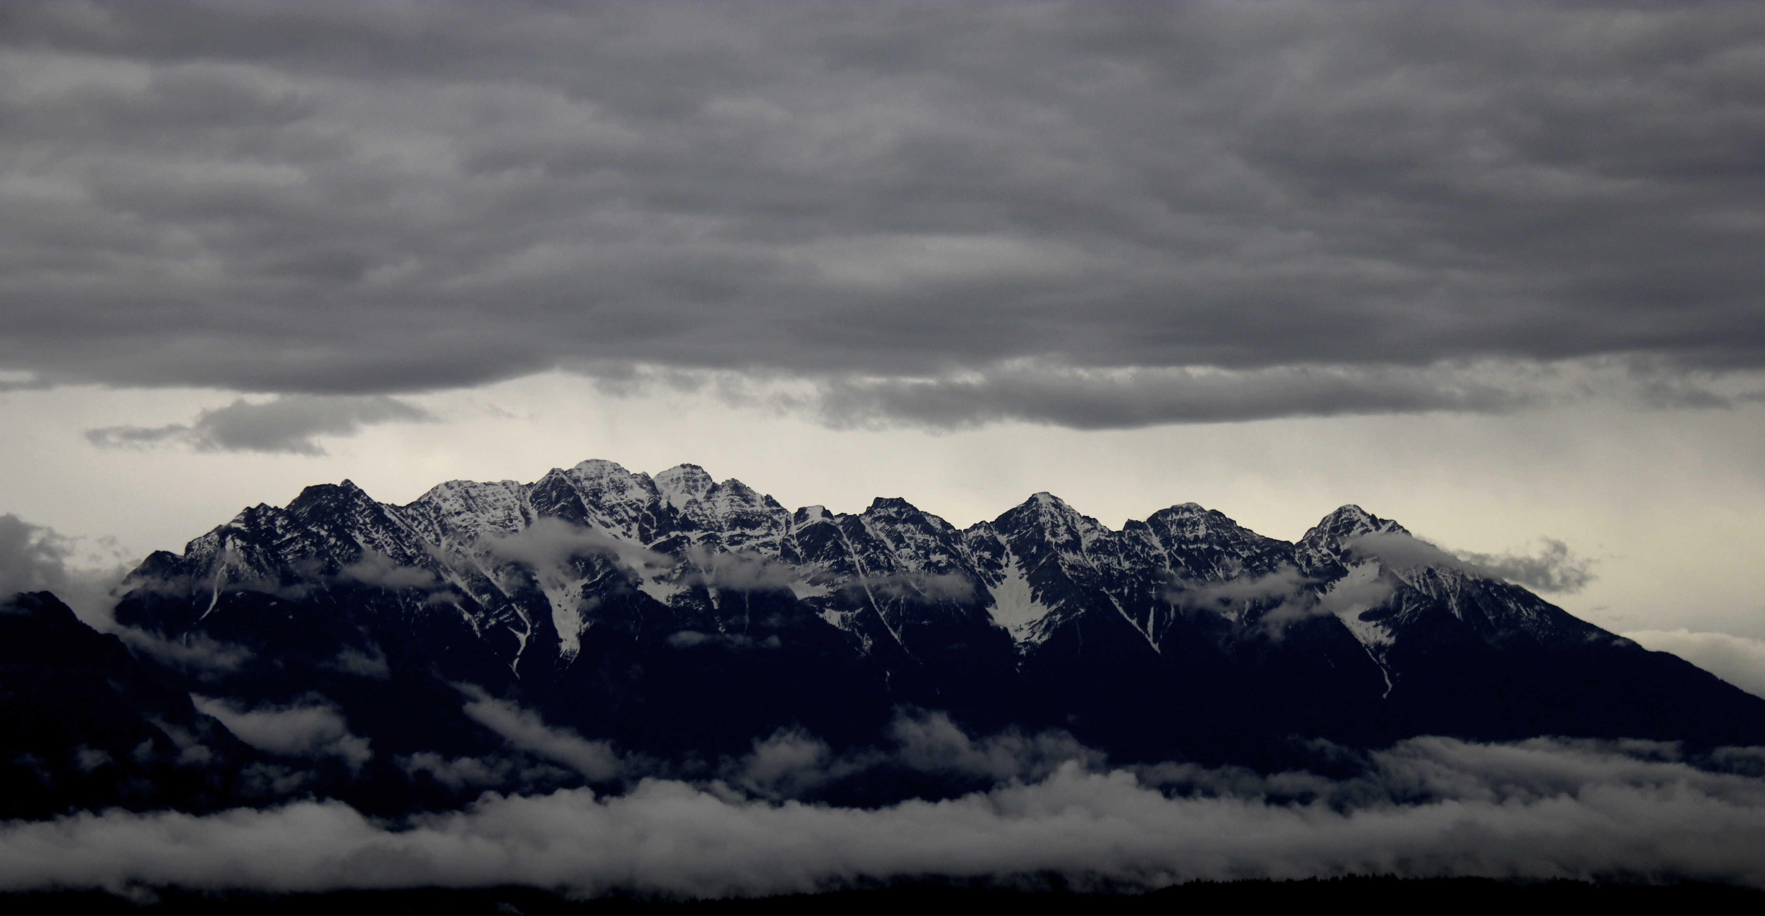
The History of Geology as a Modern Tool for Teaching Geology
Glenn Dolphin
Tamaratt Teaching Professor
University of Calgary
Calgary, Alberta, Canada
Wendy Benoit
University of Calgary
Calgary, Alberta, Canada

Slide 2
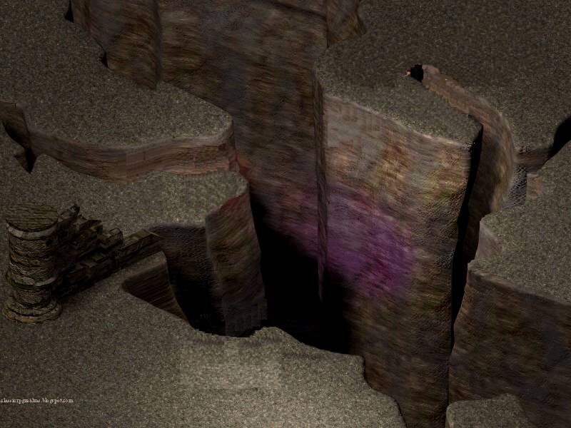
What
(Halloun & Hestenes, 1985; Libarkin & Anderson, 2005; Cheek, 2010)
Common
Science
sense
Teaching
Fairweather (2008)
Says
ideas
Notes:
Put in something about integrated instructional units…

Slide 3
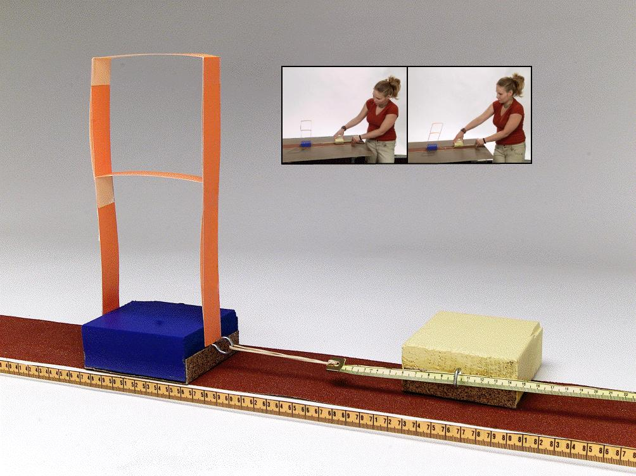
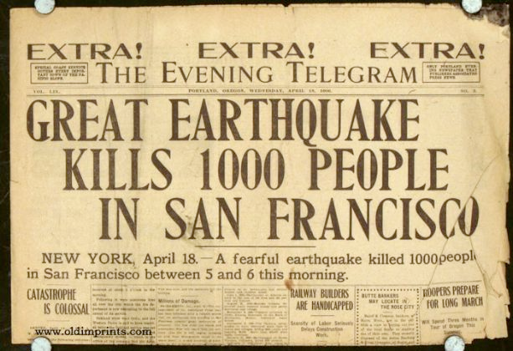
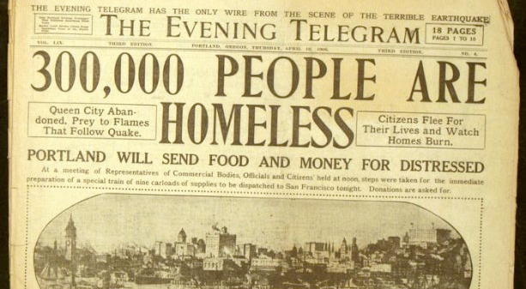
Historical Prelude
What is an earthquake?
Where does the energy for an earthquake come from?

Slide 4
Braiding history, inquiry, model-building
Herreid (2007)
Allchin (2013, 2014)
Dolphin (in review)

Slide 5

Methods
Physical science course in a Natural Science program
Instructor is a chemistry and natural science instructor
PD for case implementation included meetings before and during instruction
5 female undergraduate education majors
Participant observer – Audio recorded (subsequently transcribed) and hand written notes (Four consecutive 1.5-hour classes)

Slide 6
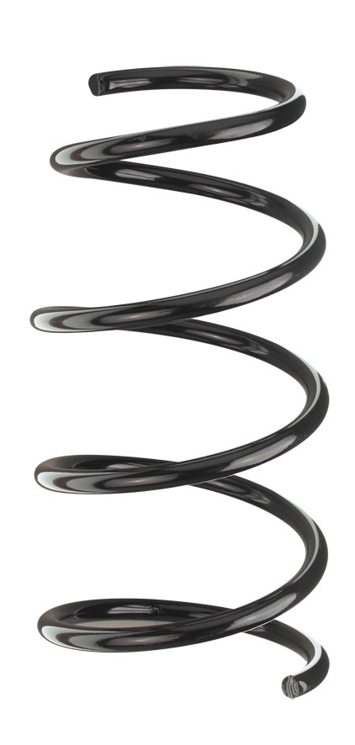
Theoretical framework
Model-based learning (Clement & Rae-Ramirez, 2008)
Descriptive?
Explanatory?
Dissonance?
Knowledge gap
Inconsistency
Usefulness
Concepts in the making
Concept
Observations

Slide 7
Findings
Model accretion
Descriptive
Danielle: Yes. So, with one elastic and two rocks, it goes like this. (She pulls the earthquake machine across the sandpaper .) (20140320:711-713)

Slide 8
Findings
Conflating “continents” with “plates”
Danielle: It's pushing down the elastic into the sandpaper. But are the spaces between the plates that…
Carrie: Substantial.
Danielle: Yeah, that substantial.
Carrie: Yeah, I hope not. Like you are just standing there and it's going to collapse one day. (20140320:557-568)

Slide 9
Findings
Conflating “continents” with “plates”
Julie: How many tectonic plates are there ? [There is about a three or four seconds pause and everyone starts to laugh]
Danielle: I don't know.
Carrie: For some reason, I think- The first thing that comes to mind is seven, but I don't think that's right .(20140327:513-521)

Slide 10
Findings
Elasticity in brittle rocks
Lucie: Do you see some vibrations ?
Danielle: In the elastics?
Lucie: No. In the… (She points to the rock on top of the two blocks)
Danielle: So, this would be like, us, basically, in a building...
Julie: Okay so what would the elastics… What would the elastics represent? (201240320:484-528)

Slide 11
Findings
Elasticity in brittle rocks
Jane: Like, it's easy to examine the friction or something like that or when the blocks are turned…or something more connected . I can see that in the real world. Whereas, the elastics, I don't know what, what that is, what force that is. (20140320:861-865)

Slide 12
Findings
Elasticity in brittle rocks
Danielle: (She pulls a couple more times ) I would think, this happens immediately but with the elastic, I had to pull out the elastic farther before any movement in the blocks happened…See, like, when I pull it, see how it bounces back? Like that's when I would imagine that's when the seismic waves would be going outward from the epicenter. (20140320:897-904)

Slide 13
Findings
Depth vs. magnitude
Julie: Do the colors mean different magnitudes?
Lucie: Color indicates depth.
Danielle: So, blue is the deepest, green, then orange, then red. So there's very little blue and mostly there's red. So red is the least; 0 to 33 km.
Jane: And where the- Would that still have to do with magnitude, though? That the deeper it is in the earth, the more dangerous the earthquake, or the more destructive? (20140327:230-247)

Slide 14
Findings
Depth vs. magnitude
Carrie: I know. Except, they're not as strong as, like, under here and in through, sort of Asia, right ?
Lucie: It's not the intensity…
Carrie: Isn't that what the color indicates?
Lucie: No, it's the depth, the depth . So here, it’s at the surface…
Danielle: The depth, yes, but that means it's less intense. This is the least here, zero the 300 km, I mean zero 33 km. And then green is 70 to 300 km's. So, they’re still less intense. (20140327:396-419)

Slide 15
Findings
Depth vs. magnitude
Danielle: Is depth same thing as magnitude? They're probably related. (20140327:539-540)
Höhler (2003) – depth (to seafloor) an abstract concept needing multiple techniques and interpretations to develop understanding.

Slide 16

Discussion – accretion & description
Why
Why
What
Why
What
Why
What
Why
What
Why
What
What

Slide 17
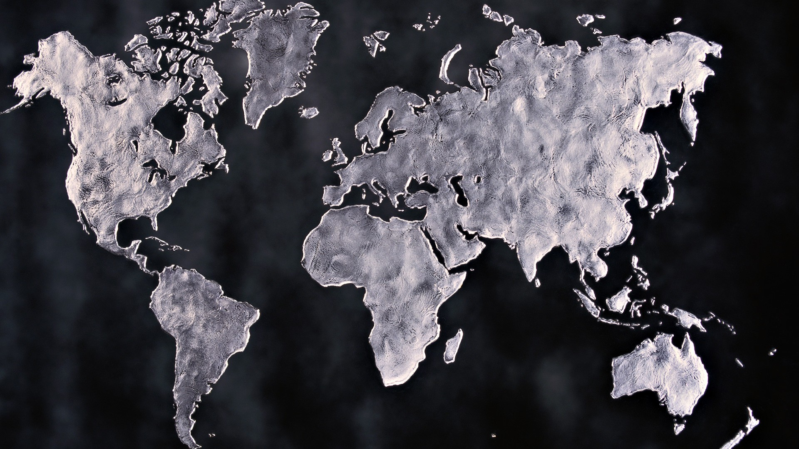
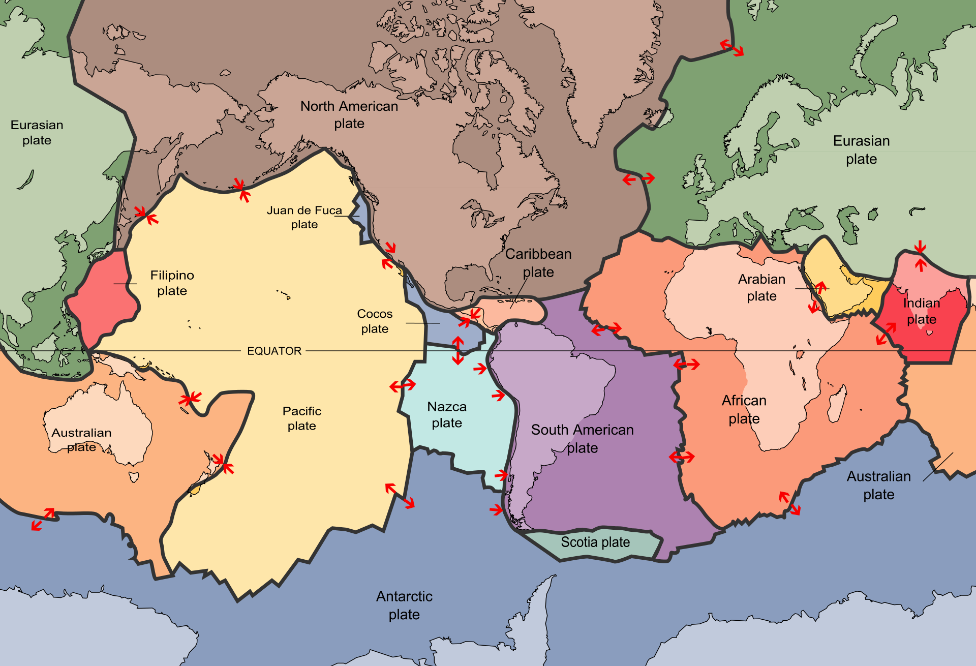
Discussion – continents v. plates Not unlike Wegener
Conflation
Carrie: Right. (She moves her hands in front of her face in opposite directions to create a horizontal circle) Yeah, like in my mind, it's like the continents are still moving and all of a sudden they’re going to come back together, and like, come in a circle and crash on the other side (giggles). (20140318:730-769)
Francek, 2013
Kirkby, 2013

Slide 18
Discussion – plate as a metaphor
Black hole
Electron cloud
Big bang
Selfish gene
DNA fingerprints
Deep time (space = time)
Convenient, but…
“the lock and key principle…acted as an ‘epistemological obstacle’ to the molecularization of genetics…as its vivid imagery made it hard to adopt a different and new perspective.” (Müller-Wille, & Rheinberger, 2012, p. 163)

Slide 19

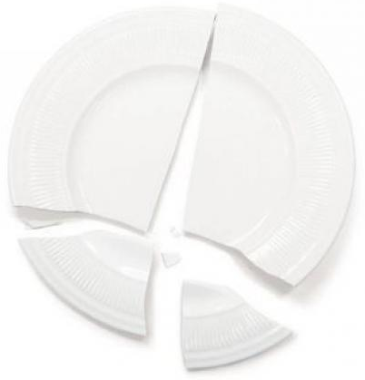
Discussion – plate as a metaphor
Separate
Brit
ttle
“The more vivid the image, the more dangerously seductive and resistant to change it is.” (Ball, 2011)

Slide 20
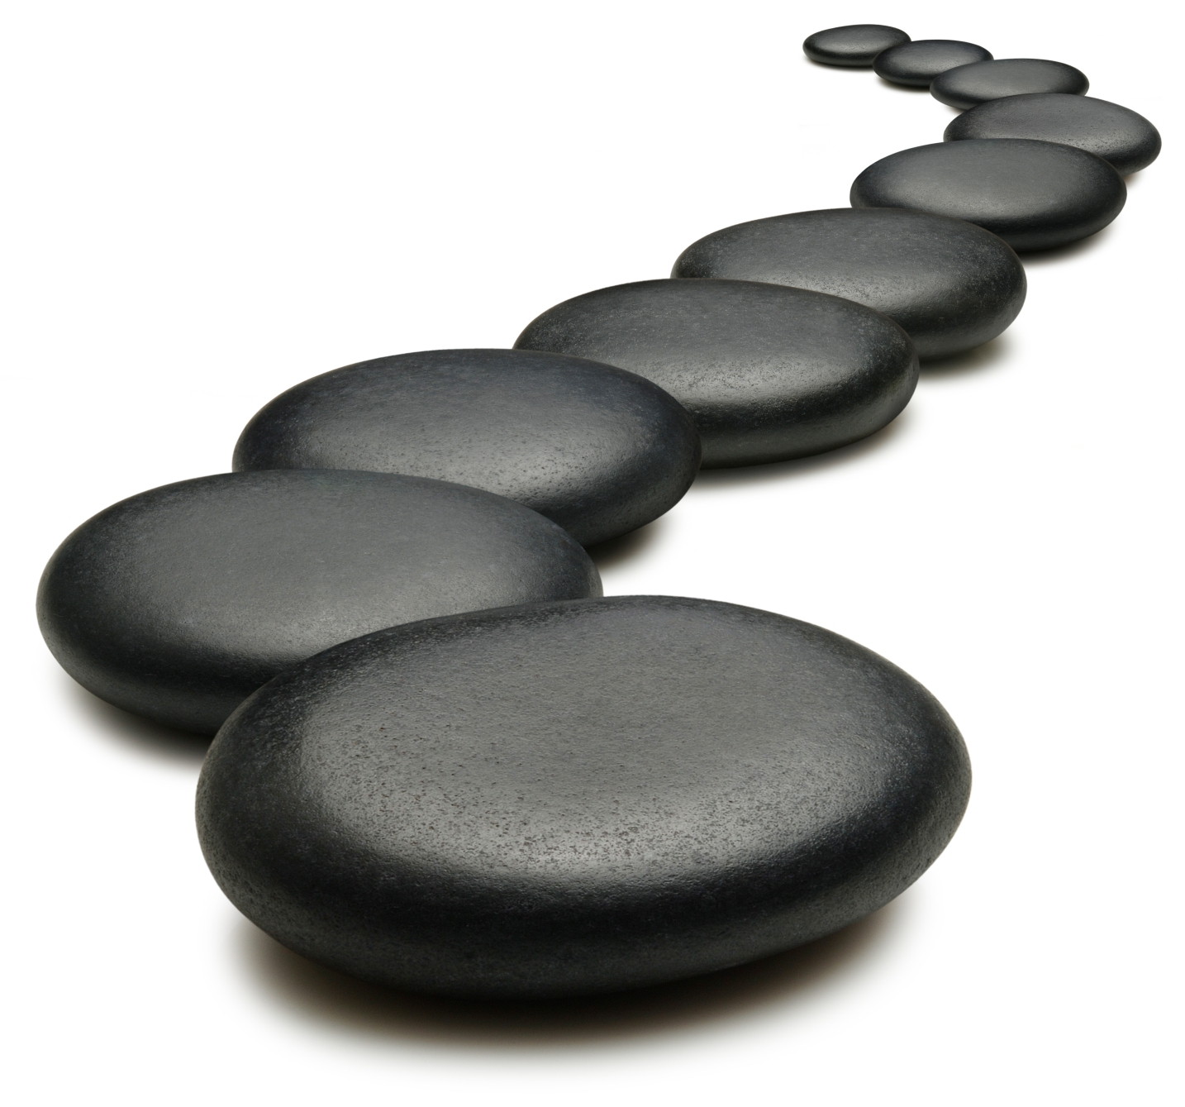
Discussion – conceptual prematurity
“A discovery is premature if its implications cannot be connected by a series of simple, logical steps to generally accepted knowledge.” (Stent, 2002,p. 24)
Plate
tectonics and the
K-Pg extinction (Glen, 2002)

Slide 21
Discussion – conceptual prematurity
Brittle
rocks
(or plates)
Elastic behavior
Brittle rocks
(or plates)
?l
?j l
?llllll

Slide 22
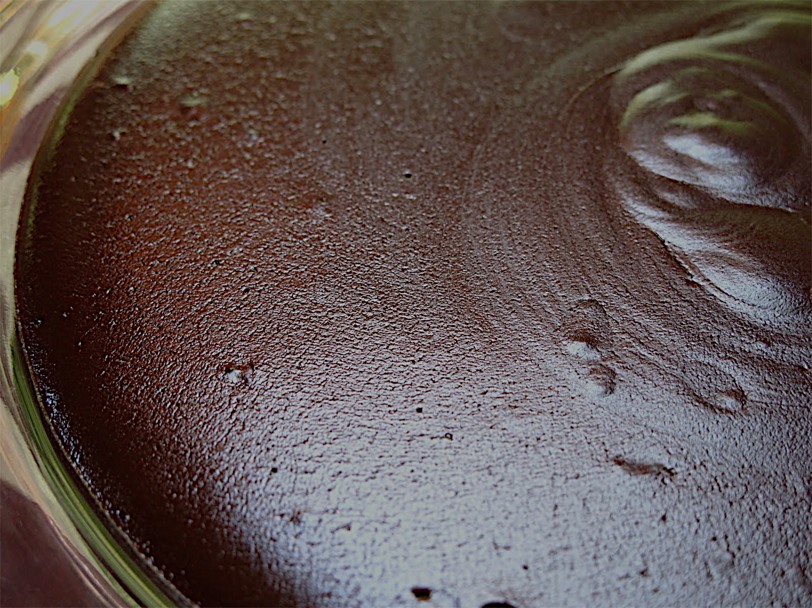
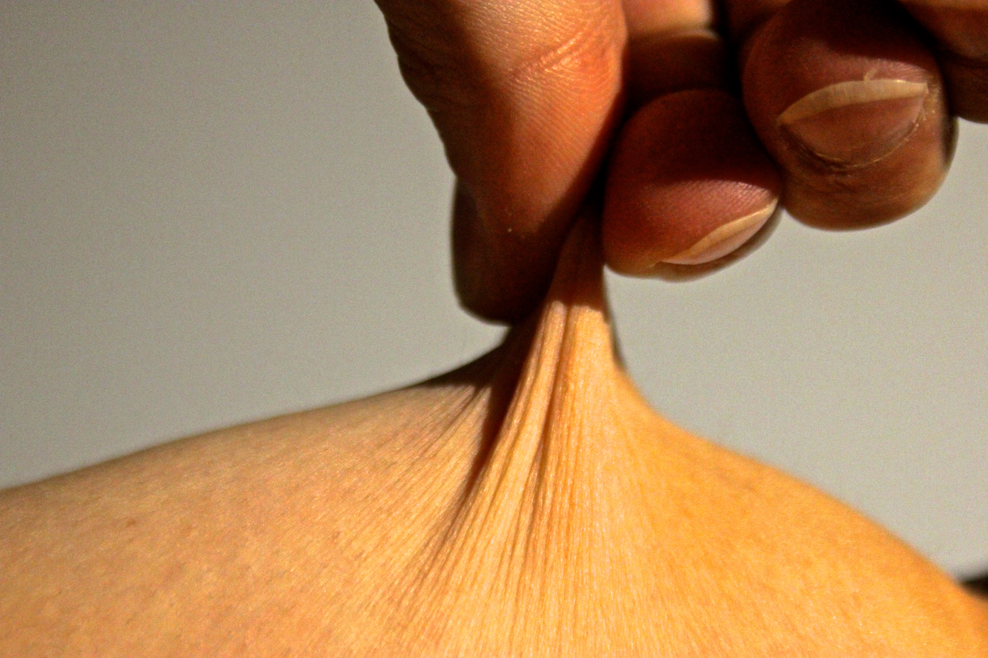
Future Investigations
A different metaphor
Lithosphere is the skin of the earth
A different perspective on boundaries
Narrow regions of deformation define “plate boundaries”

Slide 23
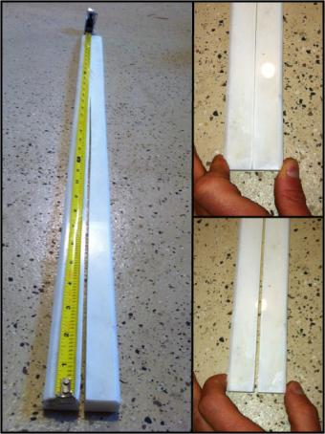
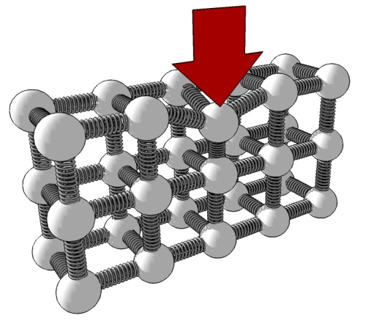
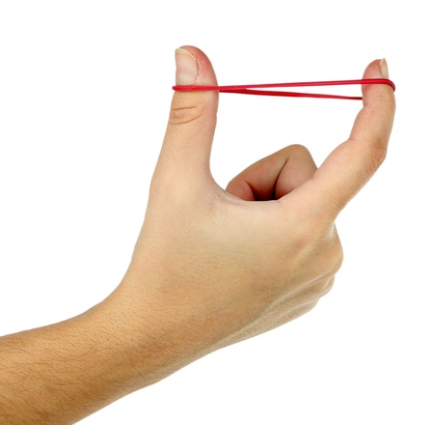
Future Investigations
Brittle
rocks
(or plates)
Elastic behavior
Brittle rocks
(or plates)
?l
?j l
?llllll

Slide 24


Glenn Dolphin
Glenn.dolphin@ucalgary.ca
Wendy Benoit
wlbenoit@ucalgary.ca

Slide 25
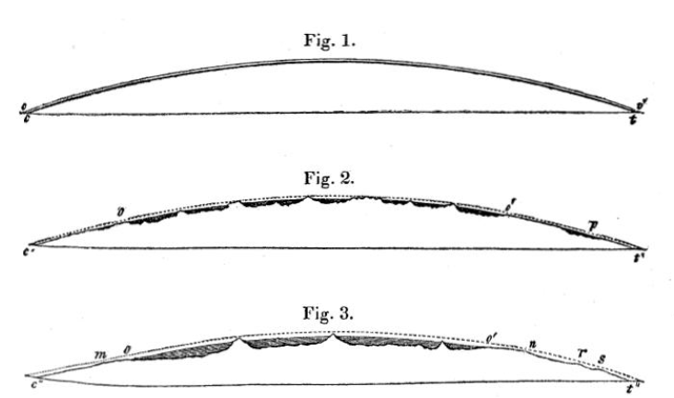
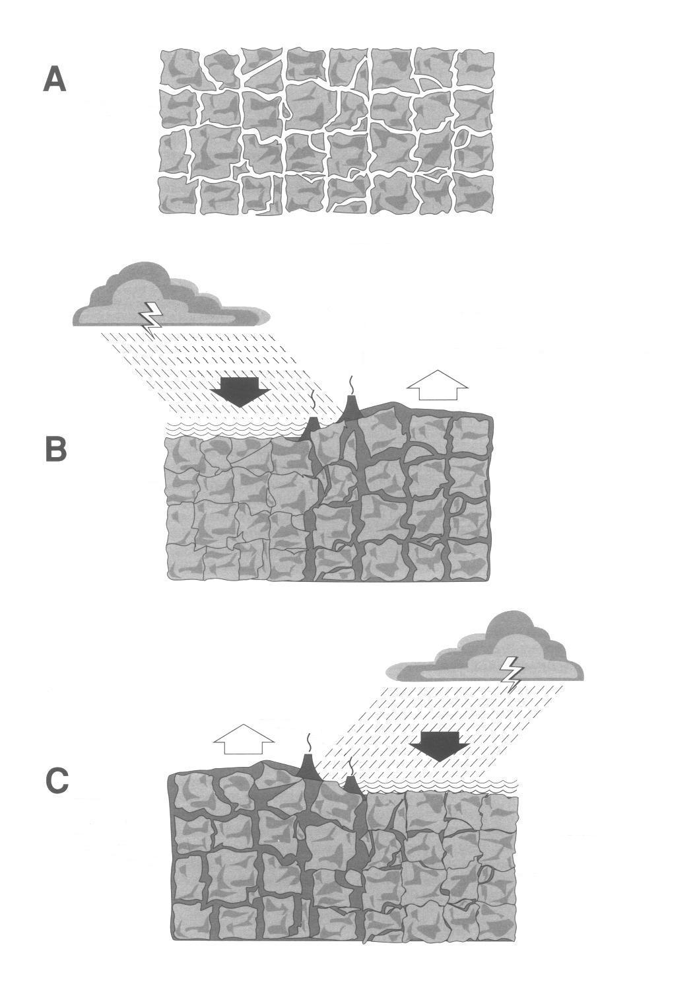
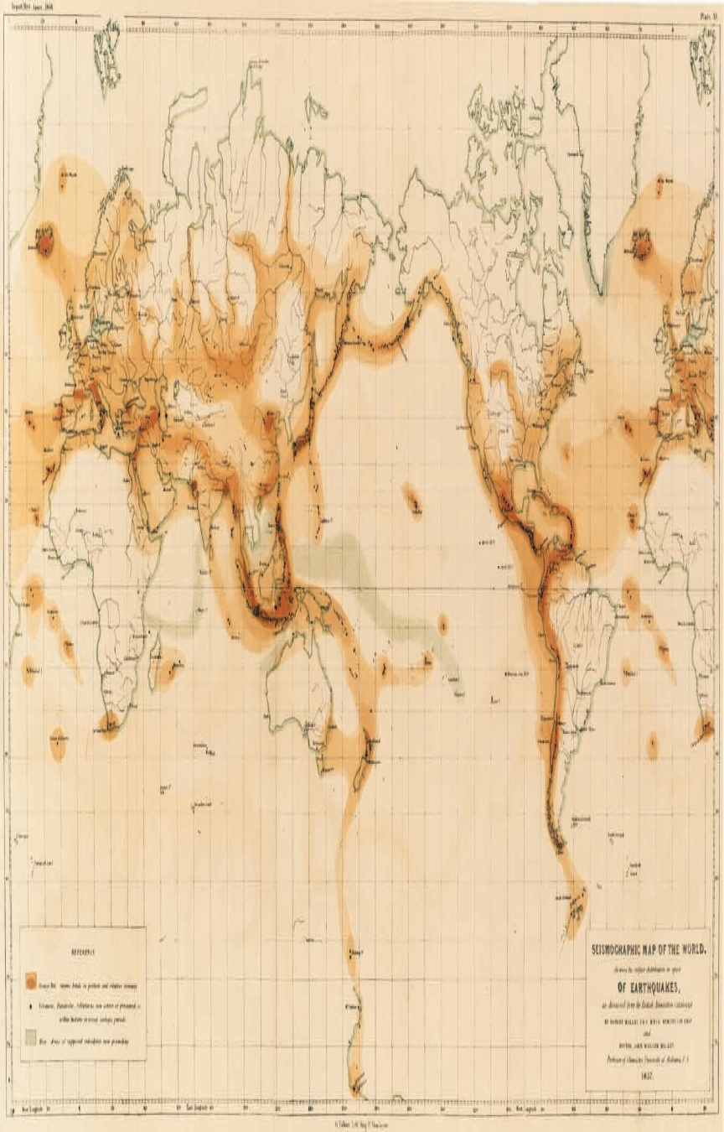
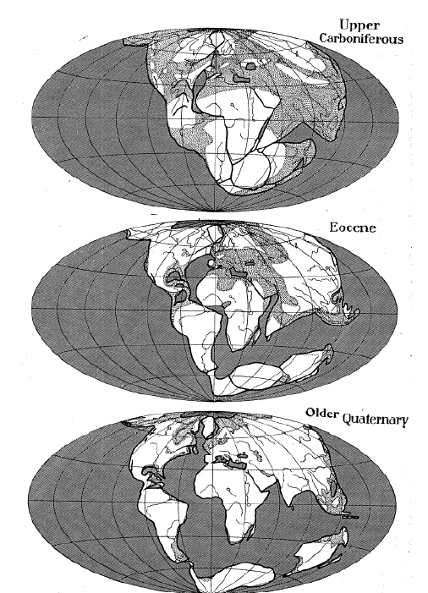
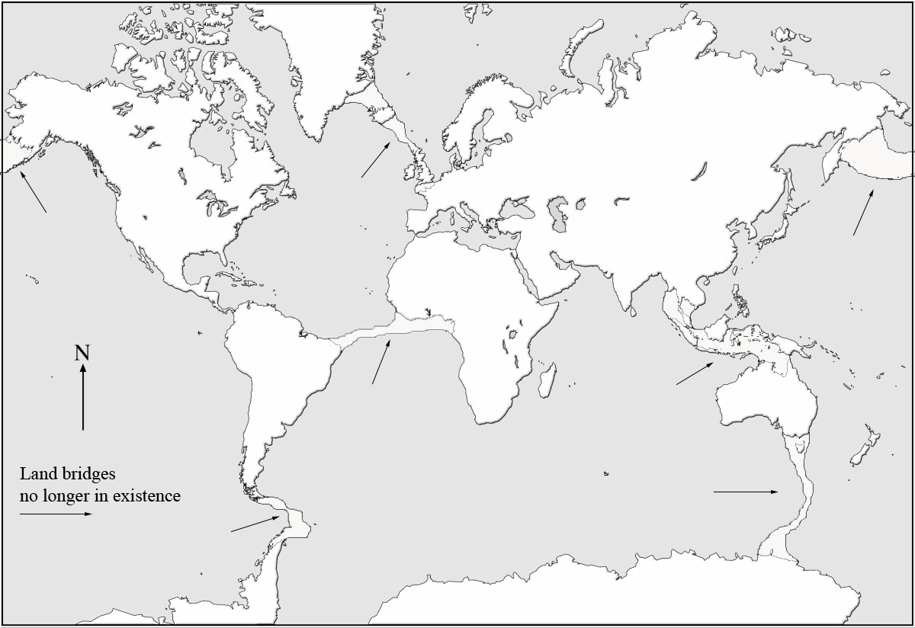
Historical Interlude #1

Slide 26
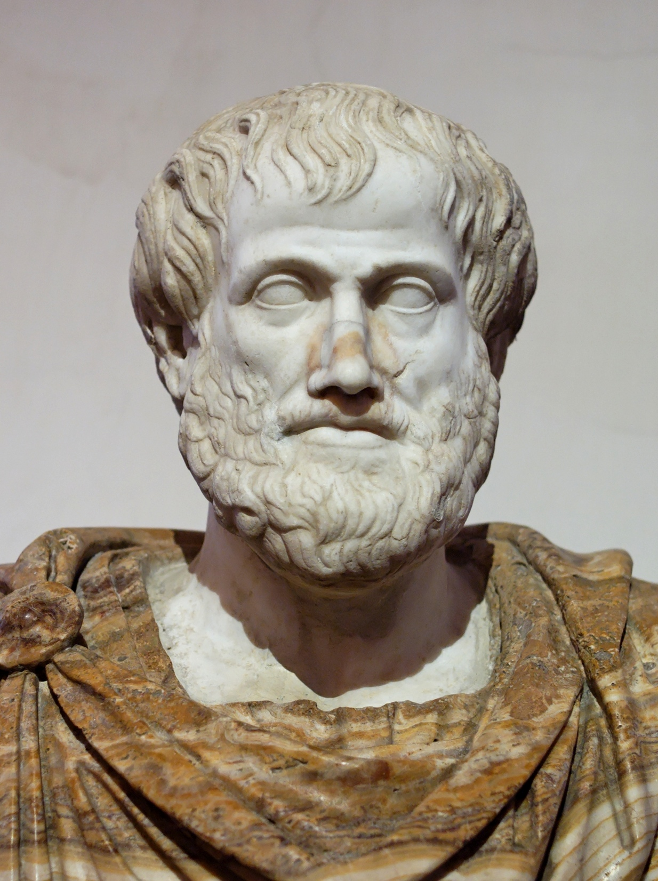
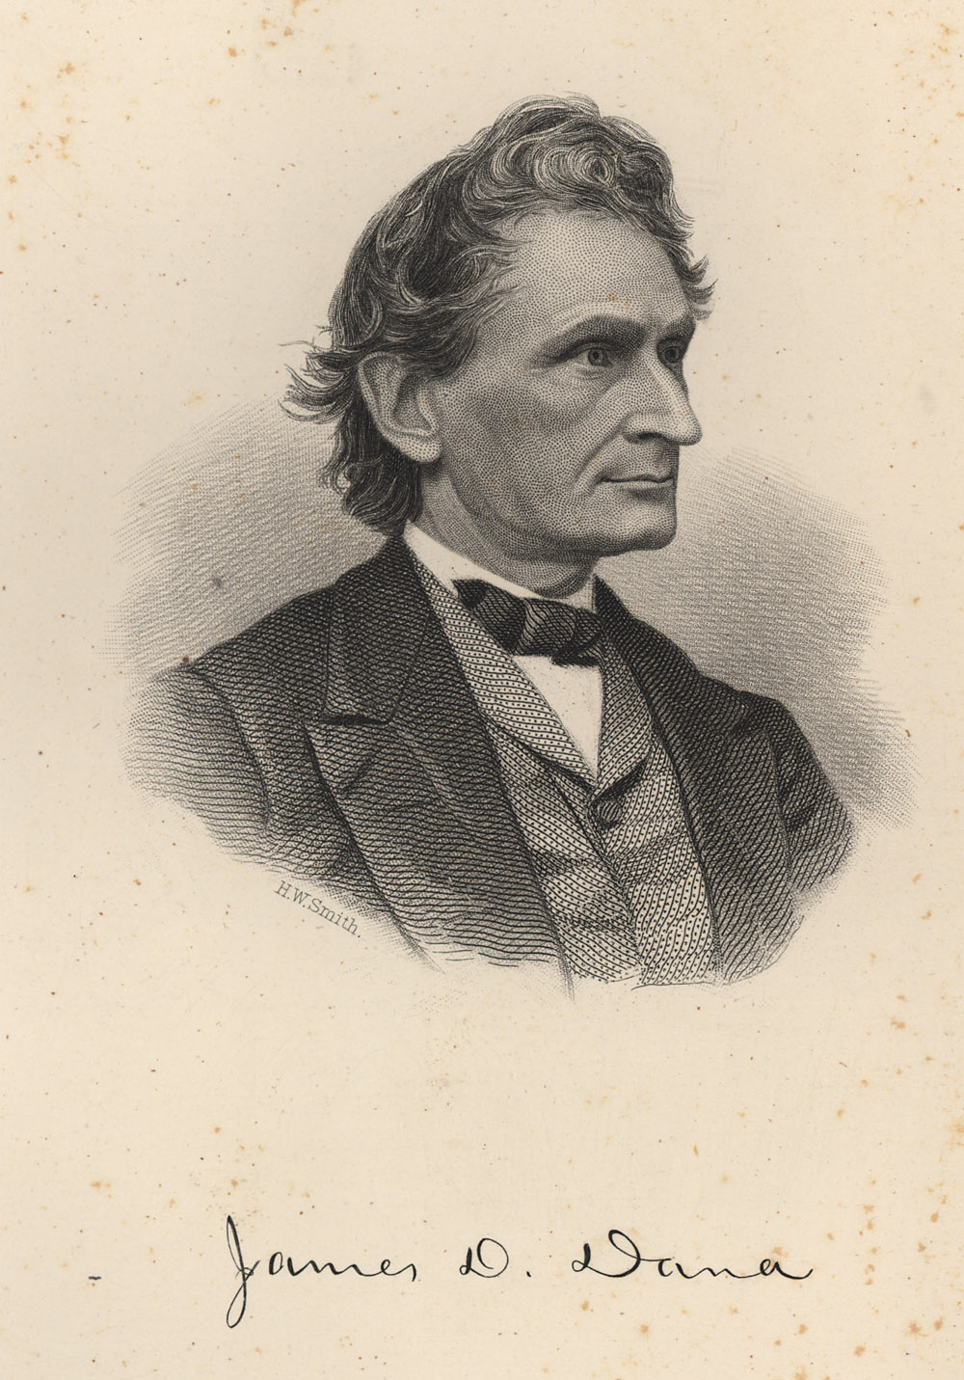
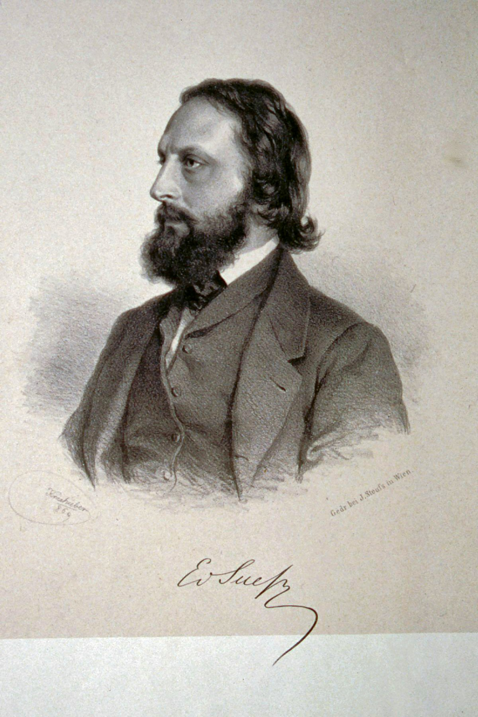
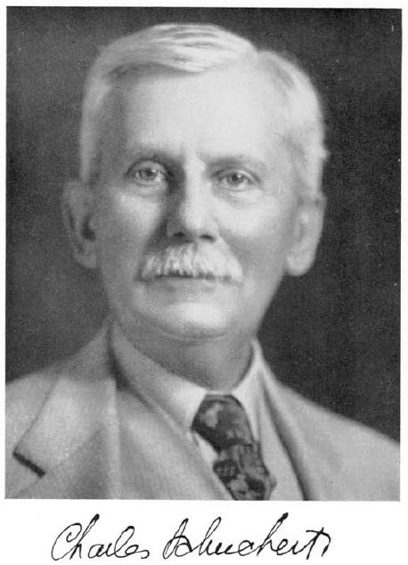
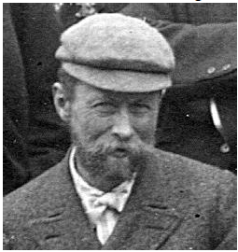
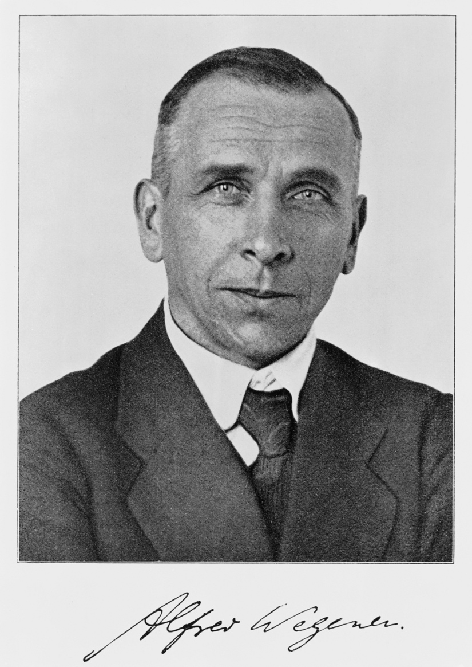
Historical Interlude #2
1813-1895
1831-1914
Aristotle
384-322 BC
1858-1942
Bailey Willis
1857-1949
1880-1930

Slide 27
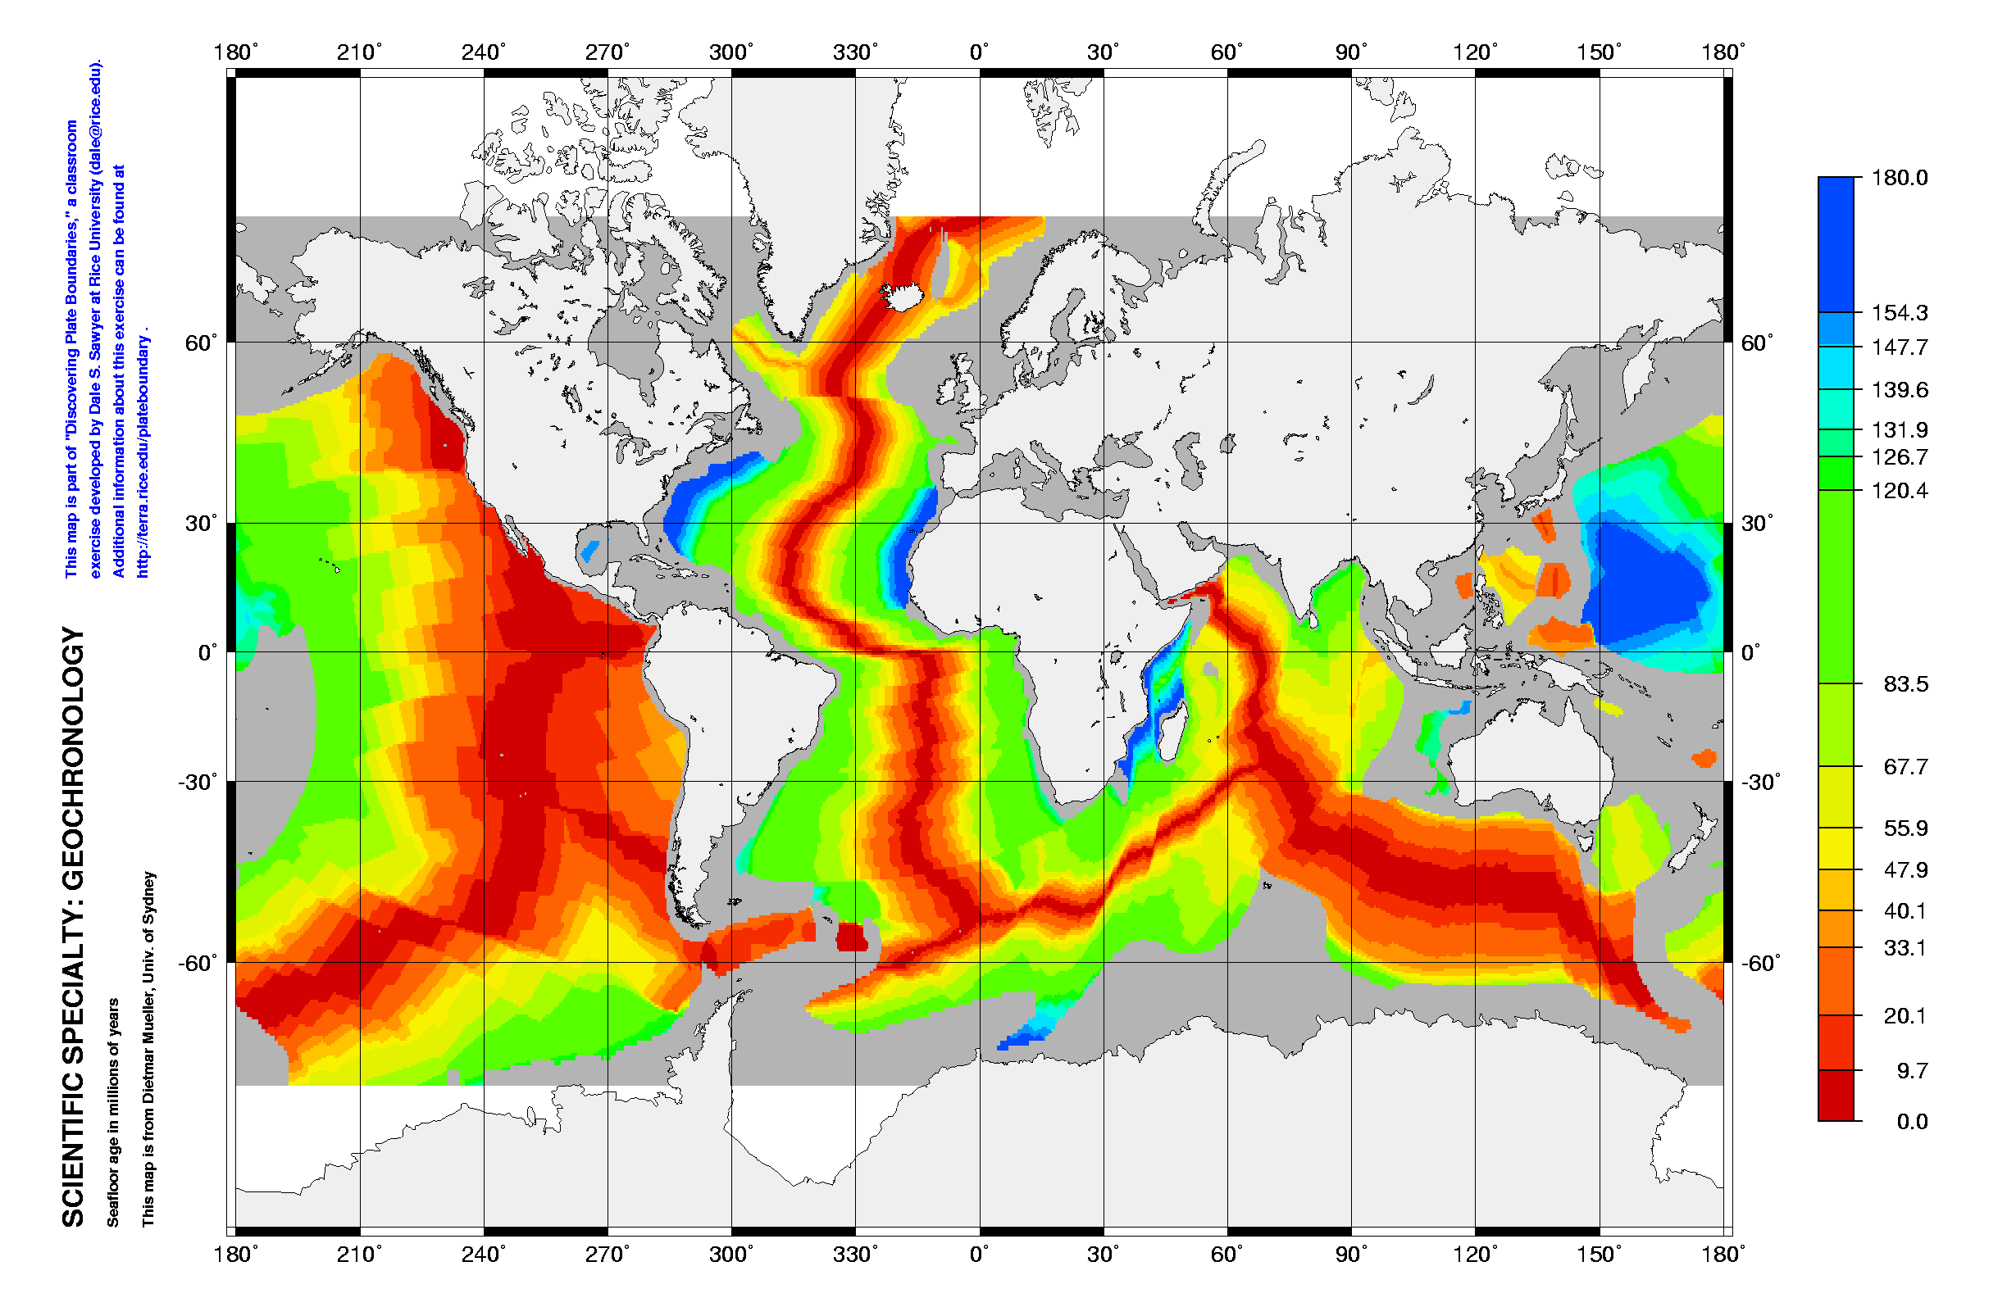
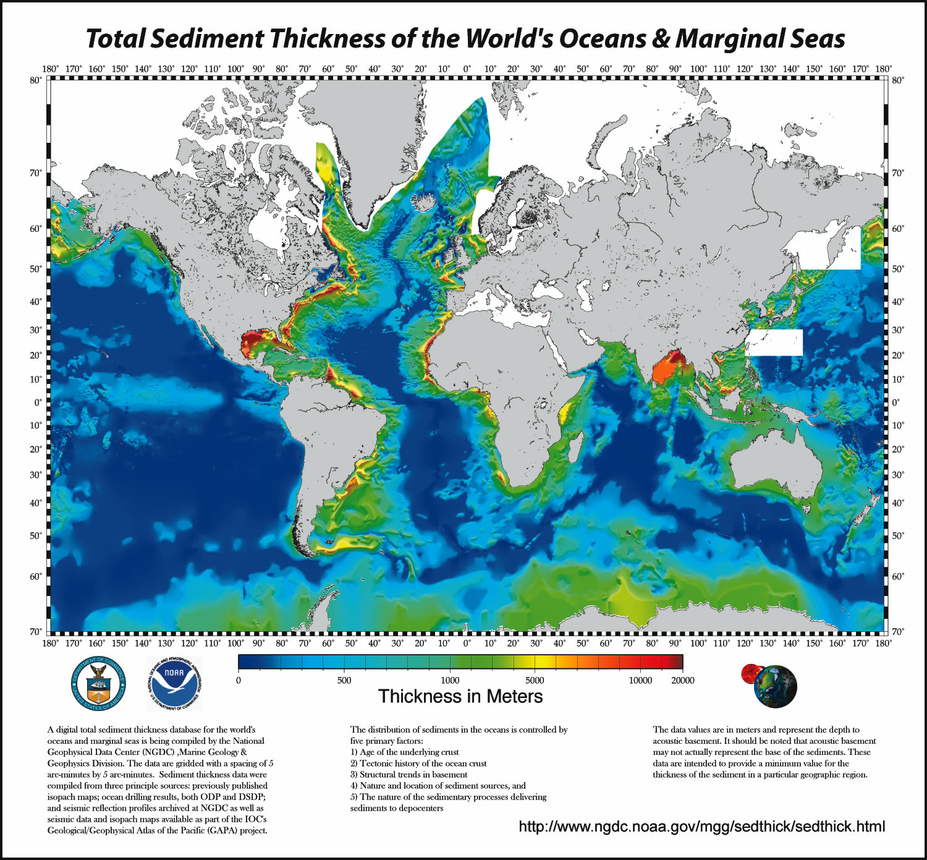
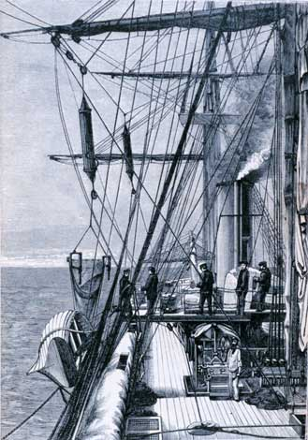
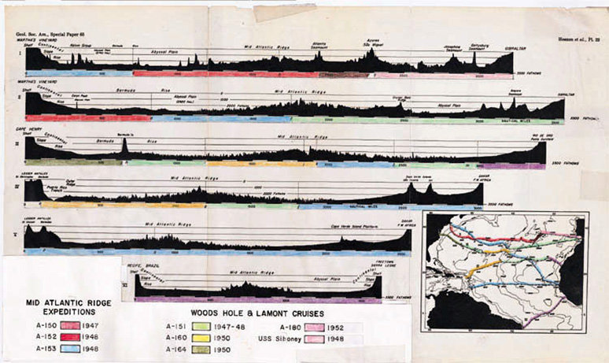
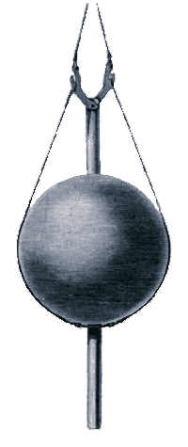
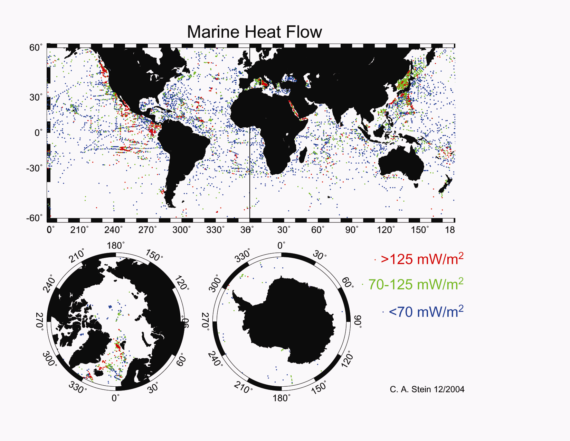
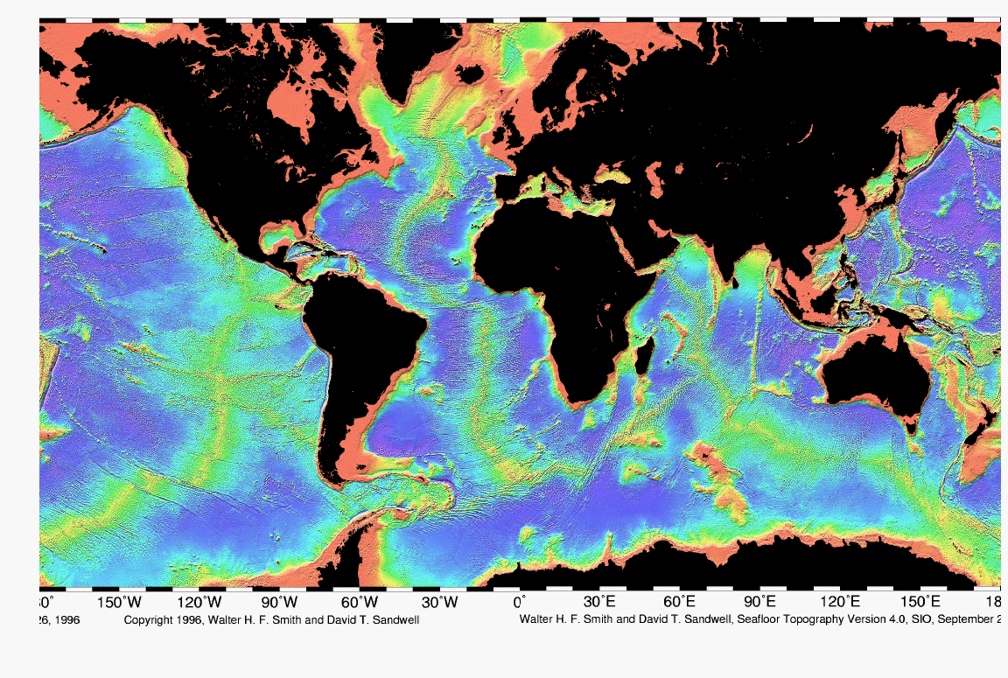
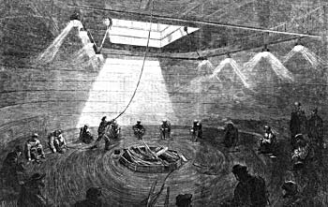
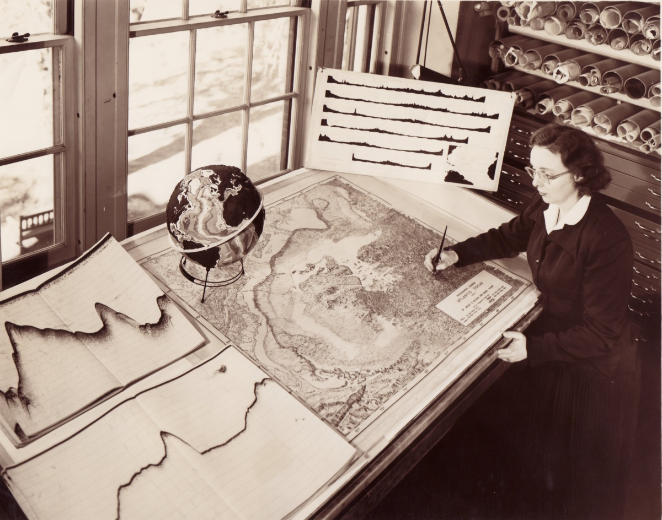
Historical Interlude #3
Marie Tharp
1920-2006

Slide 28
Historical Interlude #4
WWSSN→ earthquake browser

Slide 29
Historical Interlude #5
“Geo-poetry” and an expanding earth →draw spatial/static, causal/dynamic

