Slide 1
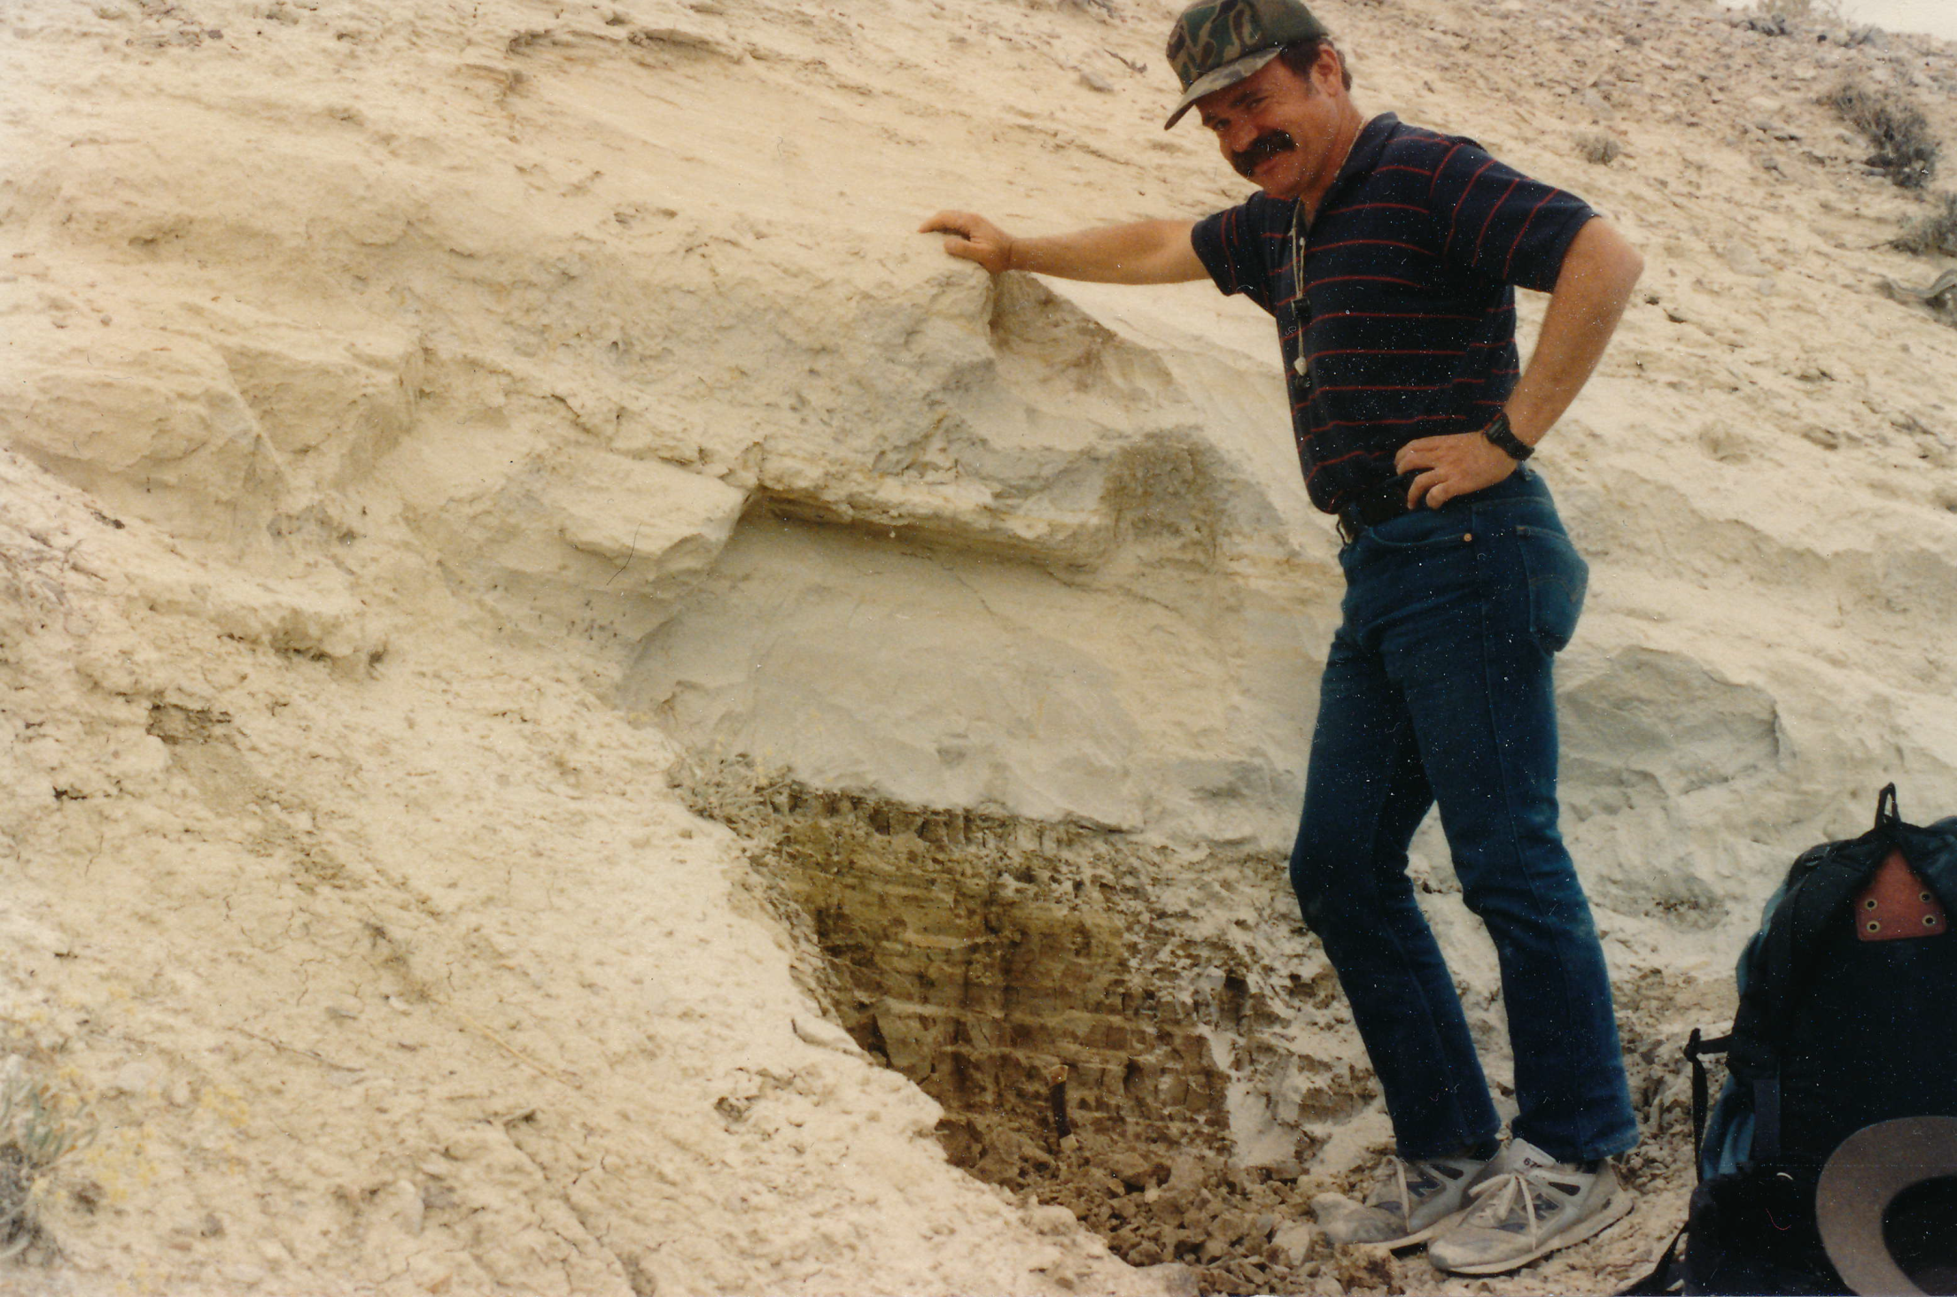
Richard M. Forester’s Solution to the Yucca Mountain, Nevada, Future Climate Conundrum
Saxon E. Sharpe
Desert Research Institute
Reno, Nevada
Photo courtesy of Robert S. Thompson

Slide 2
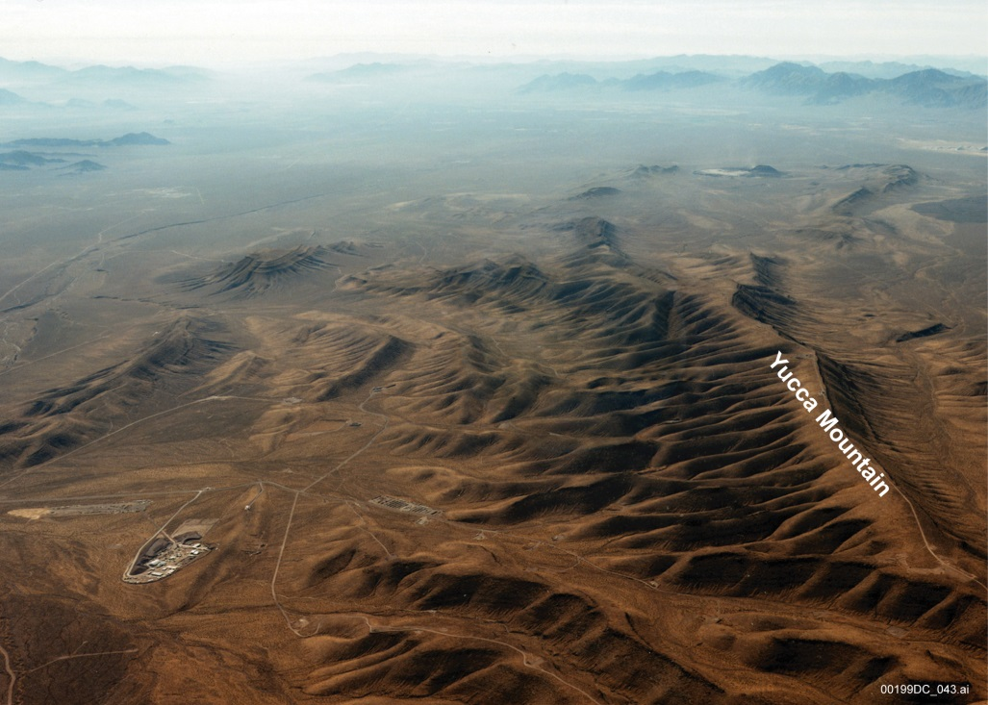
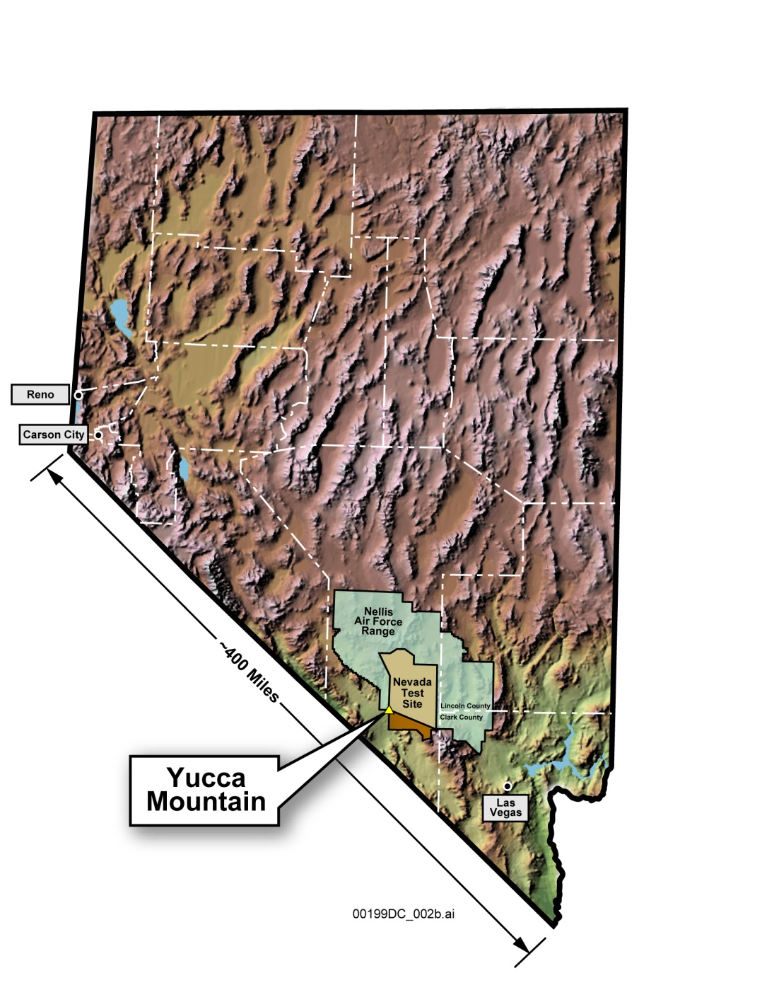
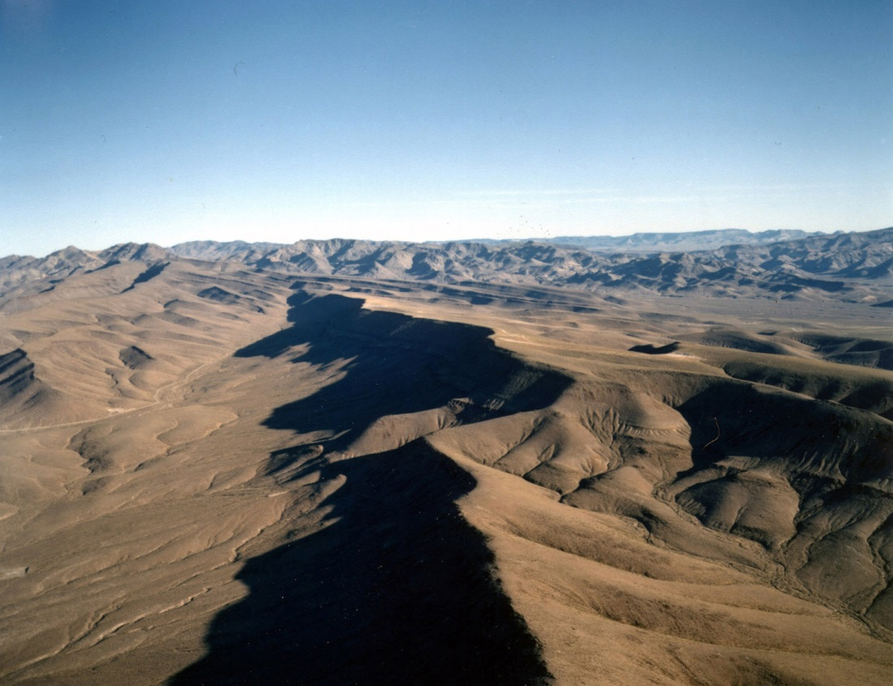
Yucca Mountain, Nevada: 1st geologic repository for high-level radioactive waste and spent nuclear fuel

Slide 3
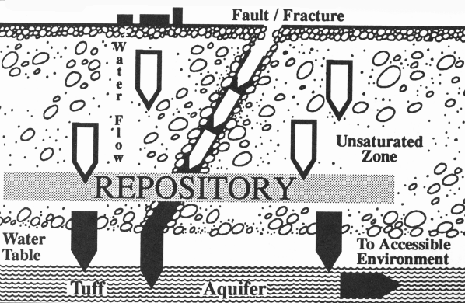
“The role of water is the most important element of the natural systems impacting repository performance”
YM Site Description 2004
Amount,
seasonality, rate &
daily values of T & P
to model the movement of water and radionuclide transport
Image: http://www.state.nv.us/nucwaste/yucca/techcon1.htm

Slide 4
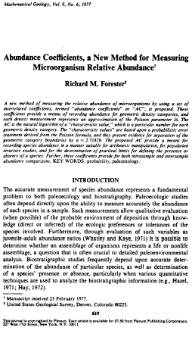
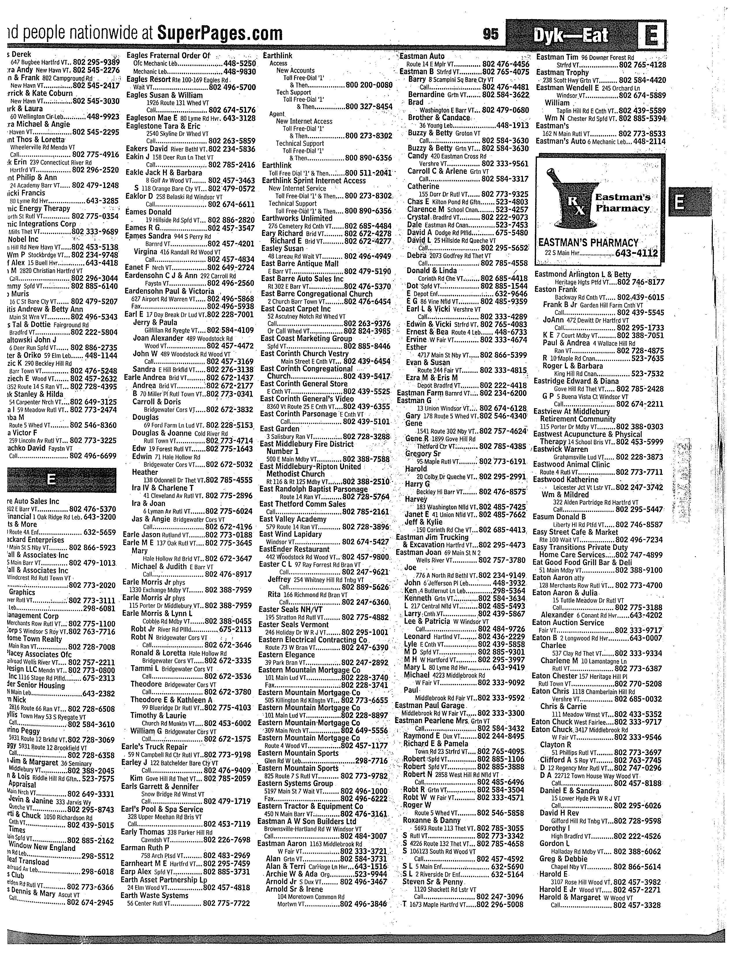
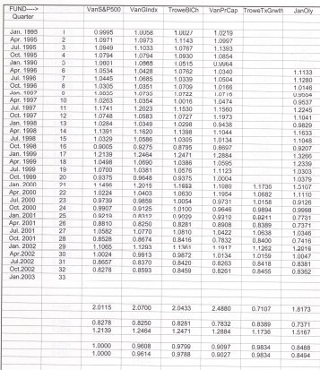
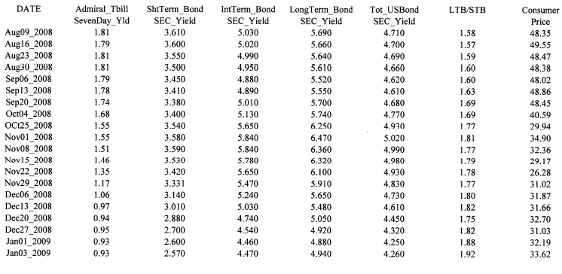
Task: Devise a method to forecast the next 10,000 + years of climate at Yucca Mountain which is scientifically sound and defensible in court. Don’t use a computer model. Don’t include anthropogenic warming.
Financial database
40 columns for each fund
Phone book
Mathematical Geology
1977, V. 9(6)
R² index fund database
covering 1995-2003

Slide 5
Rick Assumption 4
Long-term earth-based climate forcing functions, primarily tectonics, that operate on the million-year time scale have remained relatively unchanged during the last long earth climate cycle (the past 400,000 years), and will not change during the next 10,000 years.

Slide 6
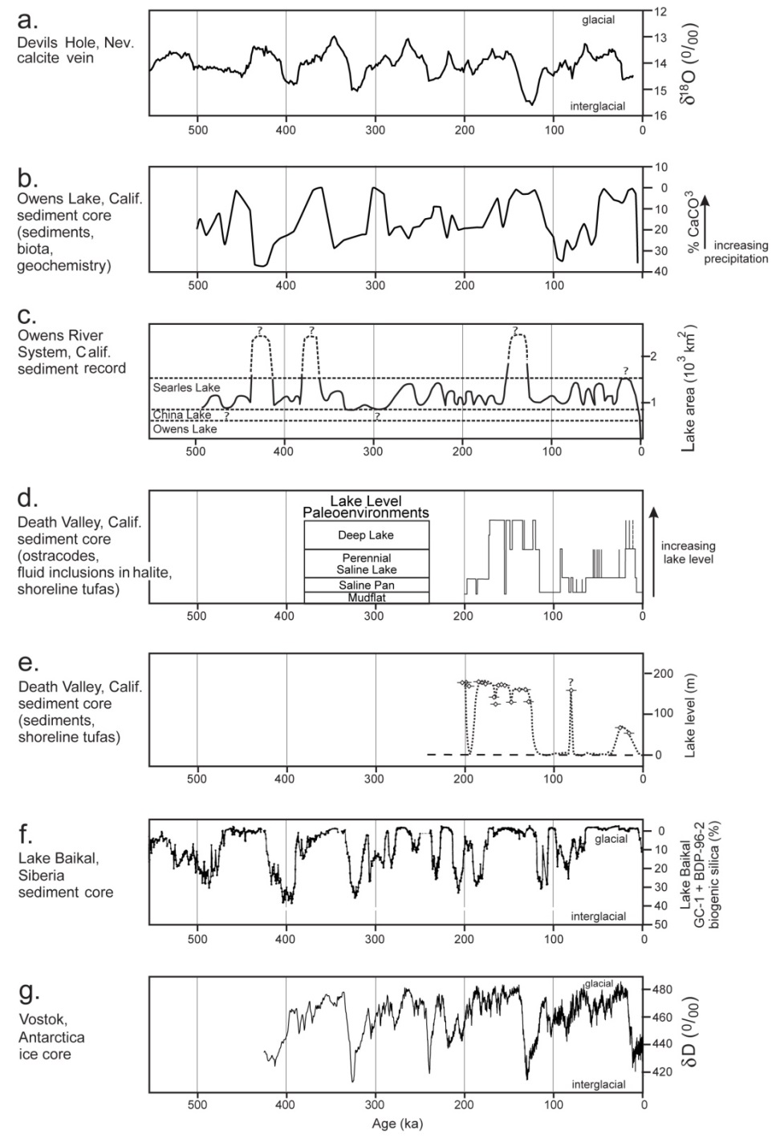
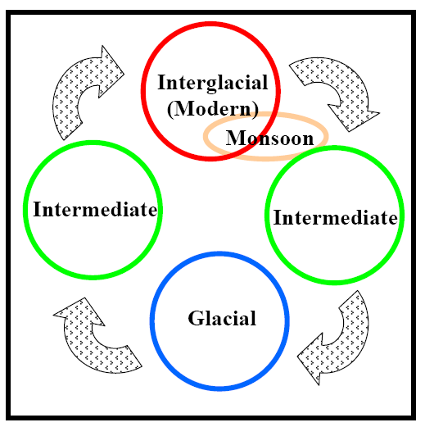
Rick Assumption 1
Climate is cyclical;
the past is the key to the future
a) Devils Hole, NV. Landwehr et al. 1997,
Winograd et al. 2006
b) Owens Lake, CA. Smith et al. 1997
c) Owens River, CA. Jannik et al. 1991
d) Death Valley, CA. Lowenstein et al. 1999
e) Death Valley, CA. Ku et al. 1998
f) L. Baikal, Siberia. Prokopenko et al. 2001
g) Vostok, Antarctica. Petit et al. 1999, 2001

Slide 7
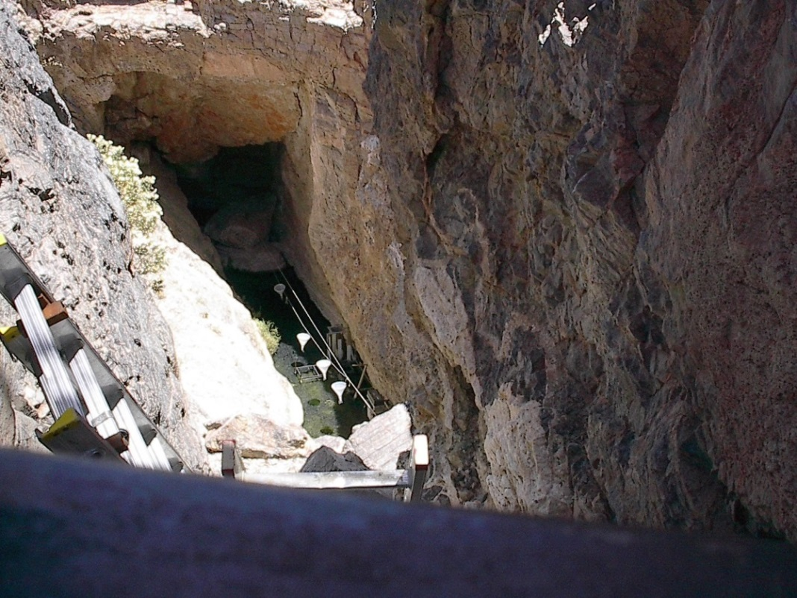
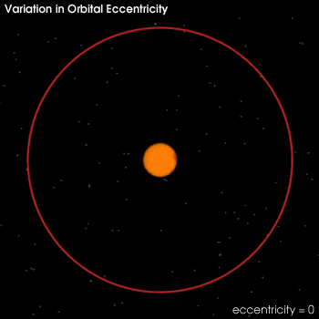
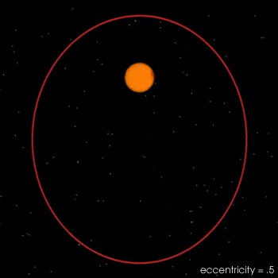
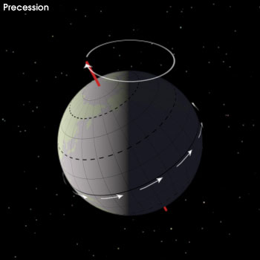
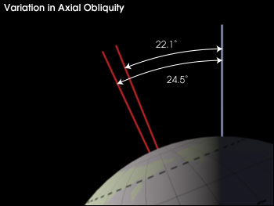
Devils Hole, Nevada Landwehr et al. 1997; Winograd et al. 1988, 1992, 2006
Eccentricity ~ 100,000 year cycle
Precession
~ 23,000 year cycle
Obliquity
~ 41,000 year cycle
http://earthobservatory.nasa.gov/Library/Giants/Milankovitch/milankovitch_2.html

Slide 8
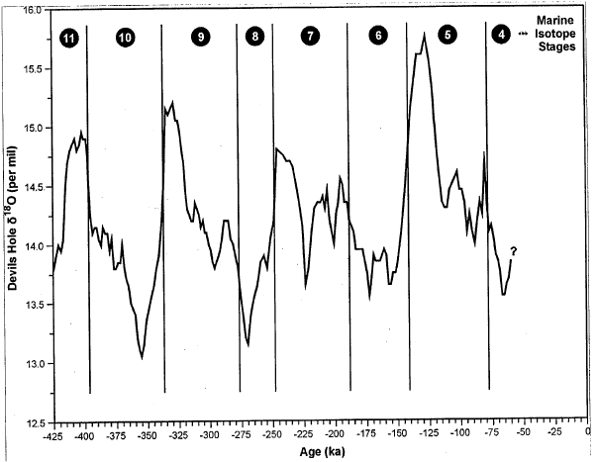
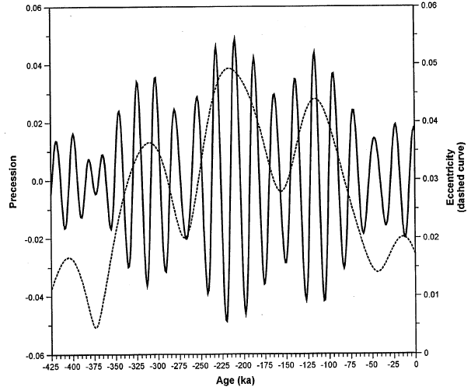
Rick Assumption 2 A relation exists between the timing of long-term climate change and orbital parameters Timing = Clock not necessarily cause and effect, not magnitude
Devils Hole, NV, Winograd et al. 1992
Orbital parameters,
Berger 1978

Slide 9
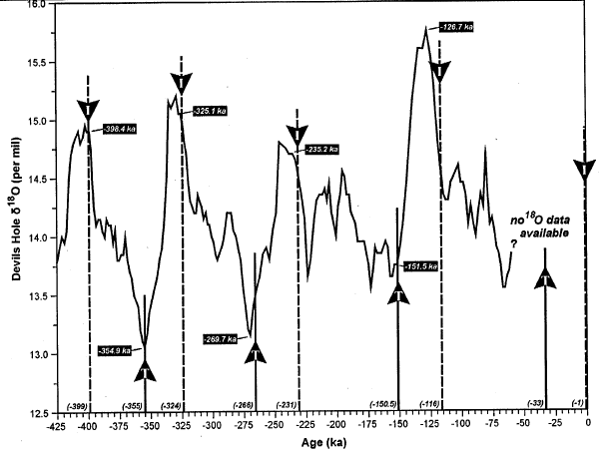
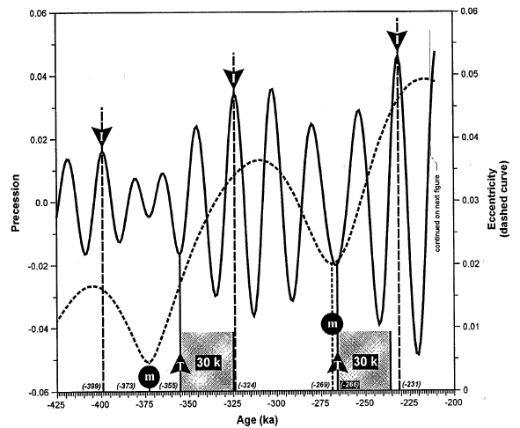
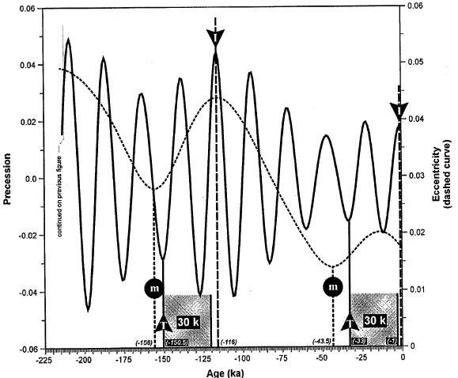
Devils Hole
Oxygen isotope Record
Landwehr et al. 1997 Winograd et al. 1988,
1992
Orbital parameters
Berger 1978

Slide 10
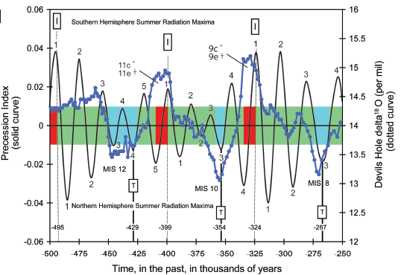
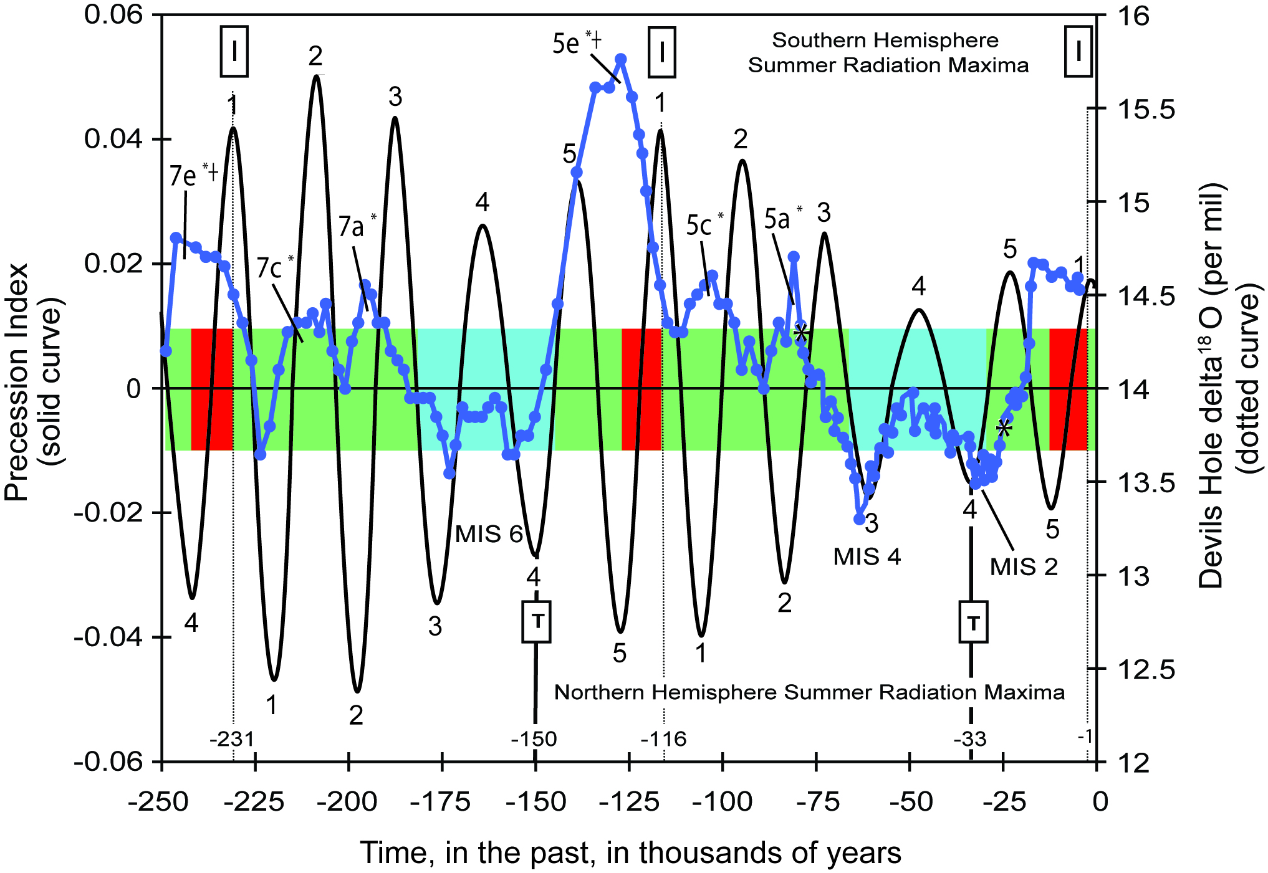
Rick Assumption 3. A relation exists between the characteristics and the sequence of late Quaternary climates. They appear to differ in a systematic way.
Data from: Landwehr et al. 1997; Winograd et al. 1988, 1992, 2006; Berger 1978
Graphs from: Sharpe 2007

Slide 11
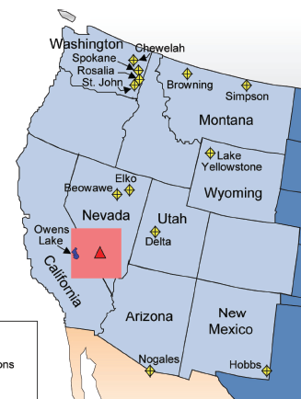
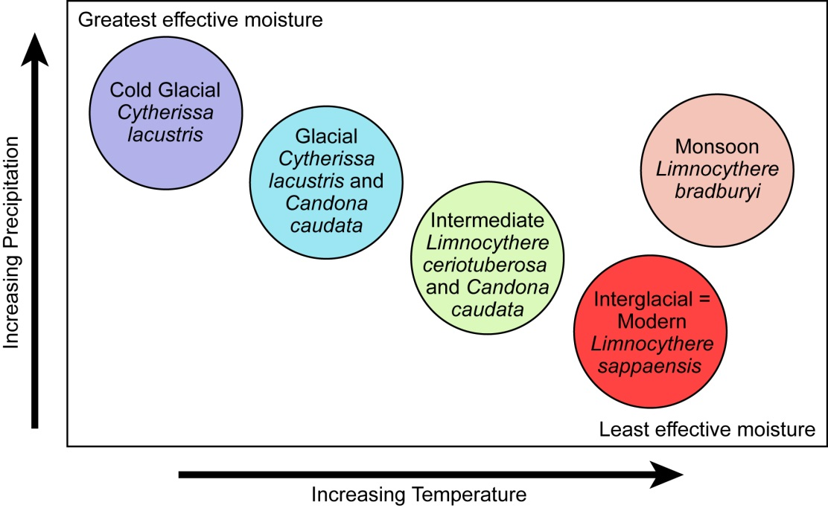
Climate States and Magnitude Select analog (modern) met stations with long records to represent upper and lower temperature and precipitation bounds for each future climate state
Glacial
(Candona is now reclassified
as Fabaeformiscandona)
Intermediate
Monsoon

Slide 12
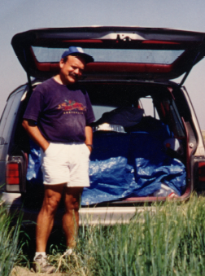
Analog met stations providing daily records of T & P for > 50 years for infiltration model
Climate State | Duration years | Representative Meteorological Stations
Modern Interglacial Climate | 400 to 600 | Yucca Mountain and regional climate stations
Monsoon Climate | 900 to 1,400 | Average Upper Bound Nogales, AZ Hobbs, NM Average Lower Bound YM site and regional stations
Intermediate (transition) Climate | 8,000 to 8,700 | Average Upper Bound Spokane, WA Rosalia, WA St. John, WA Average Lower Bound Beowawe, NV Delta, UT
Thanks, Rick!
First draft submitted 11/29/99
Approved 3/14/00
http://pbadupws.nrc.gov/docs/ML0037/ML003731021.pdf

