Slide 1

PROVIDING NGSS-FOCUSED TEACHER PROFESSIONAL DEVELOPMENT THROUGH THE EARTH2CLASS MODEL
MICHAEL J PASSOW
Earth2Class, Lamont-Doherty Earth Observatory, Palisades, NY 10964, michael@earth2class.org CRISTIANA ASSUMPCAO Colegio Bandeirantes, Sao Paulo, Brazil,
FREDERICO D BAGGIO Sao Paulo, Brazil, and Miami, FL

Slide 2
Impending implementation of the Next Generation Science Standards (NGSS) provides opportunities for improvements in classroom curricula and professional development programs
Earth2Class Workshops (E2C) at the Lamont-Doherty Earth Observatory of Columbia University (LDEO) provides one model for creating effective teacher training to meet the NGSS challenges

Slide 3
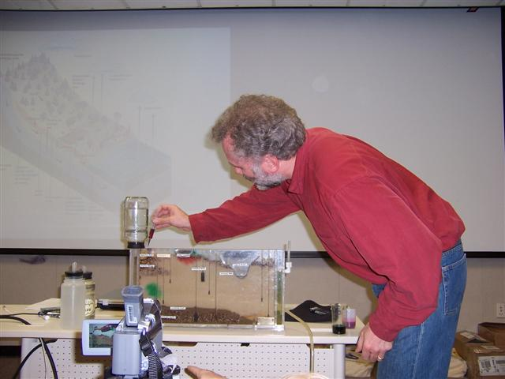
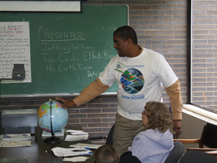
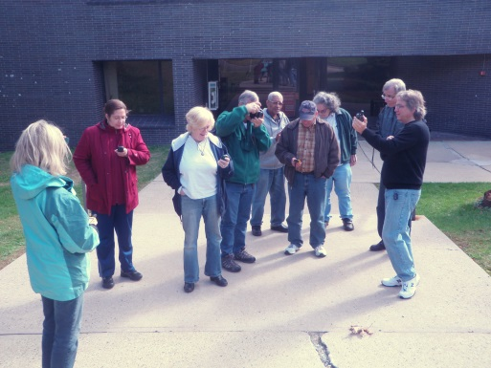
Since 1998, more than 135 workshops bringing LDEO research scientists together with classroom teachers and students from New York metropolitan area and elsewhere
Each session provides opportunity to learn first-hand about new discoveries in the wide range of investigations conducted at LDEO **Effective broader outreach strategy

Slide 4
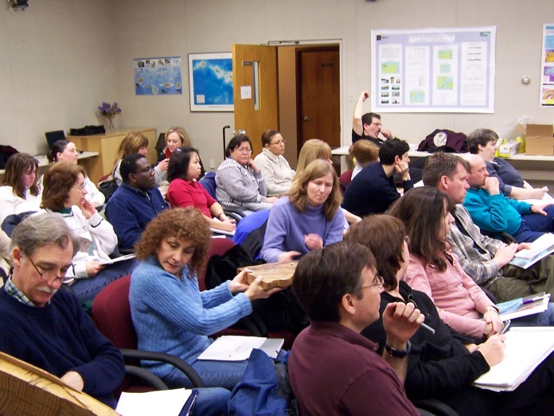
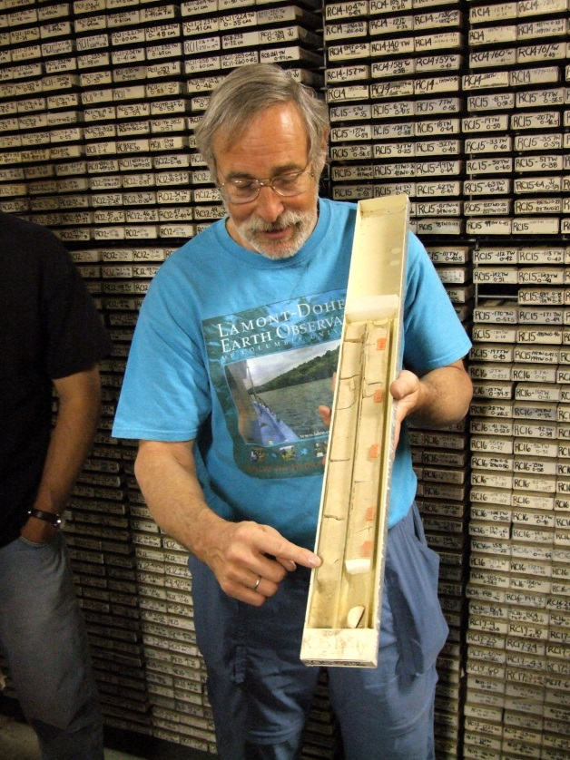
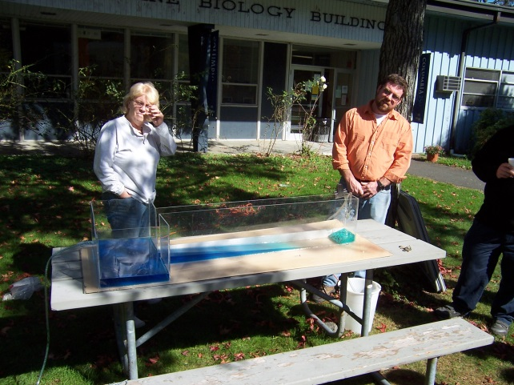
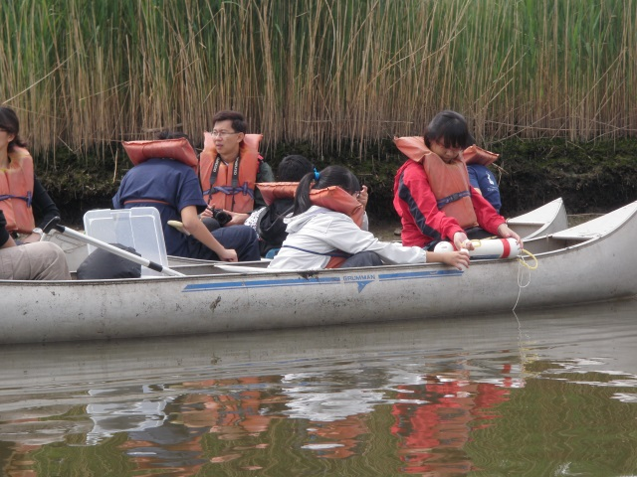
Lectures, hands-on models, tours of LDEO facilities, field experiences

Slide 5

E2C Workshop Format
08:45 – 09:30
Arrival of Participants and General Announcements
09:30 – 10:00
Background Information on Today's Topic
10:15 – 12:00
Guest Scientist(s) Presentation(s)
12:00 – 13:00 (noon - 1 pm)
Lunch with the Scientist
13:00 – 15:30 (1 pm - 3:30 pm)
Teacher networking and curriculum development

Slide 6
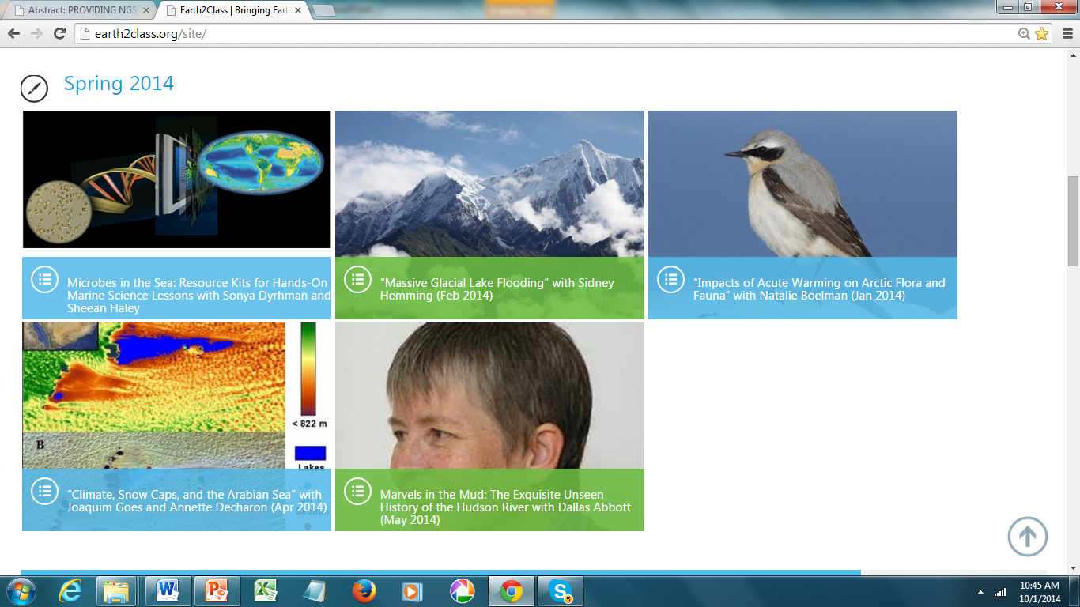
www.earth2class.org/site provides access to archived versions of Workshops

Slide 7

E2C website also provides vast array of educational resources used by teachers and students

Slide 8

Alignment with NGSS Goals
Mastery of the Disciplinary Core Ideas
Science and Engineering Practices
Understanding the Nature of Science
Cross-cutting Relationships
http://www.nextgenscience.org/next-generation-science-standards

Slide 9
Mastery of the Disciplinary Core Ideas
E2C Workshop themes directly relate to NGSS Disciplinary Core Ideas, especially
ESS2A Earth Materials & Systems
ESS2B Plate Tectonics & Large-Scale Systems
ESS2C Role of water in Surface Processes
ESS2D Weather & Climate
ESS2E Biogeology

Slide 10
ESS3A Natural Resources
ESS3B Natural Hazards
ESS3C Human Impacts on Earth Systems
ESS3D Global Climate Change
ETS1A Defining an Engineering Problem
ETS1B Developing Possible Solutions
ETS1C Optimizing the Design Solution
Also connections with Physical and Life Sciences DCIs, especially LS2 Ecosystems

Slide 11
E2C Workshops provide real-life examples of Science & Engineering Practices
1. Asking questions and defining problems
2. Developing and using models
3. Planning and carrying out investigations
4. Analyzing and interpreting data
5. Using mathematics and computational thinking
6. Constructing explanations and designing solutions
7. Engaging in argument from evidence
8. Obtaining, evaluating, and communicating information

Slide 12
Topics promote mastery of Cross-Cutting Relationships
Patterns
Cause and effect: mechanism and explanation
Scale, proportion, and quantity
Systems and system models
Energy and Matter: Flow, cycles, and conservation
Structure and function
Stability and change

Slide 13
E2C promotes understanding of the Nature of Science
Variety of Methods
Based on Empirical Evidence
Open to Revision in Light of New Evidence
Models, Laws, Mechanisms, and Theories Explain Natural Phenomena
Way of Knowing
Assumes an Order and Consistency in Natural Systems
Human Endeavor
Addresses Questions About the Natural and Material World

Slide 14
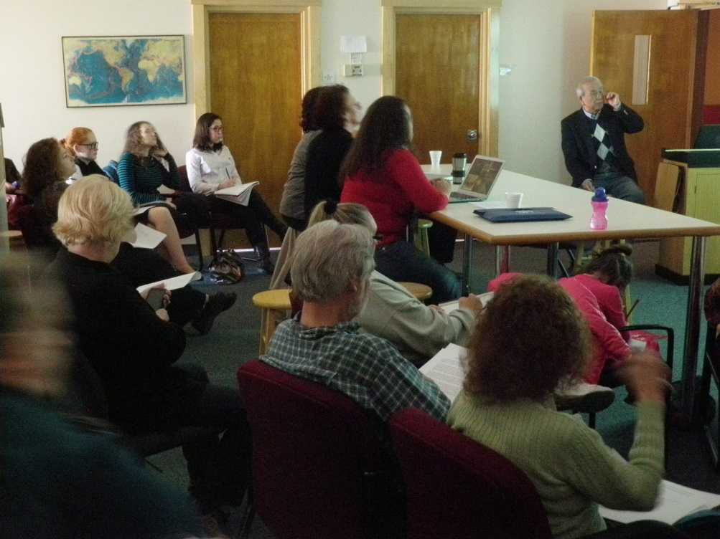
Learning about cutting-edge research multiples interest – “ownership”
Taro Takahashi sharing ocean acidification research (Nov 2013)
Teachers and students learn about background for research exploration, methods used, problems arising and overcome, and significance in future world conditions

Slide 15
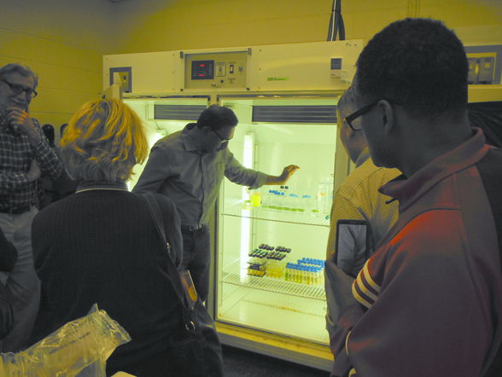
“Reality of Scientific Research”
Visit to labs and other facilities foster greater understanding of how scientists conduct investigations—much more than usual experiences in class “investigations”
Joaquim Goes explains phytoplankton lab

Slide 16
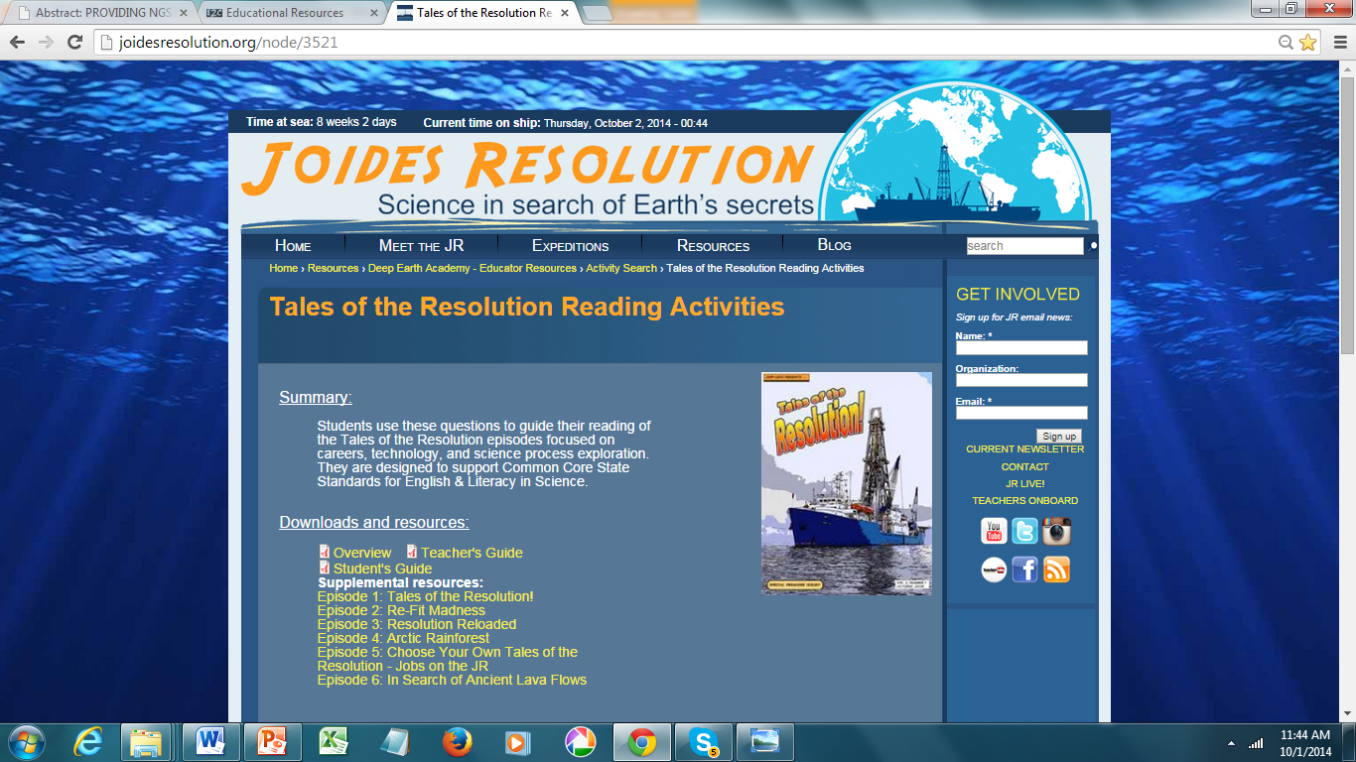
E2C-created curricular materials
http://joidesresolution.org/node/3521

Slide 17
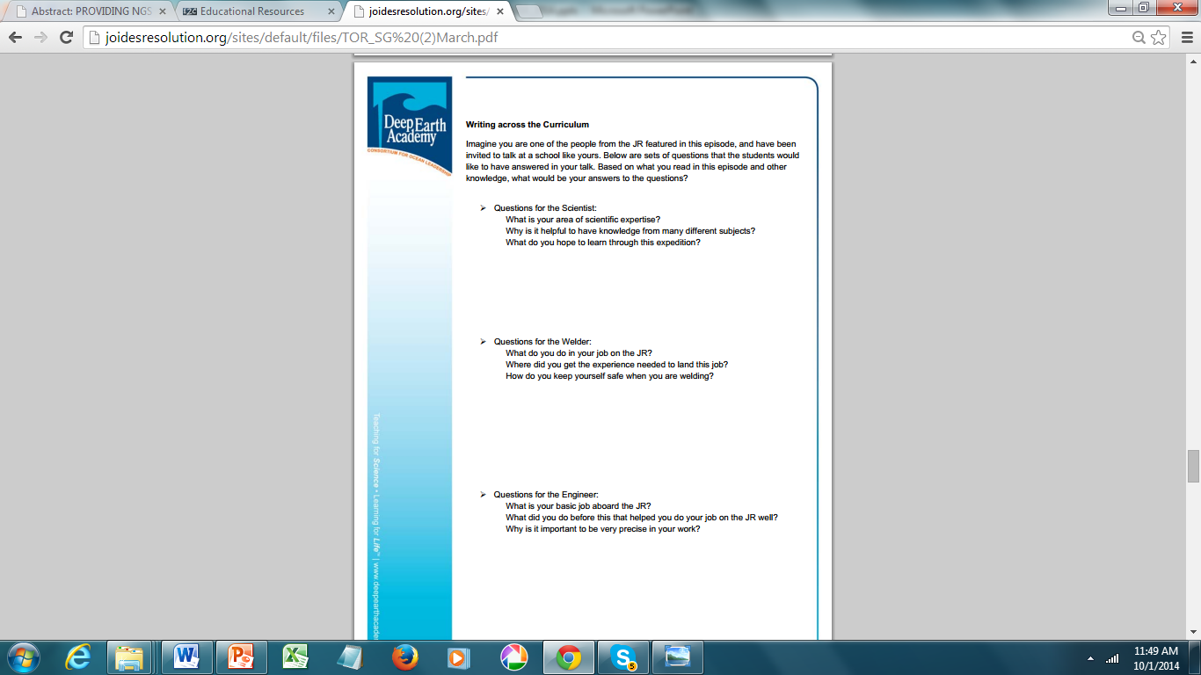
Enhancing English Language Arts skills

Slide 18
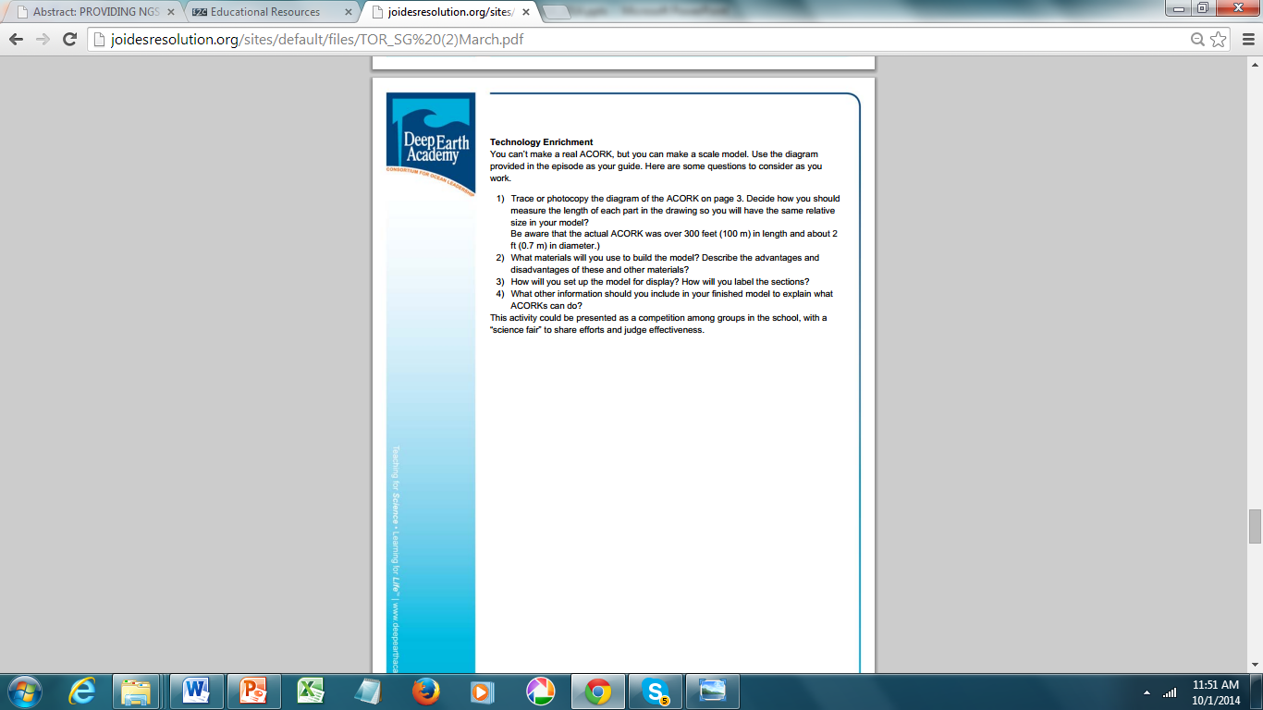
Solving engineering design problems through creating scale models

Slide 19
“Keys to Success for an E2C Approach”
Cooperation between research scientists and the education + science-based organizer
Availability of suitable venues for lectures, hands-on activities, field experiences, etc.
Affordable – registration fees, grant support
Professional development certification
Accessibility to others through website
Eventually, “reputation” for quality

Slide 20
What’s Coming Next?
E2C Workshops will continue in foreseeable future
E2C website will expand to include more NGSS resources for educators seeking to implement NGSS-based programs in their districts
This strategy can be applied in other settings, with appropriate modifications
Available to consult with those interested michael@earth2class.org

