Slide 1
The National Land Cover Database Project: The Story of Its Impact
Carol A. Deering, ERT, contractor to the U.S. Geological Survey, Earth Resources Observation and Science (EROS) Center, Sioux Falls, South Dakota, USA.
Work performed under USGS contract G10PC00044.
U.S. Department of the Interior
U.S. Geological Survey

Slide 2
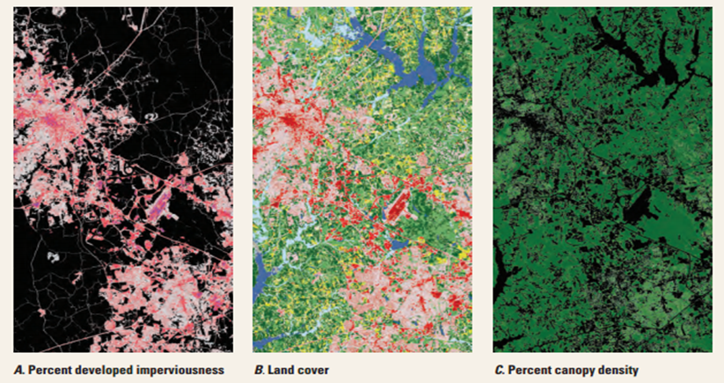
NLCD Products National Land Cover Database
suite of land cover products
4 epochs – 1992, 2001 and 1992/2001 Retrofit, 2006, 2011
30-meter resolution Landsat-based imagery + ancillary datasets
coast-to-coast land cover at regional to national scales
spatial reference and descriptive data
thematic class
impervious surface
tree canopy
change monitoring products

Slide 3
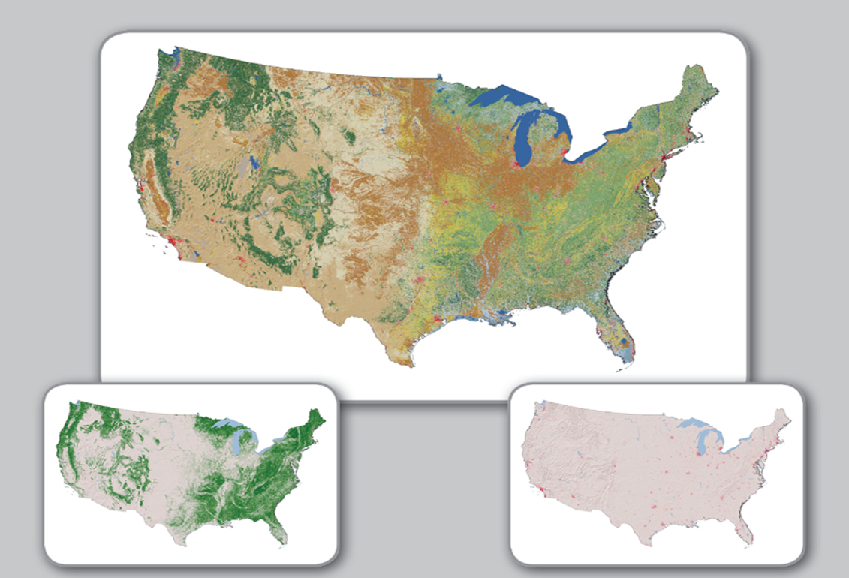
NLCD Products National Land Cover Database
NLCD2011
9 billion geographic cells
16 classes of land cover
30 billion pixels!
land cover
tree canopy
impervious surface

Slide 4
Collaboration National Land Cover Database
Multi-Resolution Land Characteristics Consortium
NASA
US Army COE
USFWS
USDA
NPS
USGS
EPA
NOAA
USFS
BLM

Slide 5

Global Reach National Land Cover Database
65 presentations at 39 conferences
28 core project publications
30 related project publications
2,605 papers citing the 28 core publications
covering 24 subject areas
by authors from 86 countries
affiliated with 160 institutions
and 38,280 publications have cited those 2,605 papers
per the Scopus index, September 2014

Slide 6
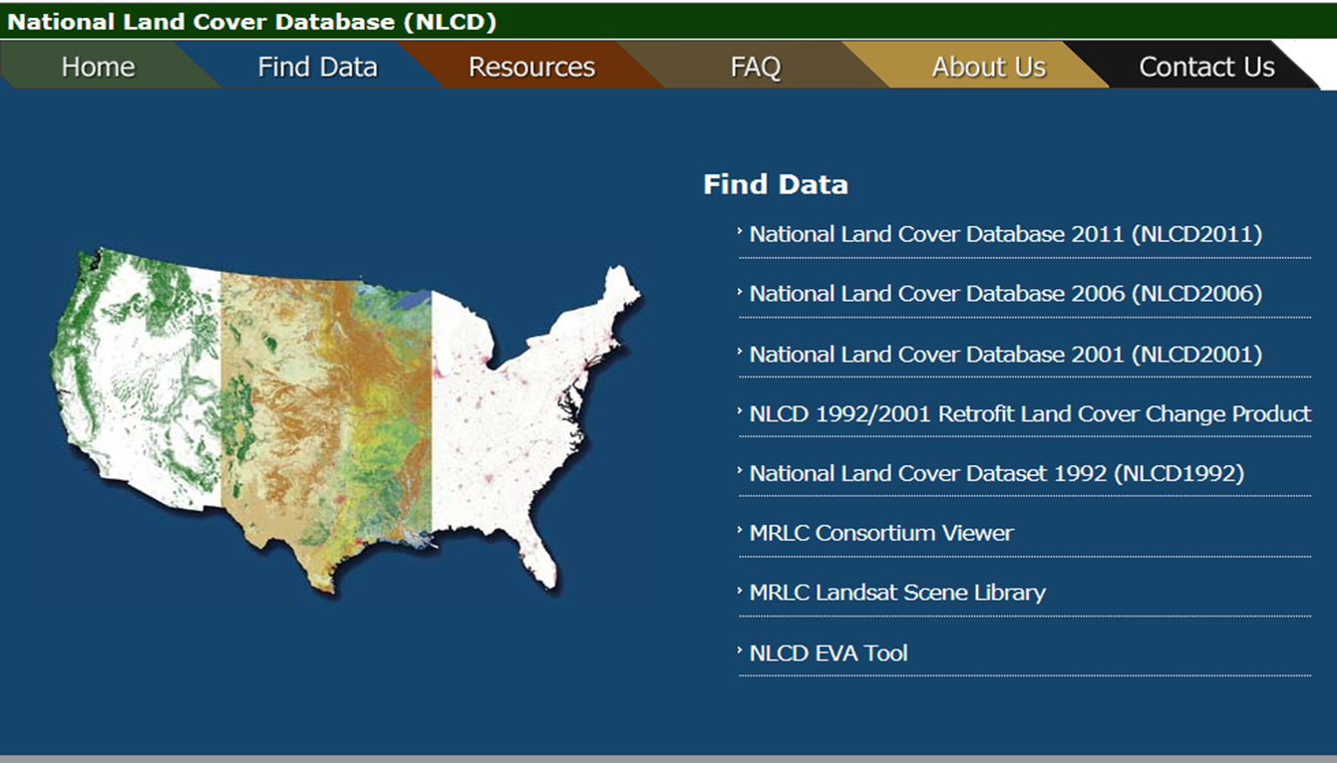
Global Reach National Land Cover Database
www.mrlc.gov

Slide 7
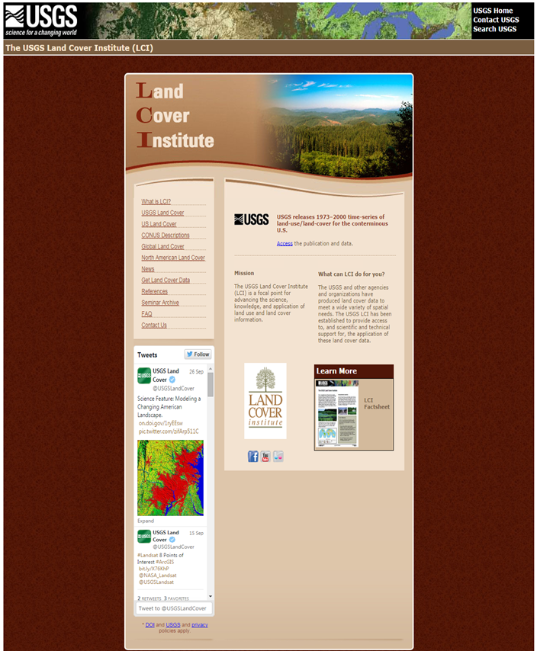
Global Reach National Land Cover Database
landcover.usgs.gov

Slide 8



Global Reach National Land Cover Database

Slide 9
Data Downloads National Land Cover Database

Slide 10
Data Downloads National Land Cover Database
Total Data Downloads, NLCD Products
574,915
Maps Rendered to Date, MRLC Web Site
5,594,773

Slide 11

R & D National Land Cover Database
NLCD1992
large area mosaicing methods
mapping zones
edge matching techniques
strategy for national accuracy assessment
NLCD2006
automated algorithm, differentiation between biomass increase/decrease from spectral change
first national accuracy assessment of both land cover class accuracy and land cover change accuracy
NLCD2001
CART land cover modeling
NLCD Mapping Tool development
PERL scripts to modify training files
SEE5 thematic land cover mapping, and technology transfer to NOAA C-CAP, GAP, LANDFIRE, NASS, NGOM
Cubist continuous field fractional vegetation mapping for forest and urban impervious mapping
MRLC "Eco zones" spatial framework
imagery pre-processing protocols, still used for NLCD2011 scenes
NLCD2011
automated Landsat data preprocessing scripts
MIICA + Zone = CCDM = improved and enhanced change products and labeling protocols
Cubist continuous field fractional vegetation mapping implemented for shrub and grass mapping
comprehensive assessment of land cover change accuracy between the last three NLCD epochs (2001-2006-2011)
NLCD1992-2001 retrofit
early prototype for spectral change analysis

Slide 12

Pushing Boundaries National Land Cover Database
Paradigm Shift
NLCD1992
First national scale, wall-to-wall land cover rendering with a consistent legend.
Leading Edge Research and Discovery
NLCD1992, 2001, 2006
Accuracy assessment of large area land cover datasets.
Concept Evolution
NLCD2001
CART to model large area land cover AND include continuous field estimates for canopy and imperviousness.
First percent canopy and percent imperviousness.
Expanded Capabilities
NLCD2006
First 5-year repeat cycle.
First database with change monitoring products.
NLCD2011
Capacity to monitor trends in land cover and impervious surface for previous epochs.
More comprehensive analysis of change and labeling of change.

Slide 13
Real-World Value National Land Cover Database
estimating pesticide use within watersheds . . .
“According to SEI Project Geoscientist John Hanzas, using the high resolution NLCD for site selection ‘helps us make a more convincing case to the EPA that we have chosen the watersheds most vulnerable to a particular pesticide.’”
Hanzas, J., 2002, National Land Cover Data: A Better Way to Estimate Pesticide Use Within Watersheds: Update, p. 1, 4.

Slide 14
Real-World Value National Land Cover Database
understanding human settlement and anthropogenic landscape change . . .
“This process of growth and change
has profound implications for the ecology of the region that will require the reformulation of resource management policies.”
Hammer, R.B., et al. 2004. Characterizing dynamic spatial and temporal residential density patterns from 1940–1990 across the North Central United States. Landscape and Urban Planning, v. 69, p. 183-199.

Slide 15
Real-World Value National Land Cover Database
understanding natural diversity and its threats to better plan and manage . . .
"By systematically evaluating communities, habitats, and conditions across the waterways of Pennsylvania, we have gained better understanding of the aquatic natural diversity and its threats. Many ACC project applications are currently underway, including conservation planning and watershed management."
Walsh, M.C., Deeds, J., and Nightingale, B., 2007, Classifying Lotic Systems for Conservation: Methods and Results of the Pennsylvania Aquatic Classification: Pennsylvania Natural Heritage Program, Western Pennsylvania Conservancy.

Slide 16
Real-World Value National Land Cover Database
determining percentage of roadless space in the lower
48 states . . .
“We calculated DTR [distance to the nearest road] for the entire United States on a 30-m grid aligned with the National Land Cover Dataset (NLCD), thus enhancing a national geospatial resource that is used for a wide variety of ecological and land-use analyses.”
Watts, R.D., et al. 2007. Roadless space of the conterminous United States. Science, v. 316, no. 5825, p. 736-738.

Slide 17
Real-World Value National Land Cover Database
identifying areas for wind energy development . . .
“The Northern Great Plains (NGP) is home both
to some of the world’s best wind resources and to remaining temperate grasslands, the most converted and least protected ecological system on the planet. Our analyses demonstrate that there are large areas where wind development would likely have few additional impacts on wildlife.”
Fargione, J., et al. 2012. Wind and wildlife in the northern Great Plains: Identifying low-impact areas for wind development, PLoS ONE, v. 7, no. 7, article number e41468.

Slide 18
Real-World Value National Land Cover Database
determining return on investment in public lands . . .
“New Hampshire's investments in land conservation are critical to creating and protecting the places and
amenities that make the state a great place to live and work. Land and water conservation contributes to a high quality of life while simultaneously stimulating economic activity across the state. This study found that every $1 invested in land conservation by New Hampshire returns $11 in economic value of natural goods and services.”
Trust for Public Land, 2014, New Hampshire's Return on Investment in Land Conservation, Trust for Public Land.

Slide 19
Real-World Value National Land Cover Database
air dispersion
air quality
atlas compilation
biodiversity
carbon flux
change detection
climate change
crop protection
economic development
ecosystem health
education
emergency response
energy development
epidemiology
fire fuels
flood hazards
forest health
hurricane hazards
land management
human health
land cover
landscape ecology
medical GIS
land-coastal linkages
military force protection
national park management
national security
pesticide management
permafrost
soil surveys
telecommunications
urban growth
U.S. census
vector borne diseases
wildfire risk
wildlife habitat
water quality

Slide 20
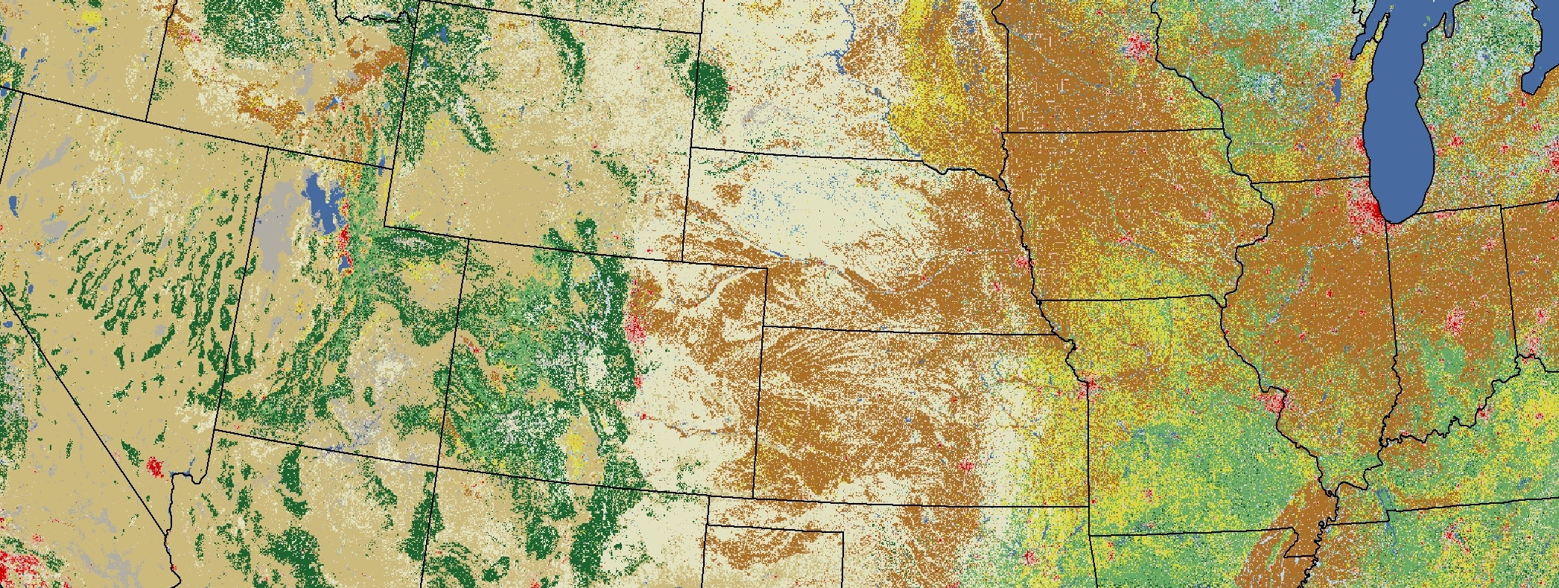
Real-World Value National Land Cover Database
shaping research across disciplines, institutions, countries
enabling knowledge discovery
paving the way in land cover mapping
National Land Cover Database Project
pushing the boundaries of land science
building capacity for problem-solving
fostering intellectual exchange and collaboration
providing data for planning and management
improving mapping with satellite imagery
engaging and educating the public

