Slide 1
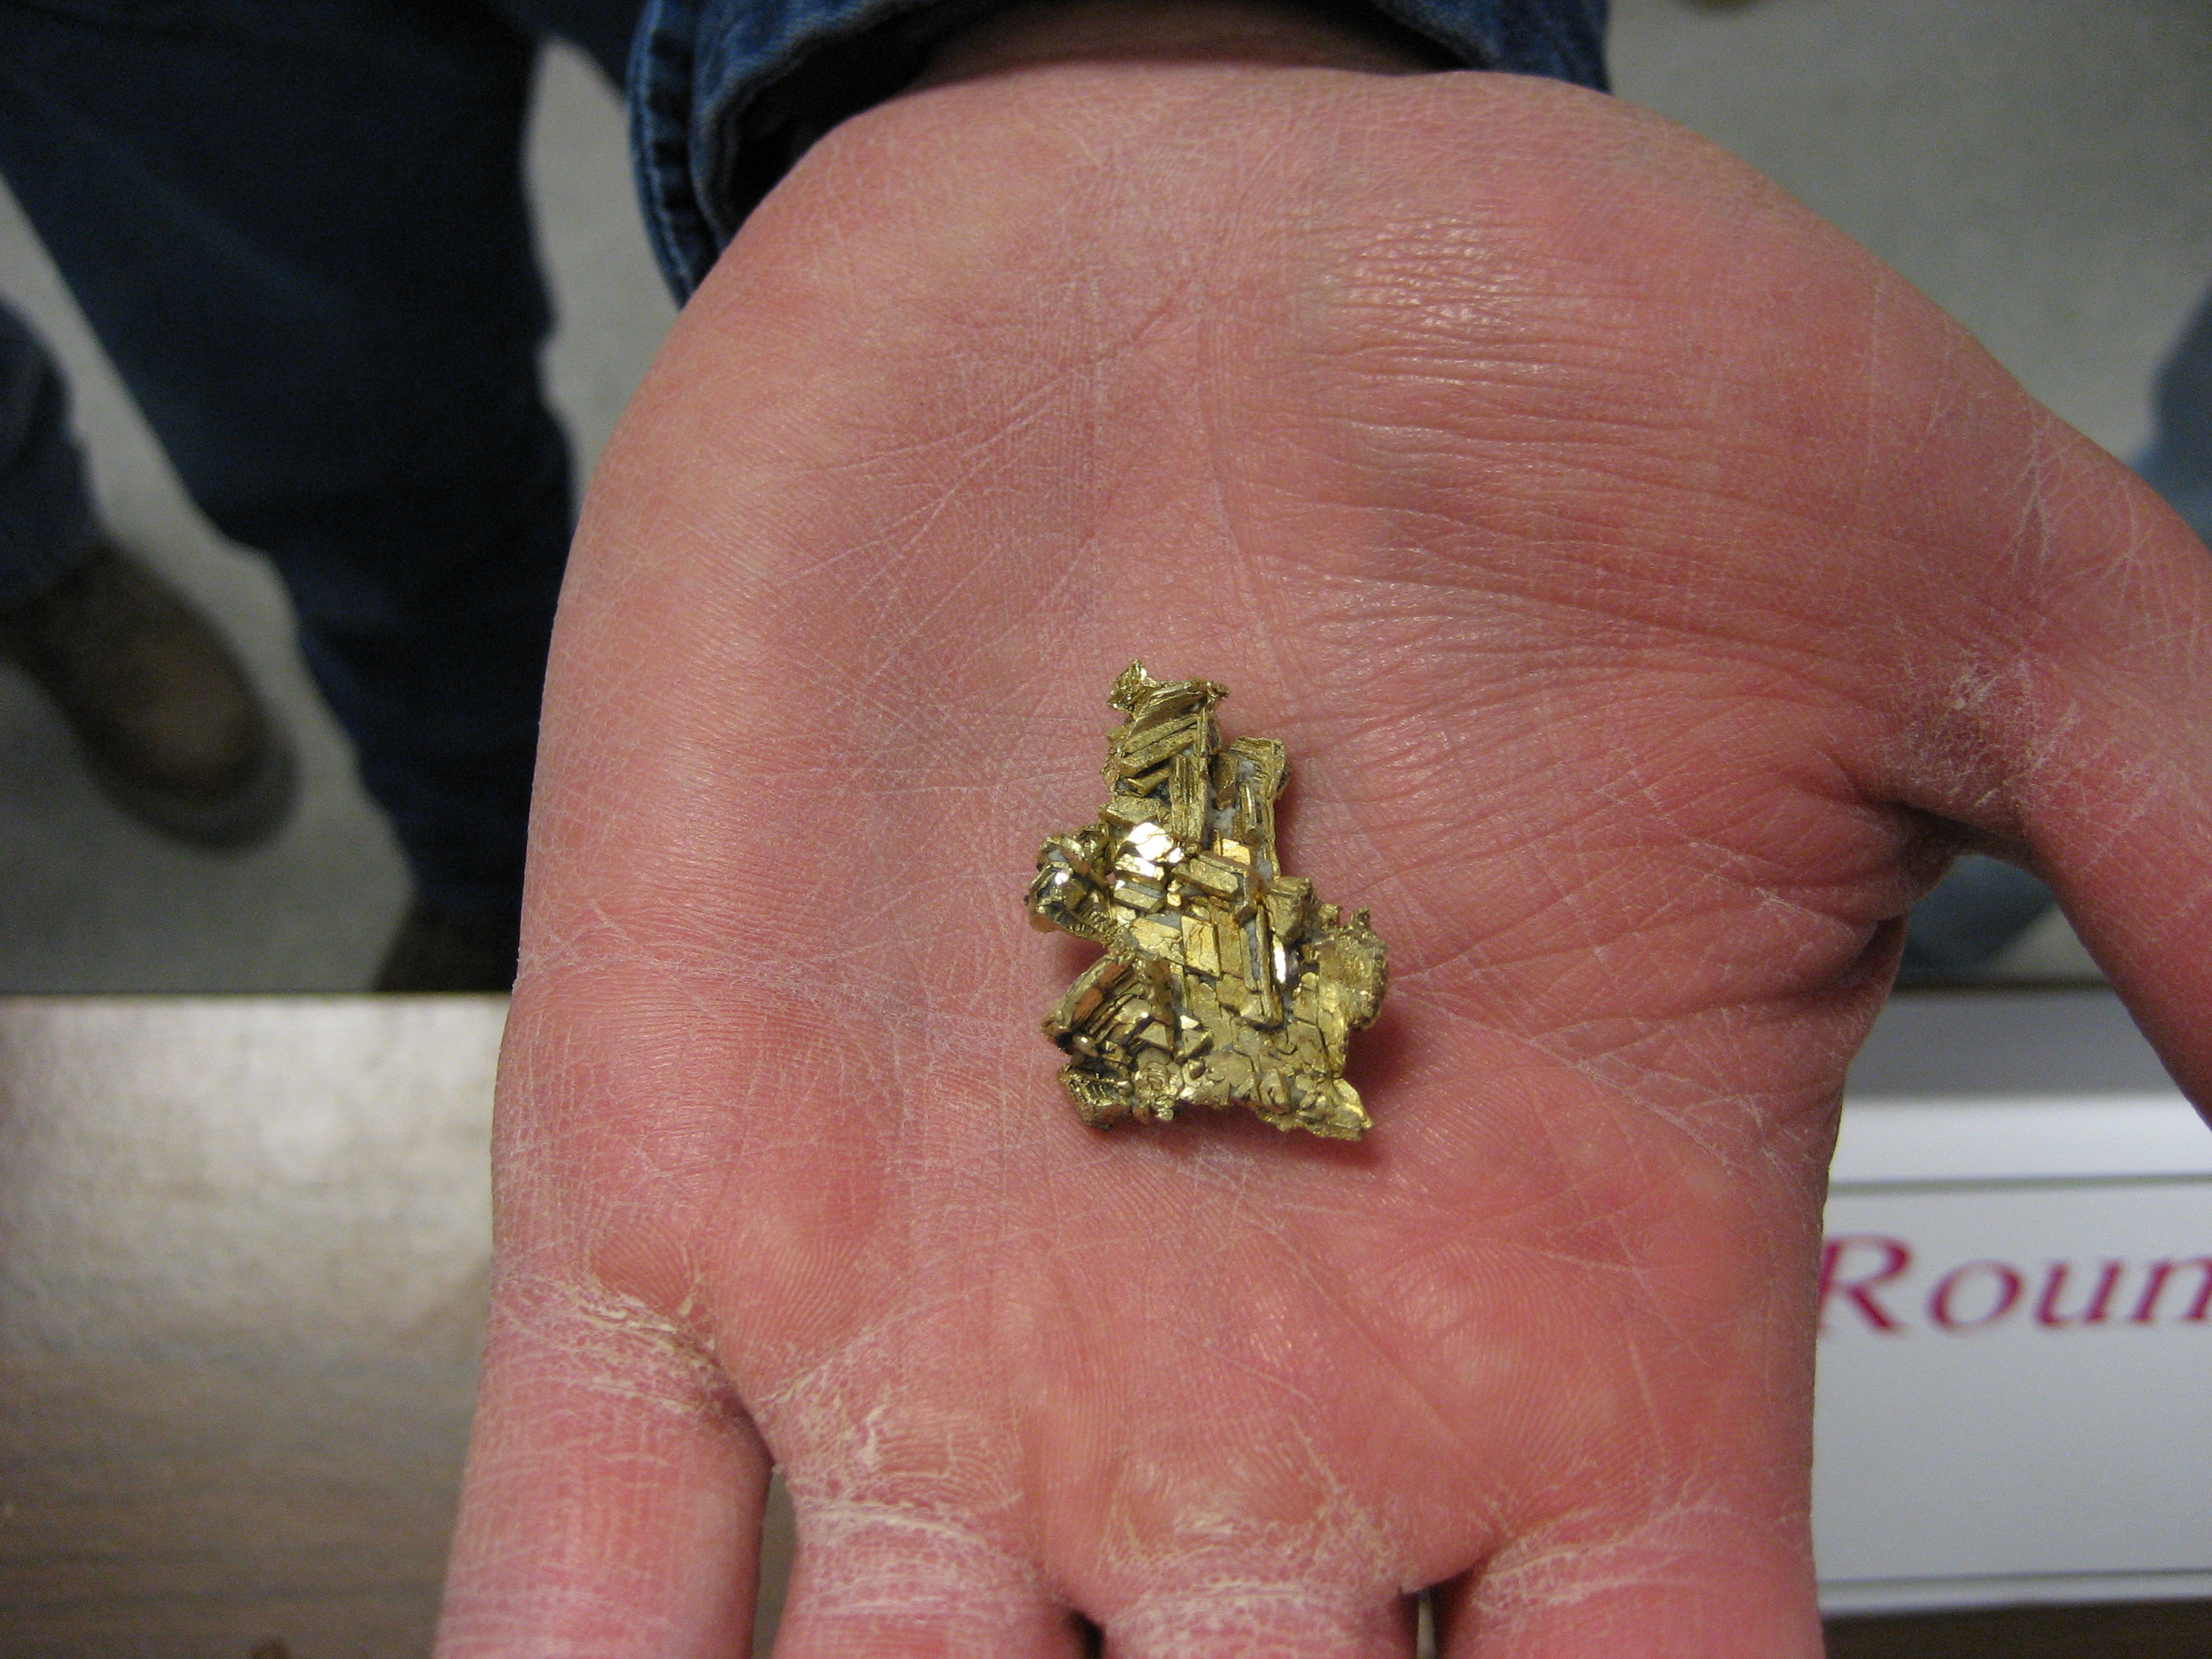

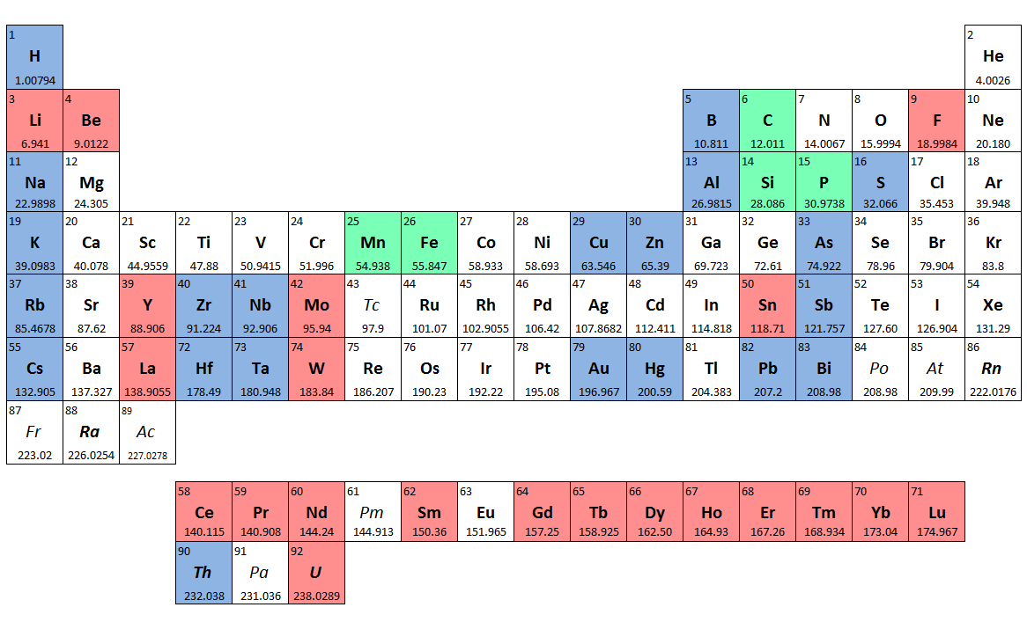


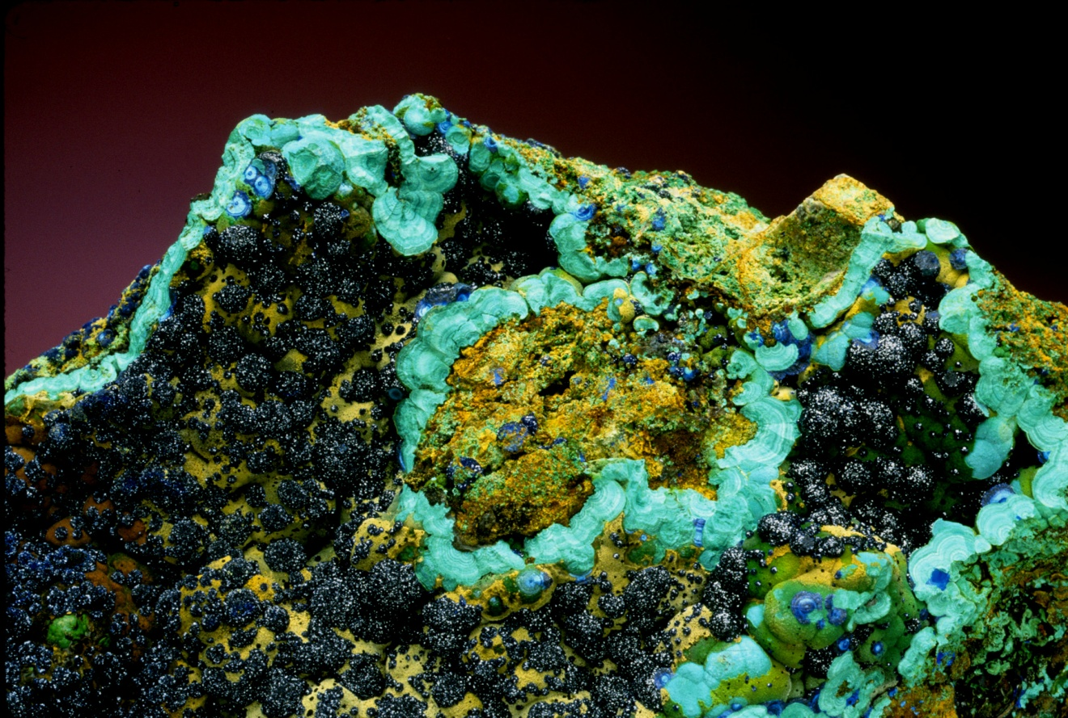
Global Change from a Mineral-Resource Perspective
Jon Price
State Geologist Emeritus
Nevada Bureau of Mines and Geology
Jonathan G. Price, llc
Azurite & Malachite, Ely, NV (J. Scovil photo)
Round Mountain, NV (2007)

Slide 2
Global Change from a Mineral-Resource Perspective
The world has changed.
China is #1.
Global demand for energy and mineral resources is the challenge for sustainability.
Round Mountain, NV (2007)

Slide 3
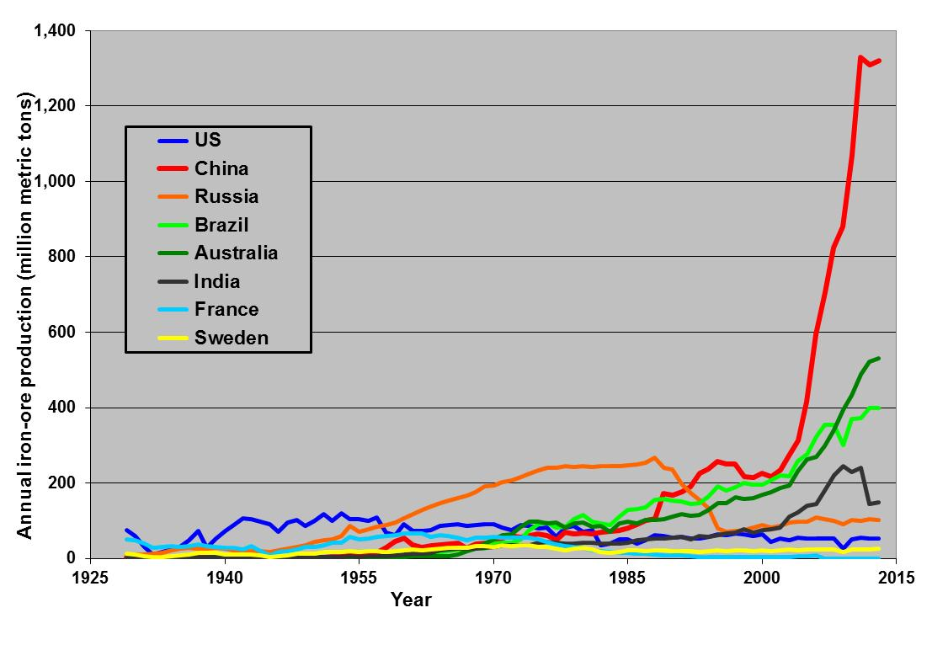
Iron-ore production, 1929-2013
Data source: USGS

Slide 4
Iron-ore production, 1929-2013
France #1 during the Great Depression
Data source: USGS

Slide 5
Iron-ore production, 1929-2013
US #1 after WWII
France #1 during the Great Depression
Data source: USGS

Slide 6
Iron-ore production, 1929-2013
USSR #1 during the Cold War
US #1 after WWII
France #1 during the Great Depression
Data source: USGS

Slide 7
Iron-ore production, 1929-2013
China has been #1 since 1992.
USSR #1 during the Cold War
US #1 after WWII
France #1 during the Great Depression
Data source: USGS
China is #1.

Slide 8
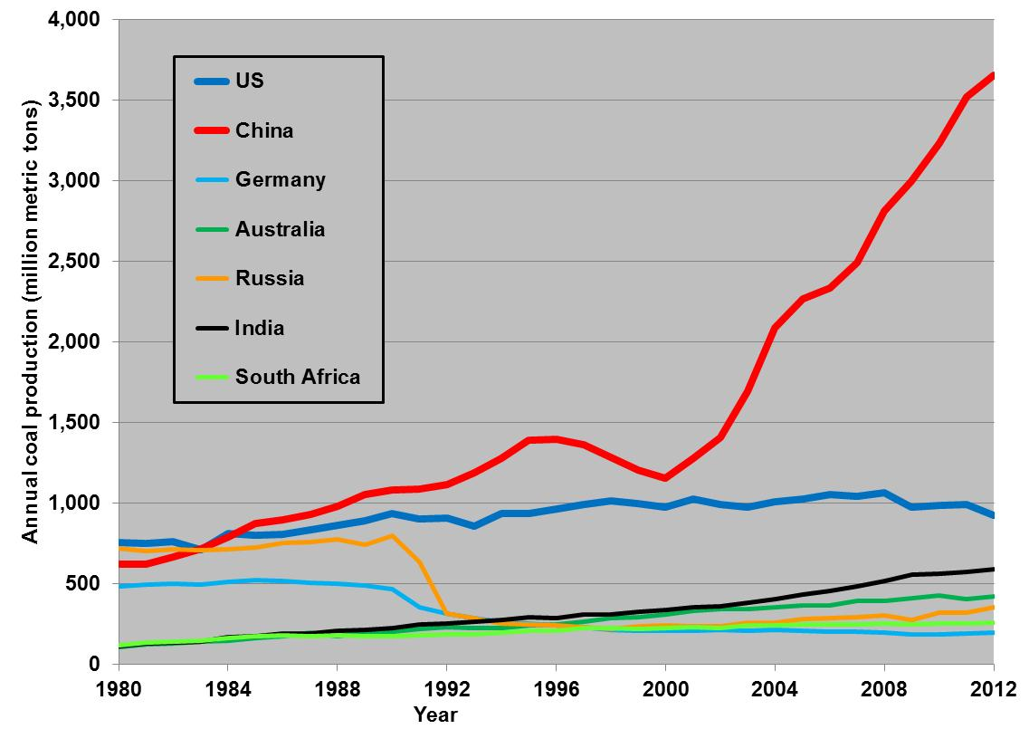
Coal production, 1980-2012
China has been #1 since 1985.
Data source: EIA/DOE

Slide 9
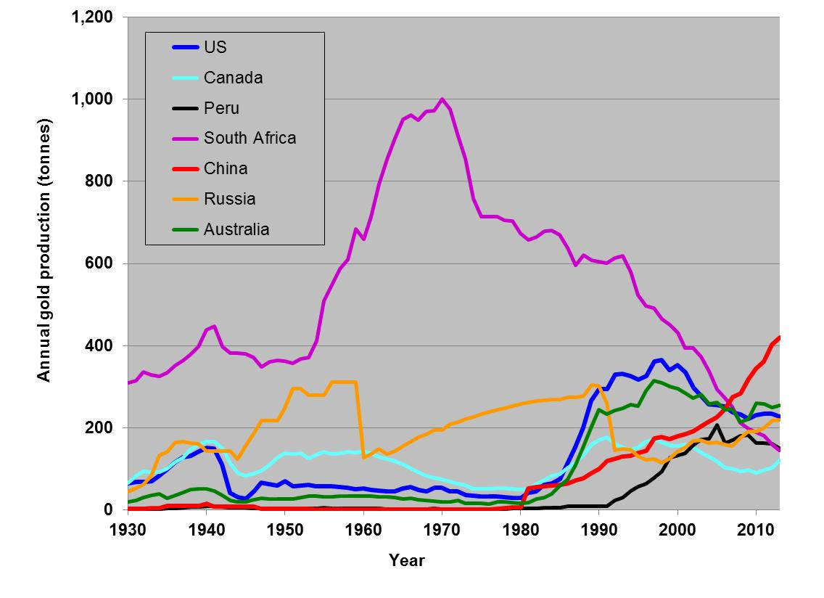
Gold production, 1930-2013
China has been #1 since 2007.
Data source: USGS

Slide 10
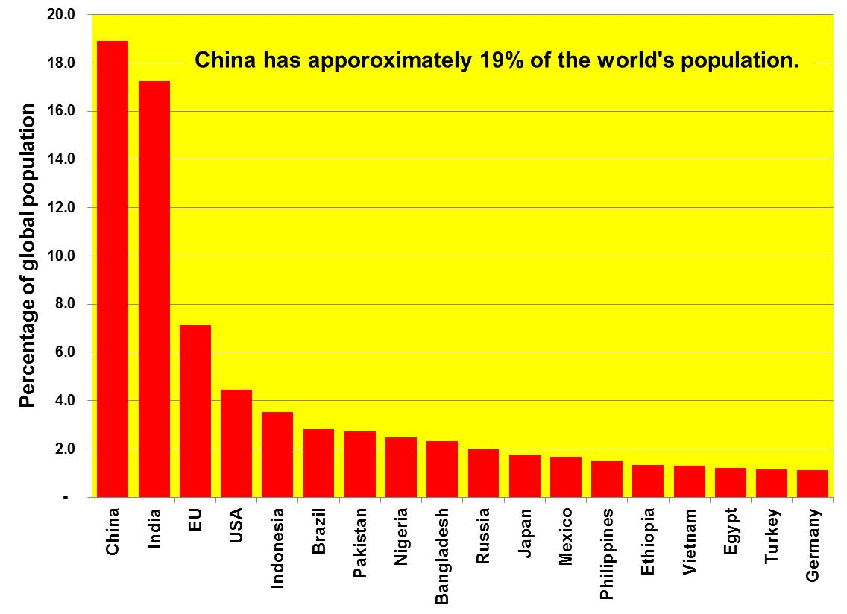
Data source: CIA
It makes sense that China is #1 in many mineral resources.

Slide 11
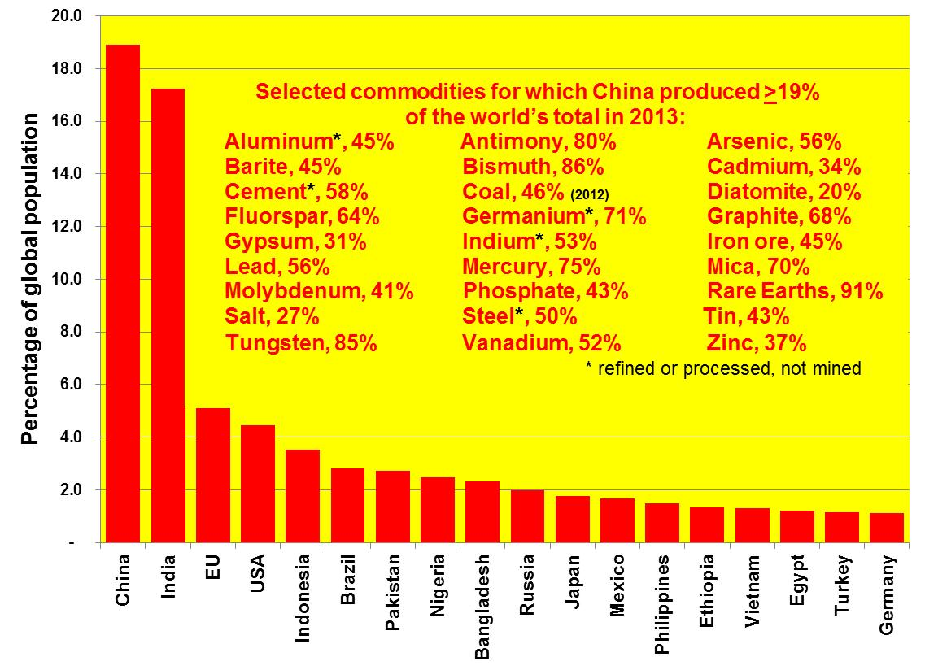
Data sources: USGS & CIA
But China produces much more than 19% of many commodities.

Slide 12
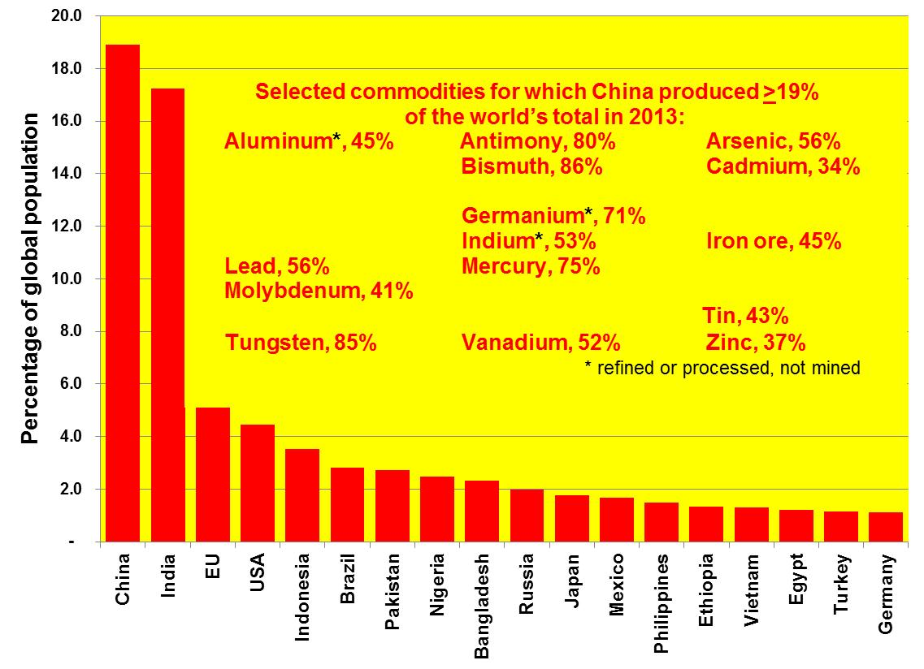
Data sources: USGS & CIA
China is #1 in more metals than any other country.

Slide 13
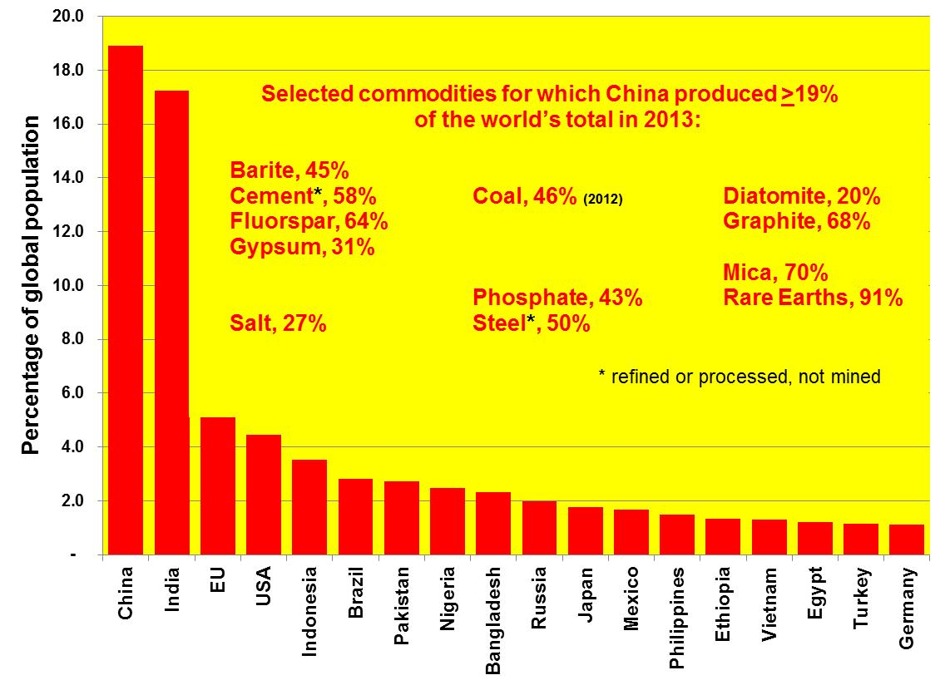
Data sources: USGS & CIA
China is #1 in more industrial minerals than any other country.

Slide 14
So what?
Who cares?

Slide 15
Global Change from a Mineral-Resource Perspective
The world has changed.
China is #1.
Global demand for energy and mineral resources is the challenge for sustainability.
Round Mountain, NV (2007)

Slide 16
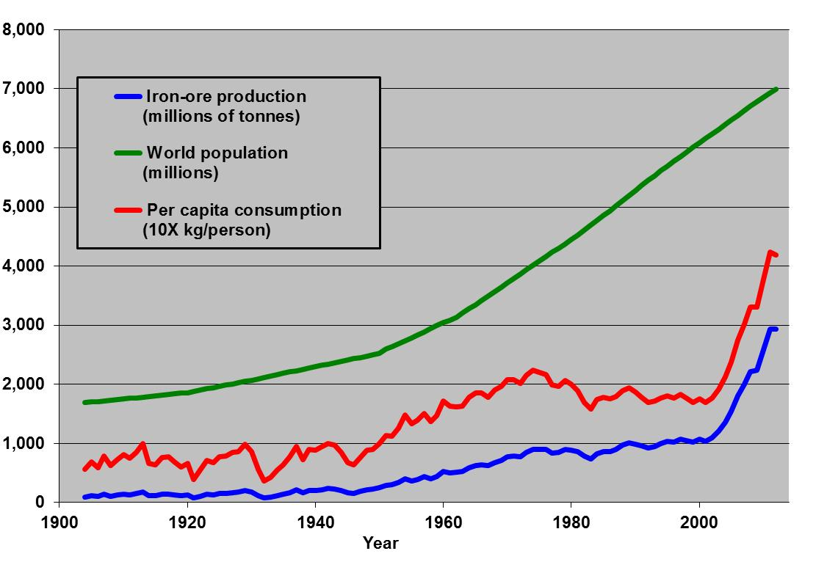
Iron, 1904-2013
Data sources: USGS & CIA
Both global production and average per-capita consumption are increasing.

Slide 17
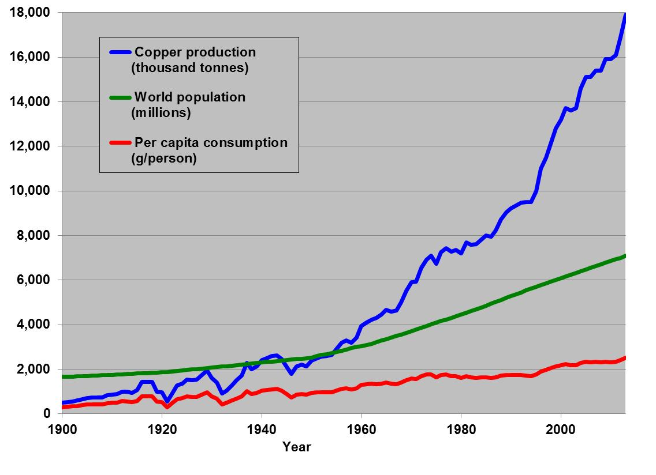
Copper, 1900-2013
Data sources: USGS & CIA
Both global production and average per-capita consumption are increasing.

Slide 18
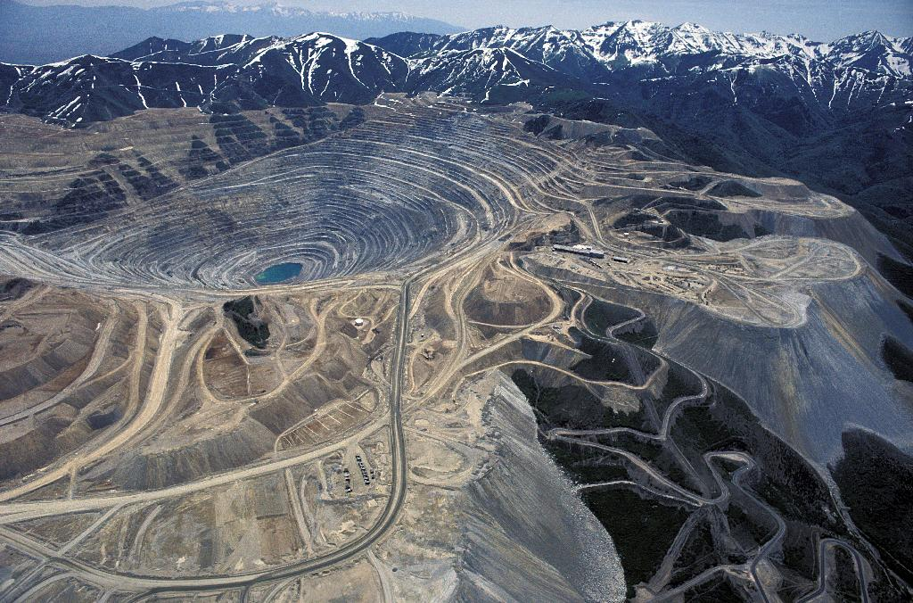
Photo copyrighted by Michael Collier, from the AGI website, Rio Tinto/Kennecott Utah Copper mine; the remaining resource as of 16 May 2008 = 3.06 million metric tons of Cu
Global copper production in 2013 (17.9 million metric tons) nearly equaled over 100 years of production from the Bingham Canyon mine (~17.2 million metric tons).

Slide 19
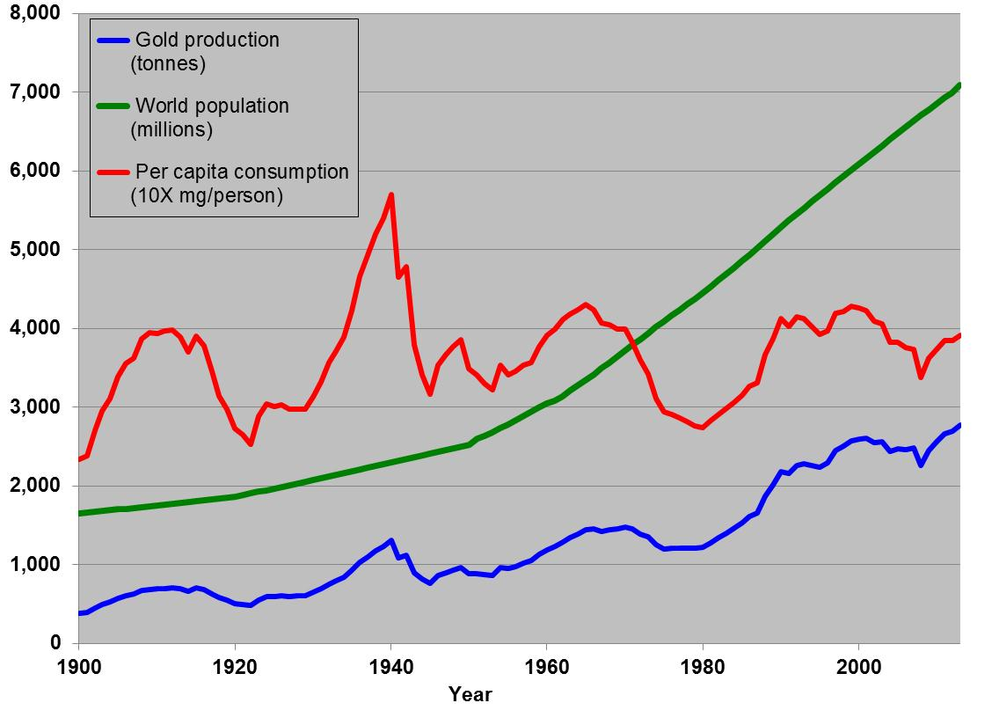
Gold, 1900-2013
Data sources: USGS & CIA
Both global production and average per-capita consumption are increasing.

Slide 20
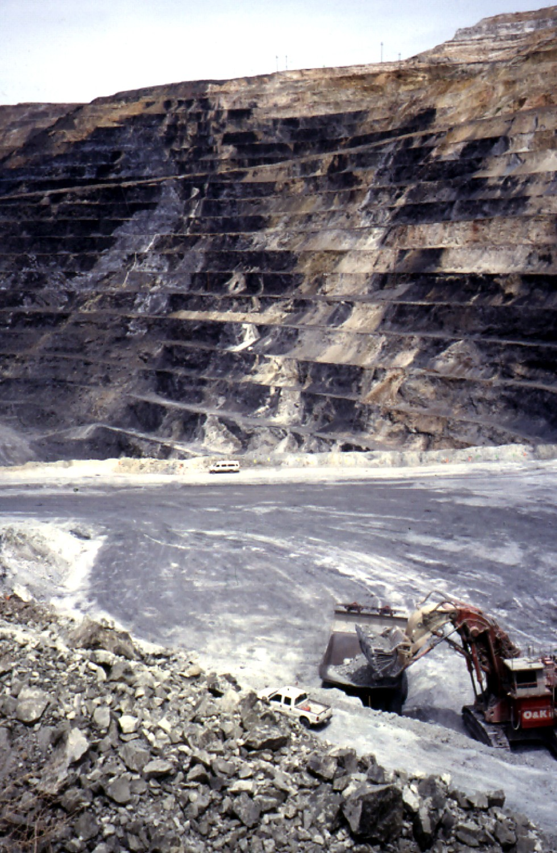
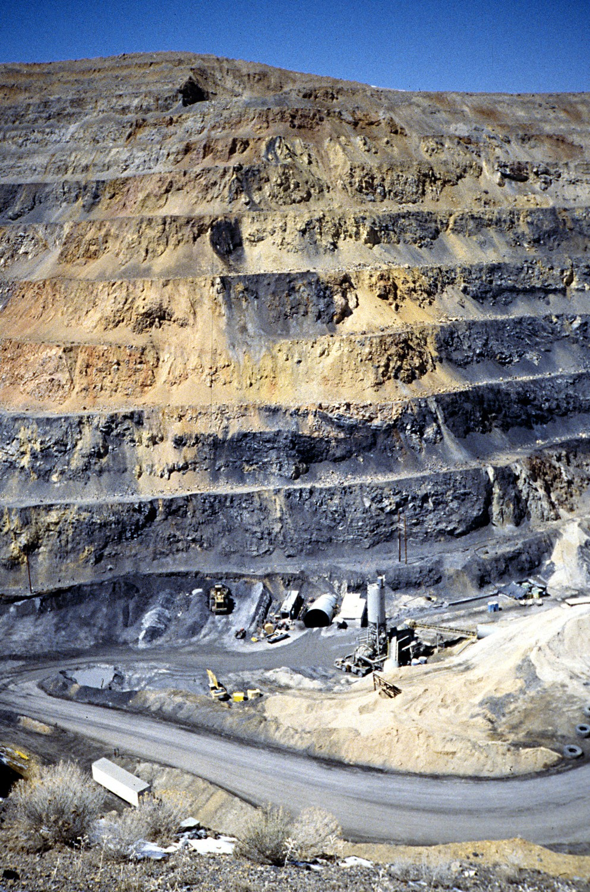
Newmont’s Carlin East pit and portal, 2000
Barrick’s Betze pit, 2000
Global gold production in 2013 (2,770 metric tons) approximately equaled the cumulative production from the Carlin trend in Nevada (~2,500 tons), one of world’s top regions.

Slide 21
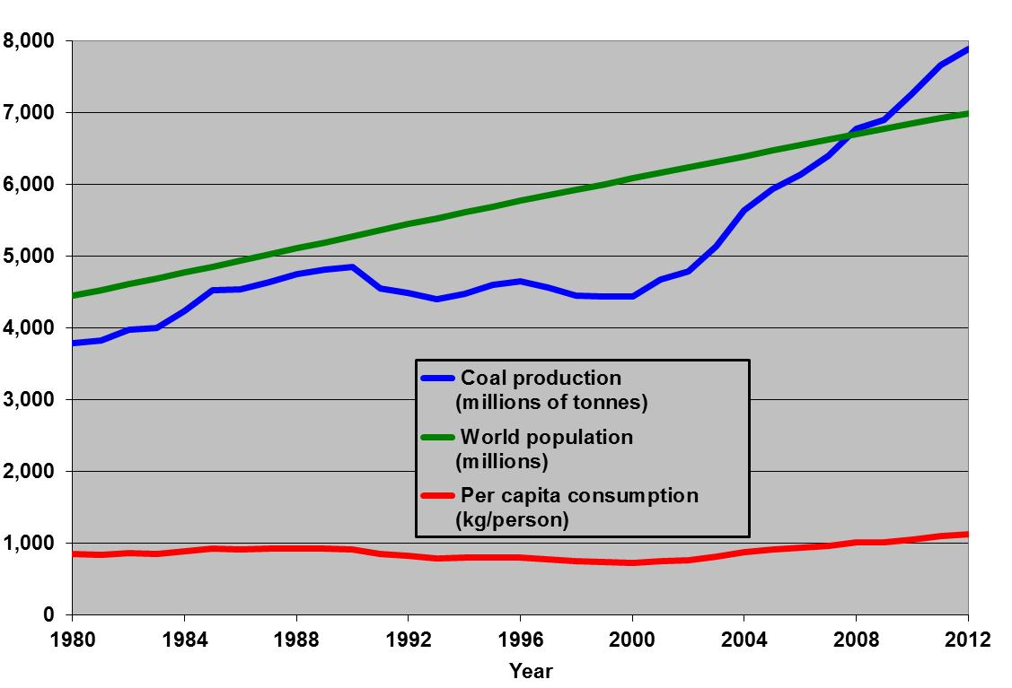
Coal, 1980-2012
Data sources: USGS & CIA
Both global production and average per-capita consumption are increasing.

Slide 22
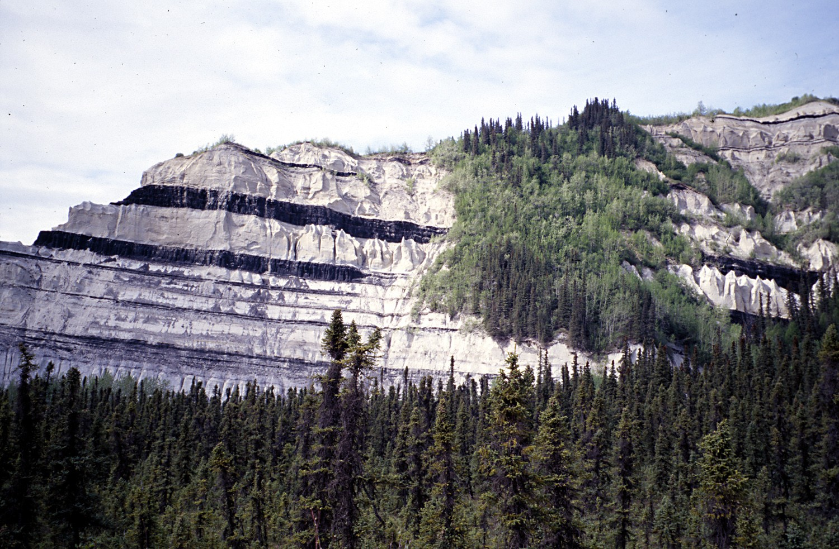
Coal seams near Healy, Alaska
Annual global coal production (~7.9 billion metric tons) equals approximately 5.6 km³ of coal, or ~1,900 km² of land with an average coal thickness of 3 m.

Slide 23
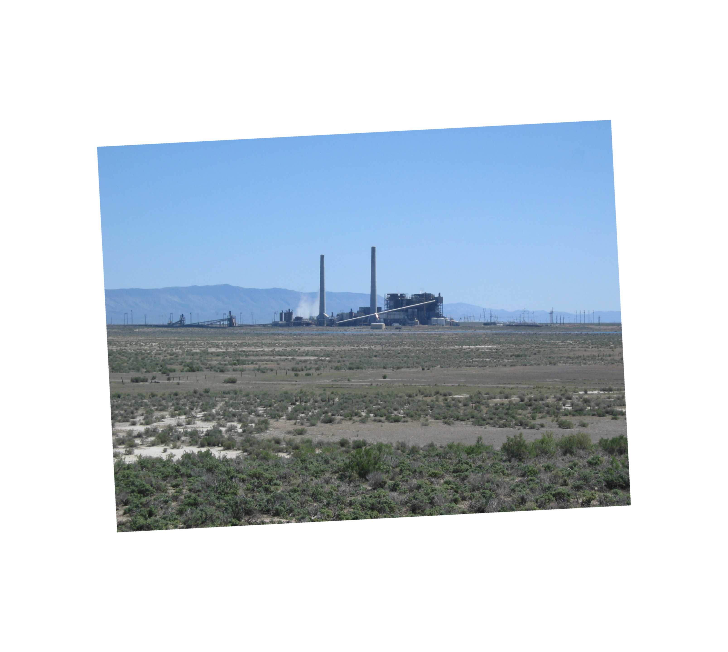
The amount of CO₂ released from burning of coal in 2012 would have been enough, without natural reduction from plant growth, rain, and other processes, to raise the concentration of CO₂ in the atmosphere by ~2.9 ppmv, a bit more than the recent global trend of CO₂ increasing ~1.8 ppmv per year.
Valmy coal-fired power plant, Humboldt County, Nevada

Slide 24
Global Change from a Mineral-Resource Perspective
The world has changed.
China is #1.
Global demand for energy and mineral resources is the challenge for sustainability.
Round Mountain, NV (2007)

Slide 25
Thank you!
Jonathan G. Price, llc
Certified Professional Geologist, Ph.D.
2210 Andromeda Way
Reno, Nevada 89509-3802 USA
Cell: 775-200-8077 or 775-250-2145
JonathanGPrice@alumni.ls.berkeley.edu

