Slide 1
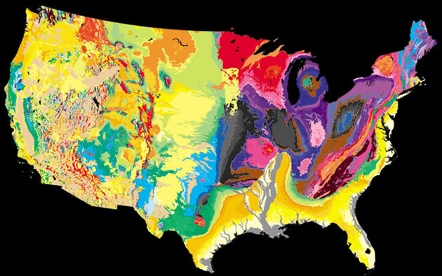
Data, Digitization and Discovery in the Paleoniches TCN
Michelle M. Casey, Úna C. Farrell, and Bruce S. Lieberman

Slide 2
Project Aims
The fossil record allows investigation of long term effects of climate change.
Create a spatial database with which to investigate the following questions:
How do species respond to environmental change through time?
What are the effects of abiotic versus biotic factors?
Do species respond individually or as a community to changing environments?
How do species niches evolve with changing climate?

Slide 3





3 major time periods/biogeographic regions:
Ordovician, Pennsylvanian, and Neogene
~546,000 invertebrate fossils
~20,000 localities
8 institutions

Slide 4
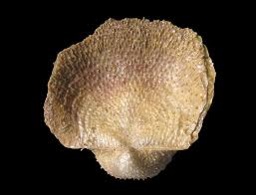
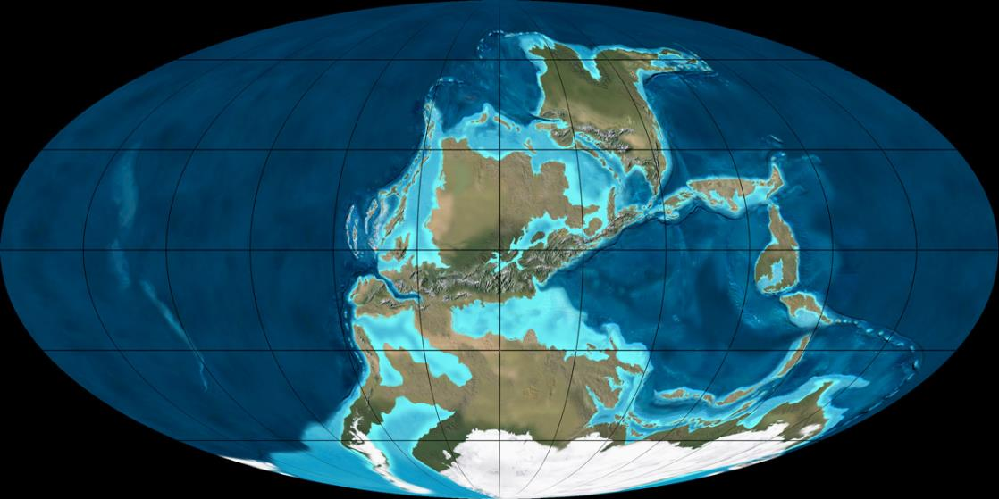
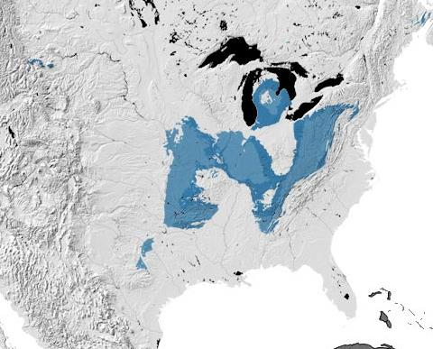
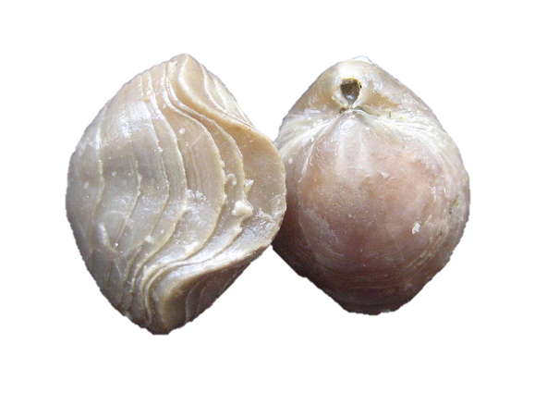
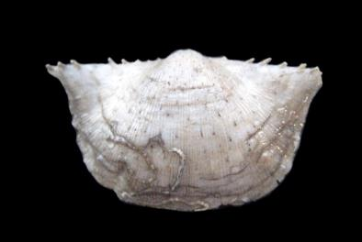
Pennsylvanian – Mid-continent
300 Ma
Ron Blakey
USGS

Slide 5

Pennsylvanian Specimens
Taxonomic Breakdown
Pennsylvanian Localities
May 2013
Pre-TCN
Georef’d
Uncatalogued
TCN
To Georef
Sept. 2014
Pre-TCN
Uncatalogued
Georeferenced
TCN
Notes:
~36,000 specimens were databased before we began work on the grant, by may of 2013 we had databased an additional ~37,000. as of last month we have databased over 89,000 specimens and this is just the Pennsylvanian. As of last Tuesday we have over 226,000 databased specimens. Last May we had georeferenced 35% of our Pennsylvanian localities. We completed georeferencing over this past summer and have 100% georefe’d Penn. localities.

Slide 6
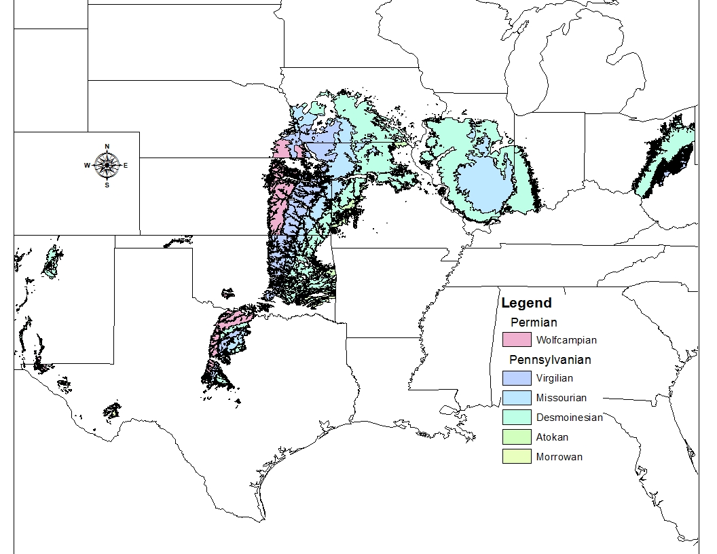
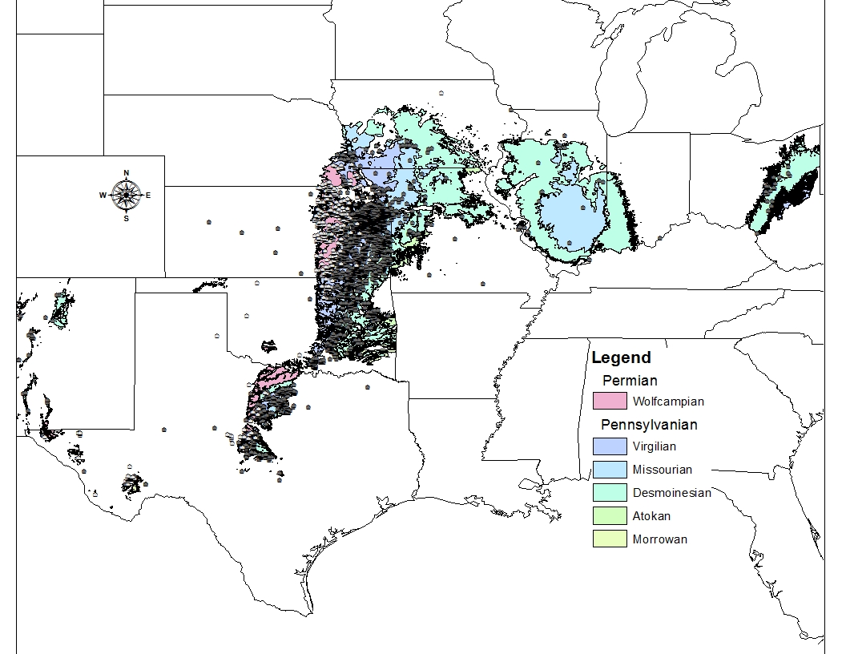
Notes:
This is map of surficial Pennsylvanian and Permain rock units by North American stage. We can use this map, created in GIS using data layers available from the state geological surveys, to test for outcrop availability bias to determine if species range size is correlated with rock volume. In addition to the Pennsylvanian, we also georeferenced 100% of our US Permian localities with 5235 georeferenced localities total and 175,659 specimens with decimal latitude and longitude.

Slide 7
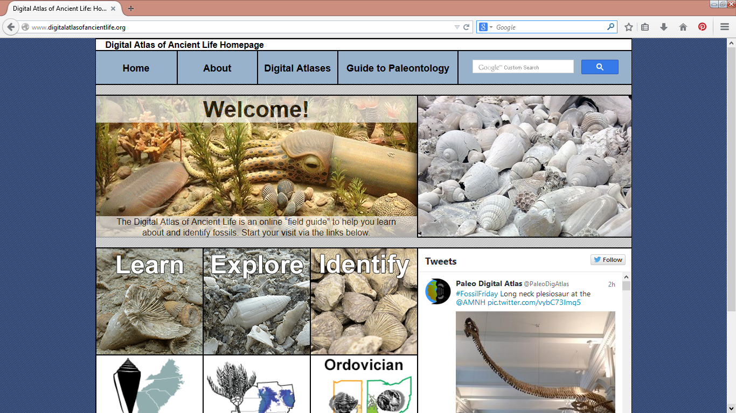
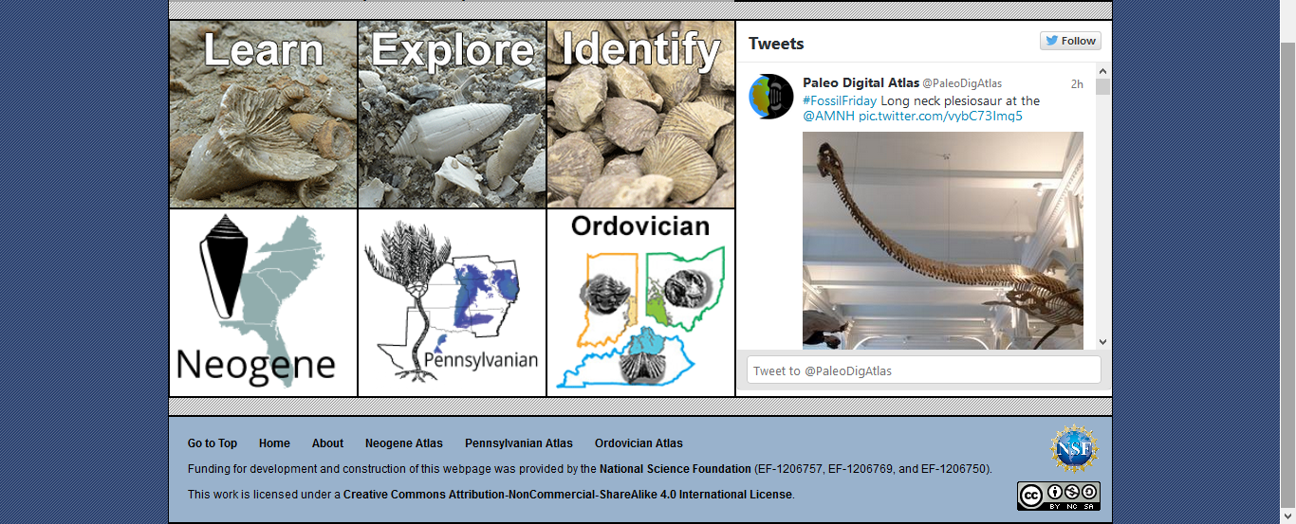
Digital Atlas of Ancient Life

Slide 8
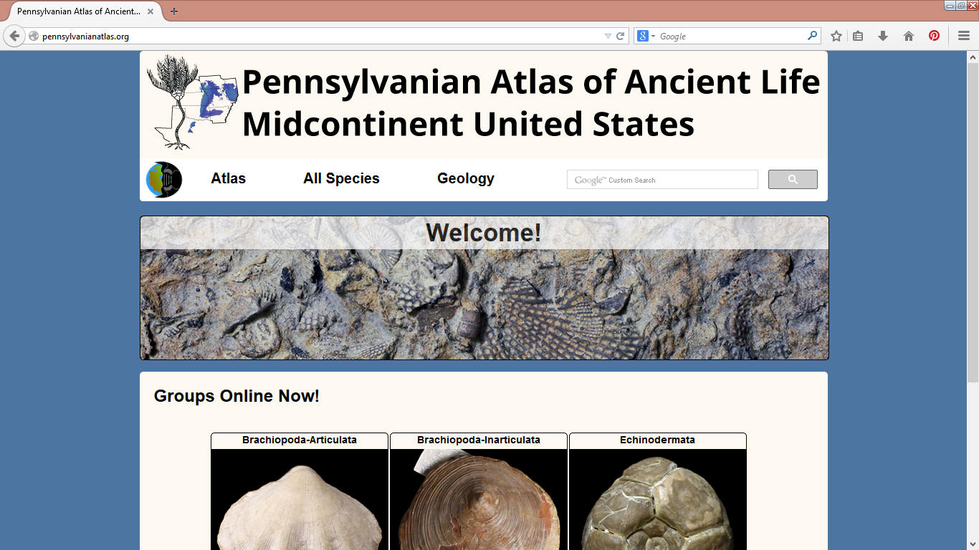
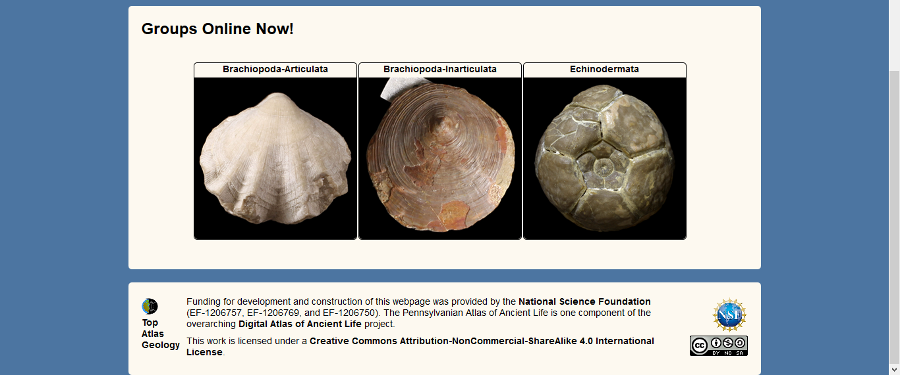
Notes:
Work in progress, especially the Pennsylvanian, Nested hierarchically by taxonomy so you can see how many species are in the genus in a particular area to focus your lit searches or aid in identifications, lists of stratigraphic units and ages where it is found, maps. Great for outreach, education, and fossil collectors.

Slide 9
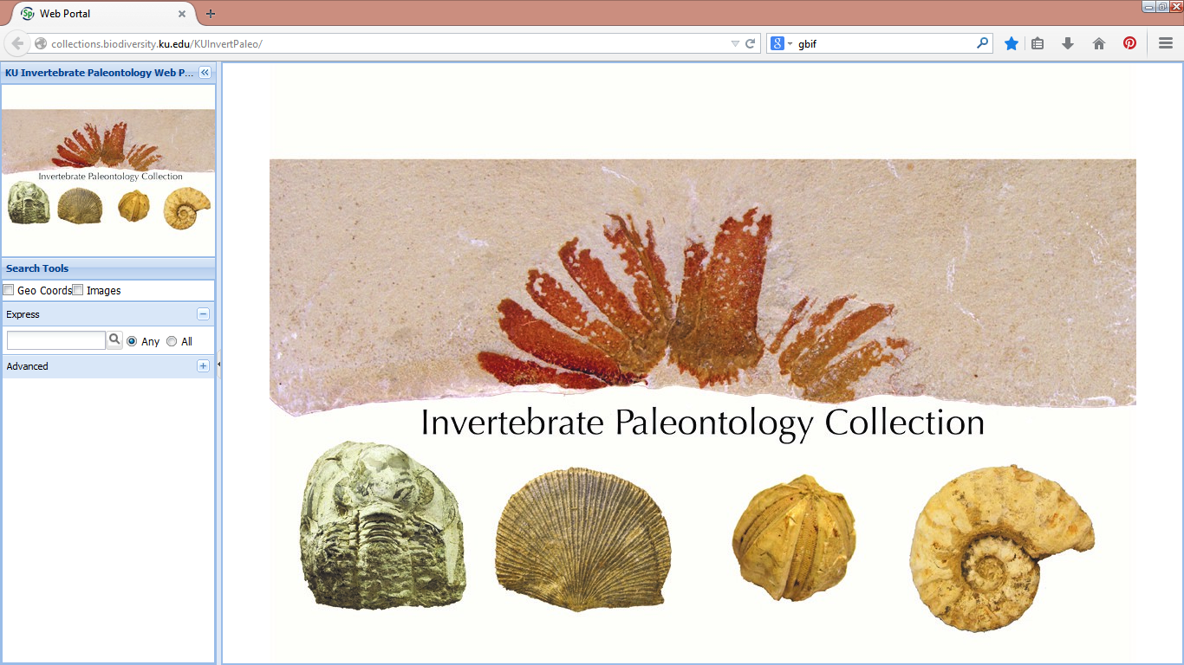
Specify Web Portal
http://collections.biodiversity.ku.edu/KUInvertPaleo/
Notes:
Useful for fossil collectors, researchers, and internally for us proofing the database.

Slide 10
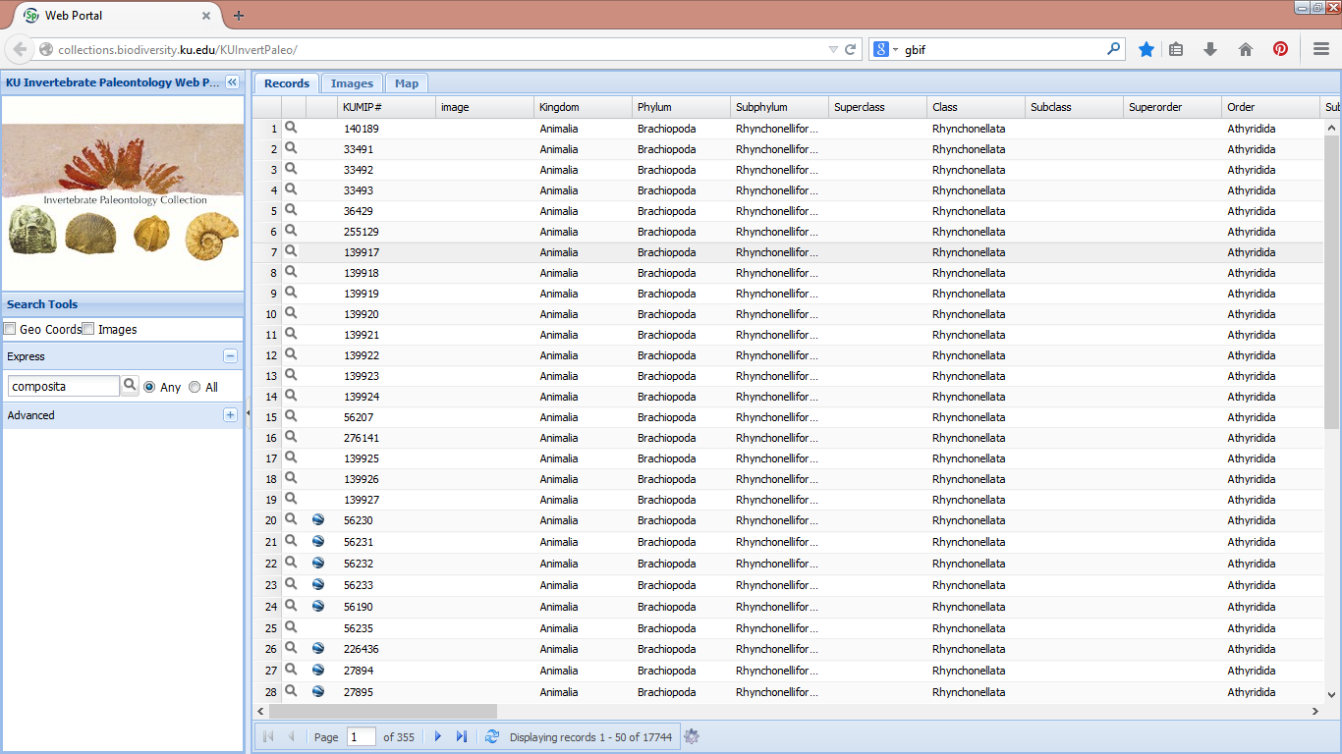
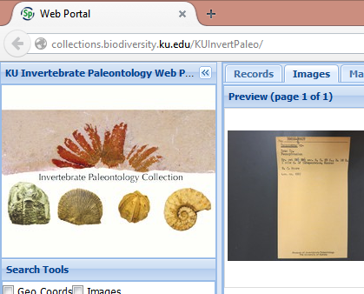

Slide 11
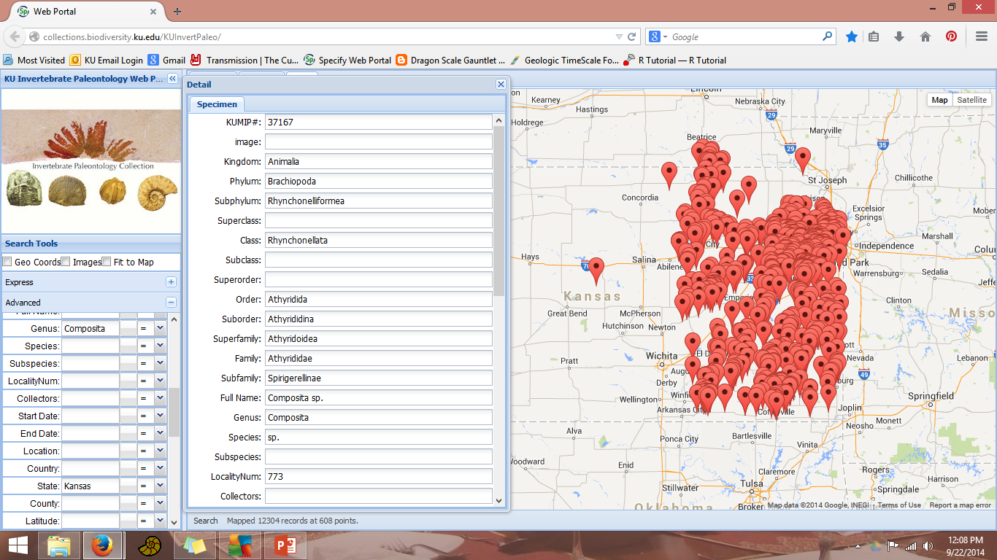
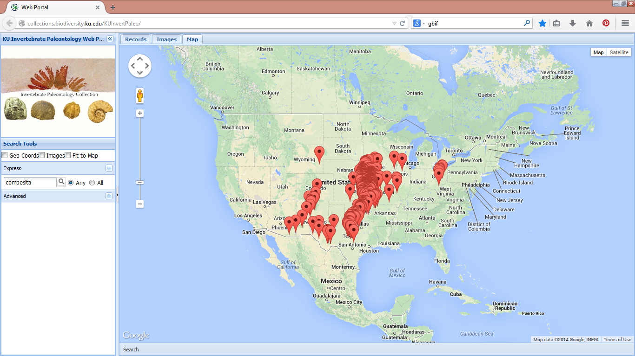
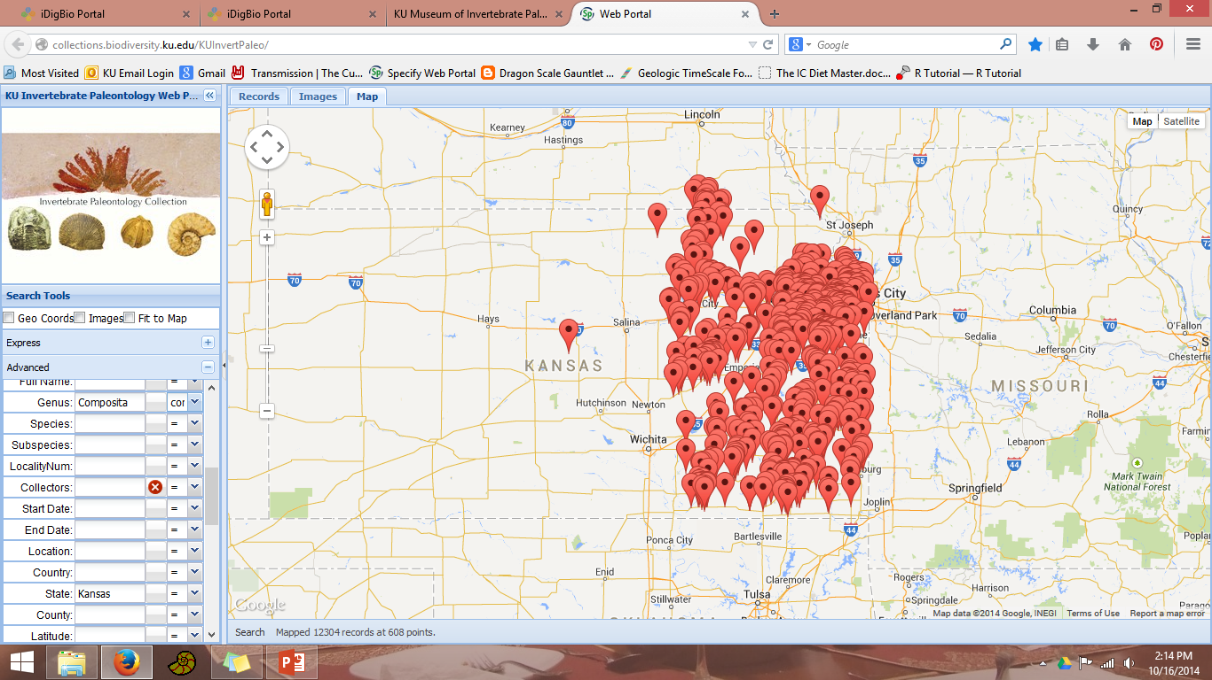
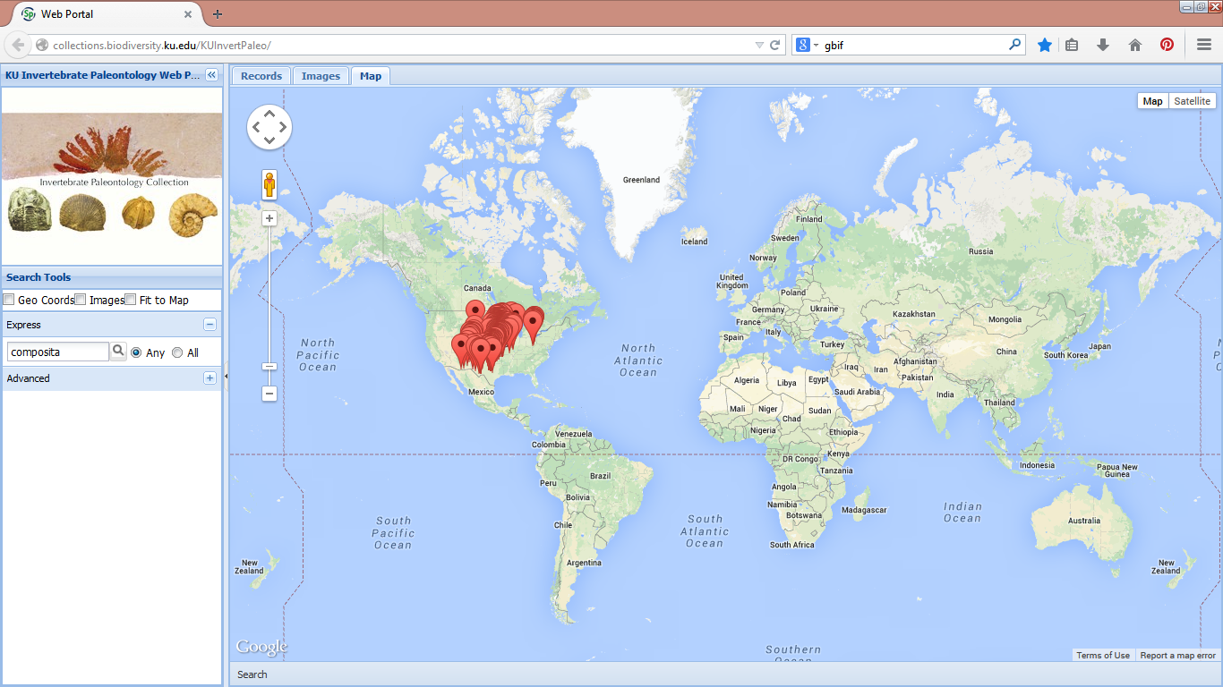
Notes:
Pros: quick and easy search, can search by any field we have in the database, allows you to do =, doesn’t =, contains, etc; directly linked to specimen number for easy look-up in specify database, use for proofing, can be used by students because easier than building a query in specify. Cons: cannot download data to a spreadsheet

Slide 12
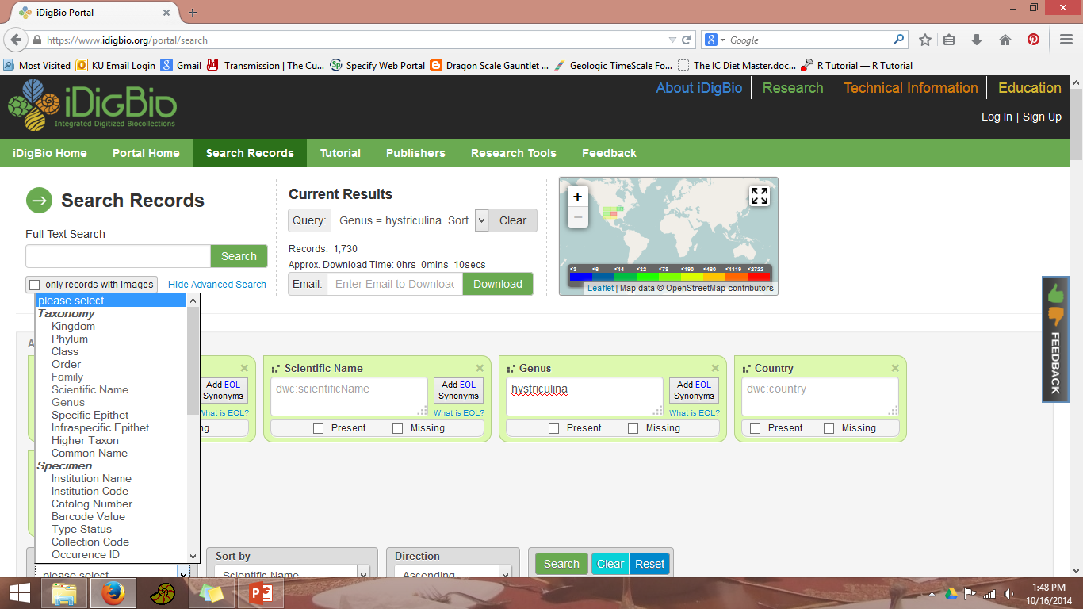
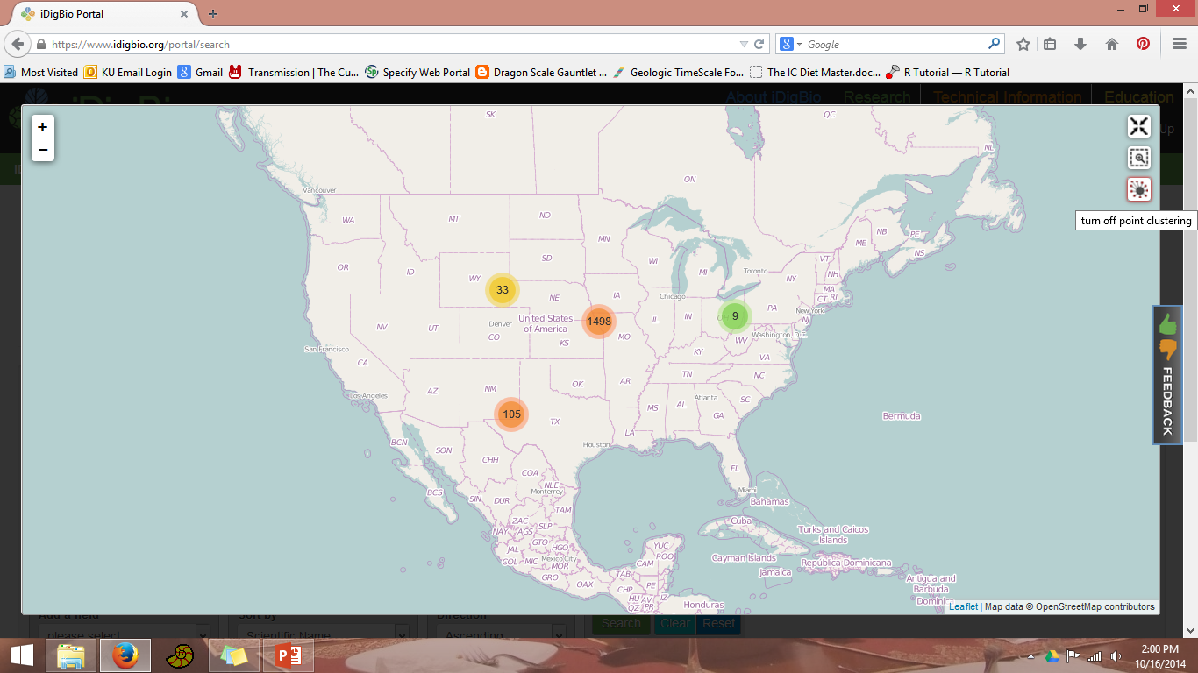
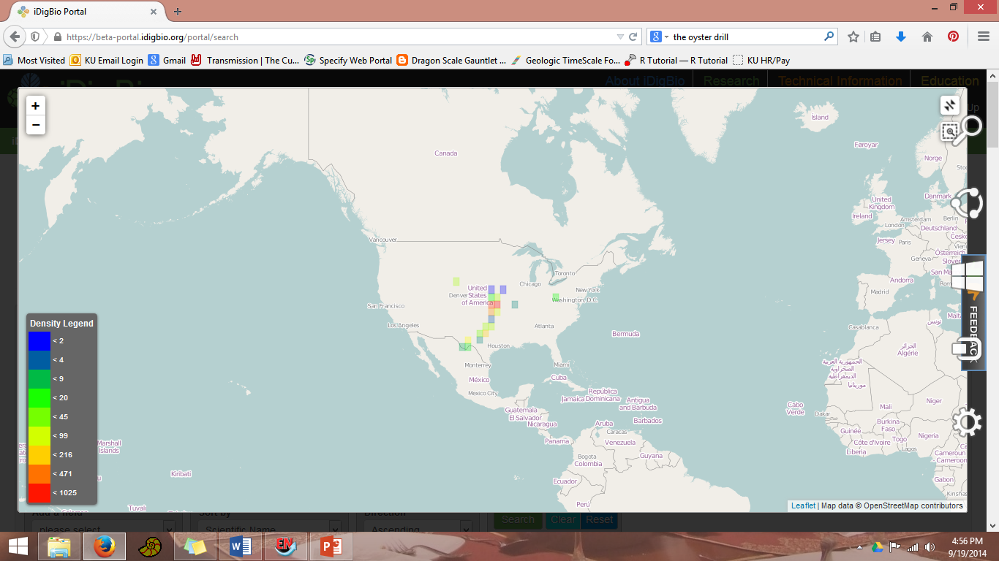
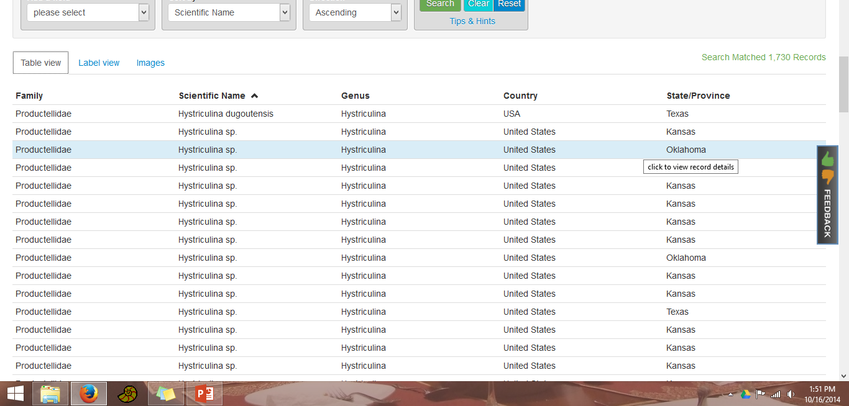
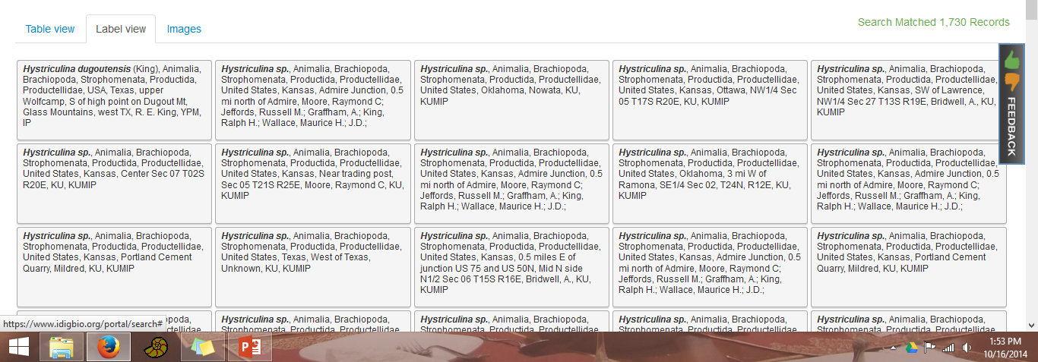
Notes:
Pros: data aggregator so you are getting multiple collections, can download the data sheet, better map visualization if you’re specifically interested in sample sizes, shows only the fields that you have listed on your search page but you can click on any record and get the full data record including the catalog number.

Slide 13
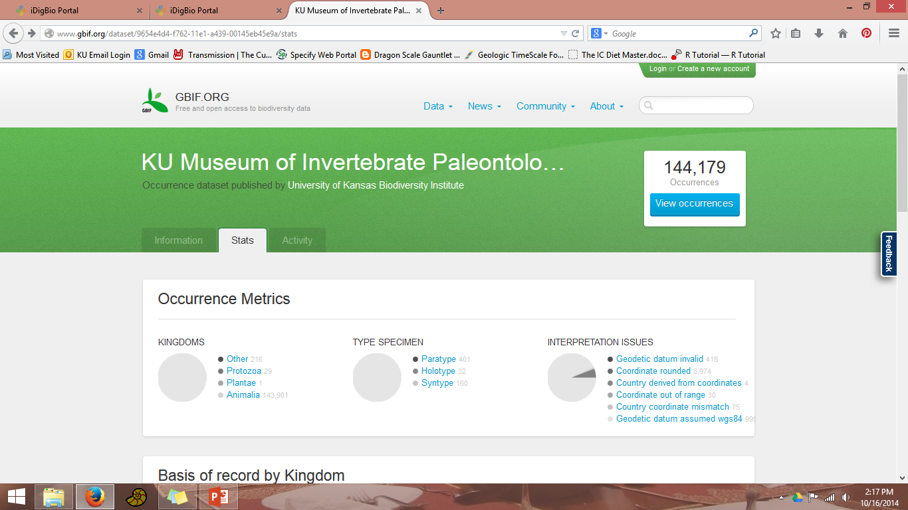
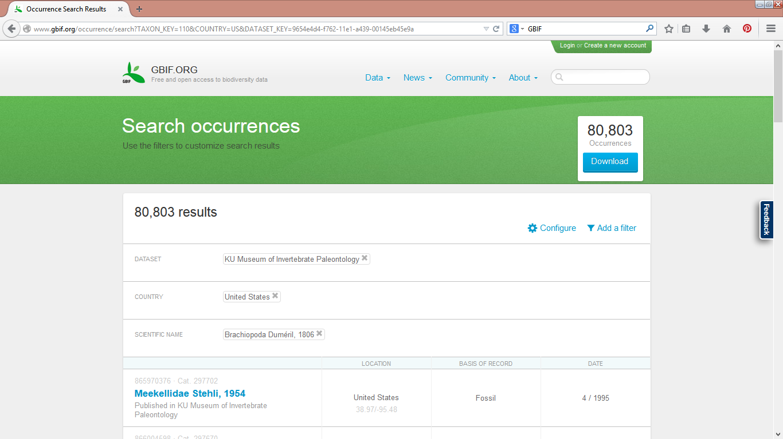
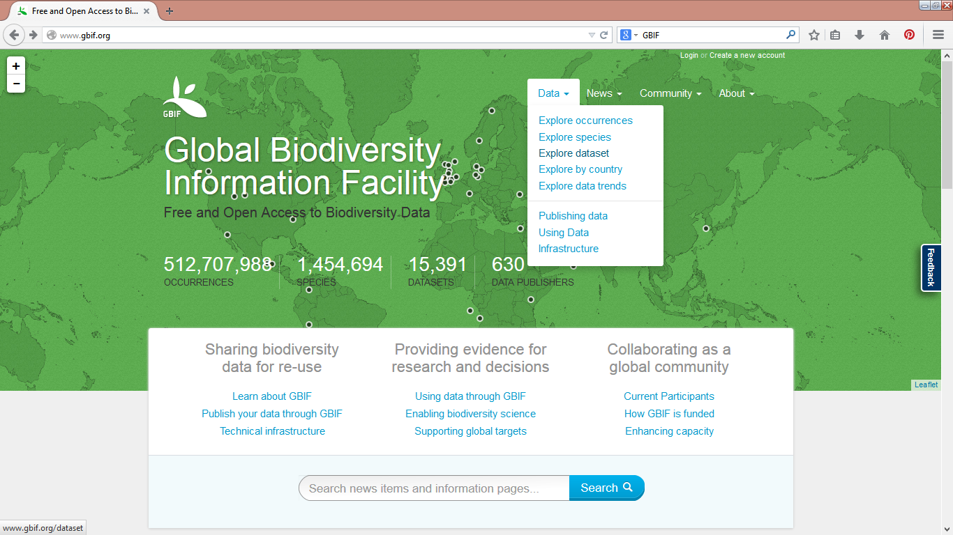
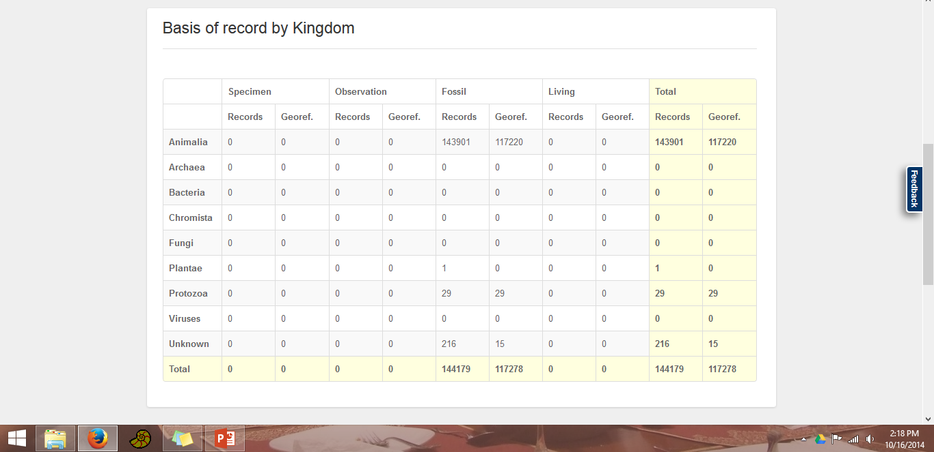
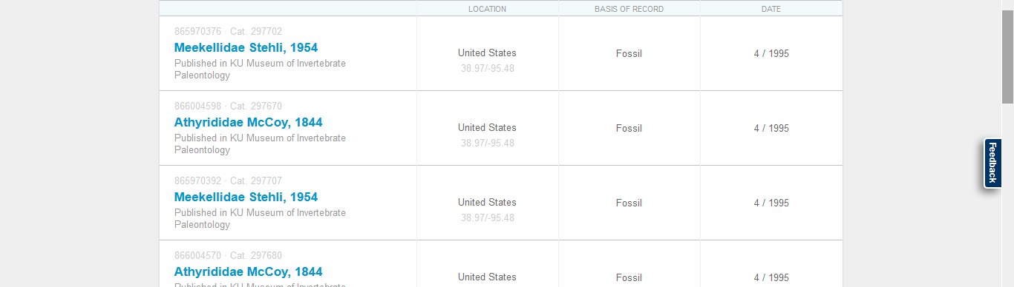
Notes:
Another data aggregator, lacks cool visualization capabilities, basically just a place to go download a data spreadsheet.

Slide 14
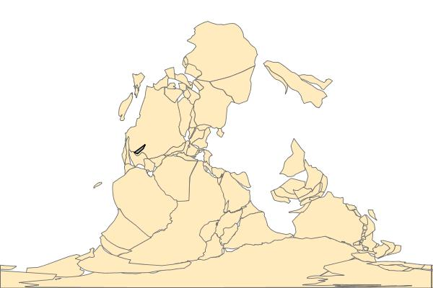
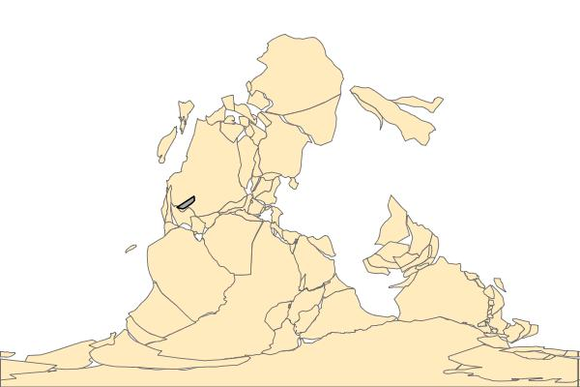
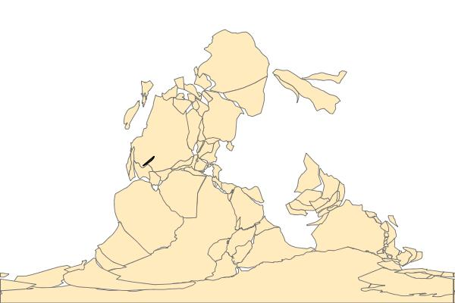
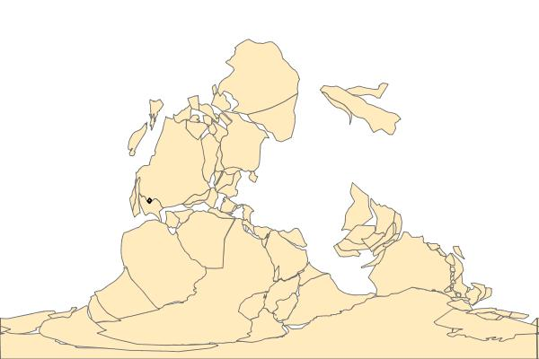
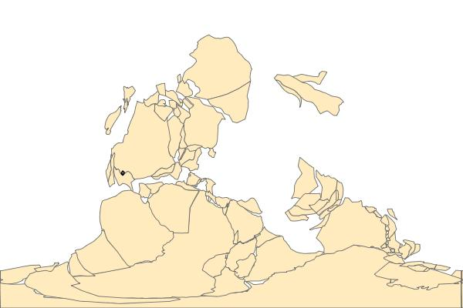
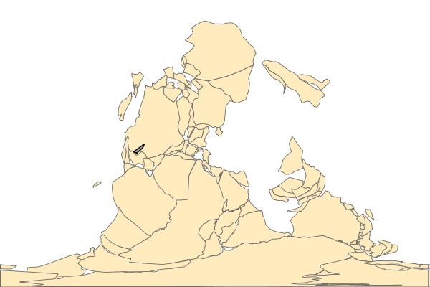
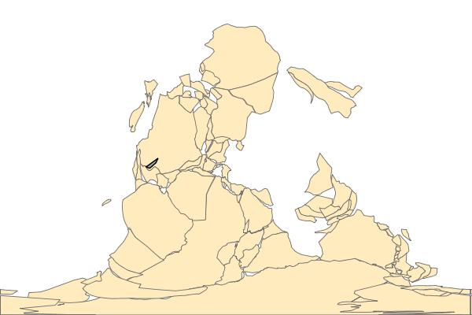
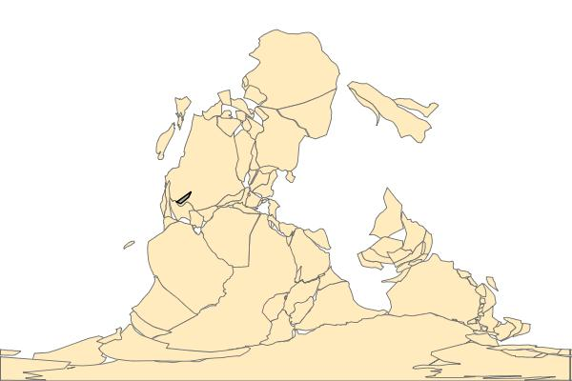
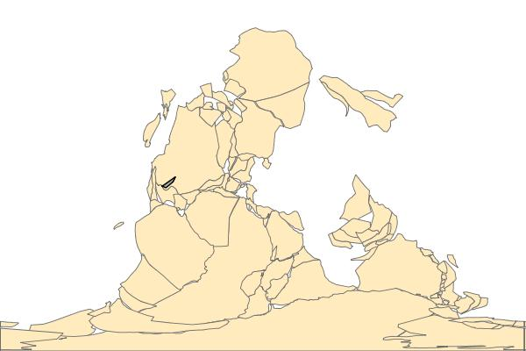
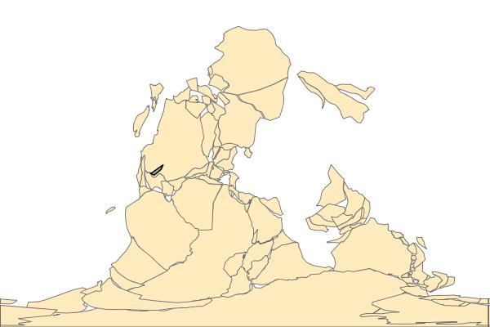
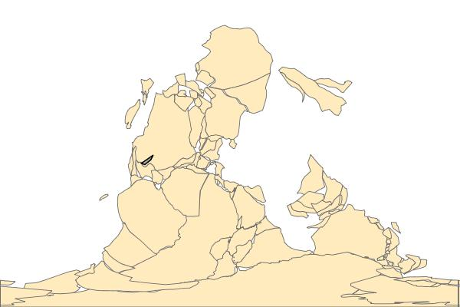

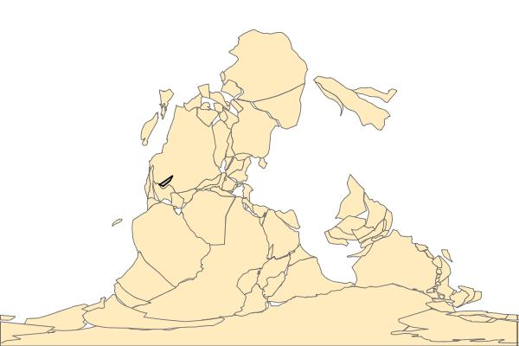





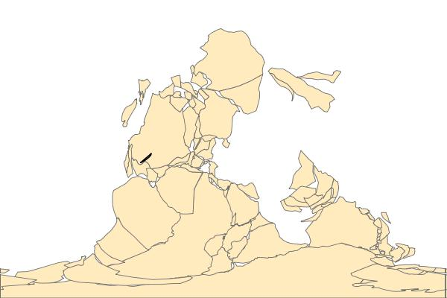
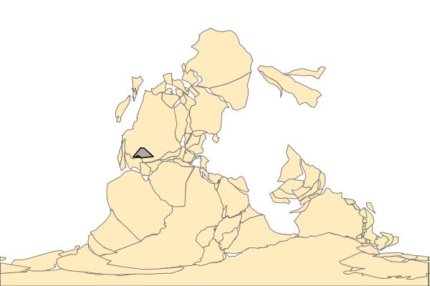

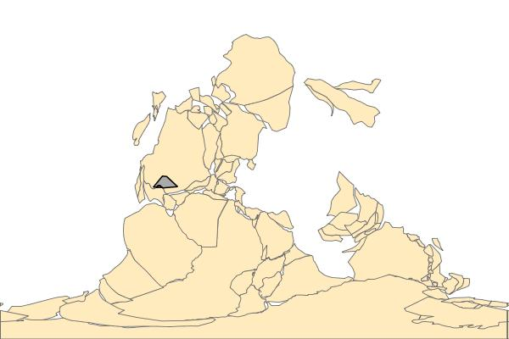

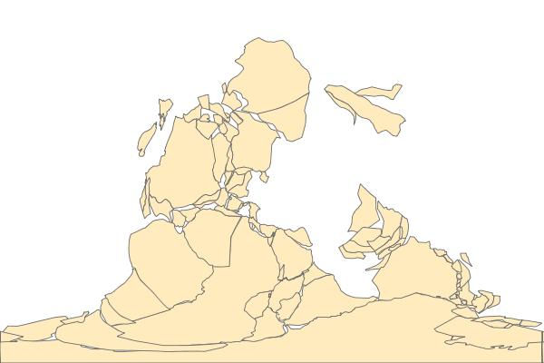
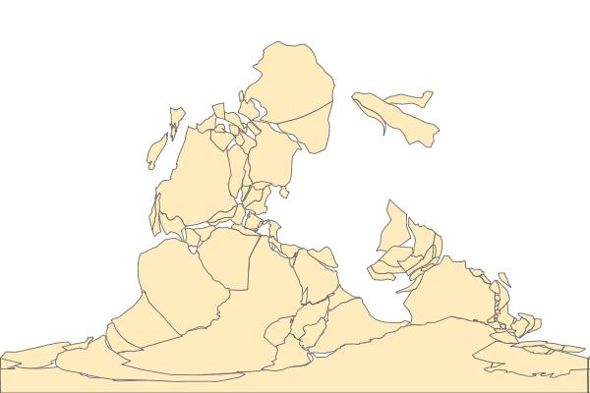



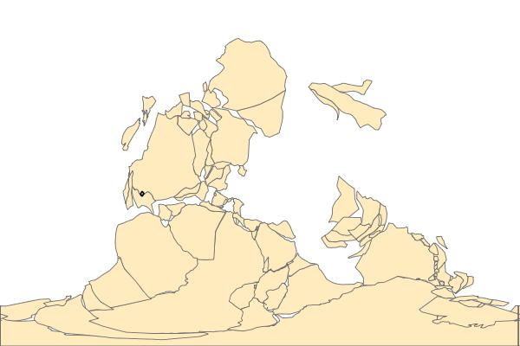
Hystriculina 315 Ma – 290 Ma
UTIG Plate Model, PaleoWeb for ArcMap, The Rothwell Group, L.P.
Notes:
To come back to the research aims I listed at the beginning of the talk, I am no working on analyzing the georeferenced brachiopod data to evaluate trends in range sizes of species through time to evaluate how rock volume and sea-level affected range size. I made this reconstruction in ArcMap using the new PaleoWeb add-in by Rothwell. This is an animation of reconstructions through the Pennsylvanian and early Permian. The gray box is the range of the genus Hystriculina, I chose a genus so it would be big enough to see at this scale. Ranges are calculated at the N. American stage level, so you’re looking at the Morrowan right now. The animation steps are 1 my, you you’ll see a few steps with the same polygon and then it will change when we cross the stage boundary. This preliminary analysis was done using only our data from KU but the final analysis will include data from the Yale Peabody museum. We can see that we have no specimens from the Atokan and that range size is greatest in the Desmoinesian. Eventually we will analyze these patterns at the species level and evaluate how common it is for species to begin small relative to their range size once they become established. Look at competitive range constrictions or investigate the impacts of biological invaders.

Slide 15




Acknowledgements
PIs: Jon Hendricks (SJSU), Alycia Stigall (OU), Ann Molineaux (UT), Derek Briggs (YPM)
Jim Beach (KU), Kendall Hauer (MUGM), Roger Portell (FLMNH), Brenda Hunda (CMC), Susan Butts (YPM), Liath Appelton (UT)
KU Student workers: Erin Saupe, Curtis Congreve, I. Wes Gapp, Sally Chang, Melissa Brooks, Melissa Sadir, Kenna Whitely, Elaheh Momtahan, Ellen Cummings
iDigBio Georeferencing Working Group, iDigBio Paleodigitization group
Theresa Miller, Andy Bentley and Specify staff
Funding sources: NSF DEB 1256993 and EF 1206757

