Slide 1
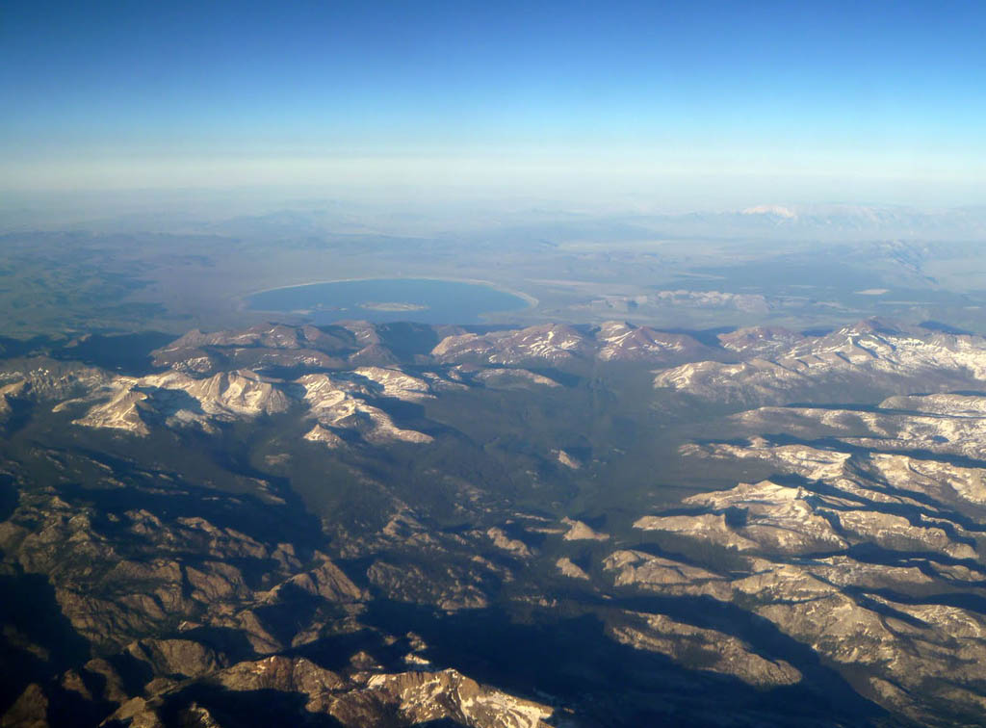


Preexisting Fractures and the Formation of an Iconic Landscape: Tuolumne Meadows, Yosemite National Park, USA
Richard A. Becker and Basil Tikoff – UW-Madison
Paul R. Riley – ExxonMobil
Neal R. Iverson – Iowa State University
Photo: Heidi Crosby
Notes:
Thank you for the introduction, Bruce, and thank you all coming out for this first talk of the meeting. I’d like to begin by acknowledging my collaborators in this research – my PhD advisor, Basil Tikoff, the student that preceded in this research, Paul Riley, and our collaborator at Iowa State, Neal Iverson, as well as our funding sources– the UW-Madison Dept of Geoscience and the Packard Foundation.

Slide 2
Tuolumne Meadows:
A Geomorphic Legacy of Volcanic
Explosions during the Cretaceous Period
Photo: Heidi Crosby
Notes:
Our central argument is this: Tuolumne Meadows, in Yosemite National Park – one of the most visited areas in one of the most visited National Parks in the United States – is the geomorphic legacy of explosive volcanic events that occurred during the Cretaceous Period. These explosive events fractured the surrounding rock in an unusual way – in a style of fracturing only recently recognized – and these profound fractures have enabled enhanced erosion of the Tuolumne Meadows area, thus explaining the area’s abnormally broad and open topography.

Slide 3
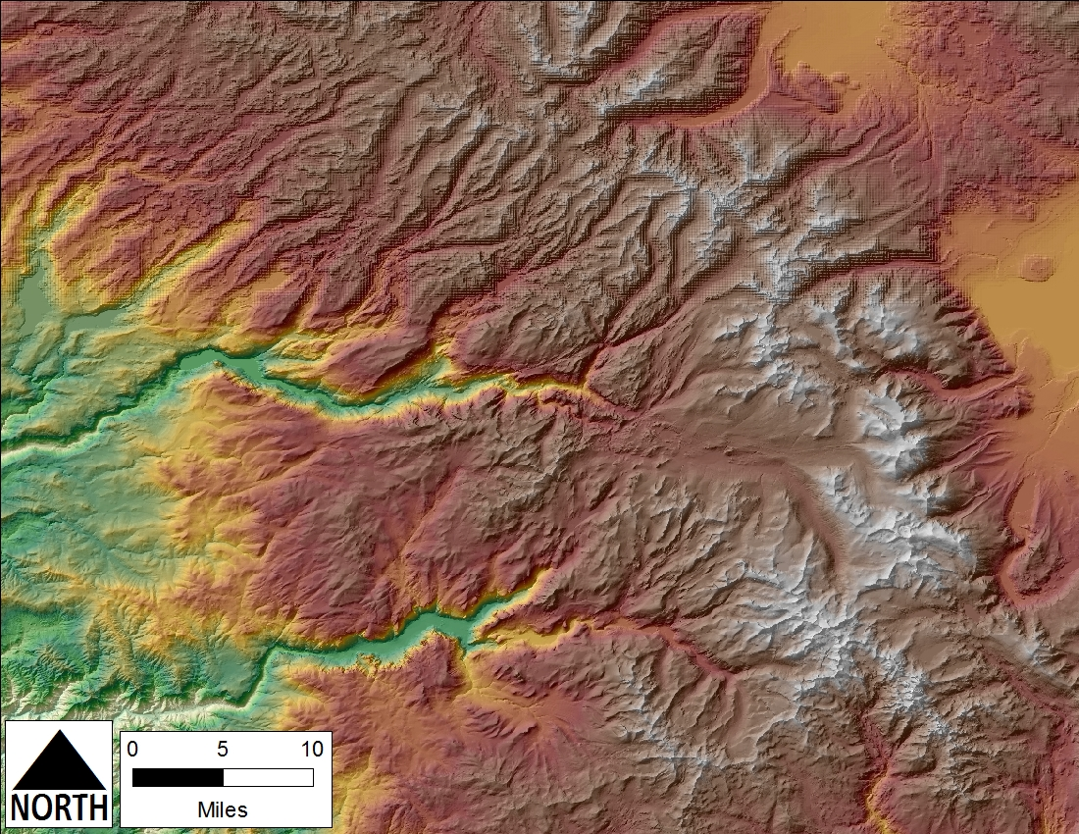
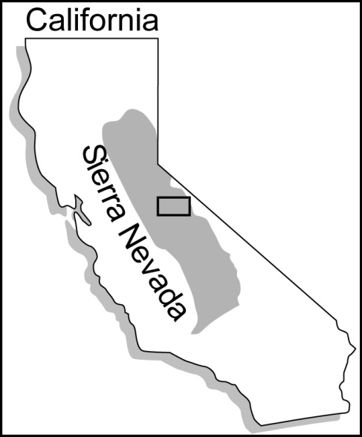
Topography
Notes:
Tuolumne Meadows is located in the eastern portion of Yosemite National Park, in the Sierra Nevada Mountains of California, and it is possibly the largest sub-alpine meadow in the Sierra Nevada. Relative to other areas near it, it is certainly anonymously broad and open. This broad and open topography is the result – we argue – of glacial erosion of Tabular Fracture Clusters – or

Slide 4
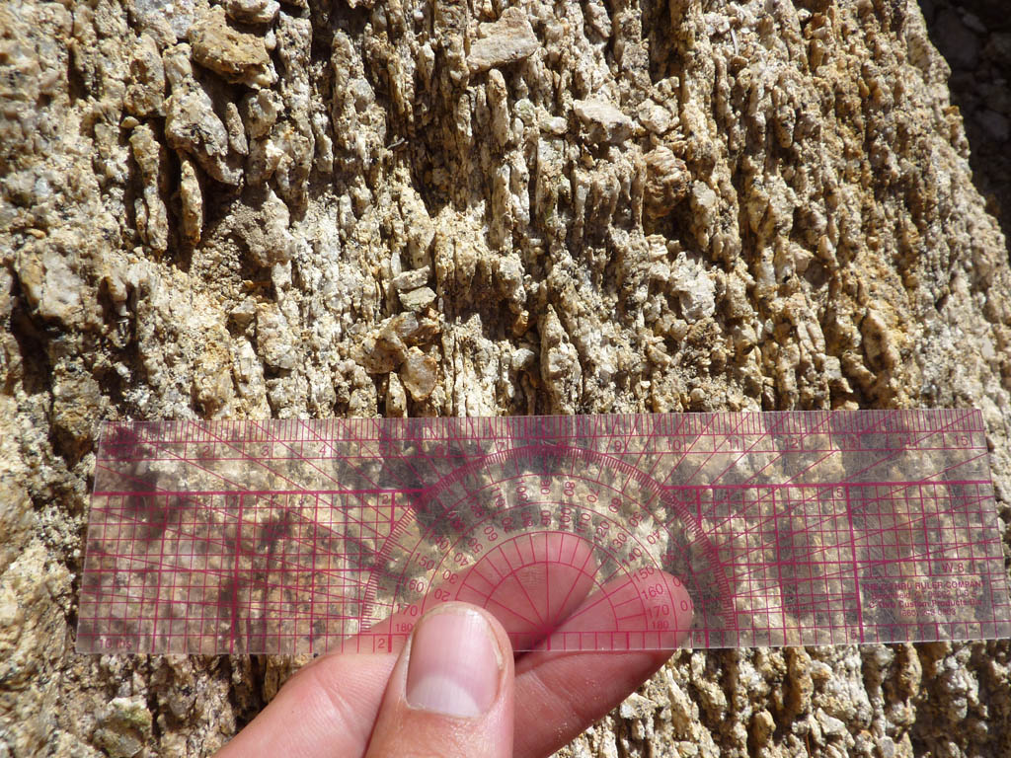
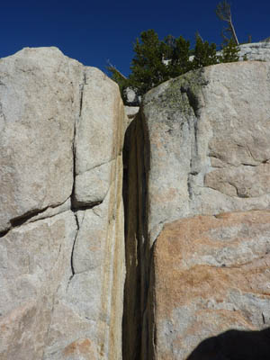
Tabular Fracture Clusters (TFCs)
“linear zones of sub-parallel, densely
spaced fractures, approximately 4-40 cm wide and 3-100 m long” --Riley and Tikoff, 2010, JSG
Notes:
TFCs – and if you’ve never heard of them before that is probably because they weren’t a part of the scientific lexicon until 2010, when two of my coauthors – Paul Riley and Basil Tikoff – described the Tuolumne Meadows outcrops in the Journal of Structural Geology. The term “Tabular Fracture Cluster” is strictly non-genetic, simply describing the features, which are “linear zones of sub-parallel, densely spaced fractures, approximately 4-40 cm wide and 3-100 m long.”

Slide 5
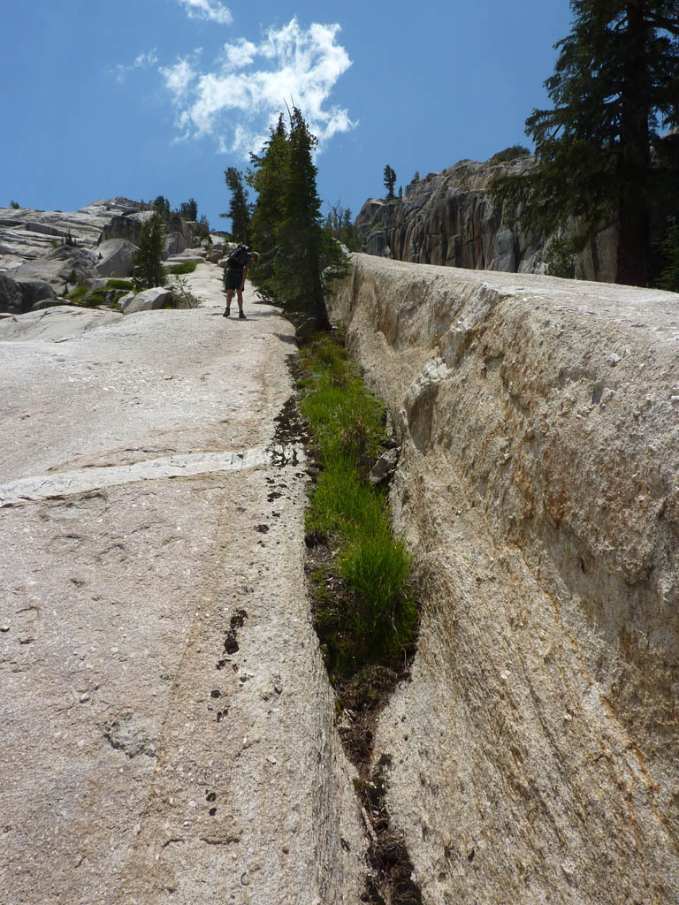
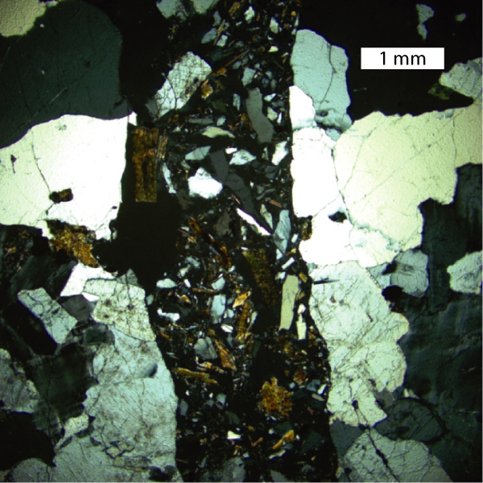
Clustered Extensional Fractures
Dike is fractured, but not offset,
by TFC.
Photomicrograph of a single fracture from a TFC; notice that mineral grains can be matched back up.
TFC
Notes:
The defining characteristic of TFCs is that they are clustered extensional fractures. This is unusual because while shear fractures and faults can be clustered, joints and other extensional fractures generally aren’t. Furthermore, linear-elastic theory, which successfully predicts the regular spacing of joints in a particular location and lithology, can’t explain why TFCs are clustered.

Slide 6
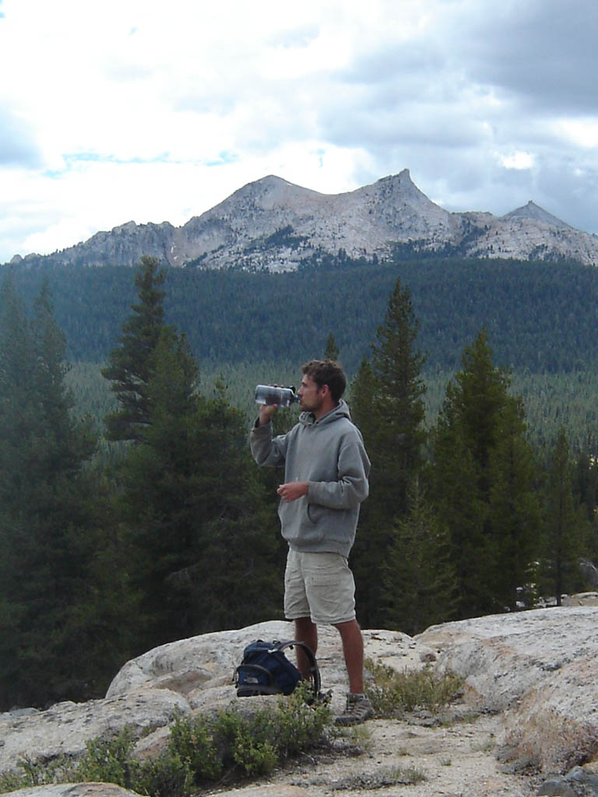
How Did the TFCs Form?
Paul Riley – PhD, 2010
“Fracture System Genesis and Organization in the Tuolumne Intrusive Suite, Sierra Nevada Batholith, CA”
Notes:
So, what are the TFCs and how did they form? That was Paul Riley’s PhD. As I preluded to at the beginning of my talk – Paul documented a connection between the TFCs and magmatic processes within the cooling Cretaceous pluton that underlies Tuolumne Meadows. Three pieces of evidence support this conclusion.

Slide 7
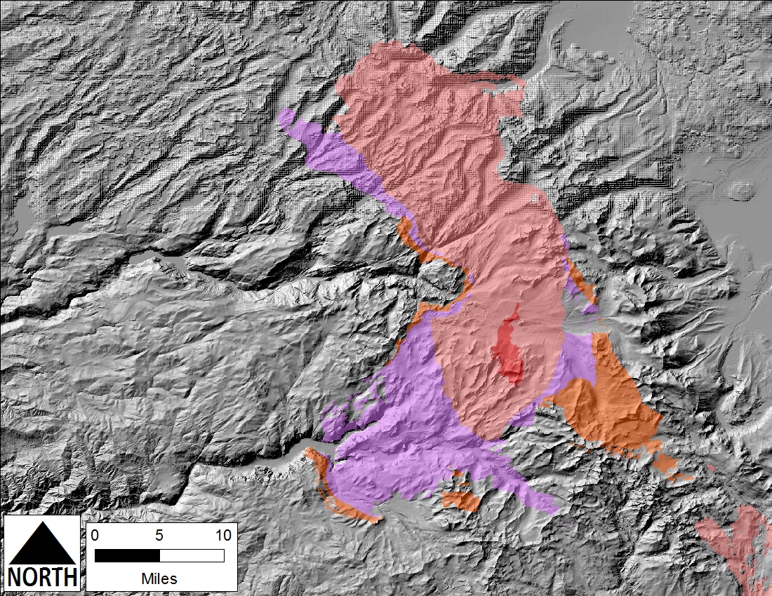
Four Plutons
Notes:
First, there is the map distribution of TFCs. There are four plutons in the Tuolumne Intrusive Suite and they are arranged in an approximately concentric pattern. The plutons become younger and more siliceous toward the middle. Calling the outermost pluton Pluton #1 and the innermost one Pluton #4, the TFCs are only found in Pluton #3, but they are most concentrated and best developed adjacent to Pluton #4. For those of you that know the area, Pluton #3 is the Cathedral Peak Granodiorite and Pluton #4 is the Johnson Granite Porphyry.

Slide 8
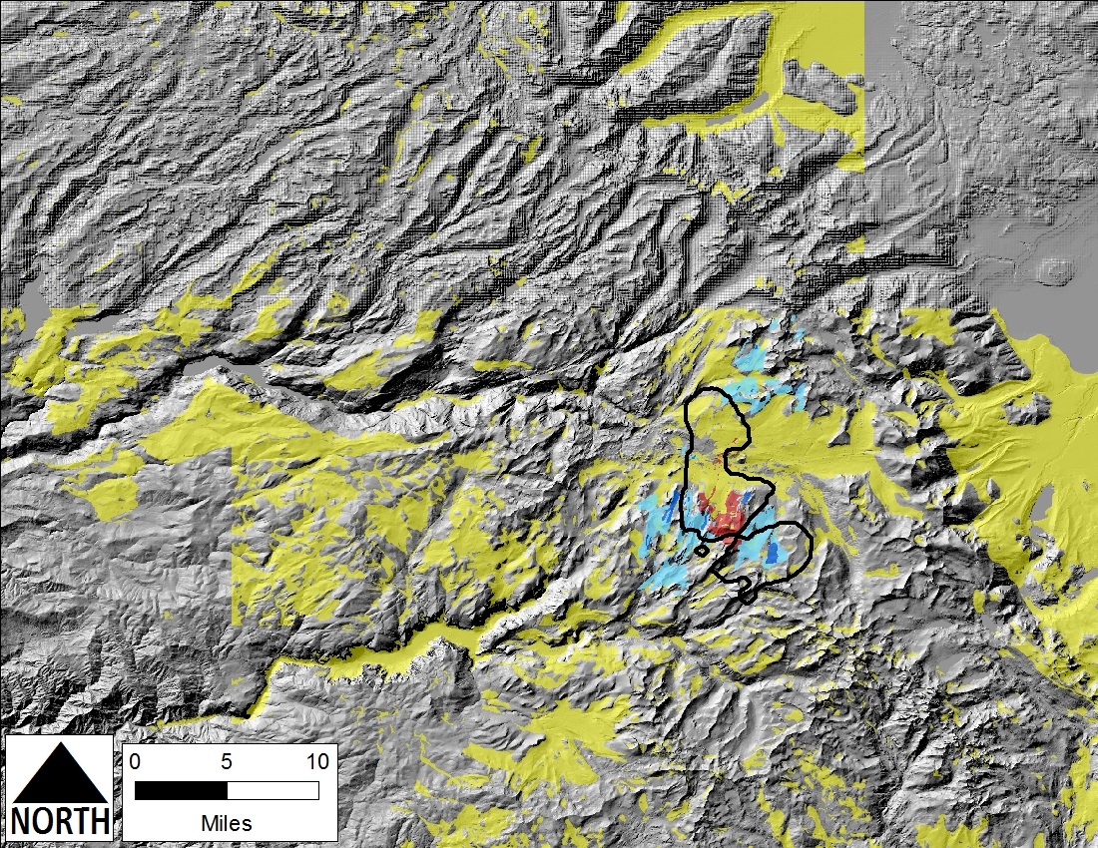
The TFCs are Adjacent to Pluton #4
Near-surface extent of pluton #4 from gravity study (Titus et al., 2005)
Light Blue = low density of TFCs
Dark Blue = high density of TFCs
Notes:
Here are the data that supports that statement. All the plutons, except Pluton #4, which is in red, have been removed from the image. The heavy black line outlines the near-surface extent of Pluton #4, as determined by a gravity study. In dark blue are the areas where the distance between adjacent TFCs (perpendicular to their strike) is 2 m or less. The light blue areas are where the distance is 2-5 m. The yellow represents area of surficial cover, so there may – or may not – be TFCs under that region. So, there is a clear connection between the TFCs and Pluton #4.

Slide 9
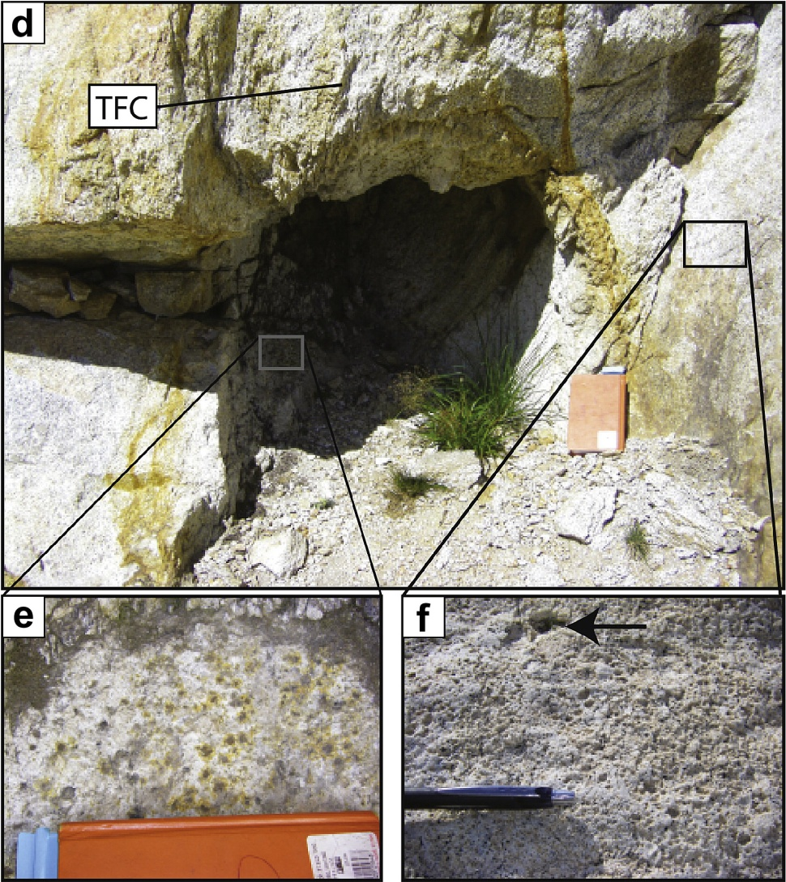
The TFCs are Linked with
Volatile Concentrations
d- A TFC emanating from a ‘spherical alteration zone’
f- Cathedral Peak granodiorite (pluton #3) adjacent to spherical alteration zones displays a pock-marked weathering appearance, which is different than elsewhere in the pluton. Arrow points to hole lined with epidote.
e- Close-up of the ‘bleached’ interior of the spherical alteration zone, with Fe stains haloing the mafic minerals
Riley and Tikoff, 2010, J of SG, Fig. 7
Notes:
Second, at the outcrop scale, there are clear linkages between the TFCs and fluid-rich structures within the pluton – such as miarolitic cavities and these “spherical alteration structures.” Here, a TFC can be seen emanating fully formed out of a spherical alteration zone. So, there is a clear connection between fluids emanating out of Pluton #4 as it cooled.

Slide 10
Clustering = Dynamic Fracturing
Notes:
So, abundant field evidence links the formation of the TFCs to volatiles released from the 85.4 Ma Johnson Granite Porphyry as it was cooling – but how do we explain the fact that the TFCs consist of clustered extensional fractures? As I said, linear elastic fracture mechanics fails to explain them, but dynamic fracturing does. In dynamic fracturing, the accumulation of strain is so rapid that the material inertia becomes important. In these cases, strain is accumulating so rapidly that there isn’t time for a single fracture to propagate through the material and instead a bifurcating fracture network develops. This phenomenon has been observed in laboratory experiments and documented in the field in association with bolide impacts.
The field evidence links the TFCs with the release of magmatic fluids from the Johnson Granite Porphyry; the clustered extensional fractures within a single TFC tells us that these releases were explosive in nature.

Slide 11
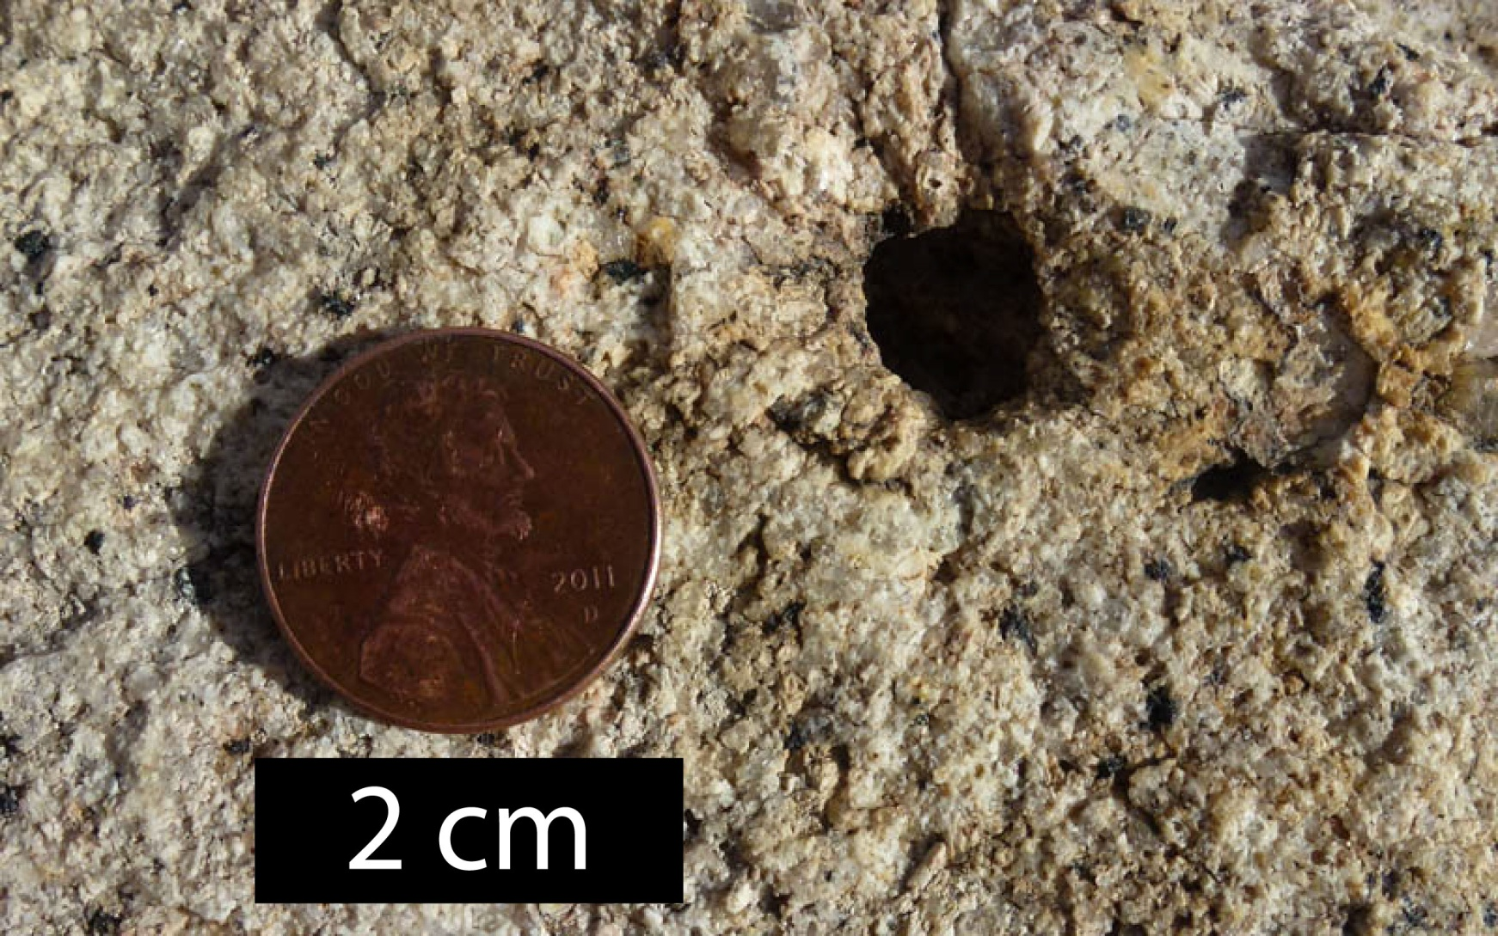
Miarolitic cavities indicate the presence of a separate fluid phase.
“The appearance of this separate fluid phase would quickly increase the volume of the system to a size beyond which the wall and roof rocks could no longer adjust without fracturing…”
(Bateman, 1992, p. 144)
Notes:
This interpretation for the origin of the TFCs is consistent with previous petrological investigations conducted in the Tuolumne Intrusive Suite (the formal name for the series of four plutons). Bateman (1992) interpreted that the first three units were undersaturated with water while Pluton #4 was oversaturated – on the basis of Pluton #4’s fine-grain size and miarolitic cavities. He writes, “the appearance of this separate fluid phase would quickly increase the volume of the system to a size beyond which the wall and roof rocks could no longer adjust without fracturing.”

Slide 12
Miarolitic cavities indicate the presence of a separate fluid phase.
“Eruption and solidification of the Johnson Granite Porphyry was [the] final stage of emplacement.”
(Bateman, 1992, p. 70)
Notes:
He concludes, “eruption of Pluton #4 was it’s final stage of emplacement.” The difference between the magmas being under/over saturated with volatiles explains why TFCs are only observed around the margins of Pluton #4.

Slide 13
Geomorphic Influence of the TFCs?
Notes:
That is the background, now we come to my PhD research. What influence have these things had on the geomorphology of the Tuolumne Meadows area? To answer that question, it would be nice if there was a second Tuolumne Meadows, one identical to the real one in all ways, except lacking in TFCs.

Slide 14
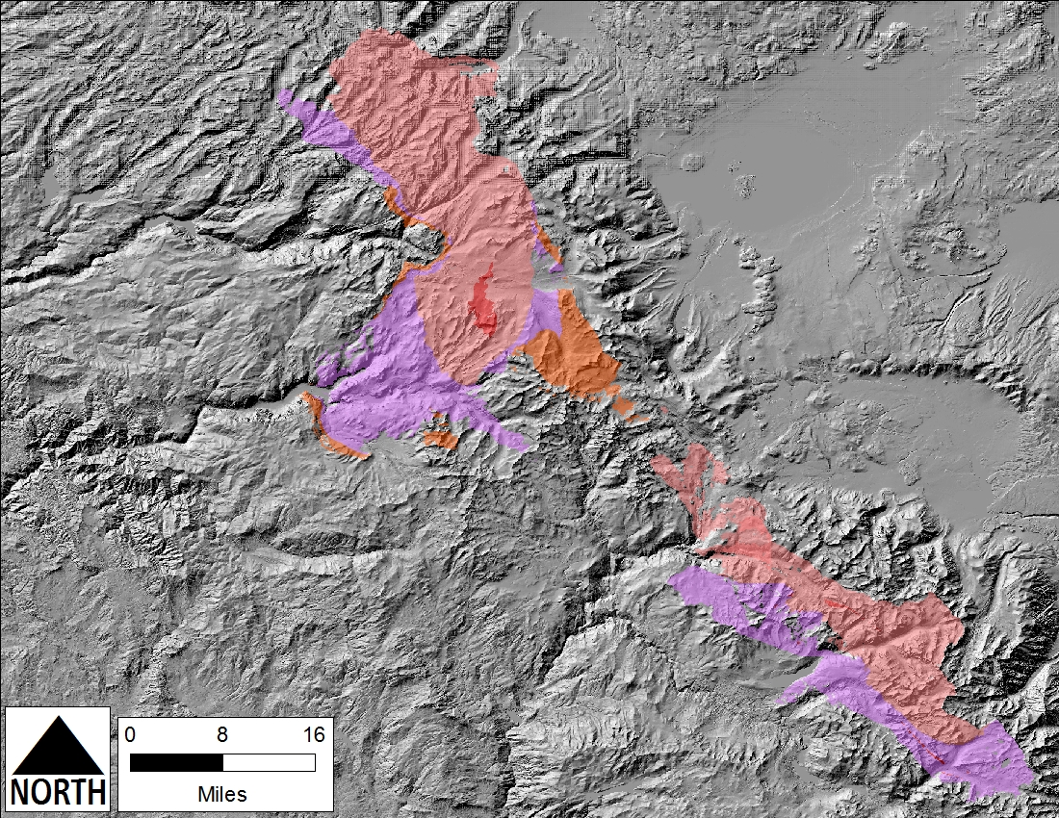
Notes:
We are fortunate, this is an analogy that the Sierra Nevada (USA) has provided us with. 70 km to the SE of Tuolumne Meadows there is another series of Cretaceous plutons that are the same composition and age – but without TFCs – that provides a natural experiment for us.

Slide 15
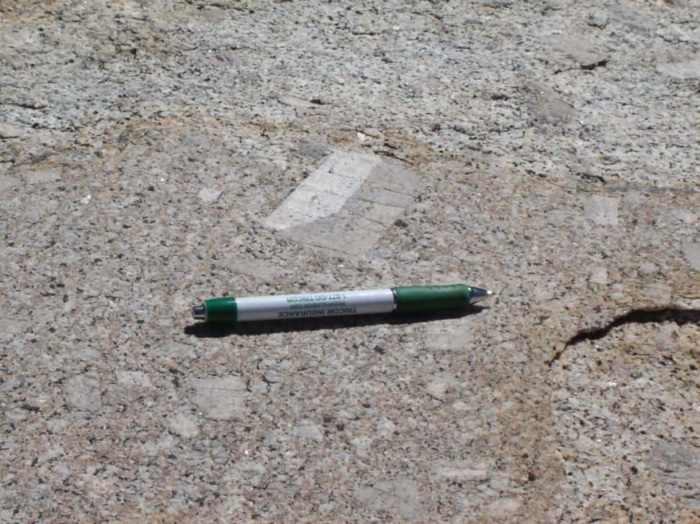
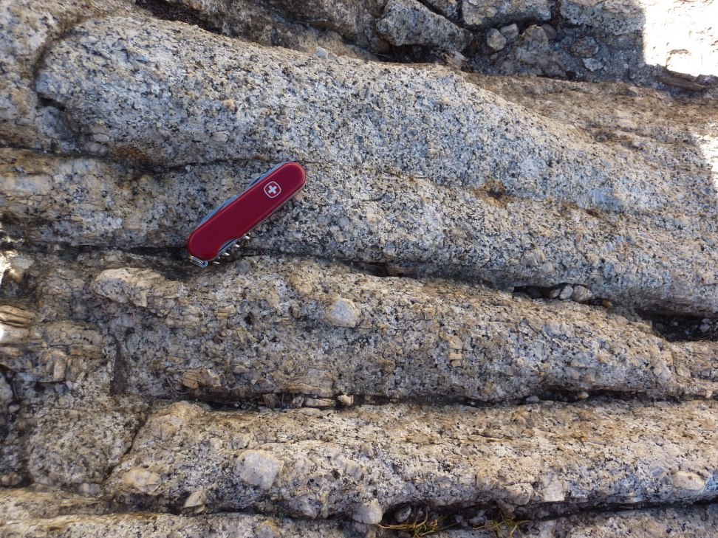
Identical Bedrock
Cathedral Peak Granodiorite
Pluton #3
Mono Creek Granite
Notes:
Other than a few percent difference in the average concentration of plagioclase, the two plutons are virtually identical. Both contain these large feldspar megacrysts that the French refer to has “horse’s teeth” – they are “horse teeth granites.”

Slide 16
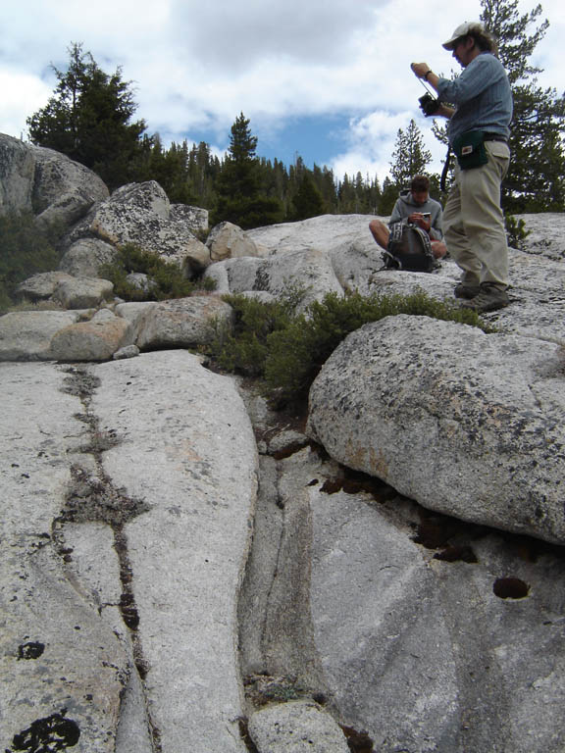
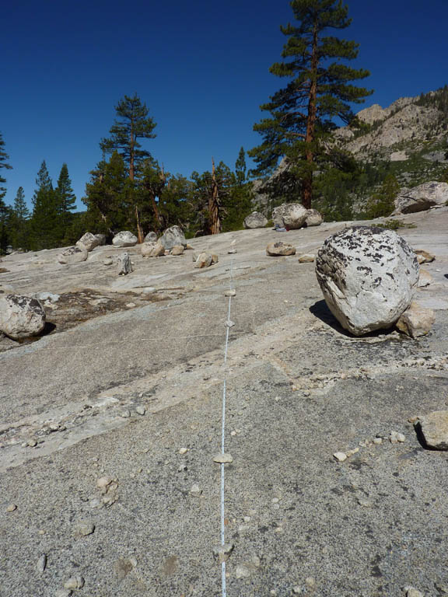
But there are only a few TFCs in the
Mono Recesses
There are several hundred TFCs in Tuolumne Meadows.
I have found only 2 TFCs in the Mono Recesses.
Notes:
Critical, there are almost no TFCs in the Mono Recesses, that is the field area to the south. In 25-30 days of fieldwork there, I have seen 2 TFCs.

Slide 17
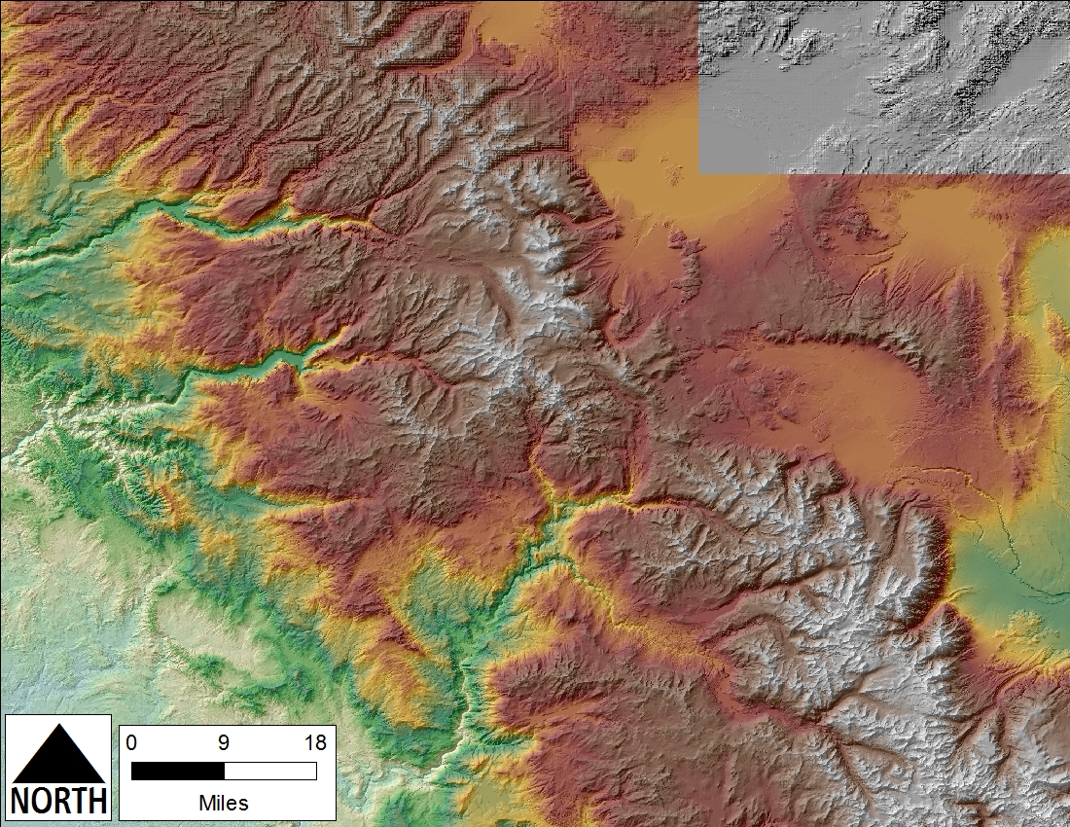
Notes:
Here are the two landscapes; note their differences. The southern, TFC-lacking, landscape has greater relief and is a collection of classic U-shaped glaciated valleys. In contrast, Tuolumne Meadows – in the north – is anomalously broad and open. Therefore, we conclude this breadth and openness to the landscape is due to the presence of TFCs in the Tuolumne Meadows area.

Slide 18
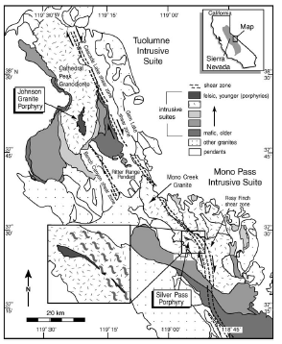
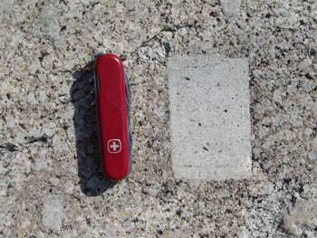

Bedrock Twins,
Titus et al., 2005, Fig. 1
Notes:
This led Basil to quip that the two landscapes are Bedrock Twins

Slide 19
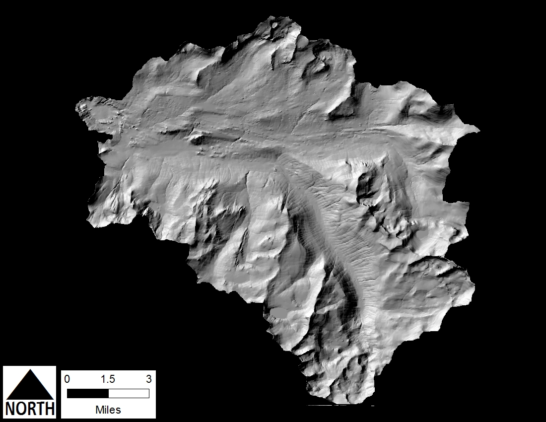
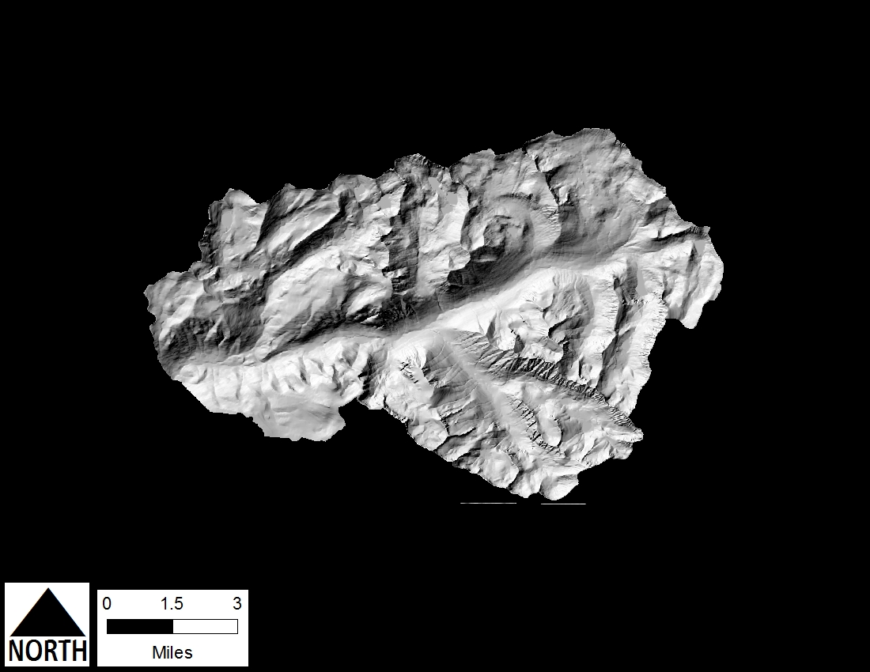
Geomorphic Cousins
Notes:
and Geomorphic Cousins. They are similar – but have been shaped by glaciation – but strikingly different in relief and slopes.

Slide 20
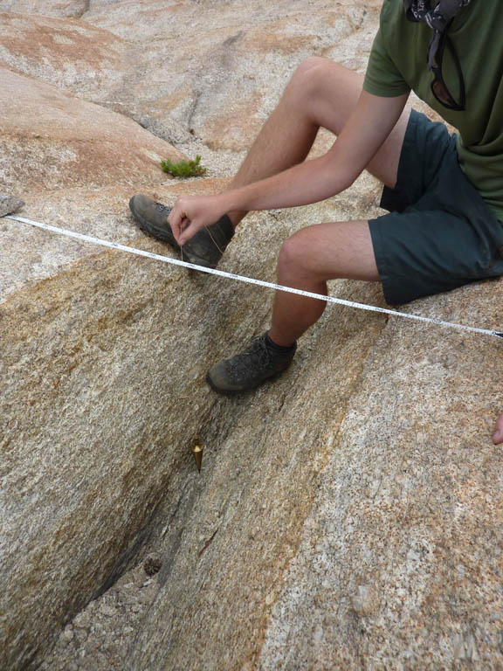
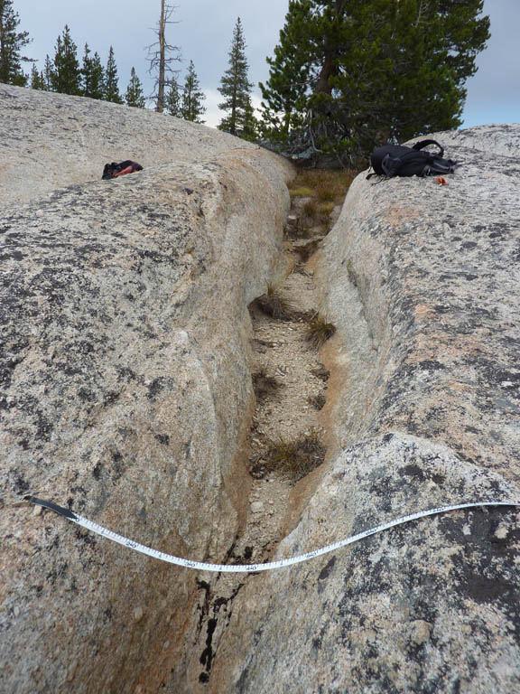
If TFCs are Isolated…
Ice-Flow Parallel
Ice-Flow Perpendicular
Notes:
If TFCs are isolated, there is little geomorphic impact, regardless of their orientation relative to ice flow.

Slide 21
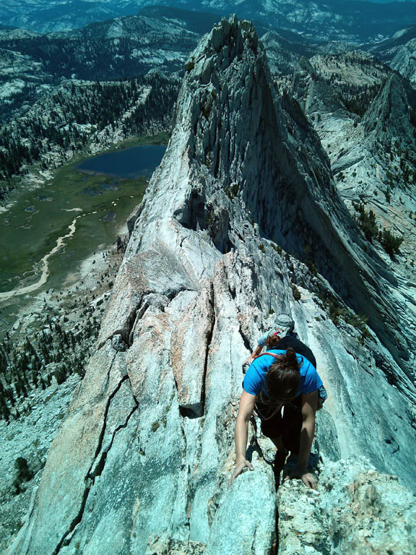
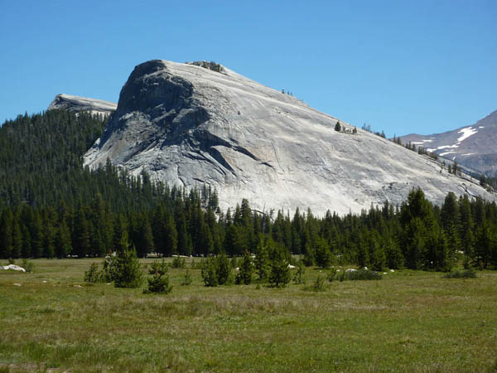
Scattered TFC Concentrations…
Ice-Flow Perpendicular
Ice-Flow Parallel
Notes:
If there are clusters of TFCs – the individual fractures within TFCs are clustered, but the TFCs themselves may also be clustered – then the more fractured areas will be more rapidly eroded. If ice was flowing parallel to the TFCs, then a sharp ridge will be left behind. Such an example is Matthes Crest, just south of Tuolumne Meadows. Alternatively, if these TFC concentrations were oriented perpendicular to ice flow, then a roche moutonnée, such as Lembert Dome, will be formed. All the best climbing in the Tuolumne Meadows area – Matthes Crest, Lembert Dome, and Cathedral Peak – owes their origin to the enhanced erosion of TFC-laden areas.

Slide 22
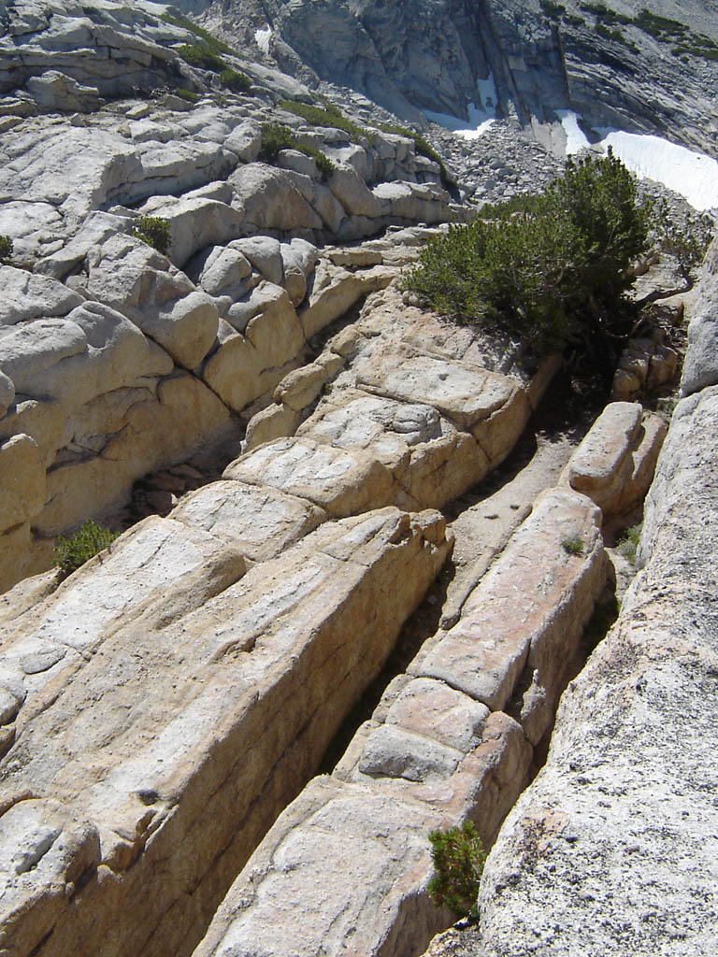
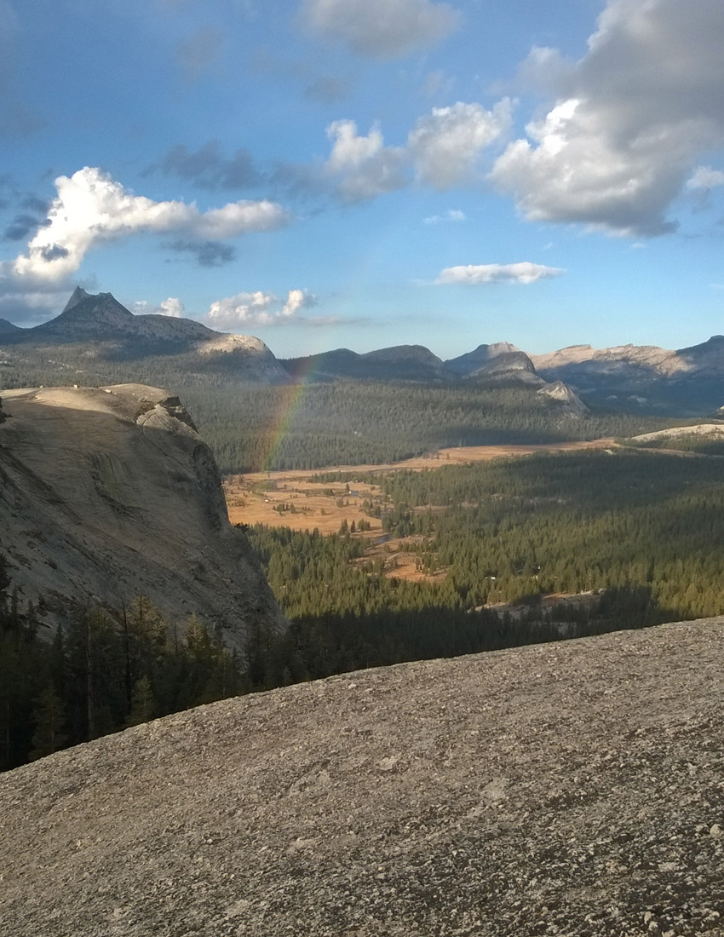
If TFCs are Concentrated…
Ice-Flow Parallel
Ice-Flow Perpendicular
Notes:
If there is uniformly a lot of fracturing and the ice was flowing parallel to the TFCs, the TFCs themselves will be eroded out, but the intervening panels of rock will be left behind, forming a series of bedrock fins that render travel perpendicular to the TFCs arduous. Lastly, if there was a concentration of TFCs perpendicular to ice flow, then the intervening panels of rock were blown out by glaciation along with the TFCs, forming a broad and open area, such as Tuolumne Meadows.

Slide 23
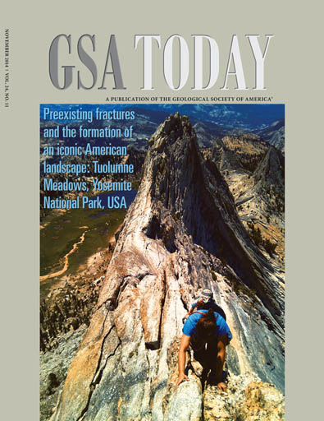
Next month’s issue of GSA Today
Notes:
More details will be coming to a mailbox near you soon! (November 2014 issue of GSA Today).

Slide 24
Conclusions
1- TFCs are a relatively unusual style of fracturing that was only recently recognized.
2- The TFCs were formed by explosive volcanic events ca. 85 Ma.
3- Glaciation has preferential eroded those highly fractured zones.
4- Thus, the Tuolumne Meadows landscape is an echo those ancient events.

Slide 25
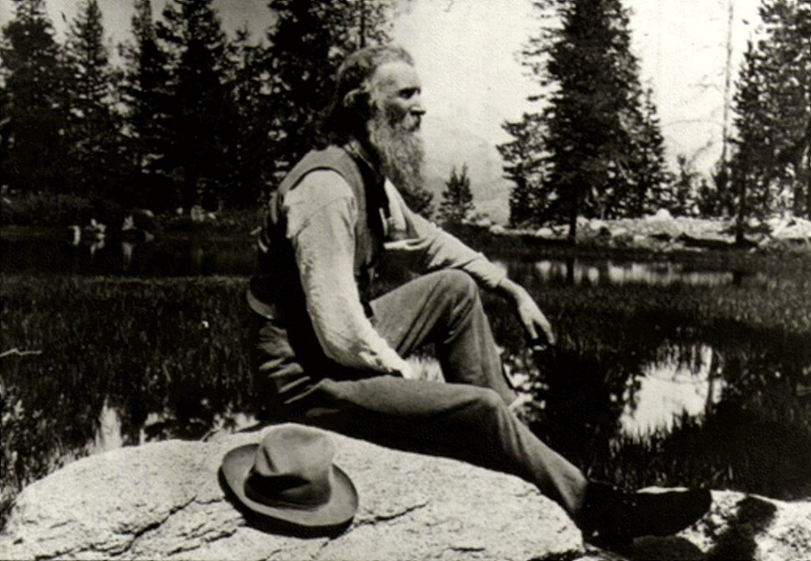
A Few Final Words by Another Person from UW-Madison…
Sept 9th
“The camp stuff is now packed on the horses… Away we go, down through the pines, leaving the lovely lawn where we have camped so long…”
NPS/GLBA Slide Collection
“The most telling thing learned in these mountain excursions is the influence of cleavage joints on the features sculptured from the general mass of the range.”

