Slide 1
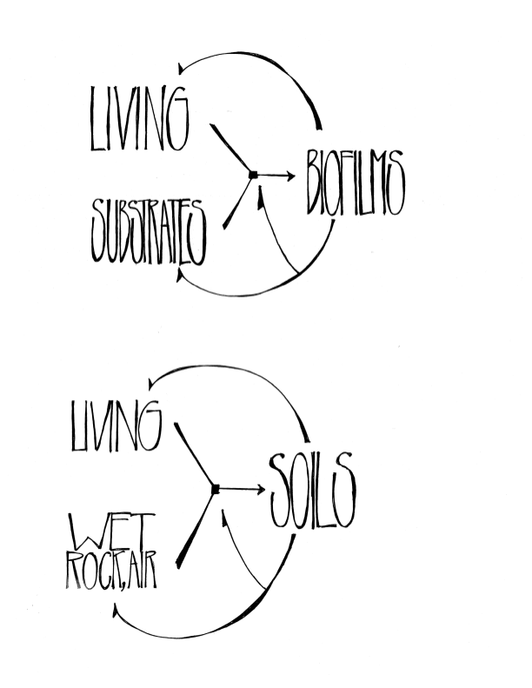
Biofilms Everywhere:
AN AUTOREGENERATIVE LOOP

Slide 2
Biofilms EverywherE
Living Consortia, Slime-on-Substrates and the Circumplanetary Climate Consortium
Kurt Andrew Grimm
Department of Earth Ocean & Atmospheric Sciences
University of British Columbia
KingFisher ResearcH — R/V TrinitySeas
kgrimm@eos.ubc.ca—drkurtgrimm.com

Slide 3
WORDS OF INTRODUCTION
Earth, Life and Environment: An evidence-based synthesis that is simple, predictive and falsifiable ought to be of interest.
Gaia Theory is imprecise, indeterminate and is now perhaps little more than a useful yet problematic metaphor, that has been largely subsumed within Earth System Science (box models).
Informed Intuition:
  Earth’s Climasphere is somehow, some kind of a very big ecosystem (?).
  Simplicity exists at the core of very much intricacy; we hunger to understand and describe it.
Biofilms Everywhere:
  The phenomena of LIVING upon SUBSTRATES produces and perpetuates BIOFILMS, that impact upon and coevolve with Living and Substrates.
  This simple autoregenerative dynamic — described herein — has operated from deeptime to present and occurs from molecular to circumplanetary scales.
  Contrasting The Climate Consortium (this paper) with chemostatic norms.

Slide 4
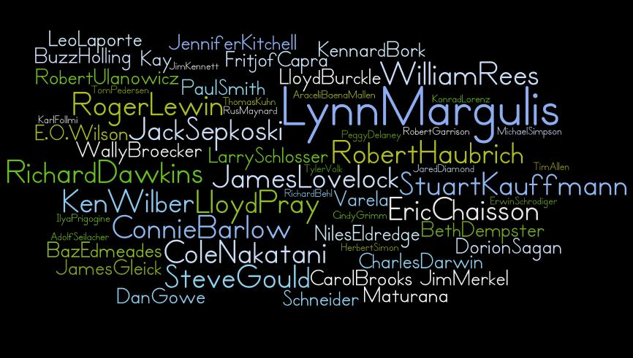

Slide 5
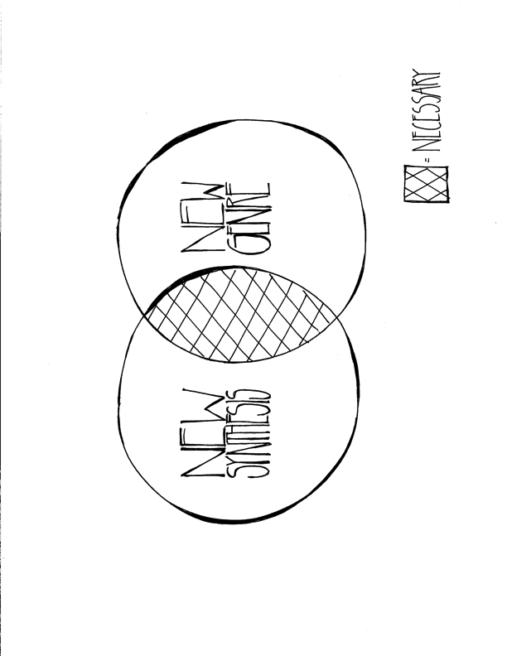

Slide 6
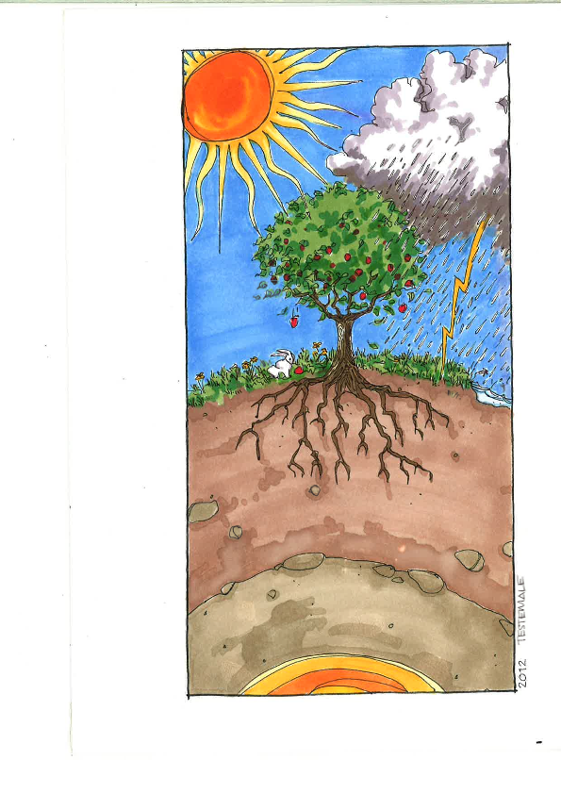
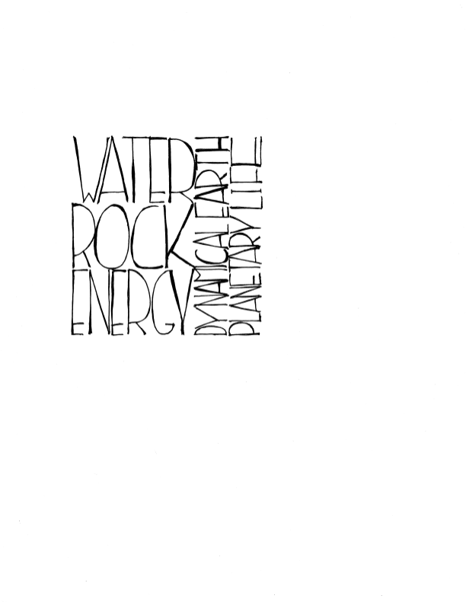

Slide 7
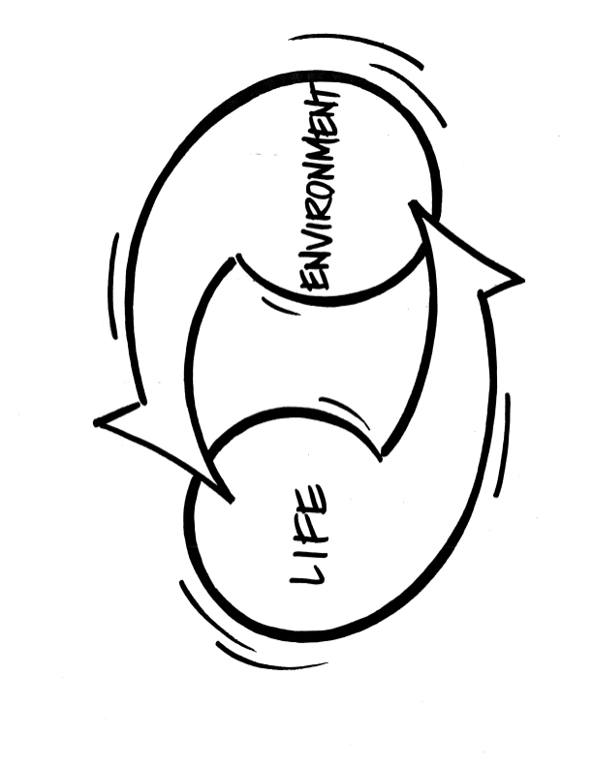
©Kurt Andrew Grimm
drkurtgrimm.com

Slide 8
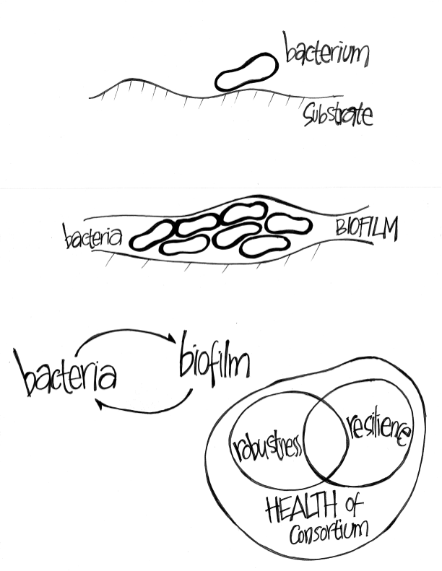
©Kurt Andrew Grimm
drkurtgrimm.com

Slide 9
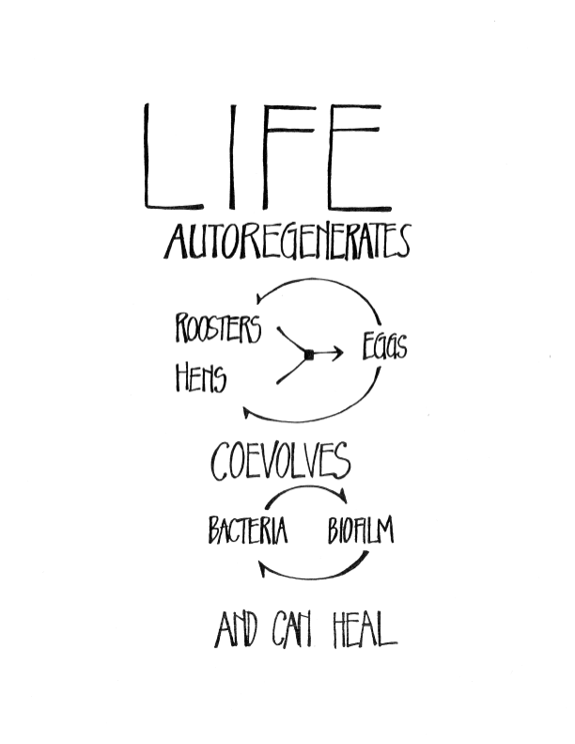

Slide 10
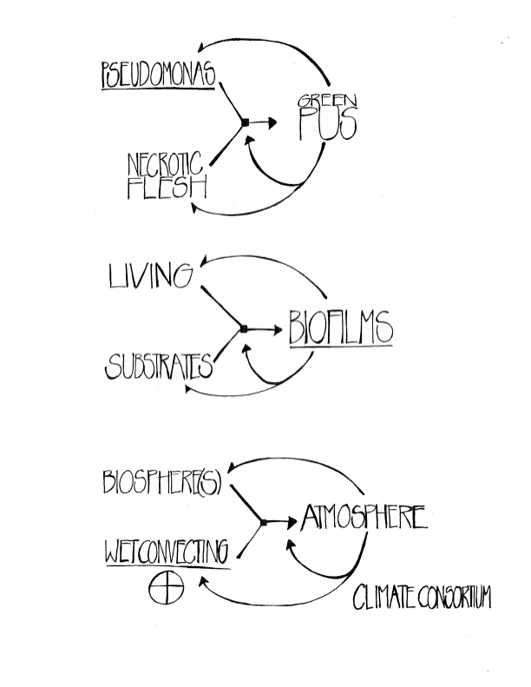

Slide 11
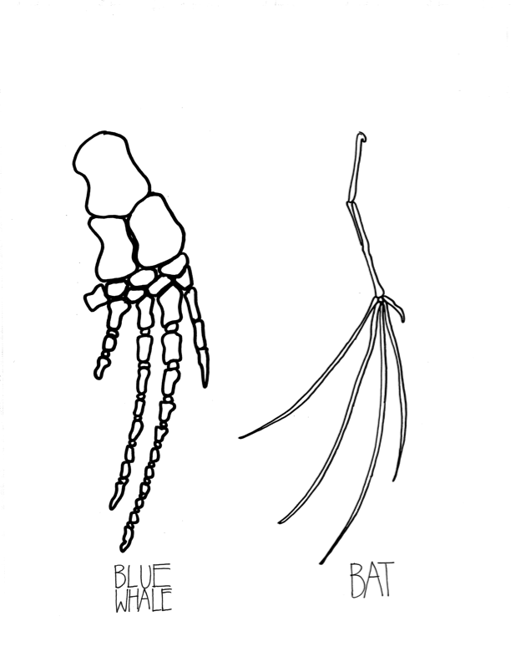
Looking for Causal and DeepTime
Unity in the Natural World…
Via
FUNCTIONAL
Homologies ?

Slide 12
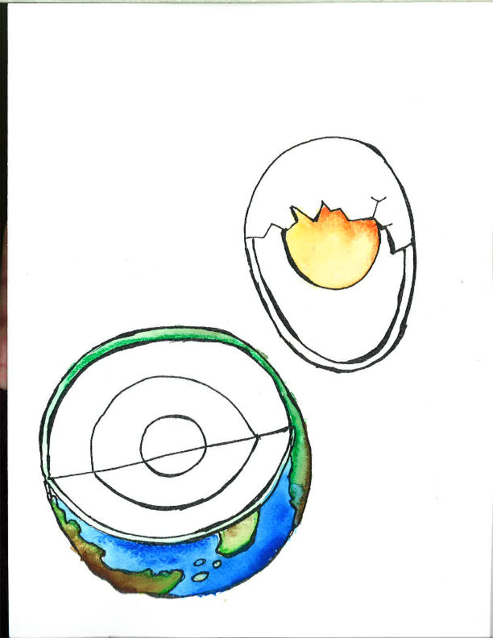
Very quickly, zip thru some art...
Earth is Layered…

Slide 13
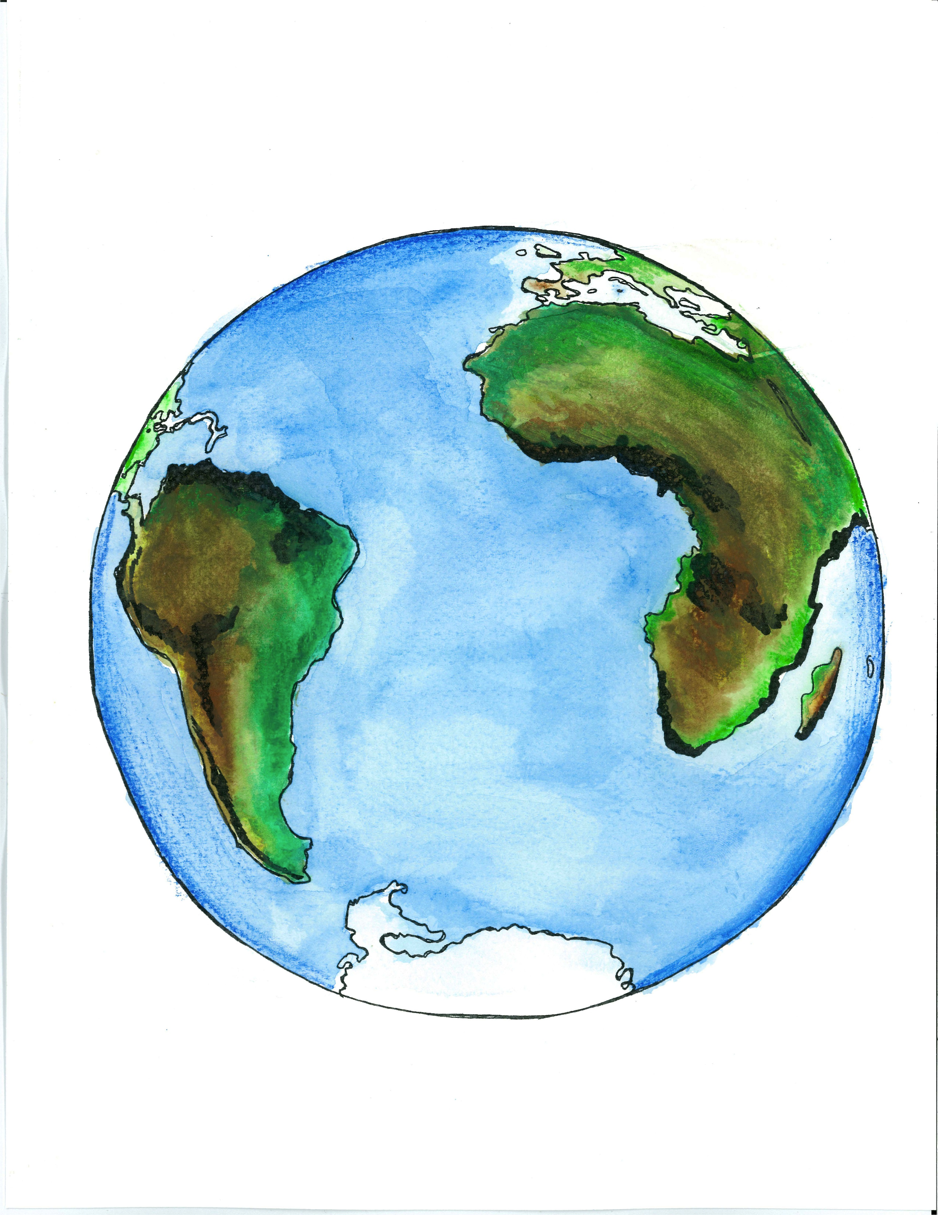
©Kurt Andrew Grimm
drkurtgrimm.com
WET…

Slide 14
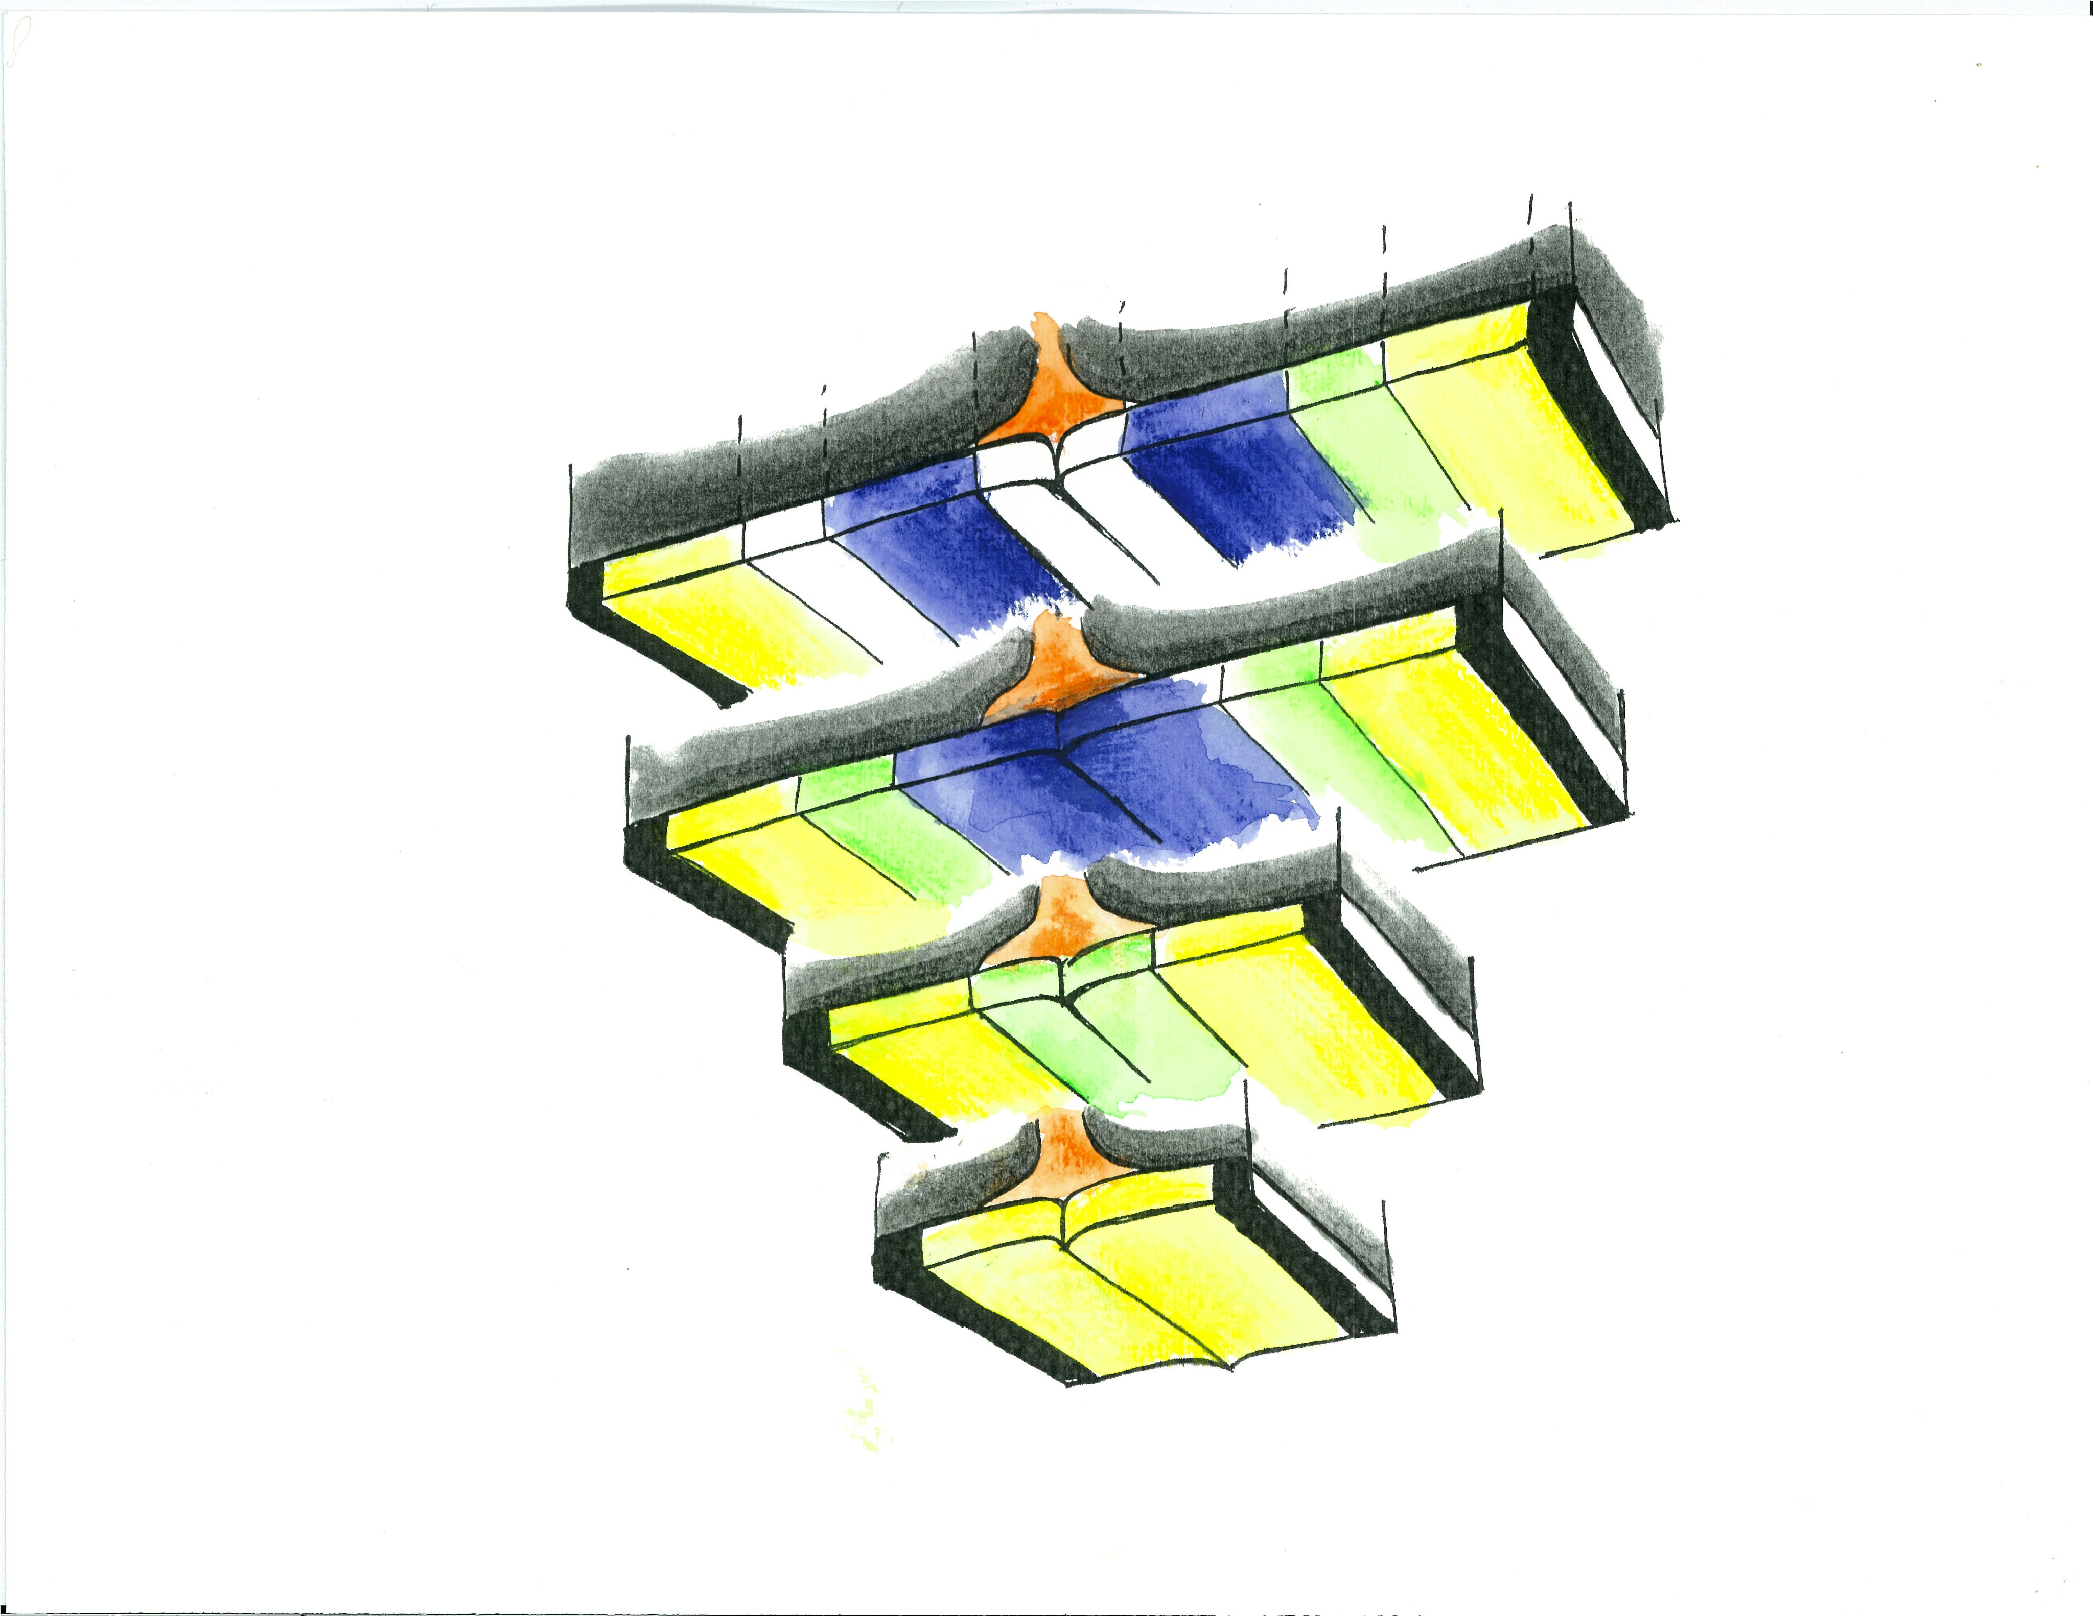
On the move…
©Kurt Andrew Grimm
drkurtgrimm.com
Dynamic….
And DynamicAL….
textbox

Slide 15
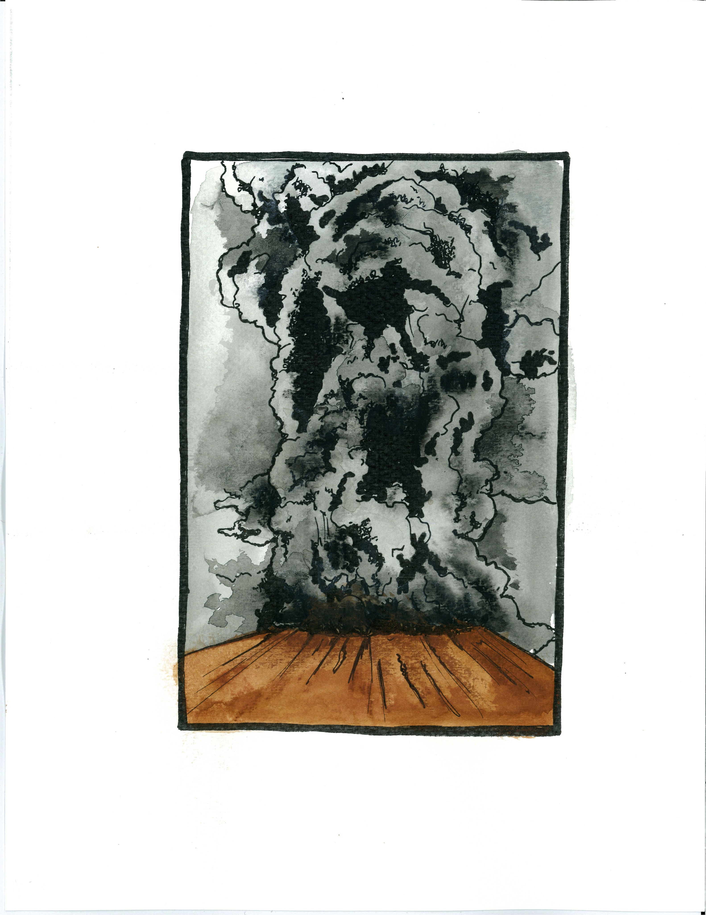
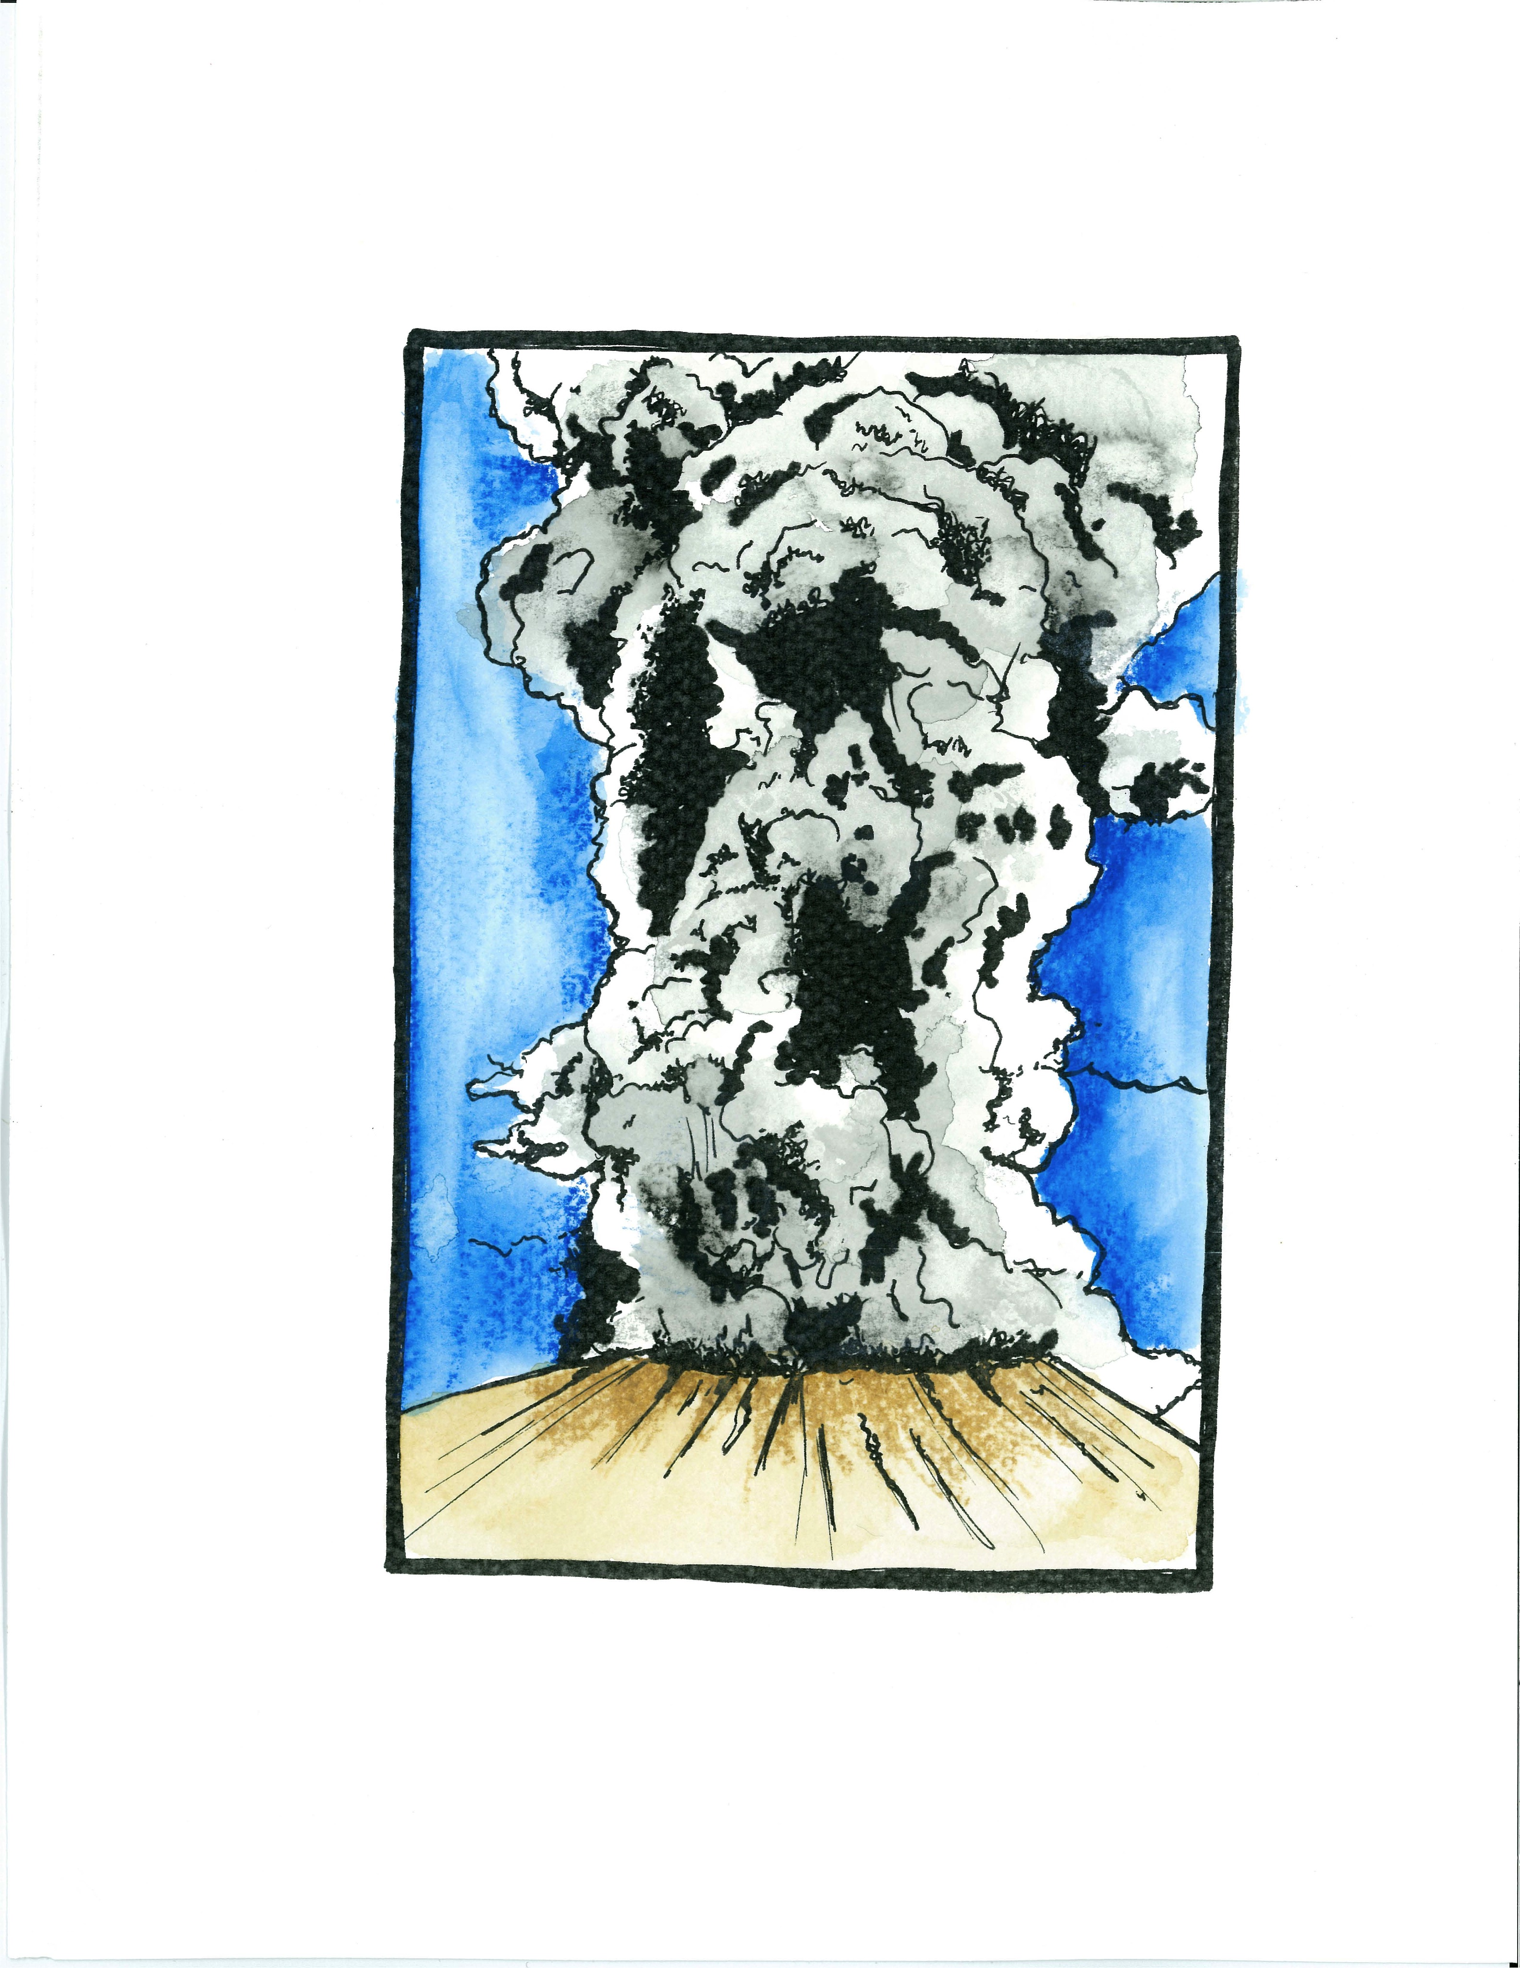
©Kurt Andrew Grimm
drkurtgrimm.com
Perpetual Recycling → NEW SUBSTRATES
textbox

Slide 16
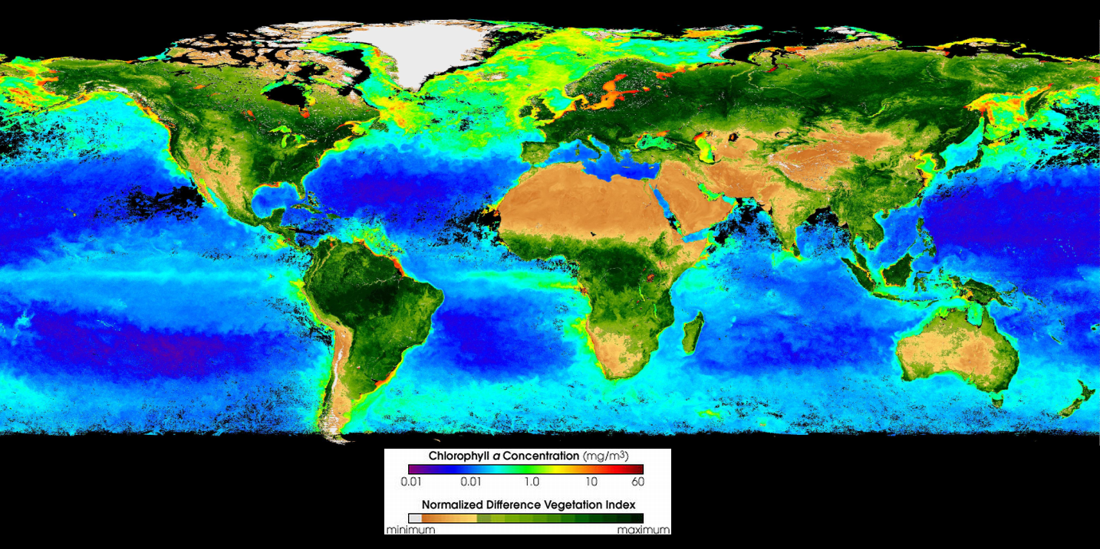
Life Exists, Evolves and CoEvolves

Slide 18
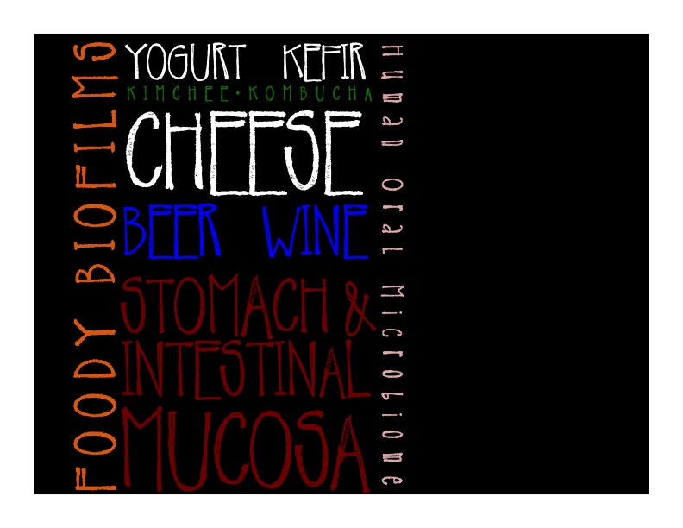

Slide 19
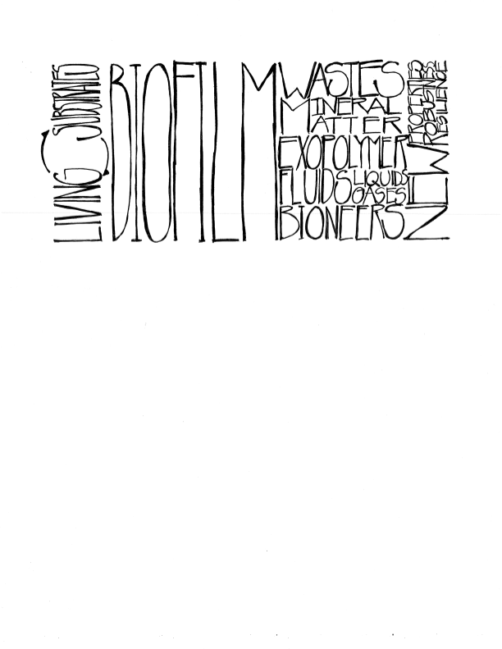
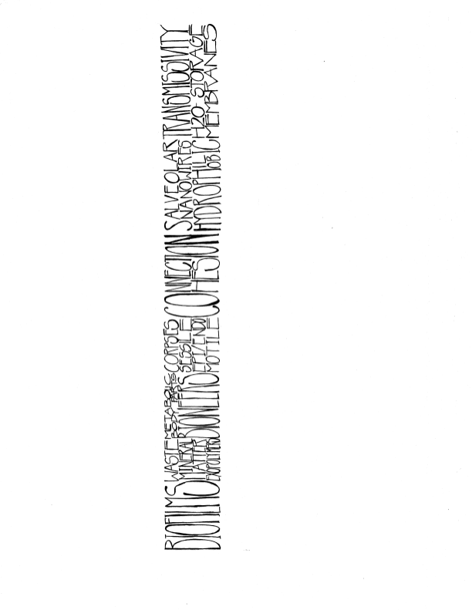

Slide 20
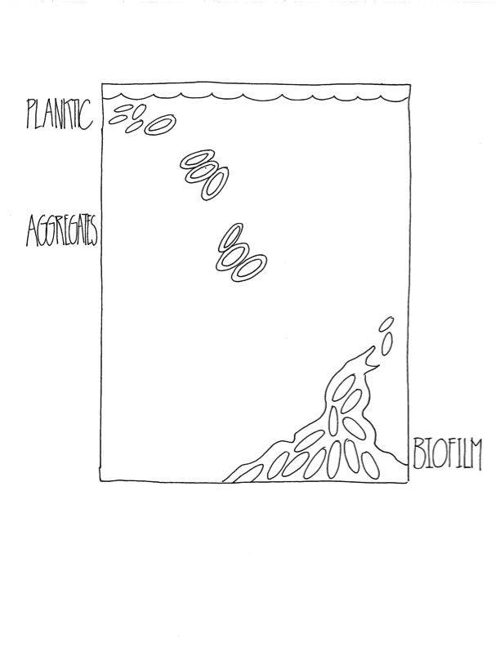

Slide 21

Brush & Floss !

Slide 22
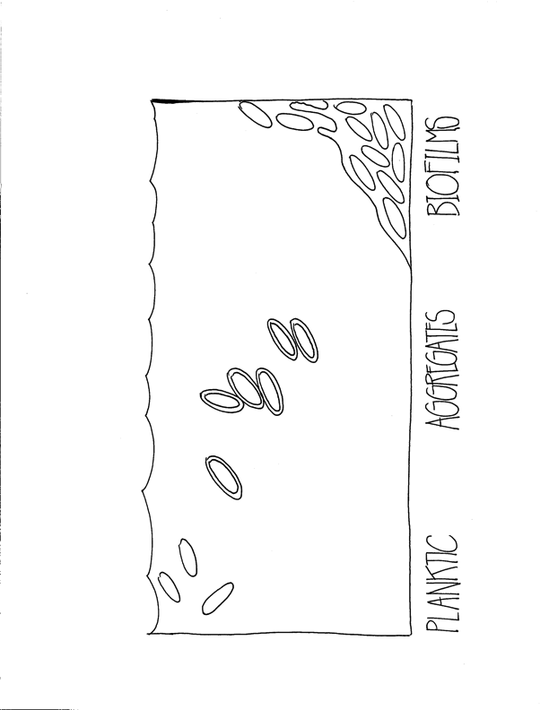

Slide 23
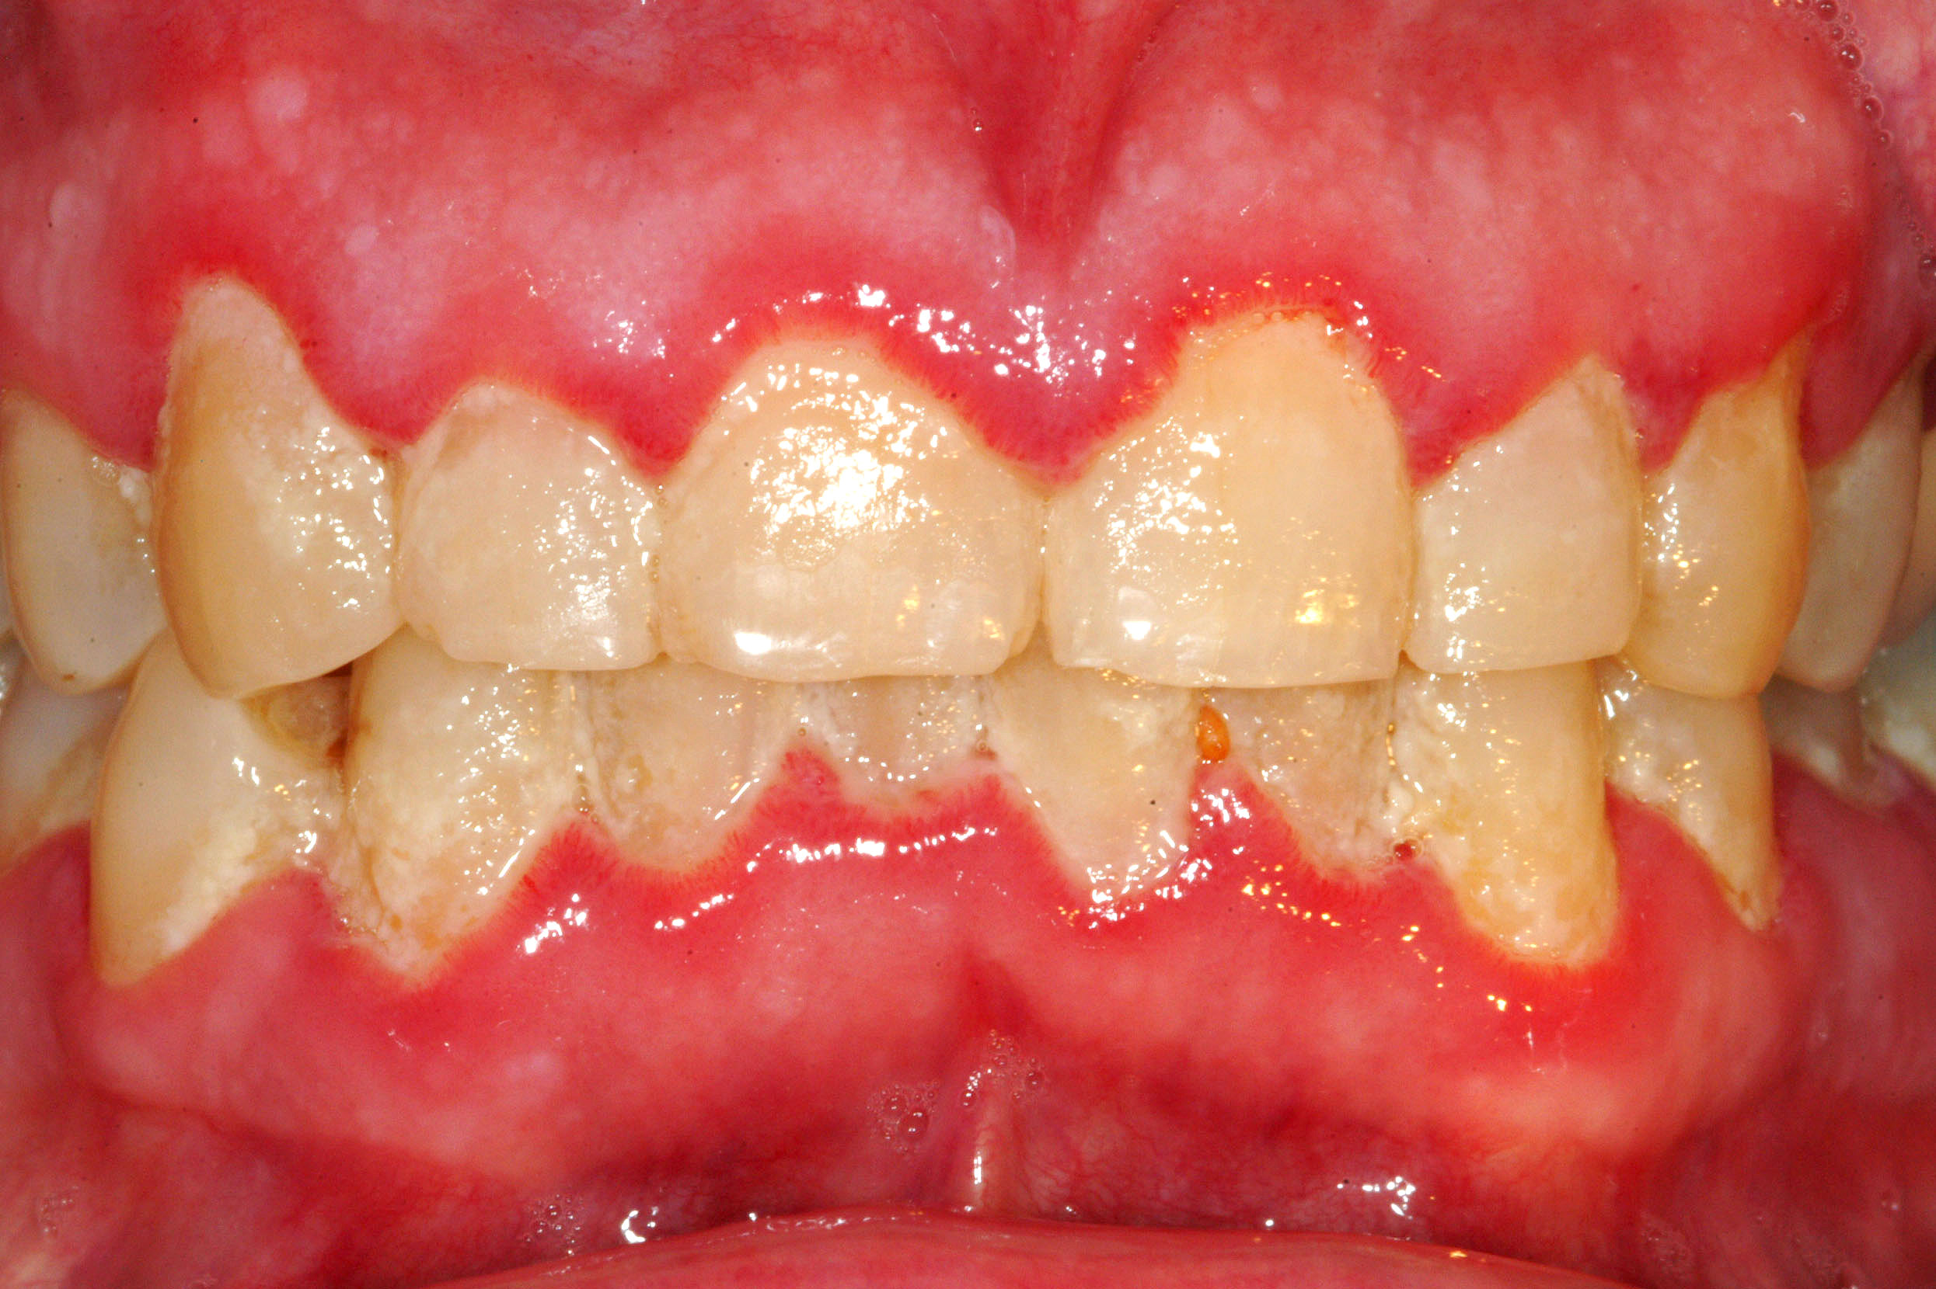
or Don’t….

Slide 24
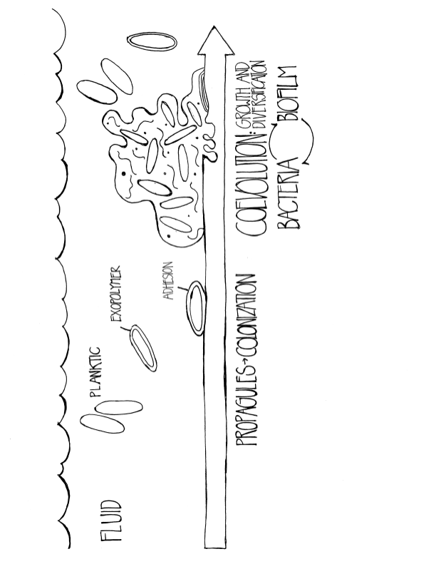

Slide 26
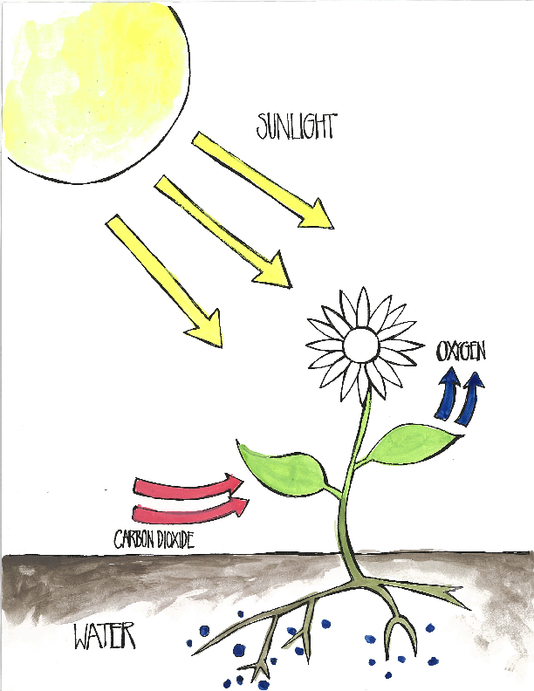

Slide 27
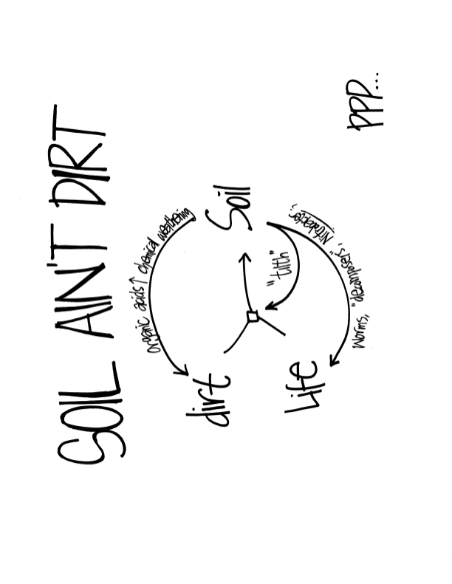

Slide 28
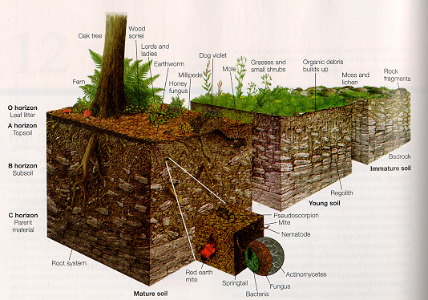
SOIL IS A BIOFILM

Slide 29
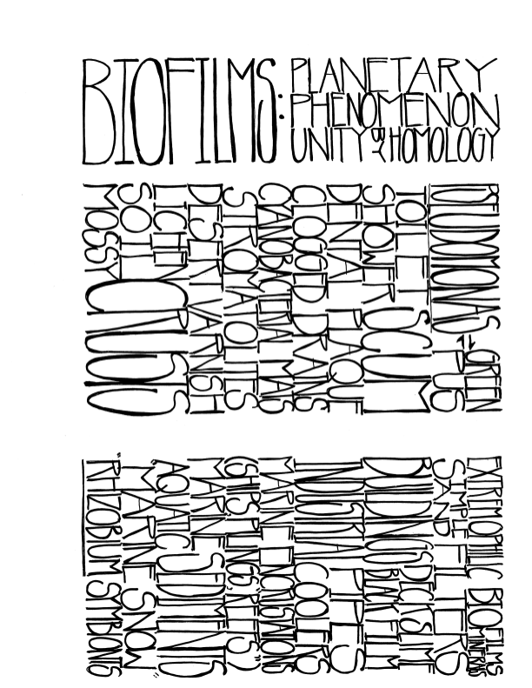

Slide 30
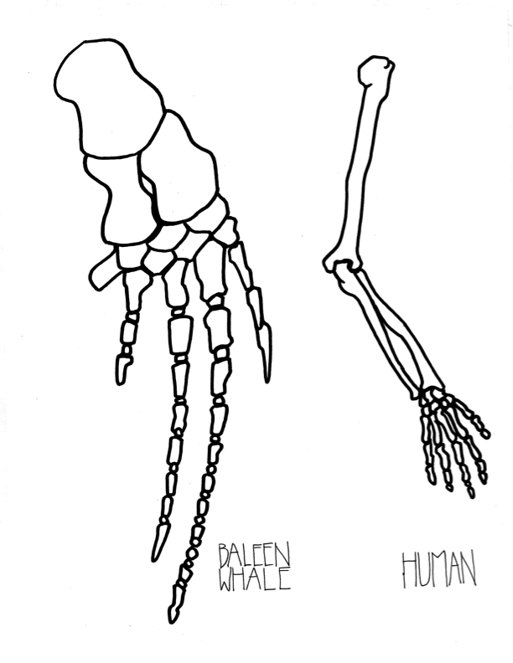
©Kurt Andrew Grimm
drkurtgrimm.com

Slide 31
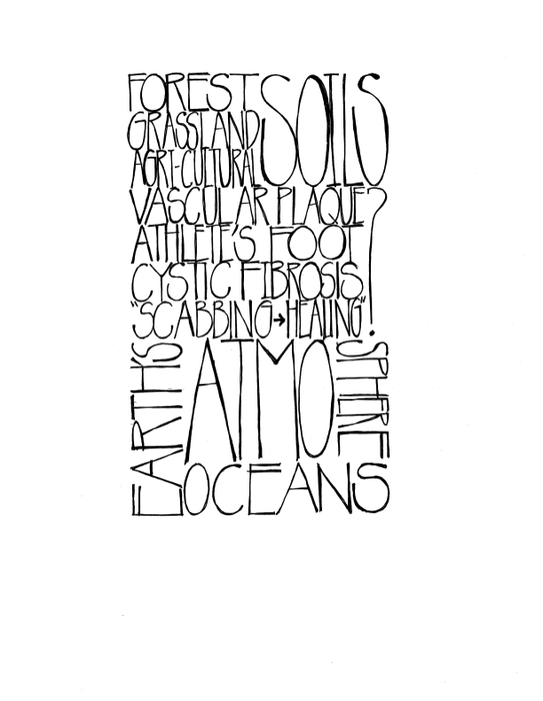

Slide 32
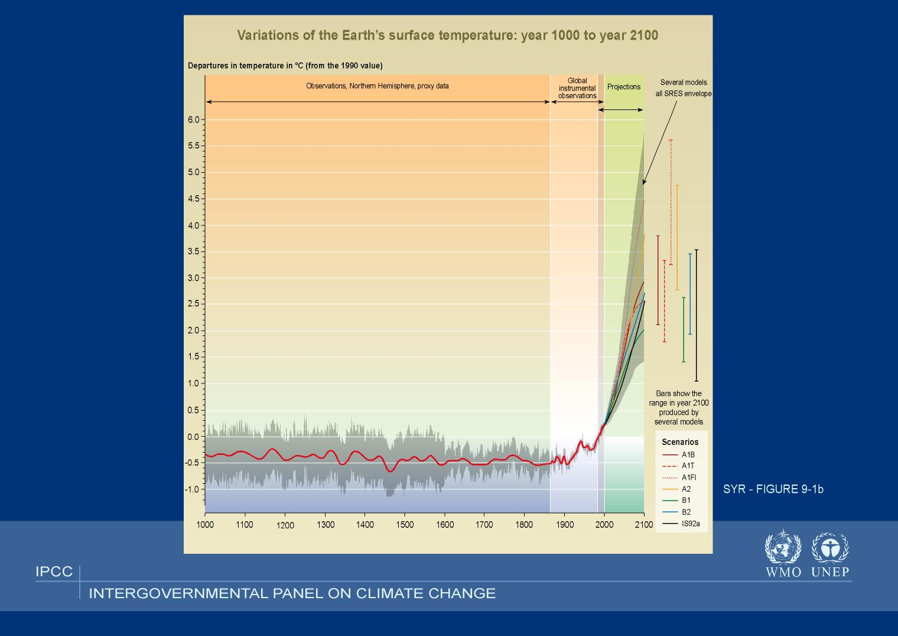
Climate CHEMOSTAT ?
Earth System Science ?
GAIA: An Indeterminate
Synthesis, a useful metaphor

Slide 33
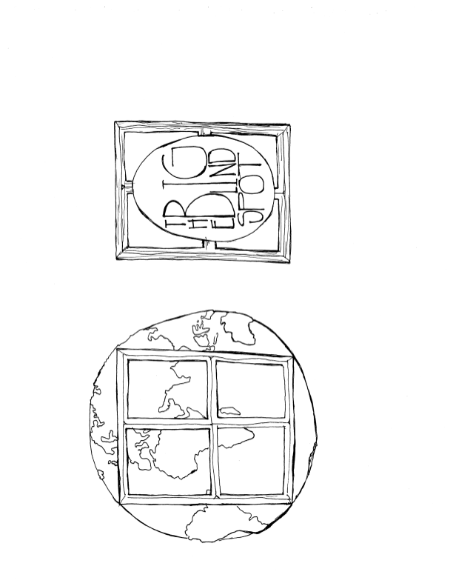

Slide 34
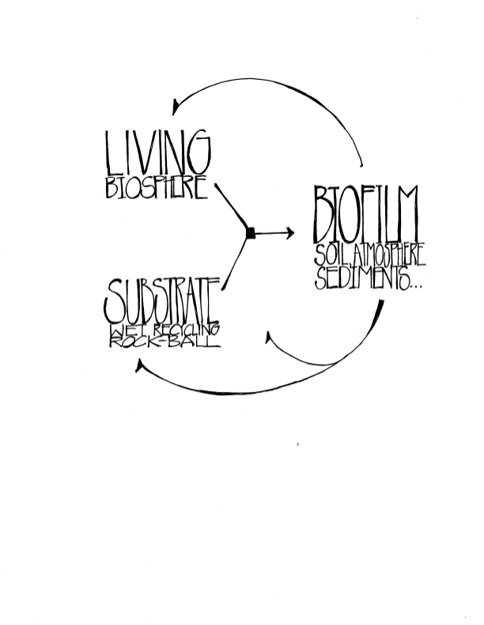

Slide 35
©Kurt Andrew Grimm
drkurtgrimm.com

Slide 36
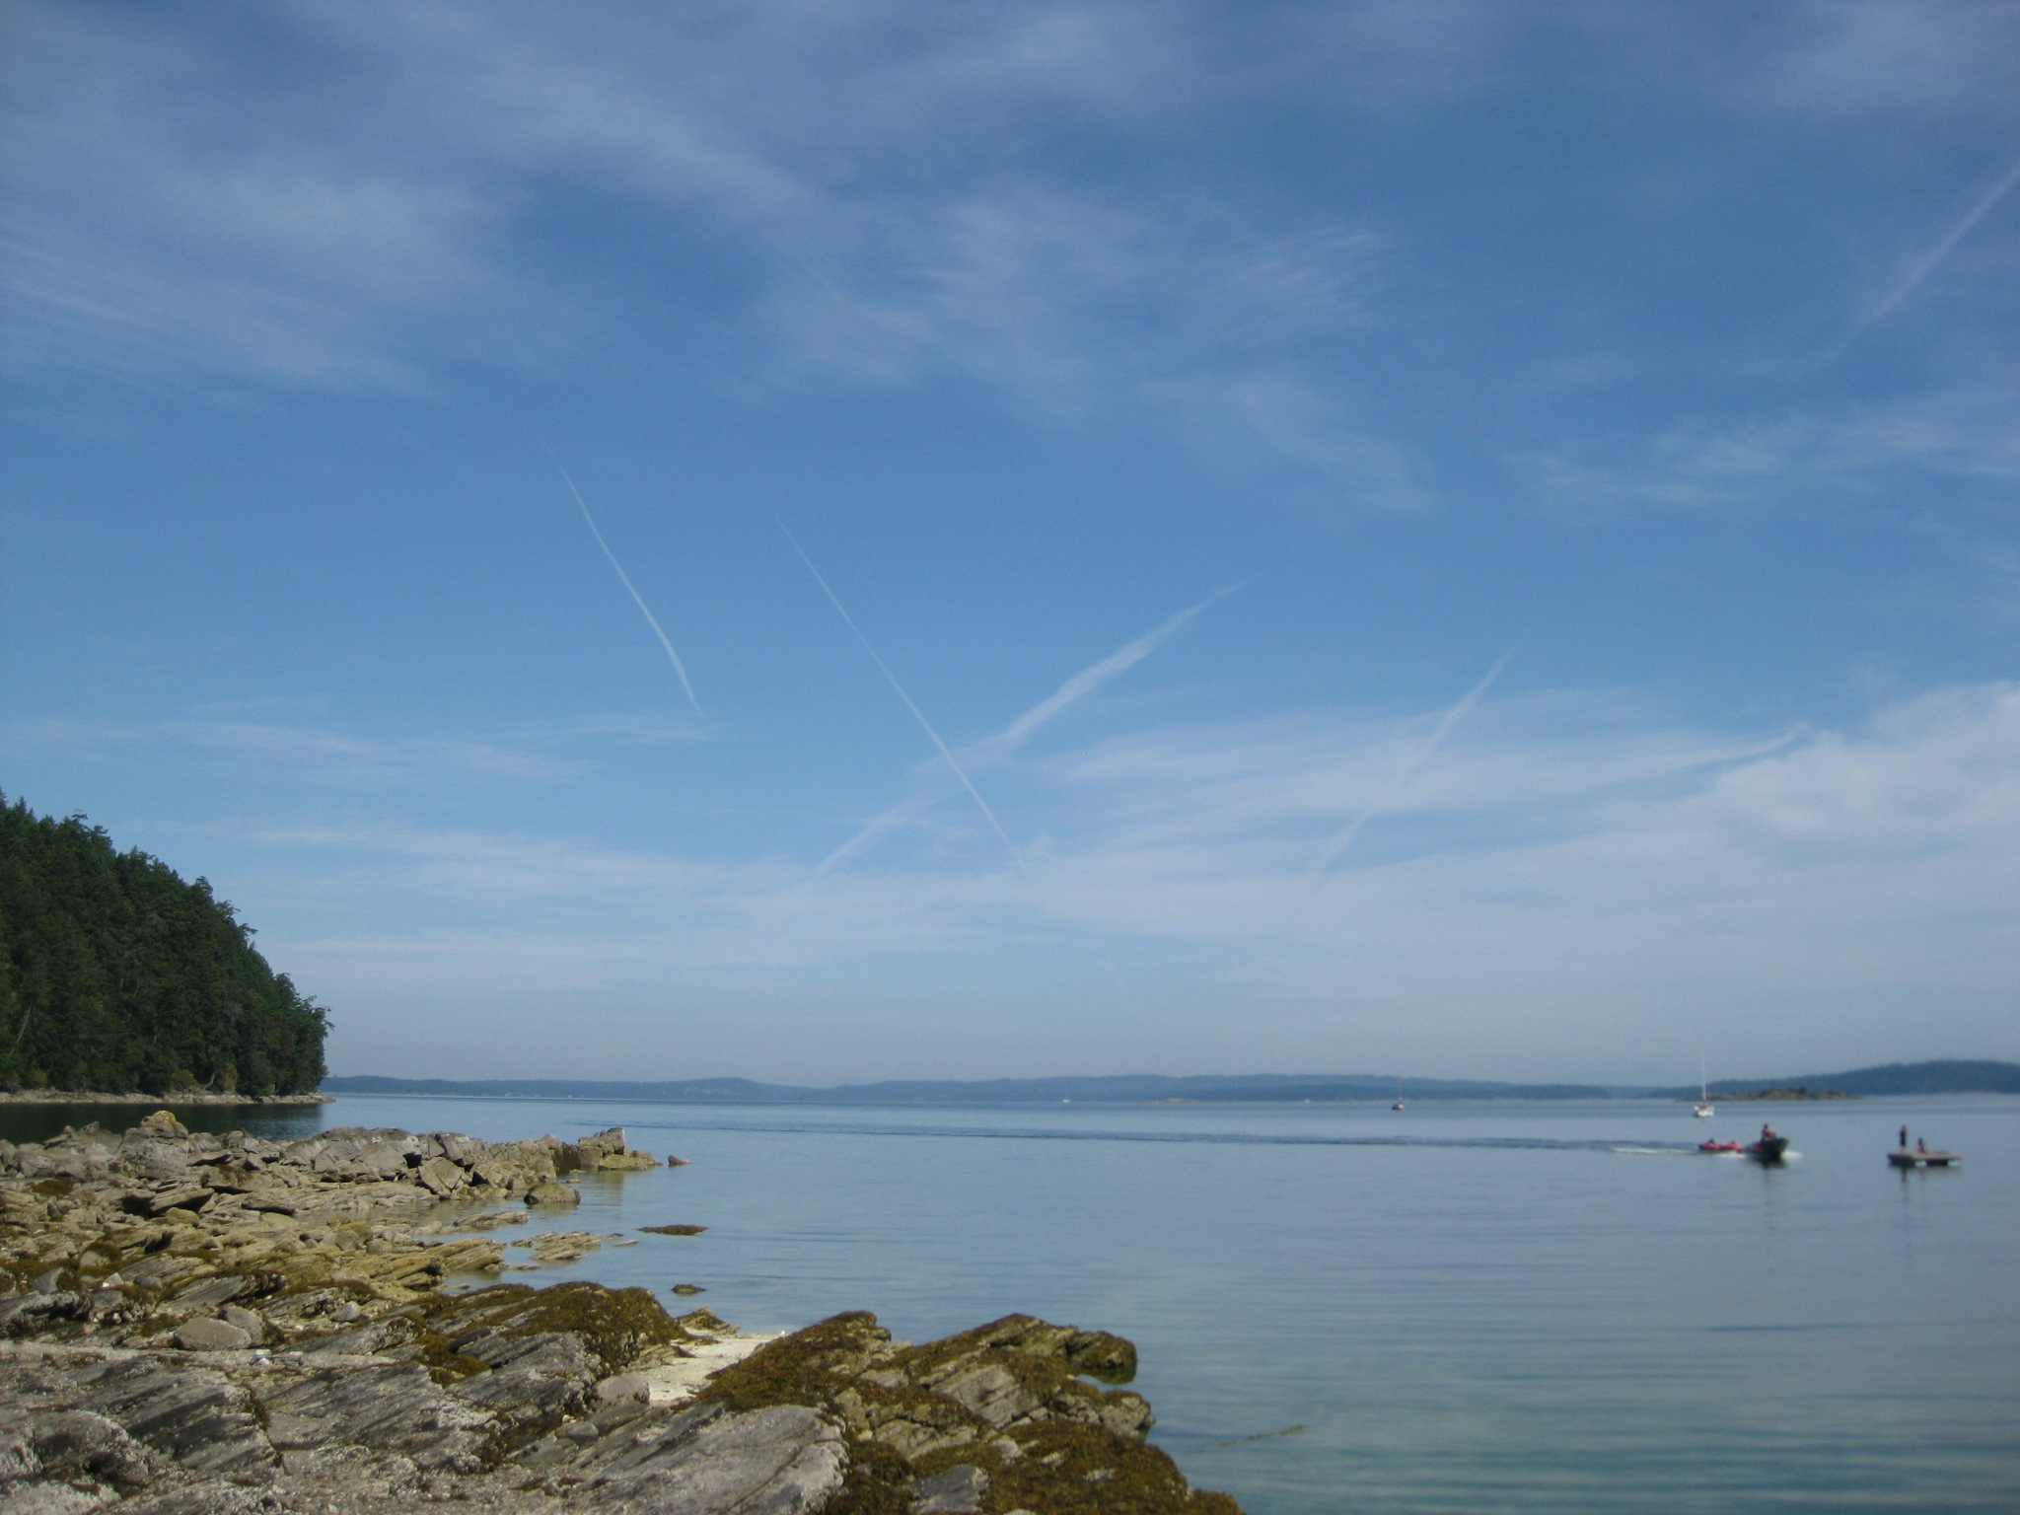
zxzx

Slide 37
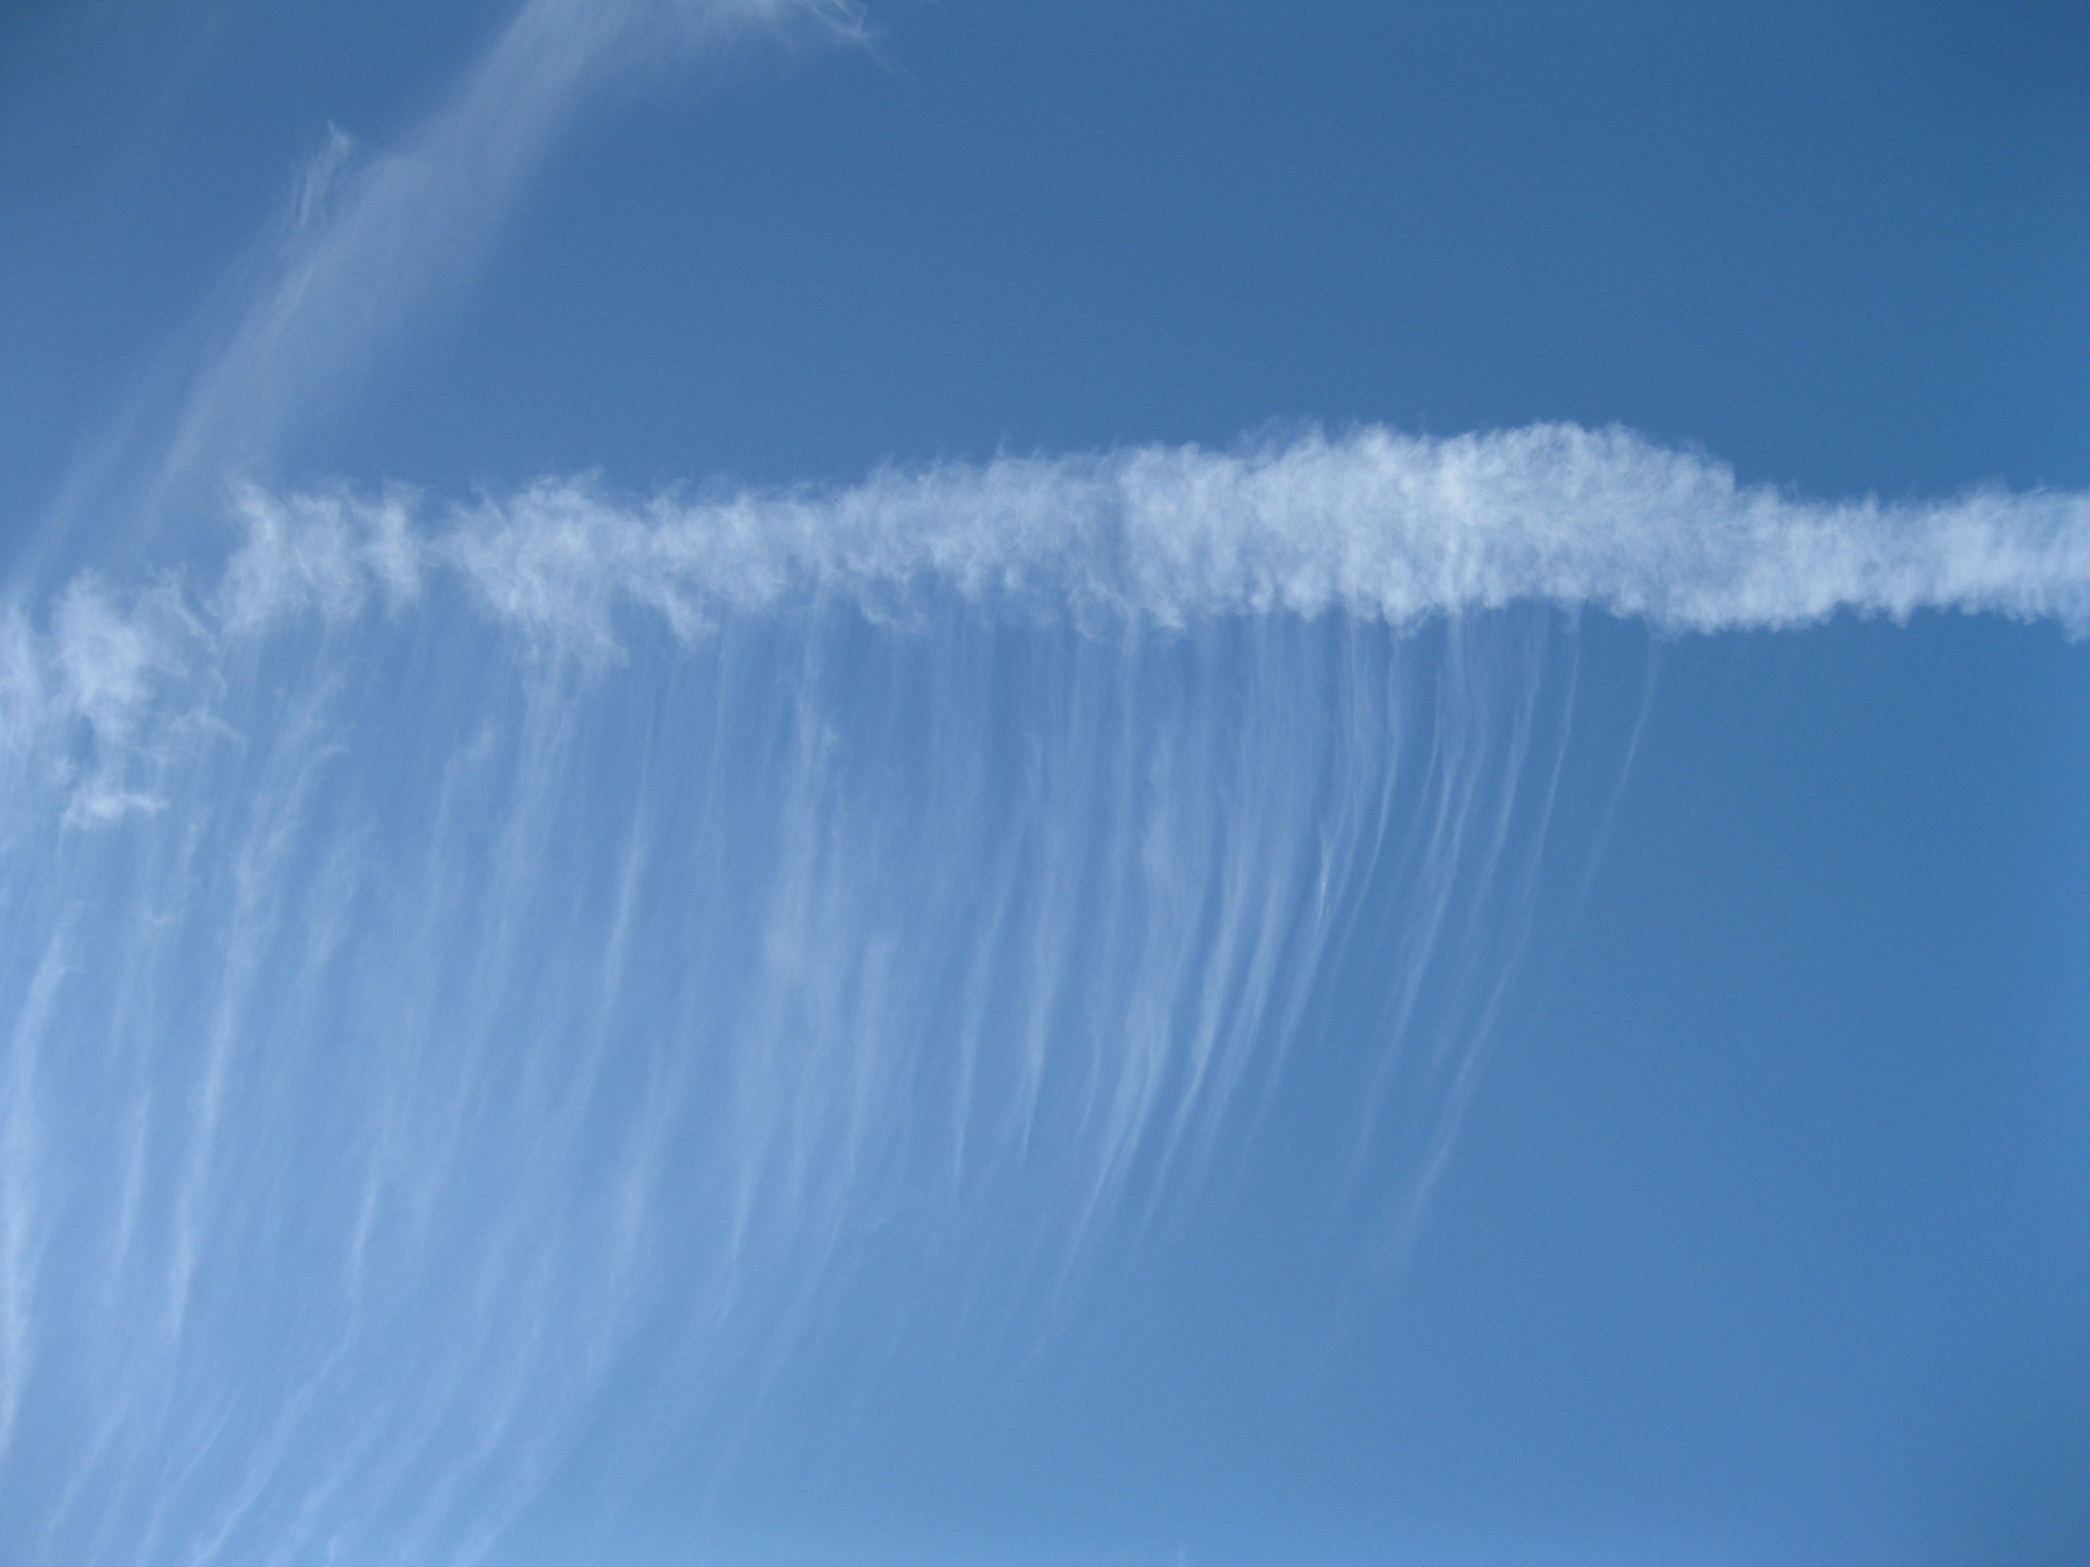
zxzx
Cloud Condensaton Nuclei (CCN)
  DMS and many terrestrial metabolites)
  Clouds that precipitate
  ICN
  Viable bacteria and fungi in clouds

Slide 38
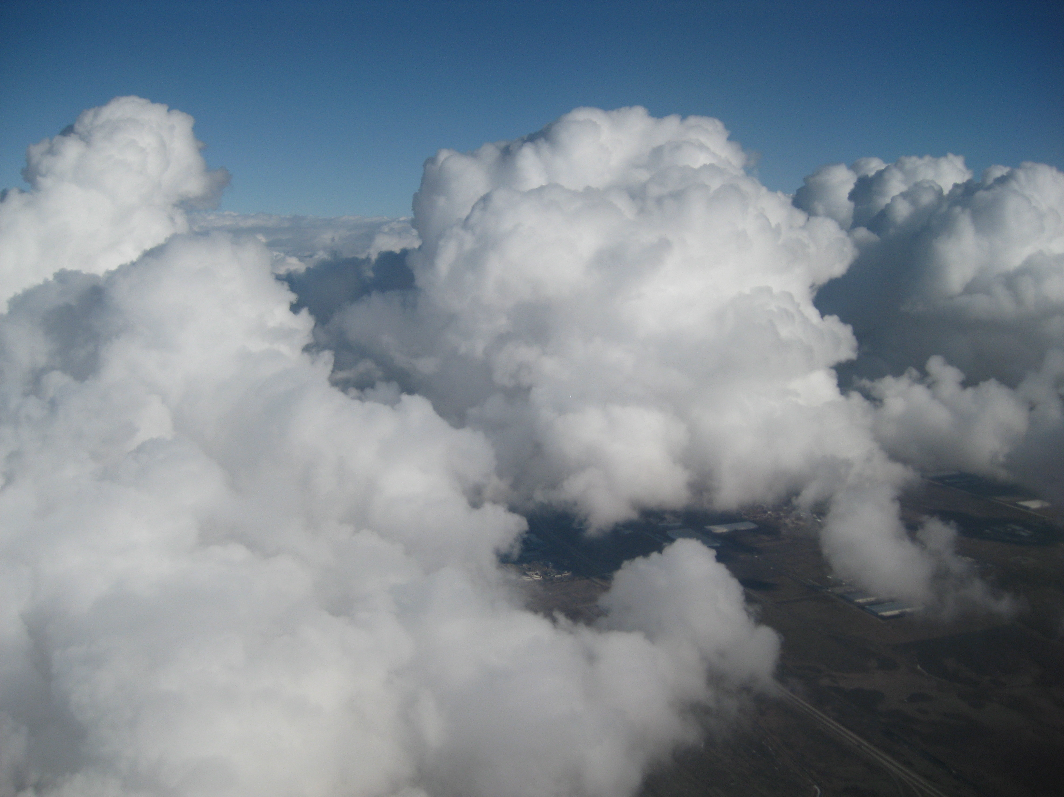

Slide 39
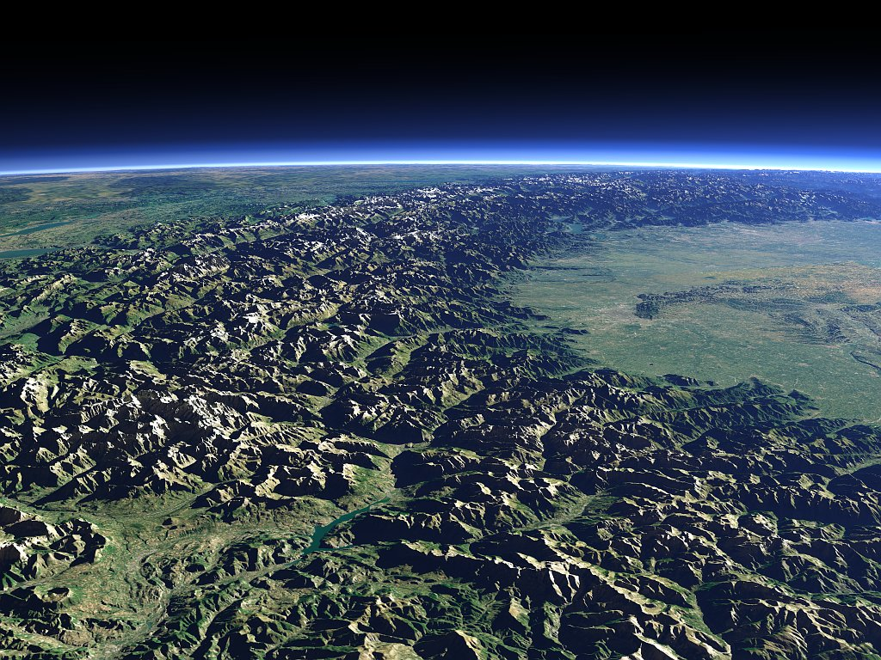
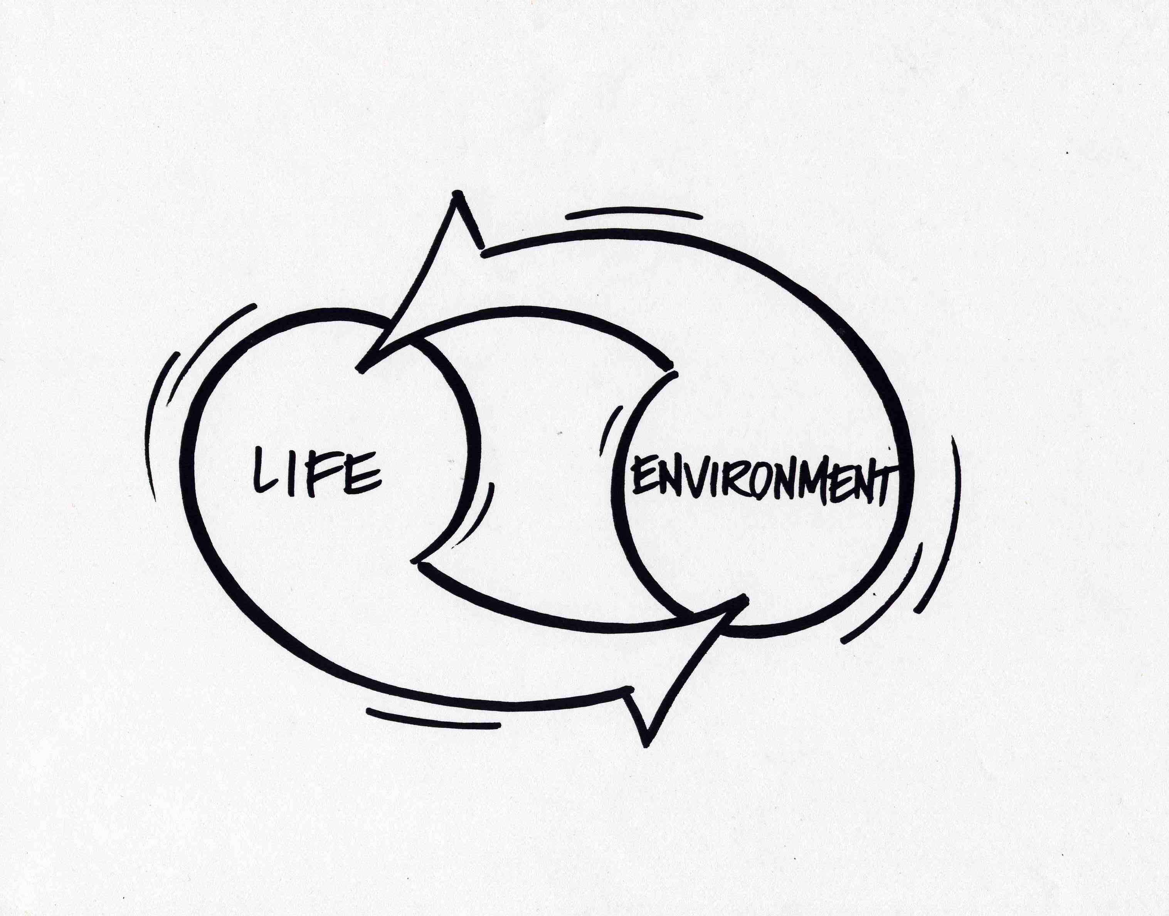
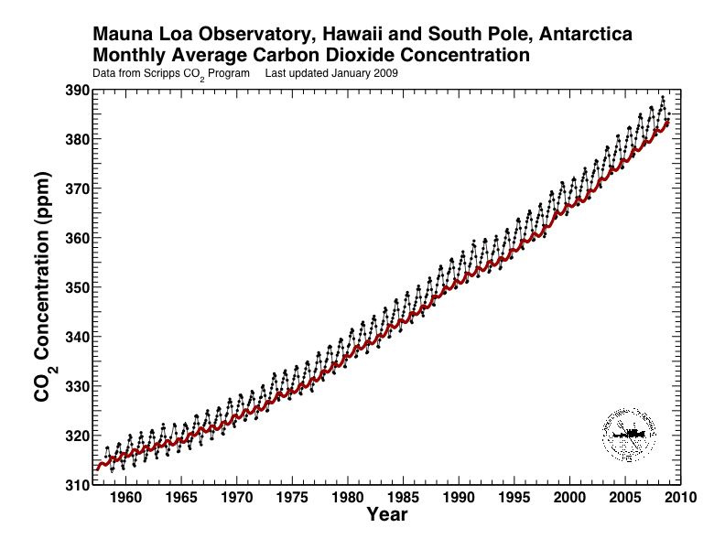
Earth’s Atmosphere is a
BIOFILM
That requires & Perpetuates
The Climate Consortium
+14 vs. -19°C
“BIOSPHERE”
“Biofilm”

Slide 40
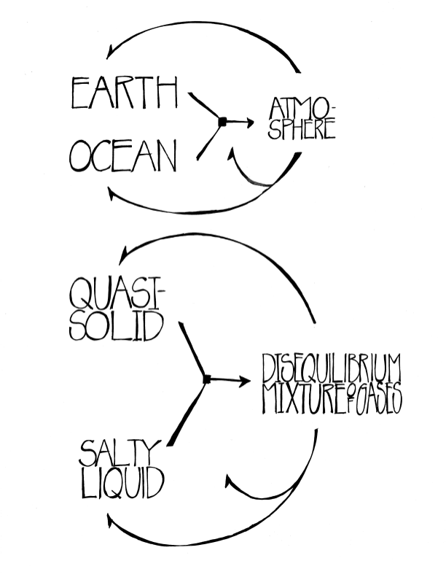

Slide 41
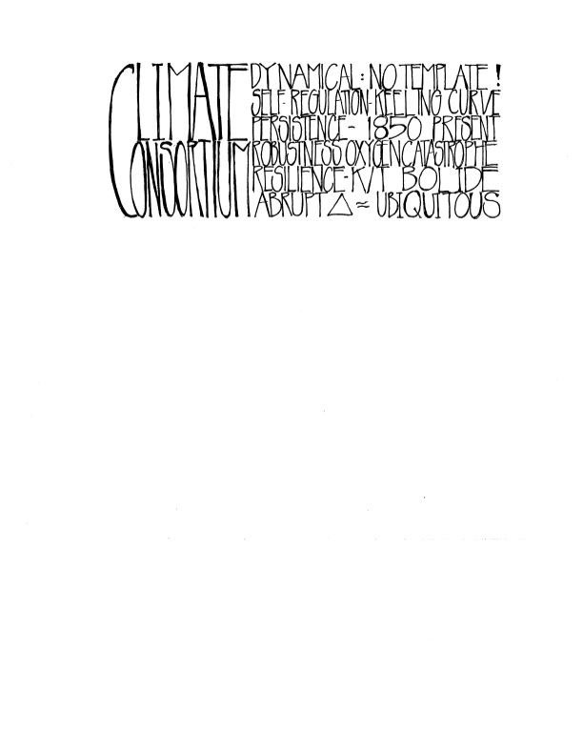

Slide 42
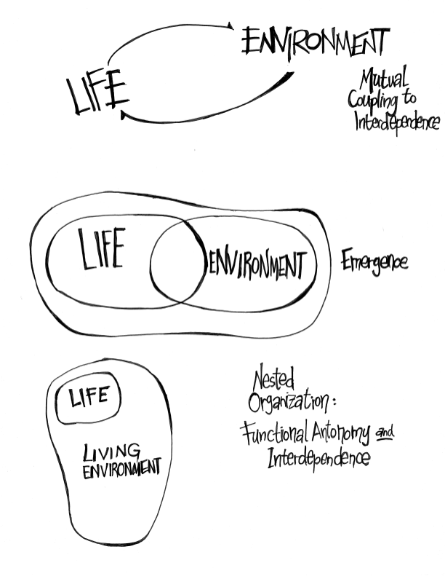

Slide 43
Biofilms Everywhere

Slide 45
Looking for Causal and DeepTime
Unity in the Natural World…
Via
FUNCTIONAL
Homologies ?

Slide 46
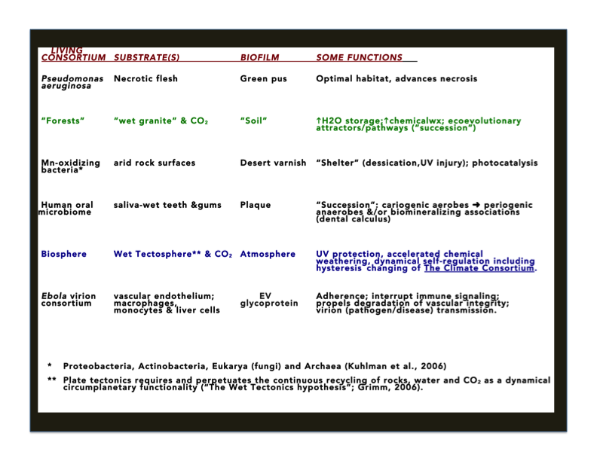

Slide 47
Biofilms Everywhere: A Wordy synopsis of The Abstract
Life is slimy and slime is everywhere; slime and Life coevolve.
From shower scum and dental plaque to soils, sediments and atmosphere, organismal consortia (groups of critters) occupy and modify substrates to produce and perpetuate biofilms.
Looking for Unity: From mechanical and structural analogies to a spectrum of functional homologies.
Every biofilm includes metabolites (including wastes), exuded exopolymers and corpses/body parts of antecedent organisms.
Every biofilm constitutes a specific habitat, imparting robustness, resilience and coherent ecoevolutionary function.
Biofilms dramatically impact adhesion, cohesion, exchanges, transmissivity (nanowires), and fluid storage/exchange capacities; unite hydrophobic/hydrophilic characteristics; propel dissolution, transformation and precipitation of minerals; permit/facilitate/enhance reproductive success, recruitment and ecological succession.
Some examples: Pseudomonas infections, dental biofilms, forest soils, atmosphere
8. Hypotheses: A. Biofilms coevolve with every living consortium;
B. Biofilms are nested and are everywhere, equalling what we conventionally call “environments”.
C. A specific process-pattern operates in the formation of every biofilm;
D. The broad spectrum of biofilms are linked (and arose from) a simple functional homology that has operated from deeptime to present, across molecular to circumplanetary scales.
E. The atmosphere is a circumplanetary biofilm, produced and perpetuated by The Climate Consortium (CC), a specific ecoevolutionary explicitly defined herein.
F. Concerning Climate changing, we need to learn to expect hysteresis changing

Slide 48
Does the CC have all the properties of other biofilms?
1. Prominence of metabolites, including waste products ?
YES: Excepting inert gases (1% Ar), all atmospheric constituents are reactants and/or products of biological processes.
YES: CCN (Cloud Condensation Nuclei):
a. Dimethyl Sulfide linking oceans, biota and atmosphere: Track Andrae et al (1983) → Toon et al (1987) → Charlson et al, 1997 → Kasting et al, 2013.
b. Mohler et al, 2007 and many other publications: Terrestrial and marine metabolites are prominent — and widely predominant — as CCN (and ICN!)
c. Amazon Example: Poschl et al., 2010. Science 329: 1513-1516.
Most terrestrial aerosols are industrial/anthropogenic
Wet-season Amazon approximates pristine (pre-Anthropogenic) condition.
Most sub µm CCN are derived from oxidation of gaseous plant metabolites.
Most ≥1µm CCN are direct metabolites released by rainforest biota
Conclusion: “Biogeochemical Reactor”: Biosphere ← → Atmosphere exchanges and photochemistry produce CCN that permit and perpetuate cloud formation, precipitation and local-to-regional, hydrologic recycling [In the language of this paper: An autocatalytic and autoregenerative process].

Slide 49
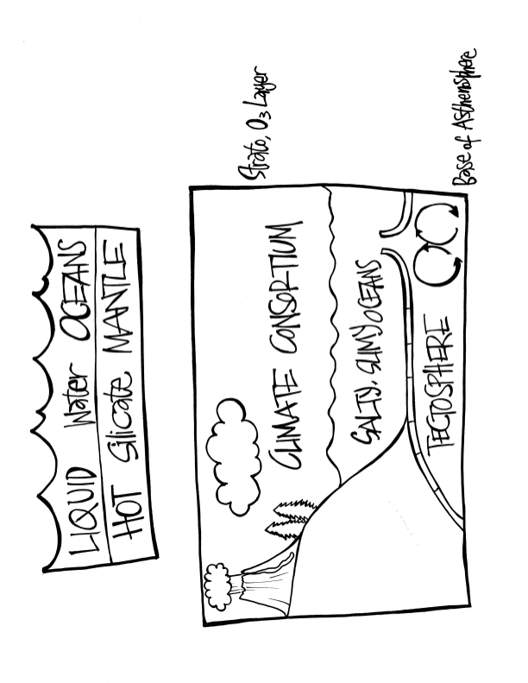
©Kurt Andrew Grimm
drkurtgrimm.com

Slide 50
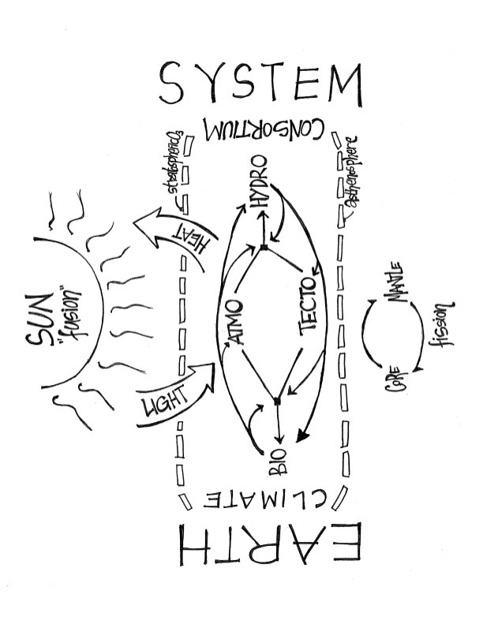
©Kurt Andrew Grimm
drkurtgrimm.com

Slide 51
