Slide 1
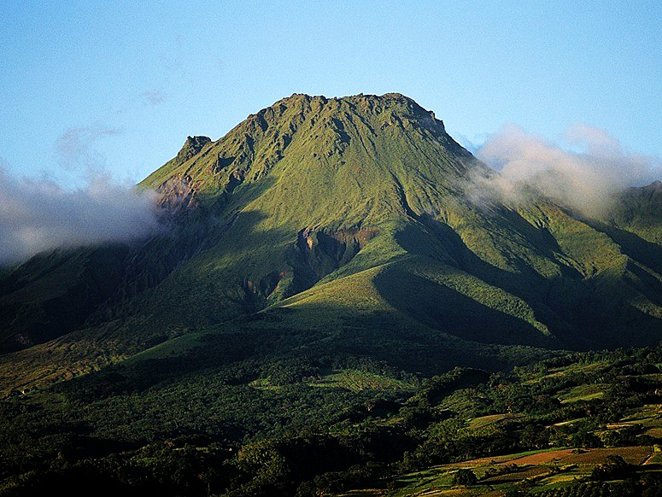




Sedimentary input to the source of Lesser Antilles lavas: A Li perspective
Ming Tang¹, Roberta Rudnick¹, Catherine Chauvel²
Department of Geology, University of Maryland
Universite´ Grenoble Alpes
Ming Tang
Fang-Zhen Teng
Mt. Pelée, Martinque
Notes:
Work of Ming Tang – current PhD student. Now we have Teng, Tang and Tang!

Slide 2
Can Li be used to trace recycling?
What do arc lavas tell us?
altered MORB
+3 to +14
serpentinite-
decollement
diapir
island arc
sediments
fluid
km
-5 to +15
+20
+20
0
30
forearc
≥+4
60
mantle
eclogite
~+4
δ⁷Li
-11 to +4
0 to +4*
90
120
*Marschall et al. (2007)
After Zack et al., 2003, EPSL
Notes:
On the one hand, heavy Li in altered MOR, on the other hand, subducted crust may be light. What do arc lavas tell us?

Slide 3
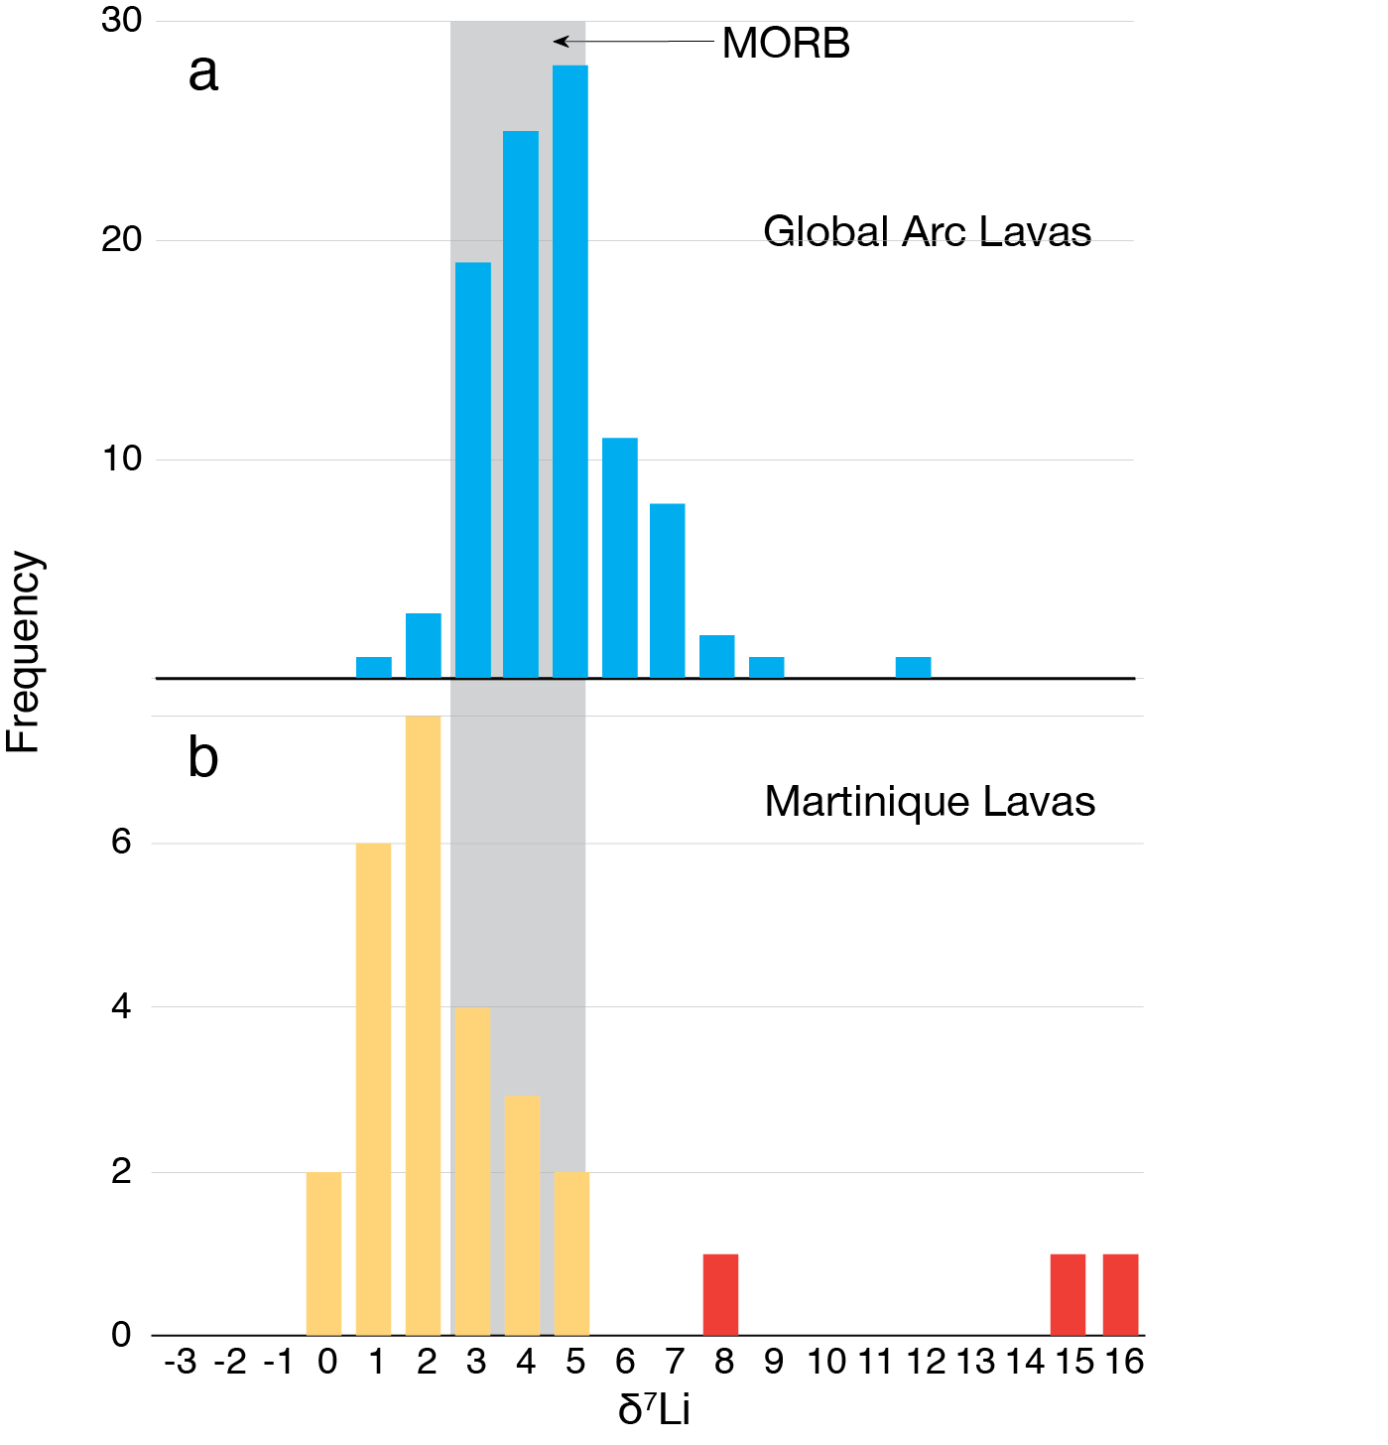
Most arcs = MORB (maybe a bit heavier)
Global Arc Lavas
Notes:
Not much deviation from MORB – maybe Li sponged up in mantle wedge, or

Slide 4
Mantle Retention of Lithium?
OUT: fluids with slab B, but little Li
From Tomascak et al. (EPSL,2002)
IN: fluids with slab Li & B

Slide 5
The case for subducted sediments in the Lesser Antilles lavas
Sediments
+10
+5
0
-5
-10
-15
-20
Labanieh et al., 2012, J. Petrol.
Notes:
Lavas fall on simple mixing curves – cannot be modeled by AFC in crust. Inferred ancient terrigenous sediment mixed into mantle source.

Slide 6
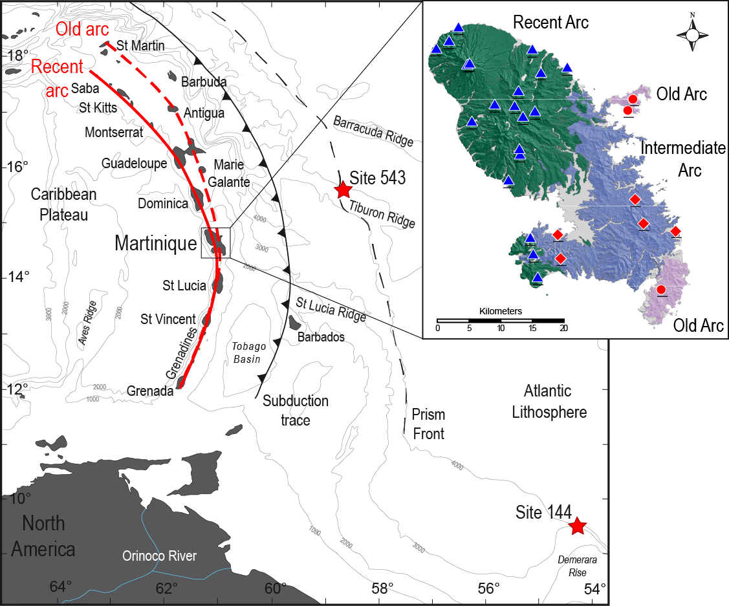
Notes:
Catherine and her students, following in the footsteps of Bill White, have done a fantastic job of looking at the geochemistry (including radiogenic isotopes) of Lesser Antilles and off-shore sediments to investigate the links between the thick terrigenous sediment package subducting beneath the LA and the arc lavas – focusing particularly on Martinique and Site 543 and 144 sediments.

Slide 7
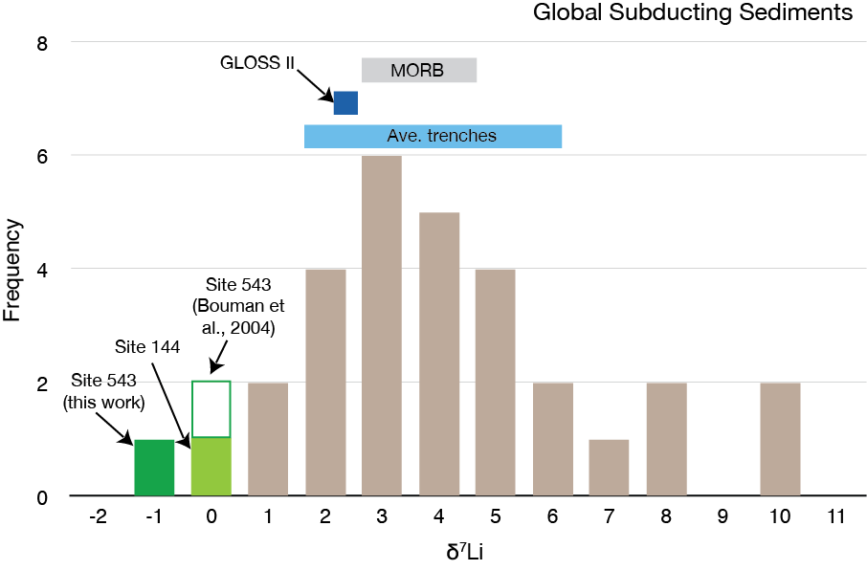
Global Subducting Sediments
Site 543
Bouman et al., 2004
Averages from Plank, 2014, TOG
Notes:
Li isotopes in subducting sediments shows a wide range in compositions. Plotted here are lithology-weighted trench averages from Plank. Generally speaking, chemical seds are heavy and have low Li concentrations whereas terrigneous seds tend to be light and have higher [Li]. LA from site 543 (northern site, n = 4) are the lightest of any.

Slide 8
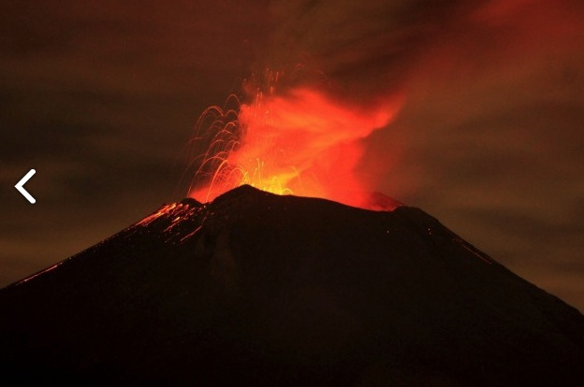
Our Project:
Analyze δ⁷Li in
subducting sediments
Martinque lavas
Do we see the sedimentary signature reappearing in the lavas?
Mt. Pelée, Martinque

Slide 9
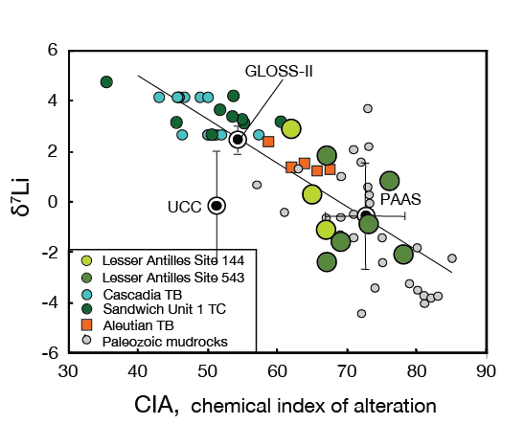
Subducting Sediments
Mt. Pelée, Martinque
Tang et al., 2014, following Plank, 2014
Notes:
Lesser Antilles subducting seds are indeed some of the lightest subducting seds. Come from heavily weathered CC – overlapping Paleozoic mudstones from Great Britain.

Slide 10
Lesser Antilles subducting sediments are global end member
Lesser Antilles subducting sediments are clearly much lighter than mantle
Mt. Pelée, Martinque
Tang et al., 2014, GCA

Slide 11
Martinique lavas Li clearly influenced by sedimentary input
Submarine eruption – interaction with seawater
Tang et al., 2014, GCA
Notes:
Three samples very heavy – submarine eruption – unusually depleted in alkali elements -- took on heavy SW Li during interaction with ocean water. Otherwise, Martinique lavas overlap or are distinctly lighter than MORB.

Slide 12
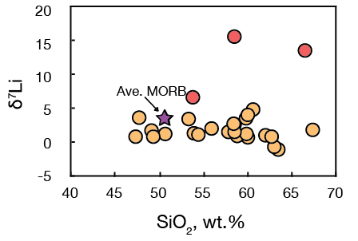
No evidence for crustal assimilation: sediments added to mantle source
Tang et al., 2014, GCA

Slide 13
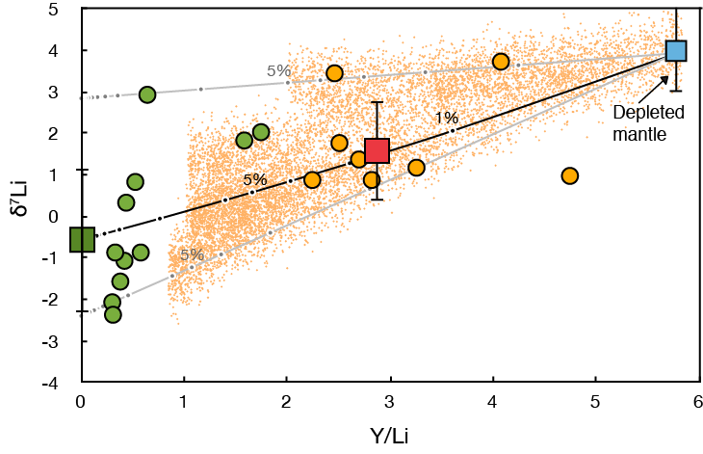
Mixing scenarios
Mt. Pelée, Martinque
Notes:
Use Y/Li so that mixing is straight line. Lower Y/Li, higher sediment input. Small orange dots are Mote Carlo outcome of mixing between DM and subducted sediments.

Slide 14
Conclusions
Li can make it through the mantle wedge!
Clear subducted terrigneous sediment signature in Martinque lavas
Probably added through melts of sediments
Notes:
Use Y/Li so that mixing is straight line. Lower Y/Li, higher sediment input. Small orange dots are Mote Carlo outcome of mixing between DM and subducted sediments.

Slide 15

Congratulations Fang-Zhen!

