Slide 1



Use of Geologic Mapping and Optical Logging to Evaluate Karst Geotechnical Risks in an Urbanized Area, City of Sete Lagoas, Minas Gerais, Brazil
Paulo Galvão¹, Todd Halihan², Ricardo Hirata¹
1. University of São Paulo, Institute of Geosciences, São Paulo, Brazil
2. Oklahoma State University, School of Geology, Oklahoma, USA

Slide 2



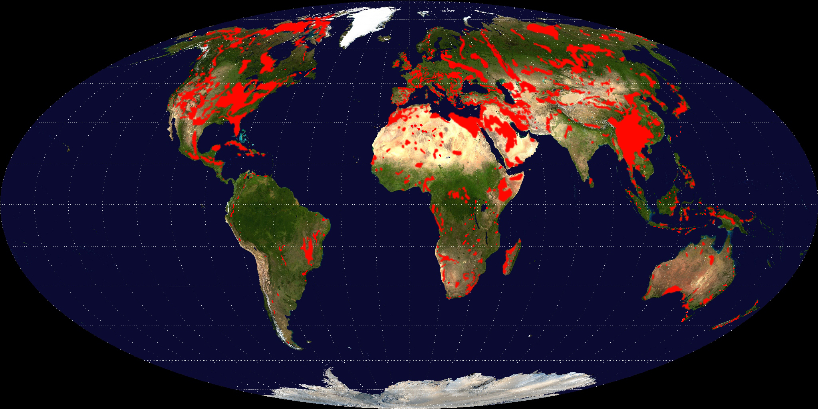
Introduction
Naturally: dissolution through faults or fractures, or through bedding planes (LaMoreaux and Newton 1986)
City of Sete Lagoas
(City of Seven Lakes)
Induced: groundwater withdrawal, construction activities, or a combination of both (Newton, 1987)
Carbonate rocks and karst areas cover about 20% of the land surface (Williams & Ford, 2006)
Carbonate outcrops
Image from Wikimedia Commons
2
Notes:
Which can undergo dissolution resulting in caves, sinkholes and, unfortunately, geotechnical problems such as collapses and subsidences, which in urbanized areas can result in serious problems.
Geotechnical issues can occur naturally or induced by human activities.
In Brazil, there is a reasonable karst region in the central part of the Country, with some medium cities having geotechnical issues.
One of these cities is the City of Sete Lagoas, the study area.

Slide 3
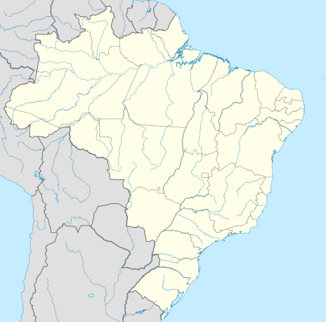
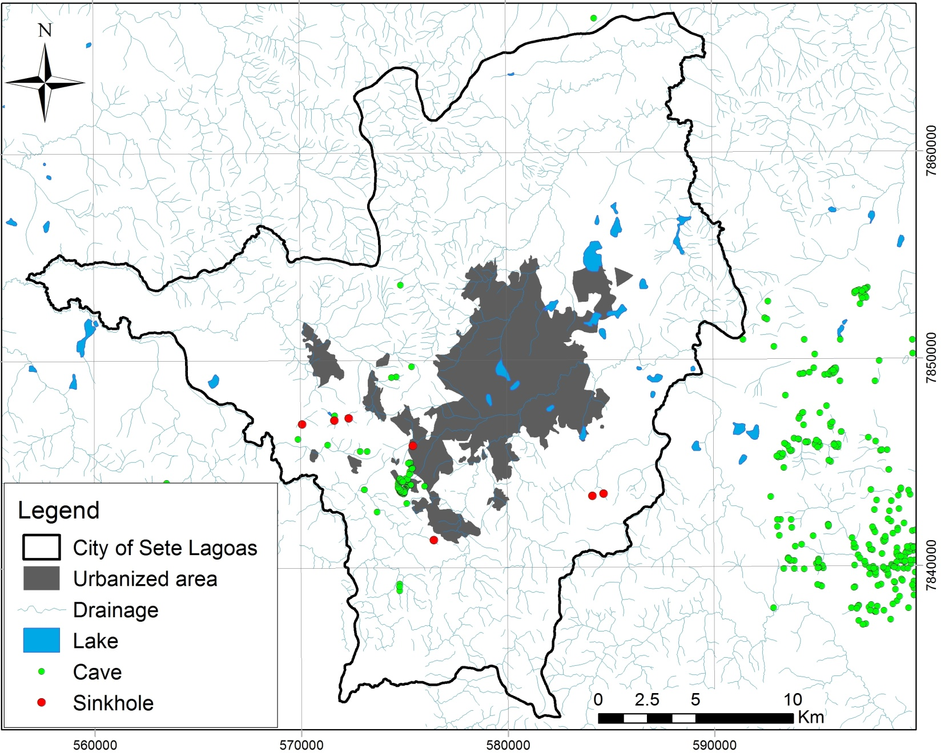
Study area
Brazil
Santa
Helena Mountain
200,000 people living
in a karst area (IBGE 2010)

Slide 4
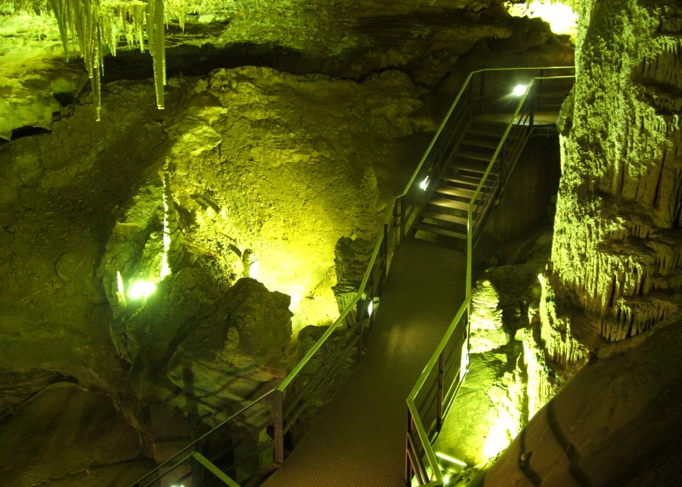
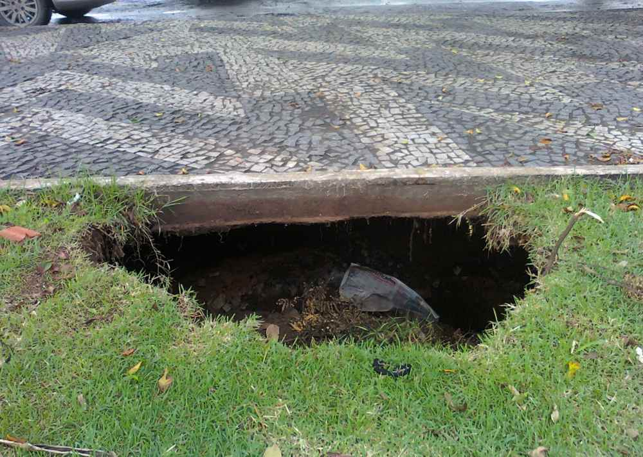
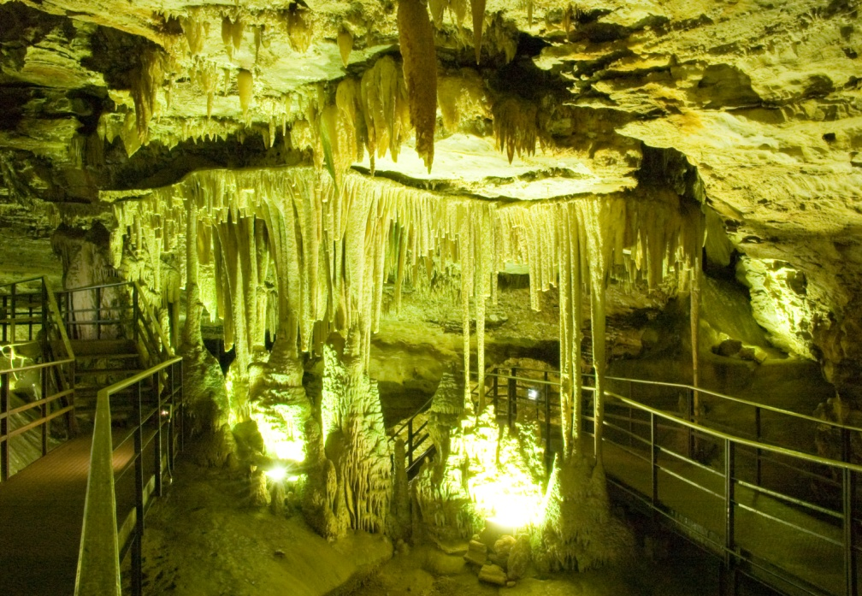
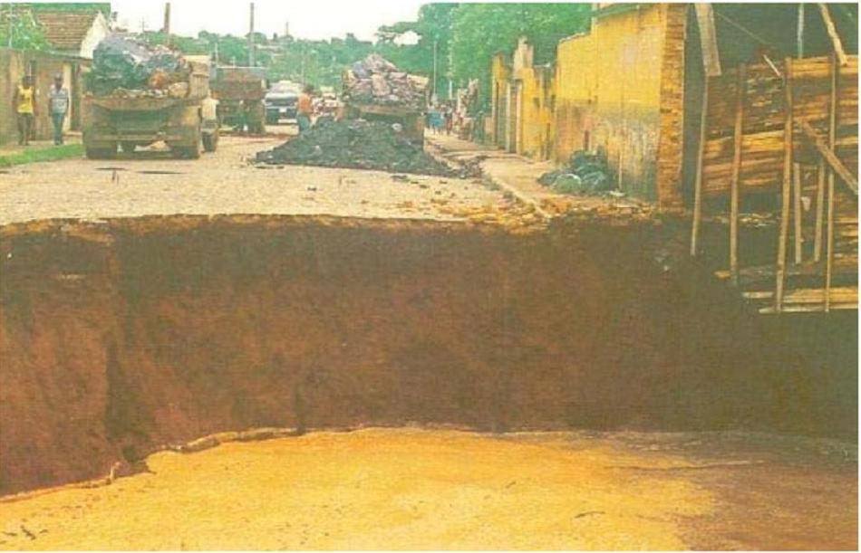
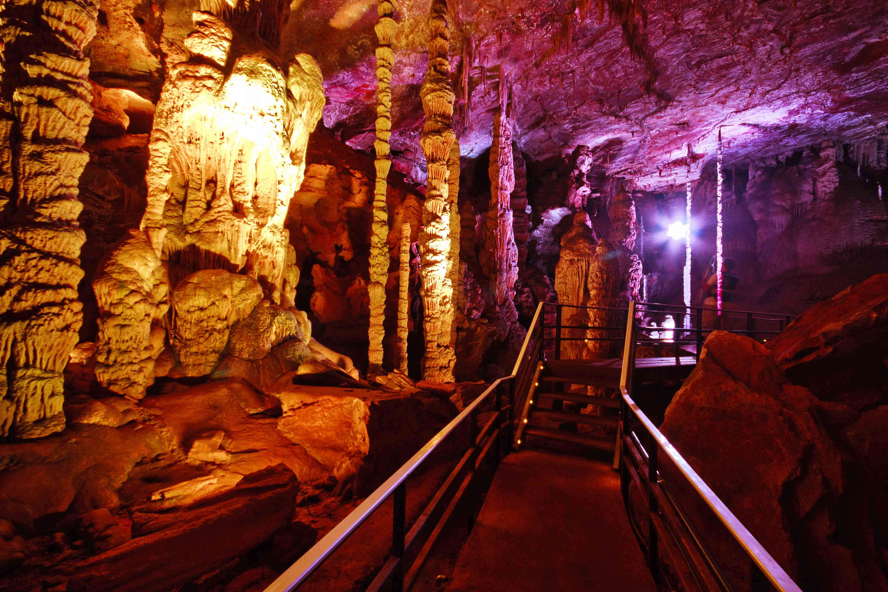
Study area
Small subsidence
However,
Gruta Rei do Mato
(Cave of the Forest King)
22 m
Big collapse in 1988 (Silva, 1988)

Slide 5
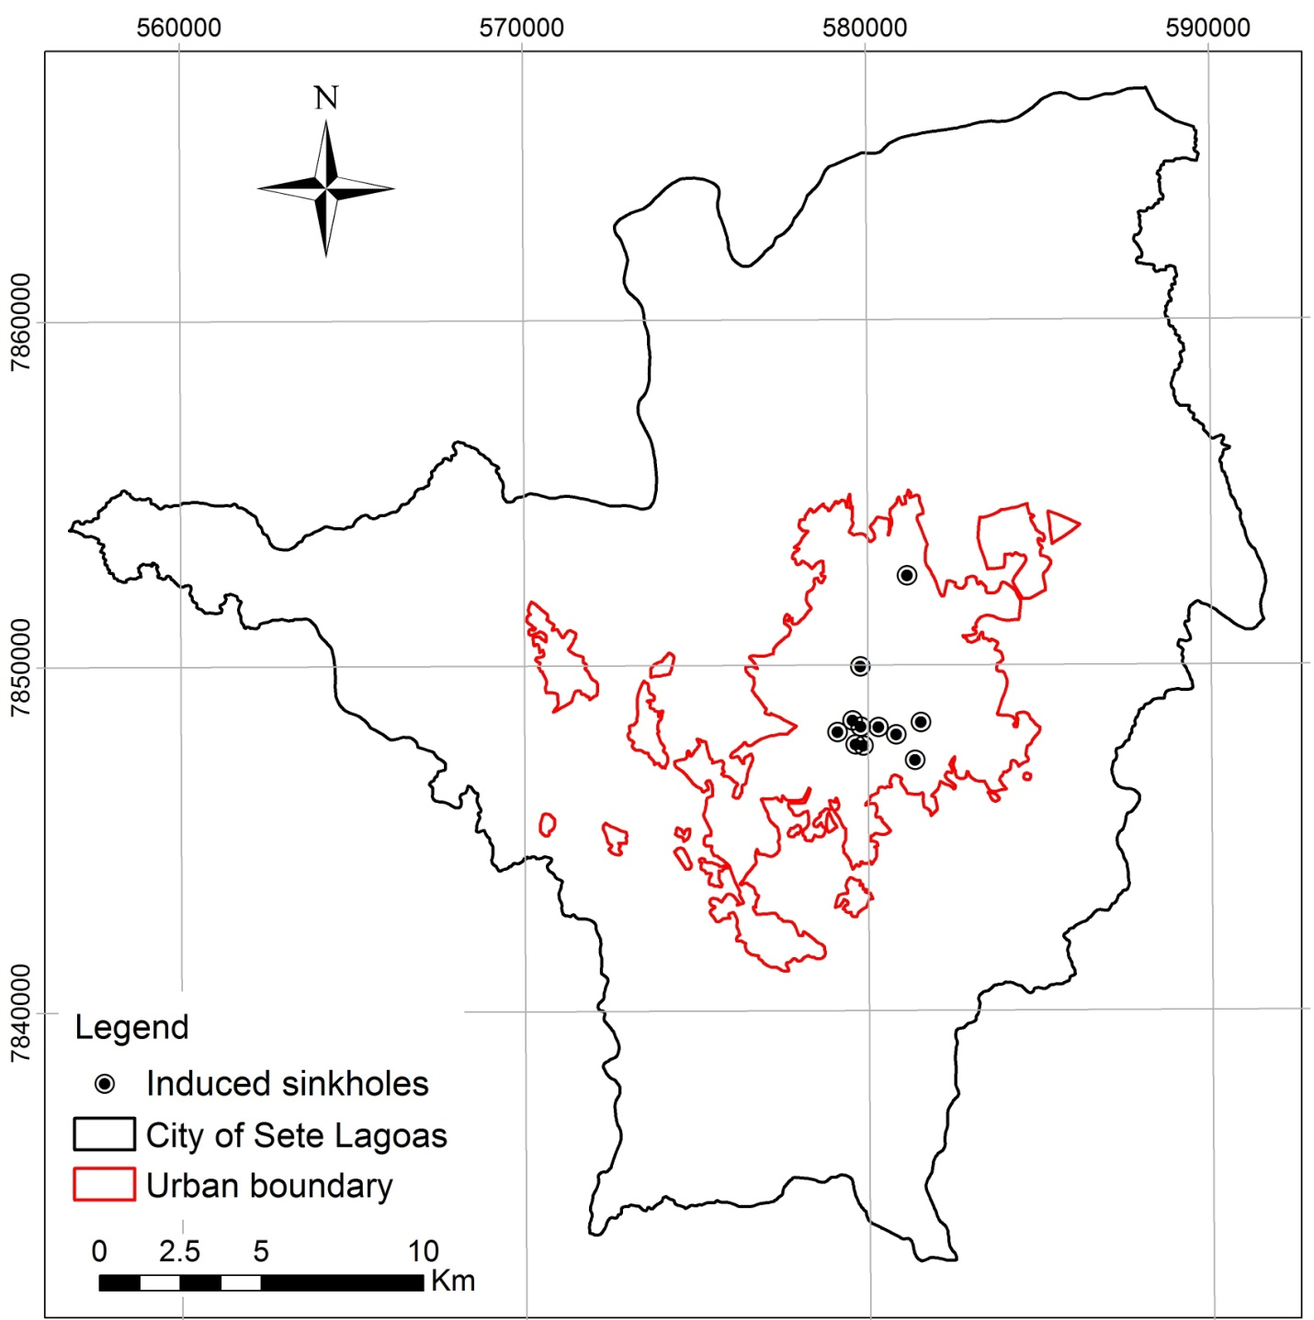
Study area
17 major
Induced sinkhole recorded

Slide 6
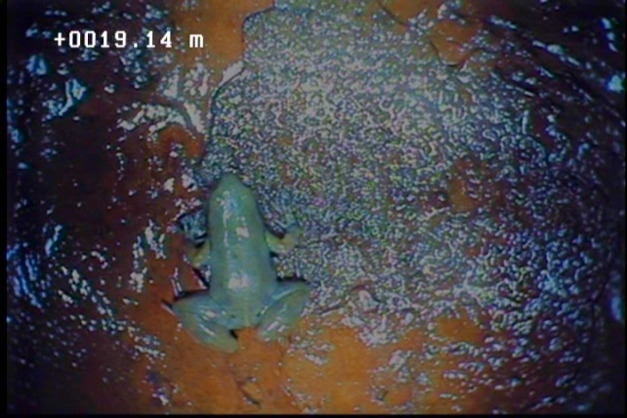
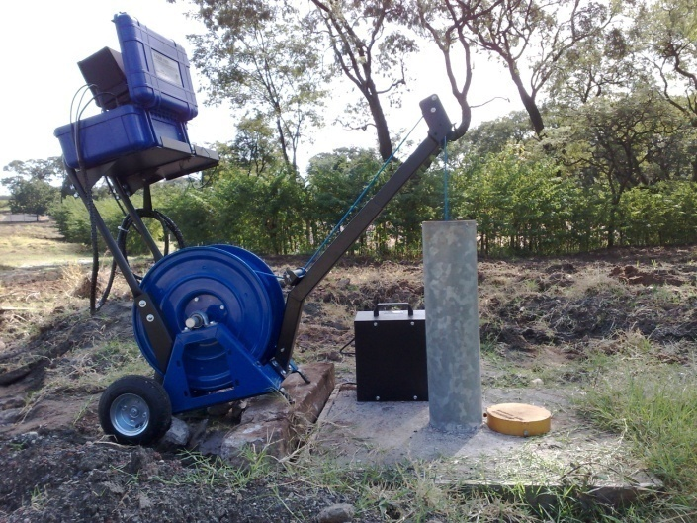
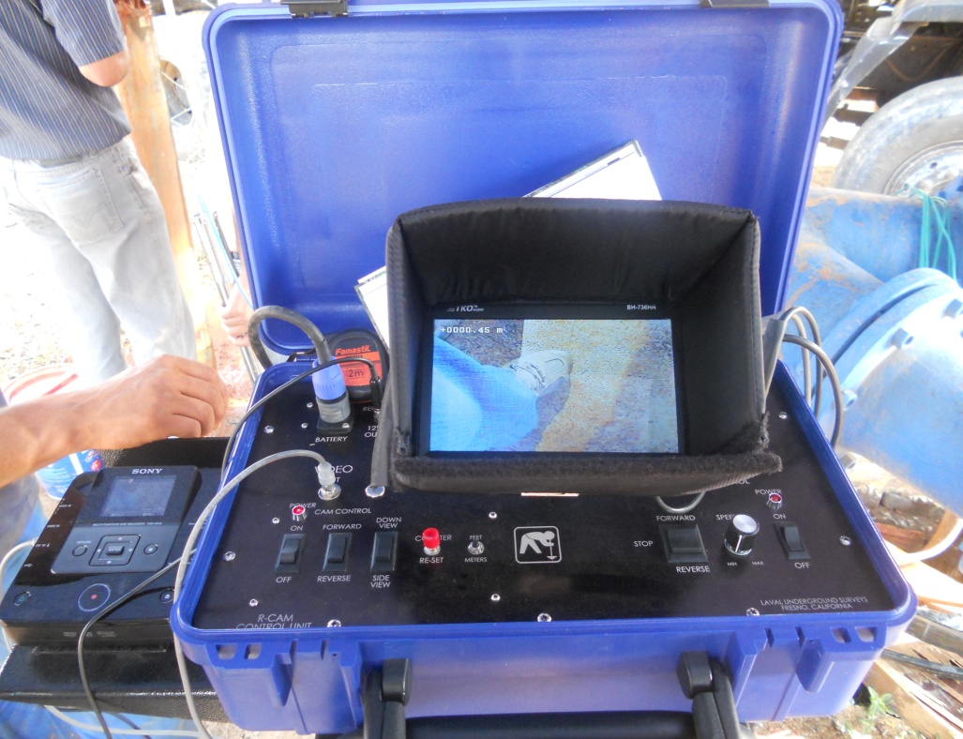
Purpose of the study
Determining the distribution of areas with karst geotechnical risks by integrating available data and acquiring optical well logs and geological data, allowing a new geological perspective, such as the structural framework of the subsurface lithologies and karst conduit geometry.
Zzzz
Regional approach:
Geological mapping in the city limits (scale 1:25,000)
Aerial photography
250 lithologic well profiles (regionally)
Local approach:
30 optical well logs (close to collapse areas)
Potentiometric measurements.

Slide 7
Results
Regional scale

Slide 8
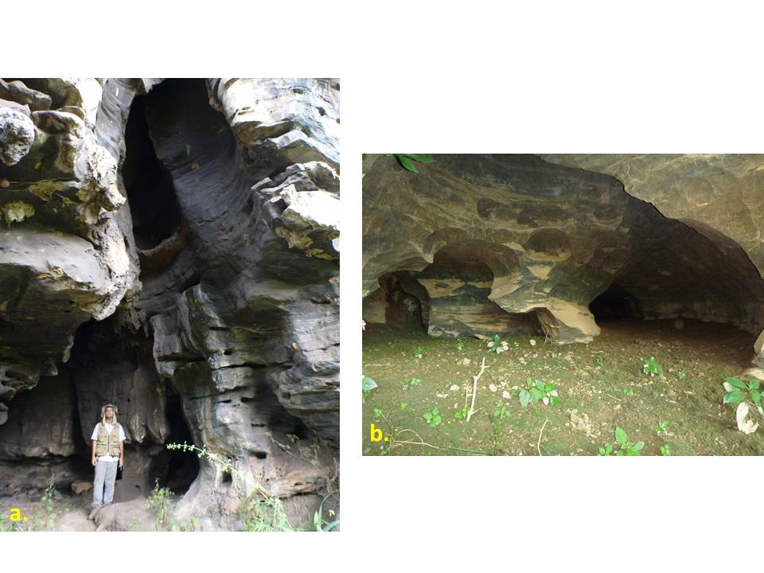
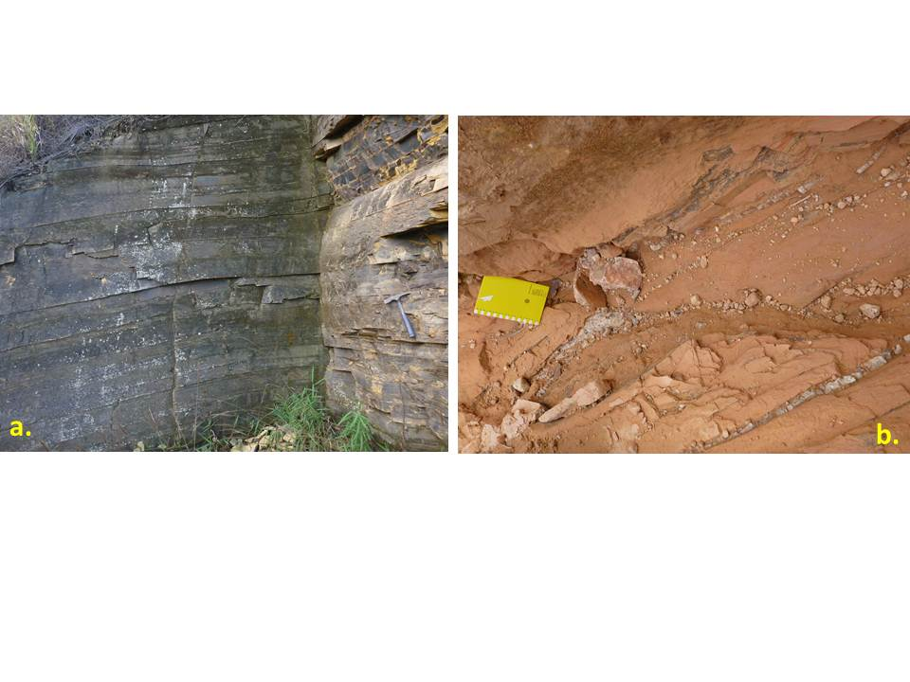
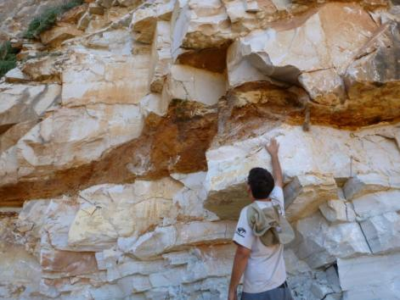
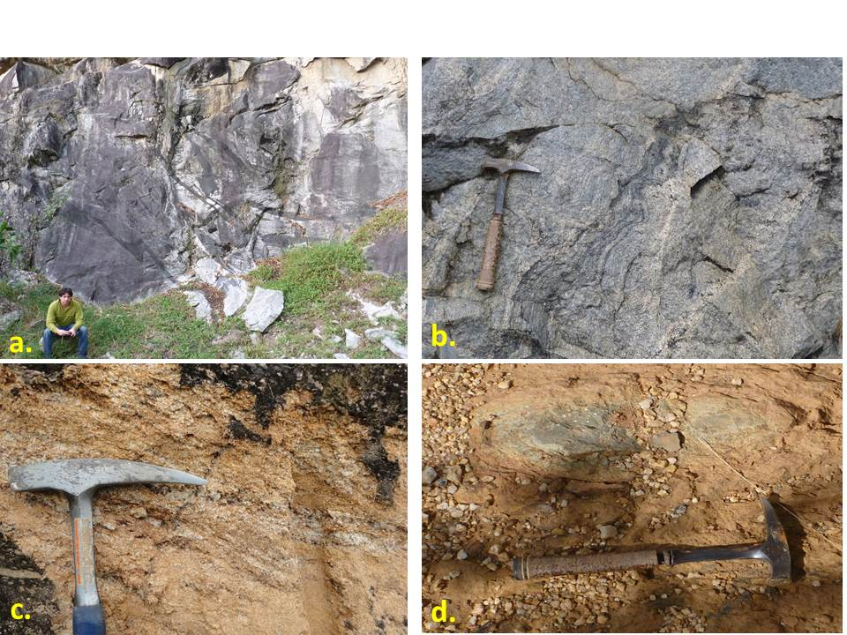
Geological mapping
Sete Lagoas Fm: Lagoa Santa Mb.
Medium grained black limestones
Dry grottoes and caves, indicating groundwater paleoconduits
Santa Helena Fm:
Slate, siltstone and marble
Cenozoic unconsolidated sediments
Sete Lagoas Fm: Pedro Leopoldo Mb.
Fine grained white limestones
Dissolution in bedding planes
Belo Horizonte Complex:
Igneous/metamorphic basement
Notes:
The study area is in a geological context of basement border, with a Neoproterozoic limestones deposited, which is divided by two members:
The oldest one, represented by fine grained white limestone, characterized by dissolution in bedding planes,
And the newest one, represented by medium grained black limestone, characterized by dry grottoes and caves, indicating groundwater paleoconduits.
Covering these limestones, there are resistant rocks, such as slate, siltstone and marble and, locally, unconsolidated sediments.

Slide 9
Geologic cross-sections
Graben area
First risk factor:
Induced sinkholes within graben area
Horst and graben system controlled by faulting
Notes:
Based on cross sections, there is a horst and graben system controlled by faulting, where the urbanized area is located, mostly, over this graben limits.
It was observed that all the induced sinkholes are located within this graben area, which was considered the first risk factor to understand the geotechnical issues!

Slide 10
Hydrogeologic data
Second risk factor:
Highest pumping rates within graben area
Flow convergence in the central area, explained by the high pumping rate in wells

Slide 11
Integrating geologic and hydrogeologic data with optical well logging and geotechnical events
Local scale – graben area

Slide 12
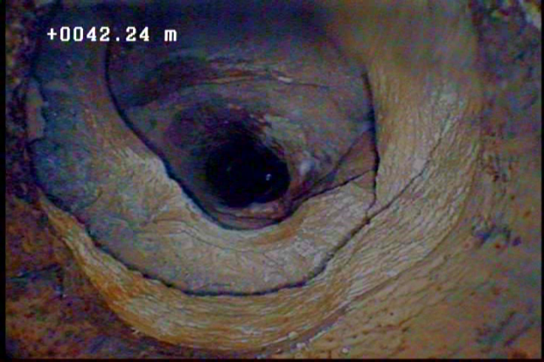
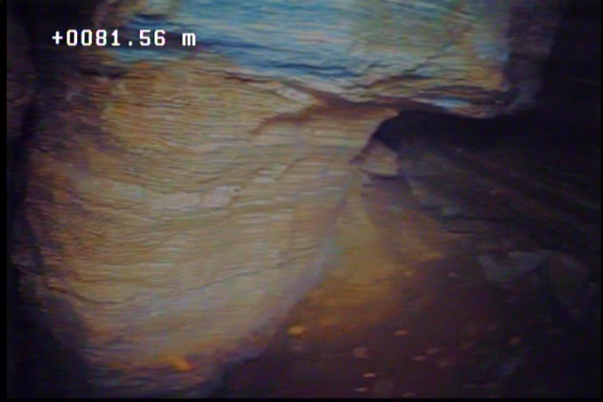
Results
Dry conduit
Downhole
view
Bedding plane
dissolution
Sidehole
view

Slide 13
Geologic conceptual model
Two continuous bedding planes that have undergone dissolution:
1) 1-8 m thick, near the contact with unconsolidated sediments
2) 10-20 m below, with 20 cm to 1 m thick.
Third risk factor:
Dry conduits caused by
high flow rate
Shallowest conduit can be entirely
in the unsaturated zone, close to wells with high pump rate

Slide 14
Collapse setting
Most karst geotechnical problems have been occurring:
1 - Within graben area
2 - With considerable flow rate
3 - Close to dry conduits
4 - Generally, in areas with limestones covered by unconsolidated sediments with an absence of resistant overlying beds (slate, marble, and siltstone).

Slide 15
Discussion
Geotechnical risks

Slide 16
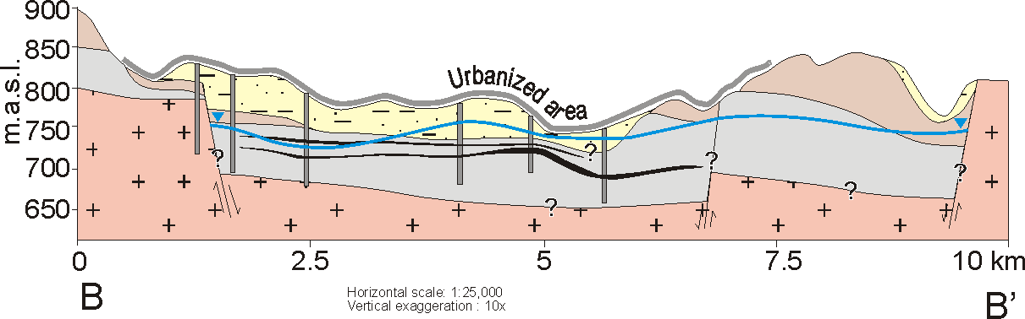
Discussion
High risk: Limestone with conduits covered by unconsolidated sediments, close to the wells with high flow rate
Medium Risk: Regions with unconsolidated sediments or limestone outcrops, and/or with resistant rocks between those.
Low Risk (caution zone): Areas 500 meters beyond other risk areas are still at risk for collapse
3
R 2
Risk 1
R 2
3

Slide 17
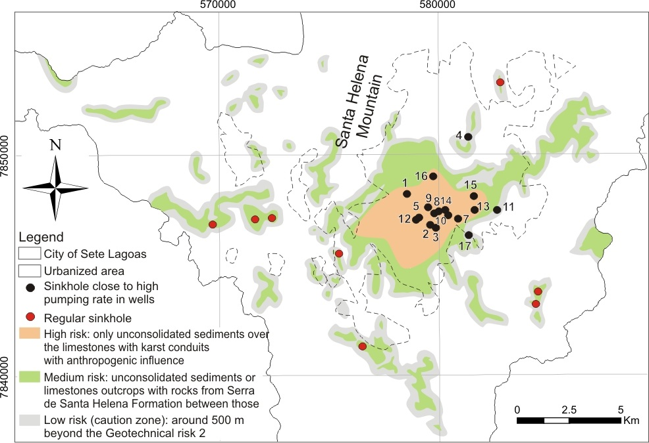
Discussion
Notes:
Now, the final geotechnical risk map, based on the geological map and its outcrops, showing the three types of risks. The orange area is the most concerning area, all located within the urbanized limits. In this portion, there is no sinkholes, but we have the same geological situation in comparison to this portion. The reason to have no collapse yet is just because there is no high flow rate in wells inducing significant decreases in water table.
On medium risk, we can see some regular sinkholes in limestone outcrops, and;
On low risk, there area three 3 sinkholes and 1 regular sinkhole, close to the limestone outcrops, which we, honestly, don’t know if were caused by pumping wells or naturally. We don’t have information enough to distinguish between these 3 points than that one here.

Slide 18
Conclusions
Urbanized area is located in a graben (barrier boundaries for groundwater), which together with karst processes explain the location of the enlarged bedding planes
Collapse related to both natural (geologic setting) and anthropogenic influences (decreased water table creating vadose conduits)
In the urbanized area, additional intensive groundwater extraction will likely induce additional collapse, which the wells with high pumping rate could be regulated to prevent these conditions

Slide 19




Acknowledgements
University of São Paulo
Institute of Geosciences
Servmar Environmental & Engineering
City of Sete Lagoas
Water Supply and Sewage Service
Well drilling company
São Paulo Research Foundation

Slide 20
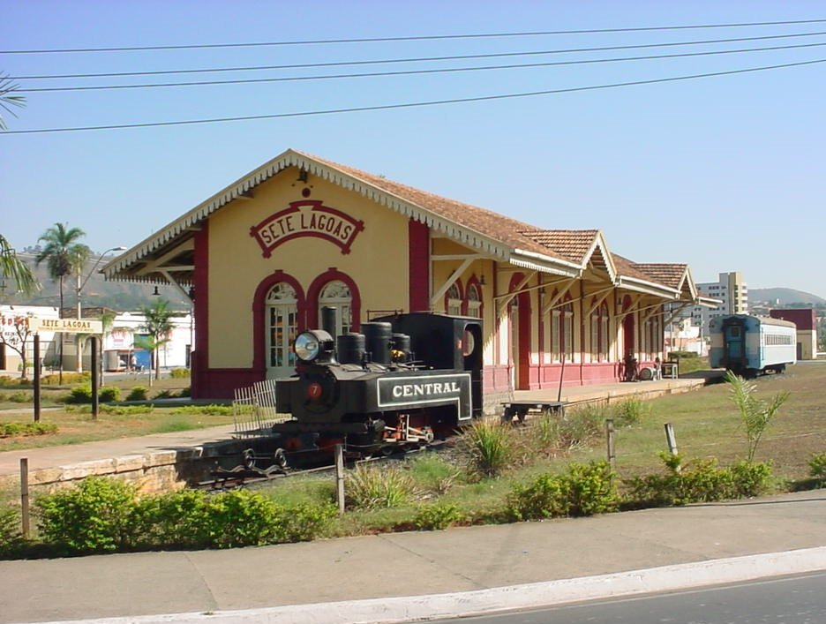
Thanks for your attention!
Questions?
hidropaulo@gmail.com
paulo.galvao@usp.br

Slide 21
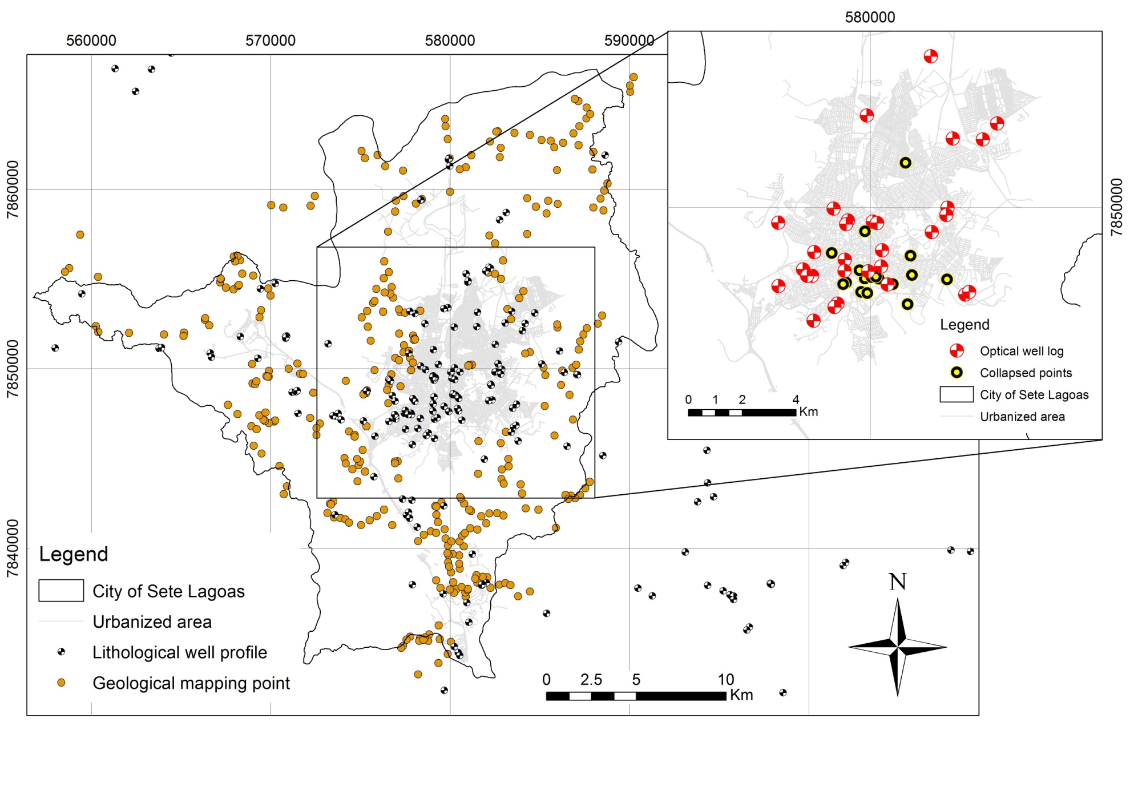
Materials and methods

Slide 22
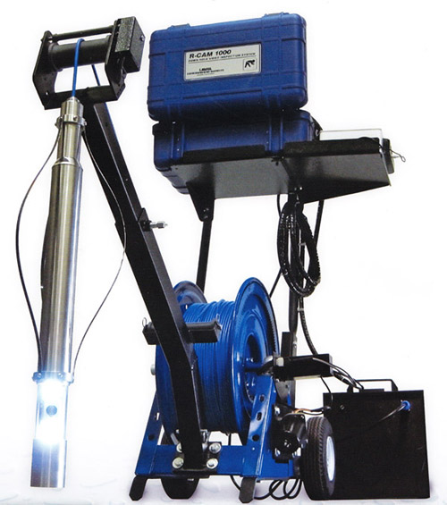
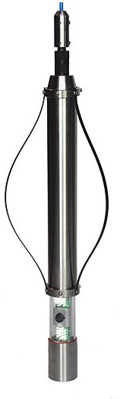
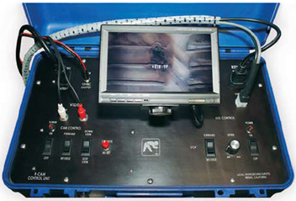
Equipment R-Cam 1000 XS Portable Borehole Camera
Monitor
Camera

Slide 23
References
Albrecht KJ (1996) Evaluation of geological and geotechnical problems in karst land - Basis for geotechnical mapping. Sao Paulo. Master Graduate in Geology - University of Sao Paulo (USP)
Branco Jr, Costa MT (1961) Belo Horizonte-Brasilia roadmap tour. In: Brazilian Congress of Geology, Brasilia. Radioactive Research Institute, Federal University of Minas Gerais (UFMG), Publication 15, Belo Horizonte, p 25
Dudley JW, AJ van der Linden, KG Mah (2009) Predicting accelerating subsidence above the highly compacting Luconia carbonate reservoirs, offshore Sarawak Malaysia. SPE Reservoir Evaluation & Engineering. 12:104-115
Ford DC, Williams PW (2007) Karst geomorphology and hydrology. 2nd edn. John Wiley & Sons, Chichester, U.K. 562 p
Hobbs SL, Gunn J (1998) The hydrogeological effect of quarrying karstified limestone: options for protection and mitigation: Quarterly Journal of Engineering Geology, v. 31, p 147-157
IBGE - Brazilian Institute of Geography and Statistics (2010). Basic Municipal Information. Avaliable: http://www.ibge.gov.br/cidadesat/topwindow.htm?1 Accessed on March 2011.
LaMoreaux PE, Newton JG (1986) Catastrophic subsidence: an environmental hazard, Shelby County, Alabama: Environmental Geology Water Science, v. 8, no. 1/2, p 25-40
Newton JG (1987) Development of sinkholes resulting from man's activities in the Eastern United States; U.S. Geological Survey Circular 968, 54 p
Oliveira LM (1997) The management of urban geological risks in karst areas. Undergraduate thesis. Pontifícia Universidade Católica do Paraná (PUC-PR). 46 p
Pessoa P (1996) Hydrogeological characterization of the region of Sete Lagoas - MG: Potentials and Risks. Master Thesis. Department of Geosciences, University of São Paulo. São Paulo
Ribeiro JH, Tuller MP, Danderfer Filho A (2003) Geological mapping of the region of Sete Lagoas, Pedro Leopoldo, Matozinhos, Lagoa Santa, Vespasiano, Capim Branco, Prudente de Morais, Confins and Funilândia, Minas Gerais State, Brazil (scale 1:50,000). 2nd edn. Belo Horizonte. 54 p
Schobbenhaus C (1984) Geology of Brazil. National Department of Mineral Production, p 275-277
Silva AB (1988) Soil subsidence in the city of Sete Lagoas, Minas Gerais State, Brazil. Brazilian Groundwater Journal, n.12
Tuller MP, Ribeiro JH, Signorelli N, Féboli WL, Pinho JMM (2010) Sete Lagoas - Abaeté Project, Minas Gerais State, Brazil. 6 geological maps, scale 1:100,000 (Geology Program of Brazil), 160p

