Slide 1


USING VETIVER GRASS TO REMOVE LEAD FROM RESIDENTIAL SOILS OF SAN ANTONIO, TEXAS:
A SIMULATED FIELD STUDY
Rupali Datta¹, Dibyendu Sarkar² and
Ramesh Attinti²
¹Biological Sciences, Michigan Technological University, Houghton, MI,
²Earth and Environmental Studies, Montclair State University, Montclair, NJ

Slide 2
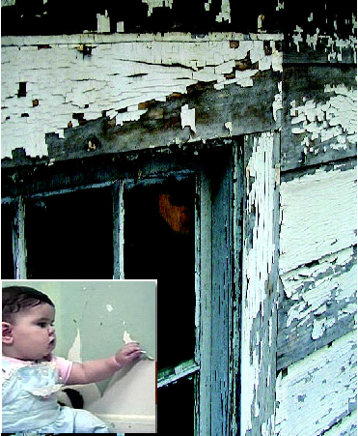
Lead toxicity
      CDC lowered the reference elevated blood lead level (EBLL) for children from 10μg/dL to 5µg/dL in 2012.
      Soil and house dust in pre-1978 homes are the principal sources of lead absorption among children.
      Traditional methods of soil remediation are expensive and unrealistic for residential soils.
http://www.epa.gov/lead/

Slide 3




Lead health effects
Young children under the age of six are especially vulnerable
low levels
Reduced IQ
Learning disabilities
Attention deficit disorders
Behavioral problems
Stunted growth
Impaired hearing
Kidney damage
high levels
Mental retardation
Coma, and death
Juvenile delinquency and criminal behavior

Slide 4
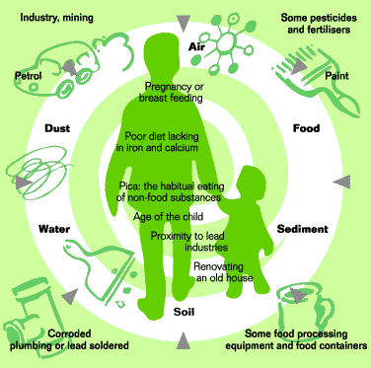
Pathways of lead in the environment
http://www.environment.nsw.gov.au/leadsafe/sources.htm

Slide 5
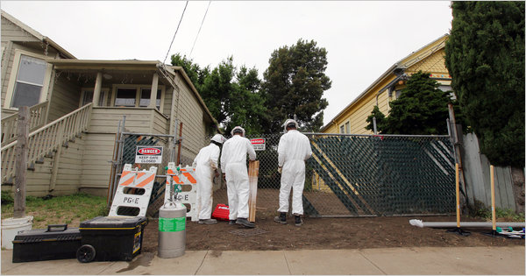
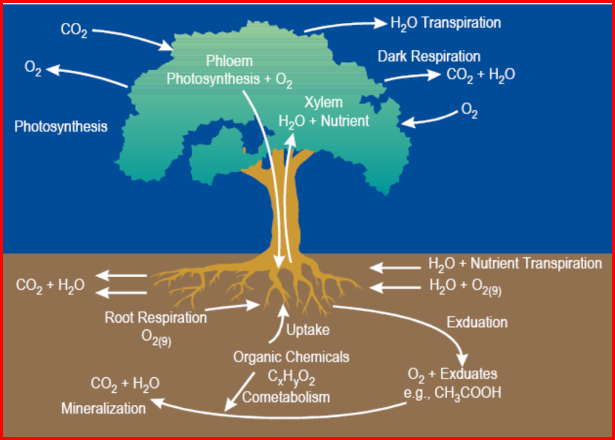
Lead remediation
Traditional method:
“Dig and haul” for residential areas
Chemical remediation
Ingestion/inhalation pathways
Phytoremediation
http://www.nytimes.com/2011/07/21/science/earth/21fishbones.html
Naval Facilities Engineering Service Center, Port Hueneme, CA.
http://www.enviro.nfesc.navy.mil/erb_a/restoration/technologies/remed/bio/phyto-rits.pdf

Slide 6
Why phytoremediation?
Comparative Mass Disposal (10 Acres)
Excavation
Phytoremediation
Biomass Ash
30,000 Tons 1200 Tons 120 Tons

Slide 7
Candidates for lead phytoremediation
Grasses Alfalfa Cabbage Sesbania sp. Vetiver | Sunflower Morning glory Red clover Corn Indian mustard

Slide 8
Hyperaccumulators
By definition must accumulate at least
100 mg kg-1 (0.01% dry wt.) Cd, As and some other trace metals
1000 mg kg-1 (0.1 dry wt.) Co, Cu, Cr, Ni and Pb and
10,000 mg kg-1 (1% dry wt.) Mn and Zn

Slide 9
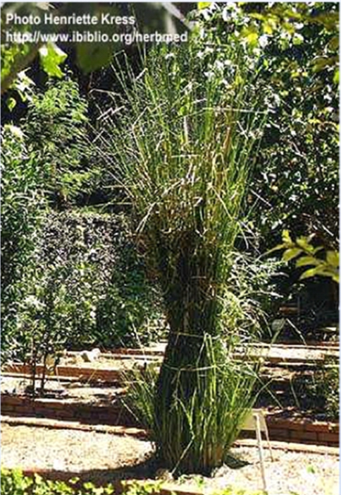
Phytoremediation - Vetiver
Hyper accumulator
Fast growing
High biomass
Extensive root system
Non Invasive
Easy to harvest

Slide 10
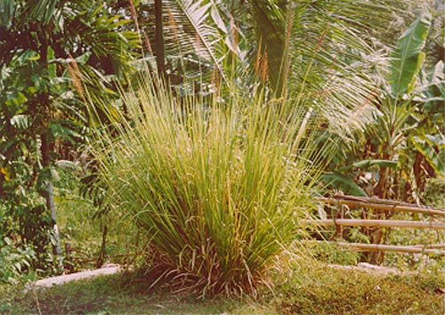
Vetiver (cont.)
Perennial grass (1-2 m tall)
Massive complex root system penetrating to deeper layers of the soil (3-4 m deep)
Reduces erosion and leaching
Survives in many different types of soil and in a wide range of climates
Inexpensive, easy to maintain

Slide 11
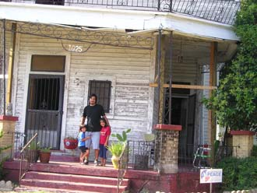
Phase I: Greenhouse study
Lead paint contaminated soil samples were collected from San Antonio, TX from 11 house sites
Soil physico-chemical properties were analyzed.
A greenhouse study was initiated
http://www2.sacurrent.com/printStory.asp?id=60413

Slide 12
Phase I: Soil properties
Soil Properties | Lead paint contamianted soil samples from house sites
 | 1 | 2 | 3 | 4 | 5 | 6 | 7 | 8 | 9 | 10 | 11
pH | 8.00 | 7.71 | 7.97 | 7.45 | 7.67 | 8.23 | 7.75 | 7.58 | 8.20 | 7.61 | 8.07
EC | 327.7 | 627.3 | 548 | 677.3 | 658.3 | 299 | 791.3 | 1,392 | 228.5 | 477 | 189.1
LOI % | 0.32 | 1.22 | 0.69 | 0.87 | 0.89 | 0.37 | 0.75 | 0.67 | 0.63 | 0.60 | 2.70
WC% | 0.18 | 0.30 | 0.29 | 0.38 | 0.35 | 0.10 | 0.40 | 0.28 | 0.53 | 0.55 | 0.06
Carbonate (%) | 31.4 | 16.3 | 27.5 | 29.9 | 29.7 | 29.6 | 23.7 | 32.8 | 37.2 | 39.2 | 48.2
Clay (%) | 4.3 | 17.8 | 12.3 | 20.5 | 6.8 | 3.5 | 5.9 | 8.5 | 46.3 | 60.5 | 54.2
Silt (%) | 30.5 | 56.8 | 57.7 | 43.1 | 43.2 | 30.4 | 70.6 | 63.4 | 43.2 | 25.4 | 29.7
Sand (%) | 65.1 | 25.4 | 30.0 | 36.4 | 50.1 | 66.1 | 23.5 | 28.2 | 10.5 | 14.0 | 16.1
Pb (Mehlich 3) | 36.8 | 287.2 | 12.7 | 235.3 | 387.7 | 102.7 | 363.2 | 317 | 876.1 | 1,071 | 321.4
Pb (Olsen) | 9.5 | 146.2 | 2.6 | 9.5 | 270.9 | 5.47 | 120 | 108.5 | 171.4 | 137.3 | 15.2
Pb (Oxalate) | 21.2 | 55.7 | 3.8 | 88.1 | 197.4 | 3.9 | 101.3 | 18.7 | 196 | 598 | 246.1
Pb (Total) | 79.1 | 1,078 | 35.53 | 1,133 | 4,182 | 305.9 | 2,365 | 2,346 | 2,278 | 3,164 | 1,513

Slide 13
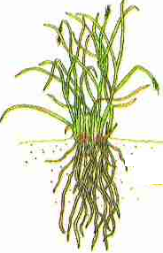


Experimental design
Vetiver grass
Vetiver grass
Soil Property
pH | 8.07 ± 0.1
EC | 189.1 ± 4.3
SOM (%) | 2.70 ± 0.2
CO₃²⁻ (%) | 48.2 ± 4.4
Clay (%) | 54.2 ± 7.6
Silt (%) | 29.7 ± 3.5
Sand (%) | 16.1 ± 2.1
Elemental Composition (mg/Kg soil)
Phosphorus | 1,056 ± 69
Calcium | 59,428 ± 4532
Magnesium | 3,278 ± 468
Iron | 14,225 ± 2691
Aluminum | 14,269 ± 1648
Lead | 1,513 ± 312
Lead
Lead
-
-
contaminated soil
contaminated soil
(6
(6
”
”
h)
h)
PVC column
PVC column
(15
(15
”
”
x 6
x 6
”
”
)
)
Clean Sand (7
Clean Sand (7
”
”
h)
h)
Plastic mesh
PVC cap
Plastic mesh
PVC cap
Leaching tube
Marble
Leaching tube
Marble
Chelants:
1) Ethylenediaminetetraacetic acid (EDTA)
2) [S,S’]ethylenediaminedisuccinic acid (EDDS)
Chelant Concentrations: EDTA and EDDS (0,5, 10, and 15 mM/ Kg soil)
Experimental Duration: 70 days (Chelant addition to the soils at the end of 2nd month)
Notes:
We used two soils, one from each location, with varying soil properties and similar soil Pb concentrations of about 1500 mg /kg soil. Baltimore soil is a slightly acidic soil with low levels of clay and carbonate, while San Antonio soil is an alkaline soil with high levels of clay, carbonate and calcium. Greenhouse Pb-phytoextraction studies were carried out in packed soil columns made of PVC (15” high x 6” diameter). Each column is filled with 7 inches height of play sand, followed by 6 inches of Pb-paint contaminated residential soil. Vetiver grass was grown in the columns with recommended water and nutrient supply. At the end of 2nd month, EDTA and EDDS were added at 0, 5, 10, and 15 mmol kg-1. Ten days after the addition of chelates, plants were harvested and being analyzed for Pb uptake and thiol content.

Slide 14
Lead uptake by vetiver
A
A
a
a
B
B
b
C
b
C
c
c
D
d
D
d

Slide 15
Lead concentrations in soil

Slide 16
Conclusions: Phase I study
Vetiver grass is a lead accumulator, and is effective in remediating lead-contaminated soils, in conjunction with chelating agents.
Lead accumulation increased with increasing concentration of chelating agents, EDTA and EDDS.
EDTA was more effective in increasing lead accumulation in vetiver compared to EDDS.
Application of chelating agents significantly increased root to shoot translocation of lead on vetiver.
Between 14-20% reduction in total soil lead was observed at the end of the study.

Slide 17
Phase II: Simulated field study
Lead paint contaminated soil samples were collected from San Antonio, TX from 9 house sites
Soil physico-chemical properties were analyzed.
A simulated field study was set up in San Antonio

Slide 18
Phase II: Simulated field study
Soil Name | pH | Total Pb concentration (mg/kg)
Sutton Dr | 7.64 ± 0.02 | 48.38 ± 3.67
Edison Dr | 7.38 ± 0.03 | 29.48 ± 2.84
W. Craig Pl | 7.37± 0.06 | 2538.38 ± 219.63
Delmar | 7.41 ± 0.03 | 1485.23 ± 110.88
Barrett Pl | 7.64 ± 0.14 | 569.15 ± 15.80
Brighton | 7.96 ± 0.13 | 400.88 ± 165.95
Ware Blvd | 7.24 ± 0.02 | 587.66 ± 65.65
Bailey Ave | 7.50 ± 0.04 | 1486.10 ± 70.66
Hackberry Ave | 7.62± 0.04 | 2143.5 ± 114.21
All data are shown as mean (n=3) ± standard deviation

Slide 19
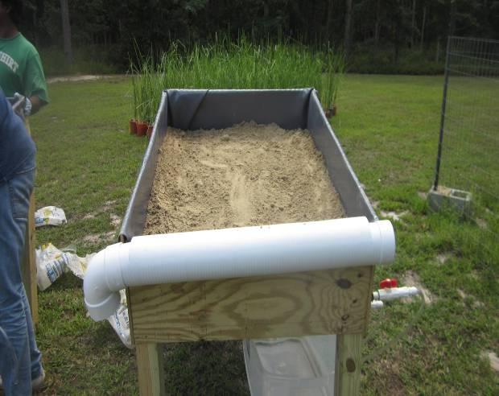
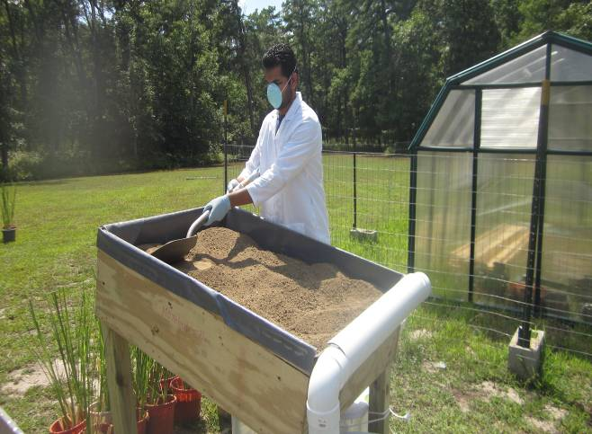
Experimental design
Wooden platforms (4’ x 3’ × I’)
5 inches of play sand
5 inches of contaminated soil
2 platforms from each site
  Vetiver grass
  Fescue grass
  No plant control
  Plants were grown for 3 months
  10 mmol/kg EDDS was applied
  Soil, plant and leachate sample were collected before and 15 d after EDDS application and analyzed for lead.

Slide 20
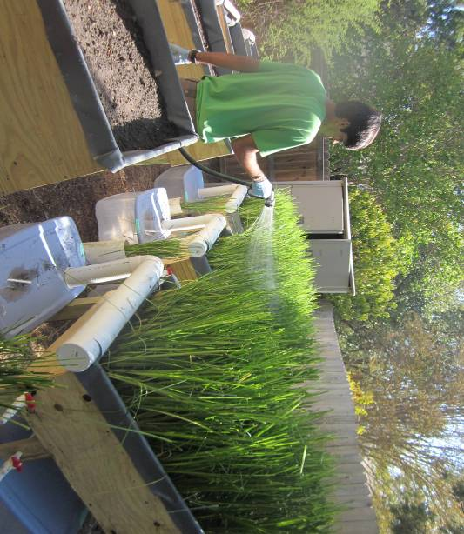
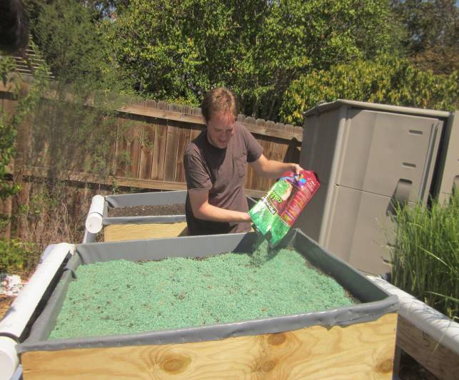
Vetiver and fescue grass platforms

Slide 21
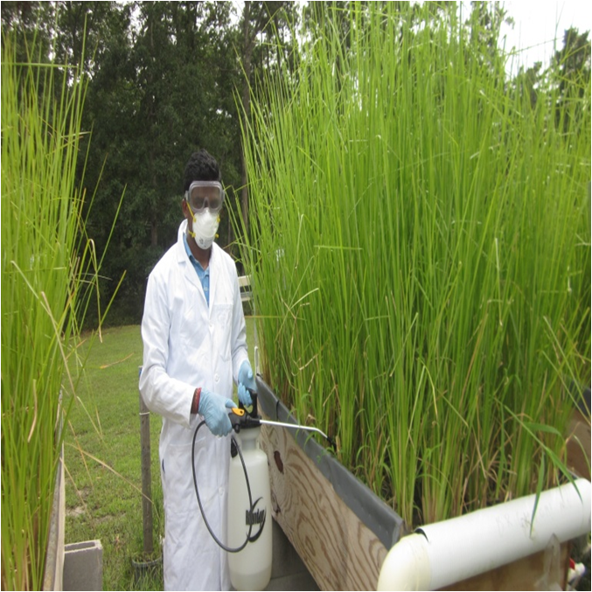
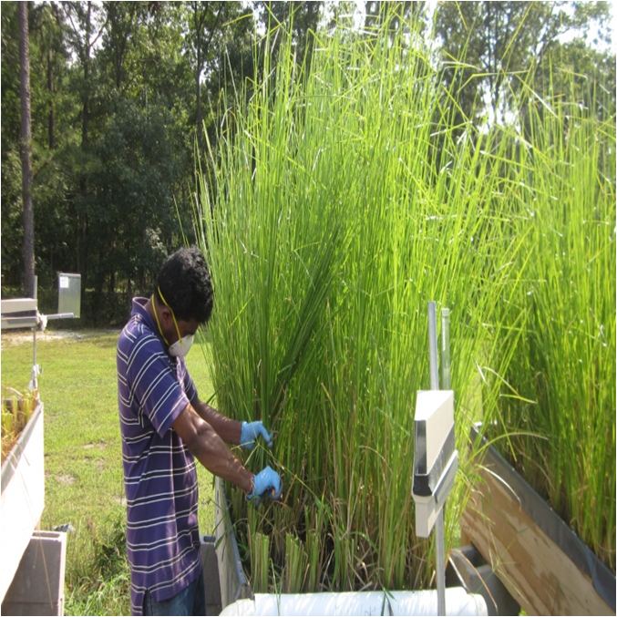
EDDS application

Slide 22
Soil Erosion from Platforms
S. No | Soil |  | Erosion (Kg)
1 | Vetiver platform | Bailey | 0.05
 |  | Craig | 0.06
3 |  | Hackberry | 0.08
4 | Fescue grass platform | Craig | 0.18
5 |  | Bailey | 0.14
6 |  | Hackberry | 0.21
7 | Control (no plant) platform |  | 0.62

Slide 23
Plant uptake: EDDS application

Slide 24
Plant uptake: EDTA application

Slide 25
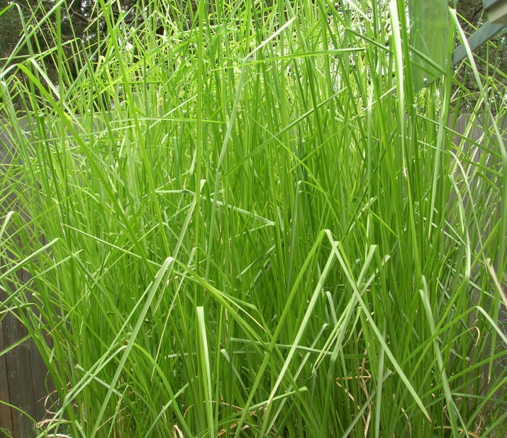
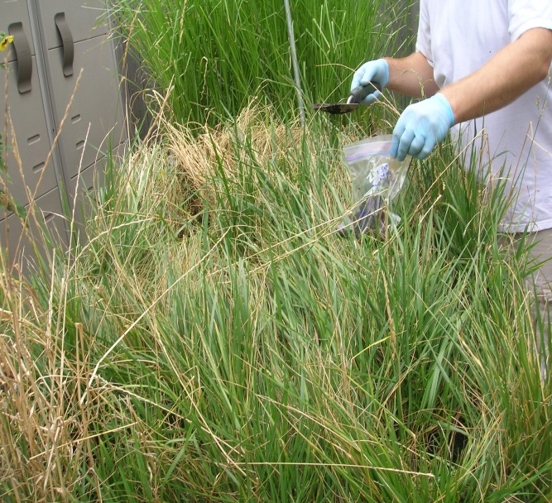
Effect of lead on grasses

Slide 26
Percent removal after five cycles

Slide 27
Lead leaching from compost
S. No | Soil name | Pb in Vetiver Compost (mg/L) | Pb in Fescue grass Compost (mg/L)
1 | Bailey | 0.85 ± 0.04 | 0.16 ± 0.05
2 | W. Craig | 0.69 ± 0.03 | 0.12 ± 0.04
3 | Hackberry | 1.14 ± 0.08 | 0.22 ± 0.03

Slide 28
Conclusions: Phase II study
Vetiver grass performed well during Phase II, and showed no phytotoxic symptoms.
Yellowing and growth inhibition was seen in control fescue grass.
Compared to fescue grass, vetiver accumulated 35-50 times higher concentration of lead.
After five cycles of chelating agent application, between 18-22% of the soil lead was reduced.
The concentration of lead in the decomposed clippings from vetiver and fescue grass were significantly lower than the USEPA TCLP limit of 5 mg/L for lead. Hence, grass clippings can be safely disposed as non-hazardous waste.

Slide 29
Acknowledgement
Lead technical studies program of Housing and Urban Development

