Slide 1
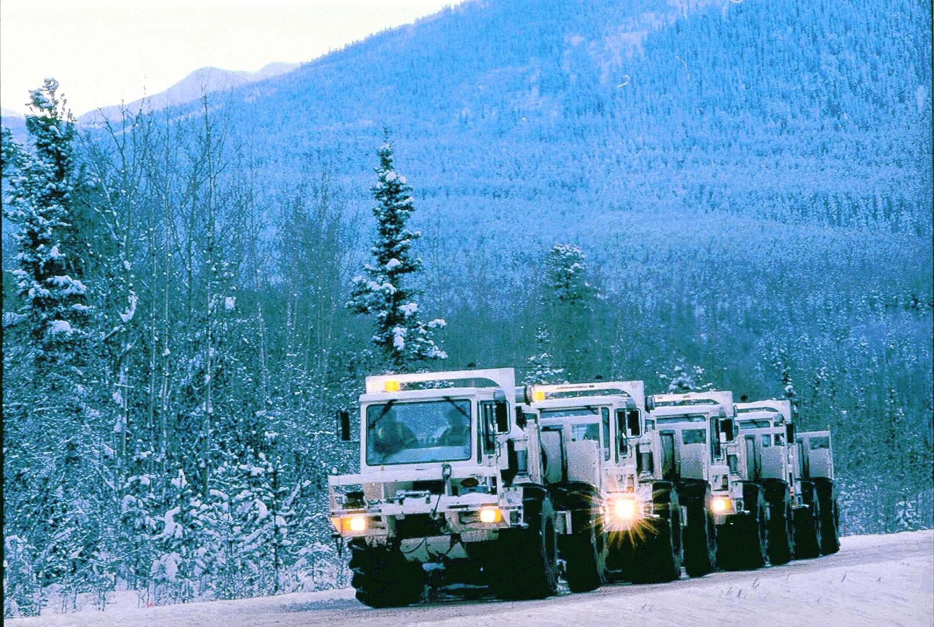

GEOPHYSICS and GEOLOGY:
An Essential Combination Illustrated by
LITHOPROBE Interpretations
Ron M. Clowes
Earth, Ocean & Atmospheric Sciences
University of British Columbia, Vancouver, Canada
rclowes@eos.ubc.ca
LITHOPROBE
GSA Vancouver, October 20, 2014

Slide 2
OVERVIEW
LITHOPROBE (1984-2005) redefined the nature of much Earth science research in Canada. Among other aspects, it:
Fostered an unprecedented degree of cooperation among Earth scientists from all sectors
Spawned a new and healthy atmosphere of scientific cooperation among geologists, geophysicists and geochemists

Slide 3
PURPOSE
To emphasize that:
Geophysicists and geologists must work together
Geophysical and geological data must be combined to achieve the best interpretation of those data, including extension to depth
Constrained models of tectonic evolution can be obtained

Slide 4
HOW?
Three examples, one from the Mesozoic –Cenozoic Cordillera and two from Precambrian transects:
Northern Cordillera (1996); craton to Cordillera transition
Mesoproterozoic Grenville Orogen (1988, 1990)
Paleoproterozoic Trans-Hudson Orogen (1992)
[For more examples with details, see paper by Clowes in Geoscience Canada, late 2014 or early 2015]

Slide 5
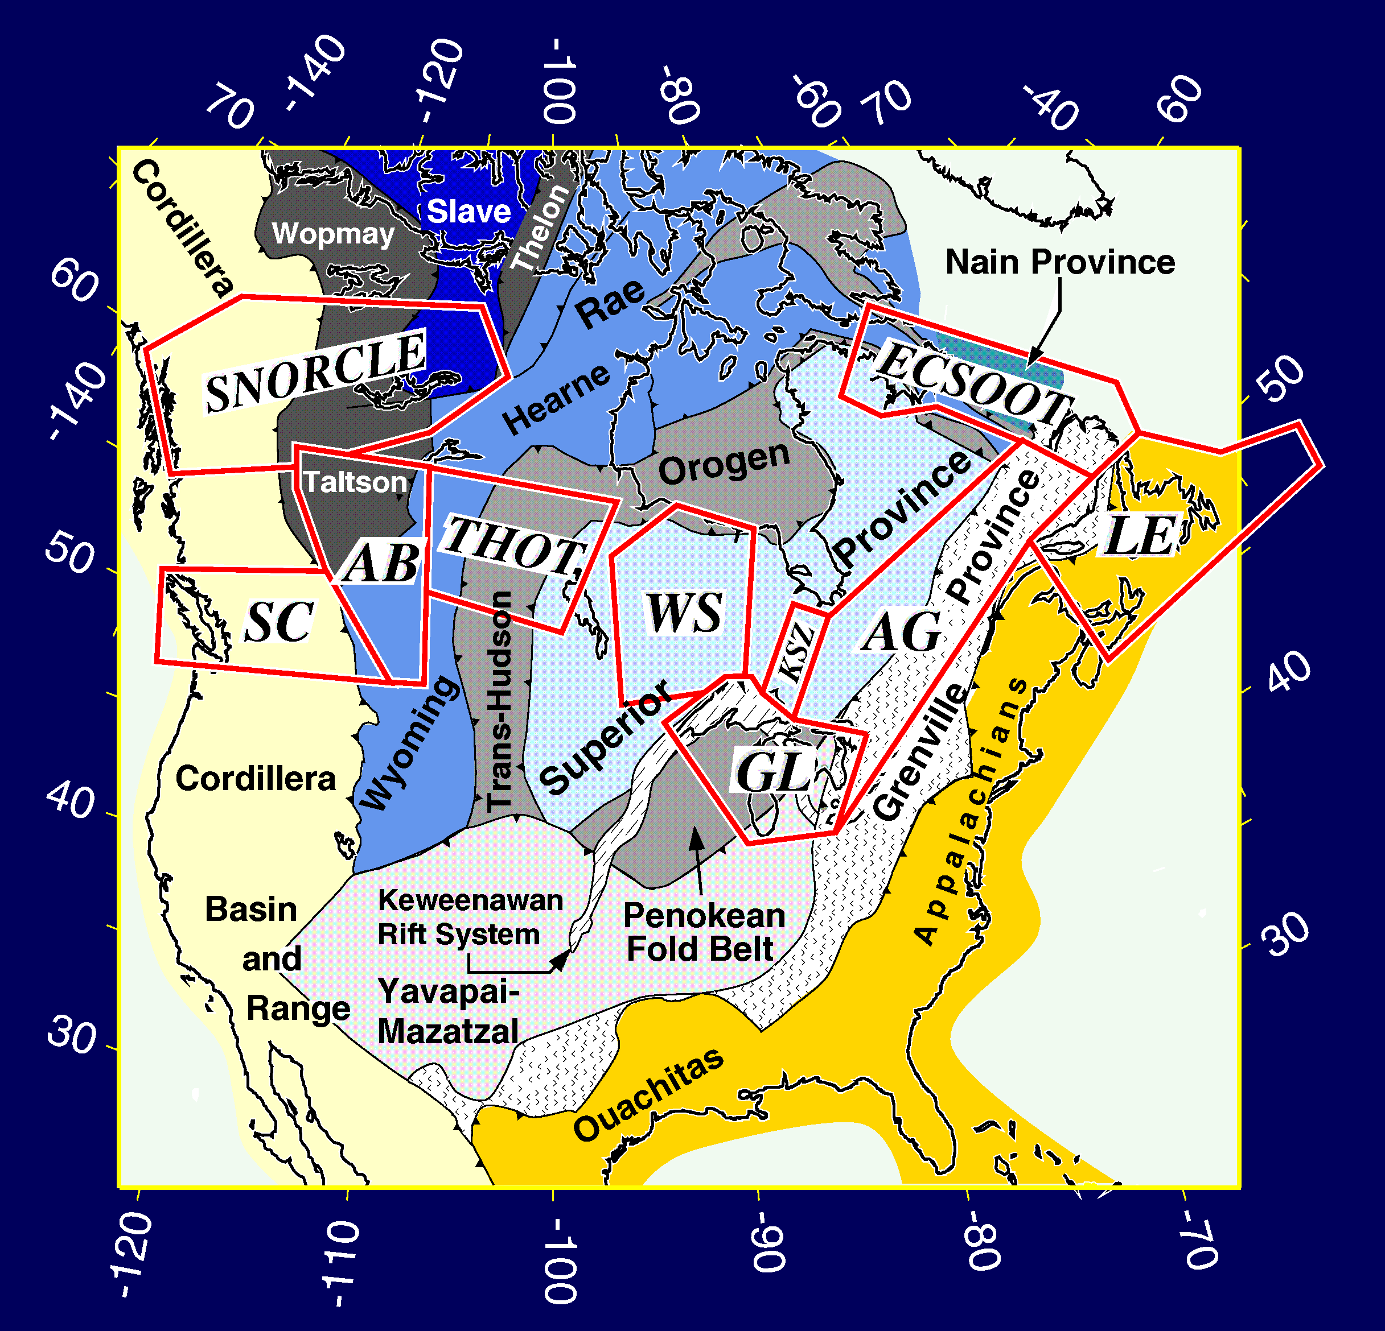
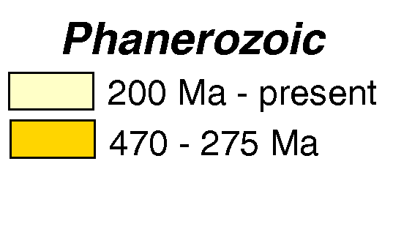
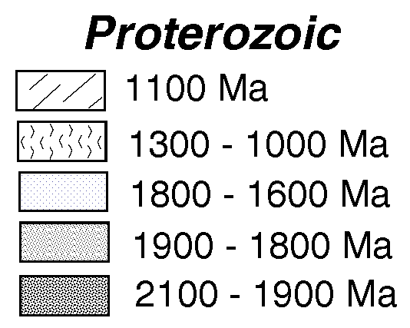
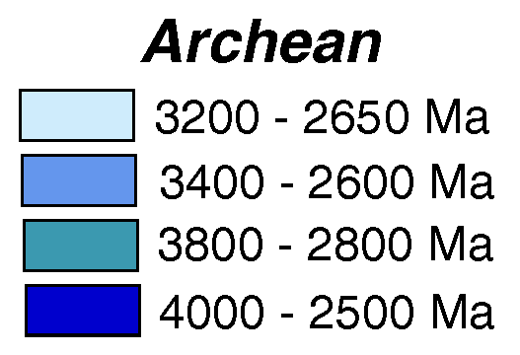
Tectonic element map of North America –
10 LITHOPROBE transect study areas – red polygons
Areas for 3 examples -- blue ovals
Crustal ages

Slide 6
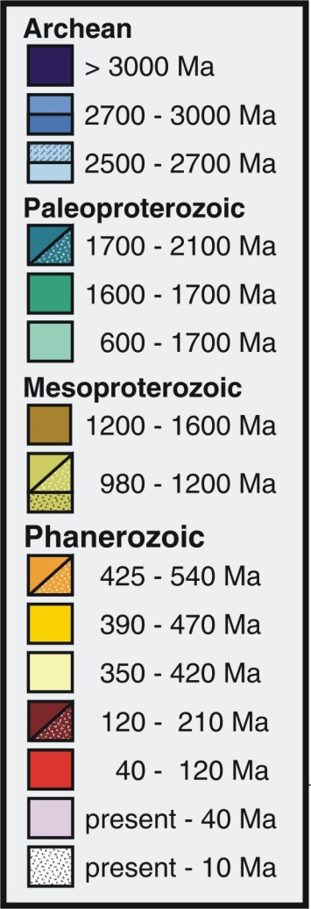
1. Transition from Paleoproterozoic Wopmay orogen to Mesozoic Cordillera across deformation front
Thelon
Slave
Rae
Wopmay
Nain
Cordillera
New Quebec
Taltson +
Trans-Hudson
Orogen
Superior
Hearne
Appalachian
Orogen
Mid-continent
rift
GrenvilleOrogen
Mid-continent
Rift
Wyoming

Slide 7
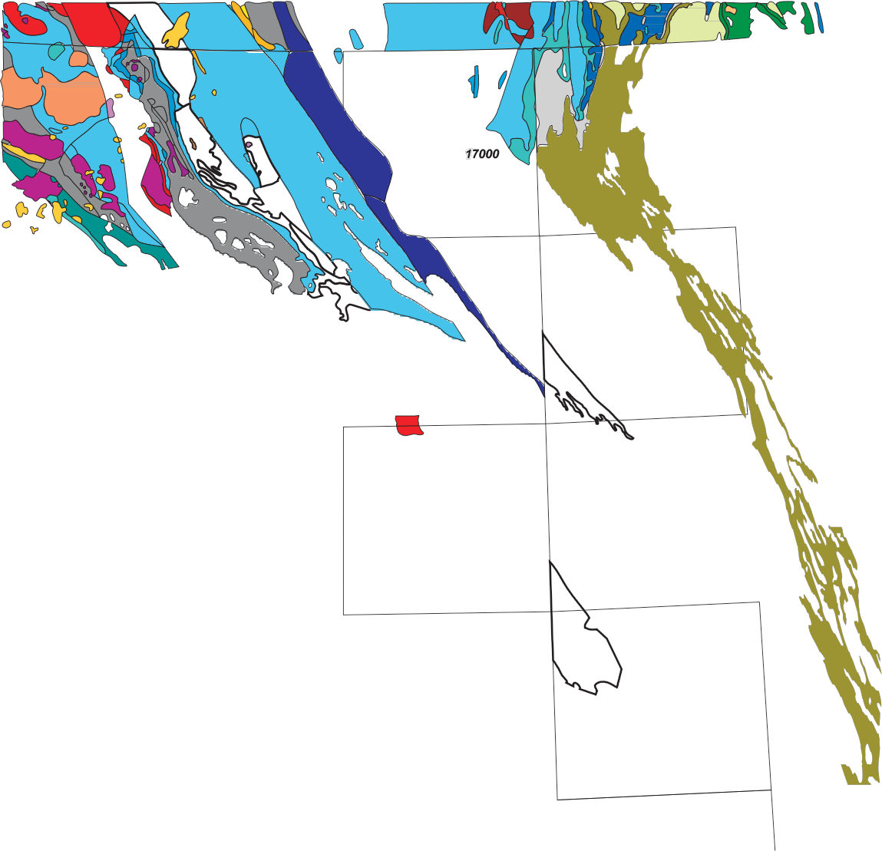
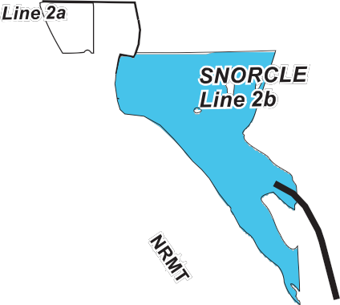

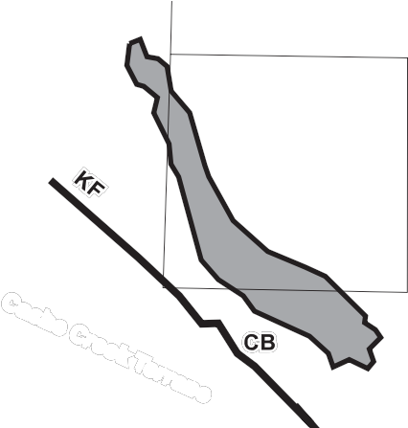
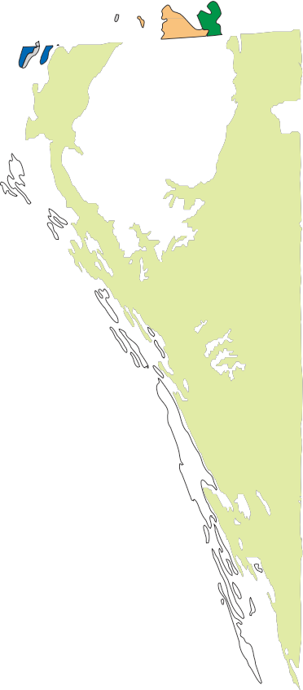
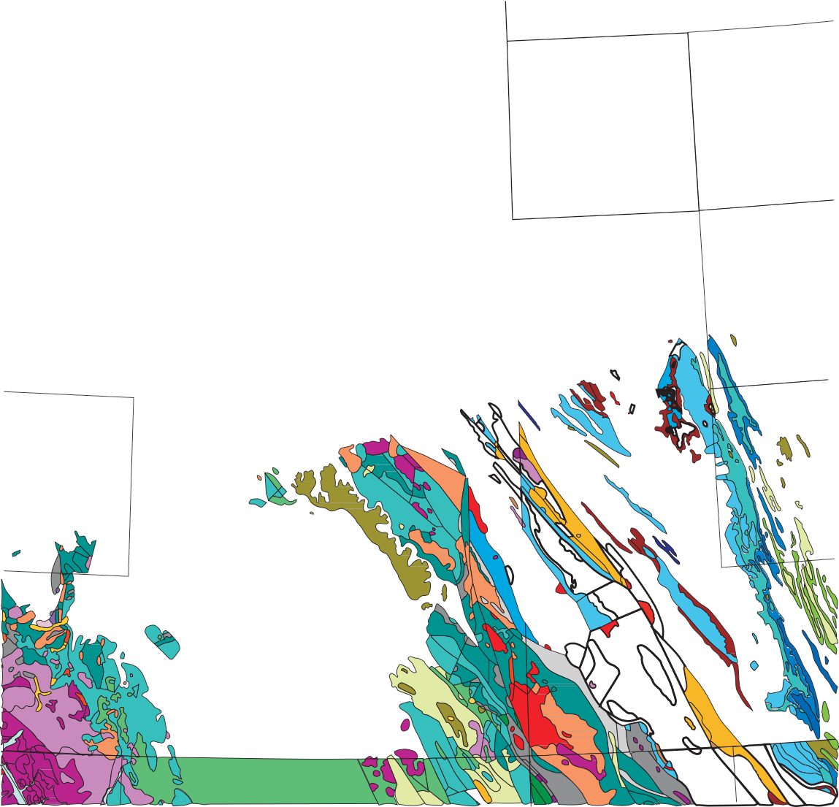
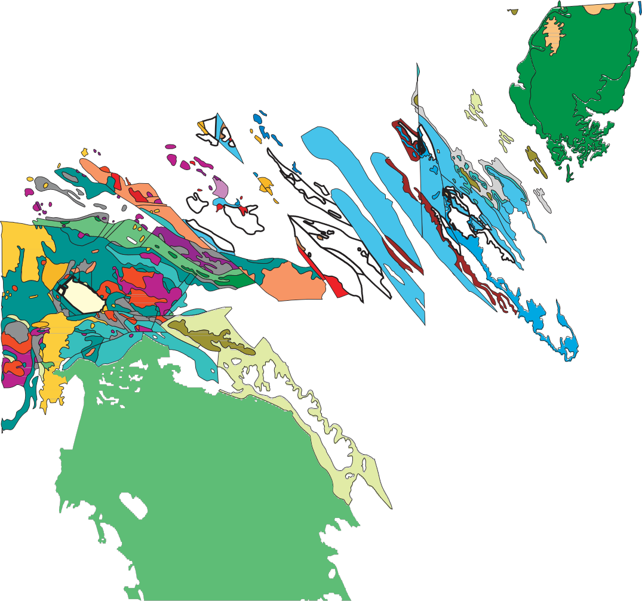
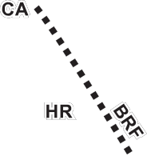
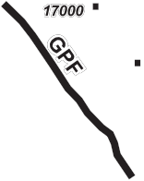
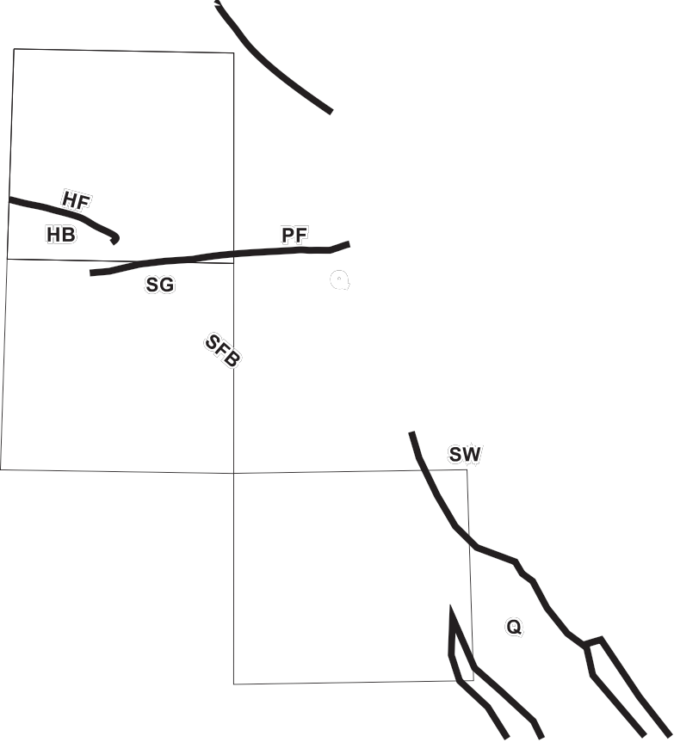

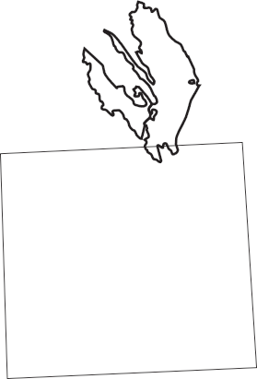


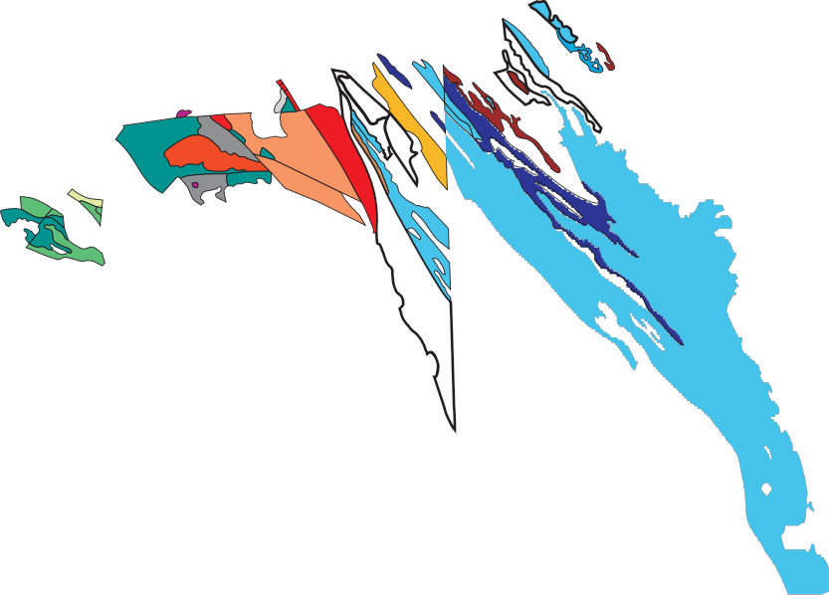

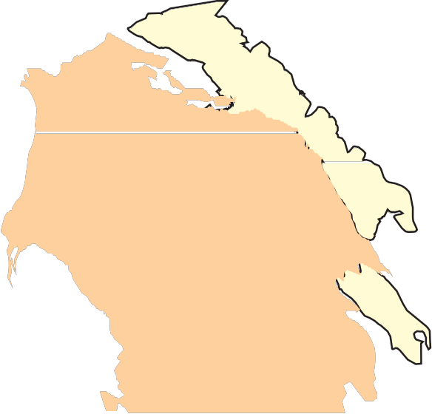
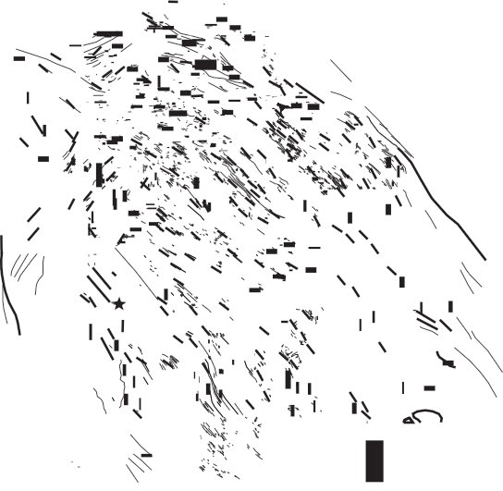



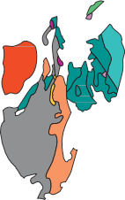

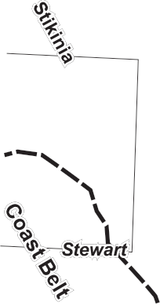




Simplified geological map of northern B.C. highlighting seismic line across deformation front and Mesoproterozoic outcrops
2
4
Muskwa assemblage
0 km 100

Slide 8
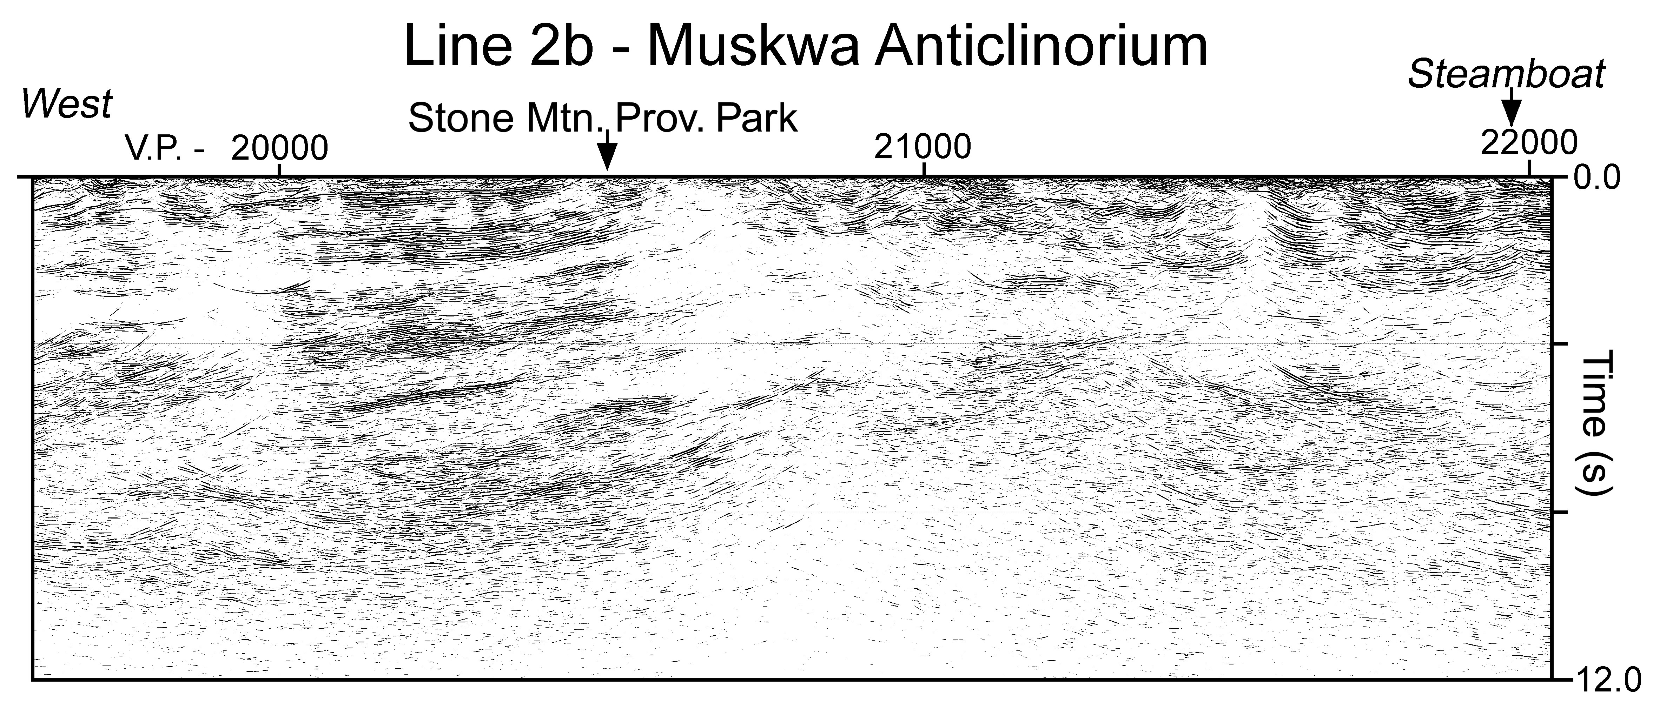
Migrated seismic reflection section and interpretation for segment of line crossing from Wopmay Orogen (Nahanni terrane) to Foreland belt of Cordillera
Deformation front
Foreland Belt
Wopmay Orogen
East
Paleozoic
Mesozoic
Mesozoic
MA
Mesoproterozoic 1.2-0.8 Ga
Muskwa Assemblage 1.8-1.2 Ga
Paleozoic-Proterozoic
MA
Paleoproterozoic <1.8 Ga
North American Basement >1.8Ga
0
km
25

Slide 9
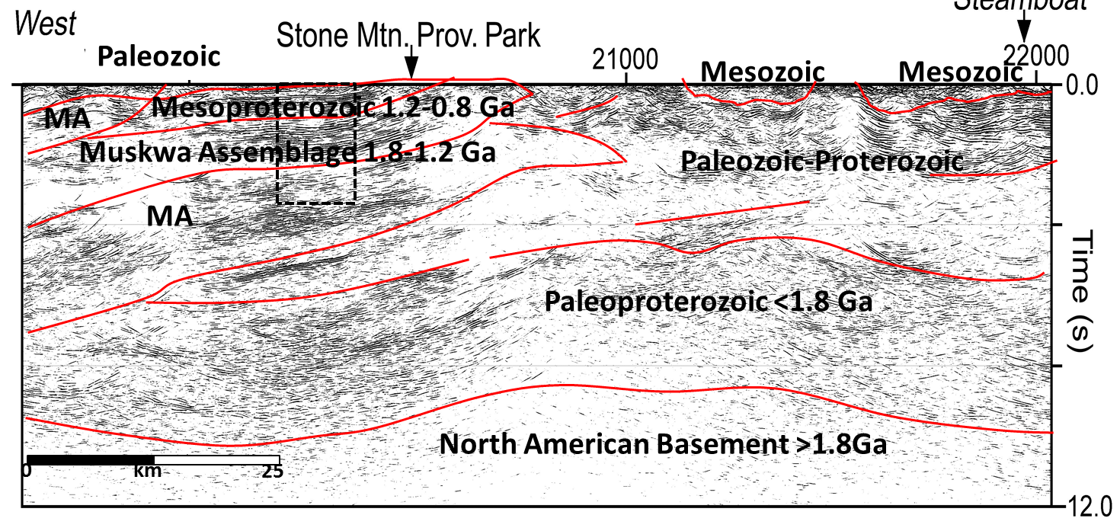
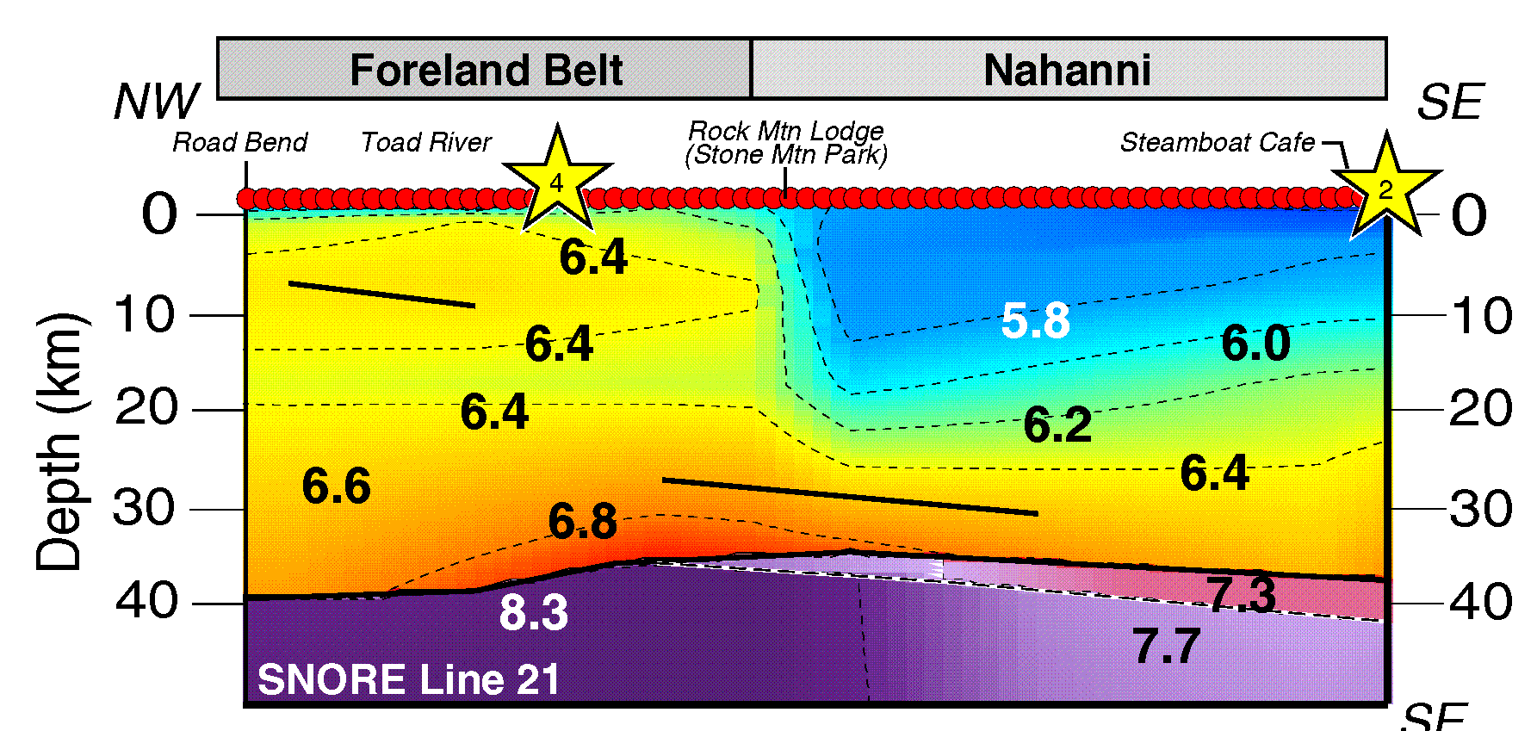
Interpreted reflection section & refraction velocity model
Deformation front
East
Depth (km)

Slide 10
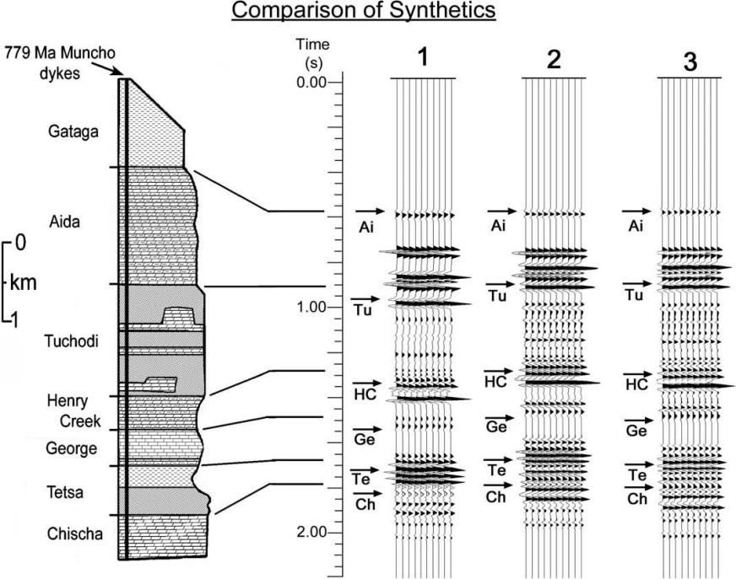
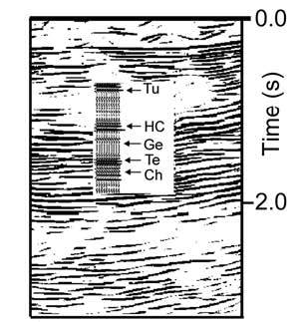
Stratigraphy of the MA correlated to 3 synthetic seismic traces from 3 V–ρ relationships for strat units; #2 is preferred
Comparison of synthetic model #2 with a part of the observed reflection section from the interpreted Muskwa assemblage
Strong evidence supporting upthrust Muskwa at
shallow depths
a)
b) With Field Data
a)
b)
Mudstone
Calcareous
Mudstone (CM)
Sandstone
Dolostone
CM
Limestone
Mudstone
Sandstone
Dolostone
Cook & Siegel, CJES, 2006
Notes:
Low velocities go to 20 km – upper ~2-5 km represent phanerozoic sediments of the western canada sedimentary basin
High velocities to the west are the Muskwa anticlinorium, upthrust middle crust that is exposed at the surface (1.8-1.5 Ga)

Slide 11
2. Grenville Orogen (1.2 – 0.9 Ga) in relation to major tectonic elements of northern N. America
Thelon
Slave
Rae
Wopmay
Nain
Cordillera
New Quebec
Taltson +
Trans-Hudson
Orogen
Superior
Hearne
Appalachian
Orogen
GrenvilleOrogen
Mid-continent
rift
Mid-continent
Rift
Wyoming

Slide 12
Geological structure map, region of Manicouagan imbricate zone (MIZ), SW Grenville, Quebec
Reflection Line 55 along Hwy 389
Geological cross-section from A to A’
Craton
Reworked Archean
MIZ-Lelukuau
MIZ-Tshenukutish
Relay SZ
Gagnon-
Knob Lake
Hart Jaune
Triassic
volc
Triple Notch SZ
Berthé
Hynes et al, CJES, 2000
Notes:
Tectonic map and cross-section of the Manicouagan Imbricate Zone. A: Structural map (after Indares and Dunning, 2004); B: N-S crustal-scale cross-section based on Lithoprobe seismic reflection data.

Slide 13
Continental Growth
Gagnon- Knob Lake
Archean Craton
Gagnon-
Reworked Archean
Line 55 reflection data;
continuous
section
overlaps
Hart Jaune
TNSZ
Berthé
Tshenukuish
RSZ
Gagnon-
Reworked Archean
Hynes et al,
CJES, 2000
Mantle
Notes:
Tectonic map and cross-section of the Manicouagan Imbricate Zone. A: Structural map (after Indares and Dunning, 2004); B: N-S crustal-scale cross-section based on Lithoprobe seismic reflection data.

Slide 14
Cross-section [A – A’] of the Manicouagan imbricate zone based on geology & reflection data
Note the Tshenukutish terrane for next slide
Seismic line
Hwy 389
Hynes et al, CJES, 2000
Notes:
Tectonic map and cross-section of the Manicouagan Imbricate Zone. A: Structural map (after Indares and Dunning, 2004); B: N-S crustal-scale cross-section based on Lithoprobe seismic reflection data.

Slide 15
Isopach map for Tshenukutish terrane
constrained by observed reflectors and geology
Yellow arrows show
transport directions
for rocks within the
terrane based on
mineral lineations
0
10
SE limit
of TNSZ
contours
20
km
SE limit of seismic
interpretation
SW limit of
RSZ contours
Hynes et al., CJES, 2000

Slide 16
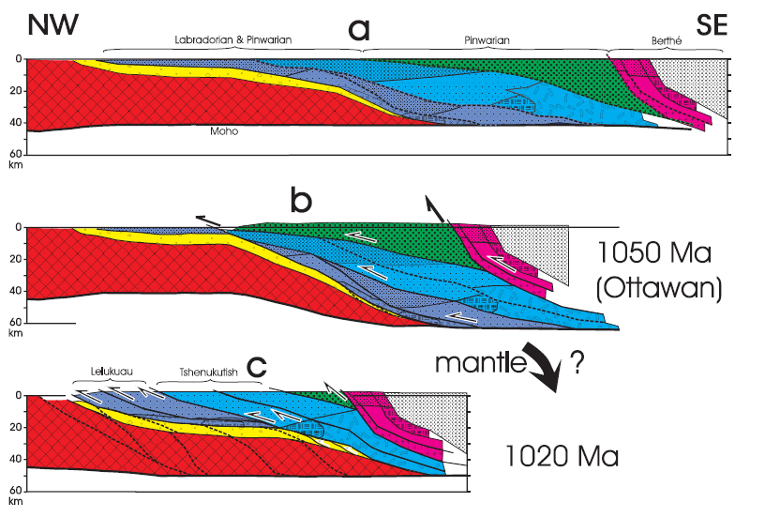
Tectonic evolution of N. Grenville Province, E. Québec
Labradorian & Pinwarian
Pinwarian
Berthé
Knob L
Later
eroded
Archean
MIZ rocks
Mantle
Crust thickened & MIZ
buried to depths >60 km
MIZ-Tshenukutish
MIZ-Lelukuau
Lelukuau
Tshenukutish
Extrusion of MIZ rocks
to shallower crustal levels
Notes:
Schematic diagram showing the stacking sequence and metamorphic evolution in the southwestern Grenville Province. A-B: Accretionary out-of-sequence overstacking of the Frontenac-Adirondack Belt on the Composite Arc Belt; C-D: Ottawan orogenic phase, in-sequence understacking of the aHP Belt, out-of-sequence overstacking of the aMP Belt and associated metamorphic overprinting of previously stacked terranes; E: Metamorphic hiatus during orogenic collapse (not illustrated); F: Rigolet orogenic phase, in-sequence understacking at the orogen margin. Active thrust systems numbered from 1-6. Large blue arrows show inferred particle paths; see text. Note that figure illustrates sequence of stacking, but does not directly[RC1] address tectonic processes involved.
[RC1]
Did you intend to say “not directly”?

Slide 17
Tectonic evolution of N. Grenville Province, E. Québec (cont.)
Lelukuau
Tshenukutish
Extrusion of MIZ rocks
to shallower crustal levels
Crust again thickened & MIZ
buried to depths >60 km
Extrusion controlled by
subsurface ramps
Lelukuau
Tshenukutish
Berthé
Knob L
RSZ
TNSZ
Archean
Mantle
Hynes et al., CJES, 2000
Notes:
Schematic diagram showing the stacking sequence and metamorphic evolution in the southwestern Grenville Province. A-B: Accretionary out-of-sequence overstacking of the Frontenac-Adirondack Belt on the Composite Arc Belt; C-D: Ottawan orogenic phase, in-sequence understacking of the aHP Belt, out-of-sequence overstacking of the aMP Belt and associated metamorphic overprinting of previously stacked terranes; E: Metamorphic hiatus during orogenic collapse (not illustrated); F: Rigolet orogenic phase, in-sequence understacking at the orogen margin. Active thrust systems numbered from 1-6. Large blue arrows show inferred particle paths; see text. Note that figure illustrates sequence of stacking, but does not directly[RC1] address tectonic processes involved.
[RC1]
Did you intend to say “not directly”?

Slide 18
3. Paleoproterozoic (2.0 - 1.8 Ga) Trans-Hudson Orogen in relation to major tectonic elements of northern North America
Thelon
Slave
Rae
Wopmay
Nain
Cordillera
New Quebec
Taltson +
Trans-Hudson
Orogen
Hearne
Superior
Appalachian
Orogen
GrenvilleOrogen
Mid-continent
Rift
Wyoming
Mid-continent
rift

Slide 19
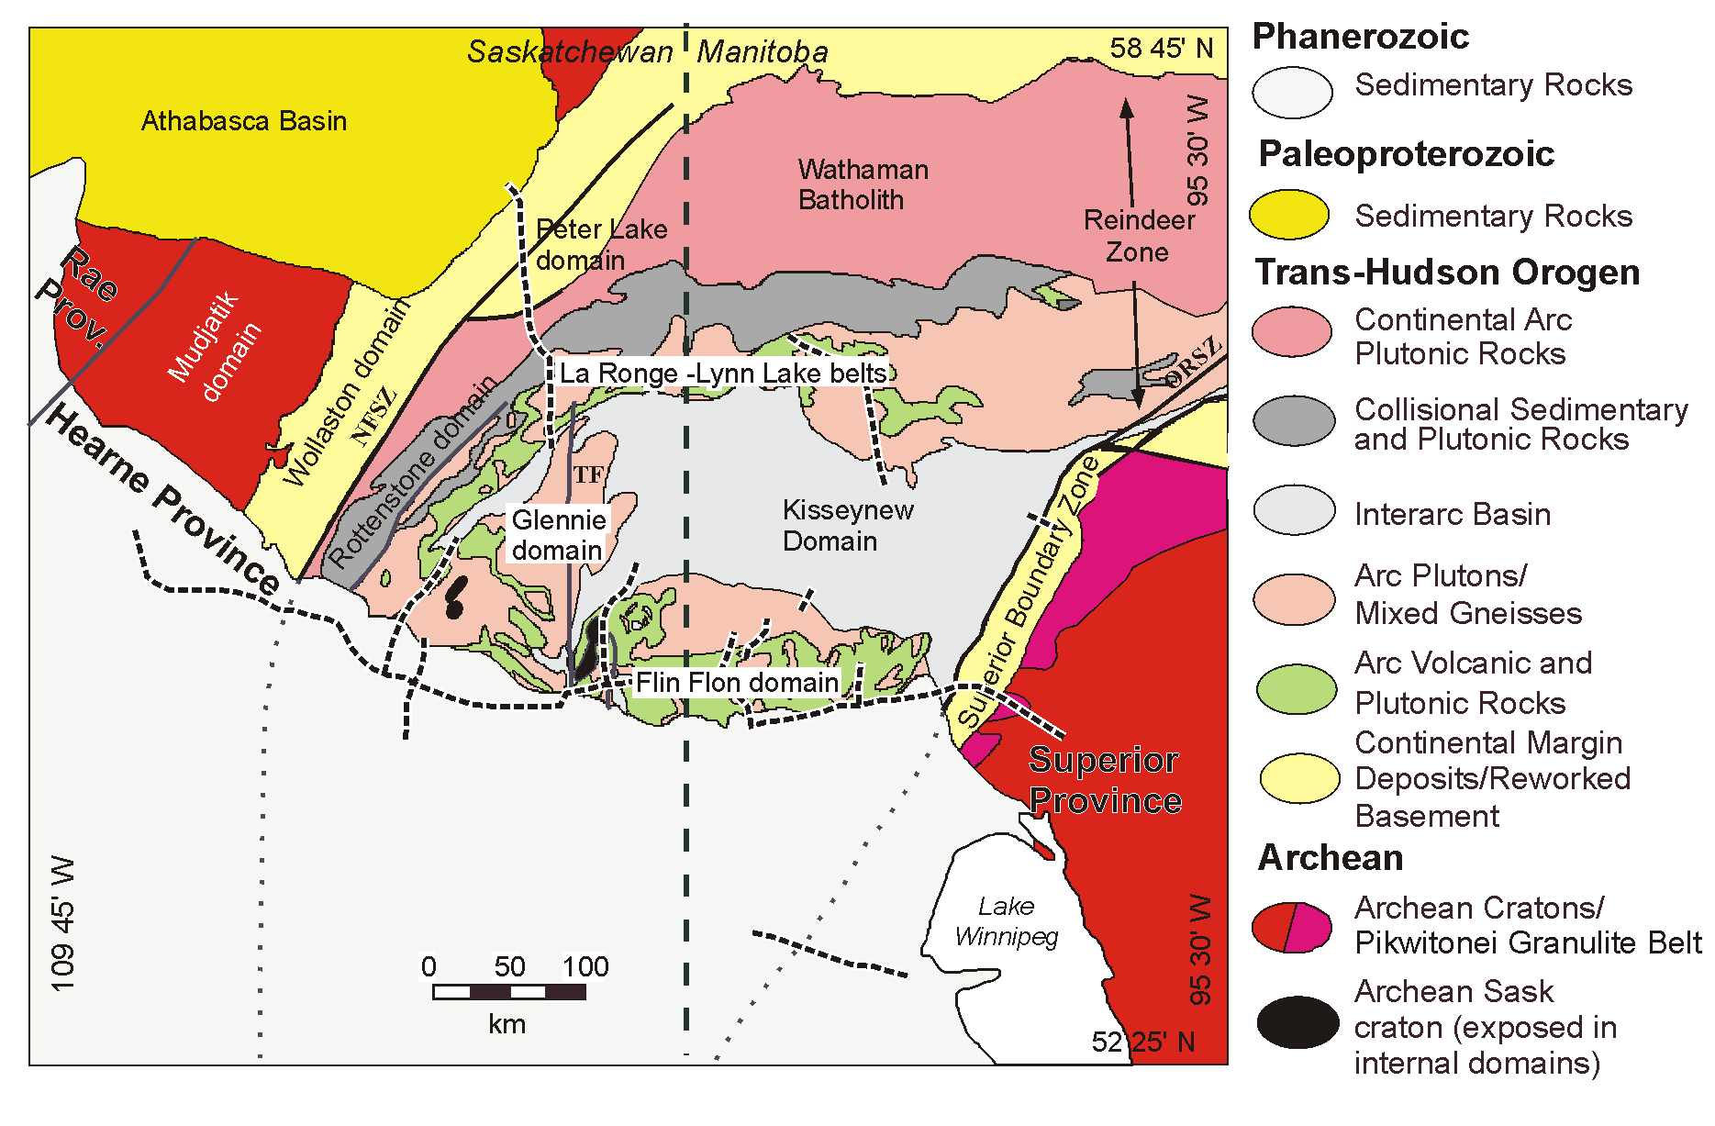
Central Reindeer Zone of Trans-Hudson Orogen
Area of detailed geological studies
Hajnal et al, CJES, 2005

Slide 20
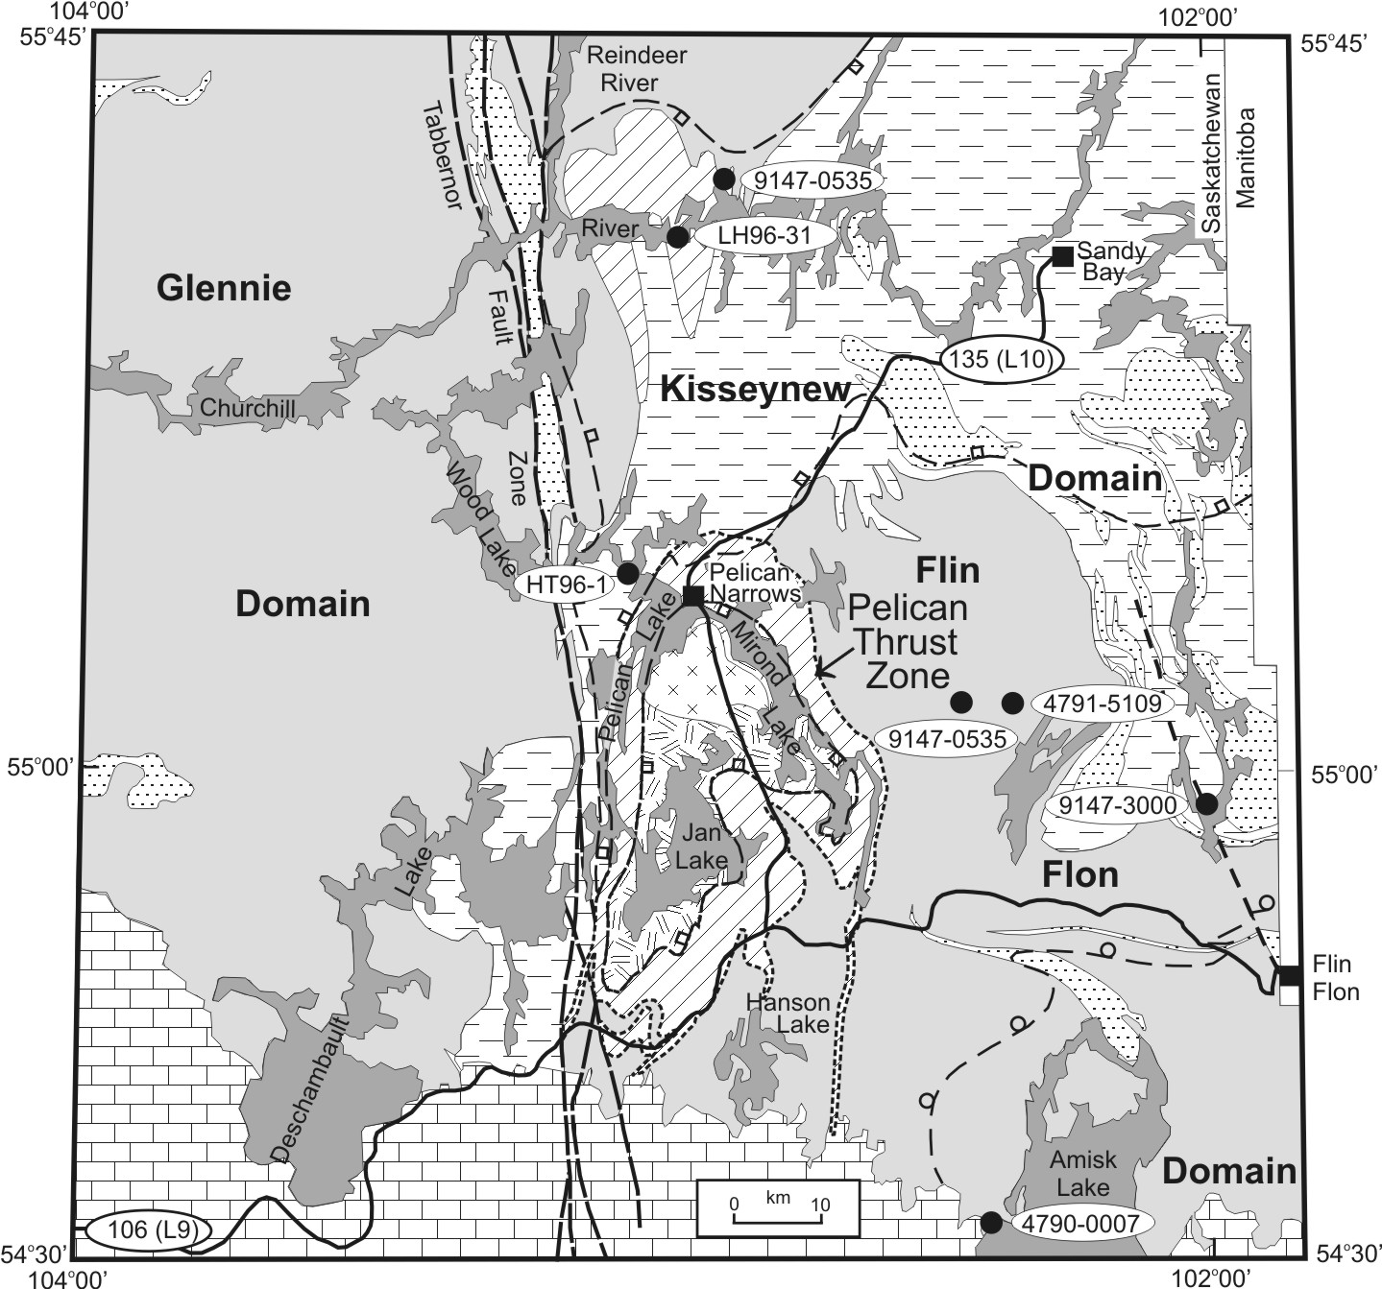
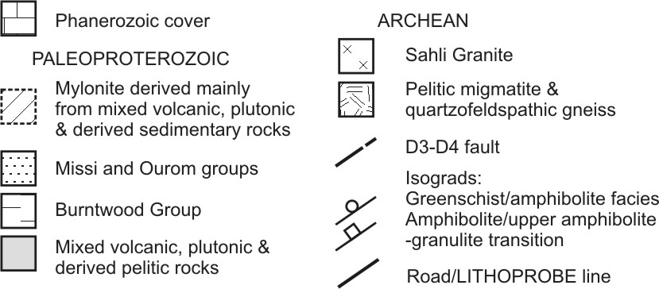
Line 10
Archean window
Pelican thrust
Line 9 east
Reflection lines
9 East and 10
over Archean
window

Slide 21
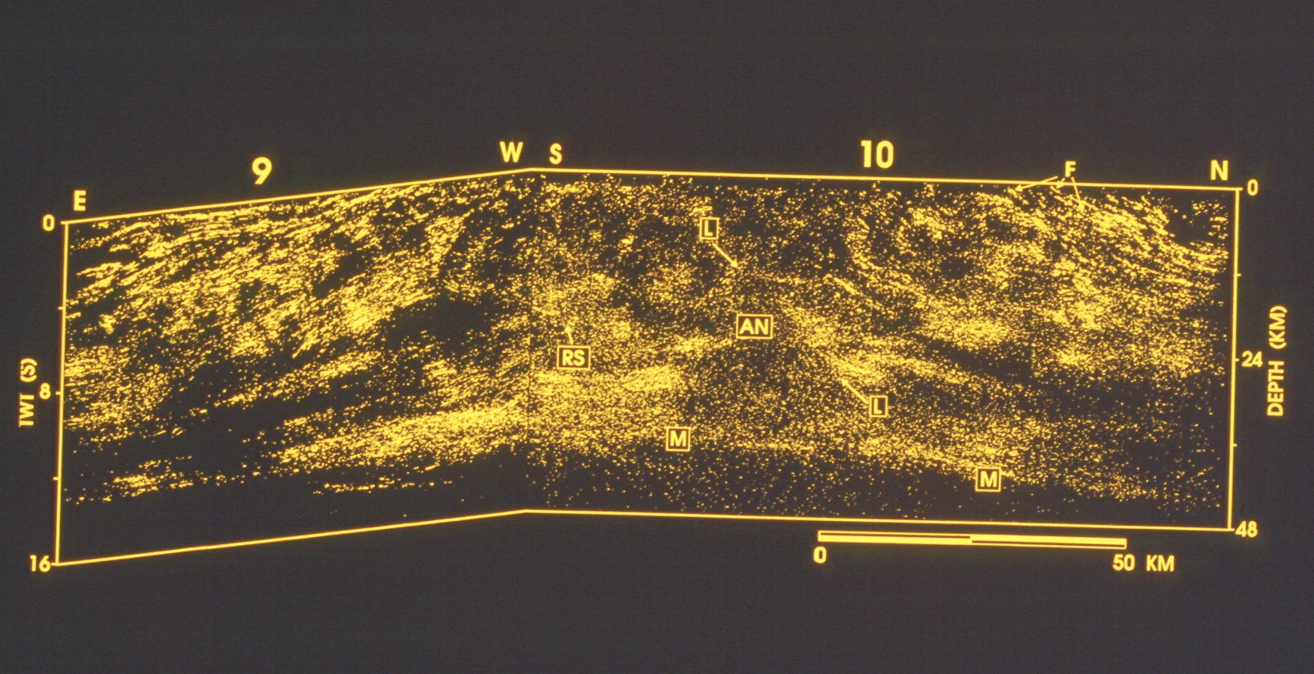
Lines 9 East and 10
Extensive Crustal Reflectivity

Slide 22
Lines 9 East and 10
PT – Pelican Thrust
PT
PT
Sask
craton
Paleoprot
PT
Paleoprot
Archean
Archean

Slide 23
Field mapping around the window of Archean rocks
MYLONITE
ZONE
ARCHEAN
20 km
Ashton et al., CJES, 2005

Slide 24
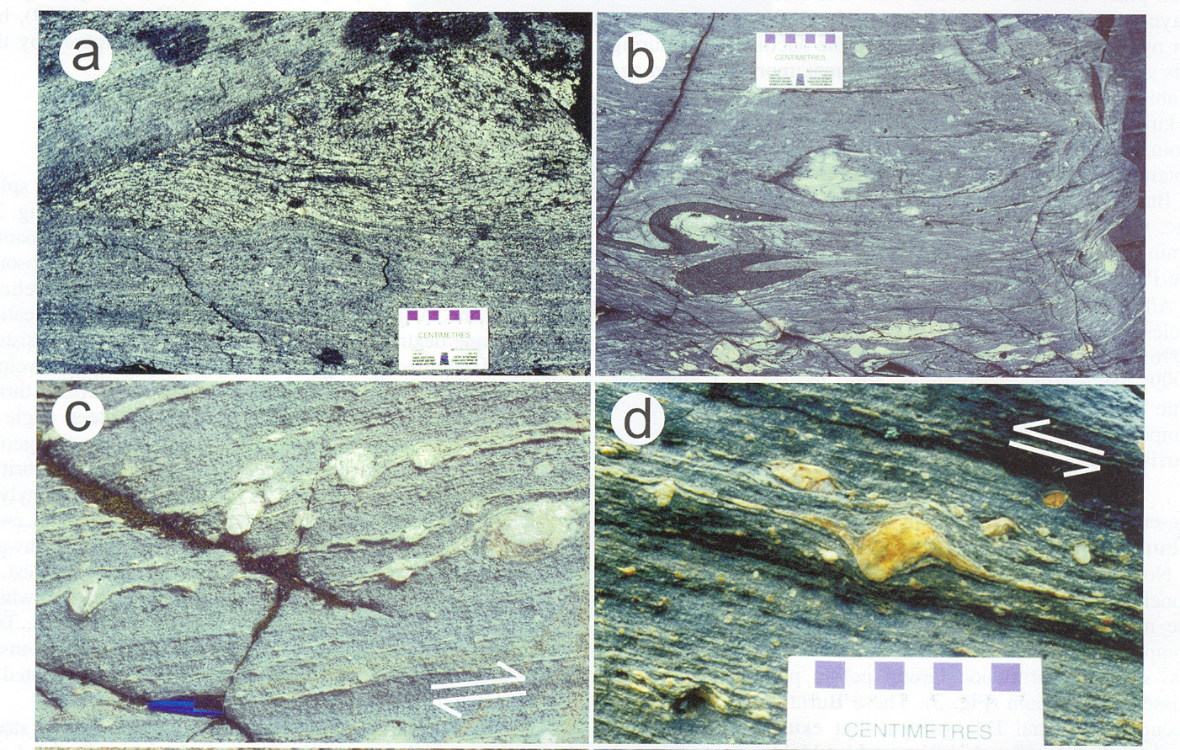
Mylonites from Pelican Thrust Zone
Strain gradient around tectonic
inclusion of granodiorite-tonalite
Sheath fold defined by attenuated
mafic dyke in mylonite
Δ-winged porphyroclasts in
mylonitic granodiorite-tonalite –
Shows dextral shear component
Δ-winged porphyroclasts in
mylonitic pelitic migmatite –
Shows low-angle reverse shear
Ashton et al., CJES, 2005

Slide 25
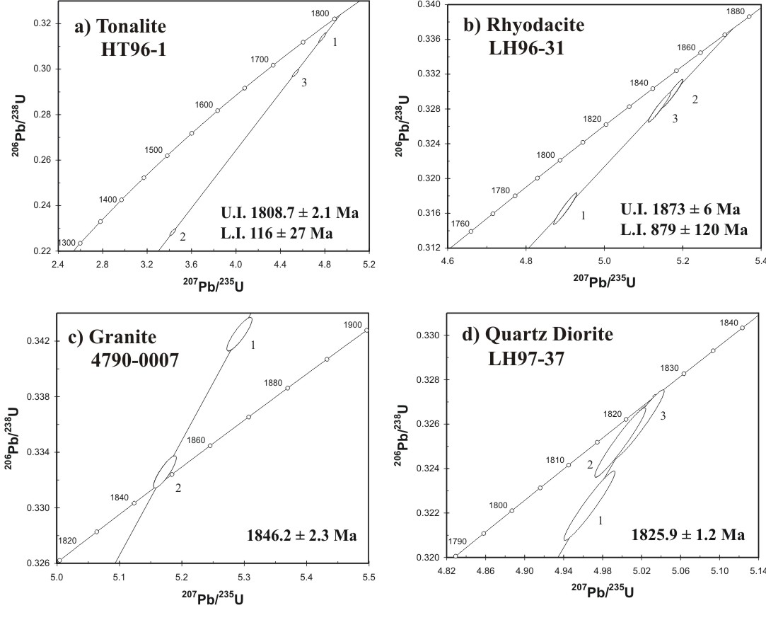
Concordia diagrams:
the need for dating structures and rocks
Ashton et al., CJES, 2005

Slide 26
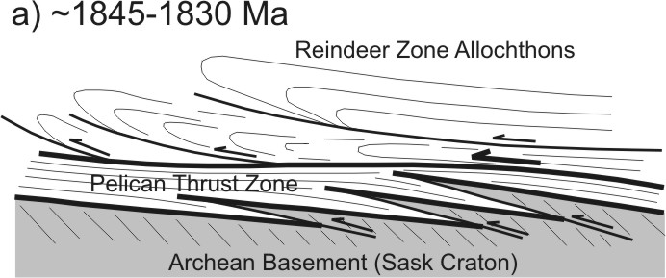
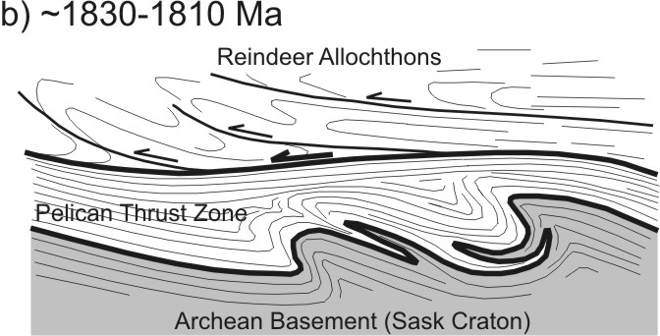
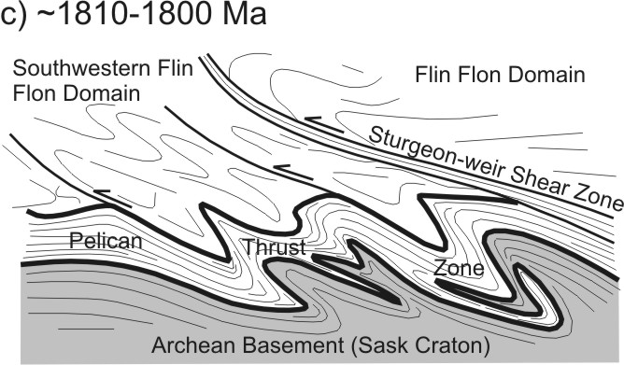
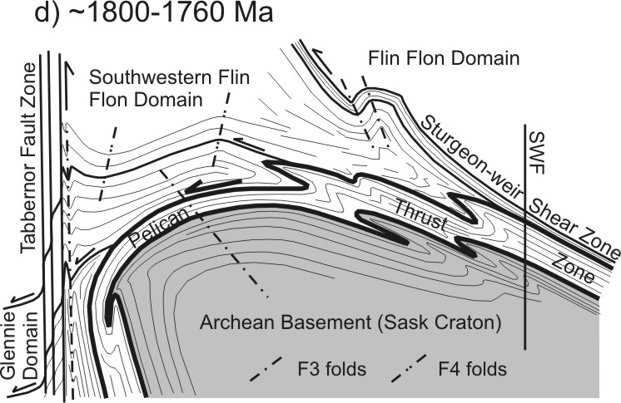
Bringing the structural, dating, seismic and other studies to a well-constrained tectonic scenario –
Development and deformation of Pelican Thrust zone
Pre-1830 SW transport of Reindeer zone
allochthons across Sask ± imbrication
Thermal softening of upper Sask craton gives
SW-vergent folding and continued thrusting
Continue SW-vergent folding & initiation of
Sturgeon-Weir SZ as a crustal-level splay
of folded PTZ
N-S folding produces W-vergent antiform; reverse E-side-up displacement along Tabbernor FZ creates intense strain
Ashton et al., CJES, 2005

Slide 27
Geophysical studies (seismic reflection, refraction, magnetics, gravity, magnetotellurics), combined with geological studies (mapping, structure, geochronology, geochemistry, petrology) can provide outstanding interpretations of present lithospheric structure and lead to fundamental understanding of tectonic evolution.
[These and more examples with details: See paper by Clowes in Geoscience Canada, late 2014 or early 2015]
Thank you!
LITHOPROBE
GSA Vancouver, October 20, 2014

