Slide 1






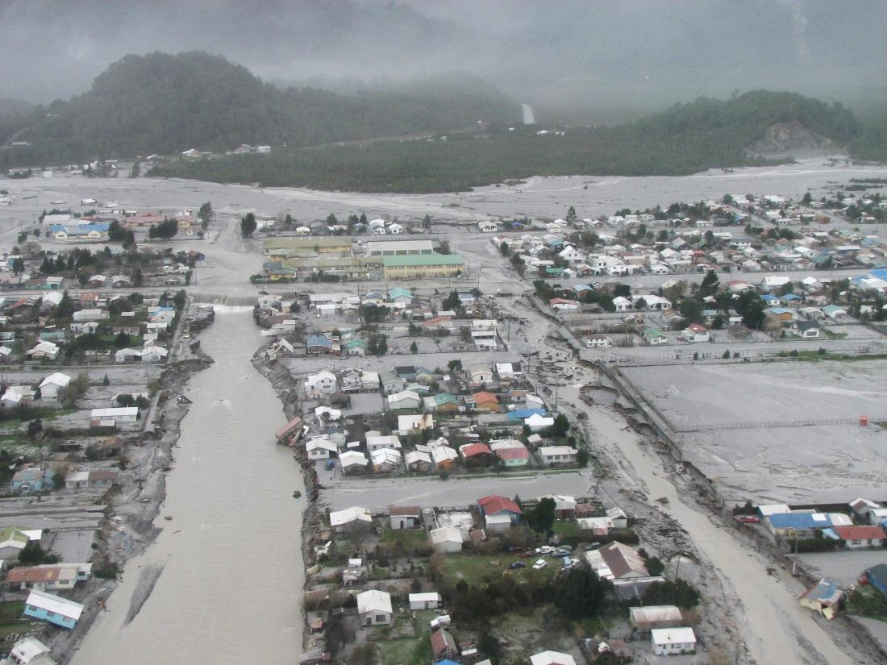
Accelerated Geomorphic Response to Massive Sediment Loading by the 2008–2009 Eruption of Chaitén Volcano, Chile, Followed by Rapid Recovery
T.C. Pierson, J. J. Major
U.S. Geological Survey
Á. Amigo, D. Bertin
Servicio Nacional de Geología y Minería
A. Iroumé, H. Ulloa
Universidad Austral de Chile
A. Andreoli
Universidad de Concepción
J. Castro
Johannes Gutenberg Universität
SERNAGEOMIN, 23 May 2008

Slide 2
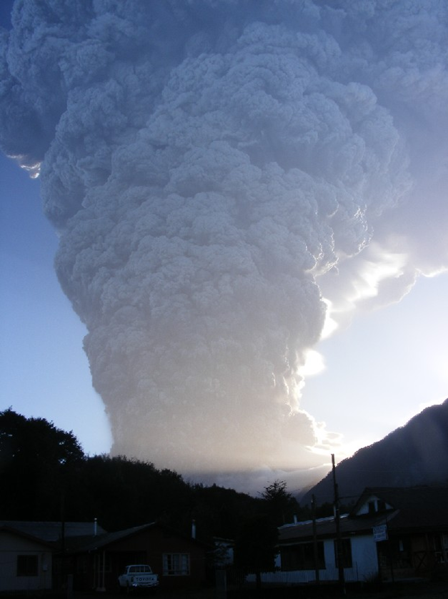
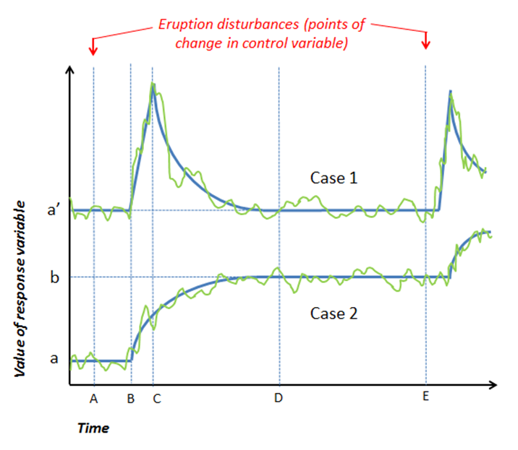

Underlying Questions:
Explosive eruptions disturb fluvial systems. . . .
How do systems respond?
How do systems recover?
Fluvial system: Chaitén River Disturbance: 2008-2009 eruption of Chaitén Volcano, southern Chile

Slide 3
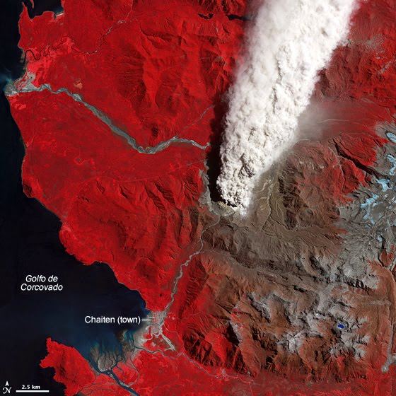
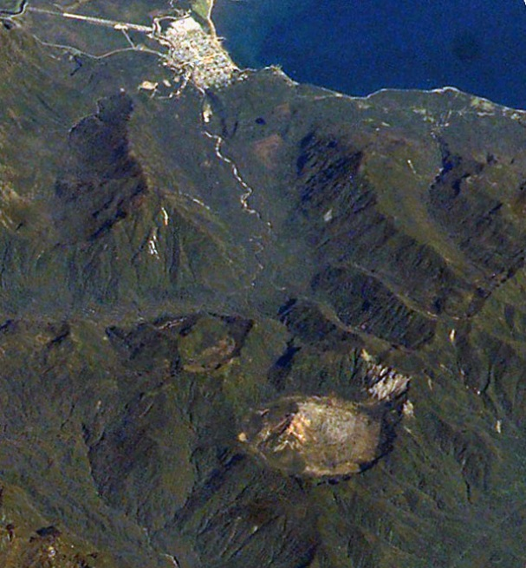
STUDY AREA LOCATION
Northern Patagonia, Chile
43°S, 73°W
Chaitén town
ASTER, 2 May 2008
Old lava dome in caldera
International Space Station, 2003

Slide 4
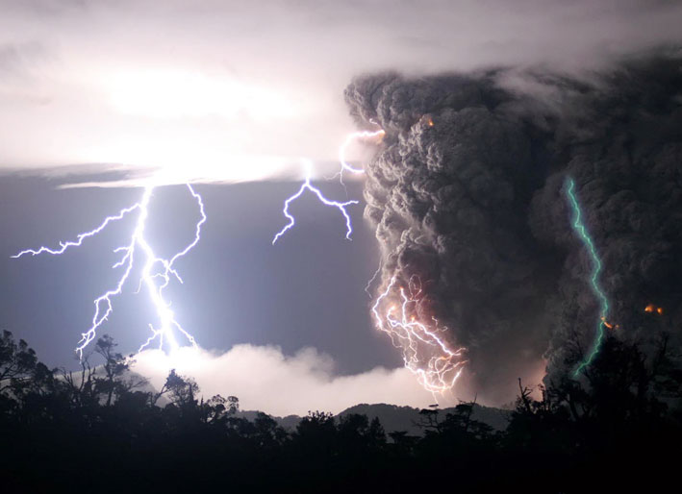
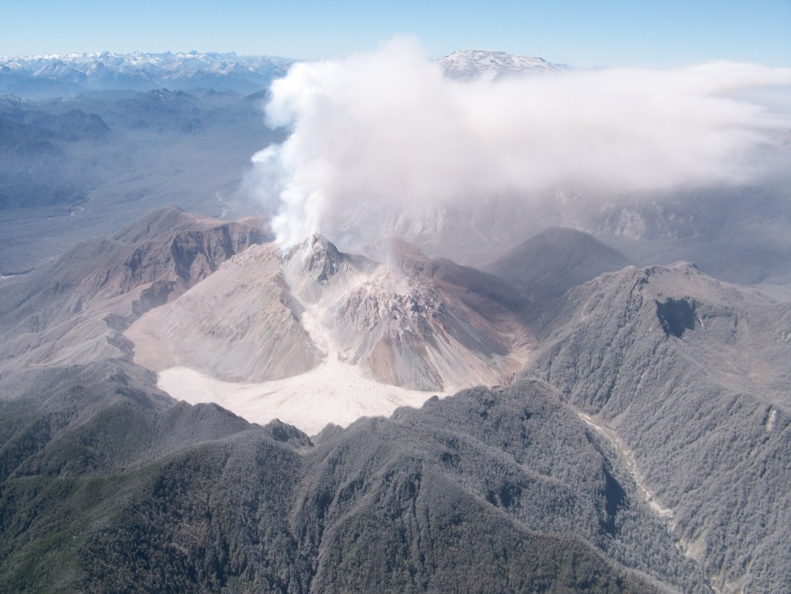
THE DISTURBANCE–
An initial explosive phase
First major high-silica rhyolite eruption (VEI 4-5) since Katmai, 1912
Starts late on 1 May 2008—27 hr after EQs first felt
Initial eruption puts ash column to ~18 km, lasts 6 hours
Nearly continuous ash emission with intermittent large explosions continued 2-8 May; ~ 1 km³ ejected; after 6 May ash is very fine
UPI photo/Landov
Followed by a dome-building phase
Lava dome extrusion first detected 9 May 2008
Extrusion rates 20-100 m³/s
Volume ~0.5 km³ by Sep 08
Two dome-collapse pyroclastic flows enter Chaitén valley; 2nd is 3 – 5 M m³
Explosive phase
Dome-building phase
SERNAGEOMIN

Slide 5
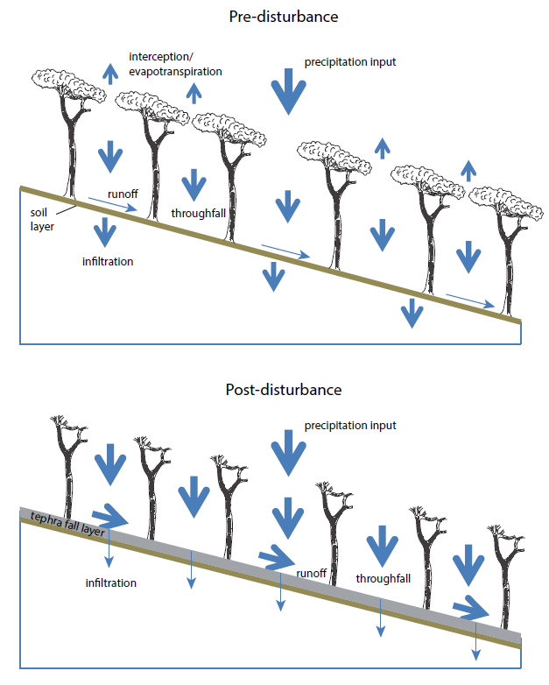
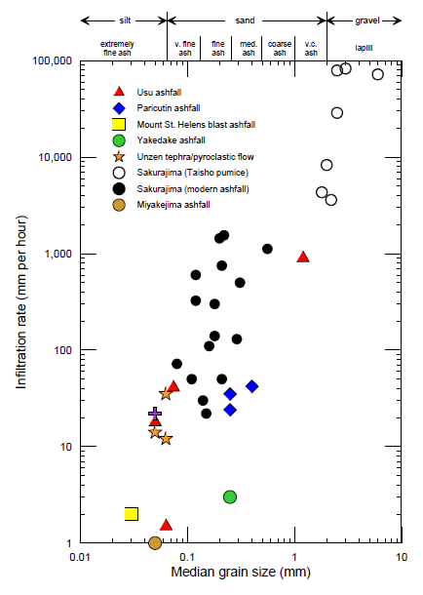
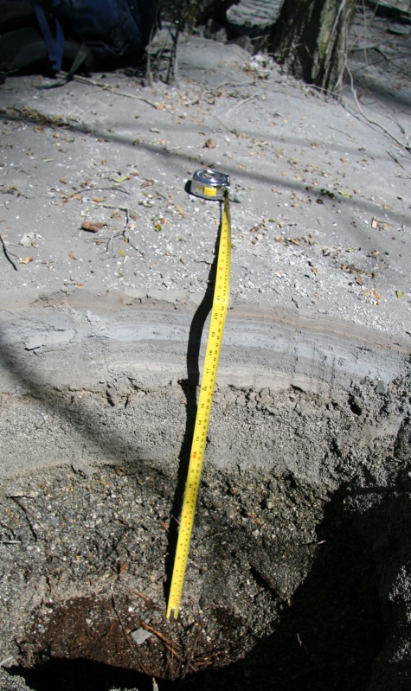
Disturbance effects: (1) vegetation damaged/destroyed, and (2) hillslopes paved with nearly impermeable fine ash layers SURFACE RUNOFF increases
AND . . .

Slide 6
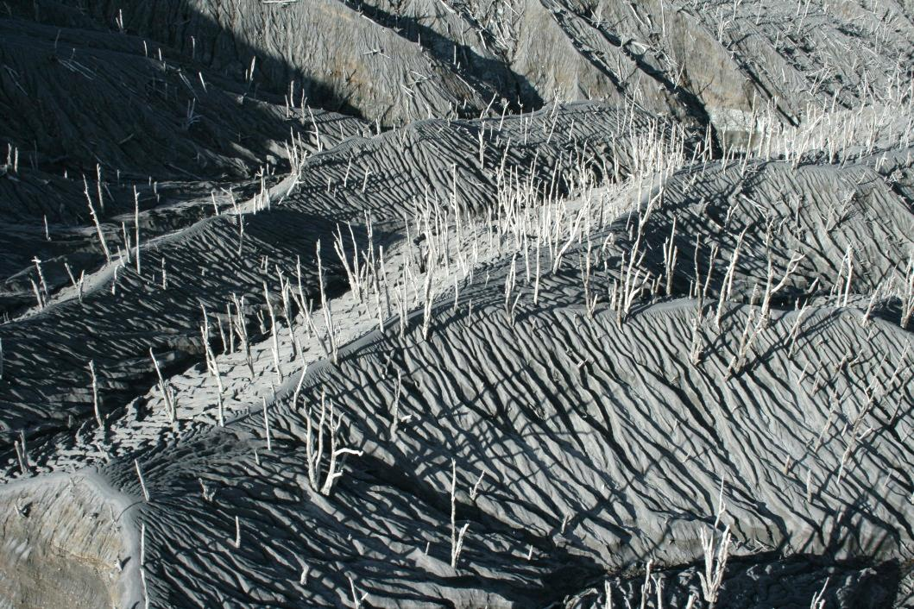
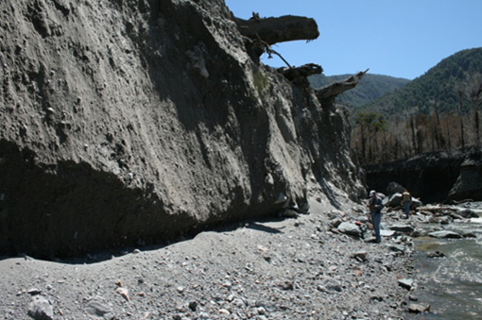
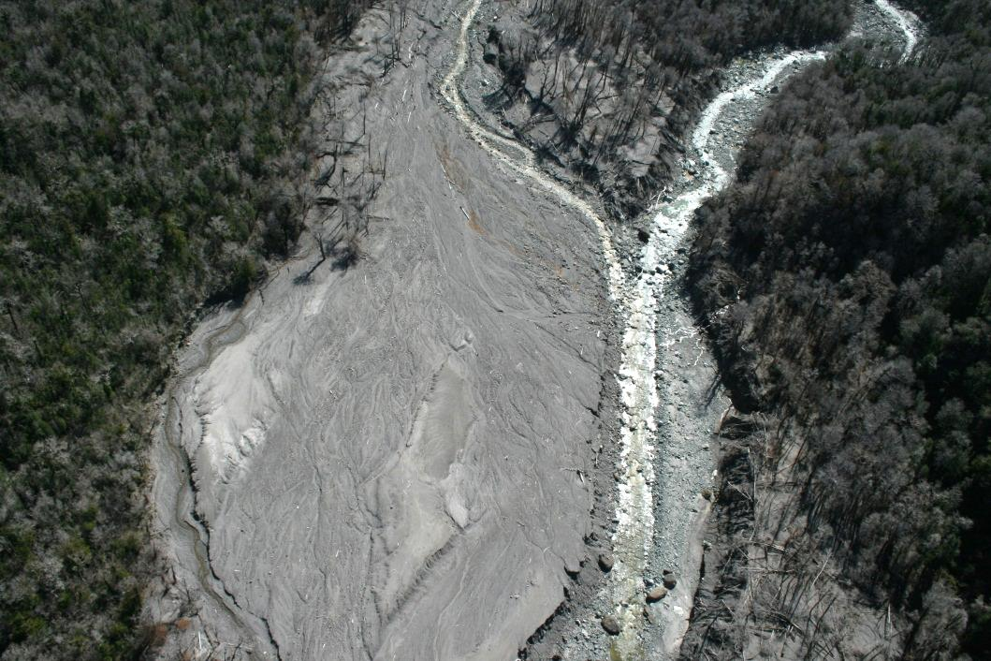
Inputs of erodible tephra and volcaniclastic mass-flow deposits
Heavy sediment loading of rivers
Tephra: Coarse to extremely fine (silt-size) ash. Moderate- to low-vesicularity pumice (1.3-1.6 g/cm³), grading up to dense glassy rhyolite (2.1-2.5 g/cm³); trace of accidental lithics.
Tephra on hillslopes: 3 to 100+ cm on 77 km² basin
PF deposits: Gravelly muddy sand textures. Dense glassy rhyolite with minor accidental granodiorite and greenschist (bedrock); trace of pumice.
Lithic pyroclastic flow deposits: up to 8 m thick, 2+ km long

Slide 7
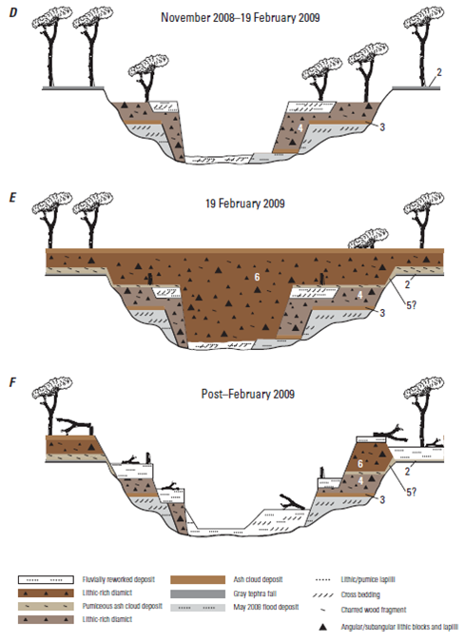
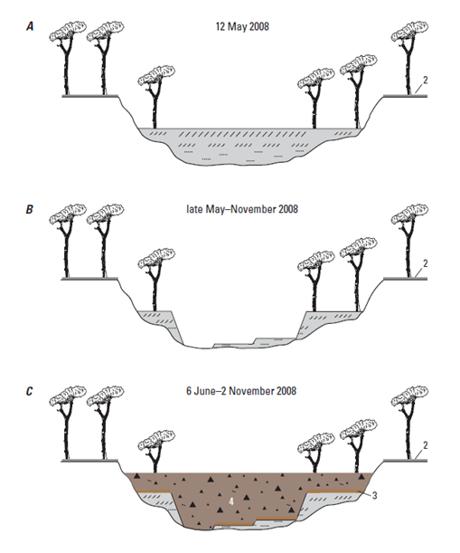
Scale/sequence of erosion in Chaitén River

Slide 8
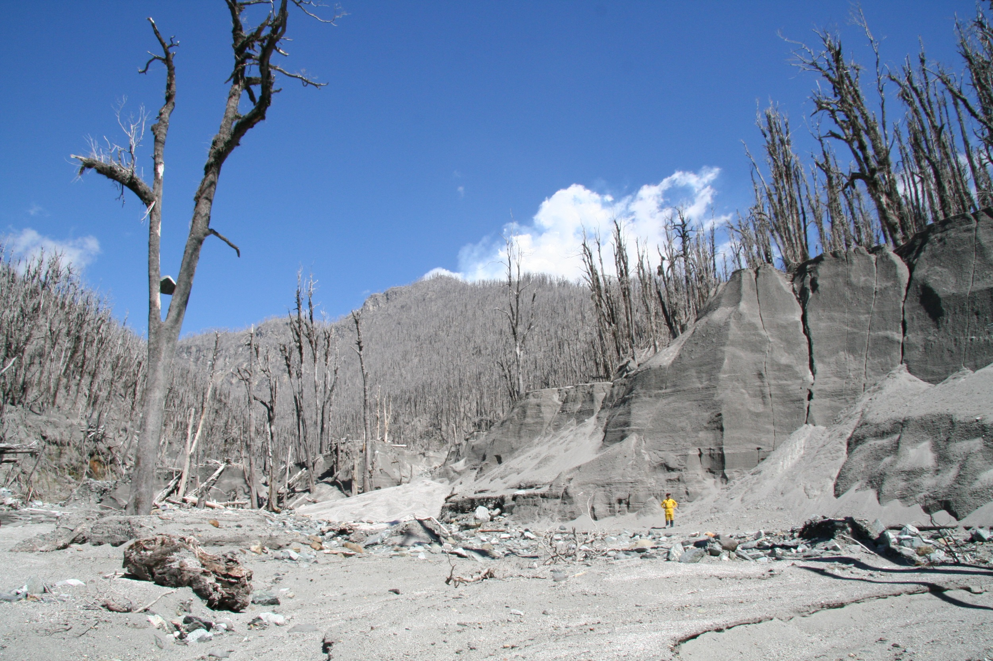
Scale of eroded sediment volumes involved . . .

Slide 9
THE RESPONSE–
Initial sediment mobilization by modest rainfall
RF pulse 1 ≈ 20 mm
RF pulse 1 ≤ 3 mm/h
Channel Aggradation 10 km Downstream of Volcano:
~4.5 m aggradation in first 24 hours
~7 m in first 48 hours

Slide 10
Resulting flow in Chaitén River: A complex multi-day flood event
An initial lahar
Subsequent streamflow flood surges
4.5 m of aggradation in 24 hr; 7 m in 48 hr
Channel avulsion
Two deltas built
KEY
Lahar (~10⁶ m³) at base of section (yellow), hyperconcentrated flow-debris flow boundary
Highly concentrated transitional flow; upper flow regime (gray)
Muddy streamflow, shallow; upper flow regime (blue)

Slide 11
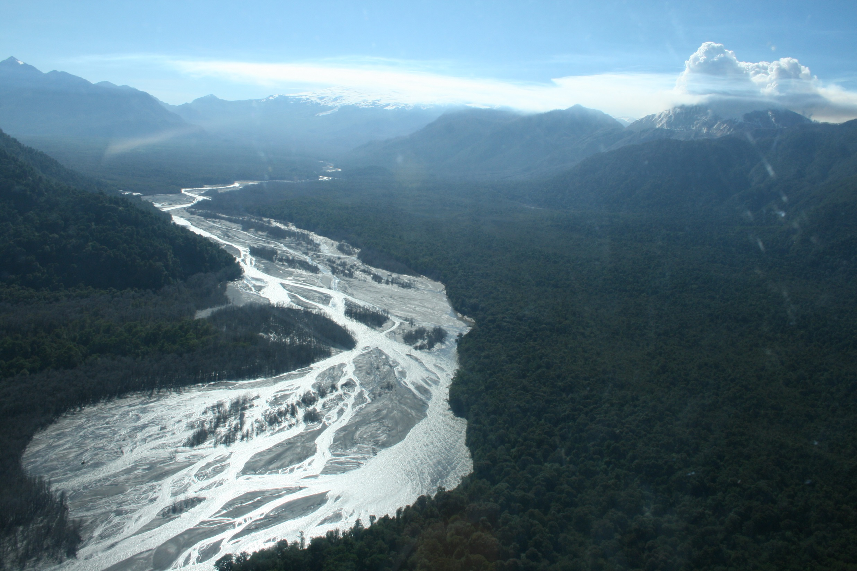
Similar responses in other proximal fluvial systems:
Aggradation
Channel widening
Fining of channel beds
Braided channel patterns
Rayas River

Slide 12
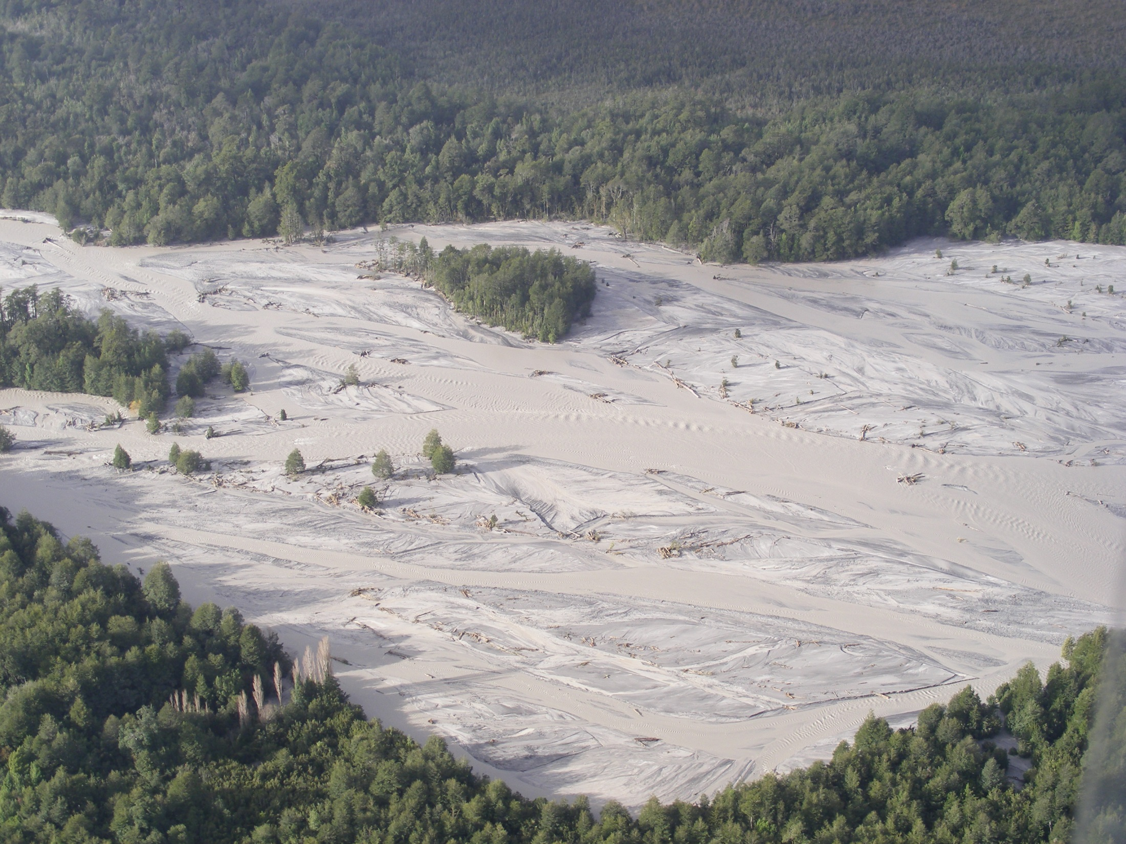
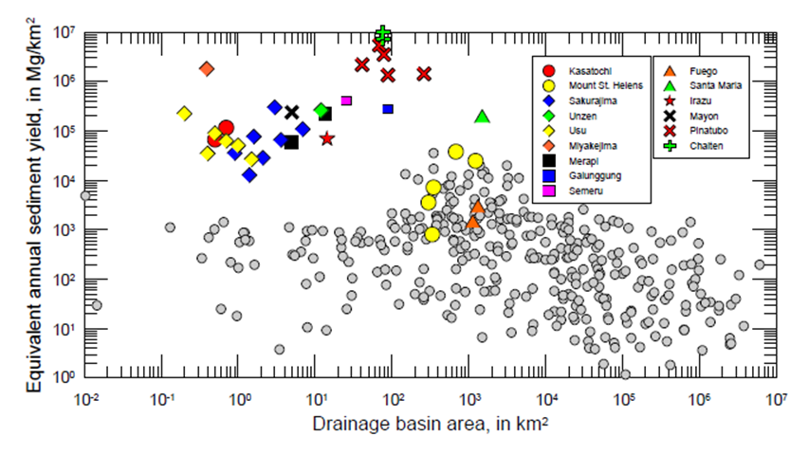
Estimated annualized sediment yield, based on delta growth rate over about 2 weeks is EXTREME.
(assume bedload = 20% of total load)

Slide 13
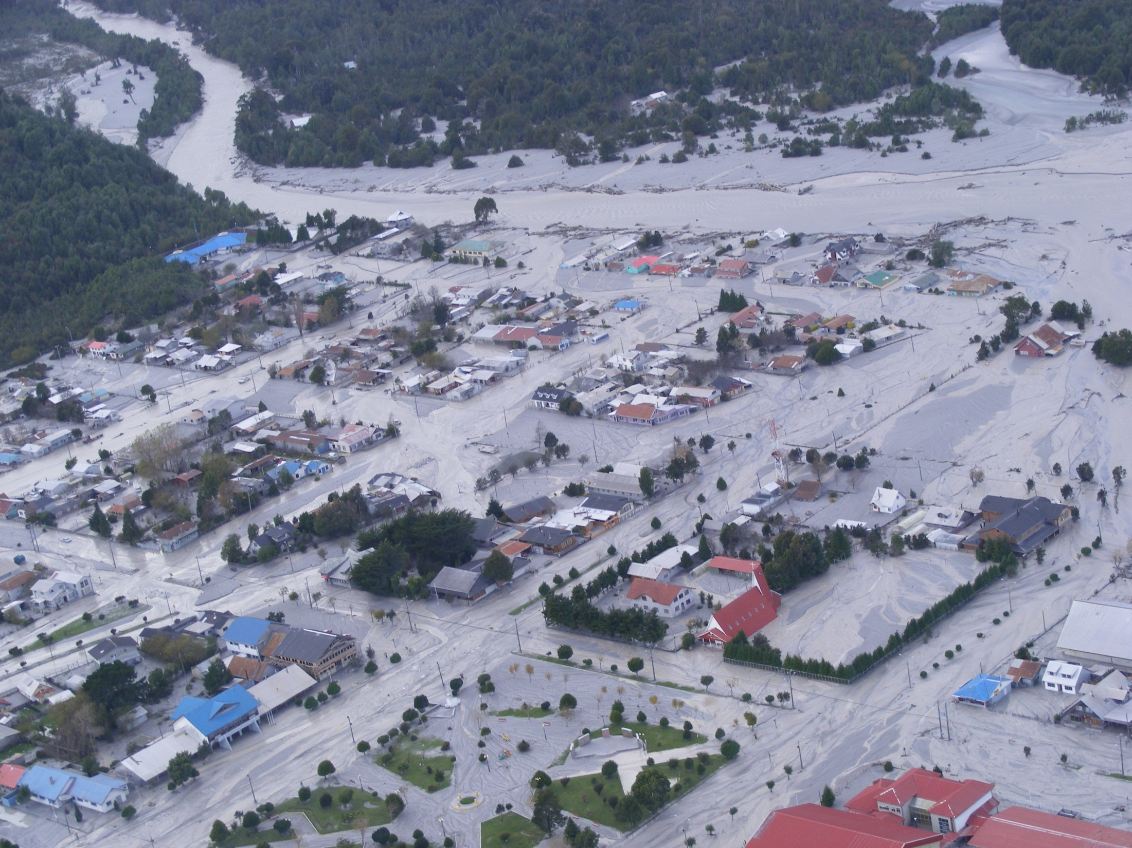
IMPACTS IN CHAITÉN TOWN
Channel avulsion
1 – 3 m fluvial deposition

Slide 14
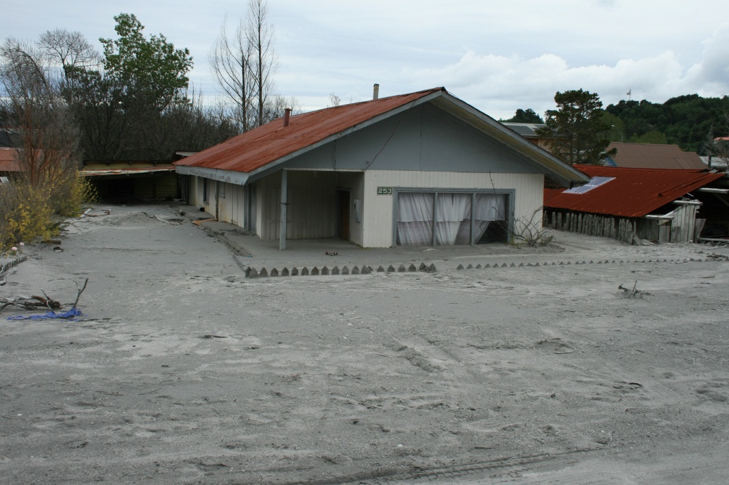
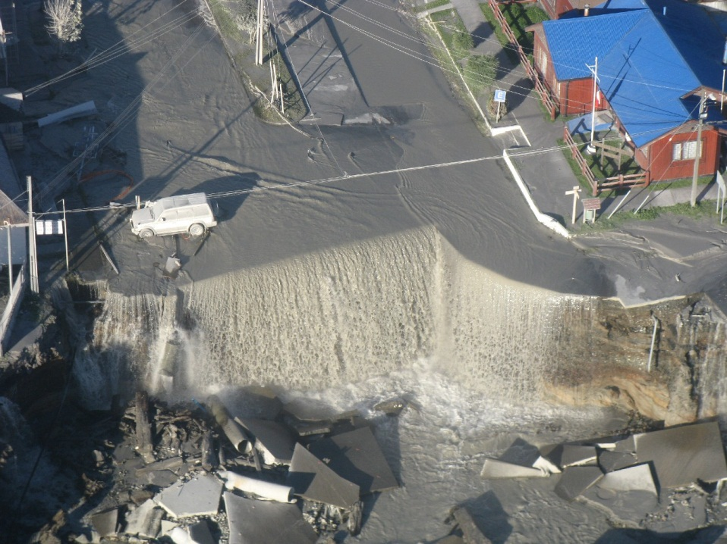
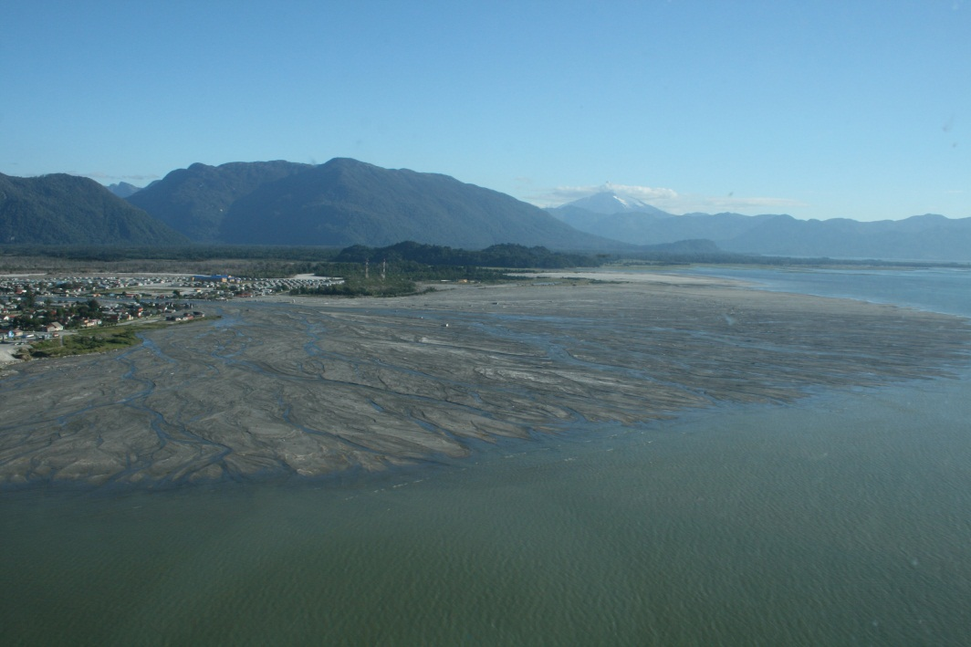
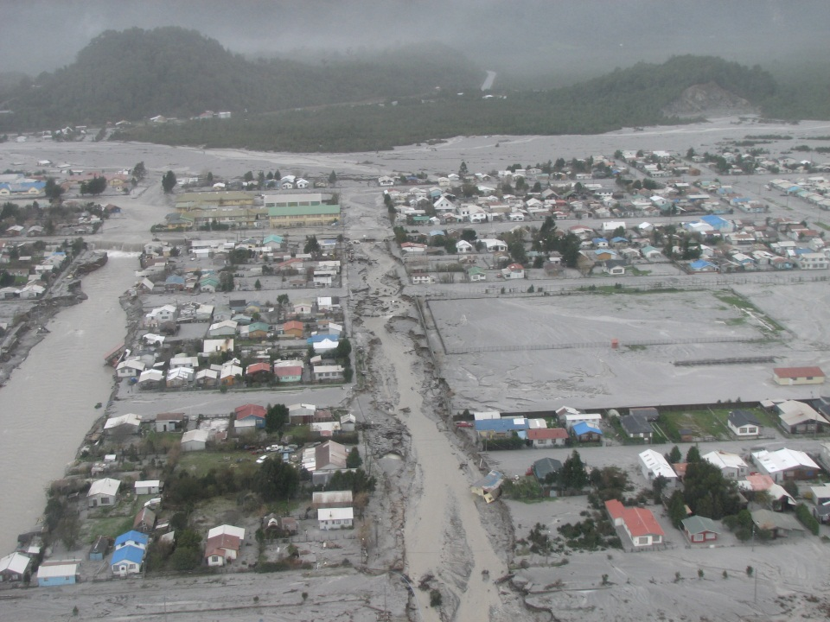
IMPACTS IN CHAITÉN TOWN
Burial of much of town in sediment 1 - 3 m thick
Knickpoint retreat; streets become channels
Formation of new delta– extended 850 m from shore by 5 Dec 2008

Slide 15
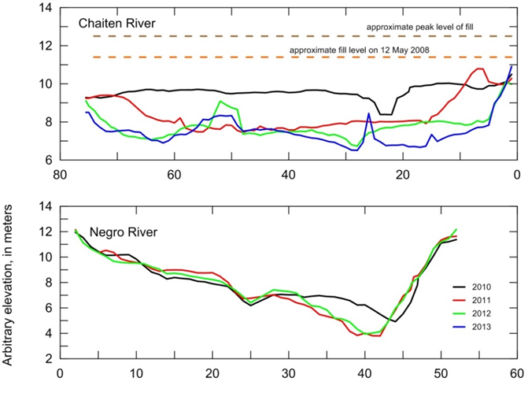
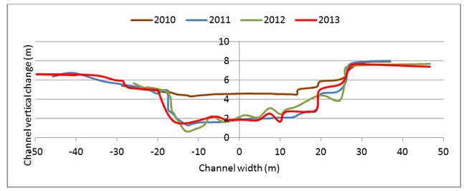
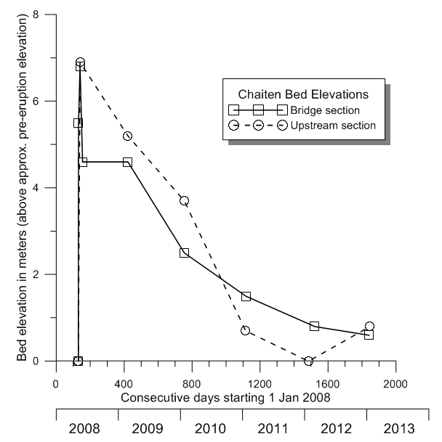
RECOVERY TRAJECTORY OVER 5 YEARS --
Distance across channel, in meters
Return to pre-eruption channel bed elevations within 4 - 5 years

Slide 16
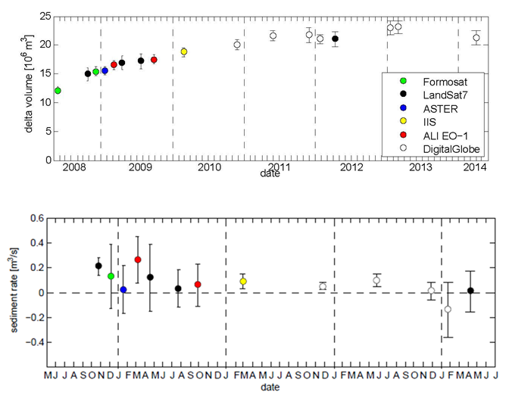
RECOVERY TRAJECTORY OVER 5 YEARS --
2008
2009
2010
2011
2012
Drastic decrease in sediment yield

Slide 17
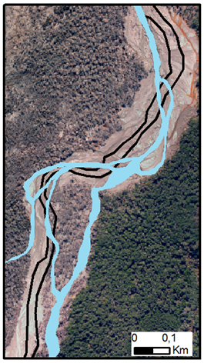
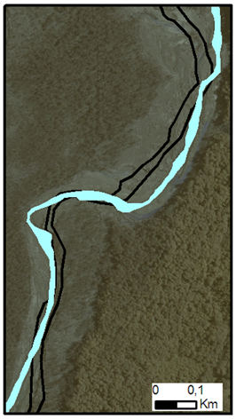
RECOVERY TRAJECTORY OVER 5 YEARS --
Black lines = pre-eruption active channel (2005)
Blue fill = active channel in the year indicated
Return to narrow, single-thread channel pattern
2009
2012

Slide 18
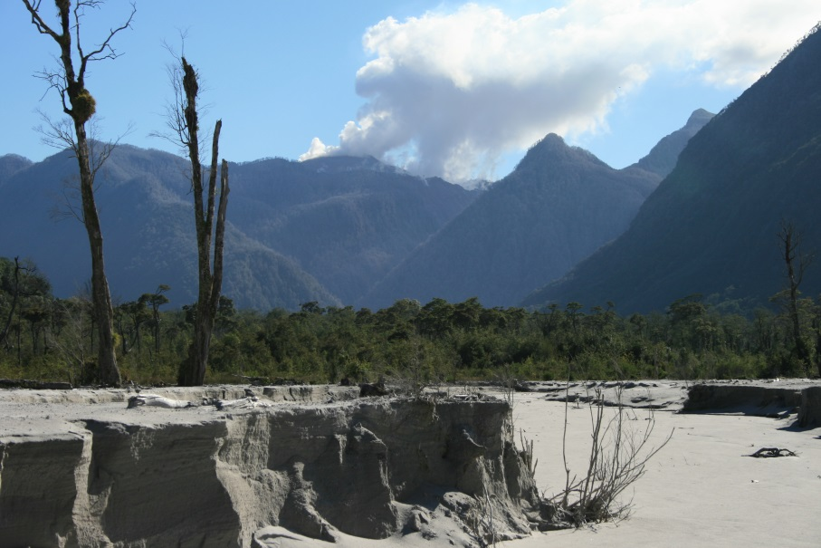
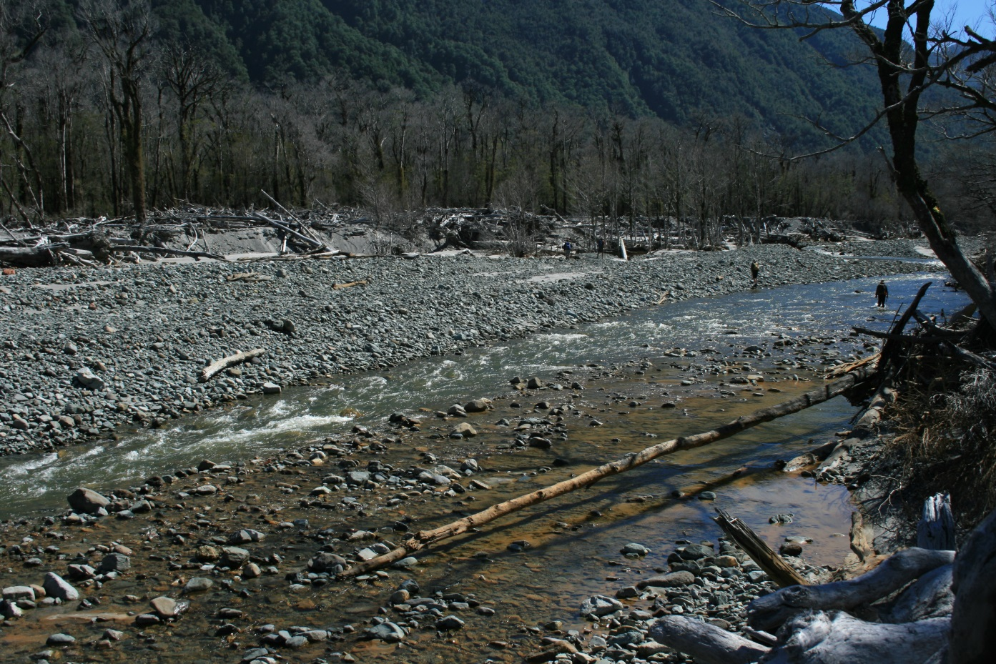
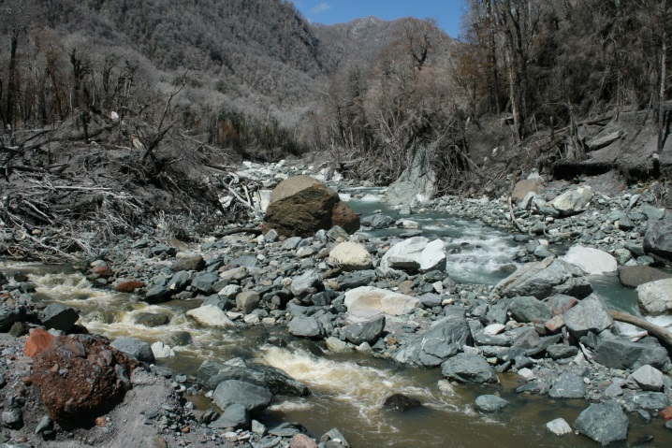
RECOVERY TRAJECTORY OVER 5 YEARS --
Return to armored channel bed
May 2008
Jan 2010
Jan 2011

Slide 19
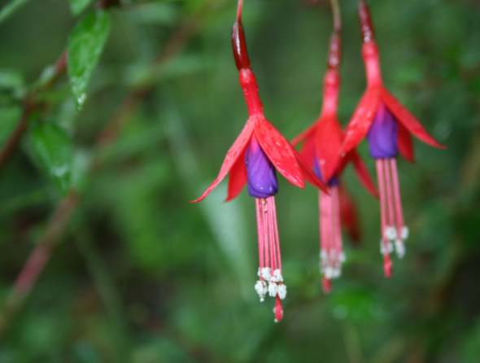
TAKE-HOME MESSAGES (AND A QUESTION)
Severe downstream sedimentation triggered by relatively minor rainfall (est. 15-30 mm/24 hours; peak intensity <5 mm/h)
Downstream channel aggradation was extremely rapid following start of rainfall ( ~4.5 m in less than 24 hours; ~7 m in 48 hours)
Sediment mobilized (primarily from tephra mantle) by an initial lahar, followed by a complex multi-peaked flood involving pulses of hyperconcentrated flow and muddy streamflow
Peak annualized sediment yield from tephra flushing perhaps highest ever measured.
Erosion of valley-filling pyroclastic-flow deposits contributed to sustained high sediment yield (but much less than from tephra erosion).
Has this fluvial system truly recovered (stabilized)?

