Slide 1
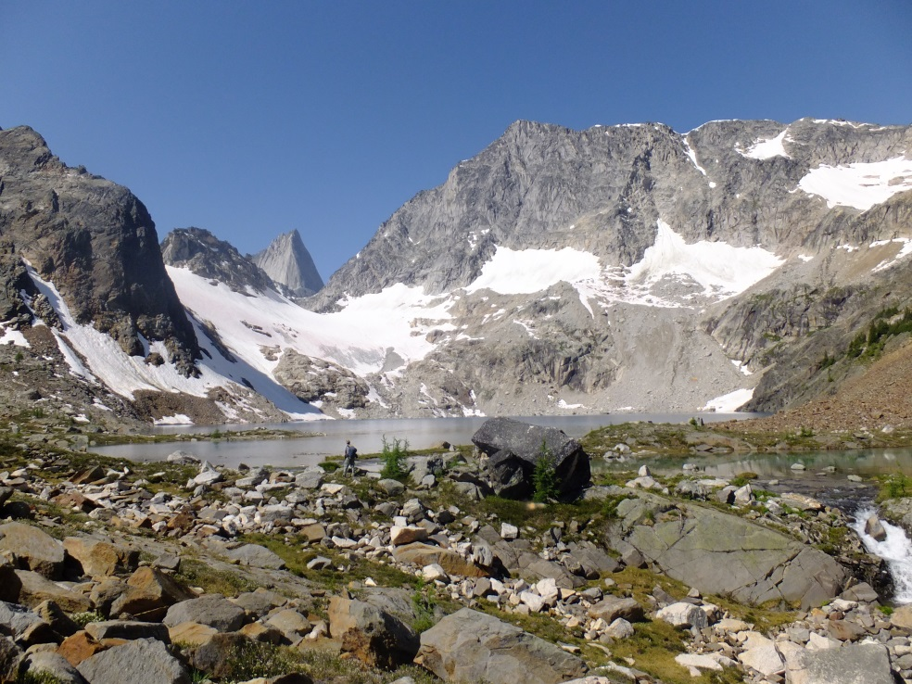

A textural study of the distribution of cordierite in metapelitic hornfelses from the Bugaboo contact aureole (SE British Columbia): Implications for the mechanisms of metamorphic crystallization
GSA Meeting, Vancouver, October 19, 2014
Petley-Ragan, A. and Gaidies, F.
Department of Earth Sciences, Carleton University, Ottawa, ON, Canada

Slide 2
Intro
Bugaboo
XR-µCT
Segmentation
Extraction
Reduce3D
Interpretation
Texture Quantification
3-dimensional data:
Textures:
RANDOM
ORDERED
CLUSTERED
Rudge et al. (2008)

Slide 3
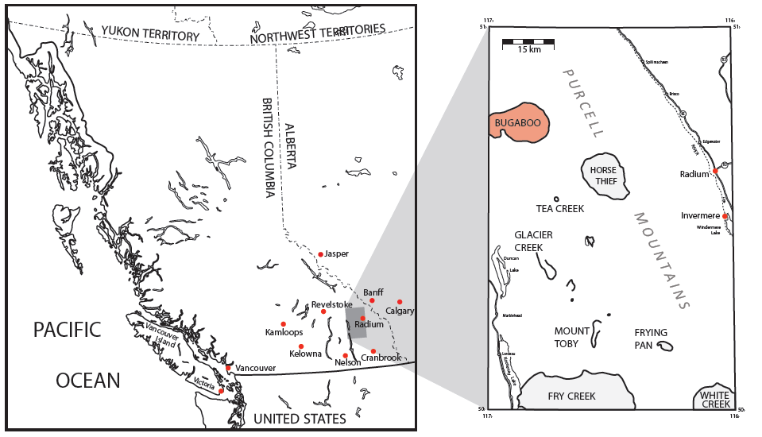
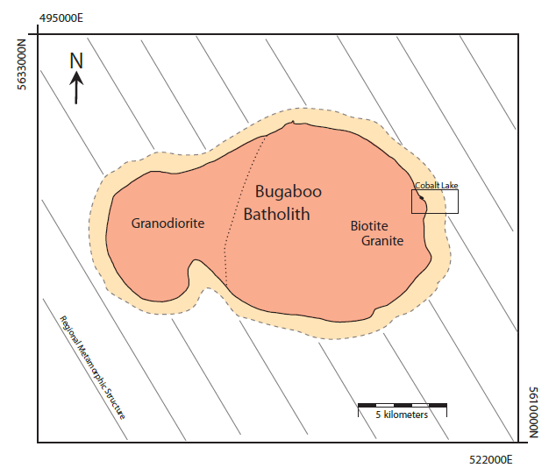
Intro
Bugaboo
XR-µCT
Segmentation
Extraction
Reduce3D
Interpretation
Bugaboo Geological Setting
Edited after DeBuhr (1999)

Slide 4
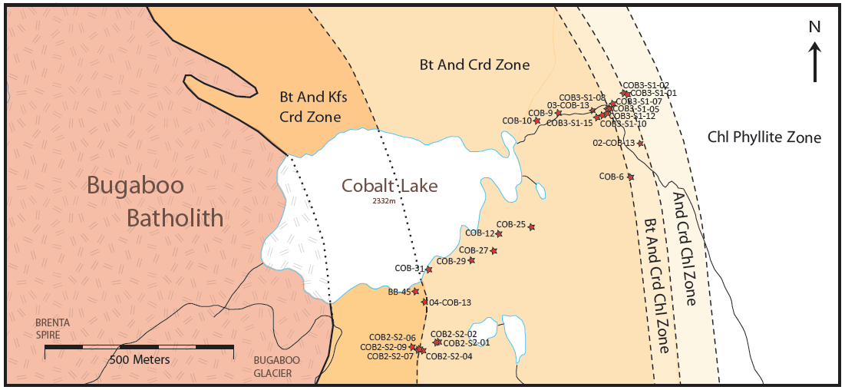
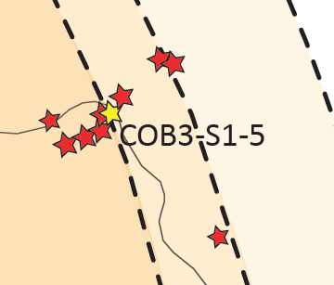
Intro
Bugaboo
XR-µCT
Segmentation
Extraction
Reduce3D
Interpretation
Bugaboo Contact Aureole
Four metamorphic zones at 1.8 - 2.2 kbar:
And Crd Chl (460-500°C)
Bt And Crd Chl (500-525°C)
Bt And Crd (525-575°C)
Bt And Kfs Crd (575-600°C)
Crd-forming reaction:
Wm + Chl + Qtz →
Bt + And + Crd + H2O
Edited after DeBuhr (1999)

Slide 5
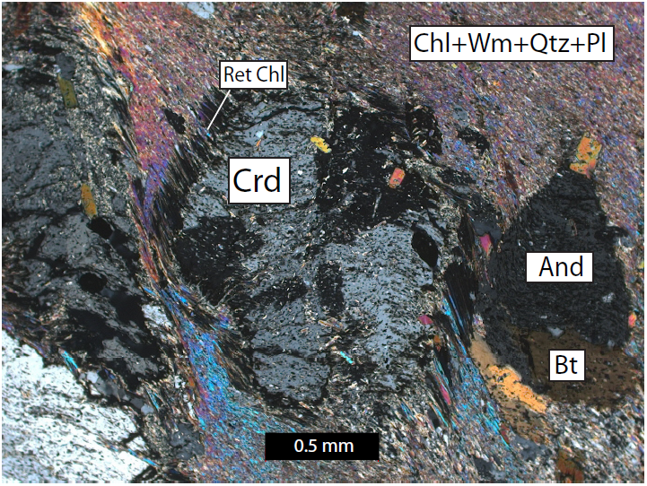
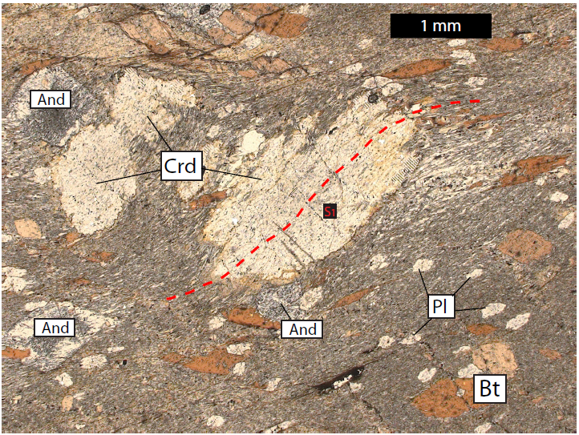
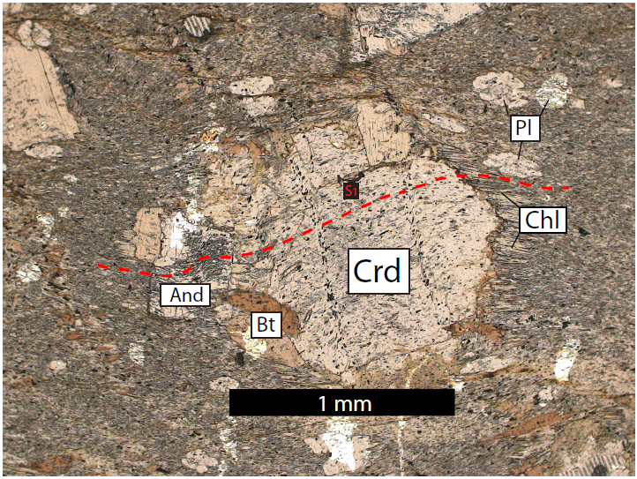
Intro
Bugaboo
XR-µCT
Segmentation
Extraction
Reduce3D
Interpretation
COB3-S1-5: Petrography
Syn-kinematic biotite, plagioclase, andalusite and cordierite porphyroblasts in a foliated matrix of quartz, white mica, plagioclase and chlorite.

Slide 6
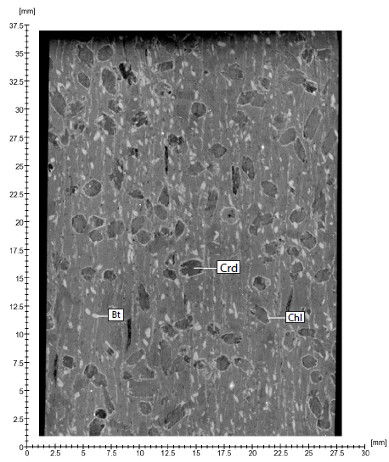
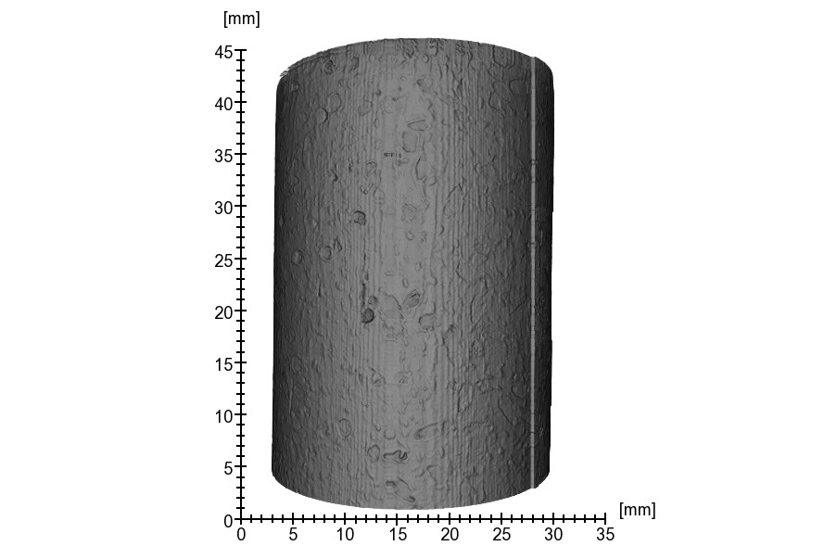
Intro
Bugaboo
XR-µCT
Segmentation
Extraction
Reduce3D
Interpretation
COB3-S1-5: X-Ray Micro-Computed Tomography
12 µm pixel size
XR-µCT obtains 3D Data:
X-Y-Z coordinates of Crd centers
Volume of Crd

Slide 7
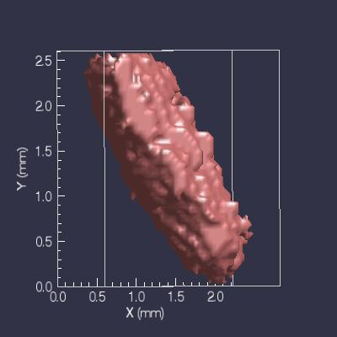
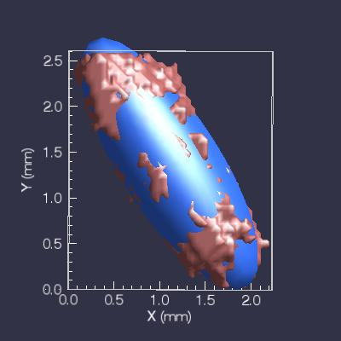
Intro
Bugaboo
XR-µCT
Segmentation
Extraction
Reduce3D
Interpretation
Cordierite Segmentation (COB3-S1-5)
Full Segmentation
Orthogonal Slice Segmentation
Images taken from Blob3D (Ketcham, 2005)
Notes:
Orthogonal slices and primitive ellipsoid

Slide 8
Intro
Bugaboo
XR-µCT
Segmentation
Extraction
Reduce3D
Interpretation
Cordierite Extraction (COB3-S1-5)
540 Crystals
9.95 vol. % Crd
Mean Volume = 1.25 mm³
Mean Aspect Ratio = 2.34
CSD

Slide 9
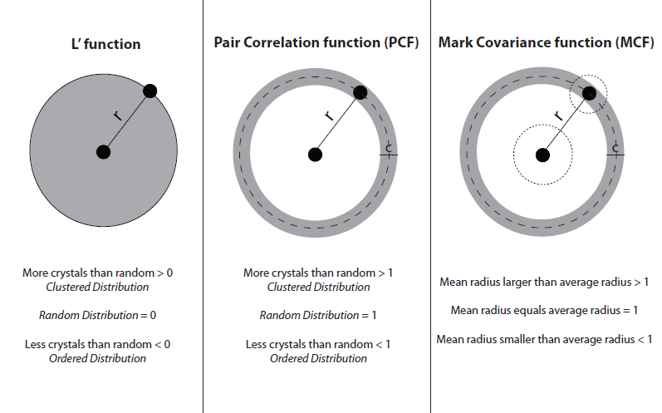
Intro
Bugaboo
XR-µCT
Segmentation
Extraction
Reduce3D
Interpretation
Scale-Dependent Statistics (Reduce3D)
r = test distance
c = shell width
Reduce3D (Hirsch, 2000; 2011)

Slide 10
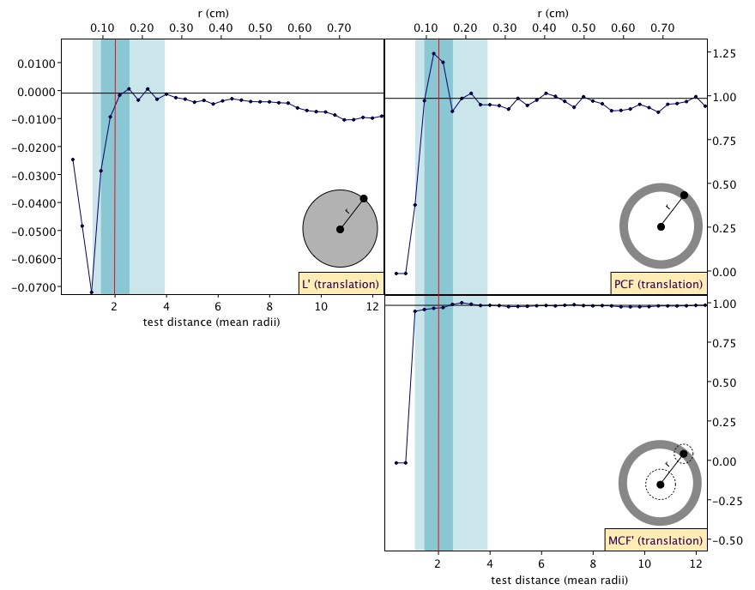
Intro
Bugaboo
XR-µCT
Segmentation
Extraction
Reduce3D
Interpretation
Scale-Dependent Statistics: Results (COB3-S1-5)
Clustering
Test statistic
Test statistic
Correlation between size and distance at smallest scales
False Ordering due to the hard core effect
Clustering at 1.1 – 1.4 mm
Average crystal size within clusters falls below the average population size
Reduce3D (Hirsch, 2000; 2011)

Slide 11
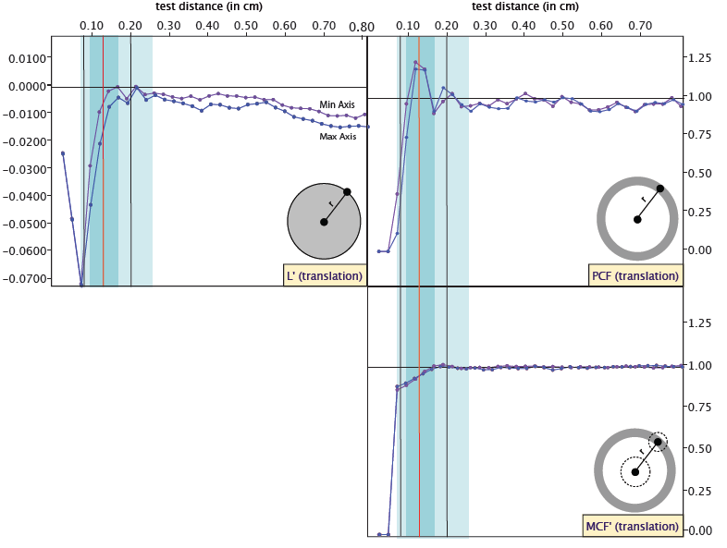
Intro
Bugaboo
XR-µCT
Segmentation
Extraction
Reduce3D
Interpretation
Scale-Dependent Statistics: Results (COB3-S1-5)
Test statistic
Test statistic
Correlation between size and distance within clusters = Ordering
Avg min axis x2
Avg max axis x2
ORDERED CLUSTERS
Reduce3D (Hirsch, 2000; 2011)

Slide 12
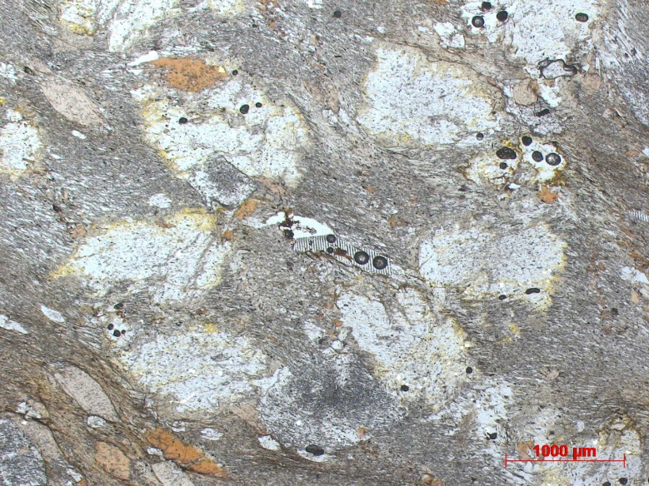
Intro
Bugaboo
XR-µCT
Segmentation
Extraction
Reduce3D
Interpretation
Interpretation of Cordierite Texture (COB3-S1-5)
Clustering at 1.1 – 1.4 mm: inhomogeneous distribution of chemical nutrients.
Clusters of smaller crystals than average: competition for chemical nutrients within crystal clusters.
Diffusion-controlled cordierite growth at lengths scales of 1.4 mm.
1 mm

Slide 13
Acknowledgements
Dave Pattison and Chris Debuhr. Department of Geoscience, University of Calgary.
Richard Ketcham, Romy Hanna and Matthew Colbert. Department of Geological Sciences, University of Texas at Austin.
Funded by NSERC – Canada Graduate Scholarship: Master’s Program
References
DeBuhr, C. L. 1999. Metamorphic petrology and mass balance analysis in the Bugaboo contact aureole. PhD Dissertation, University of Calgary.
Hirsch, D. M. 2000. Quantitative studies of porphyroblastic textures. PhD Dissertation, University of Texas at Austin.
Hirsch, D. M. 2011. Reduce3D: A tool for three-dimensional spatial statistical analysis of crystals. Geosphere, 7, p.724-732.
Ketcham, R. 2005. Computational methods for quantitative analysis of three-dimensional features in geological specimens. Geosphere, 1, p.32-41.
Rudge, J. F., Holness, M. B. and Smith, G. C. 2008. Quantitative textural analysis of packings of elongate crystals. Contrib Mineral Petrol, 156, p.413-429.
Questions?

Slide 14
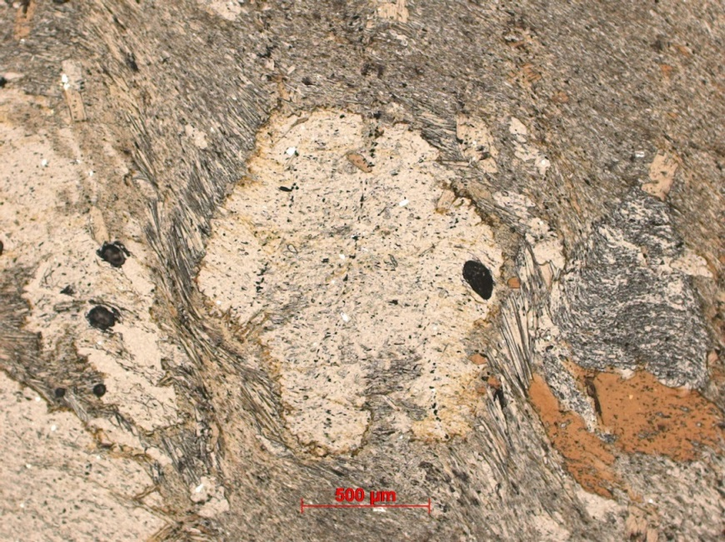
Cordierite Chemistry (COB3-S1-5)
Additional slides
Mg_{0.96}Fe_{0.74}Na_{0.30}Mn_{0.02}Al₄Si₅O₁₈

Slide 15
Cordierite & Biotite Orientation
Additional slides
Maximum Length
Minimum Length
Cordierite
Biotite

Slide 16
Segmentation Error
Additional slides
Full Segmentation
Volume = 1.659 mm³
Full Segmentation Ellipsoid
Volume = 1.793 mm³
Ortho Slices Ellipsoid
Volume = 1.138 mm³

Slide 17
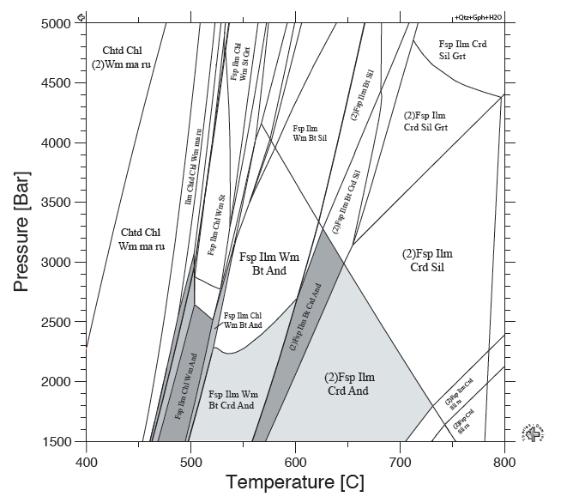
Phase Equilibria COB3-S1-5
Additional slides

Slide 18
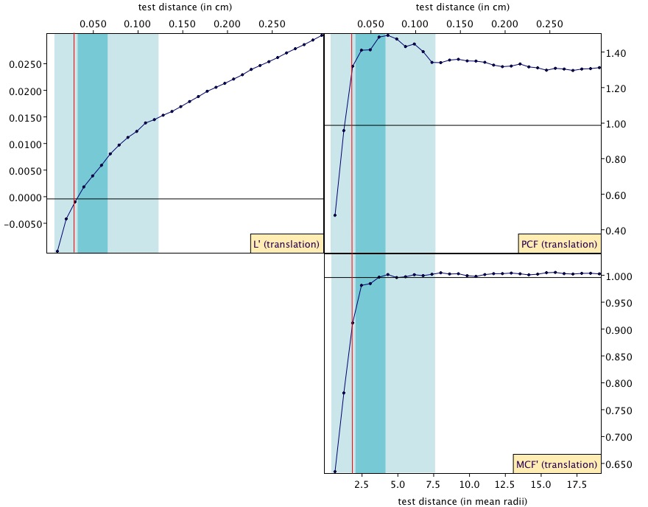
Biotite Scale-Dependent Statistics (Results)
Additional slides

