Slide 1
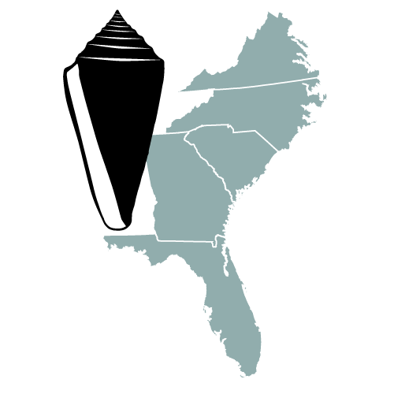


The Neogene Atlas of Ancient Life:
A New Digital Resource for Paleontology
Jonathan R. Hendricks¹
Roger W. Portell²
Nicholas L. Sylva¹
B. Alex Kittle²
Sean W. Roberts²
Nina Abdollahian¹
Anthony M. Lenci¹
¹Dept. Geol., San José State Univ.
²Florida Museum of Natural History

Slide 2
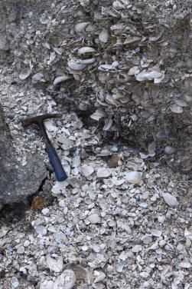
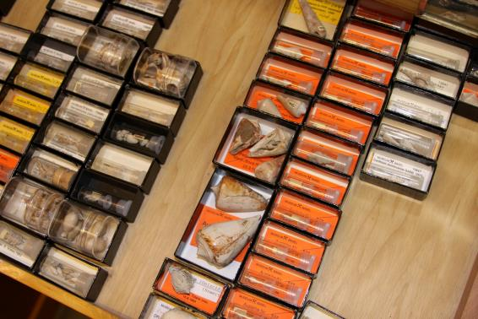
The fundamental data of paleontology consist of taxonomically identified specimens of known geographic and stratigraphic provenance that have been curated into museum collections.

Slide 3
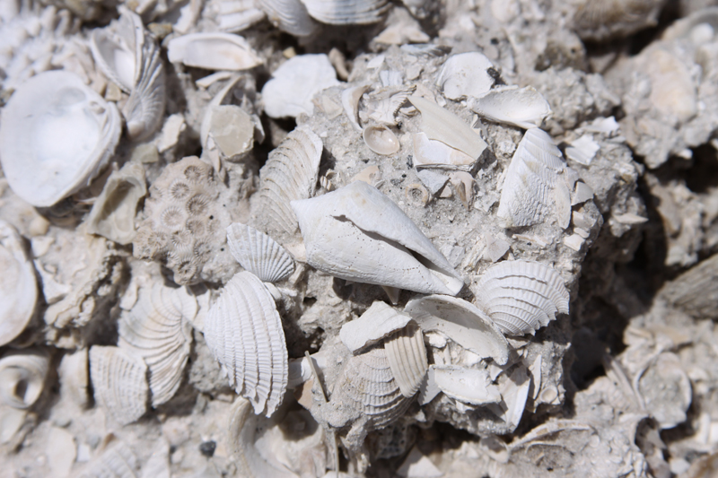

✓
Geographic position
Stratigraphic context
Species identity
✓
?

Slide 4
Tools for identifications
Most fossil identifications still require access to printed scientific literature, which may be:
  nomenclaturally out of date
  challenging to interpret (terms or figures)
  difficult or prohibitively expensive to acquire
  viewed as an alien resource by younger users
We need more and better online tools to help identify fossils.
Some excellent online resources are already available (e.g., see www.myfossil.org for examples).

Slide 5
www.digitalatlasofancientlife.org
New online resource developed to help identify and better understand fossils from particular time intervals and regions.

Slide 6

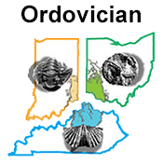
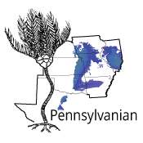
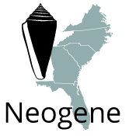
Atlases currently under development:
Digital Atlas of Ordovician Life: Cincinnati Region (www.ordovicianatlas.org)
Pennsylvanian Atlas of Ancient Life: American Midcontinent (www.pennsylvanianatlas.org)
Neogene Atlas of Ancient Life: Southeastern United States (www.neogeneatlas.org)

Slide 7
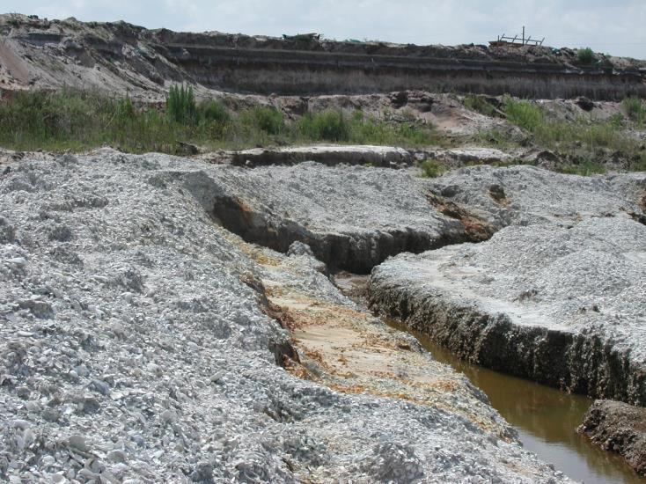
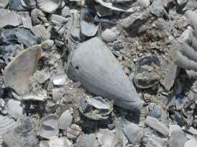
The Neogene of the S.E. U.S.A
Heavily collected by both avocational and professional paleontologists.
Massive museum collections.
Scientifically well studied.

Slide 8

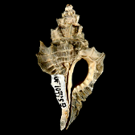
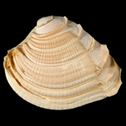
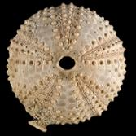
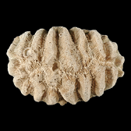
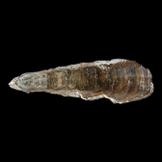
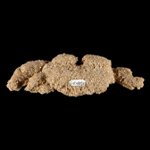
First comprehensive website structured to help users both identify and learn about fossils from this region.
Focus on mollusks, but also including echinoids, corals, brachiopods, and decapods.
Developed dynamic content management system in Wordpress for adding content; does not require programming knowledge.

Slide 9
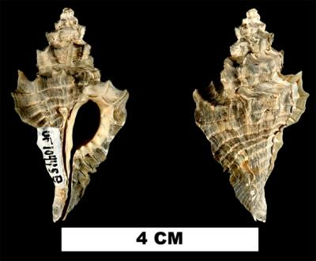
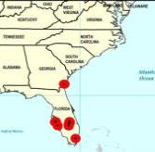
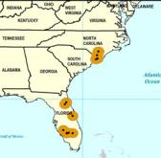
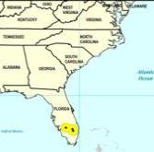
Species Pages
Up-to-date taxonomic nomenclature.
Images with Creative Commons licensing.
Stratigraphic and geographic occurrence information derived from taxonomically-vetted museum collections at the FLMNH.
Occurrence maps spanning multiple time intervals derived from georeferenced collections.
Eupleura leonensis
Late Pliocene
Occurrence records for the gastropod Eupleura leonensis.
Early Pleist.
Middle Pleist.
Notes:
Up-to-date taxonomic nomenclature based on expert opinion.
Stratigraphic and paleobiogeographic occurrence information based on vetted museum collections.

Slide 10
Species Page: Information

Slide 11
Species Page: Images

Slide 12
Species Page: Maps

Slide 13
Two Routes for Identification
Taxonomic trees
Genera
Classes
Families
Species

Slide 14
Two Routes for Identification
2. All-species page

Slide 15
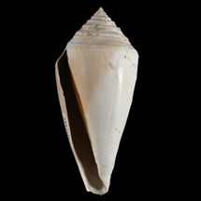
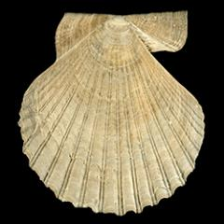
Neogene Atlas Progress & Goals
>300 species online now (>500 planned).
Planning digital, illustrated glossaries of fossil morphology, which will be integrated with the taxonomic pages.
Development of K-16 educational resources (e.g., laboratory exercises).

Slide 16

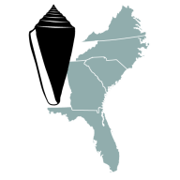

Thank You!
NSF EF-1206769 (PI Hendricks).
Project PI’s Bruce Lieberman and Alycia Stigall.
Dept. of Geology at San Jose State University.
Follow the Digital Atlas of Ancient Life project on Twitter @paleodigatlas
Websites:
Digital Atlas of Ancient Life portal:
www.digitalatlasofancientlife.org
Neogene Atlas of Ancient Life:
www.neogeneatlas.org

