Slide 1
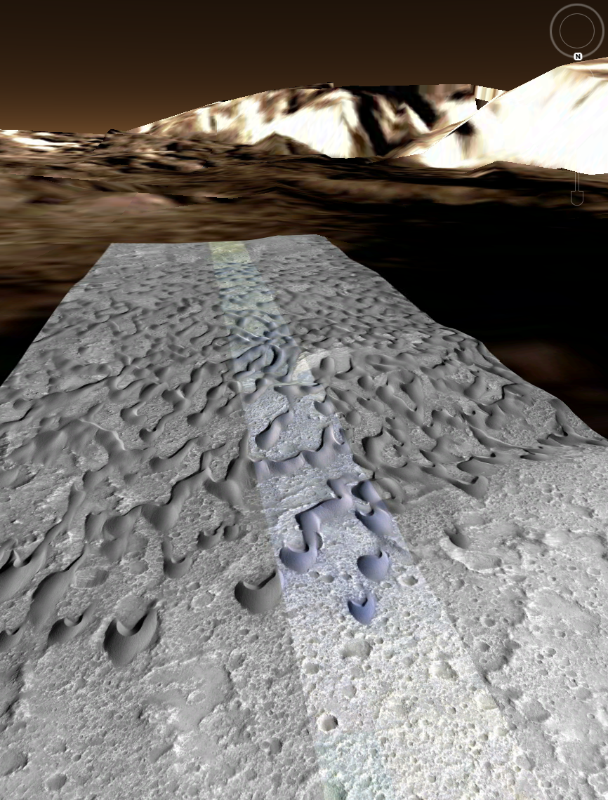



Activity of and Sediment Fluxes from Aeolian Bedforms in Herschel Crater, Mars
Kirby Runyon
kirby.runyon@gmail.com
Nathan Bridges
Francois Ayoub
Thanks to APL Graduate Student Fellowship Program

Slide 2
Relevance of Martian Aeolian Activity
Major contributor to landscape evolution
erosion and sediment deposition
Current/Past climate & geologic activity
Aeolian bedforms as wind-regime proxies
Constrain GCMs
Insight into general Martian aeolian physics
Especially partitioning sand flux into constituent processes
Development of novel methods for eventual terrestrial application
May inform grain size (comparison w/other datasets)
Focus on barchan dune fields
Compare with previous work in Nili Patera (Bridges et al., 2012; Ayoub et al., 2014)

Slide 3
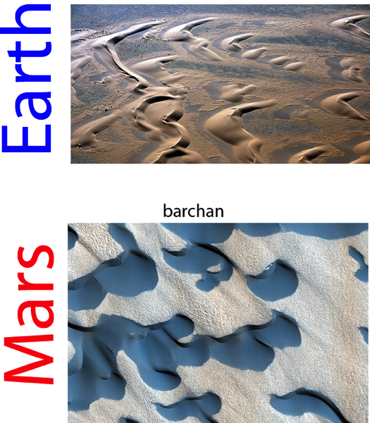
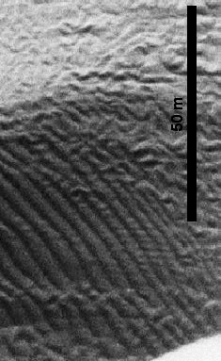
Back ground: Barchan Dunes & Ripples
Notes:
Martian ripples ripples larger and move slower than Earth’s. Track on month-years timescales. Earth change in hours, but smaller features. Use Ralph’s timelapse

Slide 4
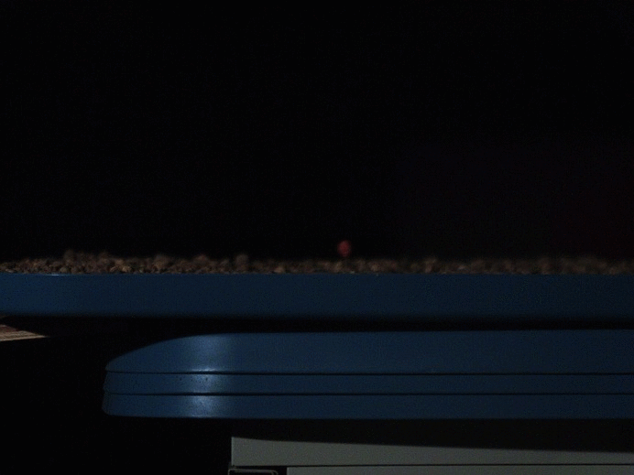
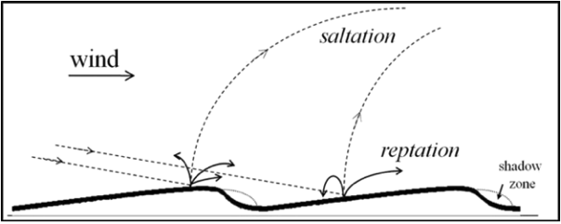
Background: Aeolian Morphodynamics
Saltation (e.g. Bagnold, 1941, Kok et al., 2012)
Wind shear stress lofts and accelerates sand grains
Creates & moves
dunes
Reptation
Landing saltator “splashes” local grains on short, ballistic trajectories.
Creates & moves ripples (Anderson, 1987)
Kok et al., 2010

Slide 5
Background: Bedform Migration Rate
Dune rate (slip face advance rate)
Ripple rate
Dune rate from reptation =
(ripple rate) x h_{r}/h_{d}
Notes:
Dana wants a diagram

Slide 6
Background: Sand Flux (assuming steady-state)
Crest sand flux = (slip face advance rate) x (dune height)
Sand flux from reptation = (ripple rate) x
(ripple half-height)
Notes:
Mean (half) height is what determines reptation sand flux

Slide 7
Questions to Address
To what percent of total flux does reptation contribute (on Mars)?
__%= reptation
saltation + reptation (+ creep + susp.)
Controls on intra- & global dune field variation

Slide 8
Fundamental Measurements
Dune slip face (lee) advancement rate
Ripple advancement rate
Dune geometry
Notes:
Schematic of quantities

Slide 9
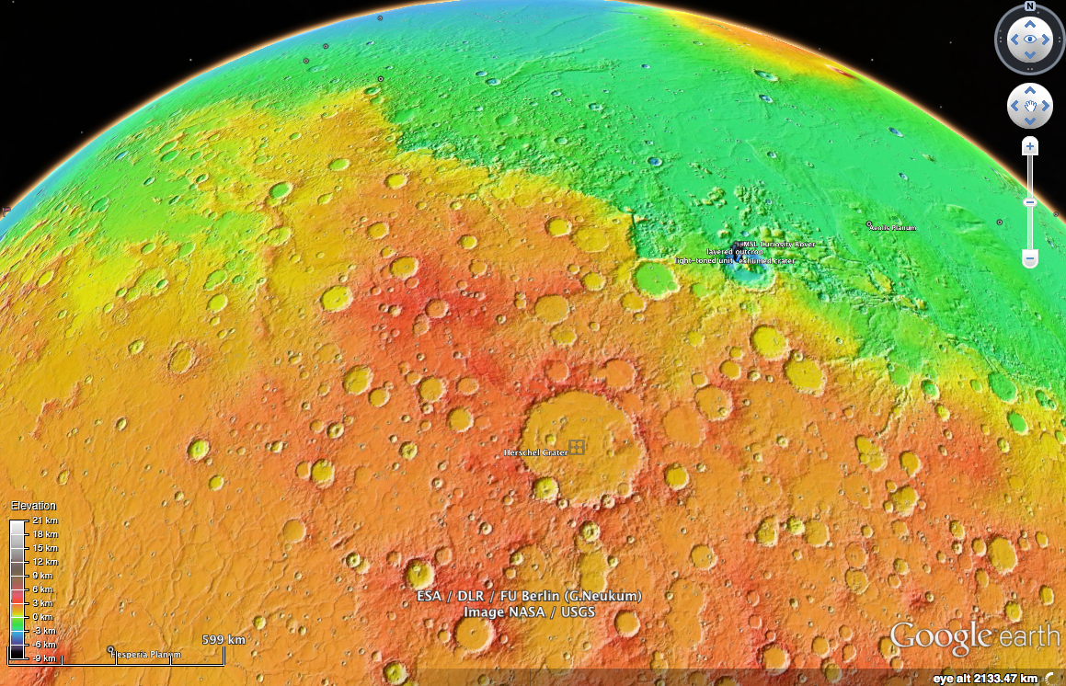
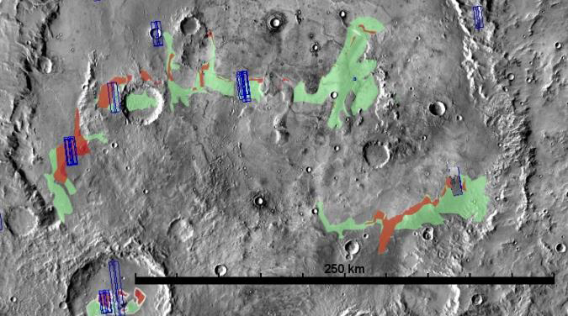
Study Site: Herschel Crater
Noachian peak-ring basin, D=~300 km
Near Gale crater landing site

Slide 10
Methods
>= 3 HiRISE images
Allows DTM generation (Kirk et al., 2008; Mattson et al., 2009)
Allows change detection
Automated ripple displacement tracking (COSI-Corr code) (Leprince et al., 2007)
Allows ripple migration rate & flux estimate
Manual slip face mapping
Tracks bulk dune migration rate & flux
Notes:
Explain HiRISE

Slide 11
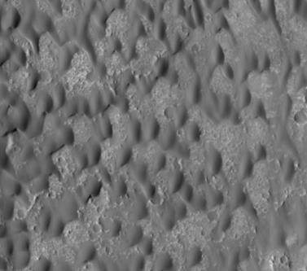
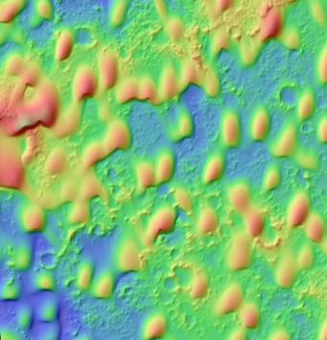
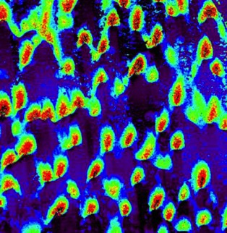
Herschel West Ripple Displacement
Image
Elevation
Change
Runyon et al., 2014
Notes:
Color bar. Each dune is a football field

Slide 12
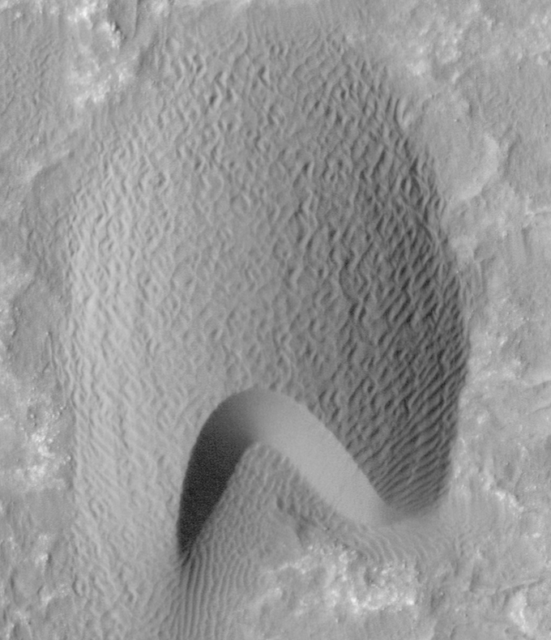
Herschel West Slip Face Advance
3.74 Earth years
100 m
Notes:
PSP_002860_1650 & ESP_020384_1650
Dune M04

Slide 13

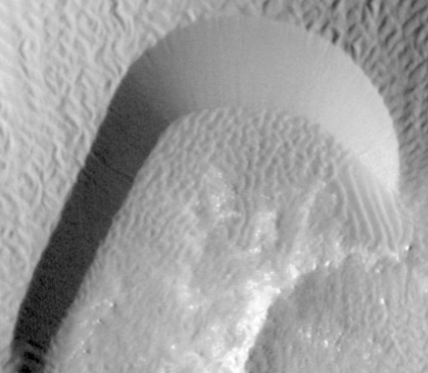
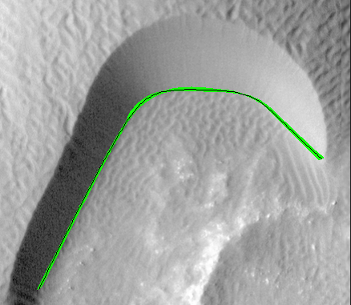
Herschel West Slip Face Advance
Manual mapping of lee-slope advance
(2100 pixels advancement)/(460 pixels arc length) = 4.56 pixel migration = 1.14 m = 0.31 m/yr
Notes:
Make blow up of green area and add 1.14 m. Green line is 1.14 m thick on average

Slide 14
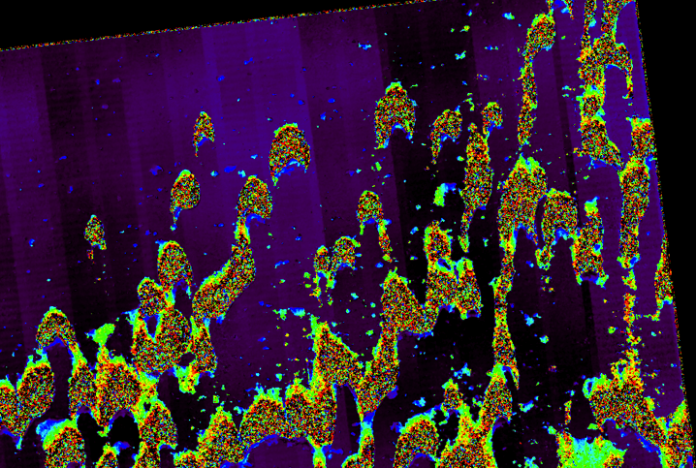
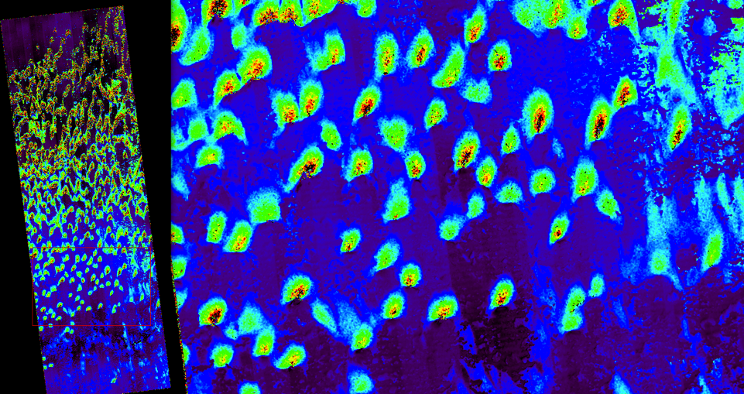
Downwind vs. Upwind Ripples
Notes:
Scale bar

Slide 15
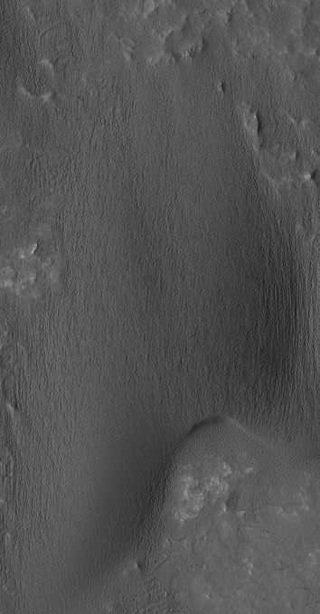
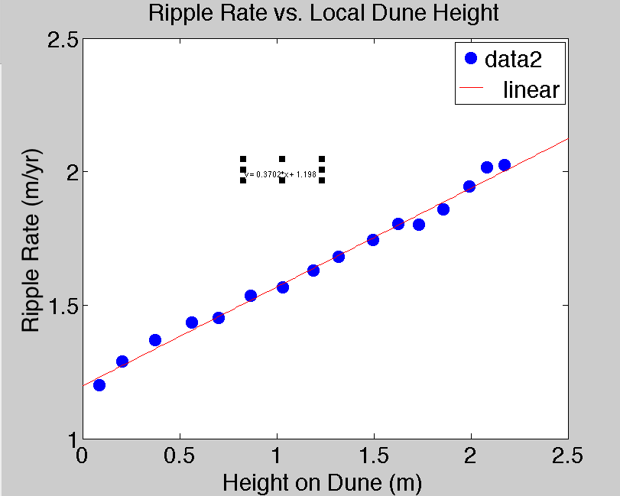
Ripple Advancement vs. Height
y = 0.3702x + 1.198
500 m

Slide 16
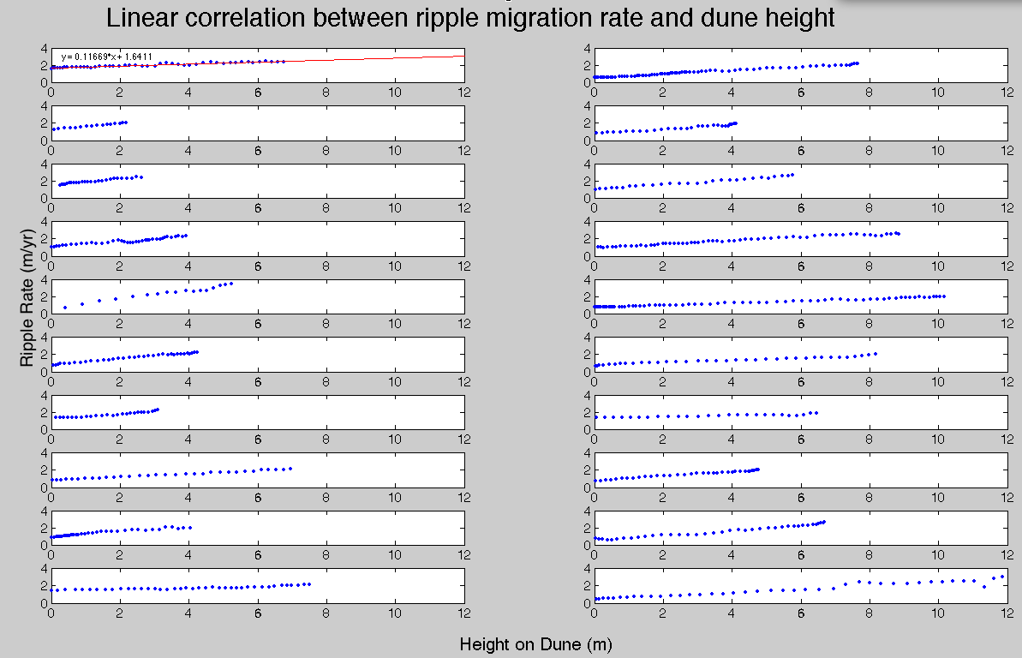
Ripple Rate vs. Height
Notes:
Also found at Nili
Min y-int: 1.6 m (Dune 20)
Max y-int: 6.1 m (Dune 1)
RipProfilesWH_slopeIntercept.txt

Slide 17
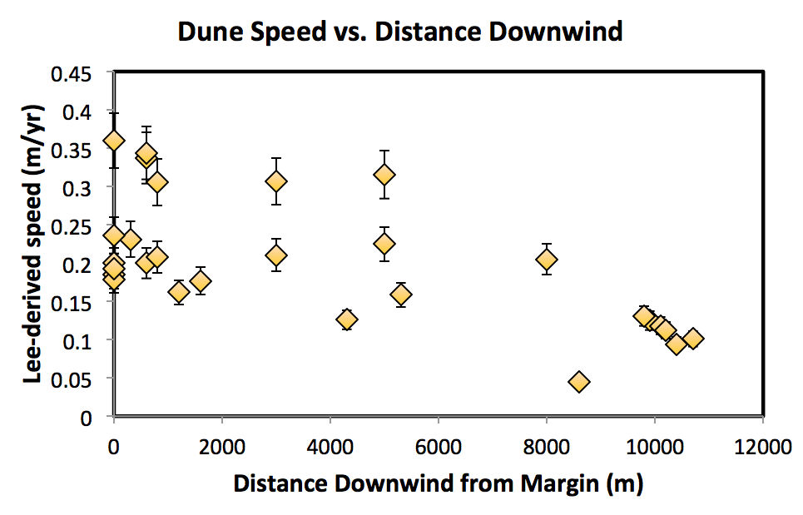
Results: Lee Rate vs. Position

Slide 18
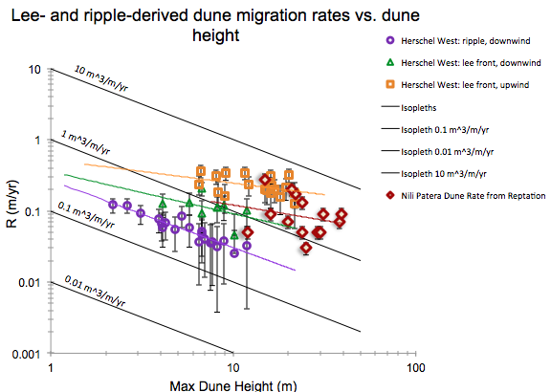

Results: Rate vs. Height
~
Notes:
Estimate uncertainty.
Nili Stuff to compare. Get on same plot

Slide 19
Results: Overview
Metric | Value (Upwind) | Units
 | (Downwind)
Average Wind Azimuth for speeds > threshold | 330˚ ± 6σ˚ | Degrees
Lee (Bulk Dune) Advance Rate | 0.23 | (m/yr)
 | 0.12
Dune migration rate from reptation | - | (m/yr)
 | 0.06
Reptation Sand Flux | - | m³/m/yr
 | 0.30
Lee-based Sand Flux | 2.99 | m³/m/yr
 | 0.86
Notes:
Third column with unit. Different color and not underline. Only important thing are reptation rate and total rate and ratio
Only 8 dunes with both ripple and slip face advance study

Slide 20
Results: Overview
Metric | Value (Upwind) | Units
 | (Downwind)
Average Wind Azimuth for speeds > threshold | 330˚ ± 6σ˚ | Degrees
Lee (Bulk Dune) Advance Rate | 0.23 | (m/yr)
 | 0.12
Dune migration rate from reptation | - | (m/yr)
 | 0.06
Reptation Sand Flux | - | m³/m/yr
 | 0.30
Lee-based Sand Flux | 2.99 | m³/m/yr
 | 0.86
~50% celerity reduction downwind

Slide 21
Results: Overview
Metric | Value (Upwind) | Units
 | (Downwind)
Average Wind Azimuth for speeds > threshold | 330˚ ± 6σ˚ | Degrees
Lee (Bulk Dune) Advance Rate | 0.23 | (m/yr)
 | 0.12
Dune migration rate from reptation | - | (m/yr)
 | 0.06
Reptation Sand Flux | - | m³/m/yr
 | 0.30
Lee-based Sand Flux | 2.99 | m³/m/yr
 | 0.86
Saltation flux ~1.9x reptation flux; consistent w/Andreotti (2004)

Slide 22
Results: Overview
Metric | Value (Upwind) | Units
 | (Downwind)
Average Wind Azimuth for speeds > threshold | 330˚ ± 6σ˚ | Degrees
Lee (Bulk Dune) Advance Rate | 0.23 | (m/yr)
 | 0.12
Dune migration rate from reptation | - | (m/yr)
 | 0.06
Reptation Sand Flux | - | m³/m/yr
 | 0.30
Lee-based Sand Flux | 2.99 | m³/m/yr
 | 0.86
Upwind flux = 3.5x downwind flux

Slide 23
Discussion
Upwind dunes ~twice as fast, larger flux.
Upwind erosion and/or downwind deposition
Still in equilibrium! (Jerolmack et al., 2012)
Downwind Herschel dunes: saltation= 1.9 x reptation…
Upwind Nili Dunes S:R ~ 4
suggests that saltation is relatively less important at lower wind shear velocity
On low end of range for Earth proposed by Andreotti (2014) of saltation:reptation = 1.5-9
Notes:
Smaller ripples at Herschel. Are they slower? Speed of nili and herschel upwind dunes. Flux vs. size of ripples. Which is controlling factor? Recast nathan’s data in terms of ripple rate up dune to compare slopes. Smaller ripples faster? But overall flux is lower…

Slide 24
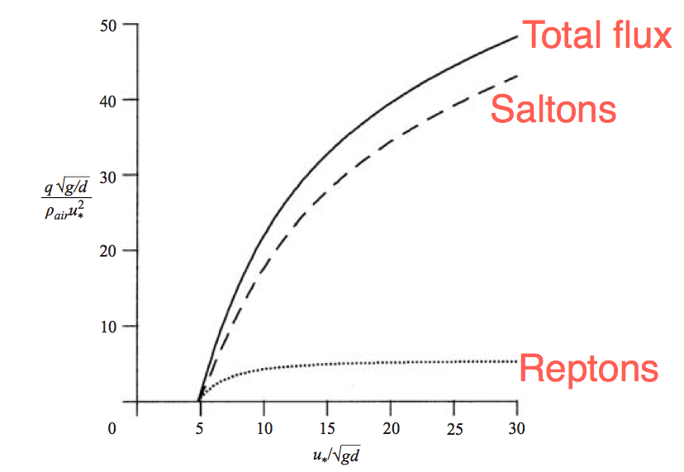
Discussion
~Nili
~Herschel
From Andreotti, 2004
Notes:
Put qualititate bars.

Slide 25
Discussion, Cont.
Herschel ripples (~26 cm high) are smaller & slower (2.29 m/yr) than Nili Patera ripples (~40 cm high, 9.37 m/yr) → 0.38 m³/m/yr vs. 1.87 m³/m/yr
inverse height-speed relation may be complicated by ∆shear stress

Slide 26
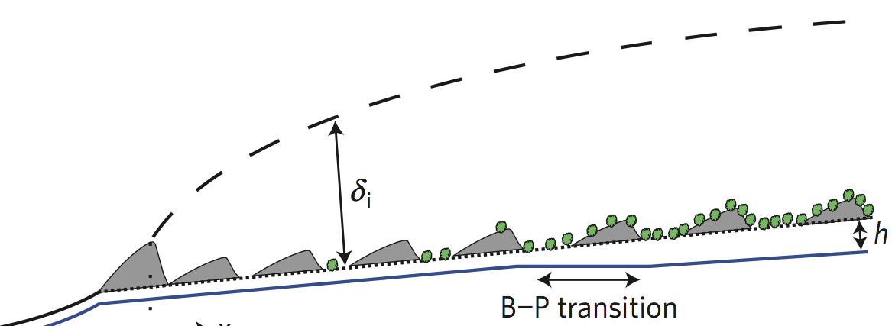
Conclusions
Only 2nd place on Mars to partition sand flux into reptation & saltation
Differences indicate different dominating factors
Saltation:reptation
Varies with wind shear stress
theory consistent with observations
Decreased downwind rates & fluxes--consistent with IBL formation/increased surface roughness?
Jerolmack et al., 2014, Fig. 2

Slide 27
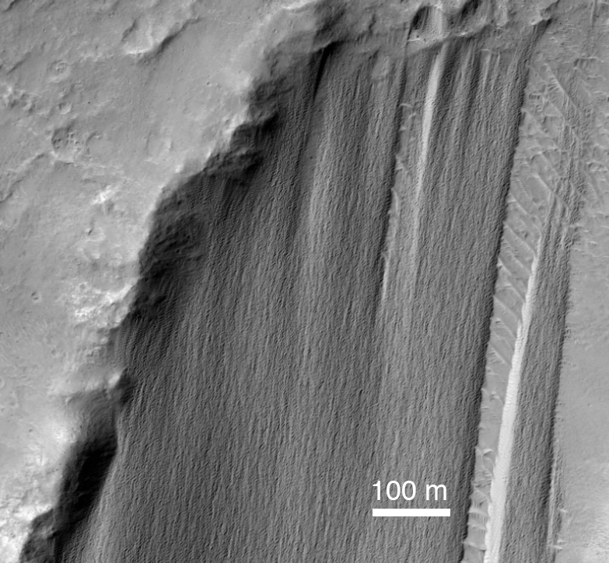
Future Work
Include sand sheet ripple migration & sand flux
Any deviations in dune inverse speed/height relation?
Compare with GCMs
Notes:
Smaller, slower rippls at Herschel → lower flux

Slide 28
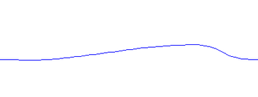
Bonus: Wind speed increase up Typical Barchan Dune Profile
~14% wind speed increase
5˚ slope

Slide 29
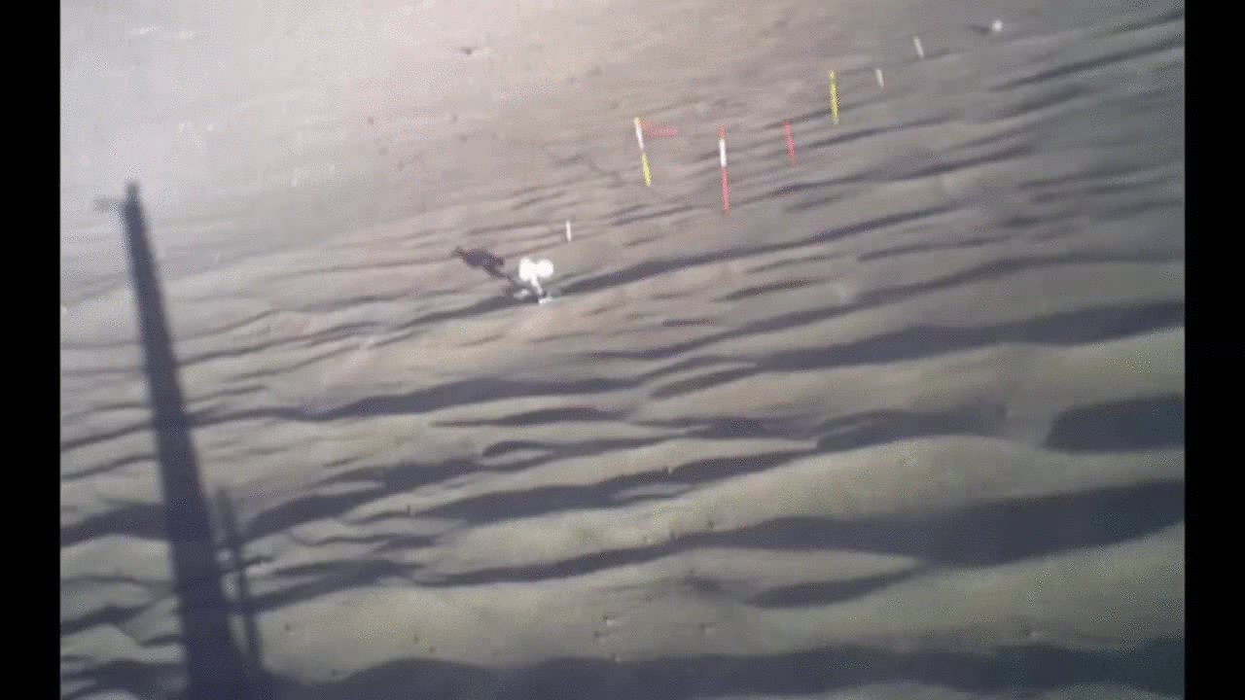
Time-Lapse Ripples: Great Sand Dunes Nat’l Park
Credit: Ralph Lorenz, APL

Slide 30
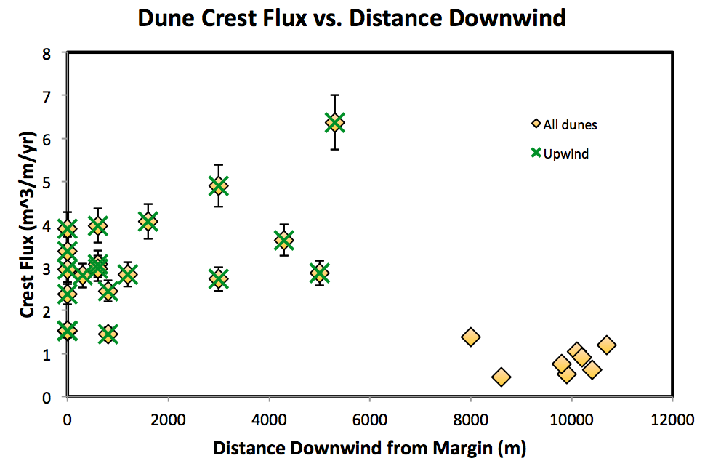
Results: Crest Flux vs. Position

Slide 31
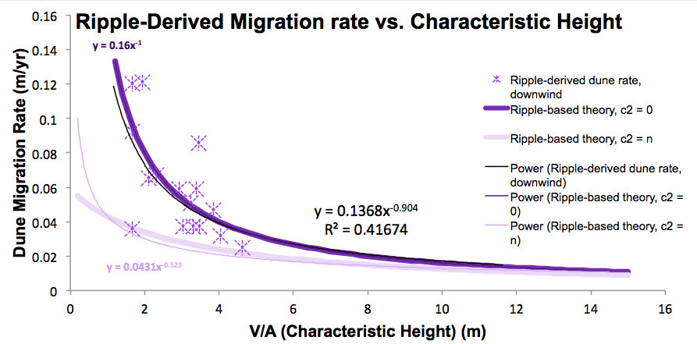
Results: Self-Similarity

Slide 32
Discussion: West Herschel
Upwind dunes ~twice as fast (via lee advance)
Lee-based fluxes are ~3.5x higher upwind
Upwind erosion and/or downwind deposition
Still in equilibrium! (Jerolmack et al., 2012)
Downwind dunes: saltation= 1.9 x reptation
Taken w/Nili results (S:R ~ 4), suggests that saltation is relatively less important at lower wind shear velocity
On low end of range for Earth proposed by Andreotti (2014) of saltation:reptation = 1.5-9
Herschel ripples (~26 cm high) are smaller & slower (2.9 m/yr) than Nili Patera ripples (~40 cm high, 9.37 m/yr) → 0.38 m³/m/yr vs. 1.87 m³/m/yr
Notes:
Smaler ripples at Herschel. Are they slower? Speed of nili and herschel upwind dunes. Flux vs. size of ripples. Which is controlling factor? Recast nathan’s data in terms of ripple rate up dune to compare slopes. Smaller ripples faster? But overall flux is lower…

