Slide 1

SPATIAL CORRELATION OF INFRARED AND PL OPTICAL CENTERS IN HYDROGEN-RICH DIAMONDS
Troy Ardon and Sally Eaton-Magaña
Gemological Institute of America
Carlsbad, CA USA

Slide 2
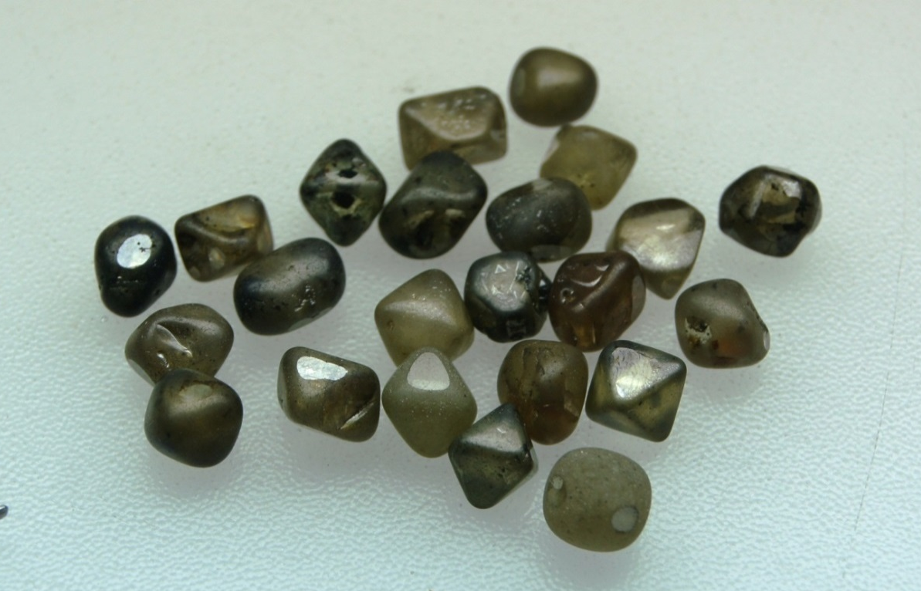
Geology of Marange
Samples sourced from Marange
Alluvial deposit
Unusually high amount of radiation damage
Commonly found containing hydrogen clouds
Image by Wuyi Wang
Notes:
The diamonds we sourced were from the Marange deposit in Zimbabwe…
And of interest to us they … *H clouds*

Slide 3
Hydrogen Clouds
Granular clouds of unknown structure and composition
Usually highly symmetric
Associated with infrared defect at 3107 cm⁻¹
Image by Jian Xin Liao
Notes:
Associated with infrared defect at 3107 cm⁻¹
Which we’ll be returning to

Slide 4
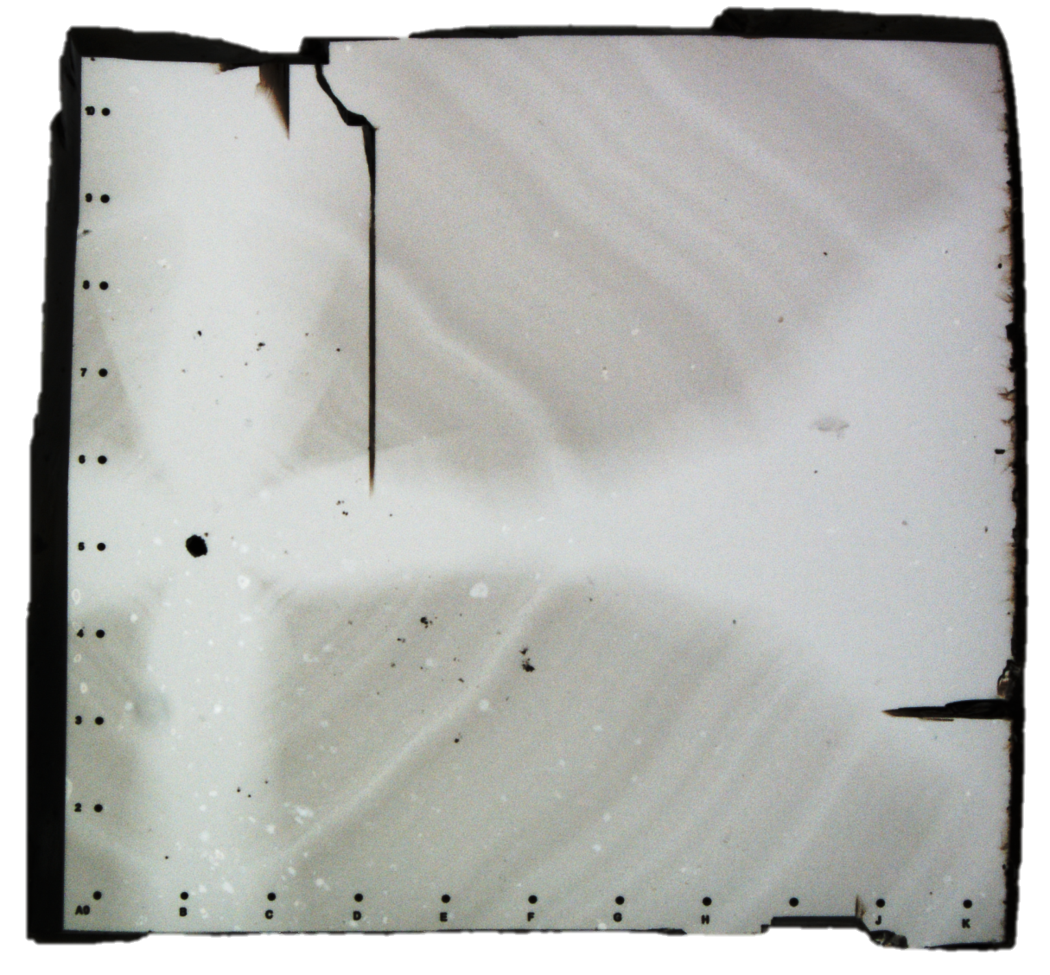
Experimental Design
Flat plate with uniform thickness
Inscribed a series of points forming axes for accurate and reproducible mapping
Cloud shape thought to show strong contrast in features

Slide 5
Experimental Design
Infrared (IR) maps taken with Nicolet iN10 IR microscope on a grid with spacing of 100 μm and with an aperture size of 100 μm X 100 μm
Photoluminescence (PL) spectroscopy taken with Renishaw inVia Raman Microscope with 488 nm, 514 nm, and 830 nm lasers on a grid with 500 μm spacing
Heated in a muffler tube furnace to temperatures of 300ºC, 600ºC, 800ºC, 1000ºC, and 1200ºC for one hour at each step.
After heating to 1200ºC, the fractures present developed and the sample broke apart.
Notes:
Mention the visible damage in the IR/PL maps

Slide 6
IR mapping
Main features tracked were the A aggregates, 3123 cm⁻¹ and 3107 cm⁻¹ hydrogen related defect.
There was no detectable signal from B-aggregated nitrogen, indicating the formation temperature was likely below 1100ºC^{[1]}
[1] Kiflawi et al., “The creation of the 3107 cm-1 hydrogen absorption peak in synthetic diamond single crystals,” Diamond and Related Materials 5 (1996) pp. 1516-1518

Slide 7
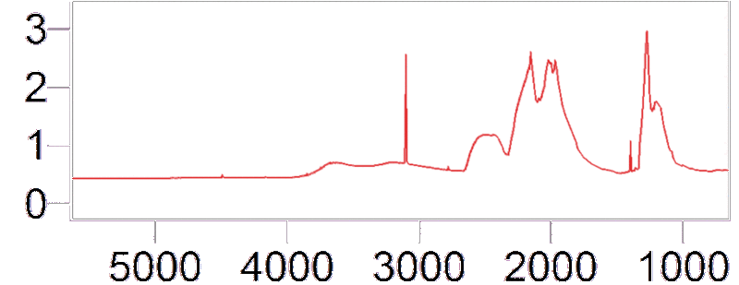
Infrared Spectrum of IaA type Diamond
A aggregates (1280 cm⁻¹)
3
N₃VH (3107 cm⁻¹)
Absorbance (a.u.)
2
1
NVH (3123 cm⁻¹)
0
5000
4000
3000
2000
1000
Wavenumber (cm⁻¹)
Notes:
This is a spectrum from a hydrogen rich part of the sample

Slide 8
A Aggregated Nitrogen
C
C
C
C
C = Carbon
N = Nitrogen
C
N
N
C
C
C
C
C
C
C
C
C

Slide 9
3123 cm⁻¹ Defect
C
C
C
C
C = Carbon
N = Nitrogen
V = Vacancy
H = Hydrogen
C
N
V
C
C
C
H
C
C
C
C
C

Slide 10
3107 cm⁻¹ Defect
C
C
N
C
C = Carbon
N = Nitrogen
V = Vacancy
H = Hydrogen
C
N
V
N
C
C
H
C
C
C
C
C

Slide 11
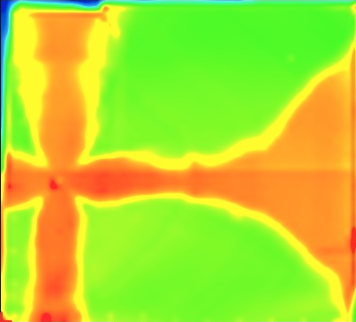
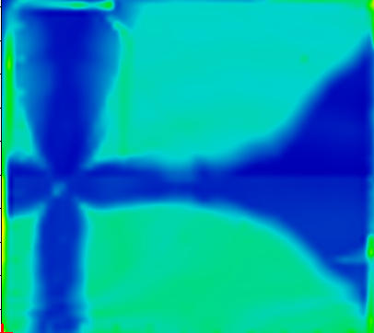
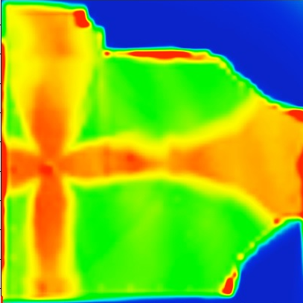
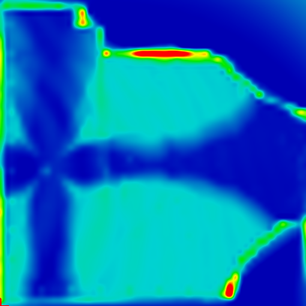
Temperature Variance of IR Defects
A Nitrogen (1280 cm⁻¹)
3107 cm⁻¹ Defect
2.0
Natural
Absorbance (a.u.)
1.0
After 1000ºC
0.0
Notes:
Talk about edge scattering effects

Slide 12
Proposed Mechanisms for Formation of N₃VH
N
N
+
N
V
H
?
N
N
+
?
N
V
N
N
V
N
H
H
?
N
V
N
+
N
H

Slide 13
PL mapping
Tracked peaks of known structure, H3 (503.2 nm), NV⁻ (637.5 nm), H2 (986.2 nm)
Tracked peaks of unknown structure at 523.5, 612.4, 700.5, 926, and 948 nm
Most defects correlated with hydrogen rich areas
Largest increase in defect concentration between 600ºC and 800ºC (temperature range when vacancies become mobile)

Slide 14
N3 Defect
C
C
N
C
C = Carbon
N = Nitrogen
V = Vacancy
C
N
V
N
Not observed in either H-rich or H-poor areas, therefore not a contributor to N₃VH
C
C
C
C
C
C
C
C

Slide 15
Proposed Mechanisms for Formation of N₃VH
N
N
+
N
V
H
?
N
N
+
?
N
V
N
N
V
N
H
H
?
N
V
N
+
N
H

Slide 16
H3 Defect
C
C
C
C
C = Carbon
N = Nitrogen
V = Vacancy
C
N
V
N
C
C
C
C
C
C
C
C
Notes:
Neutral form of defect, the negative H2 was not detected

Slide 17
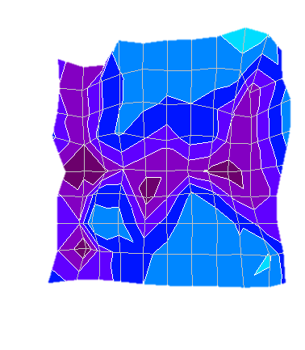
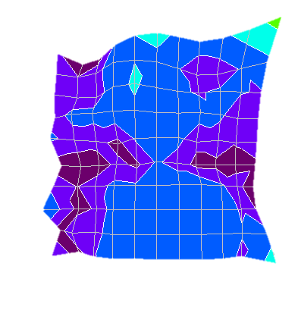
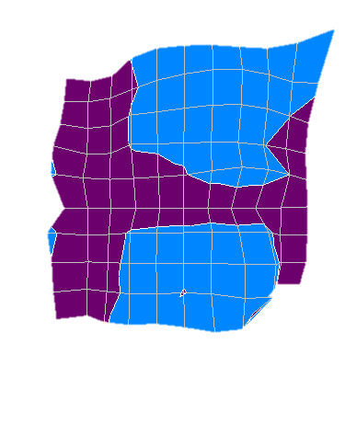
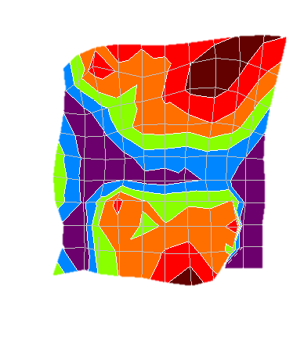
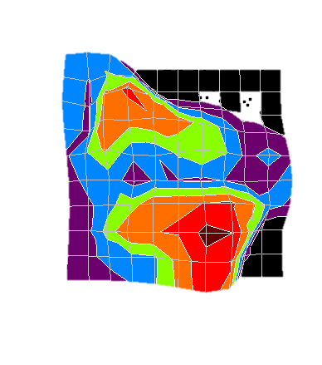
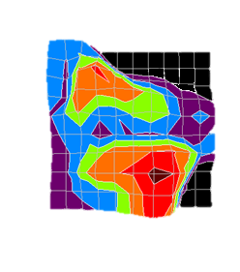
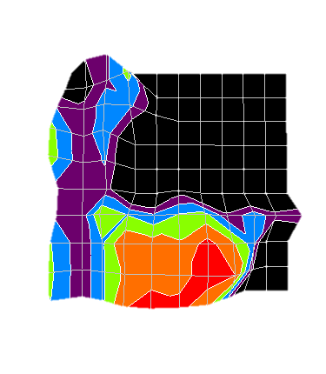
H3 Area
Natural (no heat)
300ºC
600ºC
1.20
4
4
4
4
4
Y (mm)
Y (mm)
Y (mm)
2
2
2
2
2
0
0
0
0
2
4
0
Intensity (arb. units)
2
4
2
4
2
4
2
4
X (mm)
X (mm)
X (mm)
0.60
800ºC
1000ºC
1200ºC
4
4
4
Y (mm)
Y (mm)
Y (mm)
2
2
2
0
2
4
0
2
4
0
2
4
0.00
X (mm)
X (mm)
X (mm)
Notes:
Because this defect was elevated in H rich areas rather than in H poor areas, it is unlikely to have contributed to formation of N3VH

Slide 18
Proposed Mechanisms for Formation of N₃VH
N
N
+
N
V
H
?
N
N
+
?
N
V
N
N
V
N
H
H
?
N
V
N
+
N
H

Slide 19
Analysis of IR Defect Distribution
Analysis was done along the Y coordinate at evenly spaced X coordinates
Confirmed visual analysis that showed an inverse correlation of A aggregated nitrogen with hydrogen clouds

Slide 20
Variance along the y-axis of defect concentrations
Dashed lines show position of H clouds
Peak Area (Scaled for reference)
Y Position (μm)

Slide 21
Evidence for Formation Mechanism
Other formation pathways unlikely due to absence of defects
Inverse correlation of A nitrogen shows that A nitrogen is likely depleted during formation of N₃VH
Formation pathways involving three or more defects combining likely energetically unfavorable

Slide 22
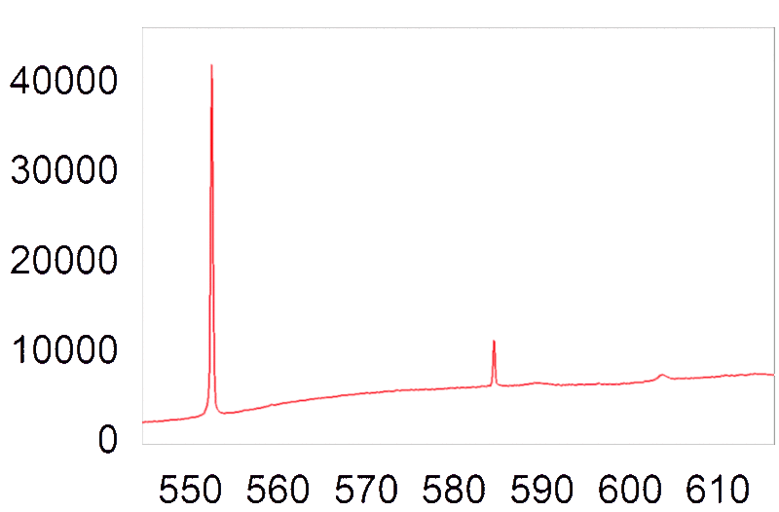
NV⁻ Centers
PL Spectrum of Hydrogen Poor Area (taken with 514 nm laser)
Only defect noted to be elevated in H poor areas
The neutral counterpart (NV⁰) was not detected
Diamond Raman Peak 552 nm
Intensity (counts)
Liquid Nitrogen Artifact
NV⁰ 575 nm (Absent)
NV⁻ 637 nm
Wavelength (nm)

Slide 23
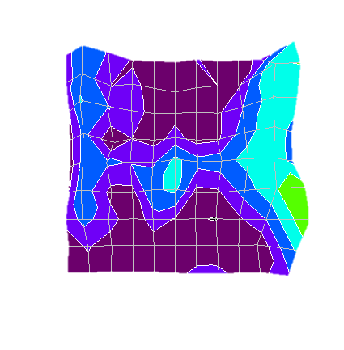
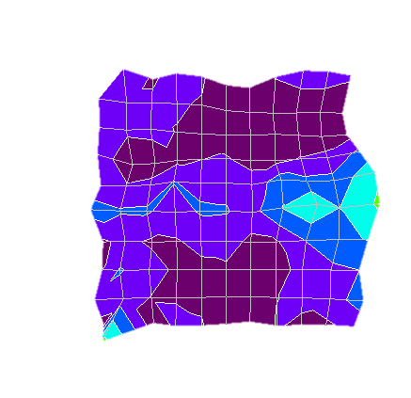
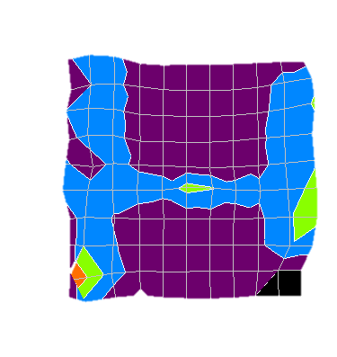
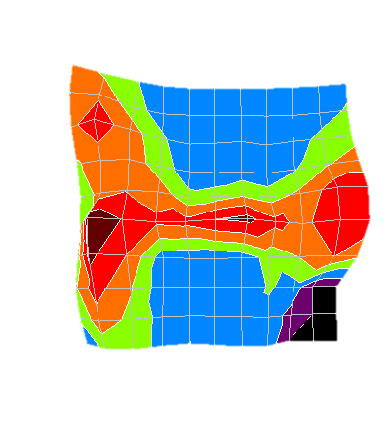
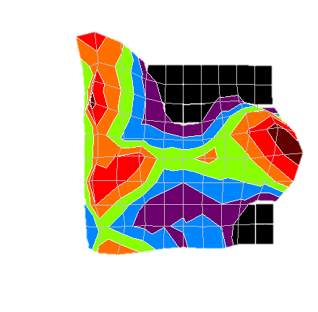
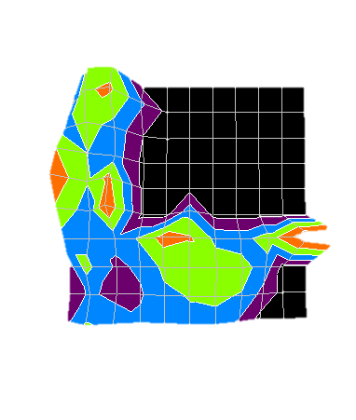
NV⁻ Centers
Natural (no heat)
300ºC
600ºC
2.00
4
4
4
Y (mm)
Y (mm)
Y (mm)
2
2
2
0
0
0
2
Intensity (arb. units)
2
4
2
4
4
X (mm)
X (mm)
X (mm)
1.00
800ºC
1000ºC
1200ºC
4
4
4
Y (mm)
Y (mm)
Y (mm)
2
2
2
0
2
4
0
2
4
0
2
4
0.00
X (mm)
X (mm)
X (mm)

Slide 24
Conclusions and Future Investigations
A-type nitrogen combining with NVH likely formation pathway for N₃VH
Many defects of unknown structure correlated with hydrogen-rich areas
Use samples with minimal fractures to push to higher temperatures

Slide 25
Questions ?

