Slide 1
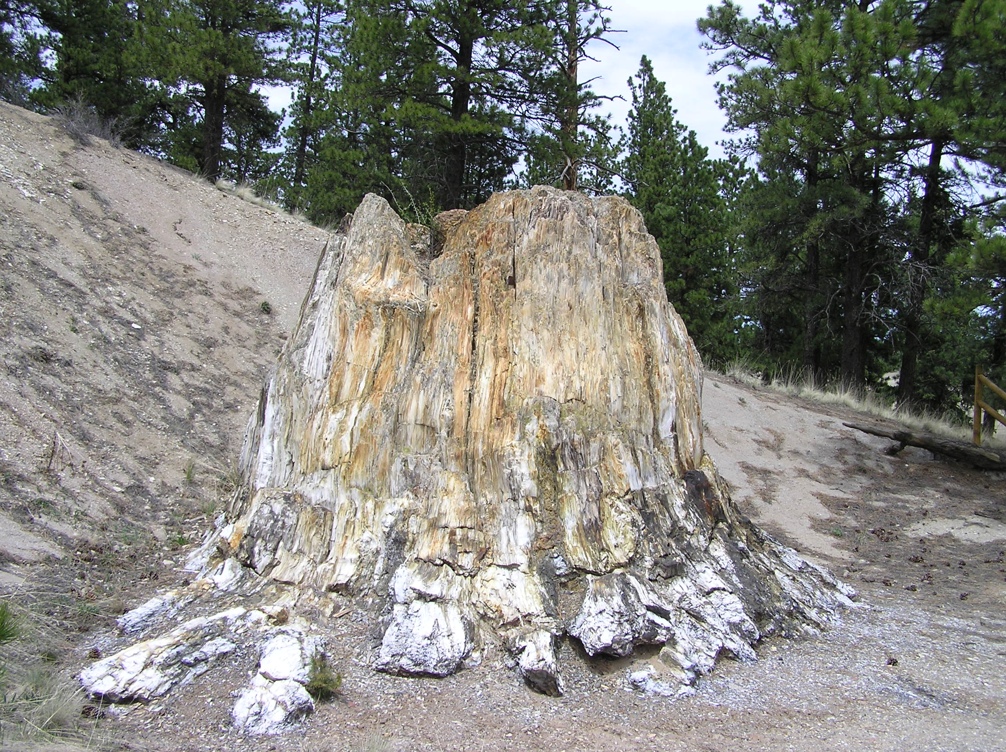
Coexistence climate analysis of the late Eocene Florissant flora, Colorado
Aly Baumgartner
GeoCorps Intern
Herb Meyer
Paleontologist Florissant Fossil Beds NM

Slide 2
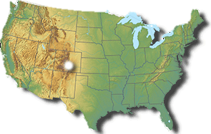
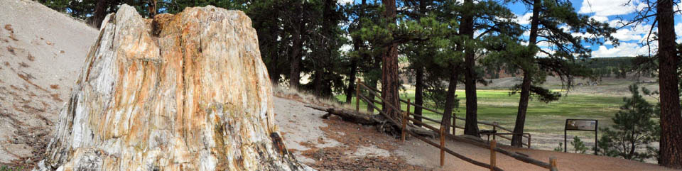
Florissant Fossil Beds
34.07 ± 0.10 Ma
Late Eocene
Lake Florissant
Plant fossils
~140-150 plant species
7 extinct genera, all families extant
Mixed broadleaved deciduous/broadleaved evergreen/ coniferous forest
Insect, vertebrate fossils

Slide 3
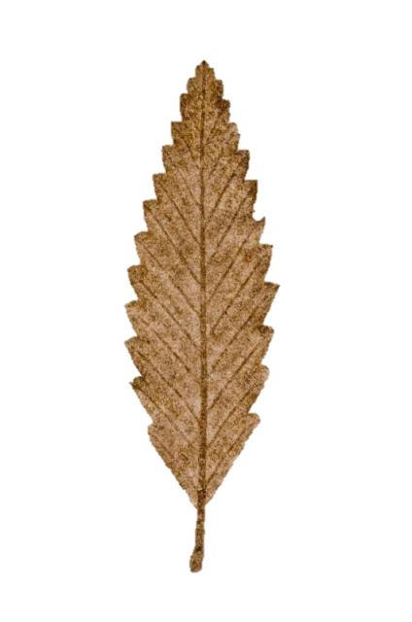
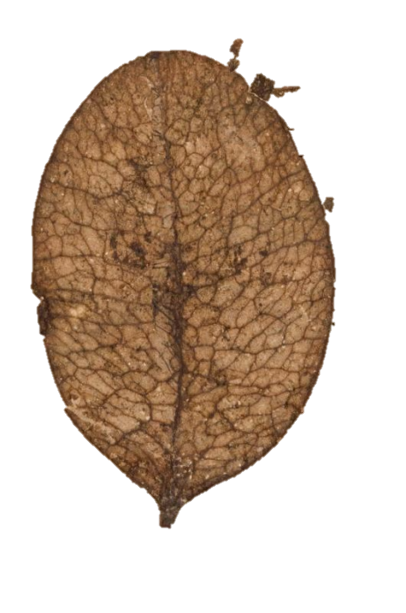
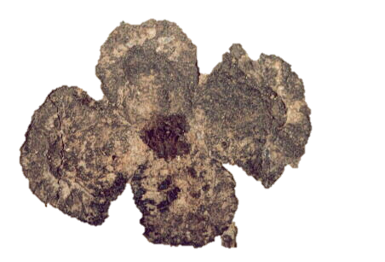
Previous Paleoclimate Work
Nearest living relative (NLR)
Leaf physiognomy/CLAMP
Weighted-averaging partial least-squares regressions (WAPLS)
Family and genus levels
MAT range: 10°C -18°C

Slide 4
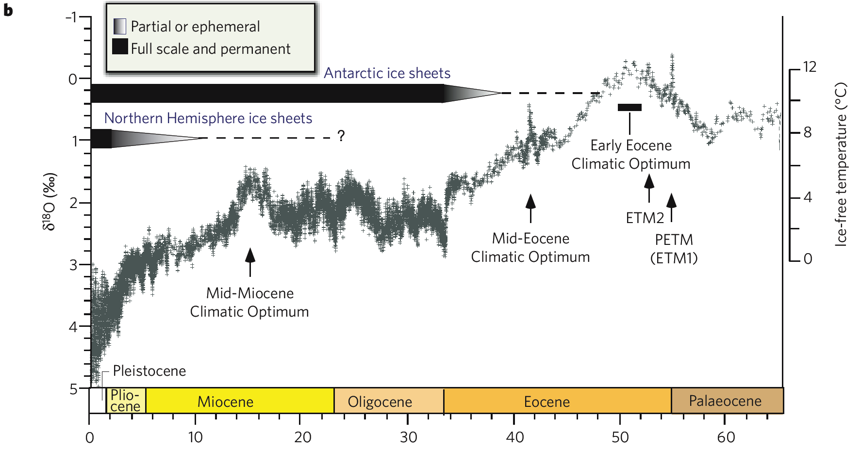

Florissant Formation

Slide 5
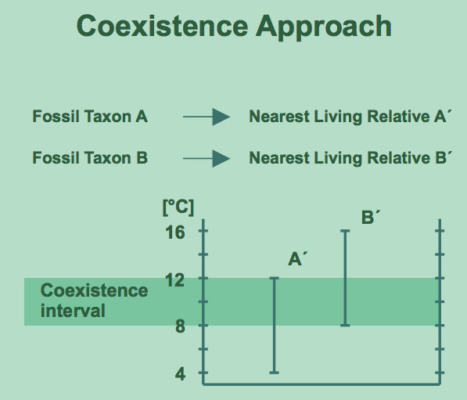
Coexistence Approach
Uses nearest living relative’s recent distribution and climatic requirements

Slide 6
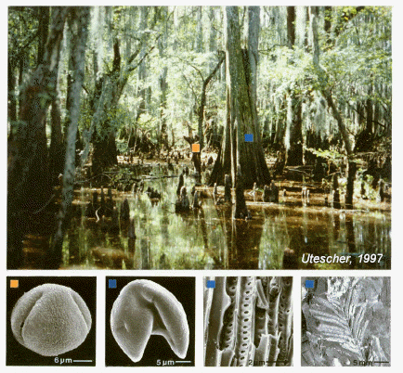
Coexistence Approach
Which taxa?
Only included previously described taxa identifiable as extant genera
Eocene requires generic level (too old for species)
Outlier taxa for any parameter completely removed from analysis
Which parameters?
Mean annual temperature (MAT) for comparison to previous studies

Slide 7
Coexistence Approach
Which databases?
Initially, Palaeoflora Database
Subsequently, obtained climate data from alternate sources
Relations Between Climatic Parameters and Distributions of Trees and Shrubs, North America. (Thompson et al., 2000)
Atlas of Woody Plants in China: Distribution and Climate Volume I (Fang et al., 2011)

Slide 8
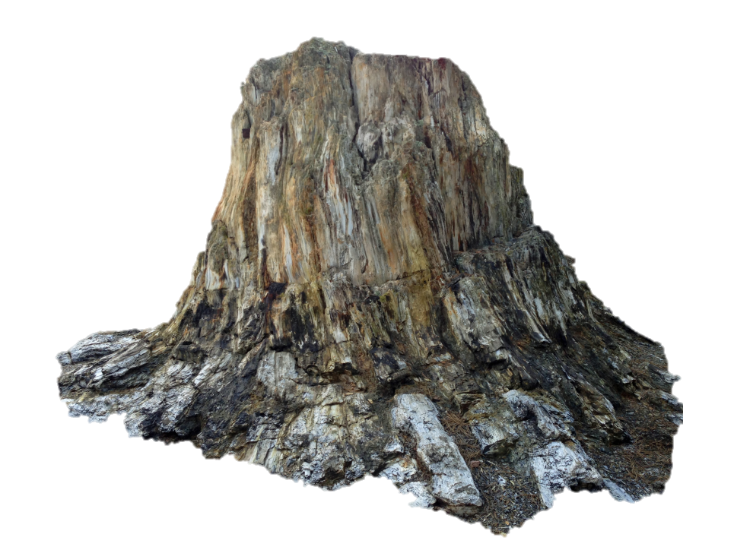
Coexistence Approach
Pros
Can be used on any plant organ
Some misidentifications may be eliminated as outliers
Cons
Possible misidentification of fossils
Possible incorrect NLR
Extinct genera
Climatic tolerances changed due to evolution
Especially older fossils

Slide 9
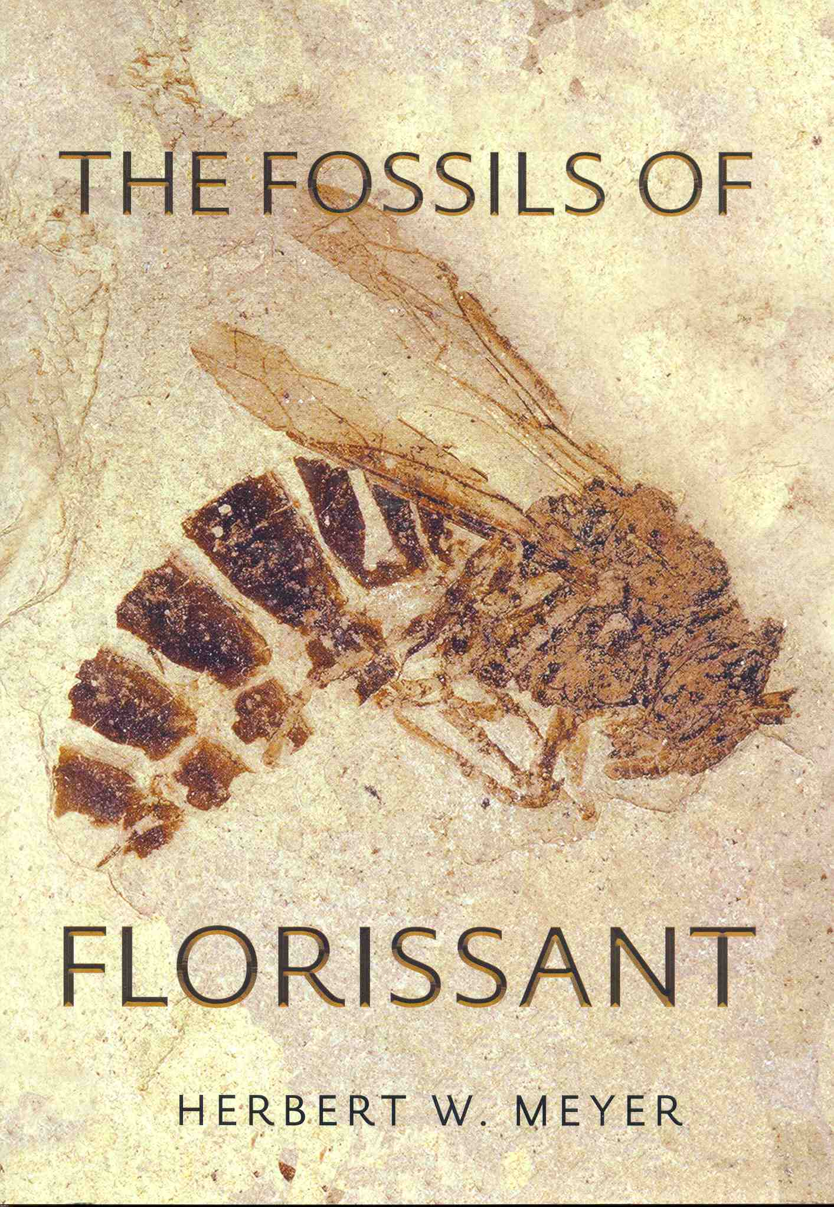
Sources
The Fossils of Florissant by Herbert W. Meyer (Appendix)
Florissant Fossil Database
Summary of current valid taxa
Macrofossils and pollen
Includes dubious identifications
Fossils from all stratigraphic units, undifferentiated

Slide 10
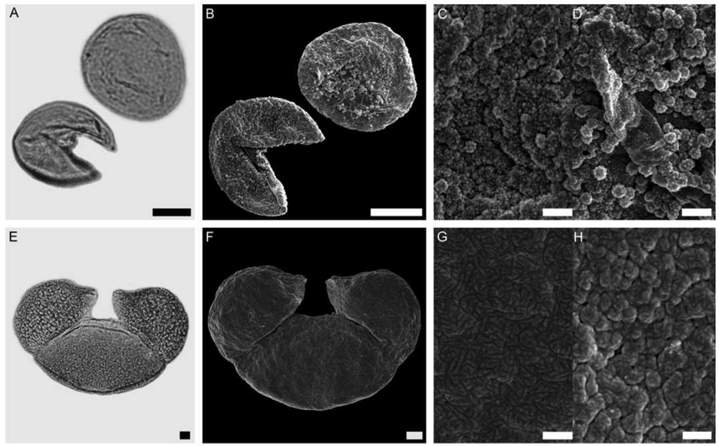
Sources
Evolutionary trends and ecological differentiation in early Cenozoic Fagaceae of western North America
Johannes Bouchal, Reinhard Zetter, Fridgeir Grimsson, and Thomas Denk, 2014
Pollen sample from single stratigraphic unit

Slide 11
Sources
Higher taxa as paleoecological and paleoclimatic indicators: A search for the modern analog of the Florissant fossil flora
Brad Boyle, Herb Meyer, Brian Enquist, Silvia Salas, 2008
Taxa evaluated by Estella Leopold, Steven Manchester and Herb Meyer
List of “confidently recorded” plant taxa
Pollen and macrofossils
Represent all stratigraphic units, undifferentiated

Slide 12
Fossils of Florissant: Macrofossil/Pollen
Notes:
FoF All Taxa (Cedrela, Colubrina, Oreopanax)

Slide 13

Fossils of Florissant: Macrofossil Taxa
Notes:
FoF Macro All Taxa (Cedrela, Colubrina, Oreopanax)

Slide 14
Fossils of Florissant: Macrofossil No Outliers
14.4-17.6°C
Notes:
FoF Macro No Outliers

Slide 15
Fossils of Florissant: Pollen
15.7-19.4°C
Notes:
FoF Pollen All Taxa/No Outliers

Slide 16
Bouchal et al.: Pollen
17-19.4°C
Notes:
Bouchal Pollen

Slide 17
Boyle et al.: Macrofossil and Pollen
Notes:
Boyle All Taxa

Slide 18
Boyle et al.: Macrofossil Taxa
10.6-17.5°C
Notes:
Boyle Macro All Taxa/No Outliers

Slide 19
Boyle et al.: Pollen Taxa
15.7-19.4°C
Notes:
Boyle Pollen

Slide 20
Boyle et al.: Macrofossil Supplemental
10-13.2°C

Slide 21
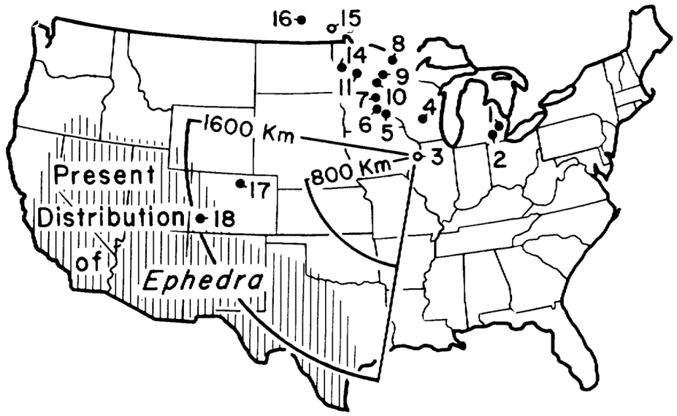
Pollen Problems
High-elevation paleo pollen assemblages problematic
Likely to have warm, low elevation pollen influx
Less likely to have cool, high elevation pollen influx
Taxa such as Ephedra can disperse >1,000 km
Pollen reconstructions tend to be warmer and wetter than those with macrofossils
Macrofossil reconstructions preferred

Slide 22
Comparisons to previous studies
Pollen
Macrofossils
Notes:
Grouped by fossil type
Best viewed as presentation

Slide 23
Comparisons to previous studies
NLR
WAPLS
CLAMP/Leaf physiognomy
Notes:
Group by method
Best viewed as presentation

Slide 24
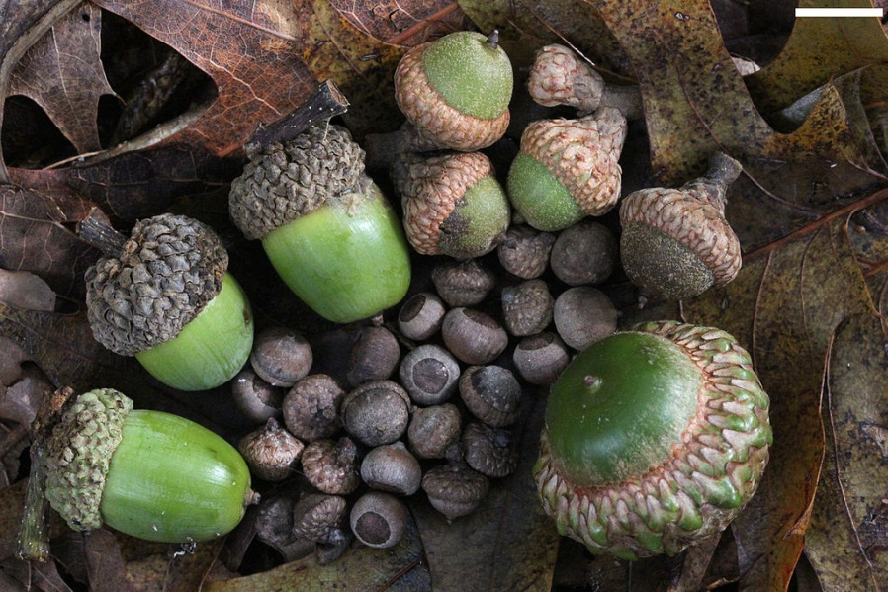
Coexistence Approach Critique
Precision and accuracy of climate data matter!
Demonstrated assumed precision 0.1° C inaccurate
Palaeoflora Database precision stated ≤ 5°C
Important lower limits
All roads lead to Carolina
560/700 taxa at 16° C
Relict taxa
Sequoia, Eucommia?
Genus v. species

Slide 25
Questions and Concerns
Why use multiple sources?
To combat bias from single sources
To include more taxa, narrower climate resolution
What about outliers/taxa not included in analysis?
Focused on MAT, fewer outliers
Confidently identified had fewer outliers
Many excluded taxa relictual
Larger range in Eocene

Slide 26
Conclusions
Pollen and macrofossil analyses differ
Pollen analyses give warmer results
At high elevation, macrofossil analyses probably more accurate
MAT: 10-13.2°C
Overlaps with previous macrofossil analyses
Cooler than analyses including pollen

Slide 27



Acknowledgements
David Greenwood for modern climate data and additional resources
GeoCorps America for research opportunity
The National Park Service and Florissant Fossil Beds National Monument for resources
Experiment and all my supporters for getting me to GSA

