Slide 1


Practical Ways Scientists Can Engage in Mars Education
Heidi L. K. Manning, Ph.D.
Concordia College, Moorhead, MN

Slide 2
Outline
Mars Student Imaging Project
Undergraduate research projects
Speak at local K-12 schools
Teacher workshops

Slide 3
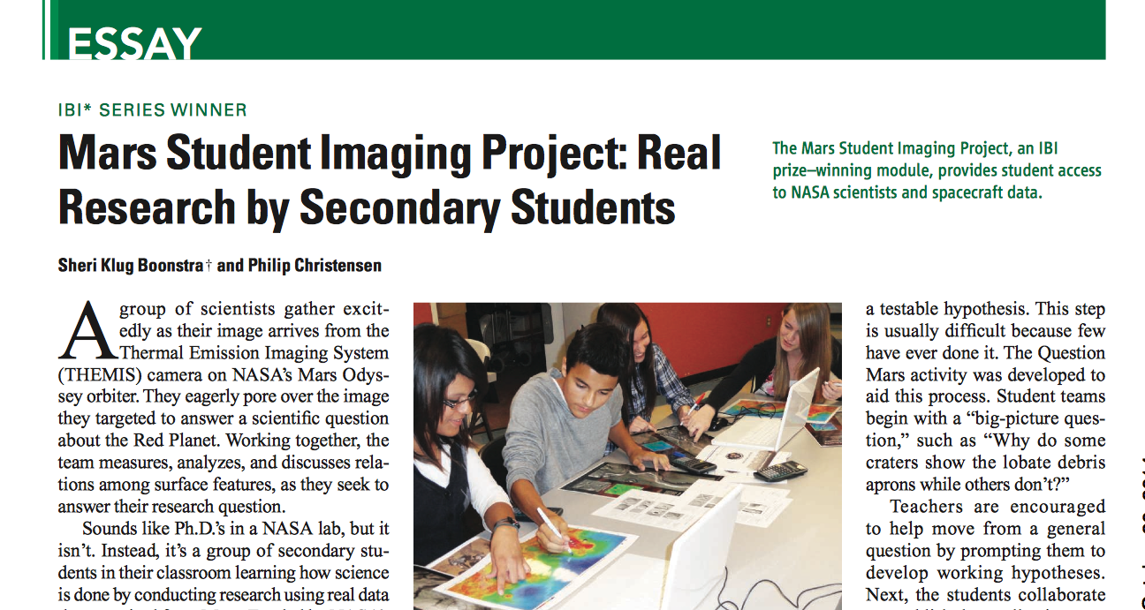
MSIP: Award Winning Project
Science, Vol. 339, Feb., 22 2013

Slide 4
Through MSIP students will:
Learn to make detailed observations of THEMIS images
Become familiar with Mars geology
Formulate their own research question
Develop a method to test their research question
Use JMARS-the GIS tool Mars geologist use in their work
Acquire their own THEMIS image
Develop skills to communicate scientific results

Slide 5
Why you should consider the Mars Student Imaging Project for your class
Excellent for teaching NGSS
Excellent for introductory science courses
  Fulfills many common goals of General Education Courses
    Nature of science as a way of knowing
    Methodology and practices of scientists
    Critical thinking skills
    Communication skills
  “Introduction to Geology”-Hobart and William Smith Colleges
  “Introductory Astronomy”-Concordia College

Slide 6
Implementation at a University
Developed for grades 5-14
Scheduling is planned for K-12 school day
  Estimate 25-30 hours of class time
Replaced all laboratory activities for the semester with MSIP activity
  When possible, incorporated previous laboratory activities into the lecture period

Slide 7
Suggested Scheduling
Week 1-2: “Mars Image Analysis”
Week 3: Introduction to JMARS
Week 4: “Question Mars”
Week 5: Prepare Proposal Presentation
Week 6: Present Proposal to ASU
Week 7-9: Data collection and analysis
  Week 8-Targeting for image
Week 10: new image analysis
Week 11 Prepare Final Presentation
Week 12: Present Final Report to ASU
Week 13: Write up Final Written Report and Poster

Slide 8
Impact of MSIP
Students are more engaged than with previous lab activities
Non-science majors are excited about science
Take more ownership of their learning
First-hand experience on how science is done

Slide 9
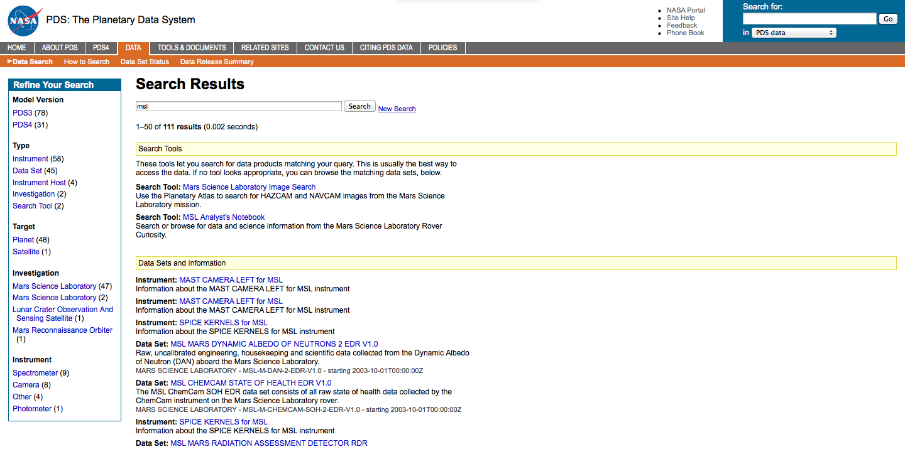
Undergraduate Research Projects
Data on the Planetary Data System
Work with students to design projects

Slide 10
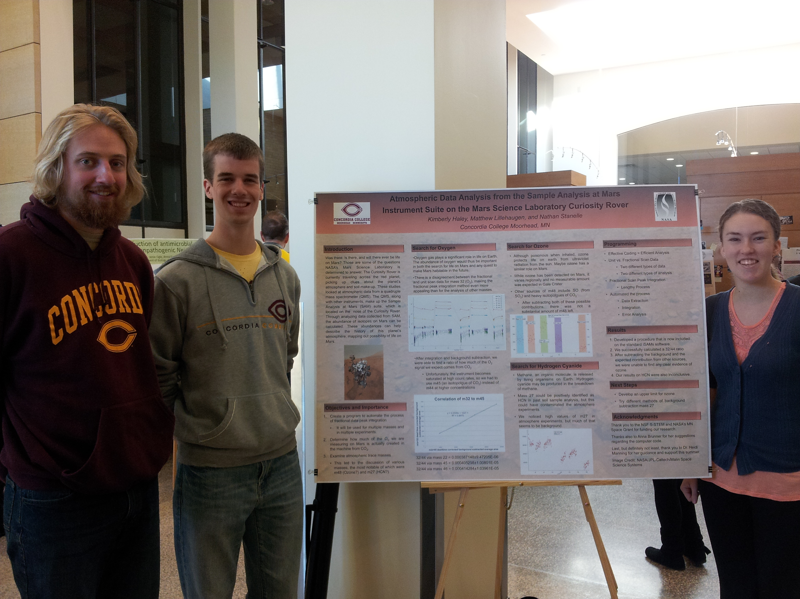
Matthew, Kim, Nathan

Slide 11
During and After School Activities
Connect with schools and science teachers
Be a guest speaker in science classes
Work with afterschool enrichment programs

Slide 12
Teacher Workshops
Connect with area teachers
  Individual science teachers
  School district curriculum coordinators
Connect with state educator groups
  MNSTA
  NDSTA

Slide 13






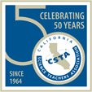
￼
￼

Slide 14
Teacher Workshops
Connect with regional school district cooperatives
  Mars Education group at ASU or NASA centers

Slide 15

Don’t be afraid to share your expertise
Notes:
Use Curiosity and Mars exploration program to generate excitement in geosciences. Share your expertise and enthusiasm for geosciences with student and teacher. And help to inspire the next generation of scientist.

