Slide 1
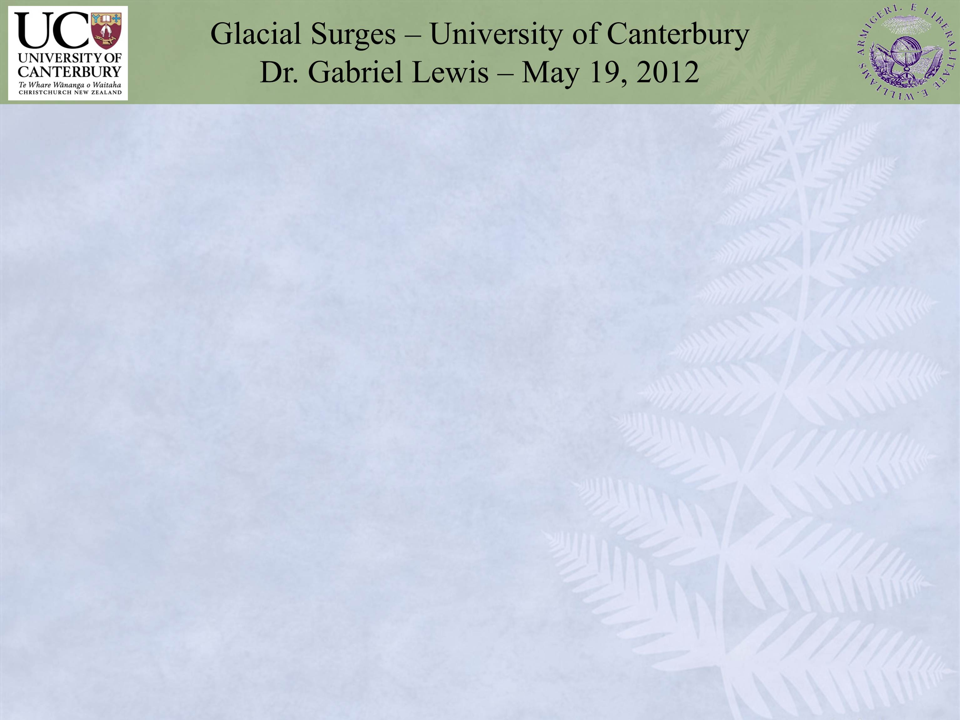
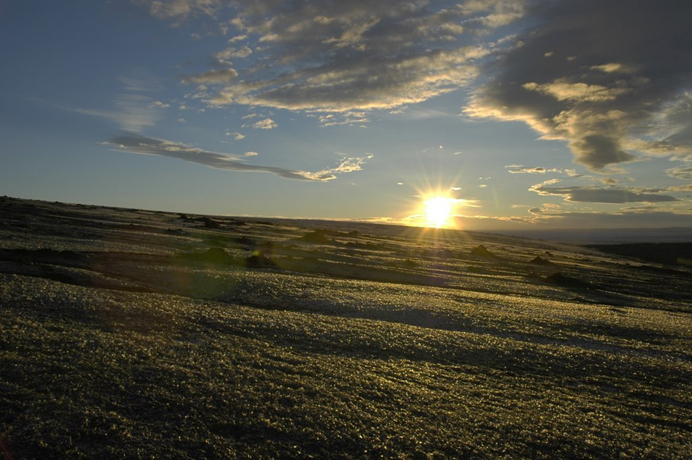
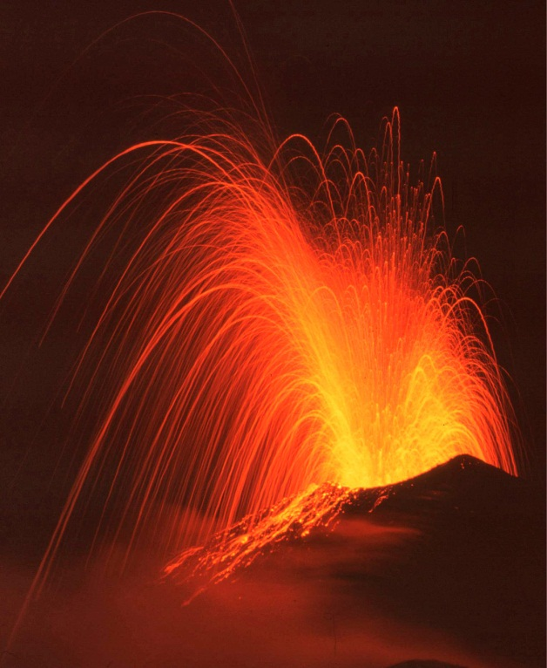
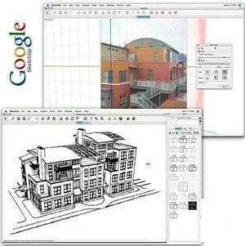


Visualising Volcanic Processes in Google Sketch-Up©: A Geologic Teaching Tool - Gabriel Lewis¹ and Samuel Hampton² ¹Dartmouth College - Gabriel.M.Lewis@Dartmouth.edu ² University of Canterbury - Samuel.Hampton@Canterbury.ac.nz
GSA Annual Meeting
October 20, 2014

Slide 2
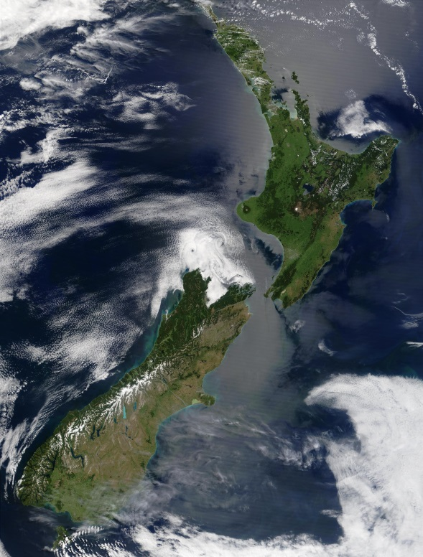
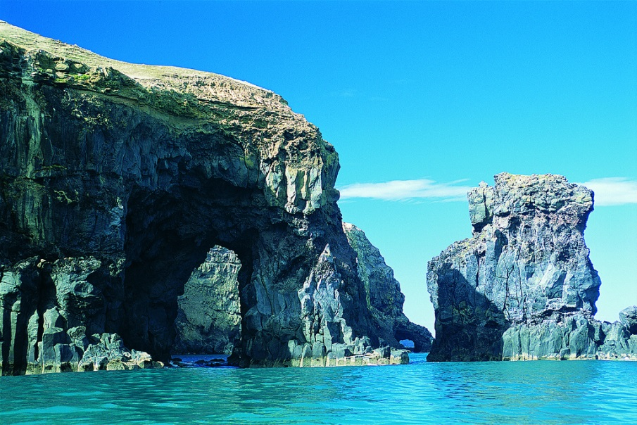
Introduction
Banks Peninsula, New Zealand is a landscape dominated by prominent eroded volcanic features
Understanding geological structures traditionally uses 2D maps and models
Outline constraints and considerations when developing and creating a 3D geologic representation of volcanic complex
Methods that educators can use to covey information to students using model
(christchurchnz.com)
Notes:
accurate model of observed geology

Slide 3
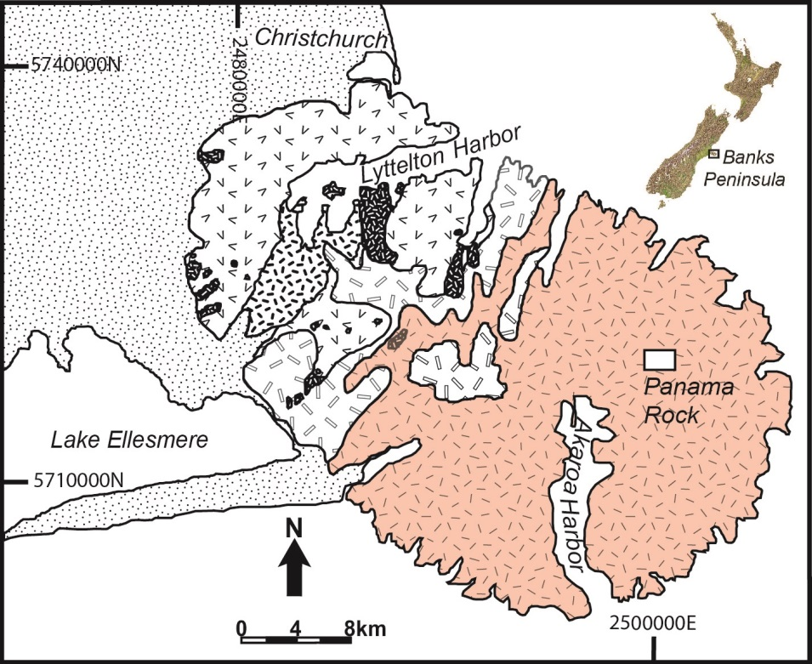
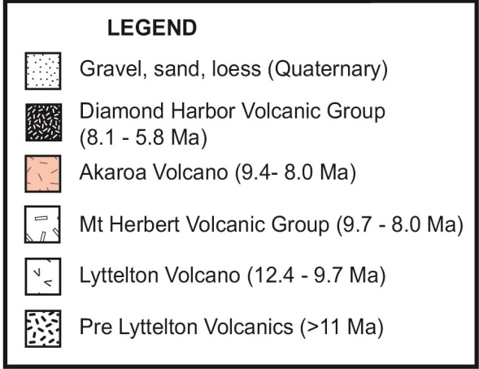
Geologic Context
Banks Peninsula comprises four stages of volcanic activity 11.0-5.8 Ma:
Mt. Herbert, Lyttelton, Diamond Harbor, and Akaroa
Akaroa volcanic complex formed 9.4-8 Ma
Series of eruptions containing crater rims, scoria cones, lava domes, and radial dike swarms
Panama Rock - a dike and dome complex in Eastern Akaroa
Notes:
New Zealand is geologically active: earthquakes, glaciers, volcanoes, etc.
High erosion rates over 8 Ma produced many prominent features

Slide 4
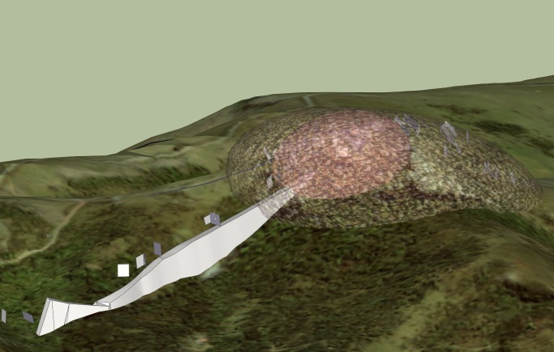
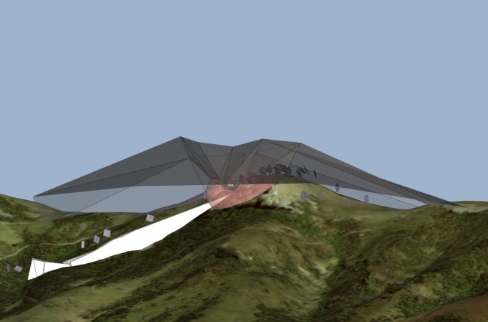
Conveying the Information
2D Maps are often confusing and vague
Relationships occur at imperceptible spatial and temporal scales
3D models are useful in expressing information students otherwise struggle to understand
Want a comprehensive teaching tool for various levels and backgrounds
Resulting geologically accurate model can be used in primary, secondary, or tertiary education

Slide 5
Understanding the Geology

Slide 6
Understanding the Geology
Notes:
LF – lava flow. FD - feeder dike. PD - pyroclastic deposits. CJD - columnar jointed dome. BD -brecciated dome. PJD- platey jointed dome. DC - dome core. ET - eroded trough.

Slide 7
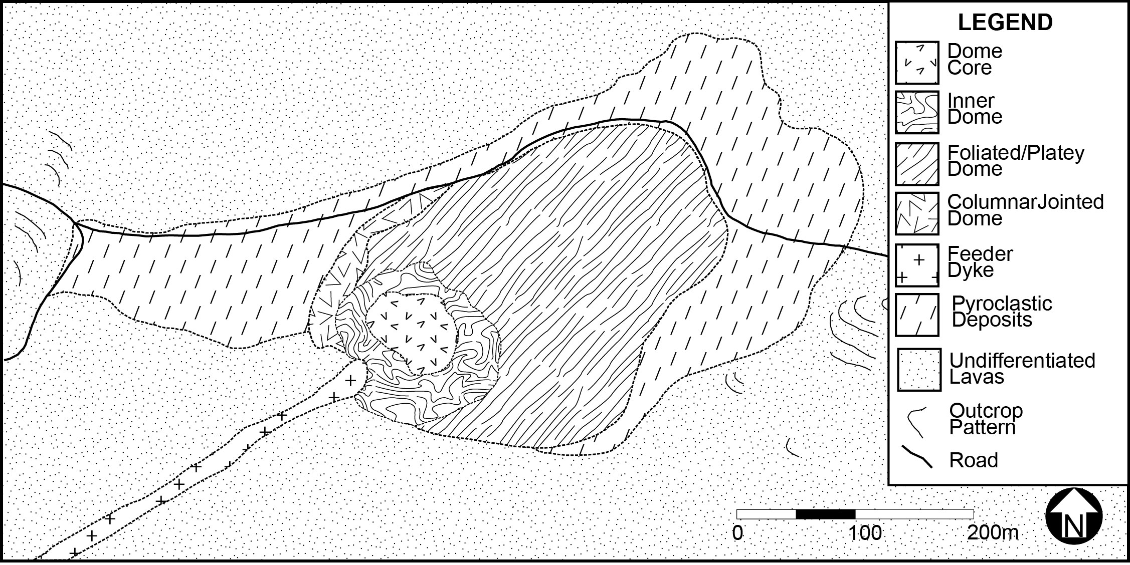

2D Geological Representation

Slide 8
3D Geological Representation
Video 1

Slide 9
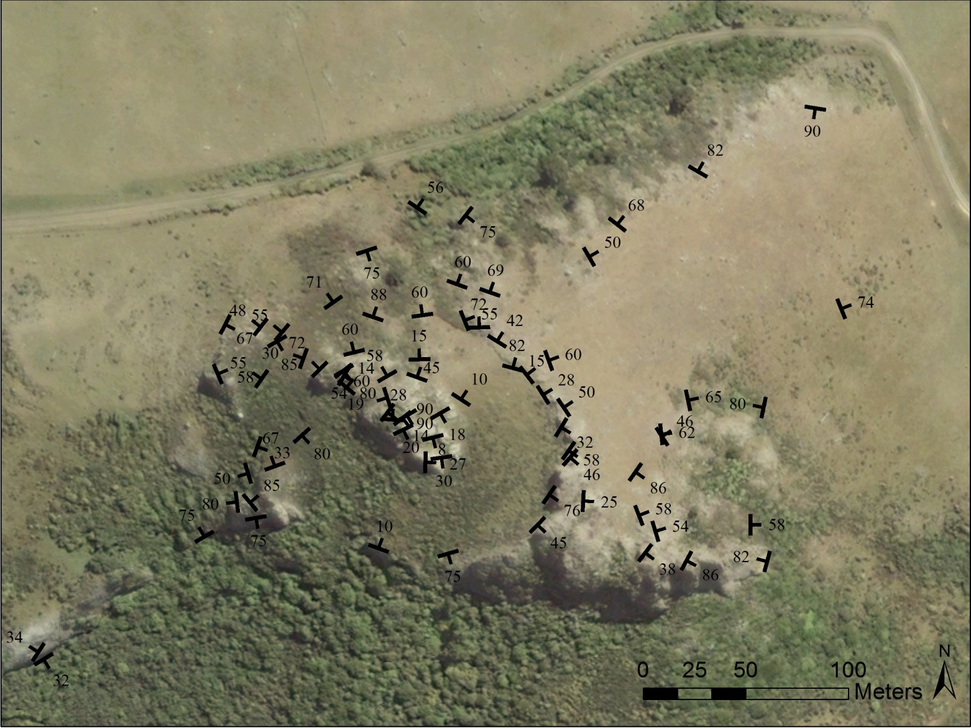
2D Structural Representation

Slide 10
3D Structural Representation
Video 2

Slide 11



Why Google SketchUp©?
ArcScene – $10,000+1500/year
Geomagic - $8000
RockWorks - $700-5000
SketchUp© - Free
User friendly and simple layout
Don’t need GIS experience
All-in-one program
3D warehouse of models
Can use on most computers

Slide 12
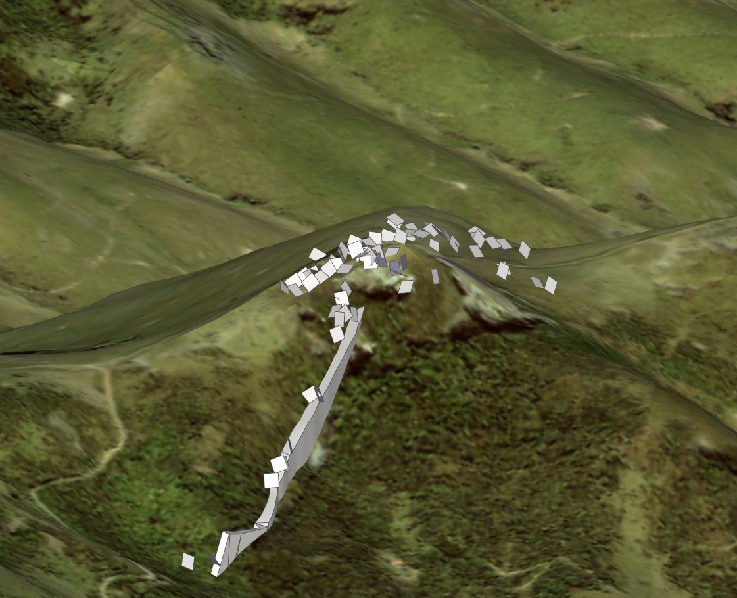
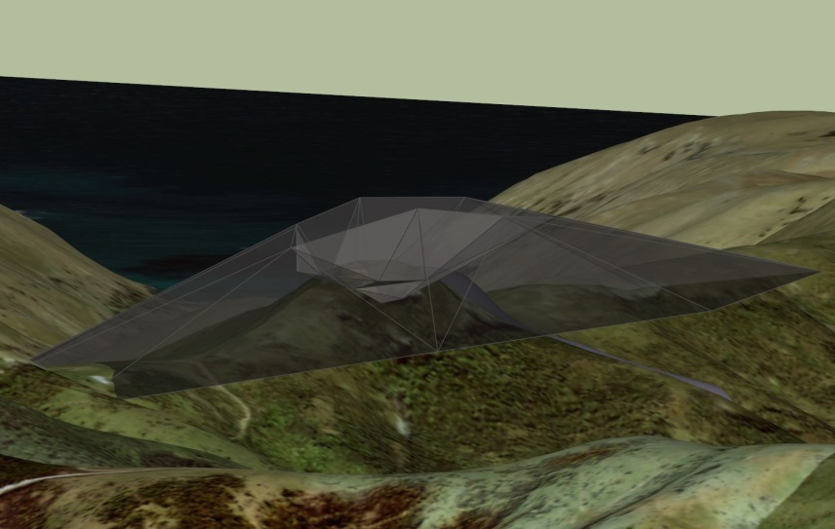
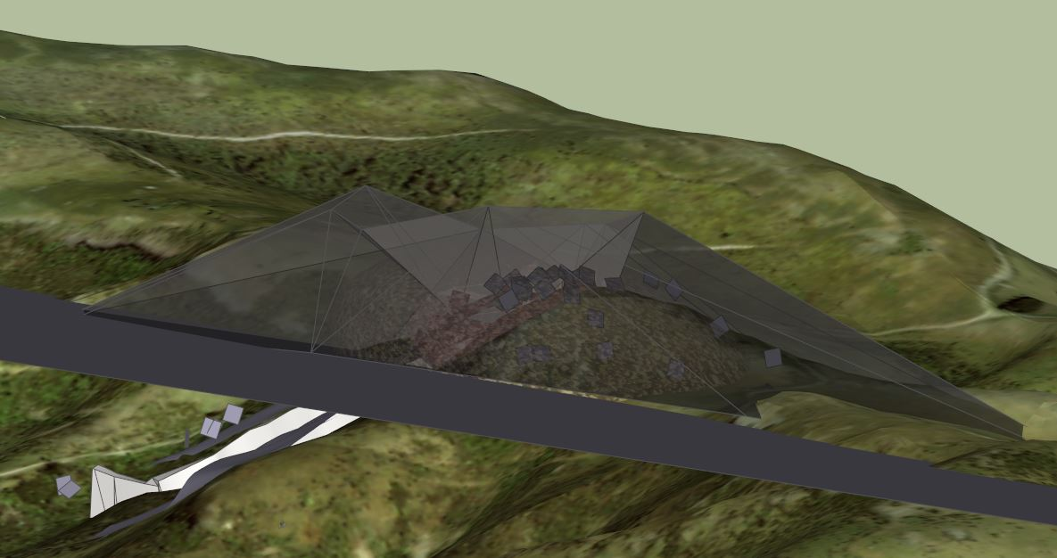
Making The Model
Easily load Google DEM and satellite imagery
Draw dike and joint planes
Trace extent of lava domes
Estimate location of scoria cone
Reconstruct flank from DEM
Notes:
Constraints and considerations for accurate virtual geologic representation
Understanding physical processes of formation and degradation
Formulate a hypothetical model - informed and constrained by geological information
Want full spectrum interactive geologically accurate model of geological processes

Slide 13
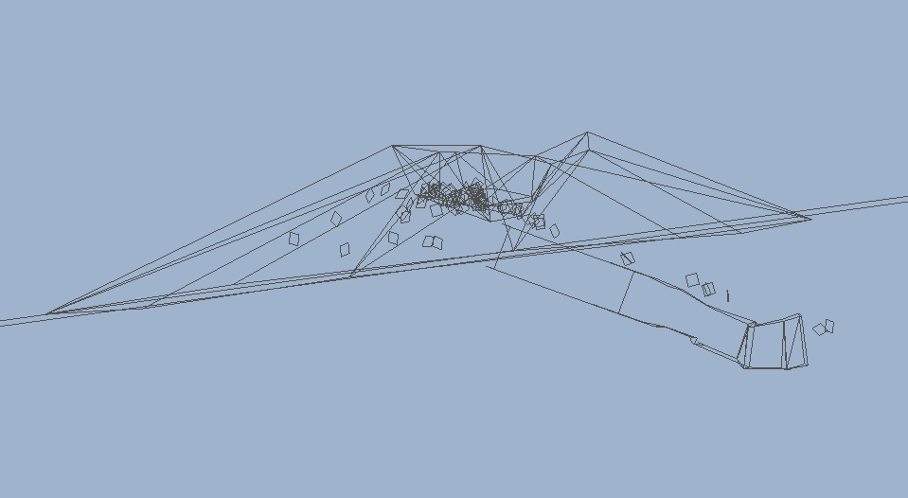
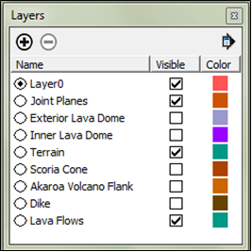
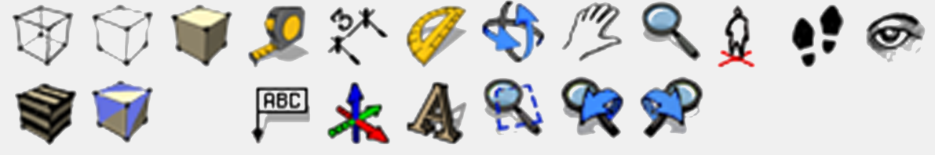
Using The Model
One can
Zoom, pan, and rotate model
Measure distances and angles
View solid or wireframe textures to see through layers
“Walk” along the DEM surface
Turn layers on and off
Allows interactive visualization of underground and eroded structures

Slide 14
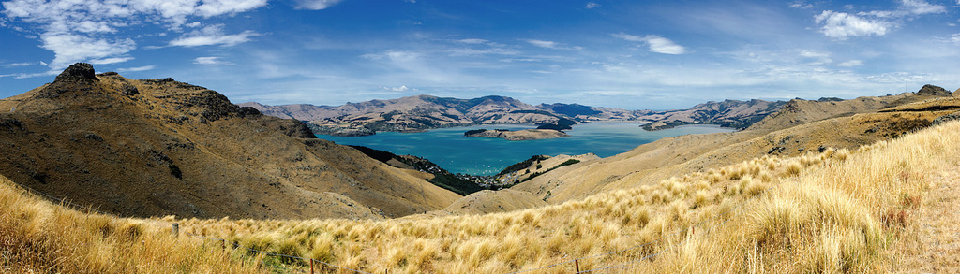
Conclusions
Geologically accurate model allows interaction with layers
Easier for beginning geologists to visualize spatial and temporal relationships
Free easy-to-use program accessible for students and teachers
Warehouse of downloadable interactive models

