Slide 1
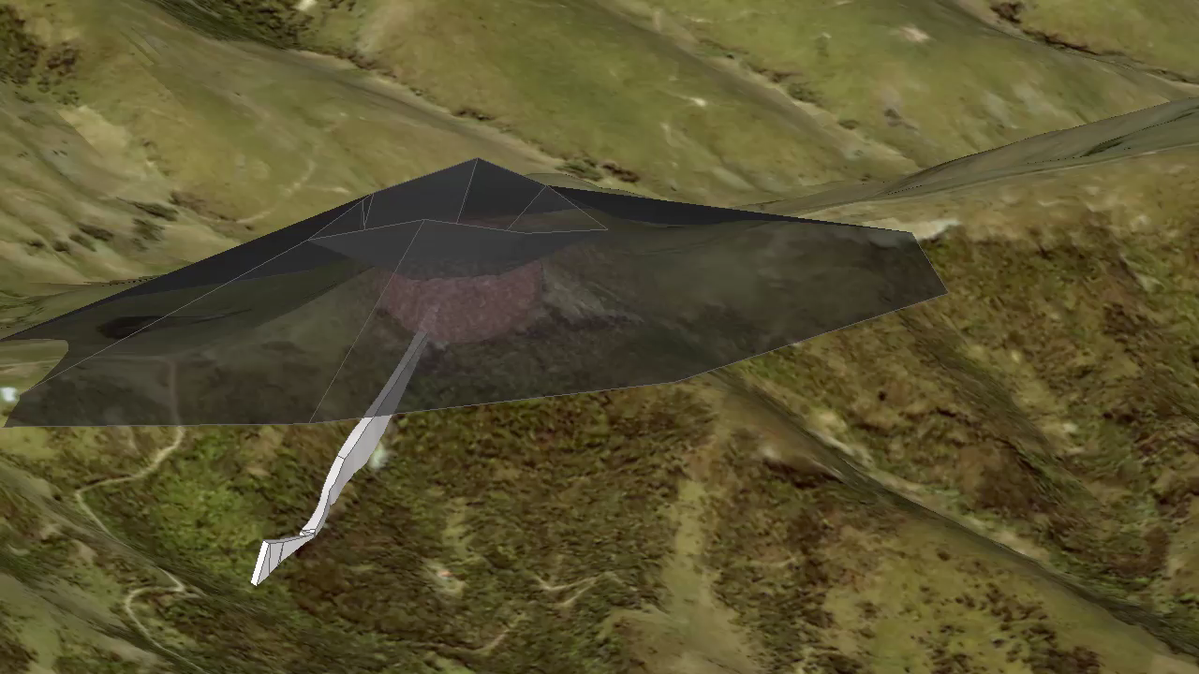
3D Geological Representation

