Slide 1
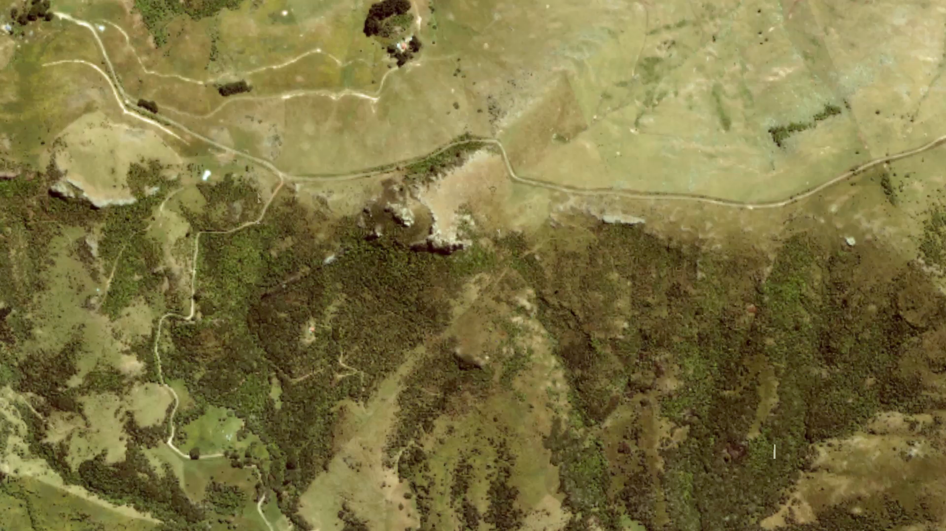
3D Structural Representation

