Slide 1
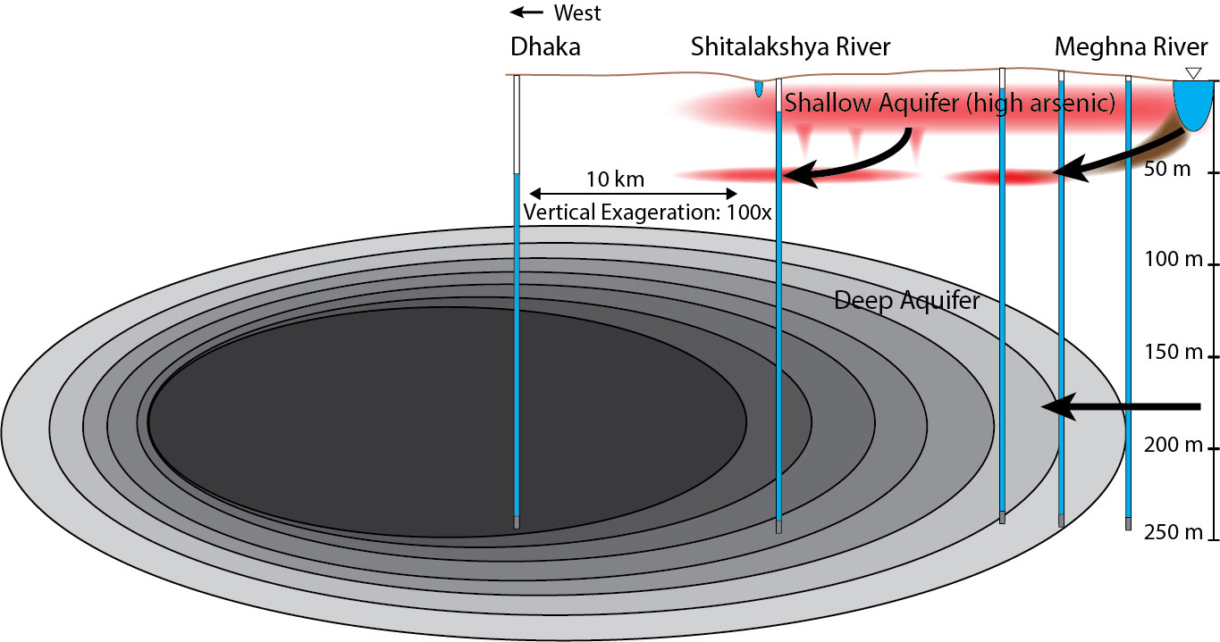
Impact of Over-pumping from Deep Aquifer in Dhaka City on the Safe Water Supply for Surrounding Rural Population
Peter Knappett
Dept. Geology & Geophysics
Texas A&M University
Mahfuz Khan, Effect of Aquifer Heterogeneity on the Sustainability of Deep Groundwater Resources in the Bengal Delta near a Mega-City Pumping Center.
Session 337, Wednesday, 1 pm. Vancouver-West Rm 110

Slide 2
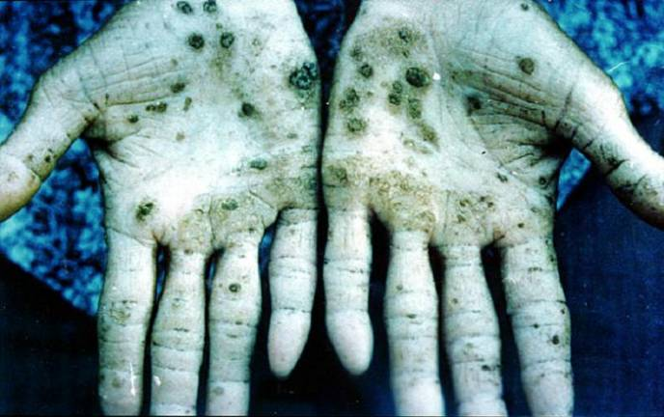
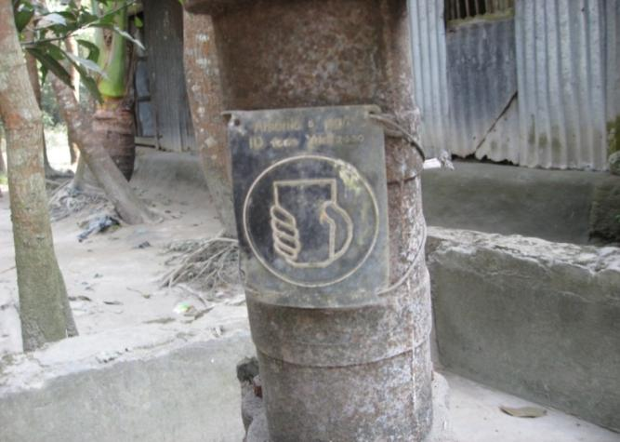
Problem - Arsenic in shallow groundwater in the Ganges-Brahmaputra Delta is the largest case ever of drinking water poisoning Causes – Arsenic naturally dissolves from minerals in the aquifer or soils. Associated with reducing, high DOC ground waters and monsoonal climates. Impact – Vast increases in intestinal cancer, Kertosis (skin lesions) Mitigation Options 1) Field testing 2) Lateral switching¹ 3) Drilling deeper² 4) Filtration ¹ van Geen et al., Bull. World Health Organ., 2002 ²DPHE/JICA, 2010
Arsenic in Asian Deltas

Slide 3
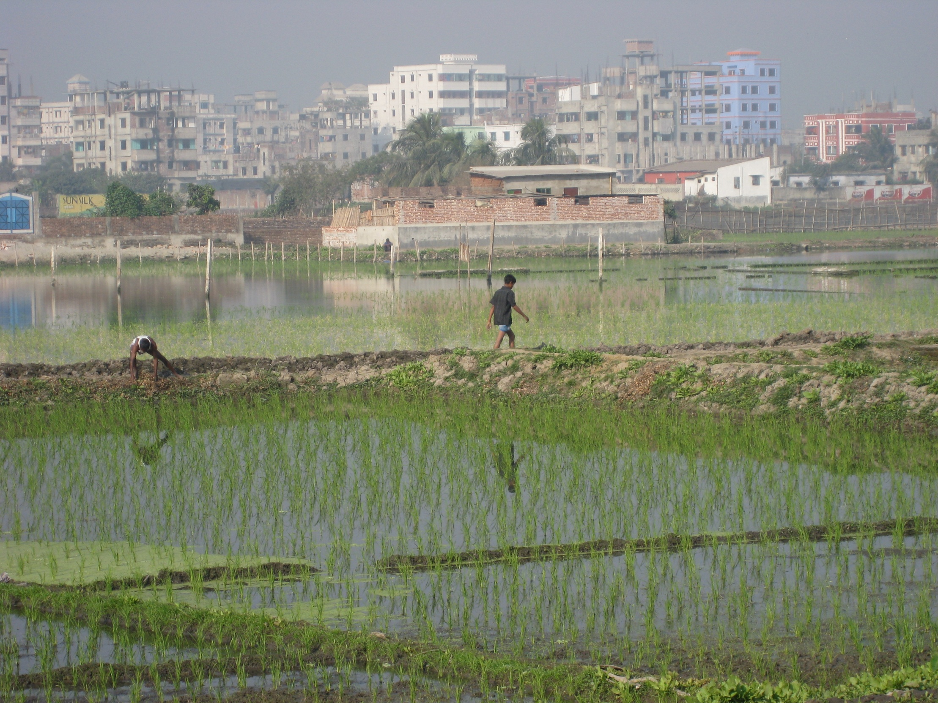
Dhaka Mega-City
Fastest Growing Mega City in the world 15 million people growing by 7 % annually
¼ of people are homeless

Slide 4
Regional Phreatic Water Table in 2007

Slide 5
Study Objectives and Hypotheses
Objective 1
Assess impact of Dhaka pumping on surrounding rural population’s access to intermediate (30-120m) and deep (>120m), low As aquifers
Objective 2
Assess impact of Dhaka pumping on sources and rates of recharge to deep aquifer
Hypothesis 1
Depressurization of the deep aquifer underlying Dhaka is limiting villager’s access to low-As aquifers
Hypothesis 2
Vertical recharge is accelerating within the expanding drawdown cone area. This increases the likelihood of downward migration of high As water

Slide 6
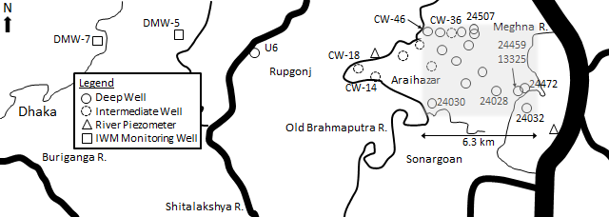
Community and Monitoring Wells with 2 Full Years of 20 min Water Level Measurements
Site Dimensions
Community Well
River Piezometer
Grey area represents modeled portion of deep aquifer

Slide 7
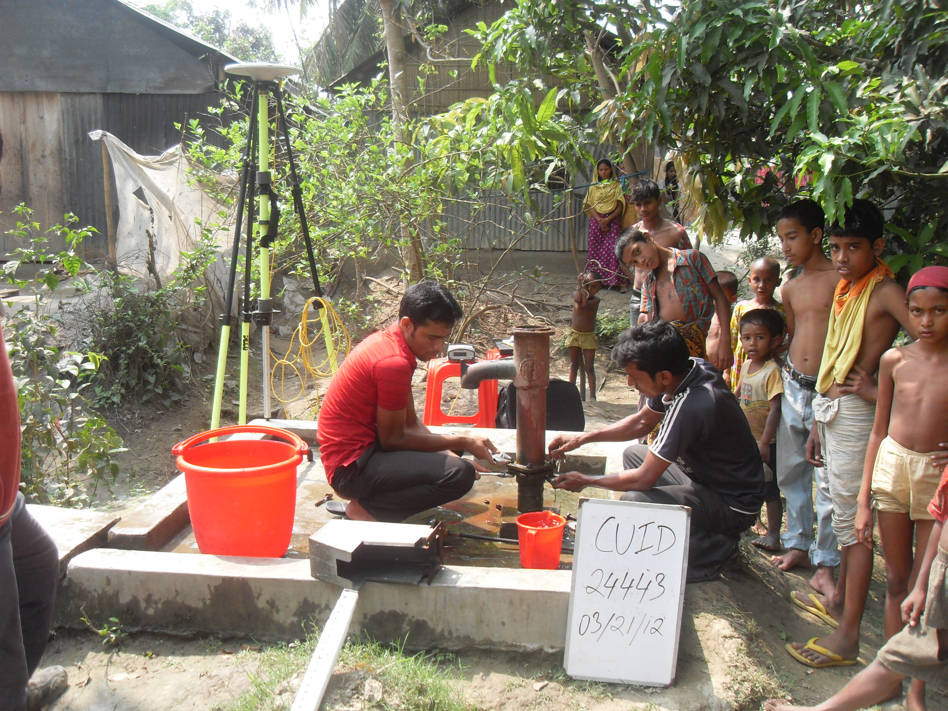
Fast Static dGPS Survey and Community Well Inventory (Feb-Apr, 2012)

Slide 8
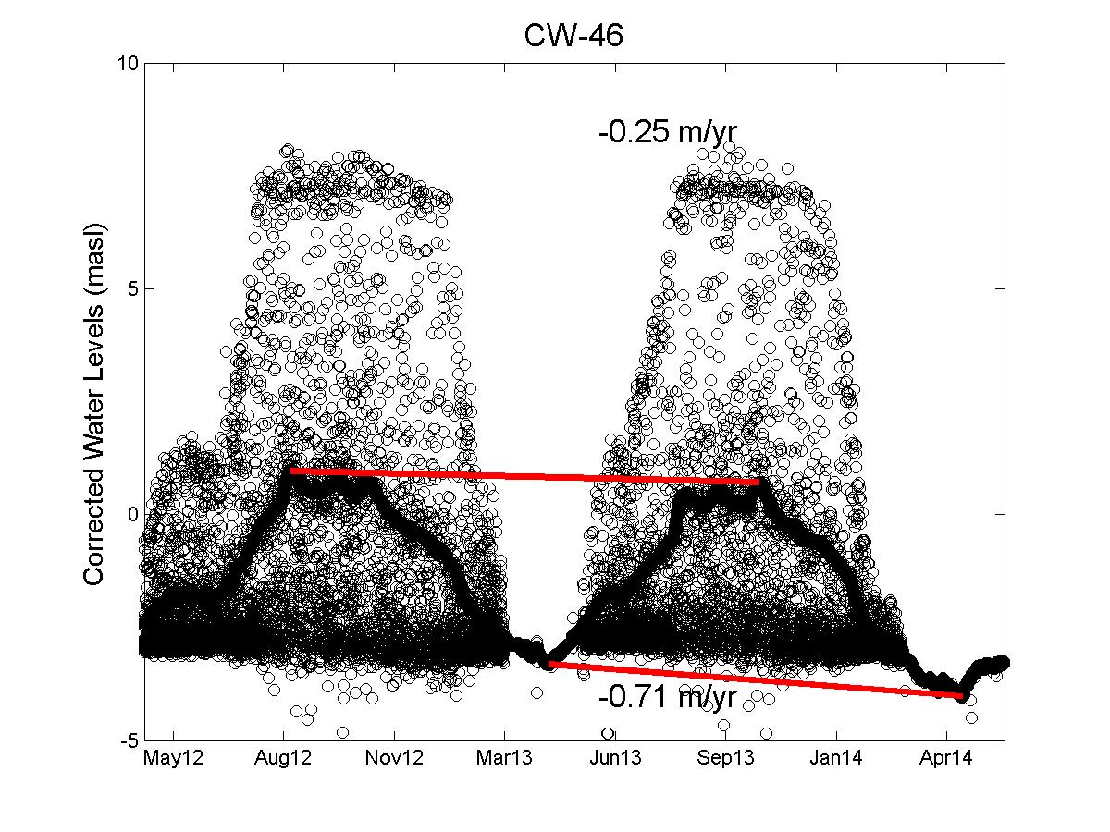
Falling Water Levels in Rural Wells
Community Well Hydrograph
Water levels in intermediate and deep wells closest to Dhaka are falling the fastest

Slide 9
Access to As-free Aquifers and Potential for Downward migration of High As Zone
Water level declines are rendering hand pumps useless for longer periods in dry season limiting villager access to As-free drinking water

Slide 10
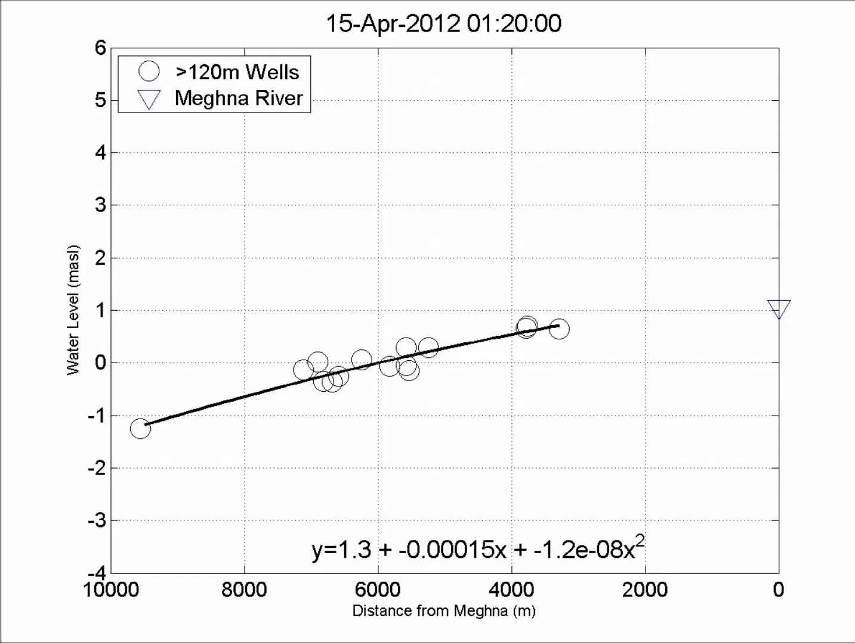
Modeling Deep Aquifer Potentiometric Surface

Slide 11
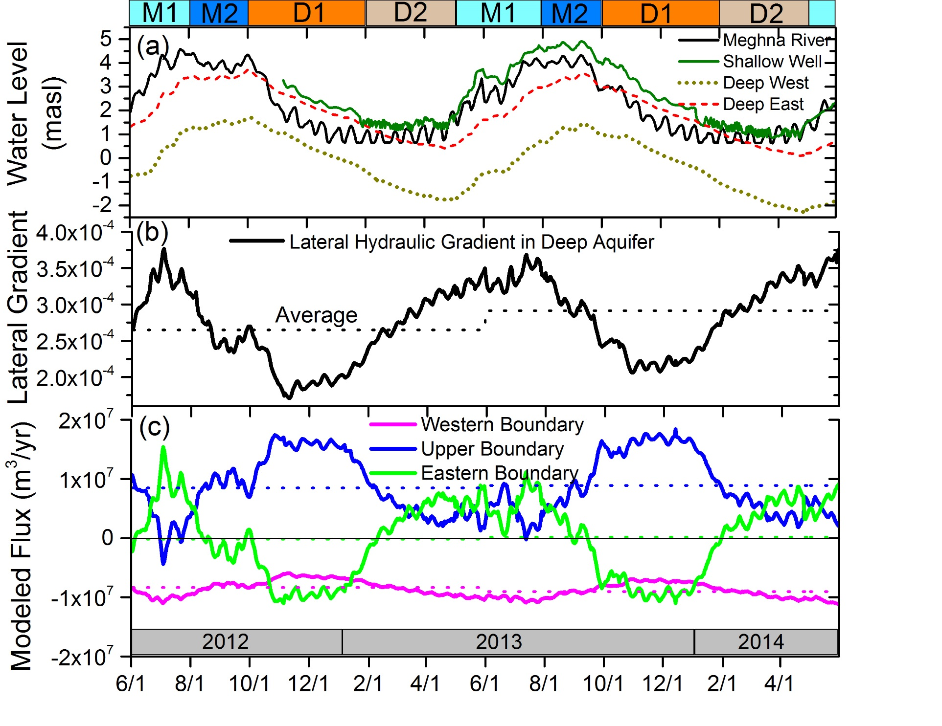
Seasonal and Interannual Trends in Eastern Araihazar
Average lateral gradient increasing
Vertical recharge peaks in early dry season

Slide 12
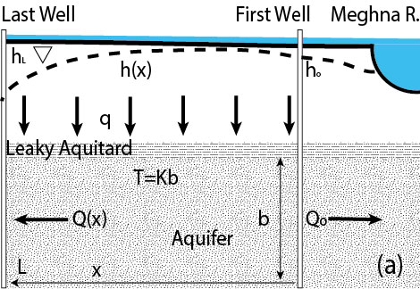
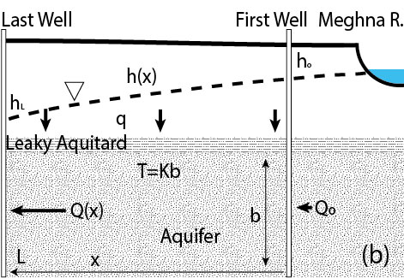
Changing Recharge Amounts/Sources to Deep Aquifer
Late Wet Season/Early Dry Season is time of maximum vertical recharge due to rainfall and flooding
Late Dry Season/Early Wet Season is time of minimum vertical recharge but maximum Dhaka influence

Slide 13
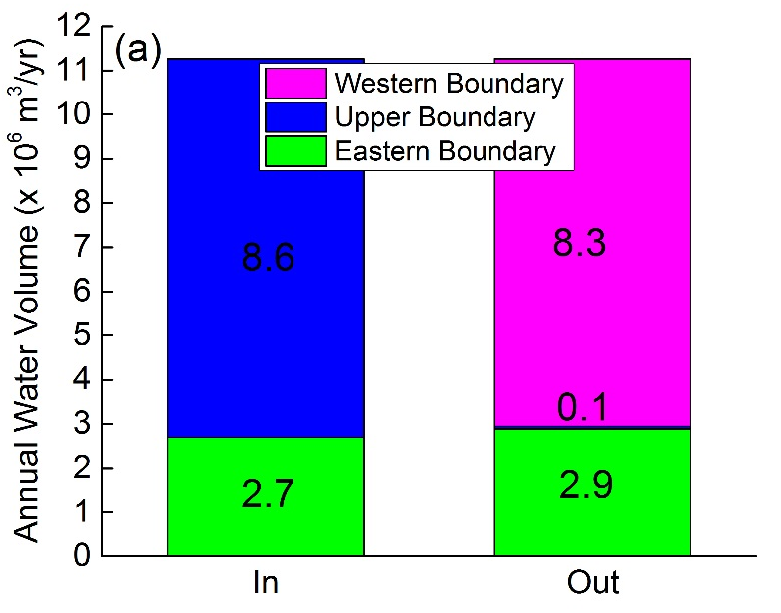
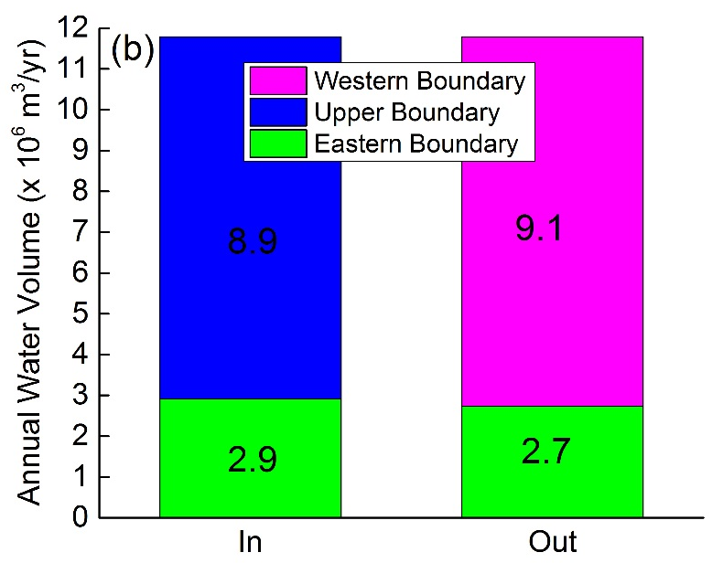
Water Budget
2012-2013
2013-2014
Deep aquifer depressurization is drawing in more shallow aquifer water into low-As aquifers and possibly inducing Meghna River recharge

Slide 14
Conclusions
Deep urban pumping coupled with shallow, natural arsenic has created drinking water scarcity in the most fresh-water saturated place on earth.
Continued increases in Dhaka pumping could do irreparable damage to intermediate and deep aquifers.

Slide 15
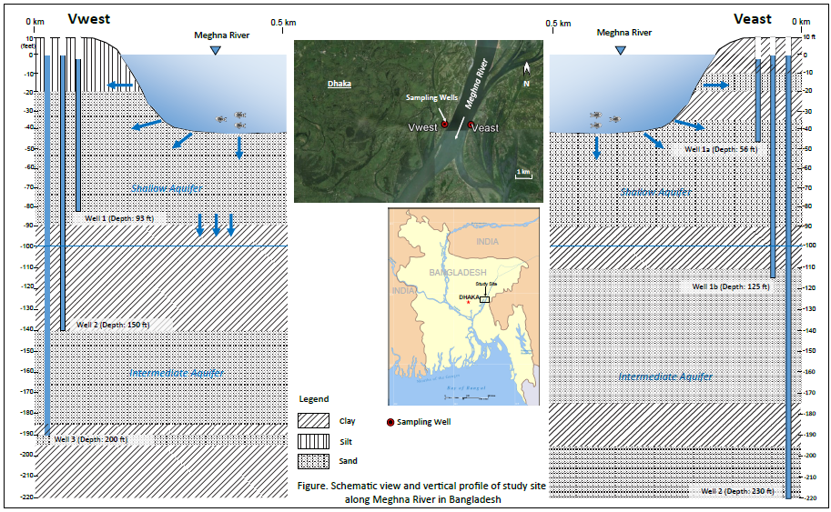
Future Work: Vertical monitoring well nests on the Meghna River will help assess the amount of captured recharge from the river due to Dhaka pumping and allow us to monitor geochemical changes.
Pin Shuai

Slide 16
Acknowledgements
A. van Geen, I. Mihajlov, K. Radlof, J. Mey, R. Mozumber, M. Stute, M. Steckler, B. Bostick (CU, LDEO)
B. Mailloux (Barnard)
H. Michael, M. Khan (U Delaware)
C. Harvey, Mason Stahl (MIT)
K. M. Ahmed, Md. Alam, H. Akhter, I. Choudhury (Dhaka U)
P. Shuai, K. Rhodes, A. van Plantinga, H. Zhan (TAMU)
L. Slater, D. Ntarlagiannis (Rutgers)
D. Mondal (SUNY Queens)
S. Barua (Kansas State U)

Slide 17
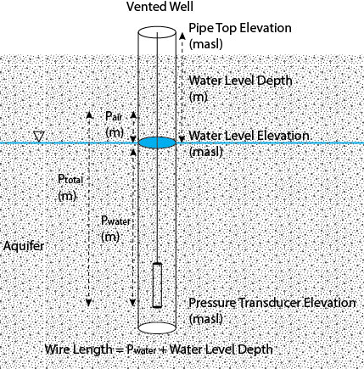
2. Methods – Measuring Water Levels

Slide 18
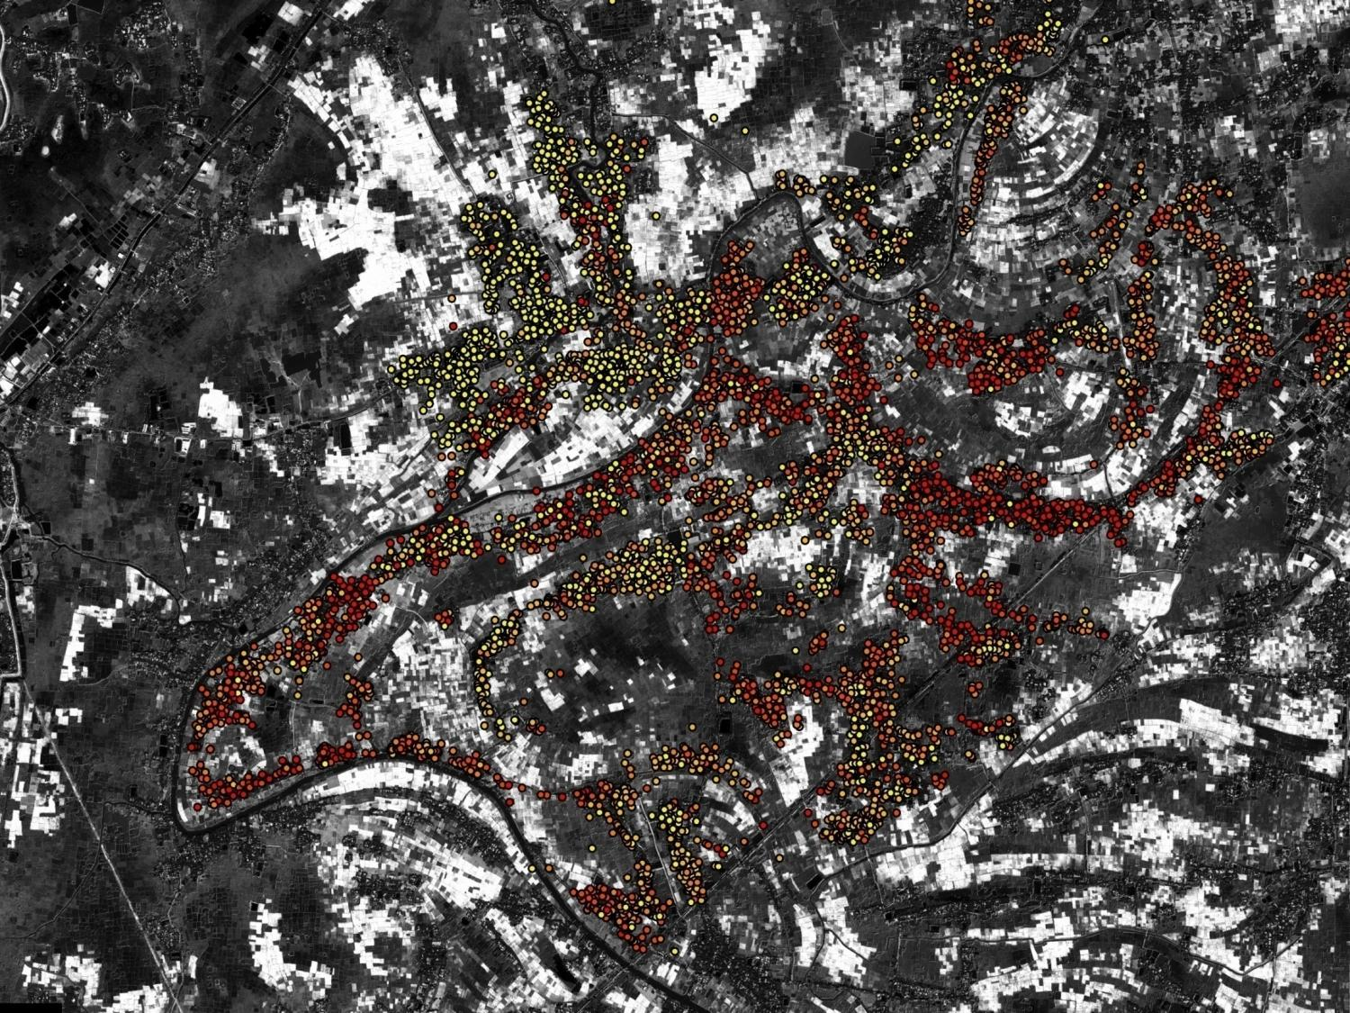
van Geen et al., Water Res. Research, 2003
2 km
Above 30 m depth, spatial distribution is highly patchy

Slide 19
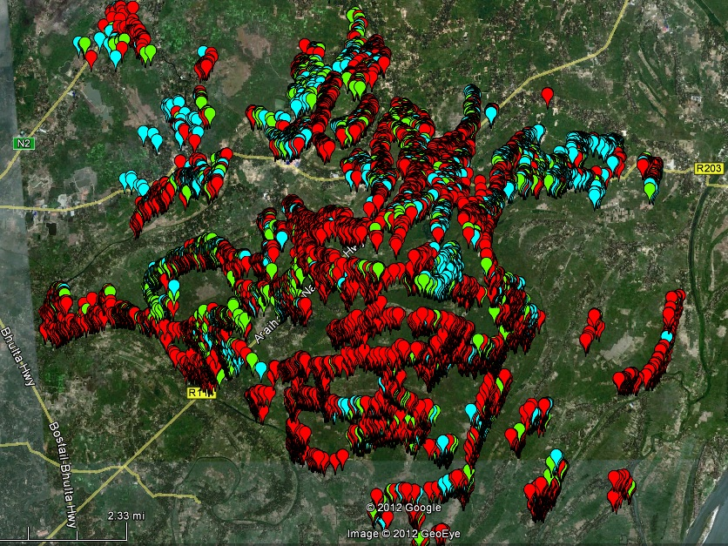
<100 ft
Or 30 m
Above 30 m depth, spatial distribution is highly patchy

Slide 20
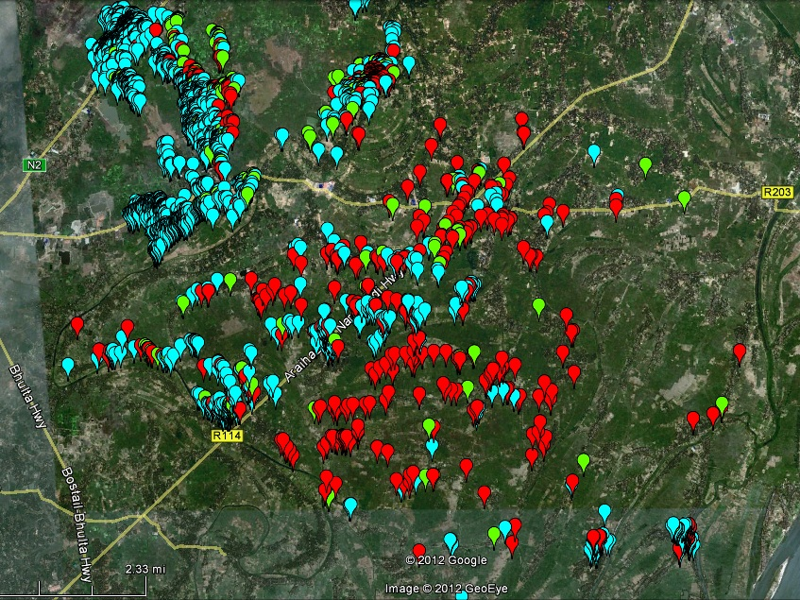
100-200 ft
30 – 60 m
From 30-60 m depth, regional differences emerge

Slide 21
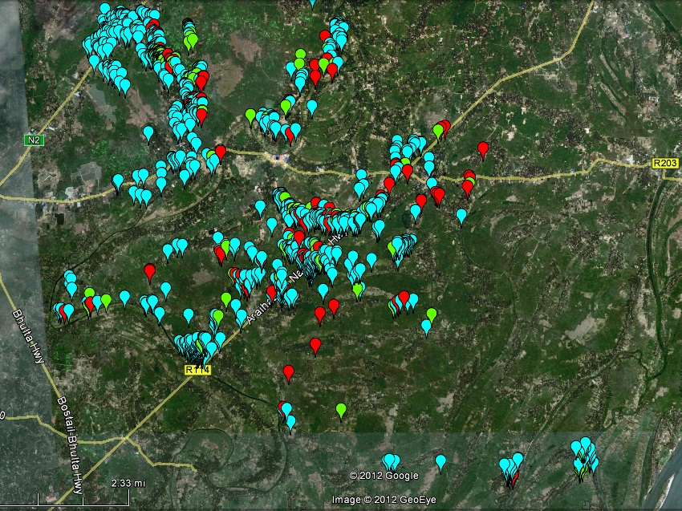
200-300 ft
60 – 90 m
Below 60 m depth, groundwater is generally safe in Araihazar

Slide 22
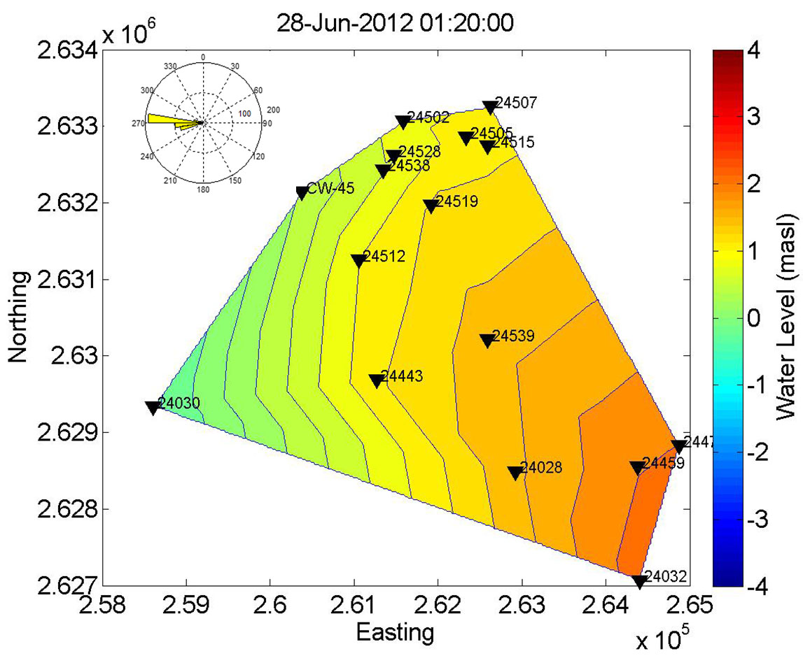
Expansion of Dhaka Drawdown Cone into Rural Areas
Year round hydraulic gradient towards Dhaka.

