Slide 1
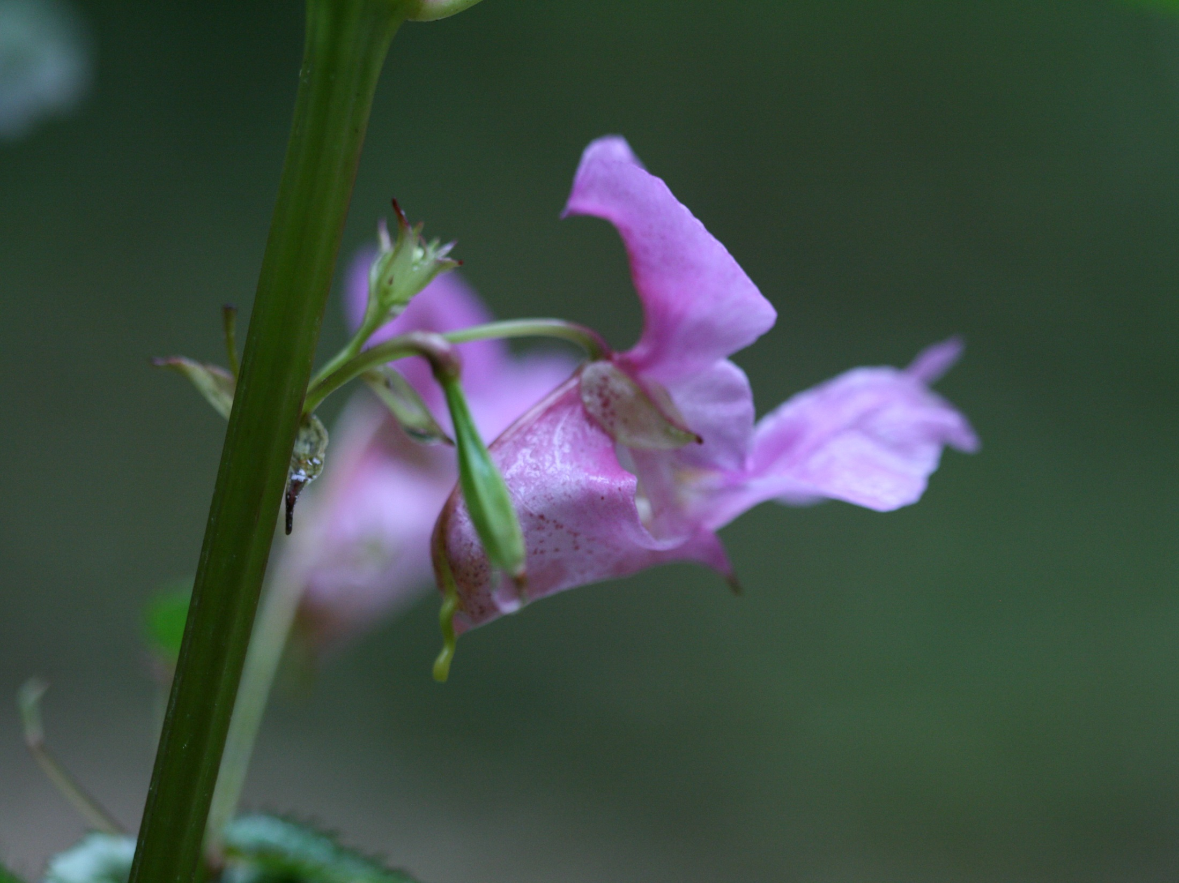



The potential influence of the invasive plant, Impatiens glandulifera, on the hydro-geomorphic stability of inland river systems
P. Greenwood, W. Fister & NJ. Kuhn
Dept. Env. Sci., University of Basel, Switzerland
philip.greenwood@unibas.ch
Geological Society of America (GSA) Conference 2014, Vancouver, Canada

Slide 2
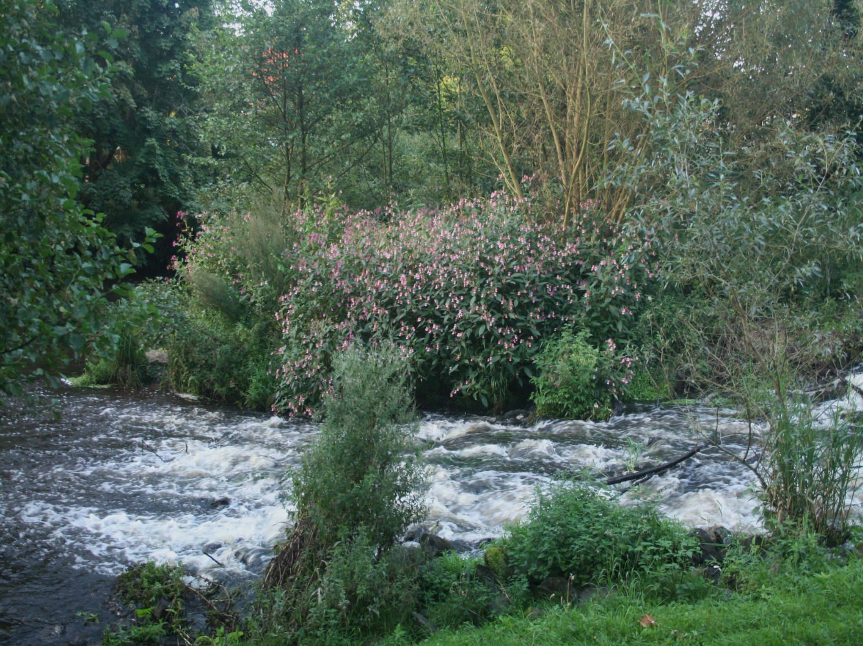
I. glandulifera – Background info.
Common English name: ‘Himalayan Balsam’
Introduced UK & mainland Europe ca. 1850s
Highly invasive
Annual Plant – seasonal die-off
Notoriety – linked to soil erosion
Habitat preference: shady, damp, nutrient-rich soils – frequently disturbed…
…Riverbanks & Riparian Zone

Slide 3
Distribution
All temperate European countries
23/28 (i.e. ~ 82%) European Union (EU) states
Occupies > 50% rivers Czech Rep.
Occupies ~13% rivers UK
est. £300 million to eradicate (US $447 million)
Common parts east & west N. America
New Zealand
Globally prevalent
Adapted from M. Winter, in Hejda, 2006

Slide 4
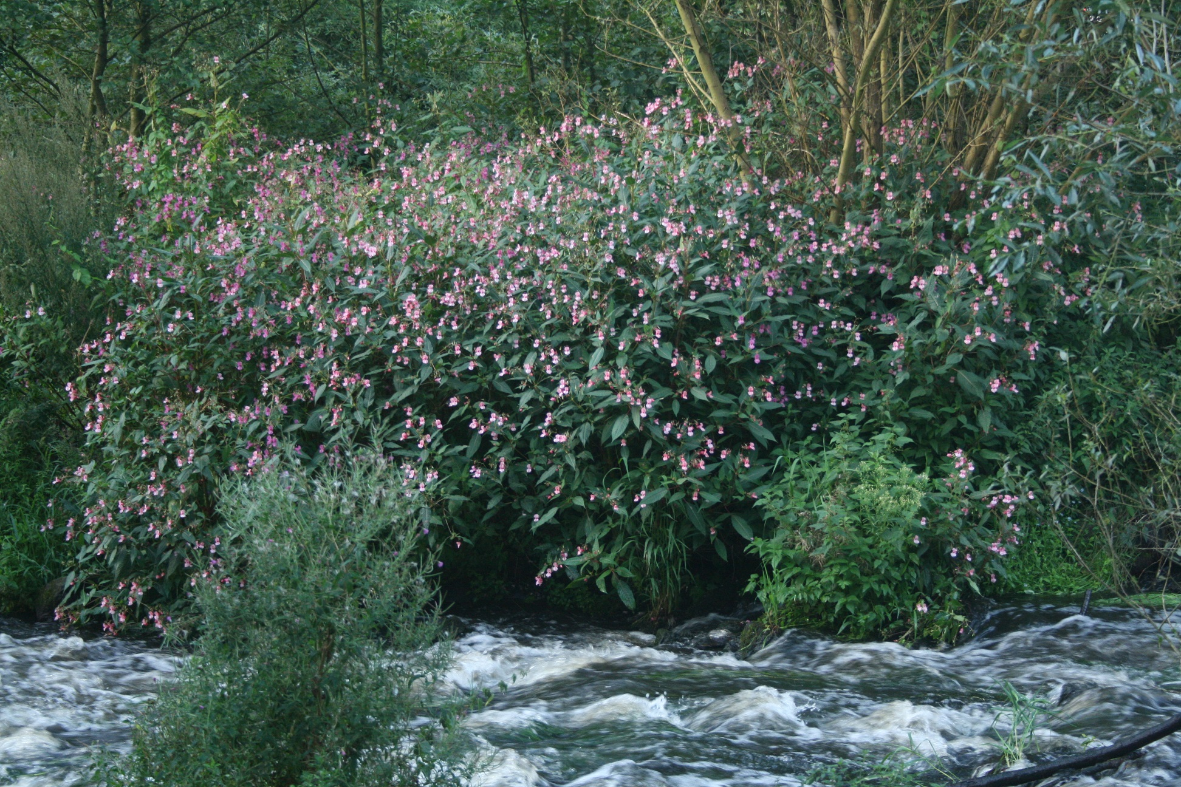
Key Physiological Traits
No natural predators
Highly competitive
over pollinate
over produce nectar
> 2,500 seeds per plant
effective seed ejection mechanism (> 4 m)
Watercourses: transport seeds
Progressive downstream colonisation
Discrete ‘stands’
High density (> 40-50 m⁻²)
Reduced sunlight
Suppressed plant growth

Slide 5
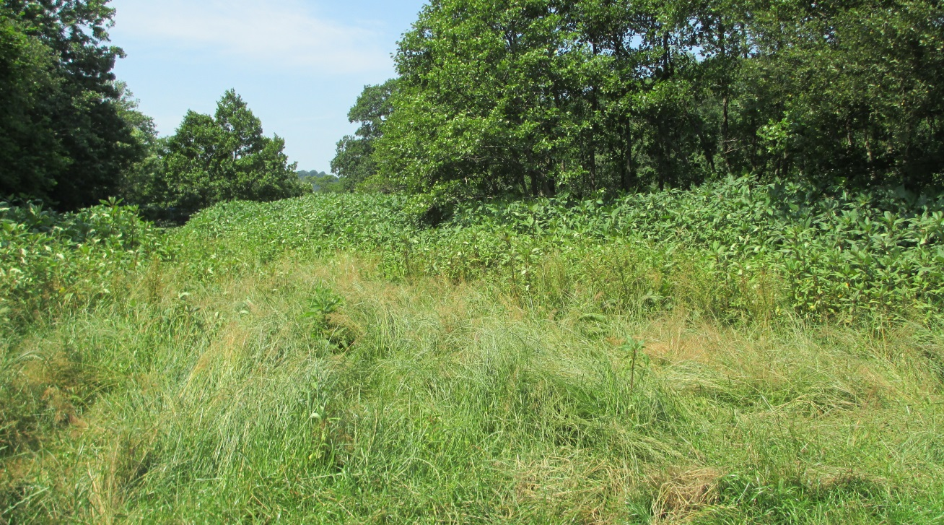
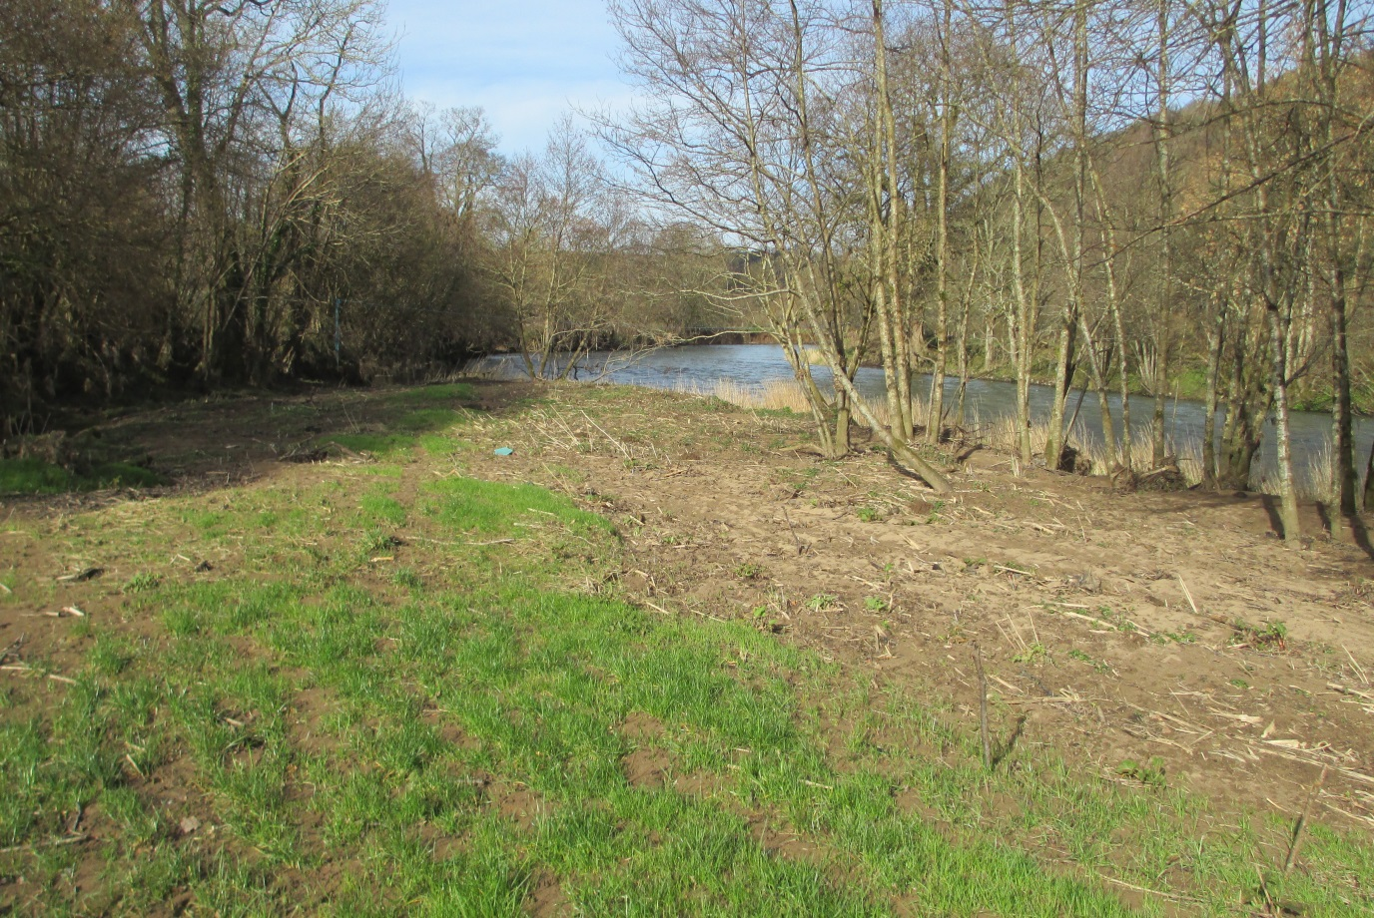
Key Lifecycle Traits
Cold intolerant
Rapid die-back
Depleted / reduced vegetation cover…
July 2013
…underlying soil – susceptible to erosion?
Dec 2013

Slide 6
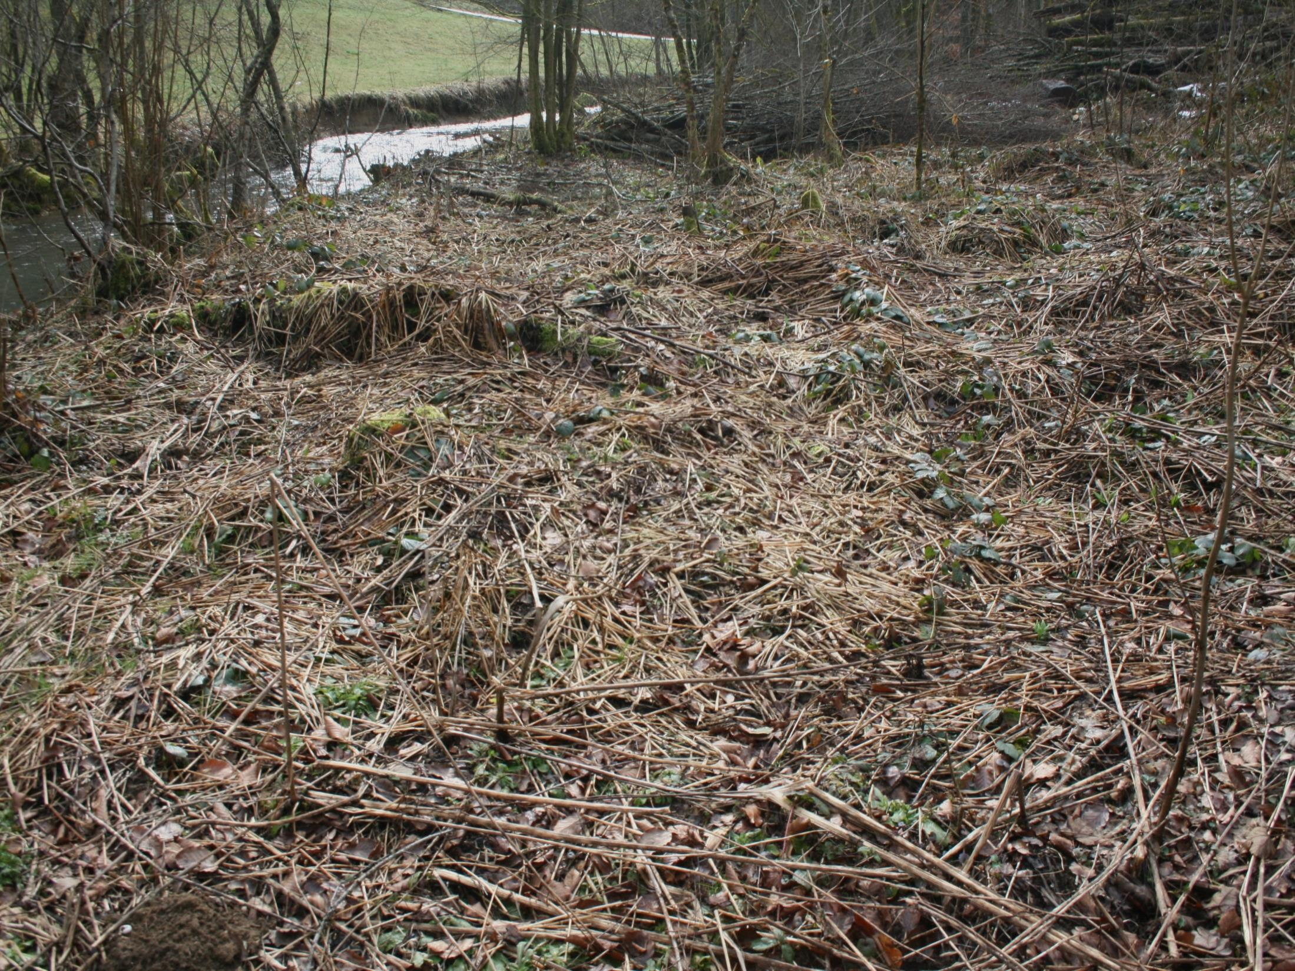
Hypothesis
PROVEN
…soil loss ‘contaminated’ sites > soil loss from [topographically] comparable areas supporting ‘natural’ vegetation…
Greenwood, P. & Kuhn, NJ. 2014. ‘’Does the invasive plant, Impatiens glandulifera, promote soil erosion along the riparian zone? An investigation on a small watercourse in northwest Switzerland’’. Journal Soils & Sediments 14(3): pp. 637-650.

Slide 7
Results – R. Ibach 2012/13
Cont. Site ID | Estimated Area Cont. (m²) | Av. Net Δ Soil Profile (mm) | Total Equivalent Soil Loss (t ha.⁻¹ yr.⁻¹)
Site 1 | 8 | -15.84 | -261.6
Site 2 | 200 | -8.77 | -144.8
Site 3 | 6 | -5.12 | -84.5
Site 4 | 4 | -21.16 | -349.4
Site 5 | 3 | -77.84 | -1285.4
Site 6 | 150 | -11.61 | -191.8
Total | 371.00 | -140.34 | -2317.5
Av. = 386 t ha.⁻¹ yr.⁻¹
Whole stream length (ca. 10 km) extrapolated = I. glandulifera feasibly responsible mobilising additional ca. 100 t fine sediment!
Comparable - regions where high magnitude events regularly recorded

Slide 8
Severe Erosion
R. Ibach 2012/13 (206 d)
R. Ibach 2013/14 (176 d)
R. Taw 2013/14 (150 d)
Av. net erosion ≥ -2 cm = 6 sites (30%)

Slide 9
Extreme Erosion
R. Ibach 2012/13 (206 d)
R. Ibach 2013/14 (176 d)
R. Taw 2013/14 (150 d)
Av. net erosion ≥ -5 cm = 3 sites (15%)

Slide 10
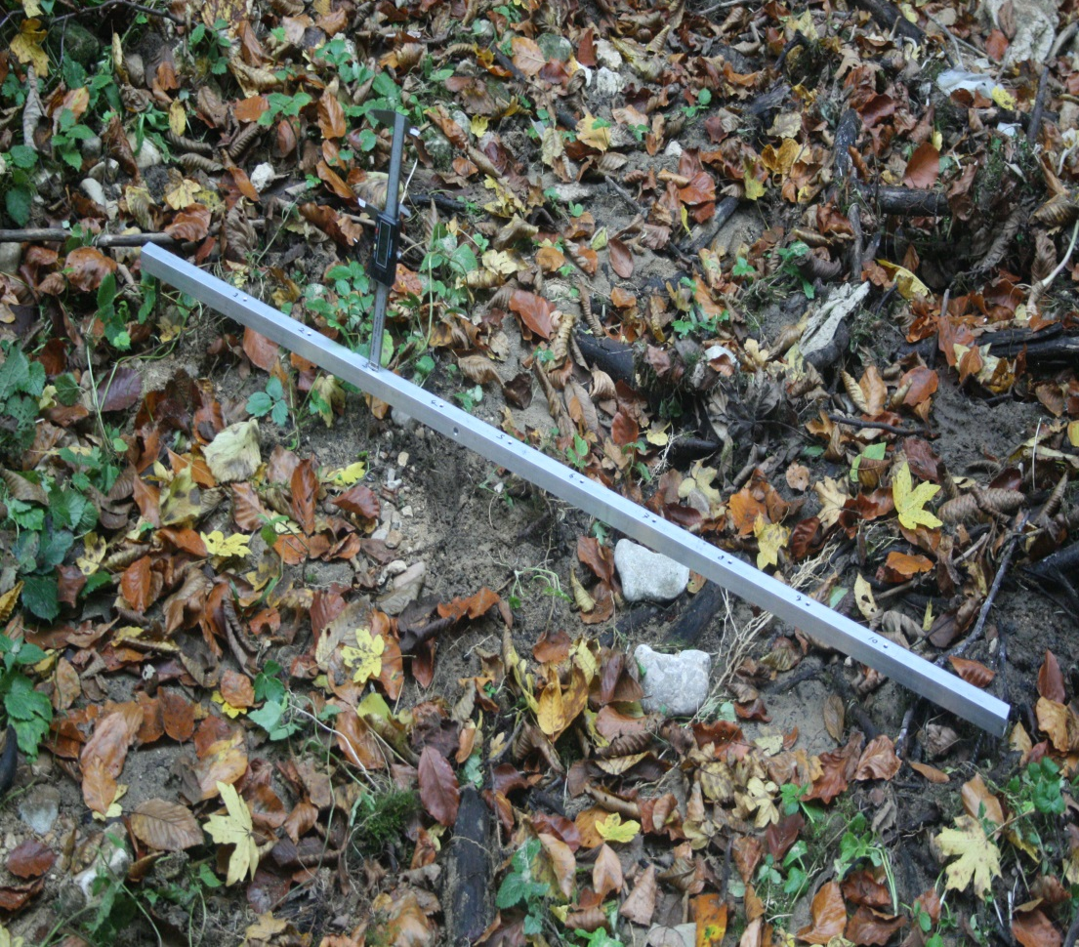
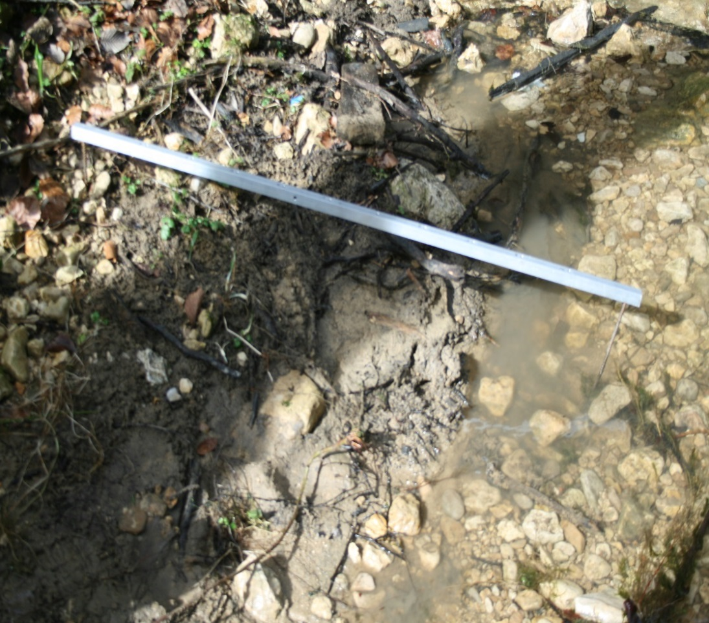
A Case of Extreme Erosion – R. Ibach 2012/13
Effect
High magnitude erosion
Loss fine-substrate
Changes in riverbank morphology
Nov 2012
Cause
I. glanduilfera colonisation
Dieback
Fine-substrate removal
Limited / no recolonisation (no viable seeds in seed-bank)
March 2013

Slide 11
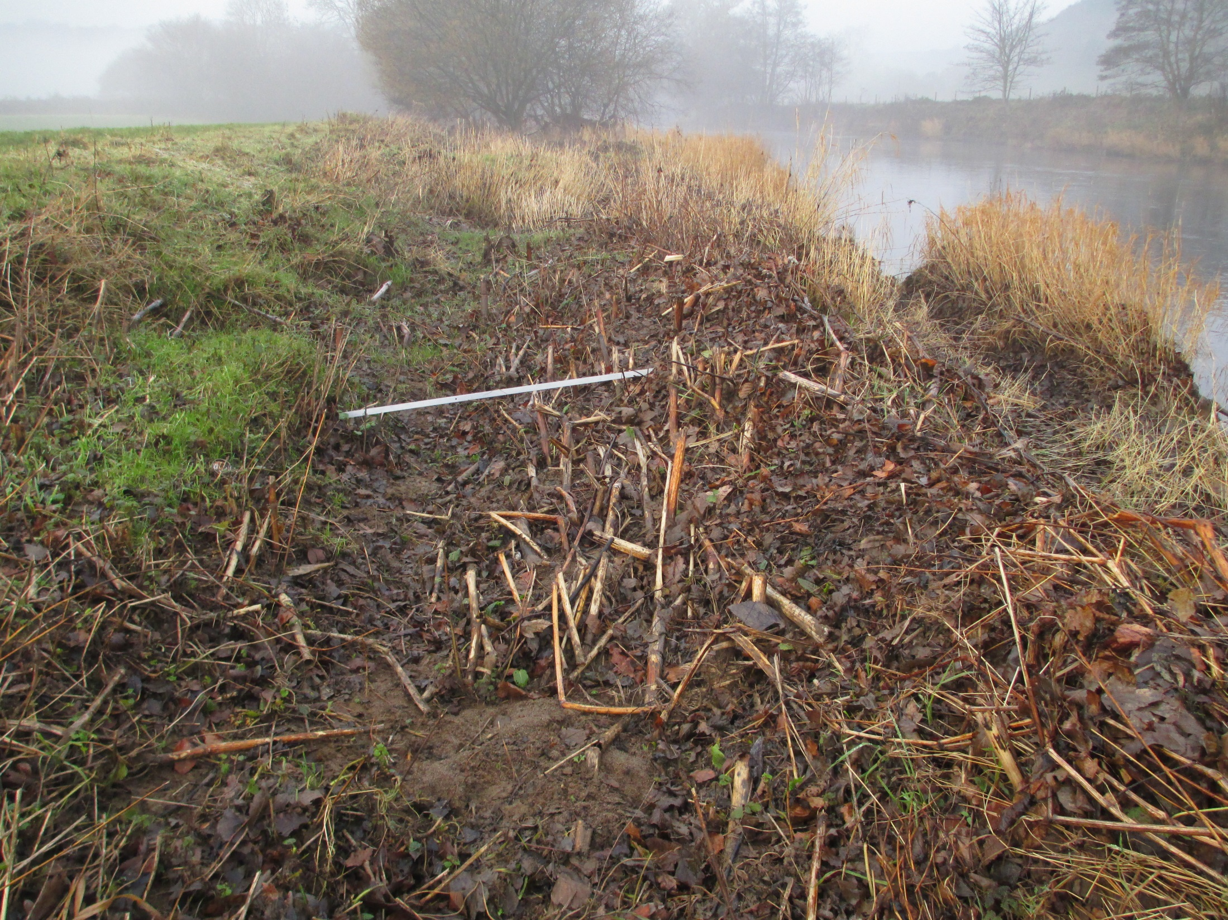
A Case of Extreme Erosion – R. Taw 2013/14

Slide 12
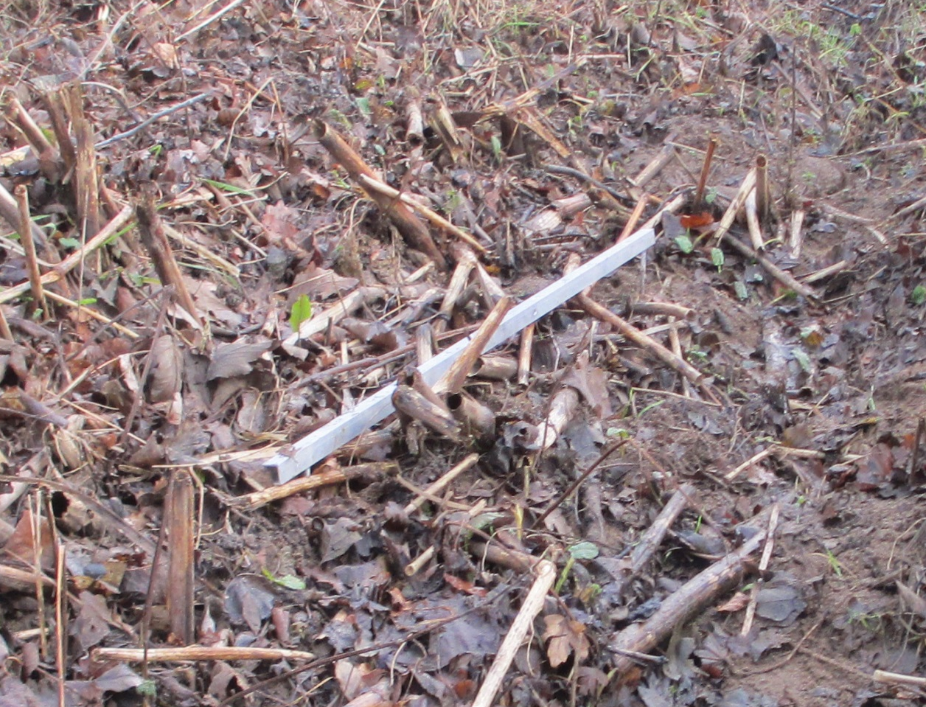
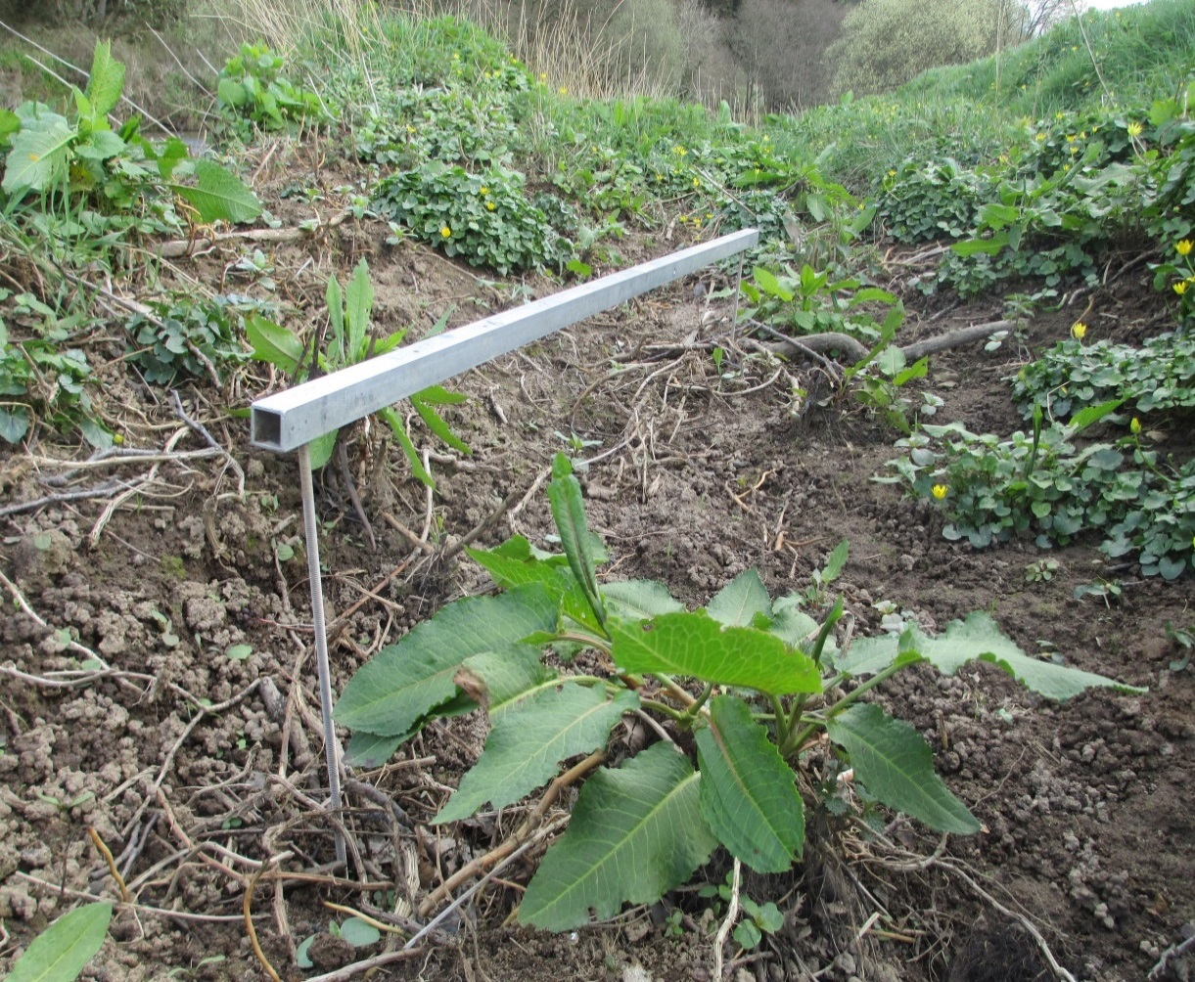
Extreme Erosion? – R. Taw
EFFECT
High magnitude scour erosion
[Formation] & Development valleys
Rapidly evolving morphology
No regrowth – Why?
Prime recolonisation territory
Repeat cycle?
Oct 2013
CAUSE
I. glandulifera colonisation
Dieback
April 2014

Slide 13
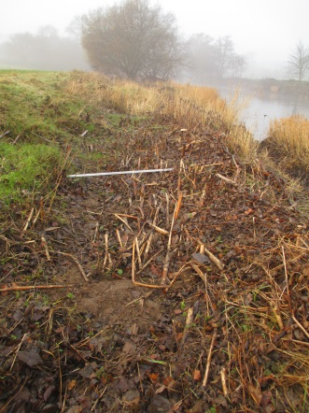
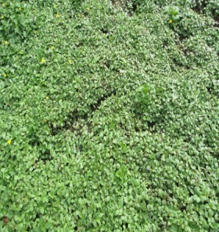
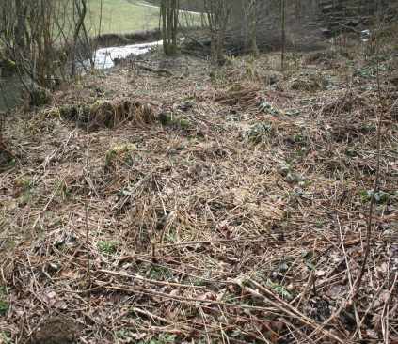
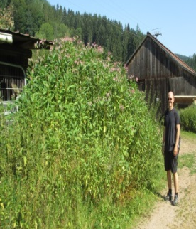
Hydro-geomorphic instability?
Severe / Extreme Erosion
Deposition/Invasion
Erosion
Colonisation/Germination
WINTER
Depleted Veg.
SPRING
Decomposition
SUMMER
AUTUMN
Growth/Maturity
Die-Off
Seed Ejection

Slide 14
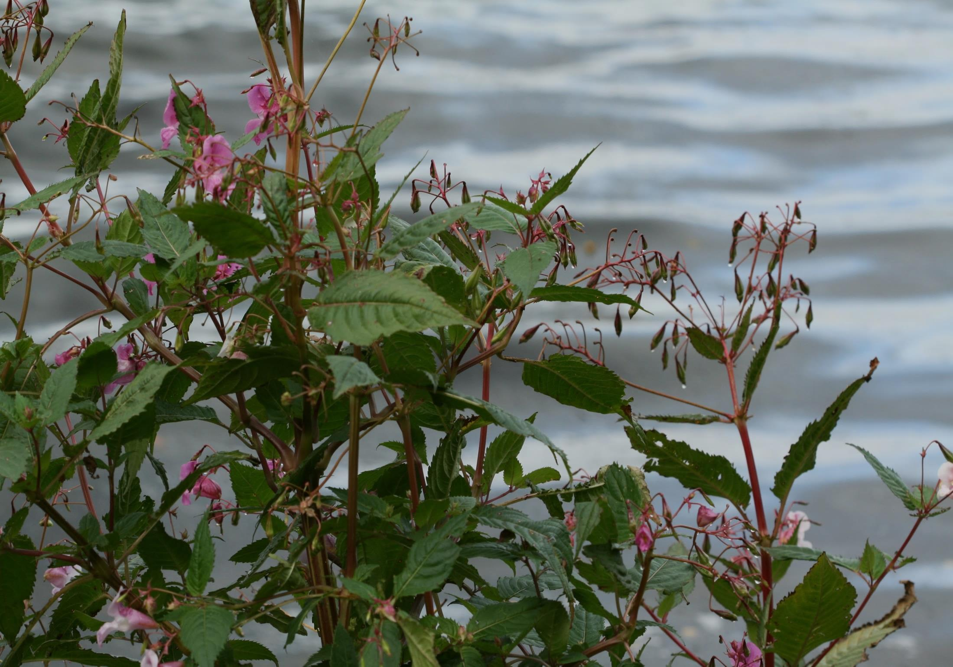
Hypothesis II
I. glandulifera: an erosion accelerant?
Continual cycles colonisation & dieback…
…often triggering severe / extreme erosion
Lack effective intervention measures = increasing encroachment
Induce hydro-geomorphic instability:
Moderate stream flow
Natural sustainable flood defence
Buffer fine-sediments & contaminants
Implications water quality
I. glandulifera – A ‘river system destabiliser’?

Slide 15
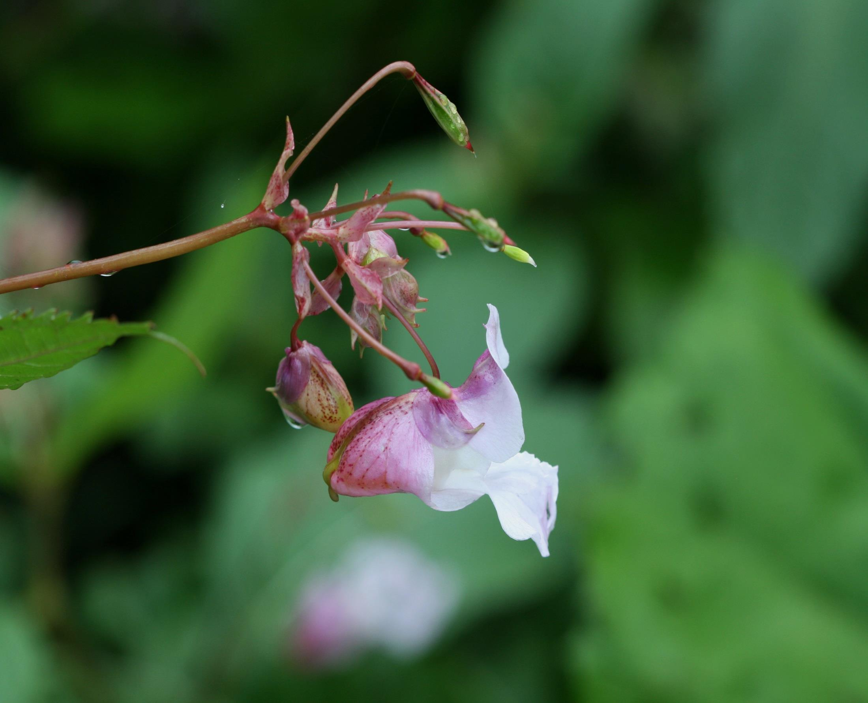
Thank you for listening!

