Slide 1

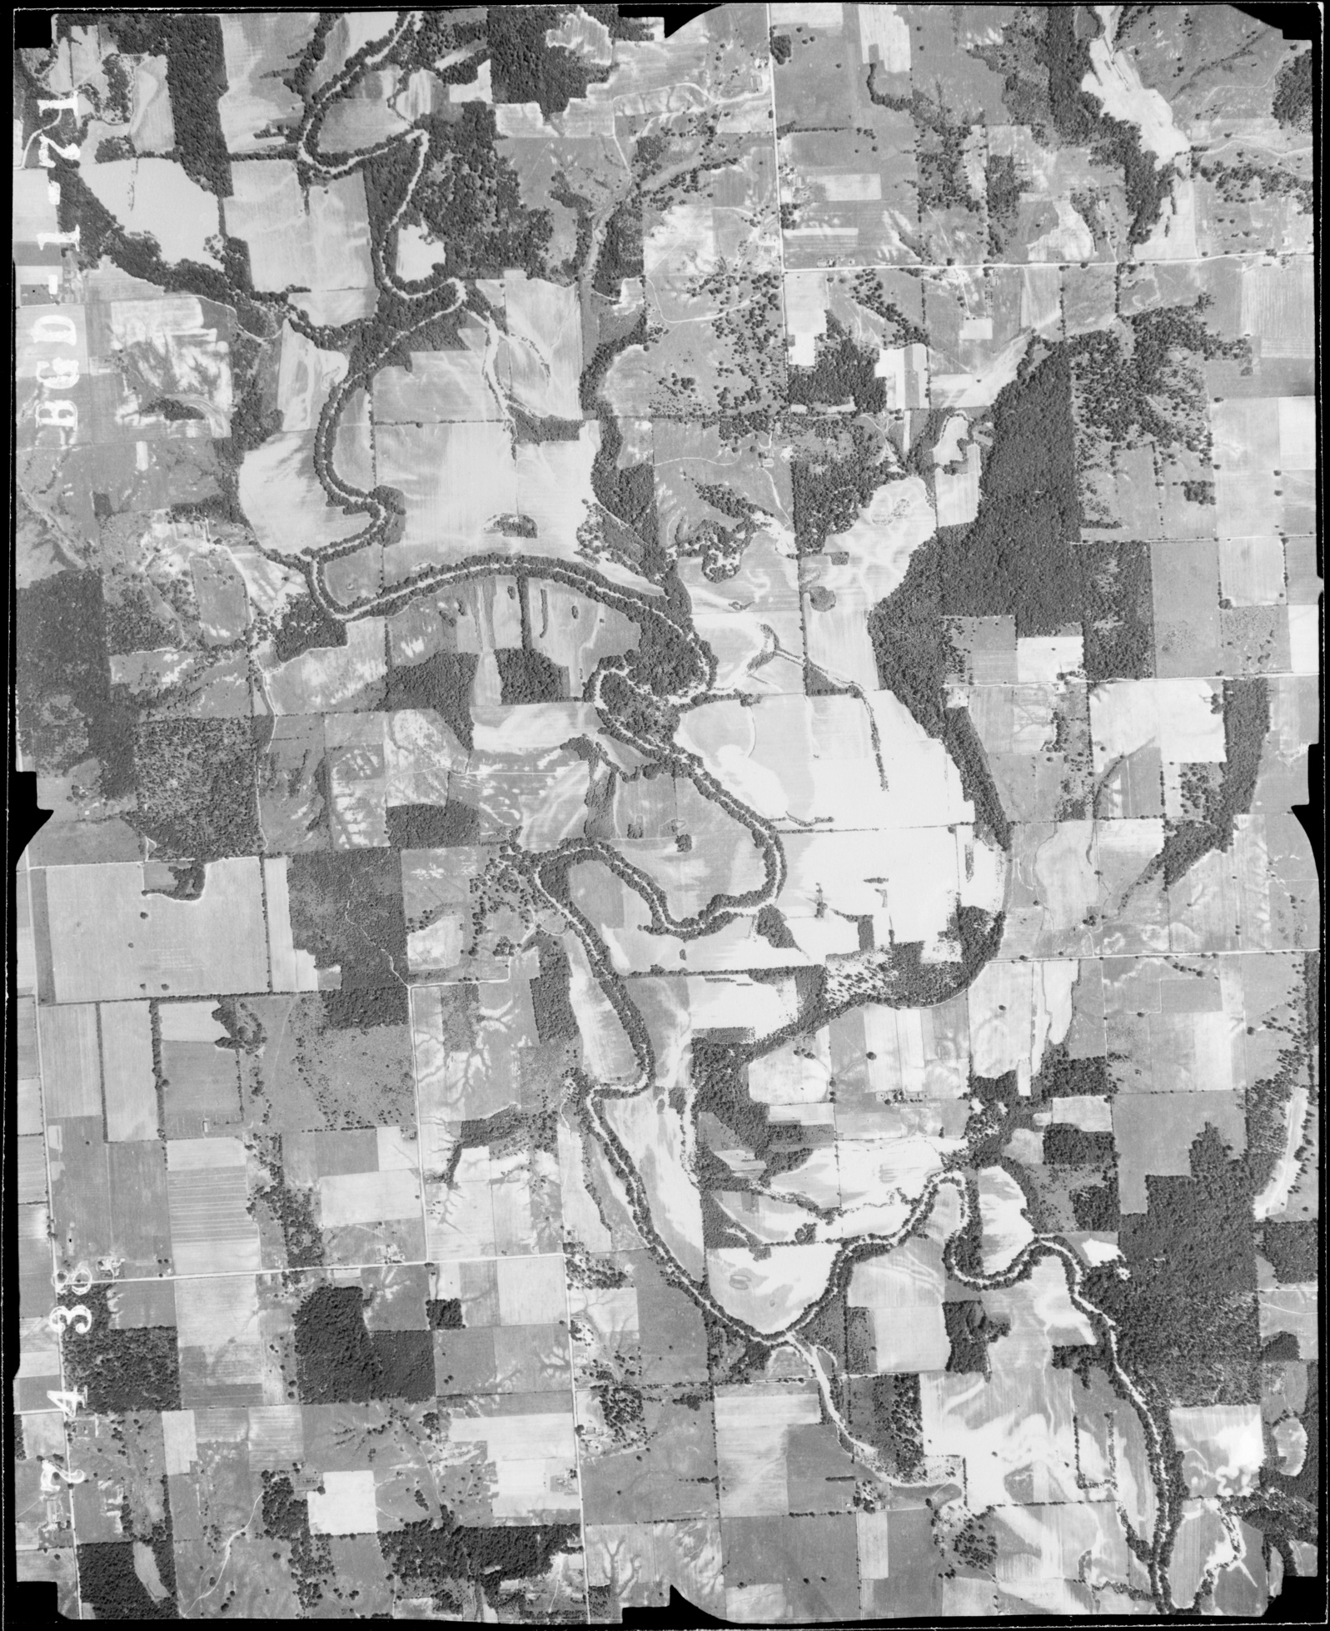
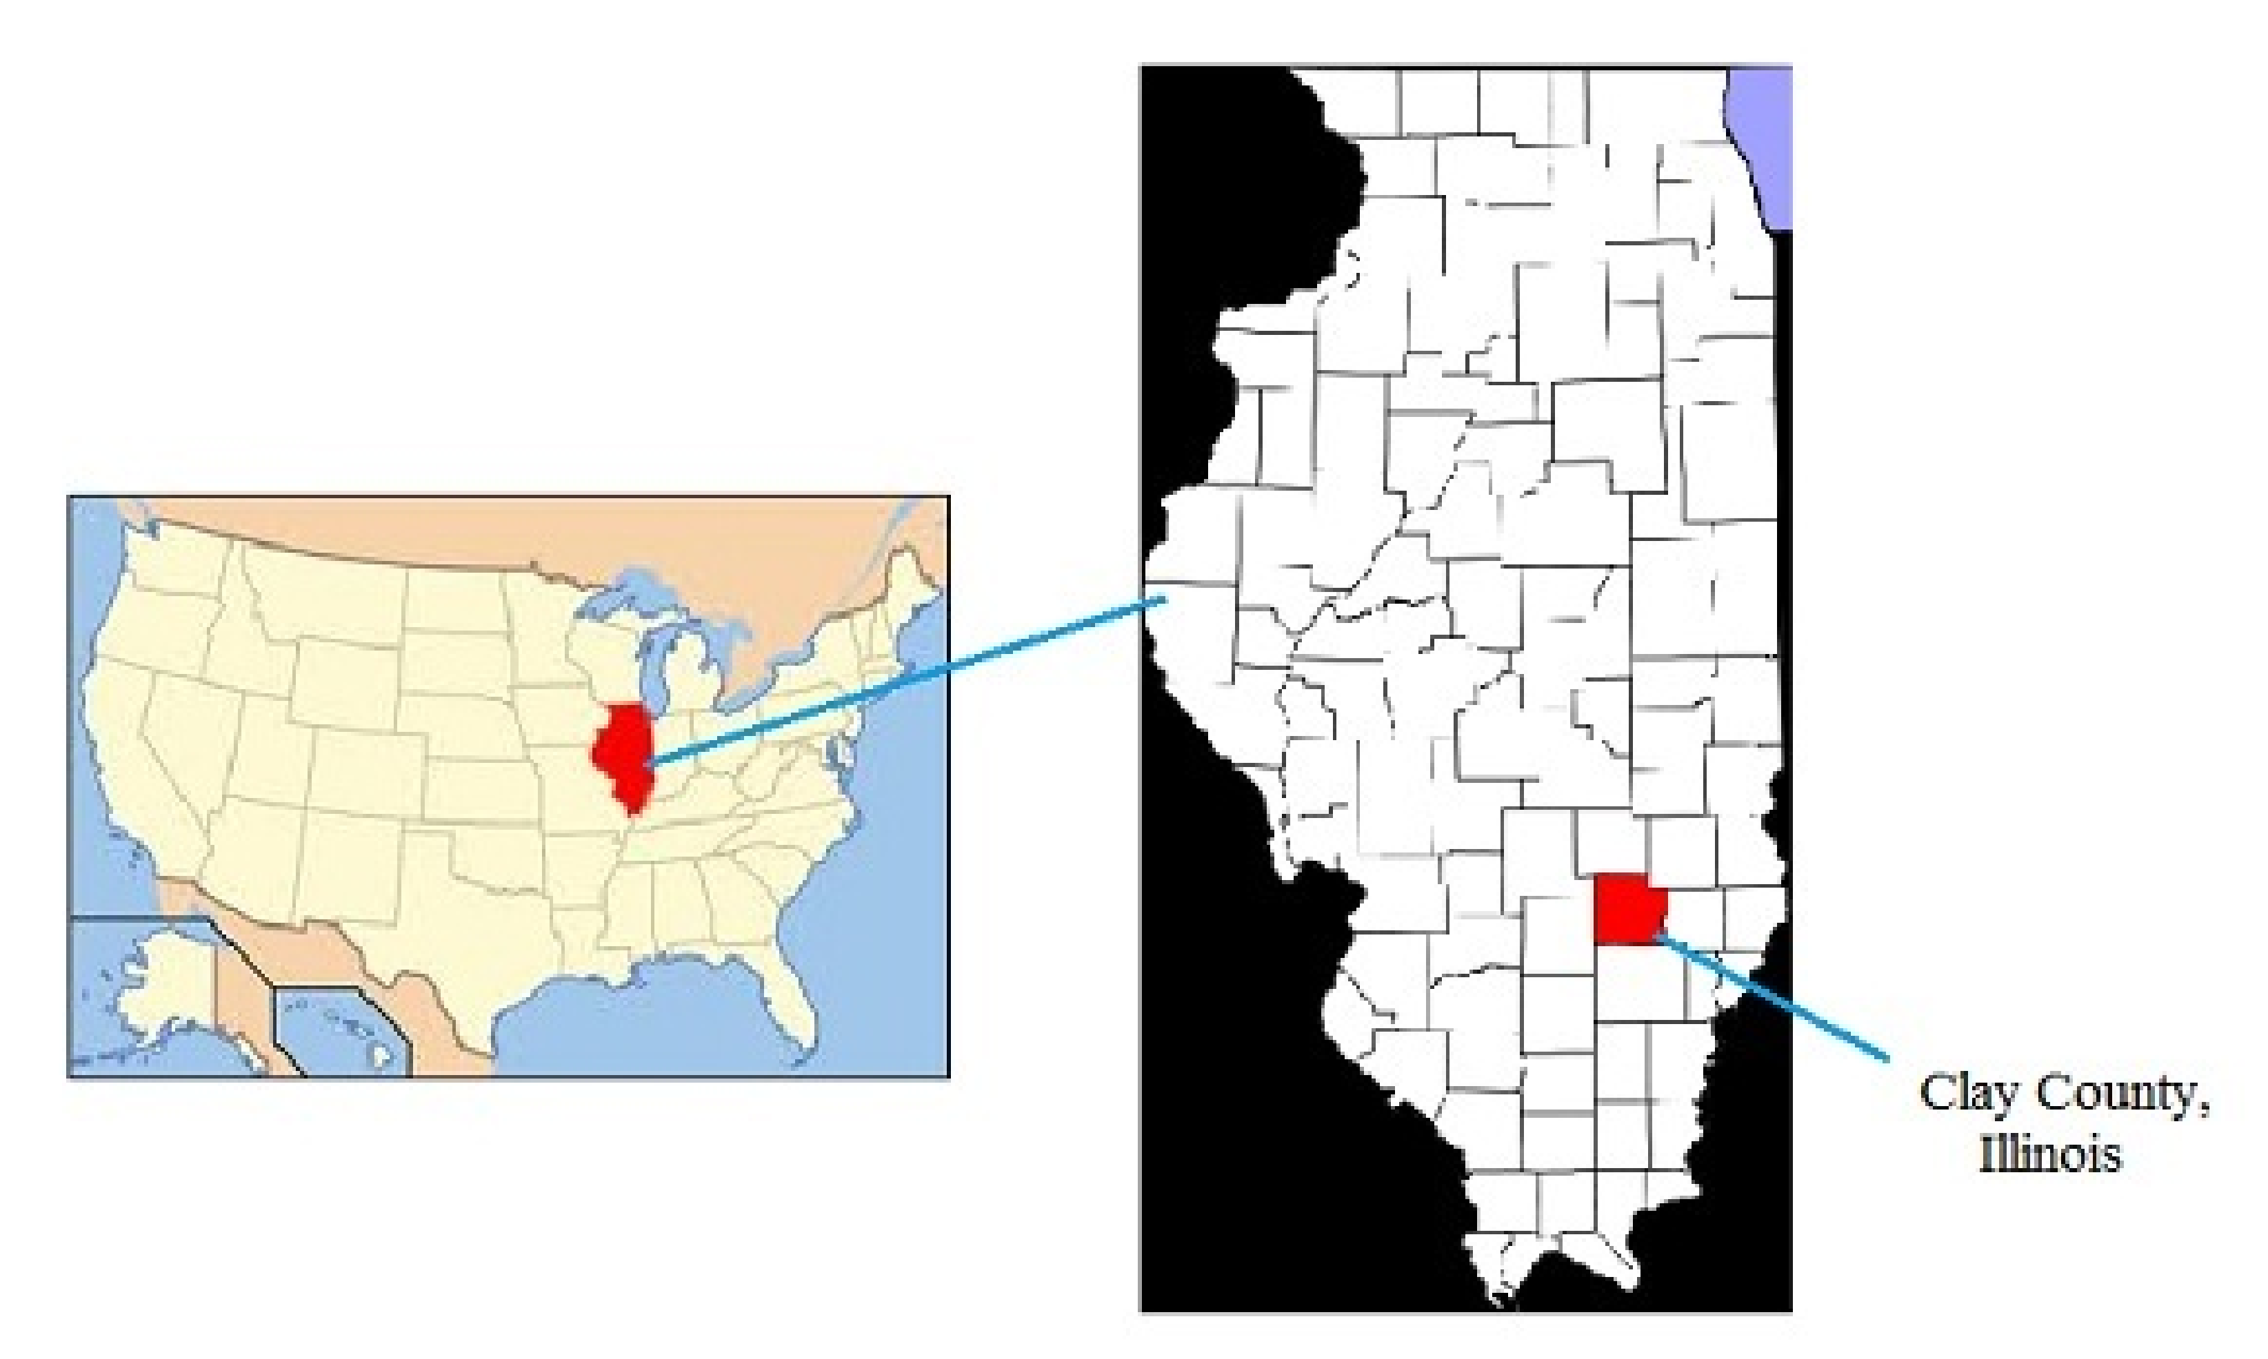
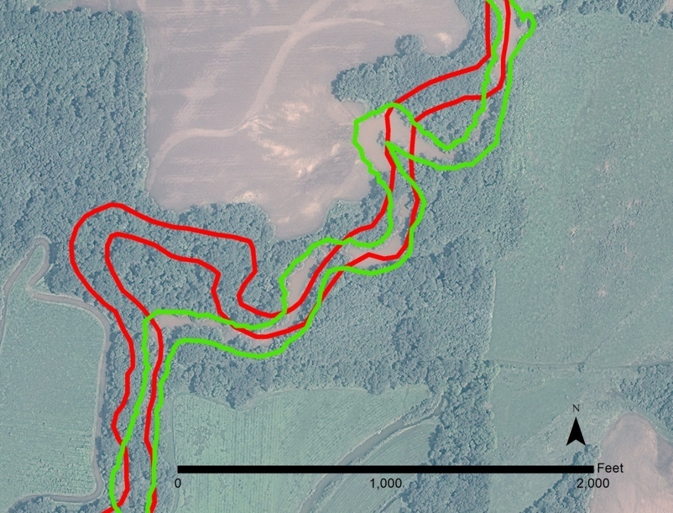
The Migration of the Little Wabash River Channel over Seven Decades – Clay County, East-Central Illinois, USA
Diane M. Burns and David C. Viertel, Eastern Illinois University, Charleston, IL
ABSTRACT
Geology consists of various landscape-changing processes. One of the most dynamic of these processes involves rivers. They cut back and forth across the landscape inscribing their channels into the underlying strata. Over time, a river’s channel is capable of laterally migrating substantial distances. The Little Wabash River in east central Illinois has been the focus of recent work to find how the channel’s path has evolved over several decades (Burns and Viertel, 2011) in the area encompassed by Effingham County. This current study takes the project forward, examining the channel’s migration through time in Clay County.
The Little Wabash is a meandering river whose headwaters originate in southwestern Coles County and flows southward approximately 200 miles to its confluence with the Wabash River. The watershed through which the Little Wabash flows is devoted primarily to corn, hay, soybean and winter wheat production (IEPA, 2006). The river winds its way across distinct properties, some of which may not be owned by the same entity on either side of the river. Therefore, any change in the stream’s path creates a loss or gain of acreage, which directly impacts the landowners. In the 2011 study, a total of 241 acres were found to now be on the opposite side of the channel’s previous path in Effingham County. The goal of this current project was to apply the same GIS techniques to the area deliminated as Clay County. Clay County’s dominant land use is also agricultural in nature, with crops of corn, soybeans, wheat, oats and sorghum. The yields from these are substantial – in 2007, for example, corn yielded 8,473,314 bushels and wheat yielded 634,160 bushels (USDA/NASS, 2007). These yields along with the other crops equated to over 72 million dollars of gross revenue in 2007 alone.
The historical channel of the Little Wabash River was digitized to establish a baseline survey using archival aerial photography acquired in 1938, which were georegistered to their proper locations and proportions. Current channel position was acquired through a basemap within the GIS ArcMap software. The comparison between the datasets highlights the alterations that have occurred along the Little Wabash River’s path over the last 75 years in Clay County.
INTRODUCTION
Throughout time, rivers meander and change their courses by water flowing actively in the channels. These changes are created geologically and instantaneously through the development of meander cutoffs. Meander cutoffs can form as either chute cutoffs or neck cutoffs, and the mechanisms by which they develop have been examined in past studies (Matthes, 1948; Crickmay, 1960; Ratzlaff, 1981; Mosley, 1975; Gay et al., 1998). These cutoffs arise from the result of headward erosion of gullies during flooding periods. The gullies begin during the initial flooding stage and complete the connection between the two parts of the main channel, creating a pathway through which the stream or river channel will continue to flow (Johnson and Paynter, 1967; Gay et al., 1998). Recent studies have examined the dynamics of changes in flow patterns in the growing meander cutoff as the water diverts from the main channel to the new one (Rhoads et al., 2009) along with the effects on sedimentation patterns and creation of sediment pulses at the cutoff as well as downstream (Zinger et al., 2010; Zinger, Rhoads and Best, 2011). The documentation and research into the physical aspects of meander cutoffs is well advanced; however, minute attention is given to the impact this phenomenon has had on land usage and land ownership as a result of channel shifts.
Previous work on the Little Wabash River’s channel migration focused on the geomorphology of Effingham County (Burns and Viertel, 2011). In that study, shifts in the channel location effected over 200 acres of land, although one section is believed to be as a result of human alteration of the path. The current study centered on Clay County was undertaken to broaden the understanding of changes along the next section of the river. Eventually, the entire river’s path will be analyzed from its headwaters to its confluence. Results of all past, current and future studies will be synthesized to complete the project.
RESULTS
After the channel pathways from the various datasets were compiled and analyzed, six major deviations from the old channel of the Little Wabash River were found. These are listed in Table 1. Many are fairly moderate in comparison to the sizes of some of the larger farms in the area; however, one deviation is rather significant – over 12 acres in area.
Although these might seem rather small in size, the majority of the farms in the area are 10 – 49 acres, and a loss or gain of 2 acres has a lot of impact. In the case of the over 12 acre cutoff, it is the equivalent to the size of an average-sized farm. The total acreage impacted by the channel migration totals almost 28 acres.
Meander | Coordinates | Acreage
1 | -88.543983, 38.828582 | 2.27
2 | -88.547383, 38.819459 | 2.83
3 | -88.472202, 38.746210 | 7.32
4 | -88.355410, 38.710217 | 2.71
5 | -88.336611, 38.704963 | 12.11
6 | -88.312481, 38.679827 | 0.53
 | Total Acres | 27.77
Figure 3 – example of the aerial photos from 1938 that were used to get the historical pathway of the Little Wabash River in Clay County, IL.
Figure below shows a reach of the Little Wabash River in 1938 (colored red). Notice that the land in the bend of the meander is clearcut and probably being used for agricultural purposes.
Table 1 – meander effects on acreage in Clay County, IL.
DISCUSSION/CONCLUSION
The purpose of studying the changes of the Little Wabash River’s channel is to ascertain how the agricultural land has been impacted. Data from this study have shown that there have been many changes to the course of the Little Wabash River over seven decades’ time. These are modifications to as little as an acre of land along smaller bends to a substantial cutoff that has affected over 12 acres. In the 1938 images, areas prior to the meander cutoffs contained cleared land and crop fields. Current imagery shows that these areas are now densely populated by trees and non-productive as far as farming is concerned.
Further investigation will be needed on many aspects of this project. First there is a need to identify land ownership throughout the decades and to outline the alterations to land ownership as a result of the development of the cutoffs. Preliminary investigation into the ownership of the plats surrounding the river cutoffs in Effingham County from the earlier study (Burns and Viertel, 2011) show the edges of the parcels to be coincident with the current river channel. As we have demonstrated through these two studies, the channel has shifted throughout time, so at some point the plats had to have been redrawn. Another phenomenon that seems to be appearing is a link between roadway construction and the creation of “mega cutoffs,” ones that are significantly larger than the average in an area. In this situation, determination of liability for loss of acreage might fall to a governmental organization, something that has not yet been investigated. Last, two different datasets have been used to compare the aerial photos with current conditions – in the 2011 study, Quickbird satellite imagery was used; in this study, ARCGIS data were used. Another study should be undertaken to determine the accuracy of the more readily available data in the name of establishing protocols and ensuring veracity.
Figure 2 – graphic showing the location of study area in Clay County, Illinois.
Figure below shows the same portion of the Little Wabash River in 2008. Notice that the older meander has been cutoff and now there are only trees in this area. Further investigation is needed to determine if this usage change was due entirely to the channel shift.
METHODS
Archival aerial images from July 5, 1938 were obtained for the section of the Little Wabash River the delineated the river’s path throughout all of Clay County to its confluence with the Wabash River (images courtesy of The Illinois Natural Resources Geospatial Data Clearinghouse). Once all of the necessary images were collected and downloaded, they were imported into ArcMap and georeferenced to their proper orientations. After all images had been processed, the banks of the river channel were outlined via digitization. A basemap from the onling ARCGIS catalog that had been created in July, 2011 was used for the comparison to current placement of the channel. The banks of the river’s channel were also outlined via digitization, and the two datasets were overlain to inspect for changes in the river’s pathway.
Figure 1 – graphic showing the land usage in Clay County, Illinois. Land usage is first categorized into Agriculture and Non-Agriculture, with further subdivisions in the Agriculture category as to what type of crop is grown (USDA, 2011).

