Slide 1
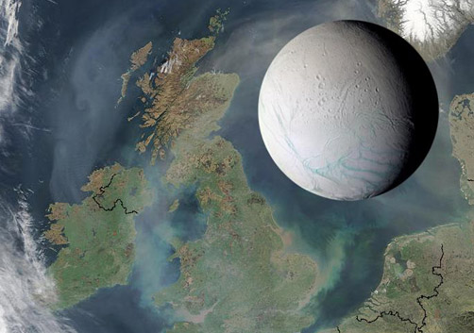
The fluffy core of Enceladus
GSA
19 October 2014
James H. Roberts
James.Roberts@jhuapl.edu
Image courtesy NASA/JPL/Space Science Institute

Slide 2
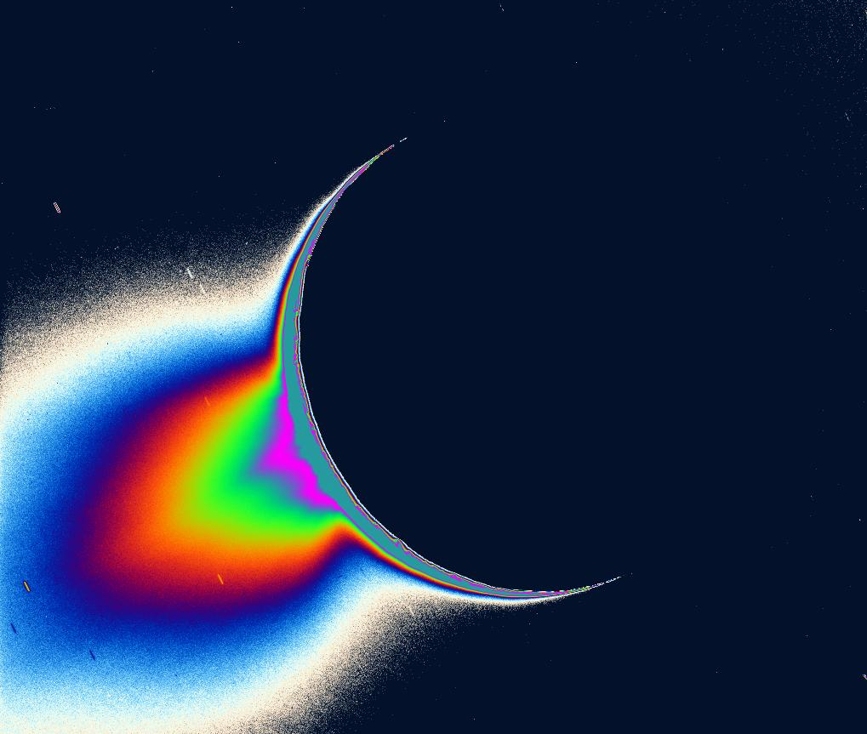
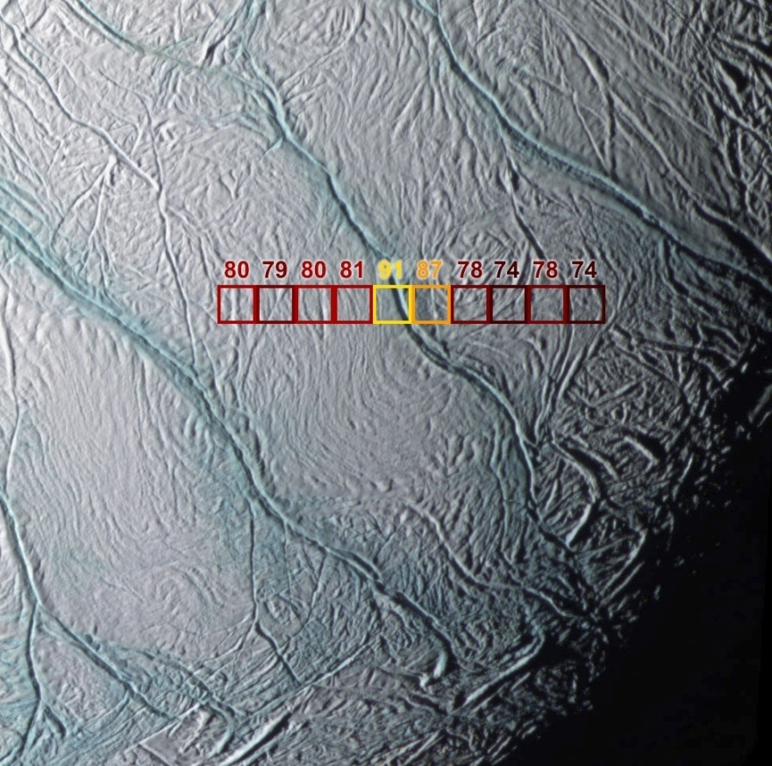
The south polar region
South Polar Plume
Tiger Stripes
35 km
Spencer et al. Science 2006
Porco et al. Science 2006
5-16 GW (70 - 200 mW m⁻²) heat flow in S. polar region (Howett et al. 2011; 2013)
Roughly 10X long-term sustainable level (Meyer and Wisdom, 2007)

Slide 3
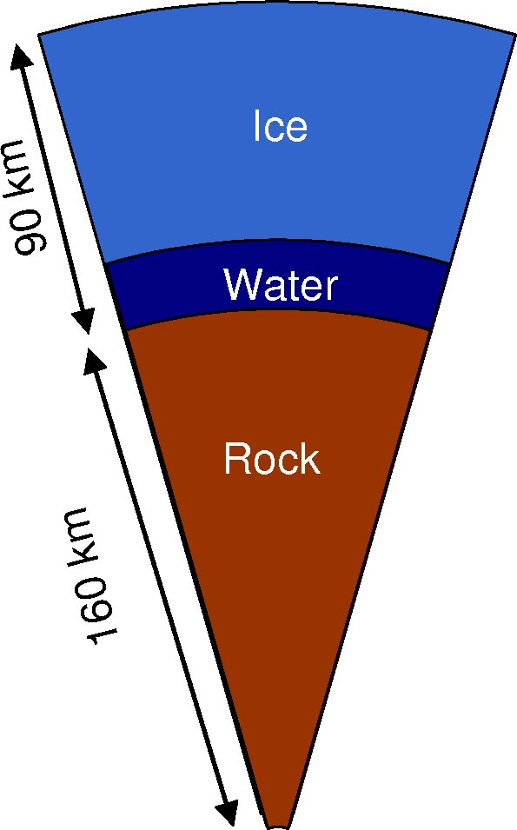
Classic Model
Enceladus has a differentiated interior (Schubert et al., 2007)
Eccentric orbit about Saturn causes time-varying tidal forces
Rocky core too rigid for substantial deformation
An ocean decouples ice shell from core, allowing deformation of the ice
Tidal energy dissipated as heat

Slide 4
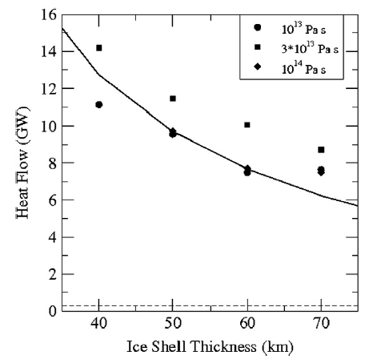
The Ocean: A Cost-Benefit Analysis
Decouples ice shell from the silicate core
Allows ice shell to deform tidally
It may not last long
Pure water ocean freezes in tens of My
Can freezing can be inhibited?
Roberts and Nimmo, (2008), Icarus

Slide 5
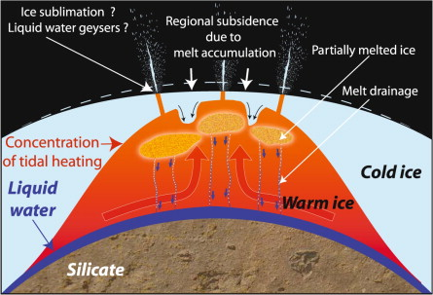
Regional Sea
A regional sea (e.g., at the south pole; Collins and Goodman, 2007)
Consistent with gravity measurements (Iess et al., 2014)
Can survive more easily than a global ocean (Tobie et al., 2008)
Somewhat restrictive size range
Seas spanning on order 120˚ of arc survive
Tobie et al. (2008), Icarus
Notes:
Too small and not enough dissipation
Too large and heat loss is too fast

Slide 6
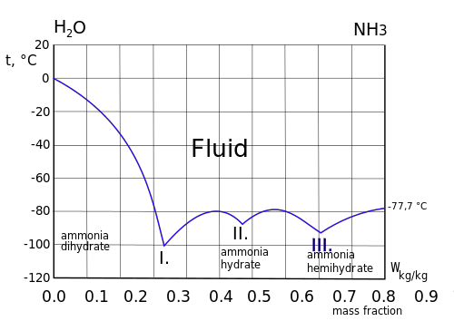
Antifreeze
NH₃, various salts depress the melting point
Possibly by 100 K
Slows down the freezing rate
May be able to prevent freezing altogether
McKinnon and Barr (2008; 2013)
How much NH₃ is in the ocean?
What does this do to the rheology?
Merkel & Bošnjaković (1929)

Slide 7
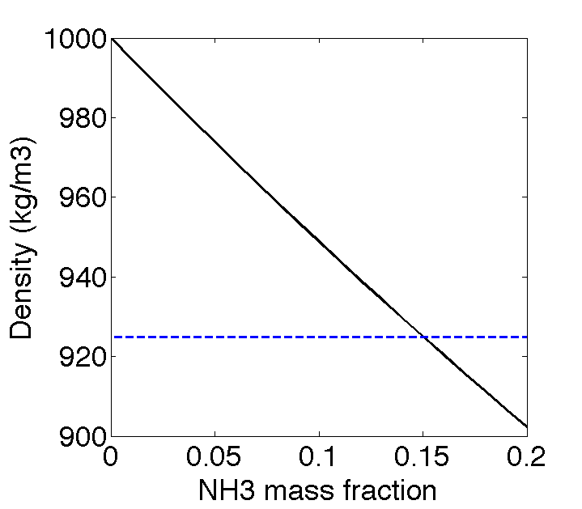
Ammonia reduces buoyancy of ice
Increased NH₃ reduces density of fluid
Solutions >15% NH₃ are less dense than Ice I
Freezing point cannot be lower than ~230 K
Ocean
Ice I
Notes:
Ice shell may delaminate and founder
We should totally investigate this system!

Slide 8
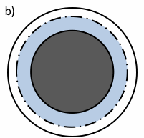
Do we even need the ocean?
Without it, the core prevents the ice from moving
The core is really the culprit
The coupling wouldn’t matter so much if the core weren’t so rigid

Slide 9
An Alternative View
Is the core consolidated?
Formation > 1.6 My after CAIs precludes melting of silicates
Central Pressure ~20 MPa
Rubble-pile core filled interstitial water or ice.
Core temperature always below brittle-ductile transition (Neveu et al., 2014)
Notes:
Not enough Al-26 to reach solidus
~1 km below Earth’s surface
~2X atm. pressure at Venus

Slide 10
Tidal Dissipation
Assume Enceladus is differentiated and frozen
Core contains 0 – 30% of ice-filled porosity
Lower limit: Core is monolithic, behaves as rock
Upper limit: Rock fragments no longer in contact, ice controls deformation
Compute tidal heating in various model Enceladi
TiRADE (Roberts and Nimmo, 2008)
Tidal Response And Dissipaton of Energy
Solve for tidal stress and strain in a multilayered visco-elastic body
Core rigidity and viscosity are a weighted log average of ice and rock values.

Slide 11
Tidally-generated Heat
Significant dissipation in core if porosity > 20 %
At 30% porosity, dissipate 1.7 GW
Mostly in core!
Factor of 20 change in heating between end-member models

Slide 12
Serpentinization
Disaggregated core → water-rock interaction, even at great depth (Neveu et al., 2014)
Example: 2Mg₂SiO₄ + 3H₂O → Mg₃Si₂O₅(OH)₄ + Mg(OH)₂
Substantial reduction in density
ρ = 2.6 g cm⁻³ (vs. 3.3 g cm⁻³ for unserp. silicates)
Serpentinized core is compatible with gravity measurements (Iess et al., 2014) that suggest a low density core
C/MR² = 0.335
Weakens core substantially
μ = 35 GPa (vs. 70-100 GPa)
η = 4*10¹⁹ Pa s (vs. > 10²⁰ Pa s)

Slide 13
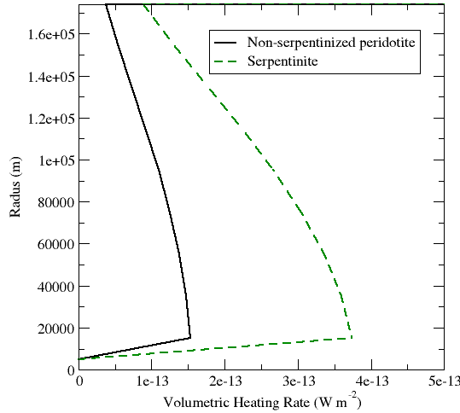
Tidally-generated Heat in Serpentinized Core
Heating doubles in a serpentinized competent core
Few % increase in ice layer

Slide 14
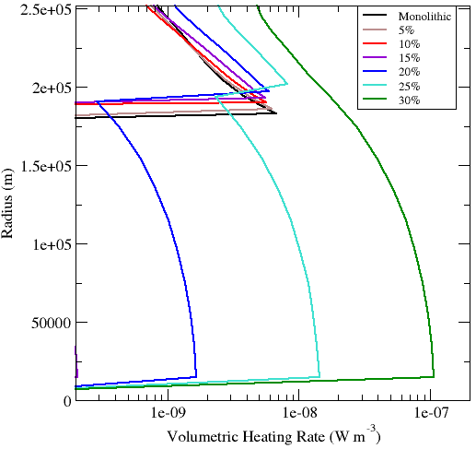
Tidally-generated Heat in Serpentinized Core
Core dissipation becomes effective at slightly lower porosities
~ 10% increase in heating overall

Slide 15
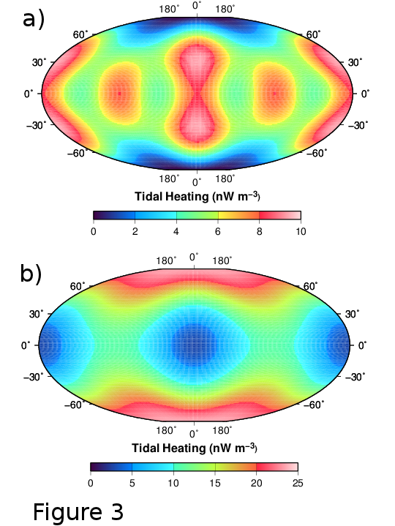
Distribution of Tidal Heat
Monolithic core
State of the core controls the pattern of heating
Rigid core
Maximum heating at mid-latitudes
Minimum heating at poles
Weak core
Maximum heating at poles
Minimum heating at sub-Saturn, anti-Saturn points
Also what you get with an ocean
Current Enceladus looks more like the bottom
Unconsolidated core

Slide 16
Implications
Enceladus may be tidally heated, even when completely frozen
Silicate core unconsolidated, lubricated by interstitial ice
Serpentinized silicates more deformable
Heating rates ~10% of observed heat flow
Consistent with the long-term sustainable level of tidal dissipation (Meyer and Wisdom, 2007)
Heat may be produced at this lower rate, and episodically released at the higher observed rate (O’Neill and Nimmo, 2010)
An ocean is not required in order to explain observed activity on Enceladus
Nor is it precluded

Slide 17
However…
How does mechanical behavior of core depend on ice fraction?
Can dissipation in core re-melt ocean?
Will the ice stay warm?

Slide 18
Thermal Evolution
Model thermal evolution in ice shell and core
Citcom in layered sphere (2D axisymmetric)
Radioactive heating in silicate-bearing core
Insulating bottom boundary
TiRADE and Citcom coupled using BFI technique
Brute Force and Ignorance
Compute viscosity based on initial temperature profile
Compute tidal heating (TiRADE)
Ingest heating into thermal model
Evolve temperature and viscosity for short time (Citcom)
Update tidal heating based on new viscosity (TiRADE)
Repeat as necessary

Slide 19
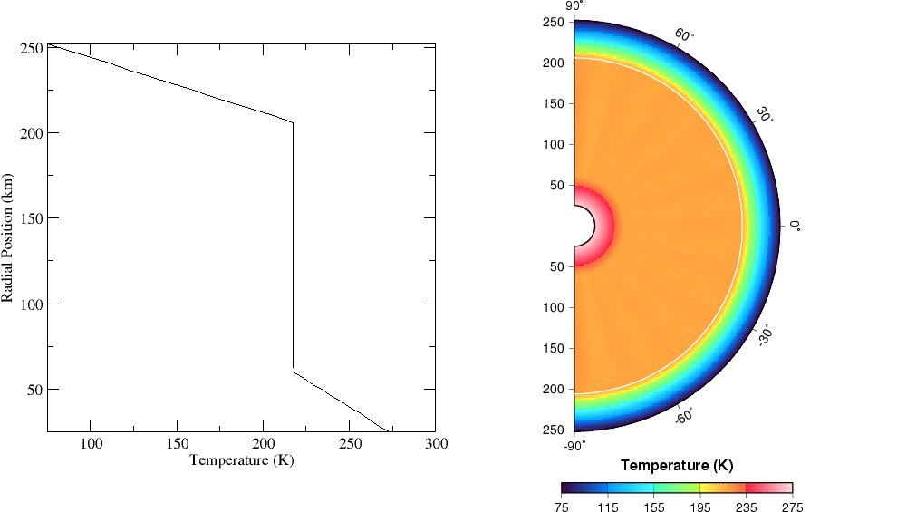
Convective interior

Slide 20
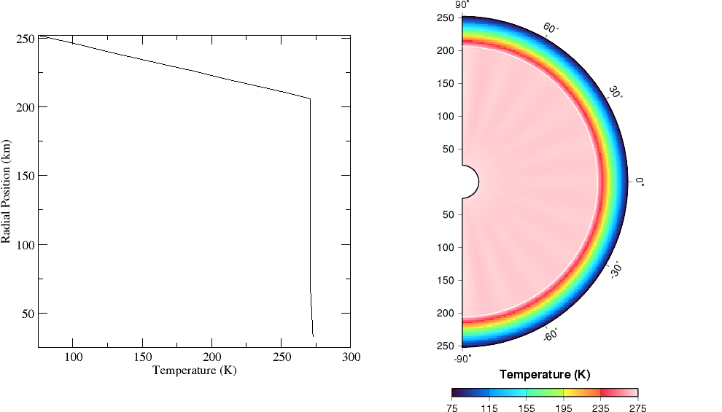
Almost melting!

Slide 21
Enhanced heating

Slide 22
Conclusions
A frozen Enceladus may be tidally heated even with no subsurface ocean
IF: The core is unconsolidated and weak
AND: The ice remains relatively warm
The core is probably fluffy (and highly serpentinized)
The ice will not stay warm without an ocean
Ocean required to sustain thermal activity
Must be present initially
Cannot form later without additional heat source
Dissipation important in core
And maybe the ocean? (Tyler, 2009, 2011; Matsuyama, 2014, in press)
This work funded by NASA’s Outer Planets Research Program
Notes:
Porosity, effective rheology not well known

Slide 24
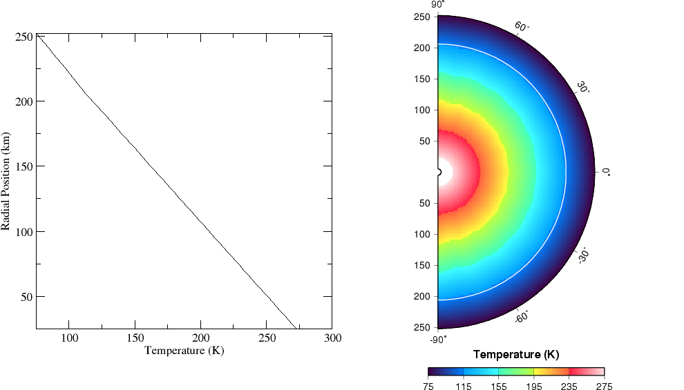
Initially cold interior

