Slide 1
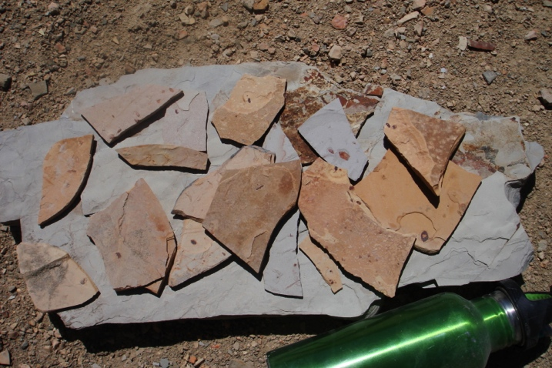
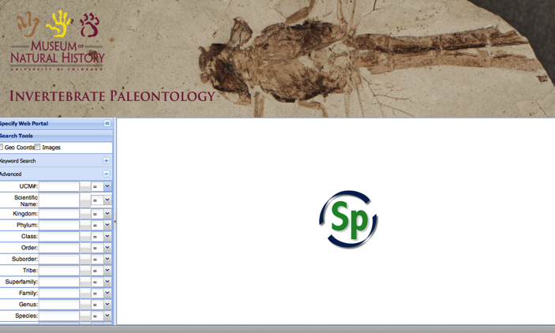

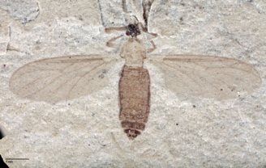
FOSSIL INSECT DIGITIZATION WORKFLOW AT THE UNIVERSITY OF COLORADO
Talia Karim¹, Lindsay Walker¹, Richard Levy²
¹CU Museum of Natural History
²Denver Botanic Gardens

Slide 2

Fossil Insect Collaborative
Seven institutions over four years
Database ~500,000 specimens
~77,000 digital images
Data sharing-
iDigPaleo, iDigBio, GBIF, etc.

Slide 3

Fossil Insect Collaborative
~100,000 specimens
Database ~76,000 new specimens
Acquire ~25,000 digital images
Georeference 172 localities
Publish data-
iDigPaleo, iDigBio, GBIF, etc.

Slide 4

Fossil Insect Collaborative
Currently:
Database ~46,700 specimens
~7,800 digital images
Publishing data-
CU websearch & GBIF

Slide 5
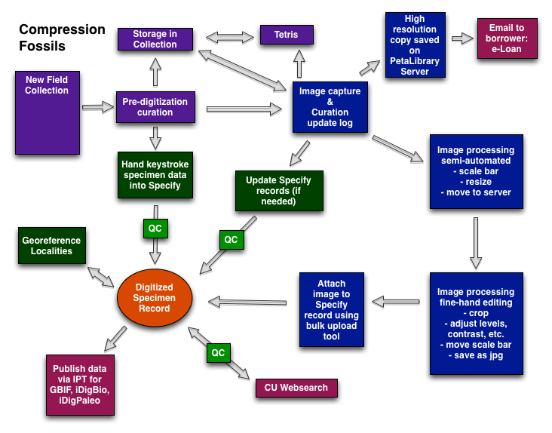
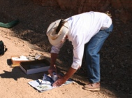

Slide 6


Slide 7
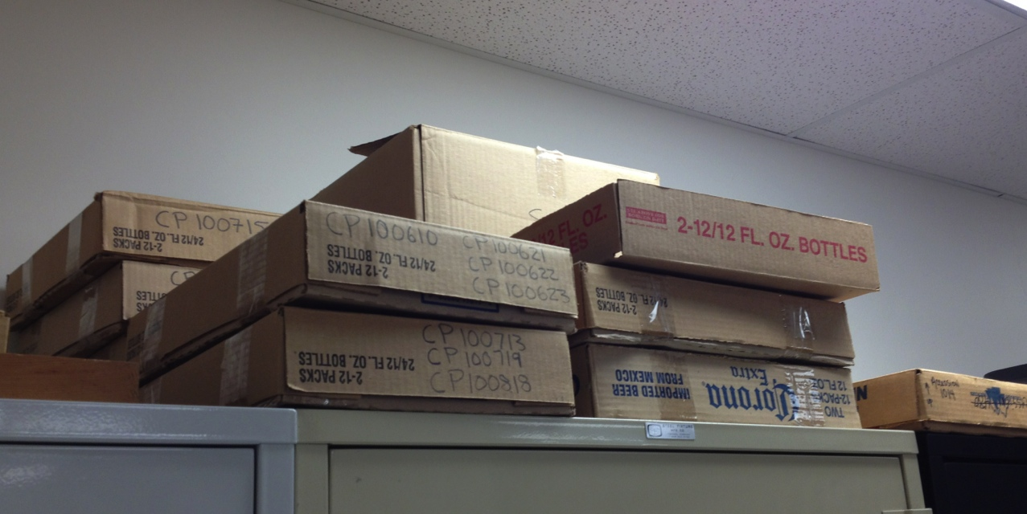
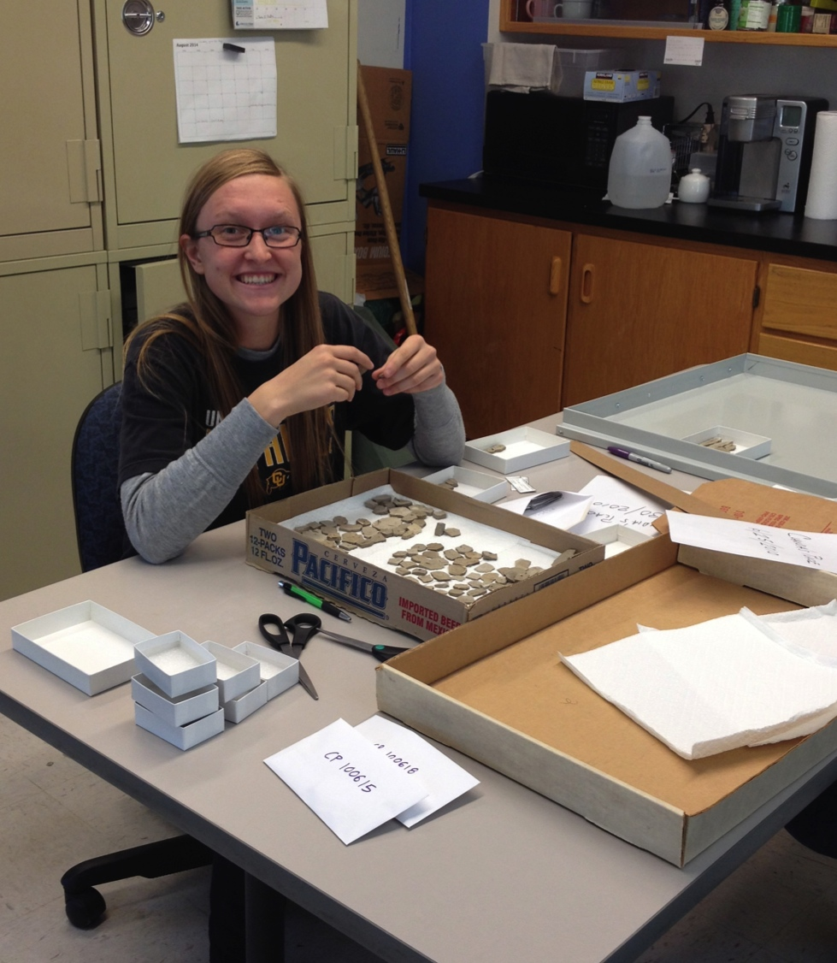
Predigitization Curation
Unpack new collections

Slide 8
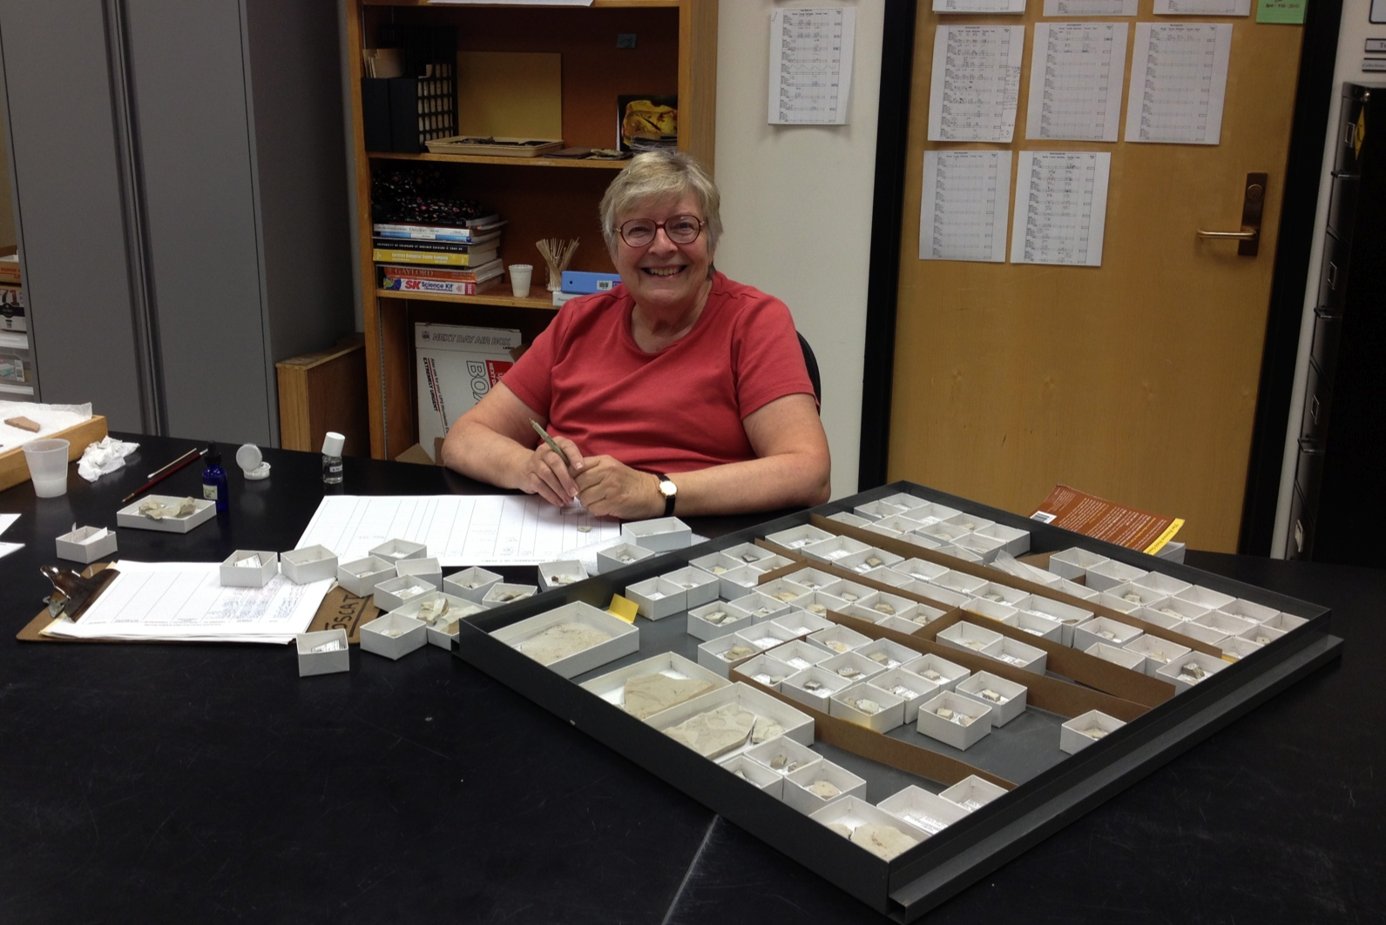
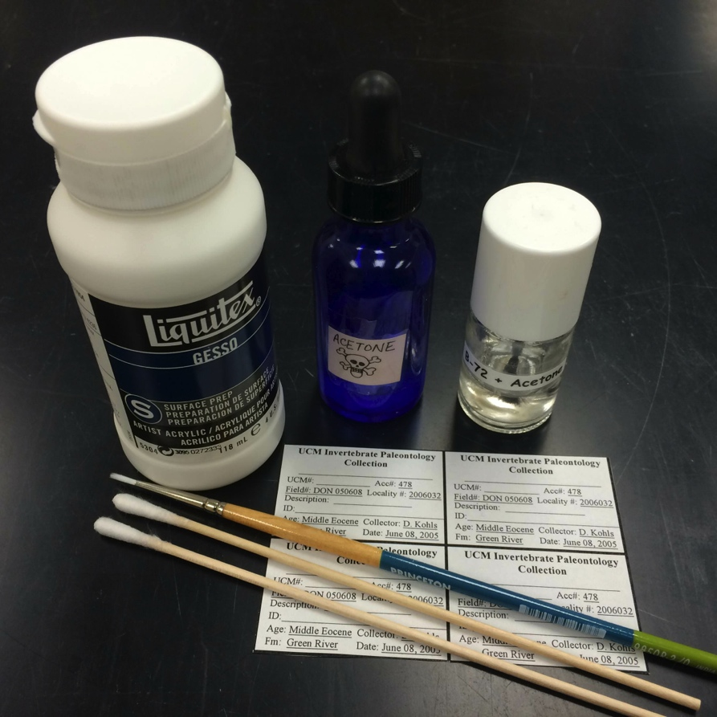
Predigitization Curation
Utilize volunteers for cataloging

Slide 10
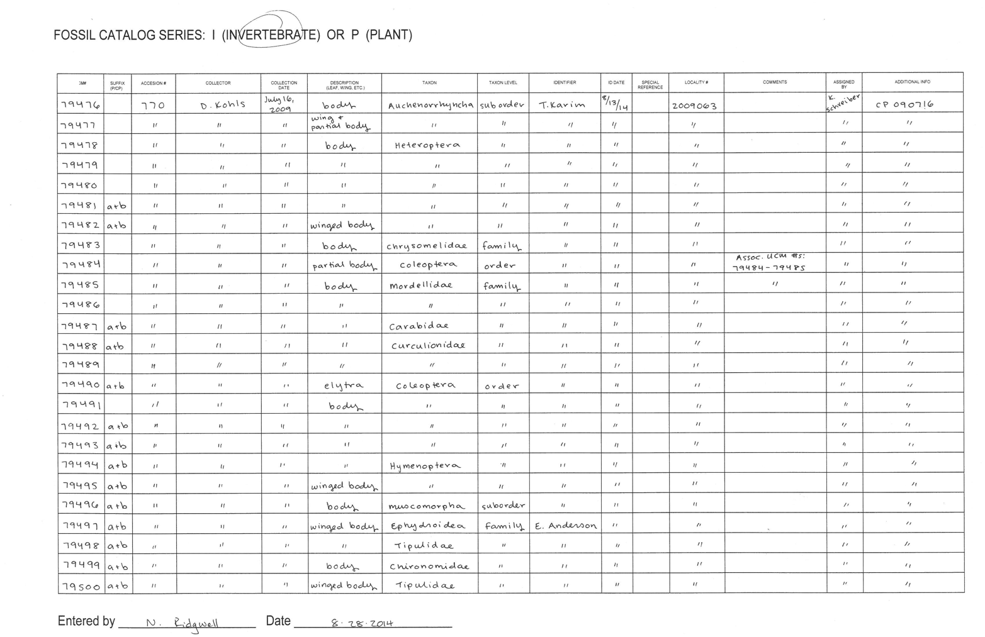
Databasing- new material
Hand keystroke data- Specify
Catalog sheet

Slide 11
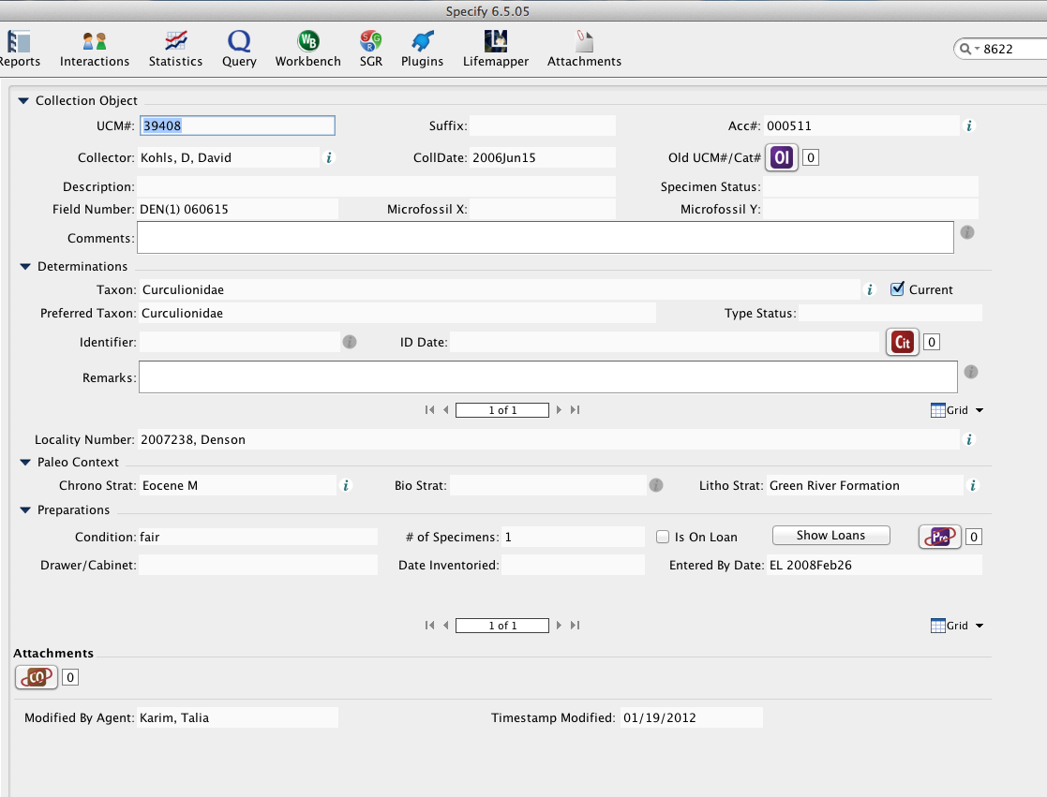
Databasing- new material
Specify 6
Collection object form
Carry forward

Slide 12
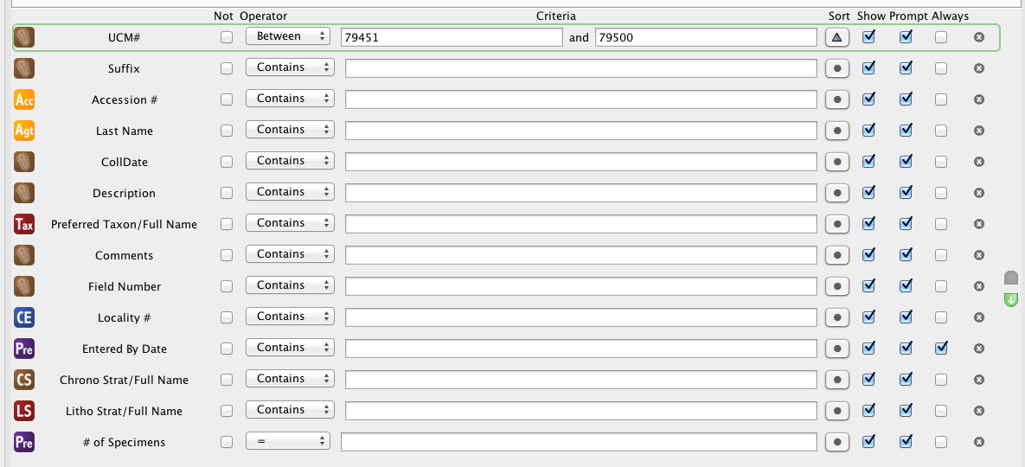
Databasing- new material
QC data entry
Specify query

Slide 13
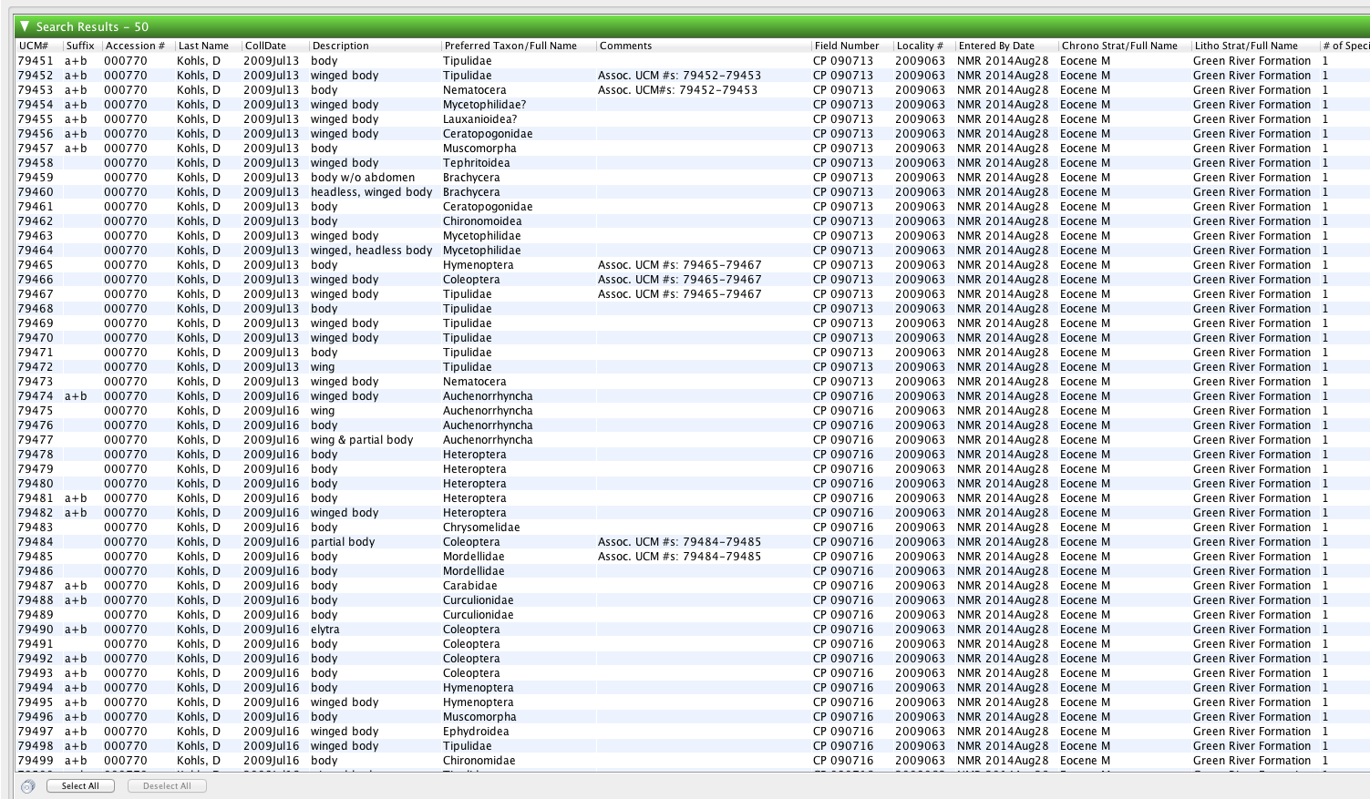
Databasing- new material
QC data entry
Specify query mimics catalog sheet

Slide 15
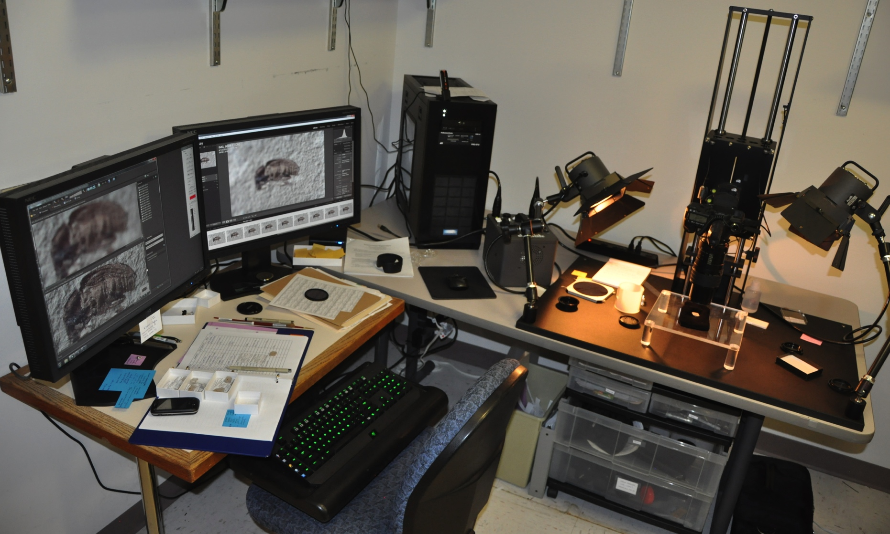
Image Capture

Slide 16
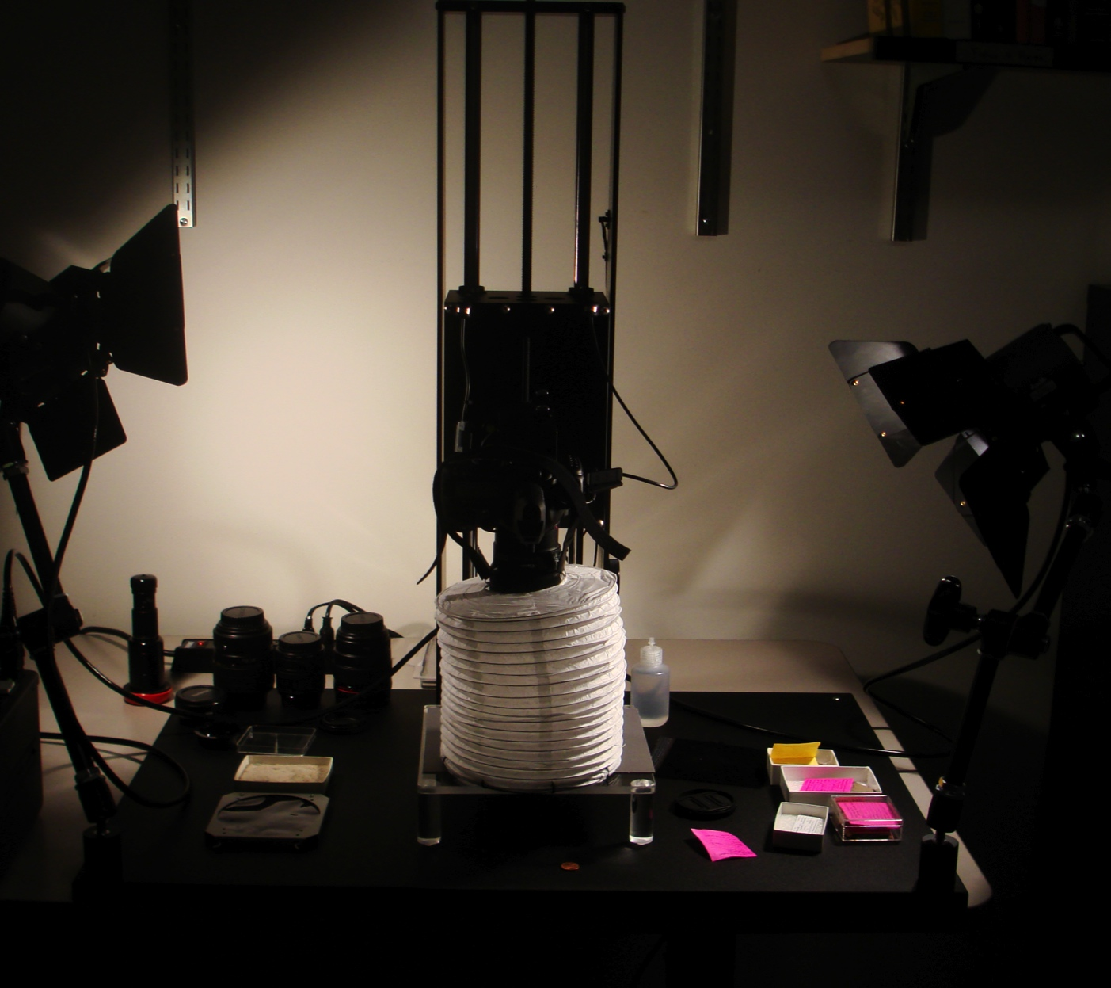
Image Capture

Slide 17
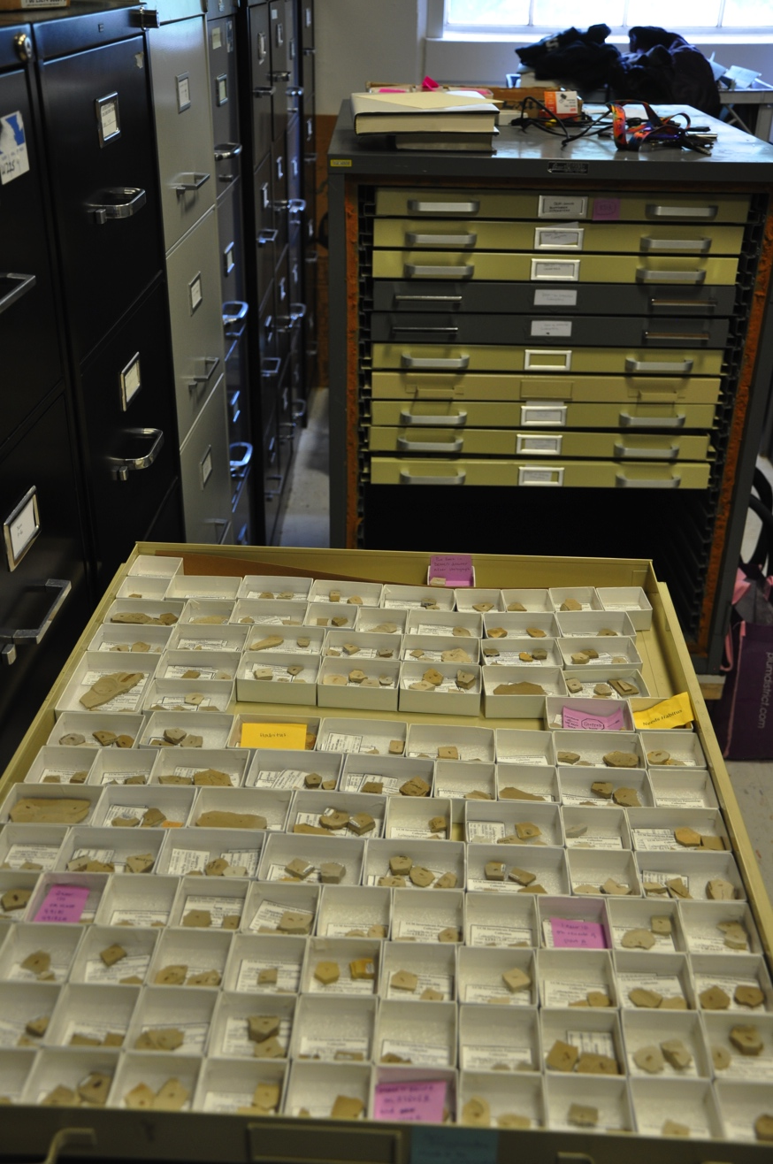
Image Capture
Rolling cabinet of drawers
Shoot by specimen size (reduce lens changes)
Save images in folders by magnification
Tag boxes for second pass

Slide 18
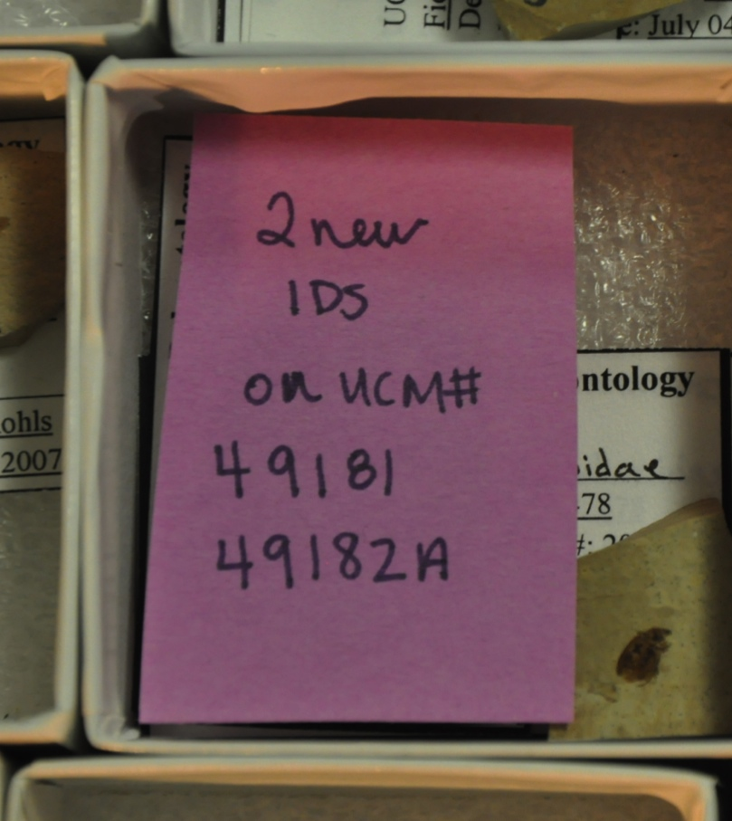
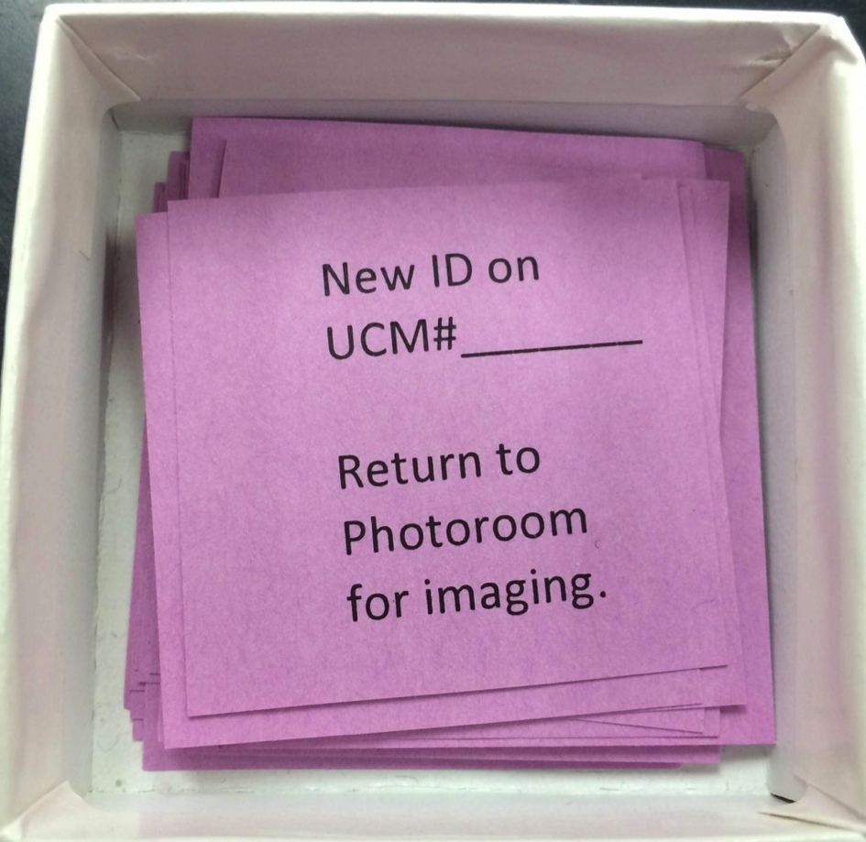
Image Capture
New catalog # required or old number illegible
New catalog # required and specimen needs to be imaged afterward

Slide 19
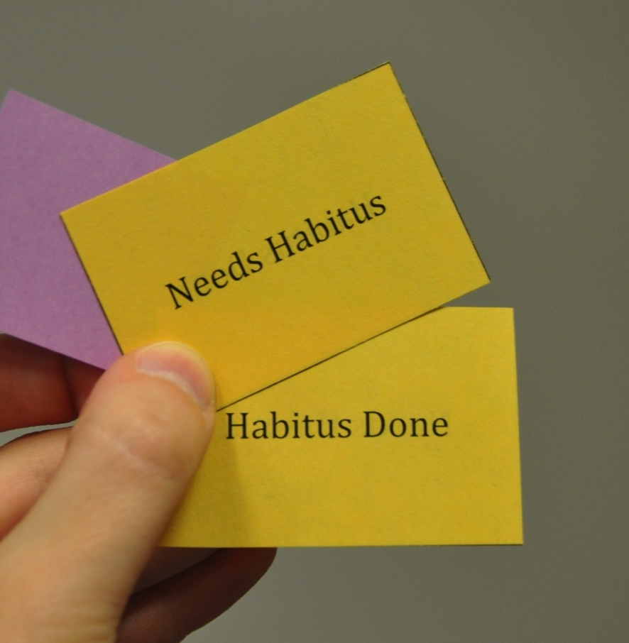
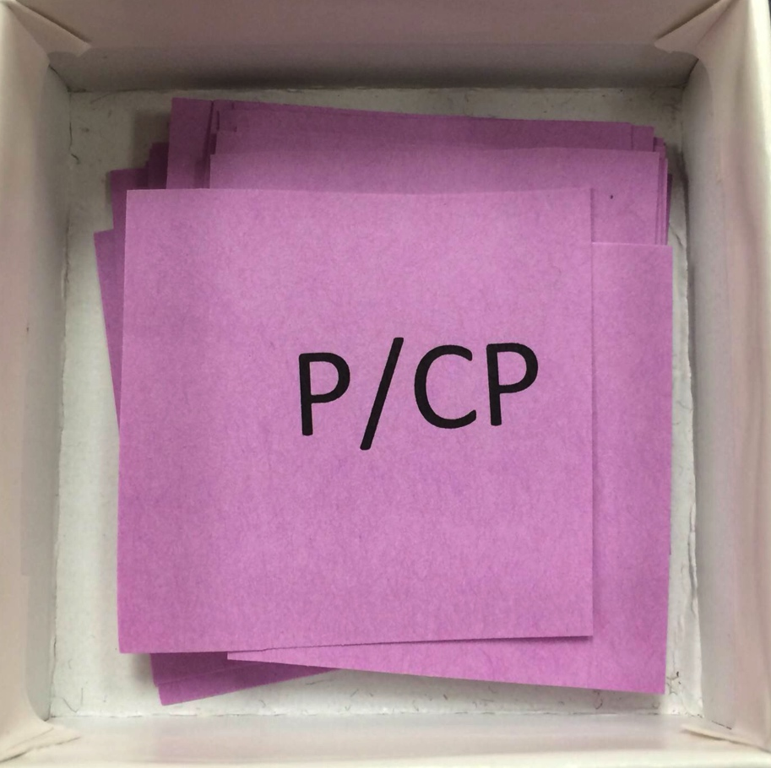
Image Capture
Specimens were cataloged separately, but are actually Part and Counterpart
Habitus image needed when >1 specimens per shale piece

Slide 20
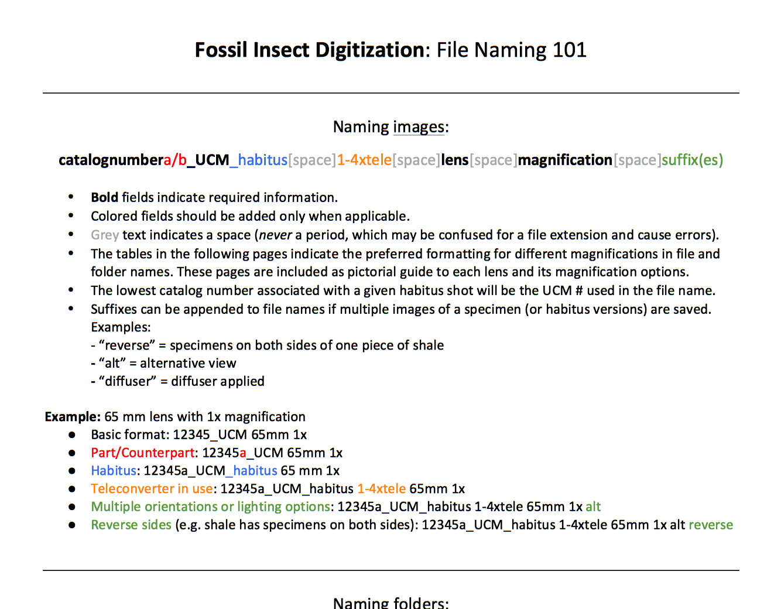
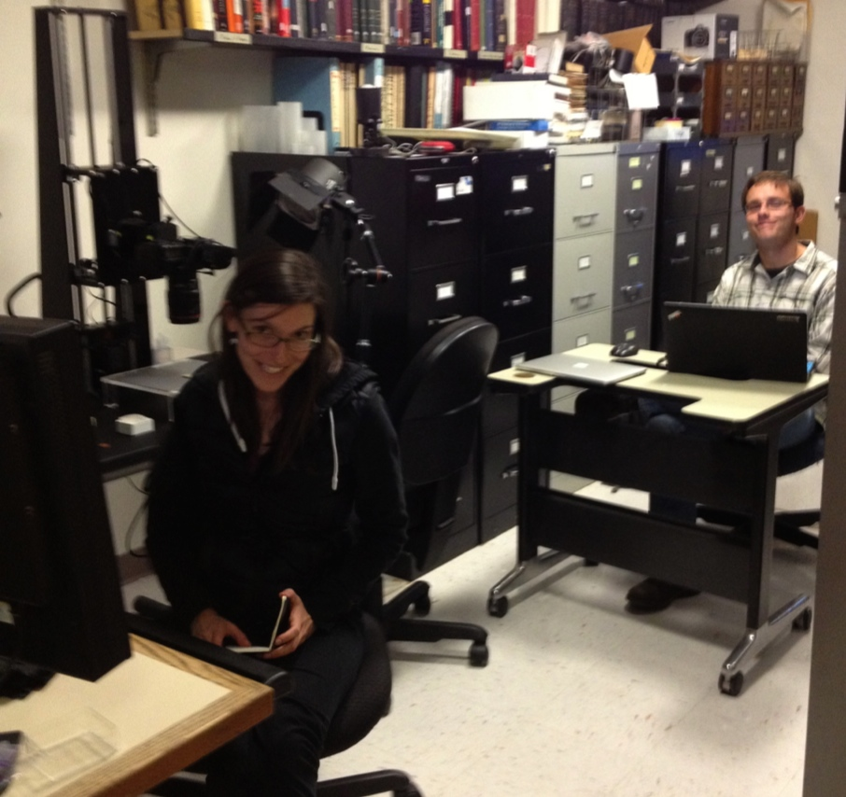
Image Capture
Written file naming & digitization protocol

Slide 21
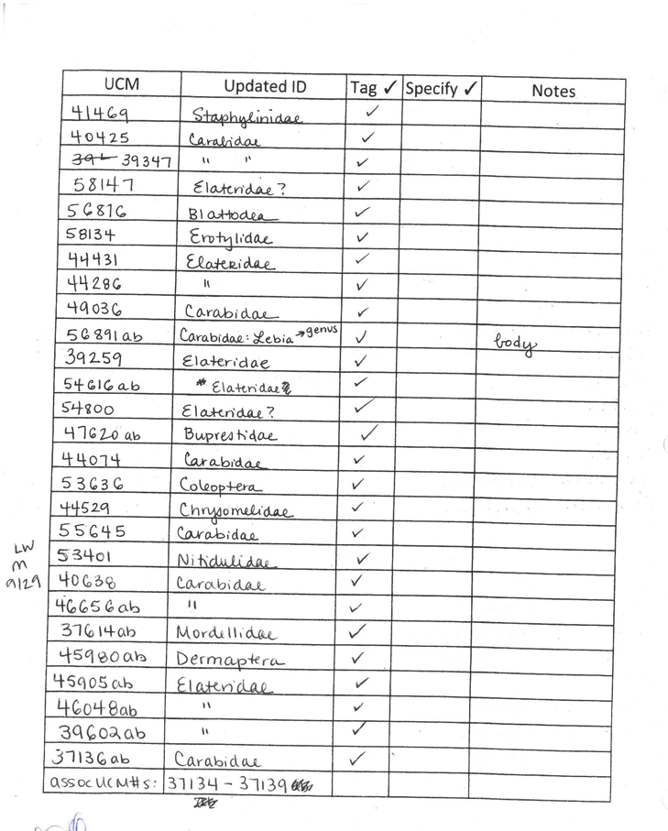
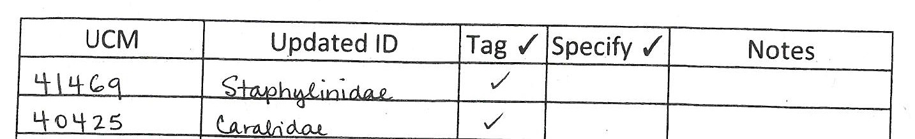
Imaging- Curation updates
Determination and other updates

Slide 23
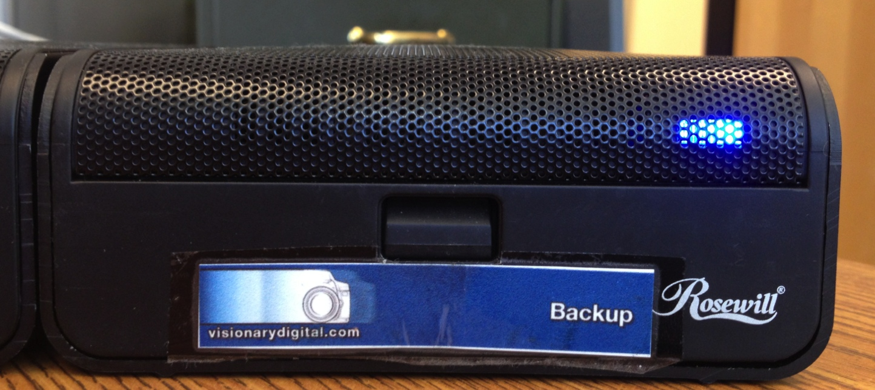
Image Archive
Unaltered tiff
Daily backup to external hard drive
Monthly backup to Peta Library
Issues:
Retrieval
Sharing
Backup

Slide 25
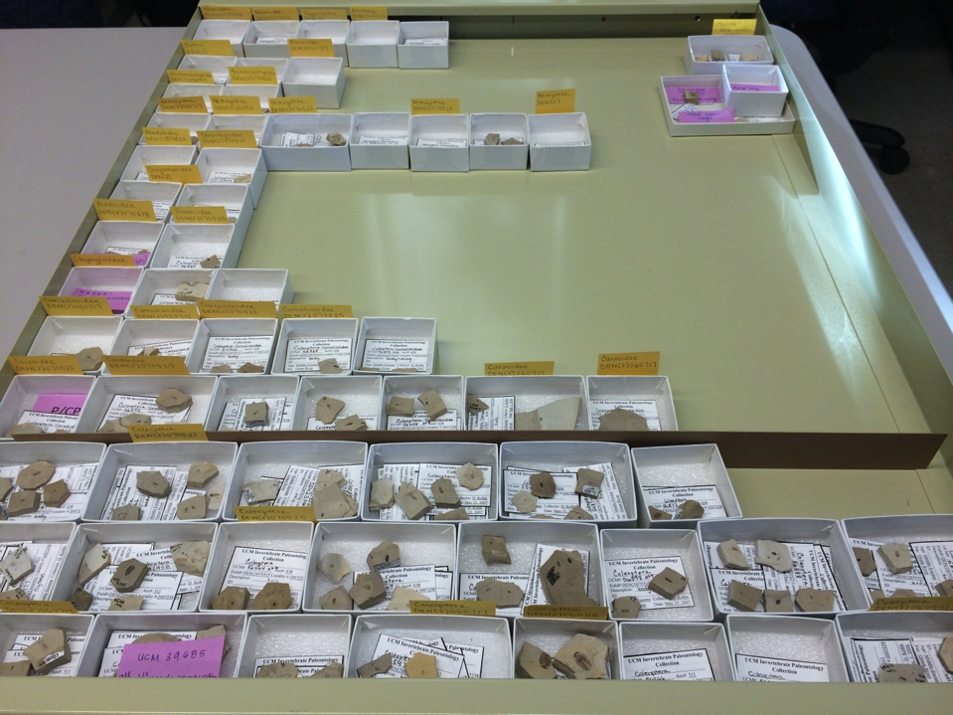
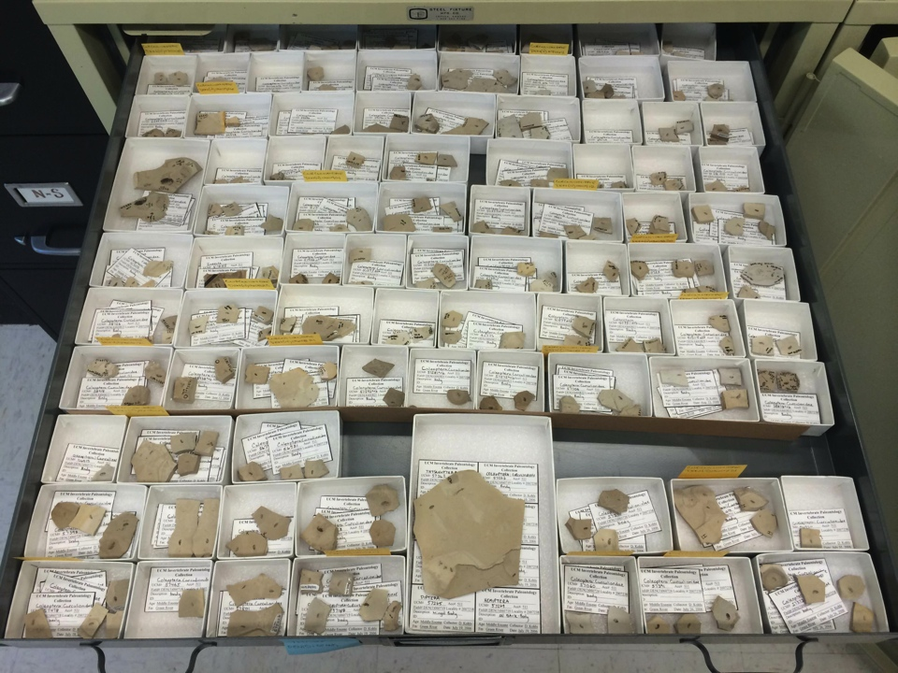
Tetris and Put Away
Completed tetris
Pre-tetris (re)organization:
Locality
Taxon (now updated)
Field Collection Date

Slide 26
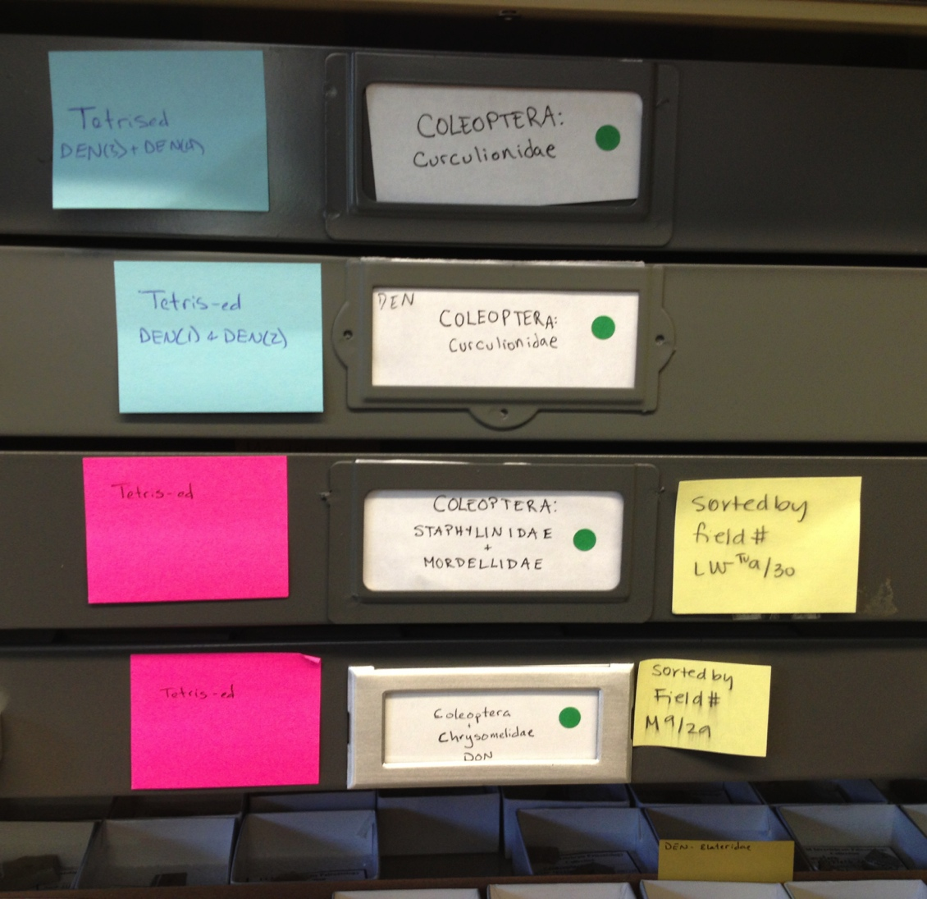
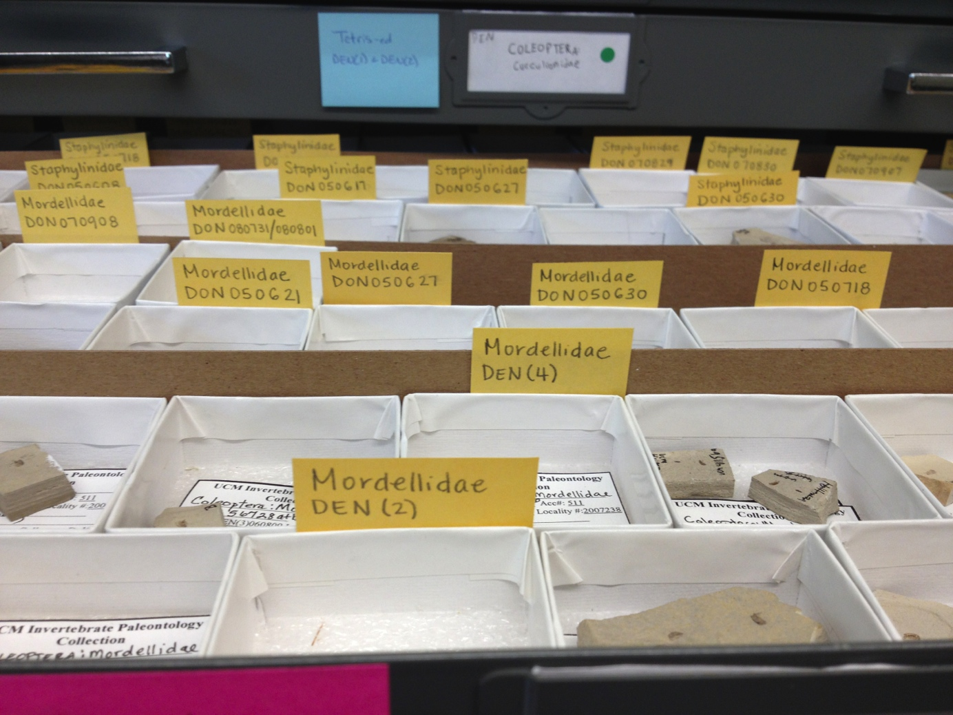
Tetris and Put Away
= drawer imaged

Slide 28
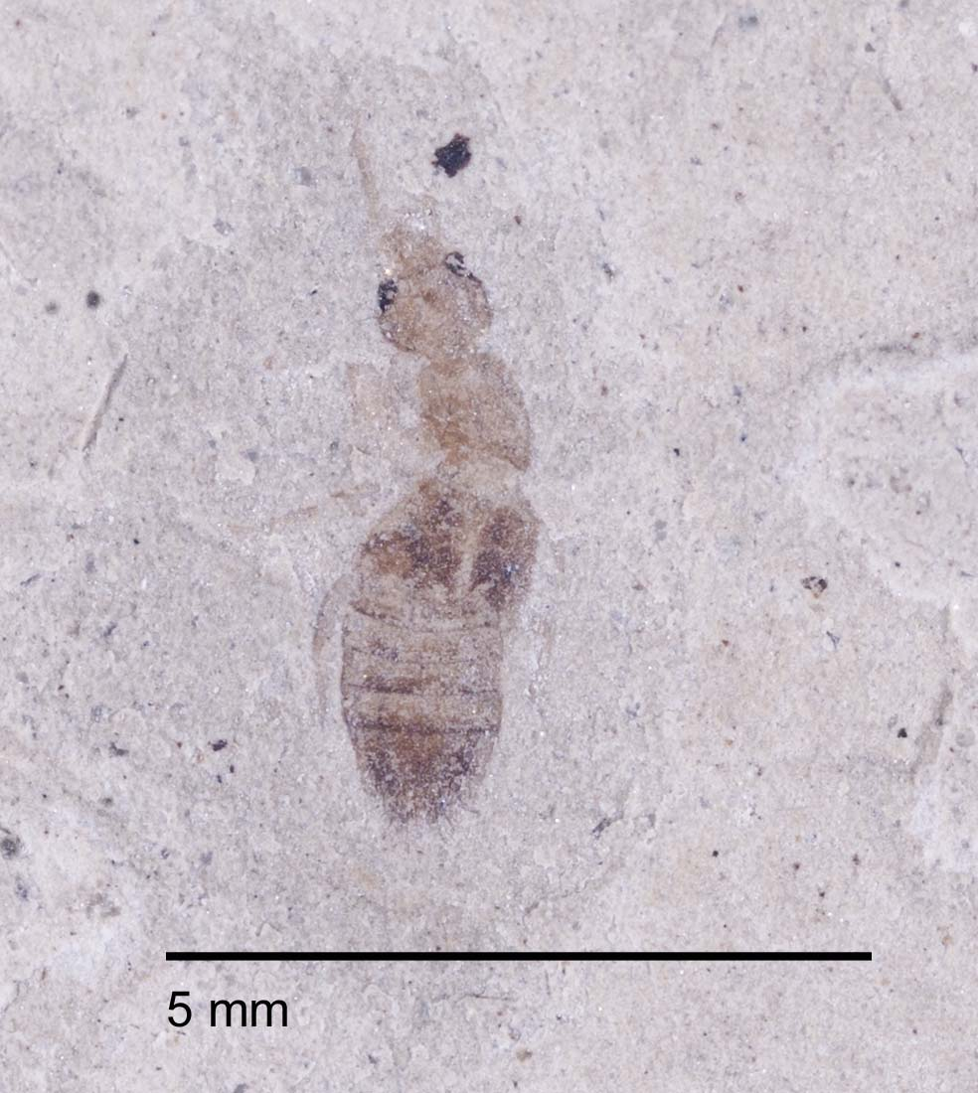
Image Processing 1
Semi-automated using Photoshop
Batch insert scale bar
Resize image
Save copy to portable drive
Future goals:
Run overnight

Slide 29
Image Processing 2
Hand/fine edits and create derivatives
Move scale bar
Adjust levels, contrast, etc.
Save as jpg

Slide 30
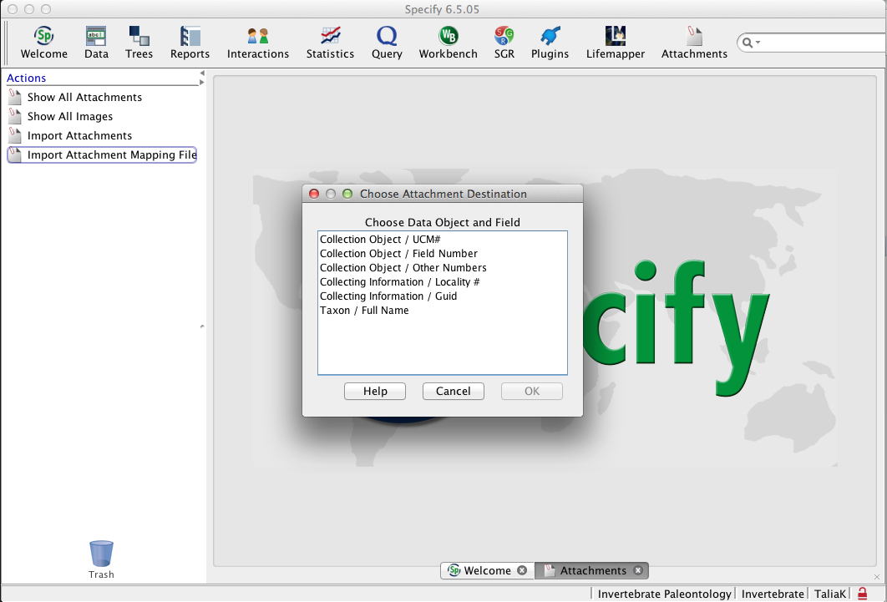
Attach to Specify
Specify bulk uploader- mapping file

Slide 32
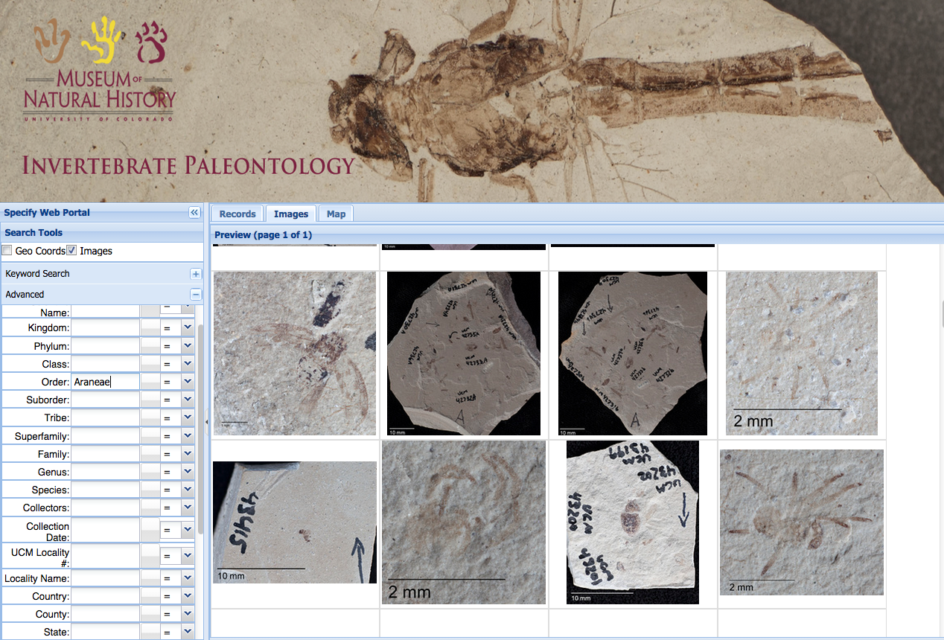
Publishing- CU Websearch
QC
invertpaleosearch.colorado.edu

Slide 33


Publishing- GBIF & iDigBio
IPT server for CU museum
Mapping fields
iDigBio helpful with data cleanup

Slide 34
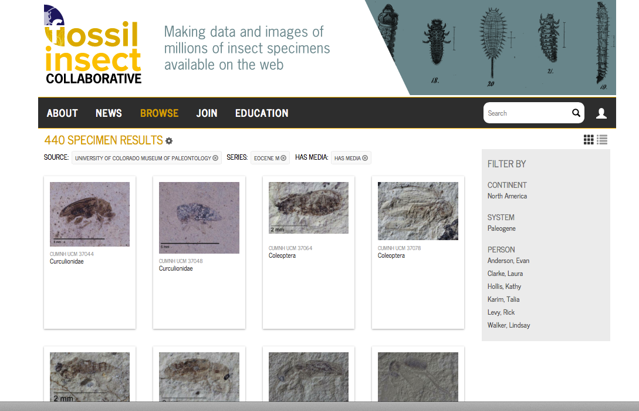
Publishing- iDigPaleo

Slide 35
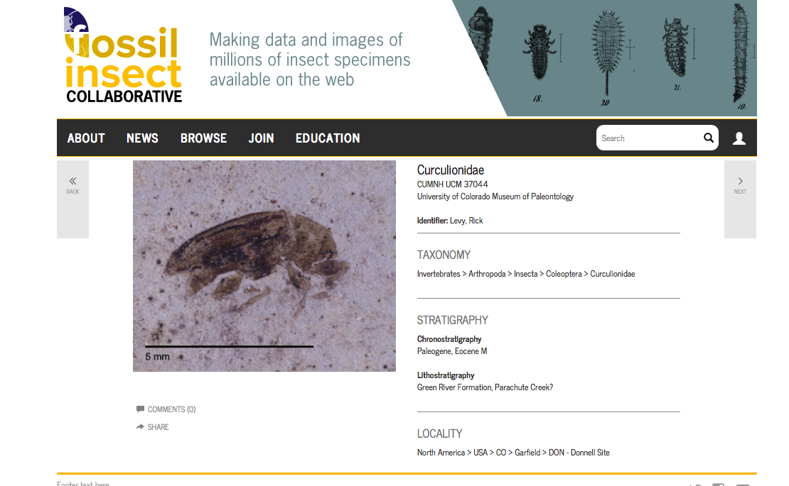
Publishing- iDigPaleo

Slide 36
Coming Soon

Slide 37
Conclusions
Workflow flexible and evolving
Imaging ➔ MANY unexpected tasks:
Determination updates in Specify
Reorganization of specimens in drawers
QC all the time everywhere

Slide 38
