Slide 1
If not now, when?
Denise J. Hills, Sandy Ebersole, and W. Edward Osborne
Geological Survey of Alabama

Slide 2
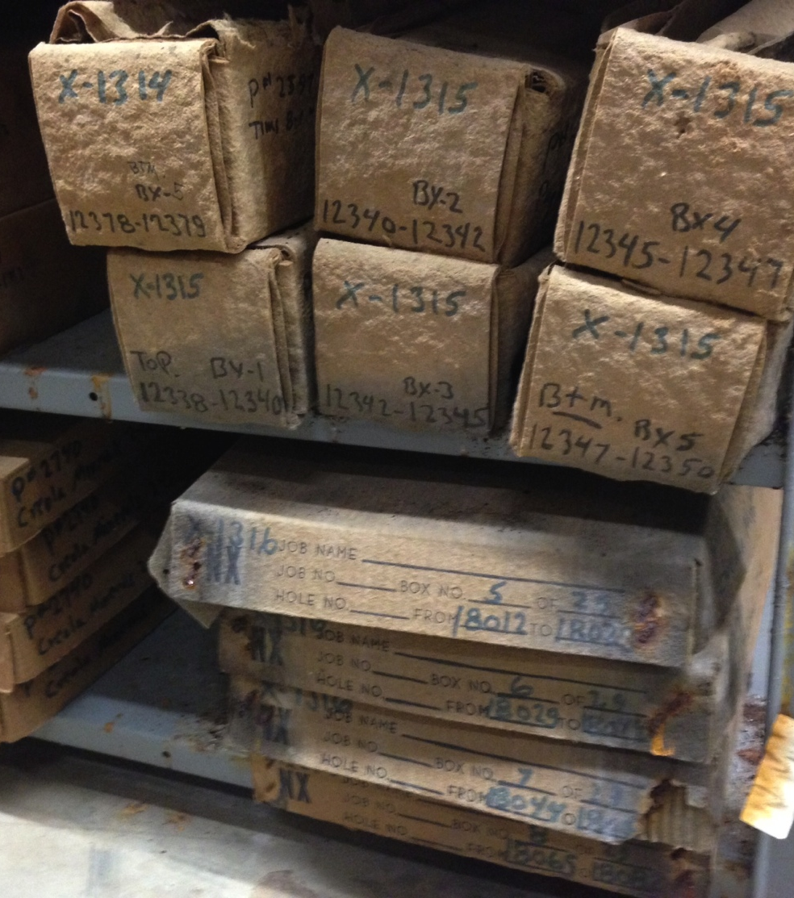
Data Preservation is Time Sensitive
Samples or media can deteriorate over time
Individual researchers have their own methodology of record-keeping
If the original researcher (or current maintainer) is no longer available, what are your options?
Notes:
Two examples:
DKM thin section DB
Recovery after Lewis’ death

Slide 3
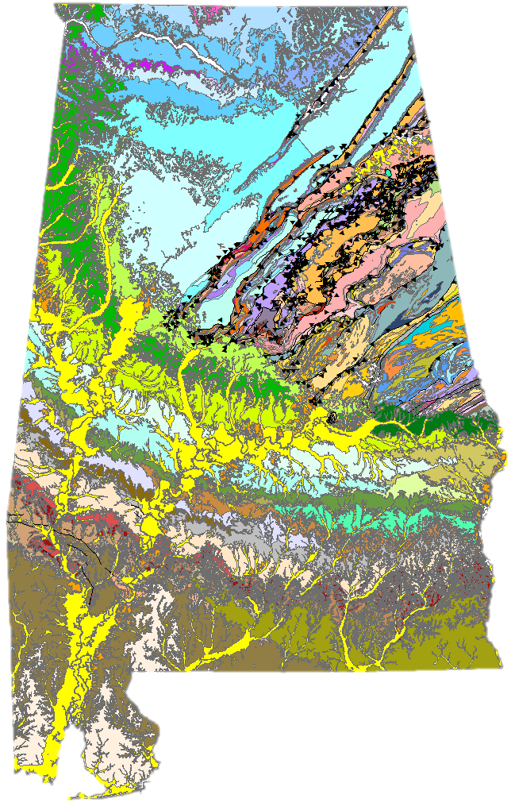
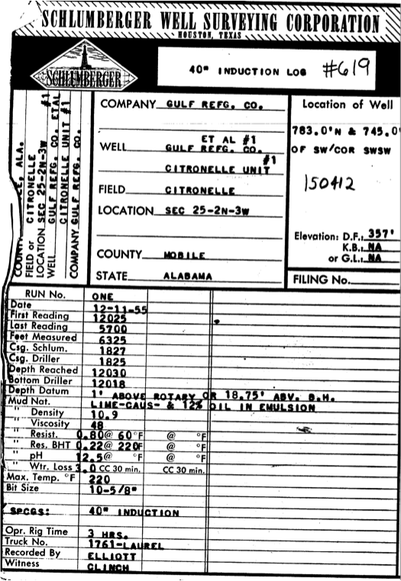
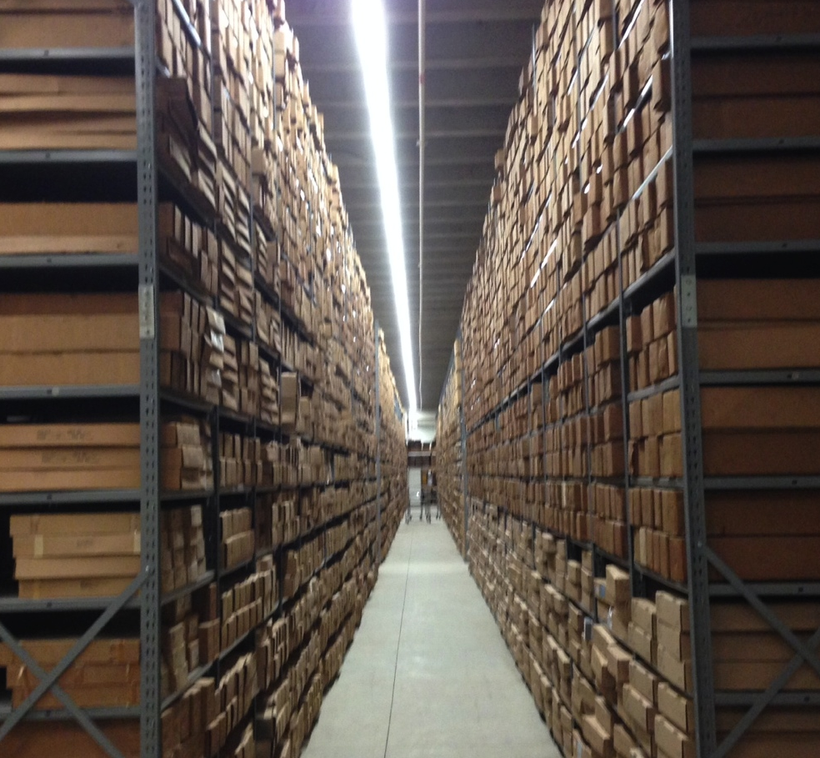
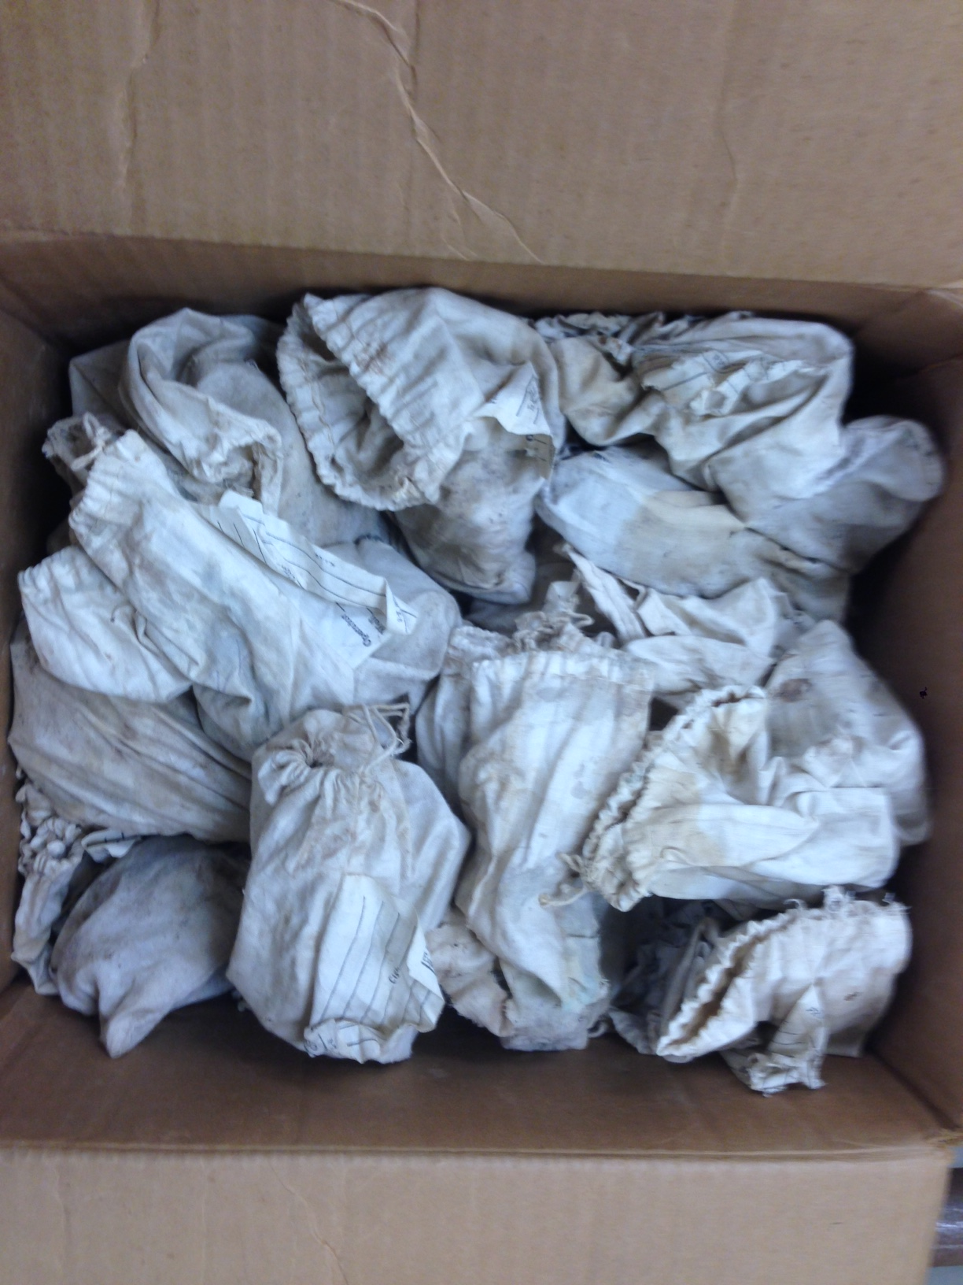
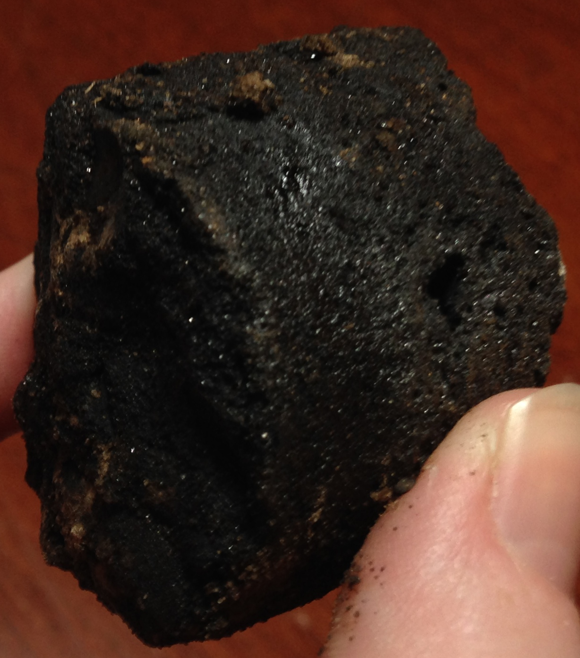
Data at the GSA/OGB
Legally charged to be a repository for data relating to energy and mineral resources.
Notes:
including:
Geophysical well logs
Cores, cuttings, and other physical samples, sometimes with descriptions
Fluid production and injection information from oil and gas wells
Geologic maps
As with many agencies, GSA/OGB has challenges:
Data discoverability often difficult
Much of the available information was analog
Even digital data was not always “machine-readable”
Lack of standardization and documentation of data and metadata
Provenance and quality often poor or unknown

Slide 4


Data Preservation Efforts at GSA/OGB
NGGDPP
NGDS
Notes:
NGGDPP –
Since 2007
>36,000 metadata records uploaded
Capturing info for >100,000 individual fossil specimens
Also includes geologic maps, oil and gas well cores, geologic cuttings, thin sections, and other physical samples
NGDS allowed GSA to generate large quantities of digitally preserved data in a standardized format
NGDS
Project ran from 2010-2013
Included
Geo map with metadata in OneGeology schema
Well Headers, >9,000
Well Log metadata, >10,000
BHT metadata, >11,000
Faults 297
Lithologic interval metadata 4,719
Through both of these projects, GSA personnel became familiar with schemas, schema-mapping, and processes to streamline metadata rescue

Slide 5
Collection Organization
Notes:
Much of the physical sample collection structure at the GSA and OGB can be broken down into parent-child relationships.
This aids in creating linked records. Well header information was recorded/QC’d through NGDS, some through NGGDPP (including core info).
Moving forward, can build on these links to reduce duplicate effort.
As part of its mandate to regulate the petroleum industry in Alabama, the OGB requires that companies drilling oil and gas wells in the state provide the GSA with a share of any well samples collected, as well as copies of any geophysical well logs or other testing undertaken. The OGB stores and maintains the geophysical well logs and other documentation, while the GSA stores and maintains the cores and cuttings in its core and sample warehouse. The parent object in the collection is typically the permitted oil and gas well, with all other information tied back to the well.
A large amount of other data at the GSA not directly related to oil and gas development, yet still associated with a permitted well, has been held or maintained by individual researchers. Access then is limited to those with the prior knowledge of what researcher to question about the availability of these data. Other challenges arise due to researchers’ individual record-keeping methodology, e.g., use a unique notation system, failure to record information that others may need to understand the work. When the individual is no longer available, the data and objects may therefore become useless. Often, then, it becomes difficult or impossible to regain the information necessary to make that data useful to another researcher.

Slide 6
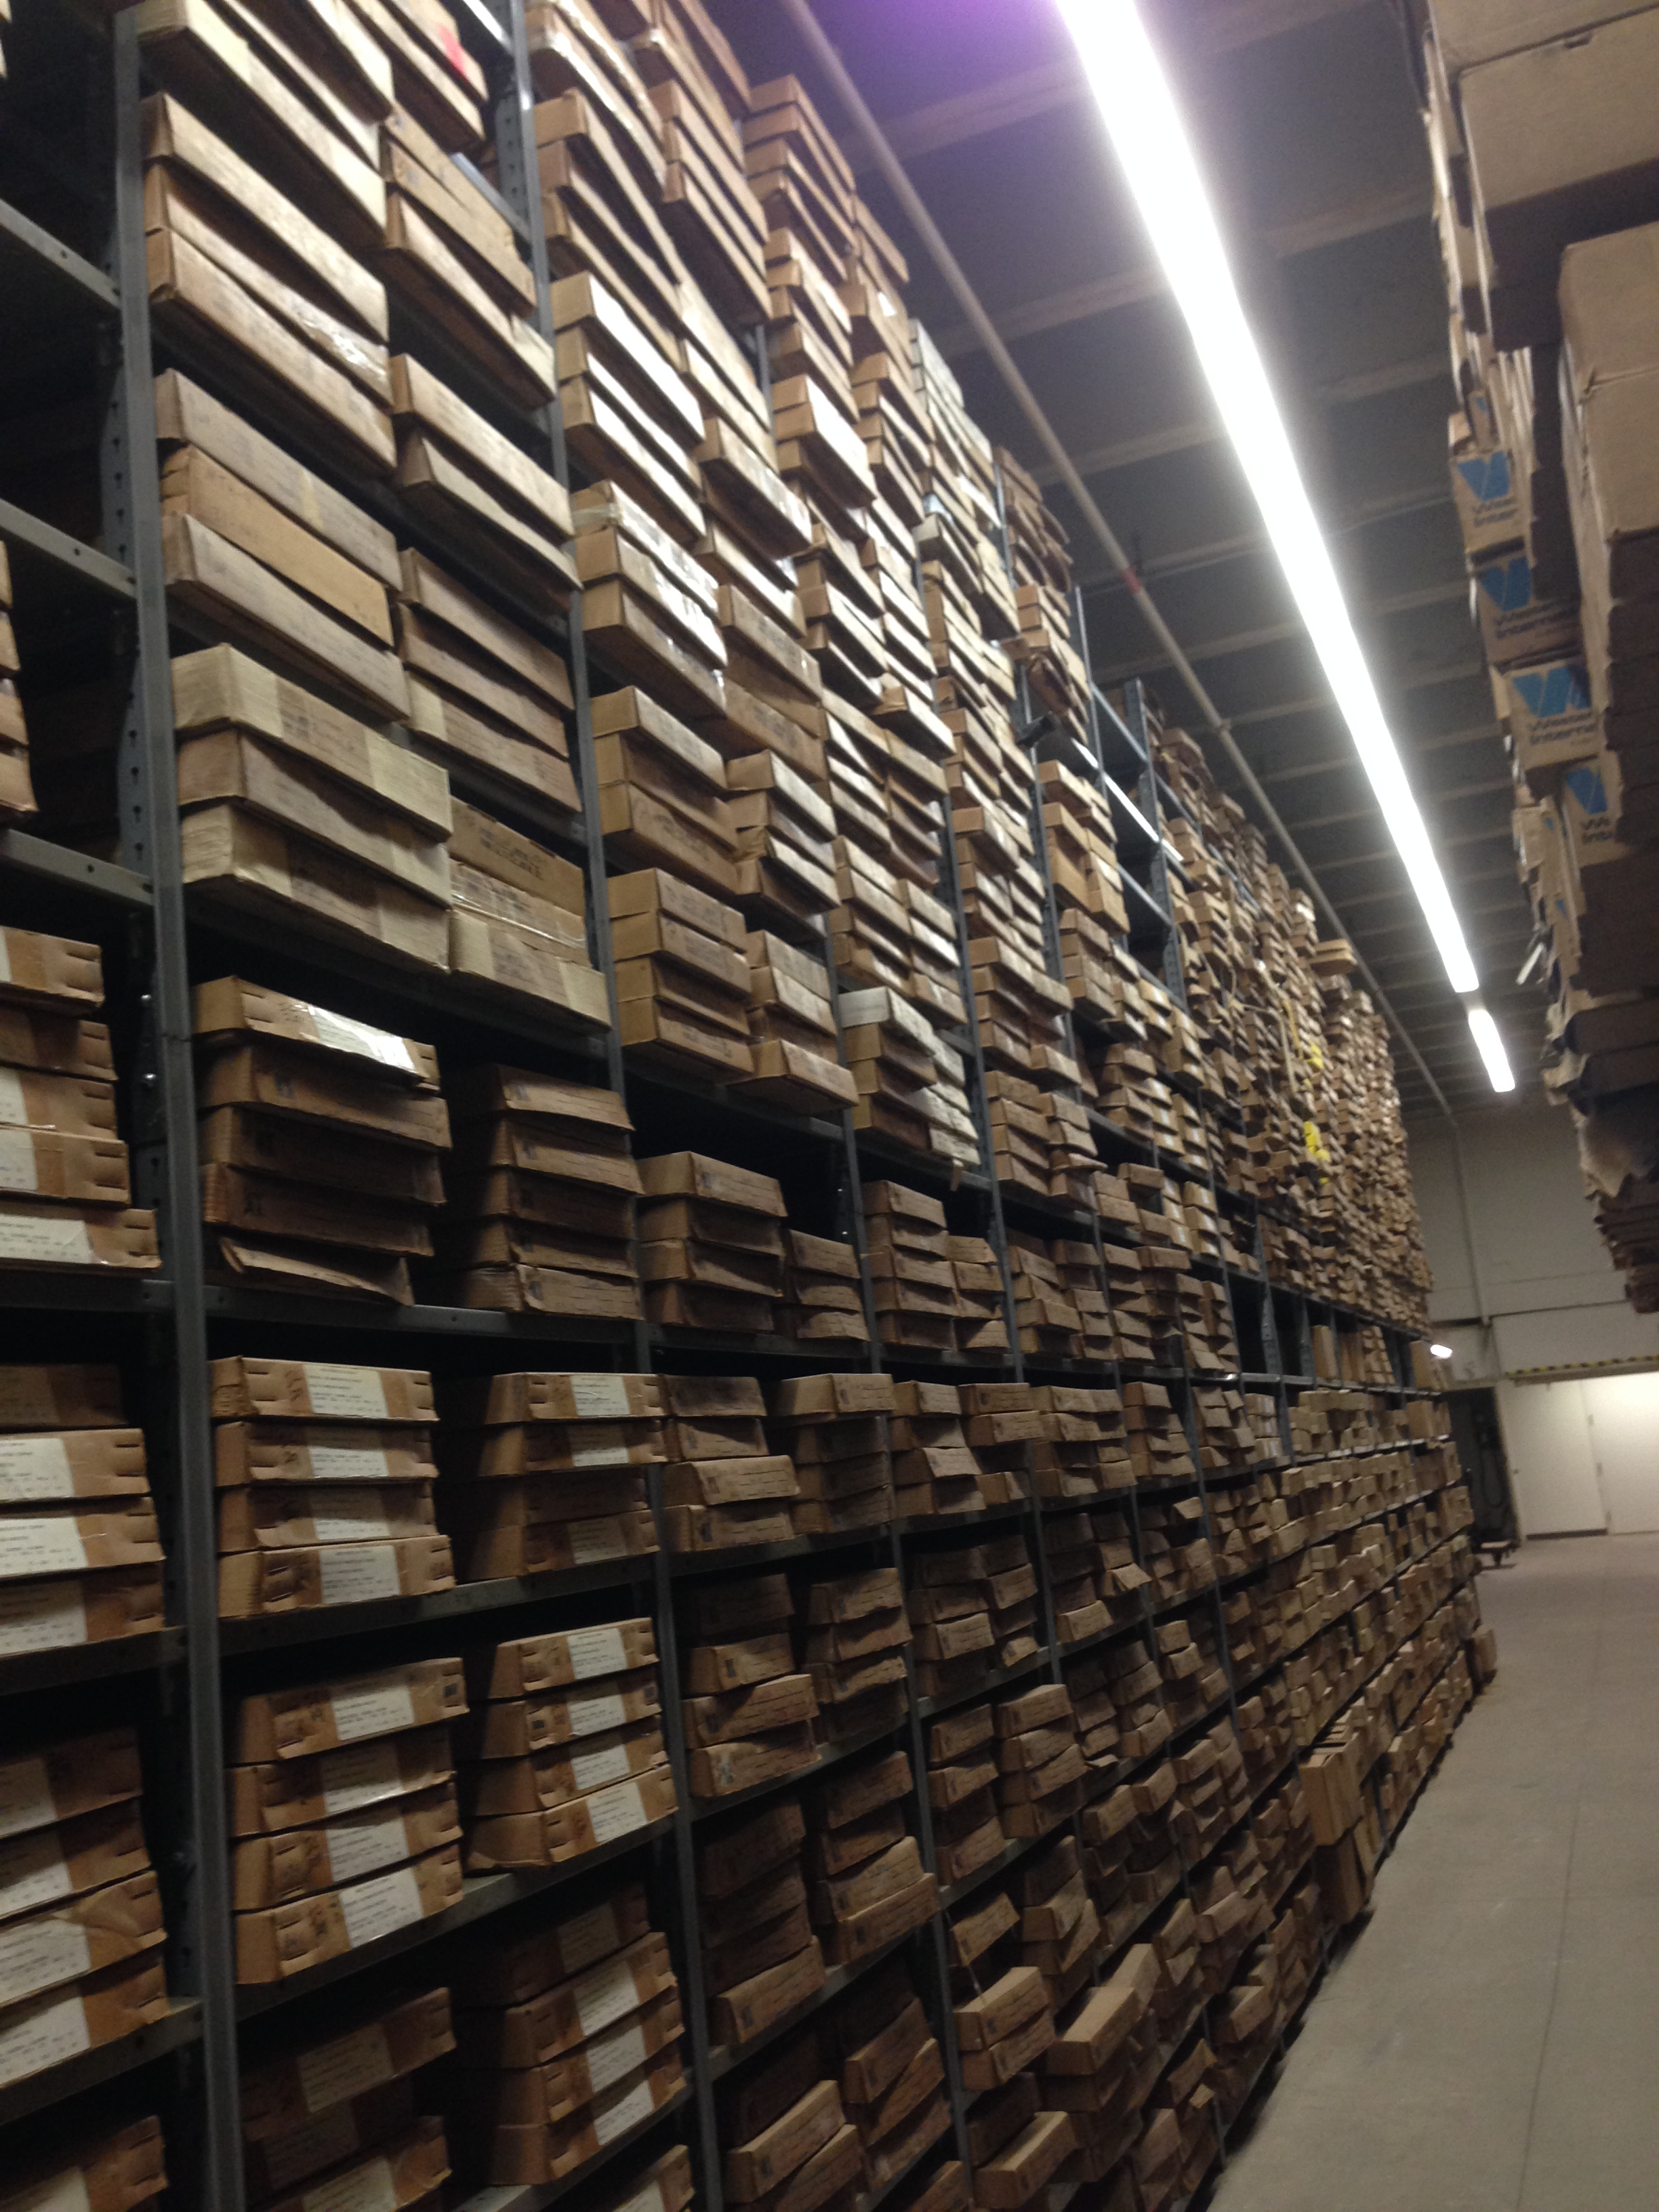
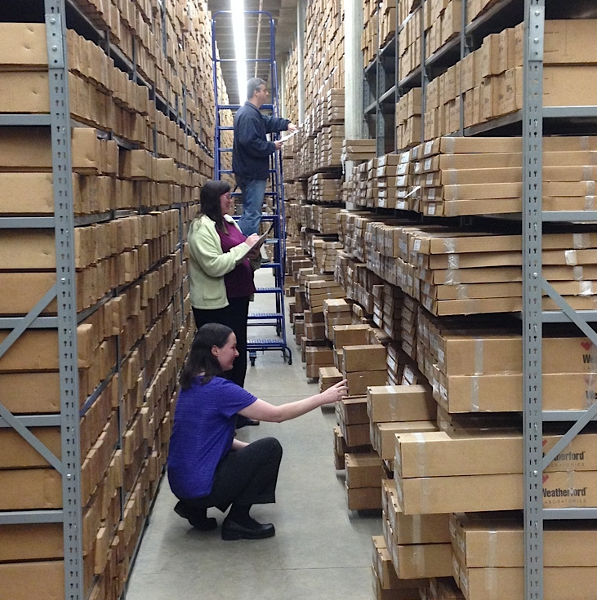
Data Management at GSA
Notes:
The GSA recently confronted this issue with the sudden death of our long-time core warehouse manager. As the warehouse filled, cores had to be shifted and relocated. The new locations were not always recorded, as the locations could be temporary until a more logical permanent location was determined. The manager had kept a “mental map” of some core locations. While he had always been able to locate these items immediately, others did not have his knowledge and thus could not replicate his work. Following his death, GSA personnel spent significant time determining physical locations of items to make up for that lack of knowledge. The GSA is actively working to prevent this sort of incident with other collections.
For example, information was maintained in several different spreadsheets. These documents contained distinct AND overlapping information. Determination of canonical files/records is a time consuming process.

Slide 7
Data Management at GSA
Notes:
DKM Thin Section DB –
We’ve been keeping track of TS with a basic spread sheet, with no way to cross reference data. Each person had their own way of doing things, of recording information.
Old “database” – single spreadsheet. Inconsistencies with measurement reporting (e.g., depths sometimes reported in full, sometimes as range, sometimes as final digits in range). Some TS had NO depth, or unknown what notation meant. It only got worse when you look at the records for photos for these TS
Top – TS record. Note depths are recorded inconsistently.
Bottom – Photomicrograph records. Note depth incompletely recorded, extensive abbreviations (not always consistent), dependency on previous info (e.g., when changing magnification).

Slide 8
Version Control
Notes:
To address lack of clarity of what file should be preeminent, we suggest the use of version control. Version control is a system that records changes to a file or set of files over time so that you can recall specific versions later. An example of a version control system is Git, developed by Linus Torvalds for Linux kernel development. Git is a distributed version control system (L) that organizes data like a set of snapshots of a mini file system – every time a project is committed (save the state of the project) in Git, the state of all the files is saved. If the file is unchanged, a new copy is not generated, just a link to the previous identical file (R)
(L) Simple diagram of a distributed version control system such as Git (modified from Figure 1-3 from ProGit manual).
(R) Demonstration of what changes with each version using a distributed version control system such as Git (modified from Figure 1-5 from ProGit manual).

Slide 9
Notes:
The first step in our process was at first look an easy one – gather the relevant records about the thin sections and photomicrographs. However, when the researcher was approached, he realized he had multiple versions of the spreadsheets he had been using. Even though the files had time and date stamps, information in the newer files was not always the most accurate. Some information captured in an older file was not present in the newer files, although it was not obsolete. It became obvious that multiple files had been developed and modified concurrently. This resulted in many hours spent sifting through the files line by line to compare the information recorded, and then to verify as best as possible the most accurate information.
We next examined the information contained within those spreadsheets to pull out the relevant metadata. This led to the discovery of several idiosyncrasies in the recordkeeping, such as inconsistent or unclear use of abbreviations as well as notations such as “same as previous” which could prove disingenuous if records were re-sorted, otherwise moved, or even deleted. Additionally, multiple categories of information (e.g., lithology, sedimentary structures) were recorded within a single cell. Recording of methodology was also inconsistent to non-existent, although as the original researcher was available, much of this information could be reconstructed from his other notes.
Semi-automated workflows were developed to aid in this “translation” process. Abbreviations were replaced with full text or standardized. Information grouped together was split into individual categories. Metadata that were gathered from the NGDS project (e.g., related to well header) could be matched with child items (e.g., Figures 6-7).
Well header metadata gathered for the NGDS project (upper) could be matched to child items (lower) based on the OGB permit number (GSAPER:624, in this instance, highlighted). The parent HeaderURI becomes the ParentSpecimenURI (blue boxes), the APINo maps to SamplingFeatureURI (green boxes), and the parent locations map to the child locations (red boxes). URI – unique record identifier

Slide 10
Notes:
The first step in our process was at first look an easy one – gather the relevant records about the thin sections and photomicrographs. However, when the researcher was approached, he realized he had multiple versions of the spreadsheets he had been using. Even though the files had time and date stamps, information in the newer files was not always the most accurate. Some information captured in an older file was not present in the newer files, although it was not obsolete. It became obvious that multiple files had been developed and modified concurrently. This resulted in many hours spent sifting through the files line by line to compare the information recorded, and then to verify as best as possible the most accurate information.
We next examined the information contained within those spreadsheets to pull out the relevant metadata. This led to the discovery of several idiosyncrasies in the recordkeeping, such as inconsistent or unclear use of abbreviations as well as notations such as “same as previous” which could prove disingenuous if records were re-sorted, otherwise moved, or even deleted. Additionally, multiple categories of information (e.g., lithology, sedimentary structures) were recorded within a single cell. Recording of methodology was also inconsistent to non-existent, although as the original researcher was available, much of this information could be reconstructed from his other notes.
Semi-automated workflows were developed to aid in this “translation” process. Abbreviations were replaced with full text or standardized. Information grouped together was split into individual categories. Metadata that were gathered from the NGDS project (e.g., related to well header) could be matched with child items (e.g., Figures 6-7).
Well header metadata gathered for the NGDS project (upper) could be matched to child items (lower) based on the OGB permit number (GSAPER:624, in this instance, highlighted). The parent HeaderURI becomes the ParentSpecimenURI (blue boxes), the APINo maps to SamplingFeatureURI (green boxes), and the parent locations map to the child locations (red boxes). URI – unique record identifier

Slide 11
Notes:
Once the original researcher reviewed the updated metadata to help reduce mistranslation and other errors, we mapped the available metadata to an existing USGIN content model for Physical Samples (v.0.8). This content model is based on consideration of content requested for other schemas and services, such as the System for Earth Sample Registration (SESAR), Geoscience Markup Language (GeoSciML), and others. Although this content model is still under review, USGIN provides a content model validation tool to verify appropriate data formatting and content. Any corrections highlighted by the validator were made prior to the final step, registration of the samples.
USGIN Content Model fields populated through the GSA workflow

Slide 12
Notes:
The USGIN Physical Samples content model includes the information necessary for SESAR registration (e.g., Figures 7-8). SESAR operates the registry that distributes the International GeoSample Number (IGSN). The IGSN is a 9-digit alphanumeric code that is assigned to specimens and related sampling features such as drill holes or wells to ensure their unique identification and unambiguous referencing of data generated by the study of samples. SESAR catalogs and preserves sample metadata profiles and then provides access to the sample catalog via search. SESAR allows for batch registration of samples, a clear need for the GSA when we are ultimately looking at hundreds of thousands of potential registrations. Through SESAR’s web interface, a batch file template can be generated (Figure 9). Once the necessary information is entered into the template (Figure 10), a simple process of copying from the USGIN content model, the samples can be registered. SESAR will then respond with the IGSNs of the samples once they are registered.
By making the legacy data rescue and preservation process as simple as possible through the development of template workflows, such as that presented here, personnel are more likely to adopt and adhere to standards. Template workflows also simplify training of additional personnel to assist in the registration process. Ultimately this increases data and metadata exposure and interoperability.

Slide 13
Notes:
The USGIN Physical Samples content model includes the information necessary for SESAR registration (e.g., Figures 7-8). SESAR operates the registry that distributes the International GeoSample Number (IGSN). The IGSN is a 9-digit alphanumeric code that is assigned to specimens and related sampling features such as drill holes or wells to ensure their unique identification and unambiguous referencing of data generated by the study of samples. SESAR catalogs and preserves sample metadata profiles and then provides access to the sample catalog via search. SESAR allows for batch registration of samples, a clear need for the GSA when we are ultimately looking at hundreds of thousands of potential registrations. Through SESAR’s web interface, a batch file template can be generated (Figure 9). Once the necessary information is entered into the template (Figure 10), a simple process of copying from the USGIN content model, the samples can be registered. SESAR will then respond with the IGSNs of the samples once they are registered.

Slide 14
Summary
Use Version Control (e.g., Git) or similar
Build on existing standards
Develop a workflow
Involve current data holder as well as those not as familiar with the information
Register your samples and data
DO IT NOW!
Notes:
Use Version Control (e.g., Git) or similar
Build on existing standards – USGIN, OneGeology, etc
Develop a workflow – iterative process to refine
Involve current data holder as well as those not as familiar with the information – current archivist checks for accuracy, others check for usability
Register your samples and data – thus, people can FIND the information and use it => becomes VALUABLE

Slide 16
Notes:
The first step in our process was at first look an easy one – gather the relevant records about the thin sections and photomicrographs. However, when the researcher was approached, he realized he had multiple versions of the spreadsheets he had been using. Even though the files had time and date stamps, information in the newer files was not always the most accurate. Some information captured in an older file was not present in the newer files, although it was not obsolete. It became obvious that multiple files had been developed and modified concurrently. This resulted in many hours spent sifting through the files line by line to compare the information recorded, and then to verify as best as possible the most accurate information.
We next examined the information contained within those spreadsheets to pull out the relevant metadata. This led to the discovery of several idiosyncrasies in the recordkeeping, such as inconsistent or unclear use of abbreviations as well as notations such as “same as previous” which could prove disingenuous if records were re-sorted, otherwise moved, or even deleted. Additionally, multiple categories of information (e.g., lithology, sedimentary structures) were recorded within a single cell. Recording of methodology was also inconsistent to non-existent, although as the original researcher was available, much of this information could be reconstructed from his other notes.
Semi-automated workflows were developed to aid in this “translation” process. Abbreviations were replaced with full text or standardized. Information grouped together was split into individual categories. Metadata that were gathered from the NGDS project (e.g., related to well header) could be matched with child items (e.g., Figures 6-7).
Well header metadata gathered for the NGDS project (upper) could be matched to child items (lower) based on the OGB permit number (GSAPER:624, in this instance, highlighted). The parent HeaderURI becomes the ParentSpecimenURI (blue boxes), the APINo maps to SamplingFeatureURI (green boxes), and the parent locations map to the child locations (red boxes). URI – unique record identifier

Slide 17
Notes:
The USGIN Physical Samples content model includes the information necessary for SESAR registration (e.g., Figures 7-8). SESAR operates the registry that distributes the International GeoSample Number (IGSN). The IGSN is a 9-digit alphanumeric code that is assigned to specimens and related sampling features such as drill holes or wells to ensure their unique identification and unambiguous referencing of data generated by the study of samples. SESAR catalogs and preserves sample metadata profiles and then provides access to the sample catalog via search. SESAR allows for batch registration of samples, a clear need for the GSA when we are ultimately looking at hundreds of thousands of potential registrations. Through SESAR’s web interface, a batch file template can be generated (Figure 9). Once the necessary information is entered into the template (Figure 10), a simple process of copying from the USGIN content model, the samples can be registered. SESAR will then respond with the IGSNs of the samples once they are registered.

Slide 18
Notes:
The USGIN Physical Samples content model includes the information necessary for SESAR registration (e.g., Figures 7-8). SESAR operates the registry that distributes the International GeoSample Number (IGSN). The IGSN is a 9-digit alphanumeric code that is assigned to specimens and related sampling features such as drill holes or wells to ensure their unique identification and unambiguous referencing of data generated by the study of samples. SESAR catalogs and preserves sample metadata profiles and then provides access to the sample catalog via search. SESAR allows for batch registration of samples, a clear need for the GSA when we are ultimately looking at hundreds of thousands of potential registrations. Through SESAR’s web interface, a batch file template can be generated (Figure 9). Once the necessary information is entered into the template (Figure 10), a simple process of copying from the USGIN content model, the samples can be registered. SESAR will then respond with the IGSNs of the samples once they are registered.

