Slide 1
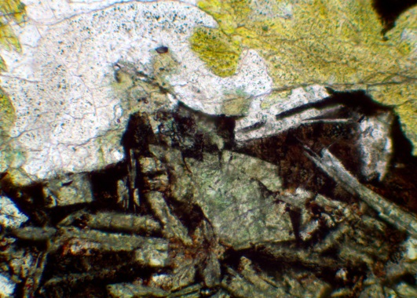
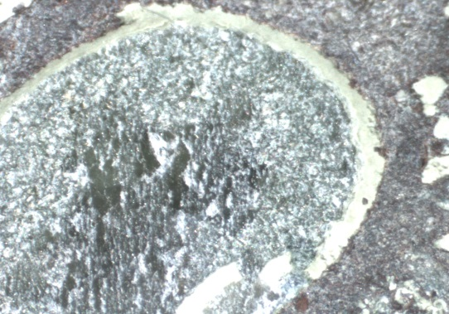
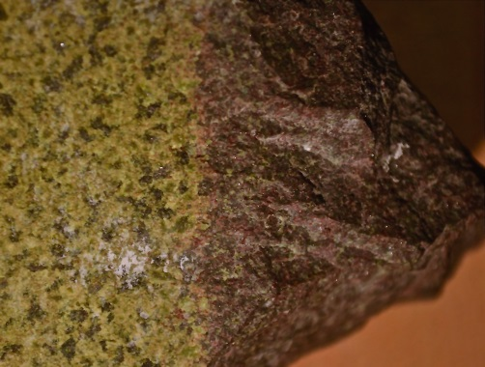
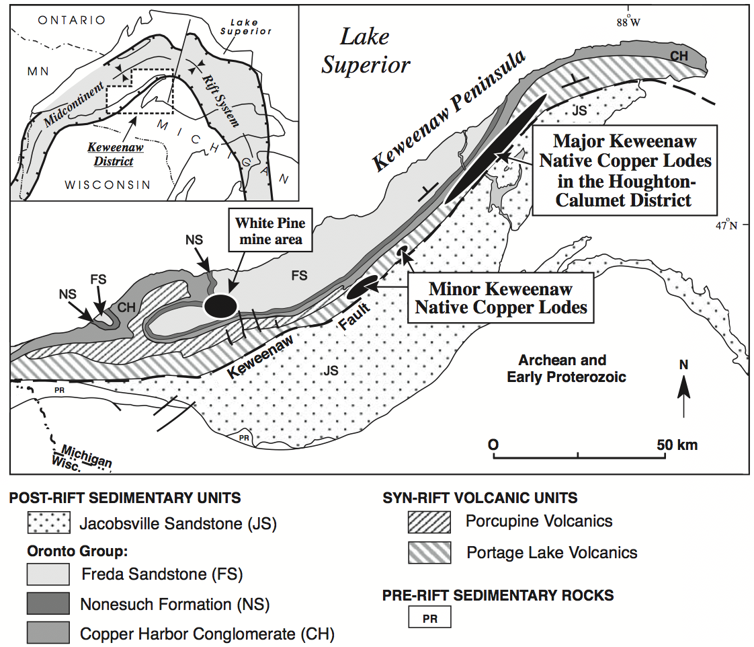
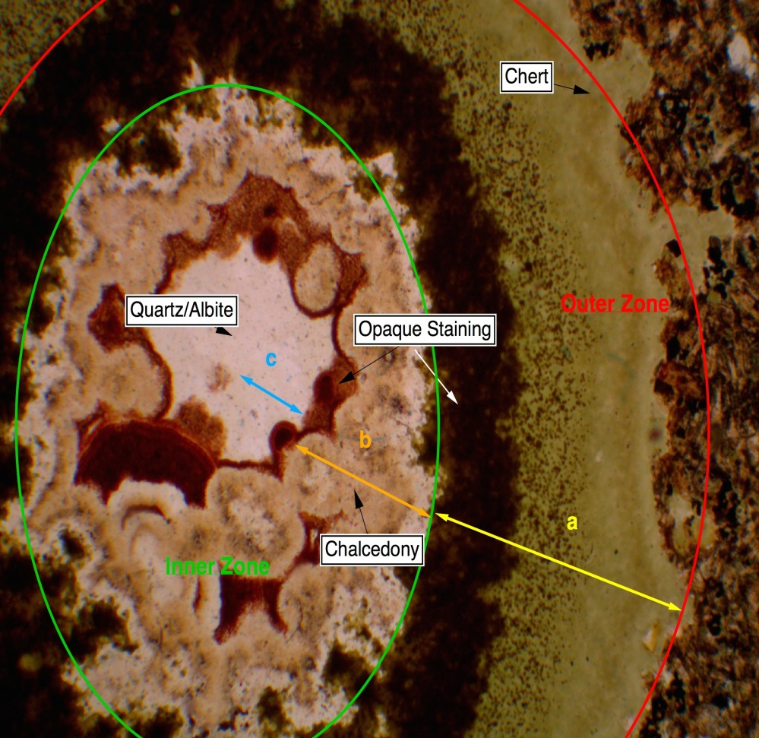
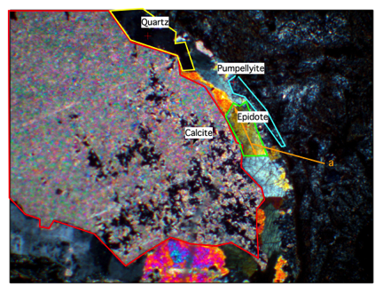
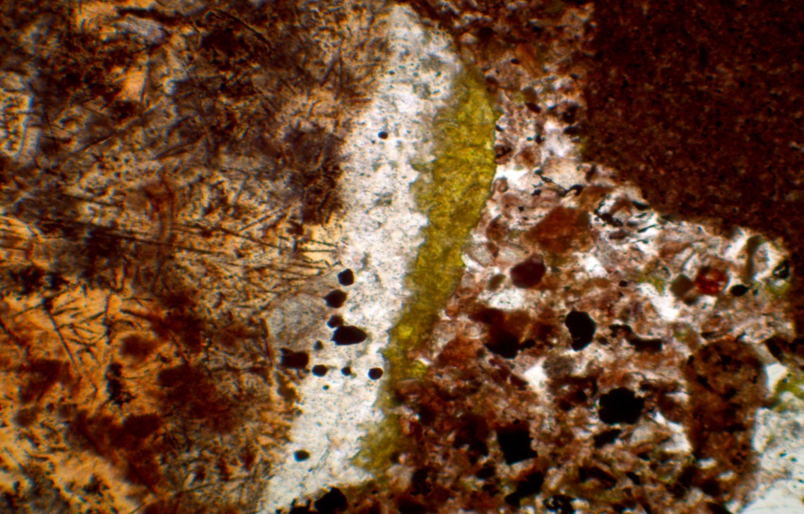
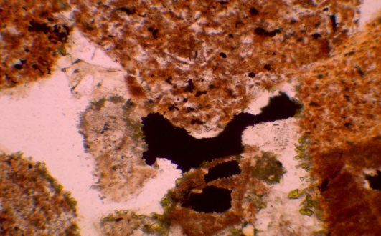
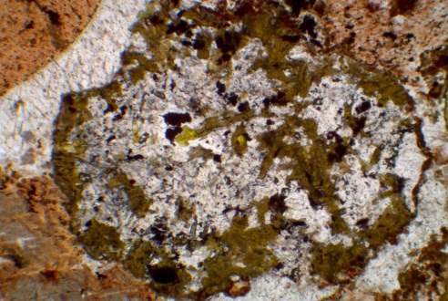
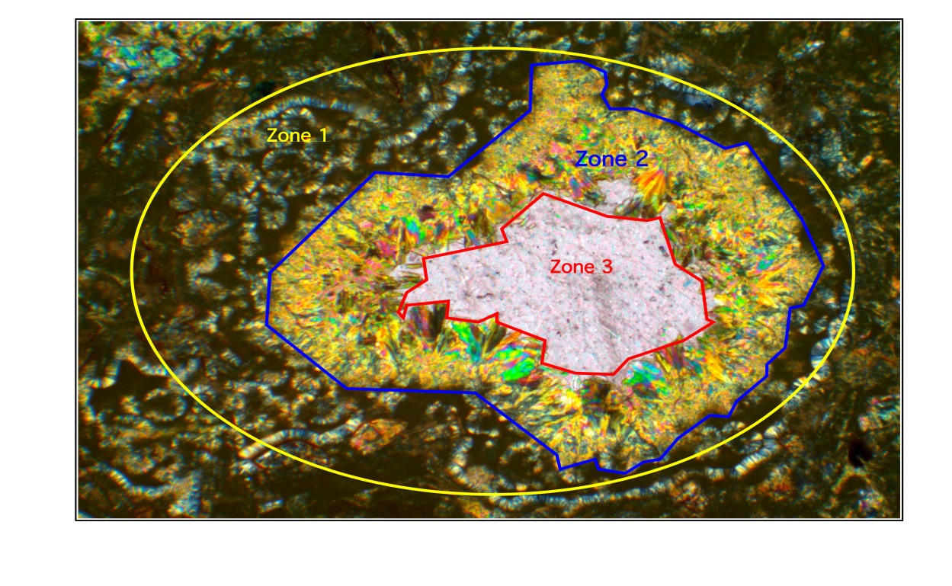
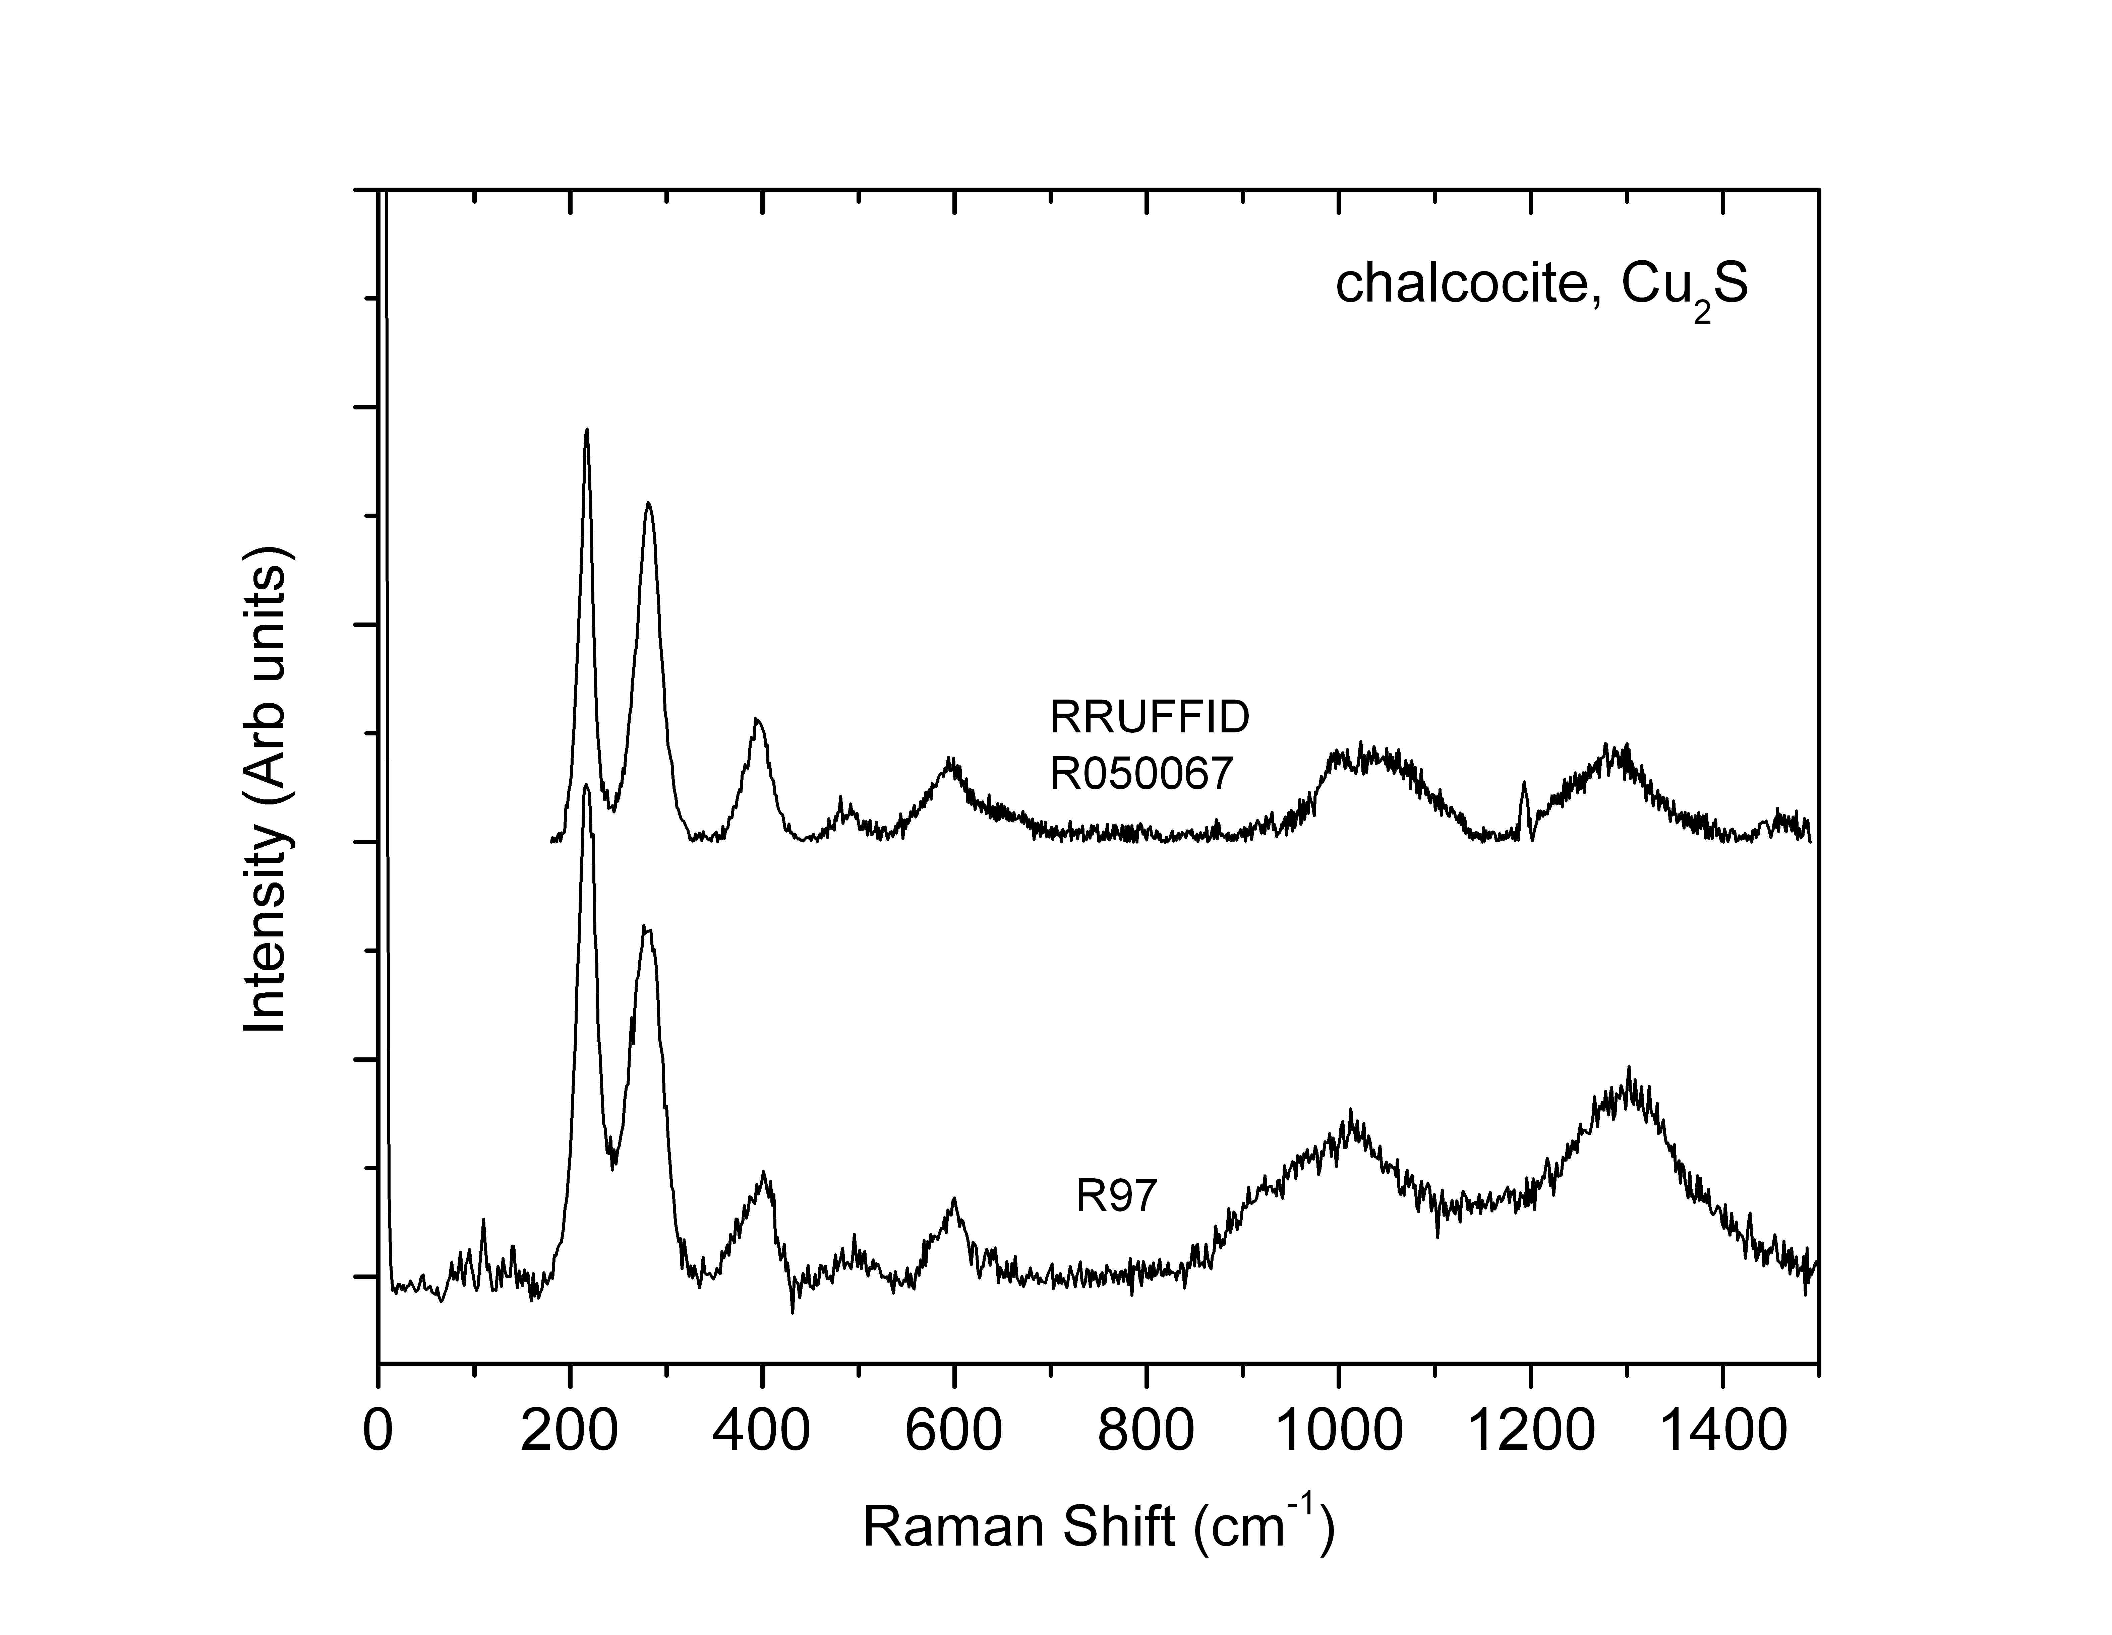
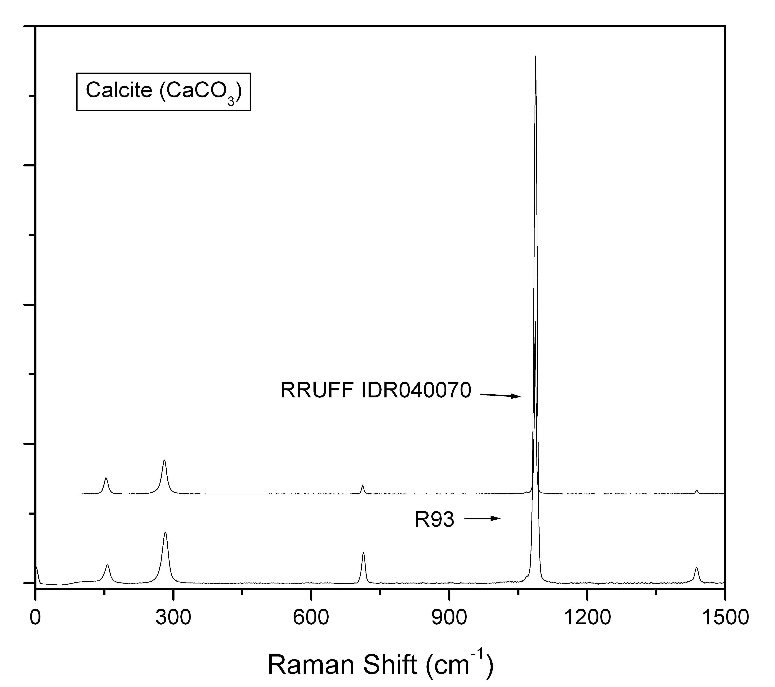
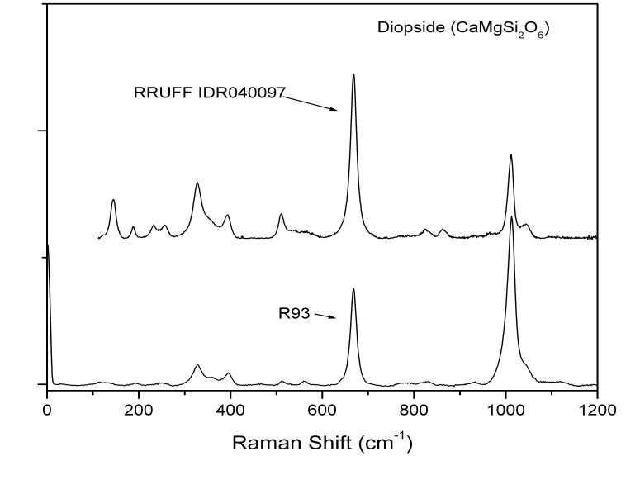
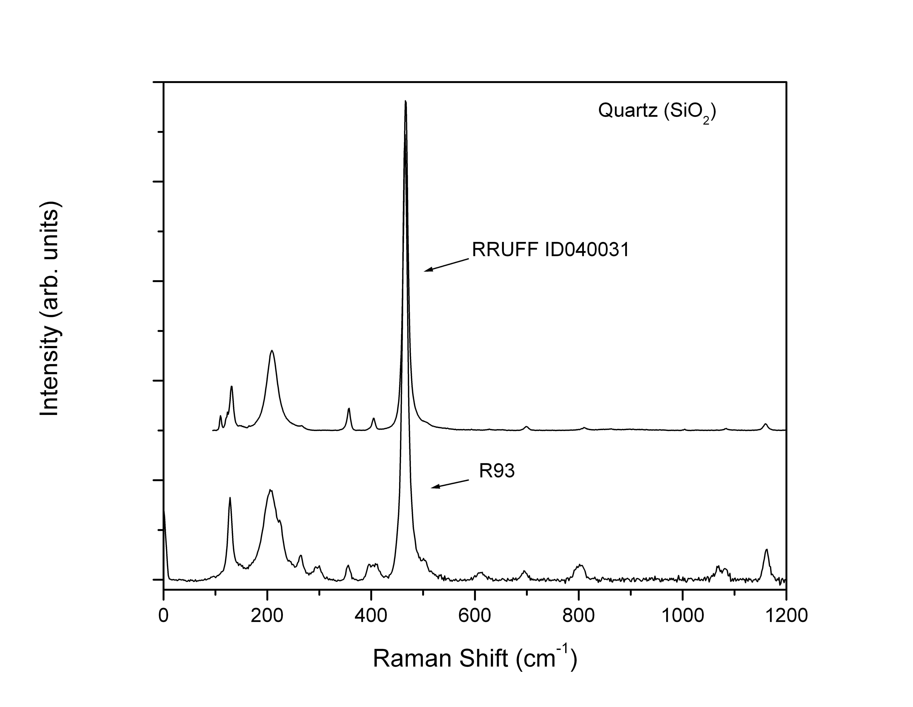
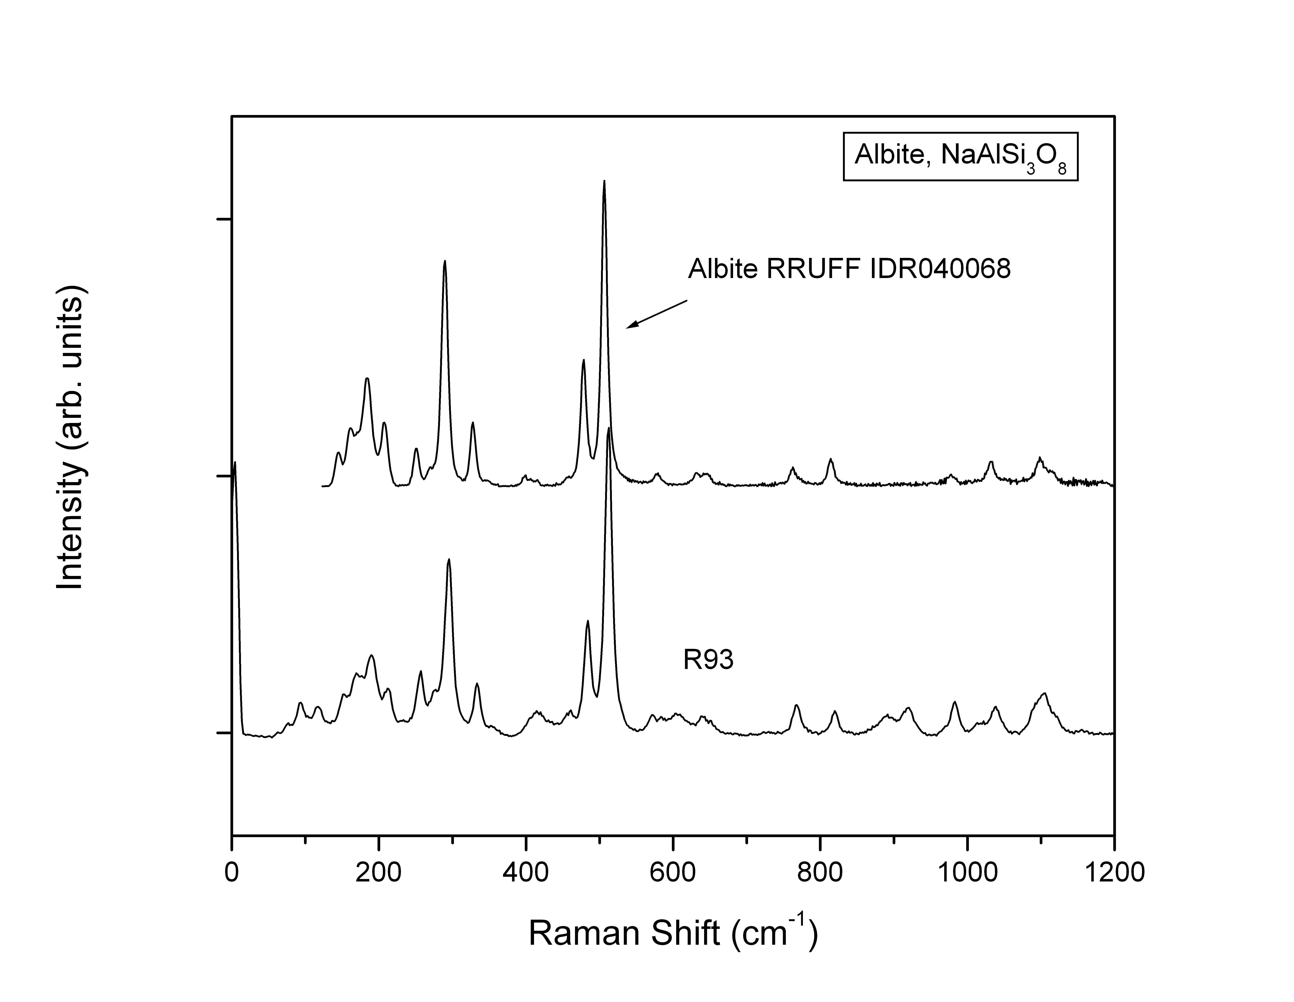
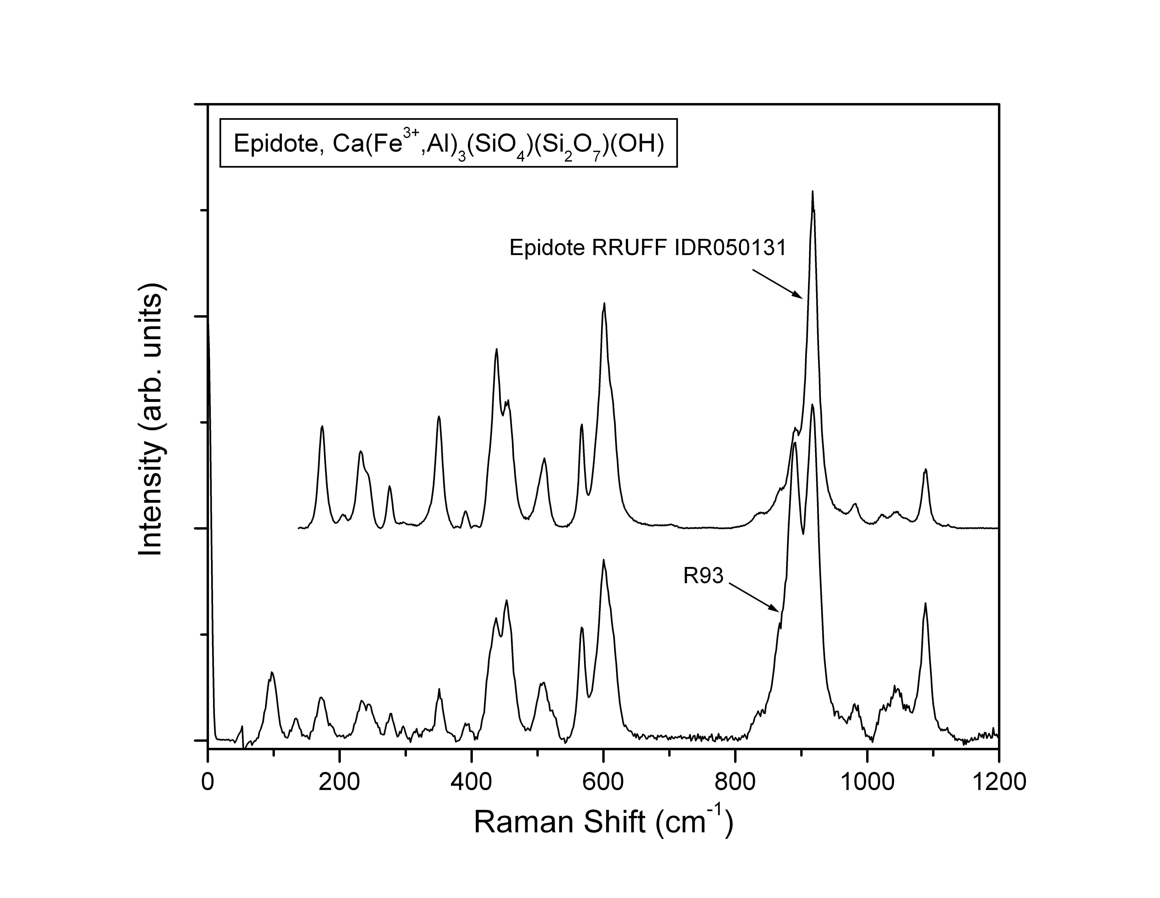
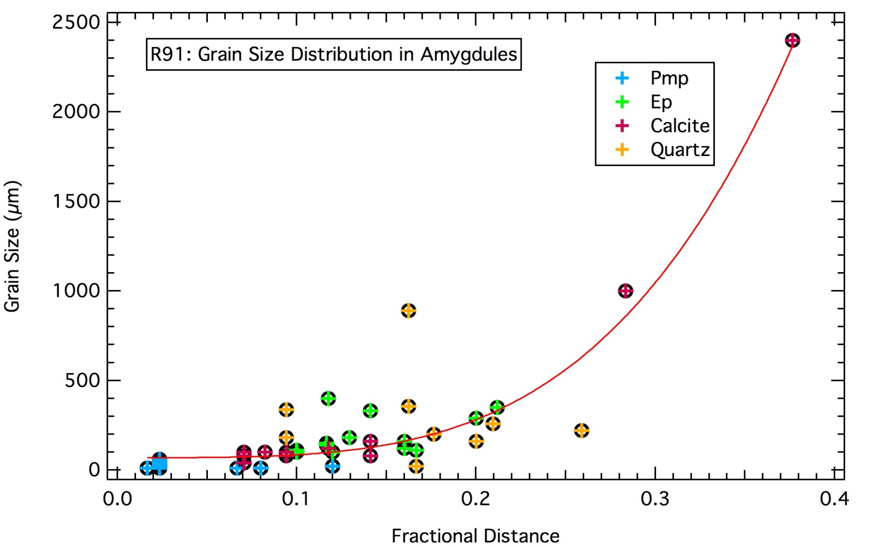
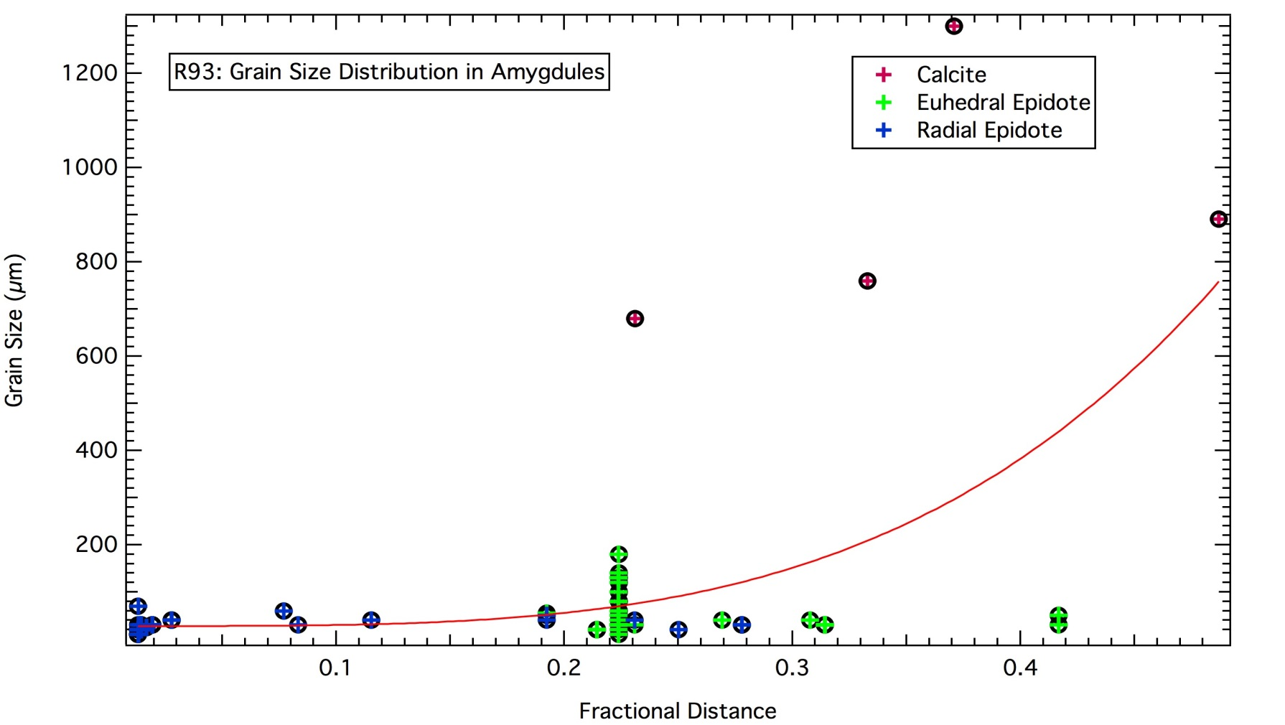
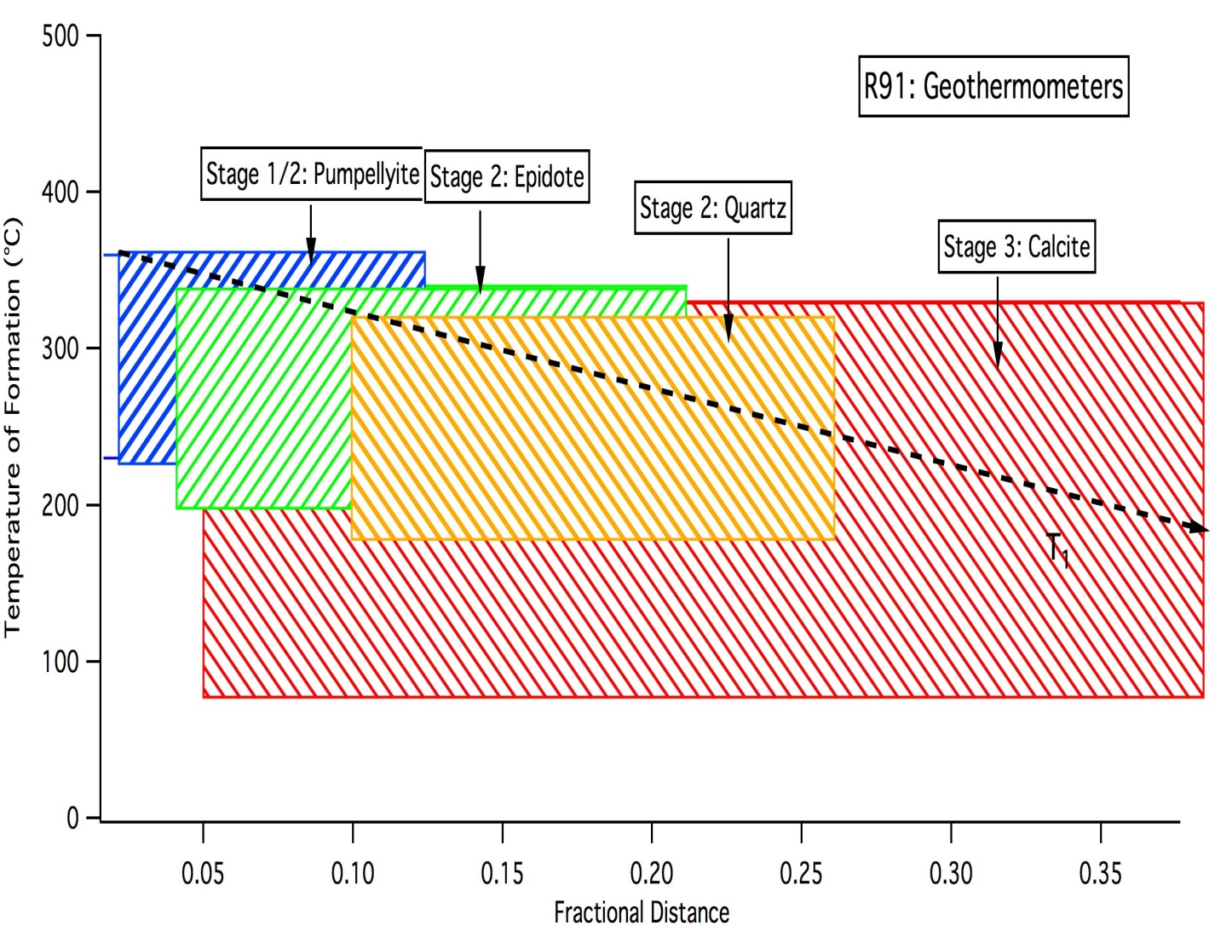
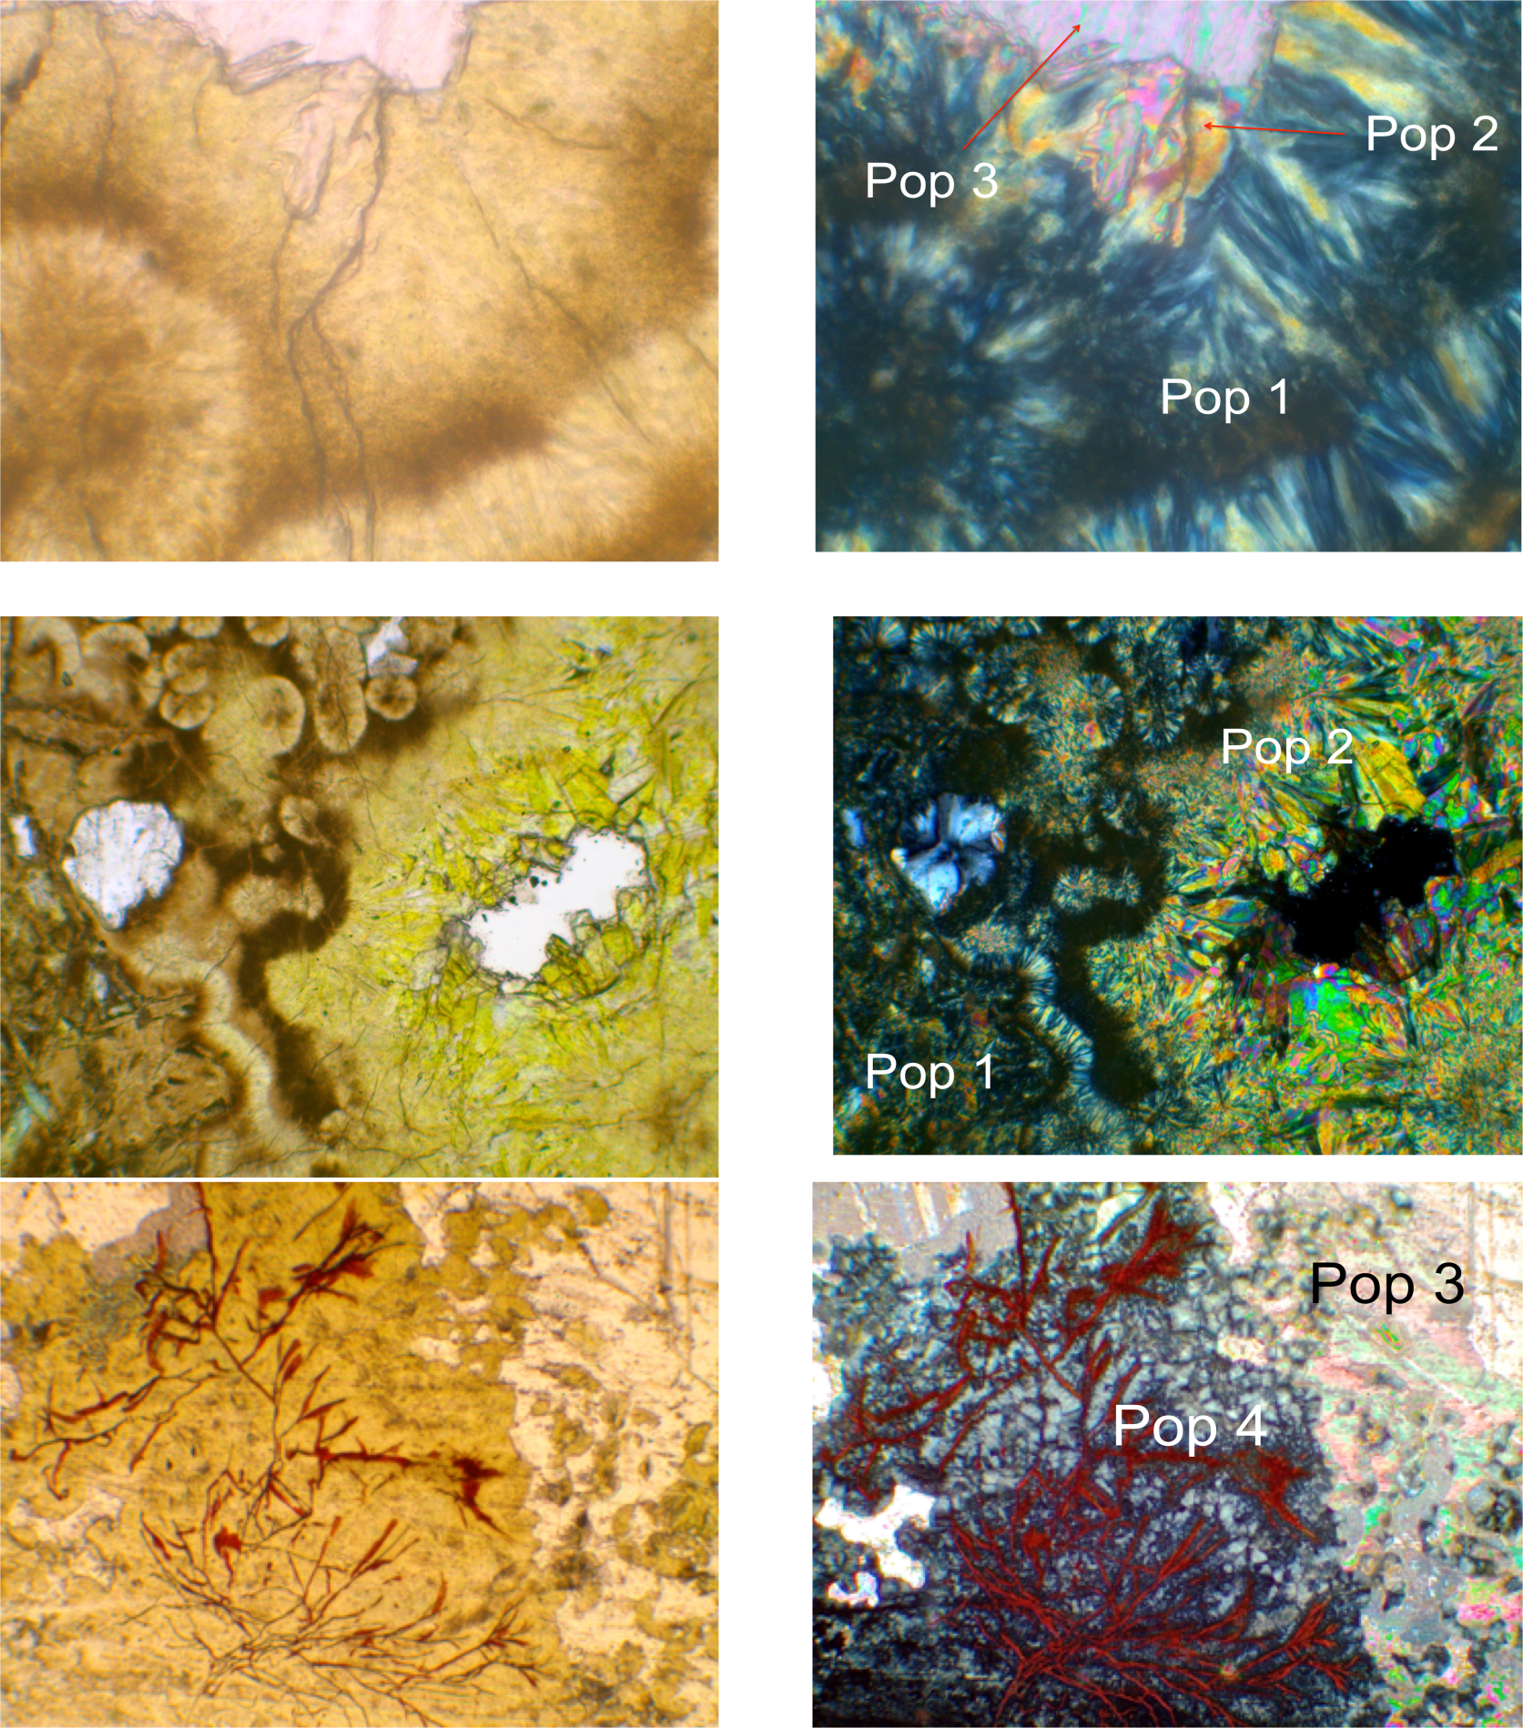
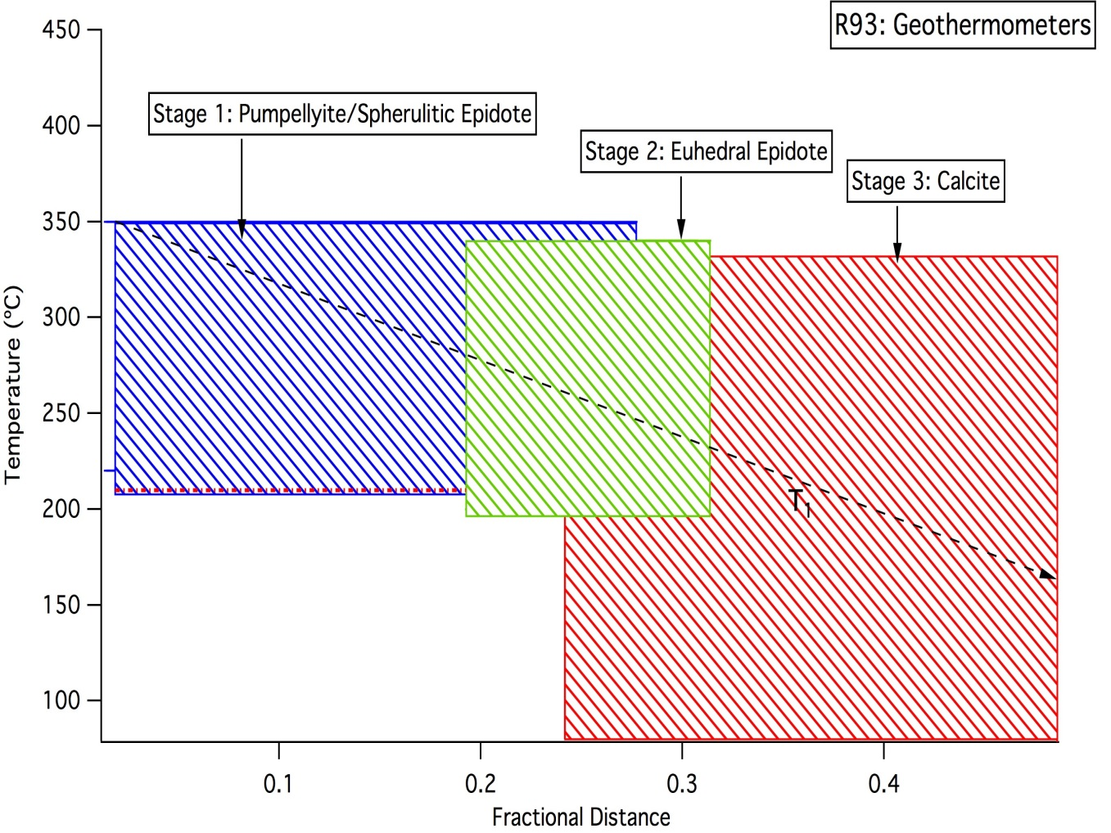
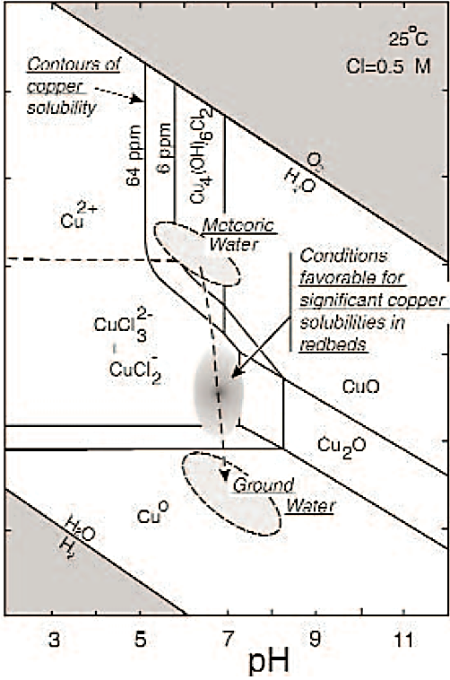
The Metamorphic Precambrian Portage Lake Volcanic Series (PLV)
Ariel Melinger-Cohen, Craig R. Bina, Steven D. Jacobsen
Department of Earth & Planetary Sciences, Northwestern University
Samples
~1.100 Ga
Midcontinent rift split North America
~1.095 Ga
2-3 myr magmatic period deposited PLV
~1.080 Ga
Thermal subsidence, sedimentary fill, burial
~1.060 Ga
Regional contraction → Exhumation of the PLV
*Abundant native copper mineral deposits in pure elemental form [Cu]
(Bornhorst, 1997)
Model: Amygdulated
Mineral Sequences
Basic Amygdaloid, from Red Jacket Shaft, Calumet, Michigan
Pumpellyite, Epidote, Calcite, Serpentine, Oxides, Quartz, Albite
Basic Amygdaloid, Red Jacket Shaft, Calumet, Michigan
Palgioclase, Calcite, Quartz and Chert, Oxides, Epidote, Pumpellyite
Epidotized Basalt, Red Jacket Shaft, Calumet, Michigan
Epidote, Calcite, Pumpellyite, Albite, Serpentine
Brown, 2006
Allouez Conglomerate, 75% Felsic clasts; 25% Matrix
Calcite, Quartz, Epidote, Feldspar, Native Copper, Opaques
Allouez Conglomerate, 70% Felsic clasts; 30% Matrix
Quartz, Calcite, Feldspar, Epidote, Native Copper
Allouez Conglomerate, 60% Felsic clasts, 40% Matrix Calcite, Quartz, Epidote, Native Copper, Opaques)
100 μm
Mineral ID with Raman Spectroscopy
Peaks are matched with spectra from the RRUFF database.
PLV Mineral Zonation and Native Copper Lodes
400 μm
Problem: Anisotropic distribution of minerals and copper deposits with unresolved timing of emplacement
Subject: Hydrothermal fluids with variables: Pressure (P), Temperature (T), Composition (X)
Amygdule borders are approximately elliptical. Distance from wall-to-grain was a median radius between the a and b axes. Grains were measured in 1-D along their longest axis.
How did P, T, and X of the hydrothermal system evolve with time to shape this metamorphic terrain?
Observations: Mineral identification; Microtextural measurements
Instruments: Polarizing petrographic microscope; Micro-Raman spectrometer
400 μm
Grain Size Distributions
Evolution of Temperature
Evolution of Fluid Composition (X)
Plane-Polarized Light
Cross-Polarized Light
Sample R93
Population 1: Spherulitic, light brown epidote
Population 2: Euhedral, yellow-green epidote
Population 3: White calcite
Population 4: Green and red serpentine
*Pop 1 is associated with pumpellyite in other samples
Epidote [Ca₂ (Fe³⁺,Al)₃(SiO₄)₃(OH)]
Pumpellyite [Ca₂(Fe²⁺,Mg)Al₂(SiO₄)
(Si₂O₇)(OH)₂•H₂O]
Calcite [CaCO₃]
Serpentine [hydrous aluminosilicate ]
25 μm
Concentric zoning→ variable X_{Fe3+} during nucleation
Graphs show grain size, distance from the amygdule wall, and mineral identity. Grain size increases away from the walls.
Temperature ranges for mineralizations in R91 and R93 decrease, in agreement with upward grain size shifts (Reyes, 1990 and Lagat, 2009). Temperature range: 80-350°C
90 μm
Equilibrium Mineral Assemblages
Stage 1: (1) Pumpellyite + Quartz; (2) Epidote + Quartz.
Stage 2: (1) Pumepellyite + Quartz; (2) Epidote + Quartz; (3) Epidote + Pumpellyite + Quartz.
Note: A remarkable increase in the amount of epidote and decrease in pumpellyite.
Stage 3: Mostly Calcite + Some Quartz + Minor Chlorite.
Increase in color→ increase in X_{Fe3+}
Deposition of Native Copper
Conclusion
Evolution of the system:
3 stage paragenesis marked by distinctive mineral assemblages
ΔX: 1st increase in X_{Fe3+;} 2nd increase in X_{CO2}
ΔT: Decreasing temperatures with time
Decreasing temperature
Reduction potential of brine is lowered
pH increases slightly (Livnat, 1983, Brown, 2006).
Results suggest compatible hydrothermal ΔT and ΔX evolutions.
Deposition of calcite+serpentine
→high X_{CO2}
→decreasing temperature
60 μm
Further Investigation
Laboratory chemical and thermometric analysis to confirm trends
Pressure and depth of metamorphism: Develop a geobarometric model and estimate burial depth
When and for how long did hydrothermal activity persist
What was the heating source? Regional vs. contact metamorphism
Works Cited
Bornhorst, T.J. (1997) Tectonic Context of Native Copper Deposits of the North American Midcontinent Rift System. Geological Society of America, Special Paper 312.
Brown, A. C. (2006) Genesis of native copper lodes in the Keweenaw District, northern Michigan: A hybrid evolved meteoric and metamophogenic model. Economic Geology, v. 10: p. 1437-444.
Jolly, W. T., and Smith R. E. (1972) Degradation and metamorphic differentiation of the Keweenawan tholeiitie lavas of northern Michigan, U.S.A. Journal of Petrology, v. 13, p. 273-309.
Lagat, J. (2009) Hydrothermal Alteration Mineralogy in Geothermal Fields with Case Examples from Olkaria Domes Geothermal Field, Kenya. Presentation. Geothermal Development Company, Nairobi, Kenya. Electronic.
Livnat, A. (1983) Metamorphism and Copper Mineralisation of the Portage Lake Lava Series, Northern Michigan. Dissertation. University of Michigan.
Reyes, A.G., (1990) Petrology of Philippine geothermal systems and the application of alteration mineralogy to their assessment. Journal of Volcanology and Geothermal Research, v. 43: 279-309.
RRUFF Project (2014). Database. <RRUFF.info>
System Cu-O-H-Cl
(Figure from Brown, 2006)

