Slide 1

Geomorphic Controls on Air Temperature Variation in the Northern Willamette Valley AVA
Cameron Penner-Ash
Kevin Pogue

Slide 2
Overview
Why Study Air Temperature Variations?
Willamette Valley AVA
Methods
Data and Analysis
Conclusions

Slide 3
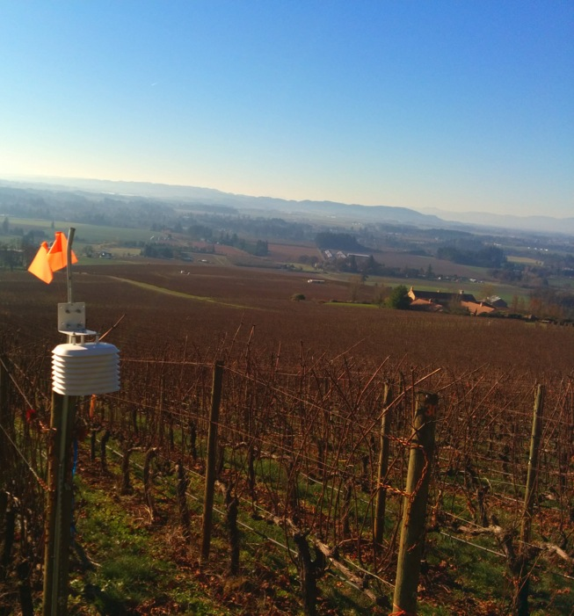
Why are Air Temperature Variations Important?
Air temperatures on a small to moderate scale vary considerably and are significantly impacted by location and regional geomorphology.
Grapes are strongly influenced by temperature variations, which determine appropriate varieties and clones.
A better understanding of the air temperature variations of a site leads to better wine. Yum.
Stoller Family Estate (Dayton, OR)
Notes:
Talk about different clones, 777 Pinot = Designer

Slide 4
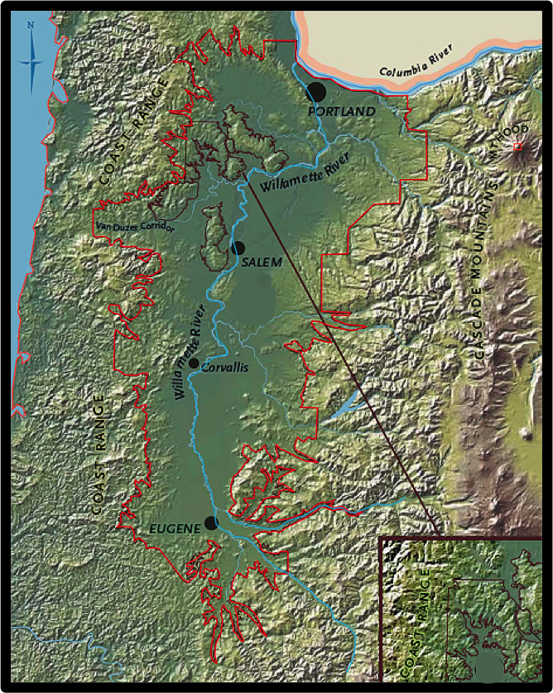
Willamette Valley American Viticultural Area (AVA)
Located between the Coast Range mountains to the west and the Cascade Mountains to the east.
Characterized as a cool climate grape growing region.
Most famous for Pinot Noir, a cool climate grape variety.
3 smaller AVAs utilized for study
  Dundee Hills
  Ribbon Ridge
  Yamhill-Carlton District

Slide 5
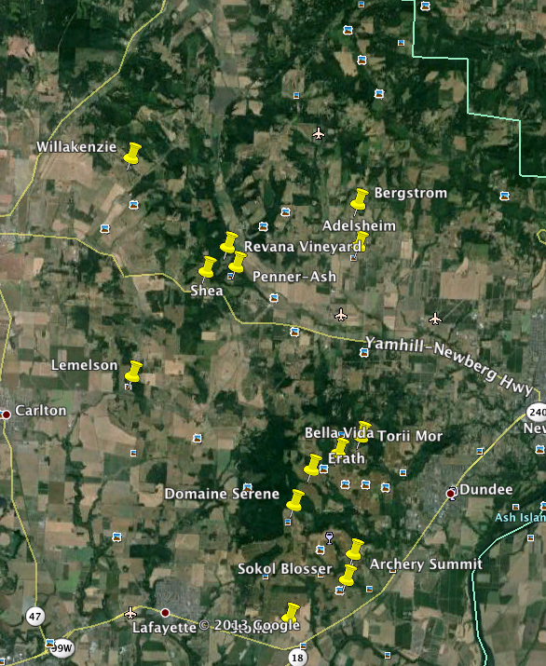
Methods – Data Logger Placement
Data Loggers were placed at a variety of aspects, elevations and slopes in order to capture the most variation.
Study Start: August 4th
Study End: November 11th

Slide 6

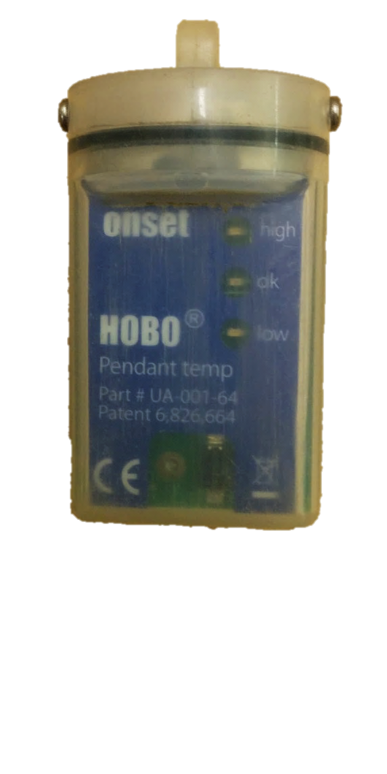
Methods – The Logger
HOBO Pendant Temperature Data Logger
  Accuracy: 0.47˚C or 0.85˚F
Solar Radiation Shield
  Ensures logger is actually measuring the air temperature and not influenced by solar radiation.

Slide 7
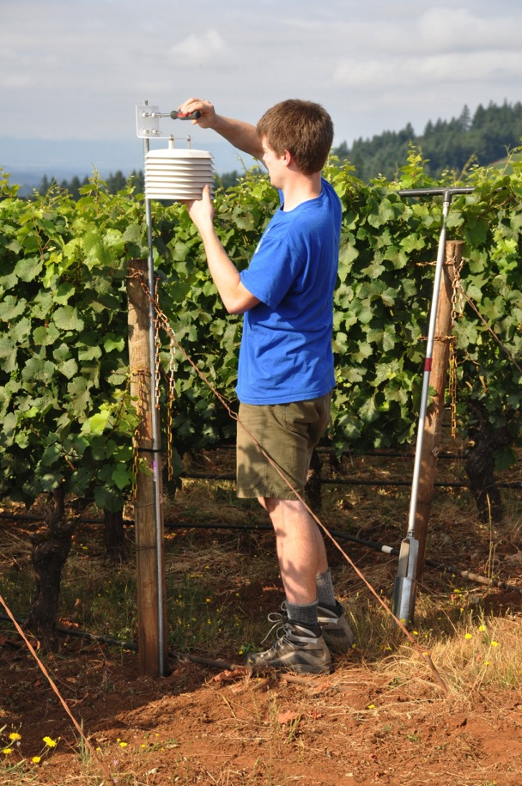
Methods – Air Temperature data logger
Placed on metal pipes and zip tied to end posts.
All sensors were installed at “eye height”
Needed to be low enough to not be hit by hedgers.
~ 1.5 m

Slide 8
Air Temperature Data

Slide 9
Average Air Temperature Versus Elevation

Slide 10
Average High Temperature Versus Elevation
Archery Summit Estate Lower

Slide 11
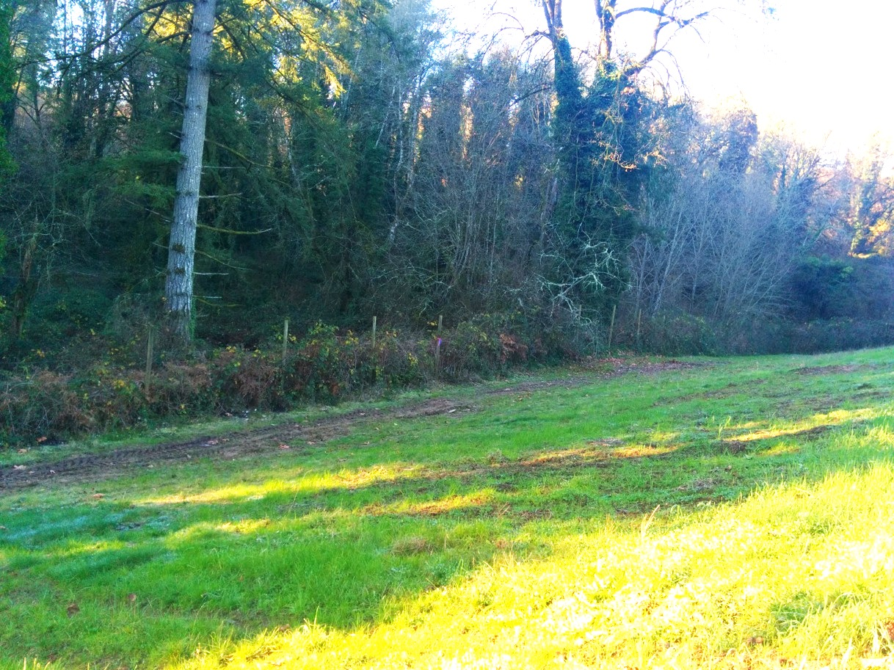
Archery Summit Estate Low
Lower Average High:
Shading from trees in the heat of the day.

Slide 12
Average Low Temperature Versus Elevation
Archery Summit Estate Upper
Archery Summit Estate Lower

Slide 13
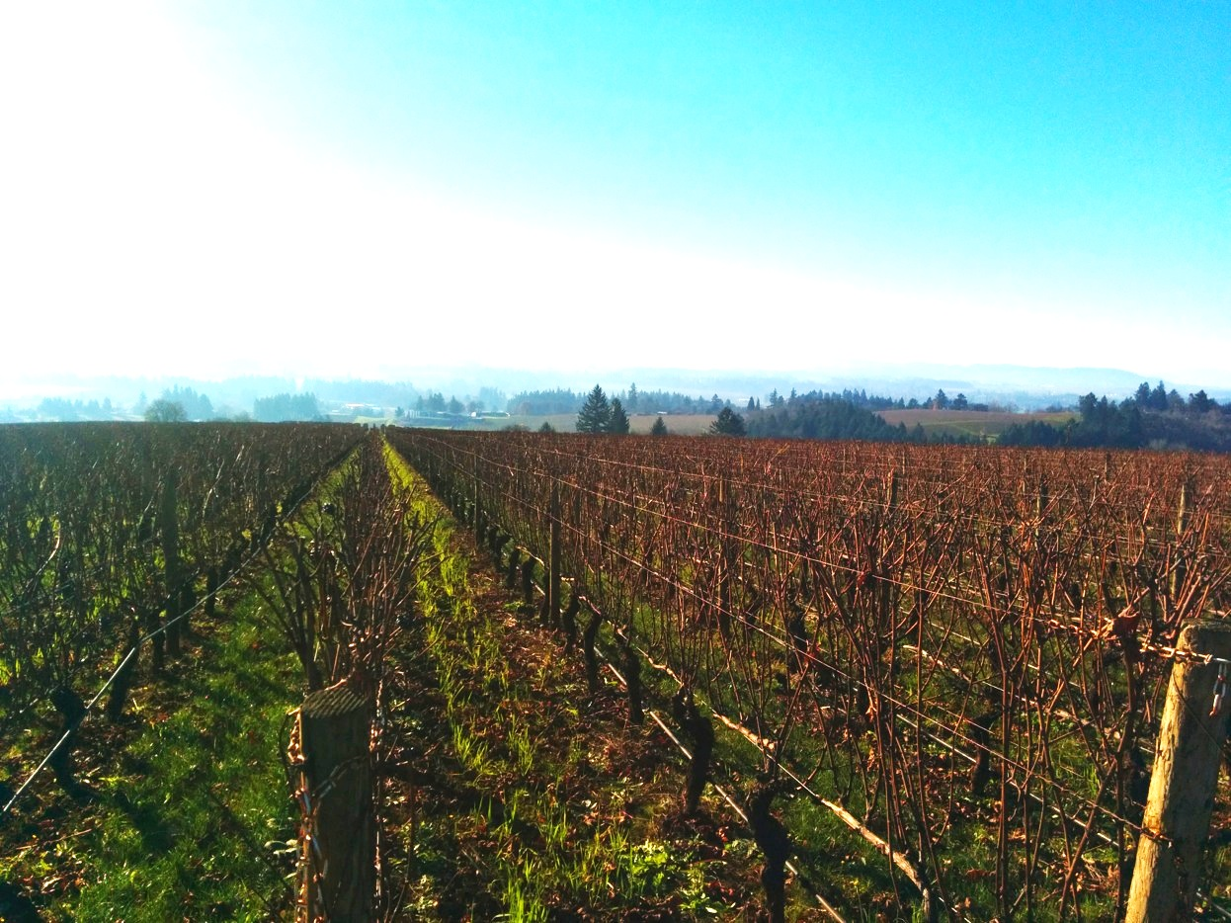
Archery Summit Estate Upper
Poor cold air drainage compared to other high flat sites

Slide 14
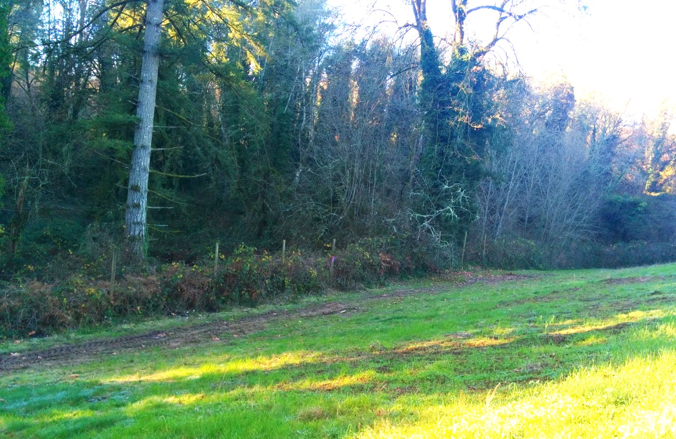
Archery Summit Estate Lower
Trees shade and prevent radiational cooling
Less frost under trees on cold nights.

Slide 15
Hill Model
Cold Air Drainage

Slide 16
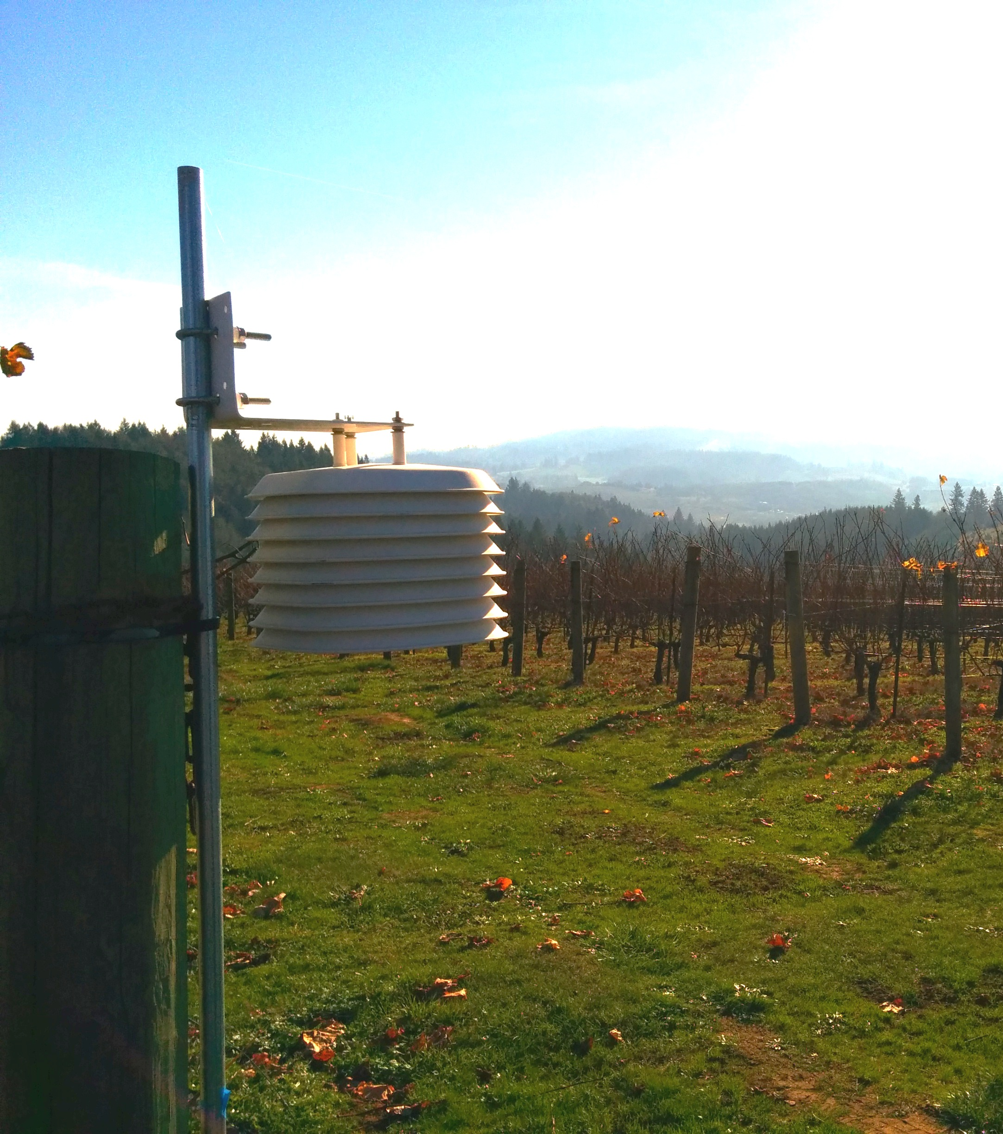
General Air Temperature Conclusions
Nearer to vegetation created a longer growing season, but heat accumulation was less.
Nocturnal cold air pooling
Lower elevations have a greater frost and freeze risk.

Slide 17
Diurnal Temperature Versus Elevation

Slide 18
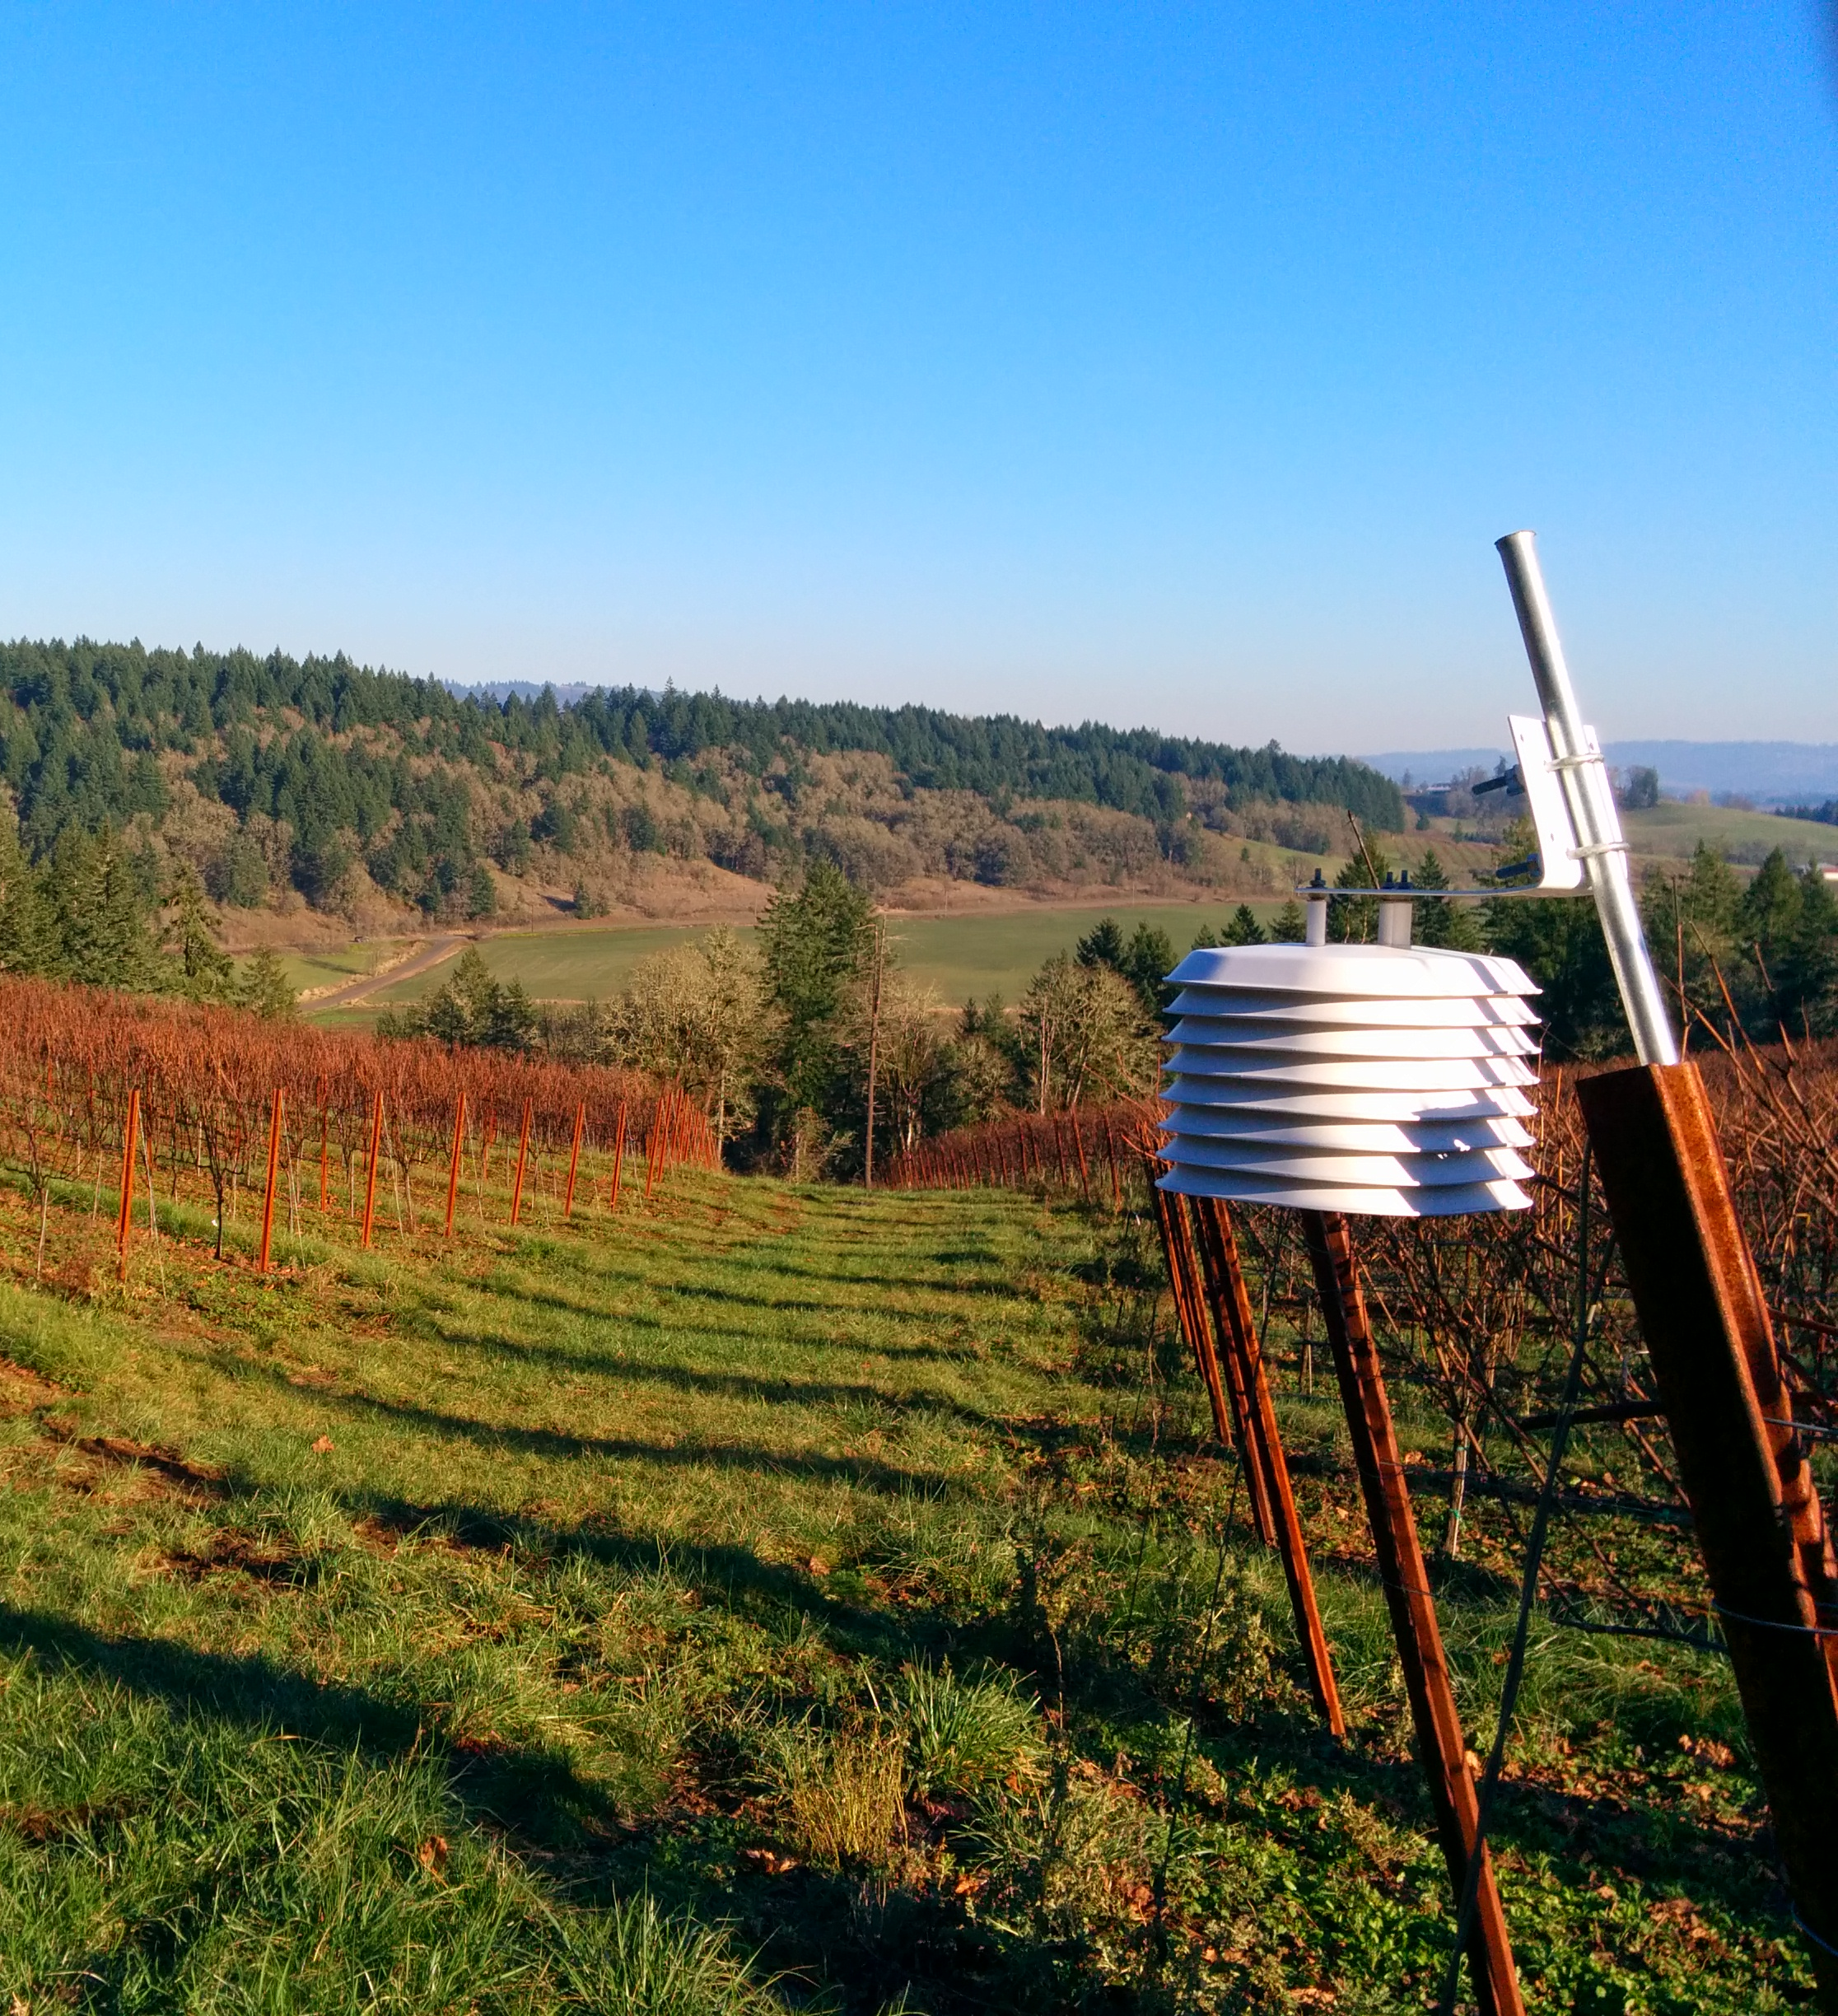
Diurnal Temperature Variation
Conclusions
A smaller diurnal variation is linked with increased phenological response. (Gladstone, 2011)
In this study, narrower diurnal temperature ranges were associated with higher elevations.
Larger diurnal temperature variation associated with increased frost and freeze risk.

Slide 19

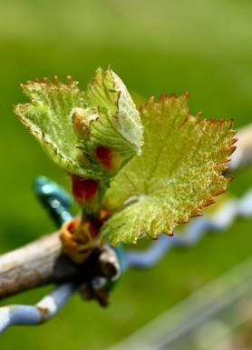
Growing Degree Days
T_{base} = 10˚ C
GDDs accumulate per day.
Photosynthesis stops around 40˚ C.
GDD is used to predict phenological stages and gauge potential ripeness.

Slide 20
Growing Degree Days Versus Elevation

Slide 21
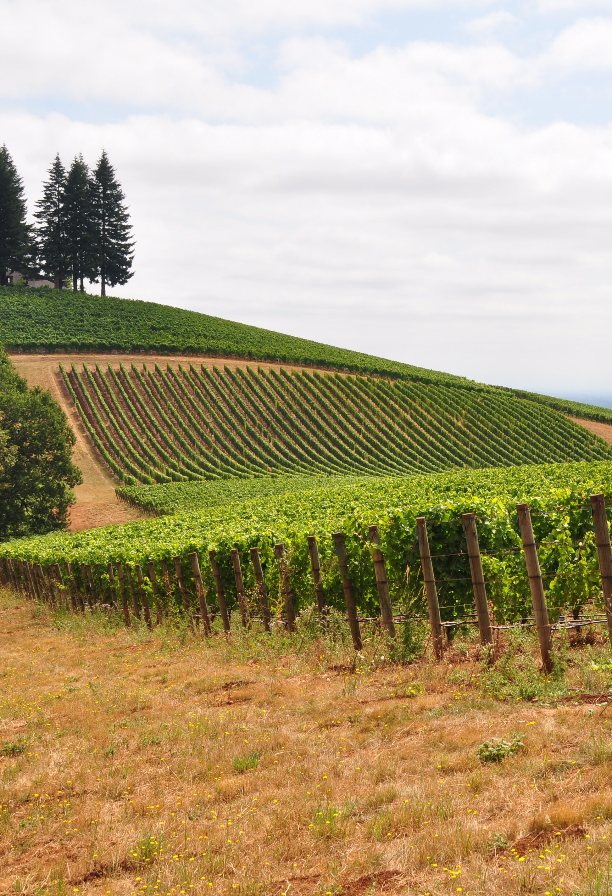
GDD Conclusions
190 increase in GDD per 1 ˚C in average temperature in the N. Willamette Valley
More GDD at higher elevation due to warmer mornings, but not because of warmer afternoon temperatures.
Within the study zone GDD increased with elevation.
  The elevation at which GDDs begin to decrease was above the maximum elevation of the study.

Slide 22
Freeze Protection
If frost occurs in late spring:
  Bud Damage
If frost occurs in early autumn, before grapes are fully ripened.
  Lower Sugars, “green” flavor components

Slide 23
Freeze Hours Versus Elevation
Alexana Lower 1.0
Alexana Lower 2.0
Beaux Frères
Penner-Ash High
Archery Summit Estate Low

Slide 24
The previous five sites were located on the sides of a cold air drainage.
Archery Summit Estate Low

Slide 25
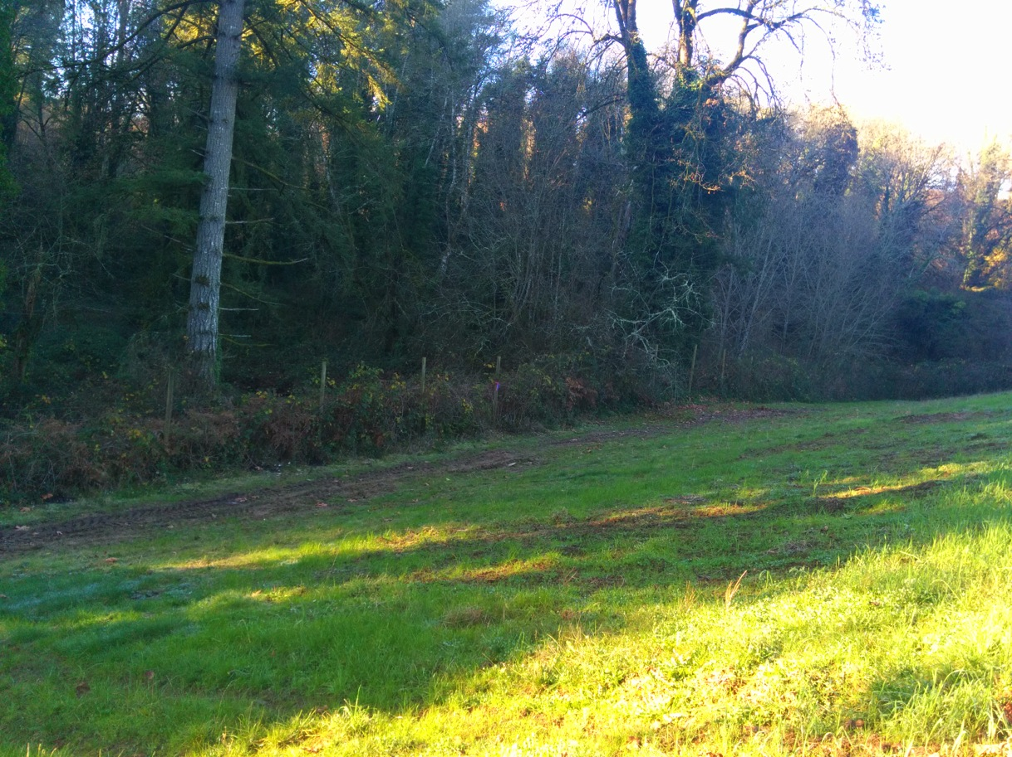
Archery Summit Estate Low

Slide 26
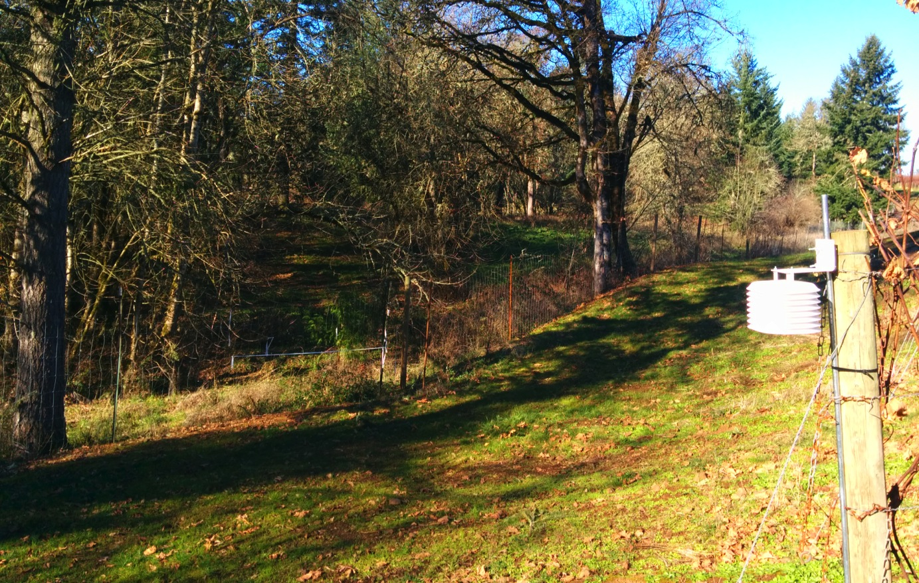
Alexana Low 2.0

Slide 27
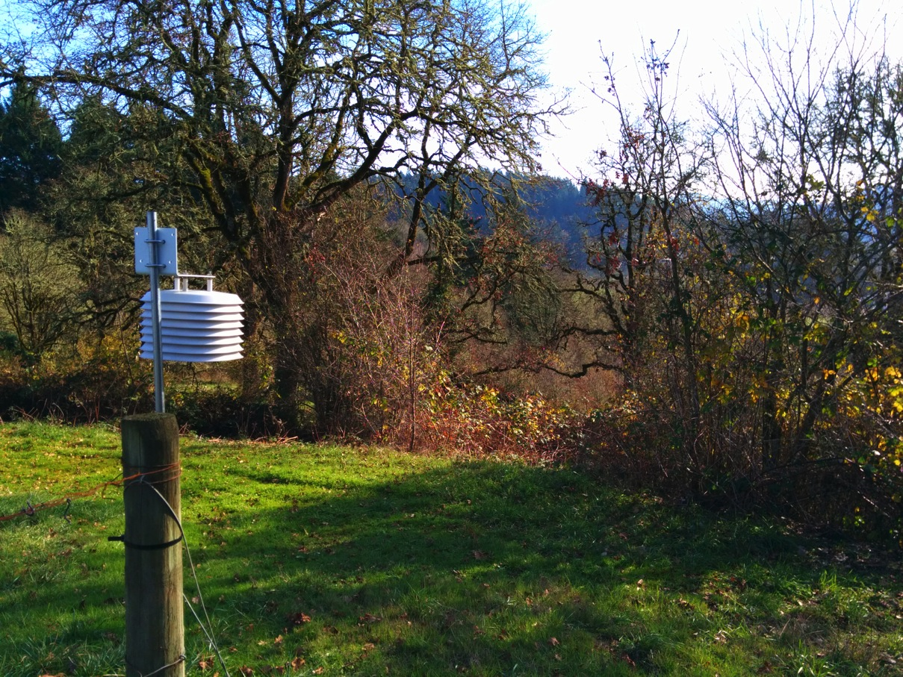
Beaux Frères Low

Slide 28
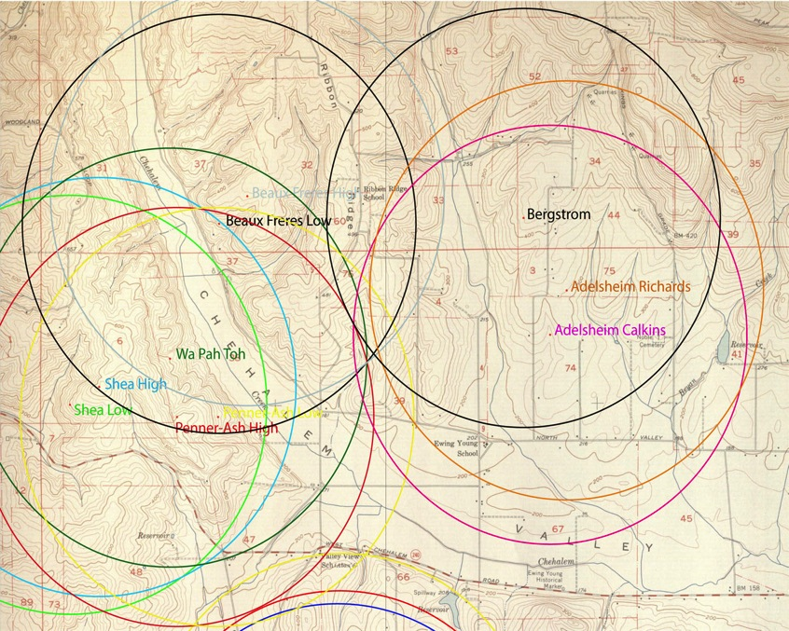
Quick Explanation: RLC
RLC =
(Elevation of Site) – (Lowest elevation within 2 km)
(Highest elevation within 2 km) – (Lowest elevation within 2 km)
Developed by Kevin Pogue and Greg Dering
Attempts to mathematically quantify geomorphic features.
1 = High point
0 = Low Point

Slide 29
Weighted Freeze Hours Versus RLC

Slide 30
First Freeze Date Versus Elevation

Slide 31
Average Temperature Versus Relative Lowness Coefficient
Bergstrom

Slide 32
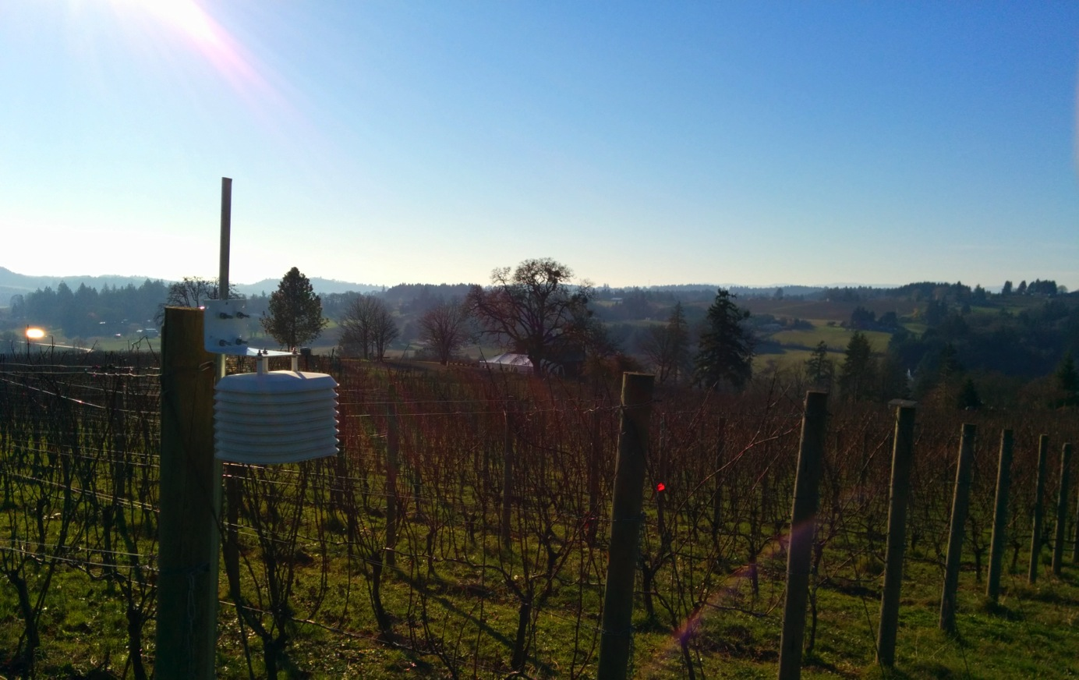
Bergström

Slide 33
Problems With RLC
2 km
Same Value
Bergström

Slide 34
The Bergstrom Problem
On broad valley with gently sloped floor.
Not in a distinct depression.
Relatively low within a 2 km radius, but within distinct depression.
The Fix: A smaller scale to resolve RLC problems.
Bergström

Slide 35
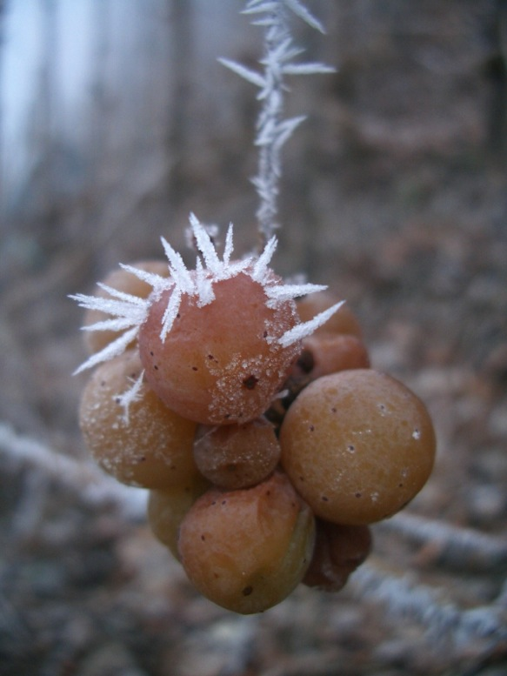
Conclusions
Proximity to drainages increases weighted frost hours.
Higher elevations spend less time below freezing.

Slide 36
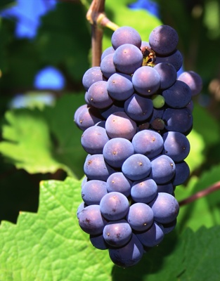
Conclusions
Planting between 200-250 meters ensures higher GDD and a smaller diurnal variation.
Close proximity to trees can shade vines, but inhibit radiational heat loss.
Close proximity to cold air drainages negates benefits of trees inhibiting radiational heat loss.

Slide 37
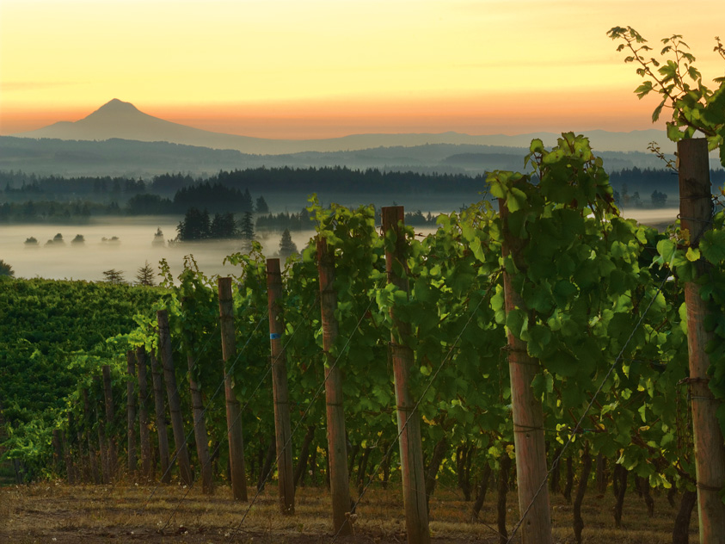
Questions?
Thank You
Questions?

Slide 38
Works Cited
Gladstone, John, Wine, Terroir and Climate Change. 2011.
Gladstone, John, Viticulture and Environment. 2002.
O’Connor, Jim E., Andrei Sarna-Wojcicki, Karl C. Wozniak, Danial J. Polette, and Robert J. Fleck, Origin, Extent, and Thickness of Quaternary Geologic Units in the Willamette Valley, Oregon. 2001.
Olson, Liesl Mackenzie Cooper, Geographical and Geomorphological Effects on Air Temperatures in the Columbia Basin’s Signature Vineyards. 2011.
Pogue, Kevin R., Gregory M. Dering, Temperature Variations in the Walla Walla Valley American Viticulture Area. 2007.

