Slide 1
Export of terrestrial dissolved organic carbon to coastal rivers as a function of climate and land-surface processes
Anthony D. Feig & Yong Q. Tian
Central Michigan University
Qian Yu
University of Massachusetts-Amherst

Slide 2

As reported by Tian, et. al, in the 2013 publication Ecological Engineering v. 54, p. 192-201

Slide 3
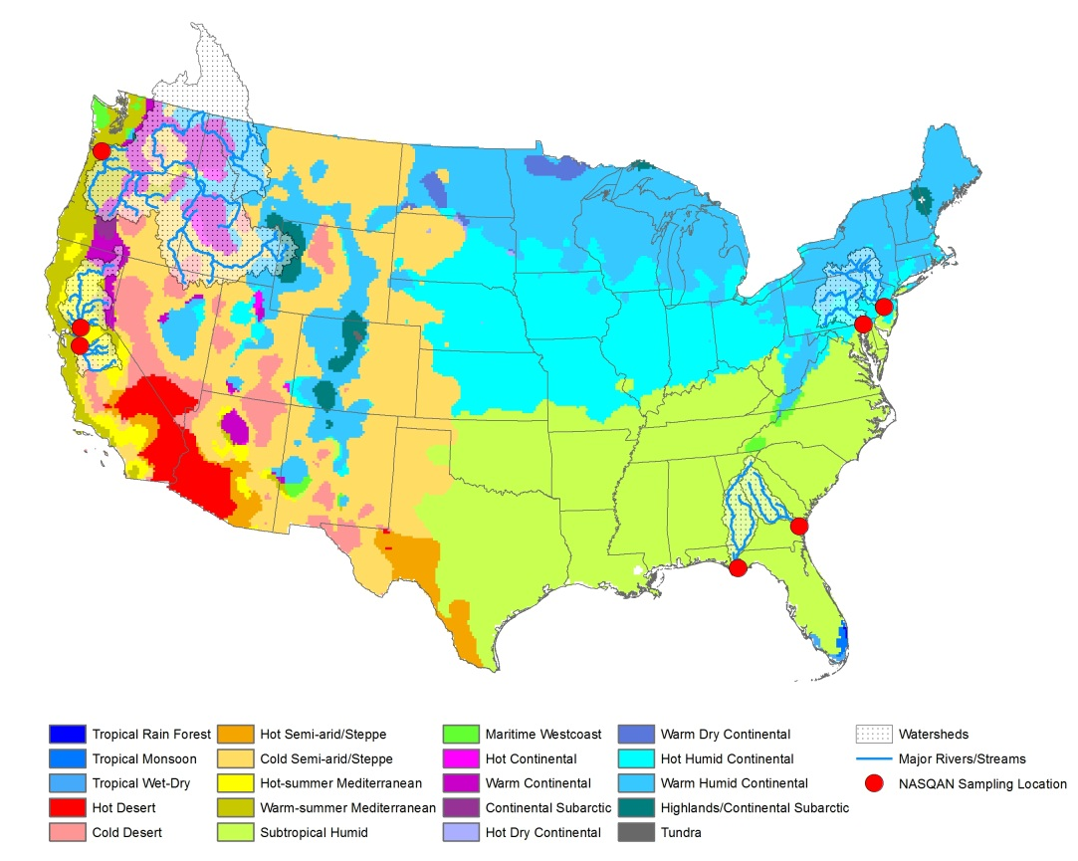
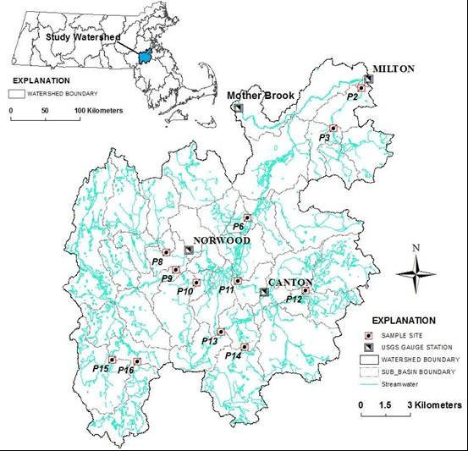
Seven study sites: Monthly readings, multiple years

Slide 4
Study site properties
 | ALT | API | COL | DEL | NEP | POT | SAC | SJQ | SUS
State | GA | FL | OR | NJ | MA | DC | CA | CA | MD
% Wetland | 13.06 | 14.64 | 2.06 | 5.72 | - | 1.15 | 2.76 | 3.26 | 2.38
% Forest | 50.48 | 50.2 | 73.57 | 67.06 | - | 58.09 | 45.06 | 62.42 | 62.45
% Agriculture | 26.37 | 25.77 | 20.94 | 16.99 | - | 31.71 | 43.62 | 29.14 | 27.43
% Developed | 10.08 | 9.4 | 3.29 | 10.23 | - | 9.05 | 8.53 | 5.17 | 7.74
CZD | S | S | M | S | S | S | S | S | S

Slide 5
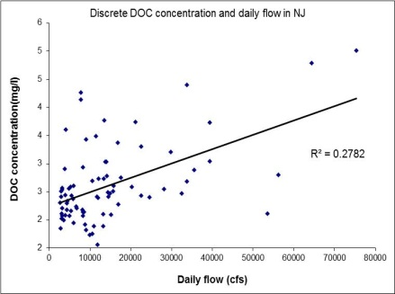
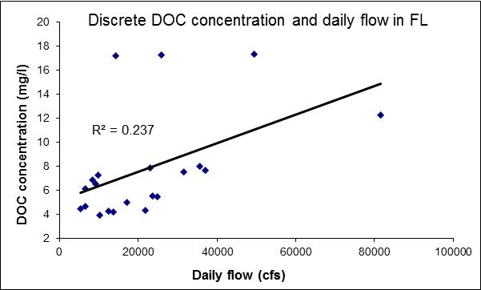
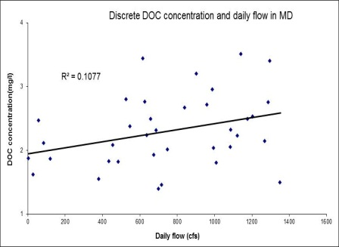
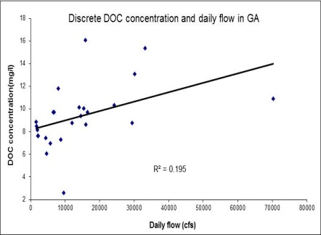
Discharge-DOC concentrations

Slide 6
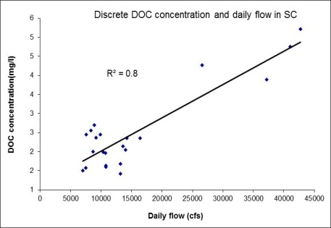
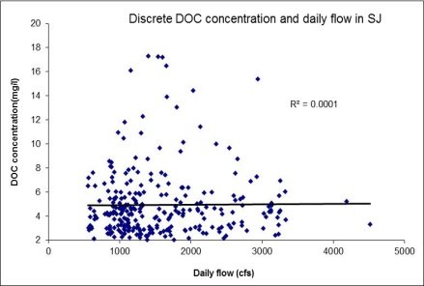
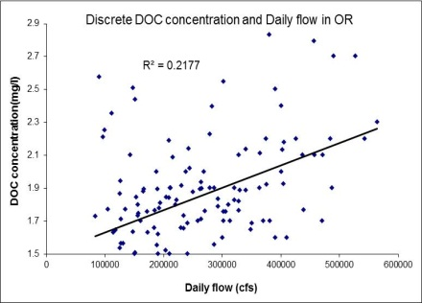
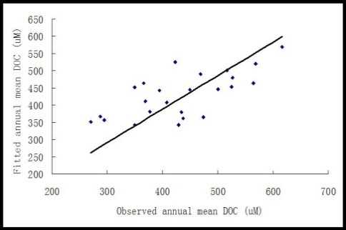
Discharge-DOC concentrations

Slide 7
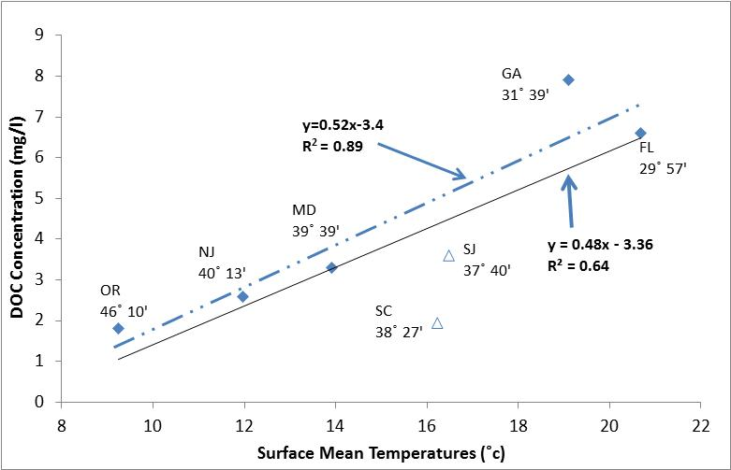
DOC vs. Surface air temperature
ALT
API
SUS
DEL
SJQ
COL
SAC

Slide 8
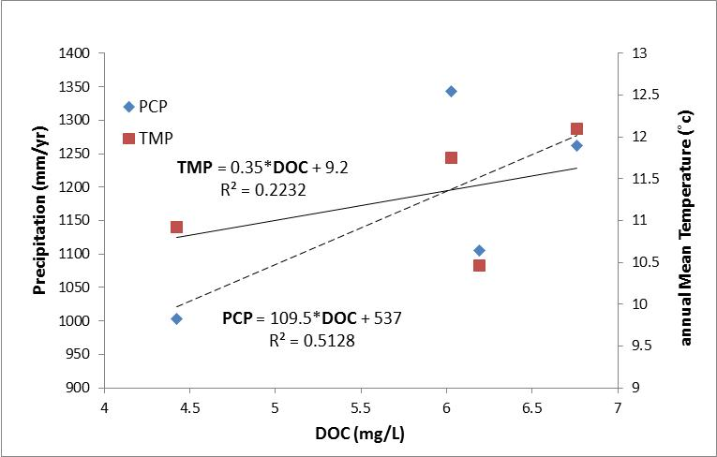
Mean DOC & annual temp., precip.

Slide 9
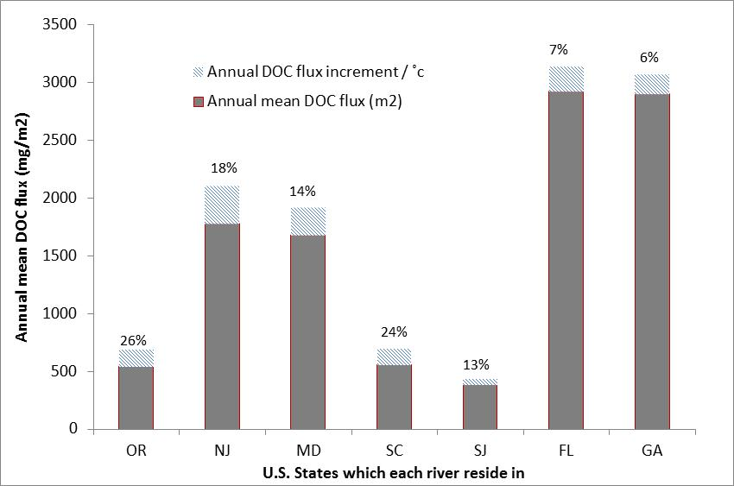
Mean DOC annual flux
COL
DEL
SUS
SAC
SJQ
API
ALT
Rivers

Slide 10
Translating temp. increases into DOC loads
1°C increase → 0.476 mg/L in-stream DOC increase
Derived from
14 years of riverine DOC data (USGS)
Observed annual mean temp increase of 1C

Slide 11
Key findings for riverine DOC export
Temperature most important if annual mean >5°C
Land surface more important if annual mean <2°C
Surface processes can vary annual DOC ±1.65 g/L
1°C increase → 0.476 mg/L in-stream DOC increase
Climate warming: greater impact in cold zones

Slide 12
Conclusions
Strong, annual-scale linear relationship:
Mean sfc temps. & mean in-stream DOC
Temperature most important if annual mean >5°C
Land surface more important if annual mean <2°C
Climate warming through biological processes
Primary driver of terrestrial DOC flux
Greater impact in cooler climates
1°C increase → 26% increase in per m² DOC yield
0.67-2.76 mg/L riverine DOC rise by 2100
1°C increase → 0.476 mg/L in-stream DOC increase

