Slide 1
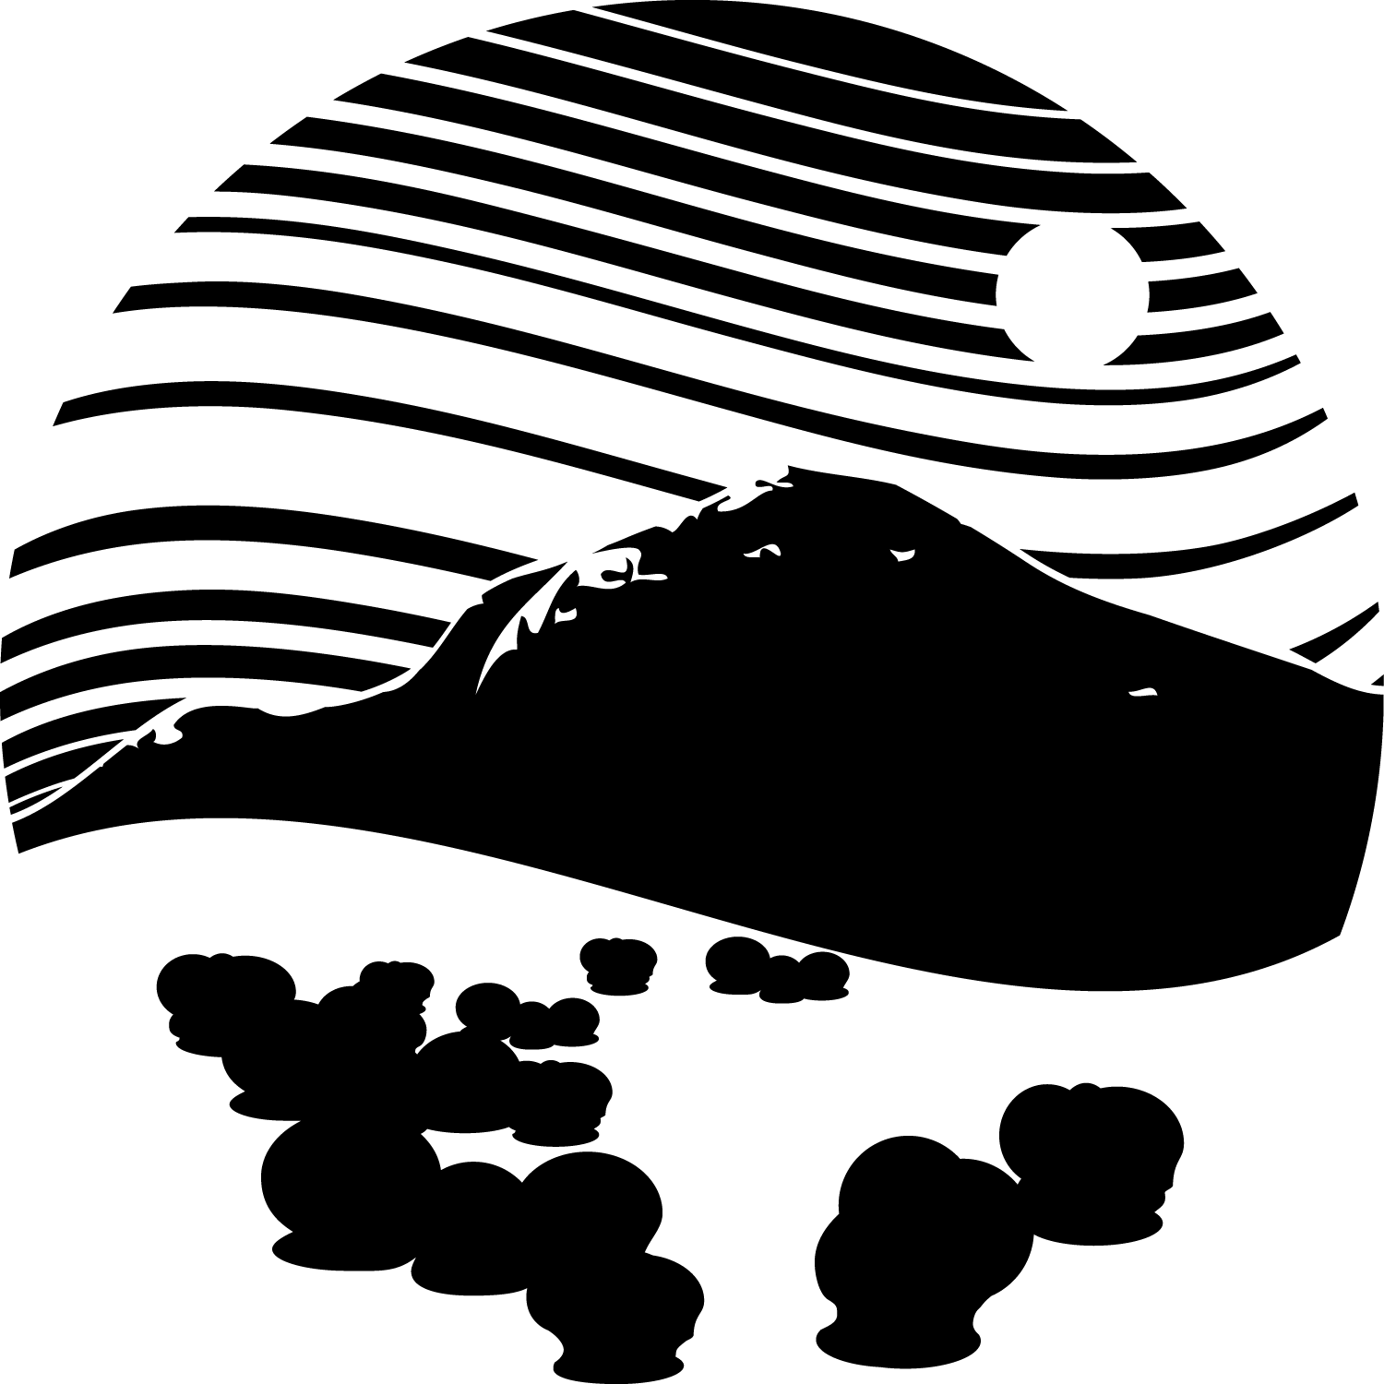
Biogeographic Patterns of
Coccolithophore
Morphological Disparity
Marites Villarosa Garcia
The University of Chicago
Department of the Geophysical Sciences

Slide 2
Factors that could influence morphological disparity
If regional disparity is tied to a regions’ | High Disparity Could Mean | Low Disparity Could Mean | Predictions of Biome(s) w/ High Disparity
Area/ Latitudinal Length | Wide range of latitudes represented | Limited range of latitudes | Gyres or long coastal currents
Ecological Diversity | Many ecological niches | Limited niches; high convergence | Tropical biomes; Vertically stratified biomes
Evolutionary History | Recent speciation; accumulation of taxa; in transition period | Strong selective of frequent extinction; taxonomic incumbency | Biomes in flux -or- cradle biomes (Tropical, gyre)

Slide 3
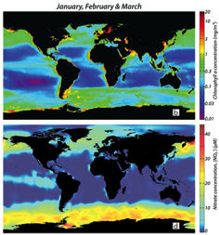
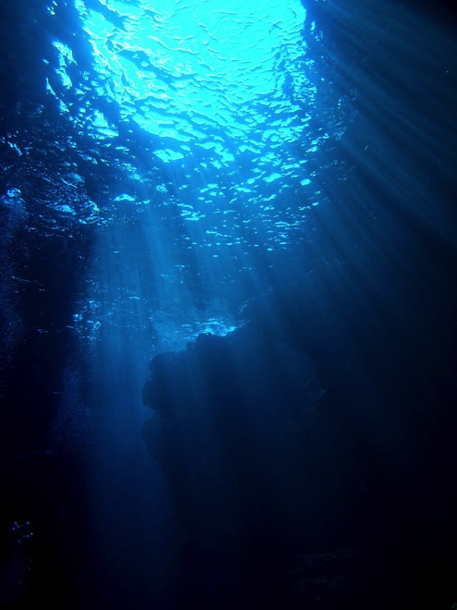
The pelagic realm is spatially heterogeneous
January, February, March
Nitrate (μmol) Chlorophyll a (mg/m3)
Sigman, D. M. & Hain, M. P. (2012) The Biological Productivity of the Ocean. Nature Education Knowledge 3(10):21

Slide 4
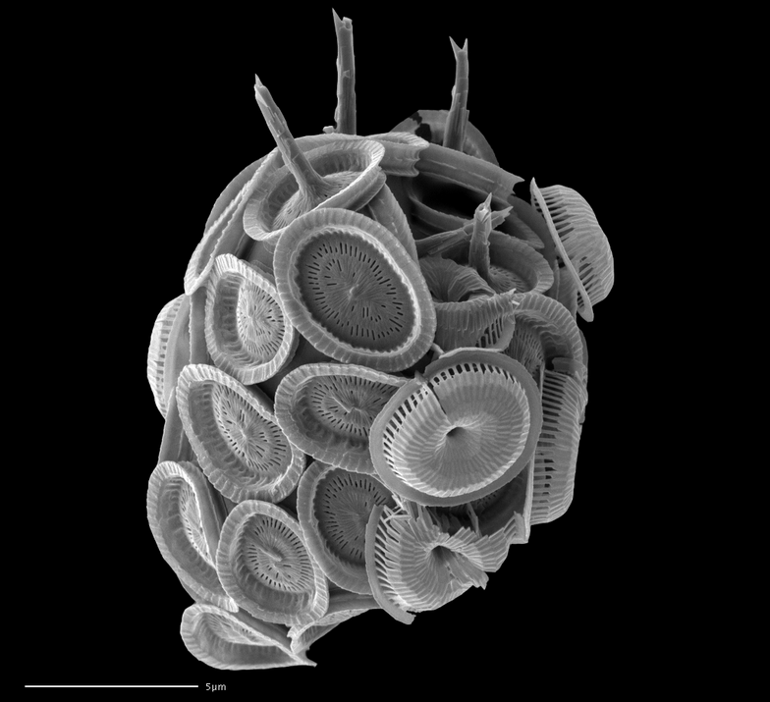
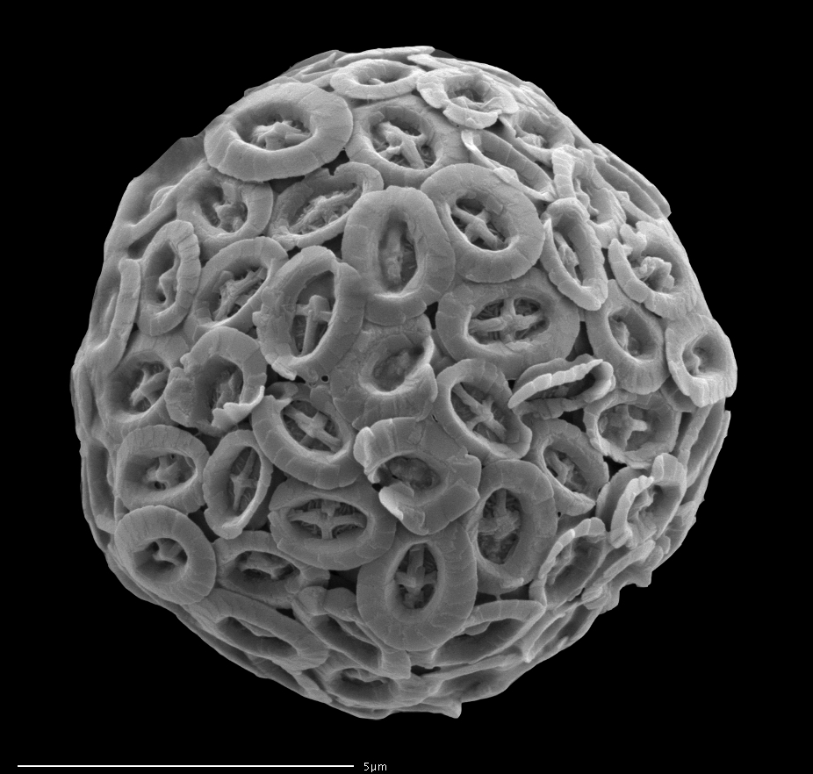
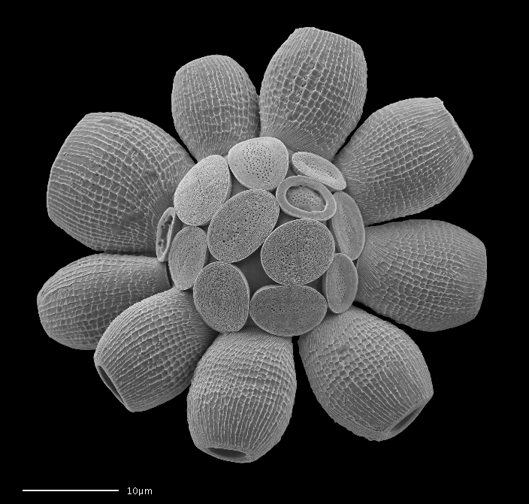
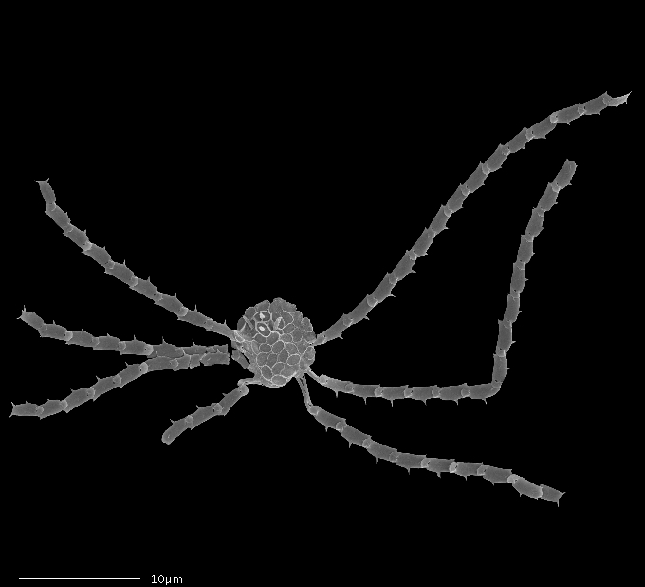
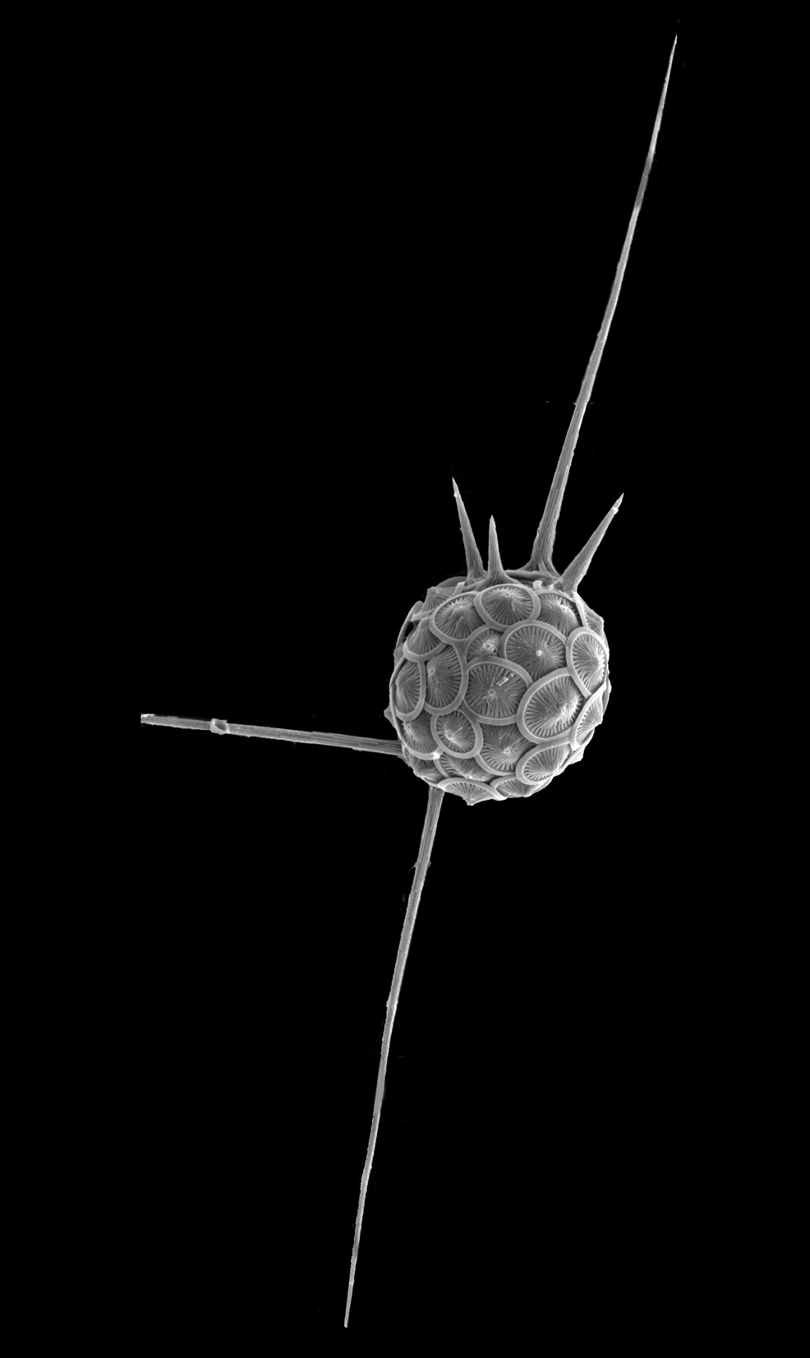
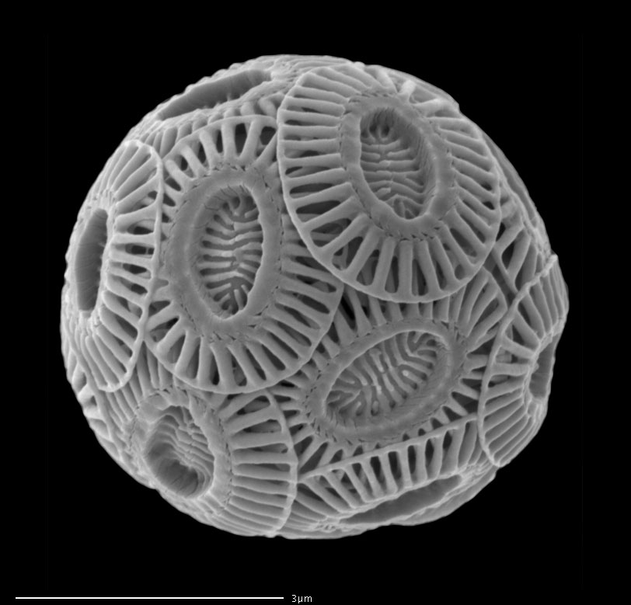
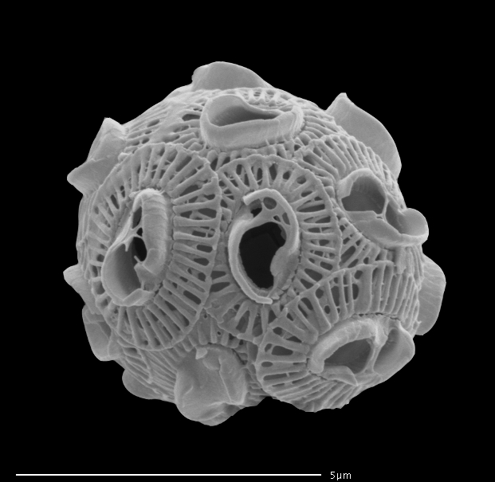
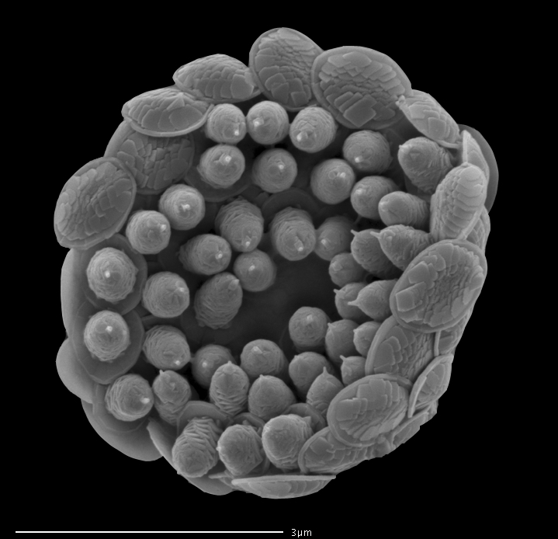
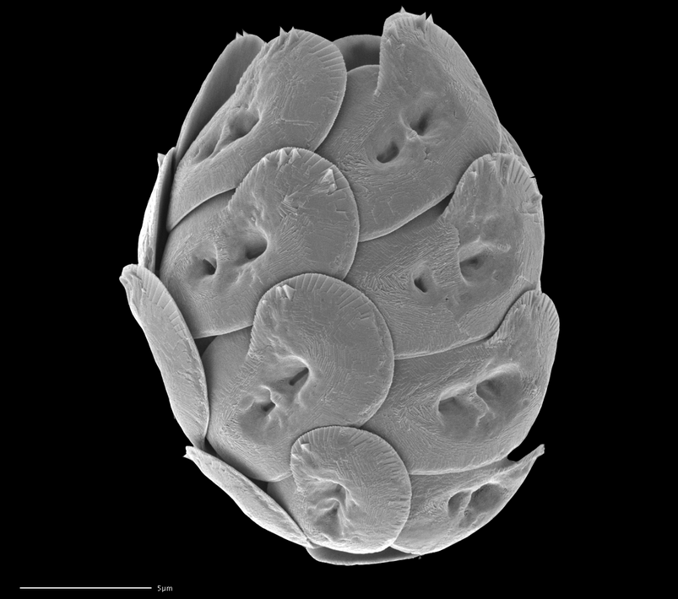
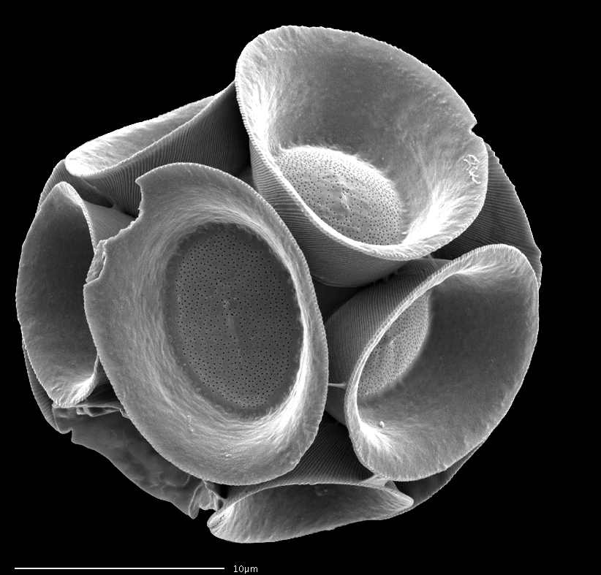
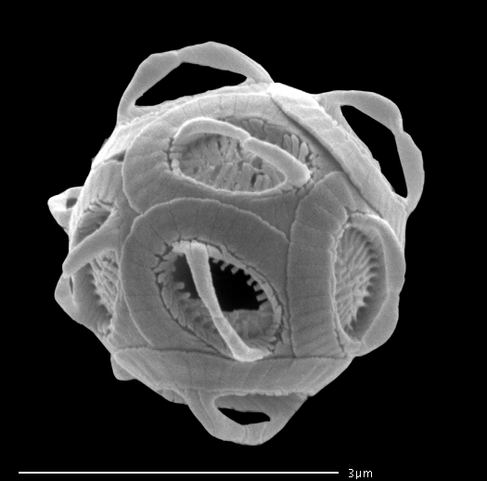
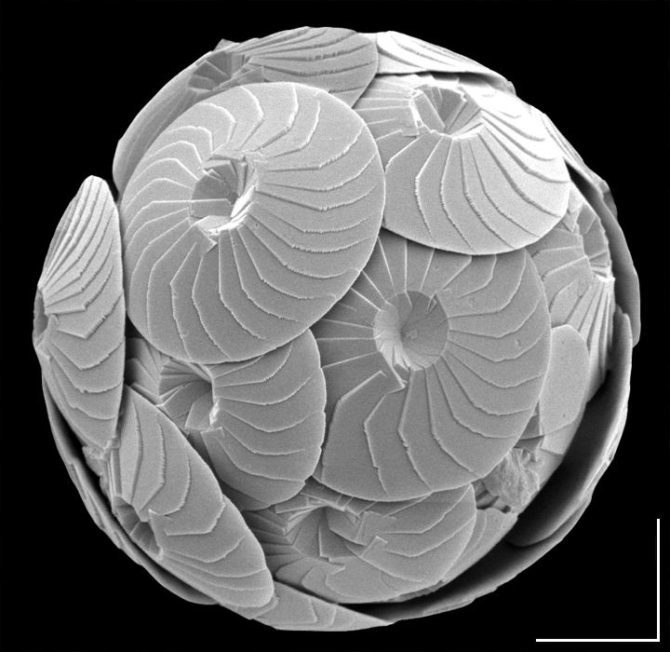
Phytoplankton can be morphologically complex
Young, J. R., Bown P. R., Lees J. A. (eds). Nannotax3 website. International Nannoplankton Association. 10 Oct 2014.
http://ina.tmsoc.org/Nannotax3
Scale bars: 1-10 μ

Slide 5
Study Questions
Does morphological disparity vary across different pelagic provinces and pelagic biomes?
Do different biomes represent different areas of morphospace?

Slide 6
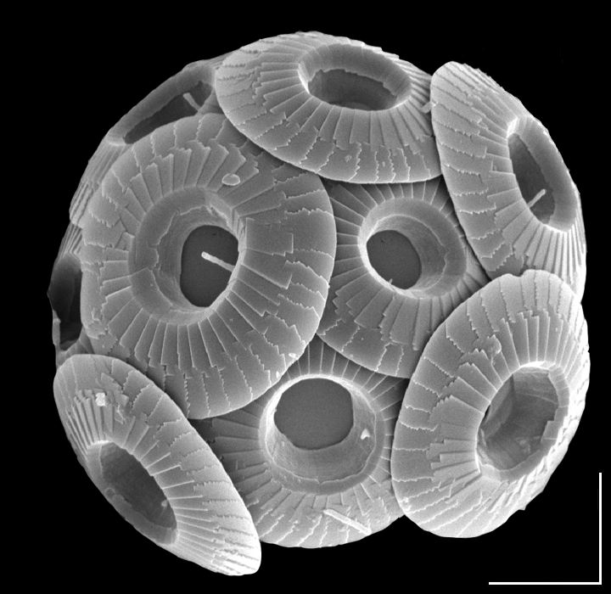
Quantifying Shape
68 binary characters, 106 species
SEMs from literature and Nannotax3
Two Main Structural Areas:
Margin
Central Area (CA)
Young, J. R., Bown P. R., Lees J. A. (eds). Nannotax3 website. International Nannoplankton Association. 10 Oct 2014.
http://ina.tmsoc.org/Nannotax3

Slide 7
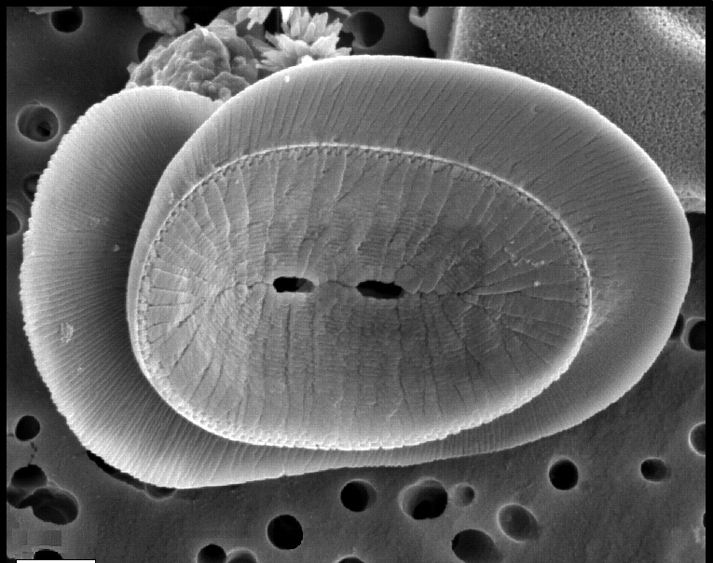
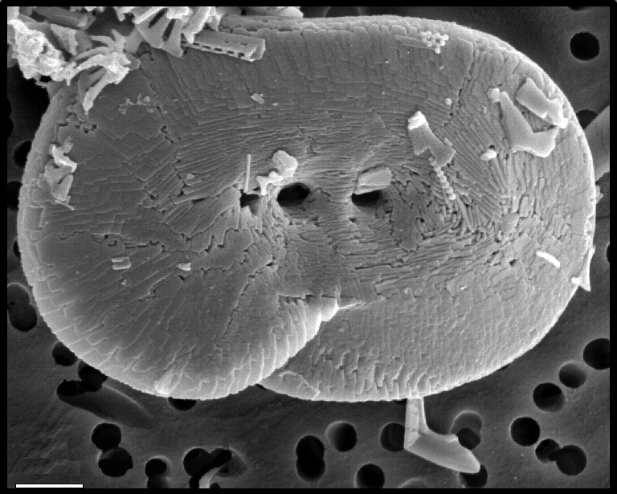
Quantifying Shape
Two views:
Proximal
Distal
Some traits are different depending on orientation
symmetrical outline
PV: elliptical
DV: asymmetric
Young, J. R., Bown P. R., Lees J. A. (eds). Nannotax3 website. International Nannoplankton Association. 10 Oct 2014.
http://ina.tmsoc.org/Nannotax3

Slide 8
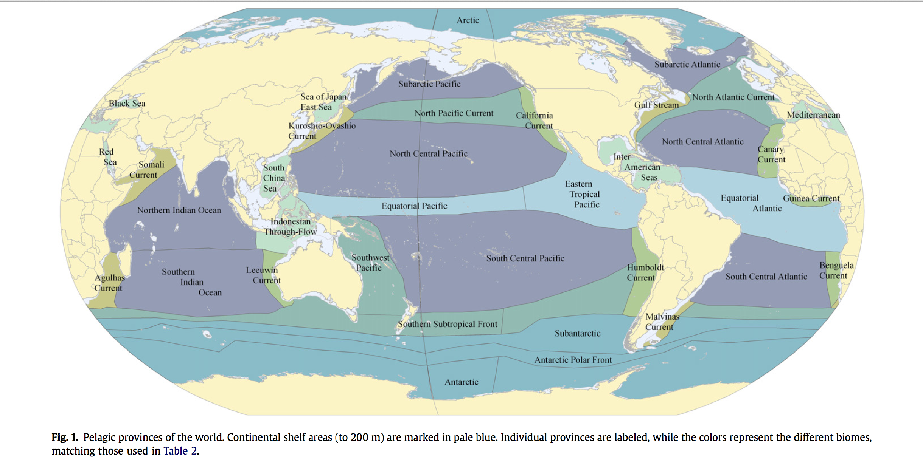
Biogeographic Provinces
Areas defined by spatially and temporally stable oceanographic conditions which host a distinct assemblage of species.
Province: North Pacific Current
34 provinces in study
Spalding et al. (2012). Ocean & Coastal Management 60:19-30

Slide 9
Ocean Basin
Area of ocean delimited by continents
Ocean Basin: Pacific
Spalding et al. (2012). Ocean & Coastal Management 60:19-30

Slide 10
Pelagic Biomes
Groups of provinces with similar oceanographic regimes
Biome: Eastern Boundary Currents
Spalding et al. (2012). Ocean & Coastal Management 60:19-30

Slide 11
Most provinces have very similar average provincial disparity
ATL MED+
IND PAC

Slide 12
Regional richness
is a poor
predictor of
regional
disparity
Western Boundary Current
Transitional
Eastern Boundary Current
Equatorial
Gyre
Biome | Avg Disparity | Avg no. sp./prov
WBC | 0.173 | 74
EBC | 0.166 | 89
Equatorial | 0.166 | 174
Gyre | 0.165 | 325
Epieric/ Shallow | 0.159 | 35
Semi-enclosed | 0.158 | 162
Polar | 0.049 | 2
Epeiric
Semi-enclosed sea

Slide 13
The coccolith-o-space
First morphospace encompassing all extant orders
Eigenvalues
PCO1: 0.66
PCO2: 0.34
PCO3: 0.23
PCO4: 0.21
PCO5: 0.17
PCO6: 0.15
PCO7: 0.14
PCO8: 0.10

Slide 14
The coccolith-o-space
PCO2:0.34
trait loading: -0.35
Huge Central Area
Small Central area or neither small nor large
trait loading: -0.60
PCO1: 0.66

Slide 15
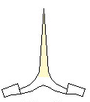

The coccolith-o-space
Protruding structure in the central area
PCO2:0.34
trait loading: -0.46
no protruding structure in central area
trait loading: 0.15
http://ina.tmsoc.org/terminology/6centralareas.htm
PCO1: 0.66

Slide 16
Biomes overlap in coccolith-o-space
PCO2:0.337
Biome
Western Boundary Current
Eastern Boundary Current
Gyre
PCO1: 0.66

Slide 17
Individual
provinces
occupy
somewhat
different areas
PCO2:0.34
Provinces within Western boundary current biome
Somali Current
Alguhas Current
Kuroshio Current
Malvinas Current
Gulf Stream
PCO1: 0.66

Slide 18
BUT, this is
due to a few
unusual taxa
U. tenuis
A. quadrilatera
PCO2:0.34
Provinces within Western boundary current biome
Somali Current
Alguhas Current
Kuroshio Current
Malvinas Current
Gulf Stream
S. tumularis
H. perplexus
S. lamina
D. tubifera
A. meteora
P. flabellifera
A. cidaris
P. vandelii
PCO1: 0.66

Slide 19
Even on different
PCO axes
PCO2:0.10
Provinces within Western boundary current biome
Somali Current
Alguhas Current
Kuroshio Current
Malvinas Current
Gulf Stream
PCO7: 0.14

Slide 20
So…
Does morphological disparity vary across different pelagic provinces and pelagic biomes?
Not really, most provinces ~0.16
Do different biome assemblages represent a different areas of morphospace?
Not really, there is a lot of overlap
There is minimal variation in morphological disparity and morphospace occupation across biomes and provinces in the modern, which suggests that major changes in either over time are likely tied to profound biological or environmental changes

Slide 21


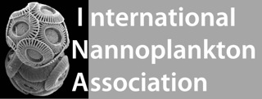
Acknowledgments
The Micropalaeontological Society
University of Chicago Graduate Student Affairs
Committee on Evolutionary Biology Hinds Fund
Michael Foote
Kevin Boyce
Maureen Coleman
Dave Jablonski
Susan Kidwell
Jeremy Young and all Nannotax3 contributors
Michael LaBarbera
Marie-Pierre Aubry
Kathleen Ritterbush
Mark Webster
Andy Michaelson
Jonathan Mitchell
Stewart Edie
David Bapst
Nadia Pierrehumbert
Peter Smits
Marie Hoerner
And all my other fellow graduate students at the University of Chicago

Slide 22
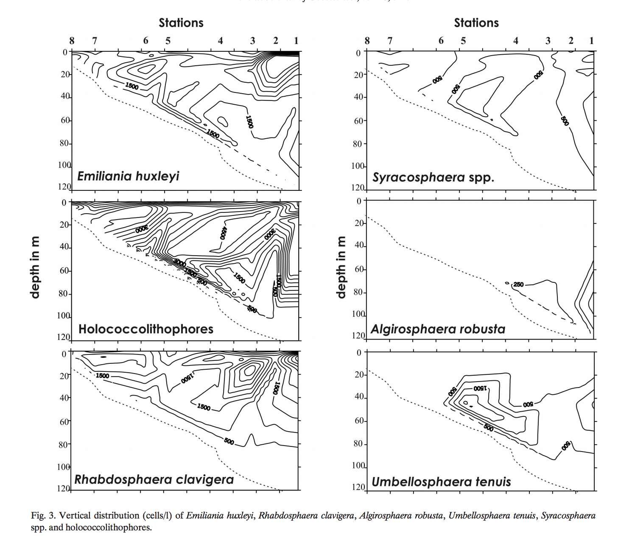
What else can we look at?
We can partition biomes by depth.
Upper/lower photic zone
Depth of thermocline
Dimiza, Triantaphyllou & Dermitzakis, 2008. Hellenic Journal of Geosciences, 43: 7-20

Slide 23
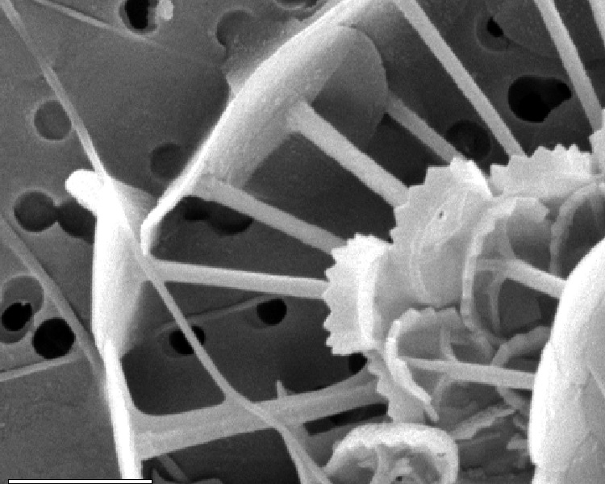
What else can we look at?
We can partition biomes by depth
We can test biological hypotheses for where trait occurrence out to be higher
Protruding structure increases drag
Expect high occurrence in highly stratified water column
Protruding structure in the central area
Environmental Exchange
Sinking Behavior
Biotic Interactions
Coccosphere Architecture

