Slide 1
EVIDENCE FOR SYN-SEDIMENTARY TECTONISM IN A PALEOPROTEROZOIC RIFT BASIN: THE ESPANOLA FORMATION, LOWER HURONIAN SUPERGROUP, CANADA
By
Mansour Al-Hashim, Patricia Corcoran
Department of Earth Sciences
Western University
GSA 2014 Annual Meeting, 19-22 October, Vancouver, BC, Canada

Slide 2
Aims of the presentation
Introducing the stratigraphy, sedimentology and depositional environment of one of the oldest carbonate deposits in the world
Presenting evidence of syn-depositional, rift-related tectonic activities from the Espanola Formation
Comparing geochemical signatures of Espanola rocks with those of other rift basin deposits

Slide 3
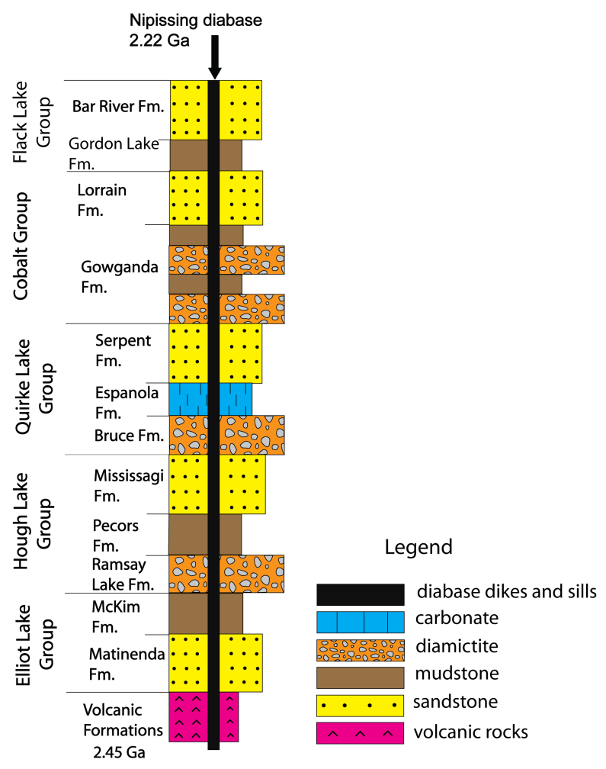
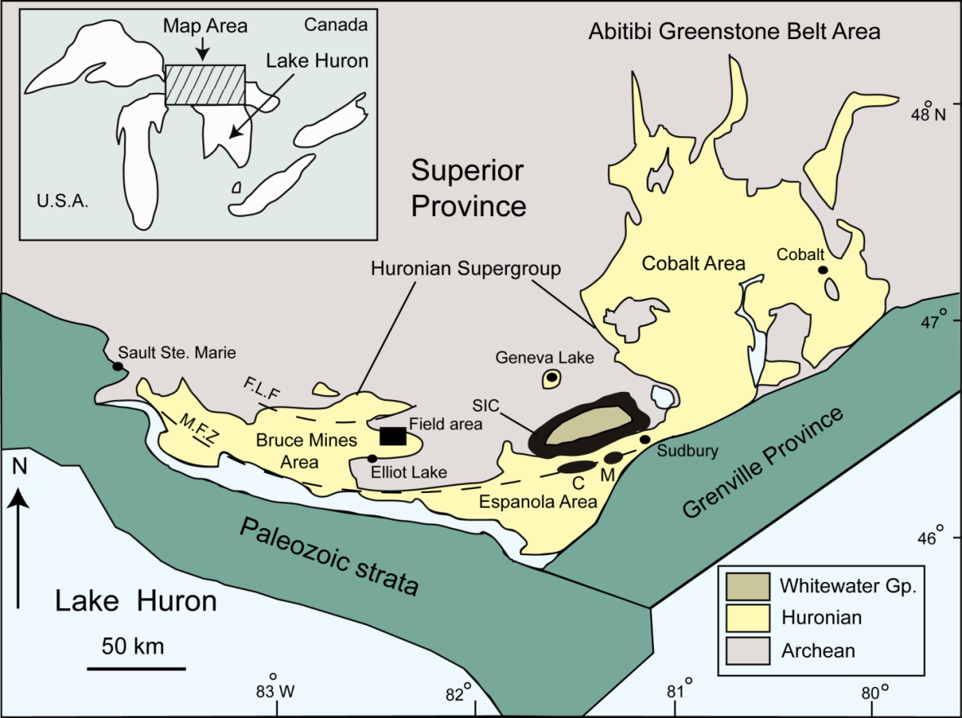
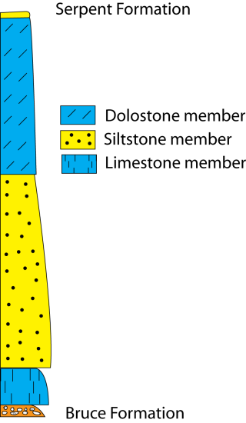
Introduction
Upper Huronian
Lower Huronian
Modified from Young et al. (2001), Bekker et al. (2005)
Modified from Bekker et al. (2005)

Slide 4
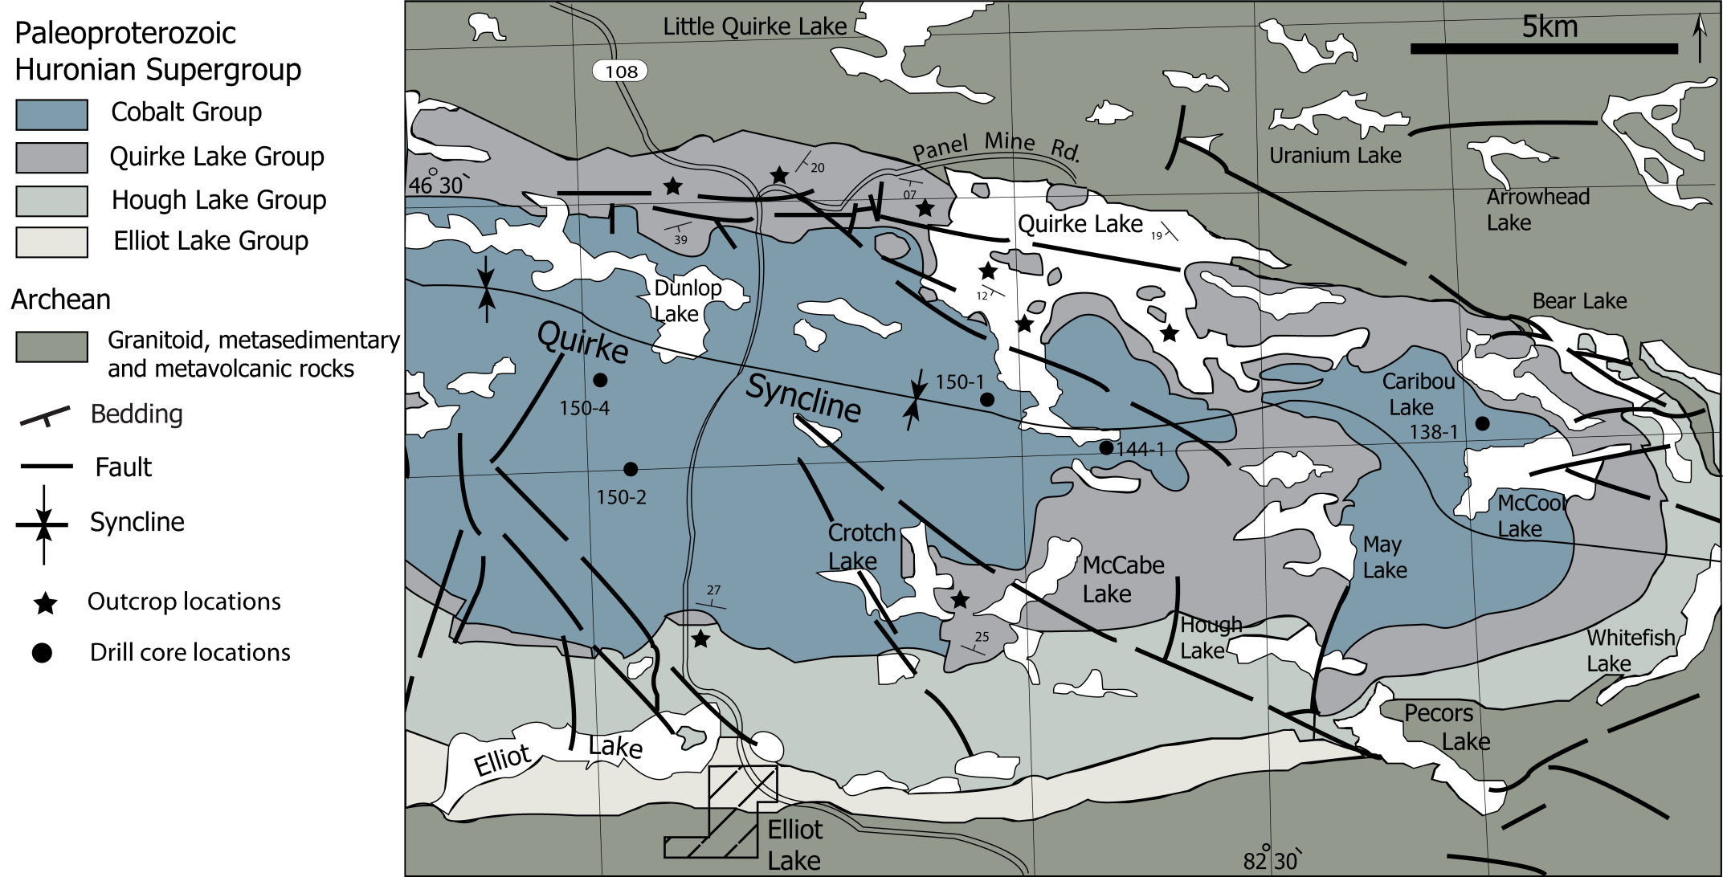
Field Area

Slide 5
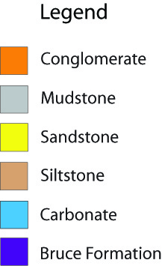
m
50
100
150
200
Core 150-2
25
75
125
175
0

Slide 6
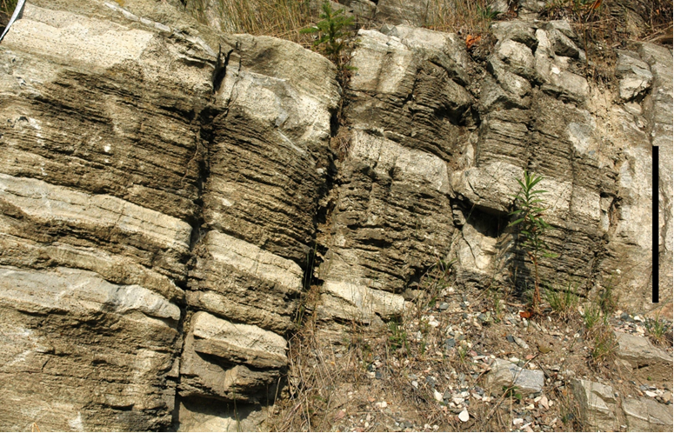
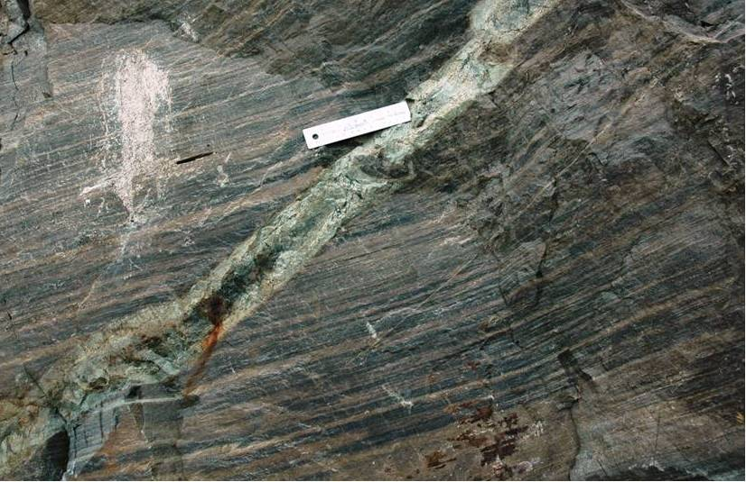
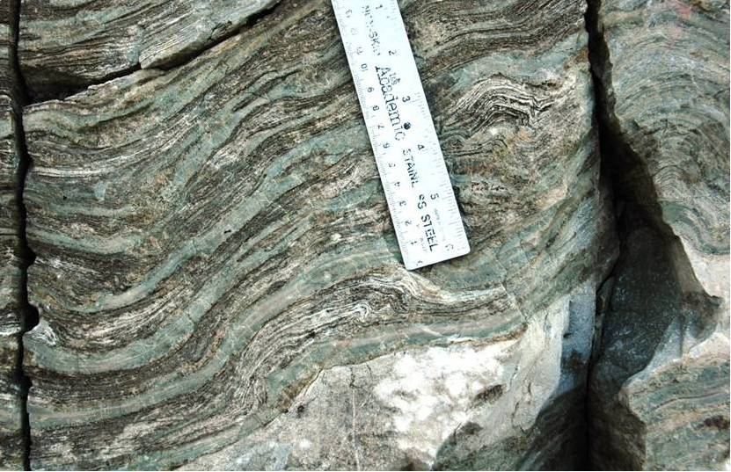
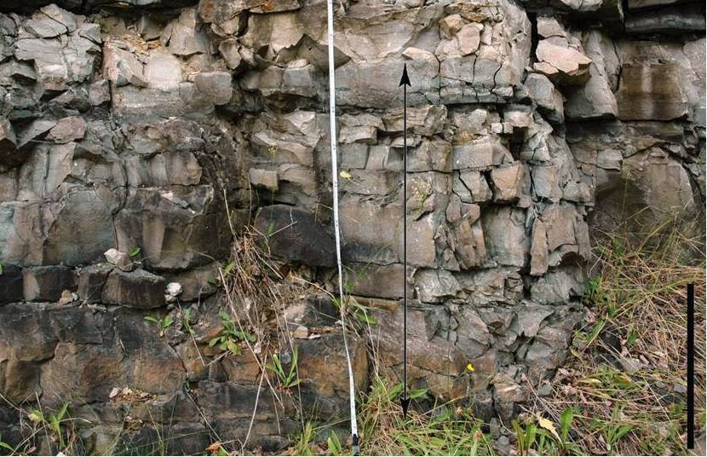
Sedimentology and Stratigraphy
Facies 1- Thickly-interbedded siltstone-carbonate
Facies 2- Interstratified mudstone-siltstone
Facies 3- Interbedded siltstone-thinly-laminated carbonate
Facies 4- Thickly bedded carbonate

Slide 7
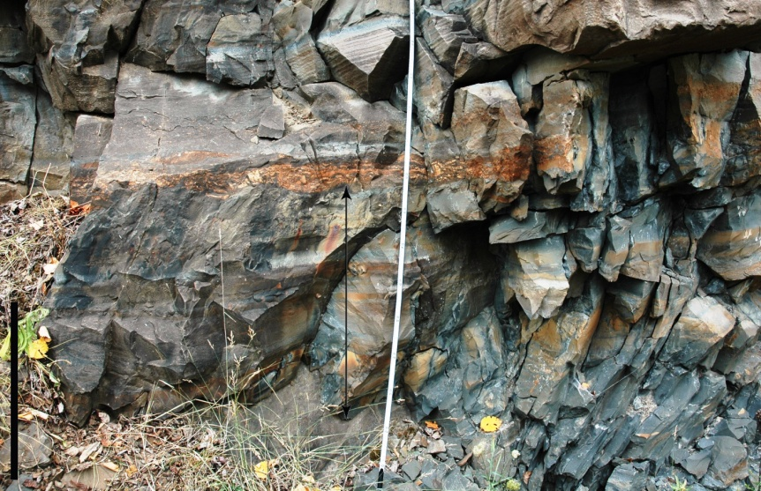
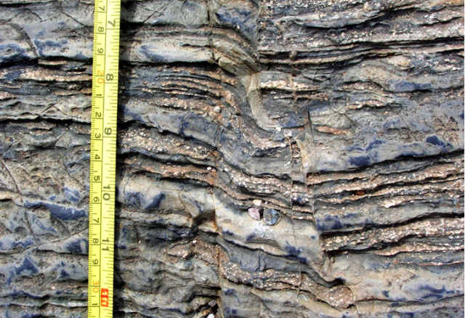
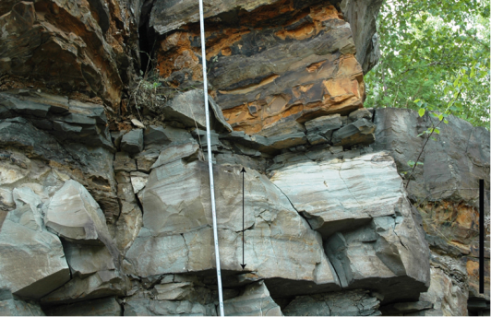
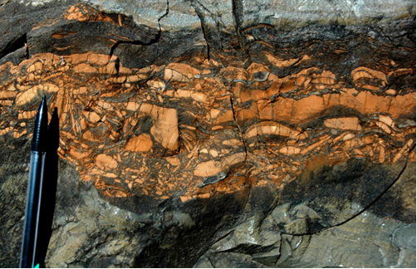
Sedimentology and Stratigraphy
Facies 5- Mudstone
Facies 6- Siltstone
Facies 7- Sandstone
Facies 8- Intraformational breccia and conglomerate

Slide 8
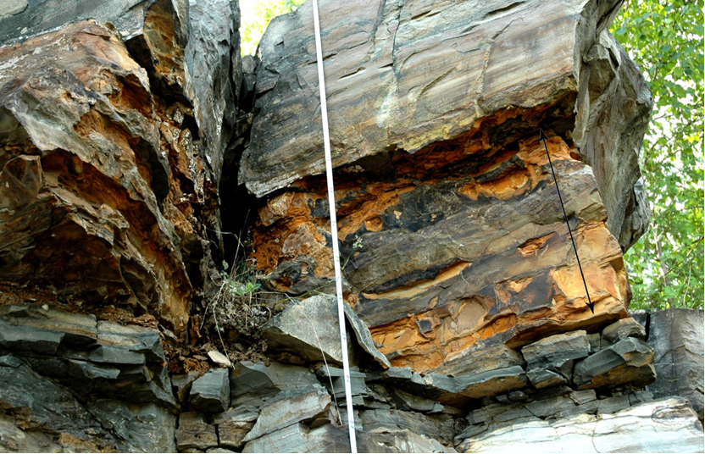
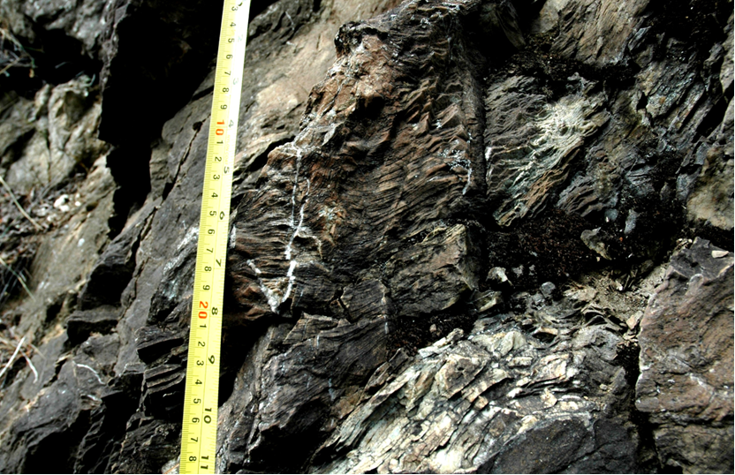
Sedimentology and Stratigraphy
Facies 9- Rusty carbonate
Facies 10- Stromatolitic carbonate

Slide 9
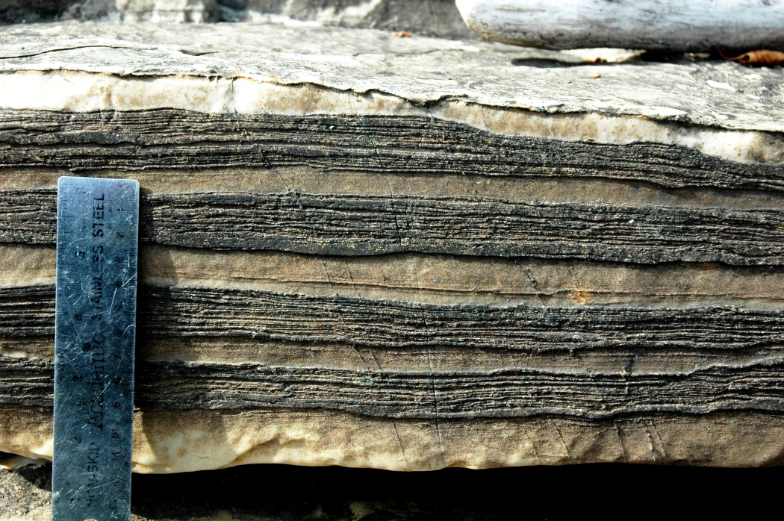
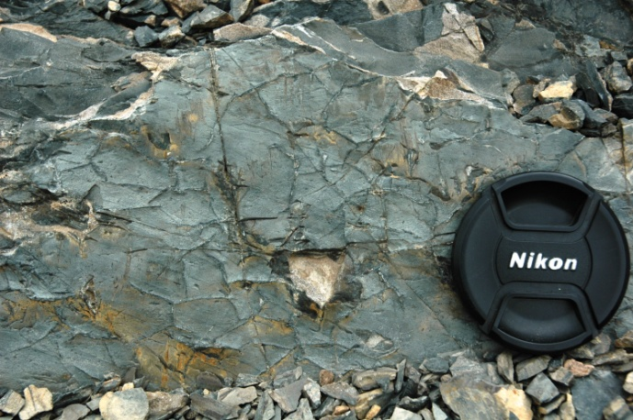
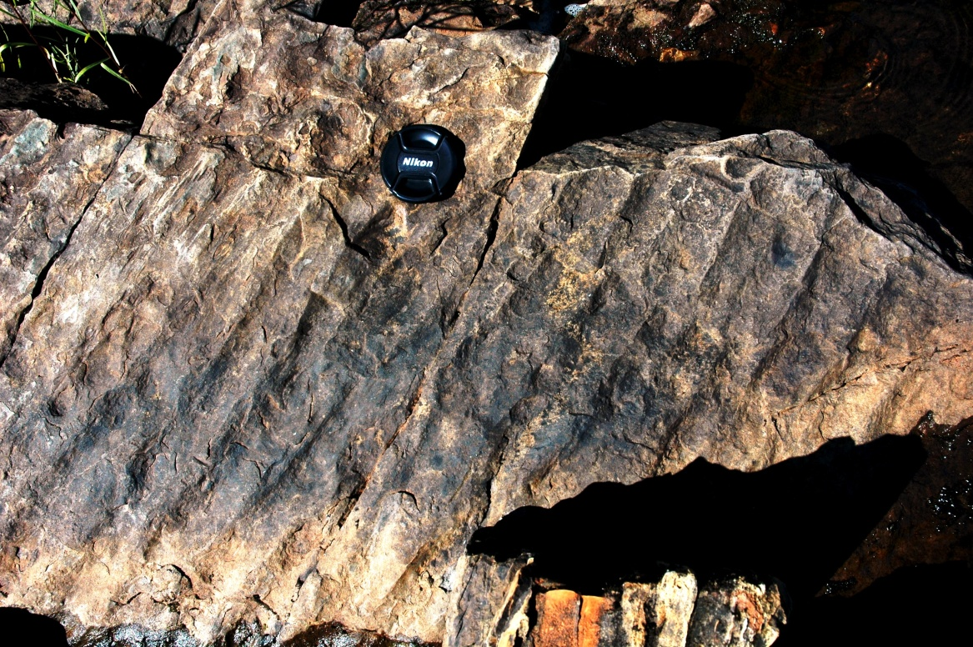
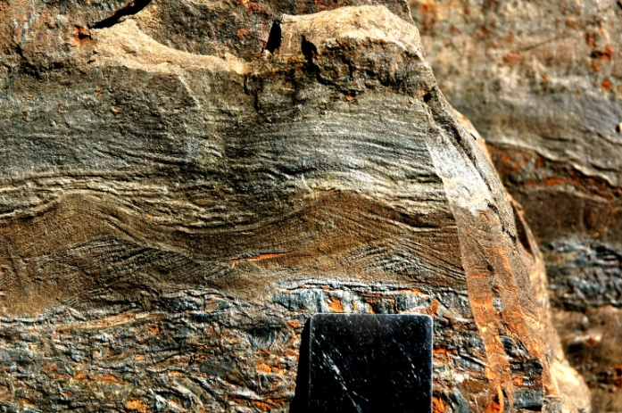
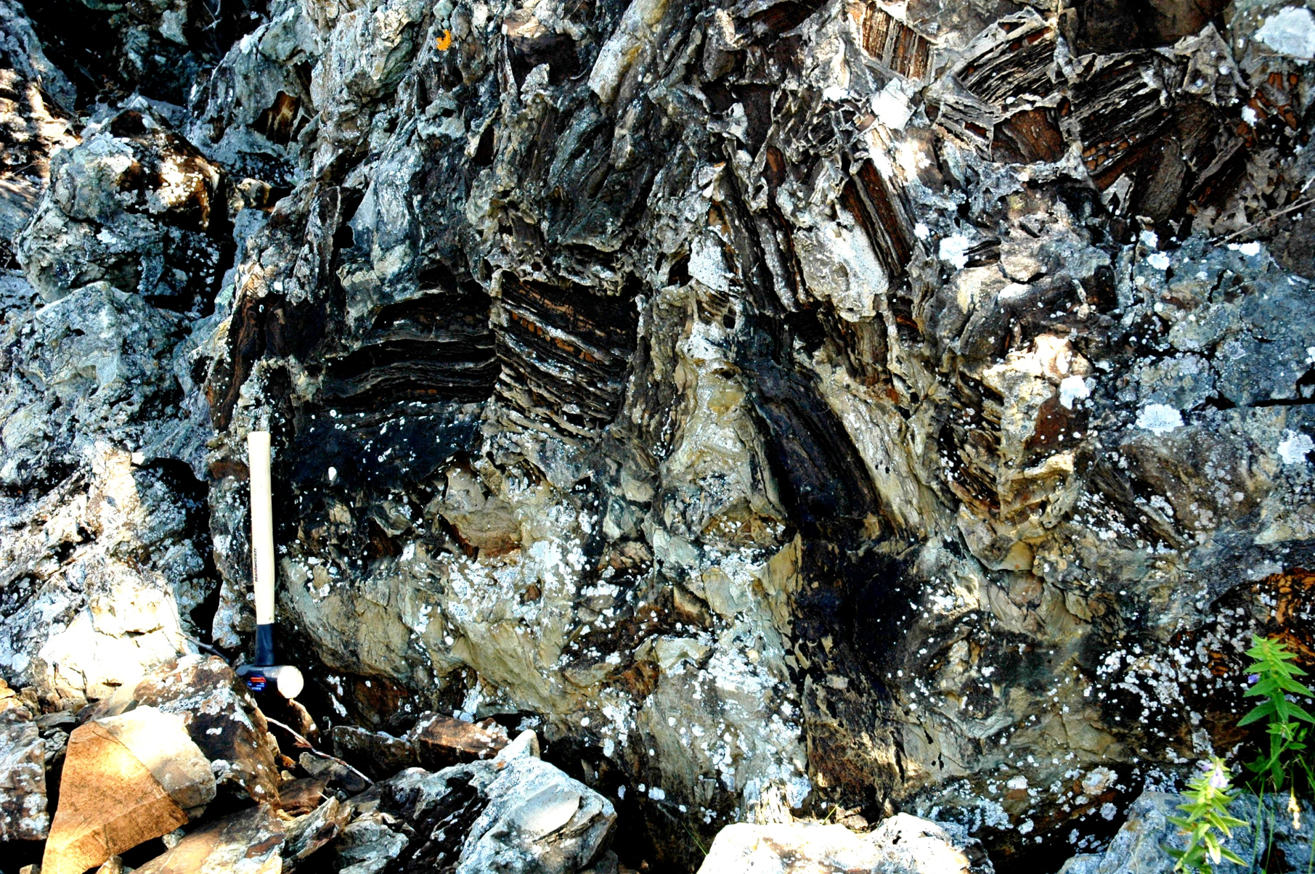
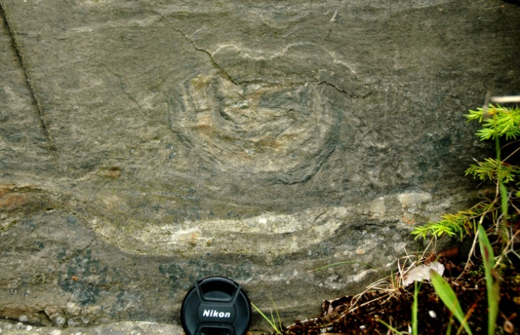
Depositional environment
The inferred characteristics of the depositional environment
Shallow-marine (intertidal)
Frequent subaerial exposure
Periodic influxes of siliciclastic sediments
Warm paleoclimate
Tectonic instability during sedimentation

Slide 10
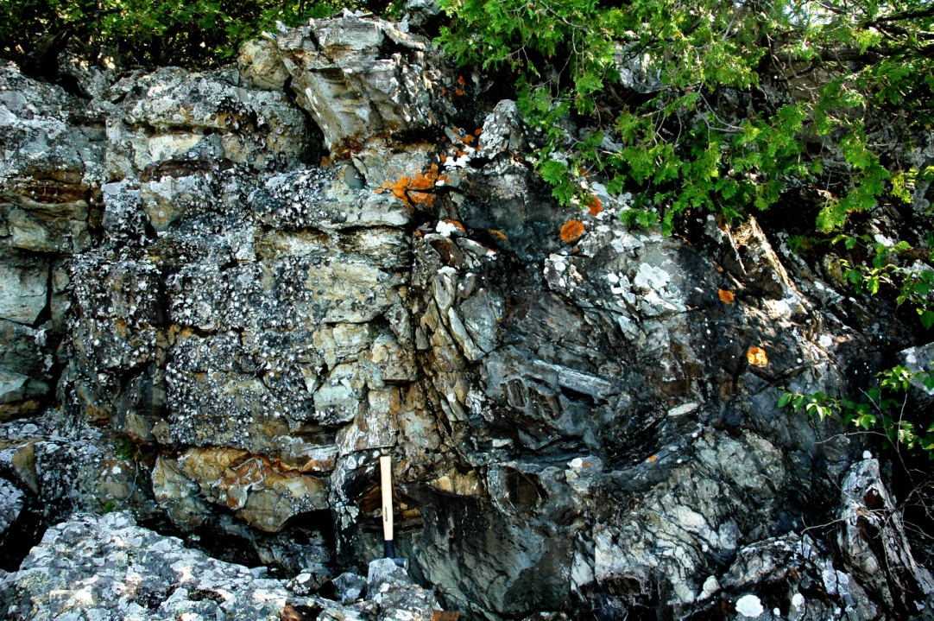
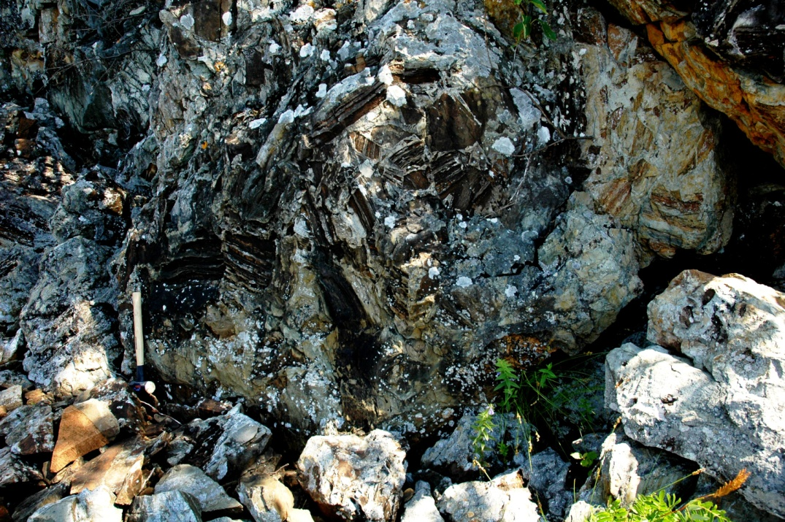
Indications of tectonic instability
Slump structures
Down-slope movement >> oversteepening of slope >> tectonic response to faulting activities
Down-slope movement >> increased water saturation by liquefaction >> seismic shaking >> tectonic and faulting activities

Slide 11
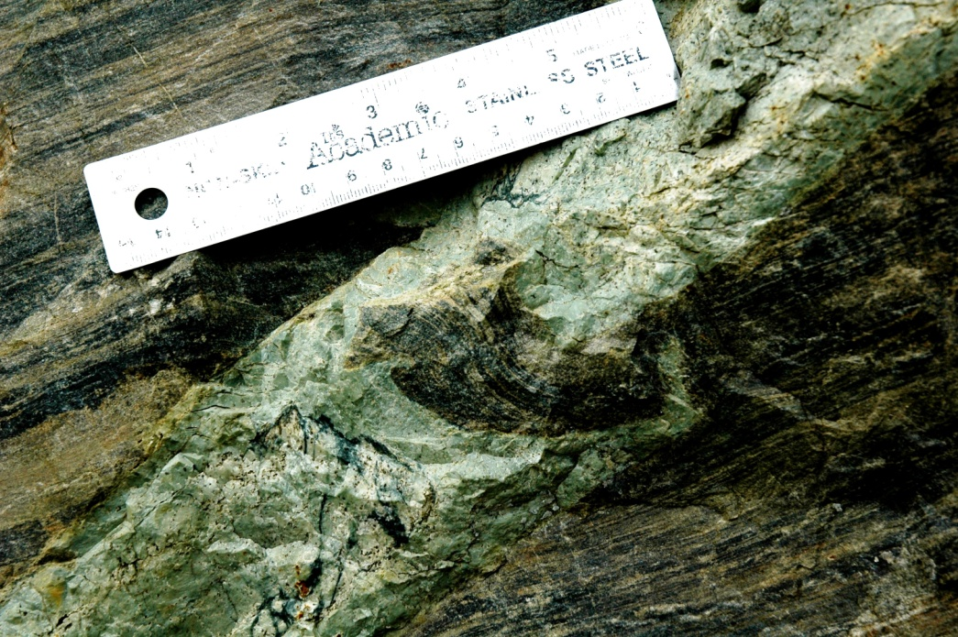
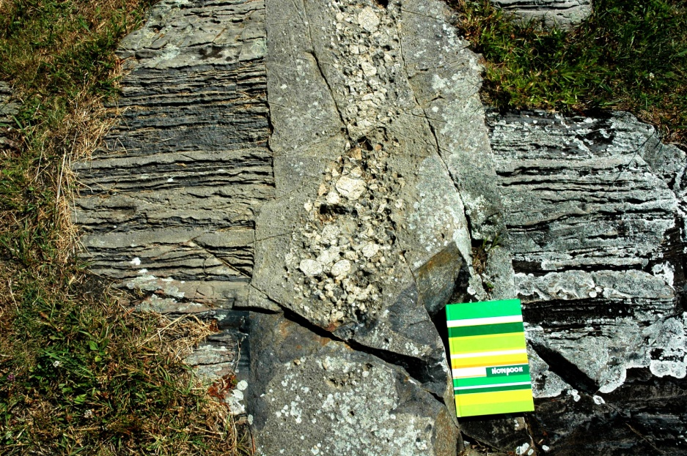
Indications of tectonic instability
Forceful intrusions
Stage 1: Tectonic instability >> faults and fractures
Stage 2: Seismic shaking >> fluidization>> mobilization and intrusion of clastic sediments

Slide 12
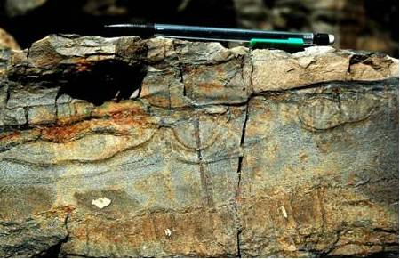
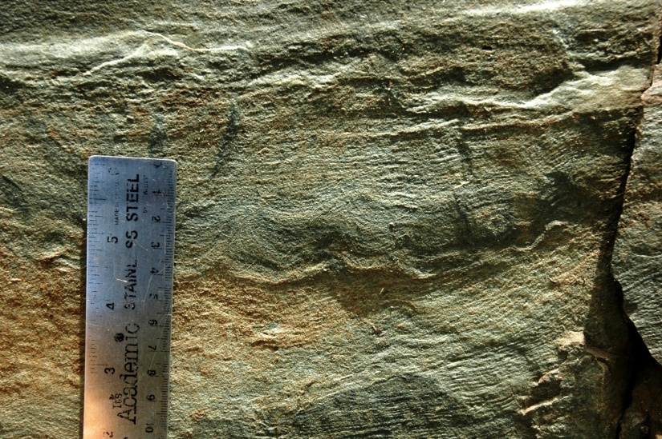
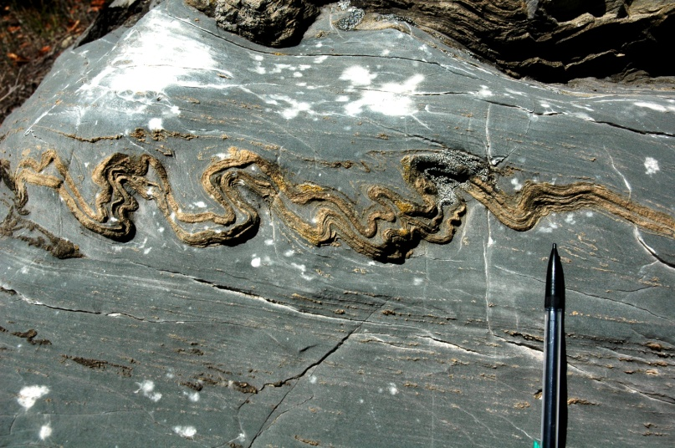
Indications of tectonic instability
Soft-sediment deformation structures (seismites)
Liquidization of unconsolidated, water-saturated sediments >> periodic and sudden syndepositional seismic activities

Slide 13
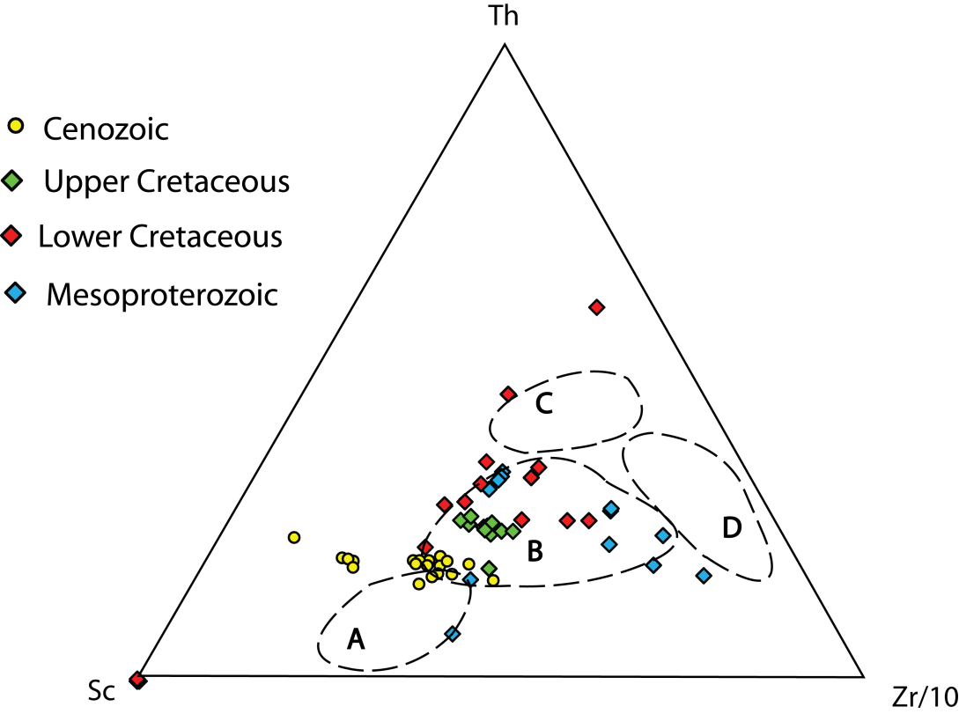
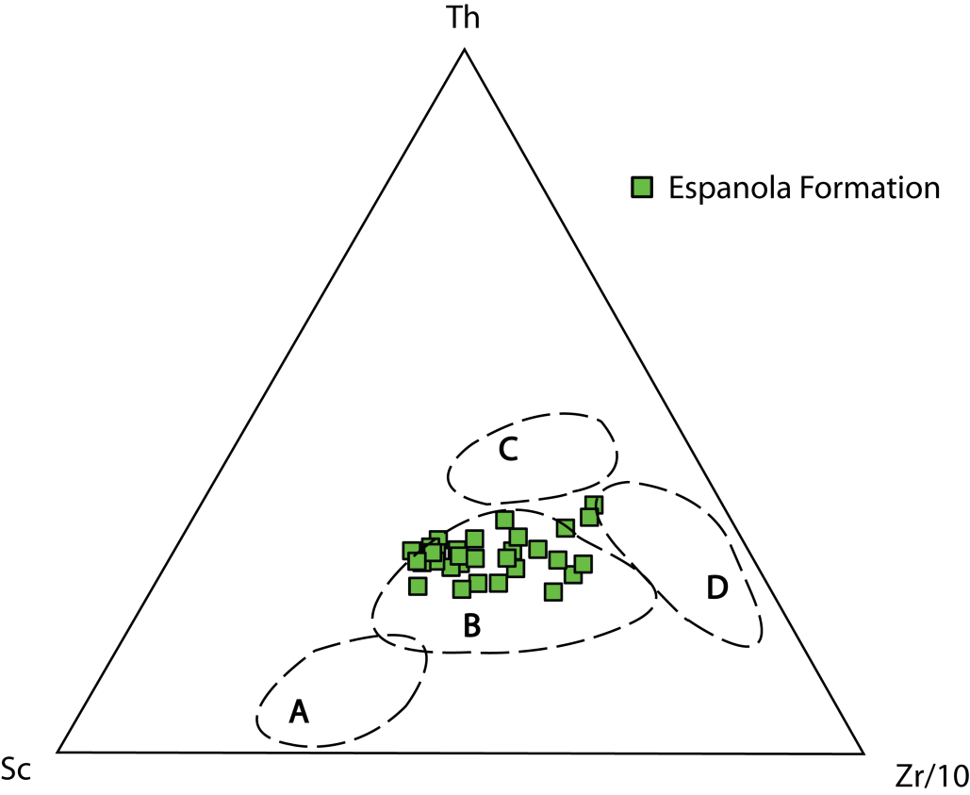
Geochemical signatures
Rift basins
Diagrams from Bhatia and Crook, 1986
A-Oceanic island arc B-Continental arc C-Active continental margin D-Passive margin

Slide 14
Weathering indices
Chemical index of alteration (CIA)
CIA = [(Al₂O₃) / (CaO* + Na₂O + K₂O + Al₂O₃)]
Material | Average CIA values
Fresh, unweathered igneous rocks | 50
Espanola Formation (siliciclastic samples) | 63
Average shales | 70 to 75
Rocks composed entirely of kaolinite, gibbsite, and/or chlorite | Close to 100
Increasing weathering
Implication: siliciclastic rocks of the Espanola Formation are immature, and indicate either negligible weathering of the source rocks or proximity to source area

Slide 15
Conclusions
The Espanola Formation was likely deposited in a rift basin characterized by active syndepositional faulting processes and associated tectonic instability
The evidence is in the form of slope failure, forceful intrusion of liquefied sediments and soft-sediment deformation
Geochemical signatures of Espanola rocks are in agreement with those reported from other rift basin deposits , which show a continental signature with geochemical immaturity

Slide 16
Thank you!

