Slide 1



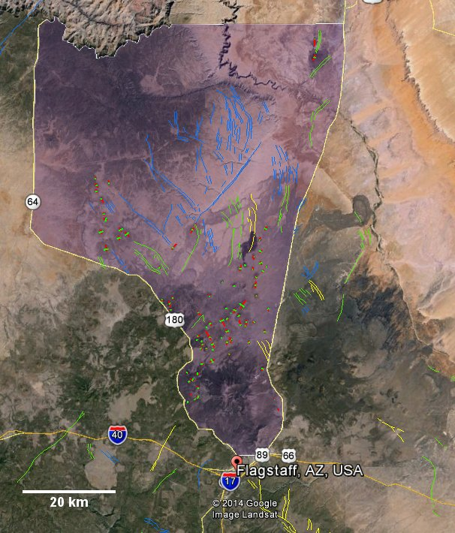
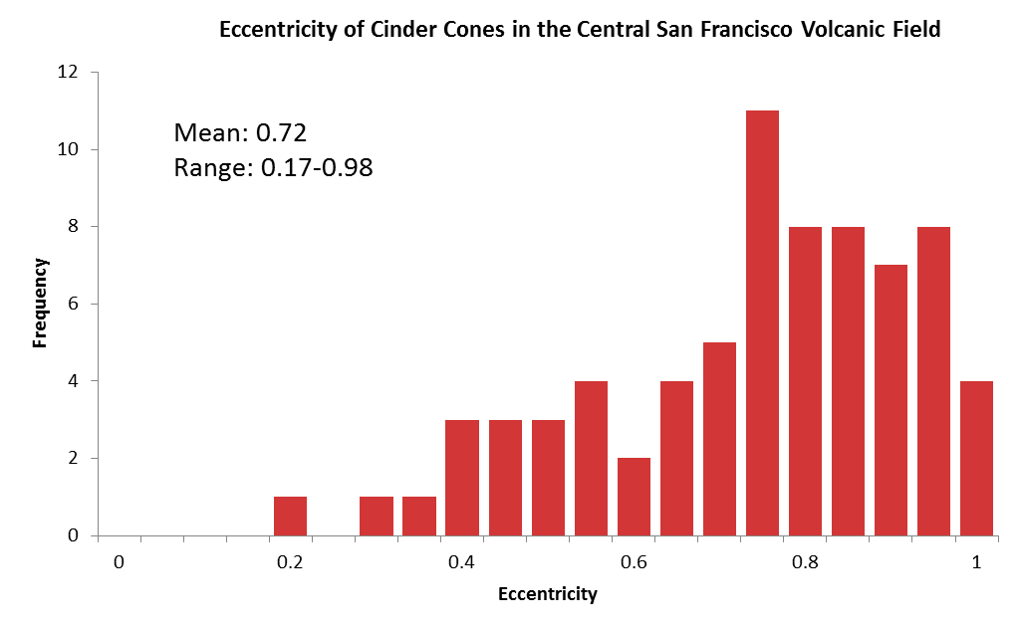
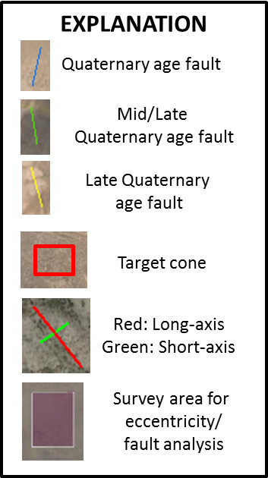
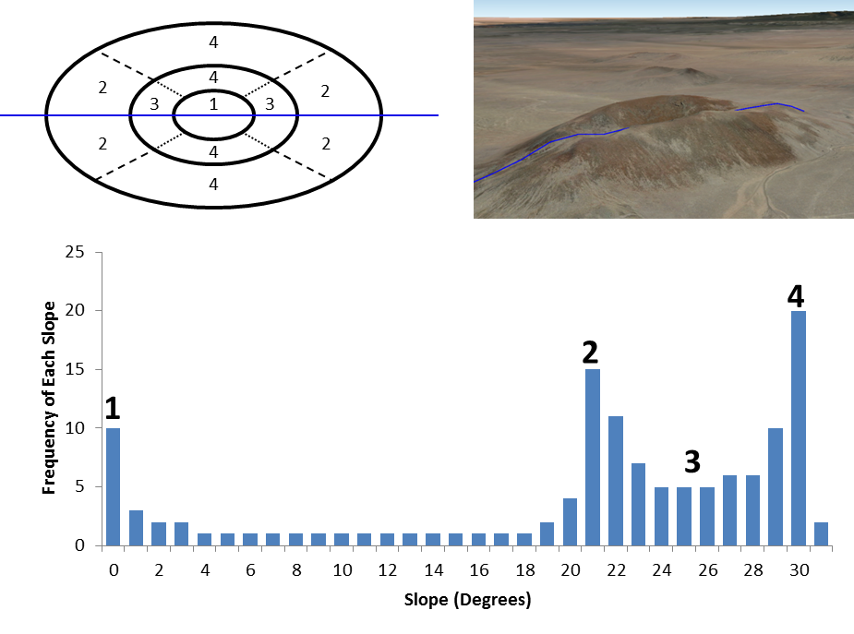
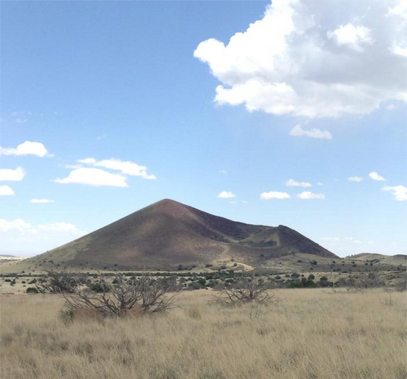
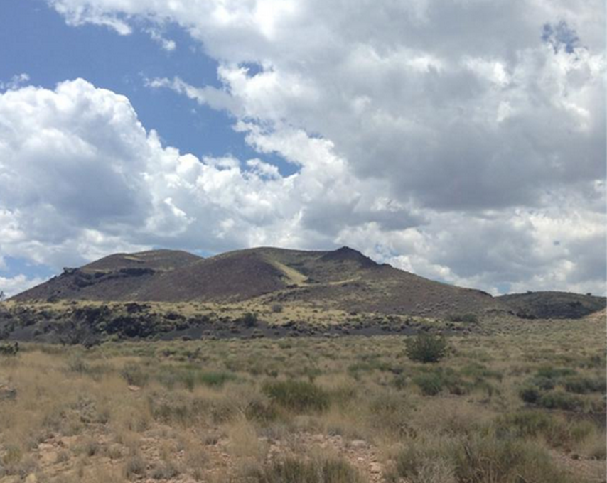
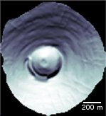
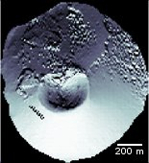
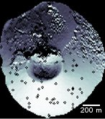
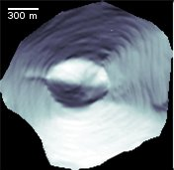
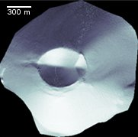
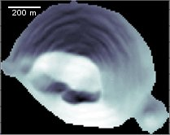
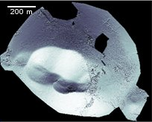
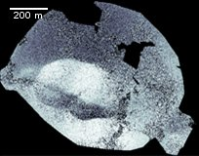
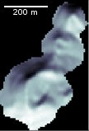
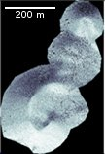
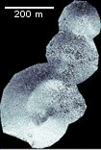



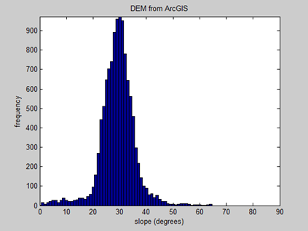
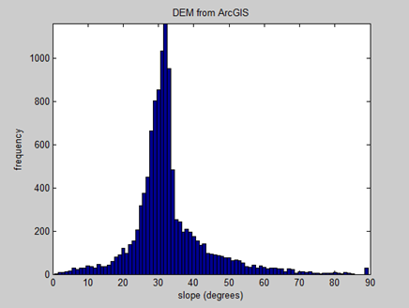

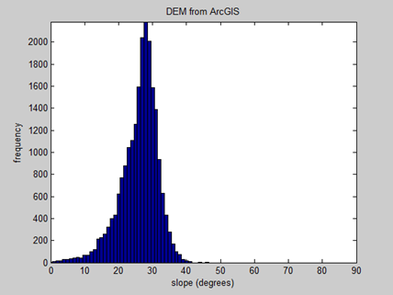
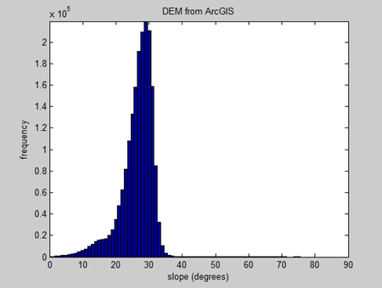
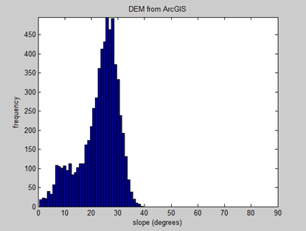
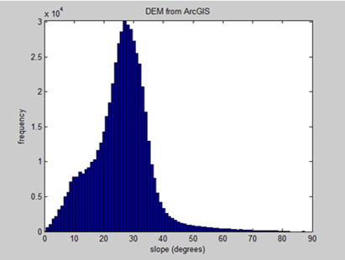
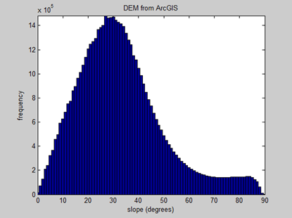
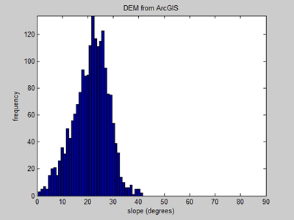
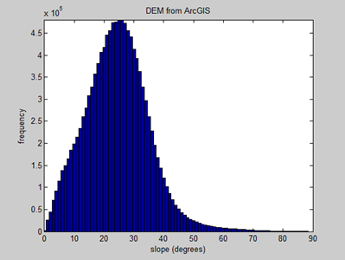
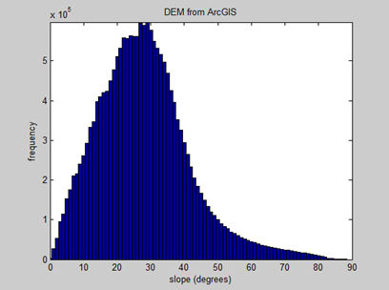
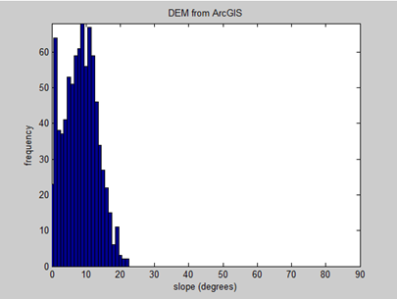
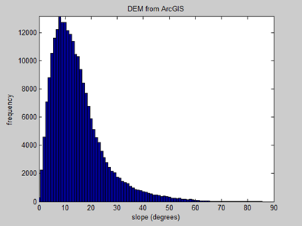
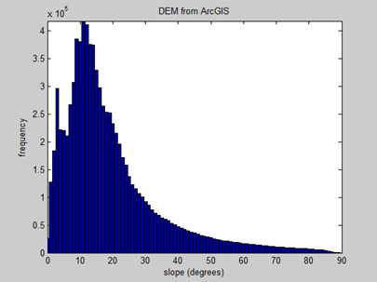
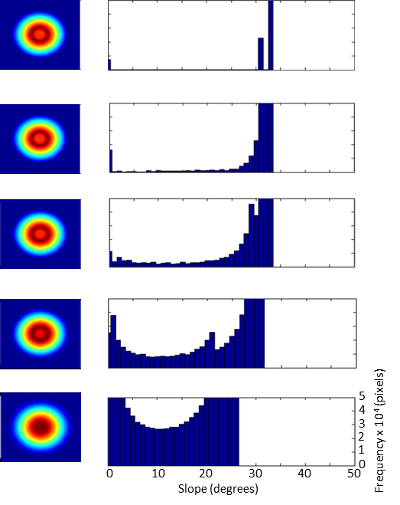
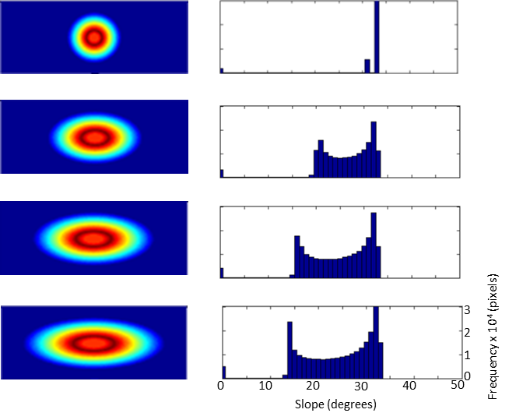
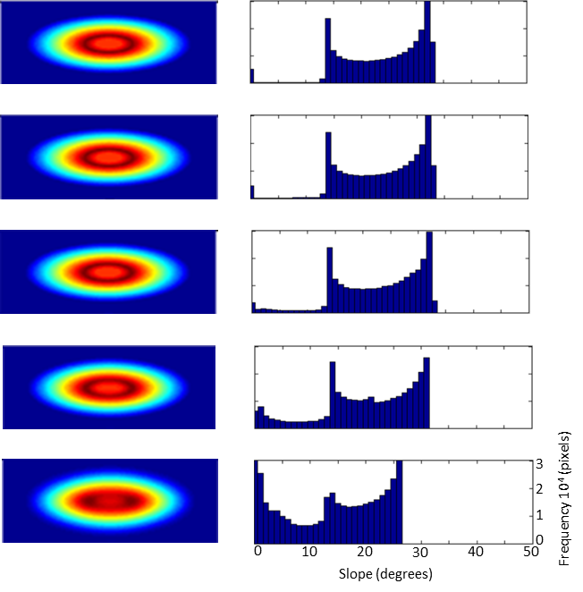
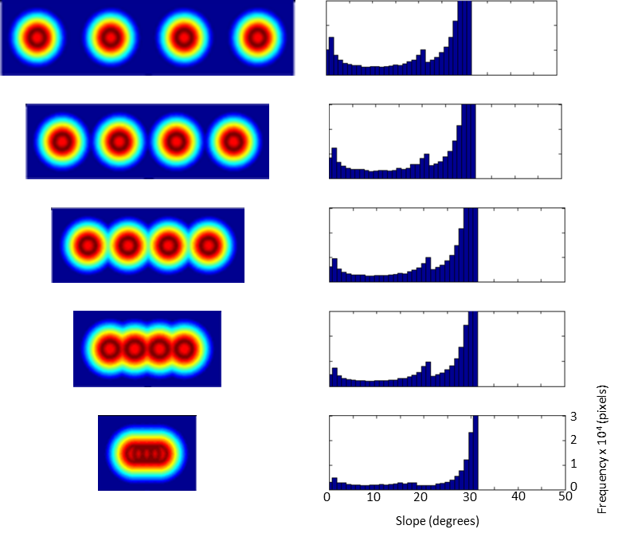

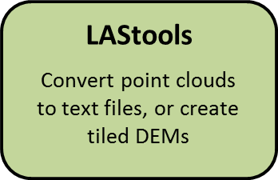







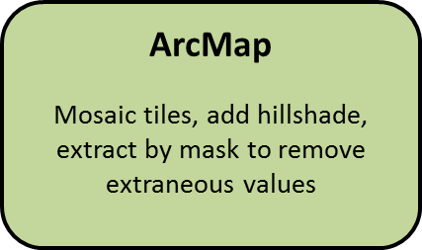



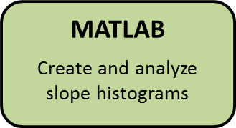
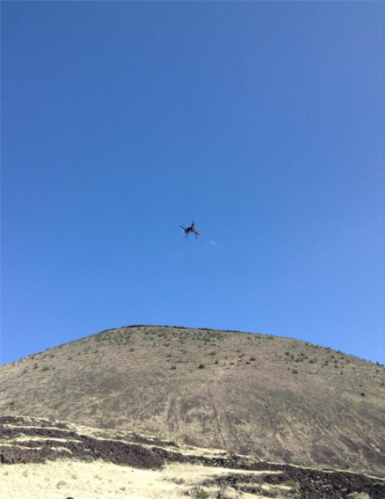
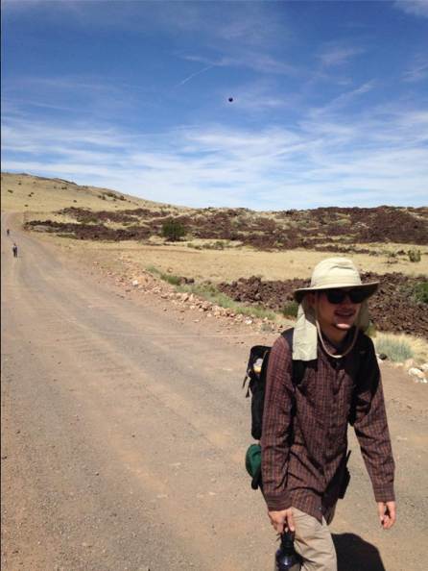

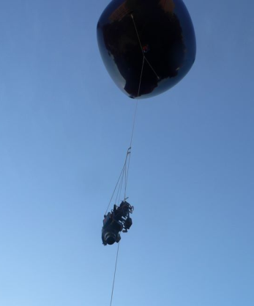
Cinder Cones with Complex Original Forms
and Implications for Morphologic Dating – REU 2014
Ryan Till¹, Ramon Arrowsmith², Fabrizio Alfano², Amanda Clarke², Mattia de’Michieli Vitturi³, Joanmarie Del Vecchio⁴, Kristin Pearthree⁵, James Muirhead⁶, Brett Carr²
The State University of New York at Buffalo, Buffalo, New York, USA. 2. Arizona State University, Tempe, Arizona, USA. 3. Instituto Nazionale di Geofisica e Vulcanologia, Sezione di Pisa, Italy.
4. Pomona College, Claremont, California, USA. 5. Oberlin College, Oberlin, Ohio, USA. 6. University of Idaho, Moscow, Idaho, U.S.A.
Introduction
Fig. 9
Cinder Cone Orientations in the
Central San Francisco Volcanic Field
Fig. 10
1
1
Fault Orientations in the
Central San Francisco Volcanic Field
1
1
Fig. 3: Crater 173, example
of elongate cone.
Fig. 2: Diagram demonstrating functionality of slope histograms with theoretical cone. Numbers on aerial view of cone represent regions of similar slope, and correspond to numbered regions on histogram.
Fig. 4: Doney Craters, example of
cone series.
Notice similar trends between fault and cone axis orientations
P-value from 2 tailed type 3 t-test = 0.2579
Fig. 8: Histogram of results from cone eccentricity analysis in survey area of figure 1. Illustration depicting control of eccentricity on ellipse shape.
Results: Eccentricity Analysis
Results: Physical Cones
Fig. 11: SP Crater; 10 m, 1 m (LAStools), 0.1 m (Points2Grid)
Fig. 12: Sunset Crater; 10 m, 1 m
(LiDAR)
Fig. 13: Crater 173; 10 m, 1 m (LAStools), 0.1 m
(Points2Grid)
Fig. 14: Southern Doney Craters; 10 m, 0.6 m (Agisoft), 0.1 m (Points2Grid)
Fig. 15: Vents 178-181; 10 m, 0.6 m (Agisoft), 0.1 m
(Points2Grid)
Run Description | Changing Variable | Results
1 cone, 700 m base, conical | kt = 0 | Conical model to act as control; decrease in max slope over time, change from exponential curve to more parabolic (Fig. 16)
 | kt = 1
 | kt = 10
 | kt = 100
 | kt = 1000
700 m initial base, 1kt | 1:1 axis ratio | Test to see how ellipticity affects slope; addition of bi-modality at onset of elongation which moves to lower slopes as ratio increases (Fig. 17)
 | 3:1 axis ratio
 | 5:1 axis ratio
 | 7:1 axis ratio
700 m initial base, 7:1 axis ratio | kt = 0 | Test to compare elongate cone with conical cone (run 1); bi-modal, higher slopes become less parabolic, lower slopes become more parabolic (Fig. 18)
 | kt = 1
 | kt = 10
 | kt = 100
 | kt = 1000
700 m base, 4 cones, 100000kt | 900 m spacing | Test to see if cone spacing in linear sequence affects slope; change from parabolic to more exponential (Fig. 19)
 | 700 m spacing
 | 500 m spacing
 | 300 m spacing
 | 100 m spacing
1 cone, 350 m base, conical | kt = 0 | Attempt to see if smaller cone erodes differently than larger cone; Same as run for 700m base cone when grid resolution is increased to match smaller size
 | kt = 1
 | kt = 10
 | kt = 100
 | kt = 1000
700 m base, 300m center-to-center spacing (100m overlap), 100000kt | 1 cone | Test to see if number of cones in linear sequence affects slope; generally stays the same except increase in frequency
 | 2 cones
 | 3 cones
 | 4 cones
Elevation plots (zero values (dark blue) are masked), and slope histograms
Results: Synthetic Cones
Fig. 1: Base map of San Francisco Volcanic Field.
Methods
0 m²
0 m²
0 m²
100 m²
1 m²
0 m²
1 m²
100 m²
10 m²
10 m²
100 m²
100 m²
0 m²
100 m²
100 m²
1000 m²
0 m²
1000 m²
100 m²
Fig. 5: Flow of methods for producing slope histograms from target cones.
Fig. 16: Single cone with increasing
morphologic age
Fig. 17: Single cone at 0 age, Increasing elongation
Fig. 18: Single elongate cone with increasing morphologic age
Fig. 19: Cone series at same age with decreasing
spacing
Fig. 6: Flying the
drone over SP
Crater for SfM.
Fig. 7: Flying the
Balloon over SP
Crater for SfM.
Table 1: MATLAB runs on synthetic cones. Results from purple rows not plotted.
Discussion & Conclusions
Acknowledgements
Diffusion modeling of volcanic cones shows that initial plan eccentricity has an effect on slope distributions. A unimodal slope histogram represents a single conical form, or a conical series with close spacing, whereas a bimodal slope histogram represents a single elongate cone, or a conical series with broad spacing. Increasing cone elongation results in a higher separation of the slope histogram modes, which does not occur in cone series regardless of the cone separation.
Remote sensing analyses reveal that all cones in the central San Francisco Volcanic Field exhibit eccentricity, which ranges from 0.17 to 0.98, with a mean eccentricity of 0.72. Main axis orientations are NNW-SSE and NNE-SSW. These trends likely reflect the orientations of dikes feeding the volcanic cones (similar to fault strike), indicating a structural control on initial cone morphology which has important implications on morphologic dating using slope analysis.
Results from analyses of slope histograms of the target cones follow results from the simulated cones. The numerical models indicate that slope abundances vary based on cone form, but cone form alone has little effect on styles and rates of degradation. Therefore, slope histograms provide a suitable method for morphologically dating cinder cones regardless of form.
Special thanks to Nancy Riggs of
NAU and the other REU Participants
IRIS 3D Quadcopter
by 3drobotics
Balloon and
camera setup
This research was funded by NSF grant EAR 1156953 and EAR 1343876.

