Slide 1


Picrite evidence for widespread Fe-rich heterogeneities in the Archean mantle
Dejan Milidragovic and Don Francis
Department of Earth and Planetary Sciences
McGill University
Magmas and their sources: A tribute to the distinguished career of Fred Frey

Slide 2
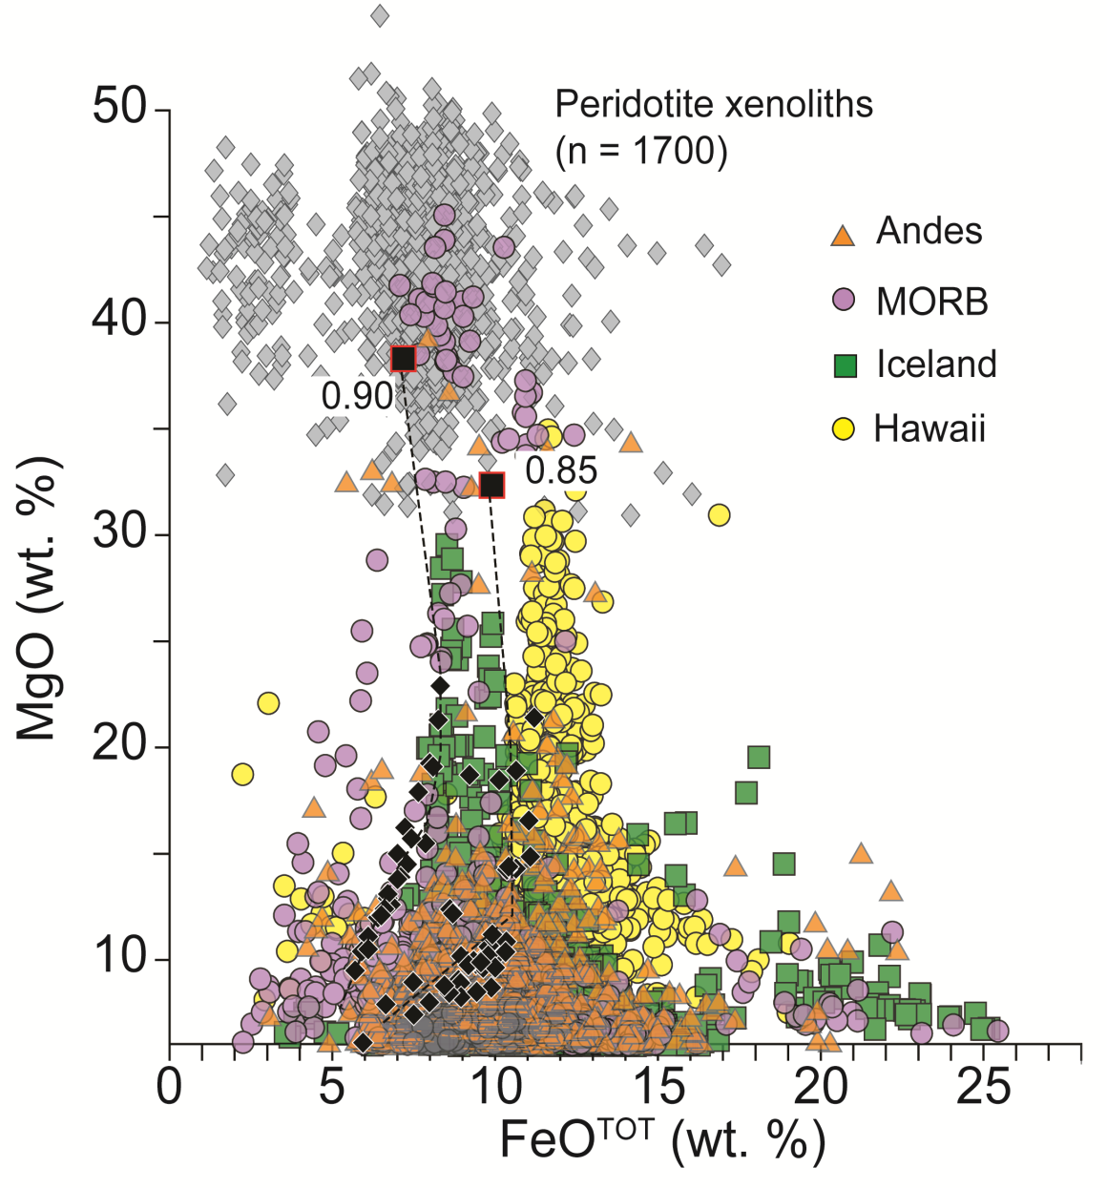
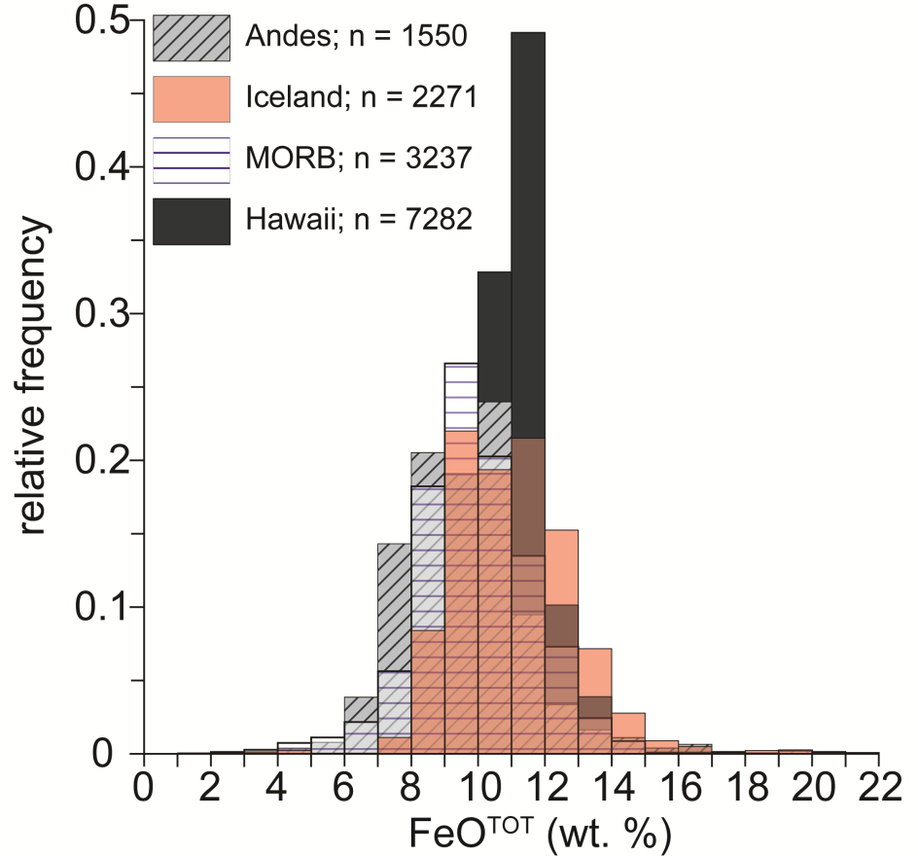
1. Background
Terrestrial basalts have a limited range of FeO contents (<13 wt. %)
Consistent with primary magmas in equilibrium with “pyrolitic” (Mg-number = 0.88-0.92), or slightly more Fe-enriched (Mg-number ~0.85) peridotites
2/18
Notes:
Modern terrestrial basalts and picrites from all tectonic settings show a limited range of iron contents, shown here on this FeOTOT histogram. Rocks with FeOTOT contents that exceed 13 wt. % are rare and limited to evolved basalts of the tholeiitic series. On this MgO vs. FeO plot it can be seen that the FeO contents of terrestrial picrites and high Mg-basalts mostly match those produced by experimental melting of “pyrolitic” mantle peridotite xenoliths (i.e. those having Mg-numbers between 0.88 and 0.92). The more iron rich lavas from Hawaii require the melting of slightly more Fe-rich peridotite with an Mg-number of 0.85.

Slide 3
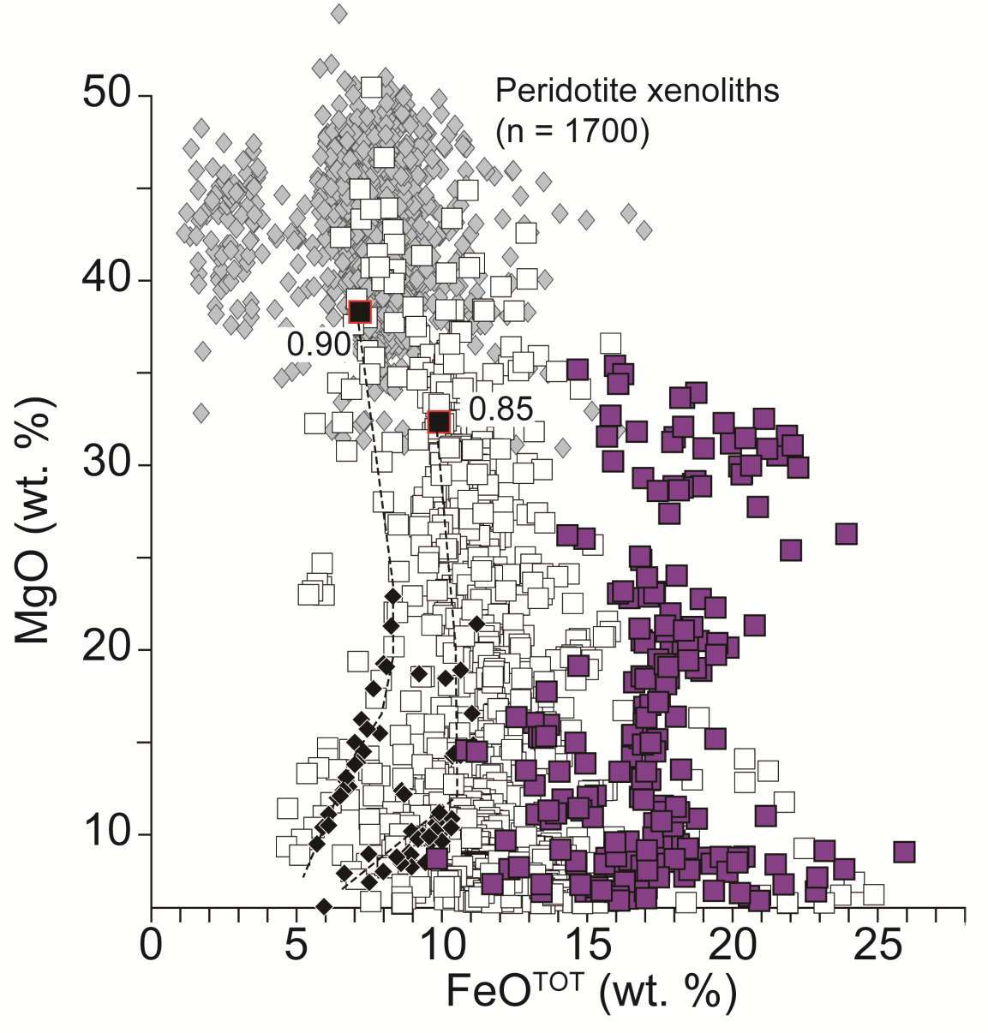
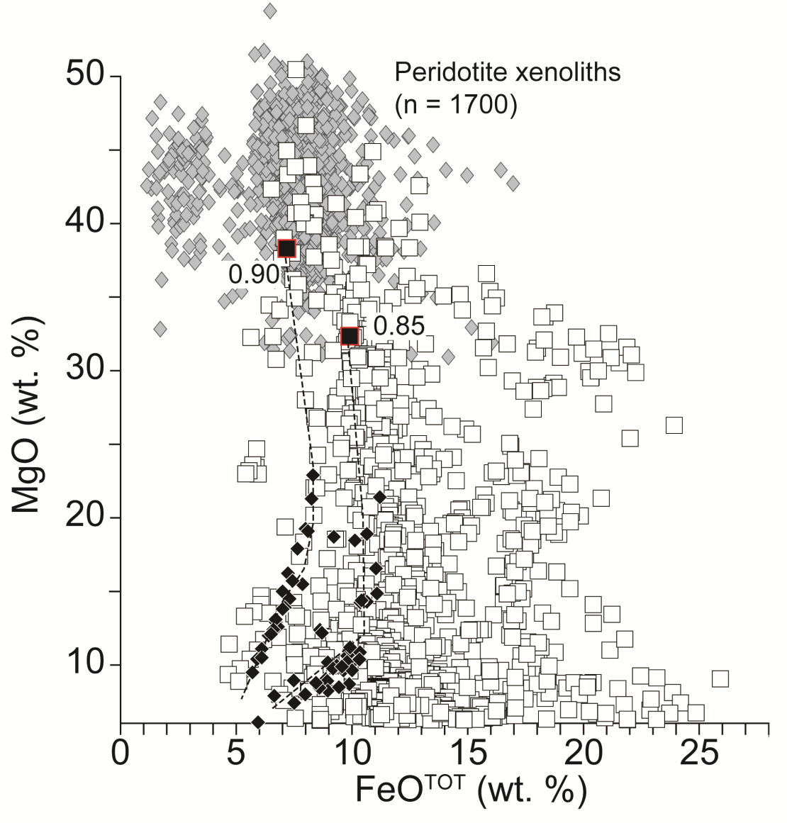
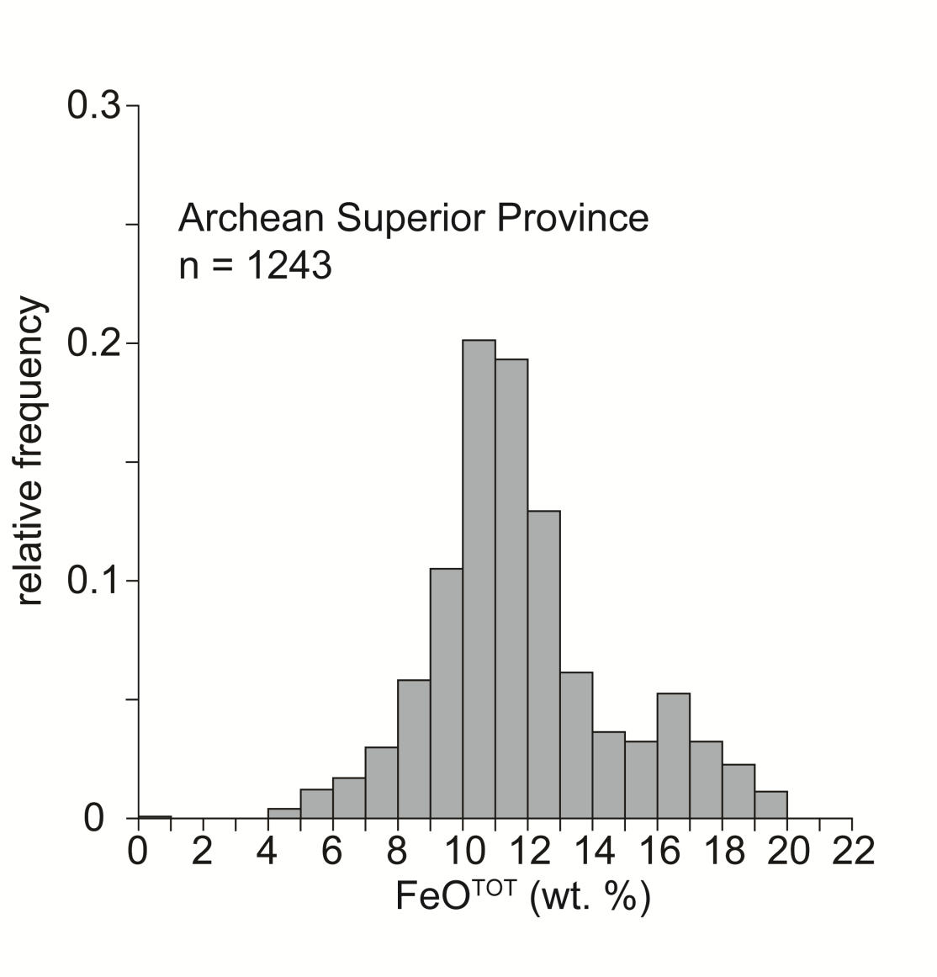
1. Background
FeO^{TOT} > 13 wt. %
Archean mafic/ultramafic rocks of the Superior Province rocks are predominantly low-FeO (<13 wt. %)
However, > 10 % of rocks have unusually high FeO, inconsistent with pyrolitic sources
3/18
Notes:
Archean mafic and ultramafic rocks, here represented by the rocks of the Superior Province and including komatiites, and tholeiitic and calc-alkaline basalts show similar FeO contents to modern day mafic and ultramafic rocks. However, a relatively small b,ut significant proportion of the Archean rocks of the Superior Province show FeO contents that exceed 13 wt. %. The low abundance of these rocks suggests that they were derived from volumetrically minor heterogeneities within the Archean mantle and we will explore the nature of these heterogeneities in this talk. For the remainder of this talk the FeO-rich mafic and ultramafic rocks and their related intrusives will be referred to as ferropicrites.

Slide 4
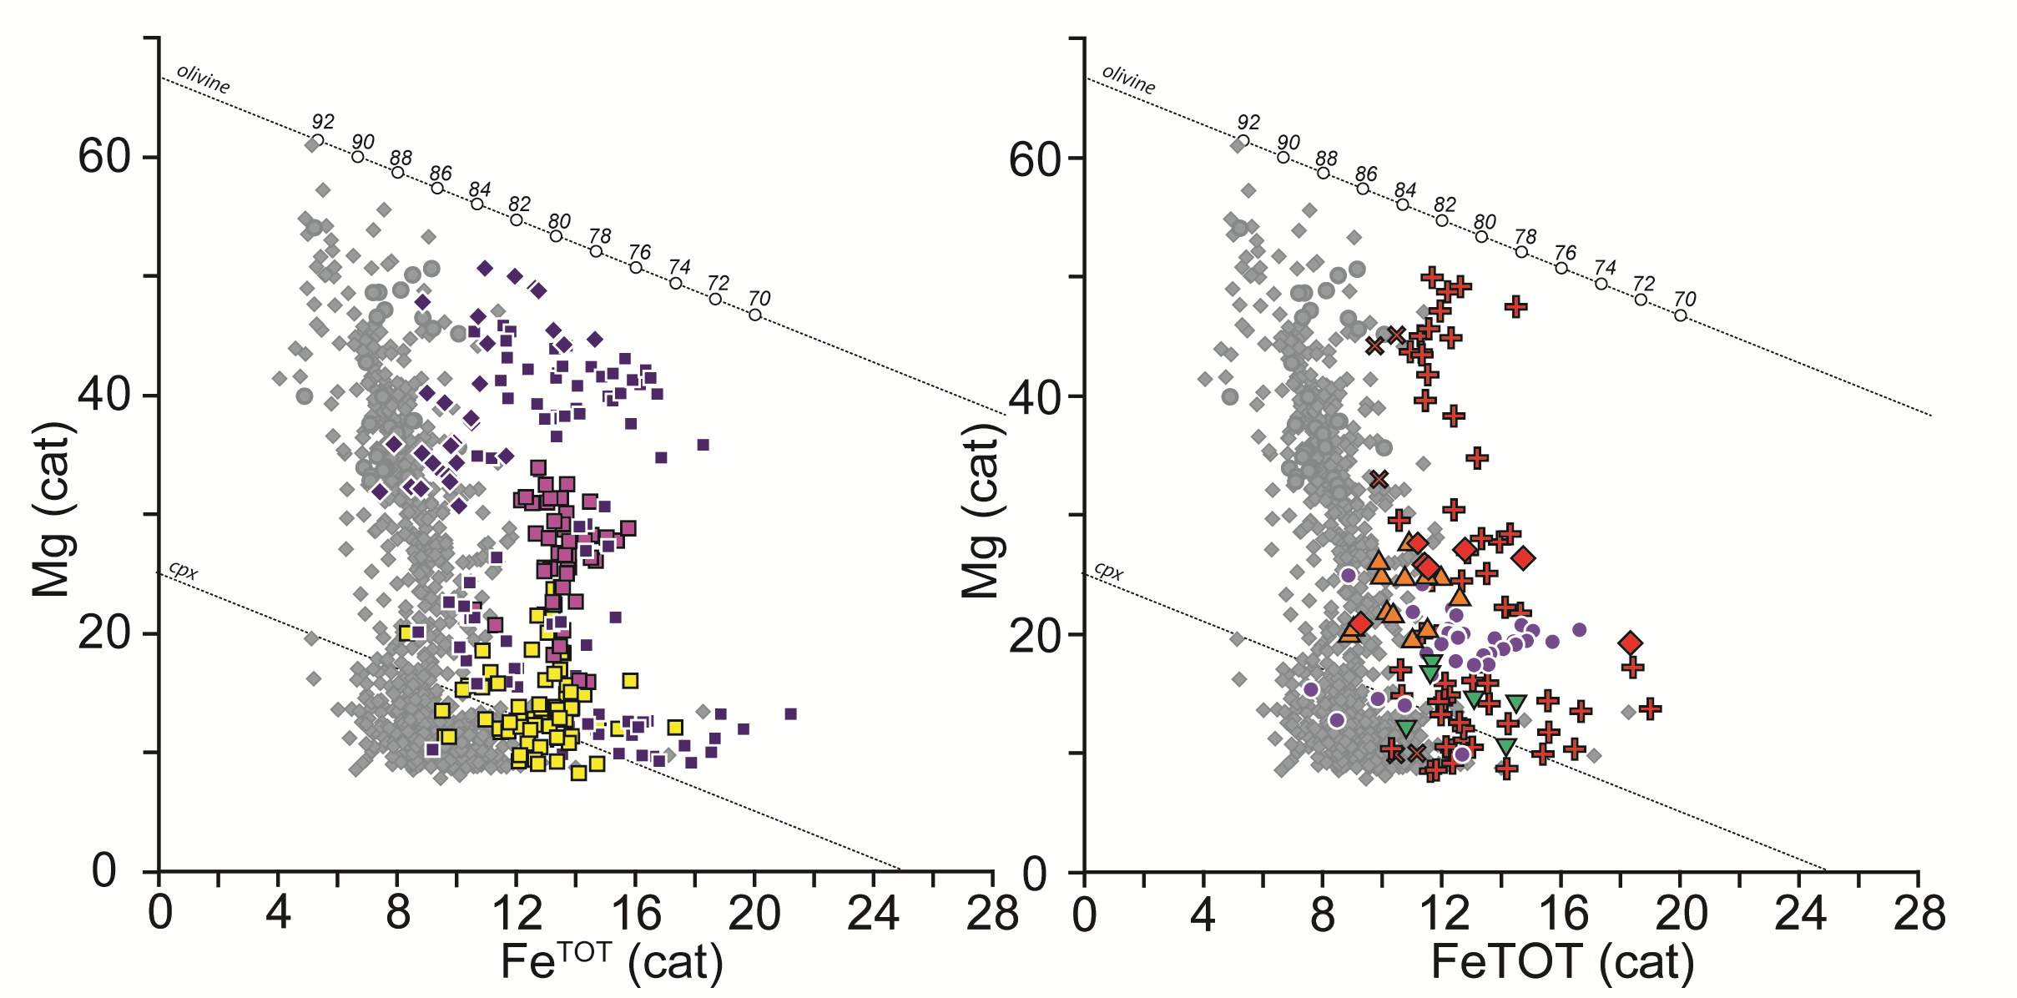
2. Neoarchean Fe-rich magmatism
Neoarchean ferropicrites in NE and S/W Superior, Slave, Kaapvaal, Yilgarn, Karelia
Main Archean (low-Fe) array
Fe^{TOT} (cat)
Fe^{TOT} (cat)
Milidragovic and Francis (in preparation)
4/18
Notes:
A survey of literature and geochemical databases shows that Fe-rich Archean rocks aren’t limited to the Superior Province.

Slide 5
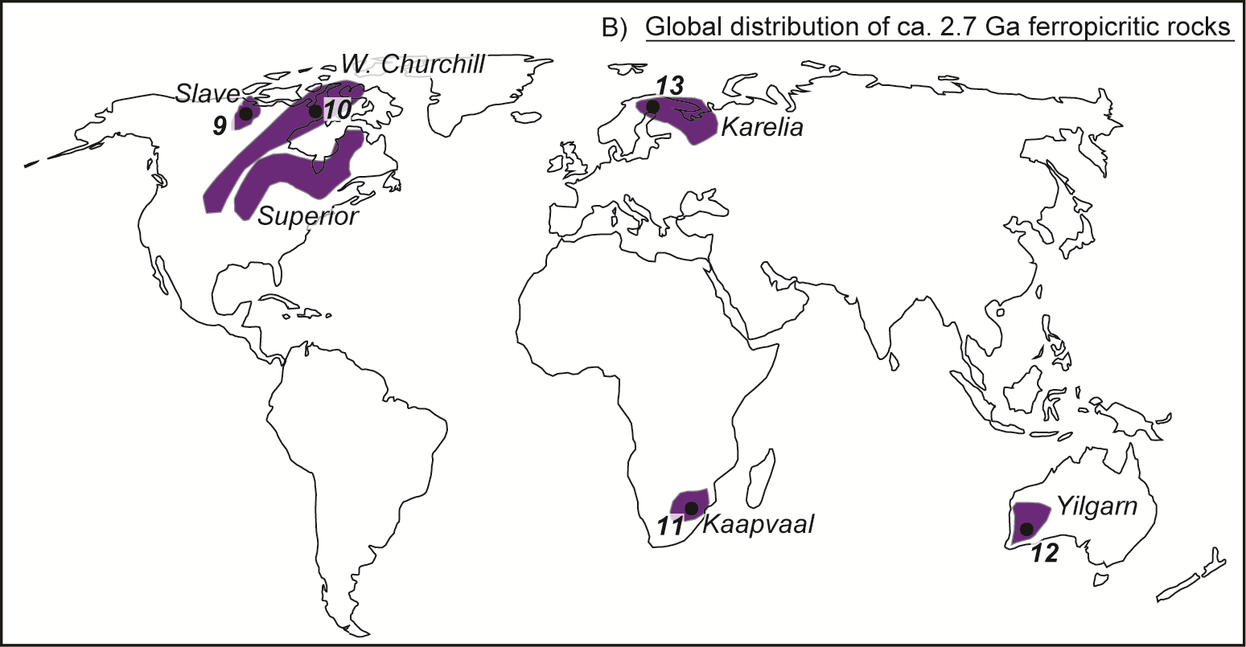
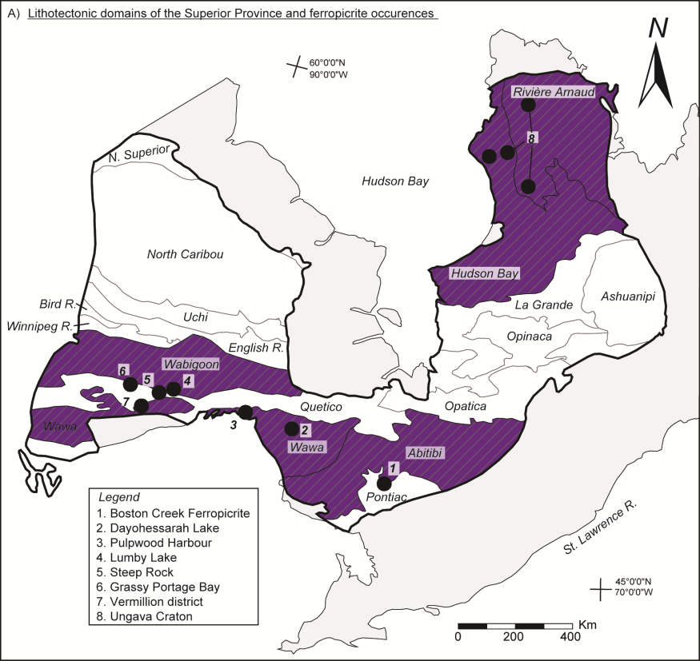
2. Neoarchean Fe-rich magmatism
Neoarchean ferropicrites in NE and S/W Superior, Slave, Kaapvaal, Yilgarn, Karelia
Milidragovic and Francis (in preparation)
5/18
Notes:
In fact, in addition to the northeastern, southern and western Superior Province Archean ferropicrites are present on 5 other cratons. The Slave, W. Churchill, Yilgarn, Kaapvaal and Karelia all host unusually Fe-rich volcanic and intrusive mafic to ultramafic rocks.

Slide 6
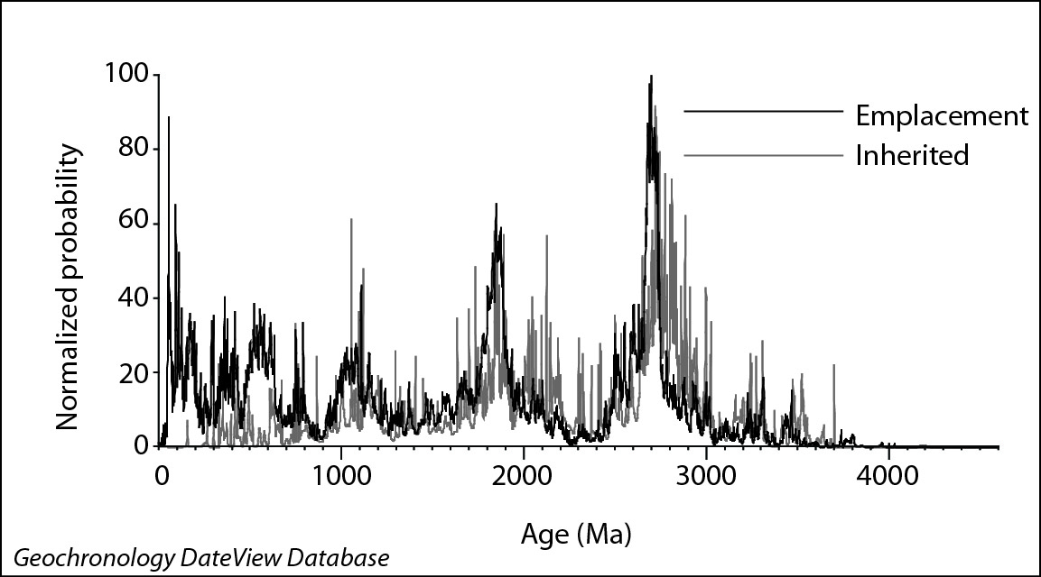
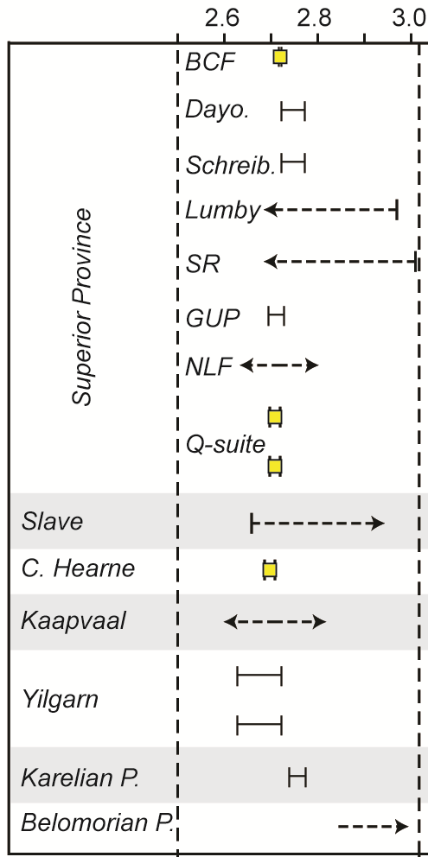
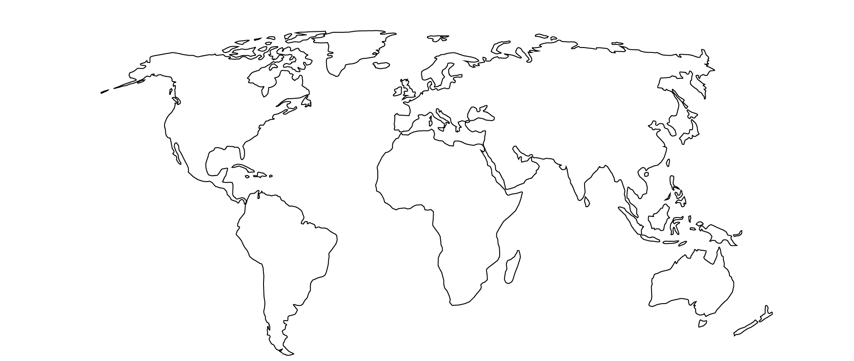
2. Neoarchean Fe-rich magmatism
Globally, ca. 2.7 Ga represents a period of intense magmatism and continental crust growth.
Age (Ga)
2700 Ma
Proterozoic
Ferropicrites in post-Archean are very rare
Permian
Ferropicrites since the Archean
E. Cretaceous
Jurassic
Notes:
Although only a few Archean ferropicrites have been directly dated, it appears that Archean ferropicrites were emplaced approximately 2.7 billion years ago, coeval with the major global mantle melting event that generated a large proportion of the Earth’s continental crust.
The relative magnitude of this event is illustrated by the strong mode in global igneous and zircon ages. This period is sometimes referred to as the Neoarchean cratonization or craton stabilization.
There are only four known post-Archean ferropicrite occurrences in the world, suggesting that the end of Archean marks an important point in the geochemical evolution of the Earth’s mantle.

Slide 7
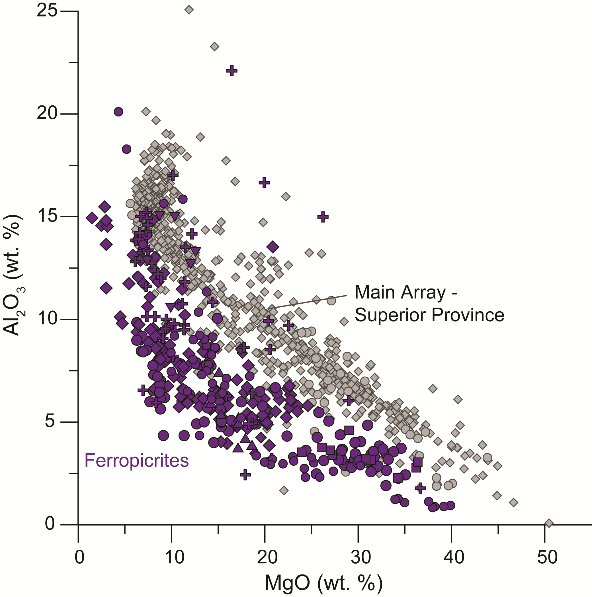
3. Geochemistry of ferropicrites
Ferropicrite characteristics
  Low Al₂O₃ and low Al₂O₃/TiO₂ ratios → often (mis)classifed as Aluminum-depleted komatiites (ADK)
7/18
Notes:
Ferropicrites, are characterized by low Al concentrations, which are lower than those of the more common Fe-poor igneous rocks at equal MgO contents. Their corresponding low Al2O3/TiO2 ratios have in some cases led to misclassification as low Al-komatiites.

Slide 8
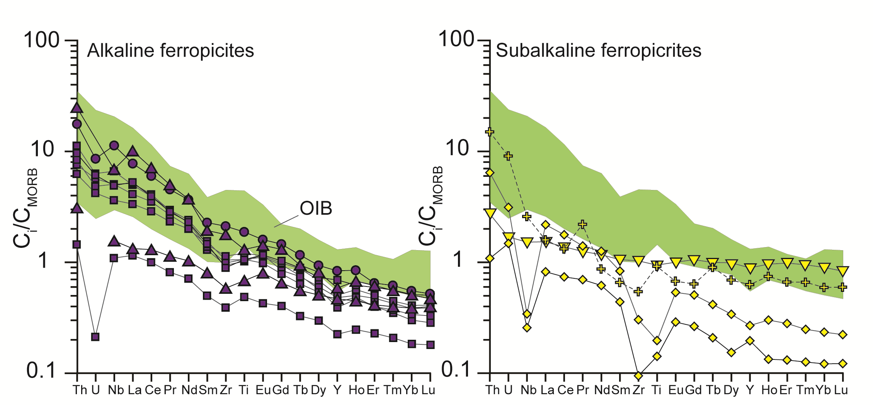
3. Geochemistry of ferropicrites
2 kinds of Neoarchean ferropicrites
  Alkaline – high Nb/Y ratios. Nd isotopic studies (e.g. Stone et al., 1995; Francis et al., 1999; Goldstein & Francis, 2008) indicate short-lived trace element enrichment (≤ 3Ga).
  Subalkaline – low Nb/Y ratios
Alkaline ferropicrites
Subalkaline ferropicrites
Milidragovic and Francis (in preparation)
Crustally contaminated ferropicrites from NESP
Notes:
Based on trace element profiles, 2 distinct types of Neoarchean ferropicrites are recognized. Alkaline ferropicrites have trace-element concentrations that resemble those of modern ocean island basalts (OIB). Isotopic studies of alkaline ferropicrites in the Slave and western Superior Province, suggest that they derive from sources with a short history of trace element enrichment and with a history of prior depletion. The “sub-alkaline” ferropicrites are decisively non alkaline and show low Nb/Y ratios.

Slide 9
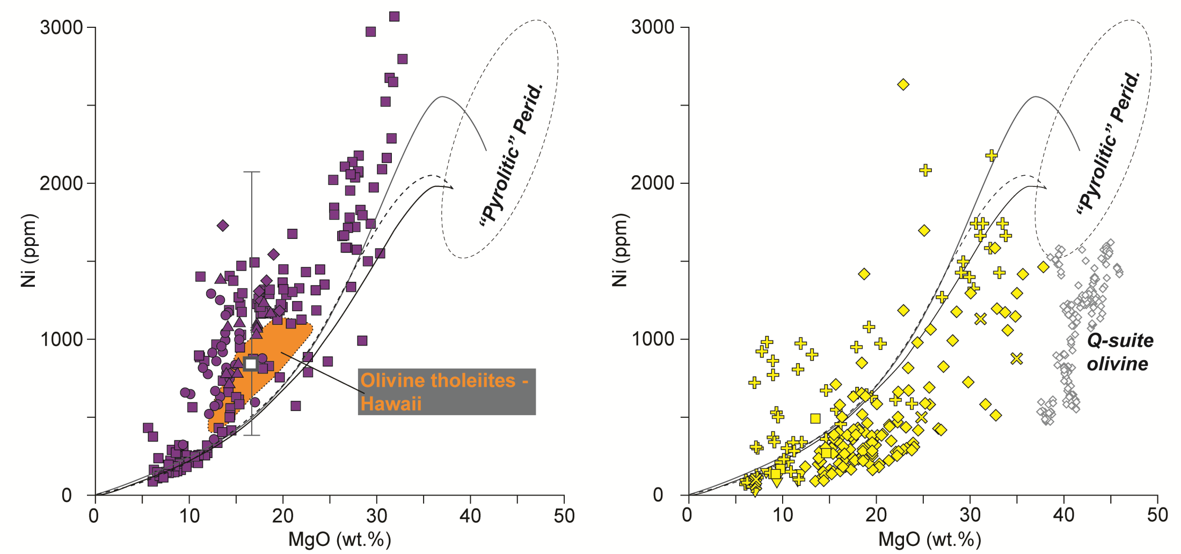
3. Geochemistry of ferropicrites
2 kinds of Neoarchean ferropicrites
    Alkaline – high Ni contents. Similar to olivine tholeiites from Hawaii
    Subalkaline – low Ni contents
Alkaline ferropicrites
Subalkaline ferropicrites
Q-suite
olivine
Milidragovic and Francis (in preparation)
Notes:
The Ni contents of the alkaline ferropicrites, shown on this Ni vs. MgO diagram, are higher than the contents of primary melts in equilibrium with the normal “pyrolitic” terrestrial mantle. Moreover, when corrected for the effects of fractional crystallization and accumulation alkaline ferropicrites have Ni contents similar to those of Hawaiian olivine tholeiites, which have been used to argue for an secondary pyroxenite source formed by metasomatism of Ni-rich peridotite. In contrast, the subalkaline ferropicrites have low Ni contents.

Slide 10
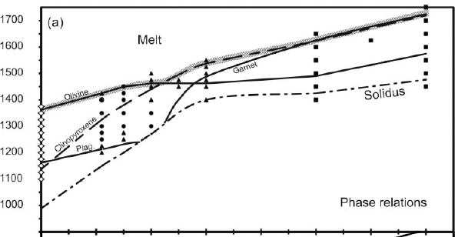
4. Insights into Neoarchean mantle
2 kinds of Neoarchean ferropicrites
    Alkaline – secondary garnet pyroxenite sources?
    Subalkaline – garnet-free peridotite sources?
Garnet-pyroxenite
(high Ni)
1700
Ferropicrite phase relations
1600
melt
garnet
1500
olivine
1400
solidus
1300
cpx
Temperature (°C)
Peridotite
(low Ni)
1200
plag.
1100
1000
0
1
2
3
4
5
6
7
Modified from Tuff et al. (2005)
Pressure (GPa)
Notes:
Previous work on ferropicrites has largely focused on determining the mineralogy of their source. Liquidus phase relationships suggest two possible source mineralogies. Some previous studies (Hanski & Smolkin, 1995; Stone et al., 1995) have argued that ferropicrites may be derived from olivine-dominated mantle, but with no garnet in residue. Other studies argued that ferropicritic magmas are generated by the melting of garnet-pyroxenite residues (Tuff et al., 2005), in which olivine is not stable. Ni content of melts generated from peridotite would be controlled by olivine. In contrast, melting of secondary pyroxenites, produced by metasomatism of peridotite, could generate magmas with high Ni contents, due to the relatively low Ni partitioning between garnet or pyroxene and melt.

Slide 11
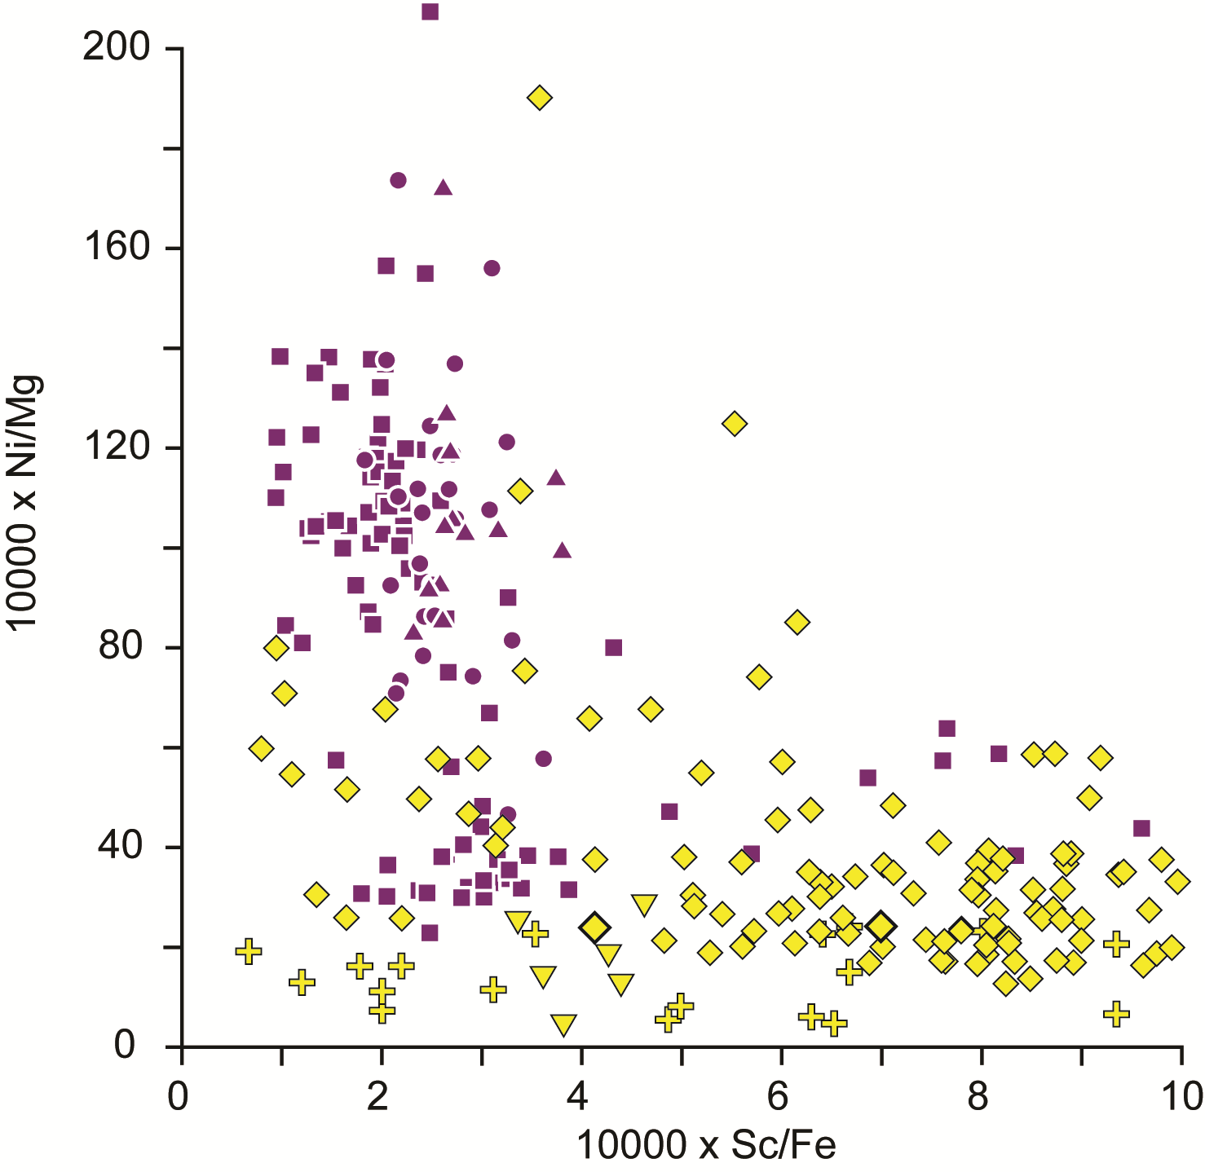
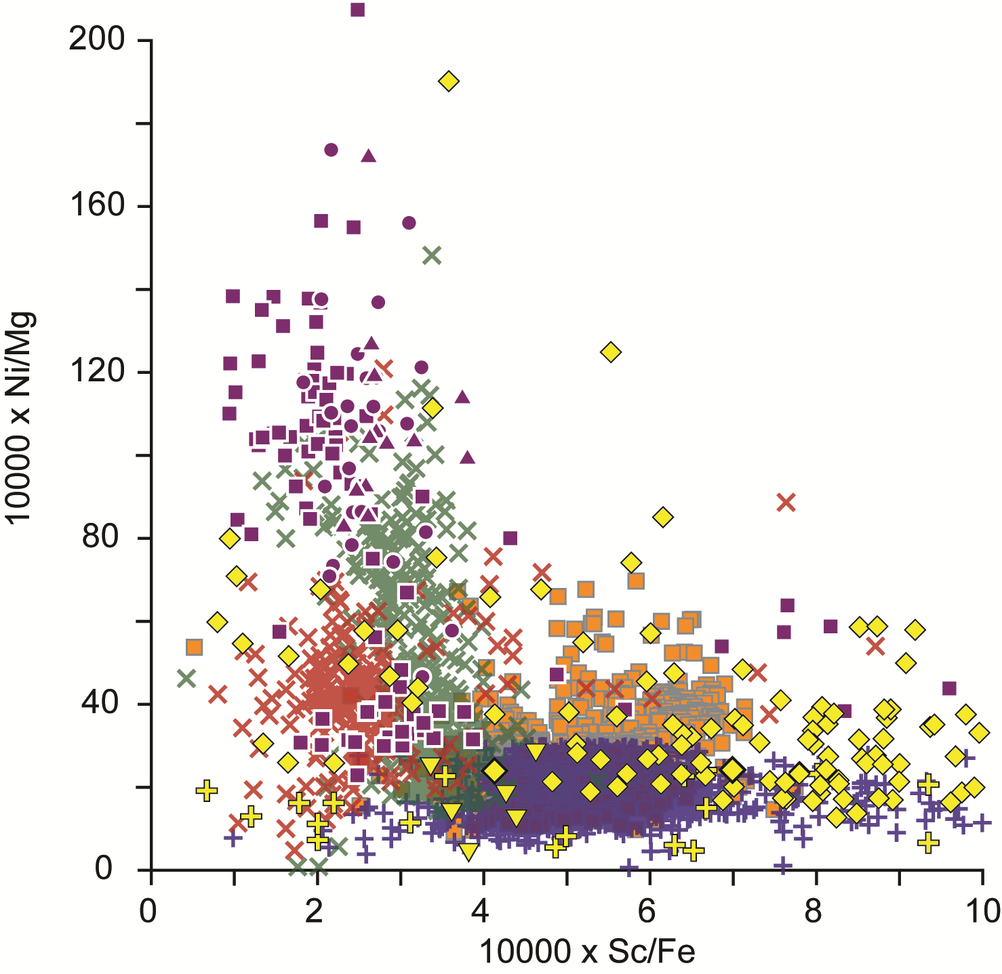
4. Insights into Neoarchean mantle
2 types of Neoarchean ferropicrites
  Alkaline – low Sc/Fe ratios
  Subalkaline – high Sc/Fe ratios
Alkaline
ferropicrites
Sc is compatible in garnet but strongly incompatible in olivine → garnet pyroxenite vs. peridotite
Hawaii – tholeiitic
n = 552
Iceland
(n = 719)
Subalkaline
ferropicrites
Hawaii – alkaline
(n = 249)
MORB
(n = 1726)
Milidragovic and Francis (in preparation)
Notes:
To evaluate whether the differences in Ni contents of Neoarchean ferropicrites could reflect mineralogically distinct sources, we looked at the Sc/Fe ratio as a discriminant between the involvement of olivine and garnet in the source. The alkaline ferropicrites have low Sc/Fe ratios that are consistent with a source dominated by garnet and pyroxene, minerals with a high afinity for Sc. In contrast, subalkaline ferropicrites have high Sc/Fe ratios, consistent with a source dominated by olivine, which has low affinity for Sc. Plotted for comparison are MORB, Iceland and Hawaiian lavas. Terrestrial magmas formed at depths in which olivine is the dominant residual mineral are characterized by relatively high Sc/Fe ratios. In contrast Hawaiian basalts, which are inferred to be derived from sources in which garnet is predominant have low Sc/Fe ratios. Geochemical considerations of transitional and compatible elements lead to the conclusion that ferropicrites are derived from both secondary pyroxenite and garnet-free peridotite sources.

Slide 12


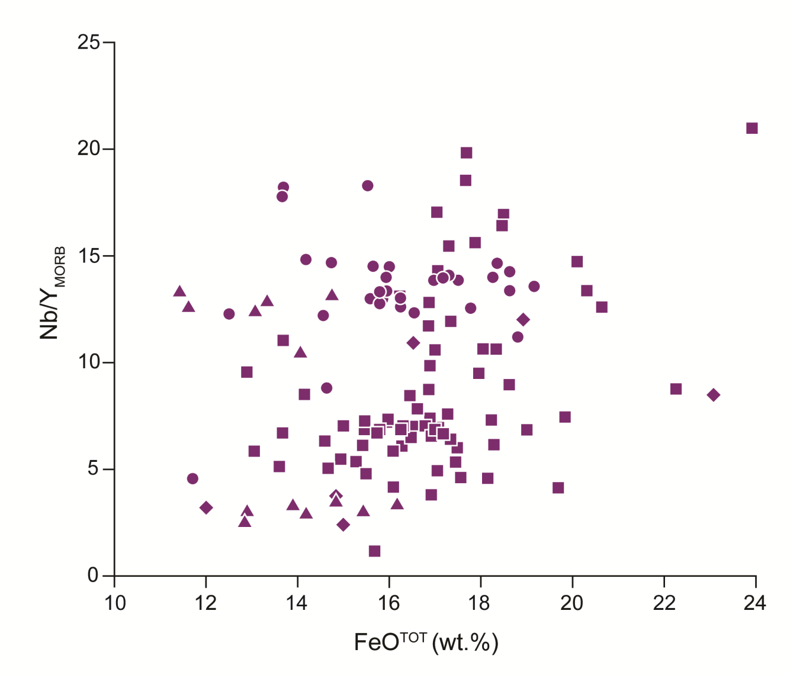
4. Insights into Neoarchean mantle
Alkaline ferropicrite source:
Metasomatism of “pyrolite” by trace-element and Fe-rich melts/fluids
Metasomatism of Fe-rich peridotite by trace-element rich melts/fluids
Milidragovic and Francis (in preparation)
12/18
Notes:
Two competing hypotheses for the Fe-enrichment of the secondary garnet-pyroxenite source of the alkaline ferropicrites. The first is that the Fe-enrichment accompanied the metasomatic addition of trace elements. The lack of correlation between the degree of enrichment (shown by Nb/Y) and Fe content is inconsistent with this hypothesis. The second possibility is that the alkaline ferropicrites were derived from metasomatized peridotites, whose iron contents were significantly higher than those of “pyrolite” .

Slide 13
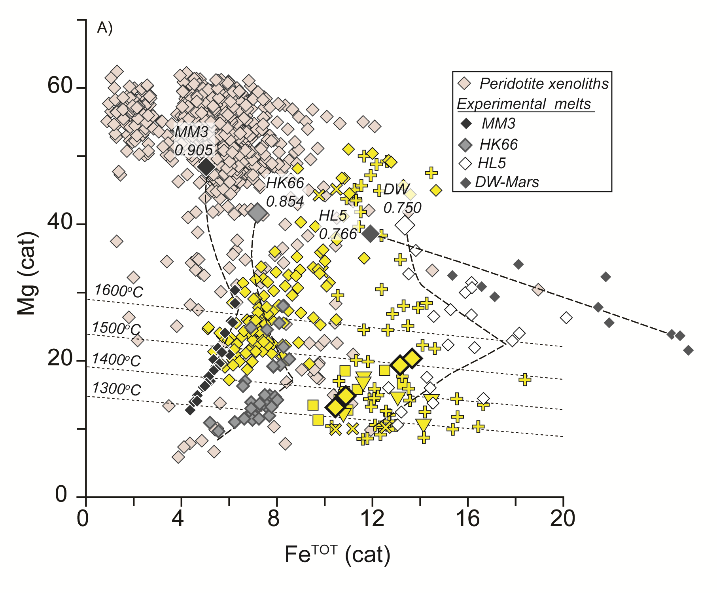
5. Fe-rich domains in the Archean mantle
Milidragovic and Francis (in preparation)
Subalkaline ferropicrite source:
Melting of peridotite with Mg-number 0.81-0.79
Approaches Fe/Mg of ordinary chondrite or Martian mantle
13/18
Notes:
Subalkaline ferropicrites require peridotite sources characterized by high Fe/Mg ratios. As shown in the first slide, melts of “pyrolitic” peridotite that constitutes the bulk of the Earth’s mantle produce Fe-poor melts. Even more exotic Fe-rich peridotites such as found as xenoliths in Hawaiian volcanoes yield melts that are significantly poorer in Fe than ferropicrites. Melts of iron rich peridotite, such as ordinary chondrite or the Martian mantle, provide better matches to the subalkaline ferropicrites. Assuming that the Fe content of a melt at a given temperature is linearly dependant on the Mg-number of the source, The Fe-rich peridotites that were parental to the subalkaline ferropicrites had Mg-numbers between 0.81 and 0.79.

Slide 14
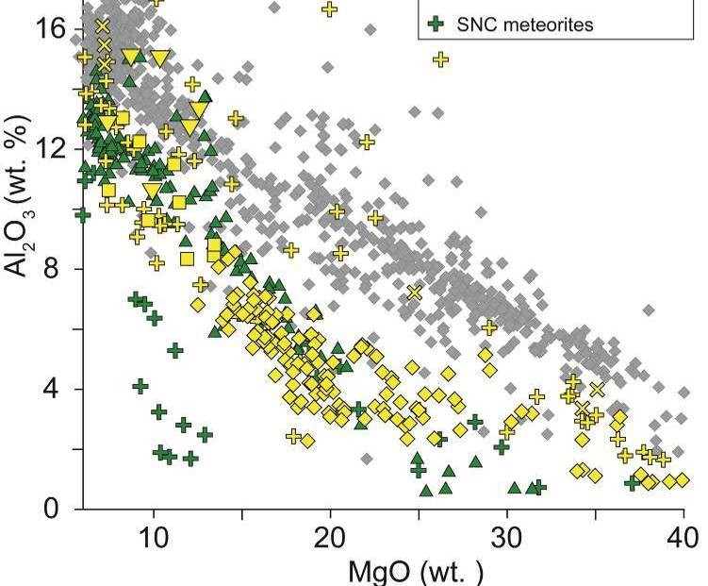
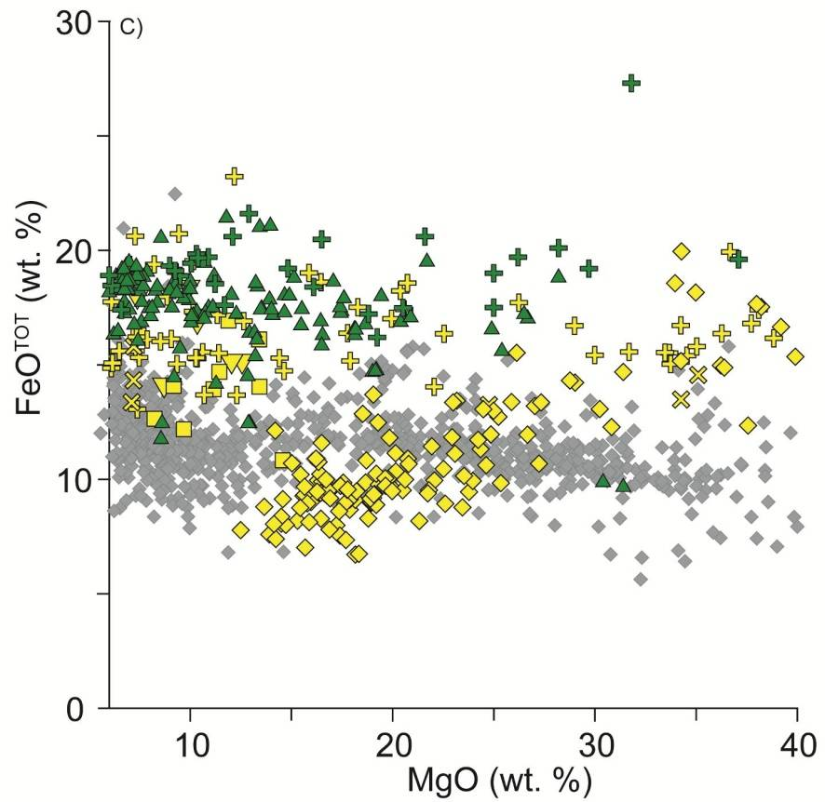
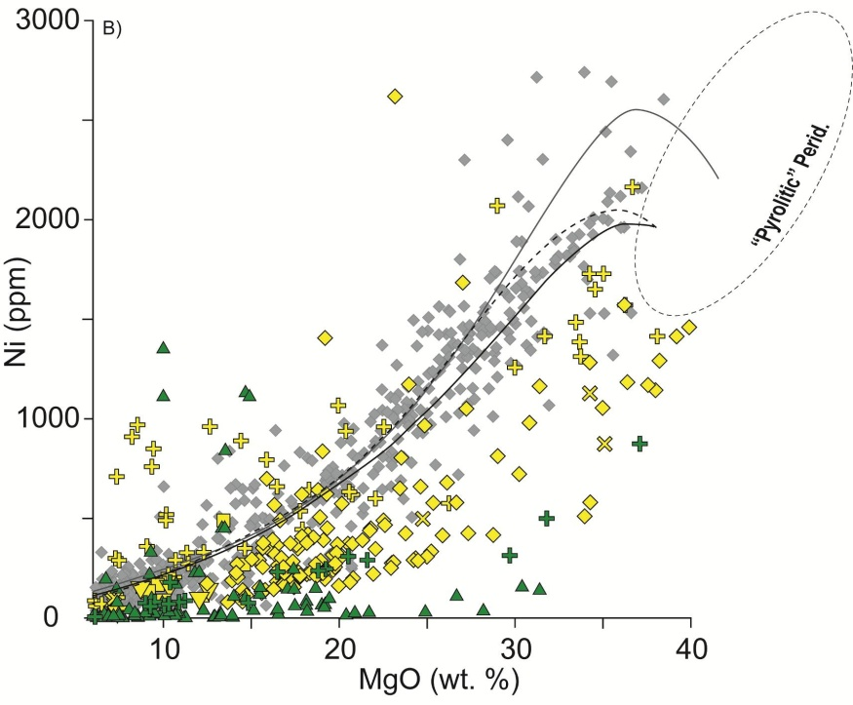
6. The origin of Fe-enrichment
Cpx cumulates
SNC meteorites
HED meteorites
Notes:
The Fe-contents of subalkaline ferropicrites are similar to those of diferentiated meterorites of the SNC and HED not only in terms of Fe, but also their relatively unusual Ni and Al concentrations. Thus although relatively rare in the terrestrial geologic record, Fe-rich ultramafic magmas are in fact common in the solar system.

Slide 15
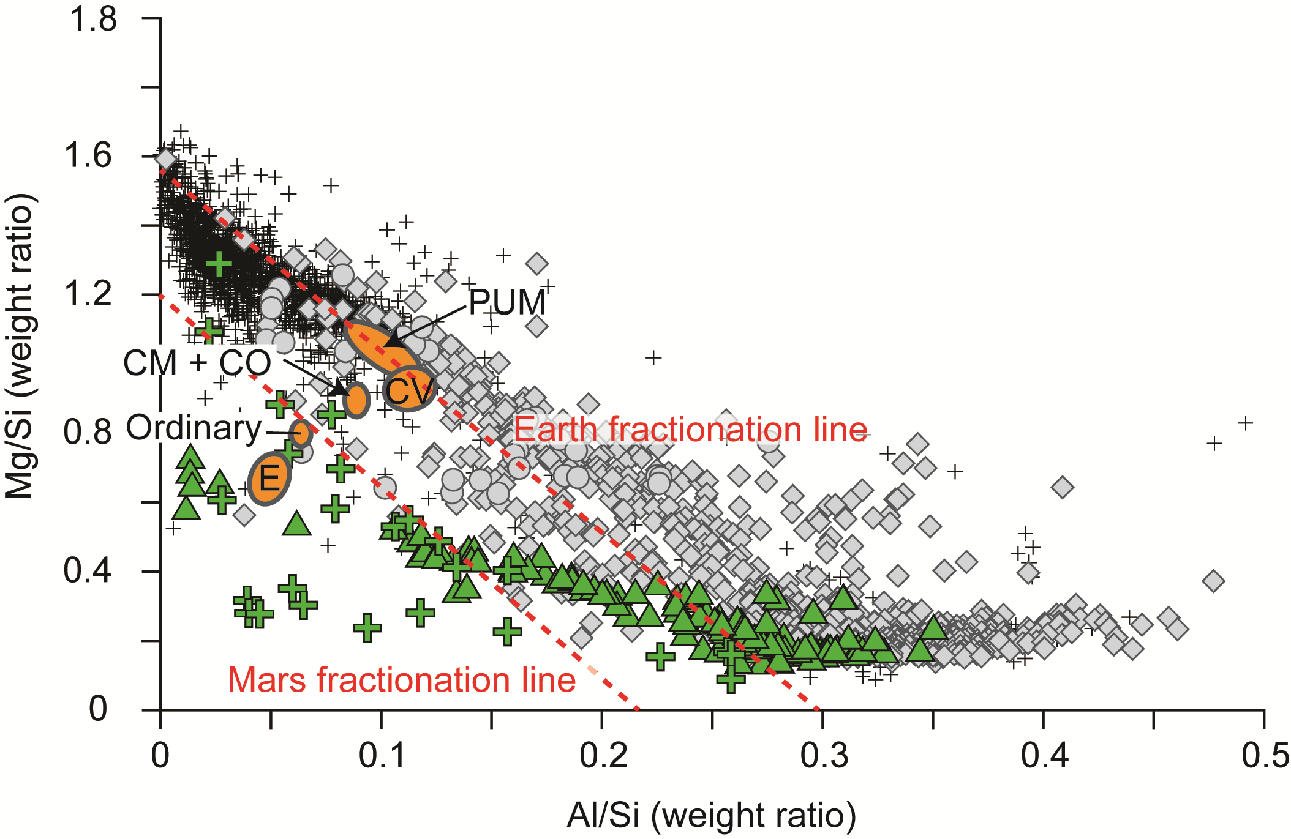
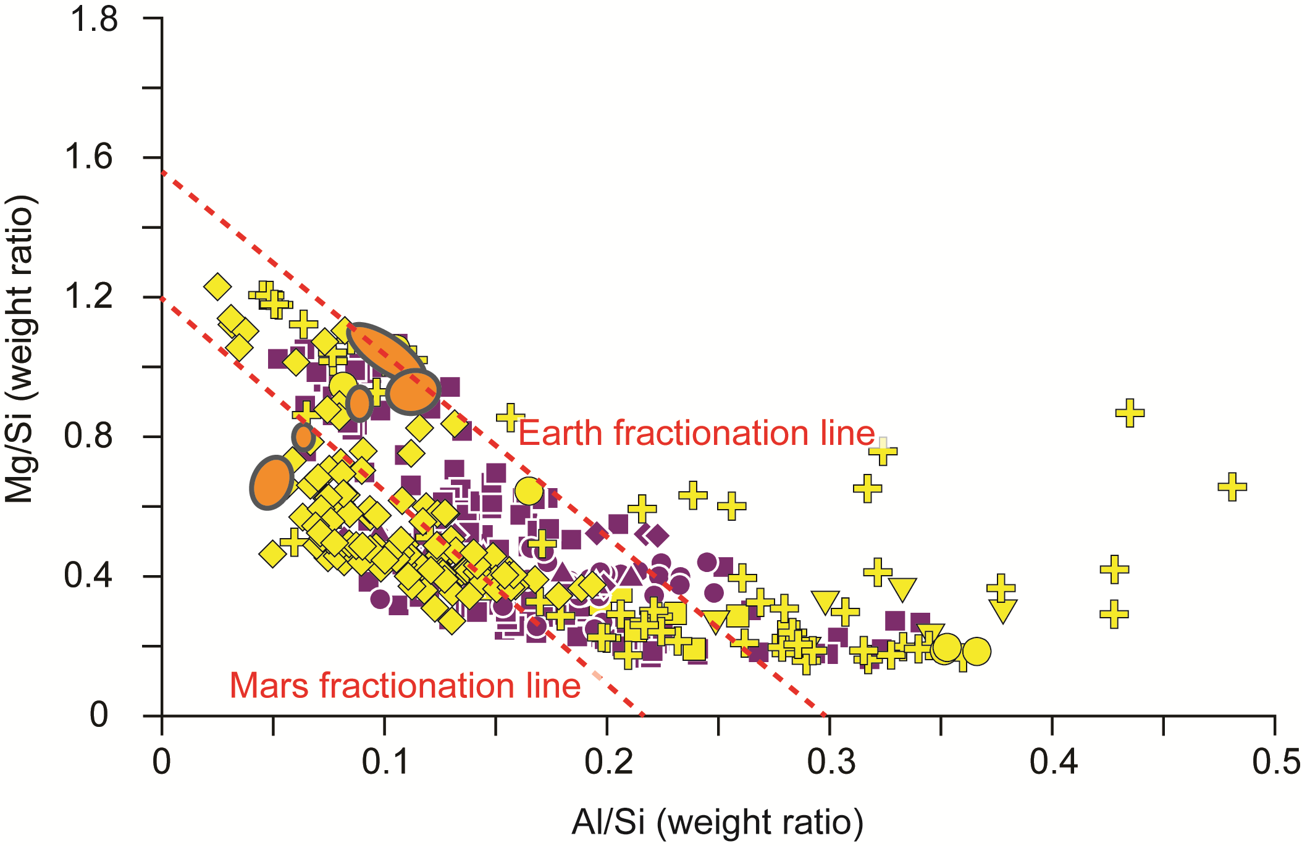
5. The origin of Fe-enrichment
Modified from Drake and Righter (2002)
15/18
Notes:
The Mg/Si vs Al/Si plot is commonly used to differentiate the parental affinities of various solar system bodies. The terrestrial ultramafic rocks including Archean volcanic and plutonic rocks and peridotite xenoliths plot along a negatively sloping terrestrial fractionation line. The SNC meteorites along with direct analyses from Mars plot along the Mars fractionation line. Neorchean ferropicrites plot below the Earth fractionation line, and closer to the fractionation lines expected for chondritic mantle compositions.

Slide 16
6. Conclusions
Fe-rich magmas were ubiquitous during the Neoarchean
2 types of Neoarchean ferropicrites
  Garnet-pyroxenite and peridotite sources
Archean ferropicrites show similarities to differentiated meteorites
16/18

Slide 17
Thank you!
17/18

