Slide 1
EarthEd2YC: NASA-NAGT Earth Education Resources for Two-Year College Faculty
T64. Transdisciplinary Thinking in Geoscience Education at Two-Year and Four-Year Colleges:
Innovations in Curriculum, Pedagogy, and Assessment in Introductory Geoscience Courses
Suzanne T. Metlay Russanne Low
NAGT Geo2YC Professional Division NASA SMD E/PO Earth Forum
Western Governors University Institute for Global Environmental Strategies
Salt Lake City, UT Arlington, VA
suzanne.metlay@wgu.edu rusty_low@strategies.org
Geological Society of America Annual Meeting
Vancouver, B.C., Canada
19 Oct 2014

Slide 2
Overview
NASA survey
NAGT Geo2YC engagement
EarthEd2YC pilot project: March-June 2014
EarthEd2YC re-launch: Feb 2015 (funding thru Oct 2015)
Webinars
Teaching/Learning Resources
Networking & Leadership Opportunities
Presenters and more Education Resources welcome!

Slide 3
Two-Year College (2YC) Faculty
Less likely to attend professional conferences, participate in NASA-sponsored professional development, or access new educational resources
Less likely to serve as a PI on a NASA education grant, mainly because of institutional capacity limitations
Challenges: Heavier teaching loads, lack of institutional support, lack of funding
YET, they serve:
Majority of 1st generation, diverse college students attend 2YC institutions
2YC = Community Colleges, City Colleges, State Colleges, Junior Colleges, Technical Colleges
45% of all STEM majors who eventually graduate at 4 year colleges
44% of all US undergraduates
Current estimate: 18 million undergrads → ~ 8 million people who may or may not graduate but will take at least one introductory science class
40% of all elementary and secondary school teachers
22% of all full-time college faculty teach at Two-Year Colleges
Notes:
Data from Low, et al (2013). See reference list at end of this presentation.

Slide 4
NASA Survey Timeline and Approach
2009: NASA Science Mission Directorate (SMD) Education and Public Outreach Forums (E/PO)
Established to represent 4 science areas: Earth, Astronomy, Heliophysics, Planetary Science
2012: Higher Education Working Group conducted:
Literature review for statistics from National Science Foundation (NSF) and National Center for Educational Statistics (NCES) on number of relevant faculty and students at 2YC
Fairly daunting task—How to access these faculty?
Often not found in departments, often not on campus, working part-time
Chose an expedient methodology that matched limited time and resources
Survey: https://www.surveymonkey.com/s/XL8HPPD
183 respondents of 324 surveyed, 57% response rate to identify/understand:
Demographic make-up and views of community college faculty who teach NASA-related STEM courses (primarily astronomy, physics, earth science and engineering)
Specific resources wanted and needed, and barriers faced, by those STEM community college faculty who incorporate STEM content into their courses
Education resources already developed or could be developed, by NASA SMD EPO that would be helpful to community college faculty
Goal: Quantify role of 2YC faculty in providing Earth & space science education for workforce development
Are 2YC faculty critical to Earth & space science workforce needs?
How can NASA programs/missions directly engage more 2YC faculty and students?
2013: 2YC faculty feedback and results from face-to-face validation study focus group

Slide 5
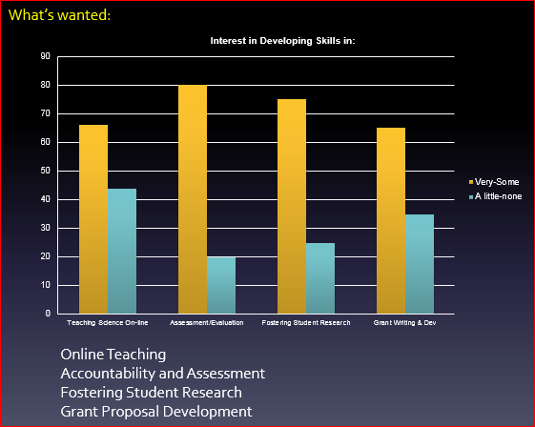
NASA Survey Results
Heavy teaching loads: Earth science instructors were more likely than astronomy or physics to teach 4 courses per term
Cutting edge science use:
More than 2/3 reported using current science in the classroom at least once a week;
40% regularly gleaned info from primary science sources and discipline-based websites
2YC Faculty requested:
Professional support for public outreach: Value and encouragement for community engagement
Validating scientific experiences for their students: Strong interest in participating in a community of scholars in scientific research activities that provide opportunities to undergraduates
Resources: Designed to excite and motivate non-majors about science

Slide 6
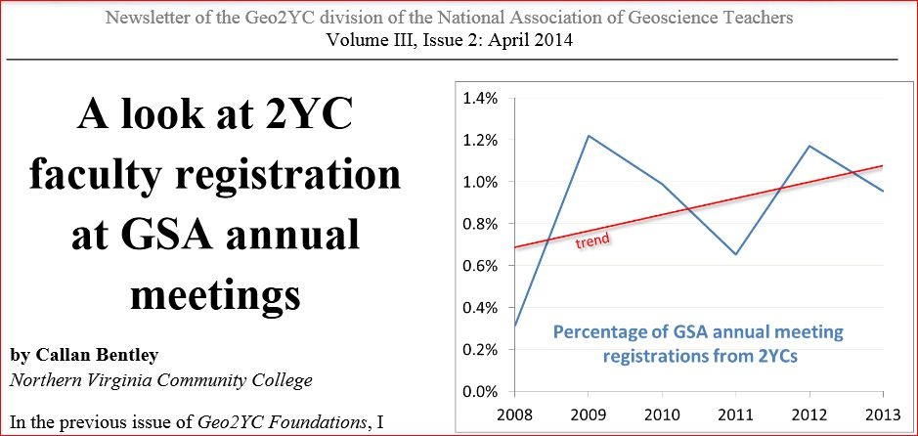
2YC Faculty Not at Professional Conferences
EarthEd2YC launched Spring 2014 in response to a documented need for resource dissemination and access for faculty who rarely attend national meetings where educational materials are routinely shared by NASA SMD E/PO professionals.

Slide 7
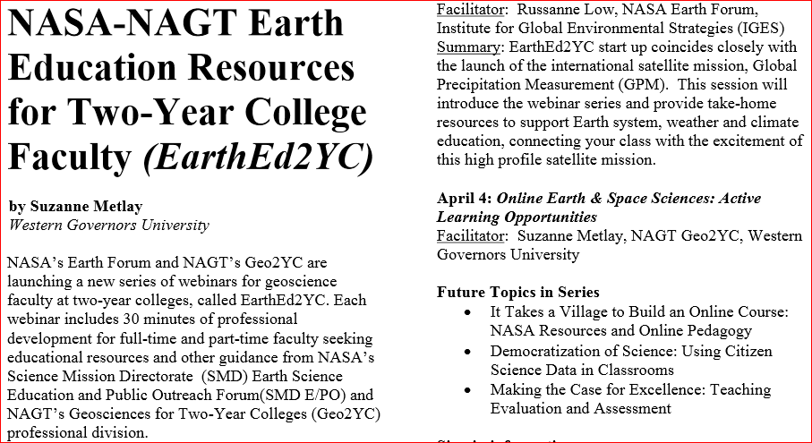
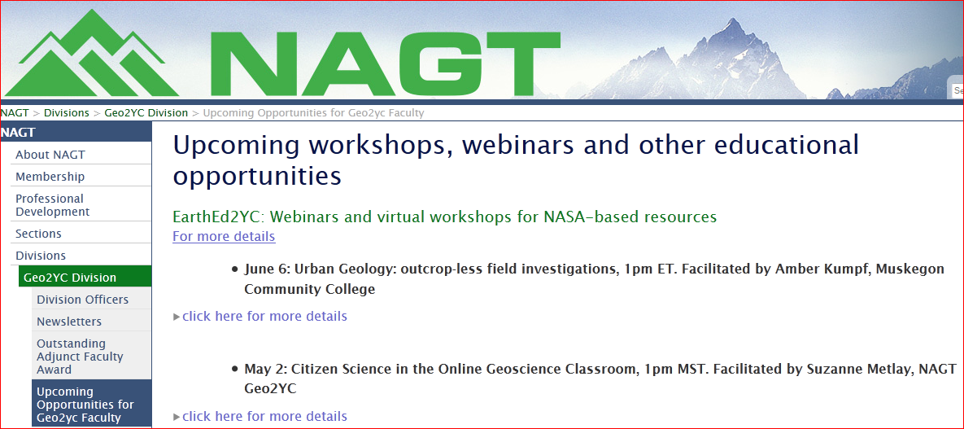
NAGT Geo2YC Engagement
Rusty Low contacted National Association of Geoscience Teachers (NAGT) Geosciences for Two-Year Colleges (Geo2YC) professional division in January 2014.
NAGT Geo2YC immediately agreed to work with NASA Earth Forum to develop EarthEd2YC.
Pilot project ran March – June 2014.

Slide 8
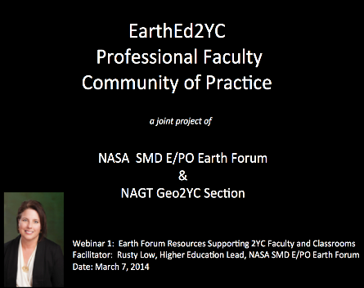
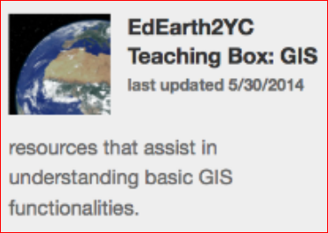
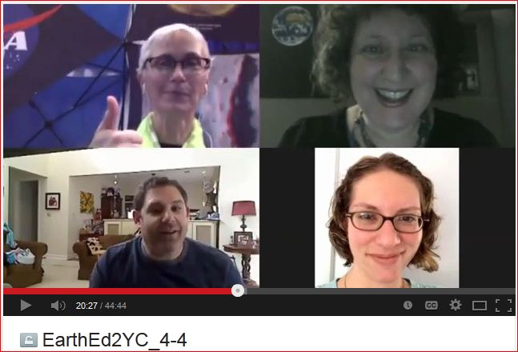
EarthEd2YC Pilot Project: 2014
A Professional Community of Practice for Earth & Space Science Faculty at Two-Year Colleges
Monthly webinar series:
First Friday of each month at 1:00pm Eastern Time
Live 20 minute presentation followed by 10 minutes of discussion, with real time chat throughout.
All resources discussed in the webinars available online.
Webinars intended to be recorded and made available for later viewing.
Participants surveyed after every webinar for immediate feedback.
Initial Topics:
March - Launch of EarthEd2YC Professional Development series: Classroom Connections to NASA Educational Resources
April - Online Earth & Space Sciences: Active Learning Opportunities
May - Citizen Science in the Online Geoscience Classroom
June - Urban Geology: Outcrop-less Field Investigations

Slide 9

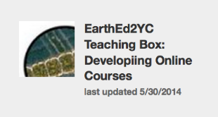

Pilot Project Problems
Intention | Actual Result | Solution
Zoom room link would be consistent throughout year. | Zoom room link varied each month. Confusion abounded! | Zoom room link (or other host site) should be locked in.
Resources archived at both NASA and NAGT sites. | NASA site required password, other barriers. | NAGT hosts resources on dedicated webpage.
Video recorded and available after each webinar. | Only 1 webinar successfully recorded and archived. | Zoom (or other host site) video should be locked in.
Participants surveyed after every webinar for continuous improvement of EarthEd2YC. | Small number of participants lead to small number statistical issues. | Accumulate survey data over longer time frame; summative assessment OK.
Webinar series would be self-sustaining as participants become presenters. | Webinar series on hiatus while organizers work to solve problems, build schedule, develop stronger infrastructure. | Re-launch in Feb 2015! Restructure EarthEd2YC to be less reliant on organizers. Build networking into more useful resource base.

Slide 10
EarthEd2YC Re-Launch: 2015
Maintaining Success | New/Expanded Features
Monthly webinar series 1st Friday of every month (except July) 1:00pm Eastern Time (10:00am Pacific) | Periodic newsletter with geoscience education links and resources Supplement to Geo2YC Foundations newsletter
Archived presentations, videos, handouts, media Resources developed by & for 2YC faculty NAGT/SERC educational products/services | EarthEd2YC Digital Teaching Boxes Featured resources using resource list creation on NASA Wavelength website: http://nasawavelength.org/
Reaching out to widely distributed, loosely connected 2YC part-time and full-time Earth & space sciences faculty | Mentoring and networking opportunities Leveraging relationships Geo2YC leadership positions
Contact:
Rusty Low, NASA Earth Forum Amber Kumpf, NAGT Geo2YC
rusty_low@strategies.org amber.kumpf@muskegoncc.edu
EarthEd2YC serves 2YC online and traditional classroom faculty. This initiative connects Earth & space sciences faculty nationwide to provide educational leadership, mentoring, professional development, and community building, while simultaneously disseminating NAGT and NASA E/PO products and programs to a broader underserved audience.

Slide 11
References
Bentley, C. (2014). A Look at 2YC Faculty Registration at GSA Annual Meetings. Foundations newsletter (NAGT Geo2YC), Volume III, Issue 2, page 1. Retrieved from: http://d32ogoqmya1dw8.cloudfront.net/files/nagt/divisions/2yc/newsletter_3.2.pdf
Low, R., CoBabe-Ammann, E., Schultz, G., Gross, M. (2013). “It Takes a Community: The Critical Role of 2YR Faculty in Earth and Space Science Workforce”, talk presented at Geological Society of America Annual Meeting, Session No. 111, Topical Session T121, Denver, CO.
- Abstract published as: Geological Society of America Abstracts with Programs. Vol. 45, No. 7, p.282; https://gsa.confex.com/gsa/2013AM/webprogram/Paper231217.html
Low, R., and Metlay, S. (2014). “EarthEd2YC: NASA-NAGT Earth Education E/PO for Two-Year College Faculty” poster presentation at NASA SMD E/PO Earth Forum meeting, Washington, D.C.
Metlay, S. (2014). NASA-NAGT Earth Education Resources for Two-Year College Faculty (EarthEd2YC). Foundations newsletter (NAGT Geo2YC), Volume III, Issue 1, page 11. Retrieved from: http://d32ogoqmya1dw8.cloudfront.net/files/nagt/divisions/2yc/geo2yc_newsletter_feb_2014.pdf
Metlay, S. (2014). EarthEd2YC on Hiatus through February 2015. Foundations newsletter (NAGT Geo2YC), Volume III, Issue 3, page 7. Retrieved from: http://d32ogoqmya1dw8.cloudfront.net/files/nagt/divisions/2yc/geo2yc_newsletter_3.3.pdf

