Slide 1
Introducing Next Generation Science Standards to the Teachers College
Session T56. Ushering in a New Era in K–16 Geoscience Education
Suzanne T. Metlay, Ph.D.
Secondary Science Education: Geosciences
Teachers College
Western Governors University
Salt Lake City, UT 84107 suzanne.metlay@wgu.edu
Geological Society of America Annual Meeting
Vancouver, B.C., Canada
19 Oct 2014

Slide 2
Our Challenge
Respectful discourse about education standards, including NGSS
Collegiality, not controversy
Personalization by state, by student
No national education standards: Necessary geosciences content & skills for Common Core State Standards, NGSS, or individual state standards
No federal mandate but federal funding may influence state policies
Each state has own K-12 education standards
Some states are using transitional or temporary standards
WGU must prepare teachers in all states/territories, regardless of state standards
WGU-Indiana students are held to different state standards and testing authorities than WGU-Washington students
What happens if students move to another state while at WGU?
Or standards change while students are enrolled?
Which licensure requirements are students held to?
How do students demonstrate competence as Earth sciences teachers?
How will WGU prepare our students to navigate this changing education standards landscape successfully and to thrive in any educational environment?

Slide 3
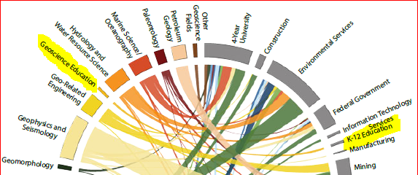
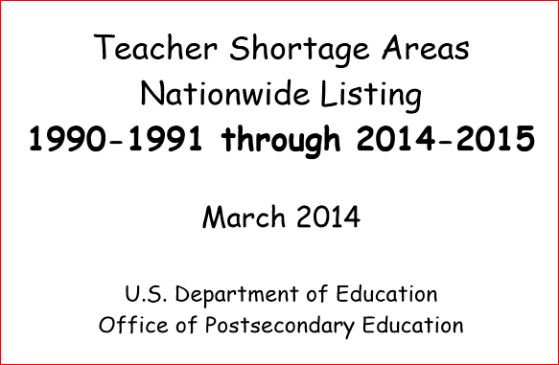
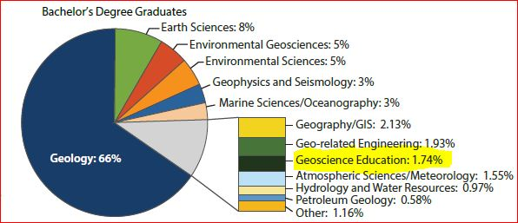
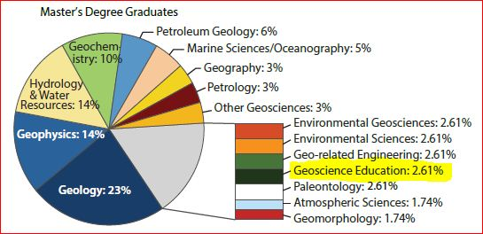
Earth Sciences: Consistently high-need, especially for low income students
Geoscience Education: U.S. Graduates equal Hires
NGSS will only increase need for Geoscience Educators in K-12 over next 5 years
Public, private, charter, online, homeschool
Notes:
Remember Carolyn Wilson’s AGI “Degree-Industry Circle” from July 2014? Colors on left represent number of graduates while gray regions on right represent number of new hires. Nearly every geoscience education graduate nationwide is getting hired by a K-12 school! Earth Sciences is consistently listed by the US Dept of Education as a high-need field in teacher shortage areas, especially for low income K-12 students across the country. College enrollments & graduation rates in geoscience education are increasing and will continue to grow, especially in states adopting the Next Generation Science Standards. (See reference list for graphics sources.)

Slide 4
WGU Graduation Rates in Secondary Science
22% of graduates in FY2014 from Secondary Science Education at
Western Governors University emphasized Earth and Space Sciences content
Direct use in Middle School or High School classrooms
Middle = Middle School Science (grades 5-9)
MATS = Master of Arts in Teaching, Science
PBTP = Post-Baccalaureate Teacher Preparation
MATS & PBTP programs provide credentials for endorsement in general or specific sciences
Biology, Chemistry, Geosciences, Physics programs
= grades 5-12, emphasis on high school content
Notes:
Geosciences Education graduates at WGU have steadily increased over past 5 fiscal years. Add in the graduates with degrees in Middle School Science since most schools, regardless of education standards, emphasize Earth & space sciences (ESS) in grades 6, 7, or 8. In FY14, 16% graduated with degrees in Geosciences Education + 6% in MSS = 22%. This does not includes PBTP or MATS graduates who will use ESS content in their classrooms. (I created and shared these graphics by email; S. Metlay, personal communication, 2014).

Slide 5
Discussing NGSS & Education Standards
2014: Independent of each other, WGU faculty began researching and discussing discipline-specific education standards. Presentations titled:
January: “NGSS Overview” to Secondary Science
April: “Finding The Common Ground” sandwich seminar
August: “The Common Core Curriculum?” to Secondary Math
We began to coordinate during the summer, co-presenting by autumn:
Sept: “Teaching Educational Standards: Common Core and Next Generation Science Standards” to Secondary Education
Science, Math, all graduate programs such as Educational Leadership
Oct: “Finding The Common Ground for Teacher Preparation: Understanding and Applying Standards” to Elementary Education
Education Standards affect all our teacher candidates and teachers of record:
Job interviewing
Lesson planning
Effective teaching
Agent of change within school or school district
Decision-making re: adopting or implementing standards
Notes:
In late 2013, I reached out to my colleague in Science Pedagogy and together we presented an introduction to NGSS to the Secondary Science team in January 2014. We had planned to expand to all of Secondary Education in the spring but circumstances delayed that presentation to September 2014. By then, we had reached out to colleagues in Secondary Math and Elementary Education; they made their own internal presentations on education standards in April 2014 and August 2014. In October 2014, I helped present to Elementary Education. In 2015, we plan more discussion throughout the Teachers College on NGSS and other education standards. (Personal communications, 2014.)

Slide 6
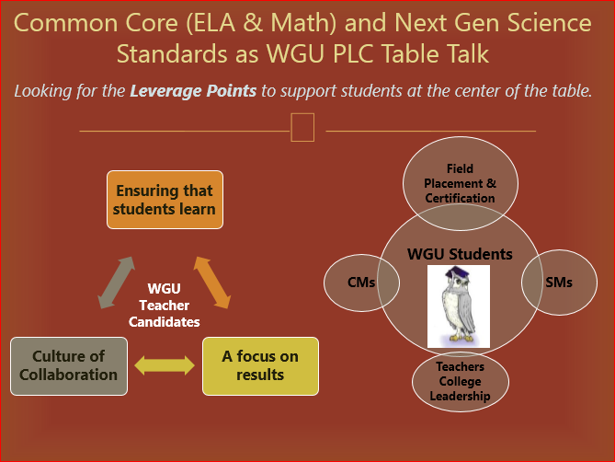
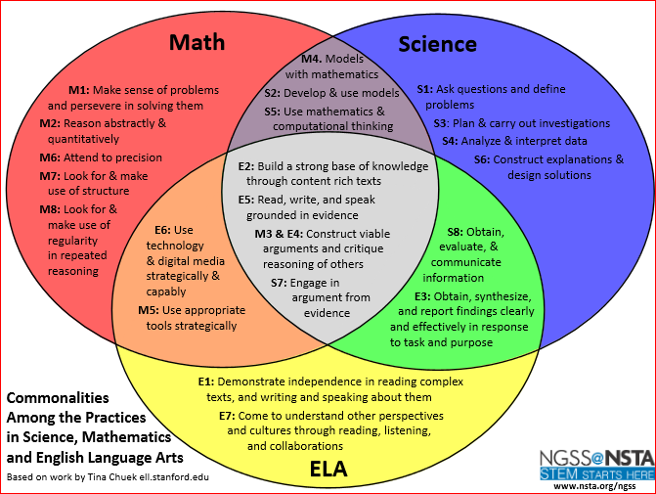
Integrated Approach to Education Standards
Standards inform expectations
Curriculum, Testing
Individual Education Plans
Diversity issues:
NGSS Appendix D
case studies
Understanding the controversy
Rationales for/against specific standards
Challenges to adoption or implementation
Tools for civil discourse and collegiality
Notes:
As a Professional Learning Community (PLC), we look to support all Teacher College students regardless of discipline or state standards. What does each unique student need to become a credentialed professional? Or to enhance what graduate students are already teaching? We seek common leverage points in science, math, English language arts, and integrated approaches at natural overlaps. Personalization is a hallmark of the WGU experience. Let’s personalize with regard to education standards to support job-seekers and educational leaders. (See reference list for graphics.)

Slide 7
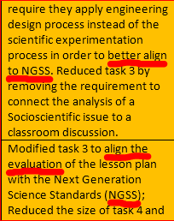
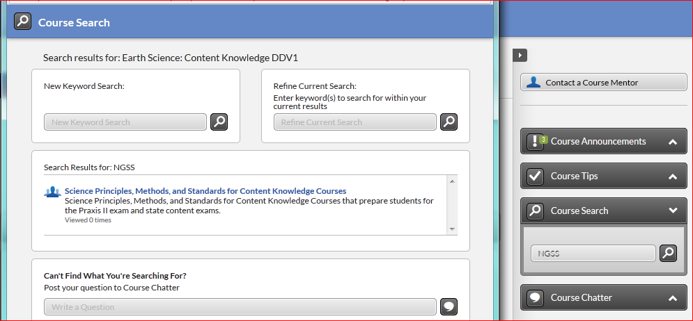
Implementing NGSS into Courses
Develop videos & articles explaining NGSS and other education standards
Knowledge Base (internal wiki)
Revise tasks/coursework to align with NGSS
Hands-on application by students
Notes:
(Graphics are screenshots of WGU Course Search and a fragment of email; personal communications, 2014.)

Slide 8
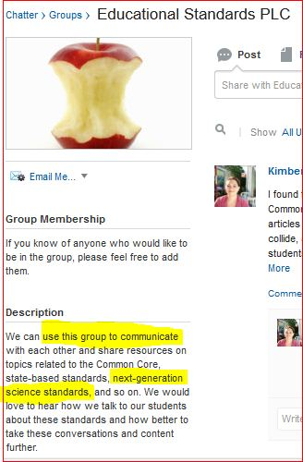

Keeping the conversation going
Pedagogy options help inform professional decisions
NGSS or alternate state standards for science
Push back or fall out across country
NGSS and Common Core are politically sensitive
Be sensitive to feelings of colleagues, students
Private schools are not obligated to use NGSS/CCSS
Public schools take years to implement NGSS, Common Core, or alternate standards as each state uses a different roll-out schedule
Stay flexible as colleagues try (and sometimes fail with)
adaptation and implementation
Provide constructive feedback
Help develop new approaches
Notes:
Using an internal Facebook-like “Chatter” area, WGU faculty have developed a Group page called Educational Standards PLC to facilitate further conversation about news, events, and information of interest. This professional learning community is completely informal and faculty-driven. (Text on blue background adapted from Metlay & Schmidt, 2014. Screenshots of Chatter area and Churchill quote; personal communications, 2014.)

Slide 9
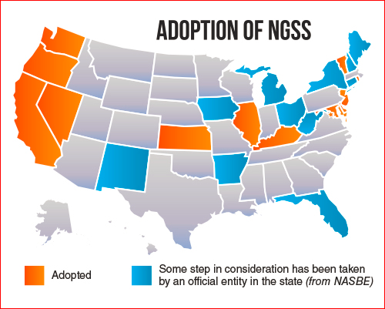
Next Steps Regarding Education Standards
Communicate education standards news throughout Teachers College
Faculty, Licensure, Records, Field Experiences (on-site student teaching)
Provide opportunities to chat, collaborate
Education standards discussion should be a part of whole program design, not just in isolated courses
Involve relevant faculty, staff, academic leadership (Dean, Provost, etc.)
Develop an overall plan to address differing science standards across states/territories
Develop an integrated approach to
education standards in appropriate
courses
Respect intellectually diverse views
Be nimble in response to rapid
changes in K-12 educational
landscape
Notes:
At WGU, Teachers College faculty are beginning to discuss how to approach the diversity of education standards in our disciplines, our states, and our students’ needs. This is still a work in progress. Here are three possible next steps… (See reference list for map graphic.)

Slide 10
References
“Adoption of NGSS Map” (2014). Retrieved from NGSS@NSTA Hub page, National Science Teachers Association website, at http://ngss.nsta.org/wp-content/uploads/2014/07/AdoptionOfNGSS_map.jpg
Cartwright, N.C., et al. (2014). “Finding The Common Ground for Teacher Preparation: Understanding and Applying Standards”. PowerPoint slides presented at Western Governors University, Elementary Education Team Meeting, October 2014.
“Commonalities among the Practices in Science, Mathematics, and Language Arts” (2013). Retrieved from National Science Teachers Association website at http://nstahosted.org/pdfs/ngss/PracticesVennDiagram.pdf
Metlay, S.T., & Schmidt, S. (2014). “NGSS Overview”. PowerPoint slides presented at Western Governors University, Secondary Education Science team Meeting, January 2014.
Wilson, C. E. (2014). “The Industries of Geoscience Graduates’ First Jobs by Degree Field”. Geoscience Currents, 90. Retrieved from American Geosciences Institute (AGI) website at http://www.americangeosciences.org/workforce/currents/industries-geoscience-graduates-first-jobs-degree-field
Wilson, C.E. (2014). “Chosen Degree Fields of Geoscience Graduates in the 2013-2014 Academic Year”. Geoscience Current, 92. Retrieved from American Geosciences Institute (AGI) website at http://www.americangeosciences.org/workforce/currents/chosen-degree-fields-geoscience-graduates-2013-2014-academic-year

