Slide 1
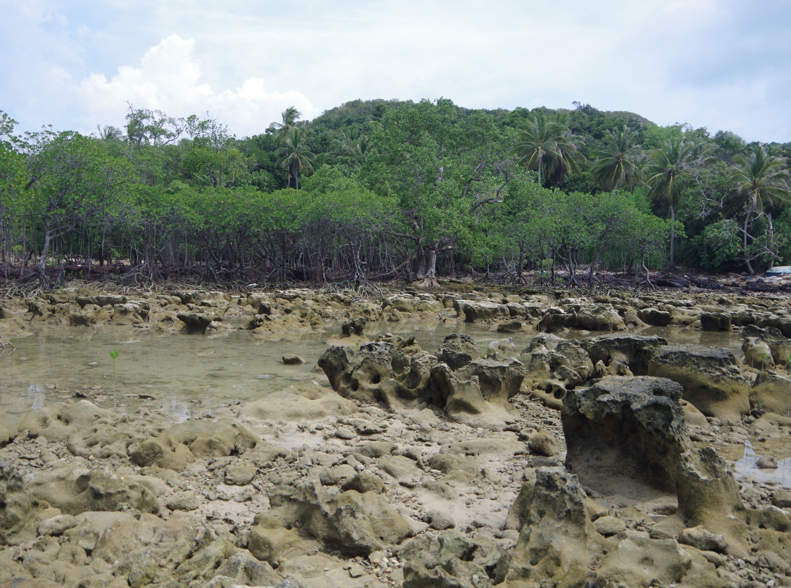
HOLOCENE RELATIVE SEA-LEVEL HIGHSTAND PATTERNS, PENINSULAR MALAYSIA EAST COAST
Peter R. Parham, Noraisyah Sapon, Rokiah Suriadi, Noor Azariyah Mohtar
Institute of Oceanography and Environment
Universiti Malaysia Terengganu

Slide 2
In this talk:
Summarize the geologic setting and post-LGM (last ca. 18,000 years) sea-level history of the Peninsular Malaysia region
Describe location, character and distribution of sea-level indicators along the Peninsular Malaysia east coast
Discuss age results and correlate with other age data from the area
Discuss implications for relative sea-level history and highstand sedimentary evolution of this coastal system

Slide 3
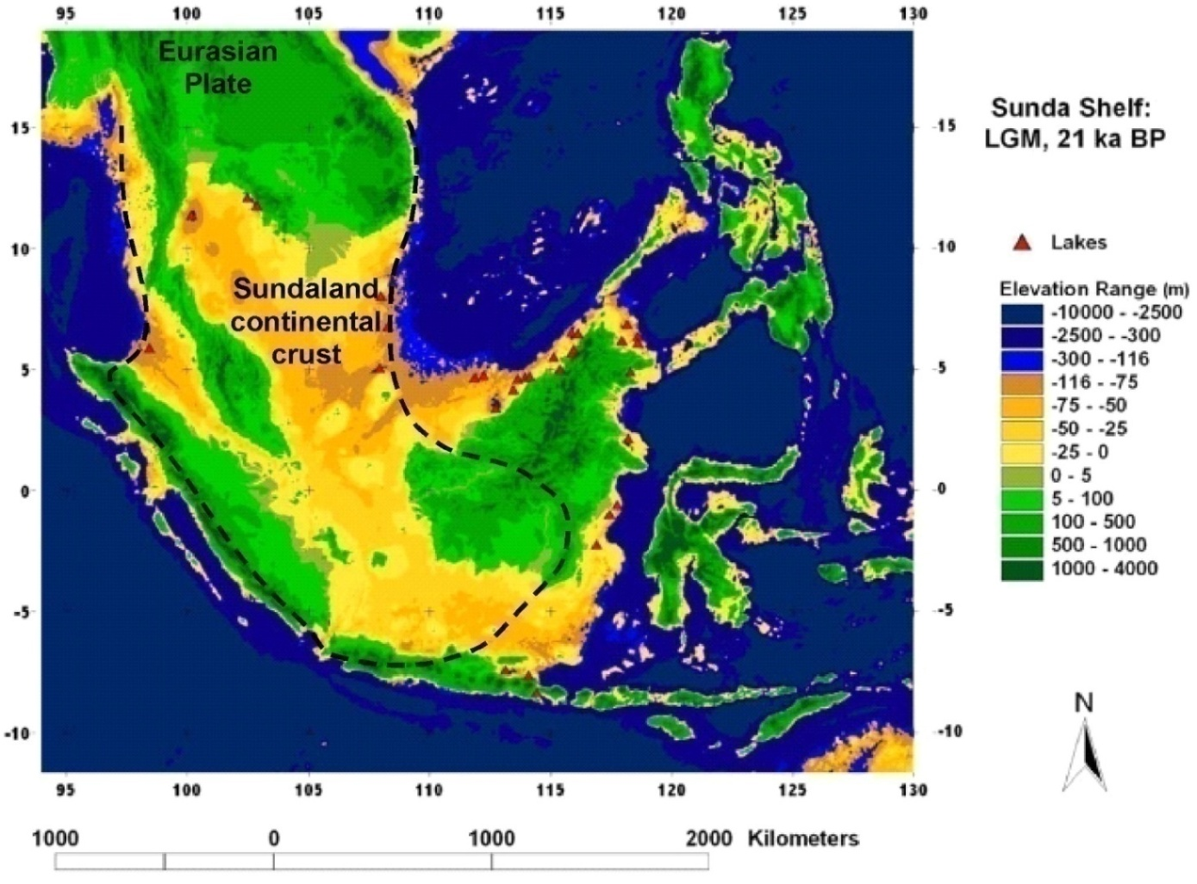
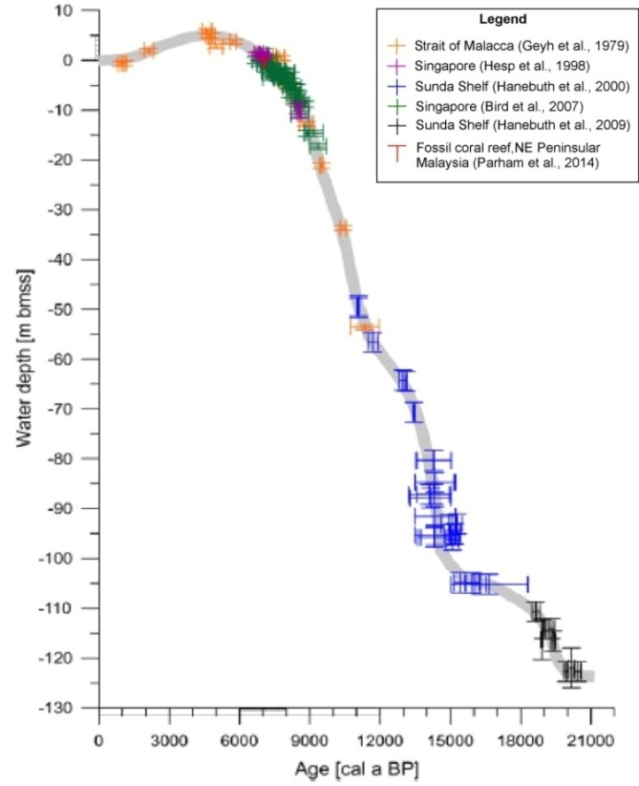
Why study this region?
Far-field sites that are tectonically stable are considered to provide the best possible record of eustatic sea-level change
East coast Peninsular Malaysia study area centrally located on Sundaland continental crust
Sundaland generally considered tectonically stable through Quaternary – should provide a good eustatic sea-level record
Map shows extent of SE Asia emergent land area (yellow) during LGM (ca. 21 ka) with sea level around 120 m below present
Sea-level curve pattern typical for tectonically stable tropical regions with a mid-Holocene highstand above present MSL and subsequent descent to around modern level in response to hydro-isostatic adjustment (HIA)
Sea level 116 m below present
Relative sea-level curve for Sunda Shelf region since LGM (ca. 21 ka)
study area
modified from Sathiamurthy and Voris (2006)
from Hanebuth et al. 2011 based on data from Geyh et al. (1979), Hesp et al. (1998), Hanebuth et al. (2000), Bird et al. (2007) and Hanebuth et al. (2009). Age/elevation data from Parham et al. (2014) added.

Slide 4
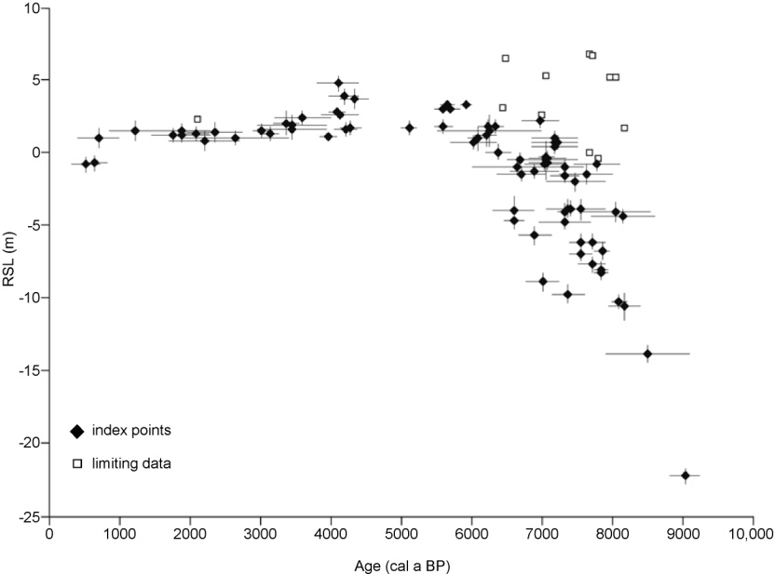
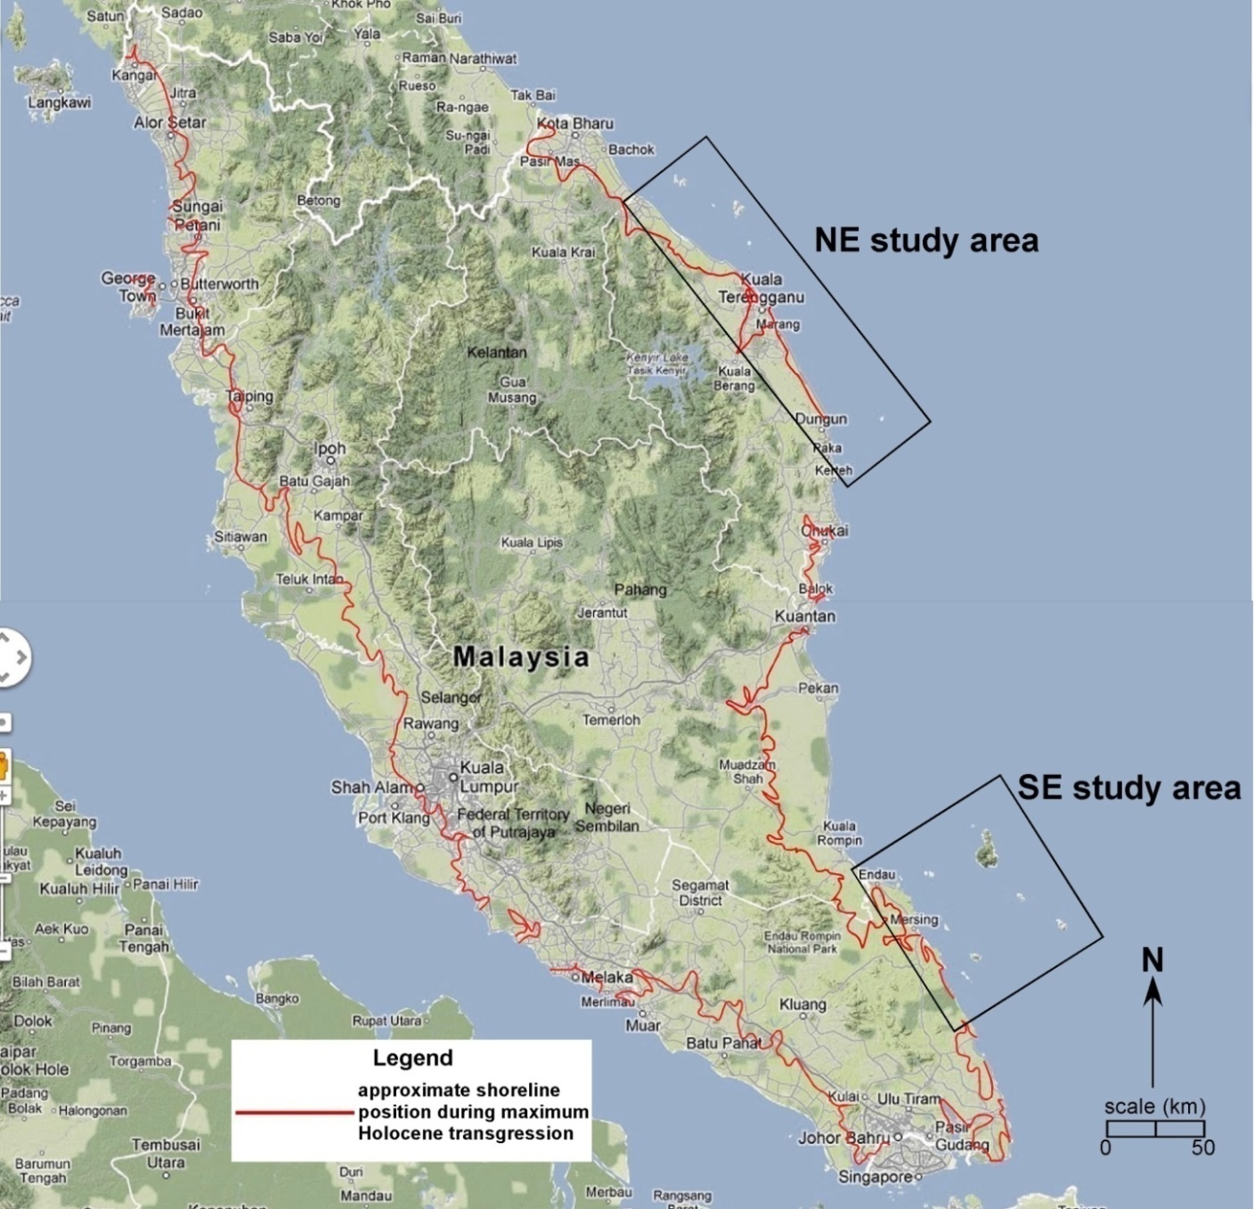
Why study the east coast of peninsular Malaysia?
Regional relative sea-level curve for last 10 ka based data compiled from numerous studies in Thailand and Peninsular Malaysia (Horton et al., 2005)
Approximation of Peninsular Malaysia coastline during maximum mid-Holocene transgression
Scatter in the Horton et al. (2005) data is attributed to the broad distribution of RSL observations (E & W coasts Thai-Malay Peninsula as far N as Chao Phraya Delta) and spatial variation in HIA across the region, suggesting that it is not valid to construct a single sea-level curve for this region.
Purpose of our ongoing study is to investigate the RSL highstand record from the Peninsular Malaysia east coast, develop a localized sea level curve and detect any potential variability within the area.
Because RSL evidence in the form of raised fossil oysters and in situ corals is especially common around islands, essentially all east coast islands were surveyed and sampled.

Slide 5
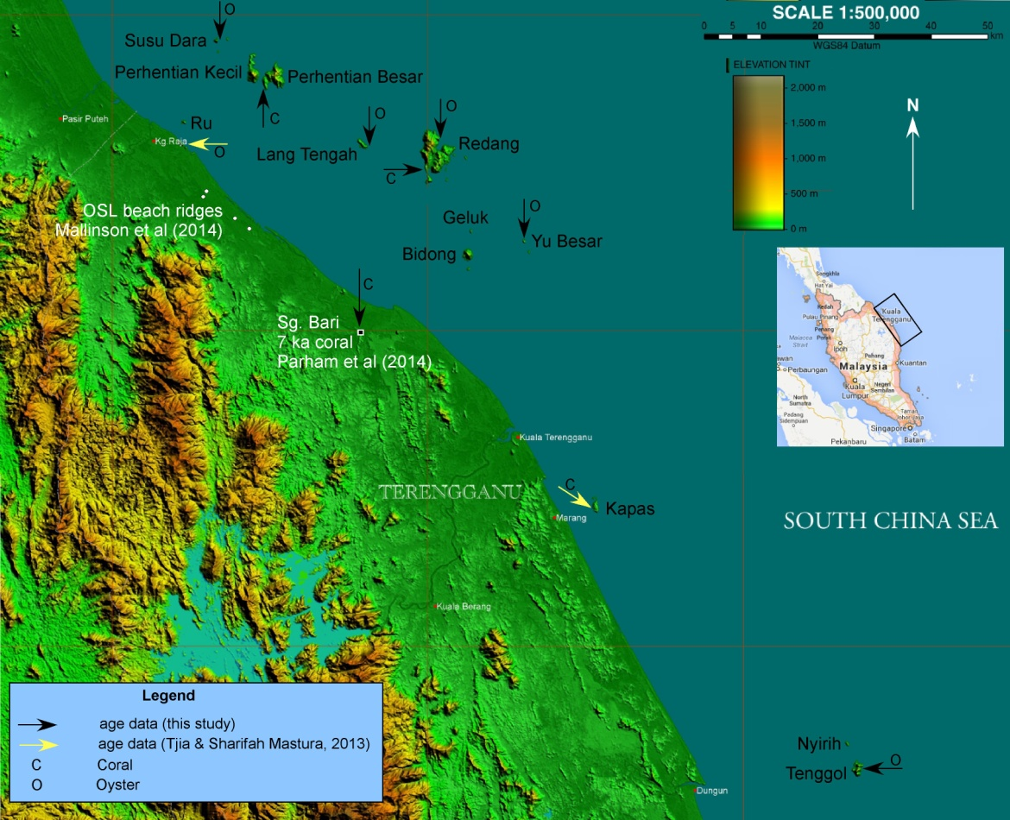
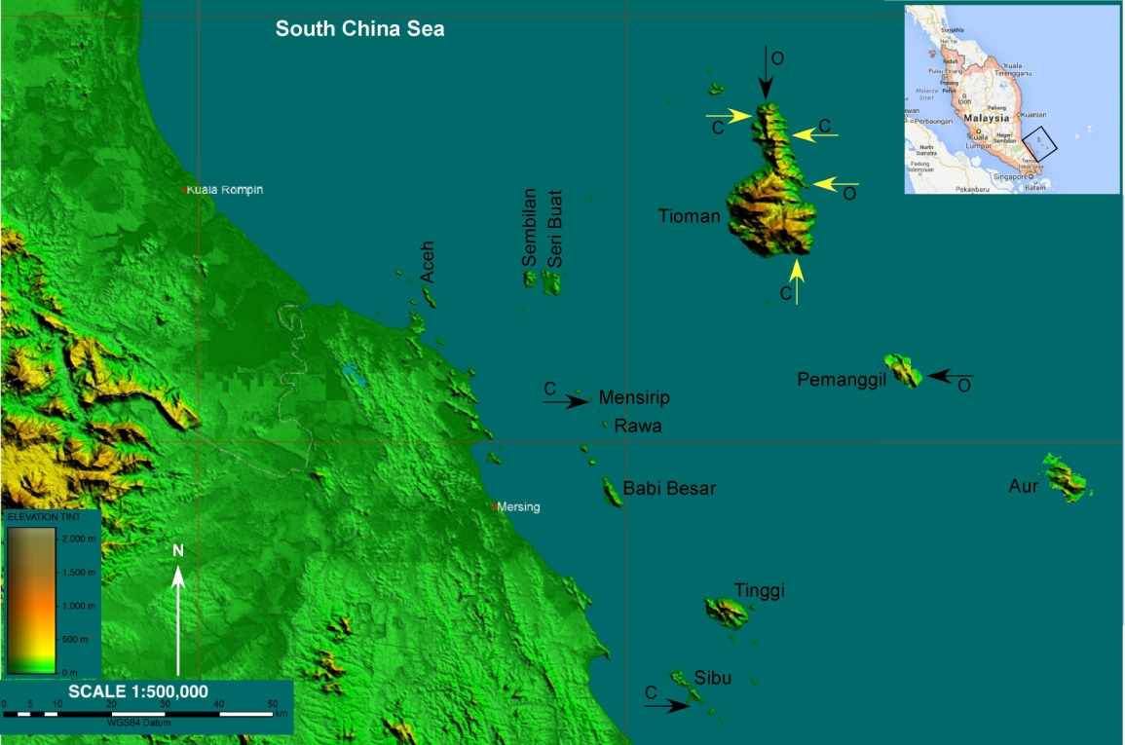
Study Areas
Maps show:
islands surveyed – coasts of almost all islands surveyed by boat and on foot
locations of age/elevation data - islands (this study; Tjia & Sharifah Mastura, 2013)
locations of RSL data on the mainland (OSL beach ridge - Mallinson et al., 2014; ¹⁴C coral - Parham et al., 2014)
substantial additional paleo-RSL elevation data have been collected but have yet to be age dated
NE Peninsular Malaysia study area
Islands
NE – mainly granitic and meta-sedimentary bedrock with rocky shorelines and occasional sandy pocket beaches
SE – volcanoclastic , granitic and gabbro bedrock with rocky, pocket-beach and mangrove-fringed shorelines
modern coral reefs extensive in both areas
Tides
Semi-diurnal
Mean tide range – ca. 2 m
Max. tide range – ca. 2.6 m
NE Monsoon setup – ca. 40 cm
Currents
Dominant current and coastal sediment transport South to North
SE Peninsular Malaysia study area
shaded relief maps modified from Ng (2007)

Slide 6
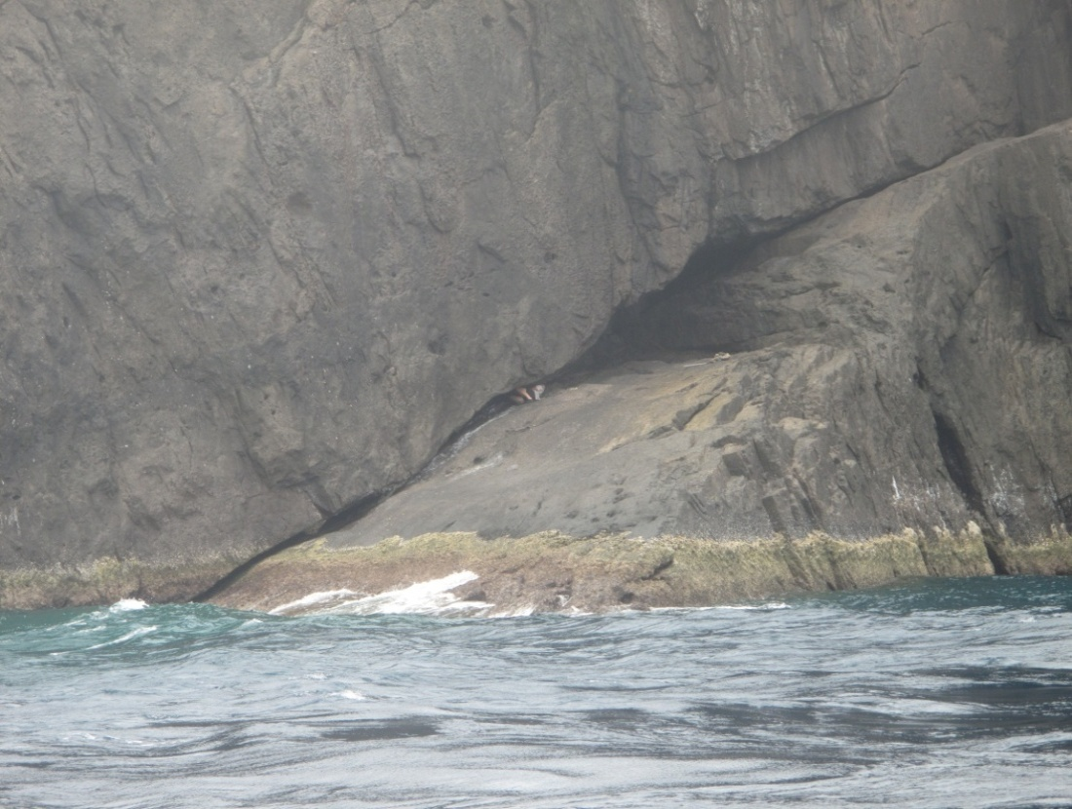
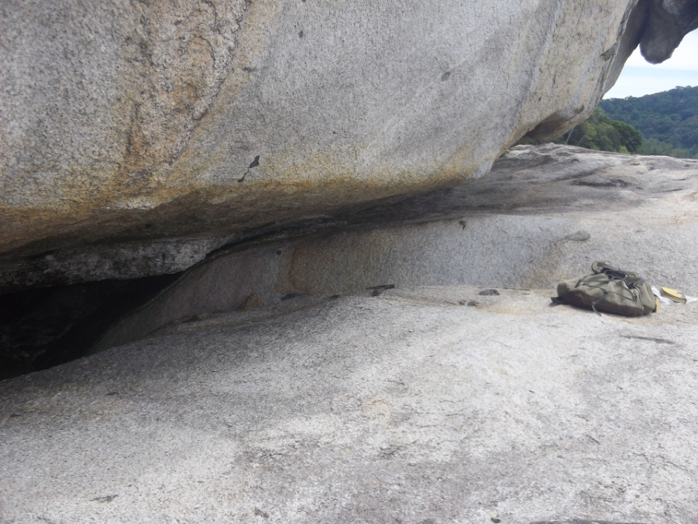
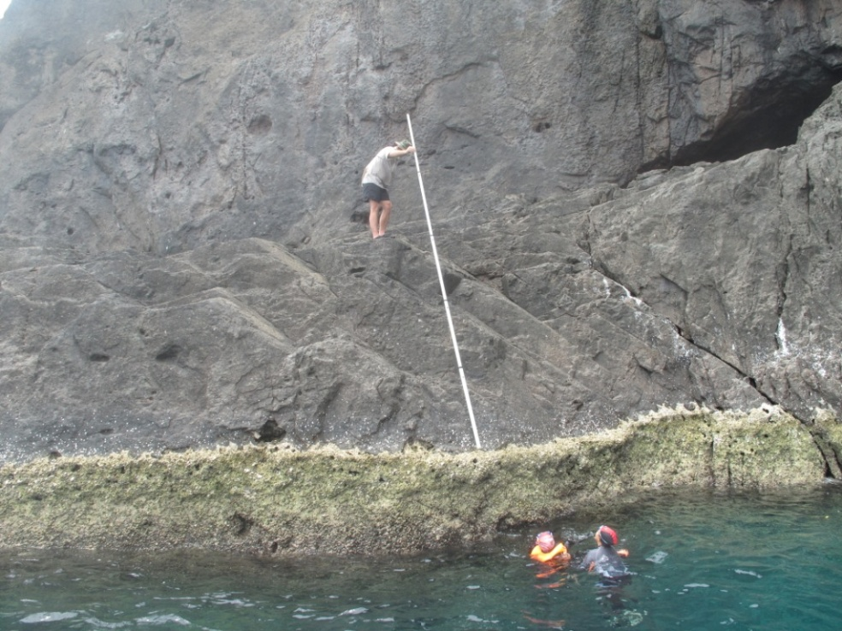
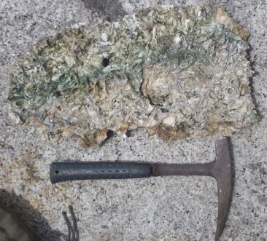
Paleo-sea-level indicators
Rock-encrusting oysters (Saccostrea cucullata)
Living oysters mainly confined to the upper intertidal zone (ca. 1 m)
Maximum modern oyster buttress thickness (optimal growth conditions) ca. 20 – 30 cm below mean high tide
Elevation of raised fossil oysters were measured from the top of the modern oyster buttress
Their elevation above this datum is inferred to represent change in RSL (+/- 50 cm vertical error) between now and the time the fossil oysters were living
Assumption: paleo-tide range similar to present
NE Study Area
emergent fossil oysters almost solely preserved in areas sheltered from acidic meteoric water

Slide 7
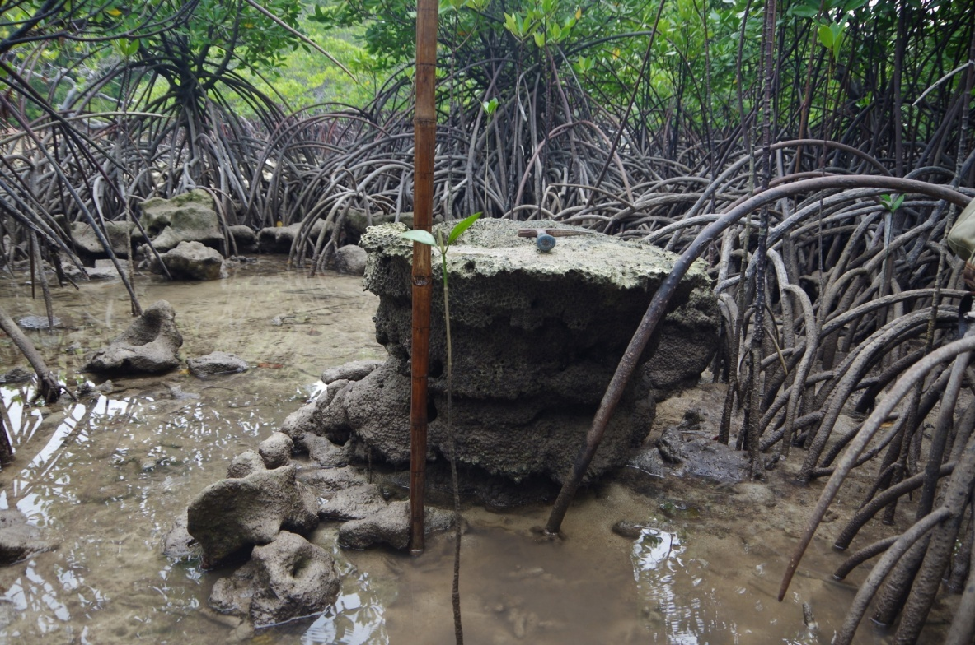
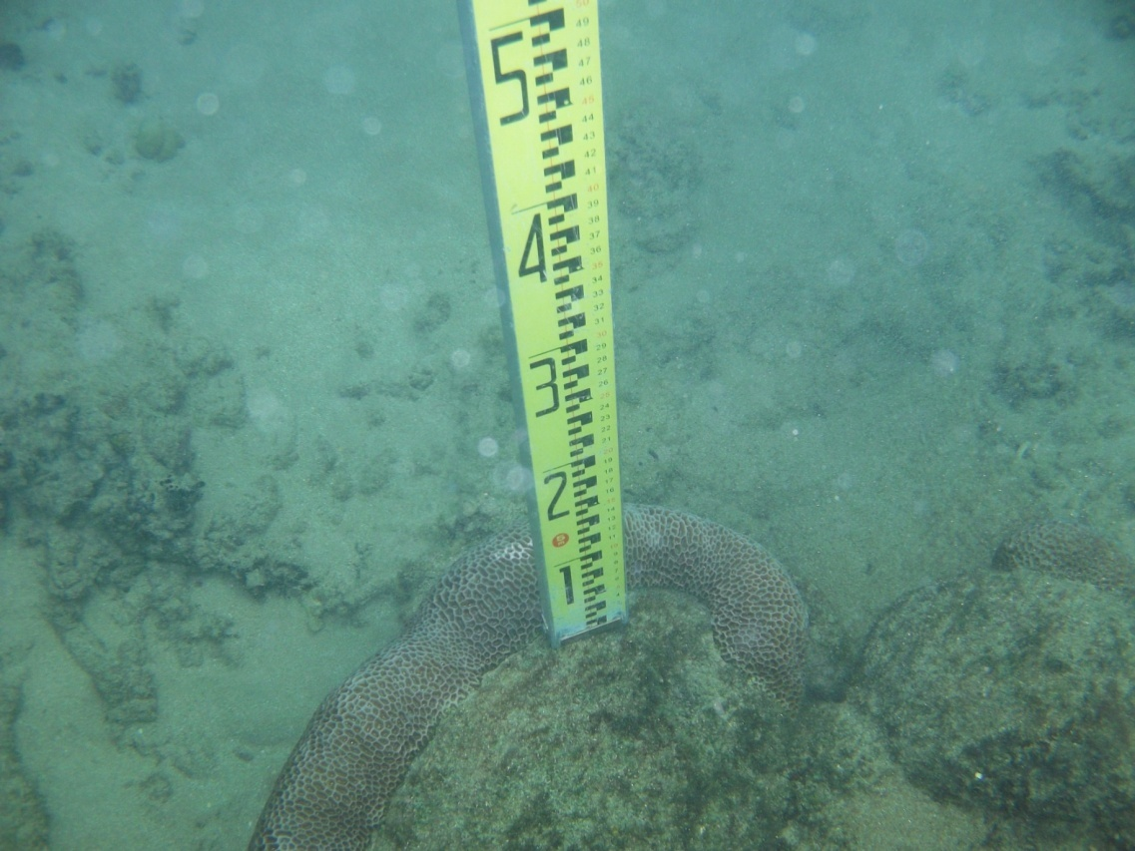
Paleo-sea-level indicators
Raised fossil massive corals (e.g. Porites, Galaxea common in study areas)
elevation of fossil coral is measured relative to the highest level of survival (HLS) of the same type modern coral in adjacent waters
HLS corresponds fairly closely (+/- a few cm) with lowest low water level
The elevation of the fossil coral above HLS is inferred to represent the minimum change in RSL between now and the time the fossil coral was living
This becomes marine limiting data because we know the RSL had to be ≥ the elevation of the fossil coral above modern HLS

Slide 8

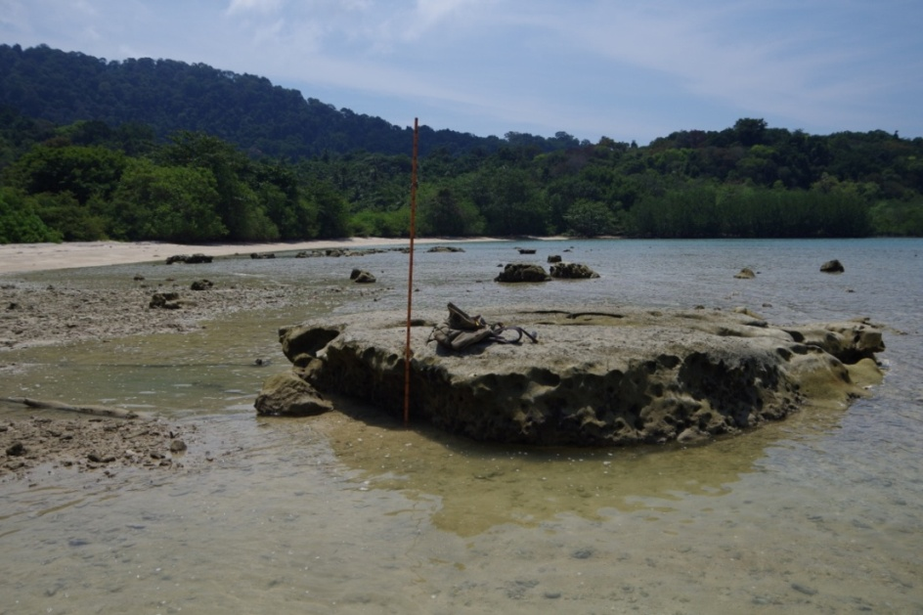
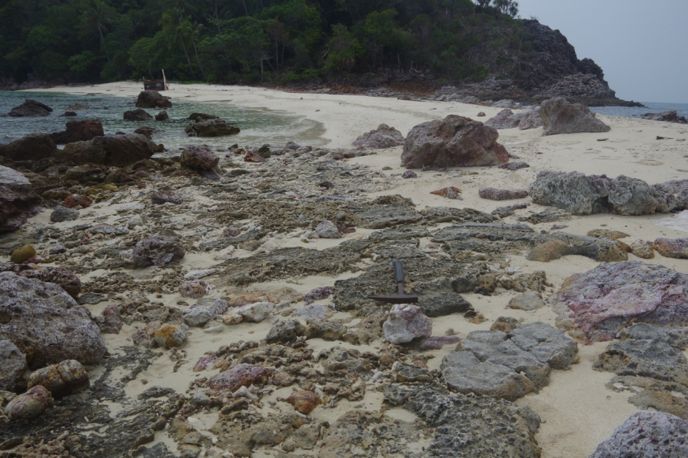
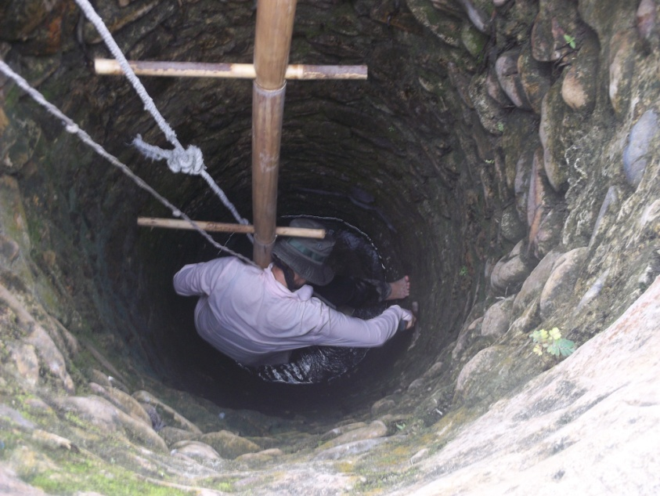
Island settings where fossil in situ corals may occur in or above the modern intertidal zone
mangroves – better preserved
fronting pocket beaches - typically karstified
Mangroves in the SE islands typically developed on fossil coral reef platforms
rocky beach faces – wave-scoured tops
beneath pocket beaches
in situ fossil corals much more common and higher elevation in the SE study area than in the NE

Slide 9
Age Data
This study
All oyster and coral samples were analyzed by Beta Analytic. Results were calibrated using Calib Rev. 6.1.0 and the Marine09 curve (Stuiver et al., 2009) and the local Delta R value of -15 and error 38 (Southon et al., 2002).
Previous studies
15 radiocarbon age estimates for east coast raised fossil oysters and coral were used from a compilation of Peninsular Malaysia sea-level data (Tjia and Sharifah Mastura, 2013). We calibrated these conventional ages as above. This is the first time this age data has been presented after appropriate calibration.
2 calibrated radiocarbon age estimates for in situ fossil coral on the NE Peninsular Malaysia mainland (Parham et al., 2014).
4 optically stimulated luminescence (OSL) age estimates (Mallinson et al., 2014) for NE peninsula beach ridge deposits aided in paleo-environmental reconstruction.

Slide 10
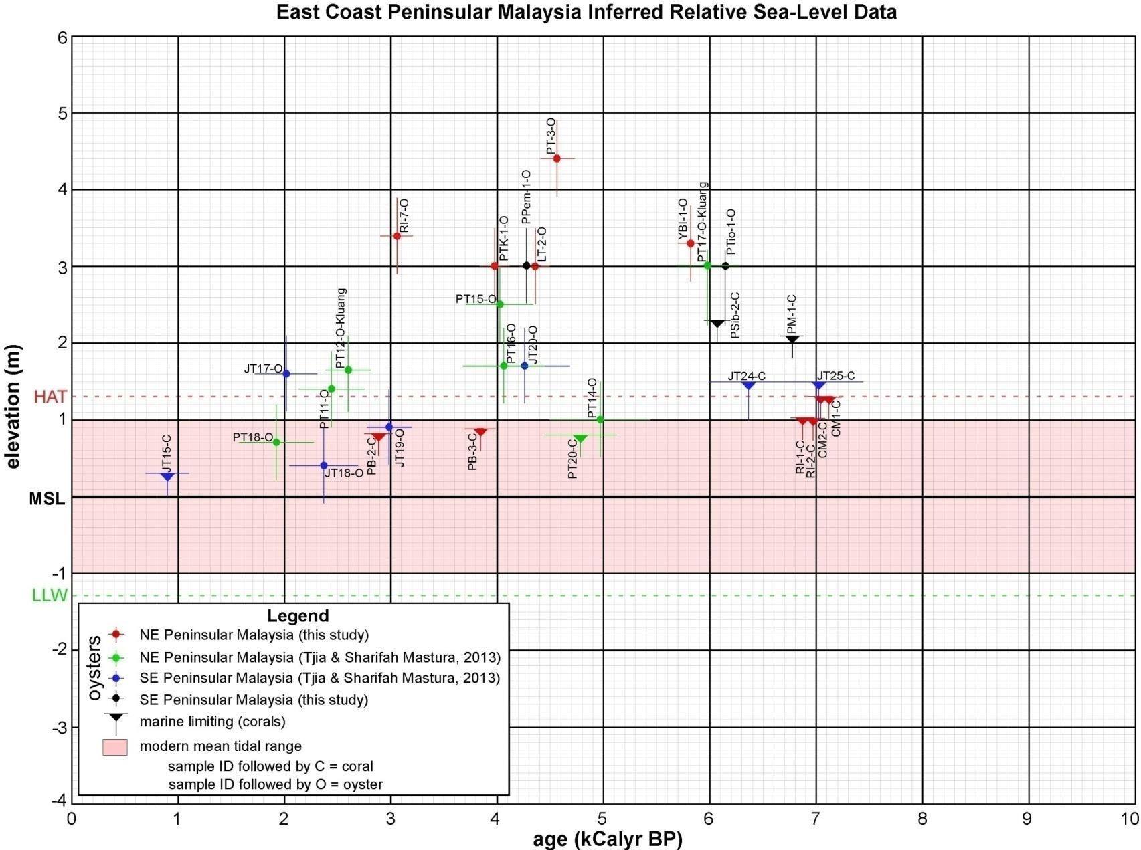
East Coast Peninsular Malaysia Inferred Relative Sea-Level Data Data points represent inferred RSL based on:
fossil oysters – their vertical relationship with top of modern oyster encrustations at the same locality (+/-50 cm)
fossil coral – their vertical relationship with HLS modern corals of same type at the same locality (oldest dates)
median ages (pts.) and 2-sigma age ranges are both plotted
scatter in younger ages
good agreement of older ages

Slide 11
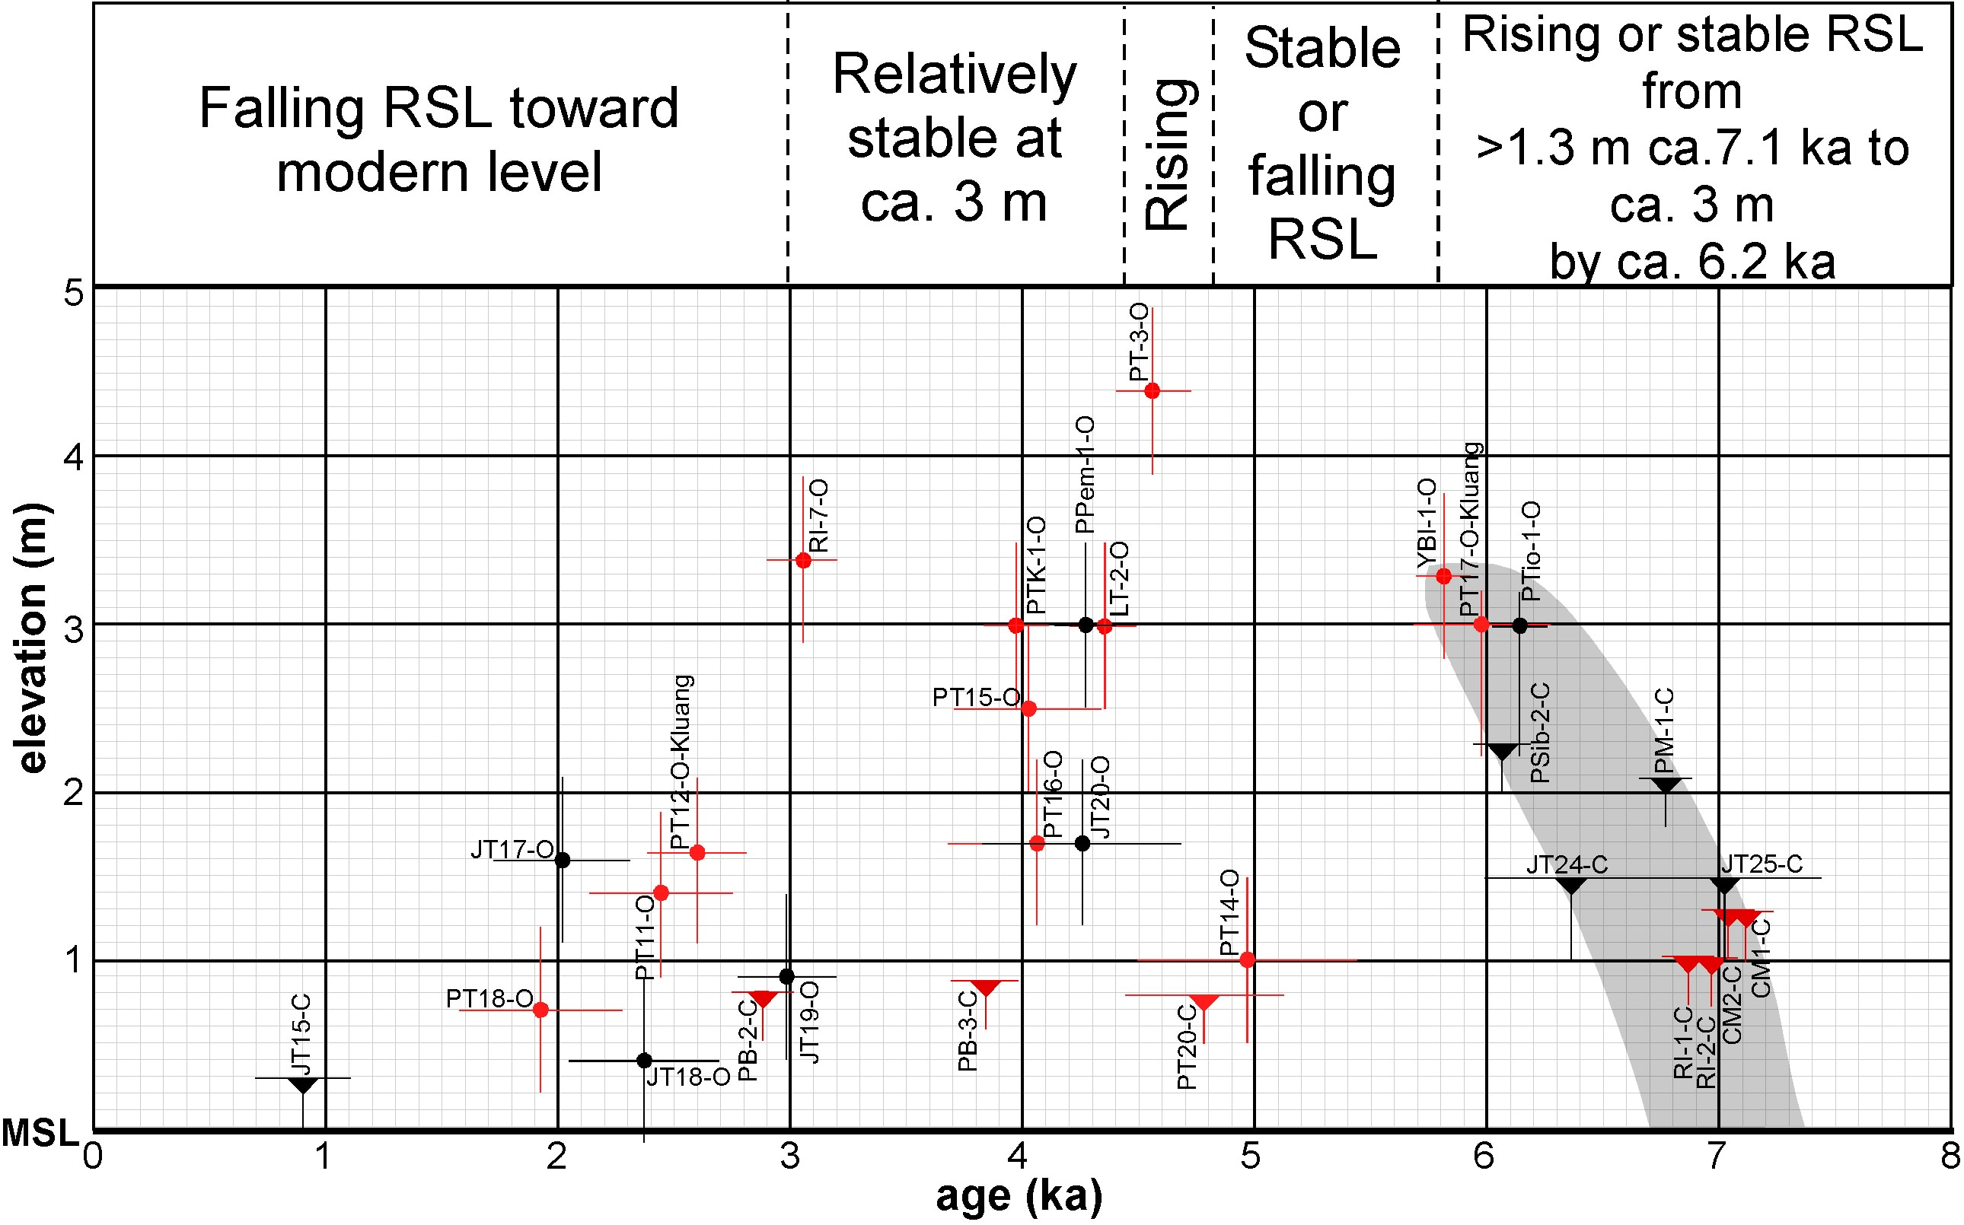
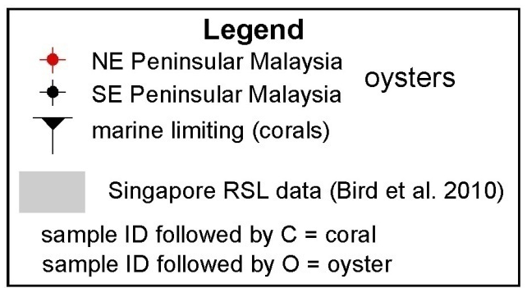
Interpretation of RSL data over the last ca.7 ka

Slide 12
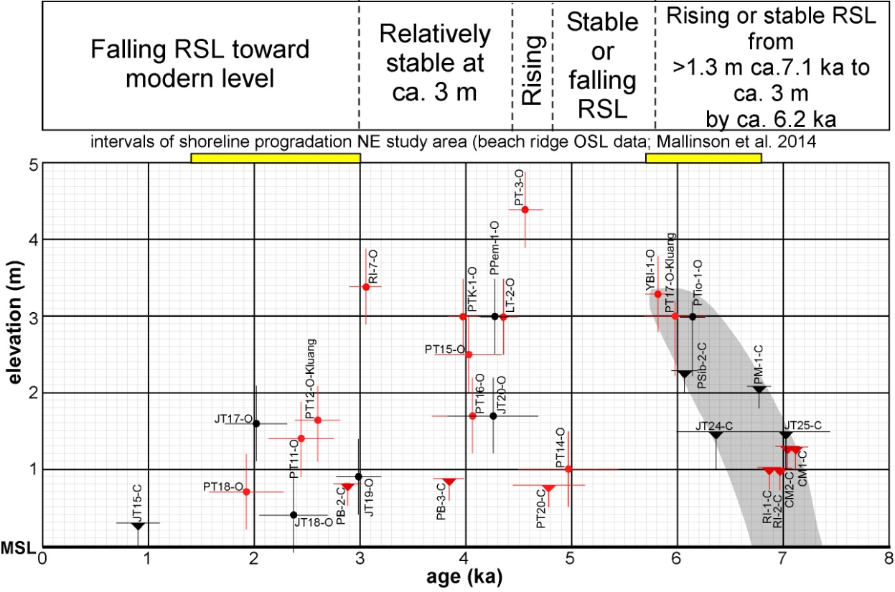
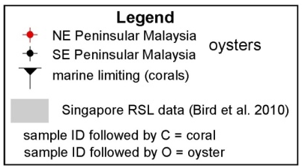
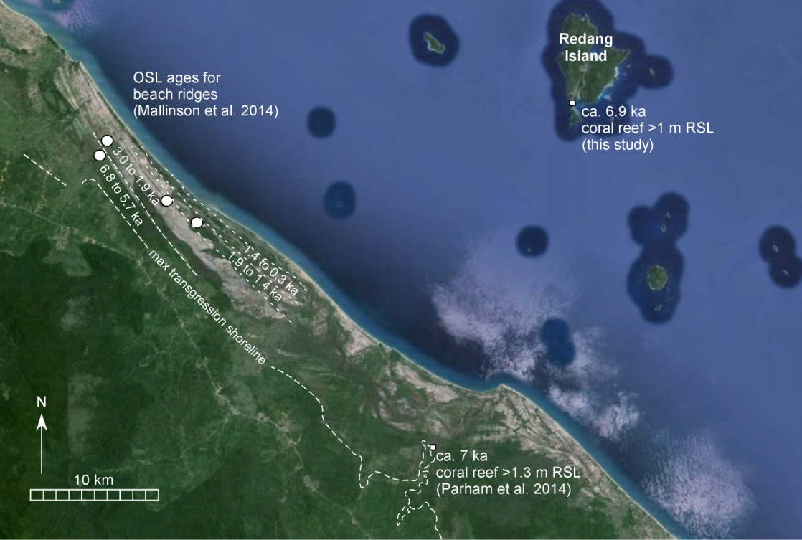
Highstand sedimentary evolution in the NE coastal system
Max. transgression ca. 7 ka with RSL from 1.3 – 3 m above present
Strandplain development by between 6.8 to 5.7 ka (OSL beach ridge) – sediment supply > RSL rise
Probable continued progradation until ca. 5 ka or after in response to stable or falling RSL
Renewed transgression and erosion of older strandplain deposits in response to RSL rise ca. 4.5 ka and/or increased storminess
Shoreline progradation resumes after around 3 ka in response to falling RSL – much younger strandplain deposits seaward

Slide 13
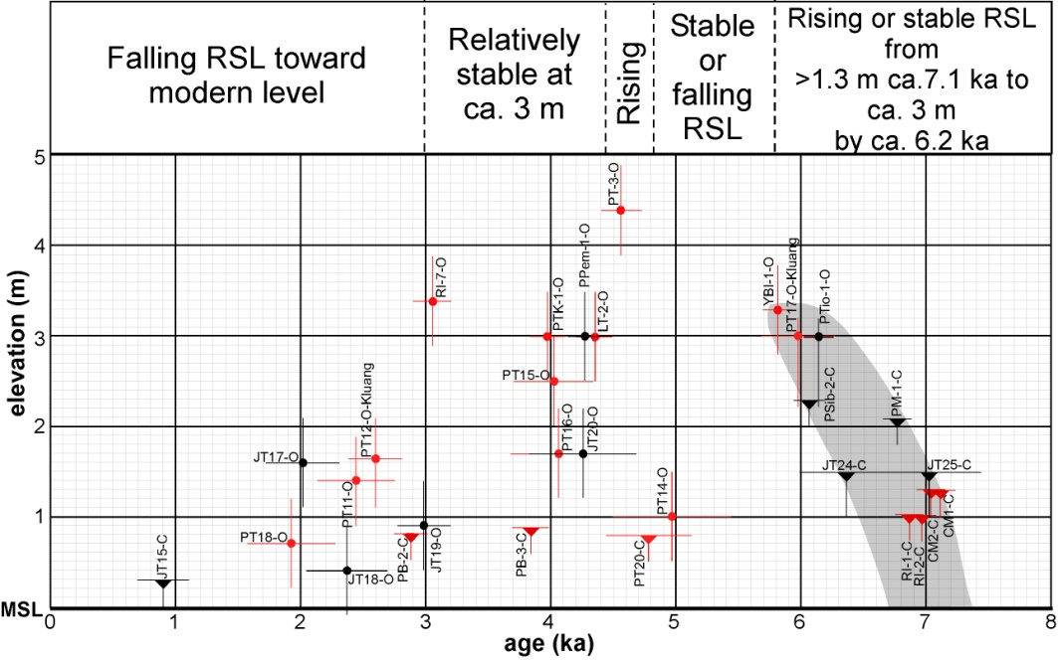
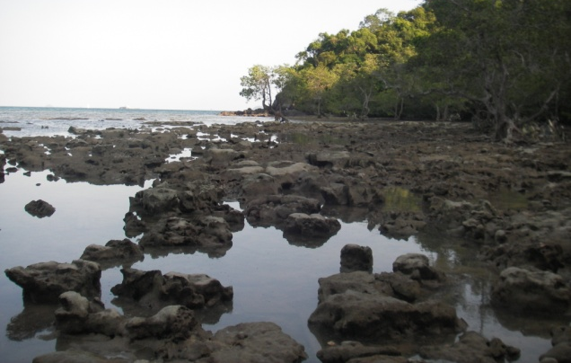
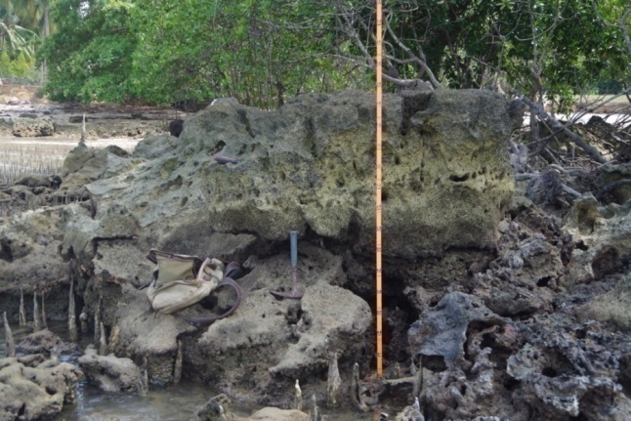
Differences between NE and SE study areas that may imply variability in HIA
NE study area
raised in situ fossil corals relatively rare (only slightly over 1 m > HLS - islands)
raised fossil oysters common up to 3.3 m above their modern counterparts with one observation at 4.4 m
SE study area
raised in situ fossil corals much more commonly preserved and at higher levels (up to 2.3 m > HLS)
raised fossil oysters never observed more than 3 m above their modern counterparts
oysters
oysters
corals
corals

Slide 14
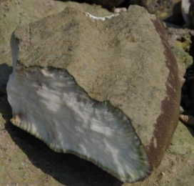
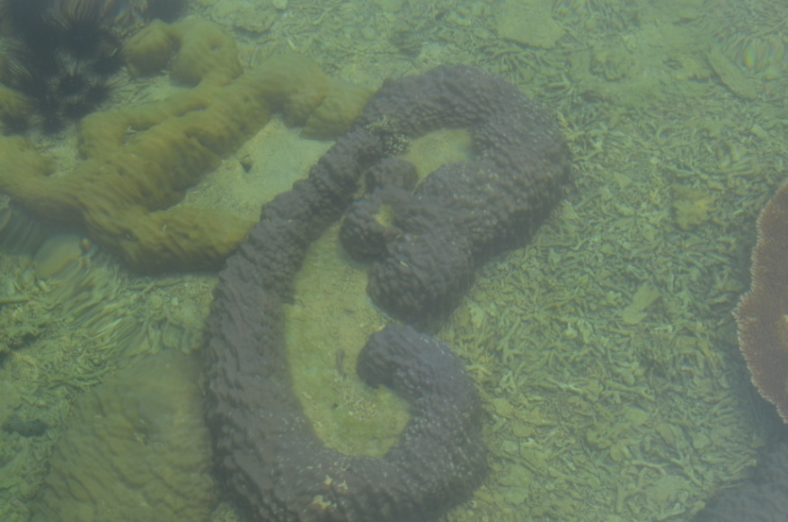
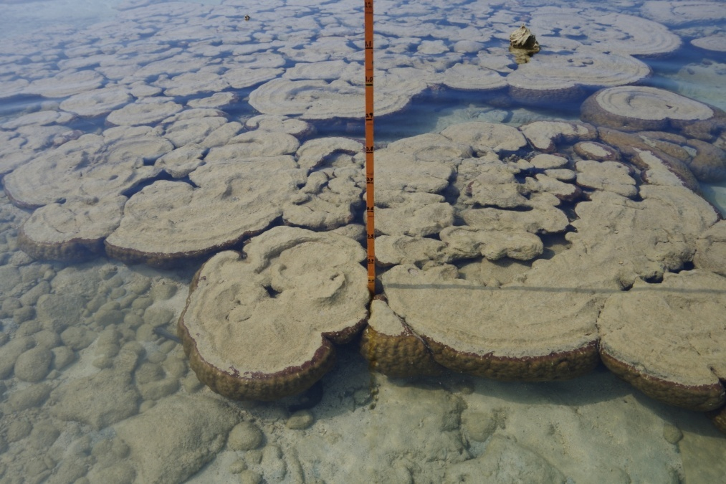
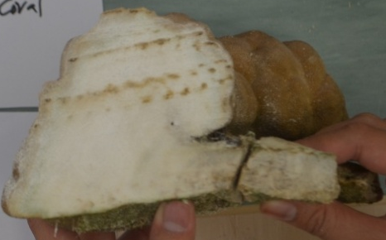
Modern RSL change trends
NE study area - rising
Throughout NE study area, massive corals at their HLS show a cup-shaped profile
SE study area – stable?
Porites microatolls have flat tops
Diagrams from Zachariasen et al. (1999)
When a coral reaches its HLS, no further upward growth is possible, horizontal growth below HLS continues
Flat top implies stable RSL conditions
Implication
Rate of uplift (HIA or other) in pace with eustatic rise
This cup shape implies rising RSL as the coral continues to grow up to its new/higher HLS over time
Implication
HIA in equilibrium – area experiencing eustatic sea-level rise

Slide 15
Conclusions
Based on extensive survey of the coasts of essentially all east coast Peninsular Malaysia Islands, our data suggest that Holocene RSL along this coast was never higher than 4.4 m above present - based on one observation
All other evidence suggests highstand of around 3 – 3.5 m between ca. 6 and 3 ka
Age data imply an increase in RSL to ca. 4 m centered around 4.5 ka and is supported by ages for cross-cutting strand-plain deposits in the NE study area
Slight differences in RSL histories are suggested by the lack of encrusting oysters above +3 m in the SE study area while in the NE, oysters are common up to 3.4 m, with one occurrence at 4.4 m
Based on coral growth patterns, RSL is currently rising along the NE peninsula coast, but appears to be stable along the SE coast
Understanding local differences in RSL change…rising, falling or stable… is critical for wise management of these coastal areas and their resources
The potential for spatial variability should always be considered when evaluating any sea-level database

Slide 16
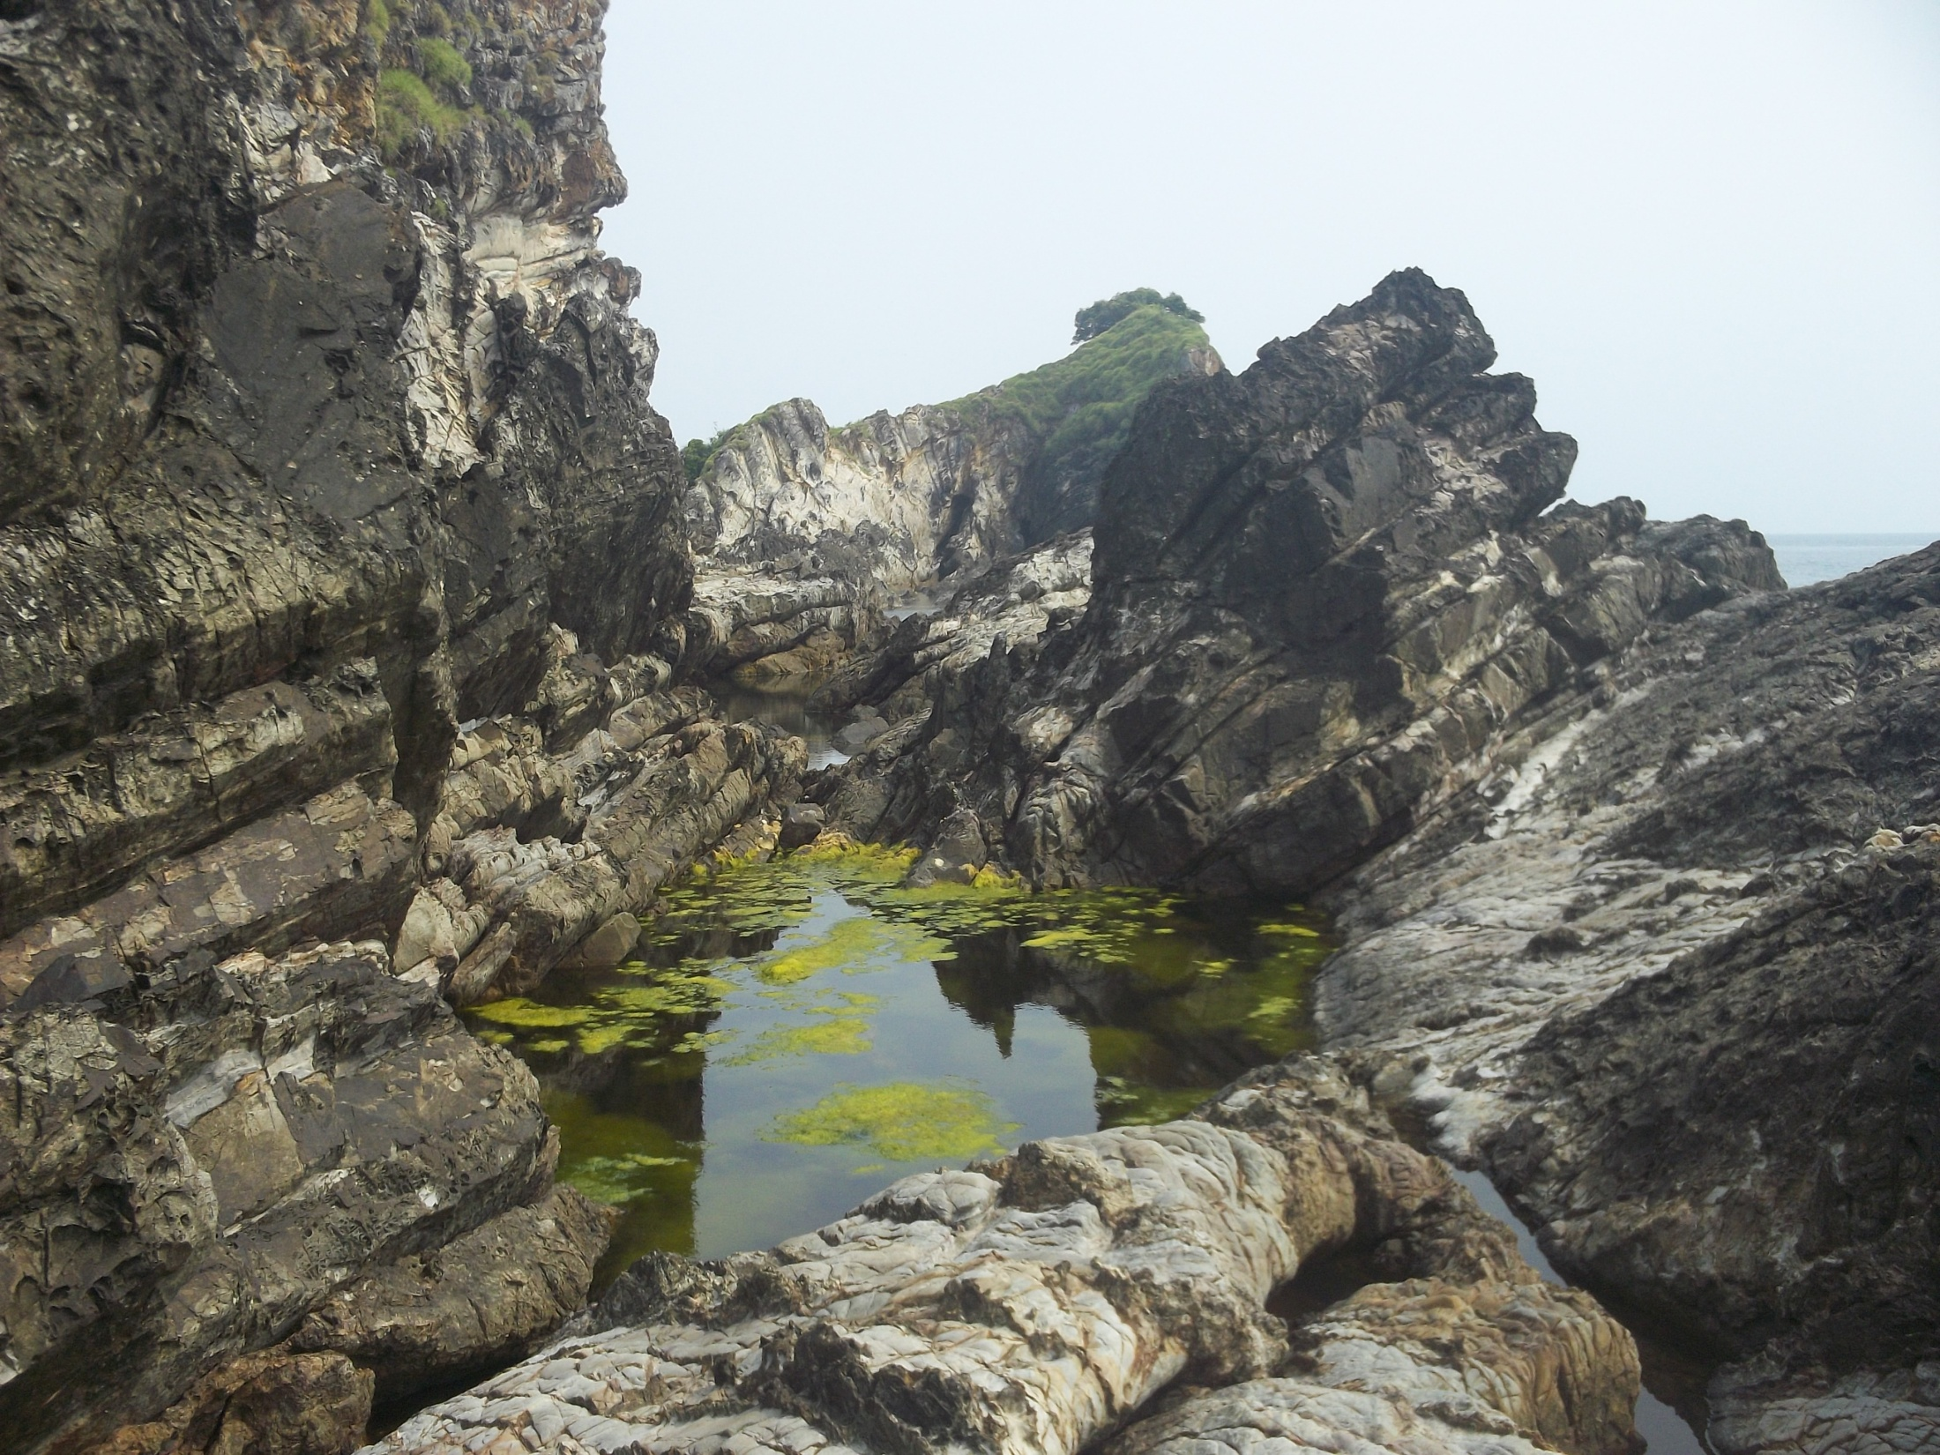
Thank you

