Slide 1
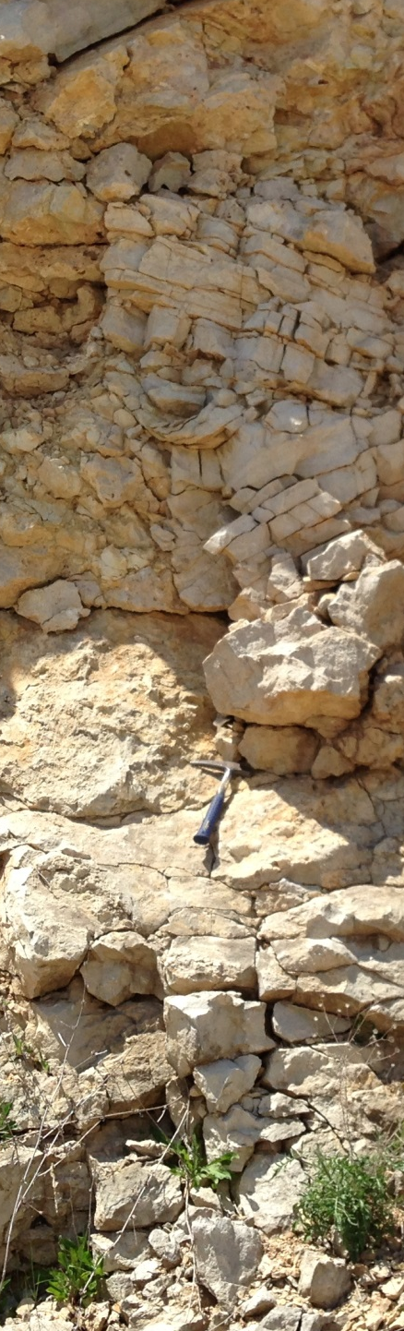

A PREVIOUSLY UNRECOGNIZED IMPACT STRUCTURE AT BRUSSELS HILL, DOOR COUNTY, WISCONSIN: BRECCIATION AND SHOCK-METAMORPHIC FEATURES
Emily Zawacki
Marcia Bjørnerud
Department of Geology

Slide 2
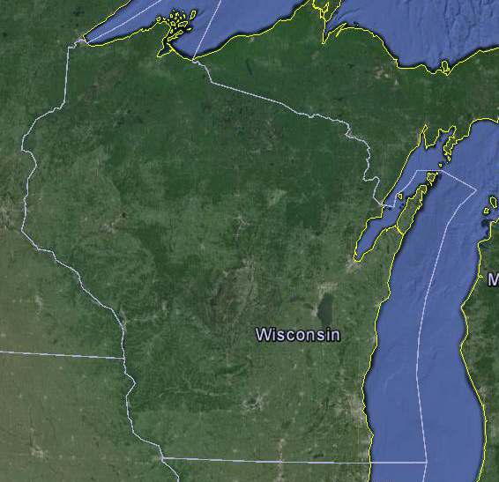
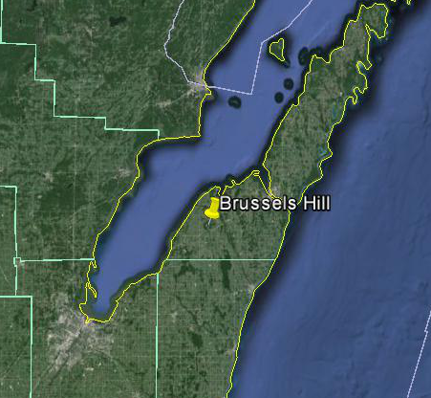
Location of Brussels Hill
Brussels, WIsconsin
145 mi
36 mi
Images from Google Earth

Slide 3
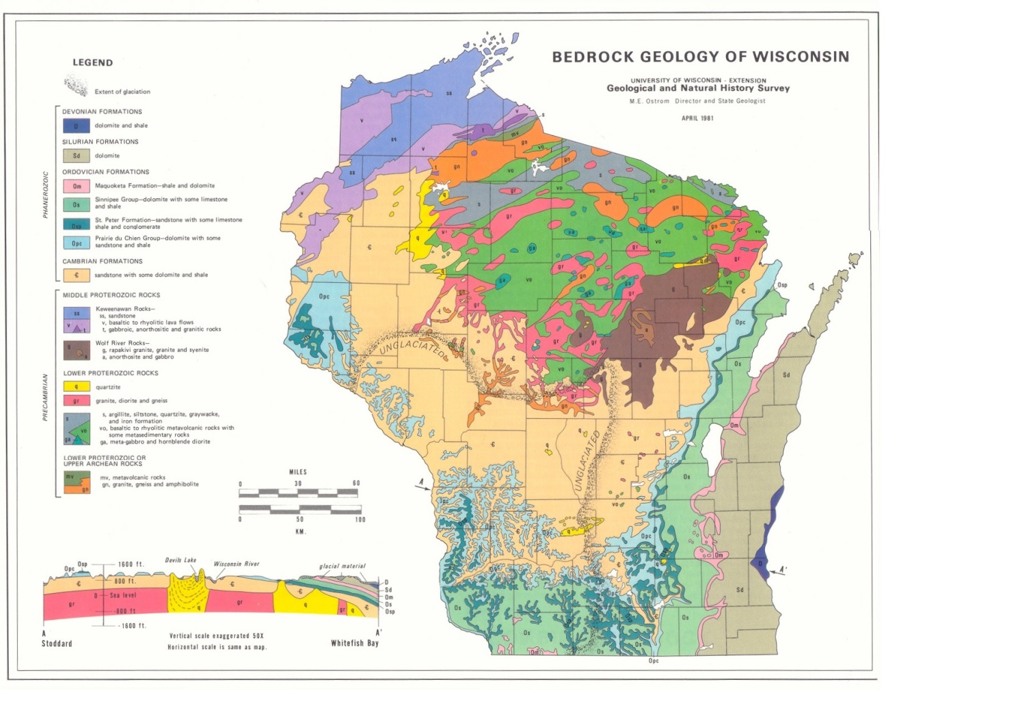
Geologic setting
Cambrian sandstone
Ordovician
Prairie du Chien
Ordovician
St. Peter
Brussels Hill
Ordovician
Sinnipee
Silurian
dolomite
Ordovician
Maquoketa
Devonian
dolomite and shale

Slide 4
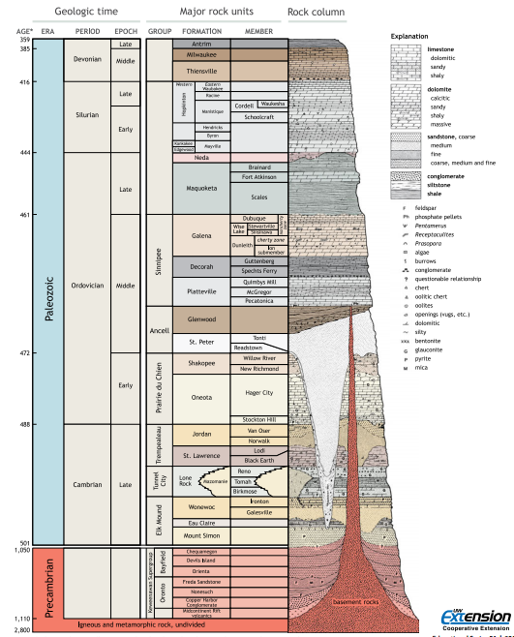
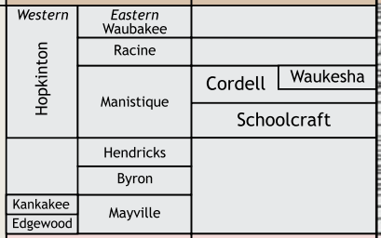
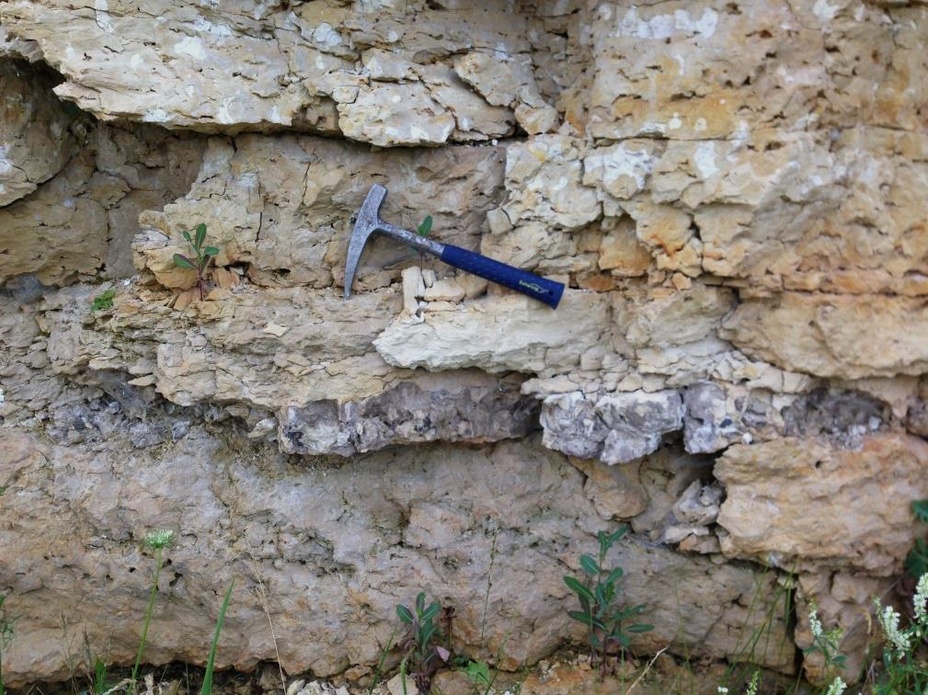
bedrock stratigraphy
416
Silurian
Burnt Bluff
444
No salt beds
Sandstone
occurrences
Hwy 57 Kewaunee/Door County Line

Slide 5
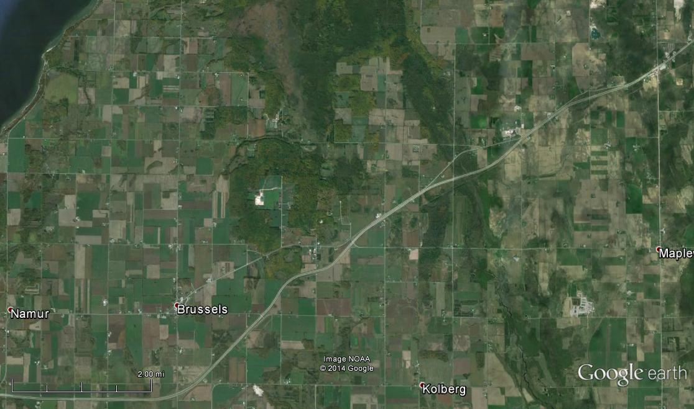
Brussels hill site
N
Google Earth image
2 mi

Slide 6
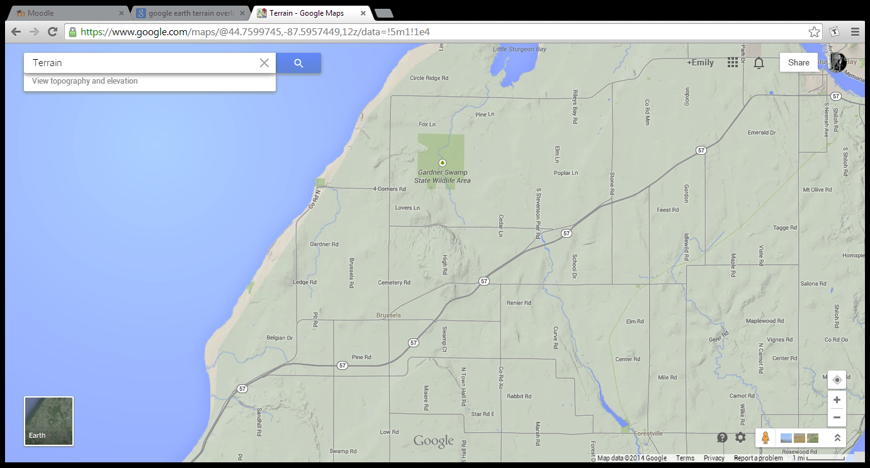
Topographic signature
1 mi
N
Google Terrain

Slide 7
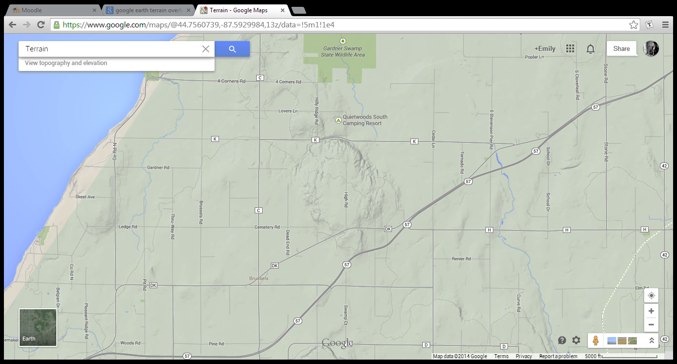
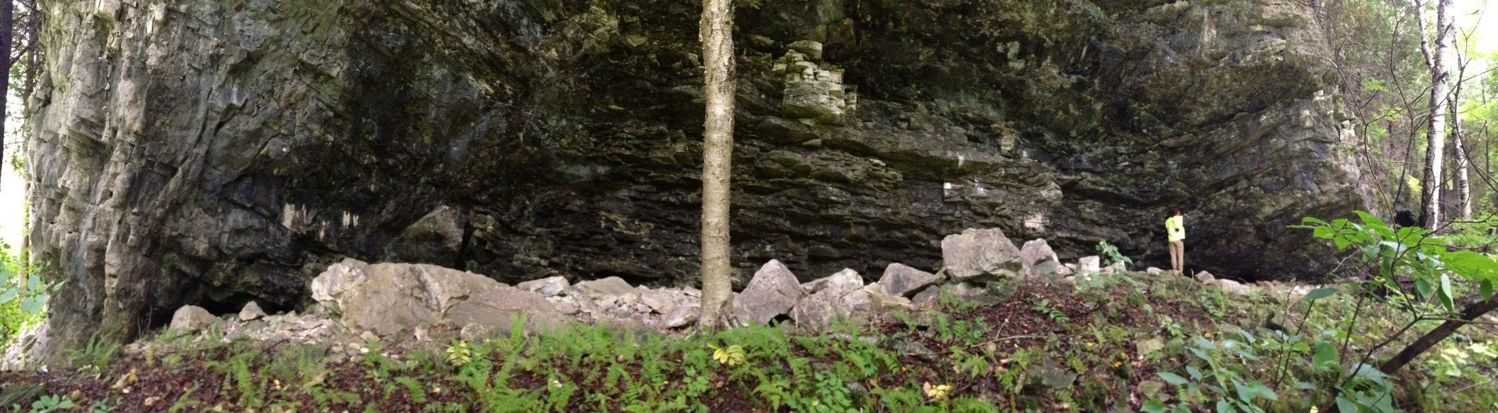
Topographic signature
5000 ft
N
Google terrain
Along County Road K
E
W

Slide 8
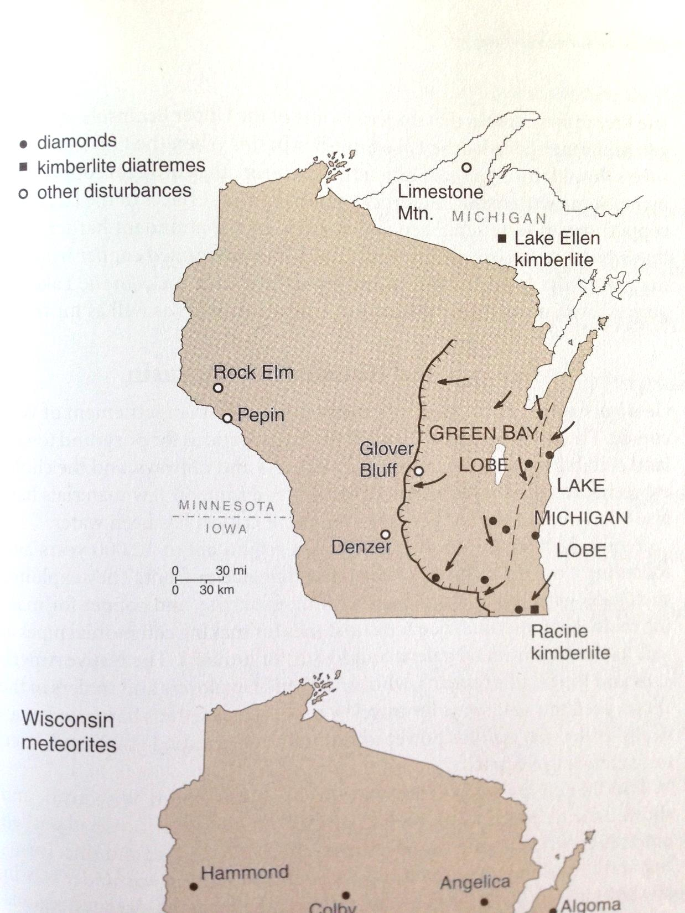
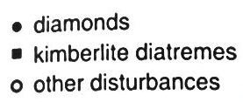
Known Impact structures in Wisconsin
Rock Elm; Pierce County
  ~6 km
  Paleozoic sedimentary
  < 500 Ma
  Identified PMs in quartz
  No shatter cones or confirmed PDFs
    French et al. (2004), GSA Bulletin
Glover Bluff; Waushara County
  ~8 km
  Cambrian sandstone and Ordovician dolomite
  < 500 Ma
  Well-developed shatter cones
    Read (1983), Meteoritics
“The distribution of diamonds and kimberlite diatremes as well as disturbances possibly formed by meteorite impacts” from Dott, Jr. & Attig (2004), Roadside Geology of Wisconsin

Slide 9
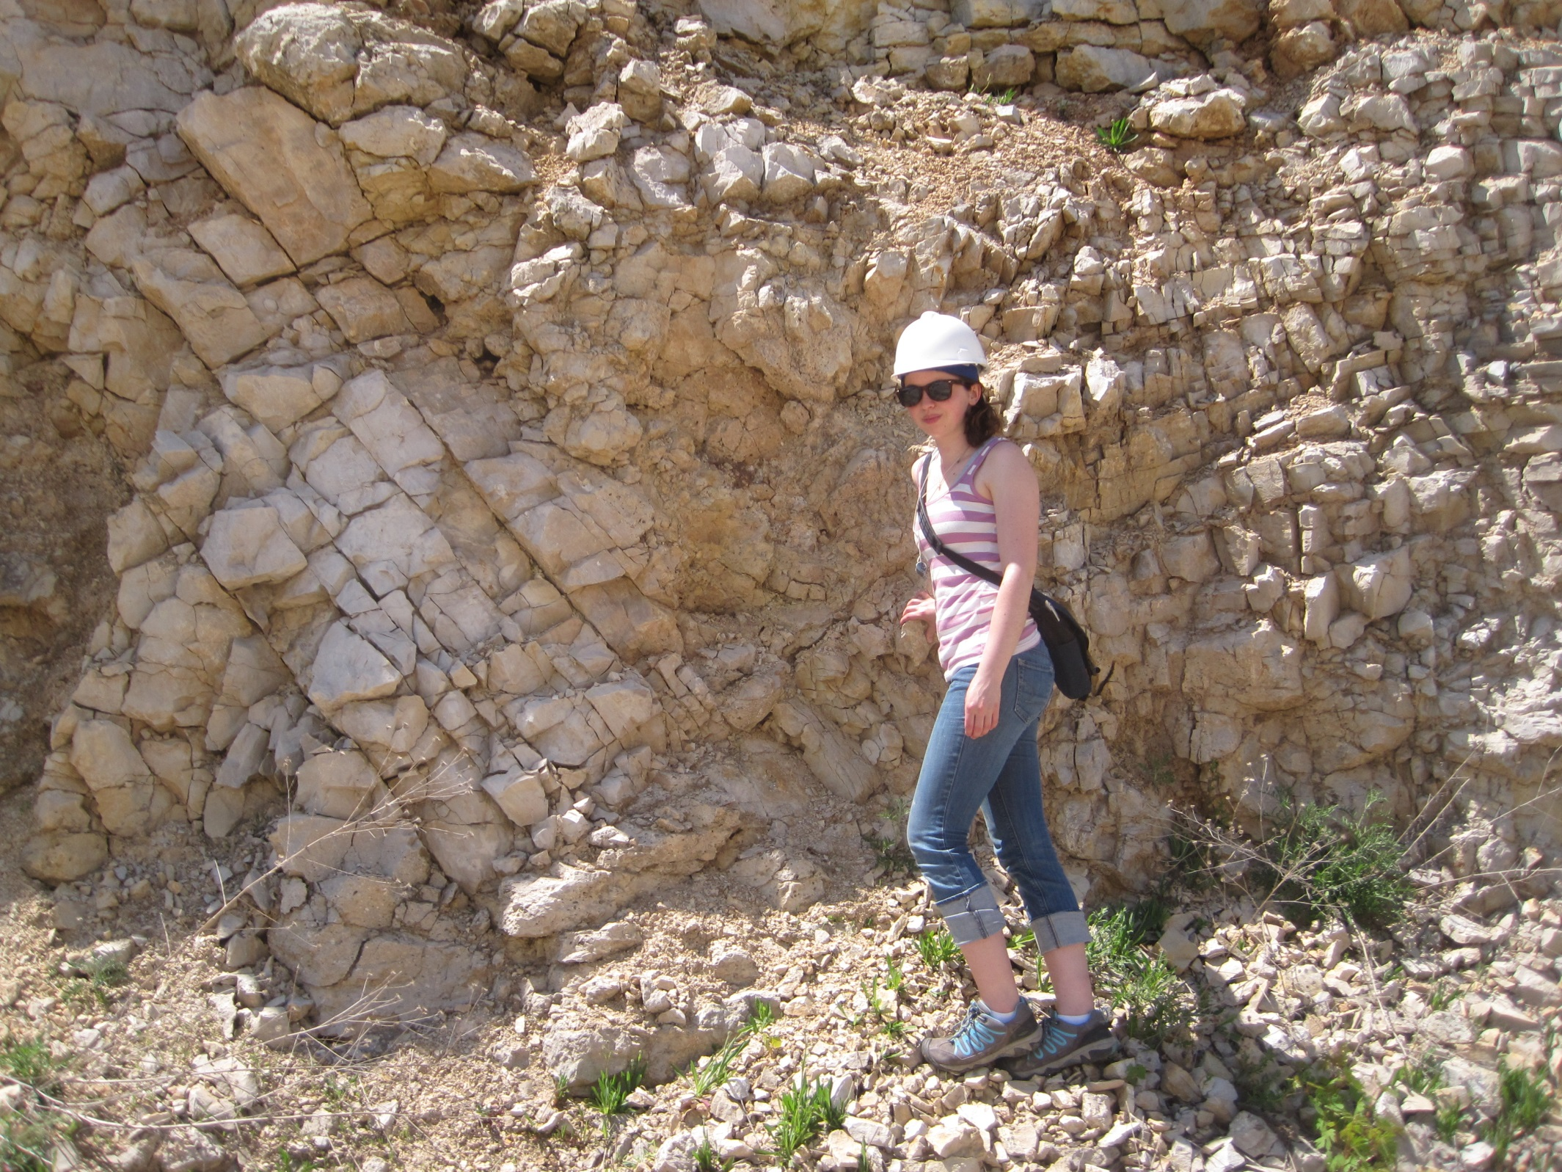

Slide 10
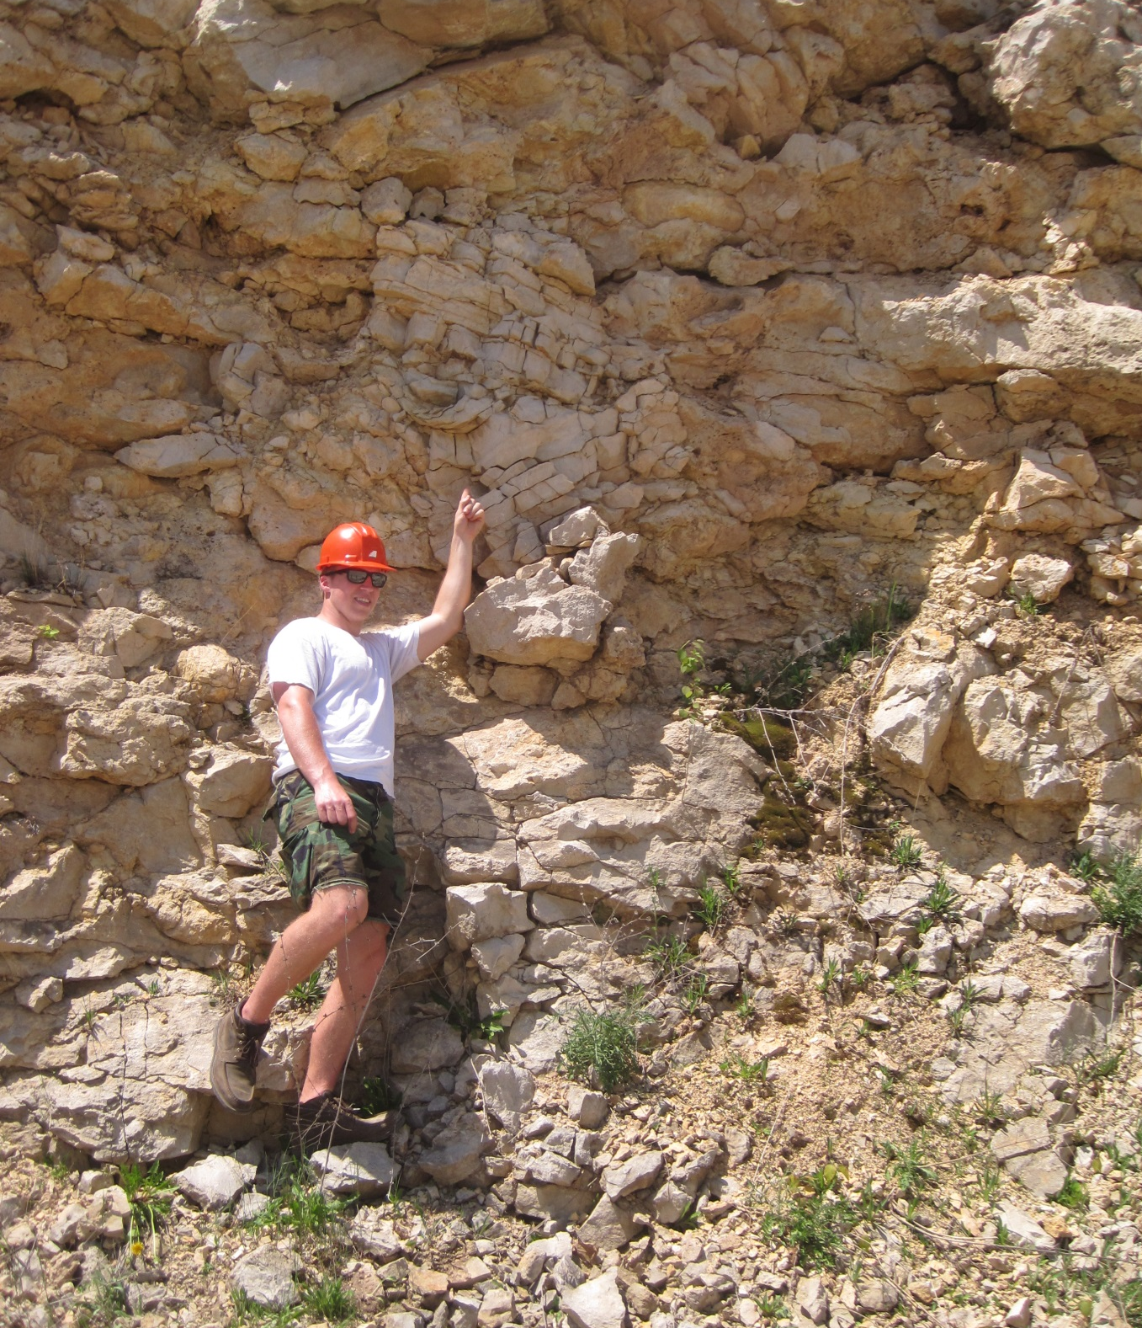
Outcrop
Features

Slide 11
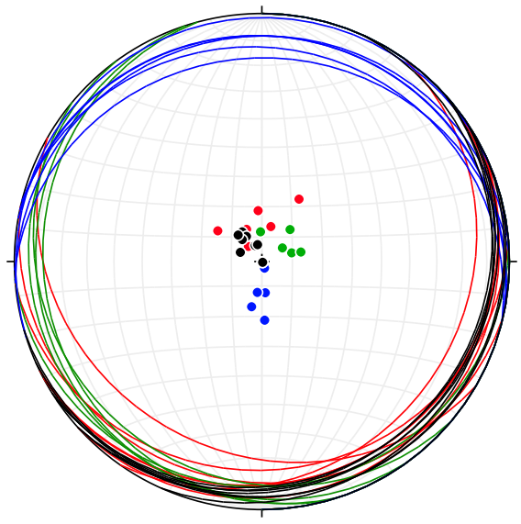
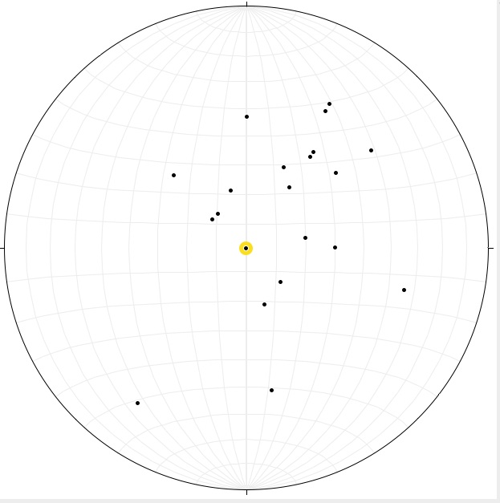
N
E
W
S
Perimeter of structure
STRUCTURAL DATA
Inside quarry—Poles to planes

Slide 12
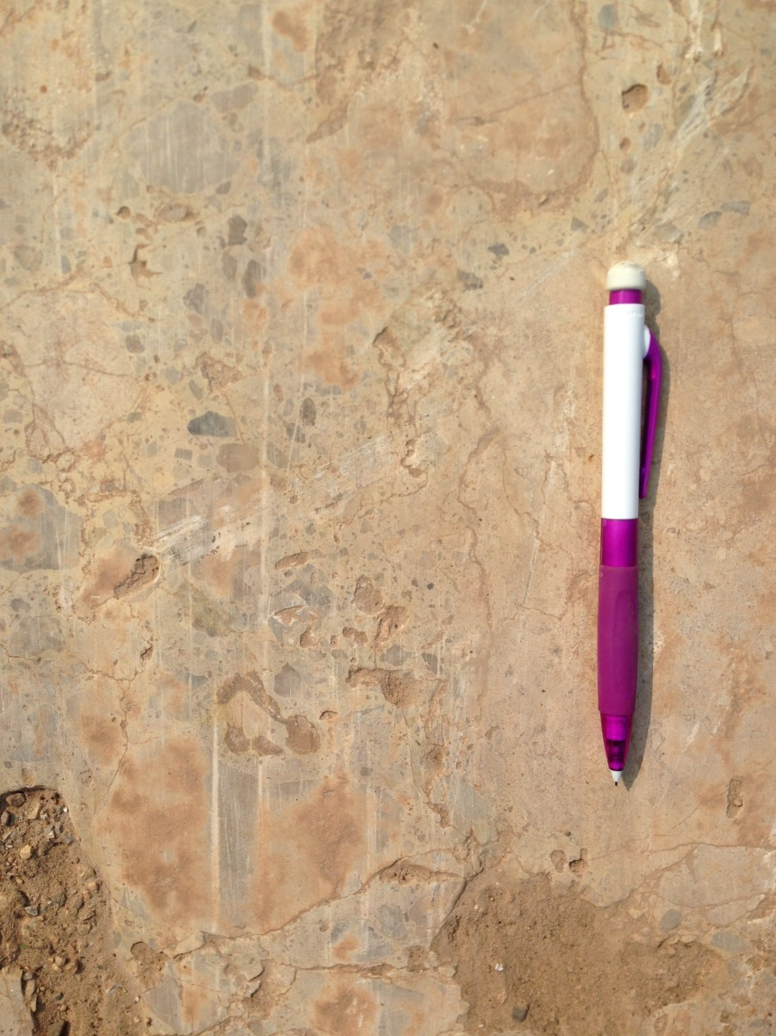
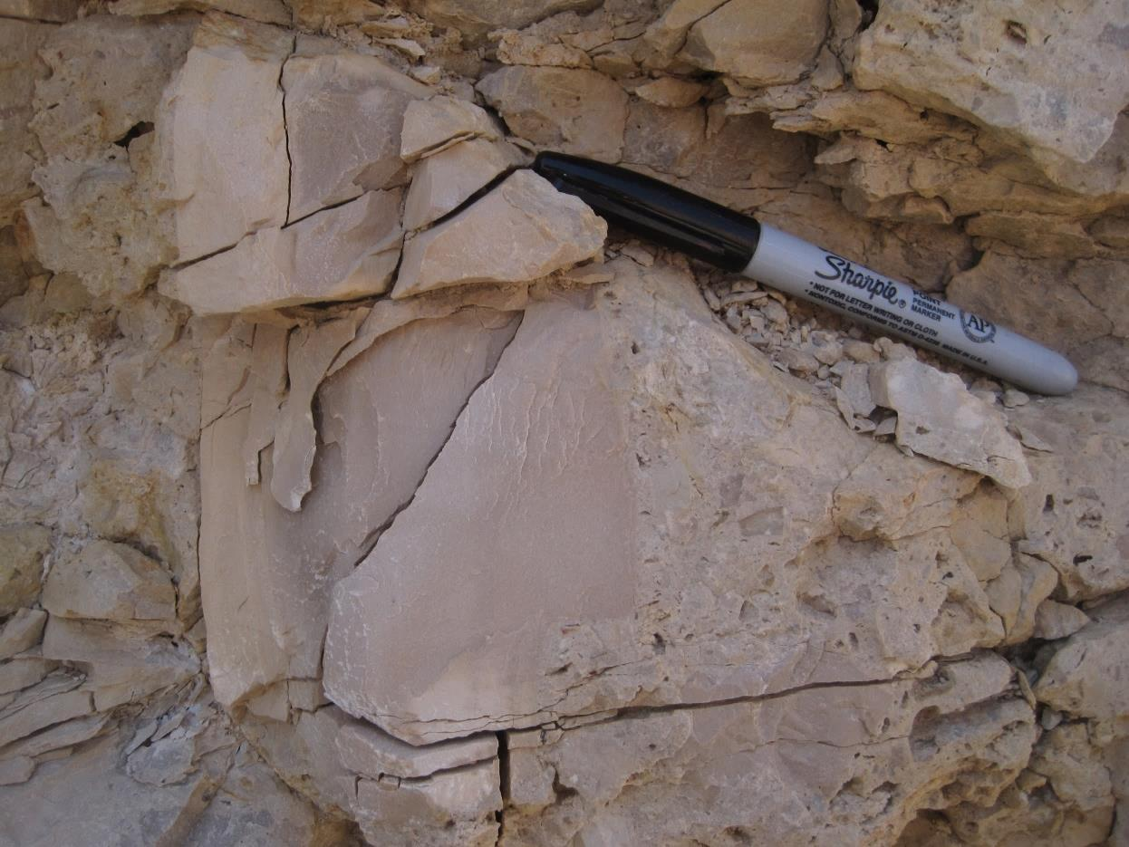
Outcrop Breccias
Glaciated breccia

Slide 13
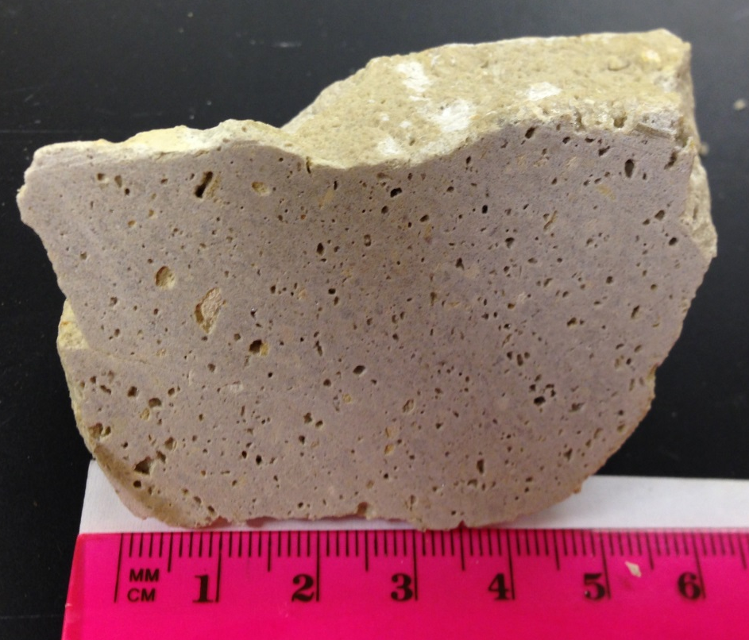
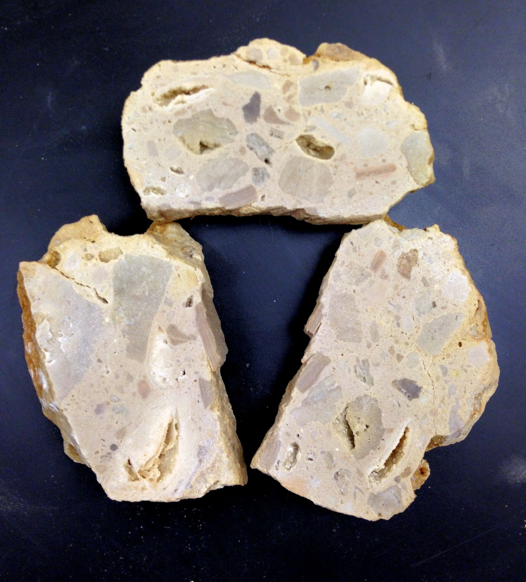
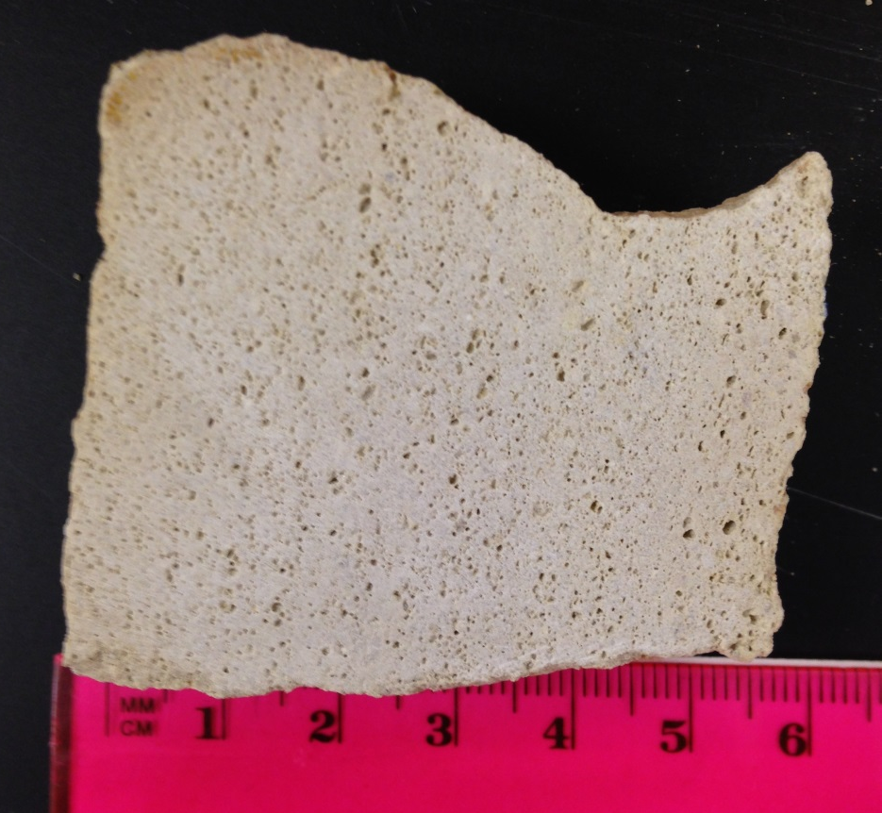
BruN99
BruN73
BruN149-2
1.75 cm
HAND SPECIMENS

Slide 14
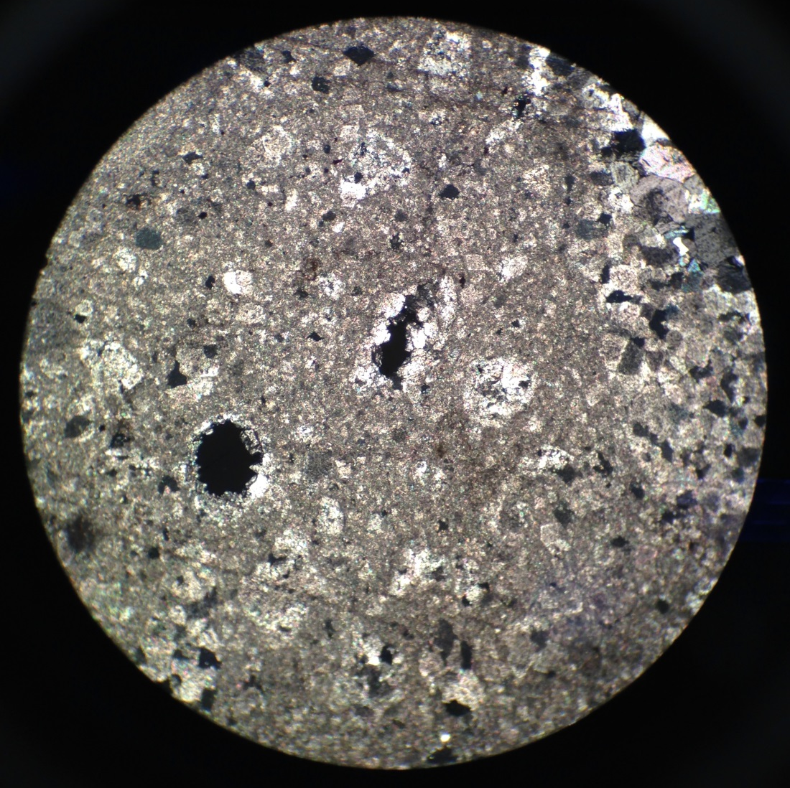
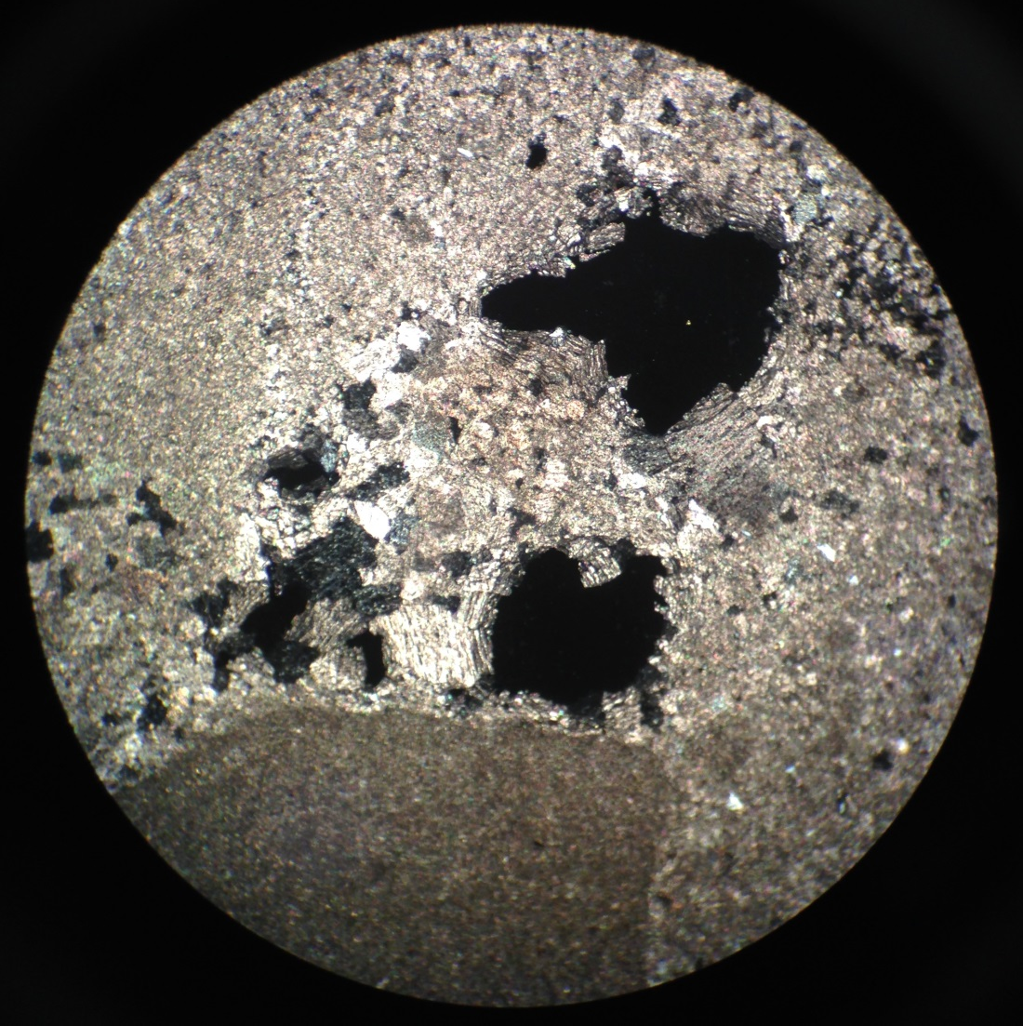
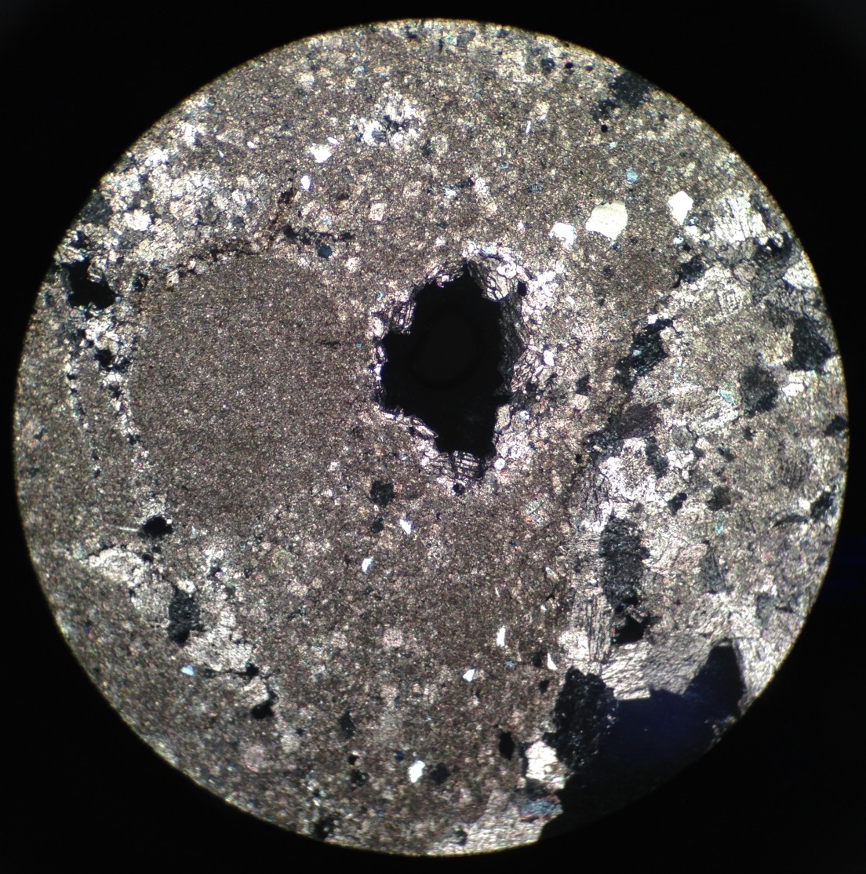
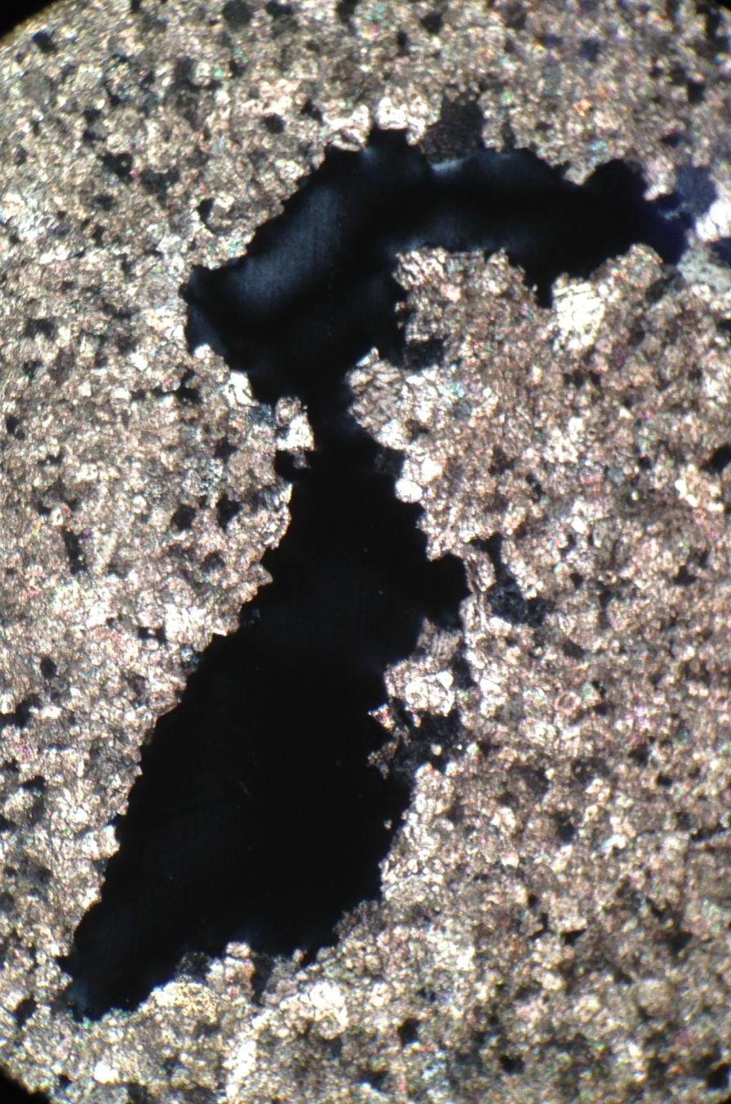

BRECCIA VUGS
Coli57B
500 µm
500 µm
BRS1A
250 µm

Slide 15
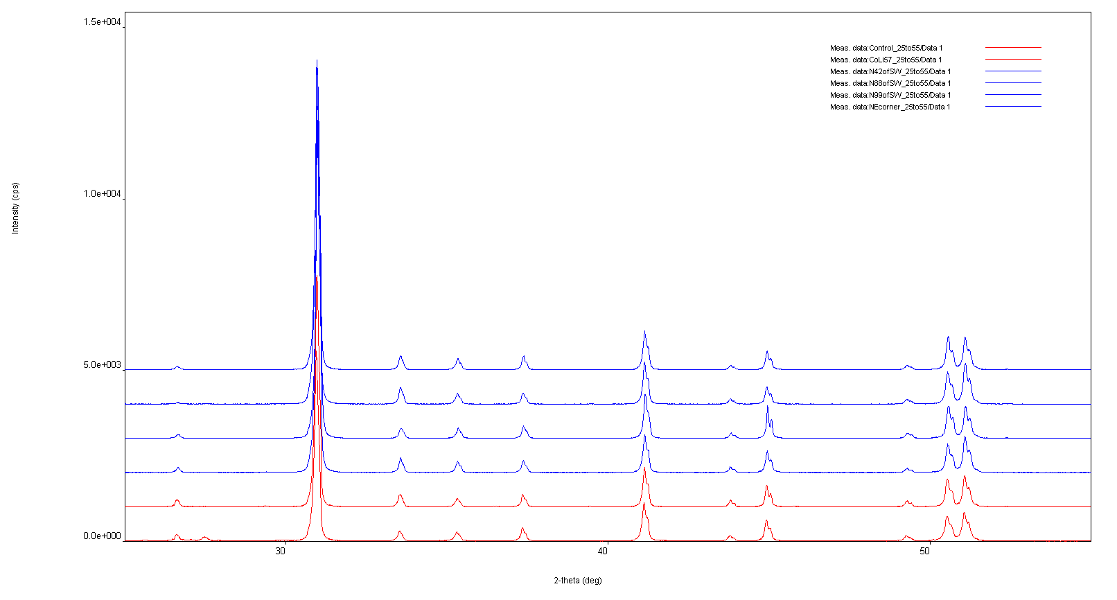
XRd Peak Broadening

Slide 16
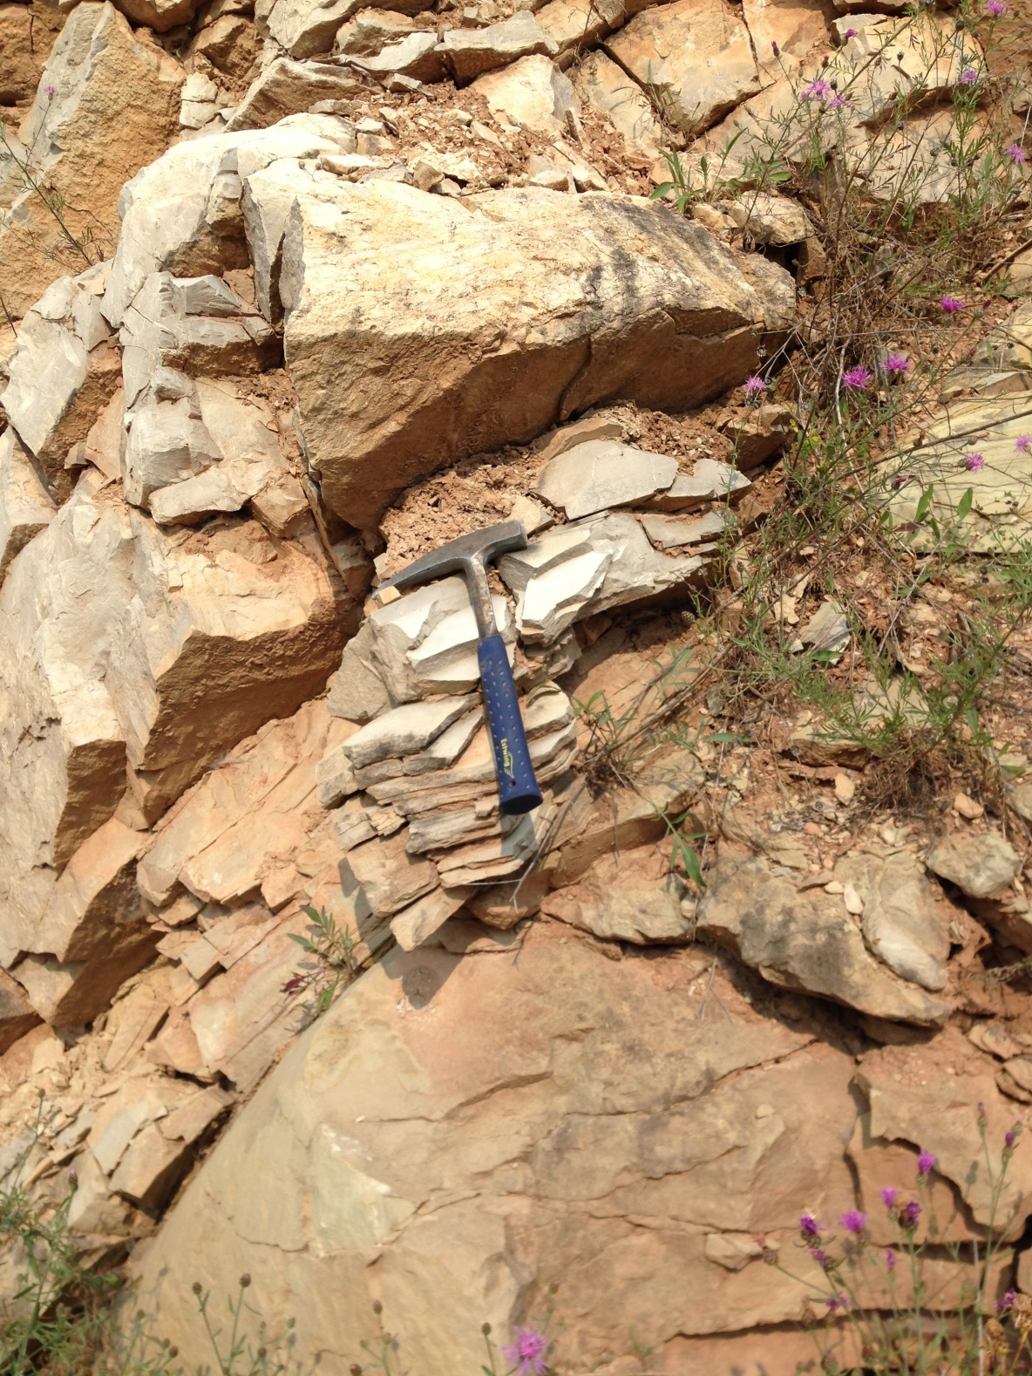
Sandstone blocks along west wall of quarry
Dolomite
149 m N of SW corner of quarry
Foliated sandstone
Massive sandstone

Slide 17
Source of sandstone?
Glauconite
  WI Cambrian sandstones
  Prairie du Chien, last occurrence (Early O)
Plagioclase feldspar
Angular and rounded grains
Tunnel City (Late Є)
~367 m
~39 m

Slide 18
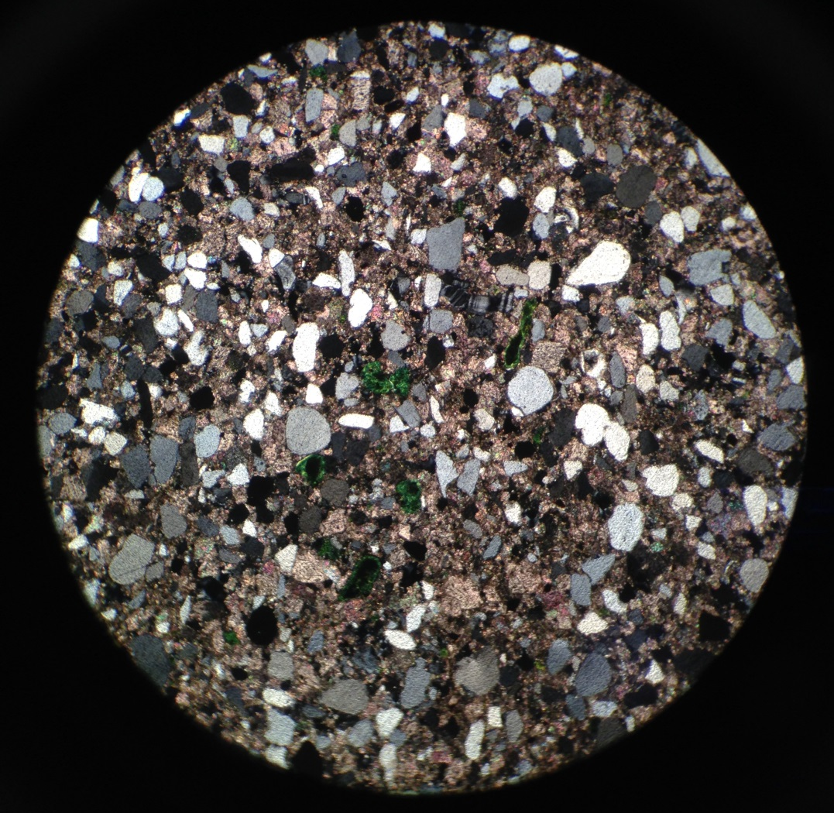
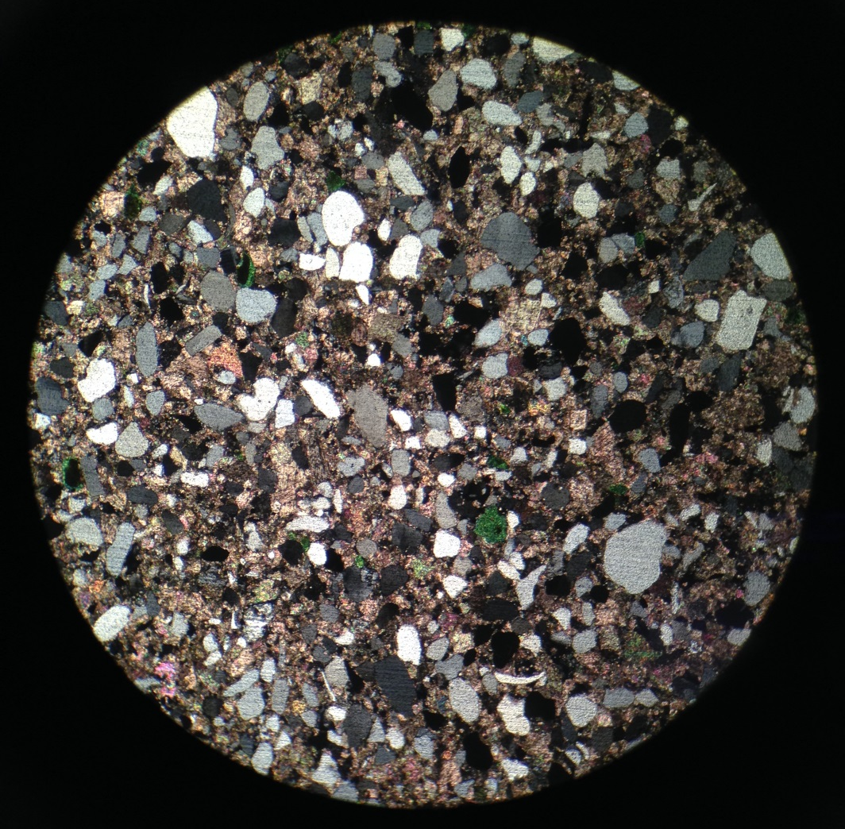
sandstone
500 µm
BruN149-3

Slide 19
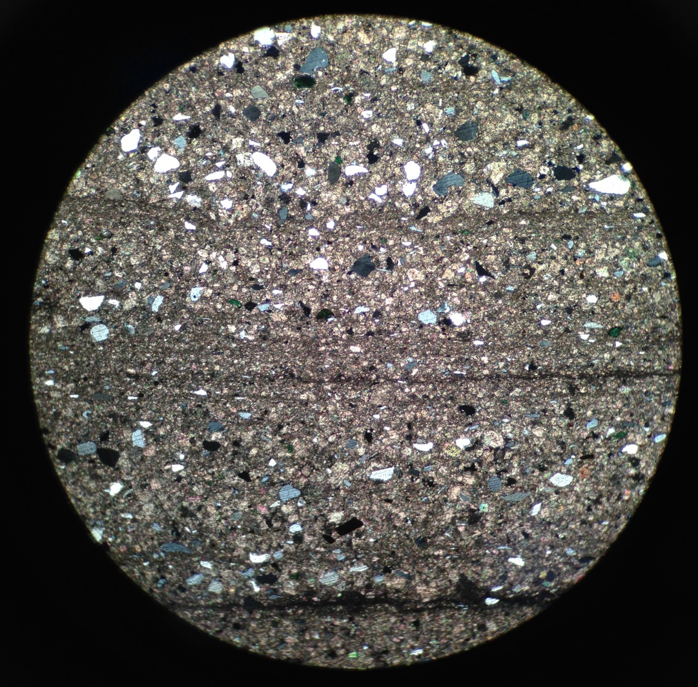
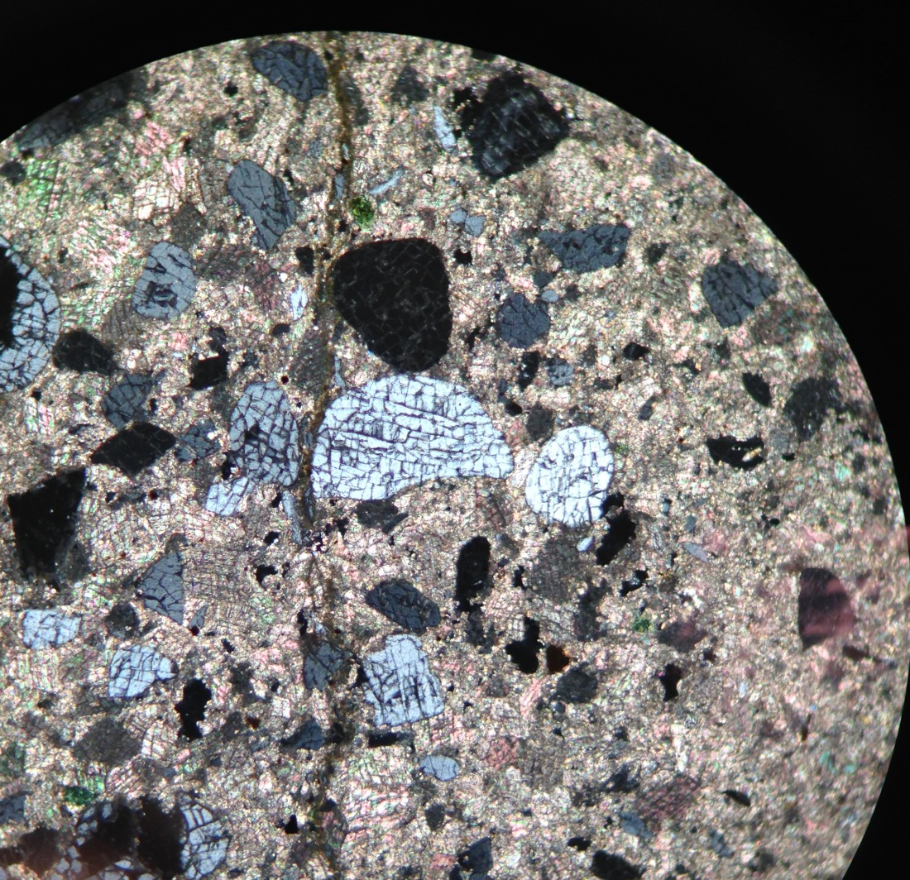
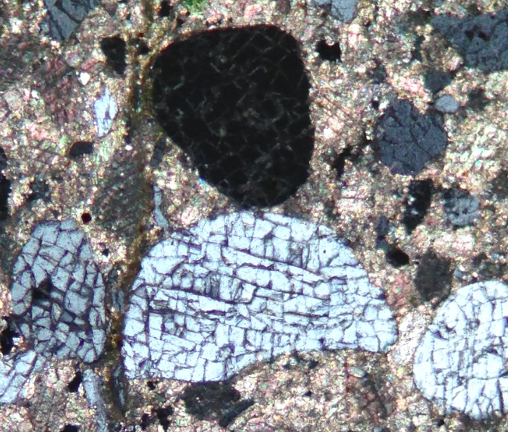
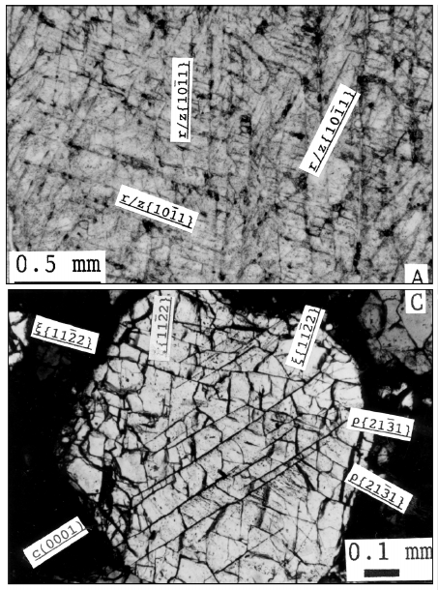
Reconstituted (?) sandstone
French et al. (2004)
250 µm
125 µm
500 µm
Bru-Sh1
BruN149-4

Slide 20
Summary
Disturbed rock in otherwise flat-lying stratigraphy
Beds on outer perimeter dip inward
Unusual micro-scale breccias
Sandstone not normally found in region
  Excavated from depth
Post Early Silurian, pre Late Pleistocene age

Slide 21
Remaining questions/puzzles
Absence of shatter cones
Planar microstructures?
Reconstituted sandstone
  Estimated excavation: 367-406 m [Tunnel City]
  283 m [Prairie de Chien, highest glauconite]
Age constraints
Remains a topographic high
Paleokarst explanation?

Slide 22
