Slide 1
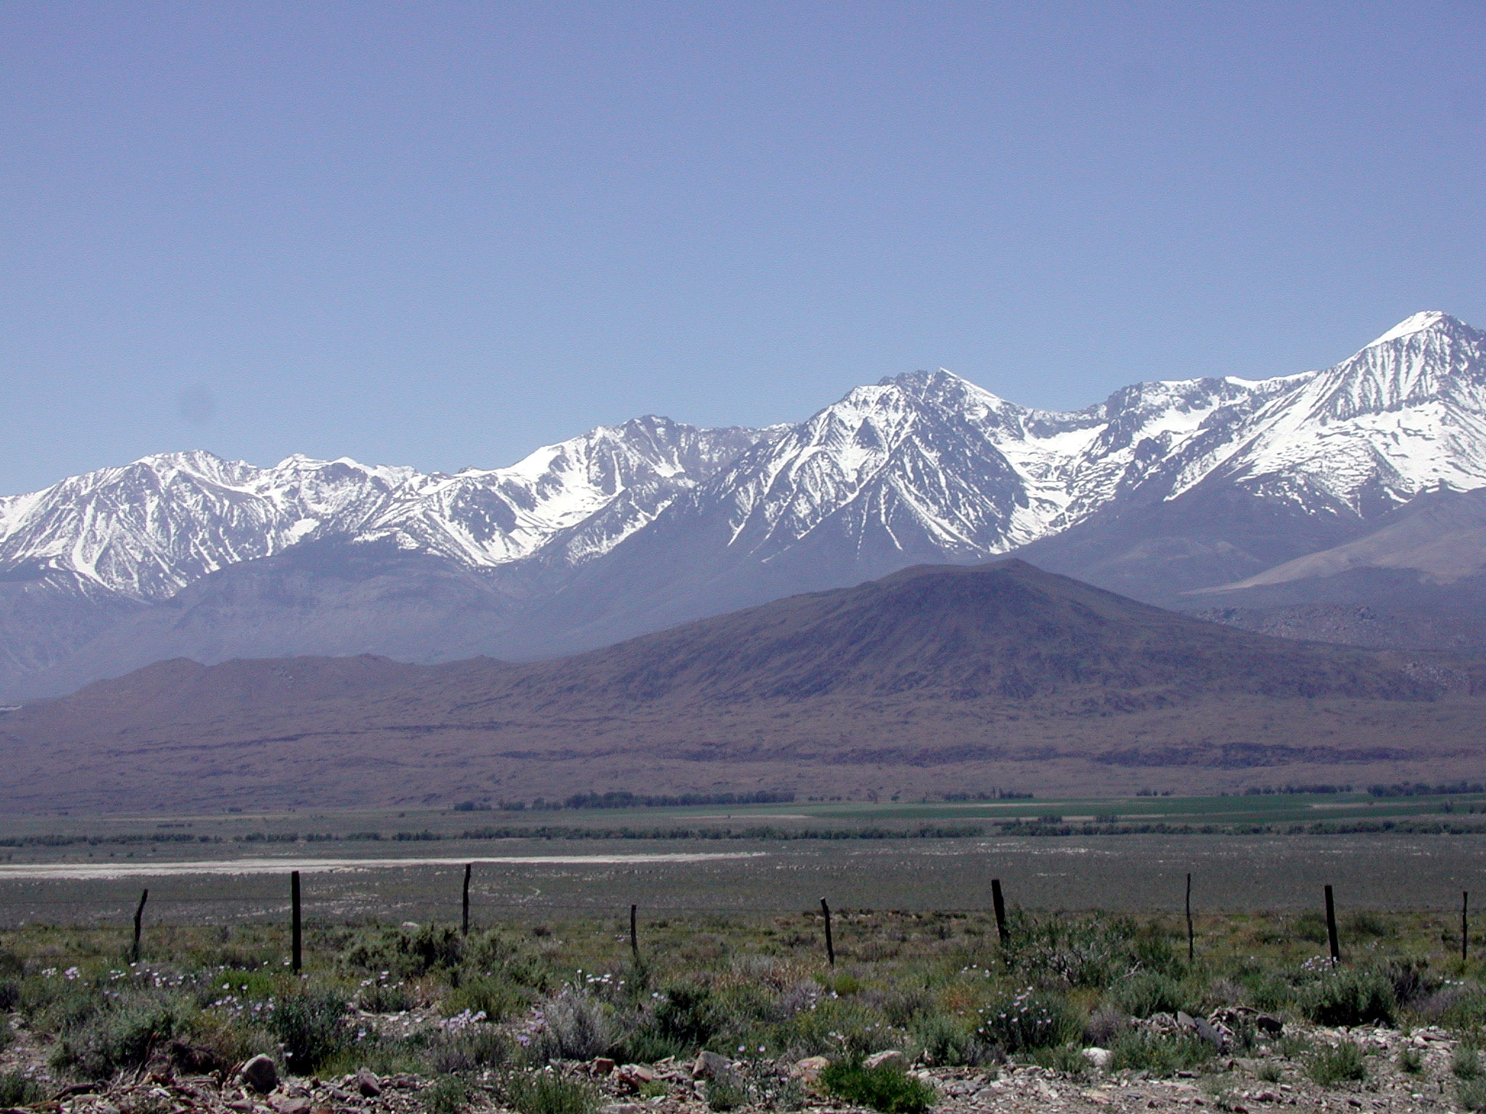
Fe-Mg Exchange Between Olivine and Liquid, as a Test of Equilibrium: Promises and Pitfalls
Keith Putirka
California State University, Fresno

Slide 2
Roeder and Emslie (1970)
conducted experiments (n= 44) at
T = 1150 – 1300 ºC
fO₂ = 10^{-0.68} – 10⁻¹²
Mg(olivine) + Fe²⁺(Liquid) = Mg(Liquid) + Fe²⁺(Olivine)

Slide 3

Roeder and Emslie (1970)
conducted experiments (n= 44) at
T = 1150 – 1300 ºC
fO₂ = 10^{-0.68} – 10⁻¹²
Mg(olivine) + Fe²⁺(Liquid) = Mg(Liquid) + Fe²⁺(Olivine)
K_{D}(Fe-Mg)^{ol-liq} = 0.30
and appears to be (mostly) independent of T, X_{i}, P

Slide 4
But Matzen et al. (2011) show that the canonical value of 0.30 may be too low, even at 1 atm (instead, K_{D} = 0.34)

Slide 5
So K_{D} = 0.30 or K_{D} = 0.34?
Why are these experimental values so different?
Sources of error when determining K_{D}
Experimental Error - is it random? (an oft implicit assumption)
Oxygen buffer → log[fO₂] (trivial)
fO₂ → Fe³⁺/Fe²⁺ ratios in the liquid (not trivial)
Mg(olivine) + Fe²⁺(Liquid) = Mg(Liquid) + Fe²⁺(Olivine)

Slide 6
We can’t ignore model error with regard to Fe³⁺/Fe²⁺
Experimental Data (LEPR)
Yielding ol + liq
with reported fO₂
n = 1110
Using Jayasuria et al. (2004), K_{D} is systematically higher than using Kress & Carmichael (1991)
The ensuing T error is 30-70ºC

Slide 7
Compare Calibration & Test data for Jayasuria et al. Eqn. 12
Jayasuria et al. (2004) Eqn. 12 works well for calibration data, but over-predicts Fe₂O₃/FeO for test data
Experiments: Fe₂O₃/FeO measured
Calib. Data: n = 218
Test data: n = 127
Global Data Set
Slope = 0.79
Intercept = 0.10
R² = 0.73
SEE = ± 0.36
N = 345

Slide 8
…..and for Kress & Carmichael (1991) Eqn. 7
Experiments: Fe₂O₃/FeO measured
Calib. Data: n = 218
Test data: n = 127
Kress & Carmichael (1991; Eqn. 7) performs slightly better for test data
Global Data Set
Slope = 0.92
Intercept = 0.11
R² = 0.77
SEE = ± 0.33
N = 345

Slide 9
….. and Kress & Carmichael (1988) is better still
Experiments: Fe₂O₃/FeO measured
Calib. Data: n = 218
Test data: n = 127
Kress & Carmichael (1988) performs even better still
Global Data Set
Slope = 1.05
Intercept = 0.06
R² = 0.82
SEE = ± 1.0
N = 345

Slide 10
A new model based on a global regression
Experiments: Fe₂O₃/FeO measured
Calib. Data: n = 345
A global regression cleans up some of the scatter
Global Data Set
Slope = 1.01
Intercept = 0.03
R² = 0.88
SEE = ± 0.24
N = 345

Slide 11
So fO₂ → Fe³⁺/Fe²⁺ represents an important source of error in K_{D}
What about experimental error?
Can (at least some of it) be random?
First, we need a model to predict K_{D}…

Slide 12
Model in GSA Abstract:
K_{D}(Fe-Mg)^{ol-liq} = 0.41 - 0.004[CaO wt. %] – 0.008[TA] - 0.006[TiO₂ wt. %]
R² = 0.24
SEE = ± 0.04
n = 1190
To get K_{D}, we assume experimental error is random

Slide 13
A New Model:
K_{D}(Fe-Mg)^{ol-liq} = 0.44 - 0.0069[Al₂O₃ wt. %] - 0.0069[TiO₂ wt. %]
K_{D} variations mostly reflect experimental error
R² = 0.30
SEE = ± 0.04
n = 1510

Slide 14
Could some error be random? Run Duration

Slide 15
Could some error be random? Temperature

Slide 16
Could some error be random? Composition (Mg)
49.5% >0
50.5% <0

Slide 17
Why, then, do Matzen et al. (2011) obtain a higher K_{D} = 0.34?
They have
lower TiO₂
lower Al₂O₃
lower Total Alkalis

Slide 18
Conclusions:
- fO₂ → Fe³⁺/Fe²⁺ models imprecise (± 0.3-0.4) & a
source of systematic error
- Experimental error may be random
We can predict K_{D} from liquid composition alone
K_{D}(Fe-Mg)^{ol-liq} = 0.33 ± 0.09 (Using new Fe³⁺/Fe²⁺)
Error = ±0.04 if K_{D}=f(X_{i})
Best to propagate error on K_{D} to get error on T

Slide 19
K_{eq} is for Mg₂SiO₄ + 2 FeO = Fe₂SiO₄ + 2MgO
Ideal activities
ΔH_{ex} = -365 kJ/mole

Slide 20
The contrast in K_{D}s reflects systematic offset in predictions of Fe³⁺/Fe²⁺
Jayasuria et al. (2004) predict higher Fe₂O₃/FeO compared to Kress & Carmichael (1991)
Experimental Data (LEPR)
Yielding ol + liq
with reported fO₂
n = 1110

Slide 21
A new model based on a global regression
Experiments: Fe₂O₃/FeO measured
Calib. Data: n = 345
Linear scale illustrates unresolved error
Global Data Set
Slope = 1.01
Intercept = 0.03
R² = 0.88
SEE = ± 0.24
N = 345

Slide 22
K_{D}(Fe-Mg)^{ol-liq} model of Toplis (2005)
Toplis (2005) model uses olivine composition as input
R² = 0.29
SEE = ± 0.04
n = 1563

Slide 23
% Difference in K_{D} Calculated using
Jayasuria v. Kress * Carmichael
The contrasts between the two models are not compositionally restricted
Experimental Data (LEPR)
n = 1110

Slide 24
% Difference in K_{D} Calculated using
Jayasuria v. Kress * Carmichael
Experimental Data (LEPR)
n = 1110
The contrasts between the two models are not compositionally restricted

Slide 25
Roeder & Emslie calibrated a model at 1200 ± 5 ºC
– and it works well (but was not generalized)
Test data (from 1995 - 2008)
n = 115
T = 1100 – 1300 ºC
Roeder & Emslie calibrated at T-independent model to predict FeO1.5/FeO
R² = 0.9
Slope = 0.67
Int. = -0.03
SEE = ± 0.4

Slide 26
Mg(olivine) + Fe²⁺(Liquid) = Mg(Liquid) + Fe²⁺(Olivine)
The models we use to calculate fO₂ from T (and P) can shift K_{D}(Fe-Mg)^{ol-liq} by up to 2.6% at 1700 ºC
Models Describing QFM
T = 800-1700ºC
Kress & Carmichael (1988)
The ensuing T error is negligible:
5 to 8 ºC at 1700 ºC

Slide 27
But we can’t ignore model error with regard to Fe³⁺/Fe²⁺
Using Jayasuria et al. (2004), K_{D} is systematically higher than using Kress & Carmichael (1991)
Experimental Data (LEPR)
Yielding ol + liq
n = 1629
The ensuing T error is 30-70ºC

Slide 28
Could some error be random? Composition (Fe)

Slide 29
% Difference in K_{D} Calculated using Jayasuria v. Kress and Car.
The contrasts between the Jayasuria and Kress and Carmichael models are not restricted with respect to composition
Experimental Data (LEPR)
n = 1110

Slide 30
% Difference in K_{D} Calculated using Jayasuria v. Kress and Car.
The contrasts between the Jayasuria and Kress and Carmichael models are not restricted with respect to Temperature
Experimental Data (LEPR)
n = 1110

