Slide 1
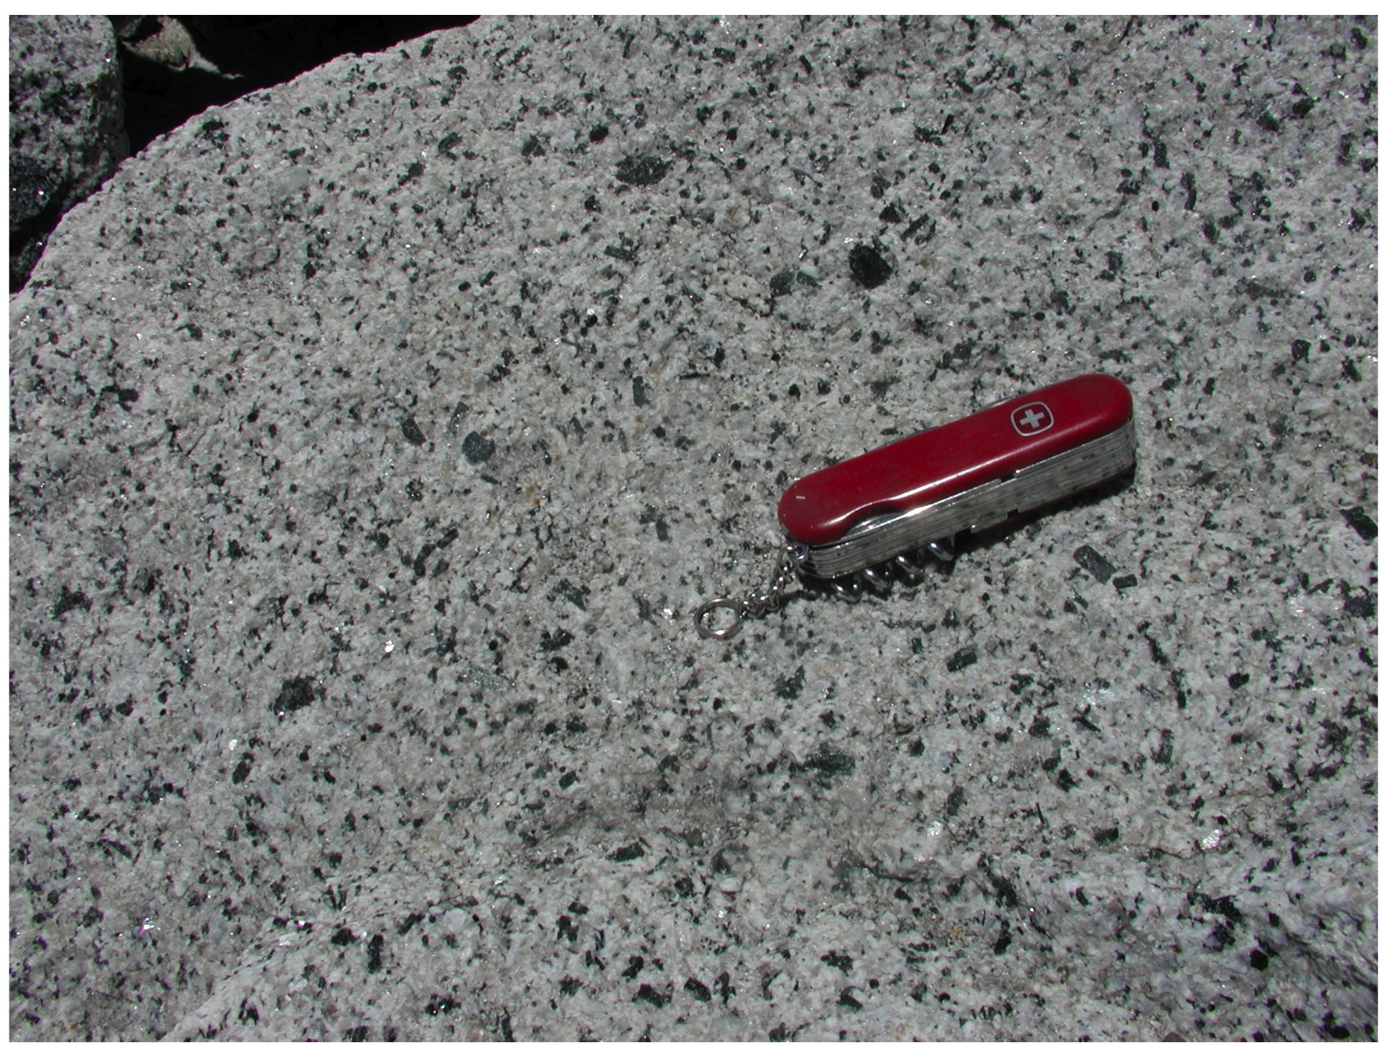
Amphibole-liquid equilibria: barometers and thermometers for volcanic systems
Keith Putirka
California State University, Fresno

Slide 2
“All models are wrong, but some
are useful”
-George Box

Slide 3
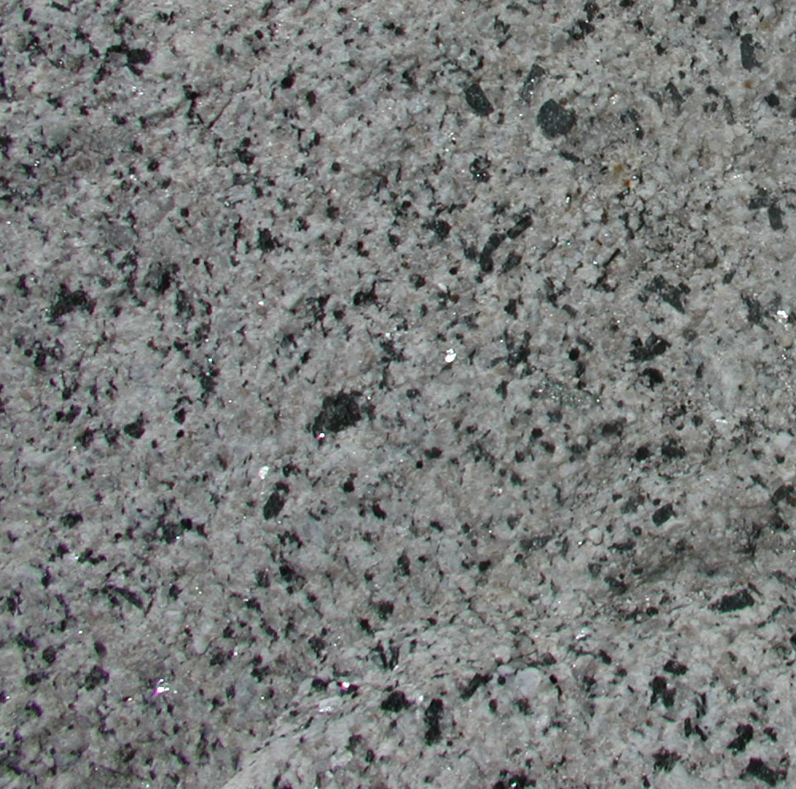
Conclusions:
• Amphibole barometry is fraught with challenges
• Existing barometers are imprecise: ± 3 to ± 6 kbar
(claimed precision is much greater)
• Precision might be reduced to ± 2.5 kbar
(not yet clear that precision can be much improved)

Slide 4
Challenges for Hbl-Barometry for Volcanic Systems
ΔV for hbl-liquid equilibria are not great, and not greatly different from one another
Mineral-liquid equilibria | % ΔV (1273 K, 1 bar)
Grunerite (27.8 J/bar) | 13.1
Cummingtonite (26.3 J/bar) | 14.2
Tremolite (27.3 J/bar) | 13.9
Ferroactinolite (28.3 J/bar) | 13.4
Termolite-Tschermakite (26.8 J/bar) | 15.0
Pargasite (27.2 J/bar) | 15.2
Jadeite | 37.9
Diopside | 17.8

Slide 5
Can a useful barometer can be calibrated?

Slide 6
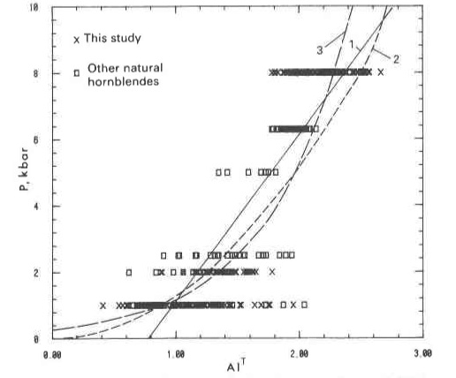
Hammerstrom & Zen (1986)

Slide 7
Ridolfi & Renzulli (2012) …
Calibrate a Amph.-only barometer for volcanic systems
Report errors of ± 1.6 to ± 0.4 kbar
Minimize error, by using experiments with
low reported errors on amphibole compositions
amphiboles that approximate natural compositions
n = 20 to 61 for their calibrations (0.1 to 2.2 Gpa)
( = 4 to 12% of currently available experiments
that report amph + liq)

Slide 8
Error on Ridolfi & Renzulli (2012) Eqn. 1d
n = 109

Slide 13
• Experimental vs. Natural Amphiboles:
- similar compositions (Al^{IV}/Al^{T} and Ti, Si)
- classified similarly
- similar stoichiometric mixing trajectories
• So how well do existing barometers work?

Slide 14
Test of Ridolfi & Renzulli (2012) Equation 1d (Best of Published models for Volc. Systems)
Slope = 1.00 int. = -0.09
R² = 0.61
SEE = ±0.41 GPa
n = 211
Non-P-dependent & Test Data
Slope = 0.74
int. = 0.13
R² = 0.40
SEE = ± 0.48 GPa
n = 344

Slide 15
A Ray of Hope…?
Source | P(GPa)
Sato et al. (2005) | 0.2
Wolf et al. (2012) | 0.2
Sato et al. (2005) | 0.3
Pichavant et al. (2002) | 0.4
Krawczynski et al. (2012) | 0.5
Sisson et al. (2005) | 0.7
Krawczynski et al. (2012) | 0.8
Test Data (GSA Abstract)
Slope = 1.3
int. = -0.13
R² = 0.87
SEE = ± 0.09 GPa
n=85

Slide 16
Test Equation in GSA Abstract
Slope = 0.87 int. = 0.14
R² = 0.52
SEE = ±0.35 GPa
n = 211
Non-P-dependent & Test Data
Slope = 0.71
int. = 0.34
R² = 0.38
SEE = ± 0.42 GPa
n = 346

Slide 17
CONCLUSIONS:
“...we cannot know that any statistical technique
scientific model we develop is useful unless
we use it.” - George Box (1976)
• Existing Amphibole barometers are imprecise
• New experiments on amphibole-saturation are needed
• Useful Amphibole barometry might not be feasible

Slide 18
Naney (1983) Amph from Model granite system

Slide 20
We can take a more thermodynamic approach (but it doesn’t help much)

Slide 21
Compare GSA Abstract with Global Regression
Source | P(GPa)
Sato et al. (2005) | 0.2
Wolf et al. (2012) | 0.2
Sato et al. (2005) | 0.3
Pichavant et al. (2004) | 0.4
Krawczynski et al. (2012) | 0.5
Sisson et al. (2005) | 0.7
Krawczynski et al. (2012) | 0.8

Slide 22
Test of Ridolfi & Renzulli (2012) Equation 1b

Slide 23
Compare GSA Abstract with Model P4
Source | P(GPa)
Sato et al. (2005) | 0.2
Wolf et al. (2012) | 0.2
Sato et al. (2005) | 0.3
Pichavant et al. (2004) | 0.4
Krawczynski et al. (2012) | 0.5
Sisson et al. (2005) | 0.7
Krawczynski et al. (2012) | 0.8

Slide 25
Test of Rudolfi and Renzulli (2012; Eqn. 1d)
Test Data
Slope = 0.64
int. = 0.27
R² = 0.53
SEE = ± 0.35 GPa
n = 392

Slide 26
Test of Barometer in GSA Abstract
Test Data
Slope = 0.93
int. = 0.20
R² = 0.53
SEE = ± 0.35 GPa
n = 392

Slide 27
Test of New Barometer
Test Data
Slope = 1.01
int. = -0.01
R² = 0.71
SEE = ± 0.27 GPa
n = 392

Slide 28
Global Regression
Calibration Data
Slope = 1.00
int. = 0.0
R² = 0.76
SEE = ± 0.25 GPa
n = 393

Slide 29
Error on Ridolfi & Renzulli (2012) Eqn. 1d
n = 109

Slide 30
Error on R&R (2012) Independent of Temperature

Slide 32
New Model, Calibrated using P-dependent Experiments
Non-P-dependent & Test Data
Slope = 0.52
int. = 0.21
R² = 0.34
SEE = ± 0.38 GPa
n = 343
Slope = 0.60 int. = 0.17
R² = 0.53
SEE = 0.28
n = 211

Slide 33
New Model, Calibrated using P-dependent Experiments
Non-P-dependent & Test Data
Slope = 0.57
int. = 0.30
R² = 0.52
SEE = ± 0.29 GPa
n = 356
Slope = 0.81 int. = 0.11
R² = 0.76
SEE = 0.24
n = 217

Slide 34
Global Regression Model

