Slide 1

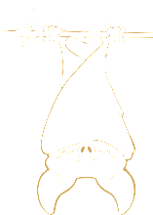
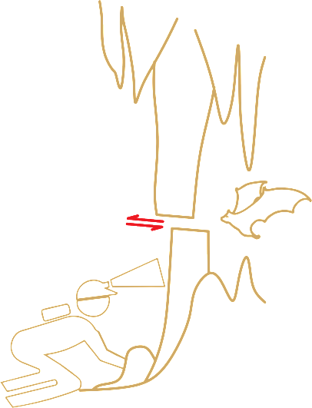






SEISMIC SLIP AND ASEISMIC CREEP ON MAJOR FAULT SYSTEMS OF THE
EASTERN ALPS RECORDED IN SHEARED FLOWSTONES
Ivanka MITROVIC ^{1,2}, Bernhard GRASEMANN ¹,
Lukas PLAN ², Ivo BARON ²
¹ Department of Geodynamics and Sedimentology, University of Vienna, Austria,
² Cave and Karst Group, Natural History Museum Vienna, Austria
Notes:
Before getting into the tectonics in caves, I want to make sure we all know what am I talking about.

Slide 2


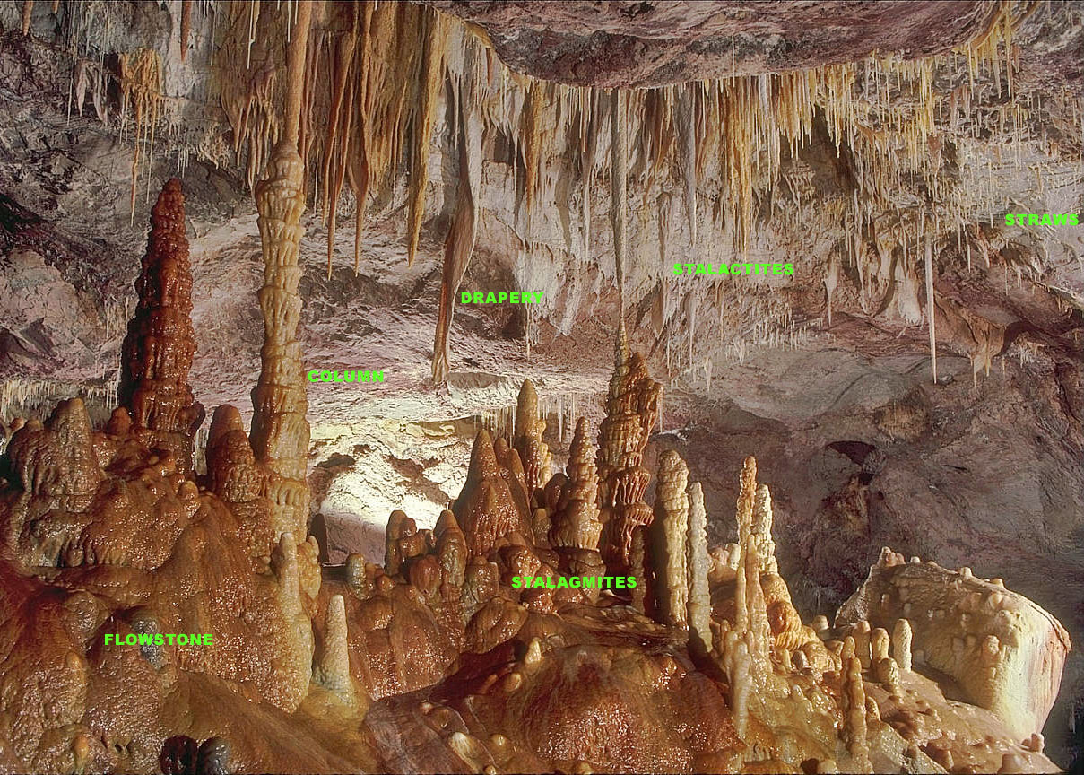
Mitrovic et al: Seismic slip and aseismic creep recorded in sheared flowstones
Speleothems (cave deposits)
Wikipedia – most common types of speleothems
Notes:
To start with, flowstones are a type of speleothems (cave deposits) composed of sheetlike calcite, often found along the cave walls.

Slide 3

Mitrovic et al: Seismic slip and aseismic creep recorded in sheared flowstones
Faults
Caves
Modelling
biology
Experiments
Cave
development
?
Earthquake
damage
environment
Natural examples
climate
Notes:
Now you might think I am in the wrong session, as we are here to study faults, and when I say “cave”, you think of climate and biology.
But what is in this intersection? We all know that most of the caves are developed along fractures and faults. There are also some studies into the earthquake damage of stalactites. But we CAN study faults in cave.

Slide 4

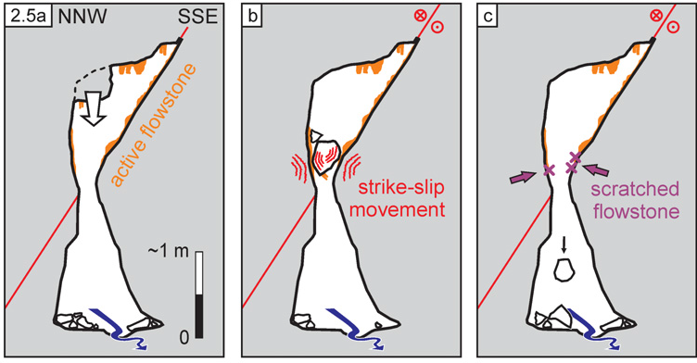
Mitrovic et al: Seismic slip and aseismic creep recorded in sheared flowstones
Paleoseismologic and neotectonic studies in caves
Plan et al, 2010
Hirschgruben cave, Hochschwab
Notes:
One of the best examples is described by Plan et al, involves breakdown of a boulder (in A), which got stuck between the two moving passage walls belonging to a large regional fault (in B). The ongoing strike-slip movement caused scratches in the flowstone of the wall and the breakup of the boulder which exposes the scratches (in C). We will look at these scratches in more detail.

Slide 5

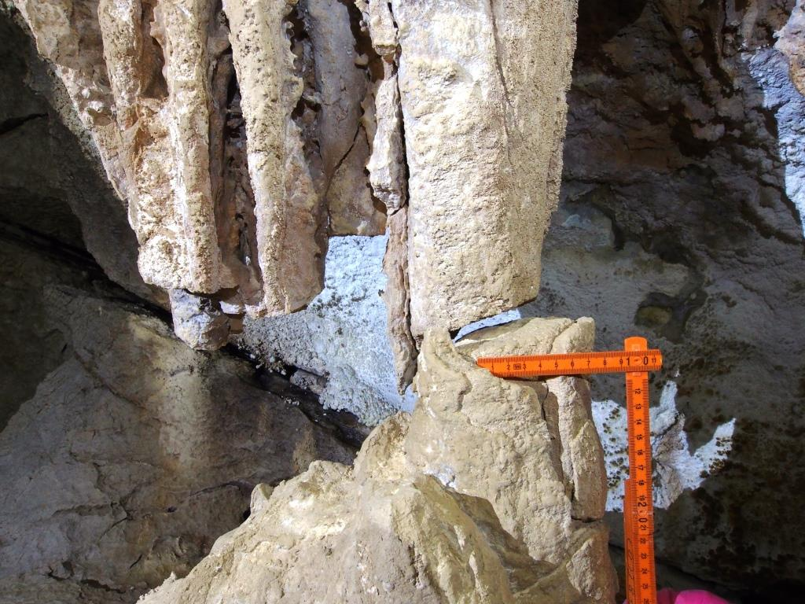
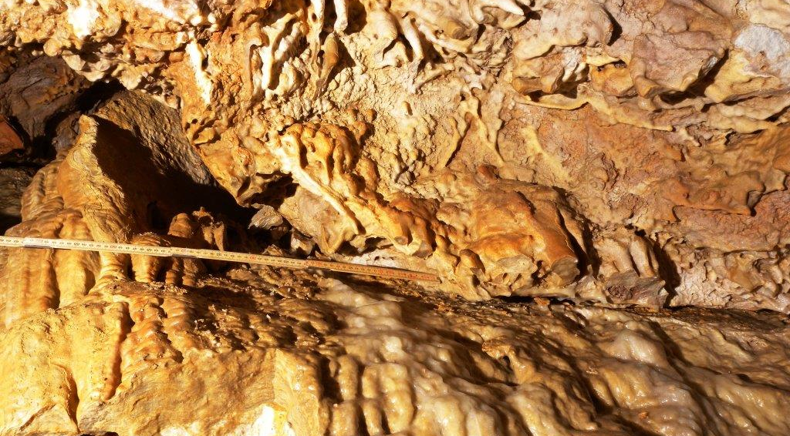
Mitrovic et al: Seismic slip and aseismic creep recorded in sheared flowstones
Paleoseismologic and neotectonic studies in caves
Hirschgruben cave, Hochschwab
Mammoth cave, Dachstein
length of displacement: 0.3 m
Notes:
Another example from the same cave is the displacement of about 30 cm of these two part of the cave wall, also causing the shearing and breaking of the flowstone. Displacement of stalactite-stalagmite pairs, or broken columns are ideal for measuring the displacement vector.

Slide 6
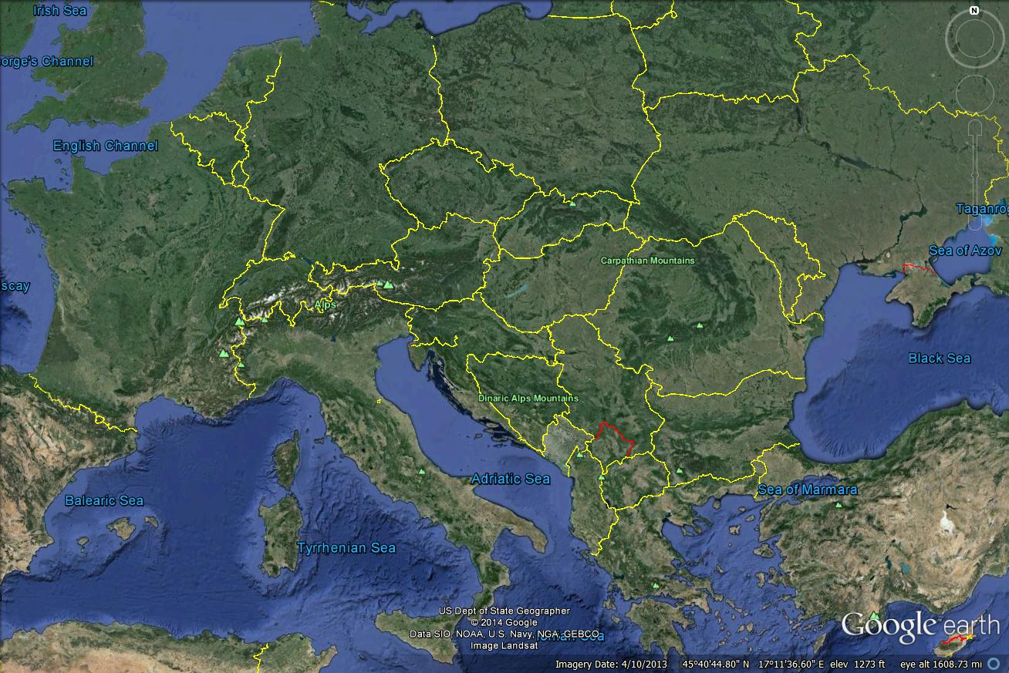
Tectonic setting
Vienna
basin
A
Carpathians
Pannonian
basin
Alps
Notes:
Before I move on, we should look into tectonic setting. As a reference, here is Austria, Alps and Carpathian arcs, and Vienna and Pannonian basin.

Slide 7
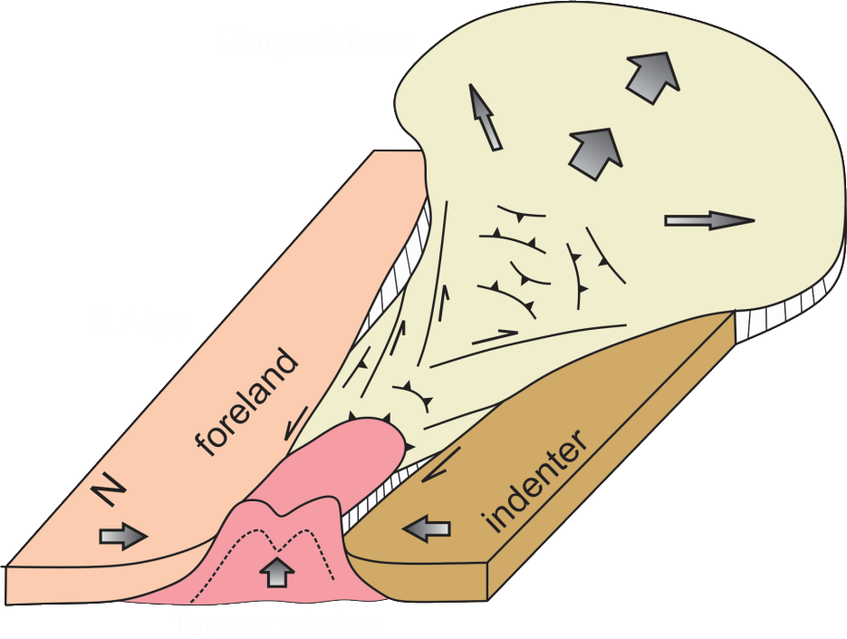
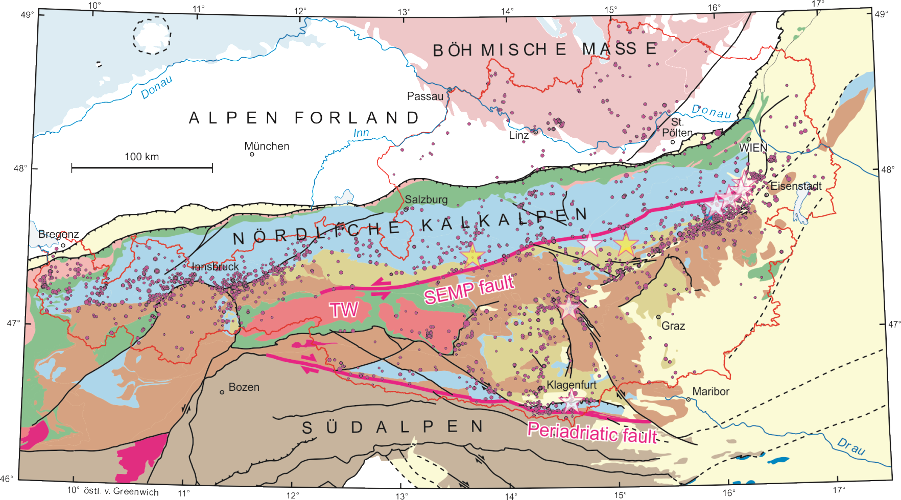


Mitrovic et al: Seismic slip and aseismic creep recorded in sheared flowstones
Earthquakes!
Tectonic setting
Salzach Ennstal Mariazeller Puchberger fault
After Chorowicz,
Univ. Pierre et
Marie Curie
Notes:
The dominant neotectonic process of the Eastern Alps, and Austria, is the lateral extrusion towards the Pannonian Basin, coeval with north-south shortening between the Adriatic and European plates. This extrusion is accommodated along two large fault systems: sinistral SEMP and dextral Peri-Adriatic fault systems. However, Mur-Muerz sinistral fault is the most seismically active, although geological evidences of the activity of all of these faults on the surface are rare. Austria’s EQ potential is up to 5 in magnitude.

Slide 8
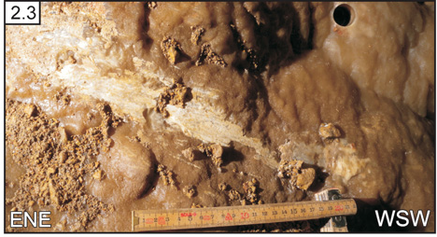

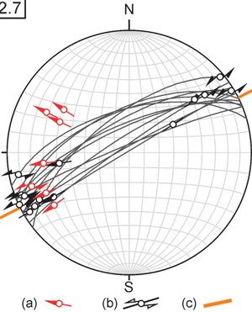
Mitrovic et al: Seismic slip and aseismic creep recorded in sheared flowstones
Paleoseismologic and neotectonic studies in caves
Stretches length:
0.3 m
Seismic SLIP
or
Aseismic CREEP
Plan et al. 2010
Notes:
Getting back to the HG cave, and looking into this sketched flowstone, and its orientations, we have to ask ourselves if this shearing occurred during seismic slip or aseismic creep.

Slide 9
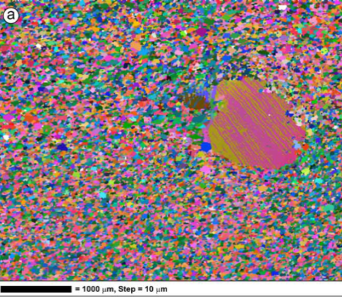
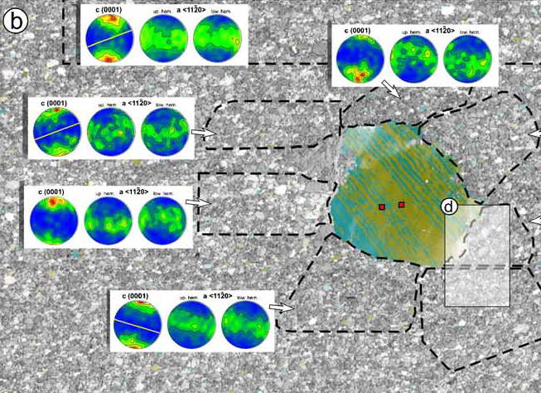
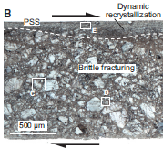
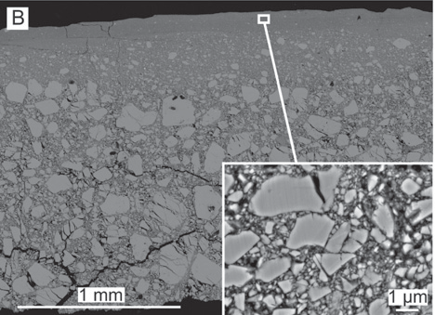
Mitrovic et al: Seismic slip and aseismic creep recorded in sheared flowstones
Seismic slip vs. aseismic creep
Electron
Backscattered
Diffraction
Bestmann et al, 2006
Smith et al, 2013
coseismic slip
v. >0.1 m s–1.
Experiments
subseismic slip
v = 0.01 m s–1
Notes:
Distinguishing between seismic slip and aseismic creep has been a main topic of many recent papers. For example, Smith et al. show the experiments on powdered calcite and the deformation caused by subseismic and coseismic slip. To further investigate the type of deformations, probably the best method is EBSD, which quantifies the crystal orientations and textures.

Slide 10
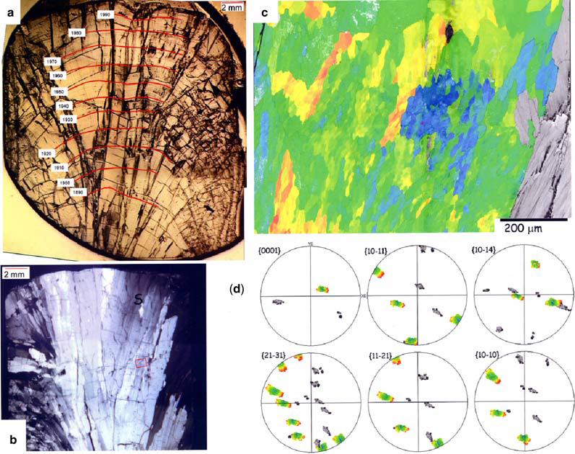
Mitrovic et al: Seismic slip and aseismic creep recorded in sheared flowstones
Seismic slip vs. aseismic creep
Electron
Backscattered
Diffraction
Bestmann et al, 2006
Fairchild et al, 2010
Undeformed
speleothem
crystal growth
Notes:
Although very powerful, EBSD plots of deformed speleothems need to be compared with undeformed samples. And this is one of the rare published maps of speleothem growth.

Slide 11

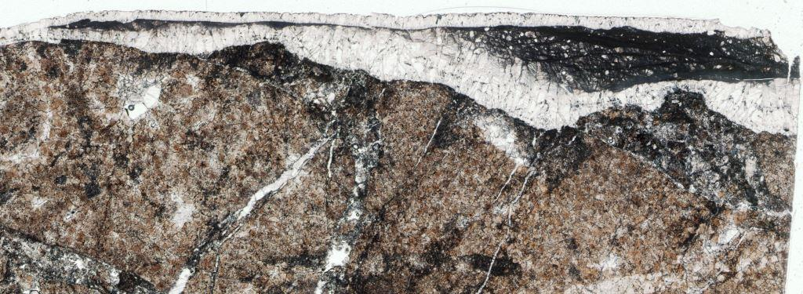
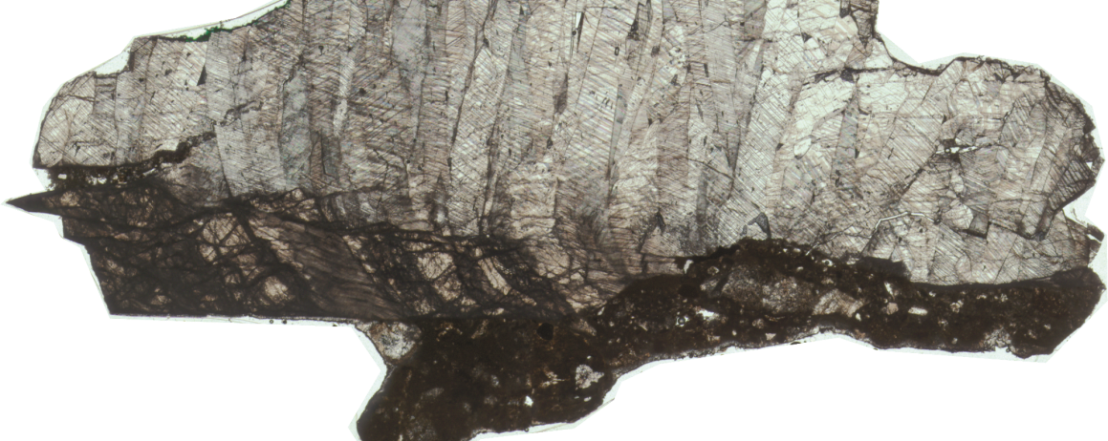
Mitrovic et al: Seismic slip and aseismic creep recorded in sheared flowstones
Microstructural analysis
Example 1
(light microscope)
Dolostone
Pre-event:
youngest age
ca. 118 ka
Flowstone
50 mm
Post-event: oldest age ca. 9 ka
Slip surface
Example 2
Notes:
I will now show you two samples taken from these sketches: in example1, the wall-rock, dolostone, is coated with flowstone. In the example2, we can see only large flowstone crystals. In both cases, we can observe pre-deformational flowstone, whose youngest age is ca.118 ka, and post-deformational, undeformed, flowstone, with the oldest age of ca 9 ka.
Of 10 stratigraphically sampled layers (one sample)

Slide 12

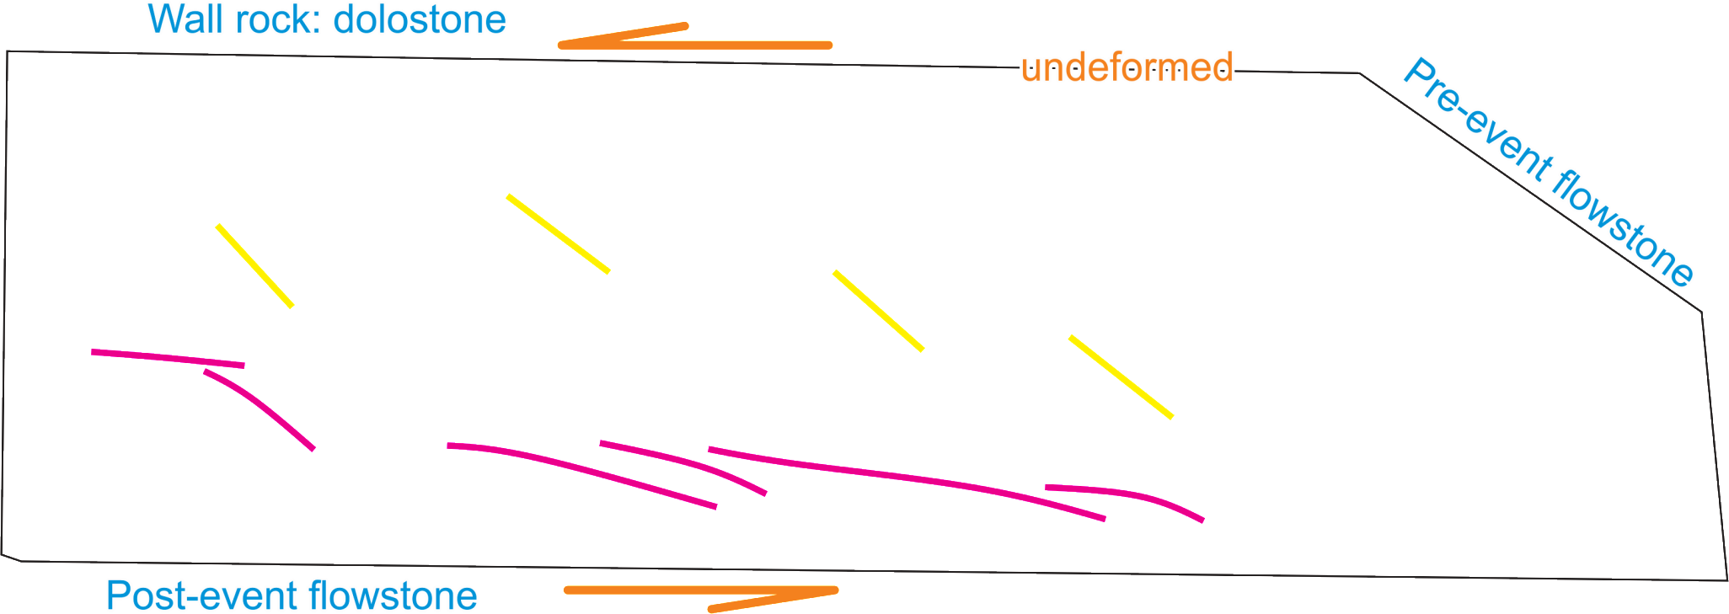
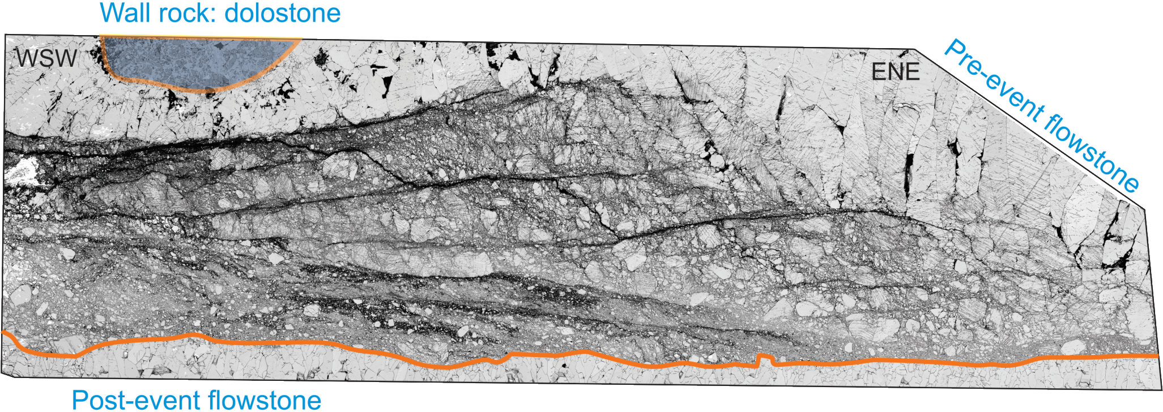
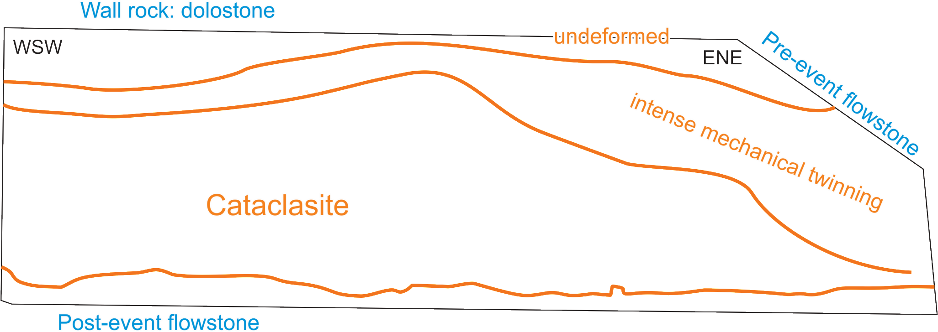
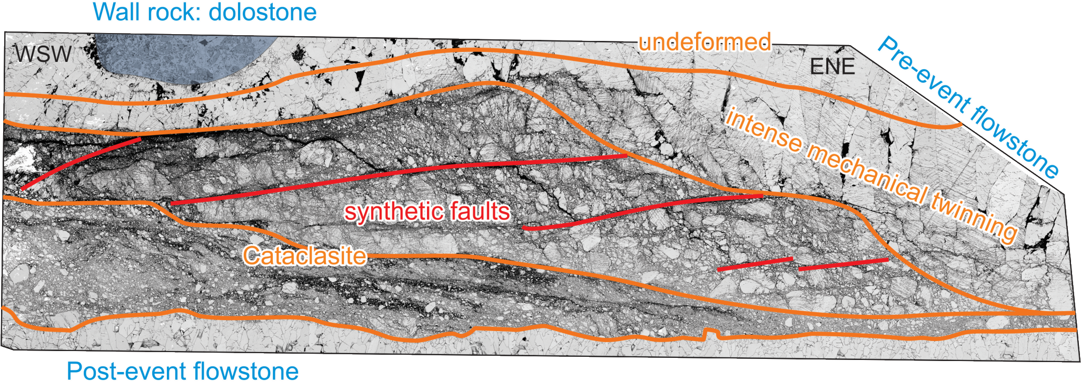

Mitrovic et al: Seismic slip and aseismic creep recorded in sheared flowstones
Microstructural analysis
Example 1
(backscattered electron images – SEM)
Notes:
The E1 further shows the progressive intensity of the deformation towards the slip surface, from undeformed crystals, over intense mechanical twinning, to cataclasite zone. The cataclasite shows grain size reduction towards the slip, synthetic faults and later open fractures. The small area on the side is analyzed with EBSD.

Slide 13
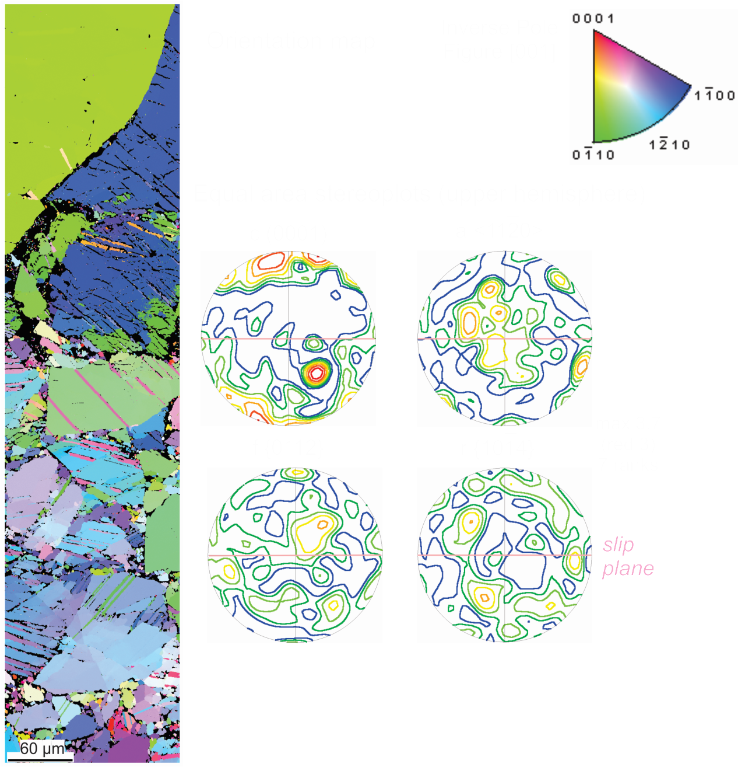
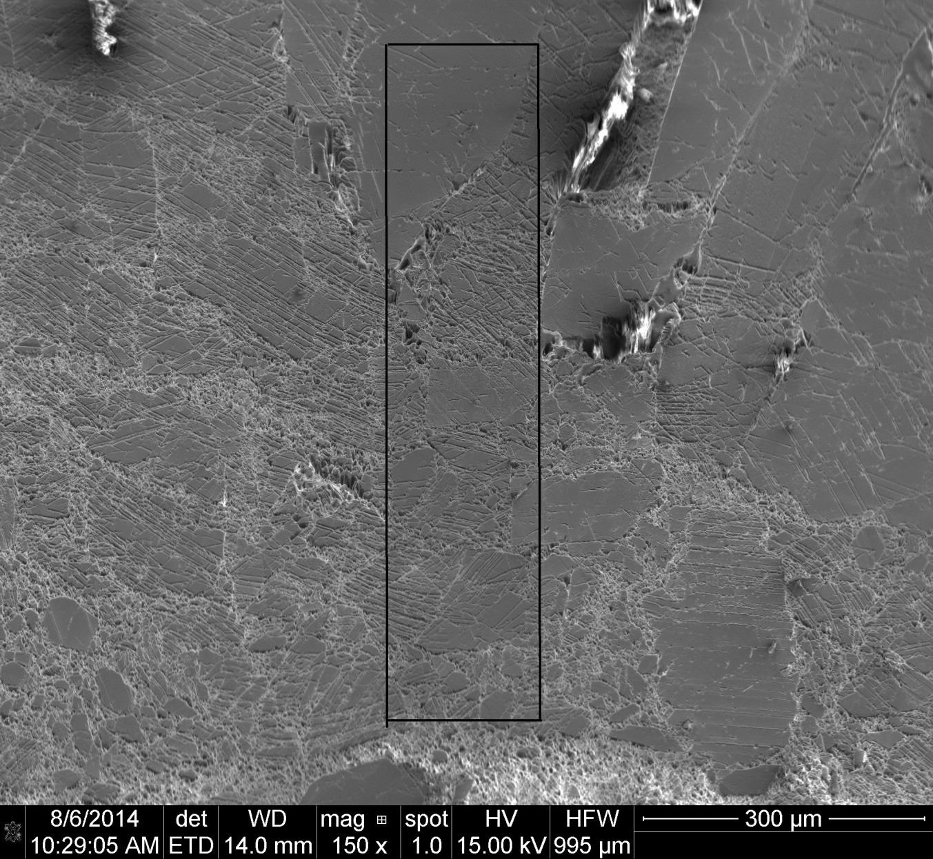

Mitrovic et al: Seismic slip and aseismic creep recorded in sheared flowstones
Microstructural analysis
Grain
size
reduction
Example 1
(BSE)
(electron backscatter diffraction – EBSD)
Notes:
The EBSD clearly shows the GSR, and pole figures for the area show relatively weak texture that still needs to be understood.
4_01
magnification: 650
step size: 0.4 microns
# of points: 845625
points per second: 16.4

Slide 14
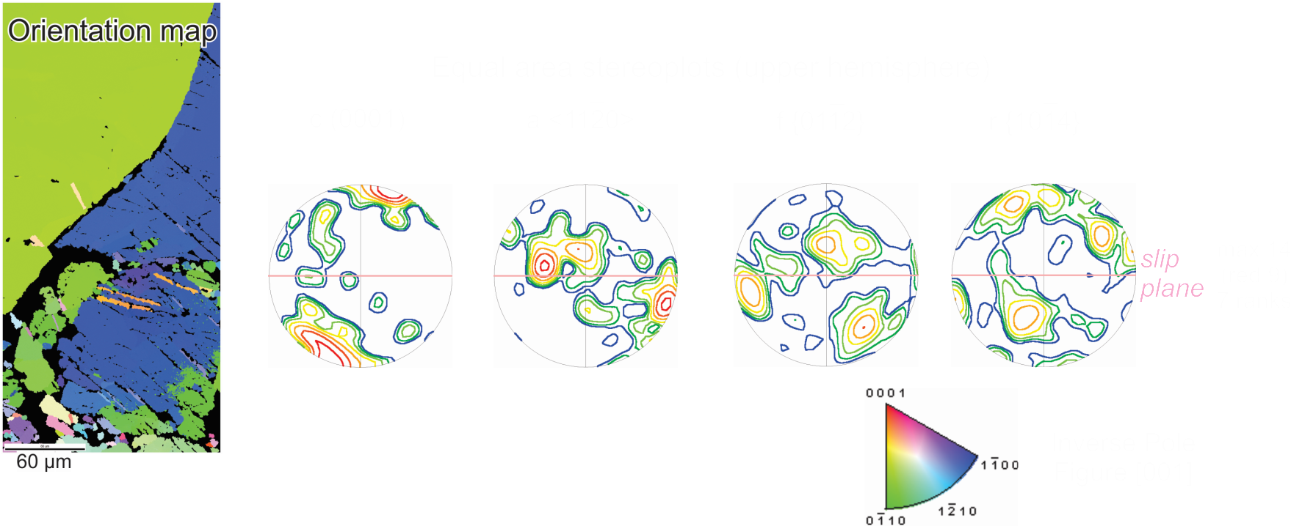



Mitrovic et al: Seismic slip and aseismic creep recorded in sheared flowstones
Example 1
Notes:
Looking each area into more details, we can see the difference in texture sharpness.

Slide 15
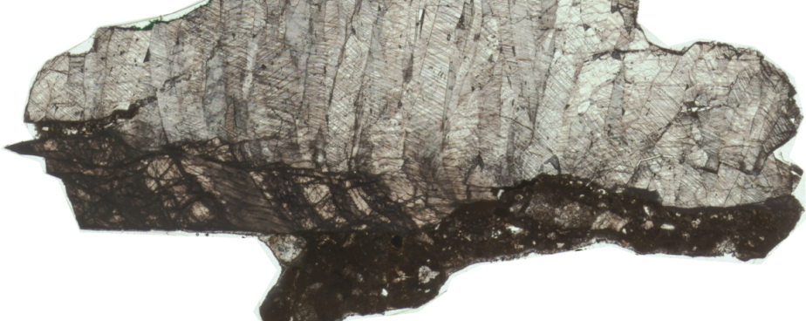
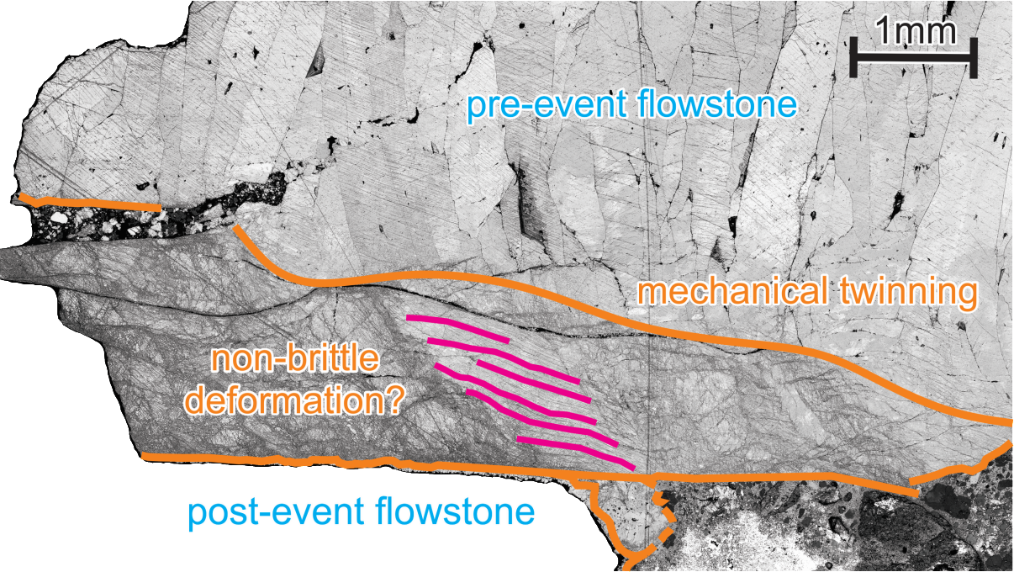
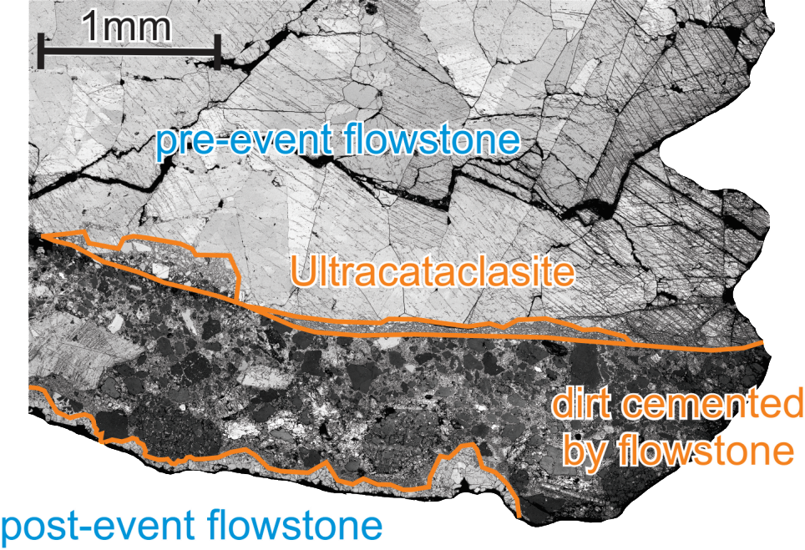

Mitrovic et al: Seismic slip and aseismic creep recorded in sheared flowstones
Microstructural analysis
(backscattered electron images – SEM)
a
b
Example 2
Notes:
In the second example, the area signed with A has a thin, ultra fine grained cataclasite, while are in B shows some non-brittle deformation of a large calcite crystal.

Slide 16
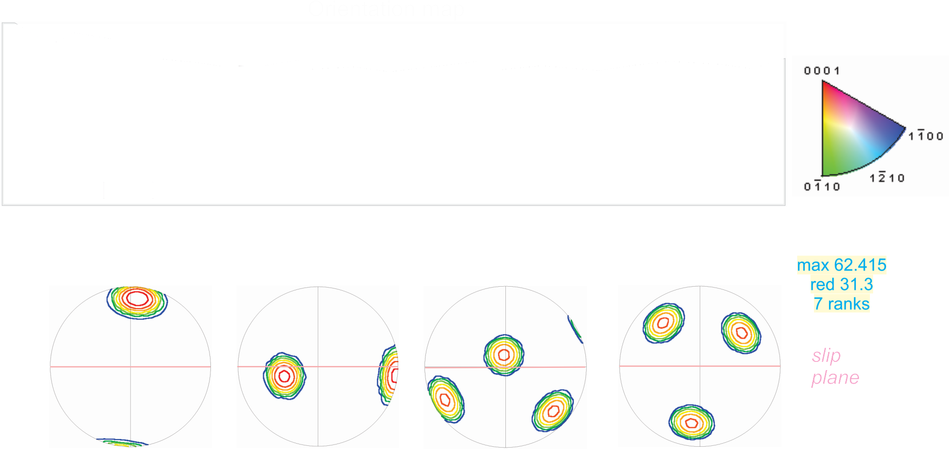


Mitrovic et al: Seismic slip and aseismic creep recorded in sheared flowstones
Microstructural analysis
(electron backscatter diffraction – EBSD)
Example 2a
Notes:
The texture plots, for the cataclastic, area show random distribution, which usually is expected for the brittle deformation. However, we can separate out the large grain, and its orientation, and compare it with the cataclastic zone.
02_02
magnification: 650
step size: 0.3 microns
# of points: 308219
points per second: 11.4

Slide 17

Mitrovic et al: Seismic slip and aseismic creep recorded in sheared flowstones
Microstructural analysis
(electron backscatter diffraction – EBSD)
Example 2a
Notes:
The cataclasite in this area has no preferred crystal orientation.

Slide 18
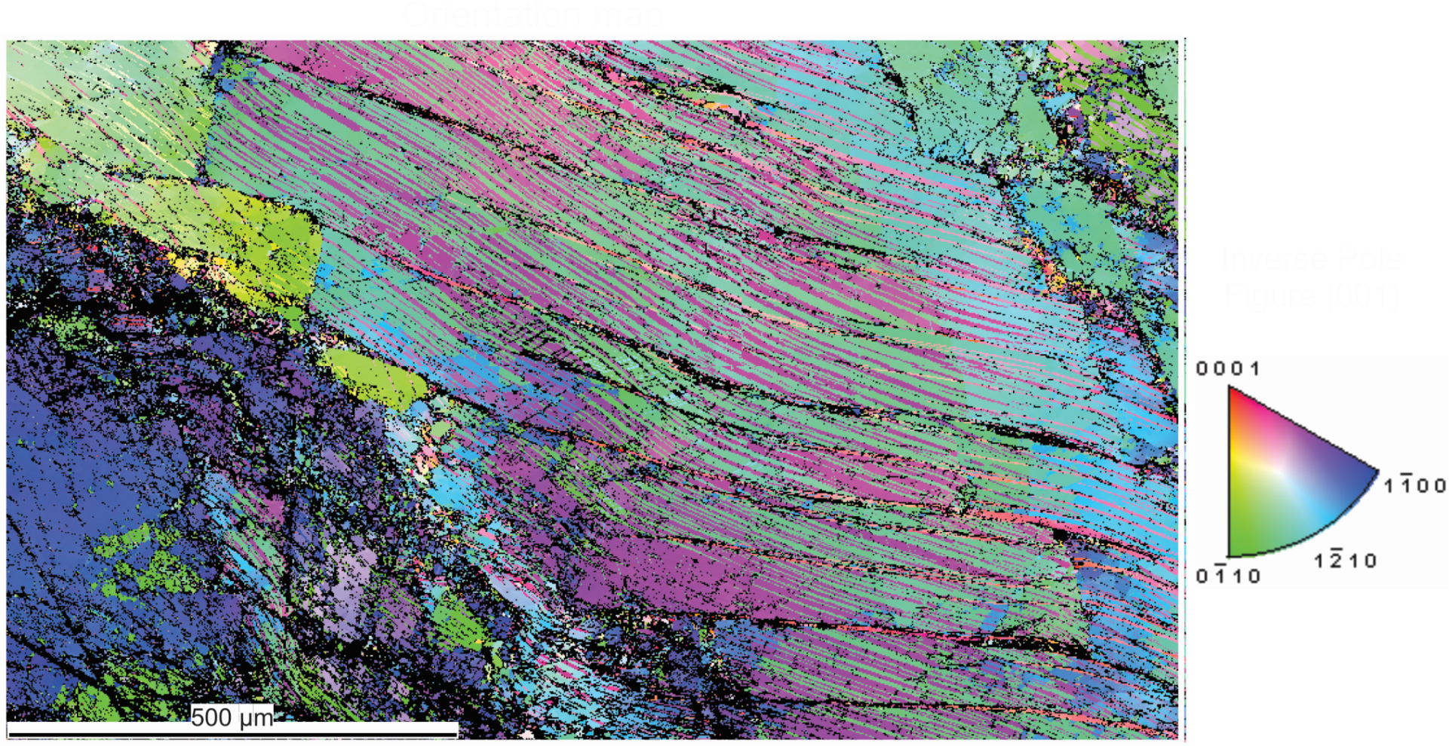
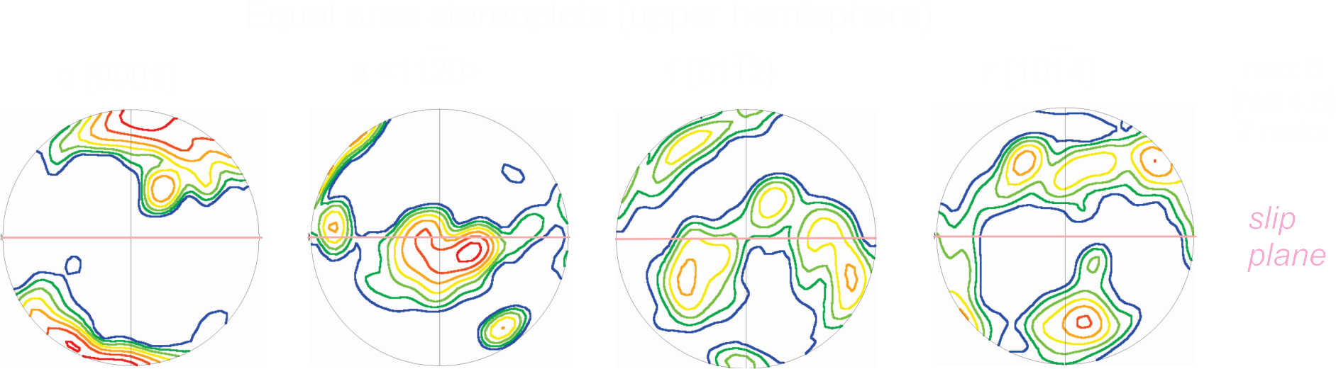
Mitrovic et al: Seismic slip and aseismic creep recorded in sheared flowstones
Microstructural analysis
Example 2b
Notes:
However, the large crystal in area B shows this gradual change in orientation of crystal lattice, its plots are, as you can see, fairly sharp, and these features indicate crystal-plastic deformation.
02_03
magnification: 500
step size: 1.45 microns
# of points: 91936
points per second: 11.8

Slide 19
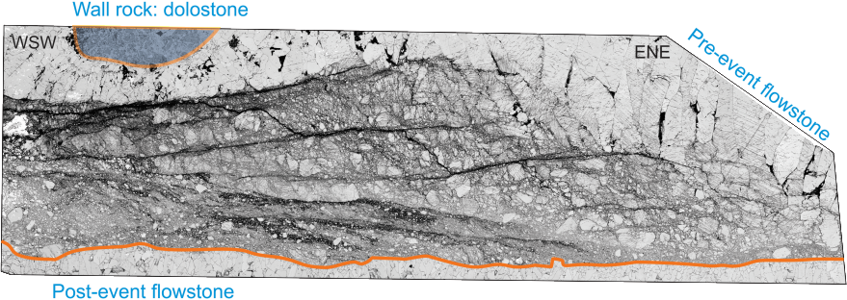
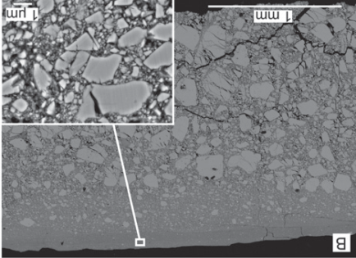
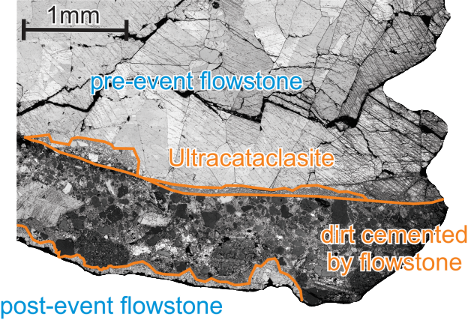


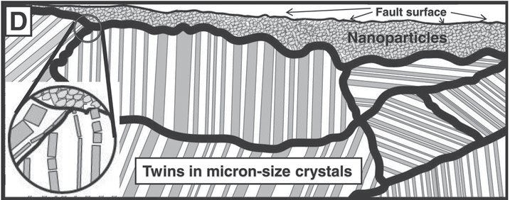
Mitrovic et al: Seismic slip and aseismic creep recorded in sheared flowstones
Seismic slip vs. aseismic creep
Temp. range: 0 – 10 C
Time: ca. 100 ka (118 – 9 ka)
Min. displacement: 0.3 m
Smith et al, 2013
Smith et al, 2013
?
subseismic slip
coseismic slip
Nanograins in carbonate fault mirrors
Siman-Tov et al, 2013
Notes:
If we know compare what we have seen in our samples with experimental work of Smith et al, we may make some references about E1 having similar character to the subseismic sample, while E2a, similar to coseismic slip, especially supported by the Siman-Tov et al work on fault mirrors. There is, of course, a question of what was the process forming the non-brittle deformation.
I also want to remind you that parameters we are dealing with involve very low temperatures and relatively short time for displacement of about 30 cm.

Slide 20
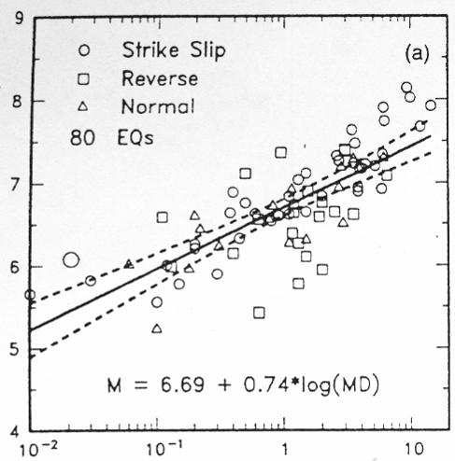
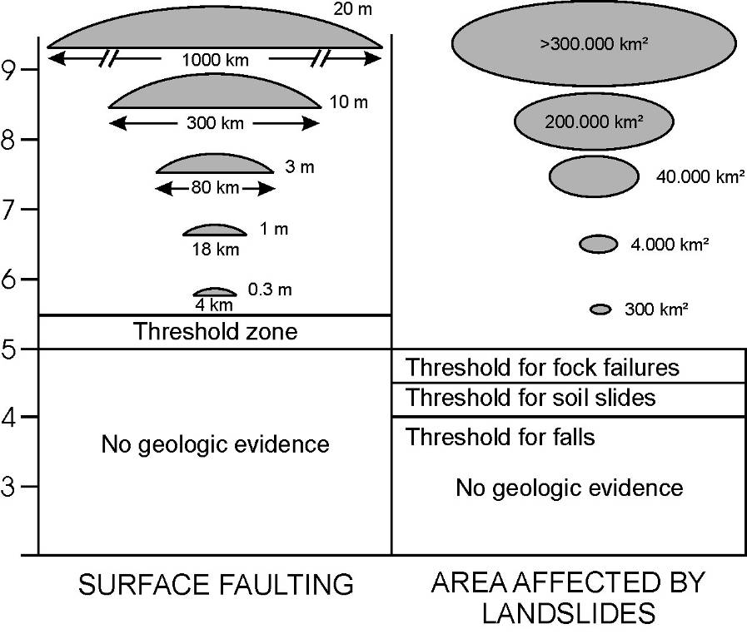

Mitrovic et al: Seismic slip and aseismic creep recorded in sheared flowstones
?
Was there an earthquake?
max. length of scratches: 0.3 m → 0.3 m min. displacement
Magnitude
Magnitude
M = 6.3 + 0.7
Wells & Coppersmith, 1994
McCalpin, 1996
Max displacement [m]
estimated magnitude of potential earthquake
Notes:
We can also plot the length of the scratches on these plots and estimate that if an EQ occurred, it had to have a magnitude of about 6.
If this is truly what we are looking at, and it is supported by microtectonics, than we can clearly conclude that speleothems can record paleoseismic events and even provide constraints on their magnitude.

Slide 21
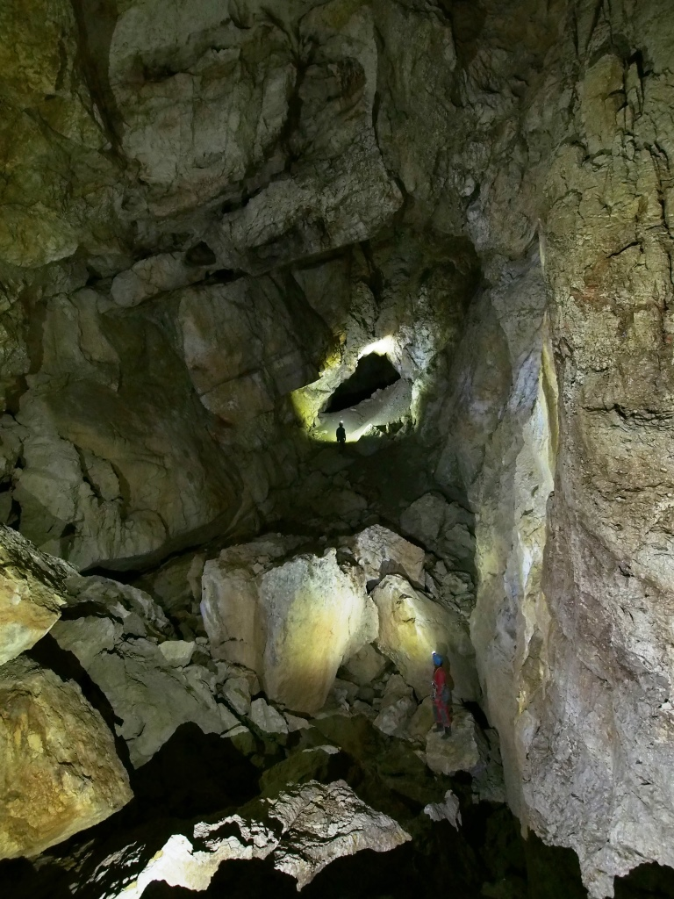

Mitrovic et al: Seismic slip and aseismic creep recorded in sheared flowstones
Mammoth cave, Dachstein
What to do?
Q1: What caused crystal-plastic deformation: slow strain rates, or heating due to friction?
?
Q2: What can twins tell us?
Q3: Can we compare whole-crystal deformation to powder experiments?
Notes:
The question we are now working on are: What caused crystal-plastic deformation: slow strain rates, or heating due to friction? What can twins tell us? Can we compare whole-crystal deformation to powder experiments?

Slide 22
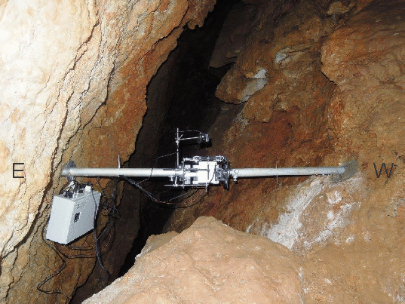
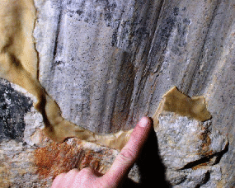


Mitrovic et al: Seismic slip and aseismic creep recorded in sheared flowstones
Active tectonics
Past events
Earthquake hazard
SPELEOTECT
Notes:
This work is part of a larger project called Speleotect, a collaboration between Uni Vie and NHM, and it investigates the active tectonics, past events and has a focus to provide an EQ hazard registry.

Slide 23
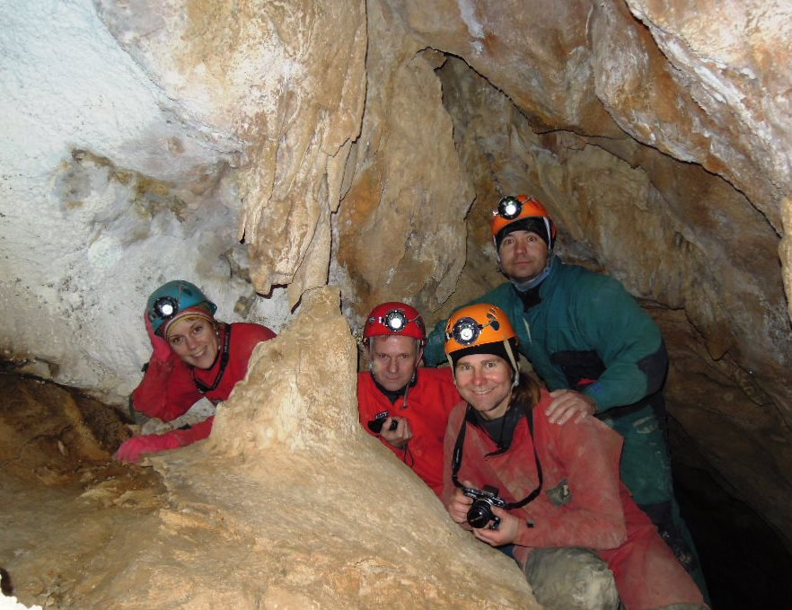


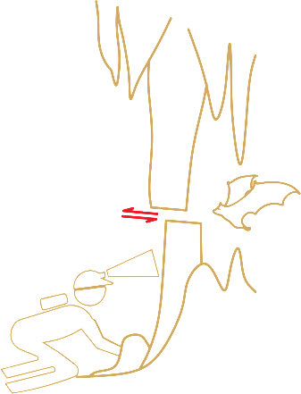
Mitrovic et al: Seismic slip and aseismic creep recorded in sheared flowstones
Mammoth cave, Dachstein
Acknowledgements:
SEM: G. Habler, D. Topa
EBSD: T. Griffiths, R. Schuster, A. Rogowitz
The project is funded by the Austrian Science Fund (FWF): P25884-N29
KEEP IN TOUCH!
ivanka.mitrovic@univie.ac.at
bernhard.grasemann@univie.ac.at
lukas @cave.at
ivo.baron@nhm-wien.ac.at
http://www.nhm-wien.ac.at/en/research/geology__paleontology/projects/fwf_p25884-n29_
Thank you!
Questions, please!

