Slide 1




TECTONO-MAGMATIC EVOLUTION OF THE EASTERN HARRISON LAKE REGION, BC, REFLECTS MID-CRETACEOUS CHANGE IN PLATE KINEMATICS
Ivanka MITROVIC, Dan GIBSON, Derek THORKELSON, Dan MARSHALL
Notes:
I will be presenting a model for the mid-Cretaceous tectono-magmatic evolution of the southern CPC, showing the change in relative plate vector along the NW side of the NA plate.

Slide 2
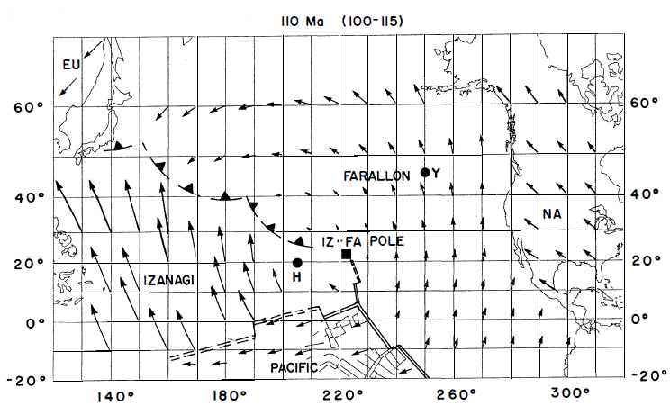
Pacific Plate Motions
Engebretson et al (1985)
Mitrovic et al: Tectono - magmatic evolution...
Notes:
Firstly, I want to go back to 1985, and remind you of the mystery involving the mid-Cretaceous tectonics of the region, marked with the red star. Here you see kinematics of the Farallon plate, relative to NA plate.

Slide 3
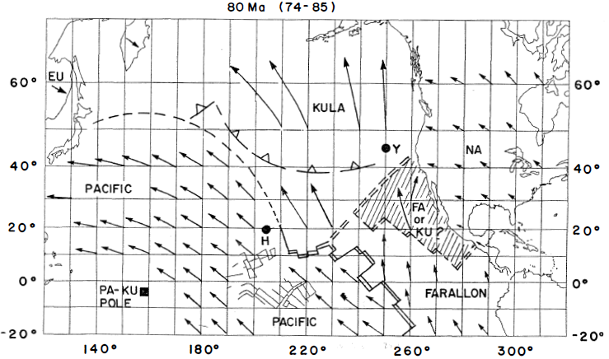
Pacific Plate Motions
Engebretson et al (1985)
Mitrovic et al: Tectono - magmatic evolution...
Notes:
However, here we see the existence of the Kula and Farallon plates and this ambiguous piece of the plate, that might have had the influence of the tectonic evolution of the area.

Slide 4
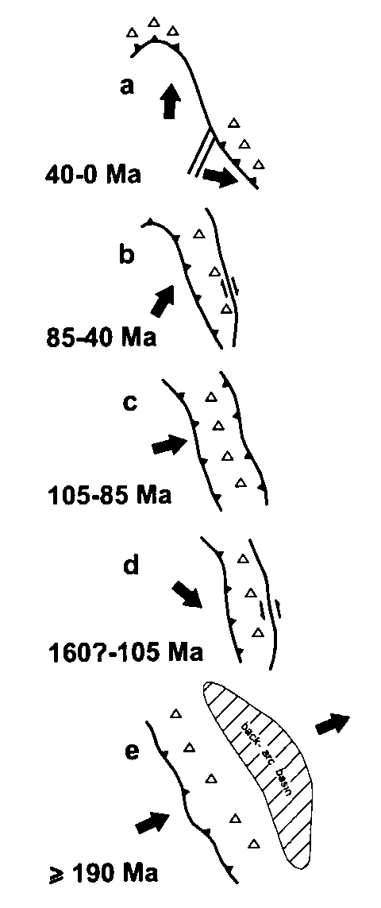
Plate tectonics of Canadian Cordillera
Metamorphism:
M₁ –Low P, Low T - Thrusting
M₂ –Low P, High T - Contact metam. (104-95 Ma)
M₃ –High P (8-10 kbar), High T (650-700°C) - magmatic loading; 96-91 Ma
M₄ – Contact metam. (92-84 Ma)
Brown et al (2000)
Structure:
D₁ – Orogen normal contraction (146–103 Ma)
D₂ – Orogen parallel displacement (96-91 Ma)
D₃ – Regional folding (96-91 Ma)
D₄ – Dextral – reverse faulting (< 91Ma)
Monger (1997)
Mitrovic et al: Tectono - magmatic evolution...
Notes:
Monger suggested in 90-ties that there was a change in plate convergence from dominantly sinistral oblique transpression during Middle Jurassic to Early Cretaceous, to dextral oblique transtension in Late Cretaceous to early Cenozoic time.
Brown have described multiple stages of the metamorphism and deformation in the area, and also proposed the Magma Loading Model.
Furthermore, both agreed on “the critical period between 105-85 Ma” with the transition from sinistral to dextral transpression and its implications for the relationships between arc magmatism and crustal thickening;

Slide 5
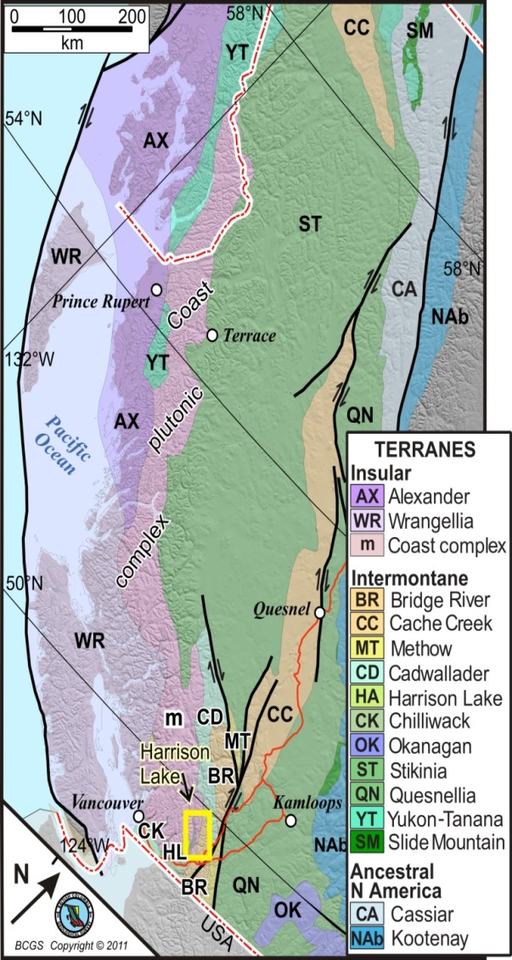
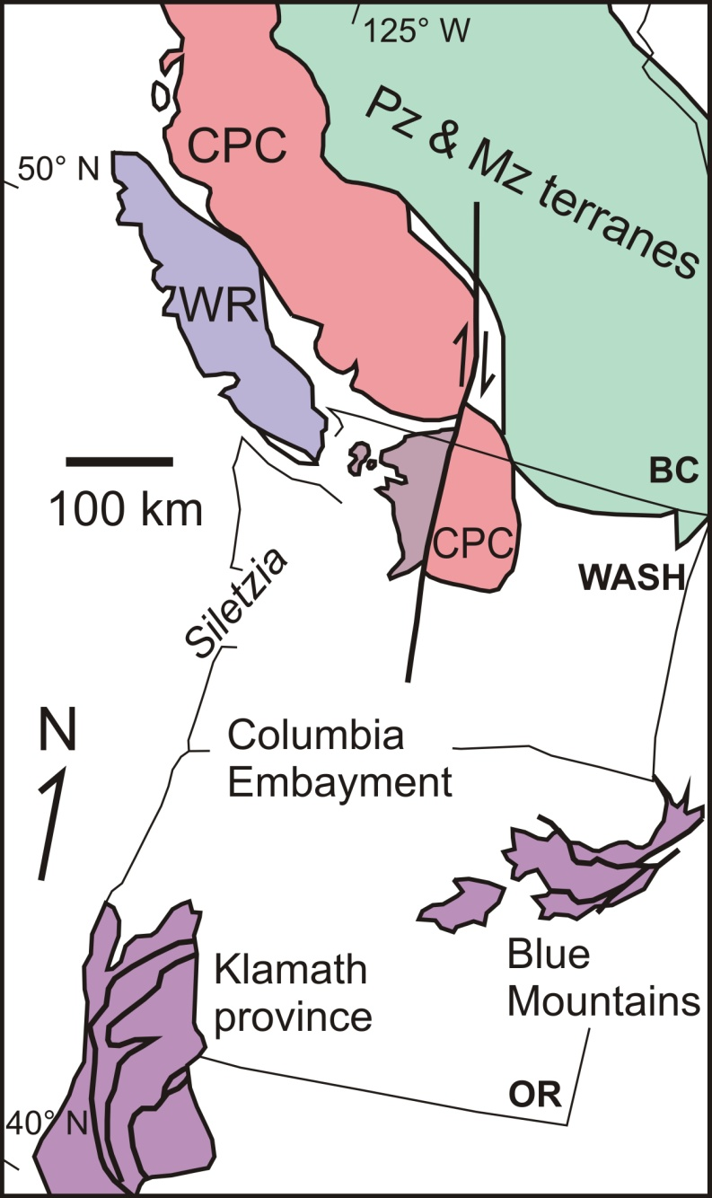
Coast plutonic complex
Brown (2012)
BCGS online resource
Mitrovic et al: Tectono - magmatic evolution...
Notes:
The CPC, as we all know, is a large orogen that envelops plutons and associated metamorphic rocks from the north Cascades in Washington State, through the Coast Mountains in BC to southern Alaska;
Relevant for this talk is that it displays features related to the change in relative plate vector;
Its southern end is cut off by dextral Fraser- Straight Creek fault system and displaced further into the Washington.
The boxes show the location of the study area.

Slide 6
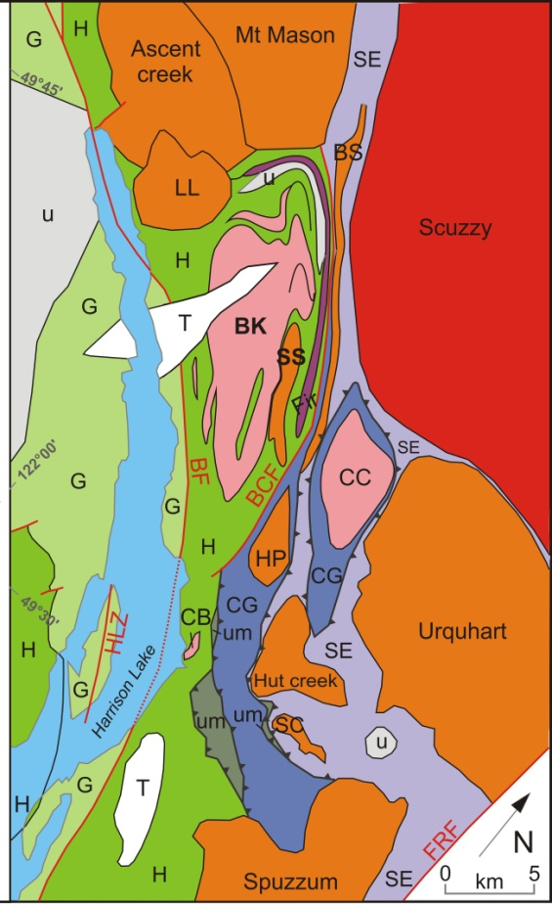
Harrison Lake area
Pluton ages (Ma)
88-84
96-89
107-100
BK Breakenridge complex
CC Clear Creek pluton
SS Snowshoe pluton
BS Big Silver pluton
G Gambier group
H Harrison lake formation/ Slollicum
SE Settler Schist
CG Cogburn group
BF Breakenridge fault
BCF Butter creek fault
HLZ Harrison lake fault zone
FRF Fraser River fault
This study after Brown et al (2000)
Mitrovic et al: Tectono - magmatic evolution...
Notes:
The study area lies north-east of Harrison Lake, and is characterized by intrusive suites varying in size, with a range in age from mid-Cretaceous to Tertiary. The most relevant for this talk are the plutons in pink, orange and red, with displayed ages of emplacement.
These plutons were emplaced in the Nooksack-Harrison terrane, an arc-related rock assemblage that consists of Middle Triassic to mid- Cretaceous volcano-sedimentary succession.
The main hero of this story is the Breakenridge pluton.

Slide 7
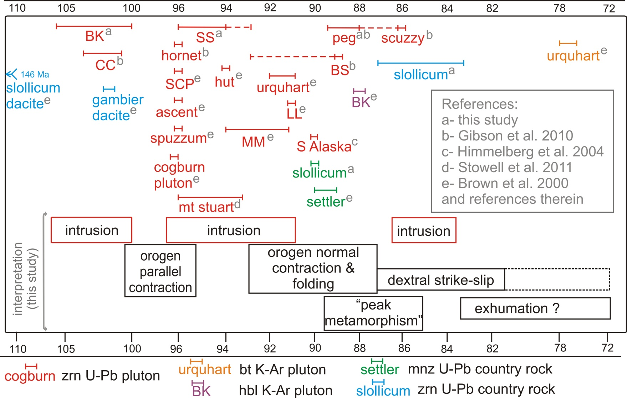
The Model
Mitrovic et al: Tectono - magmatic evolution...
Notes:
The model presented here consists of three distinct magmatic pulses, characteristic of the CPC during the Early to Late Cretaceous (110-80 Ma), and three deformational event which reflect the change in tectonic setting and evolving boundary conditions.

Slide 8
Plate tectonics of Canadian Cordillera
Metamorphism:
M₁ –Low P, Low T - Thrusting
M₂ –Low P, High T - Contact metam. (104-95 Ma)
M₃ –High P (8-10 kbar), High T (650-700°C) - magmatic loading; 96-91 Ma
M₄ – Contact metam. (92-84 Ma)
Brown et al (2000)
Structure:
D₁ – Orogen normal contraction (146–103 Ma)
D₂ – Orogen parallel displacement (96-91 Ma)
D₃ – Regional folding (96-91 Ma)
D₄ – Dextral – reverse faulting (< 91Ma)
Monger (1997)
Mitrovic et al: Tectono - magmatic evolution...
Notes:
If we go back to this slide, I just want to point out that I will be using Ned’s metamorphic and deformational events when referring to the events of interest.

Slide 9
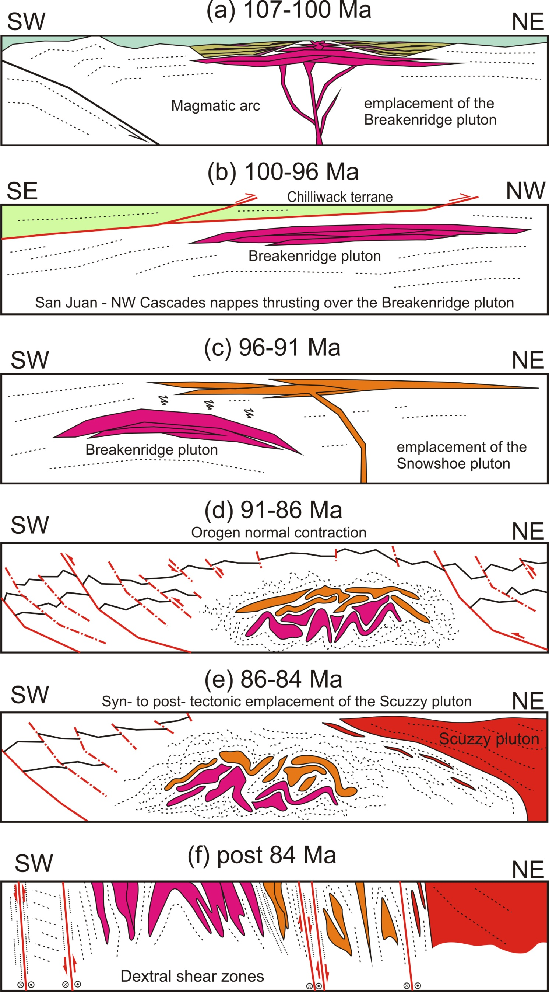
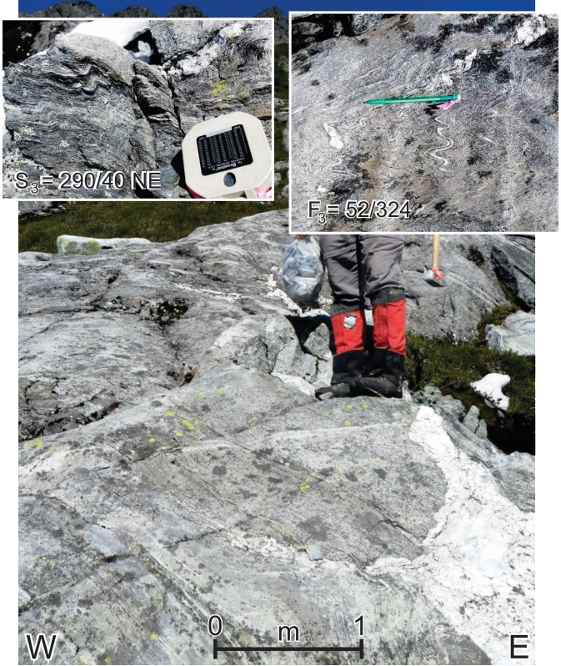
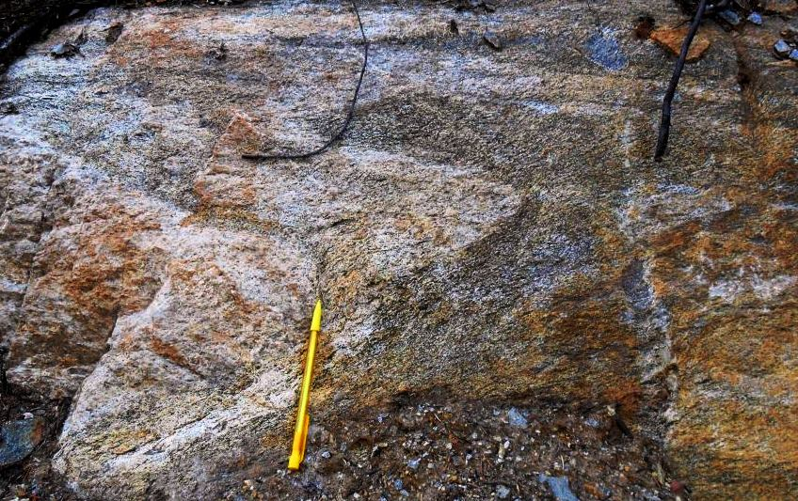
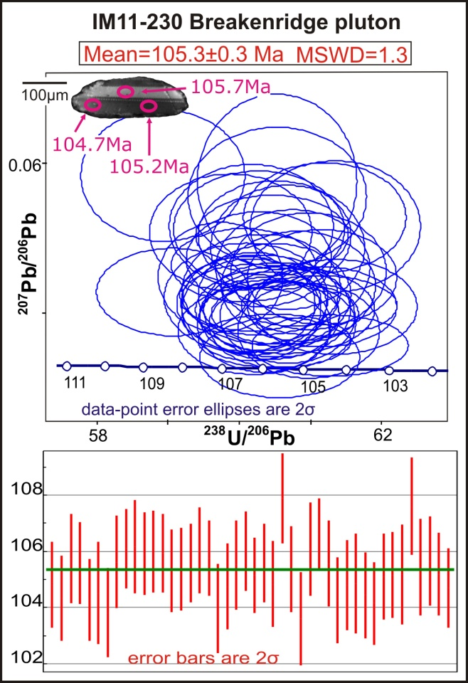
Breakenridge pluton
M_{2B} (HT, LP)
Dioritic:
107-104 Ma
Mitrovic et al: Tectono - magmatic evolution...
Notes:
The first magma pulse is represented by the 107-100 Ma Breakenridge pluton intruded within a magmatic arc, and its emplacement caused the contact metamorphism (Ned’s M2). The Breakenridge complex was emplaced through multiple, shallow, sill-like intrusions of dioritic to tonalitic composition (going to the next slide).

Slide 10
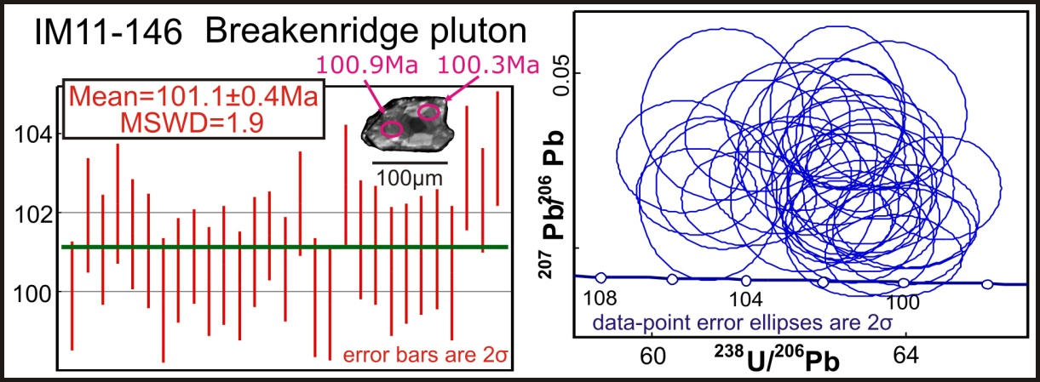
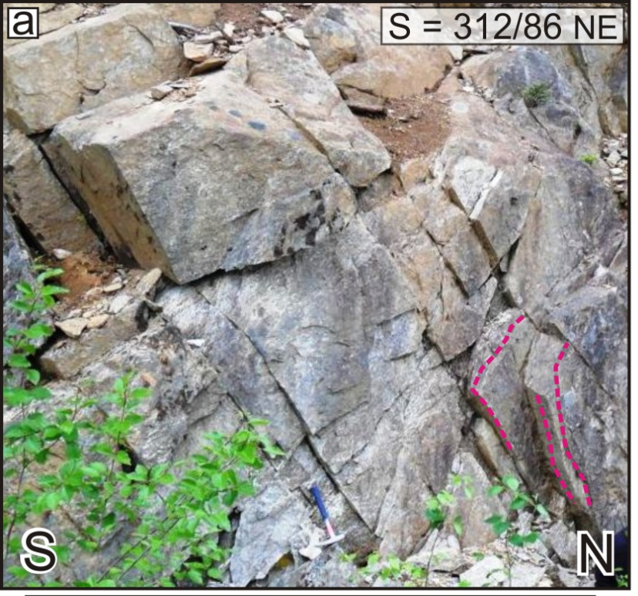
Breakenridge pluton
M_{2B} (HT, LP)
Tonalitic:
103-100 Ma
Mitrovic et al: Tectono - magmatic evolution...

Slide 11
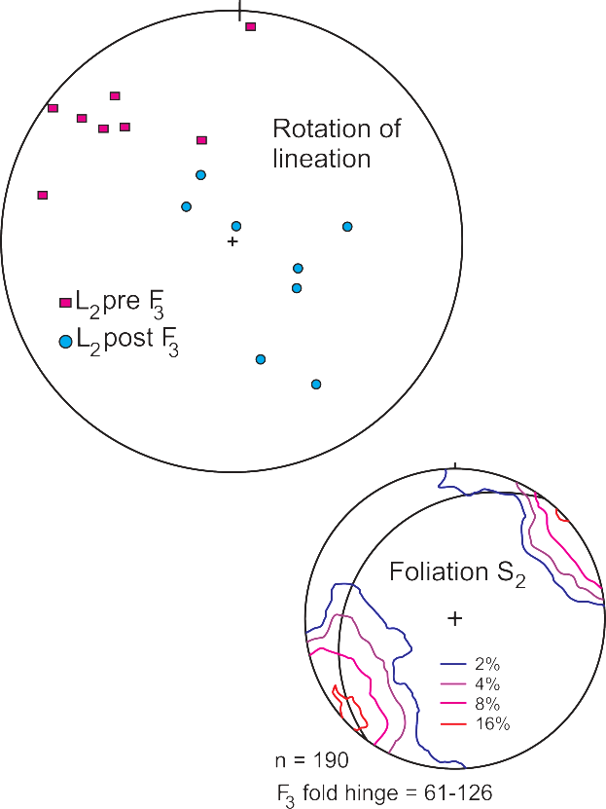
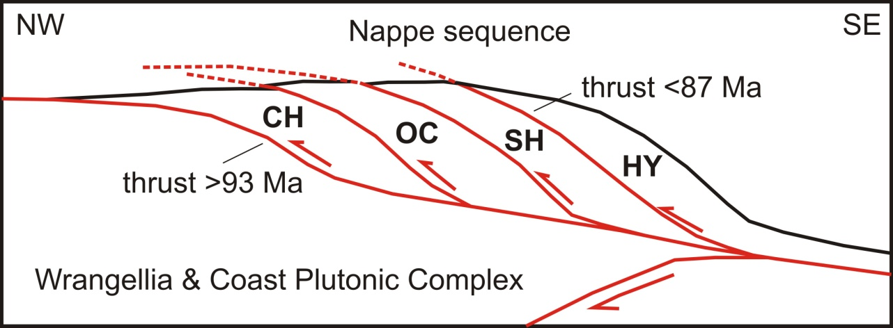
Orogen – parallel displacement
D₂
After Brown (2012).
Brown (2012)
Mitrovic et al: Tectono - magmatic evolution...
Notes:
Orogen-parallel deformation occurred during, or shortly after the emplacement of the Breakenridge pluton, forming a penetrative, largely layer parallel foliation , together with a dominant NW-SE trending and orogen-parallel stretching and mineral lineation.
This deformational event might have been a result of the northward thrusting of the San Juan-northwest Cascades nappe.
This nappe represented a “forearc sliver” that was thrust northward and eventually obducted onto the southern end of Wrangellia and the CPC.

Slide 12
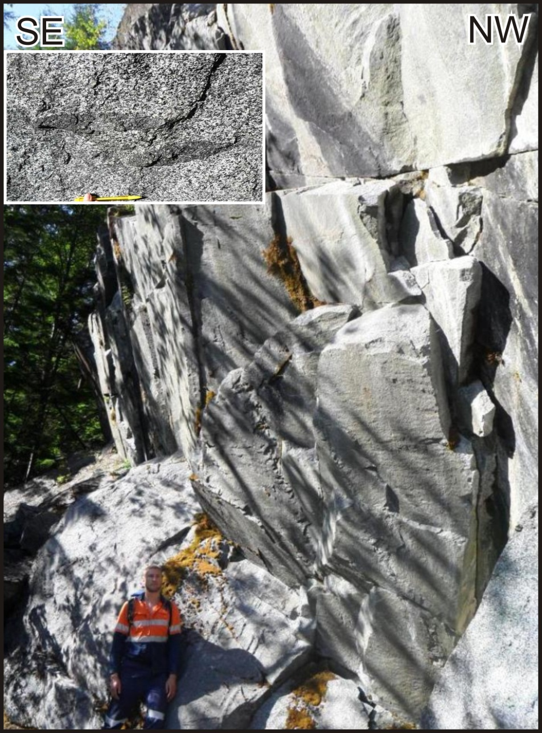
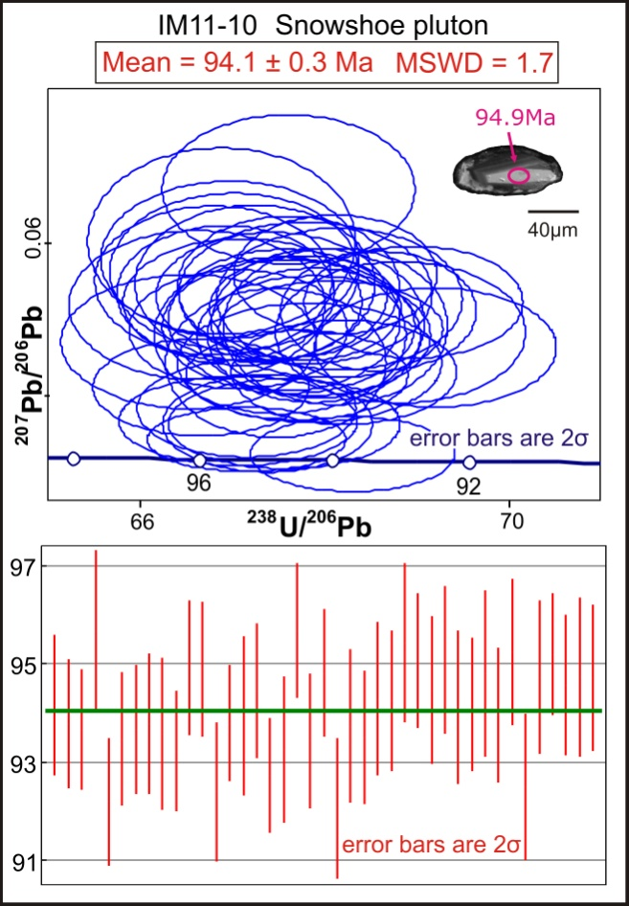
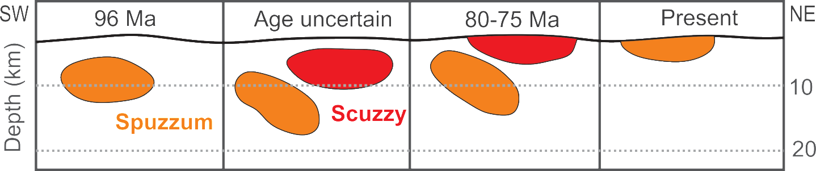
PLUTONS 96 – 91 Ma
M_{2S} (HT, LP)
Brown & Burmester (1991)
Snowshoe pluton:
96-94 Ma
Mitrovic et al: Tectono - magmatic evolution...
Notes:
The second magma pulse is represented by the emplacement of a younger plutonic suite (96-91 Ma). This plutons were intruded at higher structural levels relative to the Breakenridge pluton, as we can see on the case of the Snowshoe pluton (96-94 Ma). It caused a loading of the crust above the structurally lower Breakenridge pluton, and we propose that this pattern might explain the eastwardly increasing metamorphic gradient in the study area, from lower greenschist facies to the amphibolite facies, similar to what has been described in Ned’s paper.

Slide 13
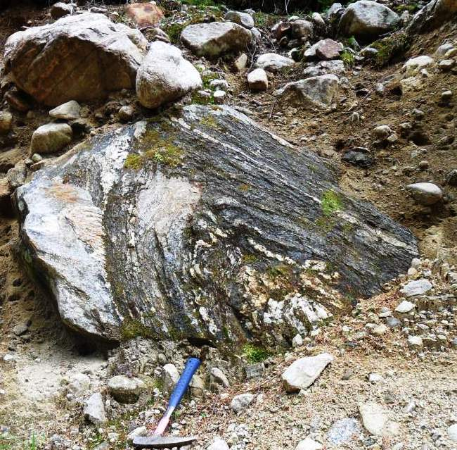
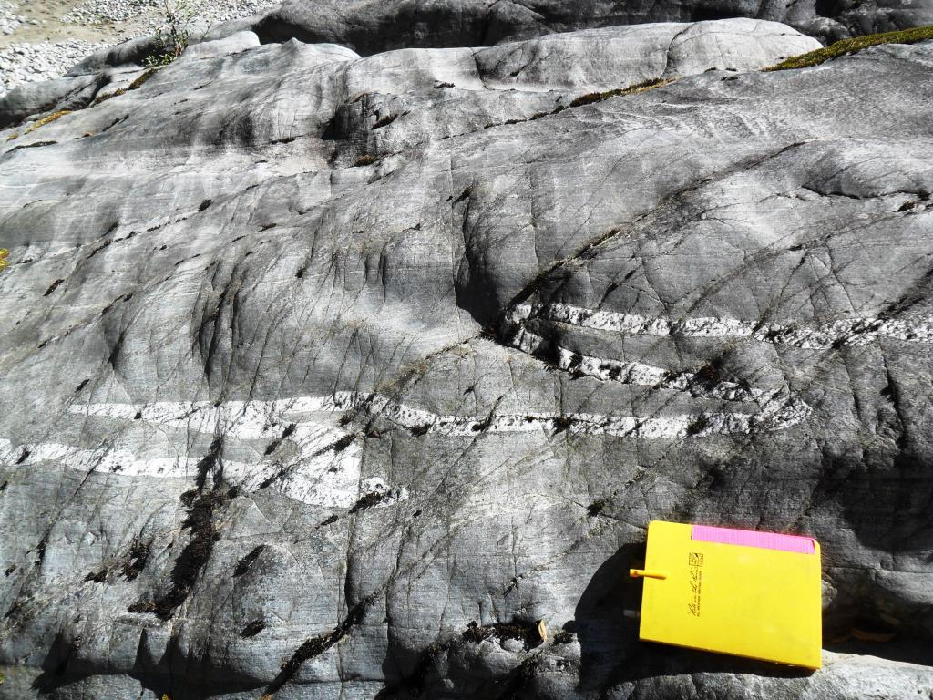
Orogen – normal contraction
D₃ (folding)
M₃ (HT, HP)
Mitrovic et al: Tectono - magmatic evolution...
Notes:
The orogen-normal compression was the final mechanism for deep burial and peak metamorphic conditions of the study area between 91-86 Ma;
this final stage of crustal loading and subsequent folding had developed the NW-SE trending Breakenridge antiform.

Slide 14
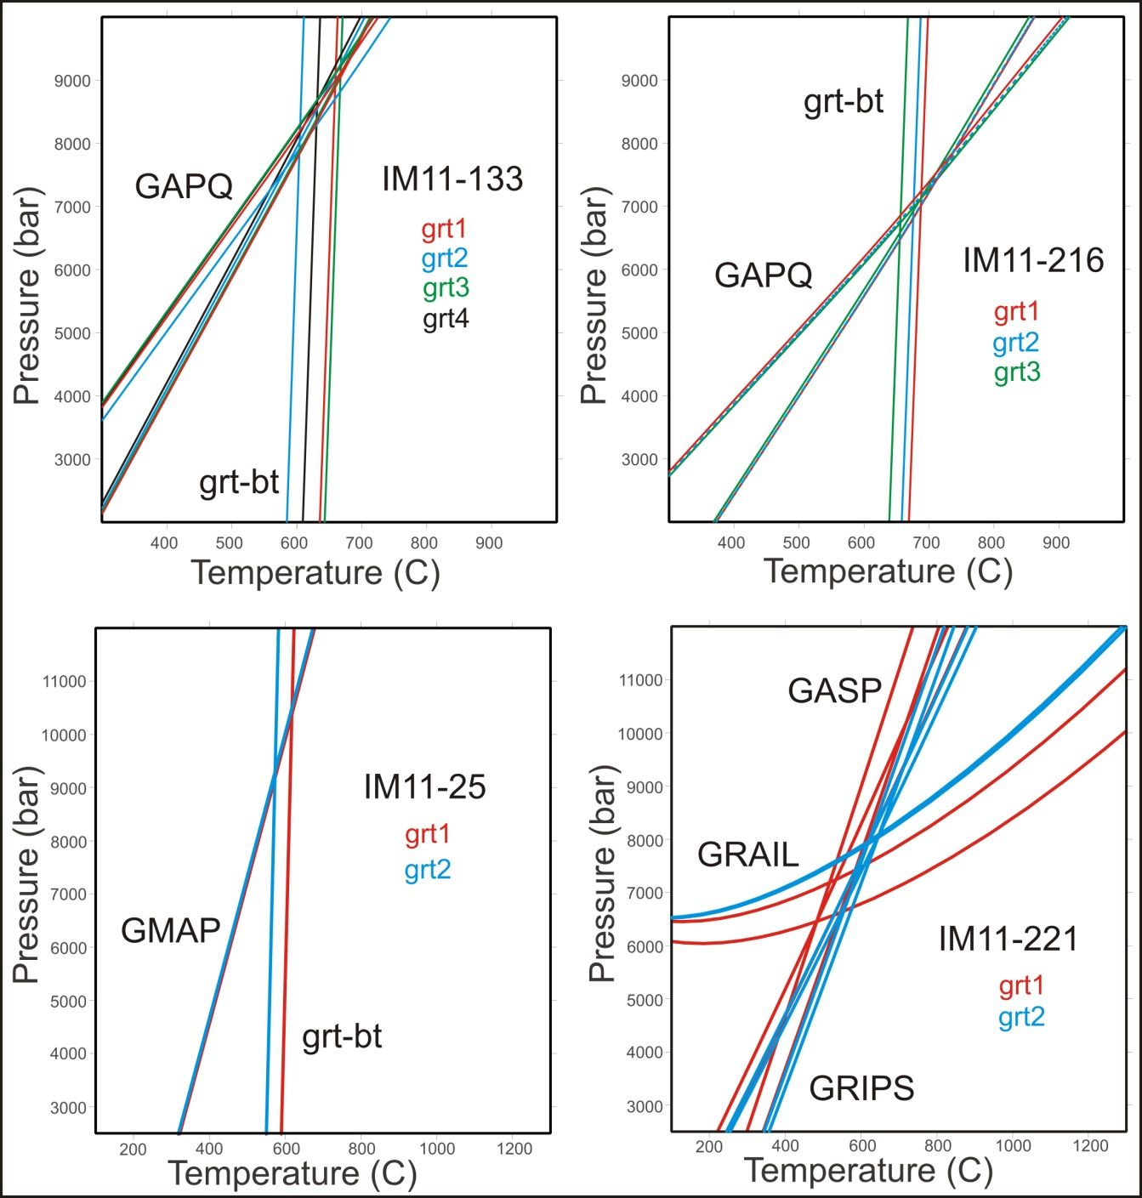
Orogen – normal contraction
8.5 kbar
650°C
7 kbar
670°C
10 kbar
600°C
7.5 kbar
600°C
Mitrovic et al: Tectono - magmatic evolution...
Notes:
The high-grade metamorphism (M3) was characterised with pressures of 7 to 10 kbar and temperatures of almost 600 to 700°C.

Slide 15
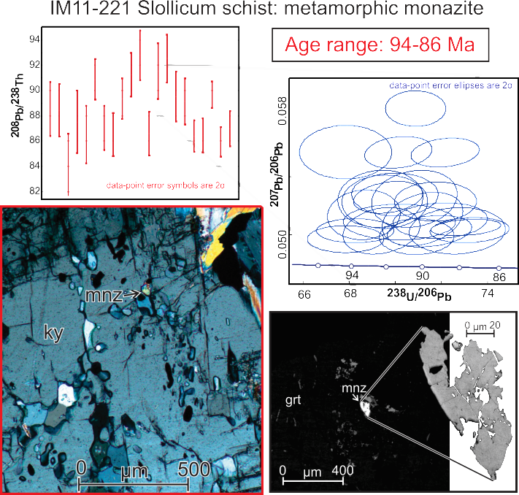
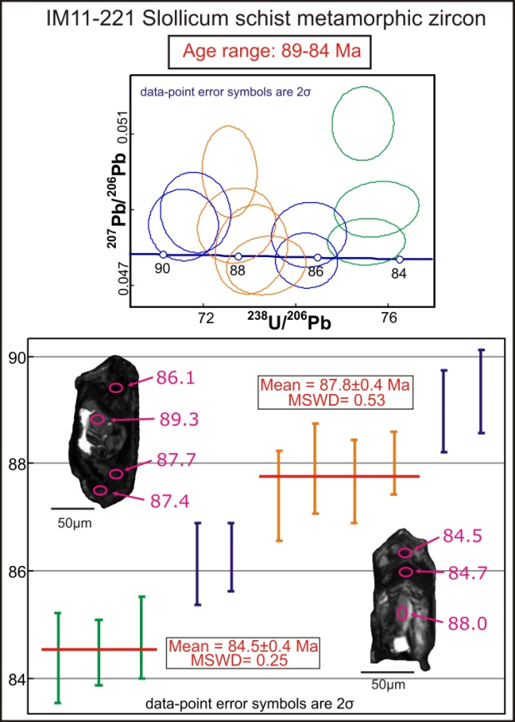
Orogen – normal contraction
Metam. zircon
age: 89-84 Ma
Metam. monazite
age: 94-87 Ma
Mitrovic et al: Tectono - magmatic evolution...
Notes:
And based on the monazite ages, the burial and heating may have been accentuated by the emplacement of the 96-91 Ma plutons; But the partial melting begun at about 89 Ma and persisted until at least until 84 Ma, as suggested by met. zircon ages, indicating the importance of the orogen-normal contraction.

Slide 16
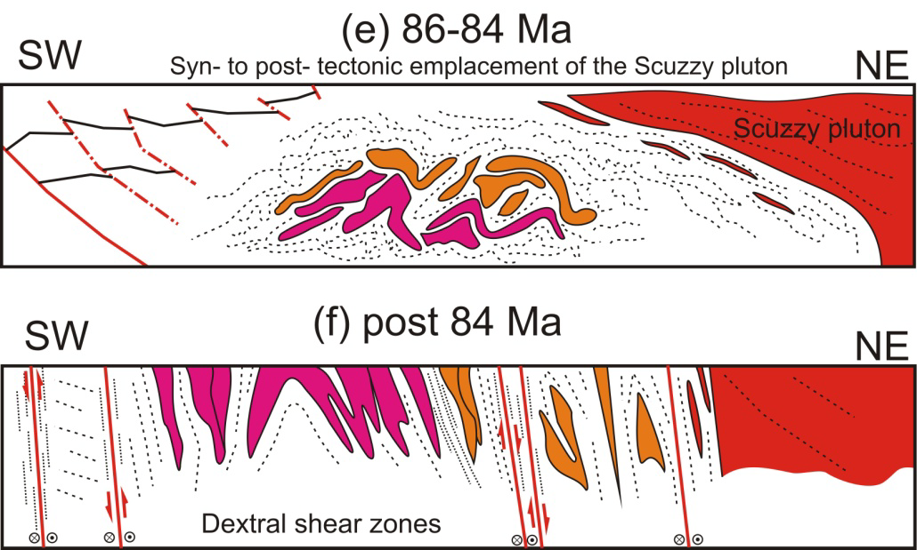
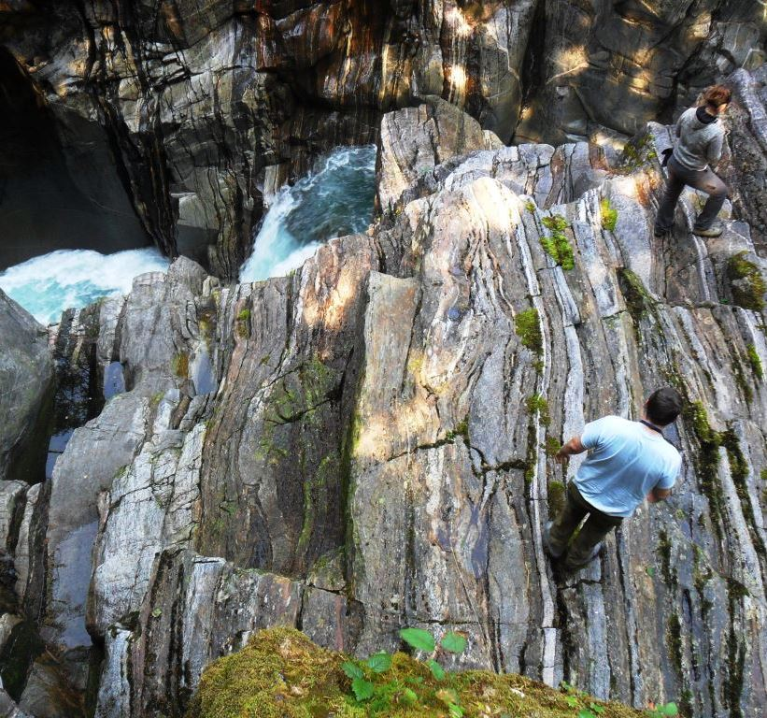
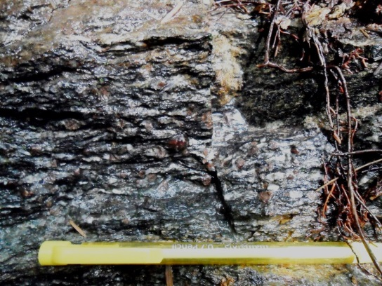
Scuzzy pluton
M₄ (HT, LP)
Mitrovic et al: Tectono - magmatic evolution...
Notes:
The third magma pulse (86-84 Ma) was synchronous with the late stages of high-grade metamorphism and early stages of oblique strike-slip movement. It was also one of the most voluminous magmatic activity belonging to the CPC.

Slide 17
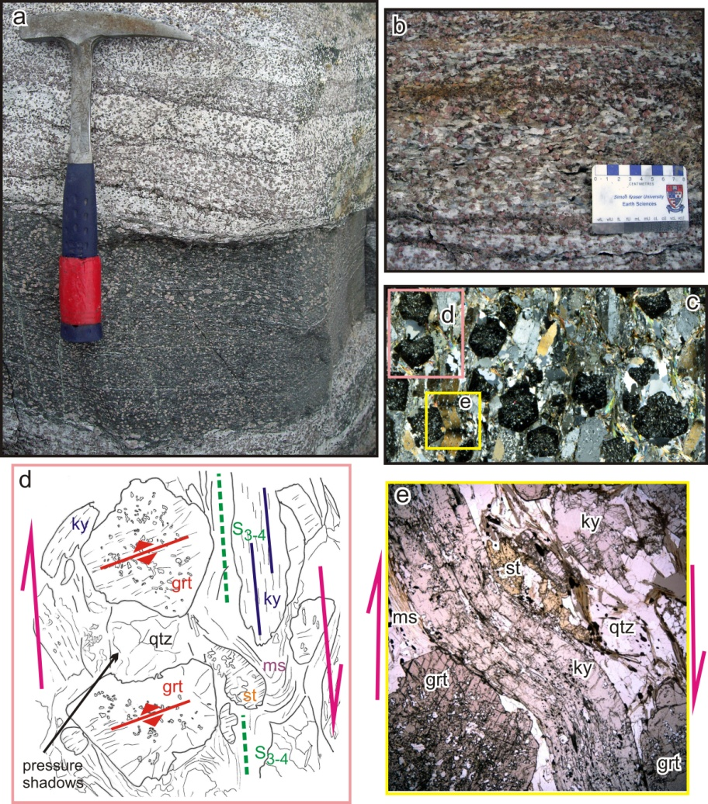
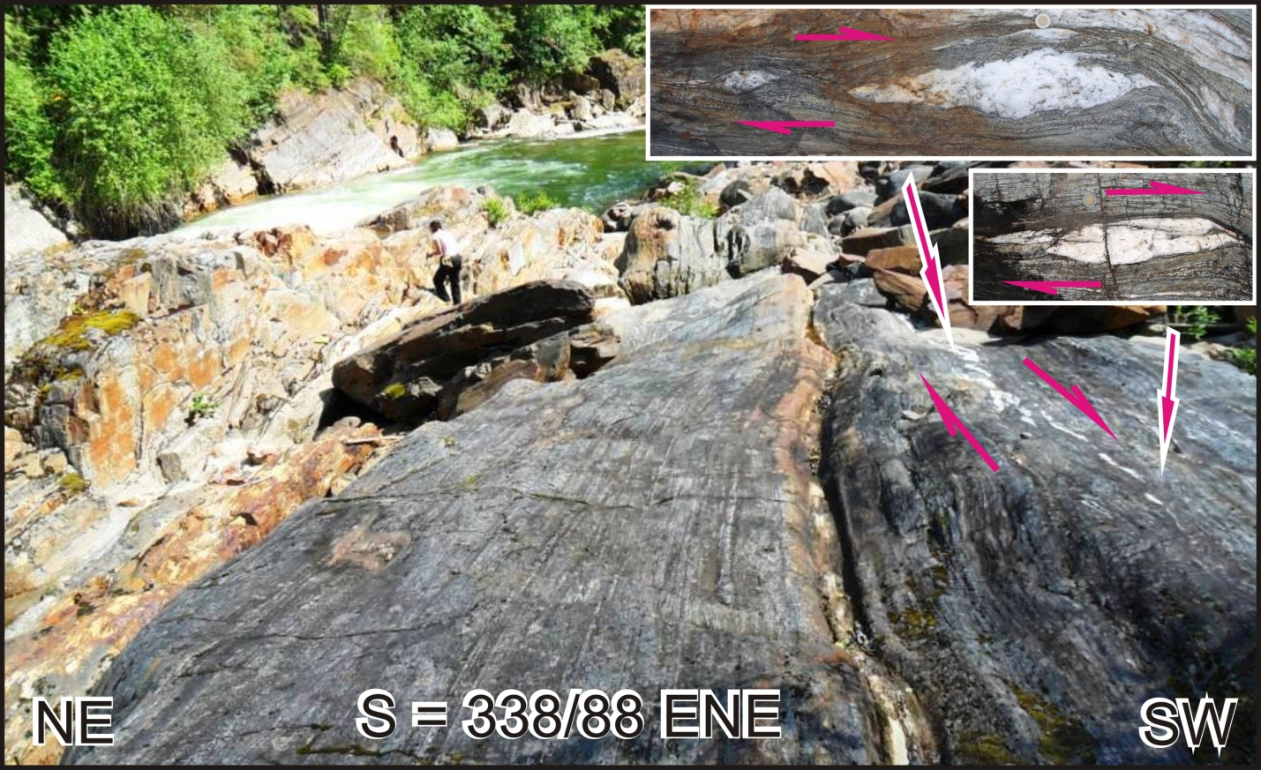
Dextral shear zone
D₄
Mitrovic et al: Tectono - magmatic evolution...
Notes:
Oblique, dextral-normal, top-to-south, shear zones facilitated the exhumation of the Breakenridge plutonic complex and the beginning of the dextral transtension. These shear zones have steep, sub-vertical foliation with shallow or horizontal lineations. The deformation of kyanite suggest that this shearing started in ductile conditions, while the rocks were still hot, and continued during cooling, as we can see on the brittle fractures of garnets.

Slide 18
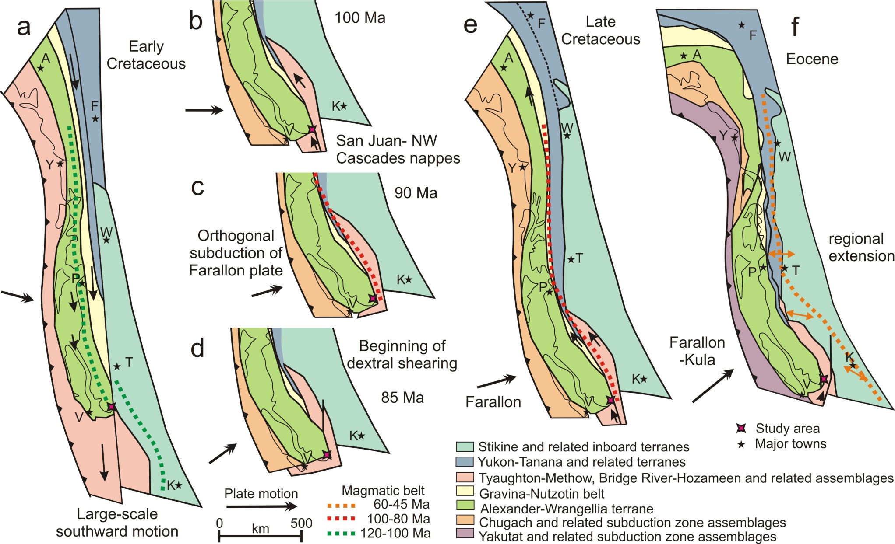
Summary
D₂
D₃
D₄
Mitrovic et al: Tectono - magmatic evolution...
This study after Gehrels et al. (2009)
Notes:
In summary, I would like to remind you that D2 event was most likely caused by the final stage of the orogen-parallel compression; The D3 event is interpreted to be a consequence of orogen-normal compression, due to the orthogonal convergence of the Farallon and North American plates. Subsequent dextral shearing (D4) allowed rapid exhumation of the deeply buried rocks.
Therefore, not only that this study shows the change in relative plate vector, but it also an attempt to unite two different models, highlighting the combined effect of contraction and magma loading processes that led to crustal thickening and peak metamorphic conditions, recorded within the Breakenridge complex.

Slide 19

Thank you!
“Nanos gigantum humeris insidentes”
(Dwarfs standing on the shoulders of giants)
Bernard of Chartres, 12th century
“If I have seen further it is by standing on the shoulders of giants.”
Isaac Newton, 1676
Advice and discussion : Ned Brown, Jim Monger, JoAnne Nelson,
Graham Nixon, Mitch Mihalynuk, John Cottle, Mati Raudsepp,
Reid Staples, Vanessa MacLean and Jaap Verbaas
Notes:
For the end, I would like to say that this research is an excellent example showing that we are dwarfs, standing on the shoulders of giants, giants like Jim, Ned and Glenn.
Also, I would like to thank everyone involved in the project and the NSERC for funding.

