Slide 1
An Assessment of natural history collections databases
Laura Brenskelle
Graduate Student
Jackson School of Geosciences, The University of Texas at Austin

Slide 2
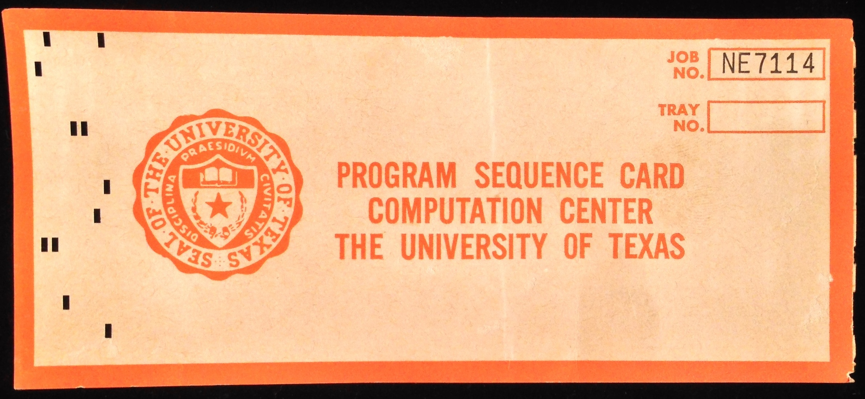
Introduction
Evolution of data management – written catalogs, punch cards, databases…
Internal use → sharing data with the public & researchers
Collections managers in the 21st century not only need to know about the discipline they work in, but they are also essentially information managers.

Slide 3
Research Questions - #1
  To what degree do natural history collections staff whom interact with a database understand its structure and how to effectively manage it?
    Informational content is accurate.
    Database is functional.
    Could be exported to another platform with relative ease.

Slide 4
Research Questions - #2
How do the structures of different natural history collections database schemas vary, and how well do these schemas match the information of the science they are mapping?

Slide 6

Research Questions - #3
Because databases play a key role in organizing and maintaining information within a collection, how will natural history collections databases and their schemas change to accommodate the emergence of various forms of derivative analytical data? How well are the caretakers of collections preparing for these changes?

Slide 7
Why?
What training could be made available to natural history museum staff that work with a database?
How could usability be improved to accurately capture information NHCs want to preserve?
What would YOU want?
Notes:
Finding middle ground

Slide 8
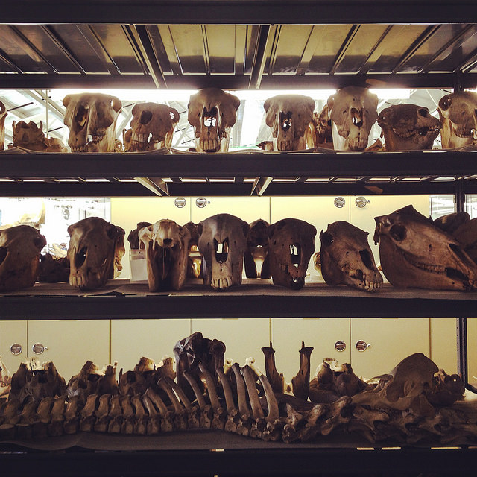
How to find the answers?
Research protocol approved by The University of Texas at Austin’s Office of Research Support Institutional Review Board (IRB)
Visiting as many diverse kinds of NHCs as possible
  Discipline
  Database system used
  Institution size
  Geographically varied – ideally

Slide 9
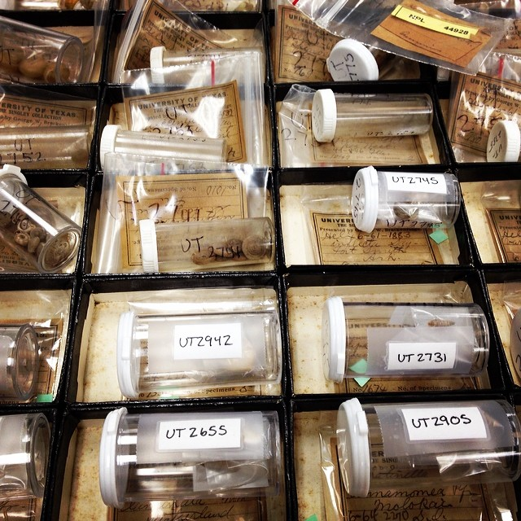
How?
Participants - collections staff that interact with and maintain the database as part of their job responsibilities
  Audio-recorded
  Anonymous and confidential
Estimated time = approximately
2 hours per institution
  30 minutes to 2 hours
  per participant

Slide 10
Step 2 – Replication
Step 1 – Observation
Participants are asked to perform specific, routine database tasks that fall within their job responsibilities
  Specialization of tasks within a single institution
Researcher repeats these tasks for herself
  Eliminate bias from an individual’s experience level
Notes:
Real step 1 – actually consent, but yes

Slide 11
Step 3 – Interview
Participants’ opinions about the software in use at their institution
Any experience with available technical support
Any training experience
How database tasks are divided among staff, if at all
Operational questions of how certain things are done at the particular institution
Future collections plans

Slide 12
Step 4 – Questionnaire
Educational experience and relevant training
Employment information
Collection-specific information
Notes:
Employment info – job title, how long have you been in this job
Collection-specific info – how many specimens, annual budget, how many users of the collection, how long has the institution been using the software currently in place

Slide 13

Currently…
Funding for travel?
6 site visits, 1 trial visit so far
Recruitment and scheduling of future visits ongoing
Notes:
2 visits + 1 trial visit but they were all very different

Slide 14
Observations
Very different database knowledge-levels
Similar future goals
Need more diversity in database systems used
Notes:
Seen these general things

Slide 15

Questions for You
As collections staff, what information would be helpful to learn from this study?
Do you think Step 2 – Replication is a viable way to eliminate the bias of experience?
Email – lbrensk@utexas.edu
Committee: Chris Bell, Matt Brown, Unmil Karadkar, Tim Rowe
Ann Molineux and Angie Thompson
Fellow paleontology graduate students at UT
Thank you for listening!
Acknowledgements

