Slide 1
Geochemical Heterogeneities in the Hawaiian Plume:
The Origin of Different Incompatible Element Ratios In Loa- and Kea-Trend Shield Lavas
Frederick A. Frey
Shichun Huang
Guangping Xu

Slide 2
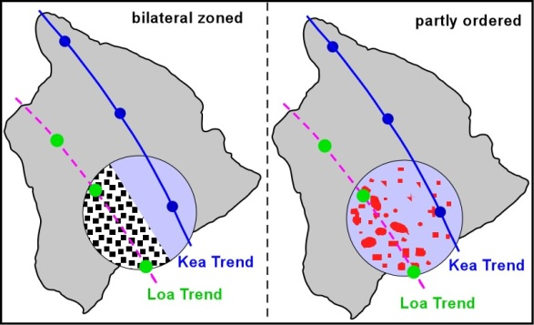
Spatial Distribution of
Loa and Kea Components
Bilateral – Abouchami et al. 2005
Partly ordered – Herzberg 2005

Slide 3
Nb
Ba
La
Nd
Sr
Th
M. Loa Kilauea
Ba/Th 1.76 1.45
Nb/La 0.89 1.07
Sr/Nd 1.17 1.04
Notes:
MgO content of the standard
3- PM normalized plot for BHVO Kilauea and a ML lava also average MORB; does this plot show anomalies relative to PM, like Ba/Th, and Loa-Kea differences such as Nb/La? Fig 3b of Pietruszka et al is such a plot.
There has been lots of discussion about the spatial distribution of geochemically distinct components, but relatively little discussion of how the different components formed (Pietruszka. et al does do this and we need to evaluate their components and how their geochemical differences formed).
How about a slide showing % altered MORB and lower crustal gabbro for 20th century Kilauea, Mauna Loa and Koolau. The Loa trend volcanoes have lower crustal gabbro and Kea has none
Spider diagram
KL2-G
ML3B-G
From Jochum G3 2006

Slide 4
The Kea-component has high ¹⁴³Nd/¹⁴⁴Nd and high Nb/La and Th/La.
However, Nb/Th is similar in both the Loa- and Kea- components.
Since Nb is similar to Th, it is La, not Nb, which causes the variations in Nb/La and Th/La
PM (0.12)
KEA
LOA
PM (8.4)
Notes:
Remove Kahoolawe
And different color for each Loa volcano
Koo-30(9B) with the lowest Nb/Th ratio
Add PM and label in Y-axis
Add vs 206/204
Change ML to prehistoric ML
Add the range of variation on Y-axis
Slide 5 (4 panels)
Top left: Nb/La vs. 143/144
Top right: Nb/La vs. La (at a given La, Nb/La varies significantly)
Lower left: Th/La vs. 143/144
Lower right: Nb/Th vs. 143/144 (note no trend)
On each panel we need to add:
a) Error bar
b) Indicate PM value for y axis ratio
c) A number indicating range of y axis ratio, perhaps “Range of Th/La = x”
d) Add Norman data to Mauna Loa data set
e) In each panel black = Kea and red = Loa, change from a single color to show each shield in different color, blue, green, black for Kea, shields; orange, red, yellow for Loa shields.
f) Consider deleting Kahoolawe data
g) Make plots vs. 206/204. Are they as good as vs. 143/144? If yes, include a panel with 206/204.

Slide 5
A surprising result is Nb/La is correlated with Sr/Nd, Sr/Nb and Ti/Eu. It is well known that Sr and Eu are sensitive to the role of plagioclase. But Nb/La is not a ratio that is recognized as being controlled by plagioclase.
5

Slide 6
The sensitivity of Th/U ratios to post-magmatic processes in Hawaiian Shield lavas.
The alteration criterion K₂O/P₂O₅ > 1.3
After alteration filtering
The sensitivity of Nb/Ta to crushing and powdering in tungsten carbide containers as indicated by red rectangle (Data from Huang & Frey (2003) for HSDP reference samples ground in WC at Univ. Mass. Data of Albarède (1996) for HSDP samples ground at Montpellier, Data of Mauna Loa (Cruise 99 data) grounded at UMass
Notes:
Add new ML data
New ML data cannot be filtered without K/P data

Slide 7
A surprising result is the Nb/La is correlated with Sr/Nd, Sr/Nb and Ti/Eu. It is well known that Sr and Eu are sensitive to the role of plagioclase. But Nb/La is not a ratio that is recognized as being controlled by plagioclase.
MgO (%)
Notes:
Ba/Th vs Sr/Nd

Slide 8
It is well established that Zr/Nb in OIB is usually correlated with isotopic ratios.
This is clearly true of the Loa- and Kea- components in Hawaiian Shield lavas
Surprisingly Zr/Nb is correlated with Th/La. Zr/Nb ratios are not controlled by plagioclase. Likely minerals controlling Zr/Nb are clinopyroxene and garnet
PM
PM (0.12)

Slide 9
What processes created different La/Th, La/Nb, Sr/Nd, Ti/Eu and Zr/Nb in Loa and Kea lavas?
1- Different extents of melting with degree
of Melting less than bulk solid/melt D
2- Residues created by fractional melting
3- Cumulates with abundant plagioclase

Slide 10
Nb/La ratio
Average fractional melting
Instantaneous
fractional melting
Batch melting
Dynamic melting
(2% porosity)

Slide 11
Residues Created by Batch, Fractional Dynamic Melting (2% Porosity)
Th/La ratio
Dynamic melting
(2% porosity)
Batch melting
Fractional melting
Notes:
4- It is well known that melts created by differences in extent of fractional crystallization do not differ significantly in in their ratios of highly incompatible elements. In contrast a very effective way to fractionate two highly incompatible elements is in the residues of fractional melting. Melts derived from such residues may differ significantly in ratios of highly incompatible elements. For example MORBS, which have LREE/HREE < PM, are derived from residues that formed during a previous melting process
Use a Xu slide from his May 11 email, showing only one ratio such as Th/La and a plot of residue ratio vs F for batch and fractional melting with no porosity and 2% porosity. It has been argued that good examples of residues created during fractional melting are high-temperature peridotites (Lizard) and abyssal peridotites (Johnson et aL); possibly a fig

Slide 12
Why does La/Nb Correlate with Sr/Nd?
They usually have very different partition coefficients e,g.. Plagioclase/Melt
Sr
An = ~72%
La
Sm
Nb
Zr
Bindeman and Davis 2000 GCA and Klemme et al, for Nb &Th

Slide 13
PM

Slide 14
D_{La}/D_{Nb} D_{Sm}/D_{Zr}
PLAGIOCLASE 31 95.4
CLINOPYROXENE 1.5 1.0
Cumulate:
50% Plag & 50 % Cpx 15.4 0.85
The mixture is an effective way to change La/Nb but not Sm/Zr
Plagioclase D:
Bindeman and Davis 2000 GCA
Klemme et al. 2002 for Nb and Th
Clinopyroxene D:
Compiled by Pietruszka et al. 2014

Slide 15
Summary of experimentally determined partition coefficients for cpx/melt and garnet/melt. Garnet - D_{Zr/Nb} = 26.5, cpx - D_{Zr/Nb} = 12.5. From Pertermann et al. (2004)
Lu
Tb

Slide 16
The Loa & Kea components have similar Tb/Lu (3 to 3.5) as Zr/Nb ranges from 7 to 20. This similarity in Tb/Lu of Loa & kea components is not consistent with garnet as the phase that controls Tb/Lu
PM
Tb/Lu for PM = 1.46

Slide 17
The Loa & Kea components have similar Tb/Lu (3 to 3.5) as Zr/Nb ranges from 7 to 20. This similarity in Tb/Lu of Loa & kea components is not consistent with garnet as the phase that controls Tb/Lu
PM
Late shield MK
Tb/Lu for PM = 1.46

Slide 18
Gt - Cpx granulite
GRANULITES
Mansur et al 2014
Mode | Gt-cpx granulite
plagioclase | 47% | 58% | Protoliths of the gt-cpx granulites originated
clinopyroxene | 35% | 19% | as plagioclase-rich cumulates with garnet formed as a sub-solidus phase
garnet | 16% | 19% | during burial to >1.7 GPa (>51km), deeper than present MOHO (Jones et al, 1983; Mansur et al., 2014)

Slide 19
CONCLUSION
The differences in Th/La, Nb/La, Sr/Nd & Zr/Nb
Between LOA & KEA trend magmas can be explained if the extreme Loa component is a cumulate composed of Plagioclase & Clinopyroxene.
Such rocks occur as lower crustal Granulites and they were recycled into the source of LOA magmas

Slide 20
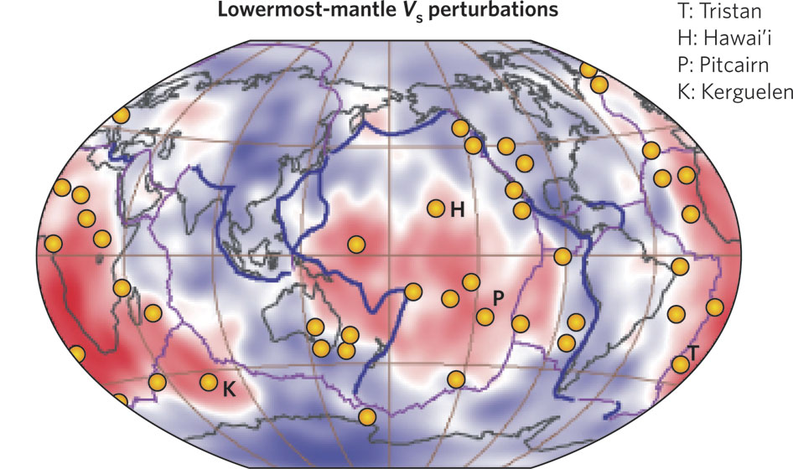
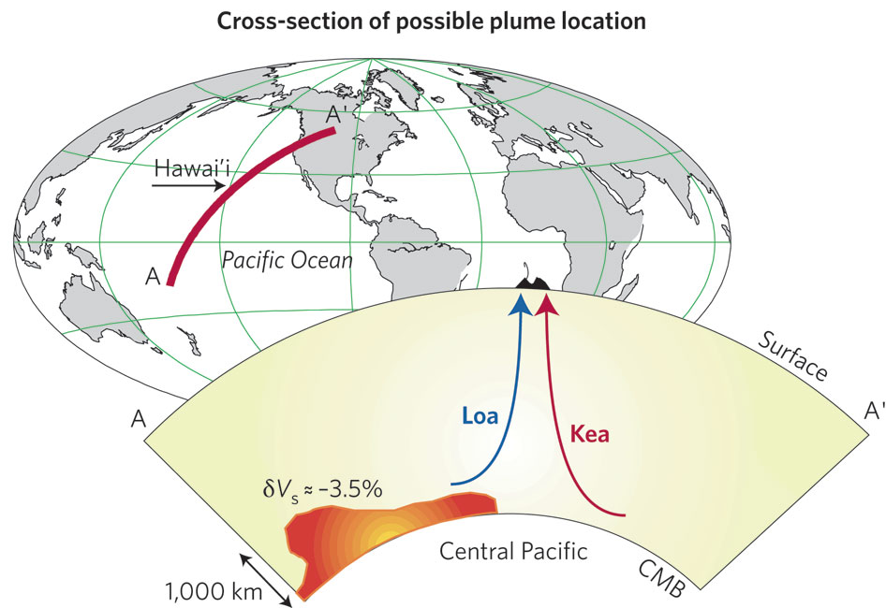
Weis et al. 2011

Slide 21
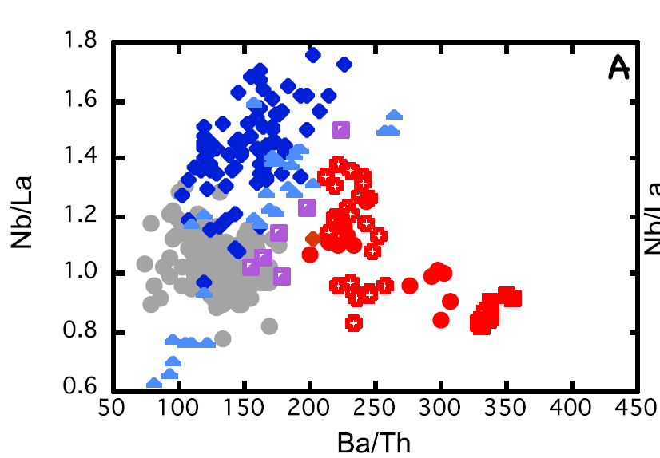

Slide 22
Note the differences in slope for partition coefficient from Lu to Sm in garnet and clinopyroxene. From Pertermann et al. (2004)

Slide 23
Residue Created by Batch Melting, Fractional Melting and Dynamic Melting (with porosity of 2%)
Note below the variable ratios expected in residues created by fractional melting

Slide 24
Significant Changes in Ratios of Incompatible Element Occurs Only when Melt fraction (F) is Low and Comparable to D; that is < 2%. F<2% is inconsistent with the Major Element Composition of Shield Forming Tholeiiic Basalt
Mineral | garnet | cpx | opx | olivine
Mode | 10% | 15% | 15% | 60%
melt mode | 30% | 40% | 20% | 10%
Nb/La ratio
From Pietruszka et al. 2014
Fractional melting
Batch melting
Dynamic melting
(2% porosity)

