Slide 1
Neogene to recent paleoprecipitation estimates in the Meade Basin, Southwest Kansas, from elemental ratios and rock magnetic properties in paleosols and modern soils
Elizabeth Roepke¹, Josh Feinberg², David L. Fox²,
Kena Fox-Dobbs¹, Pratigya Polissar³, Katie Snell⁴,
Kevin Uno³, Robert A. Martin⁵
¹Univ of Puget Sound, ²Univ of Minnesota, ³Lamont-Doherty Earth Observatory,
⁴California Institute of Technology, ⁵Murray State University

Slide 2
Background & Importance
C₄ grasslands 40% of modern terrestrial environments
Ecosystem evolution
Abiotic influence → biotic response
Precipitation, temperature, ash falls
C₃ vs C₄ plants
Small mammal ecology & evolution

Slide 3
Background & Importance
C₄ grasslands 40% of modern terrestrial environments
Ecosystem evolution
Abiotic influence → biotic response
Precipitation, temperature, ash falls
C₃ vs C₄ plants
Small mammal ecology & evolution

Slide 4
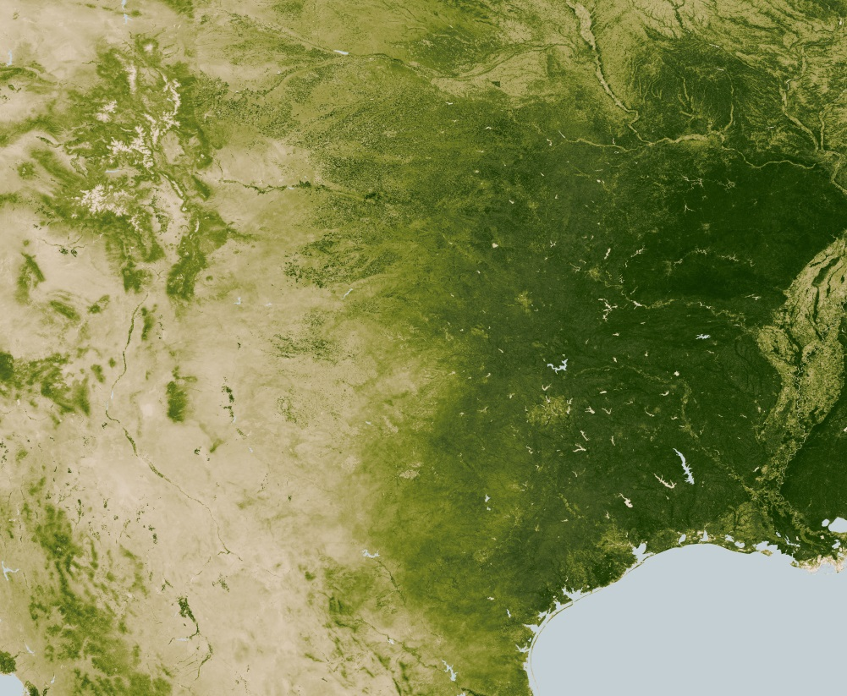
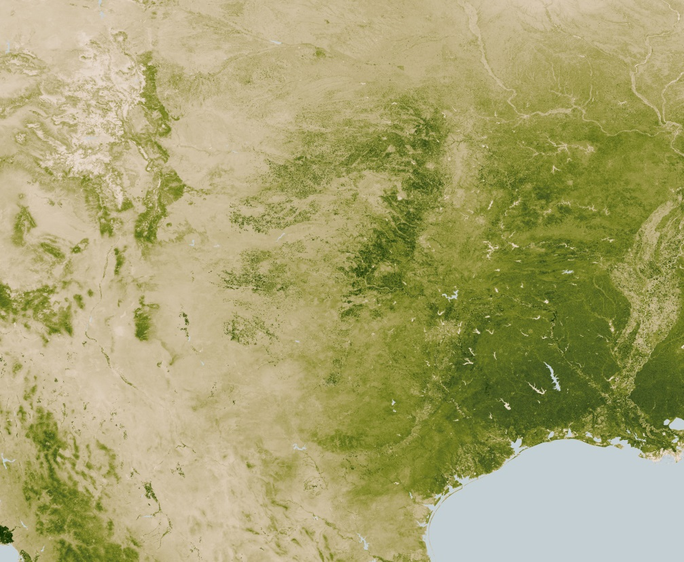
Ecological impact of precipitation
April 2012
April 2013
Meade Basin
Notes:
Strong numerical response in number of small mammals trapped, which reflects population size

Slide 5
Research Questions
How do grain size, chemical and magnetic properties vary in 4.5-0 Ma-aged paleosols in the Meade Basin?
How do paleoprecipitation estimates vary in the Meade Basin from 4.5-0 Ma?
How do the chemical and magnetic proxies for MAP compare in these paleosols?

Slide 6
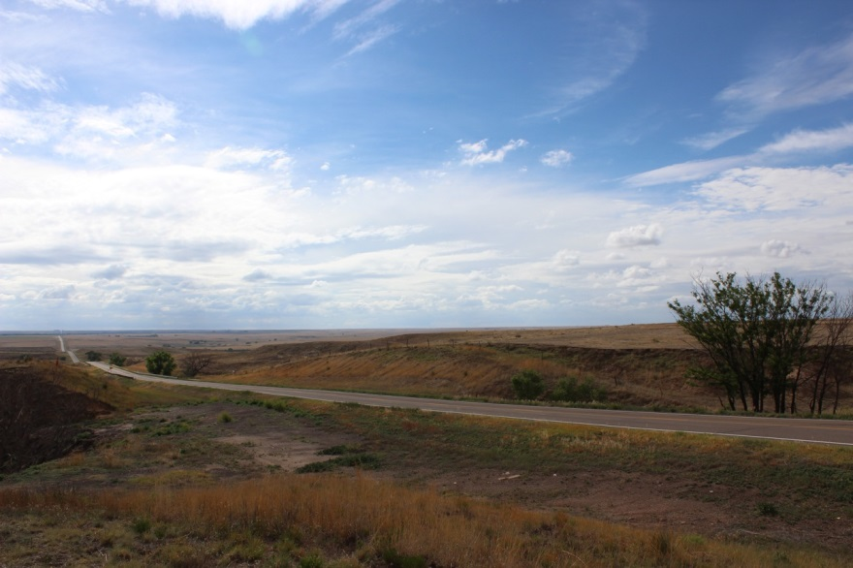
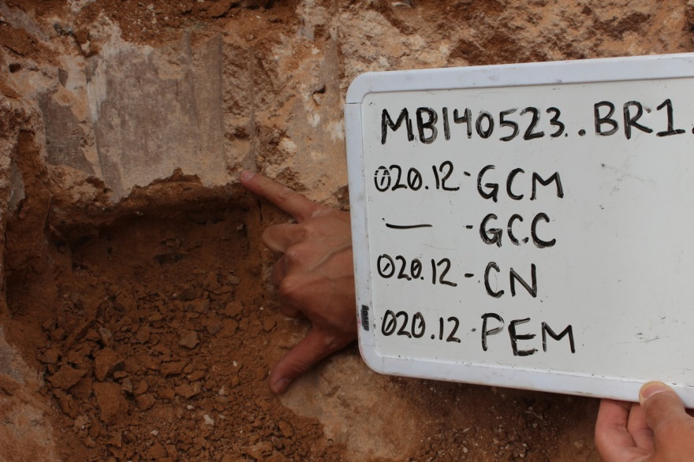
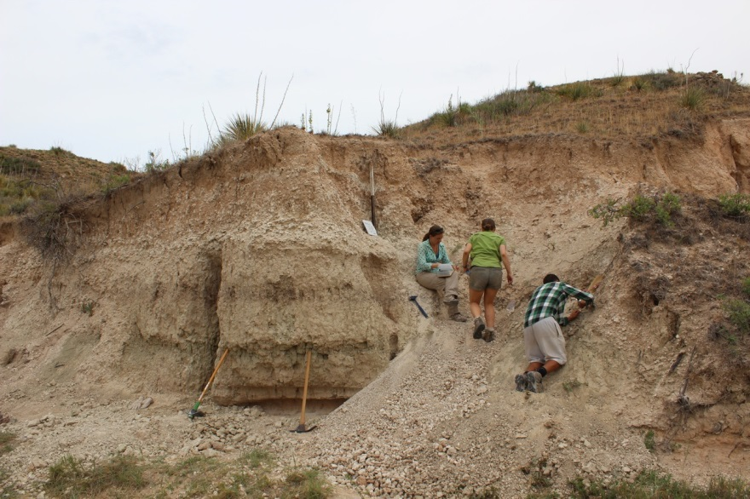
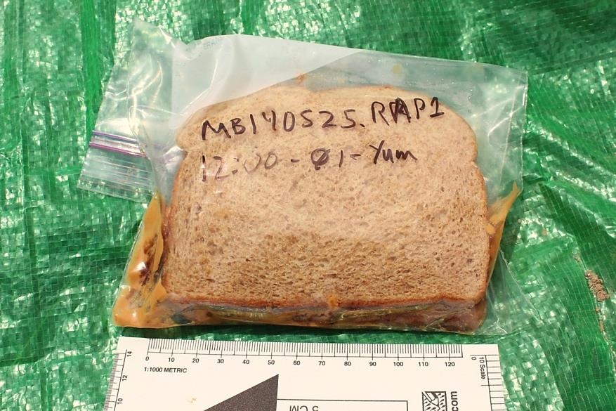
Field Methods
Notes:
Sampling team

Slide 7
Laboratory Methods
Grain Size:
Remove organics & carbonates
Particles suspended in Na-hexametaphosphate
Laser diffraction
Elemental composition:
Powdered sample digestion in HCl, HF, HNO₃
ICP-OES
Rock magnetic properties:
Percentage of fine grained pedogenic Fe-oxides → frequency dependence of susceptibility (300 A/m at 465 Hz and 4650 Hz)
Ratio of pedogenic to detrital magnetic oxides → ratio of anhysteretic to isothermal remanent magnetism (ARM and IRM)
Notes:
Field methods with pics of field work

Slide 8
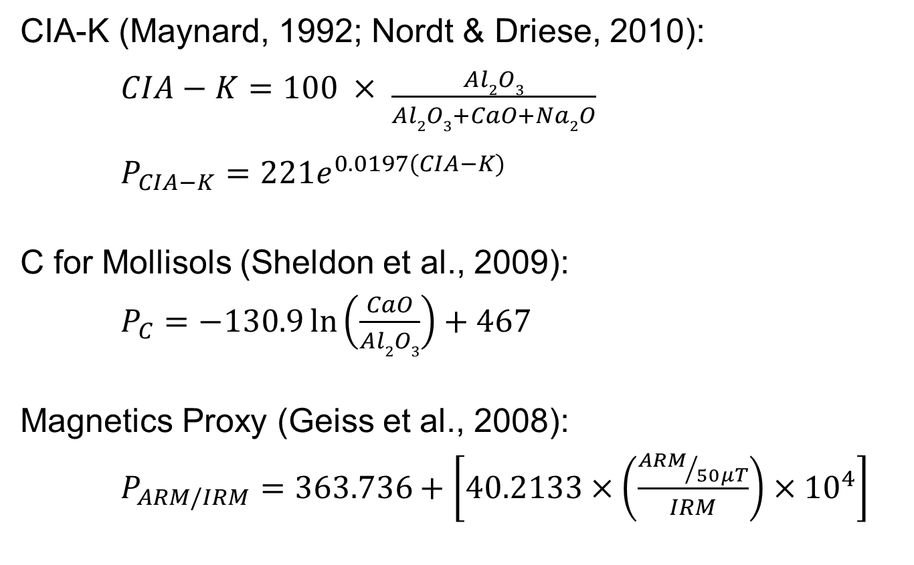
Proxies for MAP
CIA-K (Maynard, 1992; Nordt & Driese, 2010):
$CIA−K=100 × \frac{Al2O3}{Al2O3+CaO+Na2O}$
$P_{CIA−K}=221e^{0.0197(CIA−K)}$
C for Mollisols (Sheldon et al., 2009):
$P_{C}=−130.9\ln\left(\frac{CaO}{Al2O3}\right)+467$
Magnetics Proxy (Geiss et al., 2008):
$P_{ARM/IRM}=363.736+\left[40.2133×\left(\frac{{ARM}/{50μT}}{IRM}\right)×{10}^{4}\right]$

Slide 9
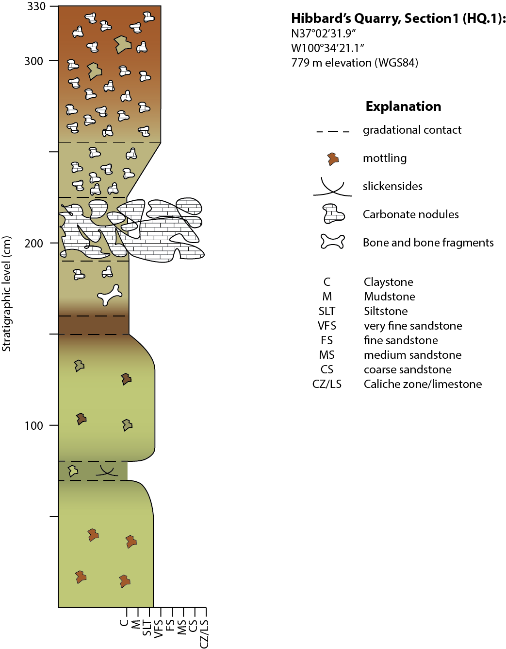
Grain Size Data
Notes:
Give approx age for section

Slide 10
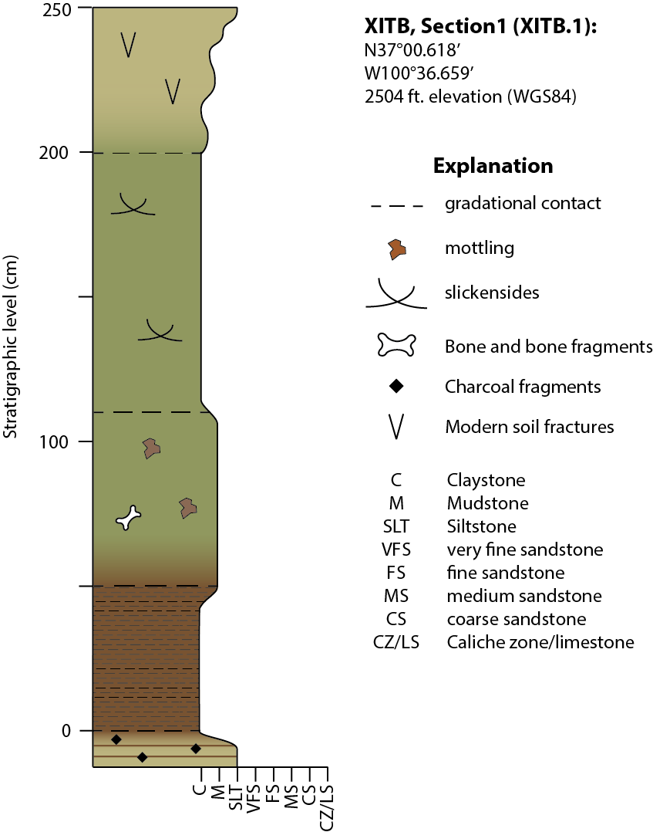
Elemental Data

Slide 11
Elemental Data

Slide 12
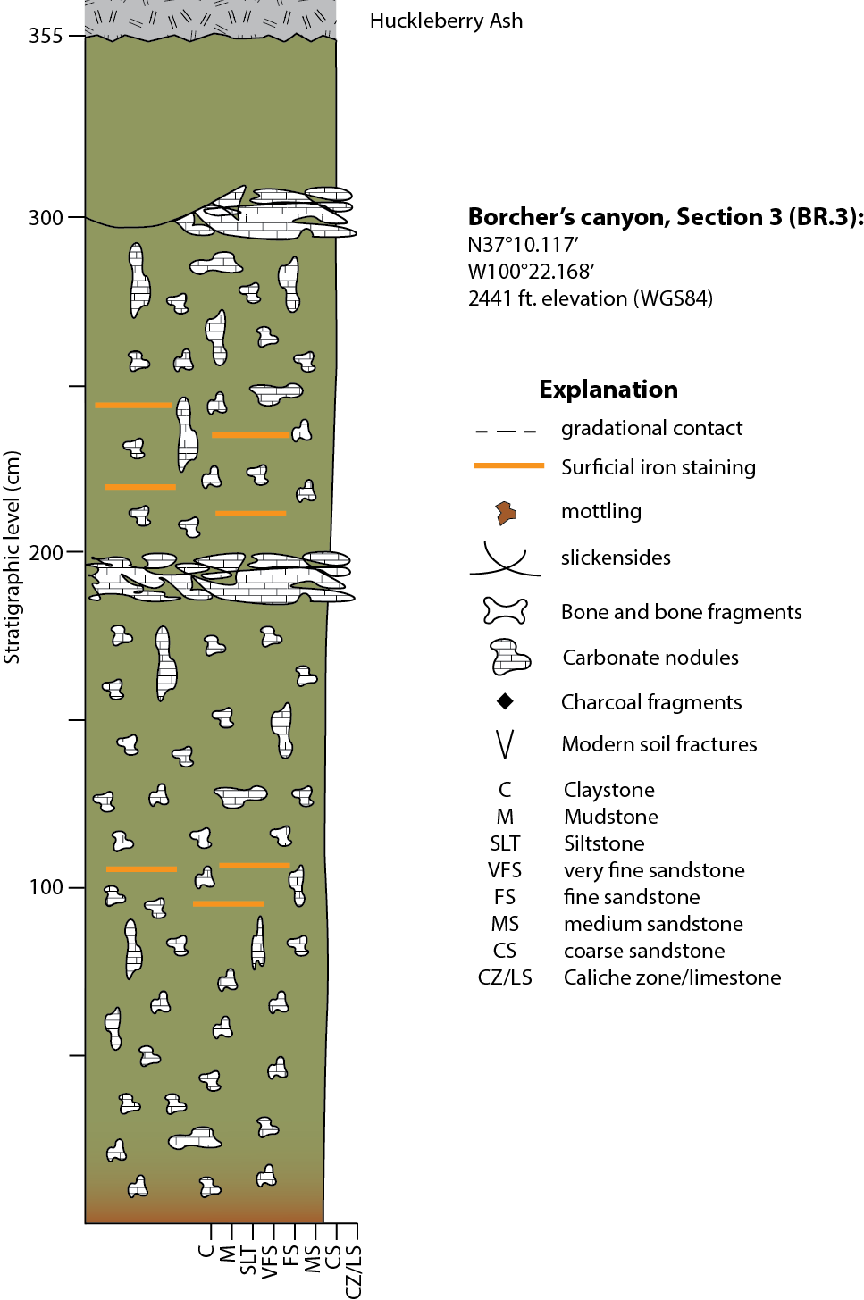
Magnetic Data
←Huckleberry Ash

Slide 13
Magnetic Data
←Huckleberry Ash

Slide 14
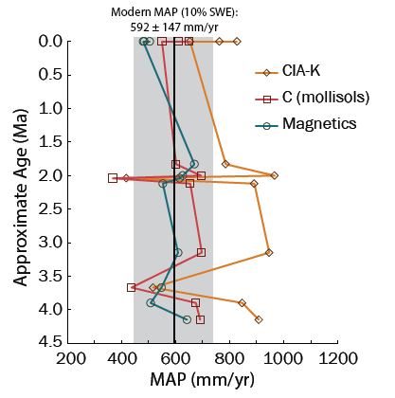
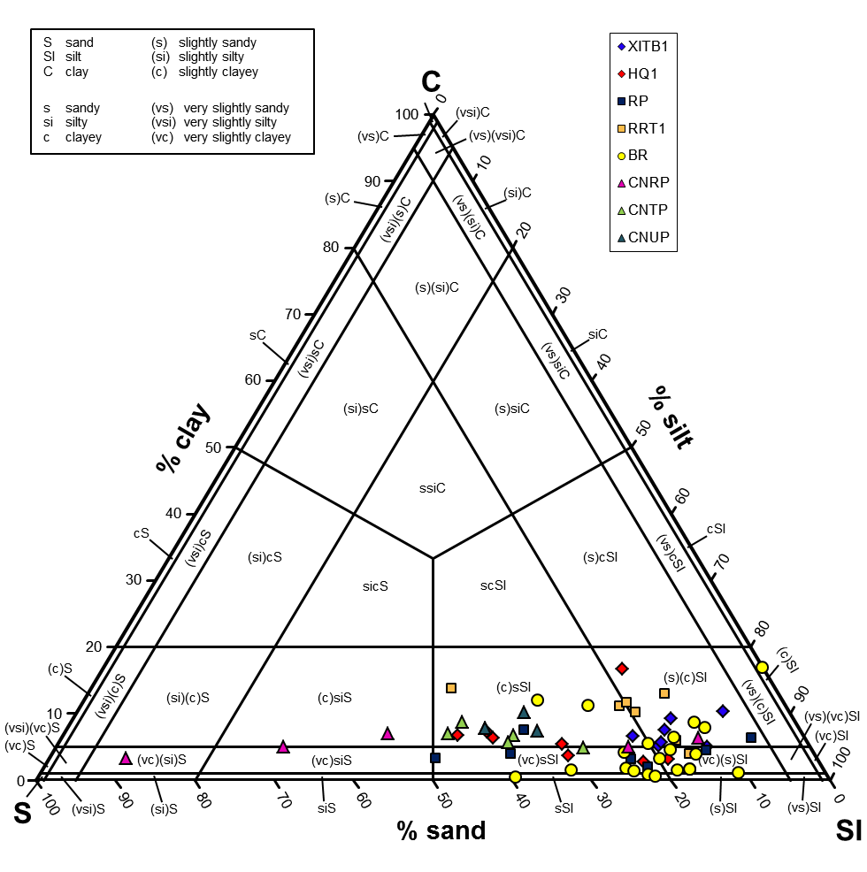
MAP estimates
Notes:
Tell people grain size data is plotted differently
Modern MAP from National climate data center
Not vertisols
Not much parent material to make clays - agrees with Some preliminary xrd shows mainly qtz
Say:
Consistent MAP trends across proxies
Periods of aridity & humidty
P_{C} most similar to modern
P_{MAG} similar prediction as P_{C}
Based on loessic soils

Slide 15
Further Work
Meade Basin:
Paleosol description/characterization
Clay mineralogy
Climate modelling (informed by MAP est.)
Elsewhere:
Magnetic proxy development for non-loessic soils
Notes:
Paleosols desc with people from SMU and baylor

Slide 16






Acknowledgements
ELT grant #:1338262

Slide 17
References
Geiss C.E., Egli R., & Zanner W, 2008, Direct estimates of pedogenic magnetite as a tool to reconstruct past climates from buried soils, Journal of Geophysical Research, v. 113, no. B1102. doi: 10.1029/2008JB005669
Nordt L. C. & Driese S. D., 2010, New weathering index improves paleorainfall estimates from vertisols: Geology, v. 38, no. 5, p. 407–410. doi:10.1130/G30689.1
Maynard J. B., 1992, Chemistry of modern soils as a guide to interpreting Precambrian paleosols, Journal Of Geology, v. 100, no. 3, p. 279-289.
Sheldon N. D., Retallack G. J., & Tanaka S., 2002, Geochemical climofunctions from North American soils and application to paleosols across the Eocene-Oligocene boundary in Oregon, The Journal of Geology, v. 110, p. 687-696.
Fox, D. L., Honey, J. G., Martin, R. A., & Peláez-Campomanes, P. (2012). Pedogenic carbonate stable isotope record of environmental change during the Neogene in the southern Great Plains, southwest Kanses, USA: Carbon isotopes and the evolution of C4-dominated grasslands. Geological Society of America Bulletin, 124(3-4), 444-462. doi: 10.1130/B30401.1
Fox, D. L., Honey, J. G., Martin, R. A., & Peláez-Campomanes, P. (2012). Pedogenic carbonate stable isotope record of environmental change during the Neogene in the southern Great Plains, southwest Kanses, USA: Oxygen isotopes and the evolution of C4-dominated grasslands. Geological Society of America Bulletin, 124(3-4), 431-443. doi: 10.1130/B30402.1

Slide 18
Notes:
End marker

Slide 19
MAP estimates
Modern: 592 ± 147 mm/yr
Notes about MAP trends

Slide 20
MAP estimates
Notes:
For Kena!

Slide 21
Grain Size Data

Slide 22
Discussion
Consistent MAP trends across proxies
Periods of aridity & humidty
P_{C} most similar to modern
P_{MAG} similar prediction as P_{C}
Based on loessic soils

